Slide 1
Automated Planning and Acting
0.812
0.868
0.918
+1
Standard Decision Making
3
0.762
0.660
-1
2
1
0.705
0.655
0.611
0.388
1
2
3
4
Tanya Braun

Slide 2
Content
Planning and Acting with Deterministic Models
Planning and Acting with Refinement Methods
Planning and Acting with Temporal Models
Planning and Acting with Nondeterministic Models
Standard Decision
Making
  Utility Theory
  Markov Decision Process / Problem (MDP)
Planning and Acting with Probabilistic Models
Advanced Decision
Making
Human-aware Planning
Notes:
1-4, 6: Planning book
5, 7: AIMA
8: Rao

Slide 3
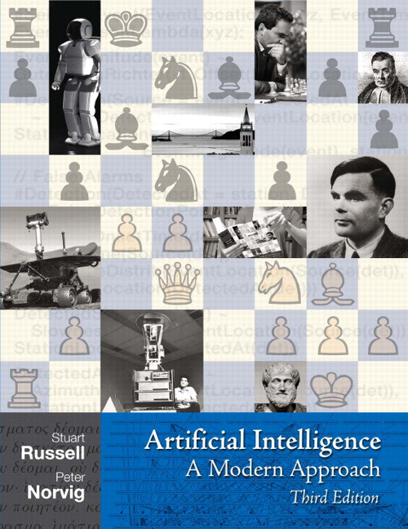
Literature
We now switch from
  Automated Planning and Acting
    Malik Ghallab, Dana Nau, Paolo Traverso
    Main source
to
  Artificial Intelligence:
  A Modern Approach (3rd ed.)
    Stuart Russell, Peter Norvig
    Decision theory
      Ch. 16 + 17
http://www.laas.fr/planning
http://aima.cs.berkeley.edu

Slide 4
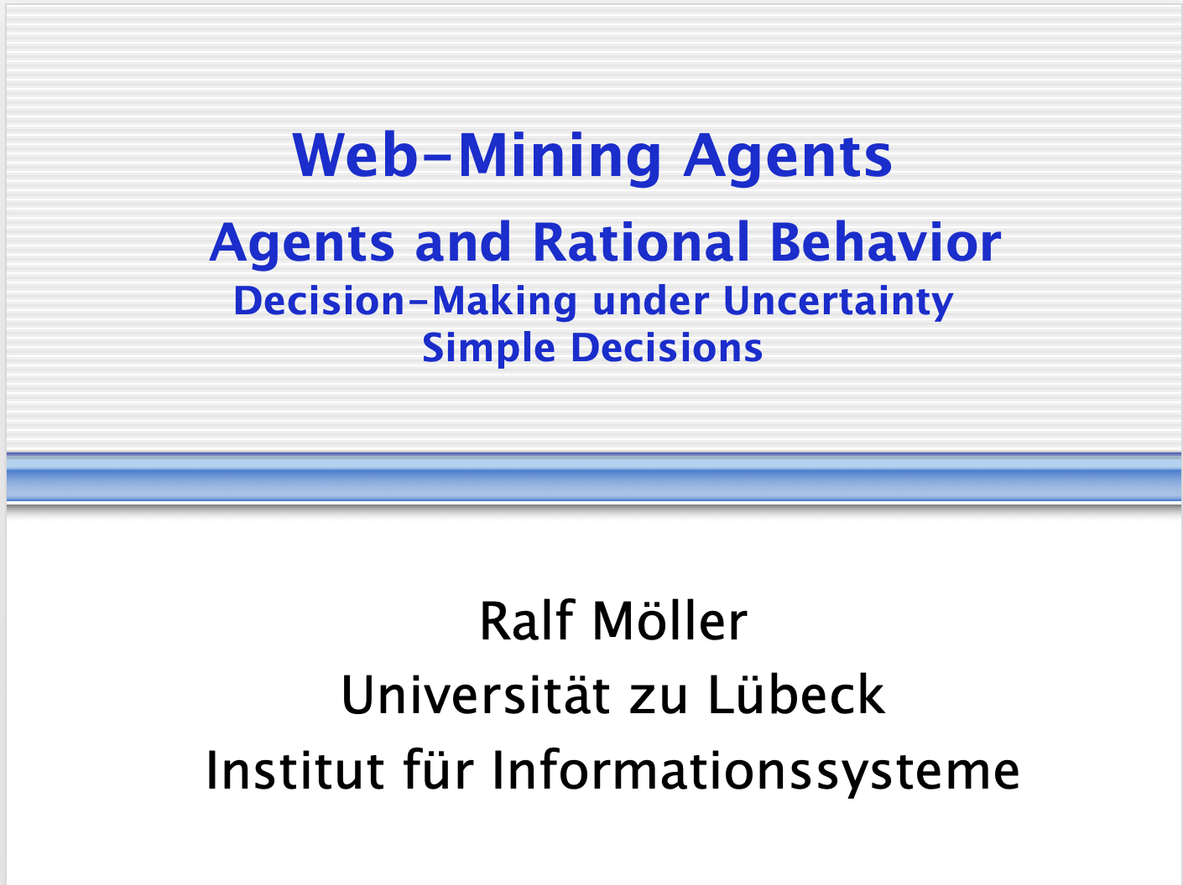
Acknowledgements
Material from Lise Getoor, Jean-Claude Latombe, Daphne Koller, and Stuart Russell
Compiled by Ralf Möller

Slide 5
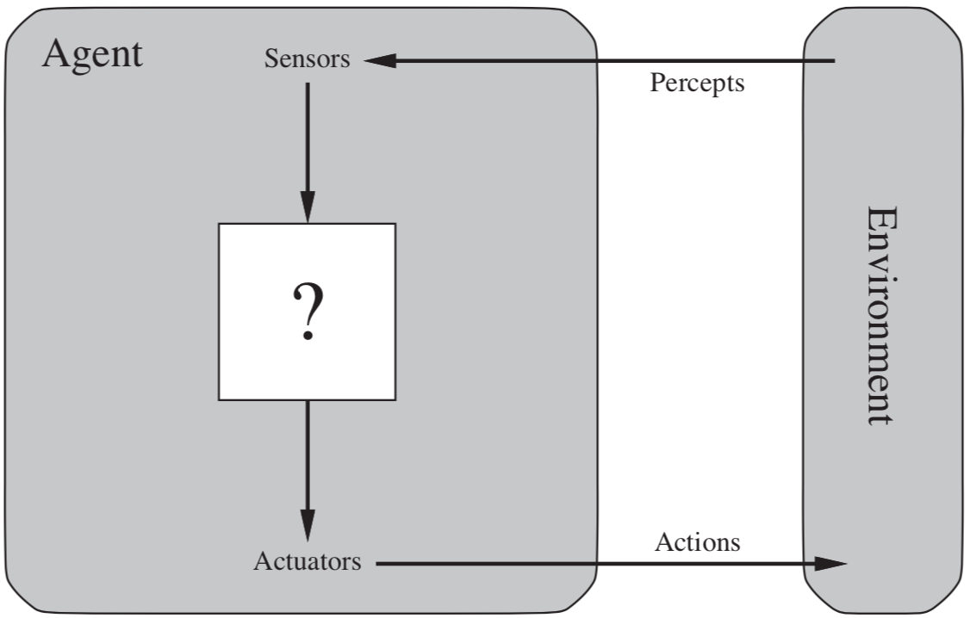
Decision Making under Uncertainty
Many environments have multiple possible outcomes
Some of these outcomes may be good;
others may be bad
Some may be very likely;
others unlikely
Figure: AIMA, Russell/Norvig

Slide 6
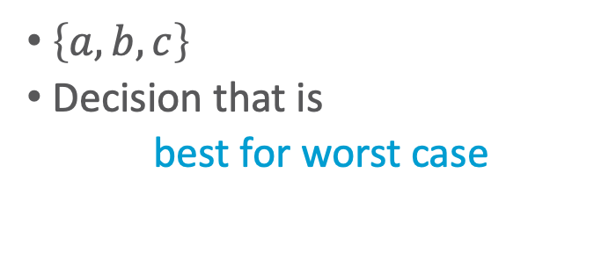
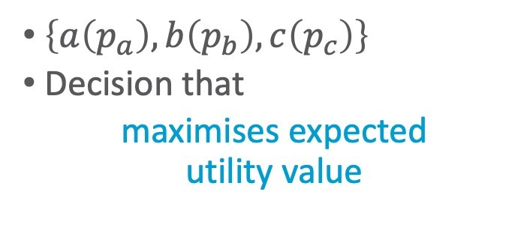
Nondeterministic vs. Probabilistic Uncertainty
?
?
a
b
c
a
b
c
Nondeterministic model
Probabilistic model
$\left\{a,b,c\right\}$
Decision that is
best for worst case
$\left\{a\left(p_{a}\right),b\left(p_{b}\right),c\left(p_{c}\right)\right\}$
Decision that
maximises expected
utility value
Notes:
Nondeterministic: Special case of probabilistic model with uniform distribution (as distribution is uniform, we can ignore it)

Slide 7
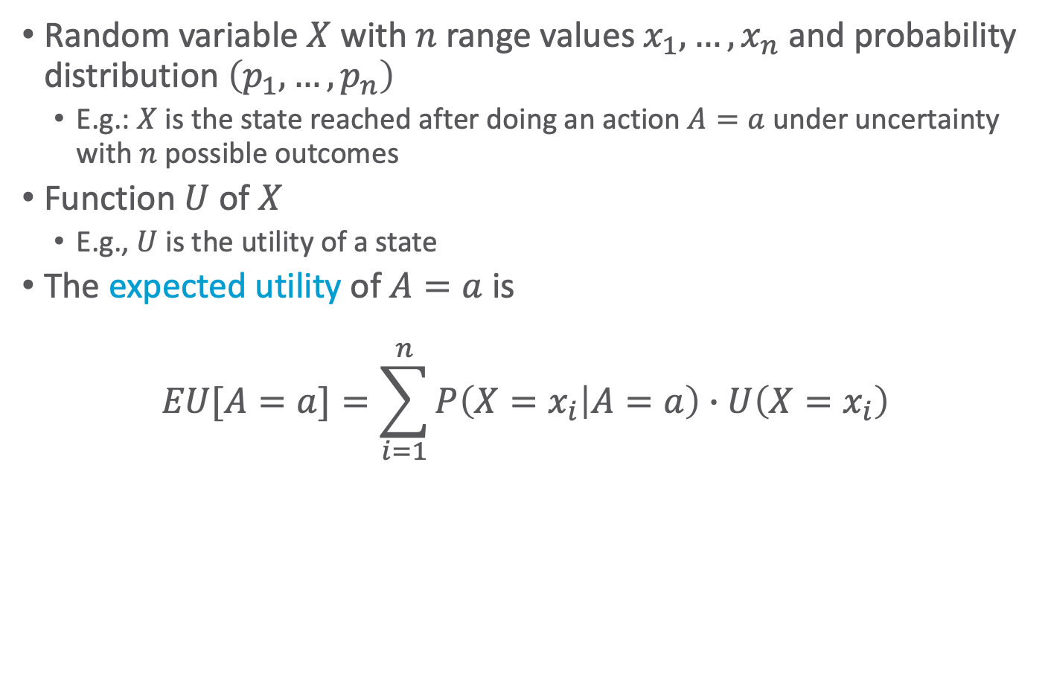
Expected Utility
Random variable $X$ with $n$ range values $x_{1},…,x_{n}$ and probability distribution $\left(p_{1},…,p_{n}\right)$
  E.g.: $X$ is the state reached after doing an action $A=a$ under uncertainty with $n$ possible outcomes
Function $U$ of $X$
  E.g., $U$ is the utility of a state
The expected utility of $A=a$ is
$EU[A=a]=\sum_{i=1}^{n}{P\left(X=x_{i} | A=a\right)∙U\left(X=x_{i}\right)}$

Slide 8











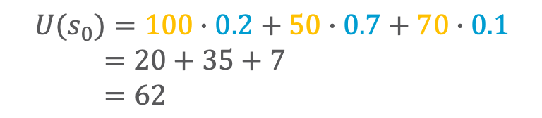
One State/One Action Example
$$s_{0}$$
$$U(s_{0})=100∙0.2+50∙0.7+70∙0.1$$
$=20+35+7$
$=62$
$$a_{1}$$
$$s_{1}$$
$$s_{2}$$
$$s_{3}$$
$$0.2$$
$$0.7$$
$$0.1$$
$$100$$
$$50$$
$$70$$

Slide 9








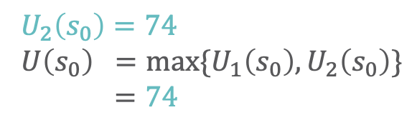

One State/Two Actions Example
$$U_{1}\left(s_{0}\right)=62$$
$$s_{0}$$
$U_{2}\left(s_{0}\right)=74$
$U\left(s_{0}\right) =max⁡\{U_{1}\left(s_{0}\right),U_{2}\left(s_{0}\right)\}$
$=74$
$$a_{1}$$
$$a_{2}$$
$$0.2$$
$$0.8$$
$$s_{1}$$
$$s_{2}$$
$$s_{3}$$
$$s_{4}$$
$$0.2$$
$$0.7$$
$$0.1$$
$$100$$
$$50$$
$$70$$
$$80$$

Slide 10


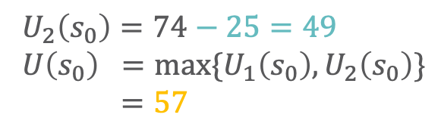

Introducing Action Costs
$$U_{1}\left(s_{0}\right)=62−5=57$$
$$s_{0}$$
$U_{2}\left(s_{0}\right)=74−25=49$
$U\left(s_{0}\right) =max⁡\{U_{1}\left(s_{0}\right),U_{2}\left(s_{0}\right)\}$
$=57$
$$a_{1}$$
$$a_{2}$$
$$−5$$
$$−25$$
$$0.2$$
$$0.8$$
$$s_{1}$$
$$s_{2}$$
$$s_{3}$$
$$s_{4}$$
$$0.2$$
$$0.7$$
$$0.1$$
$$100$$
$$50$$
$$70$$
$$80$$

Slide 11
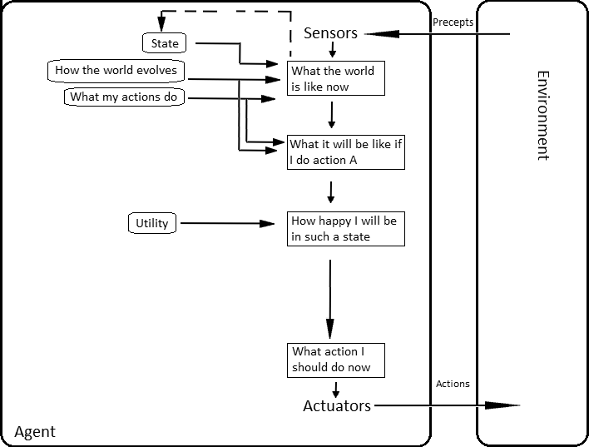
MEU Principle
A rational agent should choose the action that maximizes agent’s expected utility
This is the basis of the field of decision theory
The MEU principle provides a normative criterion for rational choice of action
AI solved?
Figure: AIMA, Russell/Norvig

Slide 12
Not quite…
Must have complete model of:
  Actions
  Utilities
  States
Even if you have a complete model, it might be computationally intractable
In fact, a truly rational agent takes into account the utility of reasoning as well – bounded rationality
Nevertheless, great progress has been made in this area, and we are able to solve much more complex decision-theoretic problems than ever before

Slide 13
Setting
Agent can perform actions in an environment
  Environment
    Time: episodic or sequential
      Episodic: Next episode does not depend on the previous episode
      Sequential: Next episode depends on previous episodes
    Non-deterministic
      Outcomes of actions not unique
      Associated with probabilities (➝ probabilistic model)
    Partially observable (treated formally as part of Topic 7 – Advanced Decision Making)
      Latent, i.e., not observable, random variables
  Agent has preferences over states/action outcomes
    Encoded in utility or utility function ➝ Utility theory
“Decision theory = Utility theory + Probability theory”
  Model the world with a probabilistic model
  Model preferences with a utility (function)
  Find action that leads to the maximum expected utility, also called decision making

Slide 14
Outline
Utility Theory – mainly Ch. 16.1-16.4
  Preferences
  Utilities
  Dominance
  Preference structure
Markov Decision Process / Problem (MDP)
  Markov property
  Sequence of actions, history, policy
  Value iteration, policy iteration
Notes:
Utility theory / decision theory: background in economy / operations research / insurance industry

Slide 15
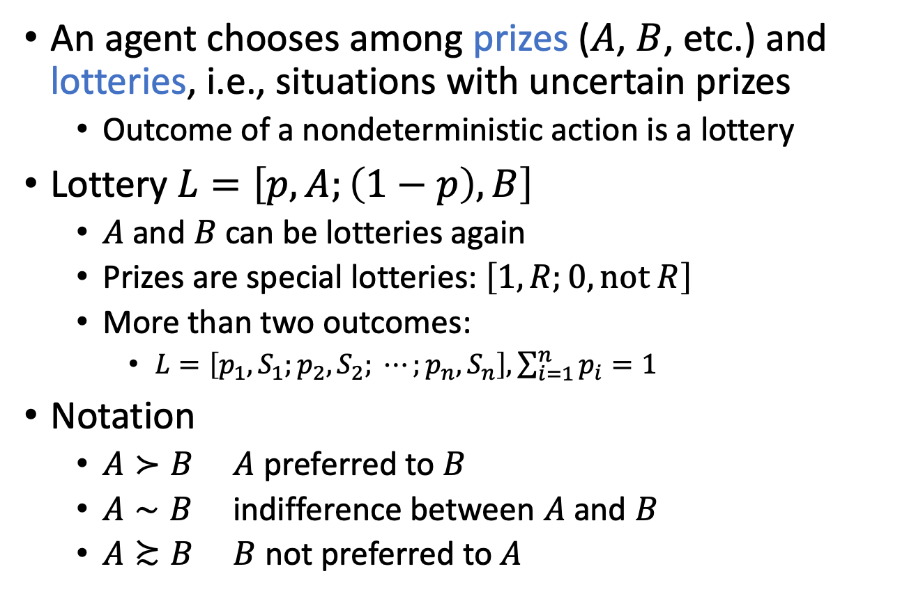
Preferences
An agent chooses among prizes ($A$, $B$, etc.) and lotteries, i.e., situations with uncertain prizes
  Outcome of a nondeterministic action is a lottery
Lottery $L=\left[p,A;\left(1−p\right), B\right]$
  $A$ and $B$ can be lotteries again
  Prizes are special lotteries: $\left[1,R;0, \text{not} R\right]$
  More than two outcomes:
    $L=\left[p_{1},S_{1};p_{2}, S_{2}; ⋯;p_{n}, S_{n}\right], \sum_{i=1}^{n}{p_{i}}=1$
Notation
  $A≻B$ $A$ preferred to $B$
  $A∼B$ indifference between $A$ and $B$
  $A≿B$ $B$ not preferred to $A$
Notes:
Think of the set of outcomes for each action as a lottery—think of each action as a ticket

Slide 16
Rational Preferences
Idea: preferences of a rational agent must obey constraints
Rational preferences ⇒ behaviour describable as maximisation of expected utility

Slide 17
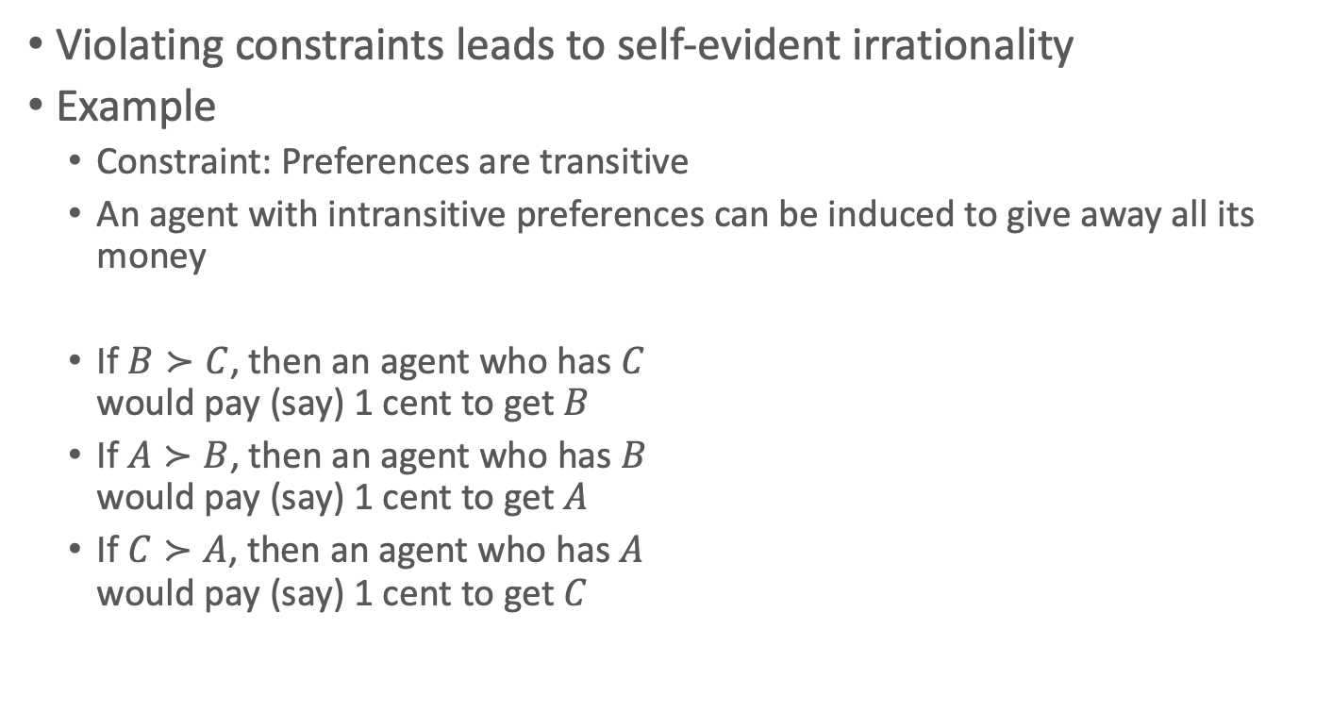
Rational Preferences (contd.)
Violating constraints leads to self-evident irrationality
Example
  Constraint: Preferences are transitive
  An agent with intransitive preferences can be induced to give away all its money
  If $B≻C$, then an agent who has $C$
  would pay (say) 1 cent to get $B$
  If $A≻B$, then an agent who has $B$
  would pay (say) 1 cent to get $A$
  If $C≻A$, then an agent who has $A$
  would pay (say) 1 cent to get $C$
B
A
C
1ct
1ct
1ct

Slide 18













Axioms of Utility Theory
Decomposability:
There is no fun in gambling.
Orderability
  $\left(A≻B\right)∨\left(A≺B\right)∨\left(A\sim B\right)$
    $\left\{≺,≻, \sim \right\}$ jointly exhaustive, pairwise disjoint
Transitivity
  $\left(A≻B\right)∧\left(B≻C\right) ⇒ \left(A≻C\right)$
Continuity
  $A≻B≻C ⇒ ∃p \left[p,A; 1−p,C\right]\sim B$
Substitutability
  $A\sim B ⇒\left[p,A;1−p,C\right]\sim \left[p,B;1−p,C\right]$
    Also holds if replacing $\sim$with $≻$
Monotonicity
  $A≻B ⇒(p≥q ⇔\left[p,A;1−p,B\right]≿\left[q,A;1−q,B\right])$
Decomposability
  $\left[p,A; 1−p, \left[q,B; 1−q, C\right]\right]\sim \left[p,A; \left(1−p\right)q, B;\left(1−p\right)\left(1−q\right), C\right]$
$$p$$
$$A$$
$$q$$
$$B$$
$$1−p$$
$$1−q$$
$$C$$
$$p$$
$$A$$
$$B$$
$$\left(1−p\right)q$$
$$\left(1−p\right)\left(1−q\right)$$
$$C$$
Notes:
Orderability: Agent has to decide (refusing to bet is like refusing to allow time to pass)
Transitivity: example did not follow this axiom
Continuity: Agent will be indifferent between getting $B$ for sure and the lottery that yields $A$ with probability $p$ and $C$ with probability $1−p$
Substitutability: If agent is indifferent between A und B, then it is indifferent between the two if they are part of a more complex lottery
Monotonicity: A preferred over B, then lottery with higher probability for A preferred
Decomposability: Compound lotteries can be reduced to simpler ones using laws of probability (deep models equivalent to broad models); We can account for the enjoyment of gambling by encoding gambling events into the state description; for example, “Have $10 and gambled” could be preferred to “Have $10 and didn’t gamble.”

Slide 19
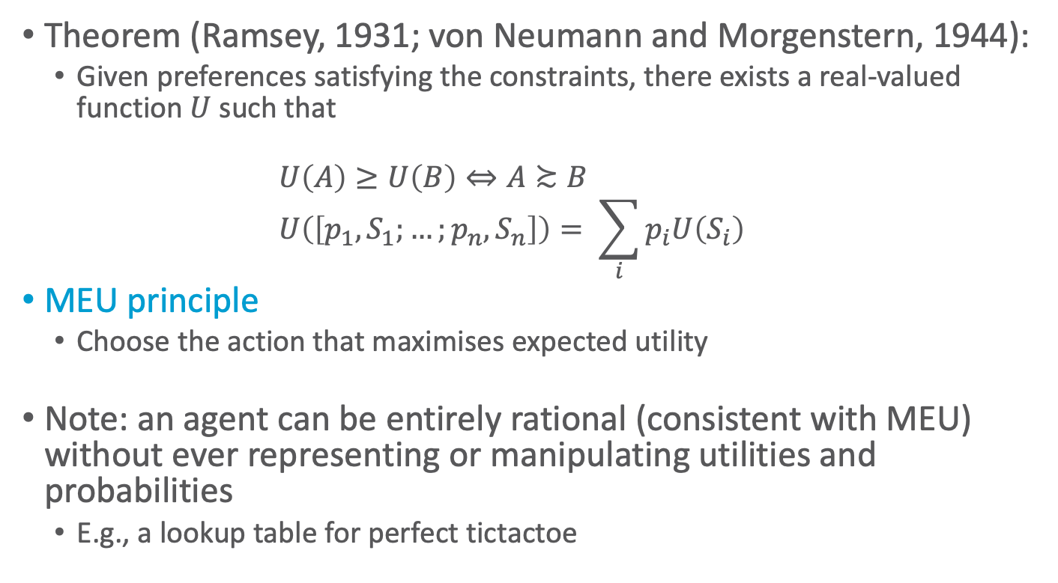
And Then There Was Utility
Theorem (Ramsey, 1931; von Neumann and Morgenstern, 1944):
  Given preferences satisfying the constraints, there exists a real-valued function $U$ such that
  $$U\left(A\right)≥U\left(B\right)⇔A≿B \\ U\left(\left[p_{1}, S_{1};…;p_{n},S_{n}\right]\right)= \sum_{i}{p_{i}U\left(S_{i}\right)}$$
MEU principle
  Choose the action that maximises expected utility
Note: an agent can be entirely rational (consistent with MEU) without ever representing or manipulating utilities and probabilities
  E.g., a lookup table for perfect tictactoe

Slide 20
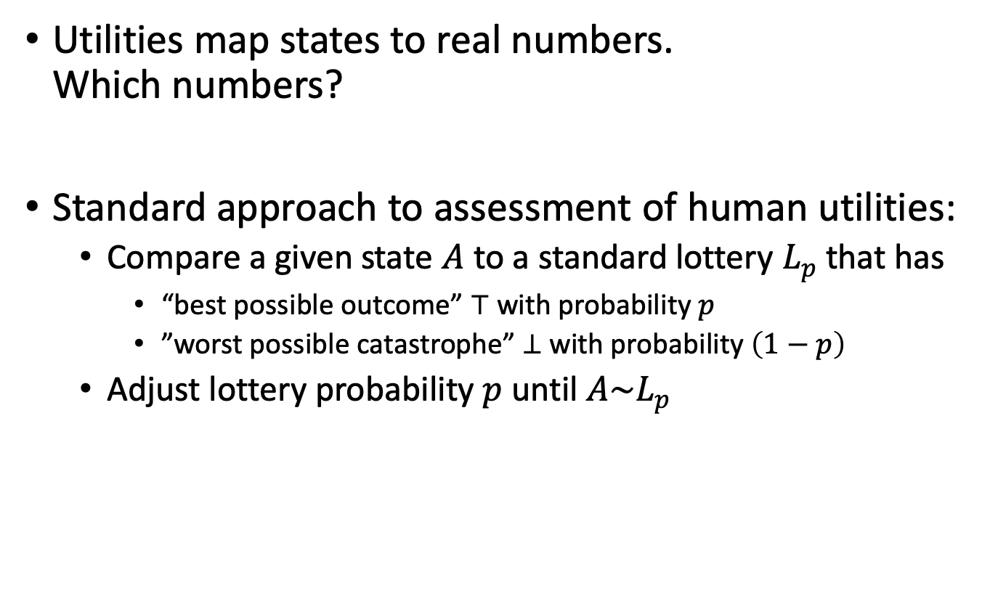



Utilities
Utilities map states to real numbers.
Which numbers?
Standard approach to assessment of human utilities:
  Compare a given state $A$ to a standard lottery $L_{p}$ that has
    “best possible outcome” $⊤$ with probability $p$
    ”worst possible catastrophe” $⊥$ with probability $\left(1−p\right)$
  Adjust lottery probability $p$ until $A\sim L_{p}$
$$0.999999$$
continue as before
pay-$30-and-continue-as-before
$$\sim L$$
$$0.000001$$
instant death

Slide 21
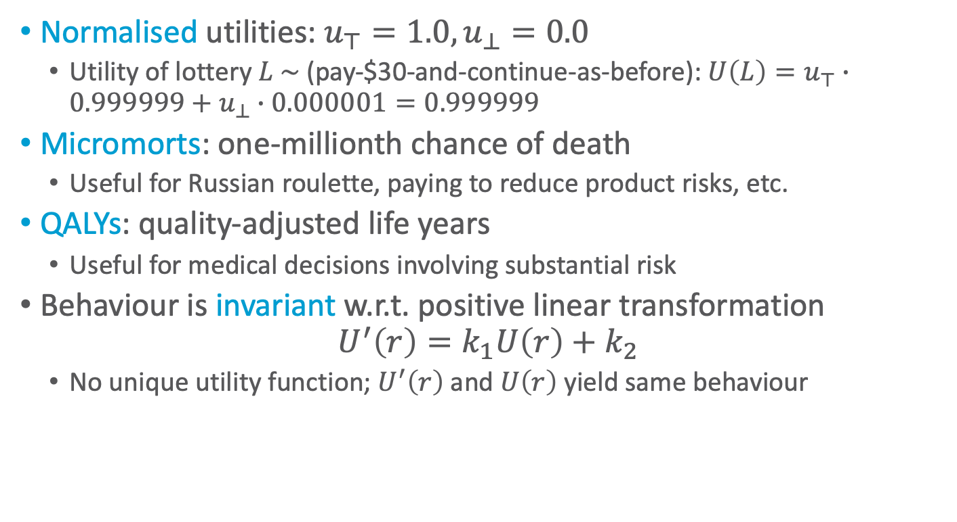
Utility Scales
Normalised utilities: $u_{⊤}=1.0,u_{⊥}=0.0$
  Utility of lottery $L \sim$ (pay-$30-and-continue-as-before): $U\left(L\right)=u_{⊤}∙0.999999+u_{⊥}∙0.000001=0.999999$
Micromorts: one-millionth chance of death
  Useful for Russian roulette, paying to reduce product risks, etc.
QALYs: quality-adjusted life years
  Useful for medical decisions involving substantial risk
Behaviour is invariant w.r.t. positive linear transformation
$$U^{′}\left(r\right)=k_{1}U\left(r\right)+k_{2}$$
  No unique utility function; $U^{′}\left(r\right)$ and $U\left(r\right)$ yield same behaviour

Slide 22
Ordinal Utility Functions
With deterministic prizes only (no lottery choices), only ordinal utility can be determined, i.e., total order on prizes
  Ordinal utility function also called value function
  Provides a ranking of alternatives (states), but not a meaningful metric scale (numbers do not matter)

Slide 23
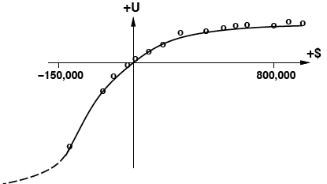
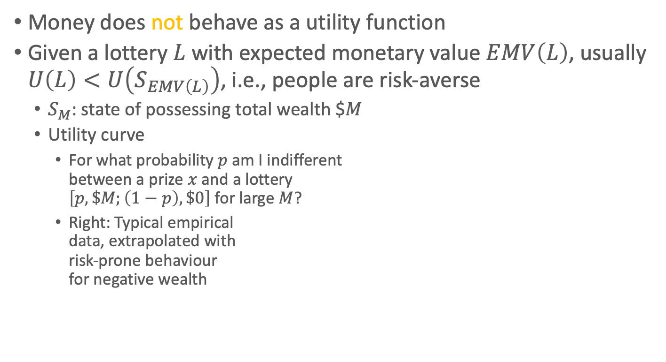
Money
Money does not behave as a utility function
Given a lottery $L$ with expected monetary value $EMV\left(L\right)$, usually $U\left(L\right)<U\left(S_{EMV\left(L\right)}\right)$, i.e., people are risk-averse
  $S_{M}$: state of possessing total wealth $$M$
  Utility curve
    For what probability $p$ am I indifferent
    between a prize $x$ and a lottery
    $\left[p,\$M;\left(1−p\right),\$0\right]$ for large $M$?
    Right: Typical empirical
    data, extrapolated with
    risk-prone behaviour
    for negative wealth
Figure: AIMA, Russell/Norvig
Notes:
Utility theory: roots in economics; obvious candidate: money (or an agent’s total net asssets)
agent prefers more money to less, all other things being equal, exhibits a monotonic preference for more money; nothing about preferences between lotteries involving money
logarithmic utility function; should not assume that this is the definitive utility function for monetary value, but it is likely that most people have a utility function that is concave for positive wealth

Slide 24
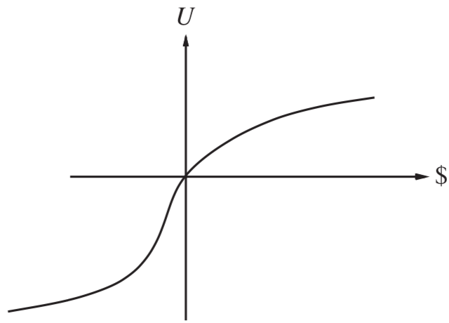

Money Versus Utility
Money $≠$ Utility
  More money is better, but not always in a linear relationship to the amount of money
Expected Monetary Value
  Risk-averse
    $U\left(L\right)<U\left(S_{EMV\left(L\right)}\right)$
  Risk-seeking
    $U\left(L\right)>U\left(S_{EMV\left(L\right)}\right)$
  Risk-neutral
    $U\left(L\right)=U\left(S_{EMV\left(L\right)}\right)$
    Linear curve
    For small changes in wealth
    relative to current wealth
Figure: AIMA, Russell/Norvig
Notes:
Averse: prefer a sure thing with a payoff that is less than the expected monetary value of a gamble
Seeking: someone already $10,000,000 in debt might well accept a gamble on a fair coin with a gain of $10,000,000 for heads and a loss of $20,000,000 for tails; Such behaviour might be called desperate, but it is rational if one is already in a desperate situation.
Neutral: Risk aversion is the basis for the insurance industry; People would rather pay a small insurance premium than gamble the price of their house against the chance of a fire. From the insurance company’s point of view, the price of the house is very small compared with the firm’s total reserves. This means that the insurer’s utility curve is approximately linear over such a small region, and the gamble costs the company almost nothing.

Slide 25
Multi-attribute Utility Theory
A given state may have multiple utilities
  ...because of multiple evaluation criteria
  ...because of multiple agents (interested parties) with different utility functions
We will look at
  Cases in which decisions can be made without combining the attribute values into a single utility value
    Strict dominance
    Stochastic dominance
  Cases in which the utilities of attribute combinations can be specified very concisely
    Preference structure
Notes:
Siting a new airport requires consideration of
disruption caused by construction;
the cost of land;
the distance from centers of population;
the noise of flight operations;
safety issues arising from local topography and weather conditions

Slide 26
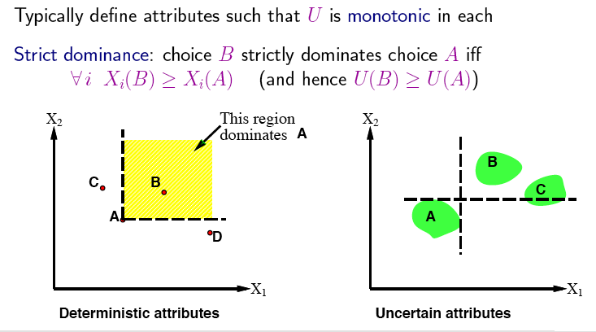
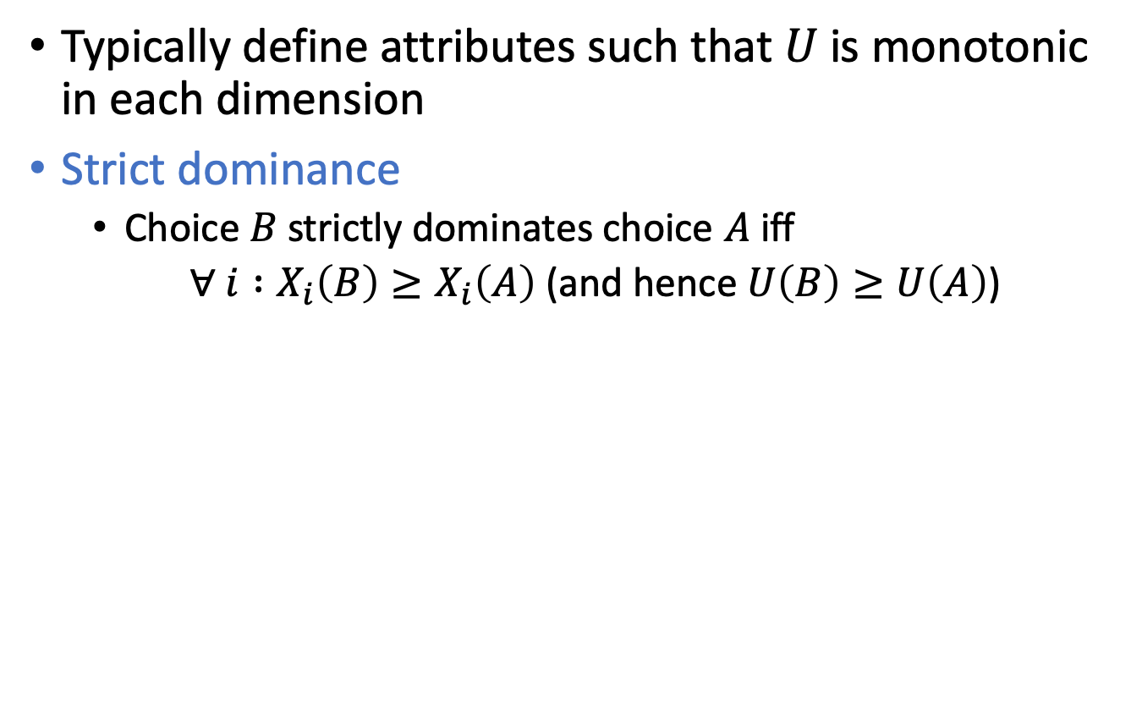
Strict Dominance
Typically define attributes such that $U$ is monotonic in each dimension
Strict dominance
  Choice $B$ strictly dominates choice $A$ iff
  $∀ i :X_{i}\left(B\right)≥X_{i}\left(A\right)$ (and hence $U\left(B\right)≥U\left(A\right)$)
Notes:
B does not strictly dominate C (and D)
Seldom unique choice
cf. skylines
Strict dominance in uncertain case even less likely ➝ stochastic dominance

Slide 27
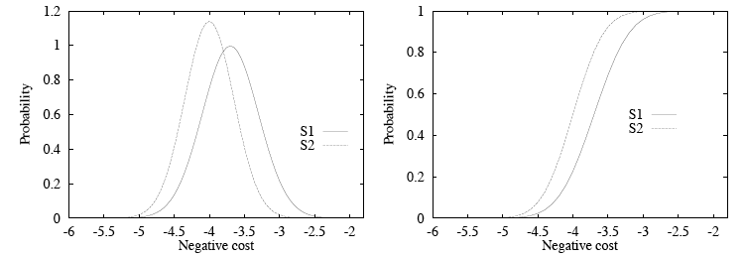
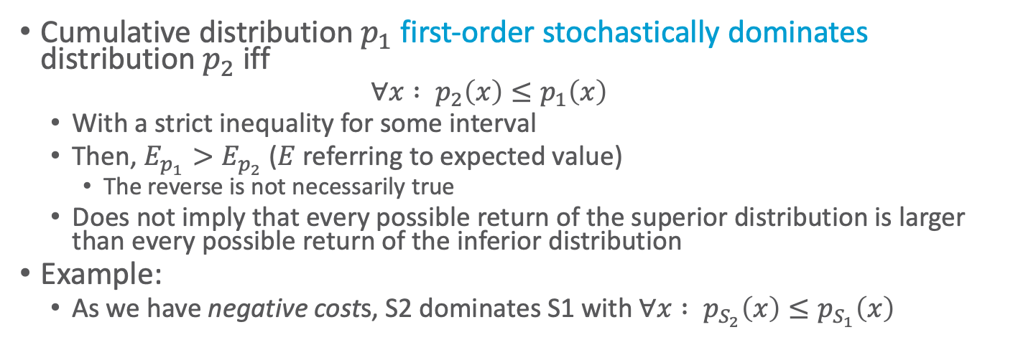
Stochastic Dominance
Cumulative distribution $p_{1}$ first-order stochastically dominates distribution $p_{2}$ iff
  $$∀x : p_{2}\left(x\right)≤p_{1}\left(x\right)$$
  With a strict inequality for some interval
  Then, $E_{p_{1}}>E_{p_{2}}$ ($E$ referring to expected value)
    The reverse is not necessarily true
  Does not imply that every possible return of the superior distribution is larger than every possible return of the inferior distribution
Example:
  As we have negative costs, S2 dominates S1 with $∀x : p_{S_{2}}\left(x\right)≤p_{S_{1}}\left(x\right)$
https://people.duke.edu/~dgraham/ECO_463/Handouts/StochasticDominance.pdf
Notes:
First-order vs. second-order dominance
S1 stochastically dominates S2: negative cost, so lower is better

Slide 28
Example
Product P
Product Q
Profit ($m) | Probability
0 to under 5 | 0.2
5 to under 10 | 0.3
10 to under 15 | 0.4
15 to under 20 | 0.1
Profit ($m) | Probability
0 to under 5 | 0.0
5 to under 10 | 0.1
10 to under 15 | 0.5
15 to under 20 | 0.3
20 to under 25 | 0.1
P first-order stochastically dominates Q
Notes:
Product P first-order stochastically dominates product Q

Slide 29
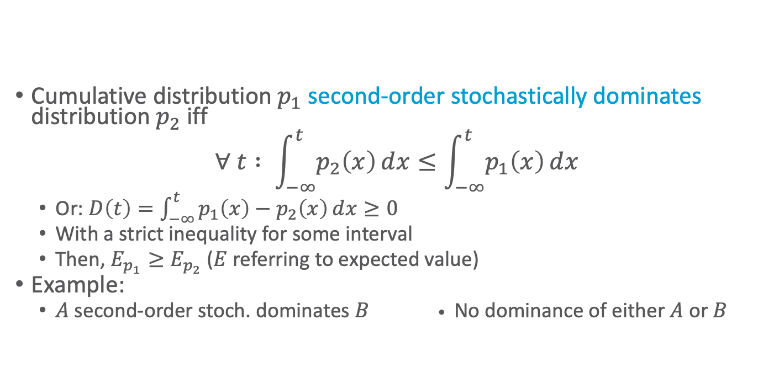
Stochastic Dominance
Cumulative distribution $p_{1}$ second-order stochastically dominates distribution $p_{2}$ iff
$$∀ t : \int_{−∞}^{t}{p_{2}\left(x\right)ⅆx}≤\int_{−∞}^{t}{p_{1}\left(x\right)ⅆx}$$
  Or: $D\left(t\right)=\int_{−∞}^{t}{p_{1}\left(x\right)−p_{2}\left(x\right)ⅆx}≥0$
  With a strict inequality for some interval
  Then, $E_{p_{1}}≥E_{p_{2}}$ ($E$ referring to expected value)
Example:
  $A$ second-order stoch. dominates $B$ • No dominance of either $A$ or $B$
t
t
t
t
https://people.duke.edu/~dgraham/ECO_463/Handouts/StochasticDominance.pdf
Figures: https://www.vosesoftware.com/riskwiki/Stochasticdominancetests.php (t=z)

Slide 30
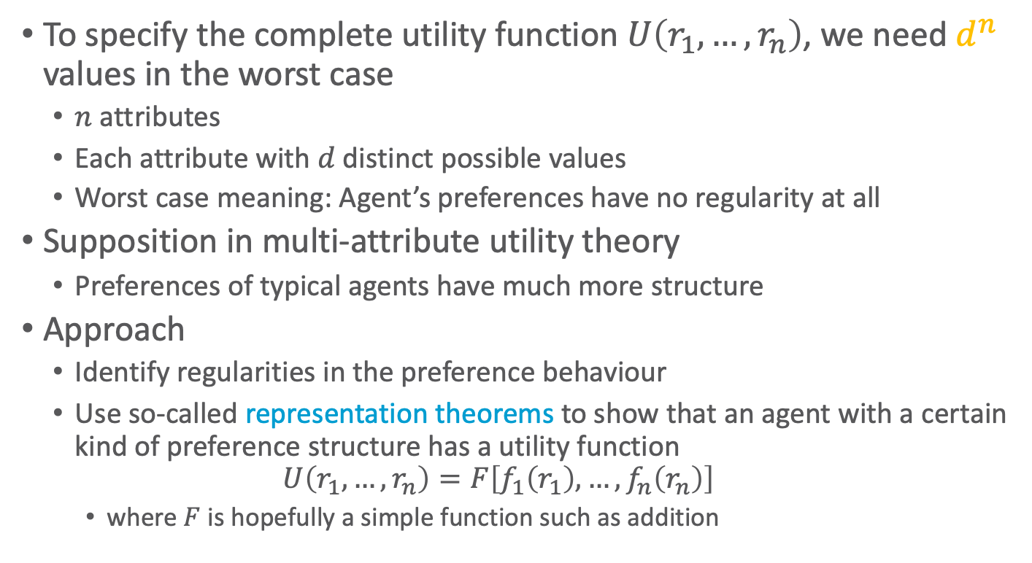
Preference Structure
To specify the complete utility function $U\left(r_{1},…,r_{n}\right)$, we need $d^{n}$ values in the worst case
  $n$ attributes
  Each attribute with $d$ distinct possible values
  Worst case meaning: Agent’s preferences have no regularity at all
Supposition in multi-attribute utility theory
  Preferences of typical agents have much more structure
Approach
  Identify regularities in the preference behaviour
  Use so-called representation theorems to show that an agent with a certain kind of preference structure has a utility function
  $$U\left(r_{1},…,r_{n}\right)=F\left[f_{1}\left(r_{1}\right),…,f_{n}\left(r_{n}\right)\right]$$
    where $F$ is hopefully a simple function such as addition
Notes:
Similar to Bayesian networks / factor graphs / Markov nets (factorisations) that decompose the joint probability of several random variables

Slide 31
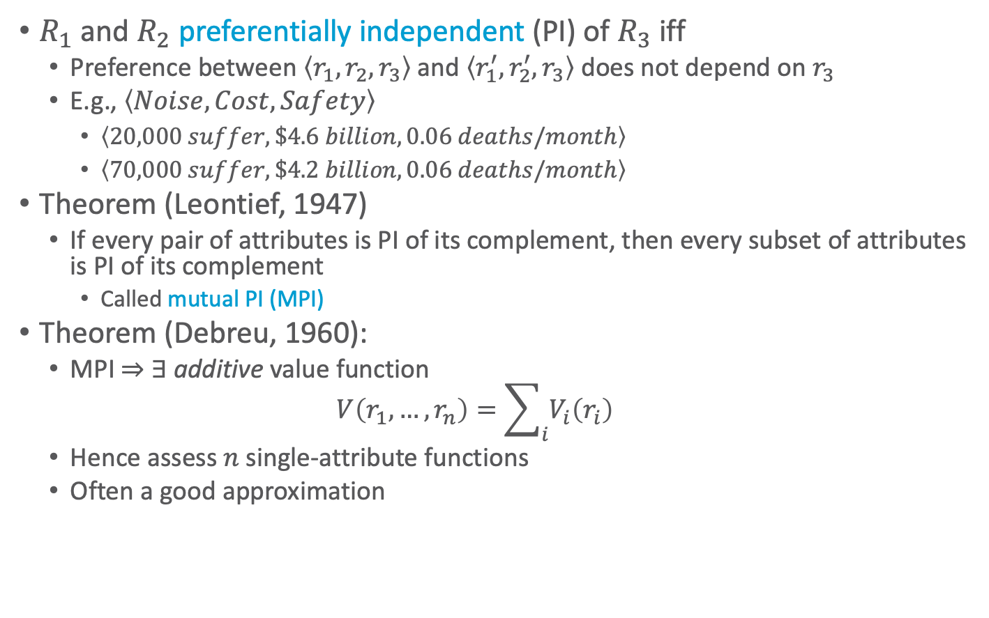
Preference Structure: Deterministic
$R_{1}$ and $R_{2}$ preferentially independent (PI) of $R_{3}$ iff
  Preference between $\left\langle r_{1},r_{2},r_{3}\right\rangle$ and $\left\langle r_{1}^{′},r_{2}^{′},r_{3}\right\rangle$ does not depend on $r_{3}$
  E.g., $\left\langle Noise, Cost, Safety\right\rangle$
    $\left\langle 20,000 suffer, \$4.6 billion, 0.06 deaths/month\right\rangle$
    $\left\langle 70,000 suffer, \$4.2 billion, 0.06 deaths/month\right\rangle$
Theorem (Leontief, 1947)
  If every pair of attributes is PI of its complement, then every subset of attributes is PI of its complement
    Called mutual PI (MPI)
Theorem (Debreu, 1960):
  MPI ⇒ ∃ additive value function
  $$V\left(r_{1},…, r_{n}\right)=\sum_{i}{V_{i}\left(r_{i}\right)}$$
  Hence assess $n$ single-attribute functions
  Often a good approximation
Notes:
MPI, where it doesn’t hold: Suppose you are at a medieval market, considering the purchase of some hunting dogs, some chickens, and some wicker cages for the chickens. The hunting dogs are very valuable, but if you don’t have enough cages for the chickens, the dogs will eat the chickens; hence, the tradeoff between dogs and chickens depends strongly on the number of cages, and MPI is violated.
The existence of these kinds of interactions among various attributes makes it much harder to assess the overall value function.

Slide 32
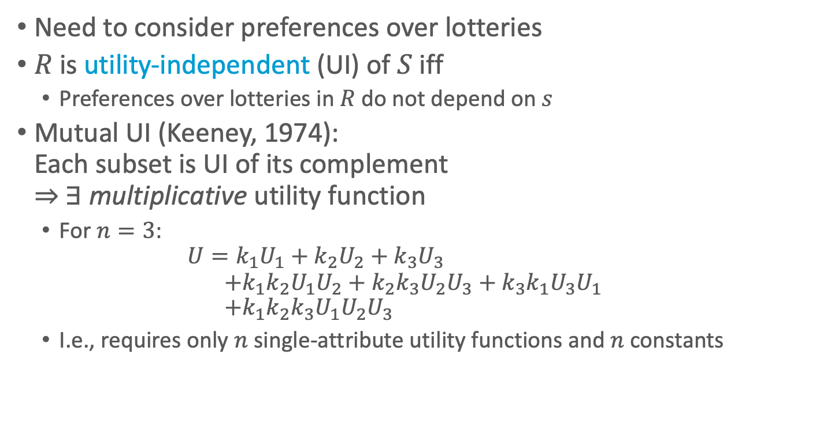
Preference Structure: Stochastic
Need to consider preferences over lotteries
$R$ is utility-independent (UI) of $S$ iff
  Preferences over lotteries in $R$ do not depend on $s$
Mutual UI (Keeney, 1974):
Each subset is UI of its complement
⇒ ∃ multiplicative utility function
  For $n=3$:
  $$U=k_{1}U_{1}+k_{2}U_{2}+k_{3}U_{3} \\ +k_{1}k_{2}U_{1}U_{2}+k_{2}k_{3}U_{2}U_{3}+k_{3}k_{1}U_{3}U_{1} \\ +k_{1}k_{2}k_{3}U_{1}U_{2}U_{3}$$
  I.e., requires only $n$ single-attribute utility functions and $n$ constants
Notes:
UI extension of PI
Routine procedures and software packages for generating preference tests to identify various canonical families of utility functions

Slide 33
Intermediate Summary
Preferences
  Preferences of a rational agent must obey constraints
Utilities
  Rational preferences = describable as maximisation of expected utility
  Utility axioms
  MEU principle
Dominance
  Strict dominance
  First-order + second-order stochastic dominance
Preference structure
  (Mutual) preferential independence
  (Mutual) utility independence

Slide 34
Outline
Utility Theory
  Preferences
  Utilities
  Dominance
  Preference structure
Markov Decision Process/Problem (MDP) – Ch. 17.1-17.3
  Markov property
  Sequence of actions, history, policy
  Value iteration, policy iteration

Slide 35
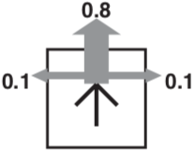
Simple Robot Navigation Problem
In each state, the possible actions are U, D, R, and L
The effect of action U is as follows (transition model):
  With probability 0.8, move up one square
    If already in top row or blocked, no move
  With probability 0.1, move right one square
    If already in rightmost row or blocked, no move
  With probability 0.1, move left one square
    If already in leftmost row or blocked, no move
Same transition model holds for D, R, and L
and their respective directions
Goal

Slide 36
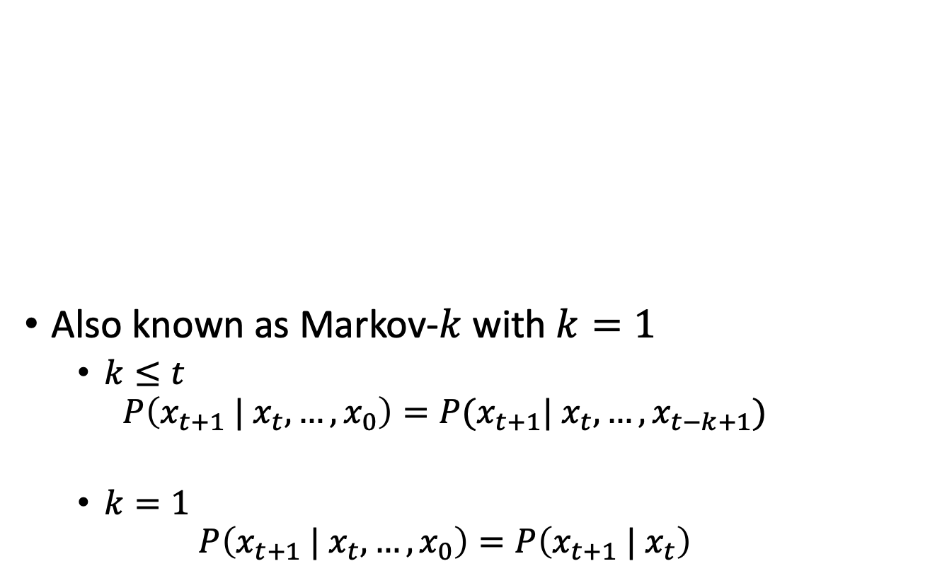
Markov Property
Also known as Markov-$k$ with $k=1$
  $k≤t$
  $$P\left(x_{t+1} | x_{t}, …, x_{0}\right)=P(x_{t+1}| x_{t}, …, x_{t−k+1})$$
  $k=1$
  $$P\left(x_{t+1} | x_{t}, …, x_{0}\right)=P\left(x_{t+1} | x_{t}\right)$$
The transition properties depend only
on the current state, not on previous
history (how that state was reached).
Notes:
Example: Hidden Markov Model (HMM)

Slide 37
Sequence of Actions
In each state, the possible actions are U, D, R, and L;
the transition model for each action is (pictured):
Current position: [3,2]
Planned sequence of actions: (U, R)
Goal
[3,2]
3
2
1
1
2
3
4

Slide 38
Sequence of Actions
In each state, the possible actions are U, D, R, and L;
the transition model for each action is (pictured):
Current position: [3,2]
Planned sequence of actions: (U, R)
  U is executed
Goal
[3,2]
3
2
[3,2]
[3,3]
[4,2]
1
1
2
3
4
Notes:
U executed
up with prob. 0.8
right with prob. 0.1
left with prob. 0.1 (left is blocked, so no move)

Slide 39
Sequence of Actions
In each state, the possible actions are U, D, R, and L;
the transition model for each action is (pictured):
Current position: [3,2]
Planned sequence of actions: (U, R)
  U has been executed
  R is executed
Goal
[3,2]
3
2
[3,2]
[3,3]
[4,2]
1
[3,1]
[3,2]
[3,3]
[4,1]
[4,2]
[4,3]
1
2
3
4
Notes:
U executed
up with prob. 0.8
right with prob. 0.1
left with prob. 0.1 (left is blocked, so no move)

Slide 40
Histories
In each state, the possible actions are U, D, R, and L;
the transition model for each action is (pictured):
Current position: [3,2]
Planned sequence of actions: (U, R)
  U has been executed
  R is executed
  9 possible sequences of states, called histories, and 6 possible final states
Goal
[3,2]
3
2
[3,2]
[3,3]
[4,2]
1
[3,1]
[3,2]
[3,3]
[4,1]
[4,2]
[4,3]
1
2
3
4
Notes:
U executed
up with prob. 0.8
right with prob. 0.1
left with prob. 0.1 (left is blocked, so no move)

Slide 41

Probability of Reaching the Goal
In each state: possible actions U, D, R, L; trans. model:
$P\left(\left[4,3\right] | \left(U,R\right).\left[3,2\right]\right)=$
$$P\left(\left[4,3\right] | R.\left[3,3\right]\right)∙P\left(\left[3,3\right] | U.\left[3,2\right]\right) \\ +P\left(\left[4,3\right] | R.\left[4,2\right]\right)∙P\left(\left[4,2\right] | U.\left[3,2\right]\right)$$
$P\left(\left[4,3\right] | R.\left[3,3\right]\right)=0.8$ $P\left(\left[3,3\right] | U.\left[3,2\right]\right)=0.8$
$P\left(\left[4,3\right] | R.\left[4,2\right]\right)=0.1$ $P\left(\left[4,2\right] | U.\left[3,2\right]\right)=0.1$
$P\left(\left[4,3\right] | \left(U,R\right).\left[3,2\right]\right)=0.8∙0.8+0.1∙0.1=0.65$
Note importance of Markov property in this derivation
Goal
[3,2]
3
2
[3,2]
[3,3]
[4,2]
1
[3,1]
[3,2]
[3,3]
[4,1]
[4,2]
[4,3]
1
2
3
4
Notes:
U executed
up with prob. 0.8
right with prob. 0.1
left with prob. 0.1 (left is blocked, so no move)

Slide 42
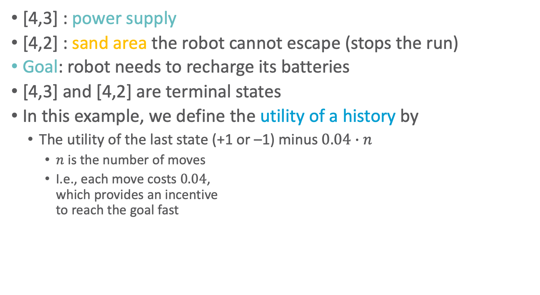
Utility Function
[4,3] : power supply
[4,2] : sand area the robot cannot escape (stops the run)
Goal: robot needs to recharge its batteries
[4,3] and [4,2] are terminal states
In this example, we define the utility of a history by
  The utility of the last state (+1 or –1) minus $0.04∙n$
    $n$ is the number of moves
    I.e., each move costs $0.04$,
    which provides an incentive
    to reach the goal fast
+1
3
-1
2
1
1
2
3
4

Slide 43
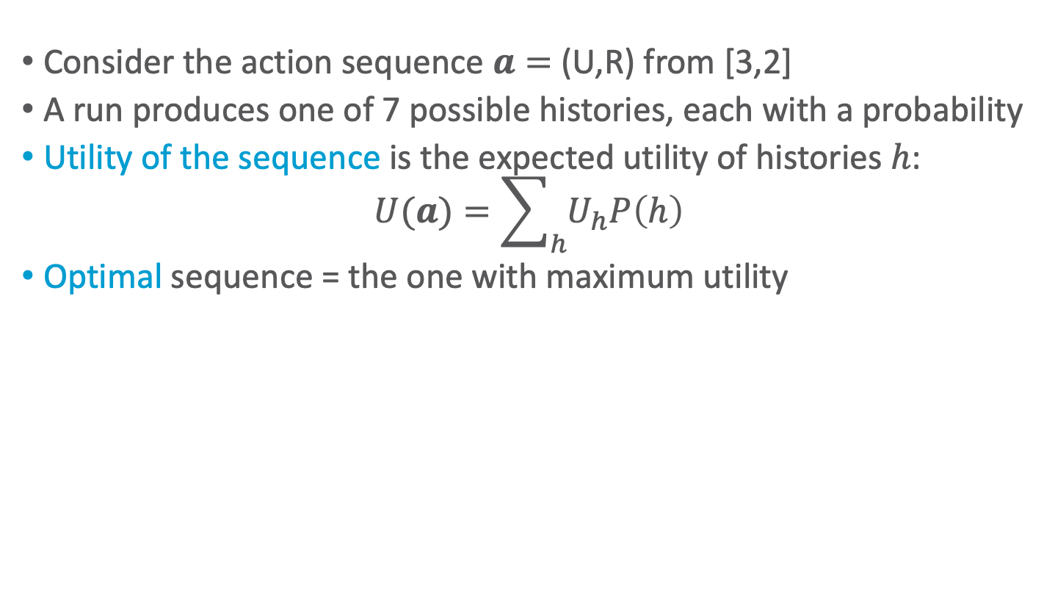
Utility of an Action Sequence
Consider the action sequence $a=$ (U,R) from [3,2]
A run produces one of 7 possible histories, each with a probability
Utility of the sequence is the expected utility of histories $h$:
$$U(a)=\sum_{h}{U_{h}P\left(h\right)}$$
Optimal sequence = the one with maximum utility
Is the optimal sequence what we want?
+1
[3,2]
3
-1
2
[3,2]
[3,3]
[4,2]
1
[3,1]
[3,2]
[3,3]
[4,1]
[4,2]
[4,3]
1
2
3
4
Notes:
only if the sequence is executed blindly!

Slide 44
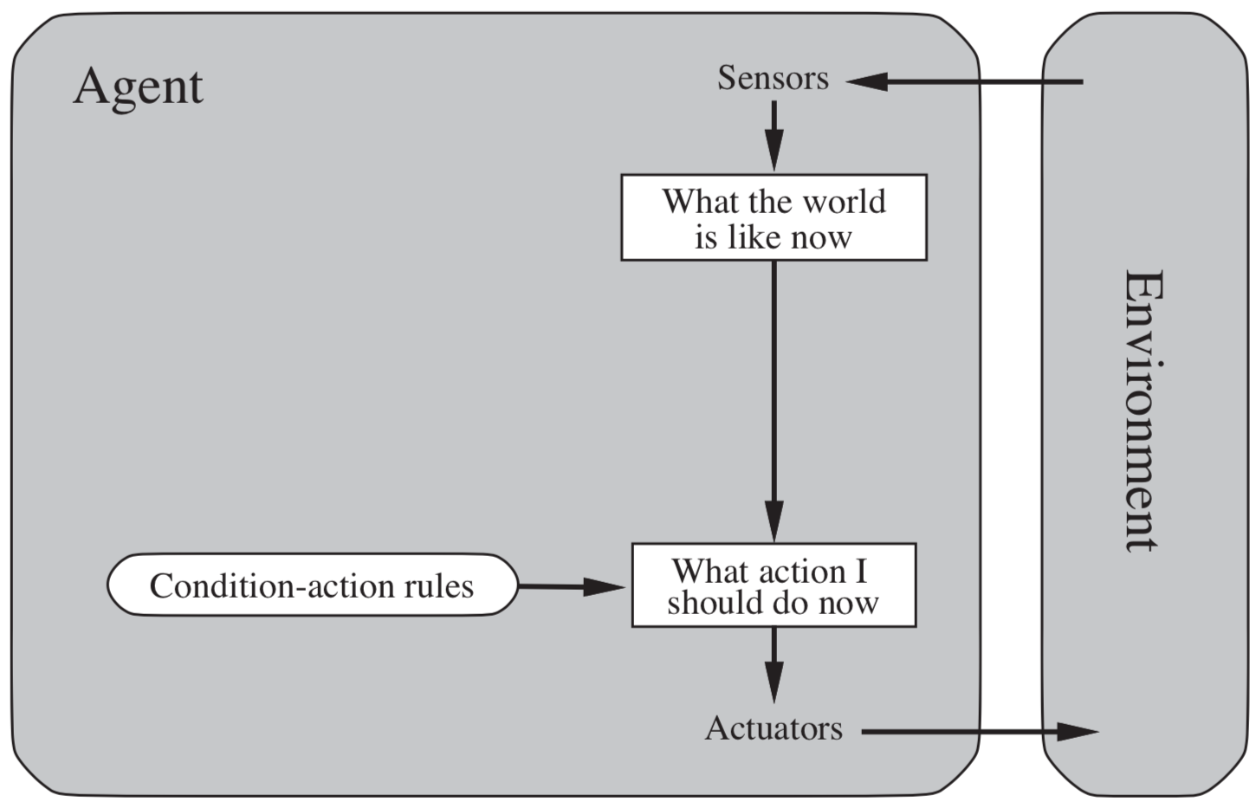
Reactive Agent Algorithm
Act()
repeat
s ← sensed state
if s is terminal then
exit
a ← choose action (given s)
perform a
Accessible or observable state
Figure: AIMA, Russell/Norvig

Slide 45
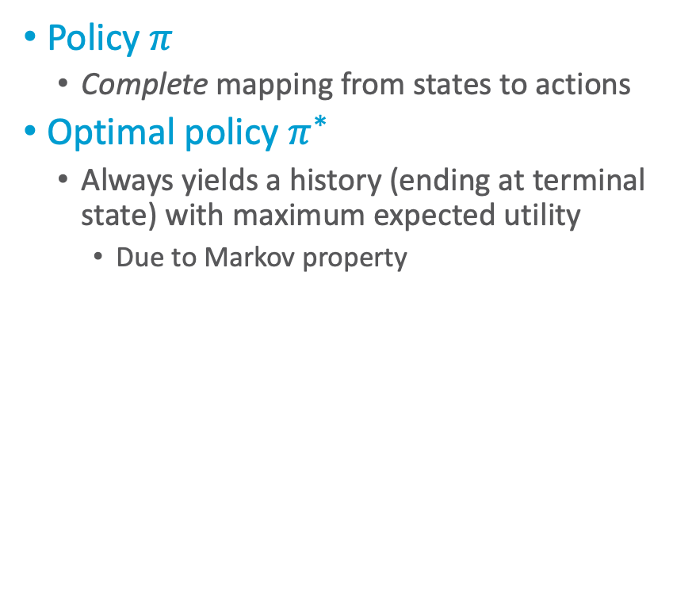
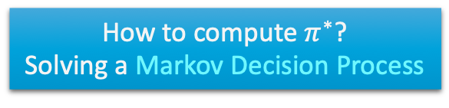
Policy (Reactive/Closed-loop Strategy)
Policy $π$
  Complete mapping from states to actions
Optimal policy $π^{∗}$
  Always yields a history (ending at terminal state) with maximum expected utility
    Due to Markov property
Act()
repeat
s ← sensed state
if s is terminal then
exit
a ← 𝜋(s)
perform a
+1
Note that [3,2] is a “dangerous” state that the optimal policy tries to avoid
3
-1
2
1
How to compute $π^{∗}$?
Solving a Markov Decision Process
1
2
3
4

Slide 46
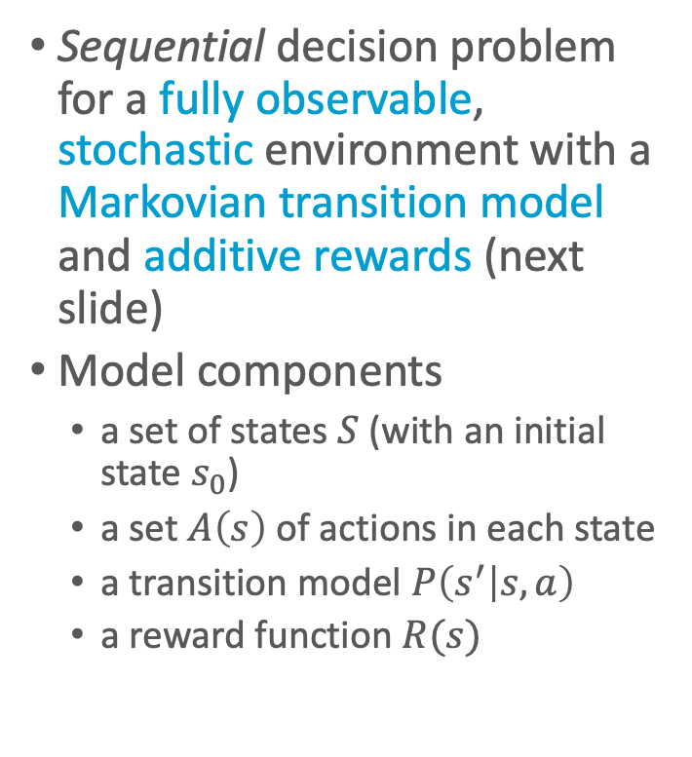

Markov Decision Process / Problem (MDP)
Sequential decision problem for a fully observable, stochastic environment with a Markovian transition model and additive rewards (next slide)
Model components
  a set of states $S$ (with an initial state $s_{0}$)
  a set $A\left(s\right)$ of actions in each state
  a transition model $P\left(s^{′} | s, a\right)$
  a reward function $R(s)$
Robot navigation example:
+1
3
-1
2
1
1
2
3
4
U, D, L, R
each move costs $0.04$

Slide 47
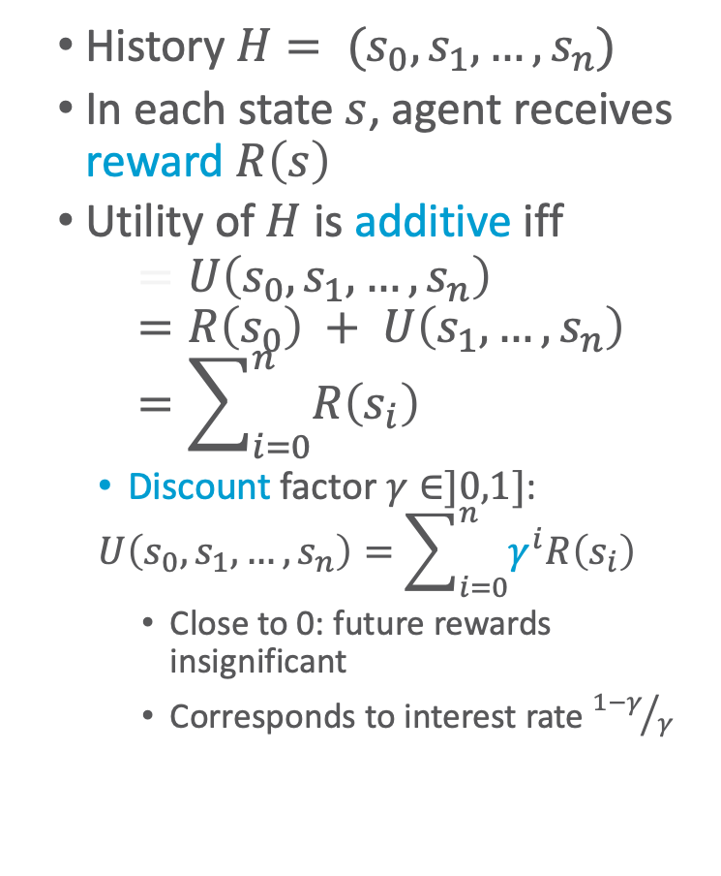

Additive Utility
History $H= (s_{0},s_{1},…,s_{n})$
In each state $s$, agent receives reward $R\left(s\right)$
Utility of $H$ is additive iff
$$=U\left(s_{0},s_{1},…,s_{n}\right)=R\left(s_{0}\right) + U\left(s_{1},…,s_{n}\right)=\sum_{i=0}^{n}{R\left(s_{i}\right)}$$
  Discount factor $γ∈]0,1]$:
  $$U\left(s_{0},s_{1},…,s_{n}\right)=\sum_{i=0}^{n}{γ^{i}R\left(s_{i}\right)}$$
    Close to 0: future rewards insignificant
    Corresponds to interest rate ${1−γ}/γ$
Robot navigation example:
  $R\left(s_{n}\right)=+1$ if $s_{n}=\left[4,3\right]$
  $R\left(s_{n}\right)=−1$ if $s_{n}=\left[4,2\right]$
  $R\left(s_{i}\right)=−0.04$ if $i=0, …, n−1$
  $γ=1$
+1
3
-1
2
1
1
2
3
4

Slide 48
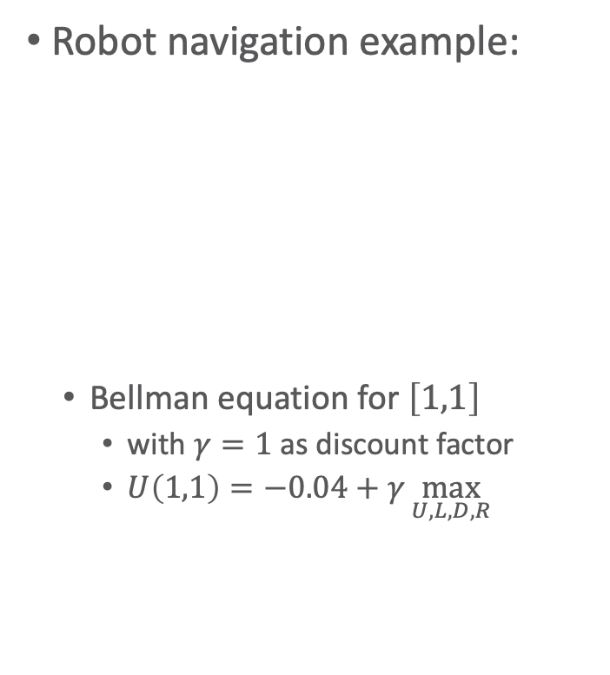
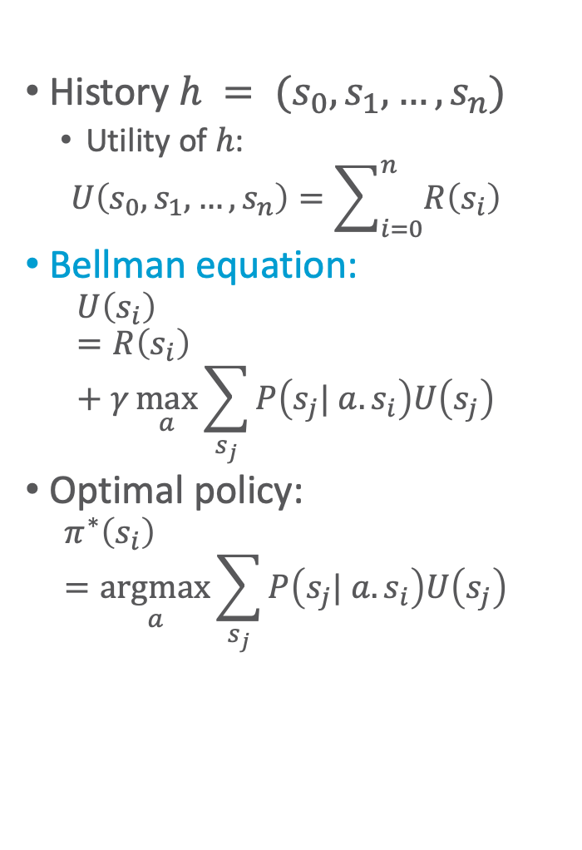
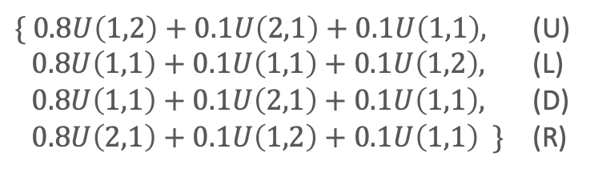
Principle of MEU
History $h = (s_{0},s_{1},…,s_{n})$
  Utility of $h$:
  $$U\left(s_{0},s_{1},…,s_{n}\right)=\sum_{i=0}^{n}{R\left(s_{i}\right)}$$
Bellman equation:
  $$U\left(s_{i}\right)=R\left(s_{i}\right)+γ\max_{a}{\sum_{s_{j}}{P\left(s_{j}| a.s_{i}\right)U\left(s_{j}\right)}}$$
Optimal policy:
  $$π^{∗}\left(s_{i}\right)=\underset{a}{argmax}{\sum_{s_{j}}{P\left(s_{j}| a.s_{i}\right)U\left(s_{j}\right)}}$$
Robot navigation example:
  Bellman equation for $\left[1,1\right]$
    with $γ=1$ as discount factor
    $U\left(1,1\right)=−0.04+γ\max_{U,L,D,R}{ }$
+1
3
-1
2
1
1
2
3
4
$\{ 0.8U\left(1,2\right)+0.1U\left(2,1\right)+0.1U\left(1,1\right),$ (U)
$0.8U\left(1,1\right)+0.1U\left(1,1\right)+0.1U\left(1,2\right),$ (L)
$0.8U\left(1,1\right)+0.1U\left(2,1\right)+0.1U\left(1,1\right),$ (D)
$0.8U\left(2,1\right)+0.1U\left(1,2\right)+0.1U\left(1,1\right) \}$ (R)

Slide 49
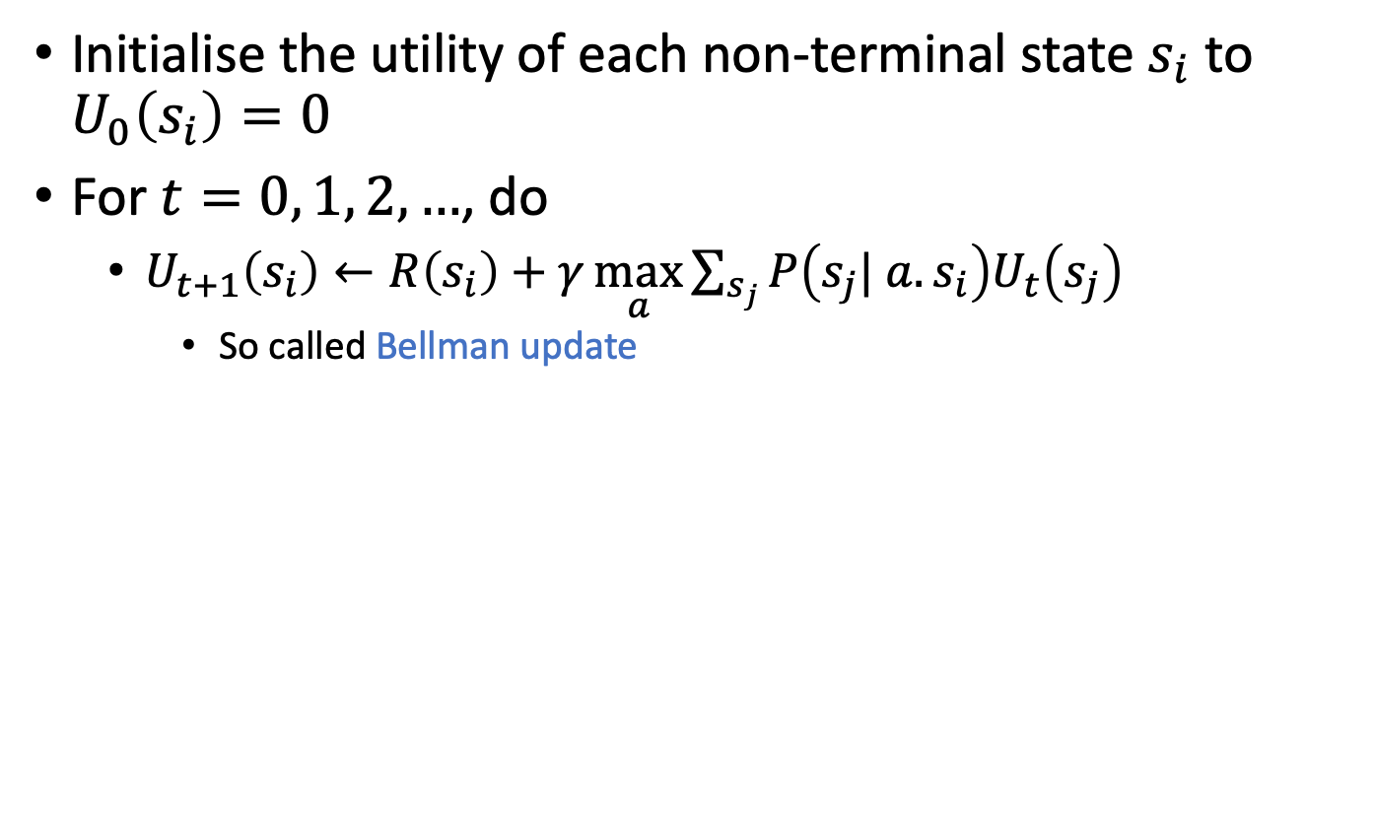
Value Iteration
Initialise the utility of each non-terminal state $s_{i}$ to $U_{0}\left(s_{i}\right)=0$
For $t=0, 1, 2, …$, do
  $U_{t+1}\left(s_{i}\right)←R\left(s_{i}\right)+γ\max_{a}{\sum_{s_{j}}{P\left(s_{j}| a.s_{i}\right)U_{t}\left(s_{j}\right)}}$
    So called Bellman update
Robot navigation example:
0
0
0
+1
3
0
0
-1
2
1
0
0
0
0
1
2
3
4

Slide 50
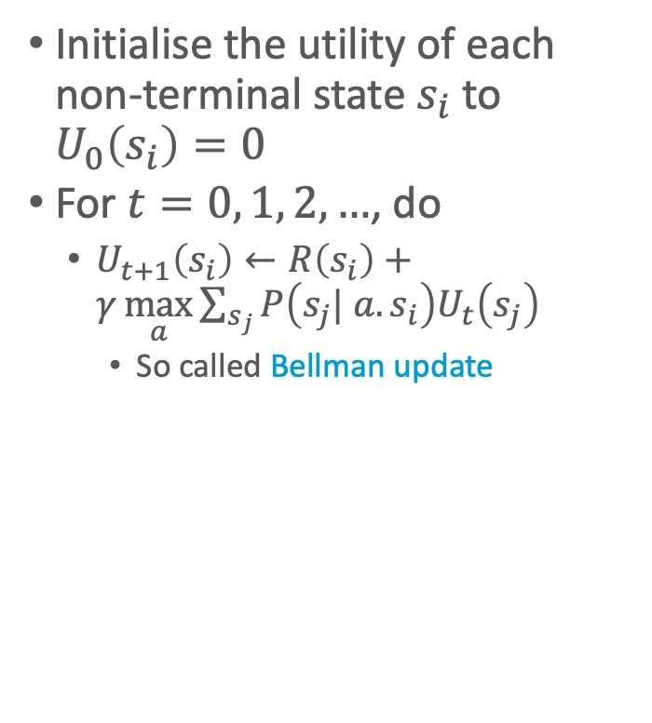


Value Iteration
Initialise the utility of each non-terminal state $s_{i}$ to $U_{0}\left(s_{i}\right)=0$
For $t=0, 1, 2, …$, do
  $U_{t+1}\left(s_{i}\right)←R\left(s_{i}\right)+γ\max_{a}{\sum_{s_{j}}{P\left(s_{j}| a.s_{i}\right)U_{t}\left(s_{j}\right)}}$
    So called Bellman update
Robot navigation example
0.812
0.868
0.918
+1
3
0.762
0.660
-1
2
1
0.705
0.655
0.611
0.388
1
2
3
4
$$U_{t}\left(\left[3,1\right]\right)$$
0.611
Note the importance of terminal states and connectivity of the state-transition graph
0.5
0
0
10
20
30
$$t$$

Slide 51

Value Iteration: Algorithm
function value-iteration(mdp,𝜖)
U’ ← 0, π ←〈〉
repeat
U ← U’
𝛿 ← 0
for each state s ∈ S do
U’[s] ← R(s) + 𝛾 max_{a∈A(s)}Σ_{s’}P(s’|a.s)U[s’]
if |U’[s] - U[s]| > 𝛿 then
𝛿 ← |U’[s] - U[s]|
until 𝛿 < 𝜖(1-𝛾)/𝛾
for each state s ∈ S do
π(s) ← argmax_{a∈A(s)}Σ_{s’}P(s’|a.s)U[s’]
return π
Returns a policy $π$
that is optimal
Inputs
  MDP:
    States $S$
    For all $s∈S$
      Actions $A\left(s\right)$
      Transition model
      $P\left(s^{′}| a.s\right)$
      Rewards $R\left(s\right)$
    Discount $γ$
  Maximum error allowed $ε$
Local variables
  $U, U^{′}$ vectors of utilities for states in $S$, initially $0$
  $δ$ maximum change in utility of any state in an iteration

Slide 52
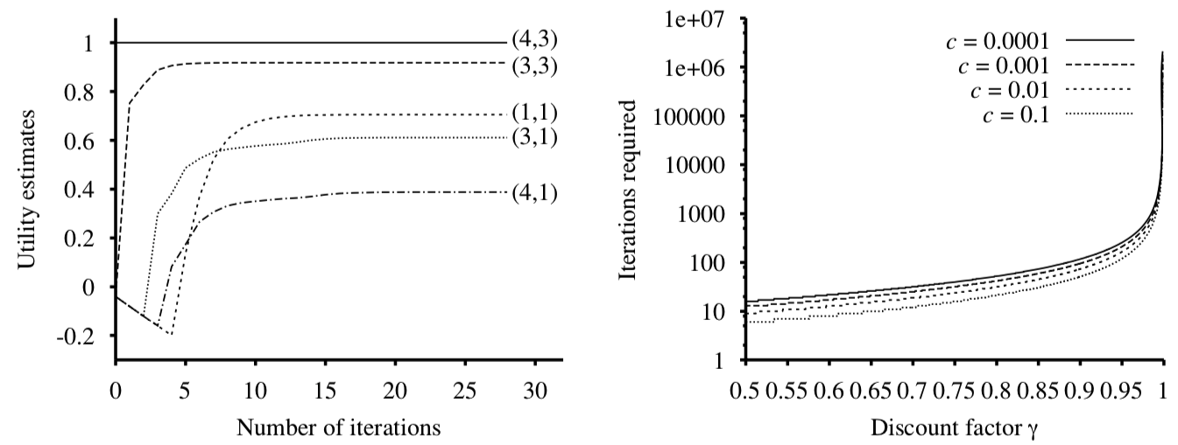

Evolution of Utilities
For $t=0, 1, 2, …$, do
  $U_{t+1}\left(s_{i}\right)←R\left(s_{i}\right)+γ\max_{a}{\sum_{s_{j}}{P\left(s_{j}| a.s_{i}\right)U_{t}\left(s_{j}\right)}}$
Value iteration ≈ information propagation
Robot navigation example
0.812
0.868
0.918
+1
3
0.762
0.660
-1
2
1
0.705
0.655
0.611
0.388
1
2
3
4
Figure right: AIMA, Russell/Norvig

Slide 53

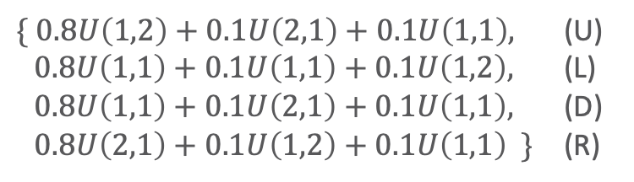
Argmax Action
For $t=0, 1, 2, …$, do
  $U_{t+1}\left(s_{i}\right)←R\left(s_{i}\right)+γ\max_{a}{\sum_{s_{j}}{P\left(s_{j}| a.s_{i}\right)U_{t}\left(s_{j}\right)}}$
Argmax action may change over iterations
Robot navigation example:
  Bellman equation for $\left[1,1\right]$
    with $γ=1$ as discount factor
    $U\left(1,1\right)=−0.04+γ\max_{U,L,D,R}{ }$
0.812
0.868
0.918
+1
3
0.762
0.660
-1
2
1
0.705
0.655
0.611
0.388
1
2
3
4
$\{ 0.8U\left(1,2\right)+0.1U\left(2,1\right)+0.1U\left(1,1\right),$ (U)
$0.8U\left(1,1\right)+0.1U\left(1,1\right)+0.1U\left(1,2\right),$ (L)
$0.8U\left(1,1\right)+0.1U\left(2,1\right)+0.1U\left(1,1\right),$ (D)
$0.8U\left(2,1\right)+0.1U\left(1,2\right)+0.1U\left(1,1\right) \}$ (R)

Slide 54





Effect of Rewards
For $t=0, 1, 2, …$, do
  $U_{t+1}\left(s_{i}\right)←R\left(s_{i}\right)+γ\max_{a}{\sum_{s_{j}}{P\left(s_{j}| a.s_{i}\right)U_{t}\left(s_{j}\right)}}$
Optimal policies for different rewards:
  For $R\left(s\right)=−0.04$, see right ⇢
Robot navigation example
+1
3
-1
2
1
1
2
3
4
+1
+1
+1
+1
-1
-1
-1
-1
$$R\left(s\right)<−1.6284$$
$$−0.4278<R\left(s\right)<−0.0850$$
$$−0.0221<R\left(s\right)<0$$
$$R\left(s\right)>0$$
Data for figures: AIMA, Russell/Norvig

Slide 55


Effect of Allowed Error & Discount
For $t=0, 1, 2, …$, do
  $U_{t+1}\left(s_{i}\right)←R\left(s_{i}\right)+γ\max_{a}{\sum_{s_{j}}{P\left(s_{j}| a.s_{i}\right)U_{t}\left(s_{j}\right)}}$
Iterations required to ensure a maximum error of $ε=c·R_{max}$
  $R_{max}$ maximum reward
Robot navigation example
  $R_{max}=$ +1
+1
3
-1
2
1
1
2
3
4
Figure right: AIMA, Russell/Norvig

Slide 56


Policy Iteration
Pick a policy $π_{0}$ at random
Repeat:
  Policy evaluation: Compute the utility of each state for $π_{t}$
    $U_{t}\left(s_{i}\right)=R\left(s_{i}\right)+γ\sum_{s_{j}}{P\left(s_{j}|π_{t}\left(s_{i}\right).s_{i}\right)U_{t}\left(s_{j}\right)}$
      No longer involves a $max$ operation as action is determined by $π_{t}$
  Policy improvement: Compute the policy $π_{t+1}$ given $U_{t}$
    $π_{t+1} \left(s_{i}\right)=\underset{a}{argmax}{\sum_{s_{j}}{P\left(s_{j}|π_{t}\left(s_{i}\right).s_{i}\right)U_{t}\left(s_{j}\right)}}$
  If $π_{t+1}=π_{t}$, then return $π_{t}$
Solve the set of linear equations:
$$U\left(s_{i}\right)=R\left(s_{i}\right)+γ\sum_{s_{j}}{P\left(s_{j}|π\left(s_{i}\right).s_{i}\right)U\left(s_{j}\right)}$$
(often a sparse system)

Slide 57

Policy Iteration: Algorithm
function policy-iteration(mdp)
repeat
U ← policy-evaluation(𝜋,U,mdp)
unchanged ← true
for each state s ∈ S do
if max_{a∈A(s)}Σ_{s’}P(s’|a.s)U[s’] > Σ_{s’}P(s’|𝜋[s].s)U[s’] then
𝜋[s] ← argmax_{a∈A(s)}Σ_{s’}P(s’|a.s)U[s’]
unchanged ← false
until unchanged
return 𝜋
Returns a policy $π$ that is optimal
Inputs: MDP
  States $S$
  For all $s∈S$, actions $A\left(s\right)$, transition model $P\left(s^{′}| a.s\right)$, rewards $R\left(s\right)$
Local variables
  $U$ vectors of utilities for states in $S$, initially $0$
  $π$ a policy vector indexed by state, initially random

Slide 58

Policy Evaluation
Compute the utility of each state for $π$
  $U_{t}\left(s_{i}\right)=R\left(s_{i}\right)+γ\sum_{s_{j}}{P\left(s_{j}|π_{t}\left(s_{i}\right).s_{i}\right)U_{t}\left(s_{j}\right)}$
Complexity of policy evaluation: $O\left(n^{3}\right)$
  For $n$ states, $n$ linear equations with $n$ unknowns
  Prohibitive for large $n$
Approximation of utilities
  Perform $k$ value iteration steps with fixed policy $π_{t}$, return utilities
    Simplified Bellman update: $U_{t+1}\left(s_{i}\right)=R\left(s_{i}\right)+γ\sum_{s_{j}}{P\left(s_{j}|π\left(s_{i}\right).s_{i}\right)U_{t}\left(s_{j}\right)}$
  Asynchronous policy iteration (next slide)
    Pick any subset of states

Slide 59
Asynchronous Policy Iteration
Further approximation of policy iteration
  Pick any subset of states and do one of the following
    Update utilities
      Using simplified value iteration as described on previous slide
    Update the policy
      Policy improvement as before
Is not guaranteed to converge to an optimal policy
  Possible if each state is still visited infinitely often, knowledge about unimportant states, etc.
Freedom to work on any states allows for design of domain-specific heuristics
  Update states that are likely to be reached by a good policy

Slide 60
Intermediate Summary
MDP
  Markov property
    Current state depends only on previous state
  Sequence of actions, history, policy
    Sequence of actions may yield multiple histories, i.e., sequences of states, with a utility
    Policy: complete mapping of states to actions
    Optimal policy: policy with maximum expected utility
  Value iteration, policy iteration
    Algorithms for calculating an optimal policy for an MDP

Slide 61


Online Decision Making
Lecture next winter term (WiSe 2022/23) on Relational Inference and Online Decision Making
Decision making based on probabilistic graphical models (PGMs)
  Do not precompute a policy beforehand but decide on an action (sequence) online given current observations
Static case (episodic, without effects on next state)
  PGMs extended with action and utility nodes
  MEU query (problem): Calculate expected utility for each action, decide to execute action with highest expected utility
Dynamic case (temporal, with effects
on next state)
  Dynamic PGMs extended with action
  and utility nodes
  MEU query (problem): Calculate
  expected utility for sequence of actions,
  decide to execute action sequence with
  highest expected utility
https://www.ifis.uni-luebeck.de/index.php?id=703&L=0

Slide 62
Outline
Utility Theory
  Preferences
  Utilities
  Dominance
  Preference structure
Markov Decision Process / Problem (MDP)
  Markov property
  Sequence of actions, history, policy
  Value iteration, policy iteration
⟹ Next: Probabilistic Models

