Slide 1
Automated Planning and Acting
d5
Probabilistic Models
c = 1
0.2
d2
0.8
d3
c = 100
c = 100
Start:
s₀= d1
d1
0.5
c = 1
d4
Goal:
S_{g}= {d4}
0.5
Tanya Braun

Slide 2
Content
Planning and Acting with Deterministic Models
Planning and Acting with Refinement Methods
Planning and Acting with Temporal Models
Planning and Acting with Nondeterministic Models
Standard Decision
Making
Planning and Acting with Probabilistic Models
  Stochastic Shortest-Path Problems
  Heuristic Search Algorithms
  Online Approaches Including Reinforcement Learning
Advanced Decision
Making
Human-aware Planning
Notes:
1-4, 6: Planning book
5, 7: AIMA
8: Rao

Slide 3
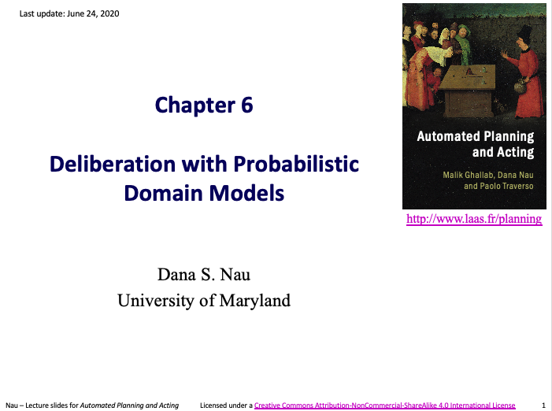
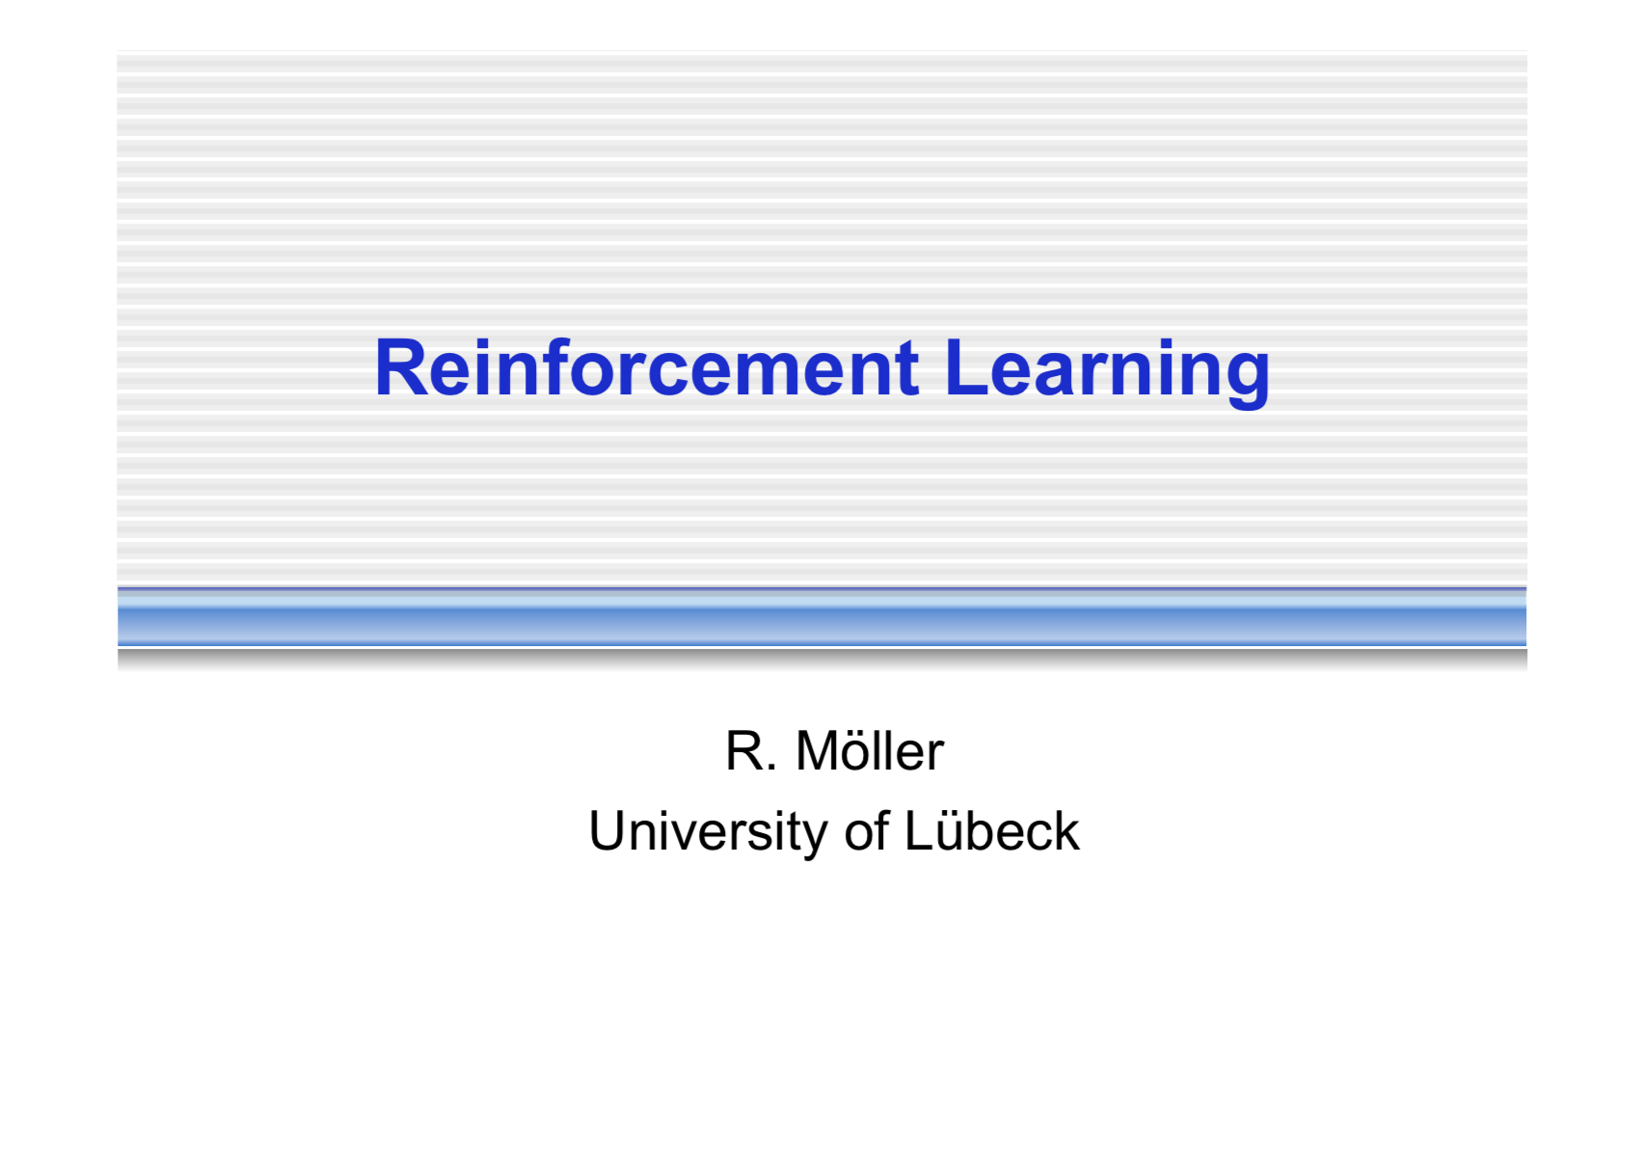
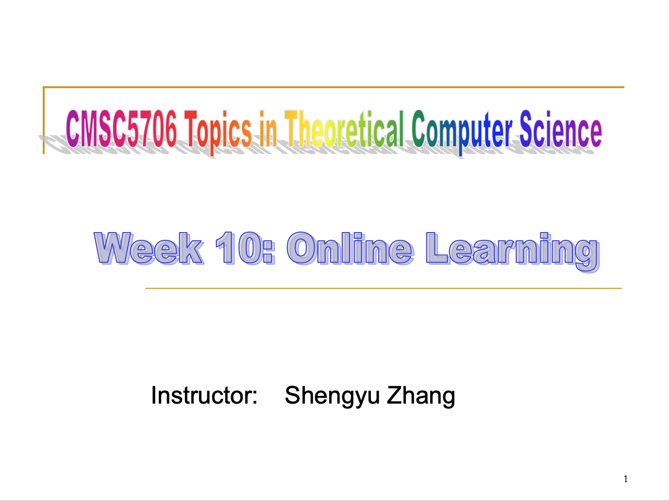
Acknowledgements
Automated Planning and Acting Chapter 6
Slides based on material provided by Dana Nau, Ralf Möller, and Shengyu Zhang

Slide 4
Outline
6.2 Stochastic shortest path problems
  Safe/unsafe policies
  Optimality
  Policy iteration, value iteration
6.3 Heuristic search algorithms
  Best-first search
  Determinisation
6.4 Online probabilistic planning
  Lookahead
  Reinforcement learning

Slide 5
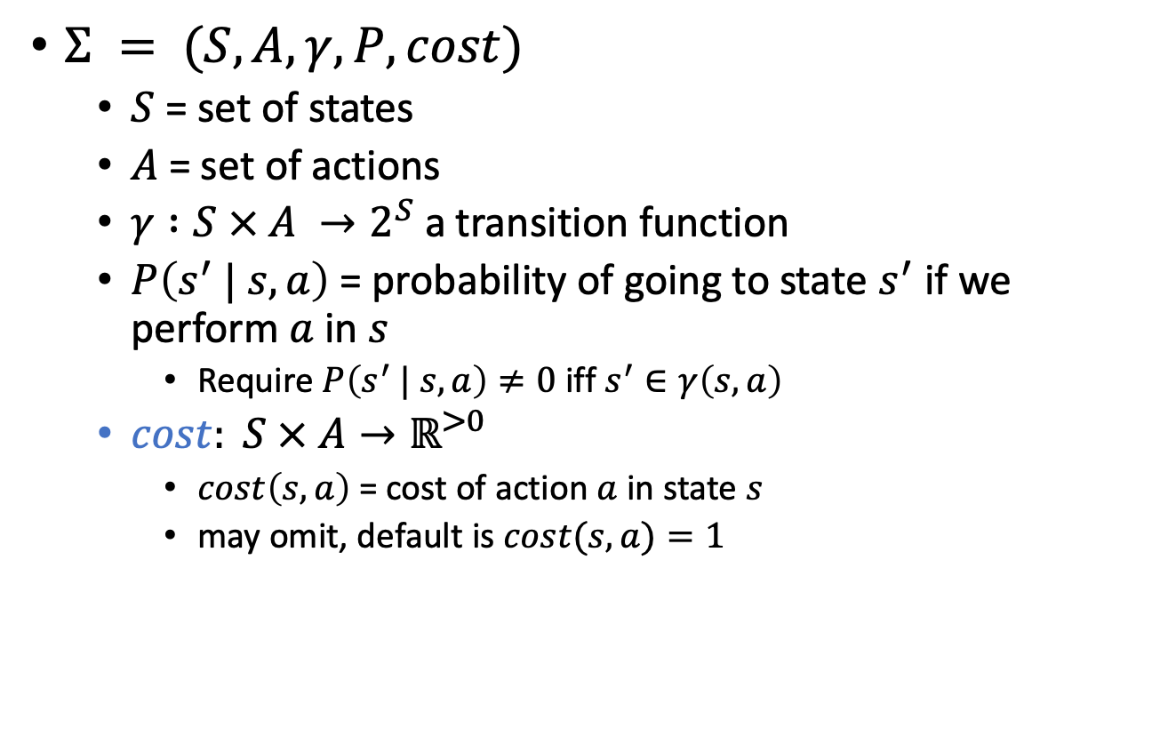
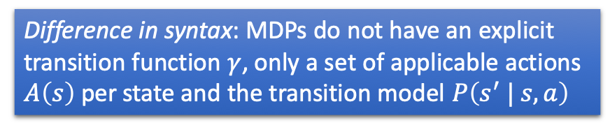
Probabilistic Planning Domain
$Σ = (S, A, γ, P, cost)$
  $S$ = set of states
  $A$ = set of actions
  $γ :S × A →2^{S}$ a transition function
  $P\left(s^{′} | s, a\right)$ = probability of going to state $s^{′}$ if we perform $a$ in $s$
    Require $P\left(s^{′} | s, a\right)≠0$ iff $s^{′}∈γ\left(s,a\right)$
  $cost: S × A→ℝ^{>0}$
    $cost\left(s,a\right)$ = cost of action $a$ in state $s$
    may omit, default is $cost(s,a)=1$
Difference in syntax: MDPs do not have an explicit transition function $γ$, only a set of applicable actions $A\left(s\right)$ per state and the transition model $P\left(s^{′} | s, a\right)$
Instead of maximising expected utility as before:
Minimise expected cost

Slide 6
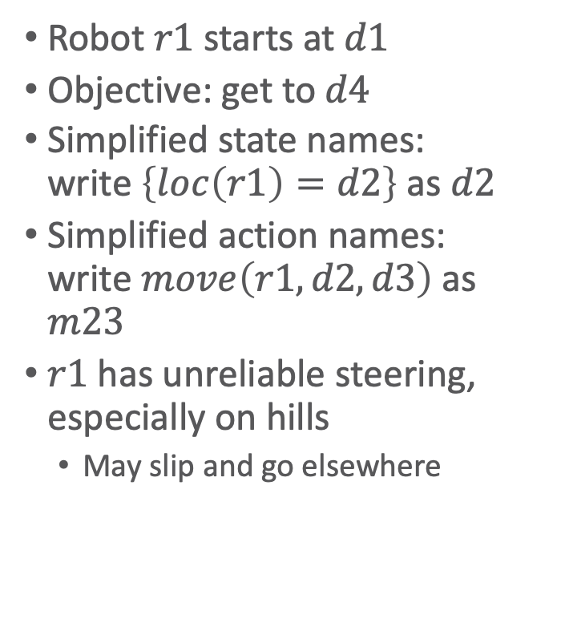

Example
Robot $r1$ starts at $d1$
Objective: get to $d4$
Simplified state names:
write $\left\{loc\left(r1\right)=d2\right\}$ as $d2$
Simplified action names:
write $move\left(r1,d2,d3\right)$ as $m23$
$r1$ has unreliable steering,
especially on hills
  May slip and go elsewhere
    $m14:P⁡(d4 | d1,m14)=0.5$
    $P⁡(d1 | d1,m14)=0.5$
    $m23:P⁡(d3 | d2,m23)=0.8$
    $P⁡(d5 | d2,m23)=0.2$
    $m21: P⁡(d2 | d1,m21)=1$
    $m34$, $m41$, $m43$, $m45$, $m52$, $m54$: like $m21$
←
→
d5
d2
→
→
↔
↔
d3
↔
d4
Start:
s₀= d1
r1
→
d4
→
→
Goal:
S_{g}= {d4}
→
←
d1

Slide 7
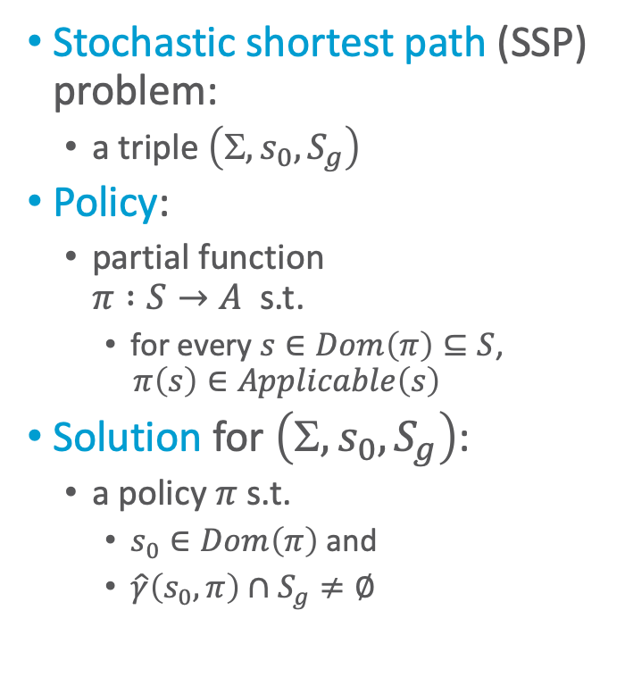

Policies, Problems, Solutions
Stochastic shortest path (SSP) problem:
  a triple $\left(, s_{0}, S_{g}\right)$
Policy:
  partial function
  $π :S→A$ s.t.
    for every $s∈Dom\left(π\right)⊆S$,
    $π\left(s\right)∈Applicable\left(s\right)$
Solution for $\left(, s_{0}, S_{g}\right)$:
  a policy $π$ s.t.
    $s_{0}∈Dom\left(π\right)$ and
    $\hat{γ}\left(s_{0},π\right)∩S_{g}≠∅$
    $m14:P(d4 | d1,m14)=0.5$
    $P(d1 | d1,m14)=0.5$
    $m23:P(d3 | d1,m23)=0.8$
    $P(d5 | d1,m23)=0.2$
m52
d5
0.2
d2
m23
0.8
d3
m32
m12
m21
m54
m43
m34
m45
d1
m41
d4
Start:
s₀= d1
0.5
Goal:
S_{g}= {d4}
0.5
m14

Slide 8
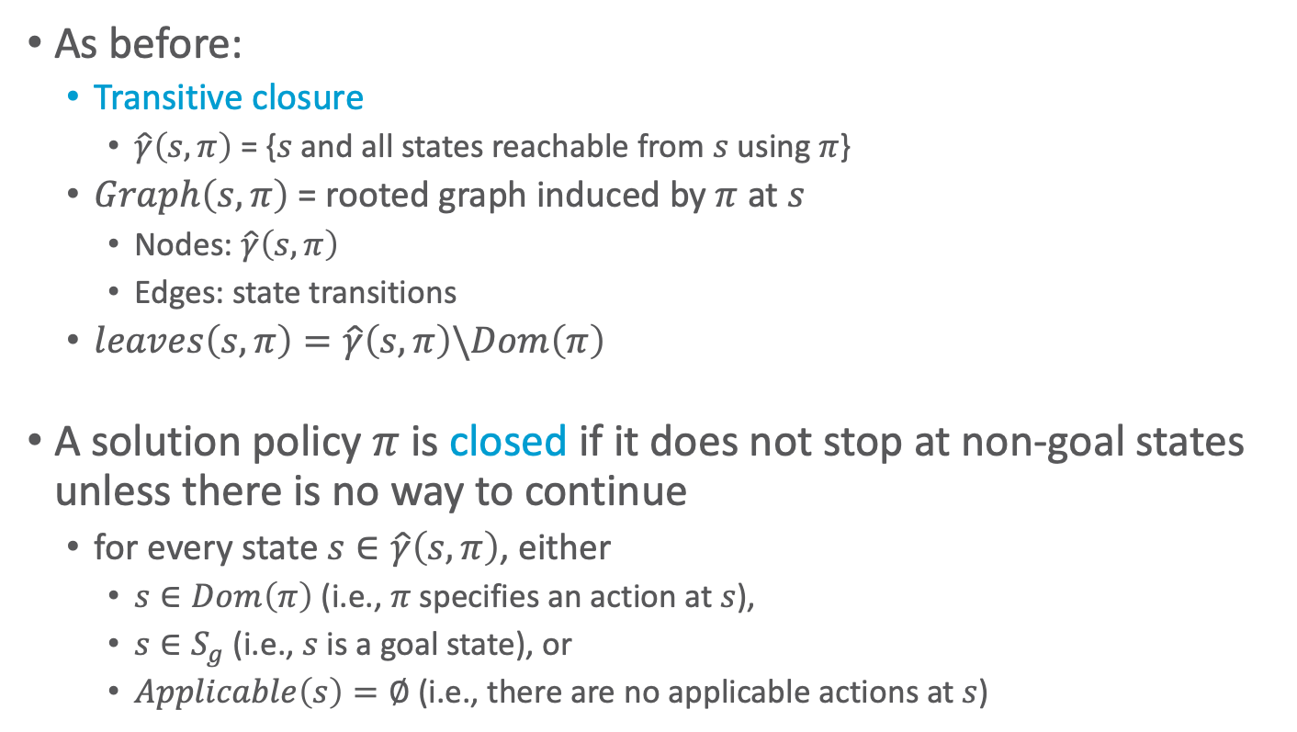
Notation and Terminology
As before:
  Transitive closure
    $\hat{γ}\left(s,π\right)$ = {$s$ and all states reachable from $s$ using $π$}
  $Graph\left(s,π\right)$= rooted graph induced by $π$ at $s$
    Nodes: $\hat{γ}\left(s,π\right)$
    Edges: state transitions
  $leaves\left(s,π\right)=\hat{γ}\left(s,π\right)\backslash Dom\left(π\right)$
A solution policy $π$ is closed if it does not stop at non-goal states unless there is no way to continue
  for every state $s∈\hat{γ}\left(s,π\right)$, either
    $s∈Dom\left(π\right)$ (i.e., $π$ specifies an action at $s$),
    $s∈S_{g}$ (i.e., $s$ is a goal state), or
    $Applicable\left(s\right)=∅$ (i.e., there are no applicable actions at $s$)

Slide 9
Dead Ends
Dead end
  A state or set of states from which the goal is unreachable
Explicit dead end
Implicit dead end
d5
d5
d6
0.2
0.2
d2
d3
d2
d3
0.8
0.8
d6
d6
0.5
0.5
d1
0.5
d4
d1
0.5
d4
Start:
s₀= d1
Goal:
S_{g}= {d4}
Start:
s₀= d1
Goal:
S_{g}= {d4}

Slide 10
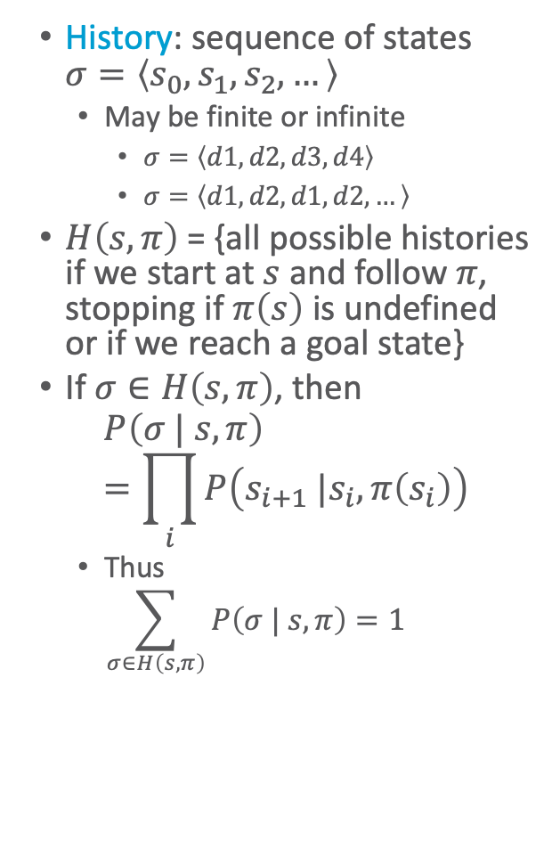

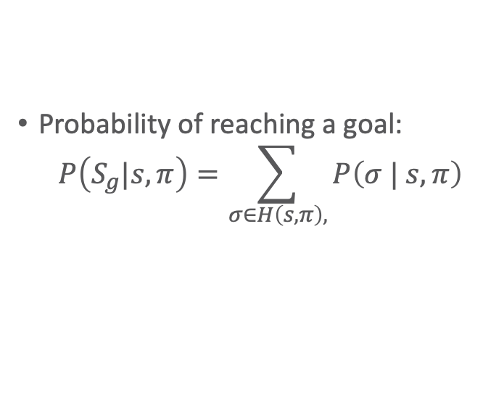
Histories
History: sequence of states $σ=\left\langle s_{0}, s_{1}, s_{2}, …\right\rangle$
  May be finite or infinite
    $σ=\left\langle d1, d2, d3, d4\right\rangle$
    $σ=\left\langle d1,d2, d1, d2,…\right\rangle$
$H\left(s,π\right)$ = {all possible histories if we start at $s$ and follow $π$, stopping if $π\left(s\right)$ is undefined or if we reach a goal state}
If $σ∈H\left(s,π\right)$, then
$$P\left(σ | s,π\right)=\prod_{i}{P\left(s_{i+1} |s_{i},π\left(s_{i}\right)\right)}$$
  Thus
  $$\sum_{σ∈H\left(s,π\right)}{P\left(σ | s,π\right)}=1$$
Probability of reaching a goal:
$$P\left(S_{g}|s, π\right)=\sum_{σ∈H\left(s,π\right),}{P\left(σ | s,π\right)}$$
$$σ \text{ends} \text{at} s∈S_{g}$$
m52
d5
0.2
d2
m23
0.8
d3
m32
m12
m21
m54
m43
m34
m45
d1
m41
d4
Start:
s₀= d1
0.5
Goal:
S_{g}= {d4}
0.5
m14
Notes:
Same as MDPs
Markov property!

Slide 11

Unsafe Solutions
Unsafe solution: $0<P\left(S_{g}|s_{0},π\right)<1$
Example:
  $π_{1}=\{\left(d1, m12\right), \left(d2, m23\right), \left(d3, m34\right)\}$
  $H\left(s_{0},π_{1}\right)$ contains two histories:
    $σ_{1}=\left\langle d1, d2, d3, d4\right\rangle$
    $P\left(σ_{1} | s_{0},π_{1}\right)$
    $=1∙0.8∙1=0.8$
    $σ_{2}=\left\langle d1, d2, d5\right\rangle$
    $P\left(σ_{2} | s_{0},π_{1}\right)$
    $=1∙0.2=0.2$
  $P\left(S_{g} | s_{0}, π_{1}\right)$
  $=0.8$
d5
0.2
d2
0.8
d3
d1
d4
Start:
s₀= d1
0.5
Goal:
S_{g}= {d4}
0.5

Slide 12

Unsafe Solutions
Unsafe solution: $0<P\left(S_{g}|s_{0},π\right)<1$
Example:
  $π_{2}=\{\left(d1, m12\right), \left(d2, m23\right), \left(d3, m34\right),$
  $\left(d5, m56\right),$ $\left(d6, m65\right)\}$
  $H\left(s_{0},π_{2}\right)$ contains two histories:
    $σ_{1}=\left\langle d1, d2, d3, d4\right\rangle$
    $P\left(σ_{1} | s_{0},π_{2}\right)$
    $=1∙0.8∙1=0.8$
    $σ_{3}=\left\langle d1, d2, d5,d6,…\right\rangle$
    $P\left(σ_{3} | s_{0},π_{2}\right)$
    $=1∙0.2∙1∙…=0.2$
  $P\left(S_{g} | s_{0}, π_{2}\right)$
  $=0.8$
d6
d5
0.2
d2
0.8
d3
d1
d4
Start:
s₀= d1
0.5
Goal:
S_{g}= {d4}
0.5

Slide 13

Safe Solutions
Safe solution: $P\left(S_{g}|s_{0},π\right)=1$
An acyclic safe solution:
  $π_{3}=\{\left(d1, m12\right), \left(d2, m23\right), \left(d3, m34\right),\left(d5,m54\right)\}$
  $H\left(s_{0},π_{3}\right)$ contains two histories:
    $σ_{1}=\left\langle d1, d2, d3, d4\right\rangle$
    $P\left(σ_{1} | s_{0},π_{3}\right)$
    $=1∙0.8∙1=0.8$
    $σ_{4}=\left\langle d1, d2, d5,d4\right\rangle$
    $P\left(σ_{4} | s_{0},π_{3}\right)$
    $=1∙0.2∙1=0.2$
  $P\left(S_{g} | s_{0}, π_{3}\right)$
  $=0.8+0.2=1$
d5
0.2
d2
0.8
d3
d1
d4
Start:
s₀= d1
0.5
Goal:
S_{g}= {d4}
0.5

Slide 14

Safe Solutions
Safe solution: $P\left(S_{g}|s_{0},π\right)=1$
A cyclic safe solution:
  $π_{4}=\{\left(d1, m14\right)\}$
  $H\left(s_{0},π_{4}\right)$ contains infinitely many histories:
    $σ_{5}=\left\langle d1, d4\right\rangle$
    $P\left(σ_{5} | s_{0},π_{4}\right)$ $=0.5={\left(\frac{1}{2}\right)}^{1}$
    $σ_{6}=\left\langle d1, d1, d4\right\rangle$
    $P\left(σ_{6} | s_{0},π_{4}\right)$
    $=0.5∙0.5=$ ${\left(\frac{1}{2}\right)}^{2}$
    …
  $P\left(S_{g} | s_{0}, π_{4}\right)$
  $=\frac{1}{2}+\frac{1}{4}+ …=1$
d5
0.2
d2
0.8
d3
d1
d4
Start:
s₀= d1
0.5
Goal:
S_{g}= {d4}
0.5

Slide 15

Safe Solutions
Safe solution: $P\left(S_{g}|s_{0},π\right)=1$
Another cyclic safe solution:
  $π_{5}=\{\left(d1, m14\right),\left(d4,m41\right)\}$
  $H\left(s_{0},π_{5}\right)=H\left(s_{0},π_{4}\right)$:
    $σ_{5}=\left\langle d1, d4\right\rangle$
    $P\left(σ_{5} | s_{0},π_{5}\right)$ $=0.5={\left(\frac{1}{2}\right)}^{1}$
    $σ_{6}=\left\langle d1, d1, d4\right\rangle$
    $P\left(σ_{6} | s_{0},π_{6}\right)$
    $=0.5∙0.5=$ ${\left(\frac{1}{2}\right)}^{2}$
    …
  $P\left(S_{g} | s_{0}, π_{5}\right)$
  $=\frac{1}{2}+\frac{1}{4}+ …=1$
d5
0.2
d2
0.8
d3
d1
d4
Start:
s₀= d1
0.5
Goal:
S_{g}= {d4}
0.5
Notes:
d4 mapping never used, as we stop when we reach goal state

Slide 16
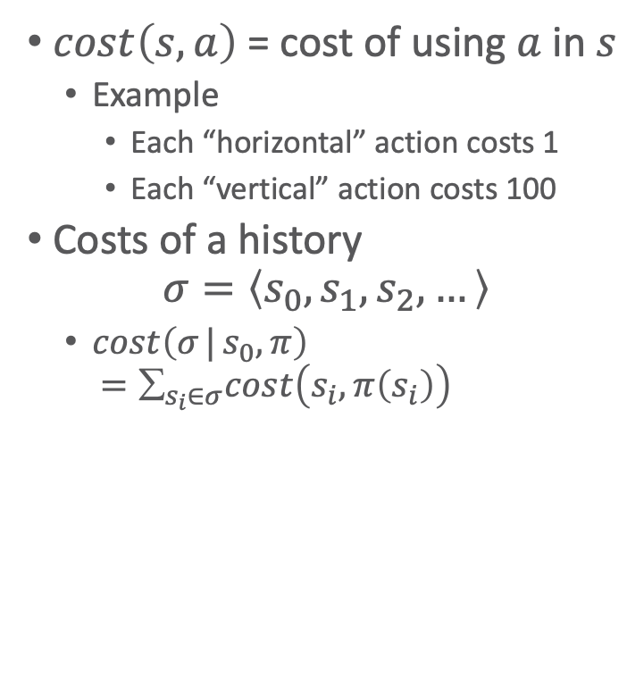
Expected Cost
$cost\left(s,a\right)$ = cost of using $a$ in $s$
  Example
    Each “horizontal” action costs 1
    Each “vertical” action costs 100
Costs of a history
$σ=\left\langle s_{0}, s_{1}, s_{2}, …\right\rangle$
  $cost\left(σ | s_{0},π\right)$
  $=∑_{s_{i}∈σ}cost\left(s_{i}, π\left(s_{i}\right)\right)$
d5
c = 1
0.2
d2
0.8
d3
c = 100
c = 100
d1
d4
Start:
s₀= d1
0.5
c = 1
Goal:
S_{g}= {d4}
0.5

Slide 17
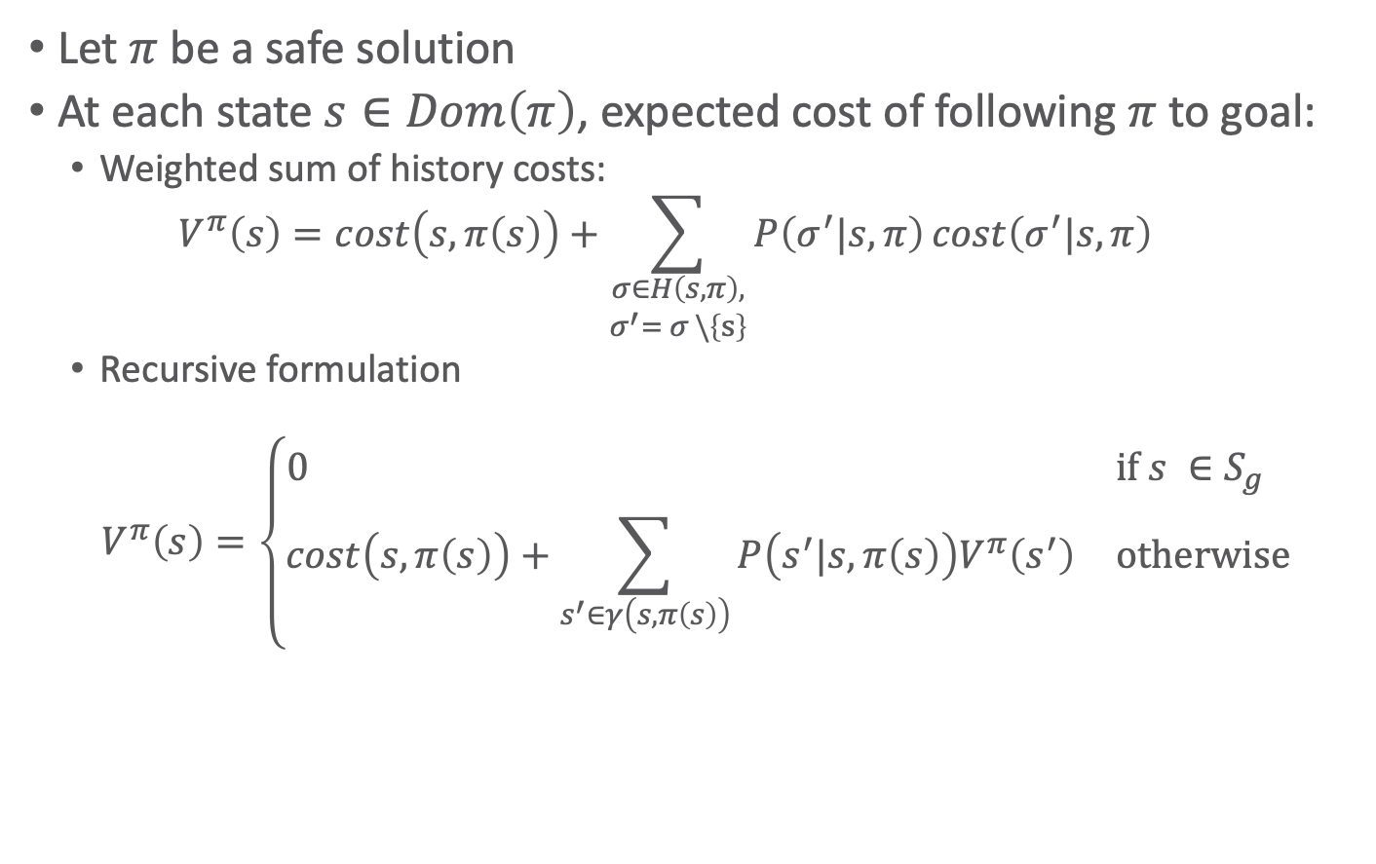
Expected Cost
Let $π$ be a safe solution
At each state $s∈Dom\left(π\right)$, expected cost of following $π$ to goal:
  Weighted sum of history costs:
  $$V^{π}\left(s\right)=cost\left(s,π\left(s\right)\right)+\sum_{\begin{aligned}σ∈H\left(s,π\right), \\ σ^{′}= σ \backslash \left\{s\right\}\end{aligned}}{P\left(σ^{′}|s,π\right)cost\left(σ^{′}|s,π\right)}$$
  Recursive formulation
  $$V^{π}\left(s\right)=\left\{\begin{matrix}0 & \text{if} s ∈S_{g} \\ cost\left(s,π\left(s\right)\right)+\sum_{s^{′}∈γ\left(s,π\left(s\right)\right)}{P\left(s^{′}|s,π\left(s\right)\right)V^{π}\left(s^{′}\right)} & \text{otherwise}\end{matrix}\right.$$
Compare policy evaluation of the policy iteration algorithm of the previous topic

Slide 18
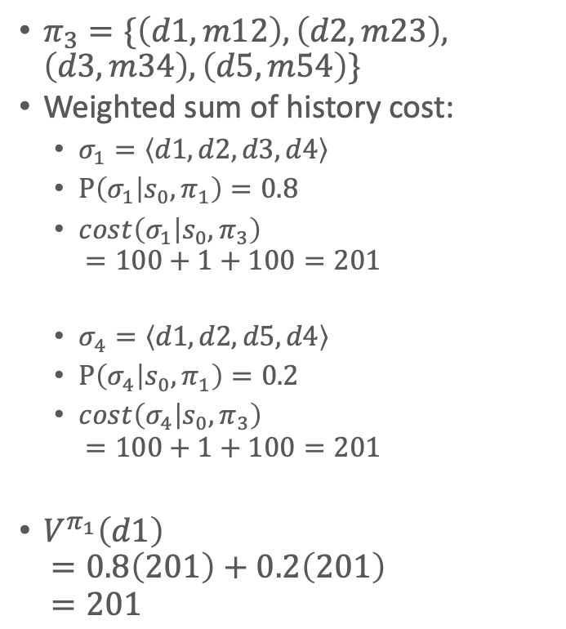

Example
$π_{3}=\{\left(d1, m12\right), \left(d2, m23\right), \left(d3, m34\right),\left(d5,m54\right)\}$
Weighted sum of history cost:
  $σ_{1}=\left\langle d1, d2, d3, d4\right\rangle$
  $P\left(σ_{1} | s_{0},π_{1}\right)=0.8$
  $cost\left(σ_{1} | s_{0},π_{3}\right)$
  $=100+1+100=201$
  $σ_{4}=\left\langle d1, d2, d5,d4\right\rangle$
  $P\left(σ_{4} | s_{0},π_{1}\right)=0.2$
  $cost\left(σ_{4} | s_{0},π_{3}\right)$
  $=100+1+100=201$
$V^{π_{1}}\left(d1\right)$
$=0.8\left(201\right)+0.2\left(201\right)$
$=201$
Recursive equation
  $V^{π_{1}}\left(d1\right)$
  $=100+V^{π_{1}}\left(d2\right)=100+1+0.8V^{π_{1}}\left(d3\right)+0.2V^{π_{1}}\left(d5\right)=100+1+0.8\left(100\right)+0.2\left(100\right)$
  $=201$
d5
c = 1
0.2
d2
0.8
d3
c = 100
c = 100
d1
d4
Start:
s₀= d1
0.5
c = 1
Goal:
S_{g}= {d4}
0.5

Slide 19
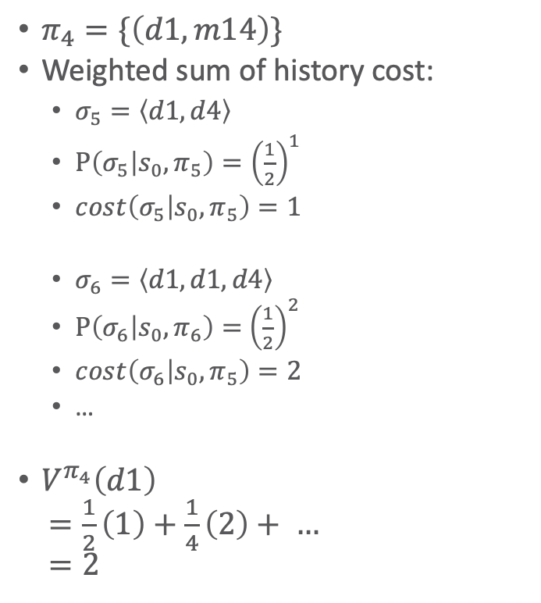
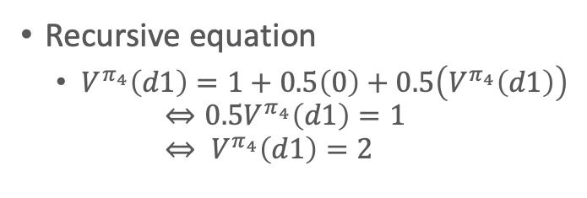
Safe Solutions
$π_{4}=\{\left(d1, m14\right)\}$
Weighted sum of history cost:
  $σ_{5}=\left\langle d1, d4\right\rangle$
  $P\left(σ_{5} | s_{0},π_{5}\right)={\left(\frac{1}{2}\right)}^{1}$
  $\operatorname{cost}\left(σ_{5} | s_{0},π_{5}\right)=1$
  $σ_{6}=\left\langle d1, d1, d4\right\rangle$
  $P\left(σ_{6} | s_{0},π_{6}\right)=$ ${\left(\frac{1}{2}\right)}^{2}$
  $\operatorname{cost}\left(σ_{6} | s_{0},π_{5}\right)=2$
  …
$V^{π_{4}}\left(d1\right)$
$=\frac{1}{2}\left(1\right)+\frac{1}{4}\left(2\right)+ …$
$=2$
Recursive equation
  $V^{π_{4}}\left(d1\right)=1+0.5\left(0\right)+0.5\left(V^{π_{4}}\left(d1\right)\right)$
  $⇔0.5V^{π_{4}}\left(d1\right)=1$
  $⇔ V^{π_{4}}\left(d1\right)=2$
d5
c = 1
0.2
d2
0.8
d3
c = 100
c = 100
d1
d4
Start:
s₀= d1
0.5
c = 1
Goal:
S_{g}= {d4}
0.5

Slide 20
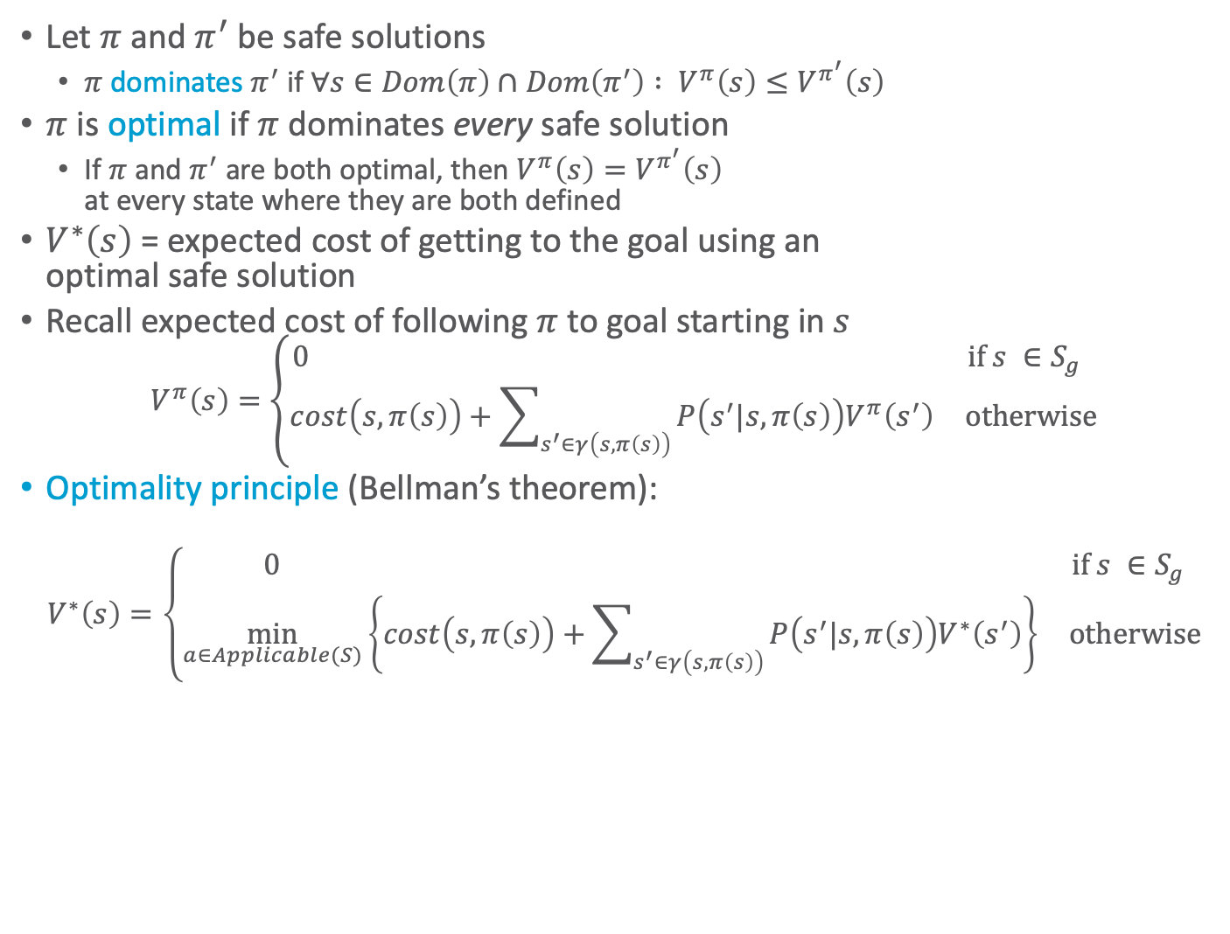
Planning as Optimisation
s₁
a
s₂
Let $π$ and $π^{′}$ be safe solutions
  $π$ dominates $π^{′}$ if $∀s∈Dom\left(π\right)∩Dom\left(π^{′}\right) : V^{π}\left(s\right)≤V^{π^{′}}\left(s\right)$
$π$ is optimal if $π$ dominates every safe solution
  If $π$ and $π^{′}$ are both optimal, then $V^{π}\left(s\right)=V^{π^{′}}\left(s\right)$
  at every state where they are both defined
$V^{∗}\left(s\right)$ = expected cost of getting to the goal using an
optimal safe solution
Recall expected cost of following $π$ to goal starting in $s$
  $$V^{π}\left(s\right)=\left\{\begin{matrix}0 & \text{if} s ∈S_{g} \\ cost\left(s,π\left(s\right)\right)+\sum_{s^{′}∈γ\left(s,π\left(s\right)\right)}{P\left(s^{′}|s,π\left(s\right)\right)V^{π}\left(s^{′}\right)} & \text{otherwise}\end{matrix}\right.$$
Optimality principle (Bellman’s theorem):
  $$V^{∗}\left(s\right)=\left\{\begin{matrix}0 & \text{if} s ∈S_{g} \\ \min_{a∈Applicable(S)}\left\{cost\left(s,π\left(s\right)\right)+\sum_{s^{′}∈γ\left(s,π\left(s\right)\right)}{P\left(s^{′}|s,π\left(s\right)\right)V^{∗}\left(s^{′}\right)}\right\} & \text{otherwise}\end{matrix}\right.$$
s
s₃
b
s₄

Slide 21
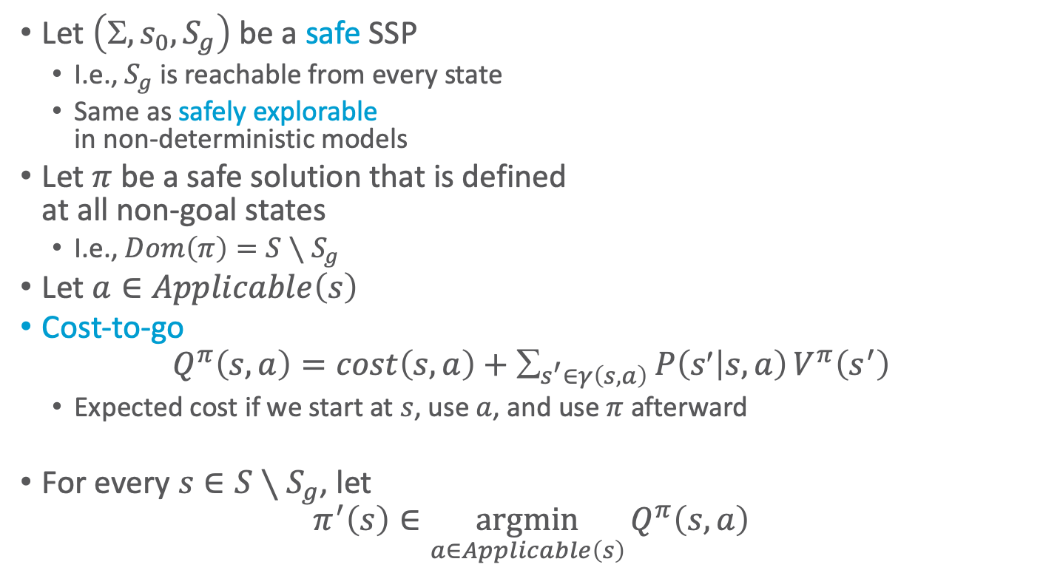
Cost to Go
s₁
a
s₂
Let $\left(, s_{0}, S_{g}\right)$ be a safe SSP
  I.e., $S_{g}$ is reachable from every state
  Same as safely explorable
  in non-deterministic models
Let $π$ be a safe solution that is defined
at all non-goal states
  I.e., $Dom\left(π\right)=S∖S_{g}$
Let $a∈Applicable\left(s\right)$
Cost-to-go
$$Q^{π}\left(s,a\right)=cost\left(s,a\right)+_{s^{′}∈γ\left(s,a\right)}P\left(s | s,a\right)V^{π}\left(s^{′}\right)$$
  Expected cost if we start at $s$, use $a$, and use $π$ afterward
For every $s∈S∖S_{g}$, let
$$π^{′}\left(s\right)∈\underset{a∈Applicable\left(s\right)}{argmin}{Q^{π}\left(s,a\right)}$$
s
s₃
b
s₄

Slide 22
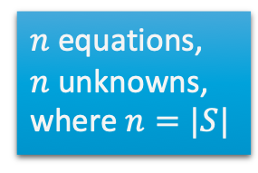
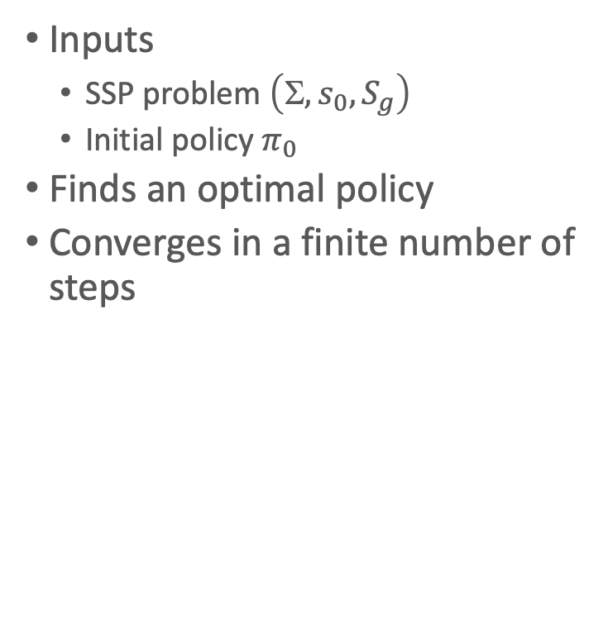
Policy Iteration
Inputs
  SSP problem $\left(, s_{0}, S_{g}\right)$
  Initial policy $π_{0}$
Finds an optimal policy
Converges in a finite number of steps
policy-iteration(𝛴,s₀,S_{g},𝜋₀)
𝜋 ← 𝜋₀
loop
compute{V^{𝜋}(s)|s ∈ S}
for every state s ∈ S \ S_{g} do
A ← argmin_{a∈Applicable(s)} Q^{𝜋}(s,a)
if 𝜋(s) ∈ A then
𝜋’(s) ← 𝜋(s)
else
𝜋’(s) ← any action in A
if 𝜋’ = 𝜋 then
return 𝜋
𝜋 ← 𝜋’
$n$ equations,
$n$ unknowns, where $n=|S|$

Slide 23
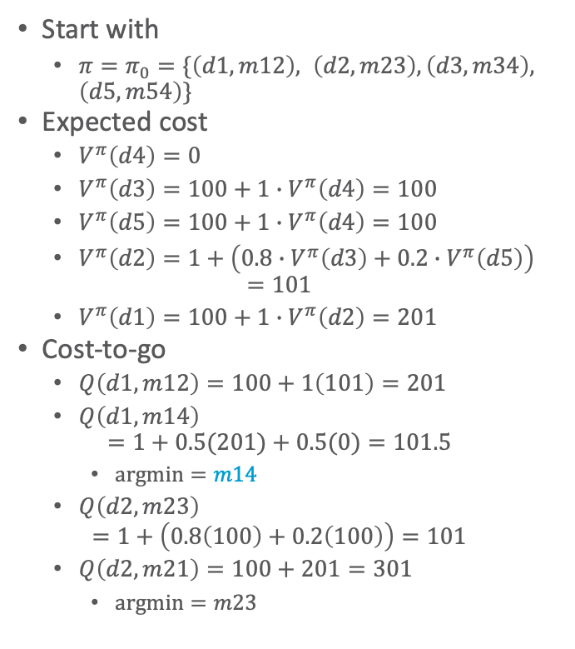

Example
Cost-to-go continued
  $Q\left(d3,m34\right)=100+0=100$
  $Q\left(d3,m32\right)=1+101=102$
    $argmin=m34$
  $Q\left(d5,m54\right)=100+0=100$
  $Q\left(d5,m52\right)=1+101=102$
    $argmin=m54$
Start with
  $π=π_{0}=\{\left(d1, m12\right), \left(d2, m23\right), \left(d3, m34\right), \left(d5,m54\right)\}$
Expected cost
  $V^{π}\left(d4\right)=0$
  $V^{π}\left(d3\right)=100+1∙V^{π}\left(d4\right)=100$
  $V^{π}\left(d5\right)=100+1∙V^{π}\left(d4\right)=100$
  $V^{π}\left(d2\right)=1+\left(0.8∙V^{π}\left(d3\right)+0.2∙V^{π}\left(d5\right)\right)$
  $=101$
  $V^{π}\left(d1\right)=100+1∙V^{π}\left(d2\right)=201$
Cost-to-go
  $Q\left(d1,m12\right)=100+1\left(101\right)=201$
  $Q\left(d1,m14\right)$
  $=1+0.5(201)+0.5(0)=101.5$
    $argmin=m14$
  $Q\left(d2,m23\right)$
  $=1+\left(0.8\left(100\right)+0.2\left(100\right)\right)=101$
  $Q\left(d2,m21\right)=100+201=301$
    $argmin=m23$
d5
c = 1
0.2
d2
0.8
d3
c = 100
c = 100
d1
d4
Start:
s₀= d1
0.5
c = 1
Goal:
S_{g}= {d4}
0.5

Slide 24
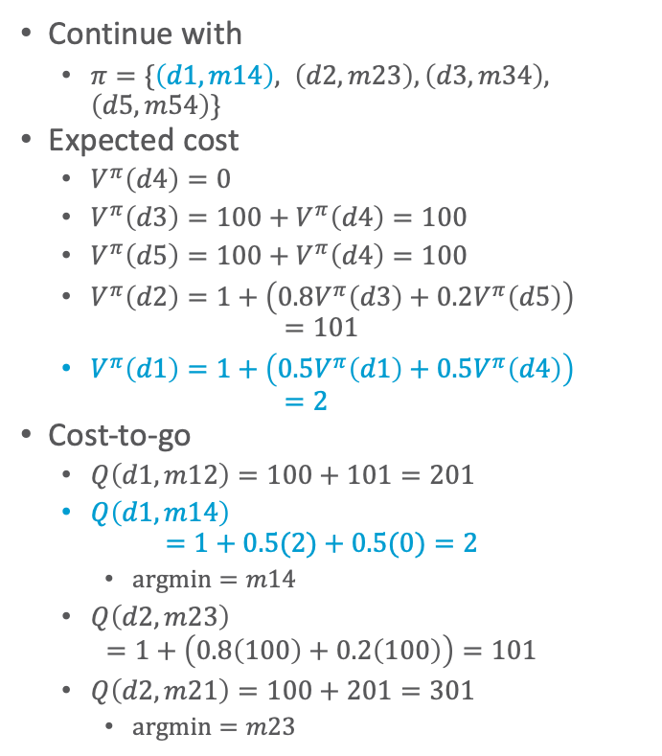
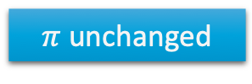

Example
Cost-to-go continued
  $Q\left(d3,m34\right)=100+0=100$
  $Q\left(d3,m32\right)=100+101=201$
    $argmin=m34$
  $Q\left(d5,m54\right)=100+0=100$
  $Q\left(d5,m54\right)=100+101=201$
    $argmin=m54$
Continue with
  $π=\{\left(d1, m14\right), \left(d2, m23\right), \left(d3, m34\right), \left(d5,m54\right)\}$
Expected cost
  $V^{π}\left(d4\right)=0$
  $V^{π}\left(d3\right)=100+V^{π}\left(d4\right)=100$
  $V^{π}\left(d5\right)=100+V^{π}\left(d4\right)=100$
  $V^{π}\left(d2\right)=1+\left(0.8V^{π}\left(d3\right)+0.2V^{π}\left(d5\right)\right)$
  $=101$
  $V^{π}\left(d1\right)=1+\left(0.5V^{π}\left(d1\right)+0.5V^{π}\left(d4\right)\right)$
  $=2$
Cost-to-go
  $Q\left(d1,m12\right)=100+101=201$
  $Q\left(d1,m14\right)$
  $=1+0.5(2)+0.5(0)=2$
    $argmin=m14$
  $Q\left(d2,m23\right)$
  $=1+\left(0.8\left(100\right)+0.2\left(100\right)\right)=101$
  $Q\left(d2,m21\right)=100+201=301$
    $argmin=m23$
d5
c = 1
0.2
d2
0.8
d3
c = 100
c = 100
d1
d4
Start:
s₀= d1
0.5
c = 1
Goal:
S_{g}= {d4}
0.5
$π$unchanged

Slide 25
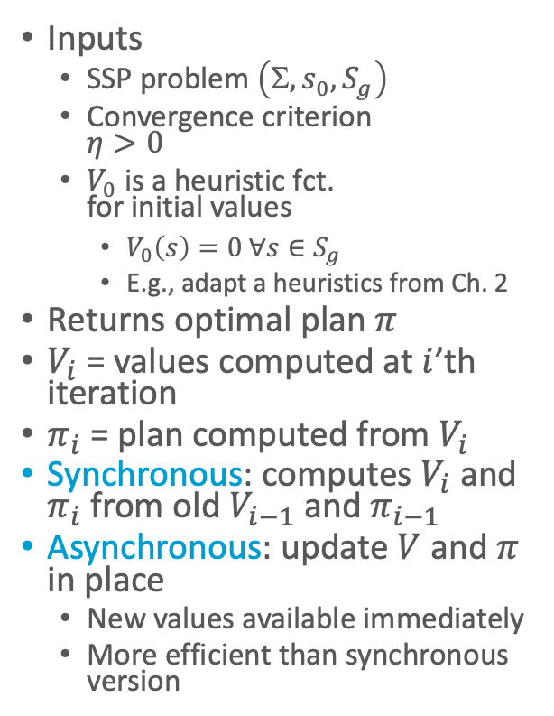
Value Iteration
sync-value-iteration(𝛴,s₀,S_{g},V₀,𝜂)
for i = 1,2,… do
for every state s ∈ S \ S_{g} do
for every a ∈ Applicable(s) do
Q(s,a) ← cost(s,a)+𝛴_{s’∈S}P(s’|s,a)V_{i-1}(s’)
V_{i}(s) ← min_{a∈Applicable(s)} Q(s,a)
𝜋_{i}(s) ← argmin_{a∈Applicable(s)} Q(s,a)
if max_{s∈S}|V_{i}(s)- V_{i-1}(s)| ≤ 𝜂 then
return 𝜋_{i}
Inputs
  SSP problem $\left(, s_{0}, S_{g}\right)$
  Convergence criterion
  $η>0$
  $V_{0}$ is a heuristic fct.
  for initial values
    $V_{0}\left(s\right)=0 ∀s∈S_{g}$
    E.g., adapt a heuristics from Ch. 2
Returns optimal plan $π$
$V_{i}$ = values computed at $i$’th iteration
$π_{i}$ = plan computed from $V_{i}$
Synchronous: computes $V_{i}$ and $π_{i}$ from old $V_{i−1}$ and $π_{i−1}$
Asynchronous: update $V$ and $π$ in place
  New values available immediately
  More efficient than synchronous version
async-value-iteration(𝛴,s₀,S_{g},V₀,𝜂)
global 𝜋 ← ∅
global V(s) ← V₀(s) ∀ s
loop
r ← max_{s∈S\Sg}Bellman-Update(s)
if r ≤ 𝜂 then
return 𝜋
Bellman-Update(s)
𝜈_{old} ← V(s)
for every a ∈ Applicable(s) do
Q(s,a) ← cost(s,a)+𝛴_{s’∈S}P(s’|s,a)V(s’)
V(s) ← min_{a∈Applicable(s)} Q(s,a)
𝜋(s) ← argmin_{a∈Applicable(s)} Q(s,a)
return |V(s)-𝜈_{old}|
Notes:
Convergence criterion based on epsilon and gamma possible

Slide 26
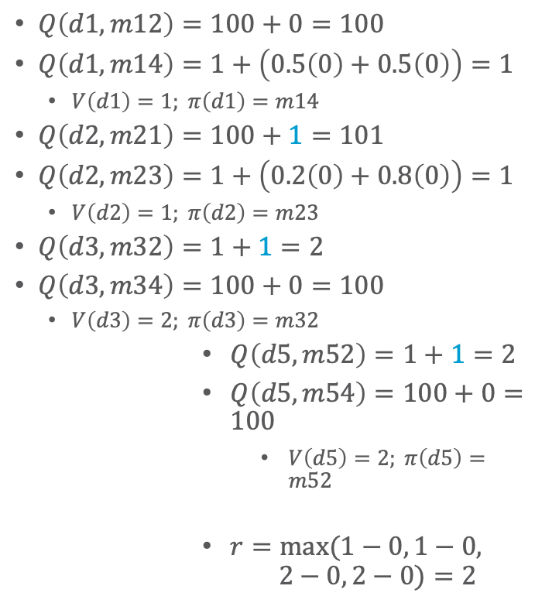
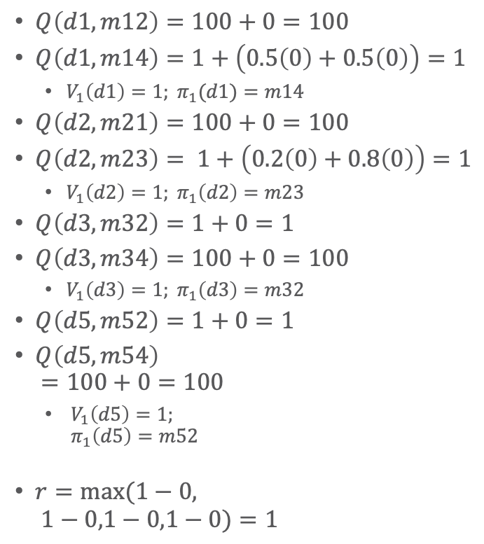

Synchronous Asynchronous
$$η = 0.2$$
$$V_{0}\left(s\right)=0 ∀s$$
$Q\left(d1,m12\right)=100+0=100$
$Q\left(d1,m14\right)=1+\left(0.5\left(0\right)+0.5\left(0\right)\right)=1$
  $V_{1}\left(d1\right)=1; π_{1}(d1)=m14$
$Q\left(d2,m21\right)=100+0=100$
$Q\left(d2,m23\right)= 1+\left(0.2\left(0\right)+0.8\left(0\right)\right)=1$
  $V_{1}\left(d2\right)=1; π_{1}\left(d2\right)=m23$
$Q\left(d3,m32\right)=1+0=1$
$Q\left(d3,m34\right)=100+0=100$
  $V_{1}\left(d3\right)=1; π_{1}\left(d3\right)=m32$
$Q\left(d5,m52\right)=1+0=1$
$Q\left(d5,m54\right)$
$=100+0=100$
  ${ V}_{1}\left(d5\right)=1;$
  $π_{1}\left(d5\right)=m52$
$r=max(1−0,$
$1−0,1−0,1−0)=1$
$Q\left(d1,m12\right)=100+0=100$
$Q\left(d1,m14\right)=1+\left(0.5\left(0\right)+0.5\left(0\right)\right)=1$
  $V\left(d1\right)=1; π\left(d1\right)=m14$
$Q\left(d2,m21\right)=100+1=101$
$Q\left(d2,m23\right)=1+\left(0.2\left(0\right)+0.8\left(0\right)\right)=1$
  $V\left(d2\right)=1; π\left(d2\right)=m23$
$Q\left(d3,m32\right)=1+1=2$
$Q\left(d3,m34\right)=100+0=100$
  $V\left(d3\right)=2; π\left(d3\right)=m32$
$Q\left(d5,m52\right)=1+1=2$
$Q\left(d5,m54\right)=100+0=100$
  $V\left(d5\right)=2; π\left(d5\right)=m52$
$r=max⁡(1−0, 1−0,$
$2−0, 2−0)=2$
c = 1
d5
0.2
d2
0.8
d3
c = 100
c = 100
Start:
s₀= d1
d1
0.5
c = 1
d4
Goal:
S_{g}= {d4}
0.5

Slide 27
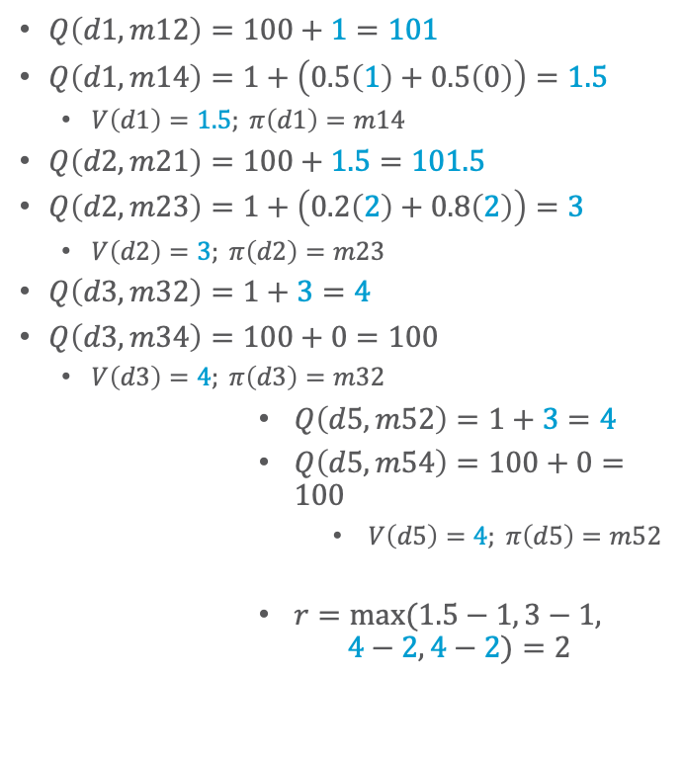
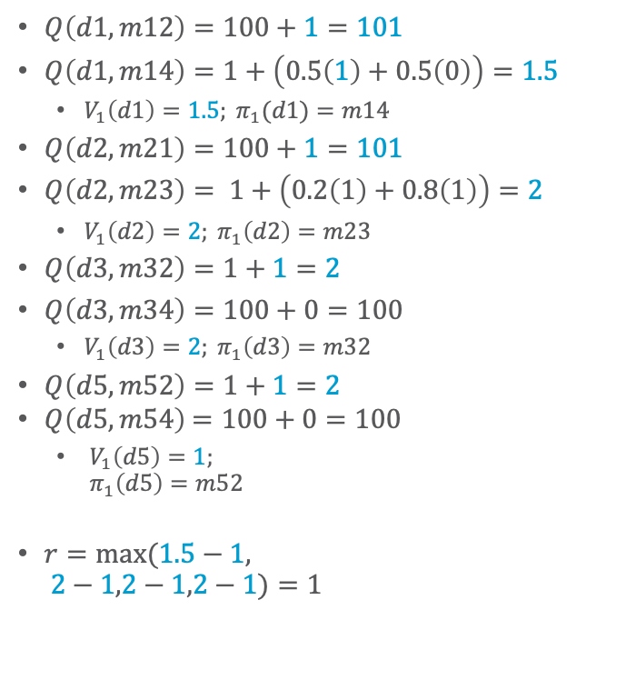



Synchronous Asynchronous
$$η = 0.2$$
$Q\left(d1,m12\right)=100+1=101$
$Q\left(d1,m14\right)=1+\left(0.5\left(1\right)+0.5\left(0\right)\right)=1.5$
  $V_{1}\left(d1\right)=1.5; π_{1}(d1)=m14$
$Q\left(d2,m21\right)=100+1=101$
$Q\left(d2,m23\right)= 1+\left(0.2\left(1\right)+0.8\left(1\right)\right)=2$
  $V_{1}\left(d2\right)=2; π_{1}\left(d2\right)=m23$
$Q\left(d3,m32\right)=1+1=2$
$Q\left(d3,m34\right)=100+0=100$
  $V_{1}\left(d3\right)=2; π_{1}\left(d3\right)=m32$
$Q\left(d5,m52\right)=1+1=2$
$Q\left(d5,m54\right)$ $=100+0=100$
  ${ V}_{1}\left(d5\right)=1;$
  $π_{1}\left(d5\right)=m52$
$r=max(1.5−1,$
$2−1,2−1,2−1)=1$
$Q\left(d1,m12\right)=100+1=101$
$Q\left(d1,m14\right)=1+\left(0.5\left(1\right)+0.5\left(0\right)\right)=1.5$
  $V\left(d1\right)=1.5; π\left(d1\right)=m14$
$Q\left(d2,m21\right)=100+1.5=101.5$
$Q\left(d2,m23\right)=1+\left(0.2\left(2\right)+0.8\left(2\right)\right)=3$
  $V\left(d2\right)=3; π\left(d2\right)=m23$
$Q\left(d3,m32\right)=1+3=4$
$Q\left(d3,m34\right)=100+0=100$
  $V\left(d3\right)=4; π\left(d3\right)=m32$
$Q\left(d5,m52\right)=1+3=4$
$Q\left(d5,m54\right)=100+0=100$
  $V\left(d5\right)=4; π\left(d5\right)=m52$
$r=max⁡(1.5−1, 3−1,$
$4−2, 4−2)=2$
c = 1
d5
0.2
d2
0.8
d3
c = 100
c = 100
$$V\left(d1\right)=1$$
$$V\left(d2\right)=1$$
$$V\left(d3\right)=1$$
$$V\left(d5\right)=1$$
$$V\left(d1\right)=1$$
$$V\left(d2\right)=1$$
$$V\left(d3\right)=2$$
$$V\left(d5\right)=2$$
Start:
s₀= d1
d1
0.5
c = 1
d4
Goal:
S_{g}= {d4}
0.5

Slide 28
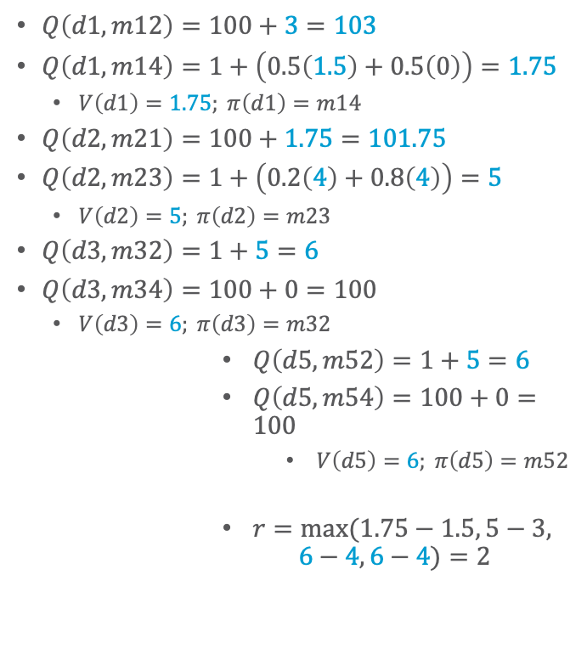
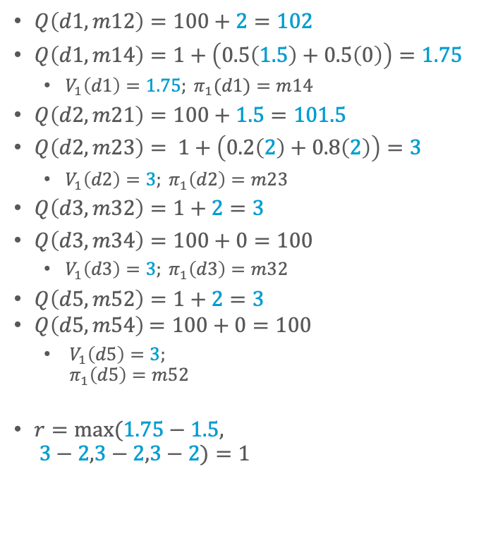


Synchronous Asynchronous
$$η = 0.2$$
$Q\left(d1,m12\right)=100+2=102$
$Q\left(d1,m14\right)=1+\left(0.5\left(1.5\right)+0.5\left(0\right)\right)=1.75$
  $V_{1}\left(d1\right)=1.75; π_{1}(d1)=m14$
$Q\left(d2,m21\right)=100+1.5=101.5$
$Q\left(d2,m23\right)= 1+\left(0.2\left(2\right)+0.8\left(2\right)\right)=3$
  $V_{1}\left(d2\right)=3; π_{1}\left(d2\right)=m23$
$Q\left(d3,m32\right)=1+2=3$
$Q\left(d3,m34\right)=100+0=100$
  $V_{1}\left(d3\right)=3; π_{1}\left(d3\right)=m32$
$Q\left(d5,m52\right)=1+2=3$
$Q\left(d5,m54\right)$ $=100+0=100$
  ${ V}_{1}\left(d5\right)=3;$
  $π_{1}\left(d5\right)=m52$
$r=max(1.75−1.5,$
$3−2,3−2,3−2)=1$
$Q\left(d1,m12\right)=100+3=103$
$Q\left(d1,m14\right)=1+\left(0.5\left(1.5\right)+0.5\left(0\right)\right)=1.75$
  $V\left(d1\right)=1.75; π\left(d1\right)=m14$
$Q\left(d2,m21\right)=100+1.75=101.75$
$Q\left(d2,m23\right)=1+\left(0.2\left(4\right)+0.8\left(4\right)\right)=5$
  $V\left(d2\right)=5; π\left(d2\right)=m23$
$Q\left(d3,m32\right)=1+5=6$
$Q\left(d3,m34\right)=100+0=100$
  $V\left(d3\right)=6; π\left(d3\right)=m32$
$Q\left(d5,m52\right)=1+5=6$
$Q\left(d5,m54\right)=100+0=100$
  $V\left(d5\right)=6; π\left(d5\right)=m52$
$r=max⁡(1.75−1.5, 5−3,$
$6−4, 6−4)=2$
c = 1
d5
0.2
d2
0.8
d3
c = 100
c = 100
$$V\left(d1\right)=1.5$$
$$V\left(d2\right)=2$$
$$V\left(d3\right)=2$$
$$V\left(d5\right)=2$$
d1
$$V\left(d1\right)=1.5$$
$$V\left(d2\right)=3$$
$$V\left(d3\right)=4$$
$$V\left(d5\right)=4$$
Start:
s₀= d1
0.5
c = 1
d4
Goal:
S_{g}= {d4}
0.5

Slide 29

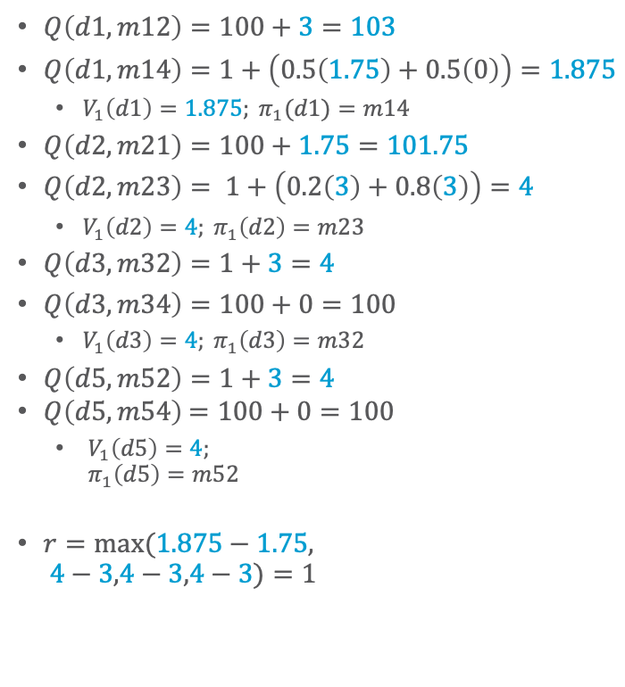


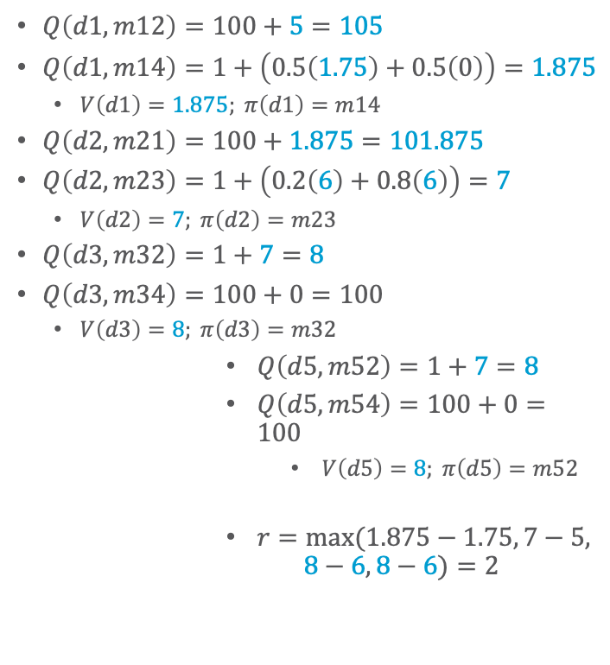
Synchronous Asynchronous
$$η = 0.2$$
  How long before $r ≤ η$?
  How long, if the “vertical” actions cost 10 instead of 100?
$Q\left(d1,m12\right)=100+3=103$
$Q\left(d1,m14\right)=1+\left(0.5\left(1.75\right)+0.5\left(0\right)\right)=1.875$
  $V_{1}\left(d1\right)=1.875; π_{1}(d1)=m14$
$Q\left(d2,m21\right)=100+1.75=101.75$
$Q\left(d2,m23\right)= 1+\left(0.2\left(3\right)+0.8\left(3\right)\right)=4$
  $V_{1}\left(d2\right)=4; π_{1}\left(d2\right)=m23$
$Q\left(d3,m32\right)=1+3=4$
$Q\left(d3,m34\right)=100+0=100$
  $V_{1}\left(d3\right)=4; π_{1}\left(d3\right)=m32$
$Q\left(d5,m52\right)=1+3=4$
$Q\left(d5,m54\right)$ $=100+0=100$
  ${ V}_{1}\left(d5\right)=4;$
  $π_{1}\left(d5\right)=m52$
$r=max(1.875−1.75,$
$4−3,4−3,4−3)=1$
$Q\left(d1,m12\right)=100+5=105$
$Q\left(d1,m14\right)=1+\left(0.5\left(1.75\right)+0.5\left(0\right)\right)=1.875$
  $V\left(d1\right)=1.875; π\left(d1\right)=m14$
$Q\left(d2,m21\right)=100+1.875=101.875$
$Q\left(d2,m23\right)=1+\left(0.2\left(6\right)+0.8\left(6\right)\right)=7$
  $V\left(d2\right)=7; π\left(d2\right)=m23$
$Q\left(d3,m32\right)=1+7=8$
$Q\left(d3,m34\right)=100+0=100$
  $V\left(d3\right)=8; π\left(d3\right)=m32$
$Q\left(d5,m52\right)=1+7=8$
$Q\left(d5,m54\right)=100+0=100$
  $V\left(d5\right)=8; π\left(d5\right)=m52$
$r=max⁡(1.875−1.75, 7−5,$
$8−6, 8−6)=2$
c = 1
d5
0.2
d2
0.8
d3
c = 100
c = 100
$$V\left(d1\right)=1.75$$
$$V\left(d2\right)=3$$
$$V\left(d3\right)=3$$
$$V\left(d5\right)=3$$
d1
$$V\left(d1\right)=1.75$$
$$V\left(d2\right)=5$$
$$V\left(d3\right)=6$$
$$V\left(d5\right)=6$$
Start:
s₀= d1
0.5
c = 1
d4
Goal:
S_{g}= {d4}
0.5
Notes:
52 iterations
7 iterations

Slide 30
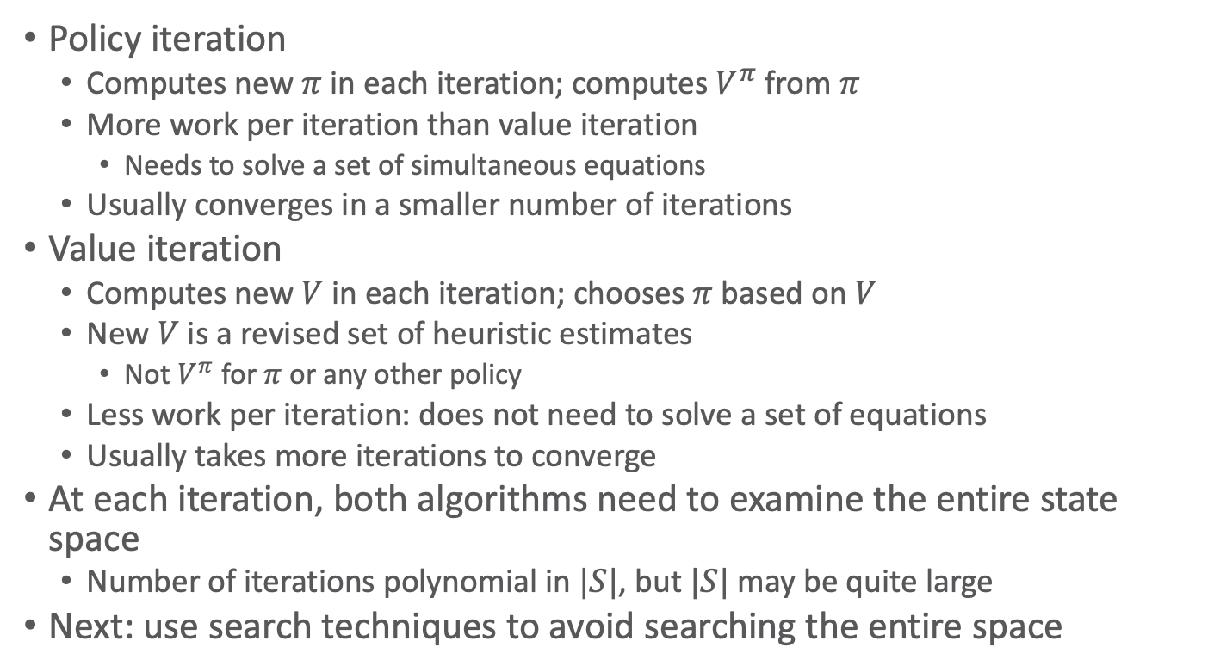
Discussion
Policy iteration
  Computes new $π$ in each iteration; computes $V^{π}$ from $π$
  More work per iteration than value iteration
    Needs to solve a set of simultaneous equations
  Usually converges in a smaller number of iterations
Value iteration
  Computes new $V$ in each iteration; chooses $π$ based on $V$
  New $V$ is a revised set of heuristic estimates
    Not $V^{π}$ for $π$ or any other policy
  Less work per iteration: does not need to solve a set of equations
  Usually takes more iterations to converge
At each iteration, both algorithms need to examine the entire state space
  Number of iterations polynomial in $|S|$, but $|S|$ may be quite large
Next: use search techniques to avoid searching the entire space

Slide 31
Summary
SSPs
Solutions, closed solutions, histories
Unsafe solutions, acyclic safe solutions, cyclic safe solutions
Expected cost, planning as optimization
Policy iteration
Value iteration (synchronous, asynchronous)
  Bellman-update

Slide 32
Outline
6.2 Stochastic shortest path problems
  Safe/unsafe policies
  Optimality
  Policy iteration, value iteration
6.3 Heuristic search algorithms
  Best-first search
  Determinisation
6.4 Online probabilistic planning
  Lookahead
  Reinforcement learning

Slide 33
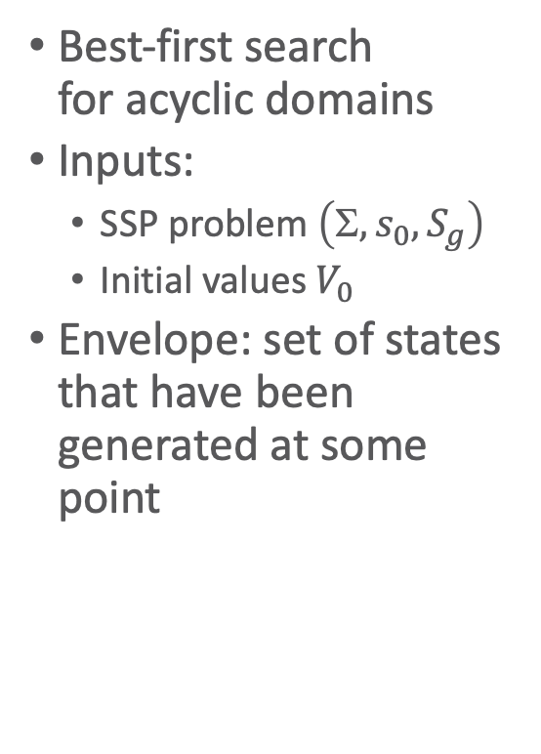
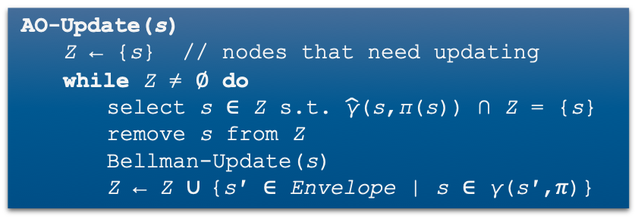



AO*
Requires acyclic $Σ$
not in book
AO∗(Σ,s₀,S_{g},V₀)
  global π ← ∅; V(s₀) ← V₀(s₀); Envelope ← {s₀}
  while leaves(s₀,π) ∖ S_{g} ≠ ∅ do
  select s ∈ leaves(s₀,π) ∖ S_{g}
    for all a ∈ Applicable(s) do
      for all s′ ∈ 𝛾(s,a) ∖ Envelope do
      V(s′) ← V₀(s′)
      Add s′ to Envelope
    AO-Update(s)
    return π
Best-first search
for acyclic domains
Inputs:
  SSP problem $\left(, s_{0}, S_{g}\right)$
  Initial values $V_{0}$
Envelope: set of states that have been generated at some point
AO-Update(s)
  Z ← {s} // nodes that need updating
  while Z ≠ ∅ do
    select s ∈ Z s.t. $\hat{\text{γ}}$(s,π(s)) ∩ Z = {s}
    remove s from Z
      Bellman-Update(s)
      Z ← Z ∪ {s′ ∈ Envelope | s ∈ γ(s′,𝜋)}
no $π$-descendants in $Z$ but $s$ itself
• ensures bottom-up updates
Bellman-Update(s)
for every a ∈ Applicable(s) do
Q(s,a) ← cost(s,a)+𝛴_{s’∈S}PR(s’|s,a)V(s’)
V(s) ← min_{a∈Applicable(s)}Q(s,a)
𝜋(s) ← argmin_{a∈Applicable(s)}Q(s,a)
the states “just above” $s$
Notes:
Envelope: set of states that have been generated at some point (goal states, fringe states – successor states unknown, interior states – successor states in envelope)
AO-update: bottom-up stage by stage update of state s back to the initial starting state (not possible for cyclic domains)

Slide 34




LAO*
$Σ$ may be cyclic or acyclic
not in book
LAO∗(Σ,s₀,S_{g},V₀)
  global π ← ∅; V(s₀) ← V₀(s₀); Envelope ← {s₀}
  loop
  if leaves(s₀,π) ⊆ S_{g} ≠ ∅ then
  return π
  select s ∈ leaves(s₀,π) ∖ S_{g}
    for all a ∈ Applicable(s) do
      for all s′ ∈ γ(s,a) ∖ Envelope do
      V(s′) ← V₀(s′)
      Add s′ to Envelope
    LAO-Update(s)
    return π
Best-first search
for both cyclic and acyclic domains
Inputs:
  SSP problem $\left(, s_{0}, S_{g}\right)$
  Initial values $V_{0}$
LAO-Update(s)
  Z ← {s}∪{s′ ∈ Envelope | s ∈ 𝛾(s′,𝜋)}
  loop
    r ← max_{s∈Z} Bellman-Update(s)
    if leaves(s₀,π) changed or r ≤ η then
    break
all $π$-ancestors of $s$ in $Envelope$
Asynchronous value iteration,
restricted to $Z$
Bellman-Update(s)
𝜈_{old} ← V(s)
for every a ∈ Applicable(s) do
Q(s,a) ← cost(s,a)+𝛴_{s’∈S}PR(s’|s,a)V(s’)
V(s) ← min_{a∈Applicable(s)} Q(s,a)
𝜋(s) ← argmin_{a∈Applicable(s)} Q(s,a)
return |V(s)-𝜈_{old}|
Different compared to AO*
Notes:
LAO update: Update the states on which the expansion of s may have an effect

Slide 35



LAO* Example
1st iteration of main loop:
Expand d1: add d2 and d4 to Envelope
Call LAO-Update(d1)
  $π$ is empty, so $Z=\left\{d1\right\}$
  Iteration 1:
  $Q\left(d1,m12\right)=100+0=100$
  $Q(d1,m14)=1+\left(0.5\left(0\right)+0.5\left(0\right)\right)=1$
    $V\left(d1\right)=1; π\left(d1\right)=m14;r=1−0=1$
  Iteration 2:
  $Q\left(d1,m12\right)=100+0=100$
  $Q\left(d1,m14\right)=1+\left(0.5\left(1\right)+0.5\left(0\right)\right)=1.5$
    $V\left(d1\right)=1.5; π\left(d1\right)=m14;$
    $r = 1.5−1=0.5$
  Iteration 3:
  $Q\left(d1,m12\right)=100+0=100$
  $Q(d1,m14)=1+\left(0.5\left(1.5\right)+0.5\left(0\right)\right)=1.75$
    $V\left(d1\right)=1.75;π\left(d1\right)=m14;$
    $r=1.75−1.5=0.25$
  Iteration 4:
  $Q\left(d1,m12\right)=100+0=100$
  $Q\left(d1,m14\right)=1+\left(0.5\left(1.75\right)+0.5\left(0\right)\right)=1.825$
    $V\left(d1\right)=1.825;π\left(d1\right)=m14;r=0.125≤η$
  LAO-Update returns
2nd iteration of main loop:
$leaves\left(π\right)=\left\{d4\right\}⊆S_{g}$
return $π$
$$η=0.2$$
$$V_{0}\left(s\right)=0 ∀s$$
d5
c = 1
0.2
d2
0.8
d3
c = 100
c = 100
d1
d4
0.5
c = 1
Goal:
S_{g}= {d4}
0.5
Start:
s₀= d1

Slide 36

Heuristics through
Determinisation
d5
m23
0.2
d2
d3
c = 1
0.8
What to use for $V_{0}$?
  One possibility: classical planner
    Need to convert nondeterministic actions into something a classical planner can use
Determinise the actions
  Suppose $γ\left(s,a\right)=\left\{s_{1}, …, s_{n}\right\}$
  $Det\left(s,a\right)=\left\{n \text{actions} a_{1}, a_{2}, …, a_{n}\right\}$
    $γ_{d}(s,a_{i})=s_{i}$
    $cost_{d}\left(s,a_{i}\right)=cost\left(s,a\right)$
Classical domain $Σ_{d}=\left(S, A_{d}, γ_{d}, {cost}_{d}\right)$
  $S$ = same as in $$
  $A_{d}=\bigcup_{a∈A,s∈S}{Det\left(s,a\right)}$
  $γ_{d}$ and ${cost}_{d}$ as above
m12
m34
c = 100
c = 10
c = 1
d6
m54
0.5
m64
d1
0.5
c = 20
m14
d4
d5
m23₂
d2
d3
c = 1
m23₁
m12
m34
c = 100
c = 10
c = 1
d6
m54
m14₂
m64
d1
c = 20
m14₁
d4

Slide 37

Heuristics through
Determinisation
d5
m23
0.2
d2
d3
c = 1
0.8
Call classical planner on $(Σ_{d}, s, S_{g})$
  Get plan $p=⟨a_{1}, a_{2}, …, a_{n}⟩$
  Return
  $V_{0}\left(s\right)=cost\left(p\right)=\sum_{i=1}^{n}{cost\left(a_{i}\right)}$
If the classical planner always returns optimal plans $p$, then $V_{0}$ is admissible
  Outline of proof:
    Let $π$ be a safe solution in $Σ$ and $p$ be an optimal plan in $Σ_{d}$ with $cost\left(p\right)=V_{0}\left(s\right)$
    Every acyclic execution of $π$ corresponds to a plan $p^{′}$ in $Σ_{d}$
      $p^{′}$ must have cost ≥ $V_{0}(s)$
      Otherwise the classical planner would have chosen $p^{′}$ instead of $p$
m12
m34
c = 100
c = 10
c = 1
d6
m54
0.5
m64
d1
0.5
c = 20
m14
d4
d5
m23₂
d2
d3
c = 1
m23₁
m12
m34
c = 100
c = 10
c = 1
d6
m54
m14₂
m64
d1
c = 20
m14₁
d4

Slide 38
Summary
AO*
  Acyclic
LAO*
  (A)cyclic
Heuristics through determinisation

Slide 39
Outline
6.2 Stochastic shortest path problems
  Safe/unsafe policies
  Optimality
  Policy iteration, value iteration
6.3 Heuristic search algorithms
  Best-first search
  Determinisation
6.4 Online probabilistic planning
  Lookahead
  Reinforcement learning

Slide 40

Planning and Acting
Run-Lookahead(Σ,s₀,S_{g},θ)
  s ← s₀
  while s ∉ S_{g} and Applicable(s) ≠ ∅ do
    a ←Lookahead(s,θ)
    perform action a
    s ← observe resulting state
Same as in Ch. 2, except $s$ instead of $ξ$
  Could use $s$ ← abstraction of $ξ$
  as in Ch. 2
  Inputs: SSP problem $\left(, s_{0}, S_{g}\right)$, vector of parameters $θ$
Could also use Run-Lazy-Lookahead or Run-Concurrent-Lookahead
What to use for Lookahead?
  AO*, LAO*, … ➝ Modify to search part of the space
  Classical planner running on determinised domain
  Stochastic sampling
  algorithms
d5
c = 1
0.2
d2
0.8
d3
c = 100
c = 100
d1
d4
Start:
s₀= d1
0.5
c = 1
Goal:
S_{g}= {d4}
0.5

Slide 41
Planning and Acting
Run-Lookahead(Σ,s₀,S_{g},θ)
  s ← s₀
  while s ∉ S_{g} and Applicable(s) ≠ ∅ do
    a ←Lookahead(s,θ)
    perform action a
    s ← observe resulting state
If Lookahead = classical planner on determinized domain
  ⇒ FS-Replan (Ch. 5)
Problem: Forward-search may choose a plan that depends on low-probability outcome
RFF algorithm (see book) attempts to alleviate this
FS-Replan(Σ,s,S_{g})
𝜋_{d} ← ∅
while s ∉ S_{g} and Applicable(s) ≠ ∅ do
if 𝜋_{d} undefined for s then
𝜋_{d} ← Forward-Search(Σ_{d},s,S_{g})
if 𝜋_{d} = failure then
return failure
perform action 𝜋_{d}(s)
s ← observe resulting state
d5
c = 1
0.2
d2
0.8
d3
c = 100
c = 100
d1
d4
Start:
s₀= d1
0.5
c = 1
Goal:
S_{g}= {d4}
0.5

Slide 42


Acting as Reinforcement Learning (RL)
Agent, placed in an environment, must learn to act optimally in it
Assume that the world behaves like an MDP, except
  Agent can act but does not know the transition model
  Agent observes its current state and its reward but does not know the reward function
Goal: learn an optimal policy
+1
3
-1
U, D, L, R
2
1
each move costs $0.04$
1
2
3
4

Slide 43
Factors That Make RL Hard
Actions have non-deterministic effects
  which are initially unknown and must be learned
Rewards / punishments can be infrequent
  Often at the end of long sequences of actions
  How does an agent determine what action(s) were really responsible for reward or punishment?
    Credit assignment problem
  World is large and complex

Slide 44

Passive vs. Active Learning
Passive learning
  Agent acts based on a fixed policy $π$ and tries to learn how good the policy is by observing the world go by
  Analogous to policy iteration (without the optimisation part)
Active learning
  Agent attempts to find an optimal (or at least good) policy by exploring different actions in the world
  Analogous to solving the underlying MDP

Slide 45

Model-based vs. Model-free RL
Model-based approach to RL
  Learn the MDP model ($P\left(s^{′} | s,a\right)$ and $R$), or an approximation of it
  Use it to find the optimal policy
Model-free approach to RL
  Derive the optimal policy without explicitly learning the model

Slide 46

Passive RL
Suppose the agent is given a policy
Wants to determine how good it is
Given $π$: Need to learn $U^{π}\left(s\right):$
?
0.812
0.868
0.918
+1
3
3
?
0.762
0.660
-1
2
2
1
1
0.705
0.655
0.611
0.388
1
2
3
4
1
2
3
4

Slide 47


Passive RL
0.812
0.868
0.918
+1
3
Given policy $π$:
  Estimate $U^{π}\left(s\right)$
Not given
  Transition model $P\left(s^{′} | s, a\right)$
  Reward function $R(s)$
Simply follow the policy for many epochs
  Epochs: training sequences / trials
  Assumption: restart or reset possible (or no terminal states with the end of an epoch given by the receipt of a reward)
0.762
0.660
-1
2
1
0.705
0.655
0.611
0.388
1
2
3
4
  $$\left(1,1\right)→\left(1,2\right)→\left(1,3\right)→\left(1,2\right)→\left(1,3\right)→\left(2,3\right)→\left(3,3\right)→\left(3,4\right)+1$$
  $$\left(1,1\right)→\left(1,2\right)→\left(1,3\right)→\left(2,3\right)→\left(3,3\right)→\left(3,2\right)→\left(3,3\right)→\left(3,4\right)+1$$
  $$\left(1,1\right)→\left(2,1\right)→\left(3,1\right)→\left(3,2\right)→\left(4,2\right)−1$$

Slide 48

Direct Utility Estimation (DUE)
Model-free approach
  Estimate $U^{π}\left(s\right)$ as average total reward of epochs containing $s$
    Calculating from $s$ to end of epoch
Reward-to-go of a state $s$
  The sum of the (discounted) rewards from that state until a terminal state is reached
Key: use observed reward-to-go of the state as the direct evidence of the actual expected utility of that state
Notes:
Cost to go: immediate cost of first action + expected cost of following policy afterwards

Slide 49

DUE: Example
Suppose the agent observes the following trial:
  ${\left(1,1\right)}_{−0.04}→{\left(1,2\right)}_{−0.04}→{\left(1,3\right)}_{−0.04}→{\left(1,2\right)}_{−0.04}→{\left(1,3\right)}_{−0.04}→{\left(2,3\right)}_{−0.04}→{\left(3,3\right)}_{−0.04}→{\left(3,4\right)}_{+1}$
The total reward starting at $\left(1,1\right)$ is $0.72$
  I.e., a sample of the observed-reward-to-go for $\left(1,1\right)$
For $\left(1,2\right)$, there are two samples of the observed-reward-to-go
  Assuming $γ=1$
  ${\left(1,2\right)}_{−0.04}→{\left(1,3\right)}_{−0.04}→{\left(1,2\right)}_{−0.04}→{\left(1,3\right)}_{−0.04}→ {\left(2,3\right)}_{−0.04}→$
  ${\left(3,3\right)}_{−0.04}→{\left(3,4\right)}_{+1}$
  [Total: $0.76$]
  ${\left(1,2\right)}_{−0.04}→{\left(1,3\right)}_{−0.04}→{\left(2,3\right)}_{−0.04}→{\left(3,3\right)}_{−0.04}→ {\left(3,4\right)}_{+1}$
  [Total: $0.84$]

Slide 50

DUE: Convergence
Keep a running average of the observed reward-to-go for each state
  E.g., for state $\left(1,2\right)$, it stores $\frac{\left(0.76+0.84\right)}{2}=0.8$
As the number of trials goes to infinity, the sample average converges to the true utility

Slide 51

DUE: Problem
Big problem: it converges very slowly!
Why?
  Does not exploit the fact that utilities of states are not independent
  Utilities follow the Bellman equation
  $$U^{π}\left(s_{i}\right)=R\left(s_{i}\right)+γ\sum_{s_{j}}{P\left(s_{j}|π\left(s_{i}\right),s_{i}\right)U^{π}\left(s_{j}\right)}$$
Dependence on neighbouring states
Notes:
No information propagation

Slide 52

DUE: Problem
Using the dependence to your advantage
  Suppose you know that state $\left(3,3\right)$ has a high utility
  Suppose you are now at $\left(3,2\right)$
  Bellman equation would be able to tell you that $\left(3,2\right)$ is likely to have a high utility because $\left(3,3\right)$ is a neighbour
DUE cannot tell you that until the end of the trial
?
3
?
2
1
1
2
3
4

Slide 53

Adaptive Dynamic Programming (ADP)
Model-based approach
Given policy $π$:
  Estimate $U^{π}\left(s\right)$
  All while acting in the environment
How?
Basically learns the transition model $P\left(s^{′} | s, a\right)$ and the reward function $R(s)$
  Takes advantage of constraints in the Bellman equation
Based on $P\left(s^{′} | s, a\right)$ and $R(s)$, performs policy evaluation (part of policy iteration)

Slide 54



Recap: Policy Iteration
Pick a policy $π_{0}$ at random
Repeat:
  Policy evaluation: Compute the utility of each state for $π_{t}$
    $U_{t}\left(s_{i}\right)=R\left(s_{i}\right)+γ\sum_{s_{j}}{P\left(s_{j}|π_{t}\left(s_{i}\right).s_{i}\right)U_{t}\left(s_{j}\right)}$
      No longer involves a $max$ operation as action is determined by $π_{t}$
  Policy improvement: Compute the policy $π_{t+1}$ given $U_{t}$
    $π_{t+1} \left(s_{i}\right)=\underset{a}{argmax}{\sum_{s_{j}}{P\left(s_{j}|π_{t}\left(s_{i}\right).s_{i}\right)U_{t}\left(s_{j}\right)}}$
  If $π_{t+1}=π_{t}$, then return $π_{t}$
Solve the set of linear equations:
$$U\left(s_{i}\right)=R\left(s_{i}\right)+γ\sum_{s_{j}}{P\left(s_{j}|π\left(s_{i}\right).s_{i}\right)U\left(s_{j}\right)}$$
(often a sparse system)
Can be solved in $O\left(n^{3}\right)$, where $n=|S|$

Slide 55

ADP: Estimate the Utilities
Make use of policy evaluation to estimate the utilities of states
To use policy equation
$U_{t+1}\left(s_{i}\right)=R\left(s_{i}\right)+γ\sum_{s_{j}}{P\left(s_{j}|π\left(s_{i}\right),s_{i}\right)U_{t}\left(s_{j}\right)}$
agent needs to learn $P\left(s^{′} | s, a\right)$ and $R\left(s\right)$
How?

Slide 56

ADP: Learn the Model
Learning $R\left(s\right)$
  Easy because it is deterministic
  Whenever you see a new state, store the observed reward value as $R\left(s\right)$
Learning $P\left(s^{′} | s, a\right)$
  Keep track of how often you get to state $s^{′}$ given that you are in state $s$ and do action $a$
  E.g., if you are in $s=\left(1,3\right)$ and you execute R three times and you end up in $s^{′}=\left(2,3\right)$ twice, then $P\left(s^{′} | \text{R}, s\right)=\frac{2}{3}$

Slide 57

ADP:
Algorithm
function passive-ADP-agent(percept)
returns an action
input: percept, indicating current state s’, reward r’
static:
  𝜋, fixed policy
  mdp, MDP with P[s’|s,a], R(s), 𝛾
  $\text{U}$, table of utilities, initially empty
  $\text{N}\text{sa}$, table of freq. for s-a pairs, initially 0
  $\text{N}\text{sas}\text{’}$, table of freq. for s-a-s’ triples, initially 0
  s,a, previous state and action, initially null
if s’ is new then
U[s’] ← r’
R[s’] ← r’
if s is not null then
increment N_{sa}[s,a] and N_{sas’}[s,a,s’]
for each t s.t. N_{sas’}[s,a,t] ≠ 0 do
P[t|s,a] ← N_{sas’}[s,a,t] / N_{sa}[s,a]
U ← Policy-evaluation(𝜋,U,mdp)
if Terminal?(s’) then
s,a ← null
else
s,a ← s’,𝜋[s’]
return a
Update reward function
Update transition model
Notes:
for loop in Update transition model: update all probabilities that change because of the updated N_{sa}

Slide 58

ADP: Problem
Need to solve a system of simultaneous equations – costs $O\left(n^{3}\right)$
  Very hard to do if you have ${10}^{50}$ states like in Backgammon
  Could make things a little easier with modified policy iteration
Can the agent avoid the computational expense of full policy evaluation?

Slide 59

Temporal Difference Learning (TD)
Instead of calculating the exact utility for a state, can the agent approximate it and possibly make it less computationally expensive?
Yes, it can! Using TD:
  $$U^{π}\left(s_{i}\right)=R\left(s_{i}\right)+γ\sum_{s_{j}}{P\left(s_{j}|π\left(s_{i}\right),s_{i}\right)U^{π}\left(s_{j}\right)}$$
  Instead of doing the sum over all successors, only adjust the utility of the state based on the successor observed in the trial
  Does not estimate the transition model – model-free

Slide 60

TD: Example
Suppose you see that $U^{π}\left(1,3\right)=0.84$ and $U^{π}\left(2,3\right)=0.92$
If the transition $\left(1,3\right)→\left(2,3\right)$ happens all the time, you would expect to see:
$U^{π}\left(1,3\right)=R\left(1,3\right)+U^{π}\left(2,3\right)$
$⇒U^{π}\left(1,3\right)=−0.04+U^{π}\left(2,3\right)$
$⇒U^{π}\left(1,3\right)=−0.04+0.92=0.88$
Since you observe $U^{π}\left(1,3\right)=0.84$ in the first trial and it is a little lower than $0.88$, so you might want to “bump” it towards $0.88$

Slide 61








Aside: Online Mean Estimation
Suppose that we want to incrementally compute the mean of a sequence of numbers
  E.g., to estimate the mean of a random variable from a sequence of samples
  $$=\frac{1}{n+1}\sum_{i=1}^{n+1}{x_{i}}$$
  $$=\left(\frac{n+1−1}{n(n+1)}\sum_{i=1}^{n}{x_{i}}\right)+\frac{1}{n+1}x_{n+1}$$
  $$=\left(\frac{1}{n}\sum_{i=1}^{n}{x_{i}}\right)−\left(\frac{1}{\left(n+1\right)}∙\frac{1}{n}\sum_{i=1}^{n}{x_{i}}\right)+\frac{1}{n+1}x_{n+1}$$
  $$={\hat{X}}_{n}+\frac{1}{n+1}\left(x_{n+1}−{\hat{X}}_{n}\right)$$
Given a new sample $x_{n+1}$, the new mean is the old estimate (for $n$ samples) plus the weighted difference between the new sample and old estimate
$$=\left(\frac{1}{n+1}\sum_{i=1}^{n}{x_{i}}\right)+\frac{1}{n+1}x_{n+1}$$
$$=\left(\frac{n}{n(n+1)}\sum_{i=1}^{n}{x_{i}}\right)+\frac{1}{n+1}x_{n+1}$$
$${\hat{X}}_{n+1}$$
average of $n+1$ samples
$$=\left(\frac{n+1}{n(n+1)}\sum_{i=1}^{n}{x_{i}}\right)−\left(\frac{1}{n\left(n+1\right)}\sum_{i=1}^{n}{x_{i}}\right)+\frac{1}{n+1}x_{n+1}$$
$$=\left(\frac{1}{n}\sum_{i=1}^{n}{x_{i}}\right)+\frac{1}{n+1}\left(x_{n+1}−\frac{1}{n}\sum_{i=1}^{n}{x_{i}}\right)$$
learning rate
sample $n+1$

Slide 62

TD Update
TD update for transition from $s$ to $s^{′}$
$$U^{π}\left(s\right)=U^{π}\left(s\right)+α\left(R\left(s\right)+ γU^{π}\left(s′\right)−U^{π}\left(s\right)\right)$$
  Similar to one step of value iteration
  Equation called backup
So, the update is maintaining a “mean” of the (noisy) utility samples
If the learning rate decreases with the number of samples (e.g., $1/n$), then the utility estimates will eventually converge to true values
$$U^{π}\left(s_{i}\right)=R\left(s_{i}\right)+γ\sum_{s_{j}}{P\left(s_{j}|π\left(s_{i}\right),s_{i}\right)U^{π}\left(s_{j}\right)}$$
new (noisy) sample of utility
based on next state
learning rate

Slide 63

TD: Convergence
Since TD uses the observed successor $s^{′}$ instead of all the successors, what happens if the transition $s⟶s^{′}$ is very rare and there is a big jump in utilities from $s$ to $s^{′}$?
  How can $U^{π}\left(s\right)$ converge to the true equilibrium value?
Answer:
The average value of $U^{π}\left(s\right)$ will converge to the correct value
  This means the agent needs to observe enough trials that have transitions from $s$ to its successors
  Essentially, the effects of the TD backups will be averaged over a large number of transitions
  Rare transitions will be rare in the set of transitions observed

Slide 64
Comparison between ADP and TD
Advantages of ADP
  Converges to true utilities in fewer iterations
  Utility estimates do not vary as much from the true utilities
Advantages of TD
  Simpler, less computation per observation
  Crude but efficient first approximation to ADP
  Do not need to build a transition model to perform its updates

Slide 65


ADP and TD
Utility estimates for 4x3 grid
  ADP, given optimal policy
    Notice the large changes occurring around the 78th trial—this is the first time that the agent falls into the −1 terminal state at (4,2)
  TD
    More epochs required
    Faster runtime per epoch
Number of epochs
Number of epochs
Figures: AIMA, Russell/Norvig

Slide 66
Overall comparisons
DUE (model-free)
  Simple to implement
  Each update is fast
  Does not exploit Bellman constraints and converges slowly
ADP (model-based)
  Harder to implement
  Each update is a full policy evaluation (expensive)
  Fully exploits Bellman constraints
  Fast convergence (in terms of epochs)
TD (model-free)
  Update speed and implementation similar to direct estimation
  Partially exploits Bellman constraints – adjusts state to “agree” with observed successor
    Not all possible successors
  Convergence in between DUE and ADP

Slide 67

Passive Learning: Disadvantage
Learning $U^{π}\left(s\right)$ does not lead to an optimal policy,
why?
  Only evaluated $π$ (no optimisation)
  Models are incomplete/inaccurate
  Agent has only tried limited actions, cannot gain a good overall understanding of $P\left(s^{′} | s,a\right)$
Solution: Active learning

Slide 68
Goal of Active Learning
Assume that the agent still has access to some sequence of trials performed by the agent
  Agent is not following any specific policy
  Assume for now that the sequences should include a thorough exploration of the space
  We will talk about how to get such sequences later
The goal is to learn an optimal policy from such sequences
  Active RL agents
    Active ADP agent
    Q-learner (based on TD algorithm)

Slide 69

Active ADP Agent
Model-based approach
Using the data from its trials, agent estimates a transition model $\hat{T}$ and a reward function $\hat{R}$
  With $\hat{T}\left(s,a,s^{′}\right)$ and $\hat{R}\left(s\right)$, it has an estimate of the underlying MDP
  Like passive ADP using policy evaluation
Given estimate of the MDP, it can compute the optimal policy by solving the Bellman equations using value or policy iteration
$$U\left(s\right)=\hat{R}\left(s\right)+γ\max_{a}{\sum_{s^{′}}{\hat{T}\left(s,a,s^{′}\right)U\left(s^{′}\right)}}$$
If $\hat{T}$ and $\hat{R}$ are accurate estimations of the underlying MDP model, agent can find the optimal policy this way

Slide 70

Issues with ADP Approach
Need to maintain MDP model
$T$ can be very large, $O\left({\left|S\right|}^{2}⋅\left|A\right|\right)$
Also, finding the optimal action requires solving the Bellman equation – time consuming
Can the agent avoid this large computational complexity both in terms of time and space?

Slide 71

Q-learning
So far, focus on utilities for states
  $U\left(s\right)$ = utility of state $s$ = expected maximum future rewards
Alternative: store Q-values
  $Q\left(a,s\right)$ = utility of taking action $a$ at state $s$
  = expected maximum future reward if action $a$ taken at state $s$
Relationship between $U\left(s\right)$ and $Q\left(a,s\right)$?
$$U\left(s\right)=\max_{a}{Q\left(a,s\right)}$$
Notes:
like cost to go for utilities (here it more or less fits)

Slide 72

Q-learning can be model-free
Note that after computing $U\left(s\right)$, to obtain the optimal policy, the agent needs to compute
$$π\left(s\right)=\underset{a}{argmax}{\sum_{s^{′}}{T\left(s,a,s^{′}\right)U\left(s^{′}\right)}}$$
  Requires $T$, model of the world
  Even if it uses TD learning (model-free), it still needs the model to get the optimal policy
However, if the agent successfully estimates $Q\left(a,s\right)$ for all $a$ and $s$, it can compute the optimal policy without using the model
$$π\left(s\right)=\underset{a}{argmax}{Q\left(a,s\right)}$$

Slide 73





Q-learning
At equilibrium when Q-values are correct, we can write the constraint equation:
$$Q\left(a,s\right)=R\left(s\right)+ γ\sum_{s^{′}}{T\left(s,a,s^{′}\right)\max_{a^{′}}{Q\left(a^{′},s^{′}\right)}}$$
$$U\left(s^{′}\right)$$
Reward at state $s$
Expected value for action-state pair $\left(a,s\right)$
Expected value averaged over all possible states $s^{′}$ that can be reached from $s$ after executing action $a$

Slide 74

Q-learning
At equilibrium when Q-values are correct, we can write the constraint equation:
$$Q\left(a,s\right)=R\left(s\right)+ γ\sum_{s^{′}}{T\left(s,a,s^{′}\right)\max_{a^{′}}{Q\left(a^{′},s^{′}\right)}}$$
Reward at state $s$
Best value at the next state = max over all actions in state $s^{′}$
Expected value for action-state pair $\left(a,s\right)$
Expected value averaged over all possible states $s^{′}$ that can be reached from $s$ after executing action $a$

Slide 75





Q-learning without a Model
Q-update: after moving from $s$ to state $s^{′}$ using action $a$
$$Q\left(a,s\right)←Q\left(a,s\right)+ α\left(R\left(s\right)+ γ\max_{a^{′}}{Q\left(a^{′},s^{′}\right)}−Q(a,s)\right)$$
  TD approach
  Transition model does not appear anywhere!
  Once converged, optimal policy can be computed without transition model
    Completely model-free learning algorithm
Old estimate of $Q\left(a,s\right)$
Difference between old estimate $Q\left(a,s\right)$ and the new noisy sample after taking action $a$
New estimate of $Q\left(a,s\right)$
Learning rate
$$0<α<1$$

Slide 76
Q-learning: Convergence
Guaranteed to converge to true Q-values given enough exploration
Very general procedure
  Because it is model-free
Converges slower than ADP agent
  Because it is completely model-free and it does not enforce consistency among values through the model

Slide 77
Exploitation vs. Exploration
Actions are always taken for one of the two following purposes
  Exploitation: Execute the current optimal policy to get high payoff
  Exploration: Try new sequences of (possibly random) actions to improve the agent’s knowledge of the environment even though current model does not show they have a high payoff
Pure exploitation: gets stuck in a rut
Pure exploration: not much use if you do not put that knowledge into practice

Slide 78


Multi-Arm Bandit Problem
So far, we assumed that the agent has a set of epochs of sufficient exploration
Multi-arm bandit problem:
Statistical model of sequential experiments
  Name comes from a traditional slot
  machine (one-armed bandit)
Question:
Which machine to play?

Slide 79

Actions
$n$ arms, each with a fixed but unknown distribution of reward
  In terms of actions: Multiple actions $a_{1}, a_{2}, …, a_{n}$
    Each $a_{i}$ provides a reward from an unknown (but stationary) probability distribution $p_{i}$
    Specifically, expectation $μ_{i}$ of machine $i$’s reward unknown
      If all $μ_{i}$’s were known, then the task is easy:
      just pick $\underset{i}{argmax} μ_{i}$
With $μ_{i}$’s unknown, question is
which arm to pull

Slide 80

Formal Model
At each time step $t=1, 2, …, T$:
  Each machine $i$ has a random reward $X_{i,t}$
    $E\left[X_{i,t}\right]=μ_{i}$ independent of the past (Markov property again)
  Pick a machine $I_{t}$ and get reward $X_{I_{t},t}$
  Other machines’ rewards hidden
Over $T$ time steps, the agent has a total reward of $\sum_{t=1}^{T}{X_{I_{t},t}}$
  If all $μ_{i}$’s known, it would have selected $\underset{i}{argmax} μ_{i}$ at each time $t$
    Expected total reward $T∙\max_{i} μ_{i}$
Agent’s “regret”: $T∙\max_{i} μ_{i} −\sum_{t=1}^{T}{X_{I_{t},t}}$
best machine’s reward
(in expectation)
agent’s reward

Slide 81
Exploitation vs. Exploration Reprise
Exploration: to find the best
  Overhead: big loss when trying the bad arms
Exploitation: to exploit what the agent has discovered
  Weakness: there may be better ones that it has not explored and identified
Question:
With a fixed budget,
how to balance exploration
and exploitation such that
the total loss (or regret)
is small?

Slide 82

Where Does the Loss Come from?
If $μ_{i}$ is small, trying this arm too many times makes a big loss
  So the agent should try it less if it finds the previous samples from it are bad
But how to know whether an arm is good?
The more the agent tries an arm $i$,
the more information it gets
about its distribution
  In particular, the better estimate
  to its mean $μ_{i}$

Slide 83

Where Does the Loss Come from?
So the agent wants to estimate each $μ_{i}$ precisely, and at the same time, it does not want to try bad arms too often
  Two competing tasks
    Exploration vs. exploitation dilemma
Rough idea: the agent tries an arm if
  Either
  it has not tried it often enough
  Or
  its estimate of $μ_{i}$ so far is high
Notes:
Next: an algorithm implementing this idea quantitatively

Slide 84



UCB (Upper Confidence Bound) Algorithm
  UCB(A)
  Try each action a_{i} once
  loop
    choose an action a_{i} that has
    the highest value of r_{i} + √2⋅ln(t)/t_{i}
    perform a_{i}
    update r_{i} , t_{i} , t
Input: Set of actions $A$
Assume rewards
between 0 and 1
  If they are not,
  normalise them
For each action $a_{i}$ , let
  $r_{i}$ = average reward from $a_{i}$
  $t_{i}$= number of times $a_{i}$ tried
$t=_{i}t_{i}$
Confidence interval around $r_{i}$
( )
$$r_{i}$$
$$r_{i}+\sqrt{\frac{2\ln{t}}{t_{i}}}$$

Slide 85

UCB: Performance
Theorem: If each distribution of reward has support in $[0,1]$, i.e., rewards are normalised, then the regret of the UCB algorithm is at most
$$O\left(\sum_{i:μ_{i}<μ^{∗}}{\frac{\ln{T}}{Δ_{i}}}+\sum_{j∈\{1,…,n\}}{Δ_{j}}\right)$$
  $μ^{∗}=\max_{i} μ_{i}$
  $Δ_{i}=μ^{∗}−μ_{i}$
    Expected loss of choosing $a_{i}$ once
  [without proof]
Loss grows very slowly with $T$

Slide 86



UCB: Performance
Uses principle of optimism in face of uncertainty
  Agent does not have a good estimate ${\hat{μ}}_{i}$ of $μ_{i}$ before trying it many times
    Thus give a big confidence
    interval $[−c_{i},c_{i}]$ for such $i$
      $c_{i}=\sqrt{\frac{2\ln{t}}{t_{i}}}$
    And select an $i$ with maximum $μ_{i}+c_{i}$
  If an action has not been tried
  many times, then the big confidence
  interval makes it still possible to
  be tried
  I.e., in face of uncertainty (of $μ_{i}$),
  the agent acts optimistically by
  giving chances to those that have not
  been tried enough
( )
$$r_{i}$$
$$r_{i}+\sqrt{\frac{2\ln{t}}{t_{i}}}$$
Notes:
$μ_{i}$ expected reward
${\hat{μ}}_{i}$ estimate of reward
$r_{i}$ actual value during UCB

Slide 87

UCT Algorithm
UCT(𝛴,s,h)
if s ∈ S then
return 0
if h = 0 then
return V₀(s)
if s ∉ Envelope then
add s to Envelope
n(s) ← 0
for all a ∈ Applicable(s) do
Q(s,a) ← 0
n(s,a) ← 0
Untried ← {a ∈ Applicable(s)| n(s,a)=0}
if Untried ≠ ∅ then
ã ← Choose(Untried)
else
ã ← argmin_{a∈Applicable(s)}
{Q(s,a)-C⋅[log(n(s))/n(s,a)]^{½}}
s’ ← Sample(𝛴,s,ã)
cost—rollout ← cost(s,ã) + UCT(s’,h-1)
Q(s,ã) ← [n(s,ã)⋅Q(s,ã)+cost-rollout]
/(1+n(s,ã))
n(s) ← n(s) + 1
n(s,ã) ← n(s,ã) + 1
return cost-rollout
Recursive UCB computation to compute $Q\left(s,a\right)$ for cost
  Min ops instead of max
  Planning domain $Σ$, state $s$
  Horizon $h$ (steps into the future)
Anytime algorithm:
  Call repeatedly until time runs out
  Then choose action
  $$\underset{a}{argmin}{Q\left(s,a\right)}$$
d4
d2
d3
d7
Start:
s₀= d1
d6
d1
d4
Goal: S_{g}= {d4}

Slide 88

UCT as an Acting Procedure
UCT(𝛴,s,h)
if s ∈ S then
return 0
if h = 0 then
return V₀(s)
if s ∉ Envelope then
add s to Envelope
n(s) ← 0
for all a ∈ Applicable(s) do
Q(s,a) ← 0
n(s,a) ← 0
Untried ← {a ∈ Applicable(s)| n(s,a)=0}
if Untried ≠ ∅ then
ã ← Choose(Untried)
else
ã ← argmin_{a∈Applicable(s)}
{Q(s,a)-C⋅[log(n(s))/n(s,a)]^{½}}
s’ ← Sample(𝛴,s,ã)
cost—rollout ← cost(s,ã) + UCT(s’,h-1)
Q(s,ã) ← [n(s,ã)⋅Q(s,ã)+cost-rollout]
/(1+n(s,ã))
n(s) ← n(s) + 1
n(s,ã) ← n(s,ã) + 1
return cost-rollout
Suppose probabilities and costs unknown
Suppose you can restart your actor as many times as you want
Can modify UCT to be an acting procedure
  Use it to explore the environment
perform $\tilde{a}$; observe $s^{′}$

Slide 89

UCT as a Learning Procedure
UCT(𝛴,s,h)
if s ∈ S then
return 0
if h = 0 then
return V₀(s)
if s ∉ Envelope then
add s to Envelope
n(s) ← 0
for all a ∈ Applicable(s) do
Q(s,a) ← 0
n(s,a) ← 0
Untried ← {a ∈ Applicable(s)| n(s,a)=0}
if Untried ≠ ∅ then
ã ← Choose(Untried)
else
ã ← argmin_{a∈Applicable(s)}
{Q(s,a)-C⋅[log(n(s))/n(s,a)]^{½}}
s’ ← Sample(𝛴,s,ã)
cost—rollout ← cost(s,ã) + UCT(s’,h-1)
Q(s,ã) ← [n(s,ã)⋅Q(s,ã)+cost-rollout]
/(1+n(s,ã))
n(s) ← n(s) + 1
n(s,ã) ← n(s,ã) + 1
return cost-rollout
Suppose probabilities and costs unknown
  But you have an accurate simulator for the environment
Run UCT multiple times in the simulated environment
  Learn what actions work best
simulate $\tilde{a}$; observe $s^{′}$

Slide 90
UCT in Two-Player Games
Generate Monte Carlo rollouts using a modified version of UCT
  Rollout: game is played out to very end by selecting moves at random, result of each playout used to weight nodes in game tree
Main differences:
  Instead of choosing actions that minimize accumulated cost,
  choose actions that maximize payoff at the end of the game
  UCT for player 1 recursively calls UCT for player 2
    Choose opponent’s action
  UCT for player 2 recursively calls UCT for player 1
Produced the first computer programs
to play Go well
  ≈ 2008–2012
Monte Carlo rollout techniques similar
to UCT were used to train AlphaGo
Notes:
Rollout or playout: game is played out to the very end by selecting moves at random. The final game result of each playout is then used to weight the nodes in the game tree so that better nodes are more likely to be chosen in future playouts
Search graphs for games: MiniMax search, alpha-beta pruning (BA lecture: algorithms + data structures)

Slide 91
Intermediate Summary
Run-Lookahead
Reinforcement learning
  Passive learning
    DUE
    ADP
    TD
  Active learning
    Active ADP
    Q-learning
  Multi-armed bandit problem
    UCB, UCT

Slide 92
Outline per the Book
6.2 Stochastic shortest path problems
  Safe/unsafe policies
  Optimality
  Policy iteration, value iteration
6.3 Heuristic search algorithms
  Best-first search
  Determinisation
6.4 Online probabilistic planning
  Lookahead
  Reinforcement learning
⇒ Next: More on Decision Making

