Slide 1
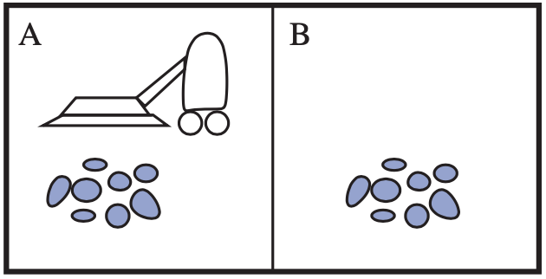
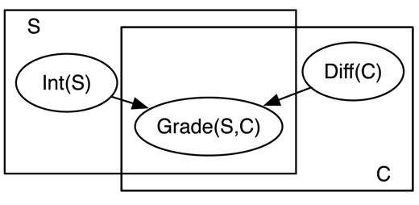


Introduction
Agent
Environment
Sensors
Percepts
?
Statistical Relational Artificial Intelligence
(StaRAI)
Actuators
Actions
$$∞ Presents\left(X, P, C\right)⇒Attends\left(X, C\right)$$
$$3.75 Publishes\left(X, C\right)∧FarAway\left(C\right)⇒Attends\left(X, C\right)$$
Tanya Braun

Slide 2
Contents
Introduction
  Artificial intelligence
  Agent framework
  StaRAI: context, motivation
Foundations
  Logic
  Probability theory
  Probabilistic graphical models (PGMs)
Probabilistic Relational Models (PRMs)
  Parfactor models, Markov logic networks
  Semantics, inference tasks
Lifted Inference
  Exact inference
  Approximate inference, specifically sampling
Lifted Learning
  Parameter learning
  Relation learning
  Approximating symmetries
Lifted Sequential Models and Inference
  Parameterised models
  Semantics, inference tasks, algorithm
Lifted Decision Making
  Preferences, utility
  Decision-theoretic models, tasks, algorithm
Continuous Space and Lifting
  Lifted Gaussian Bayesian networks (BNs)
  Probabilistic soft logic (PSL)

Slide 3
Overview: 1. Introduction
Artificial Intelligence
  Approaches: thinking / acting humanly / rationally
Framework: Agent Theory
  Agent
  Task environment
  Agent structure
Topic: StaRAI
  Motivation, context
  Relational examples, outlook on probabilistic relational models (PRMs)

Slide 4
Approaches to Artificial Intelligence (AI)
Success measure
Fidelity of human performance
Ideal performance measure rationality
All approaches researched
  Supported and hindered each other
Rationality
  System is rational if it does the “right thing,” given what it knows
Thinking Humanly | Thinking Rationally
“The exciting new effort to make computers think . . . machines with minds, in the full and literal sense.” (Haugeland, 1985) “[The automation of] activities that we associate with human thinking, activities such as decision-making, problem solving, learning…” (Bellman, 1978) | “The study of mental faculties through the use of computational models.” (Charniak and McDermott, 1985) “The study of the computations that make it possible to perceive, reason, and act.” (Winston, 1992)
Acting Humanly | Acting Rationally
“The art of creating machines that perform functions that require intelligence when performed by people.” (Kurzweil, 1990) “The study of how to make computers do things at which, at the moment, people are better.” (Rich and Knight, 1991) | “Computational Intelligence is the study of the design of intelligent agents.” (Poole et al., 1998) “AI … is concerned with intelligent behaviour in artefacts.” (Nilsson, 1998)
Thought
processes,
reasoning
Behaviour
S. Russel and P. Norvig: Artificial Intelligence – A Modern Approach, 2020.

Slide 5
Acting Humanly
Turing Test (Turing, 1950)
  Computer passes test, if a human, who asks written questions, cannot tell if the the written answers come from a human or not
    Example: Eliza, program for superficially simulating a psychiatrist
    See also Ch. 26, “Artificial Intelligence – A Modern Approach” by Russel & Norvig, including a discussion whether a computer would really be intelligent if it passed
      Regarding Eliza: human’s example closure tendencies are more pronounced for emotional/social intelligence aspects
                Cf. robot Shakey: No on who saw Shakey the first time thought it could shoot hoops, yet the first people interacting with Eliza assumed it was a real doctor
  Total Turing Test: includes a video signal to test perceptual abilities, opportunity to pass physical objects
https://en.wikipedia.org/wiki/ELIZA
https://thenewstack.io/remembering-shakey-first-intelligent-robot/
Notes:
Pass as a human

Slide 6
Acting Humanly
Subproblems to solve as part of the Turing Test
  Natural Language Processing
    Communication
  Knowledge representation
    Store knowledge and observations
  Automated reasoning
    Answer questions, draw new conclusions
  Machine learning
    Adapt to new circumstances, detect and extrapolate patterns
  Total Turing Test
    Computer vision: perceive objects
    Robotics: manipulate objects, move about
The Turing Test covers a majority of disciplines that make up AI nowadays.
But:
little research effort devoted to pass test
Instead:
Study underlying principles of intelligence
S. Russel and P. Norvig: Artificial Intelligence – A Modern Approach, 2020.
Notes:
natural language processing to enable it to communicate successfully in English;
knowledge representation to store what it knows or hears;
automated reasoning to use the stored information to answer questions and to draw new conclusions;
machine learning to adapt to new circumstances and to detect and extrapolate patterns.
computer vision to perceive objects, and
robotics to manipulate objects and move about.
The quest for “artificial flight” succeeded when the Wright brothers and others stopped imitating birds and started using wind tunnels and learning about aerodynamics. Aeronautical engineering texts do not define the goal of their field as making “machines that fly so exactly like pigeons that they can fool even other pigeons.”

Slide 7
Approaches to Artificial Intelligence (AI)
Success measure
Fidelity of human performance
Ideal performance measure rationality
All approaches followed
  Supported and hindered each other
Rationality
  System is rational if it does the “right thing,” given what it knows
Thinking Humanly | Thinking Rationally
“The exciting new effort to make computers think . . . machines with minds, in the full and literal sense.” (Haugeland, 1985) “[The automation of] activities that we associate with human thinking, activities such as decision-making, problem solving, learning…” (Bellman, 1978) | “The study of mental faculties through the use of computational models.” (Charniak and McDermott, 1985) “The study of the computations that make it possible to perceive, reason, and act.” (Winston, 1992)
Acting Humanly | Acting Rationally
“The art of creating machines that perform functions that require intelligence when performed by people.” (Kurzweil, 1990) “The study of how to make computers do things at which, at the moment, people are better.” (Rich and Knight, 1991) | “Computational Intelligence is the study of the design of intelligent agents.” (Poole et al., 1998) “AI … is concerned with intelligent behaviour in artefacts.” (Nilsson, 1998)
Thought
processes,
reasoning
Behaviour
S. Russel and P. Norvig: Artificial Intelligence – A Modern Approach, 2020.

Slide 8
Thinking Humanly
A “program thinks like a human“
  Requires a way to determine how humans think ➝ workings of the human mind
  Given theory of the mind, express theory as computer program
    If program’s input-output behaviour matches corresponding human behaviour, evidence that some of program’s mechanisms could also be operating in humans
Approach complementary to AI: Cognitive Science
  Interdisciplinary:
    Computer models from AI
    Experimental techniques from psychology
  Goal:
  Construct precise and testable theories of human mind
S. Russel and P. Norvig: Artificial Intelligence – A Modern Approach, 2020.

Slide 9
Approaches to Artificial Intelligence (AI)
Success measure
Fidelity of human performance
Ideal performance measure rationality
All approaches followed
  Supported and hindered each other
Rationality
  System is rational if it does the “right thing,” given what it knows
Thinking Humanly | Thinking Rationally
“The exciting new effort to make computers think . . . machines with minds, in the full and literal sense.” (Haugeland, 1985) “[The automation of] activities that we associate with human thinking, activities such as decision-making, problem solving, learning…” (Bellman, 1978) | “The study of mental faculties through the use of computational models.” (Charniak and McDermott, 1985) “The study of the computations that make it possible to perceive, reason, and act.” (Winston, 1992)
Acting Humanly | Acting Rationally
“The art of creating machines that perform functions that require intelligence when performed by people.” (Kurzweil, 1990) “The study of how to make computers do things at which, at the moment, people are better.” (Rich and Knight, 1991) | “Computational Intelligence is the study of the design of intelligent agents.” (Poole et al., 1998) “AI … is concerned with intelligent behaviour in artefacts.” (Nilsson, 1998)
Thought
processes,
reasoning
Behaviour
S. Russel and P. Norvig: Artificial Intelligence – A Modern Approach, 2020.

Slide 10
Thinking Rationally
Codify thinking ➝ rules
  Irrefutable reasoning processes
  Argument structures that always yield correct conclusions when given correct premises
Field of Logic
  Precise notation for statements about objects in a world and relations among them
  Programs that could, in principle, solve any solvable problem described in logical notation
  Obstacles:
    Informal knowledge
      Unstructured data
      Uncertainty
    Solving any solvable problem in practice
      Limited computational resources
Obstacles apply to any attempt to build computational reasoning systems
Formulated first in logic
S. Russel and P. Norvig: Artificial Intelligence – A Modern Approach, 2020.
Notes:
Greek philosopher Aristotle was one of the first to attempt to codify “right thinking,” that is, irrefutable reasoning processes. His syllogisms provided patterns for argument structures that always yielded correct conclusions when given correct premises—for example, “Socrates is a man; all men are mortal; therefore, Socrates is mortal.” These laws of thought were supposed to govern the operation of the mind

Slide 11
Approaches to Artificial Intelligence (AI)
Success measure
Fidelity of human performance
Ideal performance measure rationality
All approaches followed
  Supported and hindered each other
Rationality
  System is rational if it does the “right thing,” given what it knows
Thinking Humanly | Thinking Rationally
“The exciting new effort to make computers think . . . machines with minds, in the full and literal sense.” (Haugeland, 1985) “[The automation of] activities that we associate with human thinking, activities such as decision-making, problem solving, learning…” (Bellman, 1978) | “The study of mental faculties through the use of computational models.” (Charniak and McDermott, 1985) “The study of the computations that make it possible to perceive, reason, and act.” (Winston, 1992)
Acting Humanly | Acting Rationally
“The art of creating machines that perform functions that require intelligence when performed by people.” (Kurzweil, 1990) “The study of how to make computers do things at which, at the moment, people are better.” (Rich and Knight, 1991) | “Computational Intelligence is the study of the design of intelligent agents.” (Poole et al., 1998) “AI … is concerned with intelligent behaviour in artefacts.” (Nilsson, 1998)
Thought
processes,
reasoning
Behaviour
S. Russel and P. Norvig: Artificial Intelligence – A Modern Approach, 2020.

Slide 12
Acting Rationally
Rational agent approach
Agent = something that acts
  Operate autonomously
  Perceive environment
  Persist over a prolonged time period
  Adapt to change
  Create and pursue goals
Rational agent
  One that acts so as to achieve the best outcome or, when there is uncertainty, the best expected outcome
  May include thinking rationally or acting humanly, but more general
Advantage: Standard of rationality mathematically well defined
Better suited to generate agent designs that provably achieve rationality
Focus of the next slides
S. Russel and P. Norvig: Artificial Intelligence – A Modern Approach, 2020.
Notes:
Korrektes Schlussfolgern nur einen Mechanismus von vielen zur Erzielung der Rationalität
Eher geeignet, den Fortschritt zu befördern als Ansätze, die sich menschliches Handeln zum Vorbild nehmen oder auf menschlichen Gedanken basieren
Menschliche Verhalten an eine bestimmte Umgebung gut angepasst und praktisch durch die Summe der Dinge definiert, die Menschen tun

Slide 13
Interim Summary
Four approaches to define AI
  Acting humanly
    Turing test
    Subproblems: Natural language processing, knowledge representation, reasoning, machine learning, computer vision, robotics
  Thinking humanly
    Cognitive sciences as an interdisciplinary science between AI and psychology
  Thinking rationally
    Logic for knowledge representation and correct reasoning
  Acting rationally
    Rational agent as a generalisation of thinking rationally with a mathematical definition of rationality as a formal criterion
    Also contains subproblems, which the Turing test identifies
S. Russel and P. Norvig: Artificial Intelligence – A Modern Approach, 2020.

Slide 14
Overview: 1. Introduction
Artificial Intelligence
  Approaches: thinking / acting humanly / rationally
Framework: Agent Theory
  Agent
  Task environment
  Agent structure
Topic: StaRAI
  Motivation, context
  Relational examples, outlook on probabilistic relational models (PRMs)

Slide 15
Agent
Something that perceives its environment through sensors and acts through actuators
  Human agent
    Sensors: eyes, ears, further organs
    Actuators: hands, legs, mouth, other body parts
  Robot agent
    Sensors: cameras, infra-red sensors, etc.
    Actuators: motors
  Software agent
    Goal: document retrieval, DR
    Sensors: input interface for textual queries
    Actuators: output interface for documents
Agent
Environment
Sensors
Percepts
?
Actions
Actuators
S. Russel and P. Norvig: Artificial Intelligence – A Modern Approach, 2020.

Slide 16
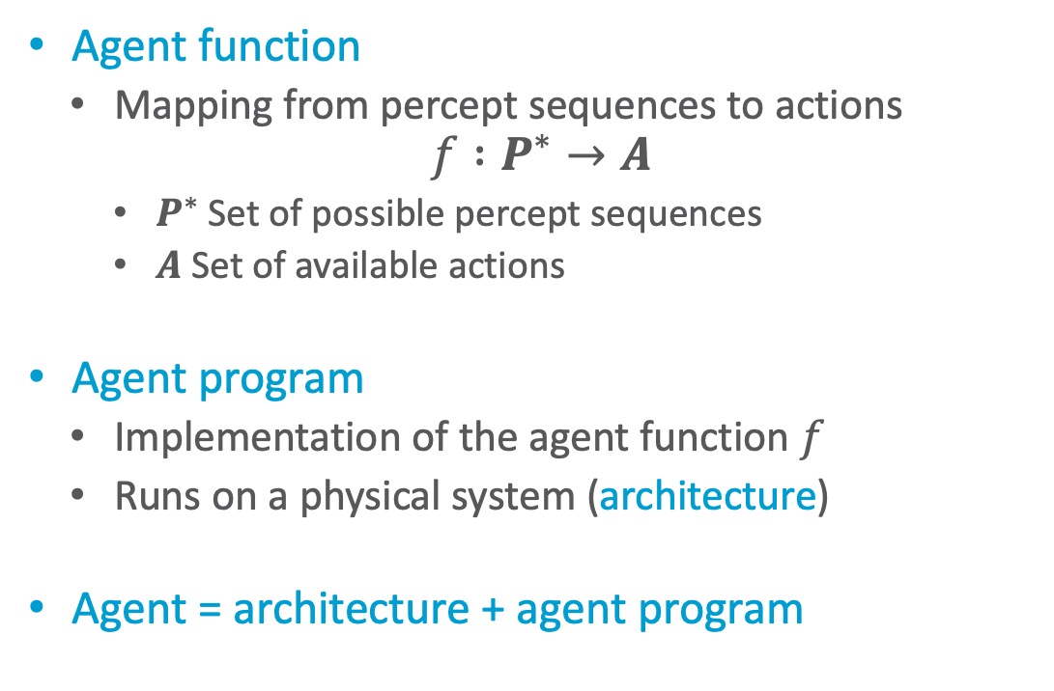
Agent Behaviour
Agent function
  Mapping from percept sequences to actions
$$f :P^{∗}→A$$
    $P^{∗}$ Set of possible percept sequences
    $A$ Set of available actions
Agent program
  Implementation of the agent function $f$
  Runs on a physical system (architecture)
Agent = architecture + agent program
Agent
Environment
Sensors
Percepts
?
Actions
Actuators
S. Russel and P. Norvig: Artificial Intelligence – A Modern Approach, 2020.
Notes:
Bildverarbeitung/NN: Abfolge der Pixel, Aktion: Klassifikation
Roboter: Videobildsequenz, andere Sensorwerte, Aktion: Bewegung
Doc. Retr.: Dok (Sequenz von Worten); Aktion: Auswahl von Dokumenten

Slide 17
Simple Example
Vacuum cleaner
  Two locations: squares A, B
  Possible percepts: location; location clean, dirty
  Available actions: right, left, vacuum
Agent function in table
  Mapping increasingly longer percept sequences to actions
    Optimisable, as action only depends on last observation (and not the sequence)
  How table is filled defines the agent
    Different agents possible
Percept sequence | Action
[A, Clean] | Right
[A, Dirty] | Vacuum
[B, Clean] | Left
[B, Dirty] | Vacuum
[A, Clean], [A, Clean] | Right
[A, Clean], [A, Dirty] | Vacuum
… | …
[A, Clean], [A, Clean], [A, Clean] | Right
[A, Clean], [A, Clean], [A, Dirty] | Vacuum
… | …
S. Russel and P. Norvig: Artificial Intelligence – A Modern Approach, 2020.

Slide 18
Rationality
Rationality is not omniscience!
Depends on four things:
  Performance measure, defines criterion of success
  Agent’s prior knowledge of environment
  Actions that agent can perform
  Agent’s percept sequence to date
Rational agent:
  For each possible percept sequence, a rational agent should select an action
  expected to maximize its performance measure,
  given evidence provided by percept sequence and
  whatever built-in knowledge the agent has.
➝ Rational = intelligent
Agent
Environment
Sensors
Percepts
?
Actions
Actuators
Notes:
What is rational at any given time depends on four things:
• The performance measure that defines the criterion of success.
• The agent’s prior knowledge of the environment.
• The actions that the agent can perform.
• The agent’s percept sequence to date.

Slide 19
Further Agent Properties
Properties that agent behaviour can exhibit:
  Rationality
  Flexibility
    Reactive
    Proactive
    Social (in multi-agent systems)
  Autonomy
  Mobility
  Veracity
  Benevolence
  Ability to learn / adapt
Agent
Environment
Sensors
Percepts
?
Actions
Actuators
Notes:
Veracity: no knowingly false information passed along
Benevolence: agents do what is expected of them

Slide 20
Task Environment
Task environments
  Essentially the “problems” to which rational agents are the “solutions”
  Specify using PEAS description
    Performance measure
    Environment
    Actuators
    Sensors
Properties of task environment
Modelling the environment
Determine agent design
Attention: Name collision between
task environment und environment.
We will after this part usually only talk about the environment.
S. Russel and P. Norvig: Artificial Intelligence – A Modern Approach, 2020.

Slide 21
PEAS – Example
Medical diagnosis system
Software agent for document retrieval, DR
  Sensors: input interface for textual queries
  Actuators: output interface for documents
Agent Type | Performance Measure | Environment | Actuators | Sensors
Medical diagnosis system | Healthy patient, reduced costs | Patient, hospital, staff | Display of questions, tests, diagnoses, treatments, referrals | Keyboard entry of symptoms, findings, patient’s answers
What makes up the environment? What is a fitting performance measure?
S. Russel and P. Norvig: Artificial Intelligence – A Modern Approach, 2020.
Notes:
Um optimal zu arbeiten, braucht er Verarbeitungsfähigkeiten für natürliche Sprache, er muss lernen, woran jeder Benutzer und Inserent interessiert ist, und er muss seine Pläne dynamisch ändern können – wenn beispielsweise die Verbindung zu einer Nachrichtenquelle ausfällt oder wenn eine neue Quelle online geht. Das Internet ist eine Umgebung, deren Komplexität der physischen Welt gleichkommt und zu deren Einwohnern viele künstliche und menschliche Agenten gehören.

Slide 22
Properties of Task Environments
Fully observable (vs. partially observable)
  Agent‘s sensors give access to complete state of environment at each point in time
Single agent (vs. multiple agents)
  Single agent acts in environment
  Can depend on modelling if something in environment is an object or another agent
  Multi-agent systems:
    Cooperative vs. competitive
    Communication possible?
Deterministic (vs. stochastic)
  Next state of environment completely determined by current state and action executed by agent
  Strategic: if environment deterministic except for actions of other agents
S. Russel and P. Norvig: Artificial Intelligence – A Modern Approach, 2020.

Slide 23
Properties of Task Environments
Special property: known (vs. unknown)
Agent’s (or designer’s) state of knowledge about its environment beforehand
No property of the environment
Episodic (vs. sequential)
  Agent‘s experience divided into atomic “episodes”
    Episode = agent perceives a single percept and then performs a single action
  Choice of action in each episode depends only on episode itself
Static (vs. dynamic)
  Environment unchanged while agent is deliberating
  Semi-dynamic: environment itself does not change with passage of time but agent's performance score does
Discrete (vs. continuous)
  Applies to state of the environment, to the way time is handled, and to the percepts and actions
  Finite number of distinct states, percepts, actions, time steps
S. Russel and P. Norvig: Artificial Intelligence – A Modern Approach, 2020.

Slide 24
Properties of Task Environments – Example
Task environment | Observable | Single agent | Deterministic | Episodic | Static | Discrete
Medical diagnosis | Partially | Single | Stochastic | Sequential | Dynamic | Continuous
Self-driving taxi | Partially | Multi | Stochastic | Sequential | Dynamic | Continuous
Chess with a clock | Fully | Multi | Deterministic | Sequential | Semi | Discrete
How about image classification?
S. Russel and P. Norvig: Artificial Intelligence – A Modern Approach, 2020.
Notes:
Wir haben die Aufgabe der medizinischen Diagnose als Einzelagent eingeordnet, weil der Krankheitsprozess eines Patienten nicht profitabel als Agent modelliert wird; ein System zur medizinischen Diagnose könnte jedoch auch mit widerspenstigen Patienten und einem skeptischen Team zu tun haben, sodass die Umgebung auch einen Multiagentenaspekt haben könnte. Darüber hinaus ist die medizinische Diagnose episodisch, wenn man die Aufgabe als Auswahl einer Diagnose anhand einer gegebenen Liste von Symptomen betrachtet; das Problem ist sequenziell, wenn die Aufgabe den Vorschlag einer Testreihe, die Auswertung von Fortschritten im Laufe der Behandlung usw. beinhalten kann
Image classification: Fully Single Deterministic Episodic Semi Continuous

Slide 25
Representation of the Environment
Depends on properties of the task environment
  Discrete/continuous, static/dynamic, episodic/sequential, ...
Determine expressiveness of representation
  Increasing complexity and expressiveness
  Atomic
    Each state not further dividable (no internal structure)
  Factorised
    Partitioning of state into fixed set of variables / attributes that can take a value
    Representation: state-variable models, propositional logic, probabilistic graphical models (PGMs)
  Structured
    Objects, relations among them
    Representation: relational databases + PGMs, first-order logic
    Advertisement:
    Lecture „Automated Planning and Acting“
    Advertisement:
    Lecture „Data Science / Intro to AI“
    This lecture on StaRAI!
S. Russel and P. Norvig: Artificial Intelligence – A Modern Approach, 2020.

Slide 26
Performance Measure: Good Behaviour
What is the right thing to do?
  Agent generates sequence of actions given percepts
  Causes environment to go through sequence of states
  If sequence desirable / conforms to our expectations, then agent performed well
Performance measure that evaluates any given sequence of environemnt states
Agent
Environment
Sensors
Percepts
?
Actions
Actuators
S. Russel and P. Norvig: Artificial Intelligence – A Modern Approach, 2020.

Slide 27
Back to the Vacuum Cleaner
Given this task environment, rational?
Performance Measure
  1 point for each clean square in each time step over a life span of 1000 time steps
Environment
  Locations (A, B) prior knowledge
  Not known: initial location, dirt distribution
  Action Vacuum cleans the current location; clean location remains clean
  Actions Left and Right move the agent accordingly, except if that moves the agent out of the environment, then it stays put
  Location and dirtiness perceived correctly
Percept sequence | Action
[A, Clean] | Right
[A, Dirty] | Vacuum
[B, Clean] | Left
[B, Dirty] | Vacuum
[A, Clean], [A, Clean] | Right
[A, Clean], [A, Dirty] | Vacuum
… | …
[A, Clean], [A, Clean], [A, Clean] | Right
[A, Clean], [A, Clean], [A, Dirty] | Vacuum
… | …
S. Russel and P. Norvig: Artificial Intelligence – A Modern Approach, 2020.
Notes:
It suffices to show that for all possible actual environments (i.e., all dirt distributions and initial locations), this agent cleans the squares at least as fast as any other agent. This is trivially true when there is no dirt. When there is dirt in the initial location and none in the other location, the world is clean after one step; no agent can do better. When there is no dirt in the initial location but dirt in the other, the world is clean after two steps; no agent can do better. When there is dirt in both locations, the world is clean after three steps; no agent can do better. (Note: in general, the condition stated in the first sentence of this answer is much stricter than necessary for an agent to be rational.)

Slide 28
Back to the Vacuum Cleaner
Given this task environment, rational?
Performance Measure
  1 point for each clean square in each time step over a life span of 1000 time steps
  1 point deduction for each Left or Right action
Environment
  As before
Additional action: No-Op
  Adapt agent function such that in the case of dirt the locations get cleaned once and then No-Op
  If locations can get dirty again, repeat cleaning round in intervals
Percept sequence | Action
[A, Clean] | Right
[A, Dirty] | Vacuum
[B, Clean] | Left
[B, Dirty] | Vacuum
[A, Clean], [A, Clean] | Right
[A, Clean], [A, Dirty] | Vacuum
… | …
[A, Clean], [A, Clean], [A, Clean] | Right
[A, Clean], [A, Clean], [A, Dirty] | Vacuum
… | …
How do we get a better agent?
S. Russel and P. Norvig: Artificial Intelligence – A Modern Approach, 2020.
Notes:
If environment unknown: explore

Slide 29
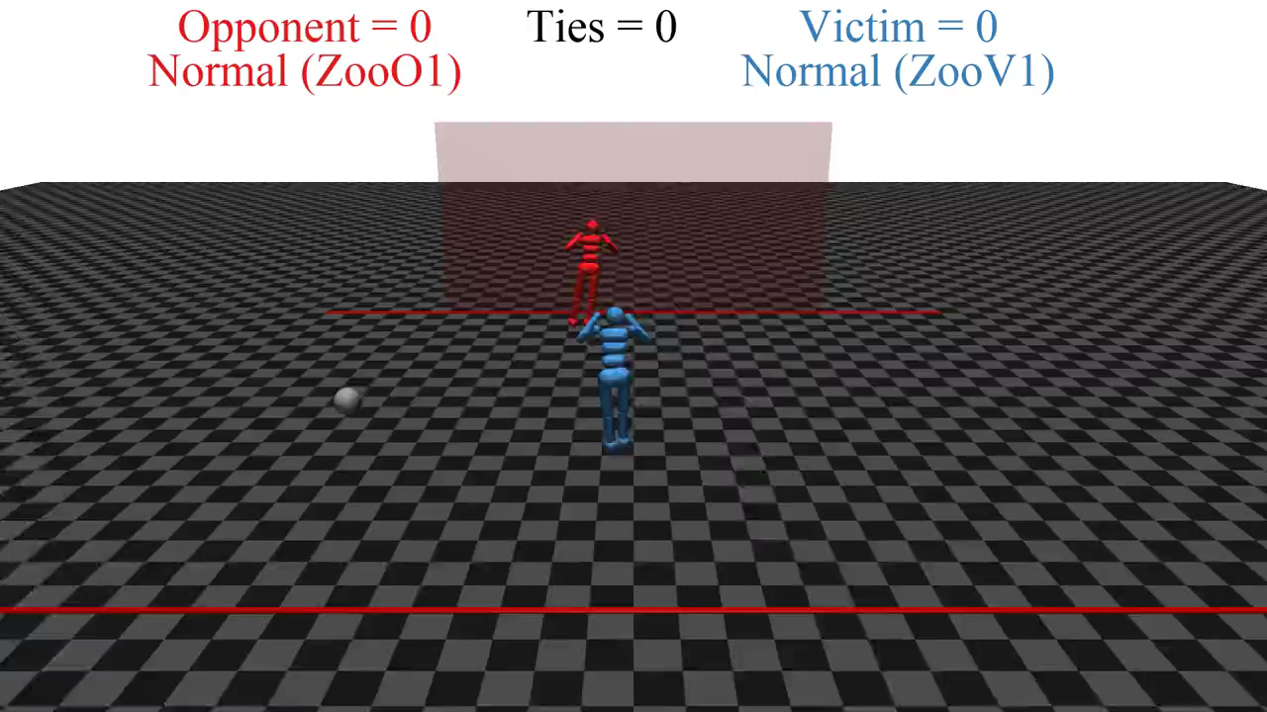
Quelle: https://people.eecs.berkeley.edu/~russell/talks/2020/russell-aaai20-hntdtwwai-4x3.pptx
Notes:
Open AI
RL 1-2 hrs (one goalie, one shooter)
two simulated robots

Slide 30
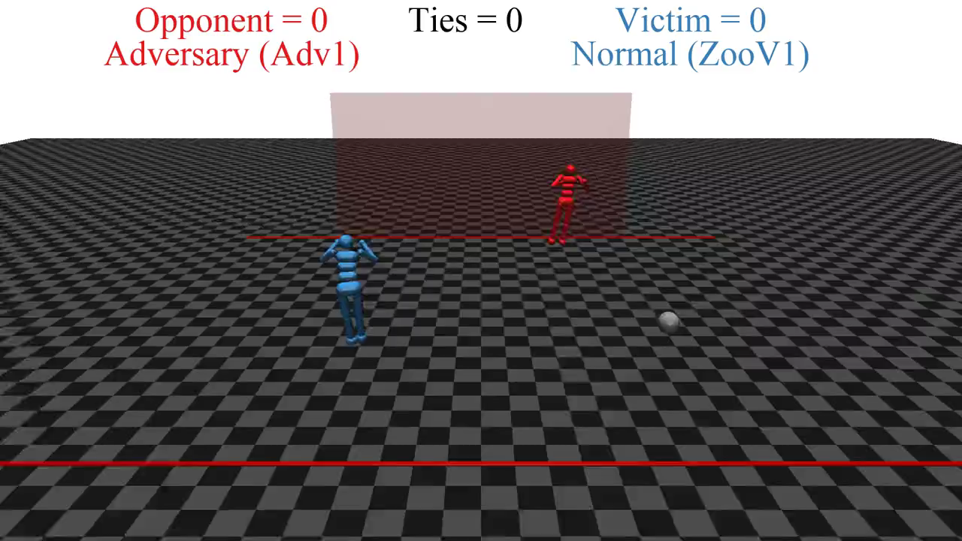
Quelle: https://people.eecs.berkeley.edu/~russell/talks/2020/russell-aaai20-hntdtwwai-4x3.pptx
Notes:
Keep blue robot as is
Red robot continues to learn

Slide 31
Performance Measure
Amount of dirt?
Hard to determine
  Not one fixed performance measure for all tasks and agents
Clean locations?
Percept sequence | Action
[A, Clean] | Right
[A, Dirty] | Vacuum
[B, Clean] | Left
[B, Dirty] | Vacuum
[A, Clean], [A, Clean] | Right
[A, Clean], [A, Dirty] | Vacuum
… | …
[A, Clean], [A, Clean], [A, Clean] | Right
[A, Clean], [A, Clean], [A, Dirty] | Vacuum
… | …
As a general rule, it is better to design performance measures according to what one actually wants in the environment, rather than according to how one thinks the agent should behave.
S. Russel and P. Norvig: Artificial Intelligence – A Modern Approach, 2020.
Notes:
Wenn wir Erfolg als Meinung des Agenten zu seiner eigenen Leistung definieren, könnte ein Agent perfekte Rationalität erreichen, indem er einfach von sich selbst behauptet, seine Leistung sei perfekt.
We might propose to measure performance by the amount of dirt cleaned up in a single eight-hour shift. With a rational agent, of course, what you ask for is what you get. A rational agent can maximize this performance measure by cleaning up the dirt, then dumping it all on the floor, then cleaning it up again, and so on. A more suitable performance measure would reward the agent for having a clean floor
Beispielsweise könnte je ein Punkt für jedes saubere Quadrat pro Zeitschritt erteilt werden (und vielleicht Strafpunkte für verbrauchte Elektrizität und erzeugten Lärm).

Slide 32
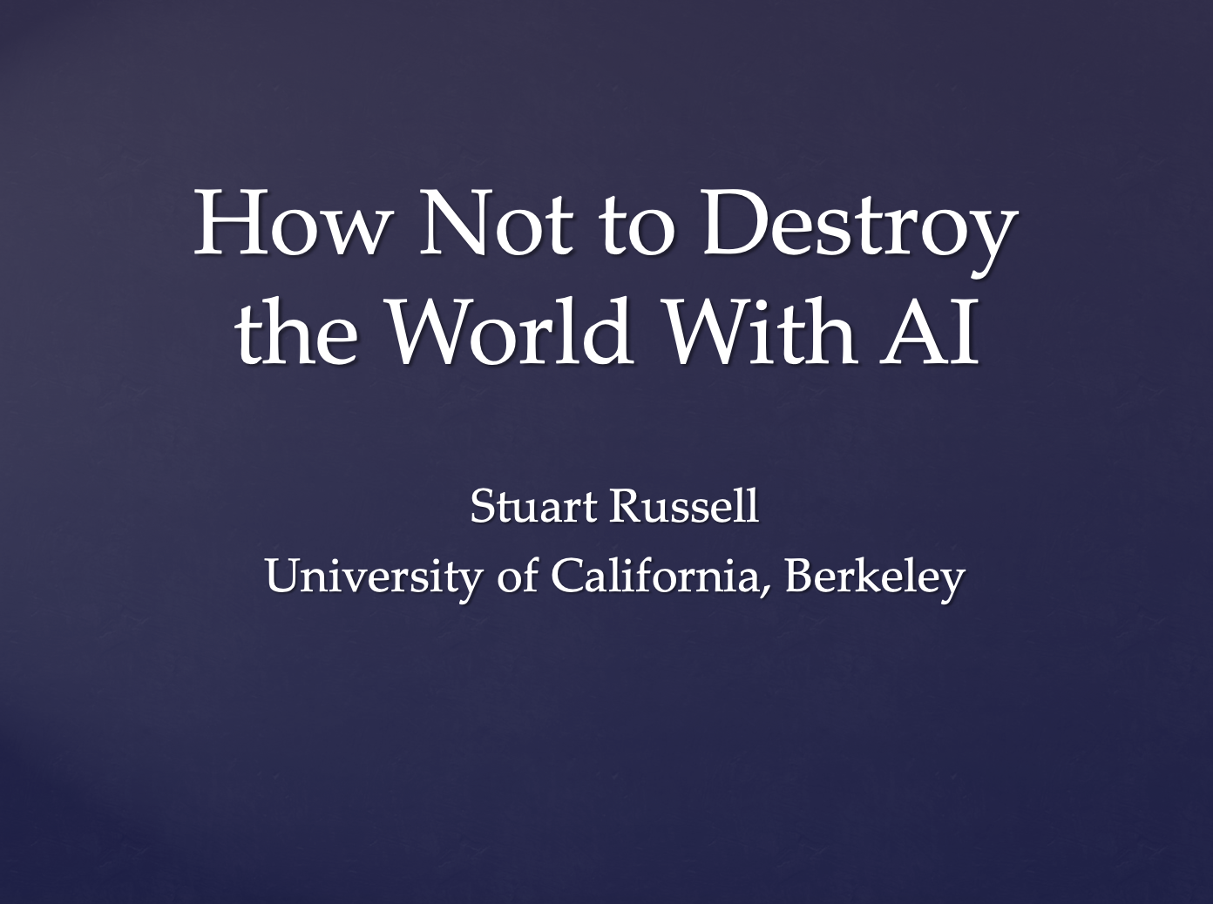
Side Note: Current Research
Idea:
    Humans: intelligent to the extent that our actions can be expected to achieve our goals
    Maschines: intelligent to the extent that their actions can be expected to achieve their goals
    Maschines are beneficial to the extent that their actions can be expected to achieve our goals n
  Approach: Performance measure unknown, human as assistant
Goal: Provably beneficial AI
  See for example Stuart Russell
Human goal
Human behaviour
Agent behaviour
Presentation: https://www.youtube.com/watch?v=QPSgM13hTK8
Slides: https://people.eecs.berkeley.edu/~russell/talks/2020/russell-aaai20-hntdtwwai-4x3.pptx

Slide 33
Implementing Agents
Agent = architecture + program
  Architecture
    Entity with corresponding physical sensors and actuators
      Entity = computer, robot, software (interfaces as sensors and actuators)
  Program
    Implementation of an agent function
    Runs on an architecture
  Both depend on task environment
Implementation necessary, but how?
Agent
Environment
Sensors
Percepts
?
Actions
Actuators
S. Russel and P. Norvig: Artificial Intelligence – A Modern Approach, 2020.

Slide 34
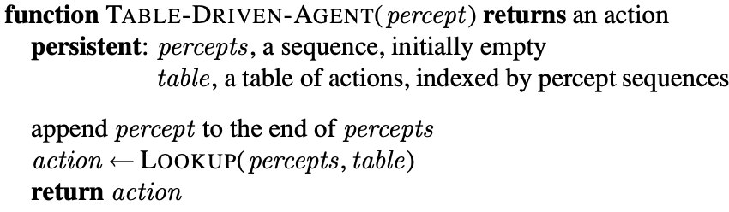
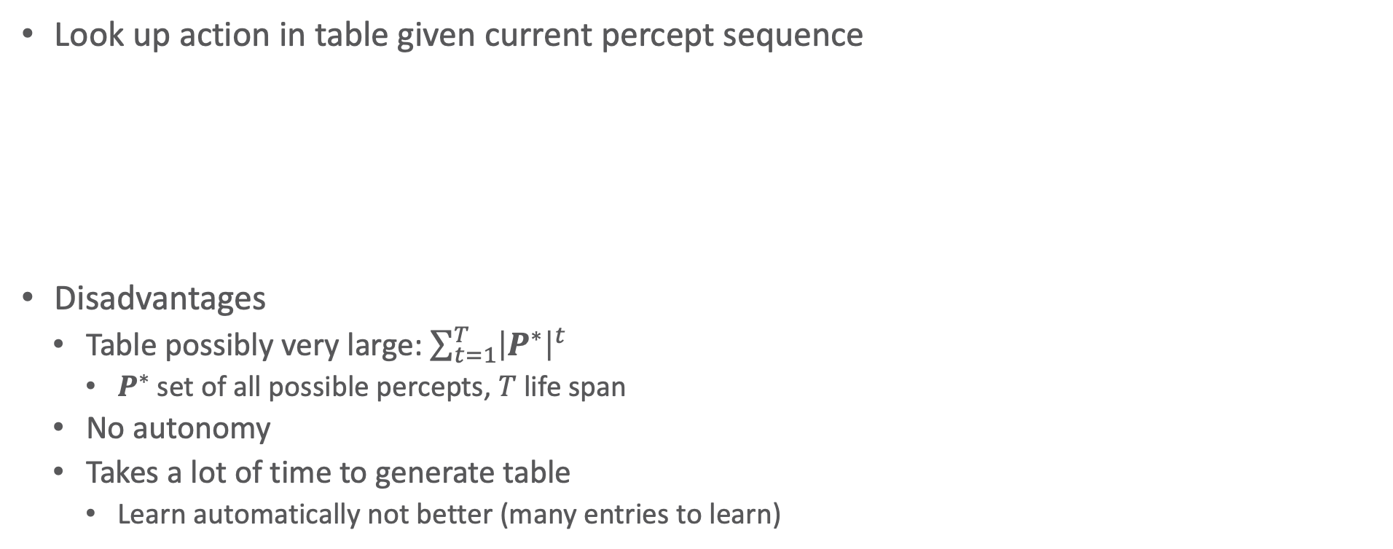
Simple Table-driven Agent
Look up action in table given current percept sequence
Disadvantages
  Table possibly very large: $\sum_{t=1}^{T}{{\left|P^{∗}\right|}^{t}}$
    $P^{∗}$ set of all possible percepts, $T$ life span
  No autonomy
  Takes a lot of time to generate table
    Learn automatically not better (many entries to learn)
Percept sequence | Action
[A, Clean] | Right
[A, Dirty] | Vacuum
[B, Clean] | Left
[B, Dirty] | Vacuum
[A, Clean], [A, Clean] | Right
[A, Clean], [A, Dirty] | Vacuum
… | …
[A, Clean], [A, Clean], [A, Clean] | Right
[A, Clean], [A, Clean], [A, Dirty] | Vacuum
… | …
S. Russel and P. Norvig: Artificial Intelligence – A Modern Approach, 2020.

Slide 35
Agent Structure
General agent structures for implementing agent functions:
  Ordered by increasing generalisation
  Simple reflex agent
  Model-based reflex agent
  Goal-based agent
  Utility-based agent
  Learning agent
  Human-aware agent (current research)
Agent
Environment
Sensors
Percepts
?
Actions
Actuators
S. Russel and P. Norvig: Artificial Intelligence – A Modern Approach, 2020.

Slide 36
Agent Structure: Simple Reflex Agent
Actions chosen based on current percept
  Ignores previous percepts
  No modelling of the environemnt
Only correct decision on action if environment fully observable
  If partially observable, inifinite loops possible
    (Partial) solution:
    Choose random action
Agent
Environemnt
Sensors
What the world
is like now
Condition-action rules
What action I
should do now
Actuators
S. Russel and P. Norvig: Artificial Intelligence – A Modern Approach, 2020.

Slide 37
Implementation of a Simple Reflex Agent
function Simple-Reflex-Agent(percept) returns an action
persistent: rules, a set of condition-action rules
state ⟵ Interpret-Input(percept)
rule ⟵ Rule-Match(state, rules)
action ⟵ rule.Action
return action
General
representation
Example
vacuum cleaner
function Reflex-Vacuum-Agent([location, status]) returns an action
persistent: rules, a set of condition-action rules
if status = Dirty then return Vacuum
else if location = A then return Right
else if location = B then return Left
S. Russel and P. Norvig: Artificial Intelligence – A Modern Approach, 2020.

Slide 38
Agent Structure: Model-based Reflex Agent
Given partial observability, keep track of not observable part
  Using internal state
    Depends on percept sequence
    Encode not observable aspects of the current state
      Encoding of environment atomic, factorised or structured
Update internal state with information over
  How environment evolves independently of agent
  Effect of actions on environment
Agent
Environment
Sensors
State
What the world
looks like now
How the world evolves
What my actions do
Condition-action rules
What action I
should do now
Actuators
S. Russel and P. Norvig: Artificial Intelligence – A Modern Approach, 2020.

Slide 39
Implementation of a Model-based Reflex Agent
function Model-based-Reflex-Agent(percept) returns an action
persistent: state, the agent’s current conception of the world state
model, a description of how the next state depends on current state and action
rules, a set of condition-action rules
action, the most recent action, initially none
state ⟵ Update-State(state, action, percept, model)
rule ⟵ Rule-Match(state, rules)
action ⟵ rule.Action
return action
S. Russel and P. Norvig: Artificial Intelligence – A Modern Approach, 2020.
Notes:
NoOp Staubsaugroboter

Slide 40
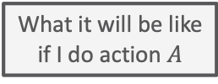
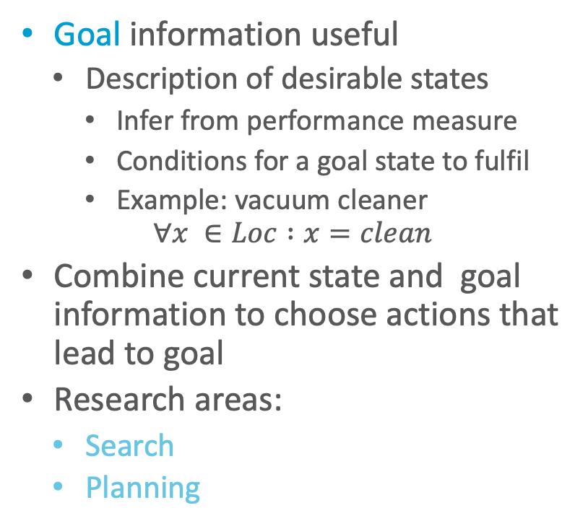
Agent Structure: Goal-based Agent
Goal information useful
  Description of desirable states
    Infer from performance measure
    Conditions for a goal state to fulfil
    Example: vacuum cleaner
    $$∀x ∈Loc :x=clean$$
Combine current state and goal information to choose actions that lead to goal
Research areas:
  Search
  Planning
Agent
Environment
Sensors
State
What the world
is like now
How the world evolves
What my actions do
What it will be like
if I do action $A$
Goals
What action I
should do now
Actuators
S. Russel and P. Norvig: Artificial Intelligence – A Modern Approach, 2020.

Slide 41
Agent Structure: Utility-based Agent
Goal-based: binary distinction between happy and unhappy
Utility as a distribution over possible states
  What we look at later in the lecture
  Essentially an internalisation of the performance measure
    If internal utility function agrees with external performance measure:
    Agent that chooses actions to maximize its utility will be rational according to the external performance measure
Agent
Environment
Sensors
State
What the world
is like now
How the world evolves
What my actions do
What it will be like
if I do action $A$
Utility
How happy I will be
in such a state
What action I
should do now
Actuators
S. Russel and P. Norvig: Artificial Intelligence – A Modern Approach, 2020.
Notes:
Conflicting goals ➝ allows for trade-off
Several goals that each cannot be reached with certainty ➝ weigh likelihood of success against importance of goals

Slide 42
Agent Structure: Learning Agent
Performance standard
So far: Agents select actions
  Make decisions about actions
How do agent programs emerge?
  Too laborious to do by hand
Generate learning agent, let it learn
  Allows agent to operate in initially unknown environments and to become more competent
  Research area:
  Reinforcement Learning
Agent
Environment
Critic
Sensors
feedback
Learning
element
changes
Performance
element
knowledge
learning
goals
Problem
generator
    Advertisement: Lecture „Deep Reinforcement Learning“ (PI, 4) by Malte Schilling this semester
Actuators
S. Russel and P. Norvig: Artificial Intelligence – A Modern Approach, 2020.
Notes:
In seinem berühmten frühen Aufsatz betrachtet Turing (1950) die Idee, seine intelligenten Maschinen tatsächlich manuell zu programmieren. Er schätzt, wie viel Arbeit das bedeuten würde, und kommt zu dem Schluss: „Eine schnellere Methode scheint wünschenswert“

Slide 43
Agent Structure: Learning Agent
Performance standard
4 conceptual components
  Learning element
    Make improvements
  Performance element (agent so far)
    Select actions
  Critic
    Feedback on results
    Used by learning element to determine how performance element should be modified to do better
  Problem generator (for exploration)
    Suggest actions that will lead to new and informative experiences
Agent
Environment
Critic
Sensors
feedback
Learning
element
changes
Performance
element
knowledge
learning
goals
Problem
generator
Actuators
S. Russel and P. Norvig: Artificial Intelligence – A Modern Approach, 2020.
Notes:
Wenn wir versuchen, einen Agenten zu entwerfen, der eine bestimmte Fertigkeit erlernt, ist die erste Frage nicht: „Wie schaffe ich es, dies zu lernen?“, sondern: „Welche Art Leistungselement braucht mein Agent, um dies zu tun, nachdem er gelernt hat?“
Beispiel des automatisierten Taxis zurückkommen. Das Leistungselement besteht aus einer Sammlung von Wissen und Prozeduren, die dem Taxi zur Auswahl seiner Fahrtaktionen zur Verfügung stehen. Das Taxi gelangt auf die Straße und fährt unter Verwendung dieses Leistungselementes. Die Kritik beobachtet die Welt und gibt Informationen an das Lernelement weiter. Nachdem das Taxi beispielsweise schnell über drei Spuren hinweg links abgebogen ist, beobachtet die Kritik die Beschimpfungen durch andere Fahrer. Aus dieser Erfahrung kann das Lernelement eine Regel formulieren, die besagt, dass dies eine schlechte Aktion war, und das Leistungselement wird verändert, indem die neue Regel installiert wird. Der Problemgenerator könnte bestimmte Verhaltensbereiche identifizieren, die verbessert werden müssen, und Experimente vorschlagen, wie beispielsweise das Ausprobieren von Bremsen auf unterschiedlichen Straßenbelägen unter unterschiedlichen Bedingungen.
RL: Der Taxifahrer-Agent erhält keinerlei Trinkgeld von den Fahrgästen, die während der Fahrt völlig durchgeschüttelt wurden. Der externe Leistungsstandard muss den Agenten darüber informieren, dass der Verlust von Trinkgeldern ein negativer Beitrag zu seiner Gesamtleistung ist. Auf diese Weise könnte der Agent lernen, dass aggressive Manöver nicht zu seinem eigenen Nutzen beitragen. In gewisser Weise identifiziert der Leistungsstandard einen Teil der eintreffenden Wahrnehmung als Belohnung (oder Strafe), die ein direktes Feedback zur Qualität des Verhaltens des Agenten bereitstellt.

Slide 44
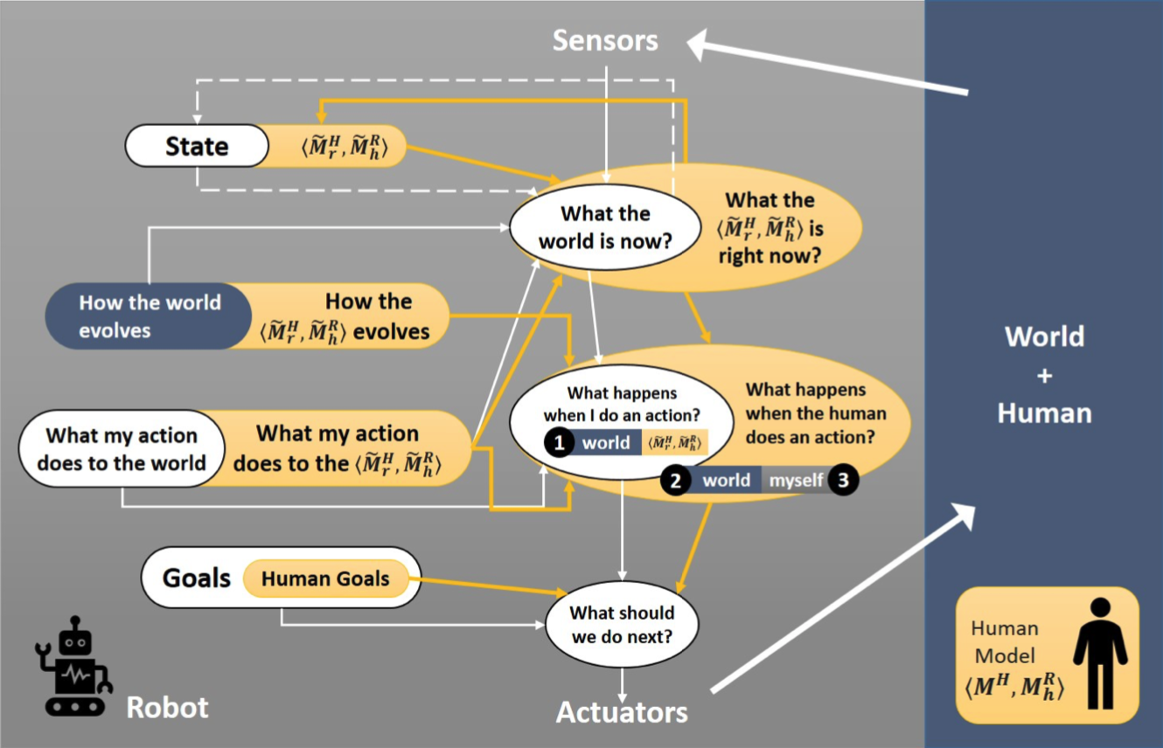
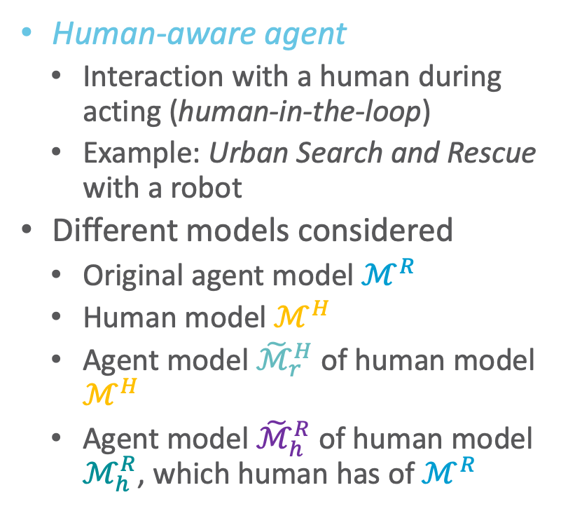
Side Note: Current Research
Human-aware agent
  Interaction with a human during acting (human-in-the-loop)
  Example: Urban Search and Rescue with a robot
Different models considered
  Original agent model $ℳ^{R}$
  Human model $ℳ^{H}$
  Agent model ${\tilde{ℳ}}_{r}^{H}$ of human model $ℳ^{H}$
  Agent model ${\tilde{ℳ}}_{h}^{R}$ of human model $ℳ_{h}^{R}$, which human has of $ℳ^{R}$
http://bit.ly/3bno2io
Notes:
Darstellung als Erweiterung des zielbasierten Agenten

Slide 45



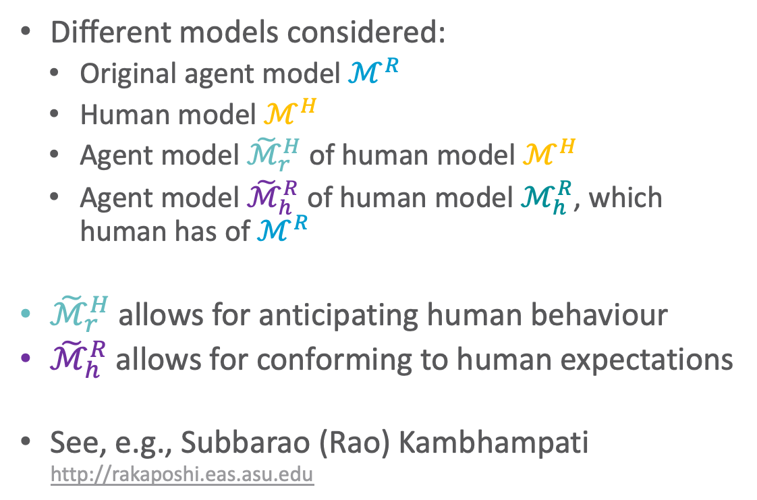


Side Note: Current Research
Different models considered:
  Original agent model $ℳ^{R}$
  Human model $ℳ^{H}$
  Agent model ${\tilde{ℳ}}_{r}^{H}$ of human model $ℳ^{H}$
  Agent model ${\tilde{ℳ}}_{h}^{R}$ of human model $ℳ_{h}^{R}$, which human has of $ℳ^{R}$
${\tilde{ℳ}}_{r}^{H}$ allows for anticipating human behaviour
${\tilde{ℳ}}_{h}^{R}$ allows for conforming to human expectations
See, e.g., Subbarao (Rao) Kambhampati
http://rakaposhi.eas.asu.edu
$${\tilde{ℳ}}_{h}^{R}$$
$${\tilde{ℳ}}_{r}^{H}$$
$$ℳ_{h}^{R}$$
$$ℳ^{H}$$
$$ℳ^{R}$$
http://bit.ly/3bno2io

Slide 46
Interim Summary
Agent = architecture + agent program
Task environment
  Description: PEAS
    Performance measure not easy to formalise
  Properties of task environment
    Fully observable (vs. partially observable); single agent (vs. multiple agents); deterministic (vs. stochastic), strategic; episodic (vs. sequential); static (vs. dynamic), semi-dynamic; discrete (vs. continuous); special: known (vs. unknown)
  Environment encoding
    Atomic, factorised, structured
Agent structure
  Simple / model-based reflex agent, goal- / utility-based agent; learning agent

Slide 47
Overview: 1. Introduction
Artificial Intelligence
  Approaches: thinking / acting humanly / rationally
Framework: Agent Theory
  Agent
  Task environment
  Agent structure
Topic: StaRAI
  Motivation, context
  Relational examples, outlook on probabilistic relational models (PRMs)

Slide 48
Take Your Spreadsheet …
Features
Objects
Kristian Kersting. Statistical Relational AI. Tutorial at KI 2018.

Slide 49

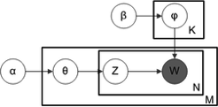
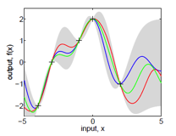
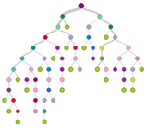
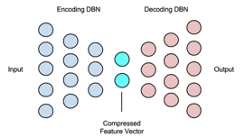
… and Apply Some AI/Machine Learning Methods
Features
Big Data Matrix Factorization
Latent Dirichlet Allocation
Is it really that simple?
Objects
Gaussian Processes
Decision Trees/Boosting
Diffusion Models
and many more …
Autoencoder, Deep Learning
Kristian Kersting. Statistical Relational AI. Tutorial at KI 2018.

Slide 50
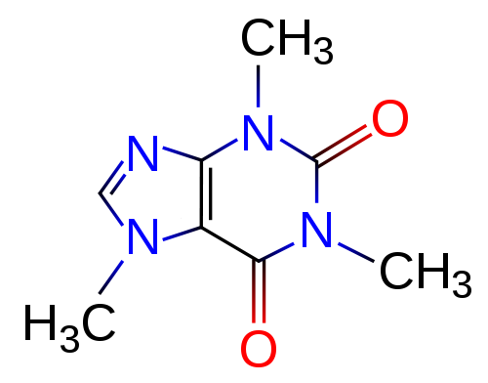

Learning and Mining with Graphs
Haussler ’99, Gärtner, Flach, Wrobel COLT’03, Vishwanathan, Schraudolph, Kondor, Borgwardt JMLR’10, Shervashidze, Schweitzer, van Leeuwen, Mehlhorn, Borgwardt JMLR’11, Neumann, Garnett, Bauckhage, Kersting MLJ’16, Morris, Kersting, Mutzel, ICDM´17, and many more
Kristian Kersting. Statistical Relational AI. Tutorial at KI 2018.

Slide 51
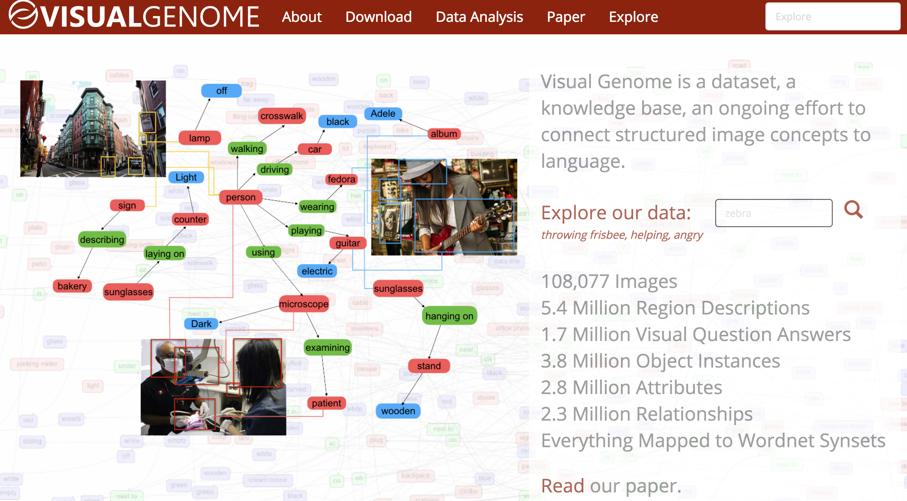
Complex data networks!
[Lu, Krishna, Bernstein, Fei-Fei „Visual Relationship Detection“ CVPR 2016]
Examples not stored in a single table but in a large, heterogenous graph with attributes!
  Actually, most data in the world is stored in relational databases
Kristian Kersting. Statistical Relational AI. Tutorial at KI 2018.

Slide 52

Heart diseases and strokes – cardiovascular disease – are expensive for the world
According to the World Heart Federation, cardiovascular disease cost the European Union €169 billion in 2003 and the USA about €310.23 billion in direct and indirect annual costs. By comparison, the estimated cost of all cancers is €146.19 billion and HIV infections, €22.24 billion
Nat Rev Genet. 2012 May 2;13(6):395-405
Electronic Health Records
A New Opportunity for AI
to Save Our Lives
Kristian Kersting. Statistical Relational AI. Tutorial at KI 2018.

Slide 53
Connection to AI, Agents, and Environments
AI: intelligent systems in the real world
The world has things in it!
The world is uncertain!
Probabilistic graphical models
First-order logic
The world is uncertain!
The world has things in it!
First-order probabilistic languages
Figure based on Stuart Russell
Notes:
Bayes nets, markov networks, factor graphs

Slide 54
Connection to AI, Agents, and Environments
AI: intelligent systems in the real world
The world has things in it!
The world is uncertain!
Probabilistic graphical models
First-order logic
The world is uncertain!
The world has things in it!
First-order probabilistic languages
Figure based on Stuart Russell
Notes:
Bayes nets, markov networks, factor graphs

Slide 55
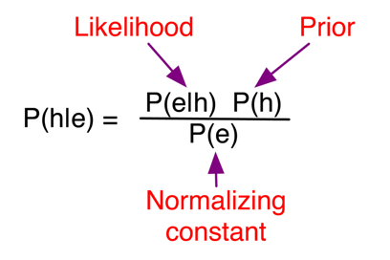
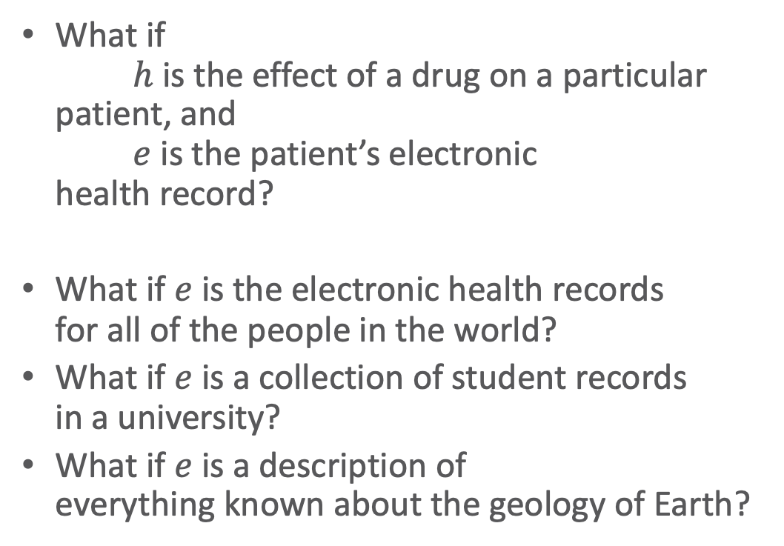
Example: Bayes’ Rule
What if
$h$ is the effect of a drug on a particular
patient, and
$e$ is the patient’s electronic
health record?
What if $e$ is the electronic health records
for all of the people in the world?
What if $e$ is a collection of student records
in a university?
What if $e$ is a description of
everything known about the geology of Earth?

Slide 56
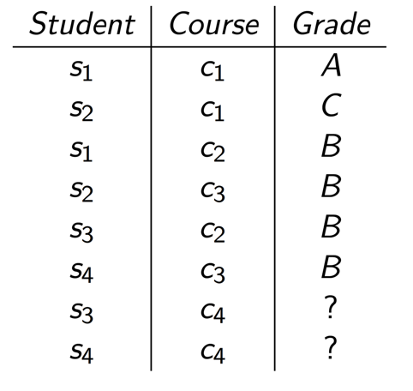
Example: Predicting Grades
Students s3 and s4 have the same averages, on courses with the same averages.
Which student would you expect to do better?

Slide 57
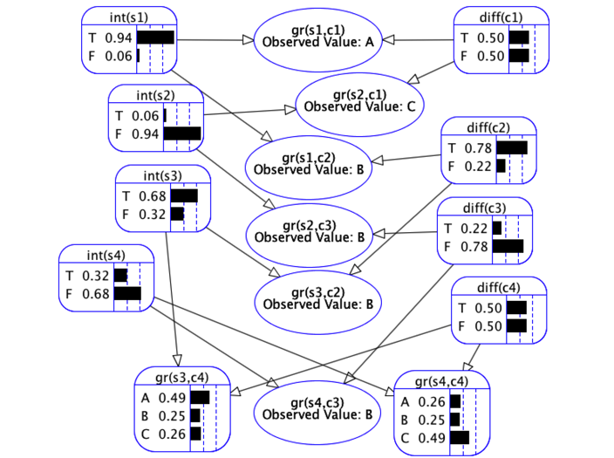

Example: Predicting Grades
Rigid and large graphical model
Available features
  Student $s$ intelligence: $Int\left(s\right)$
    Discrete (Boolean) range: $T,F$
  Course $c$ difficulty: $Diff\left(c\right)$
    Discrete (Boolean) range: $T,F$
  Student $s$ grade in course $c$: $Gr\left(s,c\right)$
    Discrete range: $A,B,C$
So, we should expect student s3 to perform better

Slide 58
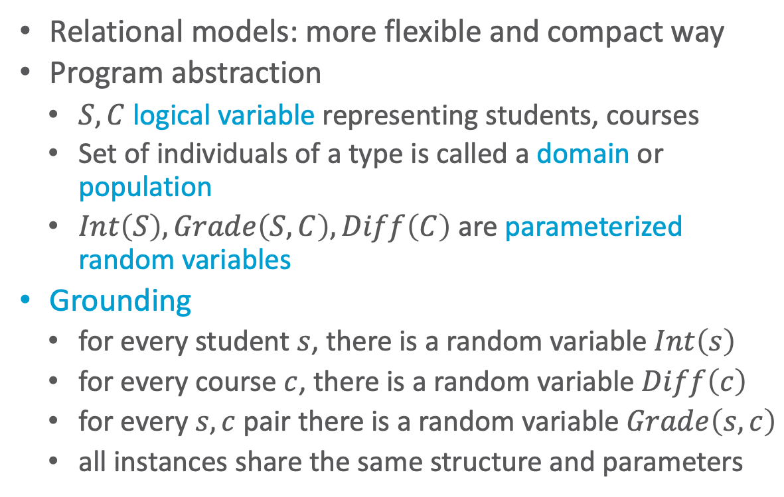
Example: Predicting Grades
Relational models: more flexible and compact way
Program abstraction
  $S,C$ logical variable representing students, courses
  Set of individuals of a type is called a domain or population
  $Int\left(S\right), Grade\left(S, C\right), Diff\left(C\right)$ are parameterized random variables
Grounding
  for every student $s$, there is a random variable $Int\left(s\right)$
  for every course $c$, there is a random variable $Diff\left(c\right)$
  for every $s,c$ pair there is a random variable $Grade\left(s,c\right)$
  all instances share the same structure and parameters
Called plate notation, plates are pictured as boxes, denoting logical variables, types, groups

Slide 59
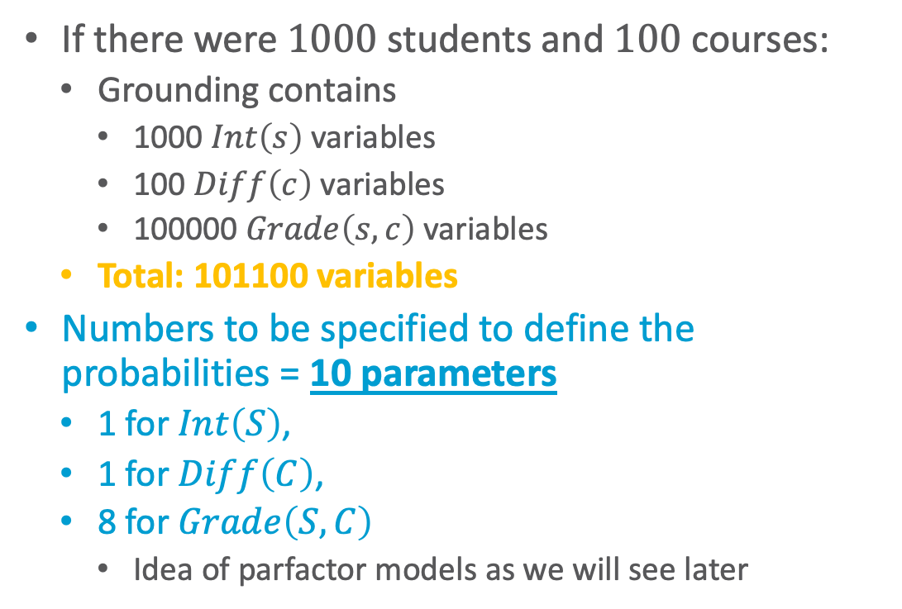

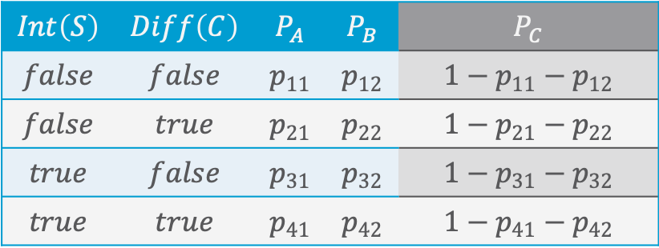
Example: Predicting Grades
If there were $1000$ students and $100$ courses:
  Grounding contains
    1000 $Int\left(s\right)$ variables
    100 $Diff\left(c\right)$ variables
    100000 $Grade\left(s,c\right)$ variables
  Total: 101100 variables
Numbers to be specified to define the probabilities = 10 parameters
  1 for $Int\left(S\right)$,
  1 for $Diff\left(C\right)$,
  8 for $Grade\left(S,C\right)$
    Idea of parfactor models as we will see later
$$P_{v}=P\left(Gr\left(S,C\right)=v | Int\left(S\right),Diff\left(C\right)\right)$$
$$Int\left(S\right)$$ | $$Diff\left(C\right)$$ | $$P_{A}$$ | $$P_{B}$$ | $$P_{C}$$
$$false$$ | $$false$$ | $$p_{11}$$ | $$p_{12}$$ | $$1−p_{11}−p_{12}$$
$$false$$ | $$true$$ | $$p_{21}$$ | $$p_{22}$$ | $$1−p_{21}−p_{22}$$
$$true$$ | $$false$$ | $$p_{31}$$ | $$p_{32}$$ | $$1−p_{31}−p_{32}$$
$$true$$ | $$true$$ | $$p_{41}$$ | $$p_{42}$$ | $$1−p_{41}−p_{42}$$
Not necessary due to probability distributions adding to 1

Slide 60
Connection to AI, Agents, and Environments
AI: intelligent systems in the real world
The world has things in it!
The world is uncertain!
Probabilistic graphical models
First-order logic
The world is uncertain!
The world has things in it!
First-order probabilistic languages
Figure based on Stuart Russell
Notes:
Bayes nets, markov networks, factor graphs

Slide 61


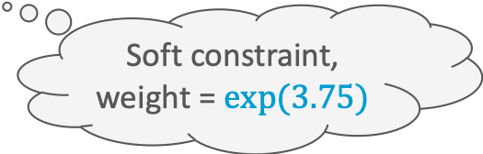

From Logics to Probabilistic Relational Models
Propositional: Descriptions about world
  Form of constraints on an environment
First-order: Objects, relations among them
  Groundings to get to propositional logic
Denote either true or false statements
Approach to soften constraints: Introduce weights to denote that statements hold to a certain degree over all possible worlds
  Example: Markov Logic Network
    We will see more of them later
$$Presents⇒Attends$$
$$Presents\left(eve,paper1,IJCAI\right)⇒Attends\left(eve,IJCAI\right)$$
Hard constraint
$$∞ Presents\left(X, P, C\right)⇒Attends\left(X, C\right)$$
$$Presents\left(X, P, C\right)⇒Attends\left(X, C\right)$$
$$3.75 Publishes\left(X, C\right)∧FarAway\left(C\right)⇒Attends\left(X, C\right)$$
Soft constraint,
weight = $exp⁡(3.75)$

Slide 62
Connection to AI, Agents, and Environments
AI: intelligent systems in the real world
The world has things in it!
The world is uncertain!
Probabilistic graphical models
First-order logic
The world is uncertain!
The world has things in it!
First-order probabilistic languages
One way of looking at it:
Statistical Relational AI
Probabilistic relational models
Figure based on Stuart Russell
Notes:
Bayes nets, markov networks, factor graphs

Slide 63

Probabilistic Relational Models (PRMs)
Random variables for combinations of individuals in populations
  Build a probabilistic model before knowing (all of) the individuals
  Learn the model for one set of individuals
  Apply the model to existing and new individuals
  Allow complex relationships between individuals
Exchangeability:
  Before we know anything about individuals, they are indistinguishable, and so should be treated identically.
Uncertainty about:
  Properties of individuals
  Relationships among individuals
  Identity (equality) of individuals
  Existence (and number) if individuals
Depicted formalisms: Parfactor graphs, Markov logic networks
$$∞ Presents\left(X, P, C\right)⇒Attends\left(X, C\right)$$
$$3.75 Publishes\left(X, C\right)∧FarAway\left(C\right)⇒Attends\left(X, C\right)$$

Slide 64
PRMs for Modelling the Environment in this Lecture
Different types of PGMs for a (relational) factorised representation of the environment and decision making
Possible to model environment with following properties
  Fully or partially observable
  Single agent
  Stochastic
  Episodic or sequential
  Static
  Discrete or continuous
Not considered in this lecture
  Multiple agents
  Deterministic, strategic
  Dynamic
Approaches exist to deal with such environments to a certain degree
Attention: In the PGM literature, the notions of static and dynamic are used instead of the notions of episodic and sequential, while the notions of static and dynamic are covered by the so-called Markov assumption or (Non-) Markovian abstraction
S. Russel and P. Norvig: Artificial Intelligence – A Modern Approach, 2020.

Slide 65
The Larger Scope: Statistical Relational Learning (SRL) & StaRAI
Study and design
  intelligent agents
  that reason about and
  act in noisy worlds
  composed of objects and relations among the objects
…
Optimization
SAT
Uncertainty
Scaling
IR
Logic
Graphs
Trees
Mining
And
Learning
KR
CV
Search
DM/ML
[Getoor, Taskar MIT Press ’07; De Raedt, Frasconi, Kersting, Muggleton, LNCS’08; Domingos, Lowd Morgan Claypool ’09; Natarajan, Kersting, Khot, Shavlik Springer Brief’15; Russell CACM 58(7): 88-97 ’15, Gogate, Domingos CACM 59(7):107-115 ´16]
Kristian Kersting. Statistical Relational AI. Tutorial at KI 2018.

Slide 66





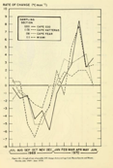

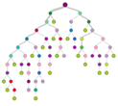
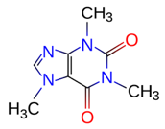




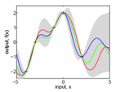





This Establishes a Novel “Deep AI”
Data and Feature
Programming
Declarative AI Programming
Symbolic-Numerical
Reasoning
(Un-)structured
and heterogenous
data sources
Statistical AI
Knowledge Base
(data, weighted rules, loops and data structures)
Inference
Results
Graph Kernels
Diffusion Processes
Random Walks
Decision Trees
Frequent Itemsets
SVMs
Graphical Models
Topic Models
Gaussian Processes
Deep Networks
Autoencoder
Matrix and Tensor
Factorization
Reinforcement Learning
…
[Ré, Sadeghian, Shan, Shin, Wang, Wu, Zhang IEEE Data Eng. Bull.’14; Natarajan, Picado, Khot, Kersting, Ré, Shavlik ILP’14; Natarajan, Soni, Wazalwar, Viswanathan, Kersting Solving Large Scale Learning Tasks’16, Mladenov, Heinrich, Kleinhans, Gonsior, Kersting DeLBP’16, Kordjamshidi, Roth, Kersting IJCAI-ECAI 2018, …]
p
Representation
Learning
0.9
Model Rules and
Domain Knowledge
AI and ML
Algorithms
External Databases
0.6
Features and Data Rules
Features and Rules
Feedback/AutoAI
Kristian Kersting. Statistical Relational AI. Tutorial at KI 2018.

Slide 67
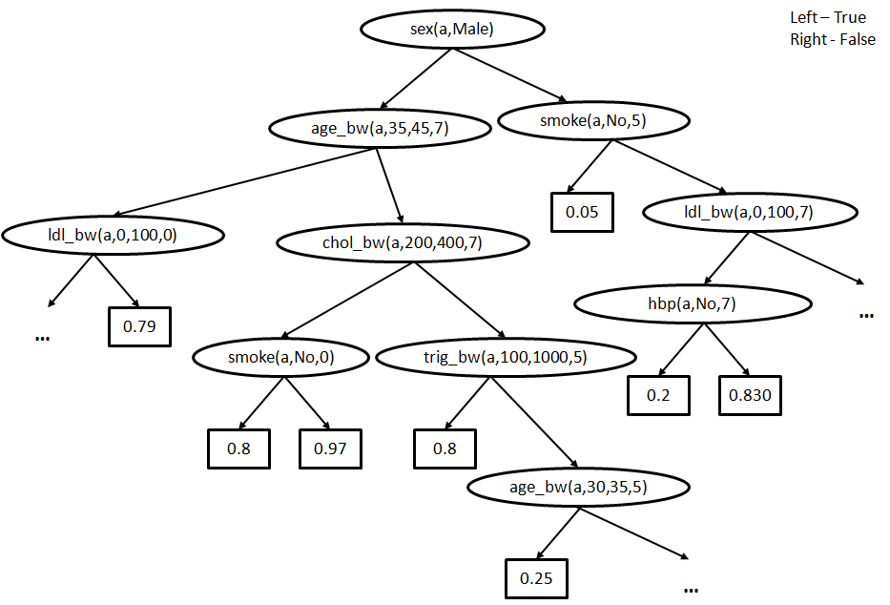
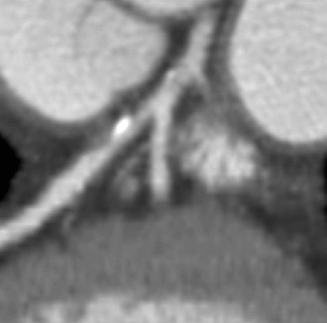
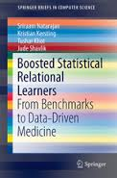
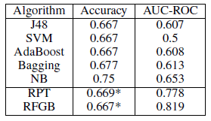
This “Deep AI” Can Understand EHRs
Atherosclerosis is the cause of the majority of Acute Myocardial Infarctions (heart attacks)
Logical Variables (Abstraction)
[Circulation; 92(8), 2157-62, 1995; JACC; 43, 842-7, 2004]
We will come back to this later in the lecture.
Rule/Database view
Plaque in the left
coronary artery
Probability
The higher, the better
Natarajan, Khot, Kersting, Shavlik. Boosted Statistical Relational Learners. Springer Brief 2015
[Kersting, Driessens ICML´08; Karwath, Kersting, Landwehr ICDM´08; Natarajan, Joshi, Tadepelli, Kersting, Shavlik. IJCAI´11; Natarajan, Kersting, Ip, Jacobs, Carr IAAI `13; Yang, Kersting, Terry, Carr, Natarajan AIME ´15; Khot, Natarajan, Kersting, Shavlik ICDM´13, MLJ´12, MLJ´15]
25%
Algorithm for Mining Markov Logic Networks | Likelihood The higher, the better | AUC-ROC The higher, the better | AUC-PR The higher, the better | Time The lower, the better
Boosting | 0.81 | 0.96 | 0.93 | 9s
LSM | 0.73 | 0.54 | 0.62 | 93 hrs
11%
78%
50%
37200x
faster
Kristian Kersting. Statistical Relational AI. Tutorial at KI 2018.
Notes:
Heart attacks: male more likely to have heart attack, changes with marriage

Slide 68
Heart diseases and strokes – cardiovascular disease – are expensive for the world
According to the World Heart Federation, cardiovascular disease cost the European Union €169 billion in 2003 and the USA about €310.23 billion in direct and indirect annual costs. By comparison, the estimated cost of all cancers is €146.19 billion and HIV infections, €22.24 billion
Nat Rev Genet. 2012 May 2;13(6):395-405
Human-centred approaches needed to ensure ethical behaviour, transparent reasoning, explainable results, privacy, …
Electronic Health Records
A New Opportunity for AI
to Save Our Lives
Kristian Kersting. Statistical Relational AI. Tutorial at KI 2018.

Slide 69
Interim Summary
Environment characterised by
  Objects and relations between them
  Uncertainty
PRMs combine both logic and probability theory
  Models covered here can model the following environment properties
    Fully or partially observable
    Single agent
    Stochastic
    Episodic or sequential
    Static
    Discrete or continuous

Slide 70
Contents
Introduction
  Artificial intelligence
  Agent framework
  StaRAI: context, motivation
Foundations
  Logic
  Probability theory
  Probabilistic graphical models (PGMs)
Probabilistic Relational Models (PRMs)
  Parfactor models, Markov logic networks
  Semantics, inference tasks
Lifted Inference
  Exact inference
  Approximate inference, specifically sampling
Lifted Learning
  Parameter learning
  Relation learning
  Approximating symmetries
Lifted Sequential Models and Inference
  Parameterised models
  Semantics, inference tasks, algorithm
Lifted Decision Making
  Preferences, utility
  Decision-theoretic models, tasks, algorithm
Continuous Space and Lifting
  Lifted Gaussian Bayesian networks (BNs)
  Probabilistic soft logic (PSL)

Slide 71
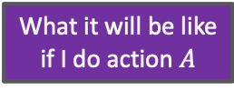
Contents in this Lecture Related to Utility-based Agents
Further topics
  (Episodic) PRMs
  Lifted inference (in episodic PRMs)
  Lifted learning (of episodic PRMs)
  Lifted sequential PRMs and inference
  Lifted decision making
  Continuous space and lifting
Agent
Environment
Sensors
State
What the world
is like now
How the world evolves
What my actions do
What it will be like
if I do action $A$
Utility
How happy I will be
in such a state
What action I
should do now
Actuators

Slide 72
Overview: 1. Introduction
Artificial Intelligence
  Approaches: thinking / acting humanly / rationally
Framework: Agent Theory
  Agent
  Task environment
  Agent structure
Topic: StaRAI
  Motivation, context
  Relational examples, outlook on probabilistic relational models (PRMs)
➝ Foundations: Logic, Probability Theory, & PGMs

