Slide 1
Foundations: Probability Theory
$$R_{1}$$ | $$R_{2}$$ | $$P(R_{1},R_{2})$$
$$1$$ | $$1$$ | $$P\left(\left\{2\right\}\right)= \frac{1}{6}$$
$$1$$ | $$0$$ | $$P\left(\left\{3, 5\right\}\right)= \frac{2}{6}$$
$$0$$ | $$1$$ | $$P\left(\left\{4, 6\right\}\right)= \frac{2}{6}$$
$$0$$ | $$0$$ | $$P\left(\left\{1\right\}\right)= \frac{1}{6}$$
$$P\left(R_{1},R_{2}\right)=P\left(R_{1}\right)⋅P\left(R_{2} \right| R_{1})$$
Statistical Relational Artificial Intelligence (StaRAI)
$$P\left(R_{1}\right)=\sum_{r_{2}∈{Val(R}_{2})}{P(R_{1},{R_{2}=r}_{2})}$$
$$P\left(R_{1} | R_{2}\right)= \frac{P\left(R_{2} \right| R_{1})⋅P(R_{1})}{P(R_{2})}$$
Sagad Hamid

Slide 2
Contents
Introduction
Artificial intelligence
Agent framework
StaRAI: context, motivation
Foundations
Logic
Probability theory
Probabilistic graphical models (PGMs)
Probabilistic Relational Models (PRMs)
Parfactor models, Markov logic networks
Semantics, inference tasks
Lifted Inference
Exact inference
Approximate inference, specifically sampling
Lifted Learning
Parameter learning
Relation learning
Approximating symmetries
Lifted Sequential Models and Inference
Parameterised models
Semantics, inference tasks, algorithm
Lifted Decision Making
Preferences, utility
Decision-theoretic models, tasks, algorithm
Continuous Space and Lifting
Lifted Gaussian Bayesian networks (BNs)
Probabilistic soft logic (PSL)

Slide 3
Overview: 2. Foundations
Logic
Propositional logic: alphabet, grammar, normal forms, rules
First-order logic: introducing quantifiers, domain constraints
Probability theory
Modelling: (conditional) probability distributions, random variables, marginal and joint distributions
Inference: axioms and basic rules, Bayes theorem, independence
Probabilistic graphical models
Syntax, semantics
Inference problems

Slide 4
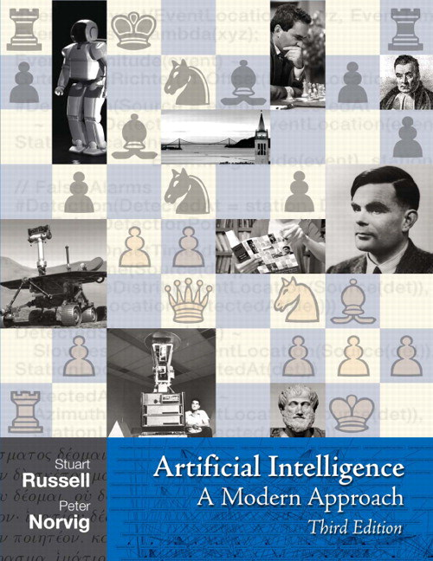
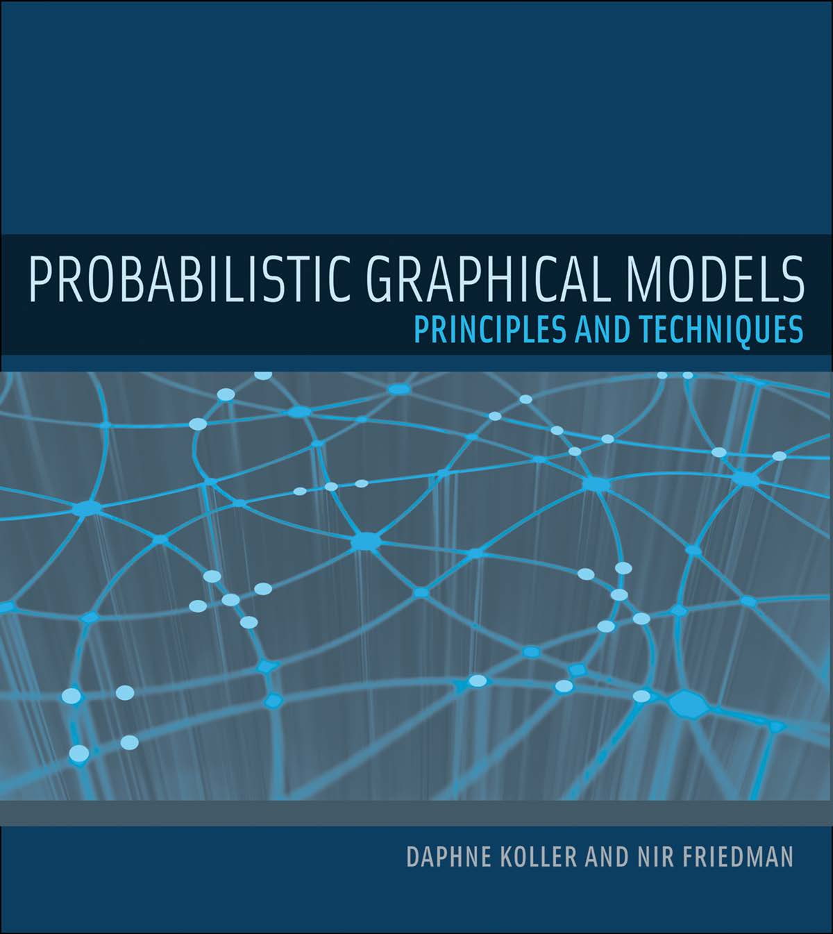
Sources
Content of the slides mainly based on the following books:

Slide 5
Motivation
Acting & Making decisions in environments with uncertainty
e.g., partially observable environment
Reasoning under uncertainty
Knowledge required about what is possible and what is probable
Framework of probability theory:
Defines possible outcomes and events
Assigns probabilities to them
Allows for calculating specific probabilities
Allows for including observations and „updating“ probabilities

Slide 6
Sample & Event Space
Sample Space
Set of possible outcomes, denoted by $Ω$
Arbitrary, non-empty set
Event Space
Set of measurable events $S$ with $α⊆Ω, α∈S$
$α$ called event
Set of subsets of $Ω$
Probabilities will be assigned to the elements of S
Properties:
$∅∈S, Ω∈S$
$α,β∈S⇒a∪β∈S$ (closed under union)
$α∈S⇒Ω\backslash α∈S$(closed under complementation)
Discrete Case: Often $𝒫(Ω)$, the power set of $Ω$

Slide 7
Probability Distribution
For a sample space $Ω$ and a corresponding event space $S$:
A probability distribution $P$ over $(Ω,S)$ is a function $P:S→ ℝ$ satisfying the following conditions:
$∀ α∈S: P\left(α\right)≥0$
$P\left(Ω\right)=1$
$α,β∈S$and$α∩β=∅⇒P\left(α∪β\right)=P\left(α\right)+P(β)$
Each value represents the probability for the corresponding event
If each possible outcome in $Ω$ has the same probability:
$∀α∈S: P(α) = \left|α\right|⋅\frac{1}{\left|Ω\right|}=\frac{|α|}{|Ω|}$
$$\sum_{ω∈Ω}{P\left(\left\{ω\right\}\right)=1}$$

Slide 8
Example - (Fair) Dice Roll
Sample space $Ω=\{1, 2, 3, 4, 5, 6\}$
Event space $S= 𝒫\left(Ω\right)=\{∅, \left\{1\right\}, \left\{2\right\},…, \left\{1, 2\right\}, \left\{1, 3\right\},…,\{1, 2, 3, 4, 5, 6\}\}$
Probability for an even number:
$P\left(even\right)=P\left(\left\{2, 4, 6\right\}\right)=P\left(\left\{2\right\}\right)+P\left(\left\{4\right\}\right)+P\left(\left\{6\right\}\right)= \frac{1}{6}+ \frac{1}{6}+\frac{1}{6}=\frac{3}{6}$
Probability for a number greater than 1:
$P\left(greaterOne\right)=P\left(\left\{2, 3, 4, 5, 6\right\}\right)=1 −P\left(\left\{1\right\}\right)=1 −\frac{1}{6}=\frac{5}{6}$
Probability for a number greater than 1 and prime:
$P\left(greaterOne∧prime\right)=P\left(\left\{2, 3, 4, 5, 6\right\}∩\left\{2, 3, 5\right\}\right)=P\left(\left\{2, 3, 5\right\}\right)=\frac{3}{6}$
Probability for a number greater than 3 or prime:
$P\left(greaterThree∨prime\right)= P\left(\left\{4, 5, 6\right\}∪\left\{2, 3, 5\right\}\right)=P\left(\{4, 5, 6\}\right)+P\left(\left\{2, 3, 5\right\}\right)−P\left(\left\{5\right\}\right)$
$$∀ω∈Ω: P\left(\left\{ω\right\}\right)= \frac{1}{6}=\frac{1}{|Ω|}$$

Slide 9
Conditional Probability Distribution
For two events $α,β∈S$, the conditional probability of $β$ given $α$ is defined as:
$P\left(β \right| α)= \frac{P(α∩β)}{P(α)}$
Requires $P\left(α\right)>0$
Note: $P\left(β \right| α) ≠P\left(α \right| β)$
$P\left(β \right| α)= \frac{P(α∩β)}{P(α)}\text{≠}\frac{P(α∩β)}{P(β)}=P\left(α \right| β)$
The probabilities are getting “updated” according to the observations
Still satisfies the properties of a probability distribution
Conditioning Operation: Takes a probability distribution, returns a probability distribution

Slide 10
Example - (Fair) Dice Roll
Observation: An even number was rolled
But we don‘t know the actual number
What is the probability for an odd number? What is the probability for a number less than 5?
$α=\{2, 4, 6\}$
$β_{1}=\{1, 3, 5\}$
$β_{2}=\{1, 2, 3, 4\}$
$P\left(odd \right| even)=P\left(β_{1} \right| α)=\frac{P(∅)}{P(α)}=0$
$P\left(lessFive \right| even)=P\left(β_{2} \right| α)= \frac{P(\{2, 4\})}{P(α)}= \frac{2}{3}$

Slide 11
Chain Rule & Bayes Theorem
From the definition of the conditional probability we can derive the product rule
$P\left(α∩β\right)=P\left(α\right)⋅P\left(β \right| α)$ for two events $α, β∈S$
The generalisation for $k$ events is known as the chain rule
$P\left(α_{1}∩…∩a_{k}\right)=P\left(α_{1}\right)⋅P\left(α_{2} \right| α_{1})⋯ P(α_{k} | α_{1}∩…∩α_{k−1})$ for events $α_{1},…,α_{k}∈S$
Order of events does not change the result
The chain rule allows for expressing a probability by means of a product of multiple (conditional) probabilities
Another rule we can derive is the Bayes theorem
$P\left(α \right| β)= \frac{P\left(β \right| α)⋅P(α)}{P(β)}$ for $α,β∈S$
Allows for calculating $P\left(α \right| β)$ using the „inverse“ conditional probability $P\left(β \right| α)$

Slide 12
(Discrete) Random Variable
A random variable is a function $R:Ω→D$
$D$ is the domain of the random variable $R$ which we will denote by $Val(R)$
Represents attributes of the elements in the sample space
Example: Rolling two (fair) dice and considering the sum of the numbers
$Ω=\left\{\left(1,1\right),\left(1, 2\right), …, \left(6, 5\right),\left(6, 6\right)\right\}$with $P\left(ω\right)=\frac{1}{36}$
Possible Sums: $D=\{2, 3, …, 12\}$
We define a random variable R$:Ω→D$ with $\left(a,b\right)↦a+b, \left(a,b\right)∈Ω$
Each $r∈Val(R)$ represents an event in the underlying event space
E.g., $P\left(R=3\right)=P\left(\left\{\left(1, 2\right),\left(2,1\right)\right\}\right)=P\left(\left\{\left(1, 2\right)\right\}\right)+P\left(\left\{\left(2, 1\right)\right\}\right)= \frac{2}{36}$
The distribution of a random variable satisfies the properties of a probability distribution
If context is known, we use the shorthand notation $P\left(r\right)$ for $P(R=r)$, $r∈Val(R)$

Slide 13
(Full) Joint Distribution
Given a set of $n$ random variables $R=\{R_{1},…,R_{n}\}$
A (full) joint distribution $P(R)$ over the random variables $R$ is a probability distribution which assigns a probability $P(R_{1}=r_{1}, …,R_{n}=r_{n})$ to every possible assignment to the random variables in $R$
Each possible assignment to the random variables $R$ represents an event
Example: (Fair) Dice Roll
We define two random variables $R_{1},R_{2}$
$R_{1}:$ Rolling a prime number
$R_{2}$: Rolling an even number
$$R_{1}$$ | $$R_{2}$$ | $$P(R_{1},R_{2})$$
$$1$$ | $$1$$ | $$P\left(\left\{2\right\}\right)= \frac{1}{6}$$
$$1$$ | $$0$$ | $$P\left(\left\{3, 5\right\}\right)= \frac{2}{6}$$
$$0$$ | $$1$$ | $$P\left(\left\{4, 6\right\}\right)= \frac{2}{6}$$
$$0$$ | $$0$$ | $$P\left(\left\{1\right\}\right)= \frac{1}{6}$$
$$Val\left(R_{1}\right)=Val\left(R_{2}\right)=\{0, 1\}$$

Slide 14
Marginal Distribution
Given a full joint distribution $P(R)$ over random variables $R$, it is possible to obtain the distribution for a subset of random variables $R^{′}⊂R$ by summing over the possible assignments $r^{′}∈Val(R^{′})$ to the random variables $R′$
Example for $R=\{R_{1}, R_{2}\}$:
$P\left(R_{1}\right)=\sum_{r_{2}∈Val(R_{2})}{P(R_{1}, R_{2}=r_{2})}$
Summing out $R_{2}$
Also called marginalisation
$P\left(R_{1}\right)$ is called the marginal distribution of $R_{1}$
$$R_{1}$$ | $$R_{2}$$ | $$P(R_{1},R_{2})$$
$$1$$ | $$1$$ | $$\frac{1}{6}$$
$$1$$ | $$0$$ | $$\frac{2}{6}$$
$$0$$ | $$1$$ | $$\frac{2}{6}$$
$$0$$ | $$0$$ | $$\frac{1}{6}$$
$$R_{1}$$ | $$P(R_{1})$$
$$1$$ | $$\frac{1}{2}$$
$$0$$ | $$\frac{1}{2}$$
+
+

Slide 15
Conditional Distributions over Random Variables
Similar to conditional distributions over events, it is possible to define the conditional distribution over random variables:
$P\left(R_{1} \right| R_{2})=\frac{P(R_{1}, R_{2})}{P(R_{2})}$
Represents a set of conditional probability distributions
Each assignment $r_{2}∈{Val(R}_{2})$ to the random variable $R_{2}$ yields a conditional probability distribution $P\left(R_{1} \right| R_{2}=r_{2})$
An additional assignment $r_{1}∈{Val(R}_{1})$ to the random variable $R_{1}$ yields the probability $P\left(R_{1}=r_{1} \right| R_{2}=r_{2})$ for a specific event in the underlying event space
$P\left(R_{1},R_{2}\right)=P\left(R_{1}\right)⋅P\left(R_{2} \right| R_{1})$ (product rule)
$P\left(R_{1}, …, R_{k}\right)=P\left(R_{1}\right)⋅P\left(R_{2} \right| R_{1})⋯P(R_{k} \left| R_{1},…,R_{k−1}\right)$ (chain rule)
$P\left(R_{1} \right| R_{2})= \frac{P\left(R_{2} \right| R_{1})⋅P\left(R_{1}\right)}{P(R_{2})}$ (Bayes theorem)

Slide 16
Example – Multiplying (Conditional) Distributions
$P\left(R_{1},R_{2}\right)=P\left(R_{1}\right)⋅P\left(R_{2} \right| R_{1})$ (product rule)
Multiply corresponding entries
$$R_{1}$$ | $$R_{2}$$ | $$P(R_{1},R_{2})$$
$$1$$ | $$1$$ | $$\frac{1}{6}$$
$$1$$ | $$0$$ | $$\frac{2}{6}$$
$$0$$ | $$1$$ | $$\frac{2}{6}$$
$$0$$ | $$0$$ | $$\frac{1}{6}$$
$$R_{1}$$ | $$R_{2}$$ | $$P\left(R_{2} \right| R_{1})$$
$$1$$ | $$1$$ | $$\frac{P(R_{1}=1, R_{2}=1)}{P(R_{1})}=\frac{1}{3}$$
$$1$$ | $$0$$ | $$\frac{P(R_{1}=1, R_{2}=0)}{P(R_{1}=1)}=\frac{2}{3}$$
$$0$$ | $$1$$ | $$\frac{P(R_{1}=0, R_{2}=1)}{P(R_{1}=0)}=\frac{2}{3}$$
$$0$$ | $$0$$ | $$\frac{P(R_{1}=0, R_{2}=0)}{P(R_{1}=0)}=\frac{1}{3}$$
$$R_{1}$$ | $$P(R_{1})$$
$$1$$ | $$\frac{1}{2}$$
$$0$$ | $$\frac{1}{2}$$
$$P\left(R_{2} \right| R_{1}=1)$$
$$=$$
$$⋅$$
$$P\left(R_{2} \right| R_{1}=0)$$

Slide 17
Independence
Independence denoted by ⊥:
Events: $α⊥β$
RVs: $R_{1}⊥R_{2}$
Two events $α, β∈S$ are independent if
$P\left(α∩β\right)=P\left(α\right)⋅P(β)$
Two events $α, β∈S$ are conditionally independent given a third event $γ∈S$ if
$P\left(α \right| β∩γ)=P\left(α | γ\right)$
(or equivalent) $P\left(α∩β \right| γ)=P\left(α \right| γ)⋅P\left(β \right| γ)$
Two random variables $R_{1}, R_{2}$ are independent if
$P\left(R_{1},R_{2}\right)=P\left(R_{1}\right)⋅P(R_{2})$
Two random variables $R_{1},R_{2}$ are conditionally independent given a third one $R_{3}$if
$P\left(R_{1}\right| R_{2}, R_{3})=P\left(R_{1} | R_{3}\right)$
(or equivalent) $P\left(R_{1},R_{2} \right| R_{3})=P\left(R_{1} \right| R_{3})⋅P\left(R_{2} \right| R_{3})$
Conditional independence is a generalisation of independence
Implies $P\left(α \right| β)=P(α)$
Implies $P\left( R_{1}\right| R_{2})=P(R_{1})$

Slide 18
Example - Independence
Assume the following joint distribution $P\left(R_{1}, R_{2}\right)$ over random variables $R_{1},R_{2}$
Product rule without independence: $P\left(R_{1},R_{2}\right)=P\left(R_{1}\right)⋅P\left(R_{2} \right| R_{1})$
Product rule with independence: $P\left(R_{1}, R_{2}\right)=P\left(R_{1}\right)⋅P(R_{2})$
$$R_{1}$$ | $$R_{2}$$ | $$P(R_{1},R_{2})$$
$$1$$ | $$1$$ | $$\frac{1}{4}$$
$$1$$ | $$0$$ | $$\frac{1}{4}$$
$$0$$ | $$1$$ | $$\frac{1}{4}$$
$$0$$ | $$0$$ | $$\frac{1}{4}$$
$$R_{1}$$ | $$P(R_{1})$$
$$1$$ | $$\frac{1}{2}$$
$$0$$ | $$\frac{1}{2}$$
$$R_{2}$$ | $$P(R_{2})$$
$$1$$ | $$\frac{1}{2}$$
$$0$$ | $$\frac{1}{2}$$
$P\left(R_{2} \right| R_{1})$ has $2⋅2=4$ entries
$P\left(R_{2}\right)$ has $2$ entries
More efficiency through independence
$$=$$
$$⋅$$

Slide 19
Probability Query
Inference: Use joint distribution $P(R)$ over a set random variables $R$ to answer queries of interest
Probability queries:
$P\left(R′\right)$for $R′⊆R$ (marginal probability distribution)
or $P(R^{′}=r′)$ for $r^{′}∈Val(R′)$ (marginal probability)
$P\left(R′\right| E=e)$ for $R^{′}⊆R, E⊆R\backslash R^{′}, e∈Val(E)$ (conditional marginal probability distribution)
or $P\left(R^{′}=r′\right| E=e)$ for $r^{′}∈Val(R^{′}), e∈Val(E)$ (conditional marginal probability)
$R′$ called query variables, $e$ called evidence
There are also other types of queries
MPE queries
MAP queries
…

Slide 20
Probability Query
Given joint distribution $P(R)$ over a set random variables $R$
Query answering: Sum out all random variables which are not in the query
Example: $P(R_{1}, R_{2}, R_{3})$
Query: $P(R_{3})$
Remaining random variables: $\left\{R_{1}, R_{2}\right\}$
Summing out remaining random variables: $P\left(R_{3}\right)= \sum_{r_{1}∈Val(R_{1})}{\sum_{r_{2}∈Val(R_{2})}{P(R_{1}=r_{1},R_{2}=r_{2},R_{3})}}$
In general: Size of a joint distribution is exponential in the number of random variables
e.g., for $n$ random variables $R_{1},…,R_{n}$ with $\left|Val\left(R_{i}\right)\right|=2$, $P(R_{1},…,R_{n})$ contains $2^{n}$ probabilities
For $n=30$we have $2^{30}=1.073.741.824$ probabilities
Due to the exponential growth: Explicit representation of $P\left(R\right)$ too large for query answering
Outlook probabilistic graphical models: exploit factorisation (represent $P\left(R\right)$ as a product of multiple distributions) and independencies for (more) efficient query answering

Slide 21
Interim Summary
Modelling:
Sample space and event space
Probability distribution: assign probabilities to events
Conditional probability distribution: incorporating observations
Random variables, joint and marginal distributions
Assignments of random variables correspond to events in the underlying event space
Inference and query answering:
Product rule, chain rule, Bayes theorem
Marginalisation / Sum out of random variables
(Conditional) independence
Probability query: Sum out non-query random variables

Slide 22
Overview: 2. Foundations
Logic
Propositional logic: alphabet, grammar, normal forms, rules
First-order logic: introducing quantifiers, domain constraints
Probability theory
Modelling: (conditional) probability distributions, random variables, marginal and joint distributions
Inference: axioms and basic rules, Bayes theorem, independence
Probabilistic graphical models
Syntax, semantics
Inference problems

