Slide 1





















Lifted Inference:
Exact Inference
$$3^{2}$$
$$3^{2}$$
$$∀X \\ X∈\text{People}$$
$$.^{\left|\text{People}\right|}$$
Statistical Relational Artificial Intelligence
(StaRAI)
$$3$$
$$26$$
$$∨$$
$$+$$
$$2$$
$$24$$
$$∧$$
$$∙$$
$$2$$
$$1$$
$$4$$
$$2$$
$$∨$$
$$∧$$
$$+$$
$$∙$$
$$c\left(X\right)$$
$$s\left(X\right)$$
$$¬s\left(X\right)$$
$$¬c\left(X\right)$$
$$6$$
$$3$$
$$1$$
$$2$$
$$∀X∈\text{People} :smokes\left(X\right)⇒cancer\left(X\right)$$
Tanya Braun

Slide 2
Contents
Introduction
  Artificial intelligence
  Agent framework
  StaRAI: context, motivation
Foundations
  Logic
  Probability theory
  Probabilistic graphical models (PGMs)
Probabilistic Relational Models (PRMs)
  Parfactor models, Markov logic networks
  Semantics, inference tasks
Lifted Inference
  Exact inference
  Approximate inference, specifically sampling
Lifted Learning
  Parameter learning
  Relation learning
  Approximating symmetries
Lifted Sequential Models and Inference
  Parameterised models
  Semantics, inference tasks, algorithm
Lifted Decision Making
  Preferences, utility
  Decision-theoretic models, tasks, algorithm
Continuous Space and Lifting
  Lifted Gaussian Bayesian networks (BNs)
  Probabilistic soft logic (PSL)

Slide 3
Outline: 4. Lifted Inference
Exact Inference
  Lifted Variable Elimination for Parfactor Models
    Idea, operators, algorithm, complexity
  Lifted Junction Tree Algorithm
    Idea, helper structure: junction tree, algorithm
  First-order Knowledge Compilation for MLNs
    Idea, helper structure: circuit, algorithm
Approximate Inference: Sampling
  Direct sampling: Rejection sampling, (lifted) importance sampling
  (Lifted) Markov Chain Monte Carlo sampling

Slide 4
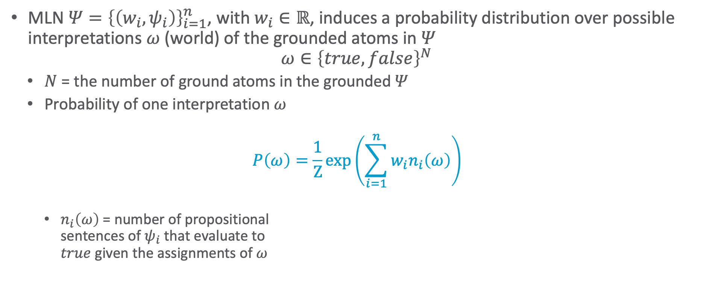

MLNs: Semantics
MLN $Ψ={\left\{\left(w_{i},ψ_{i}\right)\right\}}_{i=1}^{n}$, with $w_{i}∈ℝ$, induces a probability distribution over possible interpretations $ω$ (world) of the grounded atoms in $Ψ$
$ω∈{\left\{true,false\right\}}^{N}$
  $N$ = the number of ground atoms in the grounded $Ψ$
  Probability of one interpretation $ω$
  $$P\left(ω\right)=\frac{1}{Z}exp\left(\sum_{i=1}^{n}{w_{i}n_{i}\left(ω\right)}\right)$$
    $n_{i}\left(ω\right)$ = number of propositional
    sentences of $ψ_{i}$ that evaluate to
    $true$ given the assignments of $ω$
$$10 Presents\left(X, P, C\right)⇒Attends\left(X, C\right)$$
$$3.75 Publishes\left(X, C\right)∧FarAway\left(C\right)⇒Attends\left(X, C\right)$$

Slide 5
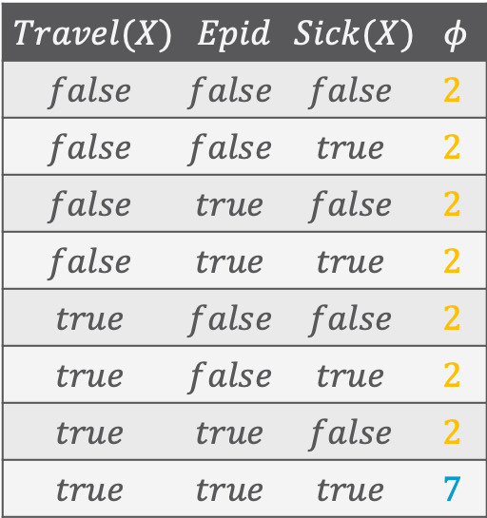
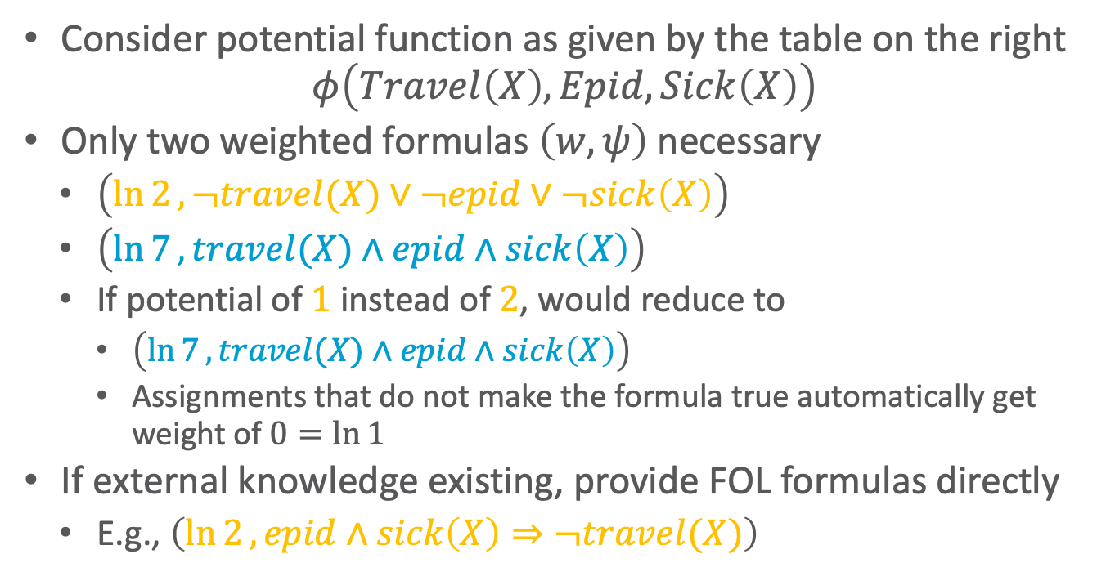
Local Symmetries and Structure
Consider potential function as given by the table on the right
$$φ\left(Travel\left(X\right),Epid,Sick\left(X\right)\right)$$
Only two weighted formulas $\left(w,ψ\right)$ necessary
  $\left(\ln{2}, ¬travel(X)∨¬epid∨¬sick\left(X\right)\right)$
  $\left(\ln{7}, travel(X)∧epid∧sick\left(X\right)\right)$
  If potential of $1$ instead of $2$, would reduce to
    $\left(\ln{7}, travel(X)∧epid∧sick\left(X\right)\right)$
    Assignments that do not make the formula true automatically get weight of $0=\ln{1}$
If external knowledge existing, provide FOL formulas directly
  E.g., $\left(\ln{2}, epid∧sick\left(X\right)⇒¬travel(X)\right)$
Use for efficient inference
$$Travel(X)$$ | $$Epid$$ | $$Sick(X)$$ | $$φ$$
$$false$$ | $$false$$ | $$false$$ | $$2$$
$$false$$ | $$false$$ | $$true$$ | $$2$$
$$false$$ | $$true$$ | $$false$$ | $$2$$
$$false$$ | $$true$$ | $$true$$ | $$2$$
$$true$$ | $$false$$ | $$false$$ | $$2$$
$$true$$ | $$false$$ | $$true$$ | $$2$$
$$true$$ | $$true$$ | $$false$$ | $$2$$
$$true$$ | $$true$$ | $$true$$ | $$7$$

Slide 6

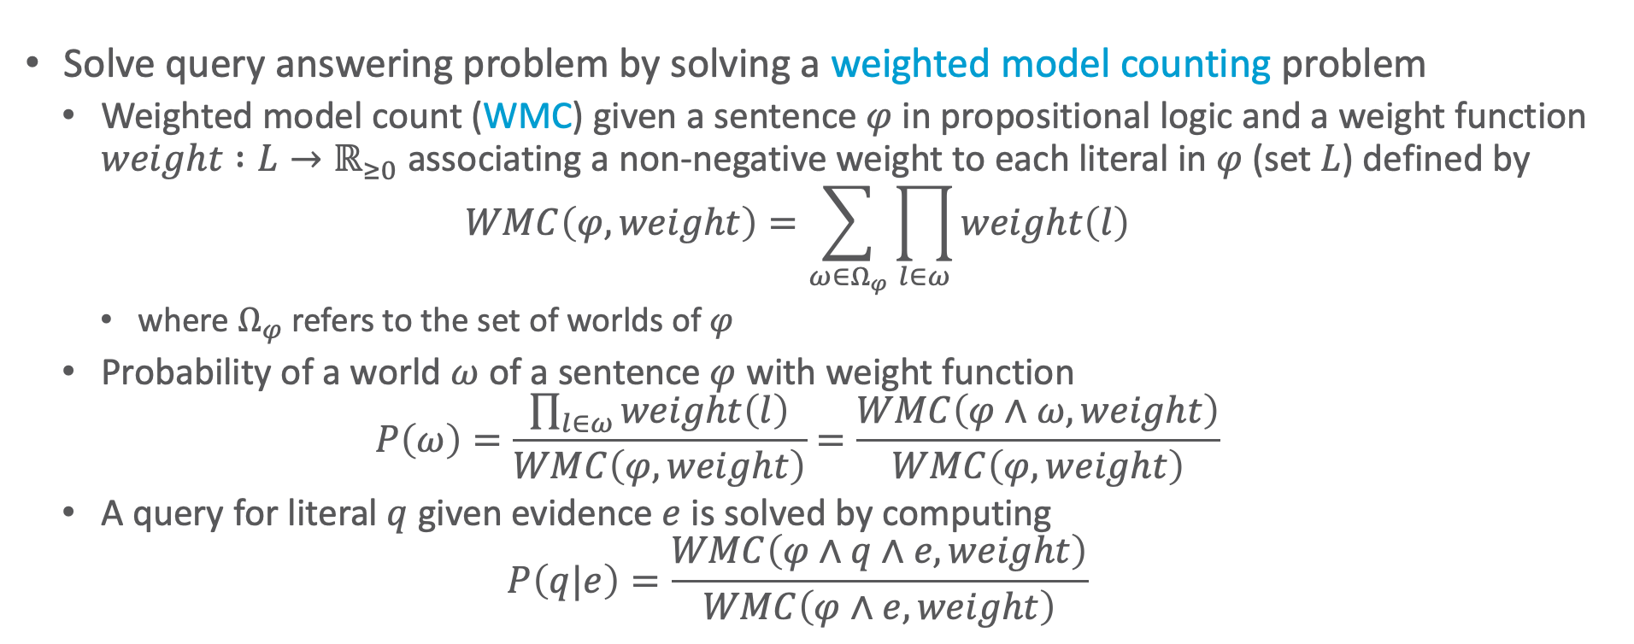
Weighted Model Counting
Solve query answering problem by solving a weighted model counting problem
  Weighted model count (WMC) given a sentence $φ$ in propositional logic and a weight function $weight :L→ℝ_{≥0}$ associating a non-negative weight to each literal in $φ$ (set $L$) defined by
  $$WMC\left(φ,weight\right)=\sum_{ω∈Ω_{φ}}{\prod_{l∈ω}{weight\left(l\right)}}$$
    where $Ω_{φ}$ refers to the set of worlds of $φ$
  Probability of a world $ω$ of a sentence $φ$ with weight function
  $$P\left(ω\right)=\frac{\prod_{l∈ω}{weight\left(l\right)}}{WMC\left(φ,weight\right)}=\frac{WMC\left(φ∧ω,weight\right)}{WMC\left(φ,weight\right)}$$
  A query for literal $q$ given evidence $e$ is solved by computing
  $$P\left(q|e\right)=\frac{WMC\left(φ∧q∧e,weight\right)}{WMC\left(φ∧e,weight\right)}$$
Vgl. $P\left(Q | E\right)=\frac{P\left(Q,E\right)}{P\left(E\right)}$
T. Sang, P. Beame, and H. Kautz: Solving Bayesian networks by weighted model counting. In: Proceedings of the Twentieth National Conference on Artificial Intelligence, 2005.

Slide 7
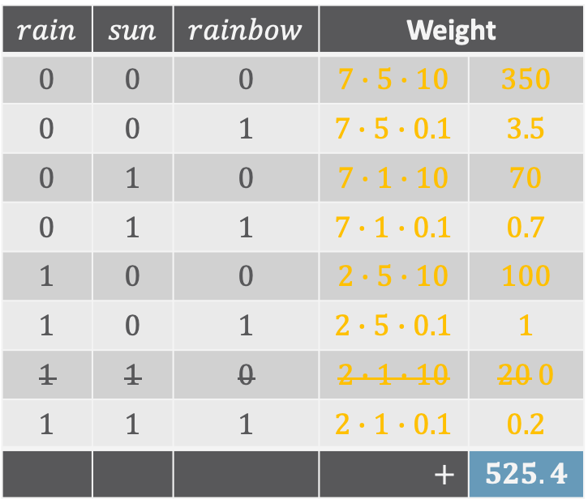


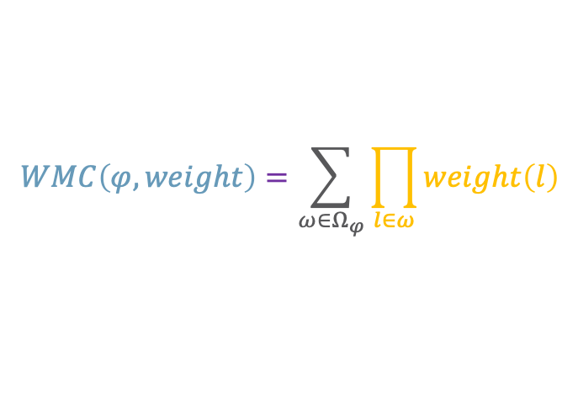
Weighted Model Counting: Example
$$WMC\left(φ,weight\right)=\sum_{ω∈Ω_{φ}}{\prod_{l∈ω}{weight\left(l\right)}}$$
Sentence
  $sun∧rain⇒rainbow$
Weight function:
  $weight\left(sun\right)=1$
  $weight\left(¬sun\right)=5$
  $weight\left(rain\right)=2$
  $weight\left(¬rain\right)=7$
  $weight\left(rainbow\right)=0.1$
  $weight\left(¬rainbow\right)=10$
$$rain$$ | $$sun$$ | $$rainbow$$ | Weight
$$0$$ | $$0$$ | $$0$$ | $$7∙5∙10$$ | $$350$$
$$0$$ | $$0$$ | $$1$$ | $$7∙5∙0.1$$ | $$3.5$$
$$0$$ | $$1$$ | $$0$$ | $$7∙1∙10$$ | $$70$$
$$0$$ | $$1$$ | $$1$$ | $$7∙1∙0.1$$ | $$0.7$$
$$1$$ | $$0$$ | $$0$$ | $$2∙5∙10$$ | $$100$$
$$1$$ | $$0$$ | $$1$$ | $$2∙5∙0.1$$ | $$1$$
$$1$$ | $$1$$ | $$0$$ | $$2∙1∙10$$ | $$20 0$$
$$1$$ | $$1$$ | $$1$$ | $$2∙1∙0.1$$ | $$0.2$$
 |  |  | $$+$$ | $$525.4$$
Each line a world $ω∈Ω_{φ}$

Slide 8
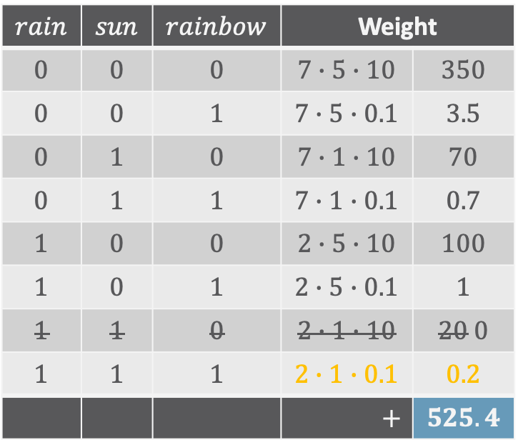
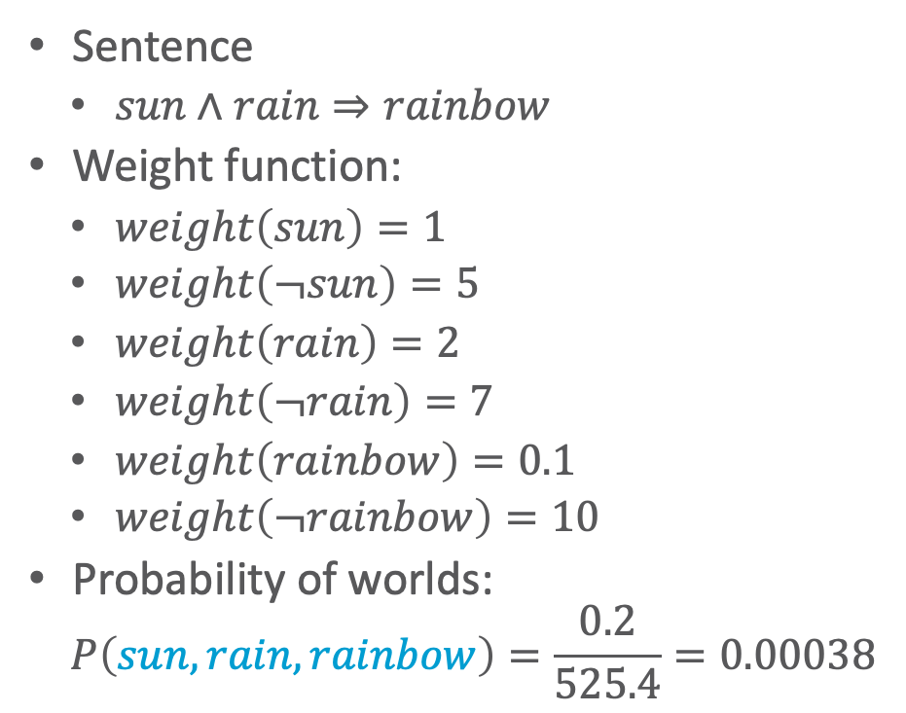
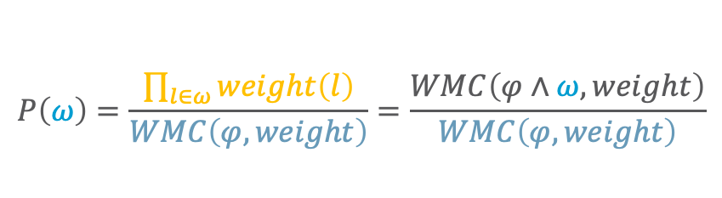

Weighted Model Counting: Example
$$P\left(ω\right)=\frac{\prod_{l∈ω}{weight\left(l\right)}}{WMC\left(φ,weight\right)}=\frac{WMC\left(φ∧ω,weight\right)}{WMC\left(φ,weight\right)}$$
Sentence
  $sun∧rain⇒rainbow$
Weight function:
  $weight\left(sun\right)=1$
  $weight\left(¬sun\right)=5$
  $weight\left(rain\right)=2$
  $weight\left(¬rain\right)=7$
  $weight\left(rainbow\right)=0.1$
  $weight\left(¬rainbow\right)=10$
Probability of worlds:
  $$P\left(sun,rain,rainbow\right)=\frac{0.2}{525.4}=0.00038$$
$$\left(sun∧rain⇒rainbow\right)∧sun∧rain∧rainbow$$
$$rain$$ | $$sun$$ | $$rainbow$$ | Weight
$$0$$ | $$0$$ | $$0$$ | $$7∙5∙10$$ | $$350$$
$$0$$ | $$0$$ | $$1$$ | $$7∙5∙0.1$$ | $$3.5$$
$$0$$ | $$1$$ | $$0$$ | $$7∙1∙10$$ | $$70$$
$$0$$ | $$1$$ | $$1$$ | $$7∙1∙0.1$$ | $$0.7$$
$$1$$ | $$0$$ | $$0$$ | $$2∙5∙10$$ | $$100$$
$$1$$ | $$0$$ | $$1$$ | $$2∙5∙0.1$$ | $$1$$
$$1$$ | $$1$$ | $$0$$ | $$2∙1∙10$$ | $$20 0$$
$$1$$ | $$1$$ | $$1$$ | $$2∙1∙0.1$$ | $$0.2$$
 |  |  | $$+$$ | $$525.4$$
$$ω=\left(sun,rain,rainbow\right)∈Ω_{φ}$$

Slide 9
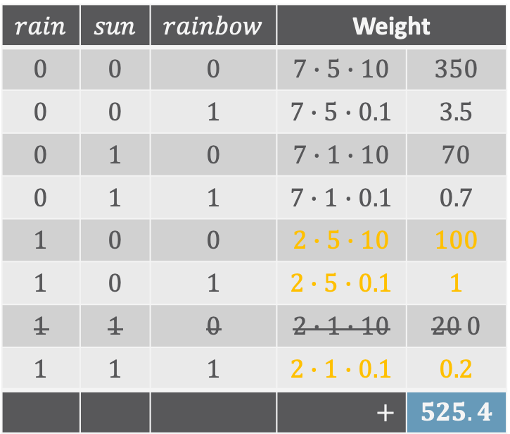
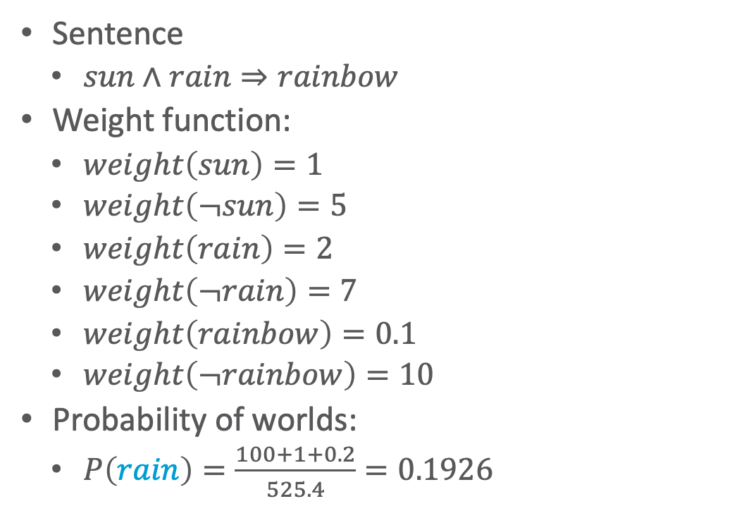



Weighted Model Counting: Example
$$P\left(q\right)=\frac{WMC\left(φ∧q,weight\right)}{WMC\left(φ,weight\right)}$$
Sentence
  $sun∧rain⇒rainbow$
Weight function:
  $weight\left(sun\right)=1$
  $weight\left(¬sun\right)=5$
  $weight\left(rain\right)=2$
  $weight\left(¬rain\right)=7$
  $weight\left(rainbow\right)=0.1$
  $weight\left(¬rainbow\right)=10$
Probability of worlds:
  $P\left(rain\right)=\frac{100+1+0.2}{525.4}=0.1926$
$$\left(sun∧rain⇒rainbow\right)∧rain$$
$$rain$$ | $$sun$$ | $$rainbow$$ | Weight
$$0$$ | $$0$$ | $$0$$ | $$7∙5∙10$$ | $$350$$
$$0$$ | $$0$$ | $$1$$ | $$7∙5∙0.1$$ | $$3.5$$
$$0$$ | $$1$$ | $$0$$ | $$7∙1∙10$$ | $$70$$
$$0$$ | $$1$$ | $$1$$ | $$7∙1∙0.1$$ | $$0.7$$
$$1$$ | $$0$$ | $$0$$ | $$2∙5∙10$$ | $$100$$
$$1$$ | $$0$$ | $$1$$ | $$2∙5∙0.1$$ | $$1$$
$$1$$ | $$1$$ | $$0$$ | $$2∙1∙10$$ | $$20 0$$
$$1$$ | $$1$$ | $$1$$ | $$2∙1∙0.1$$ | $$0.2$$
 |  |  | $$+$$ | $$525.4$$
All $ω∈Ω_{φ}$ where $rain$ holds

Slide 10
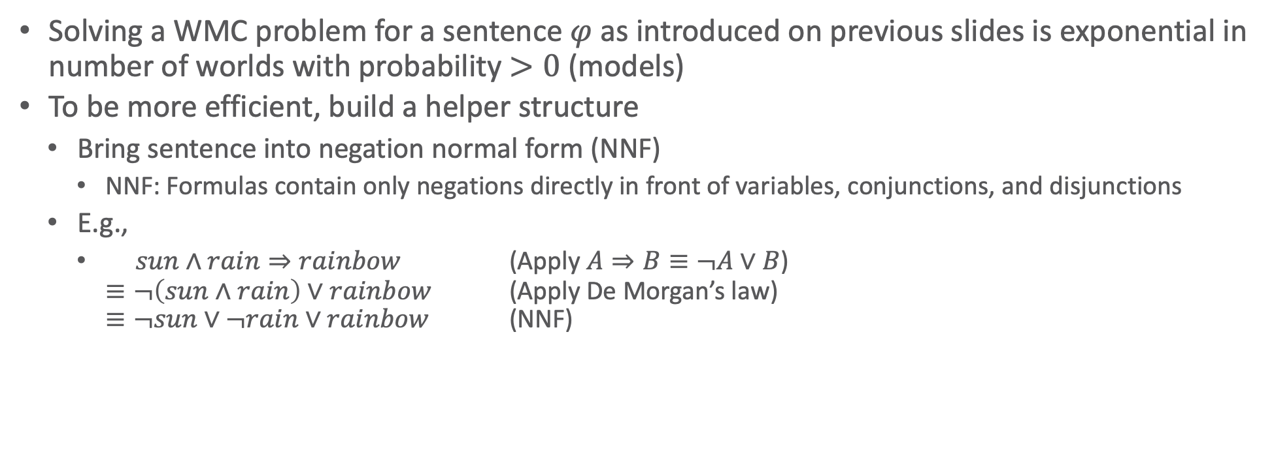
WMC and Inference
Solving a WMC problem for a sentence $φ$ as introduced on previous slides is exponential in number of worlds with probability $>0$ (models)
To be more efficient, build a helper structure
  Bring sentence into negation normal form (NNF)
    NNF: Formulas contain only negations directly in front of variables, conjunctions, and disjunctions
  E.g.,
    $sun∧rain⇒rainbow$ (Apply $A⇒B≡¬A∨B$)
    $≡¬\left(sun∧rain\right)∨rainbow$ (Apply De Morgan’s law)
    $≡¬sun∨¬rain∨rainbow$ (NNF)

Slide 11
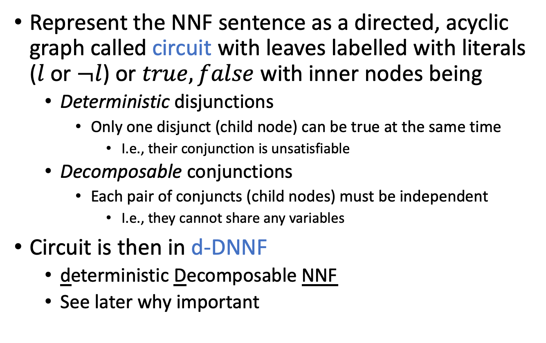
Circuits
Represent the NNF sentence as a directed, acyclic graph called circuit with leaves labelled with literals ($l$ or $¬l$) or $true,false$ with inner nodes being
  Deterministic disjunctions
    Only one disjunct (child node) can be true at the same time
      I.e., their conjunction is unsatisfiable
  Decomposable conjunctions
    Each pair of conjuncts (child nodes) must be independent
      I.e., they cannot share any variables
Circuit is then in d-DNNF
  deterministic Decomposable NNF
  See later why important
Mark Chavira and Adnan Darwiche: On probabilistic inference by weighted model counting. In: Artificial Intelligence, 2008.

Slide 12

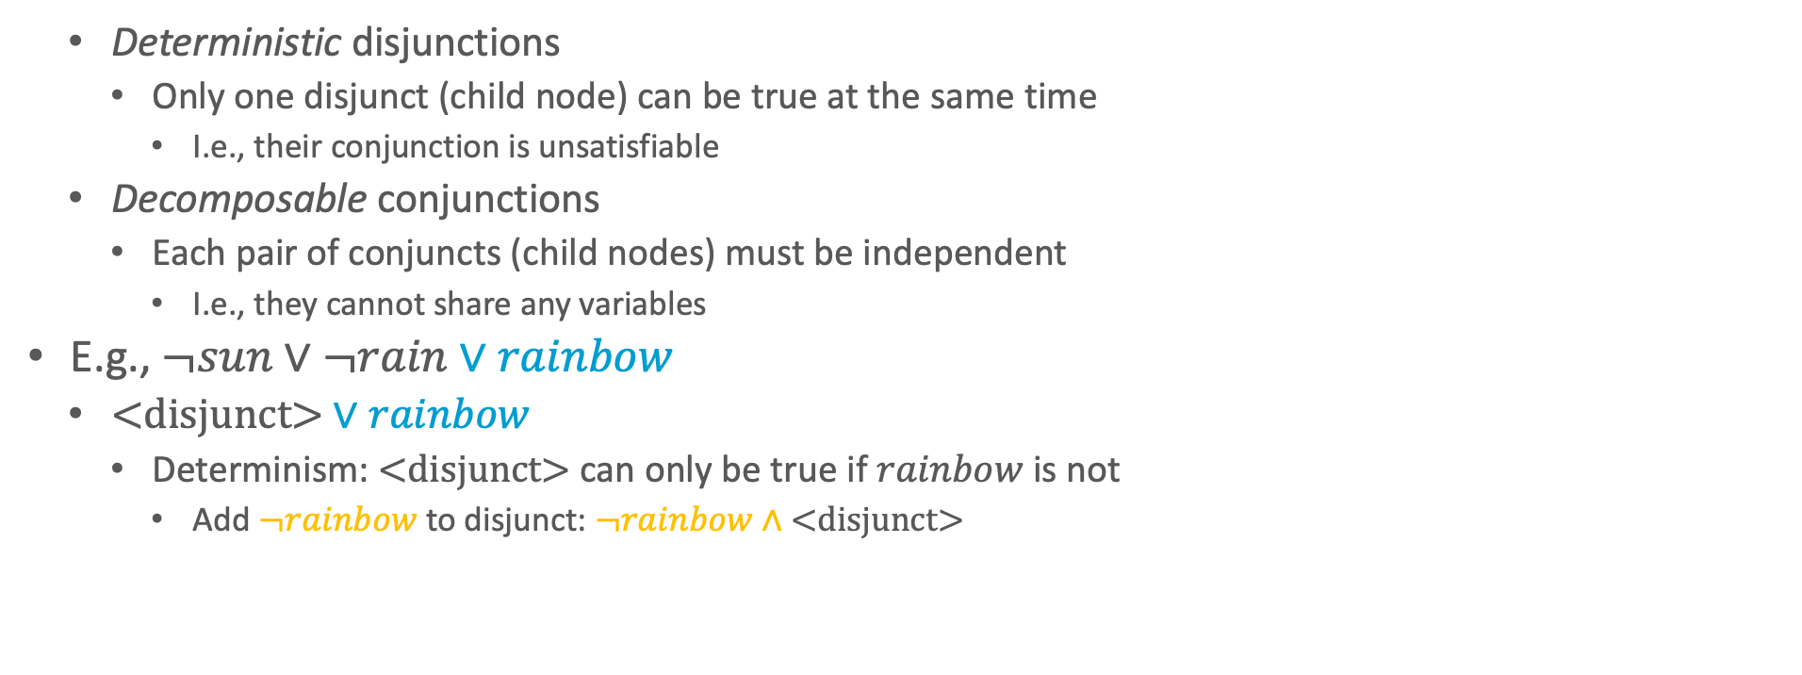


Circuits: Example
  Deterministic disjunctions
    Only one disjunct (child node) can be true at the same time
      I.e., their conjunction is unsatisfiable
  Decomposable conjunctions
    Each pair of conjuncts (child nodes) must be independent
      I.e., they cannot share any variables
E.g., $¬sun∨¬rain∨rainbow$
  $\text{<}\text{disjunct}\text{>}∨rainbow$
    Determinism: $\text{<}\text{disjunct}\text{>}$ can only be true if $rainbow$ is not
      Add $¬rainbow$ to disjunct: $¬rainbow∧\text{<}\text{disjunct}\text{>}$
$$∨$$
$$rainbow$$
$$\text{<}\text{disjunct}\text{>}$$

Slide 13


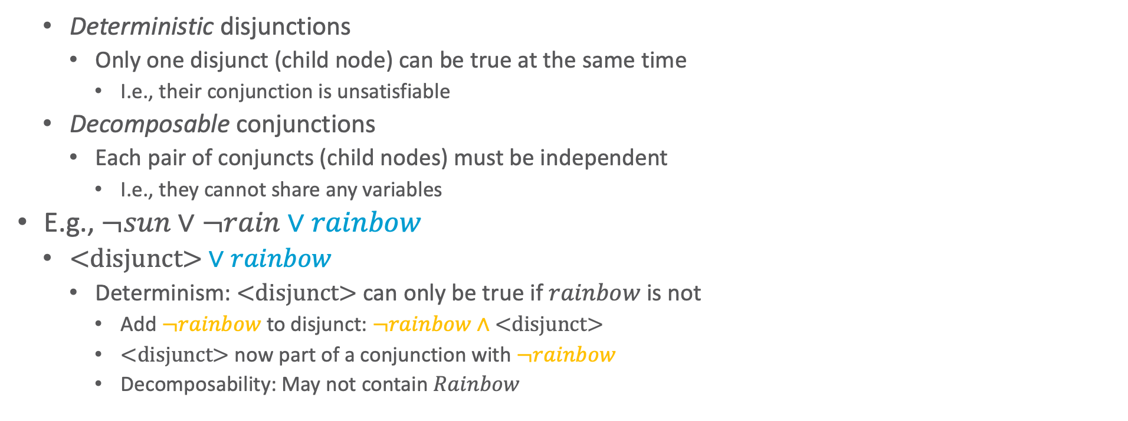

Circuits: Example
  Deterministic disjunctions
    Only one disjunct (child node) can be true at the same time
      I.e., their conjunction is unsatisfiable
  Decomposable conjunctions
    Each pair of conjuncts (child nodes) must be independent
      I.e., they cannot share any variables
E.g., $¬sun∨¬rain∨rainbow$
  $\text{<}\text{disjunct}\text{>}∨rainbow$
    Determinism: $\text{<}\text{disjunct}\text{>}$ can only be true if $rainbow$ is not
      Add $¬rainbow$ to disjunct: $¬rainbow∧\text{<}\text{disjunct}\text{>}$
      $\text{<}\text{disjunct}\text{>}$ now part of a conjunction with $¬rainbow$
        Decomposability: May not contain $Rainbow$
$$∨$$
$$rainbow$$
$$∧$$
$$\text{<}\text{disjunct}\text{>}$$
$$¬rainbow$$

Slide 14



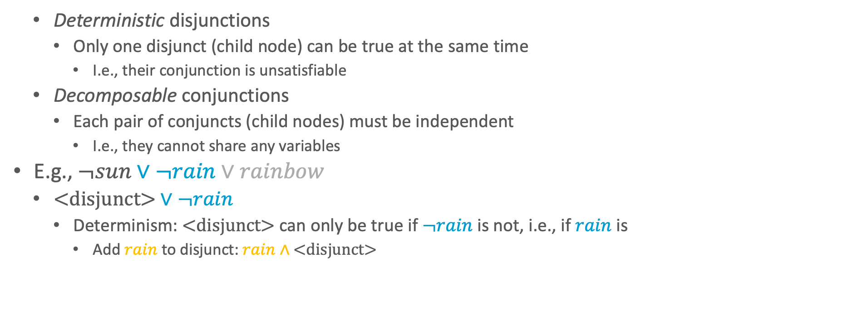




Circuits: Example
  Deterministic disjunctions
    Only one disjunct (child node) can be true at the same time
      I.e., their conjunction is unsatisfiable
  Decomposable conjunctions
    Each pair of conjuncts (child nodes) must be independent
      I.e., they cannot share any variables
E.g., $¬sun∨¬rain∨rainbow$
  $\text{<}\text{disjunct}\text{>}∨¬rain$
    Determinism: $\text{<}\text{disjunct}\text{>}$ can only be true if $¬rain$ is not, i.e., if $rain$ is
      Add $rain$ to disjunct: $rain∧\text{<}\text{disjunct}\text{>}$
$$∨$$
$$rainbow$$
$$∧$$
$$∨$$
$$¬rainbow$$
$$¬rain$$
$$\text{<}\text{disjunct}\text{>}$$

Slide 15
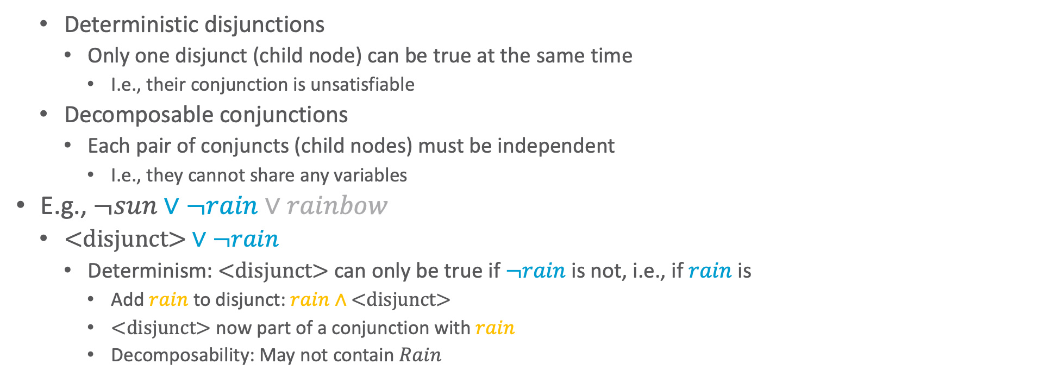



Circuits: Example
  Deterministic disjunctions
    Only one disjunct (child node) can be true at the same time
      I.e., their conjunction is unsatisfiable
  Decomposable conjunctions
    Each pair of conjuncts (child nodes) must be independent
      I.e., they cannot share any variables
E.g., $¬sun∨¬rain∨rainbow$
  $\text{<}\text{disjunct}\text{>}∨¬rain$
    Determinism: $\text{<}\text{disjunct}\text{>}$ can only be true if $¬rain$ is not, i.e., if $rain$ is
      Add $rain$ to disjunct: $rain∧\text{<}\text{disjunct}\text{>}$
      $\text{<}\text{disjunct}\text{>}$ now part of a conjunction with $rain$
        Decomposability: May not contain $Rain$
$$∨$$
$$rainbow$$
$$∧$$
$$∨$$
$$¬rainbow$$
$$¬rain$$
$$∧$$
$$\text{<}\text{disjunct}\text{>}$$
$$rain$$

Slide 16
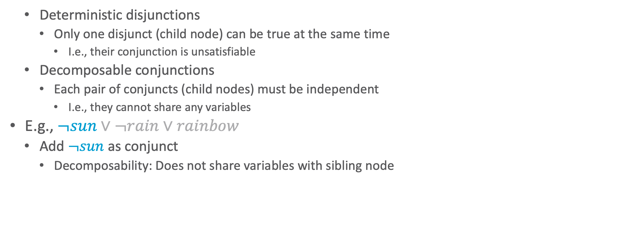





Circuits: Example
  Deterministic disjunctions
    Only one disjunct (child node) can be true at the same time
      I.e., their conjunction is unsatisfiable
  Decomposable conjunctions
    Each pair of conjuncts (child nodes) must be independent
      I.e., they cannot share any variables
E.g., $¬sun∨¬rain∨rainbow$
  Add $¬sun$ as conjunct
    Decomposability: Does not share variables with sibling node
$$∨$$
$$rainbow$$
$$∧$$
$$∨$$
$$¬rainbow$$
$$¬rain$$
$$∧$$
$$¬sun$$
$$rain$$

Slide 17
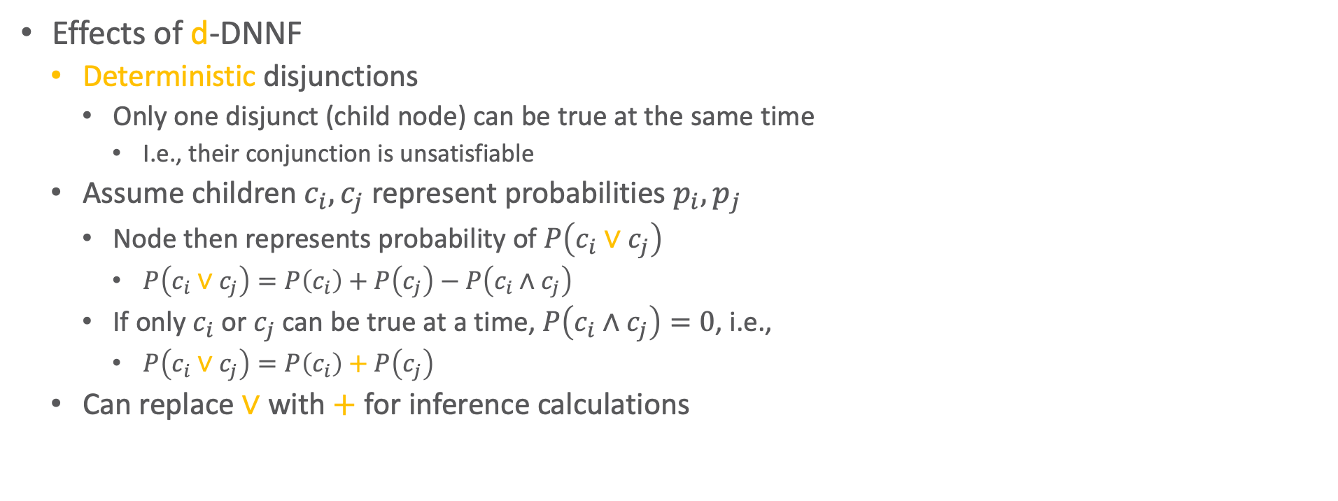



Effects of d-DNNF
Effects of d-DNNF
  Deterministic disjunctions
    Only one disjunct (child node) can be true at the same time
      I.e., their conjunction is unsatisfiable
  Assume children $c_{i},c_{j}$ represent probabilities $p_{i},p_{j}$
    Node then represents probability of $P\left(c_{i}∨c_{j}\right)$
      $P\left(c_{i}∨c_{j}\right)=P\left(c_{i}\right)+P\left(c_{j}\right)−P\left(c_{i}∧c_{j}\right)$
    If only $c_{i}$ or $c_{j}$ can be true at a time, $P\left(c_{i}∧c_{j}\right)=0$, i.e.,
      $P\left(c_{i}∨c_{j}\right)=P\left(c_{i}\right)+P\left(c_{j}\right)$
  Can replace $∨$ with $+$ for inference calculations
$$∨$$
$$rainbow$$
$$∧$$
$$∨$$
$$¬rainbow$$
$$¬rain$$
$$∧$$
$$¬sun$$
$$rain$$

Slide 18

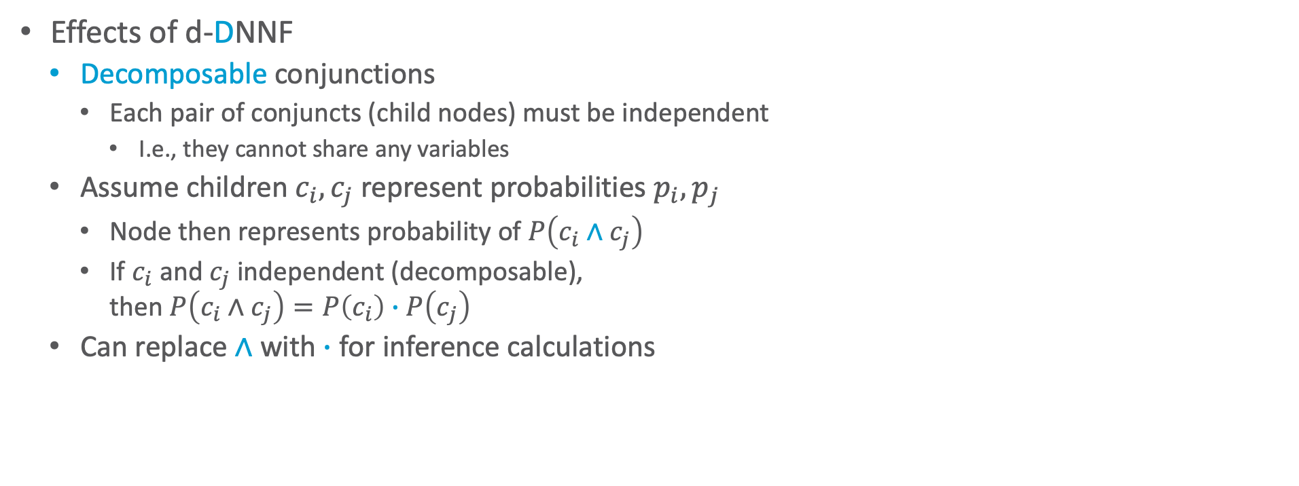

Effects of d-DNNF
Effects of d-DNNF
  Decomposable conjunctions
    Each pair of conjuncts (child nodes) must be independent
      I.e., they cannot share any variables
  Assume children $c_{i},c_{j}$ represent probabilities $p_{i},p_{j}$
    Node then represents probability of $P\left(c_{i}∧c_{j}\right)$
    If $c_{i}$ and $c_{j}$ independent (decomposable),
    then $P\left(c_{i}∧c_{j}\right)=P\left(c_{i}\right)∙P\left(c_{j}\right)$
  Can replace $∧$ with $∙$ for inference calculations
$$∨$$
$$rainbow$$
$$∧$$
$$∨$$
$$¬rainbow$$
$$¬rain$$
$$∧$$
$$¬sun$$
$$rain$$

Slide 19

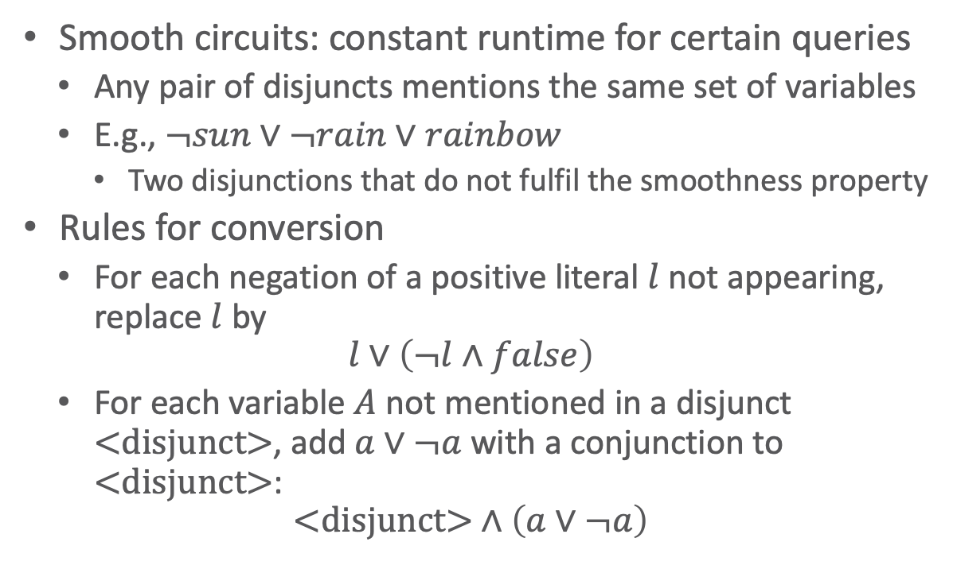

Smooth d-DNNF (sd-DNNF)
Smooth circuits: constant runtime for certain queries
  Any pair of disjuncts mentions the same set of variables
  E.g., $¬sun∨¬rain∨rainbow$
    Two disjunctions that do not fulfil the smoothness property
Rules for conversion
  For each negation of a positive literal $l$ not appearing, replace $l$ by
  $$l∨\left(¬l∧false\right)$$
  For each variable $A$ not mentioned in a disjunct $\text{<}\text{disjunct}\text{>}$, add $a∨¬a$ with a conjunction to $\text{<}\text{disjunct}\text{>}$:
  $$\text{<}\text{disjunct}\text{>}∧\left(a∨¬a\right)$$
Does not mention
$$Rain,Sun$$
$$∨$$
$$rainbow$$
$$∧$$
Does not mention
$$Sun$$
$$∨$$
$$¬rainbow$$
$$¬rain$$
$$∧$$
$$¬sun$$
$$rain$$

Slide 20





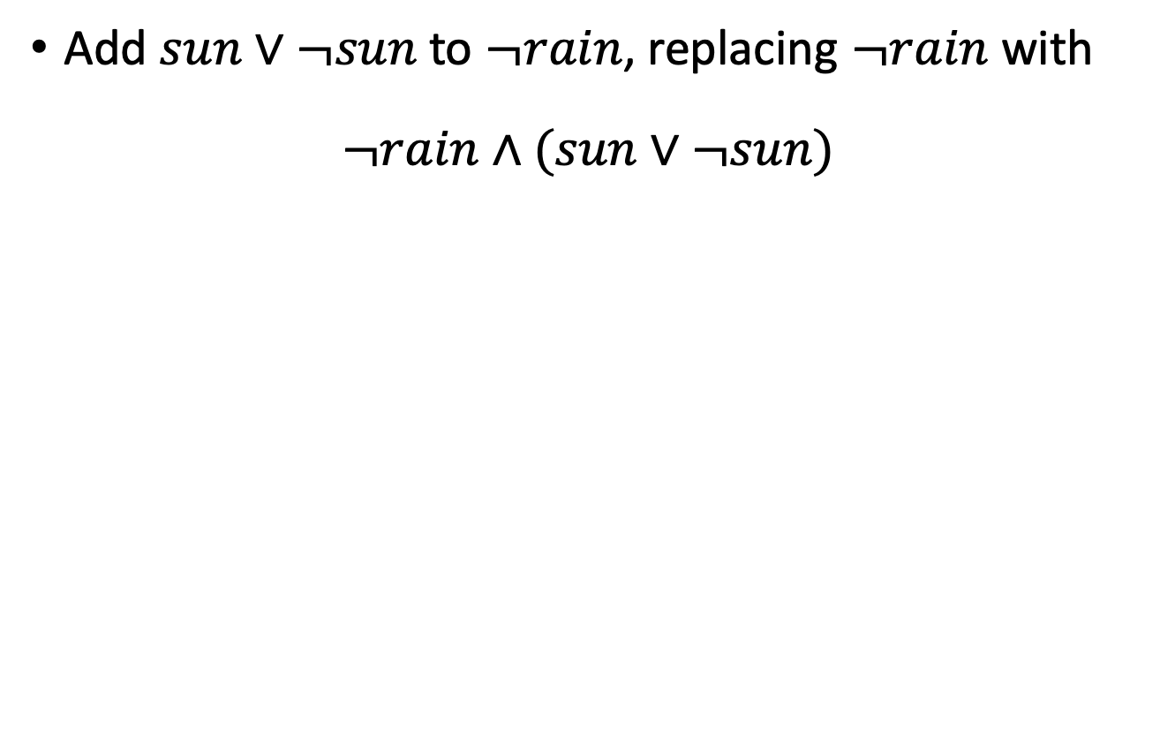








Smooth d-DNNF (sd-DNNF)
Add $sun∨¬sun$ to $¬rain$, replacing $¬rain$ with
$$¬rain∧(sun∨¬sun)$$
Does not mention
$$Rain,Sun$$
$$∨$$
Does not mention
$$Rain,Sun$$
$$∨$$
$$rainbow$$
$$∧$$
$$rainbow$$
$$∧$$
$$∨$$
$$¬rainbow$$
Does not mention
$$Sun$$
$$∨$$
$$¬rainbow$$
$$∧$$
$$∧$$
$$¬rain$$
$$∧$$
$$∨$$
$$sun$$
$$¬rain$$
$$¬sun$$
$$rain$$
$$¬sun$$
$$rain$$

Slide 21

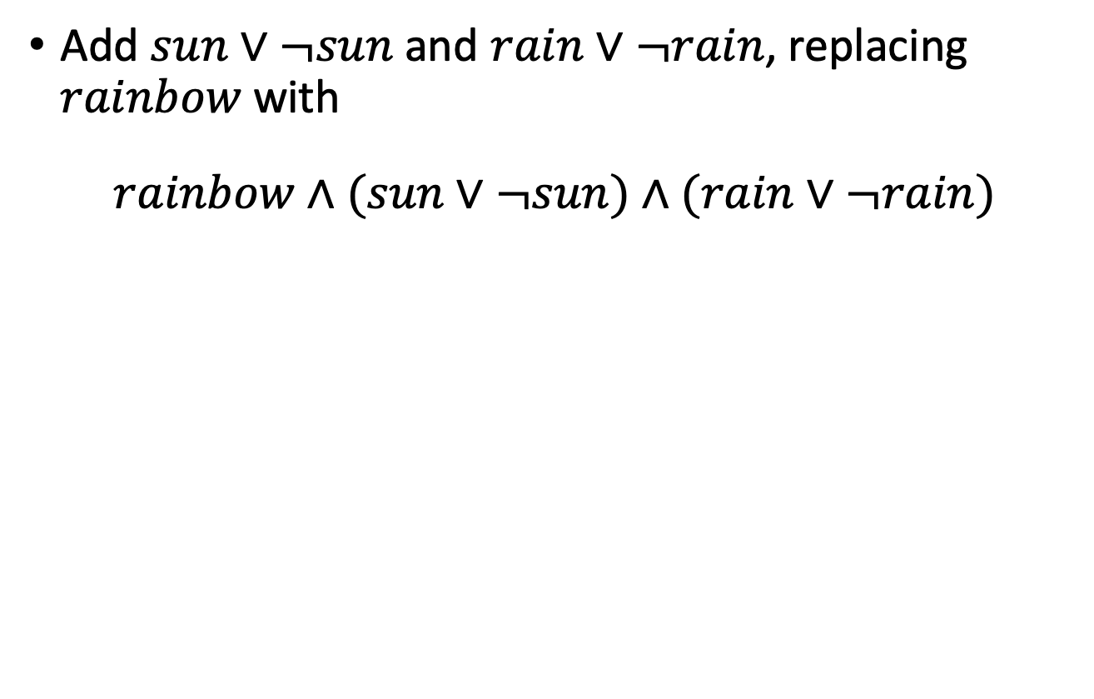








Smooth d-DNNF (sd-DNNF)
Add $sun∨¬sun$ and $rain∨¬rain$, replacing $rainbow$ with
$$rainbow∧(sun∨¬sun)∧(rain∨¬rain)$$
Does not mention
$$Rain,Sun$$
$$∨$$
$$∨$$
$$rainbow$$
$$∧$$
$$∧$$
$$∧$$
$$∨$$
$$¬rainbow$$
$$rainbow$$
$$∨$$
$$∨$$
$$¬rainbow$$
$$∧$$
$$∧$$
$$∧$$
$$∧$$
$$∨$$
$$∨$$
$$sun$$
$$¬rain$$
$$¬sun$$
$$rain$$
$$sun$$
$$¬rain$$
$$¬sun$$
$$rain$$

Slide 22















Circuit for Model Counting
Model counting problem: Count how many models fulfil a sentence
Model counting arithmetic circuit
  Replace $∧$ with $∙$
  Replace $∨$ with $+$
  Replace leaves with $1$’s
$$+$$
$$∨$$
$$∙$$
$$∙$$
$$∧$$
$$∧$$
$$1$$
$$+$$
$$+$$
$$1$$
$$rainbow$$
$$∨$$
$$∨$$
$$¬rainbow$$
$$∙$$
$$∧$$
$$∙$$
$$∧$$
$$+$$
$$∨$$
$$1$$
$$1$$
$$1$$
$$1$$
$$sun$$
$$¬rain$$
$$¬sun$$
$$rain$$

Slide 23




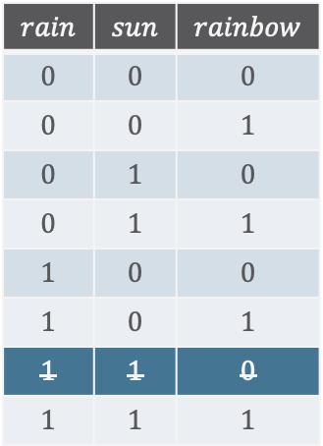






Circuit for Model Counting
Propagate $1$’s upwards (from leaves to root), using arithmetic operations in inner nodes to combine incoming numbers
  Result at root: Model count
$$7$$
$$sun∧rain⇒rainbow$$
$$+$$
$$∨$$
$$rain$$ | $$sun$$ | $$rainbow$$
$$0$$ | $$0$$ | $$0$$
$$0$$ | $$0$$ | $$1$$
$$0$$ | $$1$$ | $$0$$
$$0$$ | $$1$$ | $$1$$
$$1$$ | $$0$$ | $$0$$
$$1$$ | $$0$$ | $$1$$
$$1$$ | $$1$$ | $$0$$
$$1$$ | $$1$$ | $$1$$
$$4$$
$$3$$
$$∙$$
$$∙$$
$$∧$$
$$∧$$
$$2$$
$$3$$
$$1$$
$$+$$
$$+$$
$$1$$
$$rainbow$$
$$∨$$
$$∨$$
$$¬rainbow$$
$$2$$
$$∙$$
$$1$$
$$∧$$
$$2$$
$$∙$$
$$∧$$
$$+$$
$$∨$$
$$1$$
$$1$$
$$1$$
$$1$$
$$sun$$
$$¬rain$$
$$¬sun$$
$$rain$$

Slide 24



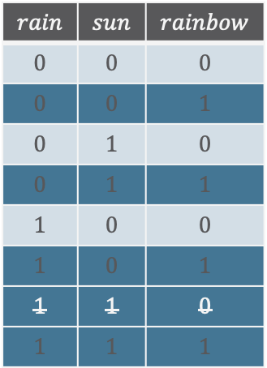

Conditioning
To get model count of models fulfilling certain truth values
  Replace $1$’s with zeros where literal contradicts truth values
  E.g., condition on $¬rainbow$
$$3$$
$$sun∧rain⇒rainbow$$
$$+$$
$$∨$$
$$rain$$ | $$sun$$ | $$rainbow$$
$$0$$ | $$0$$ | $$0$$
$$0$$ | $$0$$ | $$1$$
$$0$$ | $$1$$ | $$0$$
$$0$$ | $$1$$ | $$1$$
$$1$$ | $$0$$ | $$0$$
$$1$$ | $$0$$ | $$1$$
$$1$$ | $$1$$ | $$0$$
$$1$$ | $$1$$ | $$1$$
$$0$$
$$3$$
$$∙$$
$$∙$$
$$∧$$
$$∧$$
$$2$$
$$3$$
$$0$$
$$+$$
$$+$$
$$1$$
$$rainbow$$
$$∨$$
$$∨$$
$$¬rainbow$$
$$2$$
$$∙$$
$$1$$
$$∧$$
$$2$$
$$∙$$
$$∧$$
$$+$$
$$∨$$
$$1$$
$$1$$
$$1$$
$$1$$
$$sun$$
$$¬rain$$
$$¬sun$$
$$rain$$

Slide 25















Circuit for Weighted Model Counting
Replace literals with weights in leaves and propagate weights upwards
  Computes $WMC\left(φ,weight\right)$
  $$weight\left(sun\right)=1 \\ weight\left(¬sun\right)=5 \\ weight\left(rain\right)=2 \\ weight\left(¬rain\right)=7 \\ weight\left(rainbow\right)=0.1 \\ weight\left(¬rainbow\right)=10$$
$$525.4$$
$$+$$
$$∨$$
$$5.4$$
$$520$$
$$∙$$
$$∙$$
$$∧$$
$$∧$$
$$9$$
$$52$$
$$0.1$$
$$+$$
$$+$$
$$10$$
$$rainbow$$
$$∨$$
$$∨$$
$$¬rainbow$$
$$42$$
$$∙$$
$$10$$
$$∧$$
$$6$$
$$∙$$
$$∧$$
$$+$$
$$∨$$
$$1$$
$$7$$
$$5$$
$$2$$
$$sun$$
$$¬rain$$
$$¬sun$$
$$rain$$

Slide 26













Circuit for Weighted Model Counting
For probabilities of worlds or query terms $ω$, condition on truth values
  Compute $WMC\left(φ,weight\right)$
  Compute $WMC\left(φ∧ω,weight\right)$
  Divide the two counts
Reuse for different queries
$$0.2$$
$$+$$
$$∨$$
  $$P\left(ω=\left\{sun,rain,rainbow\right\}\right)=\frac{WMC\left(φ∧ω,weight\right)}{WMC\left(φ,weight\right)} \\ =\frac{0.2}{525.4}=0.00038$$
$$0.2$$
$$0$$
$$∙$$
$$∙$$
$$∧$$
$$∧$$
$$2$$
$$0$$
$$0.1$$
$$+$$
$$+$$
$$0$$
$$rainbow$$
$$∨$$
$$∨$$
$$¬rainbow$$
$$0$$
$$∙$$
$$0$$
$$∧$$
$$1$$
$$∙$$
$$∧$$
$$+$$
$$∨$$
$$1$$
$$0$$
$$0$$
$$2$$
$$sun$$
$$¬rain$$
$$¬sun$$
$$rain$$

Slide 27

Knowledge Compilation
Given a theory $Δ$ and a set of queries ${\left\{P\left(q_{i}|e\right)\right\}}_{i=1}^{m}$
  Build a circuit for theory $Δ$ (a conjunction of sentences)
  Make the circuit a WMC circuit
    Replace inner nodes with arithmetic operations and leaves with weights
  Condition on given evidence $e$
    Replace weights with $0$ where literals contradict $e$
  Calculate $WMC\left(Δ∧e,weight\right)$ in the circuit
    By propagating the weights upwards
  For each query $P\left(q_{i}|e\right)$ in the circuit
    Compute $WMC\left(Δ∧e∧q_{i},weight\right)$
    Return or store $P\left(q_{i}|e\right)=\frac{WMC\left(Δ∧e∧q_{i},weight\right)}{WMC\left(Δ∧e,weight\right)}$
Knowledge Compilation

Slide 28
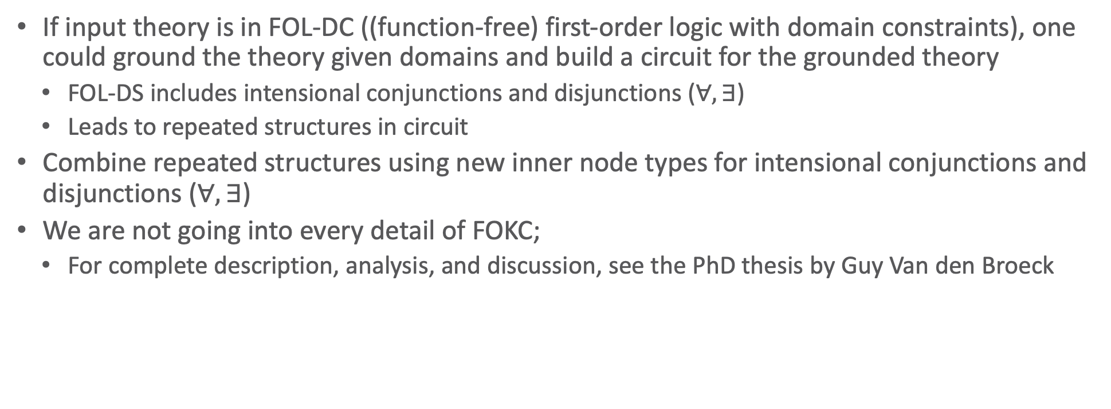
Propositional ➝ First-order
If input theory is in FOL-DC ((function-free) first-order logic with domain constraints), one could ground the theory given domains and build a circuit for the grounded theory
  FOL-DS includes intensional conjunctions and disjunctions ($∀,∃$)
  Leads to repeated structures in circuit
Combine repeated structures using new inner node types for intensional conjunctions and disjunctions ($∀,∃$)
We are not going into every detail of FOKC;
  For complete description, analysis, and discussion, see the PhD thesis by Guy Van den Broeck

Slide 29
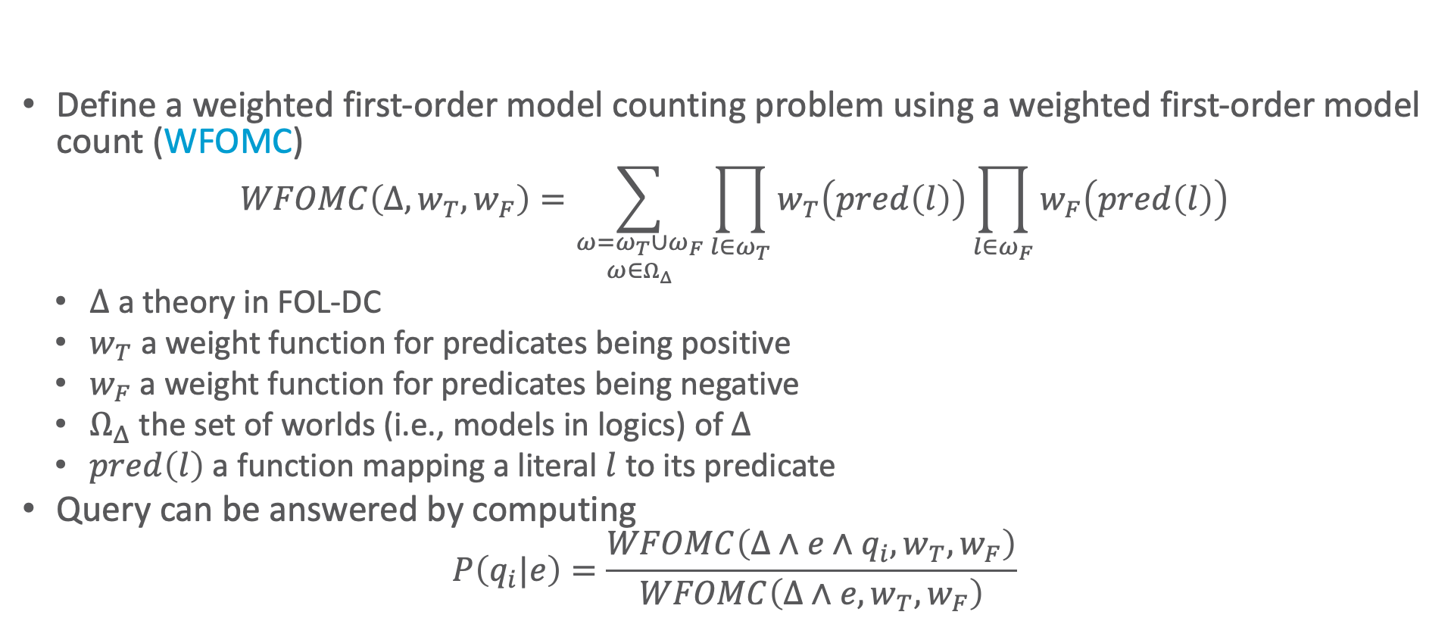
Weighted First-order Model Counting
Define a weighted first-order model counting problem using a weighted first-order model count (WFOMC)
  $$WFOMC\left(Δ, w_{T},w_{F}\right)=\sum_{\begin{aligned}ω=ω_{T}∪ω_{F} \\ ω∈Ω_{Δ}\end{aligned}}{\prod_{l∈ω_{T}}{w_{T}\left(pred\left(l\right)\right)}\prod_{l∈ω_{F}}{w_{F}\left(pred\left(l\right)\right)}}$$
  $Δ$ a theory in FOL-DC
  $w_{T}$ a weight function for predicates being positive
  $w_{F}$ a weight function for predicates being negative
  $Ω_{Δ}$ the set of worlds (i.e., models in logics) of $Δ$
  $pred\left(l\right)$ a function mapping a literal $l$ to its predicate
Query can be answered by computing
  $$P\left(q_{i}|e\right)=\frac{WFOMC\left(Δ∧e∧q_{i},w_{T},w_{F}\right)}{WFOMC\left(Δ∧e,w_{T},w_{F}\right)}$$
Guy Van den Broeck, Nima Taghipour, Wannes Meert, Jesse Davis, and Luc De Raedt: Lifted Probabilistic Inference by First-order Knowledge Compilation. In: IJCAI-11 Proceedings of the 22nd International Joint Conference on Artificial Intelligence, 2011.

Slide 30
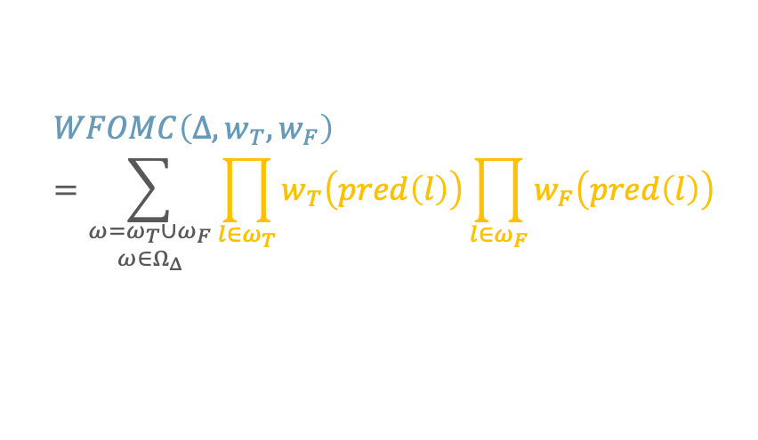
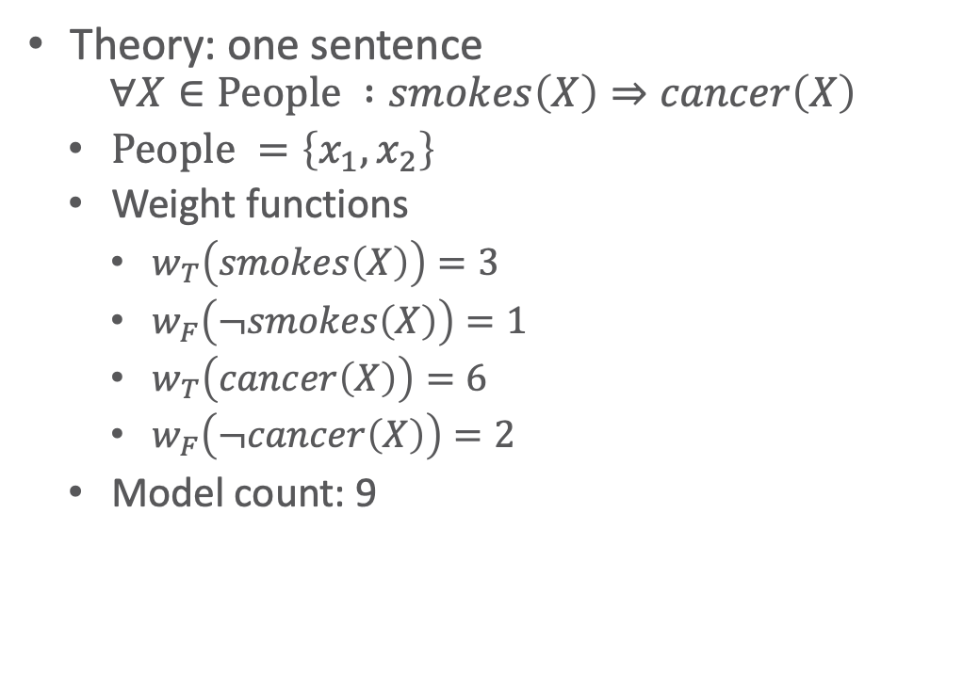
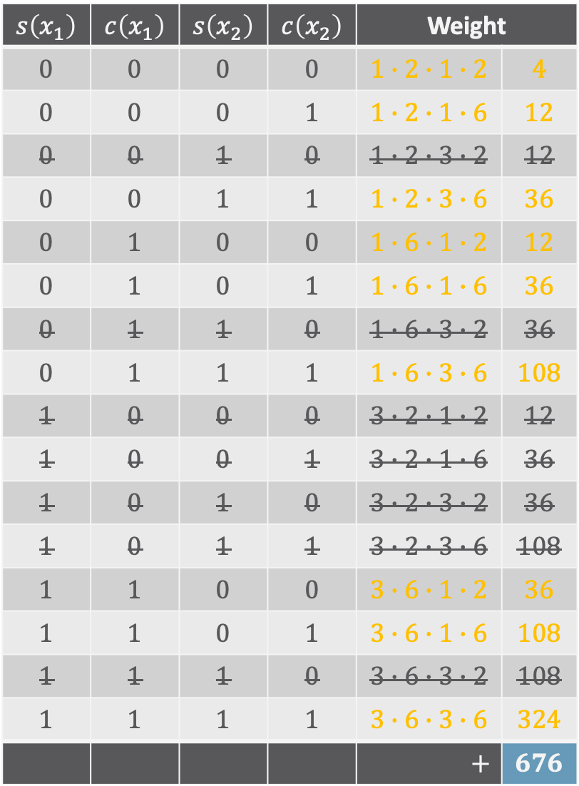
Example
$$s\left(x_{1}\right)$$ | $$c\left(x_{1}\right)$$ | $$s\left(x_{2}\right)$$ | $$c\left(x_{2}\right)$$ | Weight
$$0$$ | $$0$$ | $$0$$ | $$0$$ | $$1∙2∙1∙2$$ | $$4$$
$$0$$ | $$0$$ | $$0$$ | $$1$$ | $$1∙2∙1∙6$$ | $$12$$
$$0$$ | $$0$$ | $$1$$ | $$0$$ | $$1∙2∙3∙2$$ | $$12$$
$$0$$ | $$0$$ | $$1$$ | $$1$$ | $$1∙2∙3∙6$$ | $$36$$
$$0$$ | $$1$$ | $$0$$ | $$0$$ | $$1∙6∙1∙2$$ | $$12$$
$$0$$ | $$1$$ | $$0$$ | $$1$$ | $$1∙6∙1∙6$$ | $$36$$
$$0$$ | $$1$$ | $$1$$ | $$0$$ | $$1∙6∙3∙2$$ | $$36$$
$$0$$ | $$1$$ | $$1$$ | $$1$$ | $$1∙6∙3∙6$$ | $$108$$
$$1$$ | $$0$$ | $$0$$ | $$0$$ | $$3∙2∙1∙2$$ | $$12$$
$$1$$ | $$0$$ | $$0$$ | $$1$$ | $$3∙2∙1∙6$$ | $$36$$
$$1$$ | $$0$$ | $$1$$ | $$0$$ | $$3∙2∙3∙2$$ | $$36$$
$$1$$ | $$0$$ | $$1$$ | $$1$$ | $$3∙2∙3∙6$$ | $$108$$
$$1$$ | $$1$$ | $$0$$ | $$0$$ | $$3∙6∙1∙2$$ | $$36$$
$$1$$ | $$1$$ | $$0$$ | $$1$$ | $$3∙6∙1∙6$$ | $$108$$
$$1$$ | $$1$$ | $$1$$ | $$0$$ | $$3∙6∙3∙2$$ | $$108$$
$$1$$ | $$1$$ | $$1$$ | $$1$$ | $$3∙6∙3∙6$$ | $$324$$
 |  |  |  | $$+$$ | $$676$$
Theory: one sentence
  $$∀X∈\text{People} :smokes\left(X\right)⇒cancer\left(X\right)$$
  $\text{People} =\left\{x_{1},x_{2}\right\}$
  Weight functions
    $w_{T}\left(smokes\left(X\right)\right)=3$
    $w_{F}\left(¬smokes\left(X\right)\right)=1$
    $w_{T}\left(cancer\left(X\right)\right)=6$
    $w_{F}\left(¬cancer\left(X\right)\right)=2$
  Model count: 9
  $$WFOMC\left(Δ, w_{T},w_{F}\right)=\sum_{\begin{aligned}ω=ω_{T}∪ω_{F} \\ ω∈Ω_{Δ}\end{aligned}}{\prod_{l∈ω_{T}}{w_{T}\left(pred\left(l\right)\right)}\prod_{l∈ω_{F}}{w_{F}\left(pred\left(l\right)\right)}}$$

Slide 31
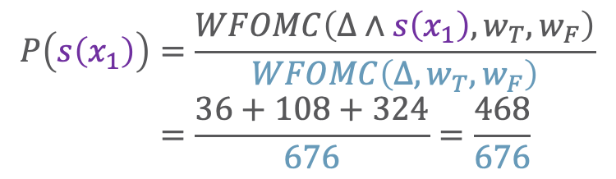

Example
$$s\left(x_{1}\right)$$ | $$c\left(x_{1}\right)$$ | $$s\left(x_{2}\right)$$ | $$c\left(x_{2}\right)$$ | Weight
$$0$$ | $$0$$ | $$0$$ | $$0$$ | $$1∙2∙1∙2$$ | $$4$$
$$0$$ | $$0$$ | $$0$$ | $$1$$ | $$1∙2∙1∙6$$ | $$12$$
$$0$$ | $$0$$ | $$1$$ | $$0$$ | $$1∙2∙3∙2$$ | $$12$$
$$0$$ | $$0$$ | $$1$$ | $$1$$ | $$1∙2∙3∙6$$ | $$36$$
$$0$$ | $$1$$ | $$0$$ | $$0$$ | $$1∙6∙1∙2$$ | $$12$$
$$0$$ | $$1$$ | $$0$$ | $$1$$ | $$1∙6∙1∙6$$ | $$36$$
$$0$$ | $$1$$ | $$1$$ | $$0$$ | $$1∙6∙3∙2$$ | $$36$$
$$0$$ | $$1$$ | $$1$$ | $$1$$ | $$1∙6∙3∙6$$ | $$108$$
$$1$$ | $$0$$ | $$0$$ | $$0$$ | $$3∙2∙1∙2$$ | $$12$$
$$1$$ | $$0$$ | $$0$$ | $$1$$ | $$3∙2∙1∙6$$ | $$36$$
$$1$$ | $$0$$ | $$1$$ | $$0$$ | $$3∙2∙3∙2$$ | $$36$$
$$1$$ | $$0$$ | $$1$$ | $$1$$ | $$3∙2∙3∙6$$ | $$108$$
$$1$$ | $$1$$ | $$0$$ | $$0$$ | $$3∙6∙1∙2$$ | $$36$$
$$1$$ | $$1$$ | $$0$$ | $$1$$ | $$3∙6∙1∙6$$ | $$108$$
$$1$$ | $$1$$ | $$1$$ | $$0$$ | $$3∙6∙3∙2$$ | $$108$$
$$1$$ | $$1$$ | $$1$$ | $$1$$ | $$3∙6∙3∙6$$ | $$324$$
 |  |  |  | $$+$$ | $$676$$
Theory: one sentence
  $$∀X∈\text{People} :smokes\left(X\right)⇒cancer\left(X\right)$$
  $\text{People} =\left\{x_{1},x_{2}\right\}$
  Weight functions
    $w_{T}\left(smokes\left(X\right)\right)=3$
    $w_{F}\left(¬smokes\left(X\right)\right)=1$
    $w_{T}\left(cancer\left(X\right)\right)=6$
    $w_{F}\left(¬cancer\left(X\right)\right)=2$
  Model count: 9
$$P\left(s\left(x_{1}\right)\right)=\frac{WFOMC\left(Δ∧s\left(x_{1}\right),w_{T},w_{F}\right)}{WFOMC\left(Δ,w_{T},w_{F}\right)} \\ =\frac{36+108+324}{676}=\frac{468}{676}=0.692$$

Slide 32







First-order (FO) Circuits
Assume theory in Skolem normal form + CNF
  Sequence of intensional conjunctions in CNF
  E.g., with $s=smokes,c=cancer$
  $$≡∀X∈\text{People} :s\left(X\right)⇒c\left(X\right) \\ ≡∀X∈\text{People} :¬s\left(X\right)∨c\left(X\right)$$
FO circuit (excerpt)
  Inner nodes:
    Extensional conjunctions/disjunctions (as before)
    Set conjunctions
  Leaf nodes
    Positive and negative predicates, $true$, $false$
  Full + construction: see PhD thesis by Guy Van den Broeck
$$∀X \\ X∈\text{People}$$
$$∨$$
$$c\left(X\right)$$
$$∧$$
$$¬s\left(X\right)$$
$$¬c\left(X\right)$$

Slide 33











Smooth FO d-DNNF Circuits
Properties
  Deterministic disjunctions
    Only one disjunct (child node) can be true at the same time
  Decomposable conjunctions
    Each pair of conjuncts (child nodes) must be independent
  Smoothness
    Each disjunct contains the same variables
smooth FO d-DNNF
FO d-DNNF
$$∀X \\ X∈\text{People}$$
$$∀X \\ X∈\text{People}$$
$$∨$$
$$∨$$
$$∧$$
$$c\left(X\right)$$
$$∧$$
$$∨$$
$$∧$$
$$c\left(X\right)$$
$$s\left(X\right)$$
$$¬s\left(X\right)$$
$$¬c\left(X\right)$$
$$¬s\left(X\right)$$
$$¬c\left(X\right)$$

Slide 34












Arithmetic FO d-DNNF Circuits
Replace
  Replace $∧$ with $∙$
  Replace $∨$ with $+$
  Replace $∀$ with exponentiation for $\left|\text{Domain}\right|$
  Replace leaves with $1$’s
  E.g., with $\left|\text{People}\right|=\left|\left\{x_{1},x_{2}\right\}\right|=2$
$$3^{2}$$
$$∀X \\ X∈\text{People}$$
$$.^{\left|\text{People}\right|}$$
$$3$$
$$∨$$
$$+$$
$$2$$
$$∧$$
$$∙$$
$$2$$
$$1$$
$$∨$$
$$∧$$
$$+$$
$$∙$$
$$c\left(X\right)$$
$$s\left(X\right)$$
$$¬s\left(X\right)$$
$$¬c\left(X\right)$$
$$1$$
$$1$$
$$1$$
$$1$$

Slide 35

















WFOMC Circuits
  $$w_{T}\left(smokes\left(X\right)\right)=3 \\ w_{F}\left(¬smokes\left(X\right)\right)=1 \\ w_{T}\left(cancer\left(X\right)\right)=6 \\ w_{F}\left(¬cancer\left(X\right)\right)=2$$
Replace
  Replace $∧$ with $∙$
  Replace $∨$ with $+$
  Replace $∀$ with exponentiation for $\left|\text{Domain}\right|$
  Replace leaves with weights
  E.g., with $\left|\text{People}\right|=\left|\left\{x_{1},x_{2}\right\}\right|=2$
$$3^{2}$$
$${26}^{2}$$
$$∀X \\ X∈\text{People}$$
$$.^{\left|\text{People}\right|}$$
  $$WFOMC\left(Δ, w_{T},w_{F}\right)=\sum_{\begin{aligned}ω=ω_{T}∪ω_{F} \\ ω∈Ω_{Δ}\end{aligned}}{\prod_{l∈ω_{T}}{w_{T}\left(pred\left(l\right)\right)}\prod_{l∈ω_{F}}{w_{F}\left(pred\left(l\right)\right)}}$$
$$3$$
$$26$$
$$∨$$
$$+$$
$$2$$
$$24$$
$$∧$$
$$∙$$
$$2$$
$$1$$
$$4$$
$$2$$
$$∨$$
$$∧$$
$$+$$
$$∙$$
$$c\left(X\right)$$
$$s\left(X\right)$$
$$¬s\left(X\right)$$
$$¬c\left(X\right)$$
$$6$$
$$3$$
$$1$$
$$2$$

Slide 36






































WFOMC Circuits
Circuits also support adaptive inference as only leaves with changed values have start propagating their values upwards
Given $P\left(q_{i}\right)$
  Basically, compile a circuit for $Δ∧q_{i}$ reusing components from the circuit of $Δ$
  E.g., $P\left(s\left(x_{1}\right)\right)$with $\left|\text{People}\right|=\left|\left\{x_{1},x_{2}\right\}\right|=2$
$$26∙18$$
$$P\left(s\left(x_{1}\right)\right)=\frac{WFOMC\left(Δ∧s\left(x_{1}\right),w_{T},w_{F}\right)}{WFOMC\left(Δ,w_{T},w_{F}\right)}=\frac{468}{676}=0.692$$
$$∙$$
$${26}^{1}$$
$$.^{\left|\text{People}∖\left\{x_{1}\right\}\right| }$$
$$∀X \\ X∈\text{People}$$
$$26$$
$$18$$
$$3$$
$$+$$
$$+$$
$$∨$$
$$24$$
$$18$$
$$∙$$
$$∙$$
$$∧$$
$$4$$
$$2$$
$$3$$
$$0$$
$$+$$
$$∙$$
$$+$$
$$∙$$
$$∨$$
$$∧$$
$$6$$
$$3$$
$$1$$
$$2$$
$$6$$
$$3$$
$$0$$
$$2$$
$$c\left(X\right)$$
$$s\left(X\right)$$
$$¬s\left(X\right)$$
$$¬c\left(X\right)$$

Slide 37
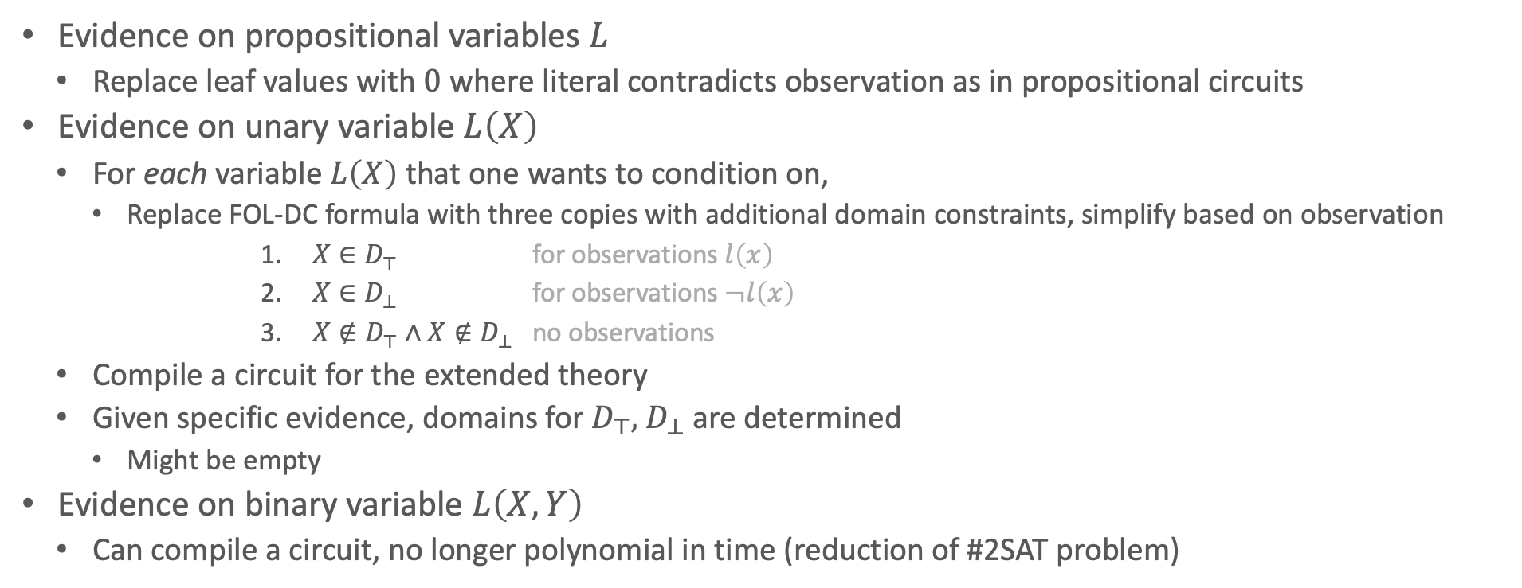
Conditioning in FO Circuits
Evidence on propositional variables $L$
  Replace leaf values with $0$ where literal contradicts observation as in propositional circuits
Evidence on unary variable $L\left(X\right)$
  For each variable $L\left(X\right)$ that one wants to condition on,
    Replace FOL-DC formula with three copies with additional domain constraints, simplify based on observation
      $X∈D_{⊤}$ for observations $l\left(x\right)$
      $X∈D_{⊥}$ for observations $¬l\left(x\right)$
      $X∉D_{⊤}∧X∉D_{⊥}$ no observations
  Compile a circuit for the extended theory
  Given specific evidence, domains for $D_{⊤},$ $D_{⊥}$ are determined
    Might be empty
Evidence on binary variable $L\left(X,Y\right)$
  Can compile a circuit, no longer polynomial in time (reduction of #2SAT problem)
Guy Van den Broeck and Jesse Davis: Conditioning in First-Order Knowledge Compilation and Lifted Probabilistic Inference. In: AAAI-12 Proceedings of the 26th AAAI Conference on Artificial Intelligence, 2012.

Slide 38


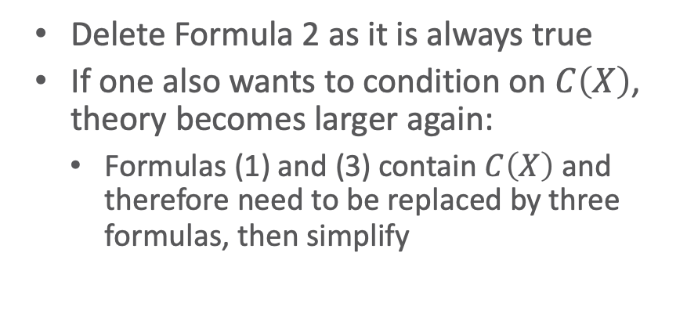












Conditioning in FO Circuits
E.g., $∀X∈\text{People} :s\left(X\right)⇒c\left(X\right)$ and $S\left(X\right)$
  $∀X∈{\text{People}}_{⊤} :s\left(X\right)⇒c\left(X\right)≡∀X∈{\text{People}}_{⊤} :c\left(X\right)$
  $∀X∈{\text{People}}_{⊥} :s\left(X\right)⇒c\left(X\right)≡∀X∈{\text{People}}_{⊥} :true$
  $∀X∈\text{People},X∉{\text{People}}_{⊤}, X∉{\text{People}}_{⊥} :s\left(X\right)⇒c\left(X\right)$
$$s\left(X\right)$$
$$¬s\left(X\right)$$
$$∧$$
  Delete Formula 2 as it is always true
  If one also wants to condition on $C\left(X\right)$, theory becomes larger again:
    Formulas (1) and (3) contain $C\left(X\right)$ and therefore need to be replaced by three formulas, then simplify
$$∀X \\ X∈{\text{People}}_{⊤}$$
$$∀X \\ X∈{\text{People}}^{′}$$
$$∨$$
$$∧$$
$$∨$$
$$∧$$
$$c\left(X\right)$$
$$c\left(X\right)$$
$$s\left(X\right)$$
$$¬s\left(X\right)$$
$$¬c\left(X\right)$$

Slide 39

First-order Knowledge Compilation (FOKC)
Given
  Theory $Δ$ in FOL-DC in Skolem NNF
  Weight function $w_{T}$ for positive predicates, weight function $w_{F}$ for negative predicates
  Set of queries ${\left\{P\left(q_{i}|e\right)\right\}}_{i=1}^{m}$
Build a WFOMC circuit $𝒞_{Δ}$ for $Δ$, also preparing for evidence on $rv\left(e\right)$
Condition on $e$
Calculate $WFOMC\left(Δ∧e,w_{T}, w_{F}\right)$ in $𝒞_{Δ}$
For each query $P\left(q_{i}|e\right)$
  Build a WFOMC circuit $𝒞_{Δ,q_{i}}$ for $Δ∧q_{i}$ conditioned on $e$
  Compute $WFOMC\left(Δ∧e∧q_{i},w_{T}, w_{F}\right)$ in $𝒞_{Δ,q_{i}}$
  Return or store $P\left(q_{i}|e\right)=\frac{WFOMC\left(Δ∧e∧q_{i},w_{T}, w_{F}\right)}{WFOMC\left(Δ∧e,w_{T}, w_{F}\right)}$
FOKC

Slide 40

MLNs for WFOMCs
Weights in MLNs specified for formulas instead of single predicates
  E.g., example from the beginning
    $\left(\ln{7}, travel(X)∧epid∧sick\left(X\right)\right),$
    $\left(\ln{2}, ¬travel(X)∨¬epid∨¬sick\left(X\right)\right)$
Trick:
  Introduce a new predicate $θ_{i}$ containing all free variables of $ψ_{i}$ as equivalent to $ψ_{i}$
    $∀X∈\text{People} : θ_{1}\left(X\right)⇔\left(travel(X)∧epid∧sick\left(X\right)\right)$
    $∀X∈\text{People} :θ_{2}\left(X\right)⇔\left(¬travel(X)∨¬epid∨¬sick\left(X\right)\right)$
  Specify weight functions such that $θ_{i}$ takes the weight of $ψ_{i}$
    $w_{T}\left(θ_{1}\left(X\right)\right)=\exp\left(\ln{7}\right)=7$
    $w_{T}\left(θ_{2}\left(X\right)\right)=\exp\left(\ln{2}\right)=2$
    All other predicates and $¬θ_{1},¬θ_{2}$ are mapped to $1$ by both $w_{T},w_{F}$

Slide 41

WFOMC Reduction
Formally, given an MLN $Ψ={\left\{\left(w_{i}, ψ_{i}\right)\right\}}_{i=1}^{n}$
  Transform each weighted formula $\left(w_{i}, ψ_{i}\right)$ into an FOL-DC formula
  $$∀X_{i},cs_{i} :θ_{i}\left(X_{i}\right)⇔ψ_{i}$$
  where
    $X_{i}$ are the free variables in $ψ_{i}$
    $cs_{i}$ is the constraint set that enforces the domain constraints as given by the MLN
    $θ_{i}\left(X_{i}\right)$ is a new predicate containing all free variables of $ψ_{i}$
  Specify weight functions $w_{T},w_{F}$ such that for each
    $w_{T}\left(θ_{i}\left(X_{i}\right)\right)=\exp\left(w_{i}\right)$
    $w_{T}\left(p_{i}\right)=1$ for all predicates $p_{i}$ occurring in $Ψ$
    $w_{F}\left(θ_{i}\left(X_{i}\right)\right)=1$
Continue with knowledge compilation

Slide 42

Example
Given
  $\left(\ln{7}, travel(X)∧epid∧sick\left(X\right)\right)$
  $\left(\ln{2}, ¬travel(X)∨¬epid∨¬sick\left(X\right)\right)$
Resulting theory ($t=travel,e=epid,s=sick$)
  $∀X∈\text{People} : θ_{1}\left(X\right)⇔\left(t(X)∧e∧s\left(X\right)\right)$
  $∀X∈\text{People} :θ_{2}\left(X\right)⇔\left(¬t\left(X\right)∨¬e∨¬s\left(X\right)\right)$
  with weight functions
    $w_{T}\left(θ_{1}\left(X\right)\right)=7$
    $w_{T}\left(θ_{2}\left(X\right)\right)=2$
    Rest mapped to $1$ by both $w_{T},w_{F}$
Transform formulas into CNF

Slide 43

Example: Normal Form
Transform formulas into CNF: $∀X∈\text{People} : θ_{1}\left(X\right)⇔\left(t(X)∧e∧s\left(X\right)\right)$
  Result (each conjunct as own formula):
    $∀X∈\text{People} :¬θ_{1}\left(X\right)∨t\left(X\right)$
    $∀X∈\text{People} :¬θ_{1}\left(X\right)∨e$
    $∀X∈\text{People} :¬θ_{1}\left(X\right)∨s\left(X\right)$
    $∀X∈\text{People} :θ_{1}\left(X\right)∨¬t(X)∨¬e∨¬s\left(X\right)$
$≡ θ_{1}\left(X\right)⇔\left(t(X)∧e∧s\left(X\right)\right)$ (resolve $⇔$)
$≡\left(θ_{1}\left(X\right)⇒\left(t\left(X\right)∧e∧s\left(X\right)\right)\right) ∧\left(θ_{1}\left(X\right)⇐\left(t(X)∧e∧s\left(X\right)\right)\right)$ (De Morgan on $⇒$)
$≡\left(¬θ_{1}\left(X\right)∨\left(t(X)∧e∧s\left(X\right)\right)\right)∧\left(θ_{1}\left(X\right)∨¬\left(t(X)∧e∧s\left(X\right)\right)\right)$ (move $¬$ inward)
$≡\left(¬θ_{1}\left(X\right)∨\left(t\left(X\right)∧e∧s\left(X\right)\right)\right)∧\left(θ_{1}\left(X\right)∨¬t\left(X\right)∨¬e∨¬s\left(X\right)\right)$ (distribute $∨$)
$≡\left(¬θ_{1}\left(X\right)∨t\left(X\right)\right)∧\left(¬θ_{1}\left(X\right)∨e\right)∧\left(¬θ_{1}\left(X\right)∨s\left(X\right)\right)∧\left(θ_{1}\left(X\right)∨¬t(X)∨¬e∨¬s\left(X\right)\right)$ (CNF)

Slide 44

Example: Normal Form
Transform formulas into CNF: $∀X∈\text{People} : θ_{2}\left(X\right)⇔\left(¬t\left(X\right)∨¬e∨¬s\left(X\right)\right)$
  Result (each conjunct as own formula):
    $∀X∈\text{People} :¬θ_{2}\left(X\right)∨¬t\left(X\right)∨¬e∨¬s\left(X\right)$
    $∀X∈\text{People} :θ_{2}\left(X\right)∨t\left(X\right)$
    $∀X∈\text{People} :θ_{2}\left(X\right)∨e$
    $∀X∈\text{People} :θ_{2}\left(X\right)∨s\left(X\right)$
$≡ θ_{2}\left(X\right)⇔\left(¬t\left(X\right)∨¬e∨¬s\left(X\right)\right)$
$≡\left(θ_{2}\left(X\right)⇒\left(¬t\left(X\right)∨¬e∨¬s\left(X\right)\right)\right) ∧\left(θ_{2}\left(X\right)⇐\left(¬t\left(X\right)∨¬e∨¬s\left(X\right)\right)\right)$
$≡\left(¬θ_{2}\left(X\right)∨¬t\left(X\right)∨¬e∨¬s\left(X\right)\right)∧\left(θ_{2}\left(X\right)∨¬\left(¬t\left(X\right)∨¬e∨¬s\left(X\right)\right)\right)$
$≡\left(¬θ_{2}\left(X\right)∨¬t\left(X\right)∨¬e∨¬s\left(X\right)\right)∧\left(θ_{2}\left(X\right)∨\left(t\left(X\right)∧e∧s\left(X\right)\right)\right)$
$≡\left(¬θ_{2}\left(X\right)∨¬t\left(X\right)∨¬e∨¬s\left(X\right)\right)∧\left(θ_{2}\left(X\right)∨t\left(X\right)\right)∧\left(θ_{2}\left(X\right)∨e\right)∧\left(θ_{2}\left(X\right)∨s\left(X\right)\right)$

Slide 45

Example: FO d-DNNF Circuit
Given theory in CNF
  $∀X∈\text{People} :¬θ_{1}\left(X\right)∨t\left(X\right)$
  $∀X∈\text{People} :¬θ_{1}\left(X\right)∨e$
  $∀X∈\text{People} :¬θ_{1}\left(X\right)∨s\left(X\right)$
  $∀X∈\text{People} :θ_{1}\left(X\right)∨¬t(X)∨¬e∨¬s\left(X\right)$
  $∀X∈\text{People} :¬θ_{2}\left(X\right)∨¬t\left(X\right)∨¬e∨¬s\left(X\right)$
  $∀X∈\text{People} :θ_{2}\left(X\right)∨t\left(X\right)$
  $∀X∈\text{People} :θ_{2}\left(X\right)∨e$
  $∀X∈\text{People} :θ_{2}\left(X\right)∨s\left(X\right)$
Resulting FO d-DNNF circuit generated by the FOKC implementation
  Some leaves repeated for readability

Slide 46















Example: FO d-DNNF Circuit
$$∨$$
$$∧$$
$$¬e$$
Given theory in CNF
  $∀X∈\text{People} :$
  $¬θ_{2}\left(X\right)∨¬t\left(X\right)∨¬s\left(X\right)∨¬e$
  $∀X∈\text{People} :$
  $θ_{1}\left(X\right)∨¬t(X)∨¬e∨¬s\left(X\right)$
  $∀X∈\text{People} :¬θ_{1}\left(X\right)∨t\left(X\right)$
  $∀X∈\text{People} :¬θ_{1}\left(X\right)∨e$
  $∀X∈\text{People} :¬θ_{1}\left(X\right)∨s\left(X\right)$
  $∀X∈\text{People} :θ_{2}\left(X\right)∨t\left(X\right)$
  $∀X∈\text{People} :θ_{2}\left(X\right)∨e$
  $∀X∈\text{People} :θ_{2}\left(X\right)∨s\left(X\right)$
$$∀X \\ X∈{\text{People}}^{′}$$
$$e$$
$$∨$$
$$∧$$
$$¬s\left(X\right)$$
$$s\left(X\right)$$
$$∨$$
$$∧$$
$$¬t\left(X\right)$$
$$t\left(X\right)$$
$$¬θ_{2}\left(X\right)$$

Slide 47














Example: FO d-DNNF Circuit
$$∨$$
$$∧$$
$$¬e$$
Given theory in CNF
  $∀X∈\text{People} :$
  $¬θ_{2}\left(X\right)∨¬t\left(X\right)∨¬s\left(X\right)∨¬e$
  $∀X∈\text{People} :$
  $θ_{1}\left(X\right)∨¬t(X)∨¬e∨¬s\left(X\right)$
  $∀X∈\text{People} :¬θ_{1}\left(X\right)∨t\left(X\right)$
  $∀X∈\text{People} :¬θ_{1}\left(X\right)∨e$
  $∀X∈\text{People} :¬θ_{1}\left(X\right)∨s\left(X\right)$
  $∀X∈\text{People} :θ_{2}\left(X\right)∨t\left(X\right)$
  $∀X∈\text{People} :θ_{2}\left(X\right)∨e$
  $∀X∈\text{People} :θ_{2}\left(X\right)∨s\left(X\right)$
$$∀X \\ X∈{\text{People}}^{′}$$
$$e$$
$$∨$$
$$∧$$
$$¬s\left(X\right)$$
$$s\left(X\right)$$
$$∨$$
$$∧$$
$$¬t\left(X\right)$$
$$t\left(X\right)$$
$$¬θ_{2}\left(X\right)$$
$$∧$$
$$θ_{1}\left(X\right)$$
$$¬θ_{2}\left(X\right)$$

Slide 48










Example: FO d-DNNF Circuit
    Not smooth since
      Right branch of root $∨$ misses $s\left(X\right),t\left(X\right)$
      Right branch of $∨$ after $∀X$ misses $t\left(X\right)$
$$∨$$
$$e$$
$$∧$$
Given theory in CNF
  $∀X∈\text{People} :$
  $¬θ_{2}\left(X\right)∨¬t\left(X\right)∨¬s\left(X\right)∨¬e$
  $∀X∈\text{People} :$
  $θ_{1}\left(X\right)∨¬t(X)∨¬e∨¬s\left(X\right)$
  $∀X∈\text{People} :¬θ_{1}\left(X\right)∨t\left(X\right)$
  $∀X∈\text{People} :¬θ_{1}\left(X\right)∨e$
  $∀X∈\text{People} :¬θ_{1}\left(X\right)∨s\left(X\right)$
  $∀X∈\text{People} :θ_{2}\left(X\right)∨t\left(X\right)$
  $∀X∈\text{People} :θ_{2}\left(X\right)∨e$
  $∀X∈\text{People} :θ_{2}\left(X\right)∨s\left(X\right)$
$$¬e$$
$$θ_{2}\left(X\right)$$
$$∧$$
$$¬θ_{1}\left(X\right)$$
$$θ_{2}\left(X\right)$$

Slide 49

Example: Smoothed FO d-DNNF Circuit
As generated by the FOKC implementation
  Grey parts new to not-smoothed version
    Abbreviated depiction of $p∨¬p$ in one node
    Not-smoothed version for comparison ⇩

Slide 50

Theoretical Results
Compilation independent of domain sizes
  Just like construction of FO jtree is also independent of domain sizes
Inference
  Polynomial in domain sizes
    Based on the computations that are computed at different node types
Completeness as before
  $ℳ^{2lv}$
    Two-logvar theories with max. two logical variables per formula
  $ℳ^{1prv}$
    One logical variable per predicate

Slide 51
Implementation
Available at
  https://github.com/UCLA-StarAI/Forclift
    May no longer work according to Guy so you may have to try
      https://github.com/tanyabraun/wfomc
  Officially three input formats
    Based on the normal form required (.wmc)
    Early version of parfactor graphs (.fg)
    MLN version (.mln)
    ➝ MLN file format only one I got the compiled version to parse

Slide 52












Runtimes: Increasing Domain Sizes
$$Nat\left(D\right)$$
$$Acc\left(I\right)$$
$$g_{1}$$
$$Epid$$
$$g_{0}$$
Example model with all domain sizes $∈\{2,4,…,20, 30, …,100, 200, …,1000\}$
No evidence
Queries: $P\left(Travel\left(x_{1}\right)\right)$, $P\left(Sick\left(x_{1}\right)\right)$, $P\left(Treat\left(x_{1},m_{1}\right)\right)$, $P\left(Nat\left(d_{1}\right)\right)$, $P\left(Man\left(w_{1}\right)\right)$, $P\left(Epid\right)$
Compare query answering times of different inference algorithms
  Propositional: VE, JT
  Lifted: LVE, LJT, FOKC
    Compare trade-off (overhead vs. fast inference) between single / multi-query algs.
$$Travel\left(X\right)$$
$$Treat\left(X,M\right)$$
Test
  Increasing
    Ground width $w_{g}$
      Default: 3
    Counting width $w_{\#}$
      Default: 1
    Number of nodes $n_{J}$
      Default: 3
    Domain size $n$
      Default: 1000
    Based on $O\left(n_{J}∙\log_{2}\left(n\right)∙r^{w_{g}}∙n^{r_{\#}w_{\#}}\right)$
$$g_{2}$$
$$g_{3}$$
$$Sick\left(X\right)$$

Slide 53





Queries
Answering
compile: all overhead time
FOKC almost invariant w.r.t. domain sizes whereas count conversion hits LVE-based algorithms
$n$ ranging from $2$ to $1000$
$n_{J}$ ranging from $2$ to $11$
FOKC does not build histograms, which blow up the representation for LVE-based algs.
$w_{g}$ ranging from $2$ to $11$
$w_{\#}$ ranging from $0$ to $9$
Runtimes in milliseconds
Default: $n=1000,n_{J}=3,w_{g}=3, w_{\#}=1$
Notes:
Compile time:
LJT: jtree construction, evidence handling, message passing
FOKC: circuit construction, conditioning, message pass for normalisation constant
QA time:
LJT: LVE on cluster
FOKC: query circuit construction, message pass (if query construction considered compile time, then compile time almost as indicated and minimal QA time)

Slide 54


Trade-off Evaluation: Criteria
For multi-query algorithms
  Overhead to set off (model is compiled into a helper structure)
  vs.
  Shorter individual query answering time
With
  $t_{q,cpl}$ runtime for answering single query with an algorithm that uses compilation
  $t_{q,uncpl}$runtime for answering single query with an algorithm without compilation
  $t_{c,cpl}$ runtime for compilation with an algorithm that uses compilation
  What is the ratio between individual query answering times?
  $$α=\frac{t_{q,cpl}}{t_{q,uncpl}}$$
  How many queries does it take to offset the overhead?
  $$β=\frac{t_{c,cpl}}{t_{q,uncpl}−t_{q,cpl}}$$
    Makes only sense if $α>1$

Slide 55

Trade-off
$n$ ranging from $2$ to $1000$
$n_{J}$ ranging from $2$ to $11$
$w_{g}$ ranging from $2$ to $11$
$w_{\#}$ ranging from $0$ to $9$
Default: $n_{J}=3,w_{g}=3, w_{\#}=1$

Slide 56
Probabilistic Theorem Proving (PTP)
Based on theorem proving in logics
Solves lifted weighted model counting problem
  Similar to the weighted first-order model counting problem by Guy Van den Broeck
  MLNs as input
Implementation available: Alchemy
  http://alchemy.cs.washington.edu
  Input format: MLNs
Vibhav Gogate and Pedro Domingos: Probabilistic Theorem Proving. In: UAI-11 Proceedings of the 27th Conference on Uncertainty in Artificial Intelligence, 2011.

Slide 57
LJT as a Framework (SKIPPED)
Remember: LJT only specifies a helper structure and steps
  I.e., no specific inference algorithm as a subroutine for its calculations
Requirements for subroutine
  Lifted evidence handling
  Lifted message calculation
    Message = parameterised queries over separators
  Lifted query answering
LJTKC: LJT with LVE & FOKC
  LVE for evidence entering and message passing
  FOKC for query answering
    Only for Boolean PRVs
    Only for single query terms
Calculated lifted? | LVE | FOKC
Evidence | ✓ | ✓
Messages | ✓ | ✗*
Queries | ✓ | ✓
* Not obvious how parameterised queries are handled in circuits
Tanya B and Ralf Möller. Fusing First-order Knowledge Compilation and the Lifted Junction Tree Algorithm. In Proceedings of KI 2018: Advances in Artificial Intelligence, 2018.

Slide 58

LJTKC: Algorithm (SKIPPED)
$LJTKC\left(G, {\left\{Q_{i}\right\}}_{i=1}^{n},{\left\{g_{e}\right\}}_{e=1}^{m}\right)$
  Construct an FO jtree $J$ for $G$
  Enter evidence ${\left\{g_{e}\right\}}_{e=1}^{m}$ into $J$
  Pass message in $J$
  for each parcluster $C_{j}$ in $J$ do
  Transform local model $G_{j}$ into an MLN $Ψ_{j}$
  Transform $Ψ_{j}$ into a theory $Δ_{j}$ in CNF with weight functions $w_{T},w_{F}$
  Build a circuit $𝒞_{j}$ for $Δ_{j}$
  Compute $c_{j}=WFOMC\left(Δ_{j},w_{T},w_{F}\right)$ in $𝒞_{j}$
  for each query term $Q_{i}$ do
  Build a circuit $𝒞_{j,q}$ for $Δ_{j}∧q_{i}$
  Compute $c_{q}=WFOMC\left(Δ_{j}∧q_{i},w_{T},w_{F}\right)$ in $𝒞_{j,q}$
  Return or store $\frac{c_{q}}{c_{j}}$

Slide 59

Summary
Propositional (weighted) model counting
  WMC definition
  Circuits:
    Inner nodes: conjunctions/disjunctions
    Leaves: literals, $true$, $false$
    Properties: d-DNNF, smooth
    Model counts, WMC by propagation
  Knowledge compilation: Inference in circuits, i.e., query answering by weighted model counting in circuits
Lifted (weighted) model counting
  WFOMC definition
  FO circuits: Inner nodes can also be set conjunctions/disjunctions
  FOKC: Inference in FO circuits
  FOKC for query answering in LJT (skipped)

Slide 60
Outline: 4. Lifted Inference
Exact Inference
  Lifted Variable Elimination for Parfactor Models
    Idea, operators, algorithm, complexity
  Lifted Junction Tree Algorithm
    Idea, helper structure: junction tree, algorithm
  First-order Knowledge Compilation for MLNs
    Idea, helper structure: circuit, algorithm
Approximate Inference: Sampling
  Direct sampling: Rejection sampling, (lifted) importance sampling
  (Lifted) Markov Chain Monte Carlo sampling

