Slide 1
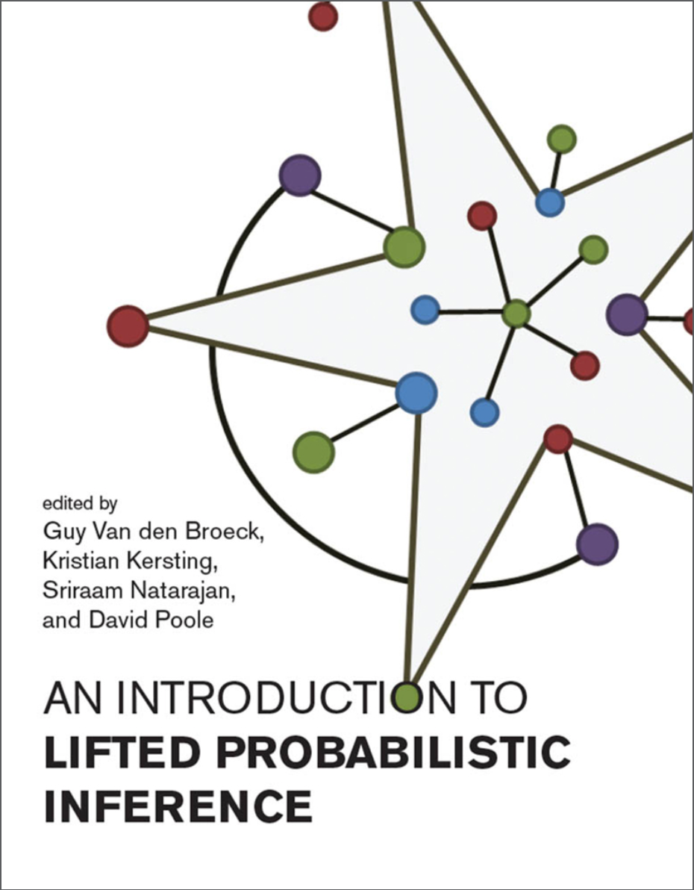
Dynamic Probabilistic Relational Models
Overview

Slide 2
Administrative Stuff: Lecture
Module: Lectures on Data Science and KI
  Module numbers: CS5070-KP04
  2+1 SWS
Lecture:
Dynamic Probabilistic Relational Models
  More specifically, probabilistic relational models and lifted probabilistic inference
Seminar: tdb
Room
  Lecture hall ITSC 2021

Slide 3
Administrative Stuff: Exam
Oral exam
  Date: probably 31.07-4.08
Conditions for participation
  Registration in Moodle
  Seminar presentation

Slide 4
Contents (preliminary)
Introduction
  StaRAI: Agent, context, motivation
Foundations
  Logic
  Probability theory
  Probabilistic graphical models (PGMs)
Probabilistic Relational Models (PRMs)
  Parfactor models, Markov logic networks
  Semantics, inference tasks
Exact Lifted Inference
  Lifted Variable Elimination
  Lifted Junction Tree Algorithm
  First-Order Knowledge Compilation
Lifted Sequential Models and Inference
  Parameterised models
  Semantics, inference tasks, algorithm
Lifted Decision Making
  Preferences, utility
  Decision-theoretic models, tasks, algorithm
Approximate Lifted Inference
Lifted Learning
  Parameter learning
  Relation learning
  Approximating symmetries

Slide 5
Goals
On a technical level
  Understand and explain the modelling, algorithm, solution approach, …
  in terms of
    Main idea
    Use cases
    Advantages / disadvantages
  Understand and explain the connection between the different models and algorithms
On a more general level
  Assess problems and current research in the context of artificial intelligence
  Insight into combining apparently diametrically opposed disciplines (here logic & probability)
Get a well-rounded overview of different aspects of lifted inference up to state-of-the art research (we should get up to at least 2020)

Slide 6
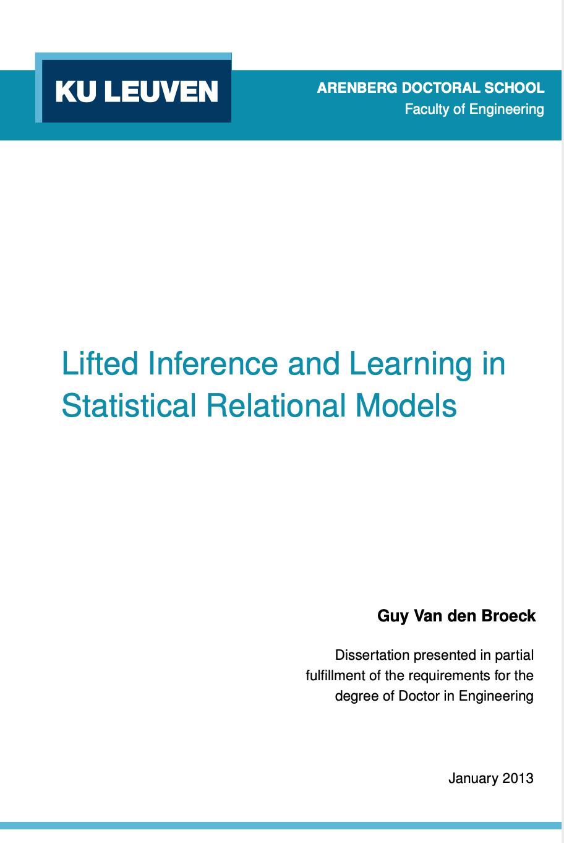
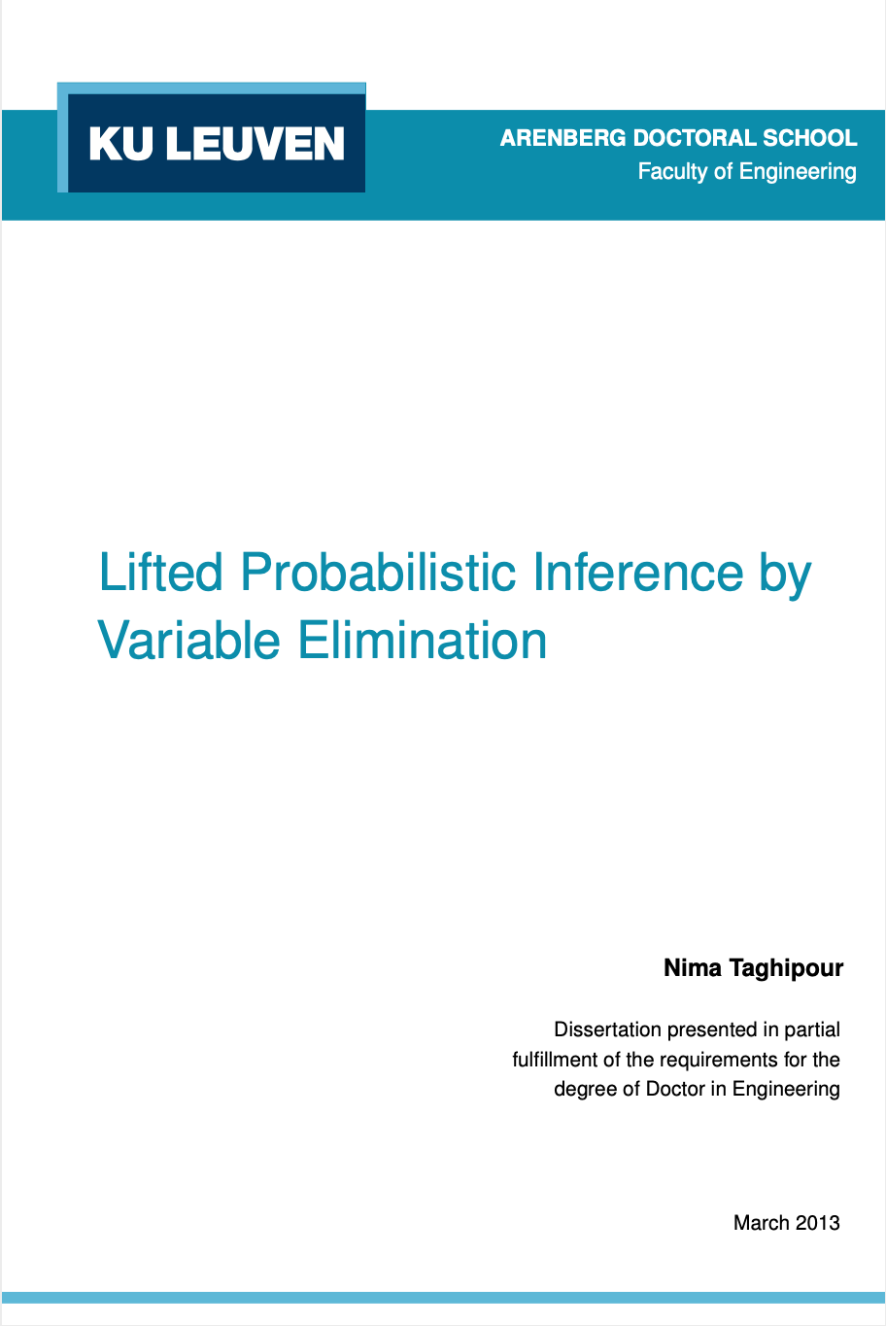
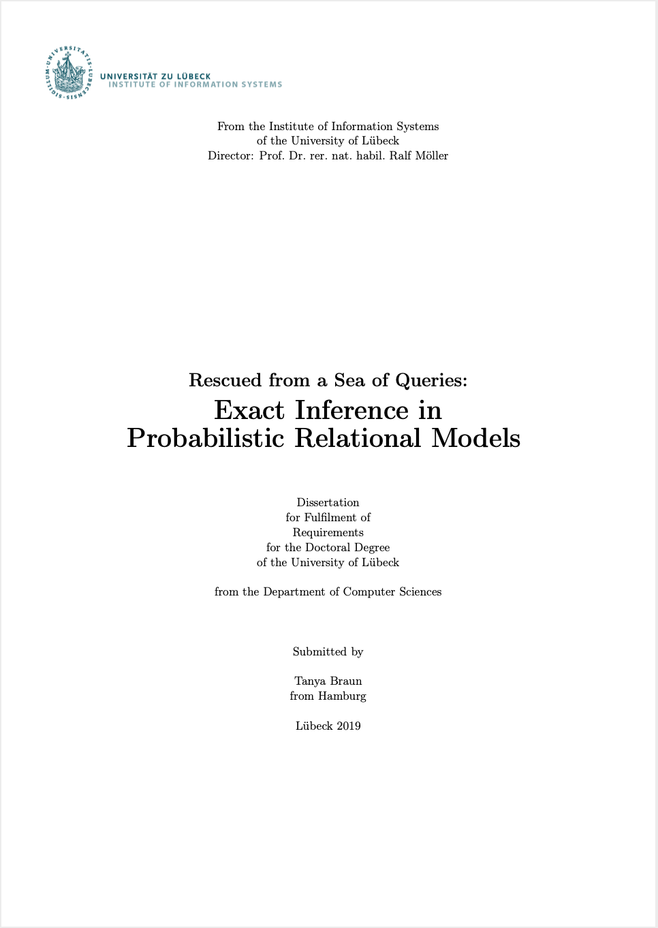
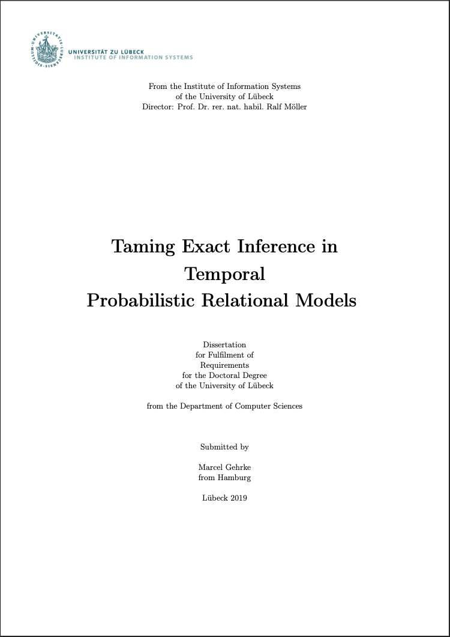
Main Sources
Further research papers referenced in slides
Lifted Inference and Learning in Statistical Relational Models
  Guy Van den Broeck, PhD thesis, 2013
Lifted Probabilistic Inference by Variable Elimination
  Nima Taghipour, PhD thesis, 2013
Rescued from a Sea of Queries: Exact Inference in Probabilistic Relational Models
  Tanya Braun, PhD thesis, 2020
Taming Exact Inference in Temporal Probabilistic Relational Models
  Marcel Gehrke, PhD thesis, 2022
http://web.cs.ucla.edu/~guyvdb/phd/guyvdb-phdthesis.pdf
https://lirias.kuleuven.be/1656026?limo=0
https://www.ifis.uni-luebeck.de/~braun/Diss/Braun_diss.pdf
https://www.ifis.uni-luebeck.de/uploads/tx_wapublications/Diss_Gehrke_public_02.pdf
Notes:
Main sources for this course

Slide 7
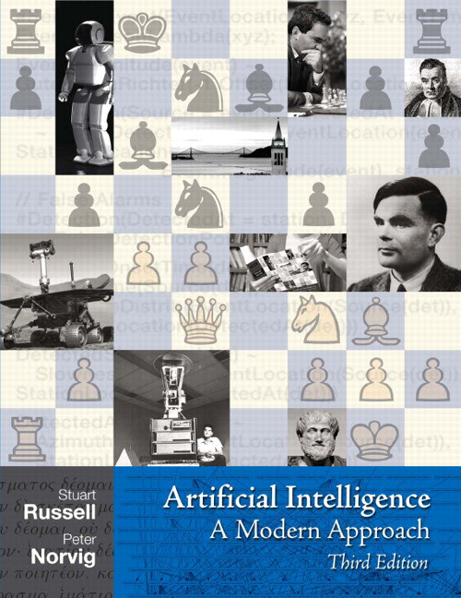
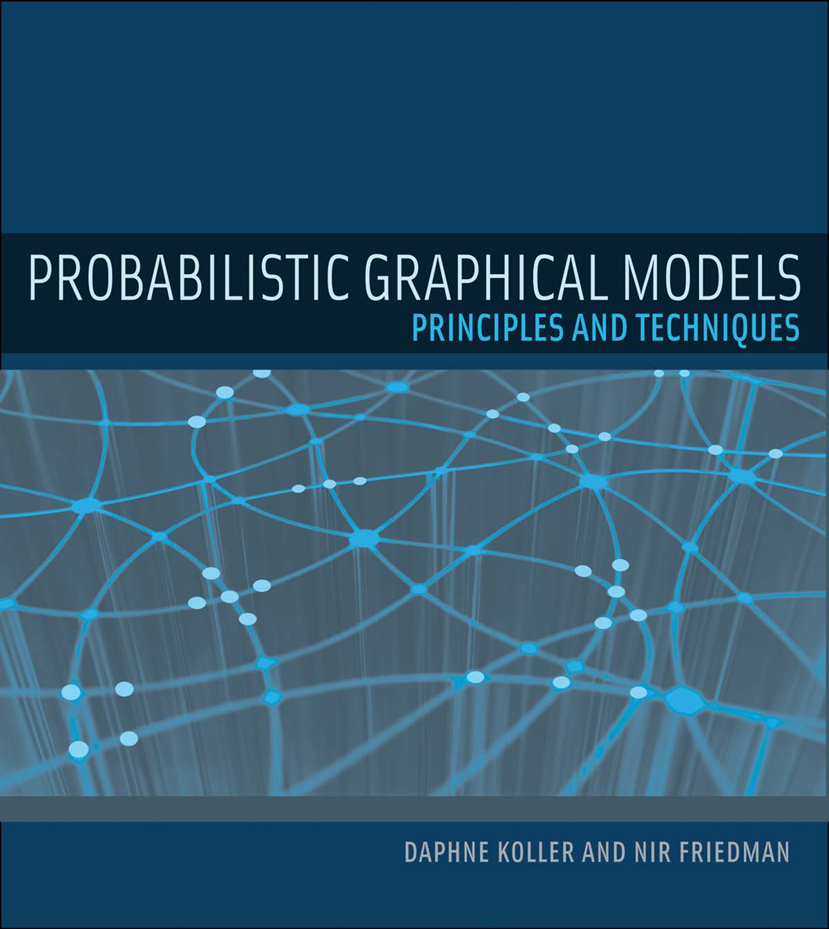
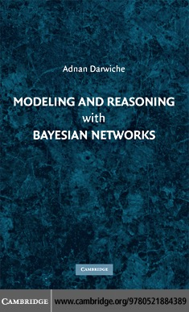
Literature: Introductory Books & Books on Foundations
Artificial Intelligence – A Modern Approach (3rd ed.)
  Stuart Russell, Peter Norvig
  Basics on agents, logic, reasoning under uncertainty
Probabilistic Graphical Models
  Daphne Koller, Nir Friedman
  General PGMs for reasoning under uncertainty
Modelling and Reasoning with Bayesian Networks
  Adnan Darwiche
  BNs for reasoning under uncertainty
http://aima.cs.berkeley.edu
https://mitpress.mit.edu/books/probabilistic-graphical-models
https://www.cambridge.org/core/books/modeling-and-reasoning-with-bayesian-networks/8A3769B81540EA93B525C4C2700C9DE6
Notes:
Find online

Slide 8
Literature: Books on StaRAI
Introduction to Statistical Relational Learning
  Editors:
  Lise Getoor, Ben Taskar
An Introduction to Lifted Probabilistic Inference
  Editors:
  Guy Van den Broeck, Kristian Kersting, Sriraam Natarajan, David Poole
https://mitpress.mit.edu/books/introduction-statistical-relational-learning
https://mitpress.mit.edu/books/introduction-lifted-probabilistic-inference
Notes:
Find online

Slide 9
Note
The lecture is new in this format (and with that, the slides and seminar)!
  The slides are based on two different versions of this lecture by Tanya Braun
    One focusing on the PGM part (https://www.ifis.uni-luebeck.de/index.php?id=703 )
    The other focusing more on the bigger picture and agents as a 3+1 lecture (https://www.uni-muenster.de/Informatik.AGBraun/teaching/wise22/starai.html)
What does that mean for this lecture?
  There might be changes in the structure
    Current structure is coherent but there might be other interesting things coming up or time runs out
  There most certainly will be typos, although we try our best to eliminate them
  Graphs or examples that appeared reasonable at the time might actually not be, which we might find out during the lecture
If you find errors or have suggestions, please do not hesitate to tell us!

Slide 10
Contents (preliminary)
Introduction
  StaRAI: Agent, context, motivation
Foundations
  Logic
  Probability theory
  Probabilistic graphical models (PGMs)
Probabilistic Relational Models (PRMs)
  Parfactor models, Markov logic networks
  Semantics, inference tasks
Exact Lifted Inference
  Lifted Variable Elimination
  Lifted Junction Tree Algorithm
  First-Order Knowledge Compilation
Lifted Sequential Models and Inference
  Parameterised models
  Semantics, inference tasks, algorithm
Lifted Decision Making
  Preferences, utility
  Decision-theoretic models, tasks, algorithm
Approximate Lifted Inference
Lifted Learning
  Parameter learning
  Relation learning
  Approximating symmetries

