Slide 1
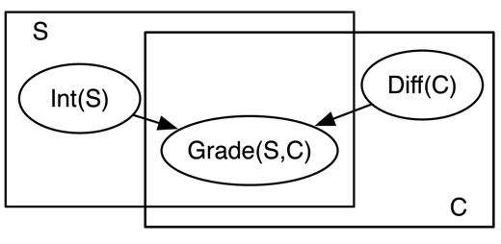
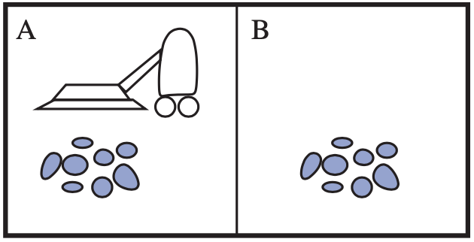


Dynamic Probabilistic Relational Models
Agent
Environment
Sensors
Percepts
?
Introduction
Actuators
Actions
$$∞ Presents\left(X, P, C\right)⇒Attends\left(X, C\right)$$
$$3.75 Publishes\left(X, C\right)∧FarAway\left(C\right)⇒Attends\left(X, C\right)$$

Slide 2
Contents
Introduction
  StaRAI: Agent, context, motivation
Foundations
  Logic
  Probability theory
  Probabilistic graphical models (PGMs)
Probabilistic Relational Models (PRMs)
  Parfactor models, Markov logic networks
  Semantics, inference tasks
Exact Lifted Inference
  Lifted Variable Elimination
  Lifted Junction Tree Algorithm
  First-Order Knowledge Compilation
Lifted Sequential Models and Inference
  Parameterised models
  Semantics, inference tasks, algorithm
Lifted Decision Making
  Preferences, utility
  Decision-theoretic models, tasks, algorithm
Approximate Lifted Inference
Lifted Learning
  Parameter learning
  Relation learning
  Approximating symmetries

Slide 3
Overview: 1. Introduction
Framework: Agent Theory
  Agent
Topic: StaRAI
  Motivation, context
  Relational examples, outlook on probabilistic relational models (PRMs)

Slide 4
Agent
Something that perceives its environment through sensors and acts through actuators
  Human agent
    Sensors: eyes, ears, further organs
    Actuators: hands, legs, mouth, other body parts
  Robot agent
    Sensors: cameras, infra-red sensors, etc.
    Actuators: motors
  Software agent
    Goal: document retrieval, DR
    Sensors: input interface for textual queries
    Actuators: output interface for documents
Agent
Environment
Sensors
Percepts
?
Actions
Actuators
S. Russel and P. Norvig: Artificial Intelligence – A Modern Approach, 2020.

Slide 5
Performance Measure: Good Behaviour
What is the right thing to do?
  Agent generates sequence of actions given percepts
  Causes environment to go through sequence of states
  If sequence desirable / conforms to our expectations, then agent performed well
Performance measure that evaluates any given sequence of environment states
Agent
Environment
Sensors
Percepts
?
Actions
Actuators
S. Russel and P. Norvig: Artificial Intelligence – A Modern Approach, 2020.

Slide 6
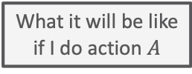
Agent Structure: Utility-based Agent
Utility as a distribution over possible states
  What we look at later in the lecture
  Essentially an internalisation of the performance measure
    If internal utility function agrees with external performance measure:
    Agent that chooses actions to maximize its utility will be rational according to the external performance measure
Agent
Environment
Sensors
State
What the world
is like now
How the world evolves
What my actions do
What it will be like
if I do action $A$
Utility
How happy I will be
in such a state
What action I
should do now
Actuators
S. Russel and P. Norvig: Artificial Intelligence – A Modern Approach, 2020.
Notes:
Conflicting goals ➝ allows for trade-off
Several goals that each cannot be reached with certainty ➝ weigh likelihood of success against importance of goals

Slide 7
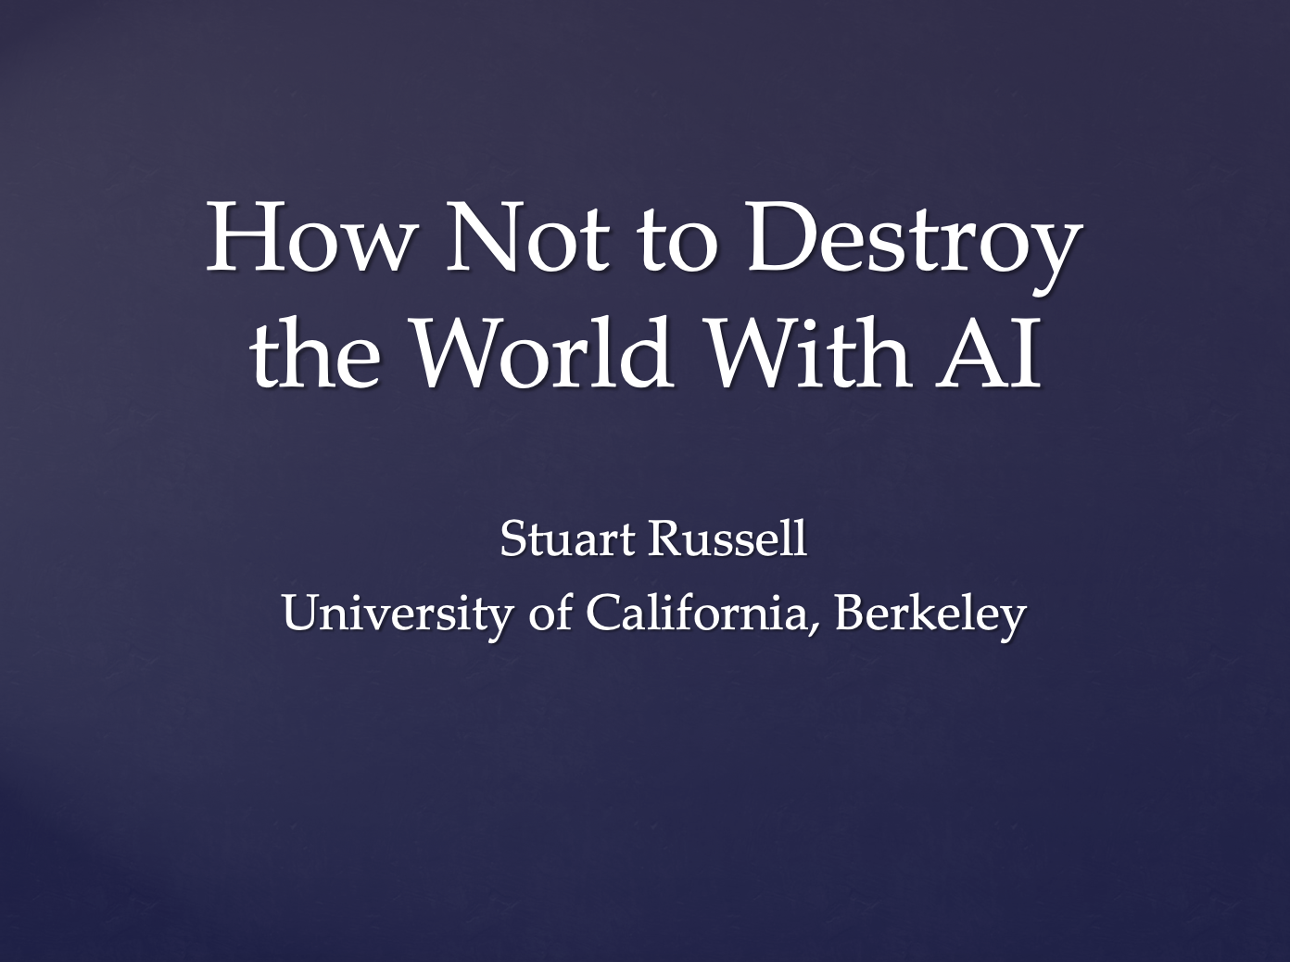
Side Note: Current Research
Idea:
    Humans: intelligent to the extent that our actions can be expected to achieve our goals
    Machines: intelligent to the extent that their actions can be expected to achieve their goals
    Machines are beneficial to the extent that their actions can be expected to achieve our goals n
  Approach: Performance measure unknown, human as assistant
Goal: Provably beneficial AI
  See for example Stuart Russell
Human goal
Human behaviour
Agent behaviour
Presentation: https://www.youtube.com/watch?v=QPSgM13hTK8
Slides: https://people.eecs.berkeley.edu/~russell/talks/2020/russell-aaai20-hntdtwwai-4x3.pptx

Slide 8
Overview: 1. Introduction
Framework: Agent Theory
  Agent
Topic: StaRAI
  Motivation, context
  Relational examples, outlook on probabilistic relational models (PRMs)

Slide 9
Take Your Spreadsheet …
Features
Objects
Kristian Kersting. Statistical Relational AI. Tutorial at KI 2018.

Slide 10

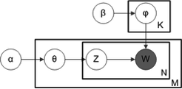
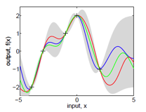
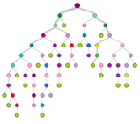
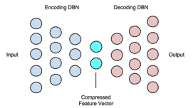
… and Apply Some AI/Machine Learning Methods
Features
Big Data Matrix Factorization
Latent Dirichlet Allocation
Is it really that simple?
Objects
Gaussian Processes
Decision Trees/Boosting
Diffusion Models
and many more …
Autoencoder, Deep Learning
Kristian Kersting. Statistical Relational AI. Tutorial at KI 2018.

Slide 11
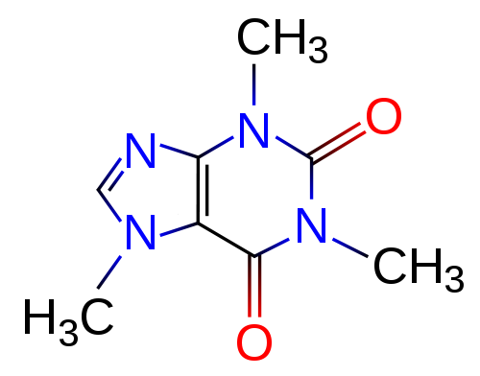
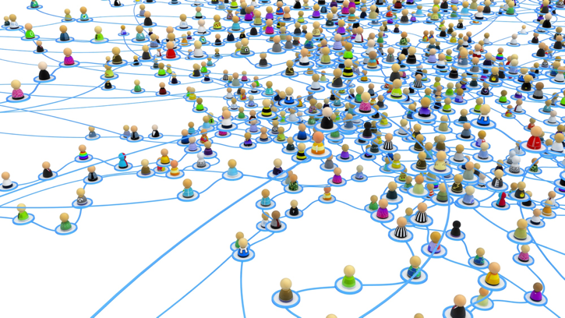
Learning and Mining with Graphs
Haussler ’99, Gärtner, Flach, Wrobel COLT’03, Vishwanathan, Schraudolph, Kondor, Borgwardt JMLR’10, Shervashidze, Schweitzer, van Leeuwen, Mehlhorn, Borgwardt JMLR’11, Neumann, Garnett, Bauckhage, Kersting MLJ’16, Morris, Kersting, Mutzel, ICDM´17, and many more
Kristian Kersting. Statistical Relational AI. Tutorial at KI 2018.

Slide 12
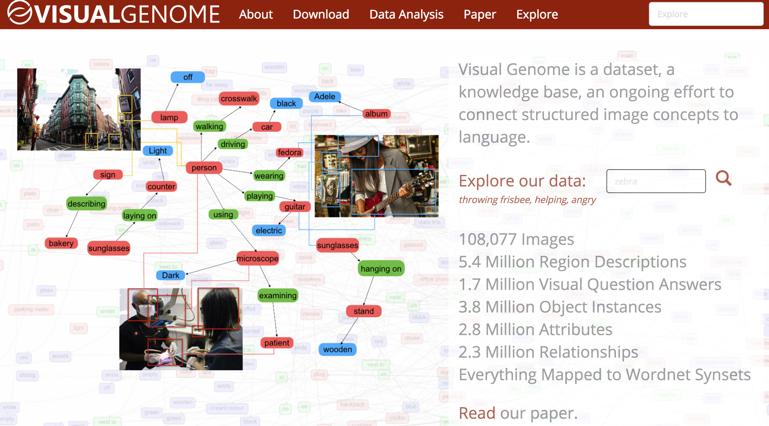
Complex data networks!
Examples not stored in a single table but in a large, heterogenous graph with attributes!
  Actually, most data in the world is stored in relational databases
[Lu, Krishna, Bernstein, Fei-Fei „Visual Relationship Detection“ CVPR 2016]
Kristian Kersting. Statistical Relational AI. Tutorial at KI 2018.

Slide 13

Heart diseases and strokes – cardiovascular disease – are expensive for the world
According to the World Heart Federation, cardiovascular disease cost the European Union €169 billion in 2003 and the USA about €310.23 billion in direct and indirect annual costs. By comparison, the estimated cost of all cancers is €146.19 billion and HIV infections, €22.24 billion
Nat Rev Genet. 2012 May 2;13(6):395-405
Electronic Health Records
A New Opportunity for AI
to Save Our Lives
Kristian Kersting. Statistical Relational AI. Tutorial at KI 2018.

Slide 14
Connection to AI, Agents, and Environments
AI: intelligent systems in the real world
The world has things in it!
The world is uncertain!
Probabilistic graphical models
First-order logic
The world is uncertain!
The world has things in it!
First-order probabilistic languages
Figure based on Stuart Russell
Notes:
Bayes nets, markov networks, factor graphs

Slide 15
Connection to AI, Agents, and Environments
AI: intelligent systems in the real world
The world has things in it!
The world is uncertain!
Probabilistic graphical models
First-order logic
The world is uncertain!
The world has things in it!
First-order probabilistic languages
Figure based on Stuart Russell
Notes:
Bayes nets, markov networks, factor graphs

Slide 16
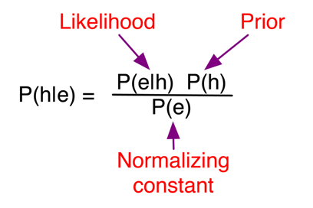
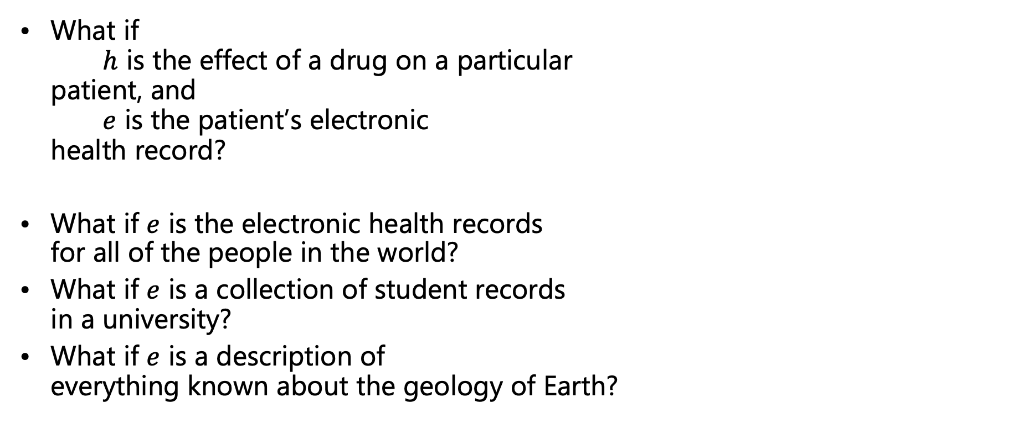
Example: Bayes’ Rule
What if
$h$ is the effect of a drug on a particular
patient, and
$e$ is the patient’s electronic
health record?
What if $e$ is the electronic health records
for all of the people in the world?
What if $e$ is a collection of student records
in a university?
What if $e$ is a description of
everything known about the geology of Earth?

Slide 17
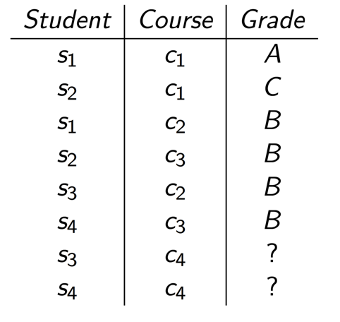
Example: Predicting Grades
Students s3 and s4 have the same averages, on courses with the same averages.
Which student would you expect to do better?

Slide 18
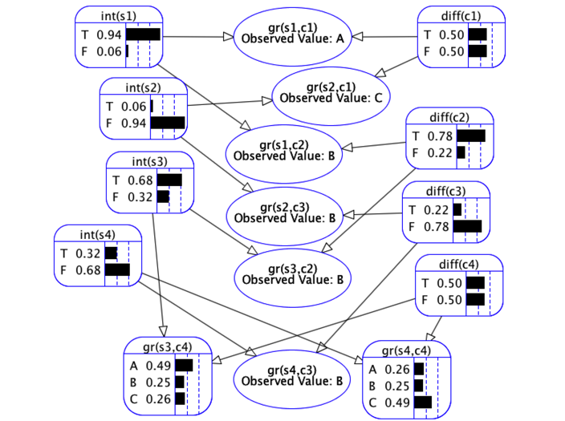
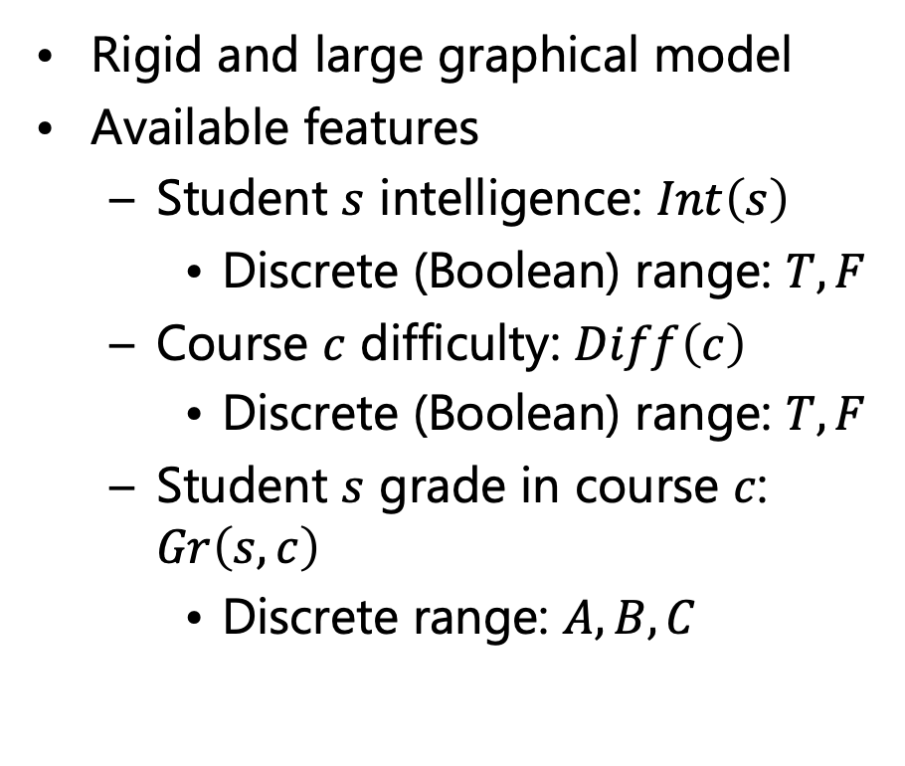
Example: Predicting Grades
Rigid and large graphical model
Available features
  Student $s$ intelligence: $Int\left(s\right)$
    Discrete (Boolean) range: $T,F$
  Course $c$ difficulty: $Diff\left(c\right)$
    Discrete (Boolean) range: $T,F$
  Student $s$ grade in course $c$: $Gr\left(s,c\right)$
    Discrete range: $A,B,C$
So, we should expect student s3 to perform better

Slide 19
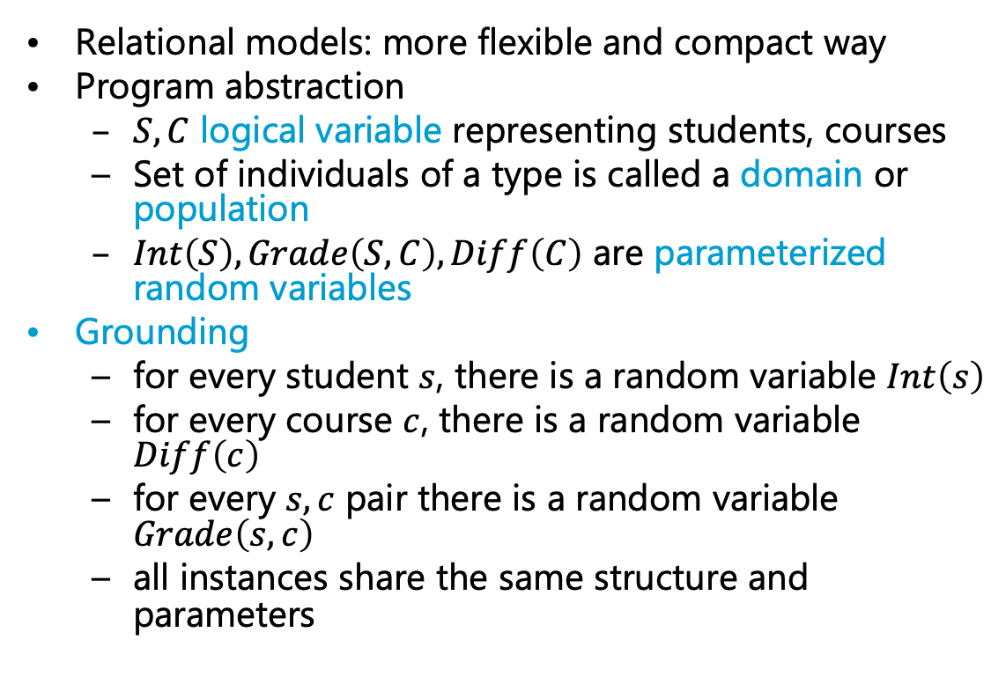
Example: Predicting Grades
Relational models: more flexible and compact way
Program abstraction
  $S,C$ logical variable representing students, courses
  Set of individuals of a type is called a domain or population
  $Int\left(S\right), Grade\left(S, C\right), Diff\left(C\right)$ are parameterized random variables
Grounding
  for every student $s$, there is a random variable $Int\left(s\right)$
  for every course $c$, there is a random variable $Diff\left(c\right)$
  for every $s,c$ pair there is a random variable $Grade\left(s,c\right)$
  all instances share the same structure and parameters
Called plate notation, plates are pictured as boxes, denoting logical variables, types, groups

Slide 20
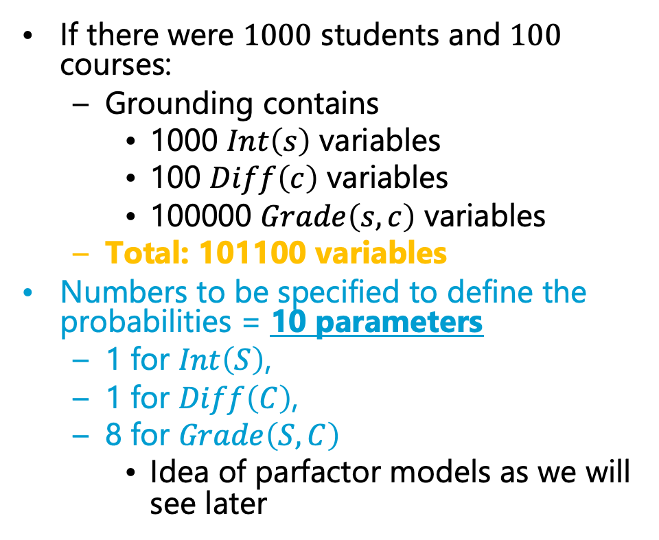

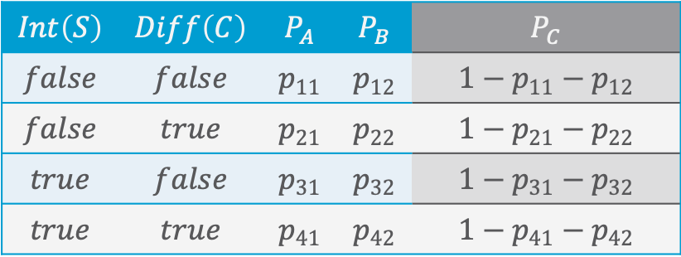
Example: Predicting Grades
If there were $1000$ students and $100$ courses:
  Grounding contains
    1000 $Int\left(s\right)$ variables
    100 $Diff\left(c\right)$ variables
    100000 $Grade\left(s,c\right)$ variables
  Total: 101100 variables
Numbers to be specified to define the probabilities = 10 parameters
  1 for $Int\left(S\right)$,
  1 for $Diff\left(C\right)$,
  8 for $Grade\left(S,C\right)$
    Idea of parfactor models as we will see later
$$P_{v}=P\left(Gr\left(S,C\right)=v | Int\left(S\right),Diff\left(C\right)\right)$$
$$Int\left(S\right)$$ | $$Diff\left(C\right)$$ | $$P_{A}$$ | $$P_{B}$$ | $$P_{C}$$
$$false$$ | $$false$$ | $$p_{11}$$ | $$p_{12}$$ | $$1−p_{11}−p_{12}$$
$$false$$ | $$true$$ | $$p_{21}$$ | $$p_{22}$$ | $$1−p_{21}−p_{22}$$
$$true$$ | $$false$$ | $$p_{31}$$ | $$p_{32}$$ | $$1−p_{31}−p_{32}$$
$$true$$ | $$true$$ | $$p_{41}$$ | $$p_{42}$$ | $$1−p_{41}−p_{42}$$
Not necessary due to probability distributions adding to 1

Slide 21
Connection to AI, Agents, and Environments
AI: intelligent systems in the real world
The world has things in it!
The world is uncertain!
Probabilistic graphical models
First-order logic
The world is uncertain!
The world has things in it!
First-order probabilistic languages
Figure based on Stuart Russell
Notes:
Bayes nets, markov networks, factor graphs

Slide 22


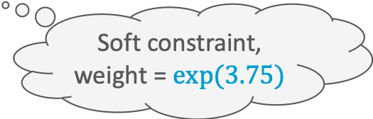

From Logics to Probabilistic Relational Models
Propositional: Descriptions about world
  Form of constraints on an environment
First-order: Objects, relations among them
  Groundings to get to propositional logic
Denote either true or false statements
Approach to soften constraints: Introduce weights to denote that statements hold to a certain degree over all possible worlds
  Example: Markov Logic Network
    We will see more of them later
$$Presents⇒Attends$$
$$Presents\left(eve,paper1,IJCAI\right)⇒Attends\left(eve,IJCAI\right)$$
Hard constraint
$$∞ Presents\left(X, P, C\right)⇒Attends\left(X, C\right)$$
$$Presents\left(X, P, C\right)⇒Attends\left(X, C\right)$$
$$3.75 Publishes\left(X, C\right)∧FarAway\left(C\right)⇒Attends\left(X, C\right)$$
Soft constraint,
weight = $exp⁡(3.75)$

Slide 23
Connection to AI, Agents, and Environments
AI: intelligent systems in the real world
The world has things in it!
The world is uncertain!
Probabilistic graphical models
First-order logic
The world is uncertain!
The world has things in it!
First-order probabilistic languages
One way of looking at it:
Statistical Relational AI
Probabilistic relational models
Figure based on Stuart Russell
Notes:
Bayes nets, markov networks, factor graphs

Slide 24

Probabilistic Relational Models (PRMs)
Random variables for combinations of individuals in populations
  Build a probabilistic model before knowing (all of) the individuals
  Learn the model for one set of individuals
  Apply the model to existing and new individuals
  Allow complex relationships between individuals
Exchangeability:
  Before we know anything about individuals, they are indistinguishable, and so should be treated identically.
Uncertainty about:
  Properties of individuals
  Relationships among individuals
  Identity (equality) of individuals
  Existence (and number) of individuals
Depicted formalisms: Parfactor graphs, Markov logic networks
$$∞ Presents\left(X, P, C\right)⇒Attends\left(X, C\right)$$
$$3.75 Publishes\left(X, C\right)∧FarAway\left(C\right)⇒Attends\left(X, C\right)$$

Slide 25
PRMs for Modelling the Environment in this Lecture
Different types of PGMs for a (relational) factorised representation of the environment and decision making
Possible to model environment with following properties
  Fully or partially observable
  Single agent
  Stochastic
  Episodic or sequential
  Static
  Discrete or continuous
Not considered in this lecture
  Multiple agents
  Deterministic, strategic
Approaches exist to deal with such environments to a certain degree
Attention: In the PGM literature, the notions of static and dynamic are used instead of the notions of episodic and sequential, while the notions of static and dynamic are covered by the so-called Markov assumption or (Non-) Markovian abstraction
S. Russel and P. Norvig: Artificial Intelligence – A Modern Approach, 2020.

Slide 26
The Larger Scope: Statistical Relational Learning & StaRAI
Study and design
  intelligent agents
  that reason about and
  act in noisy worlds
  composed of objects and relations among the objects
…
Optimization
SAT
Uncertainty
Scaling
IR
Logic
Graphs
Trees
Mining
And
Learning
KR
CV
Search
DM/ML
[Getoor, Taskar MIT Press ’07; De Raedt, Frasconi, Kersting, Muggleton, LNCS’08; Domingos, Lowd Morgan Claypool ’09; Natarajan, Kersting, Khot, Shavlik Springer Brief’15; Russell CACM 58(7): 88-97 ’15, Gogate, Domingos CACM 59(7):107-115 ´16]
Kristian Kersting. Statistical Relational AI. Tutorial at KI 2018.

Slide 27
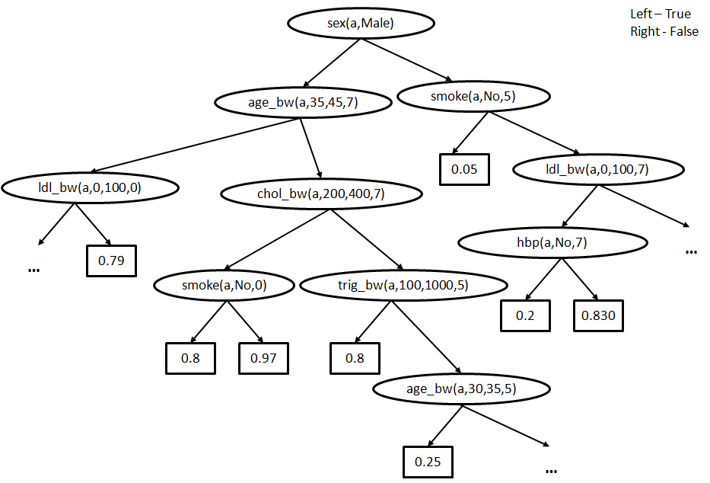
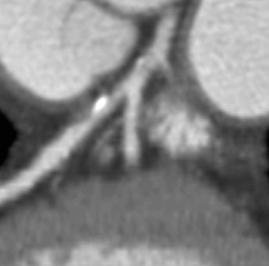
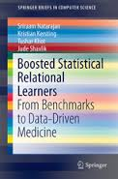
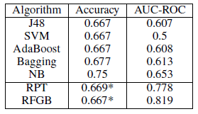
This “Deep AI” Can Understand EHRs
Atherosclerosis is the cause of the majority of Acute Myocardial Infarctions (heart attacks)
Logical Variables (Abstraction)
[Circulation; 92(8), 2157-62, 1995; JACC; 43, 842-7, 2004]
We will come back to this later in the lecture.
Rule/Database view
Plaque in the left
coronary artery
Probability
The higher, the better
Natarajan, Khot, Kersting, Shavlik. Boosted Statistical Relational Learners. Springer Brief 2015
[Kersting, Driessens ICML´08; Karwath, Kersting, Landwehr ICDM´08; Natarajan, Joshi, Tadepelli, Kersting, Shavlik. IJCAI´11; Natarajan, Kersting, Ip, Jacobs, Carr IAAI `13; Yang, Kersting, Terry, Carr, Natarajan AIME ´15; Khot, Natarajan, Kersting, Shavlik ICDM´13, MLJ´12, MLJ´15]
25%
Algorithm for Mining Markov Logic Networks | Likelihood The higher, the better | AUC-ROC The higher, the better | AUC-PR The higher, the better | Time The lower, the better
Boosting | 0.81 | 0.96 | 0.93 | 9s
LSM | 0.73 | 0.54 | 0.62 | 93 hrs
11%
78%
50%
37200x
faster
Kristian Kersting. Statistical Relational AI. Tutorial at KI 2018.
Notes:
Heart attacks: male more likely to have heart attack, changes with marriage

Slide 28
Heart diseases and strokes – cardiovascular disease – are expensive for the world
According to the World Heart Federation, cardiovascular disease cost the European Union €169 billion in 2003 and the USA about €310.23 billion in direct and indirect annual costs. By comparison, the estimated cost of all cancers is €146.19 billion and HIV infections, €22.24 billion
Nat Rev Genet. 2012 May 2;13(6):395-405
Human-centred approaches needed to ensure ethical behaviour, transparent reasoning, explainable results, privacy, …
Electronic Health Records
A New Opportunity for AI
to Save Our Lives
Kristian Kersting. Statistical Relational AI. Tutorial at KI 2018.

Slide 29
Interim Summary
Environment characterised by
  Objects and relations between them
  Uncertainty
PRMs combine both logic and probability theory
  Models covered here can model the following environment properties
    Fully or partially observable
    Single agent
    Stochastic
    Episodic or sequential
    Static
    Discrete or continuous

Slide 30
Contents
Introduction
  StaRAI: Agent, context, motivation
Foundations
  Logic
  Probability theory
  Probabilistic graphical models (PGMs)
Probabilistic Relational Models (PRMs)
  Parfactor models, Markov logic networks
  Semantics, inference tasks
Exact Lifted Inference
  Lifted Variable Elimination
  Lifted Junction Tree Algorithm
  First-Order Knowledge Compilation
Lifted Sequential Models and Inference
  Parameterised models
  Semantics, inference tasks, algorithm
Lifted Decision Making
  Preferences, utility
  Decision-theoretic models, tasks, algorithm
Approximate Lifted Inference
Lifted Learning
  Parameter learning
  Relation learning
  Approximating symmetries

Slide 31
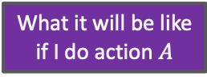
Contents in this Lecture Related to Utility-based Agents
Further topics
  (Episodic) PRMs
  Lifted inference (in episodic PRMs)
  Lifted sequential PRMs and inference
  Lifted decision making
  Lifted learning (of episodic PRMs)
Agent
Environment
Sensors
State
What the world
is like now
How the world evolves
What my actions do
What it will be like
if I do action $A$
Utility
How happy I will be
in such a state
What action I
should do now
Actuators

Slide 32
Overview: 1. Introduction
Artificial Intelligence
  Approaches: thinking / acting humanly / rationally
Framework: Agent Theory
  Agent
  Task environment
  Agent structure
Topic: StaRAI
  Motivation, context
  Relational examples, outlook on probabilistic relational models (PRMs)
➝ Foundations: Logic, Probability Theory, & PGMs

