Slide 1

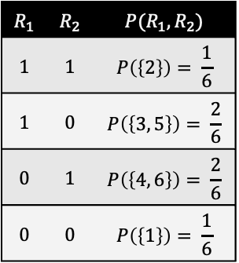
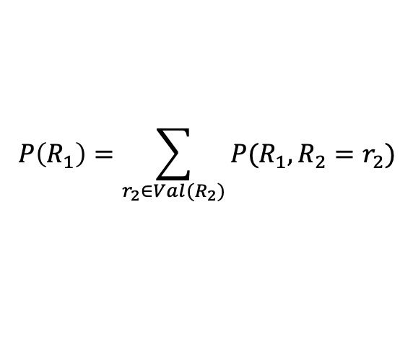
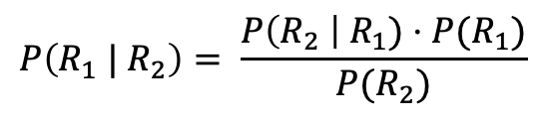
Dynamic Probabilistic Relational Models
$$R_{1}$$ | $$R_{2}$$ | $$P(R_{1},R_{2})$$
$$1$$ | $$1$$ | $$P\left(\left\{2\right\}\right)= \frac{1}{6}$$
$$1$$ | $$0$$ | $$P\left(\left\{3, 5\right\}\right)= \frac{2}{6}$$
$$0$$ | $$1$$ | $$P\left(\left\{4, 6\right\}\right)= \frac{2}{6}$$
$$0$$ | $$0$$ | $$P\left(\left\{1\right\}\right)= \frac{1}{6}$$
$$P\left(R_{1},R_{2}\right)=P\left(R_{1}\right)⋅P\left(R_{2} \right| R_{1})$$
Foundations:
Probability Theory
$$P\left(R_{1}\right)=\sum_{r_{2}∈{Val(R}_{2})}{P(R_{1},{R_{2}=r}_{2})}$$
$$P\left(R_{1} | R_{2}\right)= \frac{P\left(R_{2} \right| R_{1})⋅P(R_{1})}{P(R_{2})}$$

Slide 2
Contents
Introduction
  StaRAI: Agent, context, motivation
Foundations
  Logic
  Probability theory
  Probabilistic graphical models (PGMs)
Probabilistic Relational Models (PRMs)
  Parfactor models, Markov logic networks
  Semantics, inference tasks
Exact Lifted Inference
  Lifted Variable Elimination
  Lifted Junction Tree Algorithm
  First-Order Knowledge Compilation
Lifted Sequential Models and Inference
  Parameterised models
  Semantics, inference tasks, algorithm
Lifted Decision Making
  Preferences, utility
  Decision-theoretic models, tasks, algorithm
Approximate Lifted Inference
Lifted Learning
  Parameter learning
  Relation learning
  Approximating symmetries

Slide 3
Overview: 2. Foundations
Logic
  Propositional logic: alphabet, grammar, normal forms, rules
  First-order logic: introducing quantifiers, domain constraints
Probability theory
  Modelling: (conditional) probability distributions, random variables, marginal and joint distributions
  Inference: axioms and basic rules, Bayes theorem, independence
Probabilistic graphical models
  Syntax, semantics
  Inference problems

Slide 4
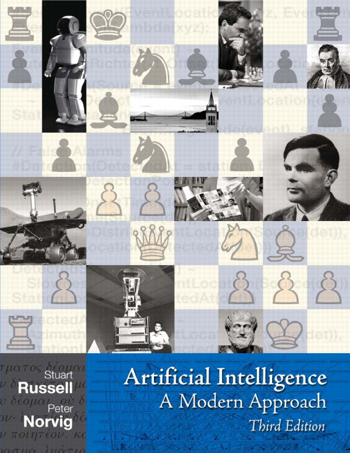
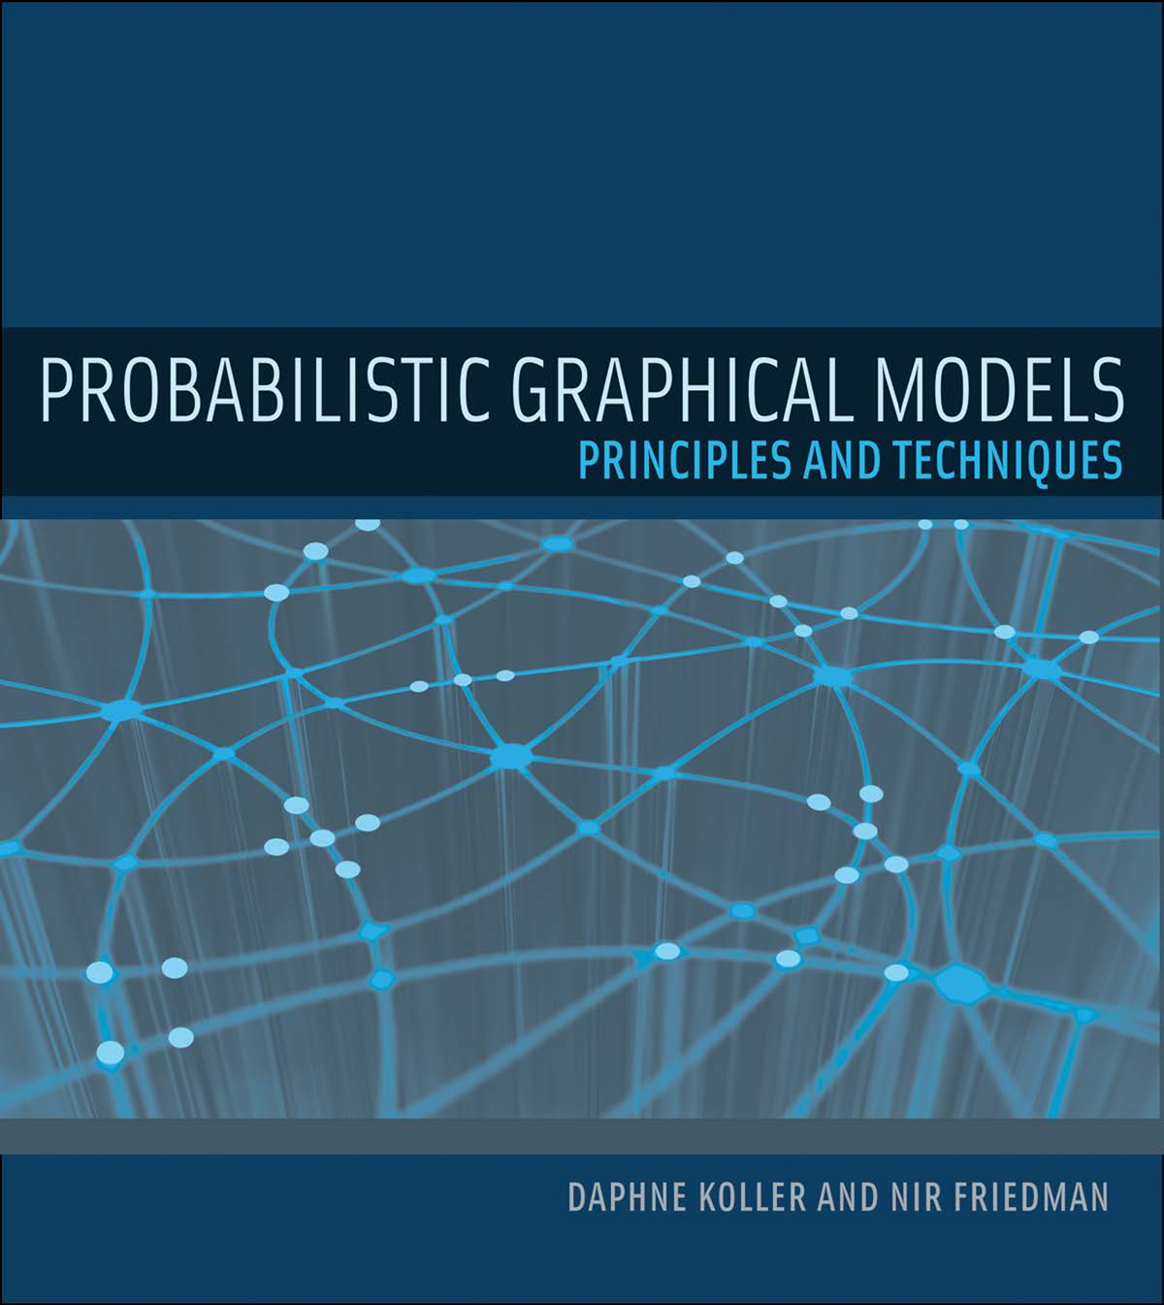
Sources
Content of the slides mainly based on the following books:

Slide 5
Motivation
Acting & Making decisions in environments with uncertainty
  e.g., partially observable environment
Reasoning under uncertainty
Knowledge required about what is possible and what is probable
Framework of probability theory:
  Defines possible outcomes and events
  Assigns probabilities to them
  Allows for calculating specific probabilities
  Allows for including observations and „updating“ probabilities

Slide 6
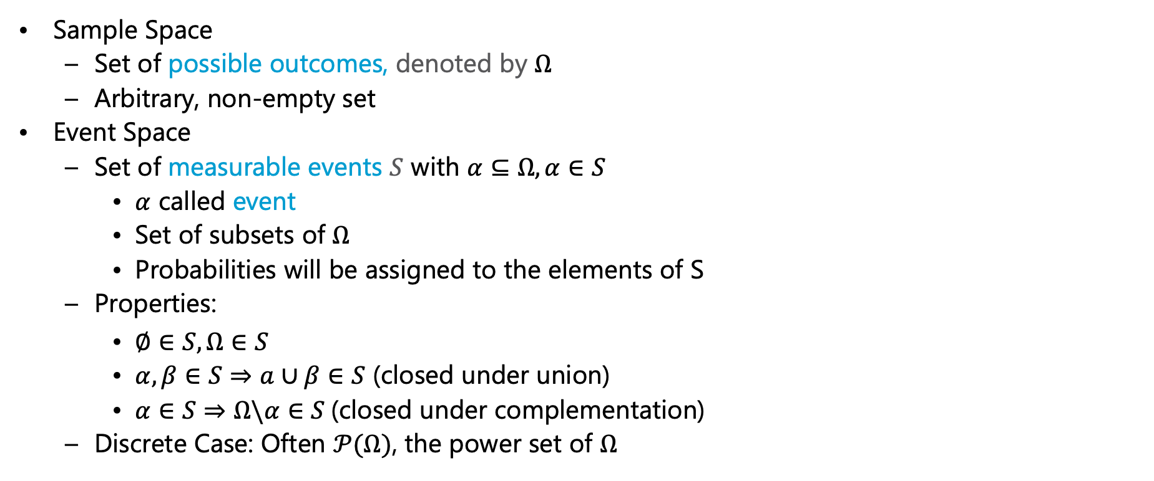
Sample & Event Space
Sample Space
  Set of possible outcomes, denoted by $Ω$
  Arbitrary, non-empty set
Event Space
  Set of measurable events $S$ with $α⊆Ω, α∈S$
    $α$ called event
    Set of subsets of $Ω$
    Probabilities will be assigned to the elements of S
  Properties:
    $∅∈S, Ω∈S$
    $α,β∈S⇒a∪β∈S$ (closed under union)
    $α∈S⇒Ω\backslash α∈S$(closed under complementation)
  Discrete Case: Often $𝒫(Ω)$, the power set of $Ω$

Slide 7
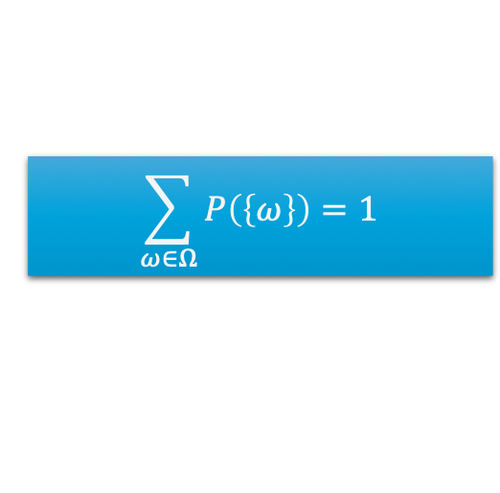
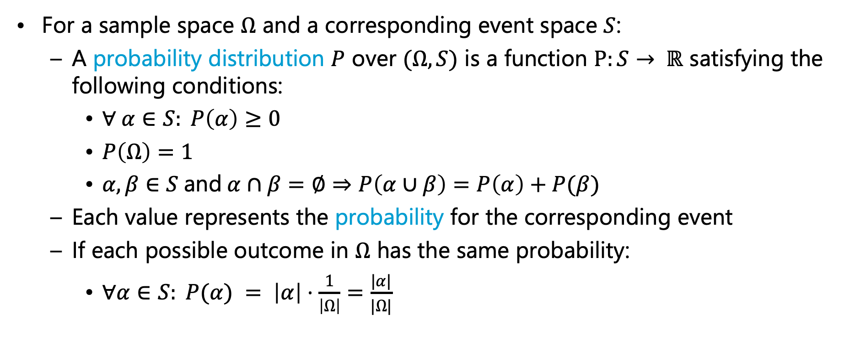
Probability Distribution
For a sample space $Ω$ and a corresponding event space $S$:
  A probability distribution $P$ over $(Ω,S)$ is a function $P:S→ ℝ$ satisfying the following conditions:
    $∀ α∈S: P\left(α\right)≥0$
    $P\left(Ω\right)=1$
    $α,β∈S$and$α∩β=∅⇒P\left(α∪β\right)=P\left(α\right)+P(β)$
  Each value represents the probability for the corresponding event
  If each possible outcome in $Ω$ has the same probability:
    $∀α∈S: P(α) = \left|α\right|⋅\frac{1}{\left|Ω\right|}=\frac{|α|}{|Ω|}$
$$\sum_{ω∈Ω}{P\left(\left\{ω\right\}\right)=1}$$

Slide 8
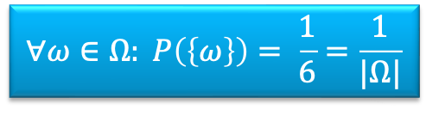
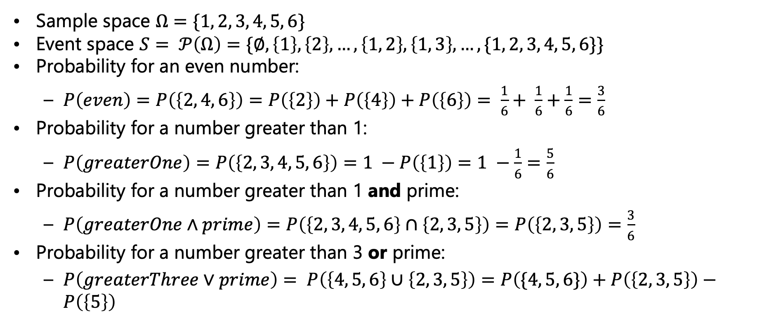
Example - (Fair) Dice Roll
Sample space $Ω=\{1, 2, 3, 4, 5, 6\}$
Event space $S= 𝒫\left(Ω\right)=\{∅, \left\{1\right\}, \left\{2\right\},…, \left\{1, 2\right\}, \left\{1, 3\right\},…,\{1, 2, 3, 4, 5, 6\}\}$
Probability for an even number:
  $P\left(even\right)=P\left(\left\{2, 4, 6\right\}\right)=P\left(\left\{2\right\}\right)+P\left(\left\{4\right\}\right)+P\left(\left\{6\right\}\right)= \frac{1}{6}+ \frac{1}{6}+\frac{1}{6}=\frac{3}{6}$
Probability for a number greater than 1:
  $P\left(greaterOne\right)=P\left(\left\{2, 3, 4, 5, 6\right\}\right)=1 −P\left(\left\{1\right\}\right)=1 −\frac{1}{6}=\frac{5}{6}$
Probability for a number greater than 1 and prime:
  $P\left(greaterOne∧prime\right)=P\left(\left\{2, 3, 4, 5, 6\right\}∩\left\{2, 3, 5\right\}\right)=P\left(\left\{2, 3, 5\right\}\right)=\frac{3}{6}$
Probability for a number greater than 3 or prime:
  $P\left(greaterThree∨prime\right)= P\left(\left\{4, 5, 6\right\}∪\left\{2, 3, 5\right\}\right)=P\left(\{4, 5, 6\}\right)+P\left(\left\{2, 3, 5\right\}\right)−P\left(\left\{5\right\}\right)$
$$∀ω∈Ω: P\left(\left\{ω\right\}\right)= \frac{1}{6}=\frac{1}{|Ω|}$$

Slide 9
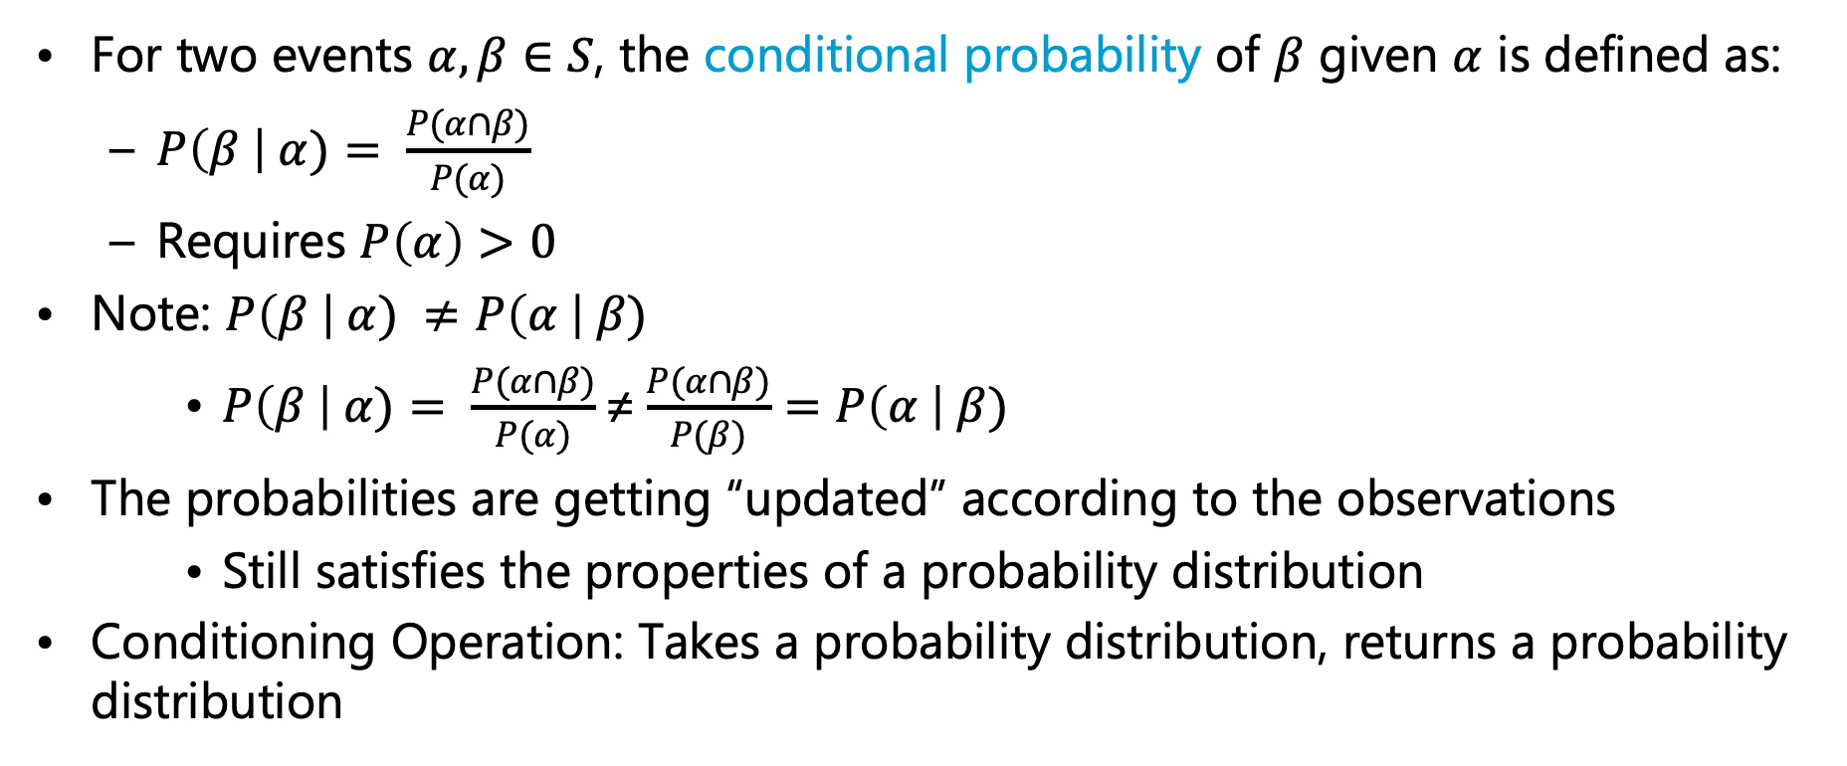
Conditional Probability Distribution
For two events $α,β∈S$, the conditional probability of $β$ given $α$ is defined as:
  $P\left(β \right| α)= \frac{P(α∩β)}{P(α)}$
  Requires $P\left(α\right)>0$
Note: $P\left(β \right| α) ≠P\left(α \right| β)$
    $P\left(β \right| α)= \frac{P(α∩β)}{P(α)}\text{≠}\frac{P(α∩β)}{P(β)}=P\left(α \right| β)$
The probabilities are getting “updated” according to the observations
    Still satisfies the properties of a probability distribution
Conditioning Operation: Takes a probability distribution, returns a probability distribution

Slide 10
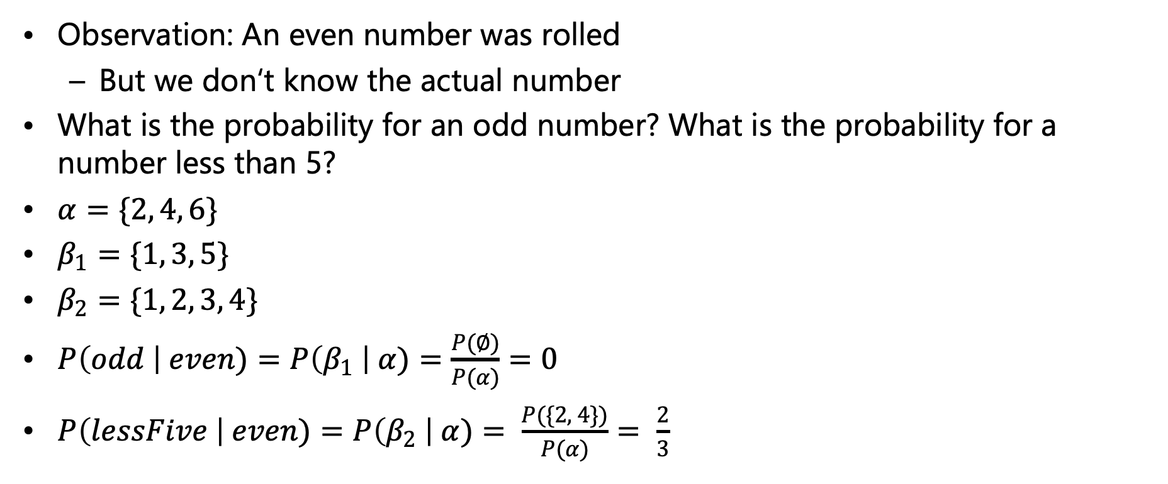
Example - (Fair) Dice Roll
Observation: An even number was rolled
  But we don‘t know the actual number
What is the probability for an odd number? What is the probability for a number less than 5?
$α=\{2, 4, 6\}$
$β_{1}=\{1, 3, 5\}$
$β_{2}=\{1, 2, 3, 4\}$
$P\left(odd \right| even)=P\left(β_{1} \right| α)=\frac{P(∅)}{P(α)}=0$
$P\left(lessFive \right| even)=P\left(β_{2} \right| α)= \frac{P(\{2, 4\})}{P(α)}= \frac{2}{3}$

Slide 11
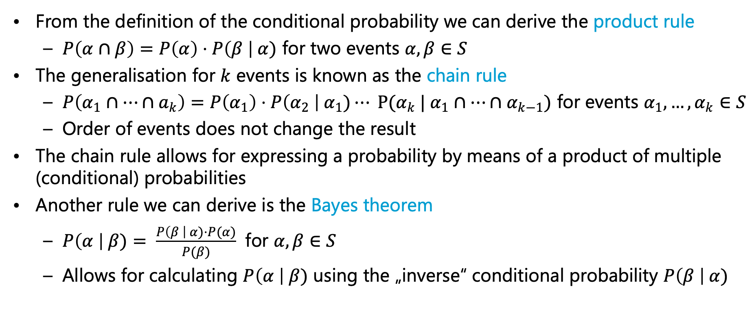
Chain Rule & Bayes Theorem
From the definition of the conditional probability we can derive the product rule
  $P\left(α∩β\right)=P\left(α\right)⋅P\left(β \right| α)$ for two events $α, β∈S$
The generalisation for $k$ events is known as the chain rule
  $P\left(α_{1}∩…∩a_{k}\right)=P\left(α_{1}\right)⋅P\left(α_{2} \right| α_{1})⋯ P(α_{k} | α_{1}∩…∩α_{k−1})$ for events $α_{1},…,α_{k}∈S$
  Order of events does not change the result
The chain rule allows for expressing a probability by means of a product of multiple (conditional) probabilities
Another rule we can derive is the Bayes theorem
  $P\left(α \right| β)= \frac{P\left(β \right| α)⋅P(α)}{P(β)}$ for $α,β∈S$
  Allows for calculating $P\left(α \right| β)$ using the „inverse“ conditional probability $P\left(β \right| α)$

Slide 12
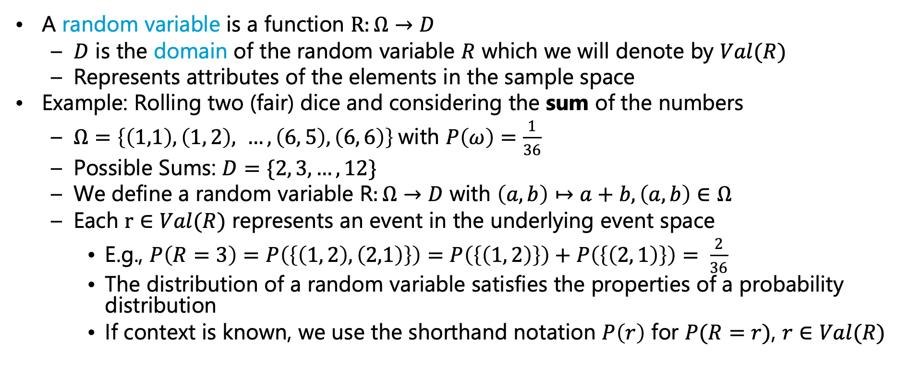
(Discrete) Random Variable
Later we call this range
A random variable is a function $R:Ω→D$
  $D$ is the domain of the random variable $R$ which we will denote by $Val(R)$
  Represents attributes of the elements in the sample space
Example: Rolling two (fair) dice and considering the sum of the numbers
  $Ω=\left\{\left(1,1\right),\left(1, 2\right), …, \left(6, 5\right),\left(6, 6\right)\right\}$with $P\left(ω\right)=\frac{1}{36}$
  Possible Sums: $D=\{2, 3, …, 12\}$
  We define a random variable R$:Ω→D$ with $\left(a,b\right)↦a+b, \left(a,b\right)∈Ω$
  Each $r∈Val(R)$ represents an event in the underlying event space
    E.g., $P\left(R=3\right)=P\left(\left\{\left(1, 2\right),\left(2,1\right)\right\}\right)=P\left(\left\{\left(1, 2\right)\right\}\right)+P\left(\left\{\left(2, 1\right)\right\}\right)= \frac{2}{36}$
    The distribution of a random variable satisfies the properties of a probability distribution
    If context is known, we use the shorthand notation $P\left(r\right)$ for $P(R=r)$, $r∈Val(R)$

Slide 13

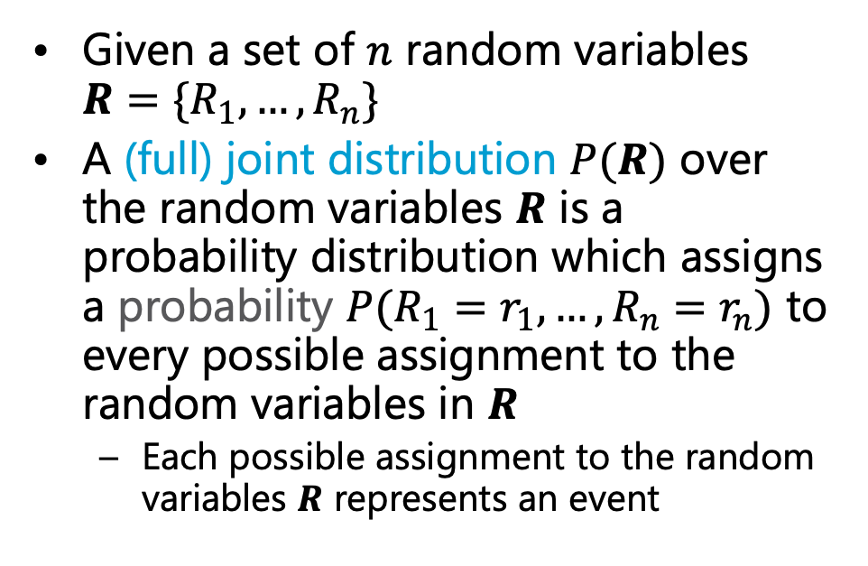

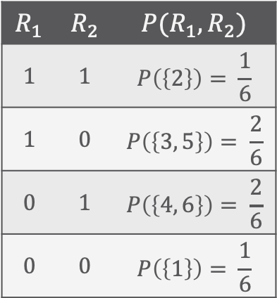
(Full) Joint Distribution
Given a set of $n$ random variables $R=\{R_{1},…,R_{n}\}$
A (full) joint distribution $P(R)$ over the random variables $R$ is a probability distribution which assigns a probability $P(R_{1}=r_{1}, …,R_{n}=r_{n})$ to every possible assignment to the random variables in $R$
  Each possible assignment to the random variables $R$ represents an event
Example: (Fair) Dice Roll
  We define two random variables $R_{1},R_{2}$
    $R_{1}:$ Rolling a prime number
    $R_{2}$: Rolling an even number
$$R_{1}$$ | $$R_{2}$$ | $$P(R_{1},R_{2})$$
$$1$$ | $$1$$ | $$P\left(\left\{2\right\}\right)= \frac{1}{6}$$
$$1$$ | $$0$$ | $$P\left(\left\{3, 5\right\}\right)= \frac{2}{6}$$
$$0$$ | $$1$$ | $$P\left(\left\{4, 6\right\}\right)= \frac{2}{6}$$
$$0$$ | $$0$$ | $$P\left(\left\{1\right\}\right)= \frac{1}{6}$$
$$Val\left(R_{1}\right)=Val\left(R_{2}\right)=\{0, 1\}$$

Slide 14
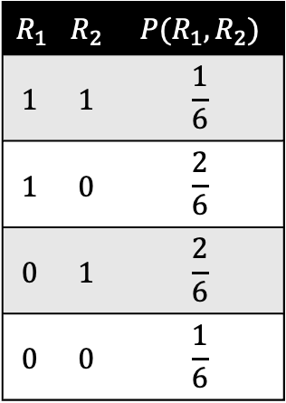
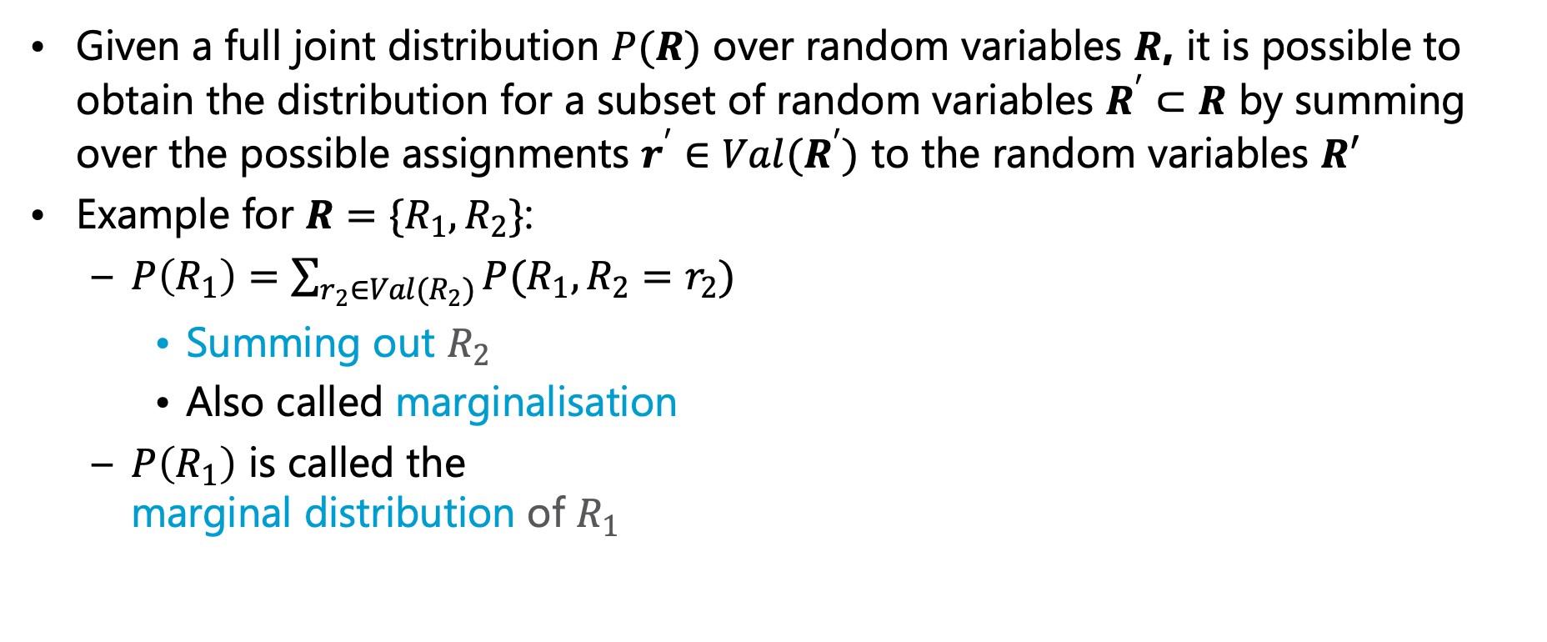
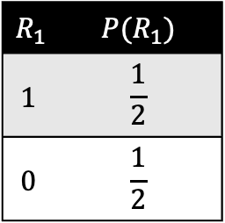
Marginal Distribution
Given a full joint distribution $P(R)$ over random variables $R$, it is possible to obtain the distribution for a subset of random variables $R^{′}⊂R$ by summing over the possible assignments $r^{′}∈Val(R^{′})$ to the random variables $R′$
Example for $R=\{R_{1}, R_{2}\}$:
  $P\left(R_{1}\right)=\sum_{r_{2}∈Val(R_{2})}{P(R_{1}, R_{2}=r_{2})}$
    Summing out $R_{2}$
    Also called marginalisation
  $P\left(R_{1}\right)$ is called the
  marginal distribution of $R_{1}$
$$R_{1}$$ | $$R_{2}$$ | $$P(R_{1},R_{2})$$
$$1$$ | $$1$$ | $$\frac{1}{6}$$
$$1$$ | $$0$$ | $$\frac{2}{6}$$
$$0$$ | $$1$$ | $$\frac{2}{6}$$
$$0$$ | $$0$$ | $$\frac{1}{6}$$
$$R_{1}$$ | $$P(R_{1})$$
$$1$$ | $$\frac{1}{2}$$
$$0$$ | $$\frac{1}{2}$$
+
+

Slide 15
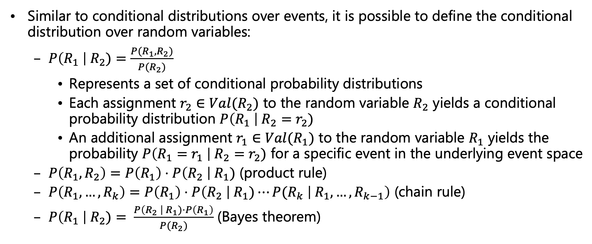
Conditional Distributions over Random Variables
Similar to conditional distributions over events, it is possible to define the conditional distribution over random variables:
  $P\left(R_{1} \right| R_{2})=\frac{P(R_{1}, R_{2})}{P(R_{2})}$
    Represents a set of conditional probability distributions
    Each assignment $r_{2}∈{Val(R}_{2})$ to the random variable $R_{2}$ yields a conditional probability distribution $P\left(R_{1} \right| R_{2}=r_{2})$
    An additional assignment $r_{1}∈{Val(R}_{1})$ to the random variable $R_{1}$ yields the probability $P\left(R_{1}=r_{1} \right| R_{2}=r_{2})$ for a specific event in the underlying event space
  $P\left(R_{1},R_{2}\right)=P\left(R_{1}\right)⋅P\left(R_{2} \right| R_{1})$ (product rule)
  $P\left(R_{1}, …, R_{k}\right)=P\left(R_{1}\right)⋅P\left(R_{2} \right| R_{1})⋯P(R_{k} \left| R_{1},…,R_{k−1}\right)$ (chain rule)
  $P\left(R_{1} \right| R_{2})= \frac{P\left(R_{2} \right| R_{1})⋅P\left(R_{1}\right)}{P(R_{2})}$ (Bayes theorem)

Slide 16

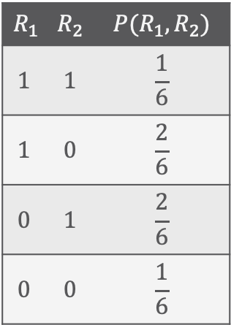



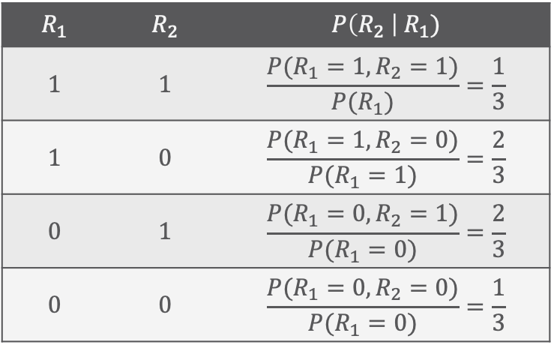
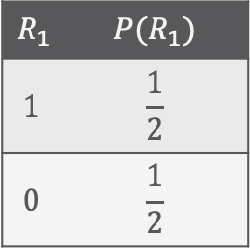

Example – Multiplying (Conditional) Distributions
$P\left(R_{1},R_{2}\right)=P\left(R_{1}\right)⋅P\left(R_{2} \right| R_{1})$ (product rule)
  Multiply corresponding entries
$$R_{1}$$ | $$R_{2}$$ | $$P(R_{1},R_{2})$$
$$1$$ | $$1$$ | $$\frac{1}{6}$$
$$1$$ | $$0$$ | $$\frac{2}{6}$$
$$0$$ | $$1$$ | $$\frac{2}{6}$$
$$0$$ | $$0$$ | $$\frac{1}{6}$$
$$R_{1}$$ | $$R_{2}$$ | $$P\left(R_{2} \right| R_{1})$$
$$1$$ | $$1$$ | $$\frac{P(R_{1}=1, R_{2}=1)}{P(R_{1})}=\frac{1}{3}$$
$$1$$ | $$0$$ | $$\frac{P(R_{1}=1, R_{2}=0)}{P(R_{1}=1)}=\frac{2}{3}$$
$$0$$ | $$1$$ | $$\frac{P(R_{1}=0, R_{2}=1)}{P(R_{1}=0)}=\frac{2}{3}$$
$$0$$ | $$0$$ | $$\frac{P(R_{1}=0, R_{2}=0)}{P(R_{1}=0)}=\frac{1}{3}$$
$$R_{1}$$ | $$P(R_{1})$$
$$1$$ | $$\frac{1}{2}$$
$$0$$ | $$\frac{1}{2}$$
$$P\left(R_{2} \right| R_{1}=1)$$
$$=$$
$$⋅$$
$$P\left(R_{2} \right| R_{1}=0)$$

Slide 17
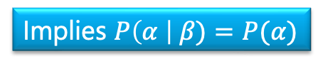
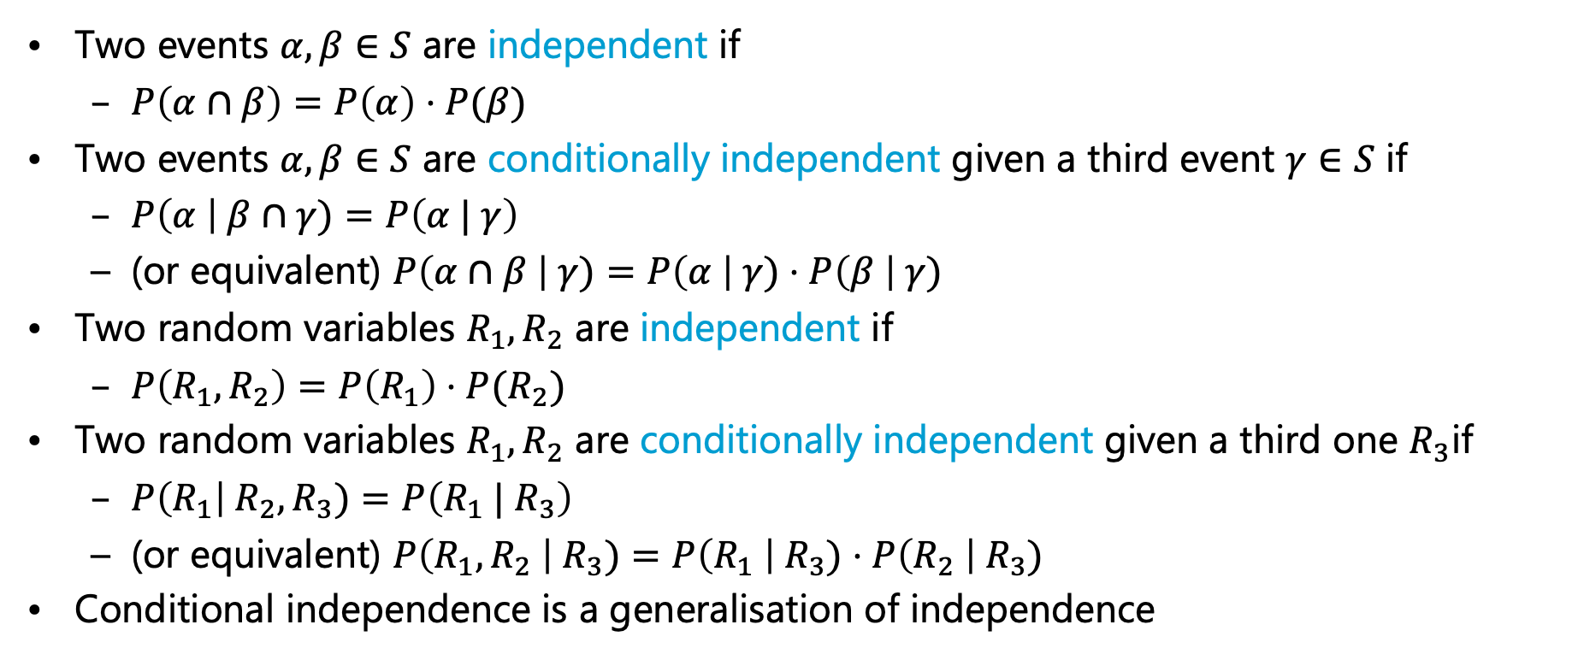

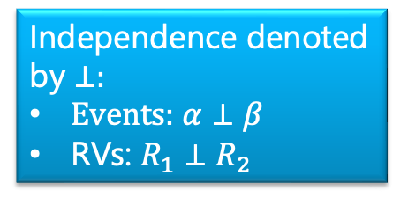
Independence
Two events $α, β∈S$ are independent if
  $P\left(α∩β\right)=P\left(α\right)⋅P(β)$
Two events $α, β∈S$ are conditionally independent given a third event $γ∈S$ if
  $P\left(α \right| β∩γ)=P\left(α | γ\right)$
  (or equivalent) $P\left(α∩β \right| γ)=P\left(α \right| γ)⋅P\left(β \right| γ)$
Two random variables $R_{1}, R_{2}$ are independent if
  $P\left(R_{1},R_{2}\right)=P\left(R_{1}\right)⋅P(R_{2})$
Two random variables $R_{1},R_{2}$ are conditionally independent given a third one $R_{3}$if
  $P\left(R_{1}\right| R_{2}, R_{3})=P\left(R_{1} | R_{3}\right)$
  (or equivalent) $P\left(R_{1},R_{2} \right| R_{3})=P\left(R_{1} \right| R_{3})⋅P\left(R_{2} \right| R_{3})$
Conditional independence is a generalisation of independence
Implies $P\left(α \right| β)=P(α)$
Independence denoted by ⊥:
Events: $α⊥β$
RVs: $R_{1}⊥R_{2}$
Implies $P\left( R_{1}\right| R_{2})=P(R_{1})$

Slide 18
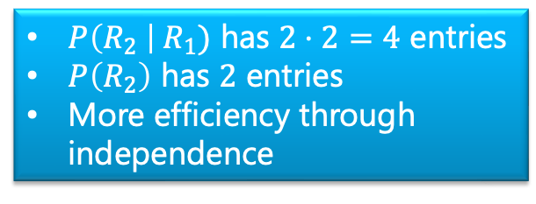
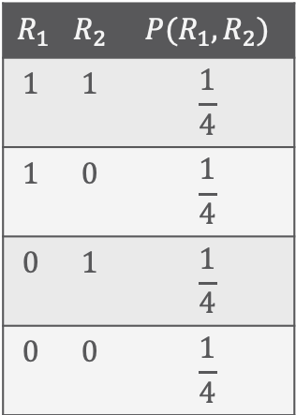
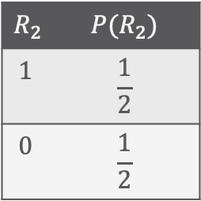

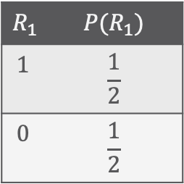
Example - Independence
Assume the following joint distribution $P\left(R_{1}, R_{2}\right)$ over random variables $R_{1},R_{2}$
  Product rule without independence: $P\left(R_{1},R_{2}\right)=P\left(R_{1}\right)⋅P\left(R_{2} \right| R_{1})$
  Product rule with independence: $P\left(R_{1}, R_{2}\right)=P\left(R_{1}\right)⋅P(R_{2})$
$$R_{1}$$ | $$R_{2}$$ | $$P(R_{1},R_{2})$$
$$1$$ | $$1$$ | $$\frac{1}{4}$$
$$1$$ | $$0$$ | $$\frac{1}{4}$$
$$0$$ | $$1$$ | $$\frac{1}{4}$$
$$0$$ | $$0$$ | $$\frac{1}{4}$$
$$R_{1}$$ | $$P(R_{1})$$
$$1$$ | $$\frac{1}{2}$$
$$0$$ | $$\frac{1}{2}$$
$$R_{2}$$ | $$P(R_{2})$$
$$1$$ | $$\frac{1}{2}$$
$$0$$ | $$\frac{1}{2}$$
$P\left(R_{2} \right| R_{1})$ has $2⋅2=4$ entries
$P\left(R_{2}\right)$ has $2$ entries
More efficiency through independence
$$=$$
$$⋅$$

Slide 19
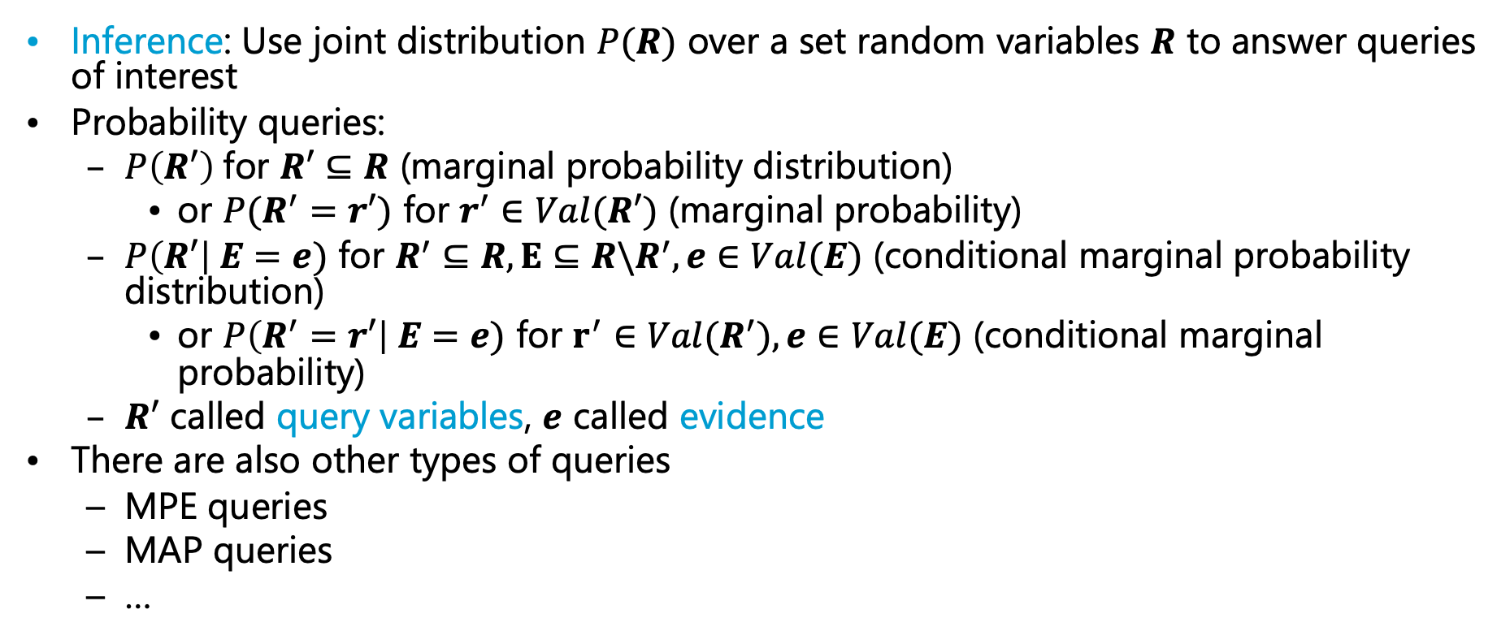
Probability Query
Inference: Use joint distribution $P(R)$ over a set random variables $R$ to answer queries of interest
Probability queries:
  $P\left(R′\right)$for $R′⊆R$ (marginal probability distribution)
    or $P(R^{′}=r′)$ for $r^{′}∈Val(R′)$ (marginal probability)
  $P\left(R′\right| E=e)$ for $R^{′}⊆R, E⊆R\backslash R^{′}, e∈Val(E)$ (conditional marginal probability distribution)
    or $P\left(R^{′}=r′\right| E=e)$ for $r^{′}∈Val(R^{′}), e∈Val(E)$ (conditional marginal probability)
  $R′$ called query variables, $e$ called evidence
There are also other types of queries
  MPE queries
  MAP queries
  …

Slide 20
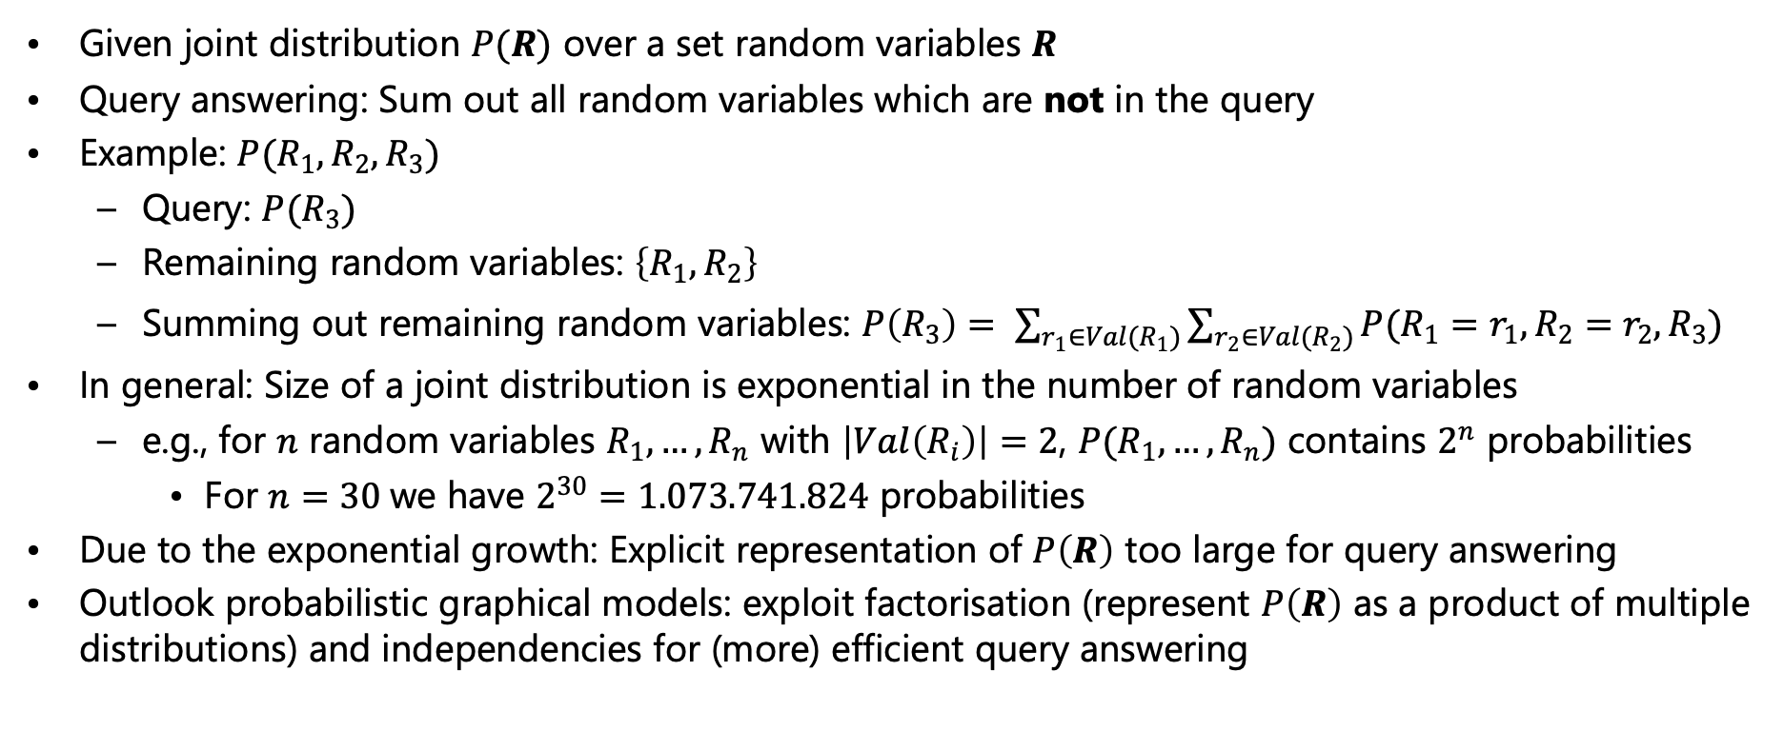
Probability Query
Given joint distribution $P(R)$ over a set random variables $R$
Query answering: Sum out all random variables which are not in the query
Example: $P(R_{1}, R_{2}, R_{3})$
  Query: $P(R_{3})$
  Remaining random variables: $\left\{R_{1}, R_{2}\right\}$
  Summing out remaining random variables: $P\left(R_{3}\right)= \sum_{r_{1}∈Val(R_{1})}{\sum_{r_{2}∈Val(R_{2})}{P(R_{1}=r_{1},R_{2}=r_{2},R_{3})}}$
In general: Size of a joint distribution is exponential in the number of random variables
  e.g., for $n$ random variables $R_{1},…,R_{n}$ with $\left|Val\left(R_{i}\right)\right|=2$, $P(R_{1},…,R_{n})$ contains $2^{n}$ probabilities
    For $n=30$we have $2^{30}=1.073.741.824$ probabilities
Due to the exponential growth: Explicit representation of $P\left(R\right)$ too large for query answering
Outlook probabilistic graphical models: exploit factorisation (represent $P\left(R\right)$ as a product of multiple distributions) and independencies for (more) efficient query answering

Slide 21
Interim Summary
Modelling:
  Sample space and event space
  Probability distribution: assign probabilities to events
  Conditional probability distribution: incorporating observations
  Random variables, joint and marginal distributions
    Assignments of random variables correspond to events in the underlying event space
Inference and query answering:
  Product rule, chain rule, Bayes theorem
  Marginalisation / Sum out of random variables
  (Conditional) independence
  Probability query: Sum out non-query random variables

Slide 22
Overview: 2. Foundations
Logic
  Propositional logic: alphabet, grammar, normal forms, rules
  First-order logic: introducing quantifiers, domain constraints
Probability theory
  Modelling: (conditional) probability distributions, random variables, marginal and joint distributions
  Inference: axioms and basic rules, Bayes theorem, independence
Probabilistic graphical models
  Syntax, semantics
  Inference problems

