Slide 1
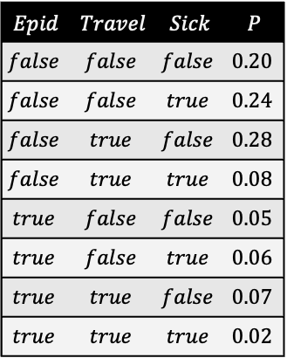
Dynamic Probabilistic Relational Models
$$Epid$$ | $$Travel$$ | $$Sick$$ | $$P$$
$$false$$ | $$false$$ | $$false$$ | $$0.20$$
$$false$$ | $$false$$ | $$true$$ | $$0.24$$
$$false$$ | $$true$$ | $$false$$ | $$0.28$$
$$false$$ | $$true$$ | $$true$$ | $$0.08$$
$$true$$ | $$false$$ | $$false$$ | $$0.05$$
$$true$$ | $$false$$ | $$true$$ | $$0.06$$
$$true$$ | $$true$$ | $$false$$ | $$0.07$$
$$true$$ | $$true$$ | $$true$$ | $$0.02$$
$$Epid$$
Foundations:
Probabilistic Graphical Models
$$Travel$$
$$Sick$$
$$Epid$$
$$Travel$$
$$Sick$$
$$Epid$$
$$Epid$$
$$Travel$$
$$Sick$$
$$Travel$$
$$Sick$$
$$P_{R}$$

Slide 2
Contents
Introduction
  StaRAI: Agent, context, motivation
Foundations
  Logic
  Probability theory
  Probabilistic graphical models (PGMs)
Probabilistic Relational Models (PRMs)
  Parfactor models, Markov logic networks
  Semantics, inference tasks
Exact Lifted Inference
  Lifted Variable Elimination
  Lifted Junction Tree Algorithm
  First-Order Knowledge Compilation
Lifted Sequential Models and Inference
  Parameterised models
  Semantics, inference tasks, algorithm
Lifted Decision Making
  Preferences, utility
  Decision-theoretic models, tasks, algorithm
Approximate Lifted Inference
Lifted Learning
  Parameter learning
  Relation learning
  Approximating symmetries

Slide 3
Overview: 2. Foundations
Logic
  Propositional logic: alphabet, grammar, normal forms, rules
  First-order logic: introducing quantifiers, domain constraints
Probability theory
  Modelling: (conditional) probability distributions, random variables, marginal and joint distributions
  Inference: axioms and basic rules, Bayes theorem, independence
Probabilistic graphical models
  Syntax, semantics
  Inference problems

Slide 4



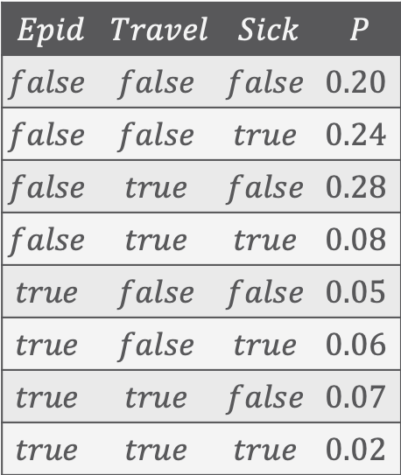





Propositional Graphical Models (PGMs)
Factorisation of a full joint according to (conditional) independences in the full joint
$$Epid$$ | $$Travel$$ | $$Sick$$ | $$P$$
$$false$$ | $$false$$ | $$false$$ | $$0.20$$
$$false$$ | $$false$$ | $$true$$ | $$0.24$$
$$false$$ | $$true$$ | $$false$$ | $$0.28$$
$$false$$ | $$true$$ | $$true$$ | $$0.08$$
$$true$$ | $$false$$ | $$false$$ | $$0.05$$
$$true$$ | $$false$$ | $$true$$ | $$0.06$$
$$true$$ | $$true$$ | $$false$$ | $$0.07$$
$$true$$ | $$true$$ | $$true$$ | $$0.02$$
$$Epid$$
$$Epid$$
$$Travel$$
$$Sick$$
$$Travel$$
$$Sick$$
Factor graph (FG)
$$Epid$$
Markov network (MN)
$$Travel$$
$$Sick$$
Bayesian network (BN)
Full joint probability distribution
Variants of PGMs

Slide 5
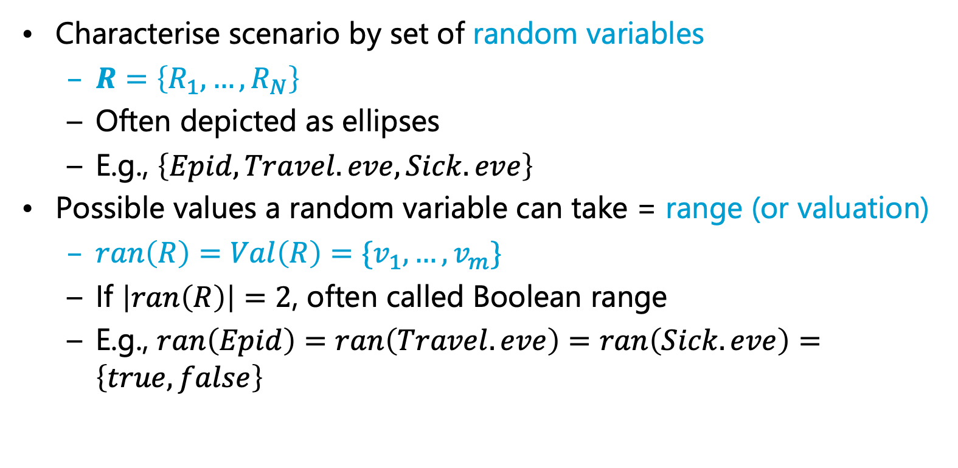


Random Variables
Characterise scenario by set of random variables
  $R=\left\{R_{1}, …, R_{N}\right\}$
  Often depicted as ellipses
  E.g., $\left\{Epid, Travel.eve, Sick.eve\right\}$
Possible values a random variable can take = range (or valuation)
  $ran\left(R\right)=Val\left(R\right)=\{v_{1},…, v_{m}\}$
  If $\left|ran\left(R\right)\right|=2$, often called Boolean range
  E.g., $ran\left(Epid\right)=ran\left(Travel.eve\right)=ran\left(Sick.eve\right)=\left\{true,false\right\}$
$$Epid$$
$$Travel$$
$$Sick$$
Notes:
Vocabulary

Slide 6
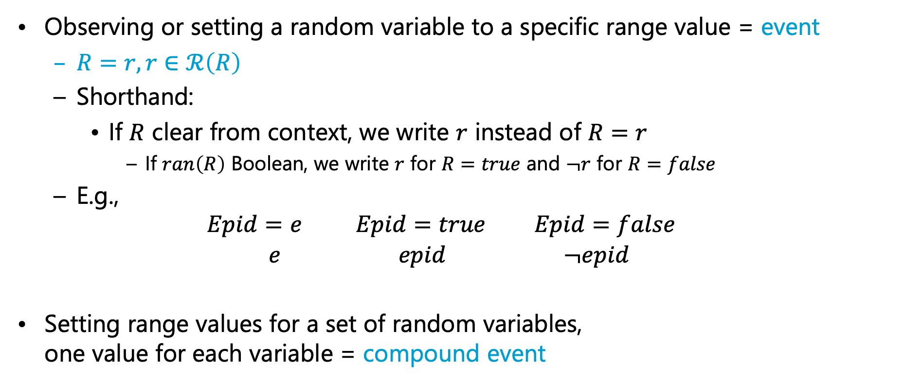
Events
Observing or setting a random variable to a specific range value = event
  $R=r, r∈ℛ\left(R\right)$
  Shorthand:
    If $R$ clear from context, we write $r$ instead of $R=r$
      If $ran\left(R\right)$ Boolean, we write $r$ for $R=true$ and $¬r$ for $R=false$
  E.g.,
  $$Epid=e Epid=true Epid=false$$
  $$e epid ¬epid$$
Setting range values for a set of random variables,
one value for each variable = compound event
$$Epid$$
$$Travel$$
$$Sick$$
Notes:
Vocabulary

Slide 7
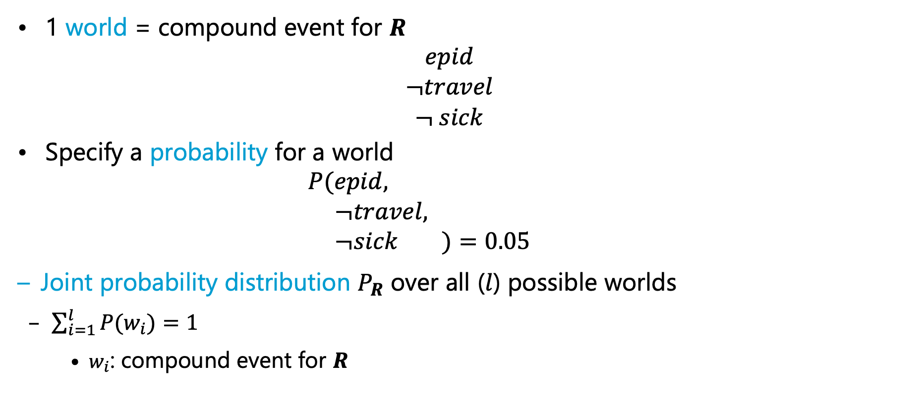




Full Joint Probability Distribution
$$Epid$$ | $$Travel$$ | $$Sick$$ | $$P$$
$$false$$ | $$false$$ | $$false$$ | $$0.20$$
$$false$$ | $$false$$ | $$true$$ | $$0.24$$
$$false$$ | $$true$$ | $$false$$ | $$0.28$$
$$false$$ | $$true$$ | $$true$$ | $$0.08$$
$$true$$ | $$false$$ | $$false$$ | $$0.05$$
$$true$$ | $$false$$ | $$true$$ | $$0.06$$
$$true$$ | $$true$$ | $$false$$ | $$0.07$$
$$true$$ | $$true$$ | $$true$$ | $$0.02$$
1 world = compound event for $R$
  $$epid \\ ¬travel \\ ¬ sick$$
Specify a probability for a world
  $$P(epid, \\ ¬travel, \\ ¬sick )=0.05$$
  Joint probability distribution $P_{R}$ over all ($l$) possible worlds
  $\sum_{i=1}^{l}{P(w_{i})}=1$
    $w_{i}$: compound event for $R$
$$Epid$$
How large is $l$?
$$P_{R}$$
$$Travel$$
$$Sick$$
Notes:
Vocabulary

Slide 8
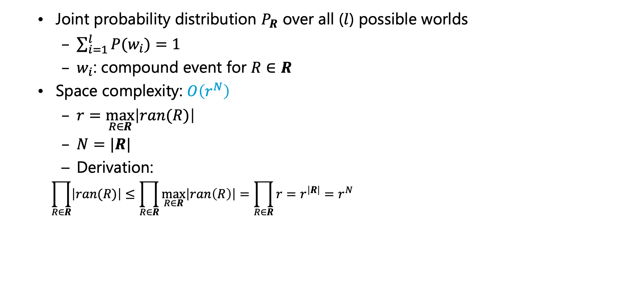

Space Complexity
$$Epid$$ | $$Travel$$ | $$Sick$$ | $$P$$
$$false$$ | $$false$$ | $$false$$ | $$0.20$$
$$false$$ | $$false$$ | $$true$$ | $$0.24$$
$$false$$ | $$true$$ | $$false$$ | $$0.28$$
$$false$$ | $$true$$ | $$true$$ | $$0.08$$
$$true$$ | $$false$$ | $$false$$ | $$0.05$$
$$true$$ | $$false$$ | $$true$$ | $$0.06$$
$$true$$ | $$true$$ | $$false$$ | $$0.07$$
$$true$$ | $$true$$ | $$true$$ | $$0.02$$
Joint probability distribution $P_{R}$ over all ($l$) possible worlds
  $\sum_{i=1}^{l}{P(w_{i})}=1$
  $w_{i}$: compound event for $R∈R$
Space complexity: $O\left(r^{N}\right)$
  $r=\max_{R∈R}\left|ran(R)\right|$
  $N=|R|$
  Derivation:
  $$\prod_{R∈R}{\left|ran(R)\right|}≤\prod_{R∈R}{\max_{R∈R}\left|ran\left(R\right)\right|}=\prod_{R∈R}{r}=r^{\left|R\right|}=r^{N}$$
$$Epid$$
Exponential in $N$!
$$P_{R}$$
Exact size
$$Travel$$
$$Sick$$
Notes:
As in example: ${r=2, n=3, r^{n}=2}^{3}=8, 2∙2∙2=8$
If one variable range size 3: ${r=3, n=3, r^{n}=3}^{3}=27, 3∙2∙2=12$

Slide 9
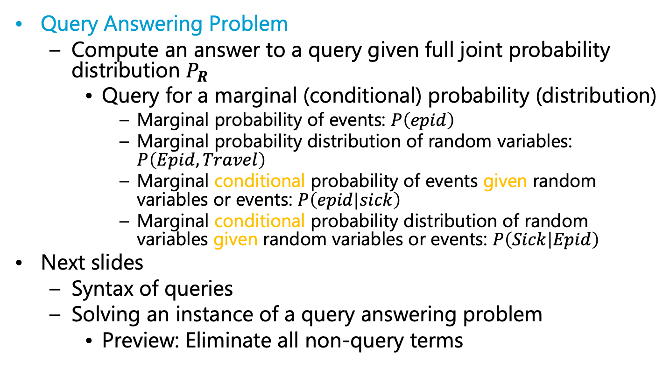
Inference Tasks
$$Epid$$ | $$Travel$$ | $$Sick$$ | $$P$$
$$false$$ | $$false$$ | $$false$$ | $$0.20$$
$$false$$ | $$false$$ | $$true$$ | $$0.24$$
$$false$$ | $$true$$ | $$false$$ | $$0.28$$
$$false$$ | $$true$$ | $$true$$ | $$0.08$$
$$true$$ | $$false$$ | $$false$$ | $$0.05$$
$$true$$ | $$false$$ | $$true$$ | $$0.06$$
$$true$$ | $$true$$ | $$false$$ | $$0.07$$
$$true$$ | $$true$$ | $$true$$ | $$0.02$$
Query Answering Problem
  Compute an answer to a query given full joint probability distribution $P_{R}$
    Query for a marginal (conditional) probability (distribution)
      Marginal probability of events: $P\left(epid\right)$
      Marginal probability distribution of random variables: $P\left(Epid,Travel\right)$
      Marginal conditional probability of events given random variables or events: $P\left(epid|sick\right)$
      Marginal conditional probability distribution of random variables given random variables or events: $P\left(Sick | Epid\right)$
Next slides
  Syntax of queries
  Solving an instance of a query answering problem
    Preview: Eliminate all non-query terms
$$Epid$$
$$P_{R}$$
$$Travel$$
$$Sick$$

Slide 10
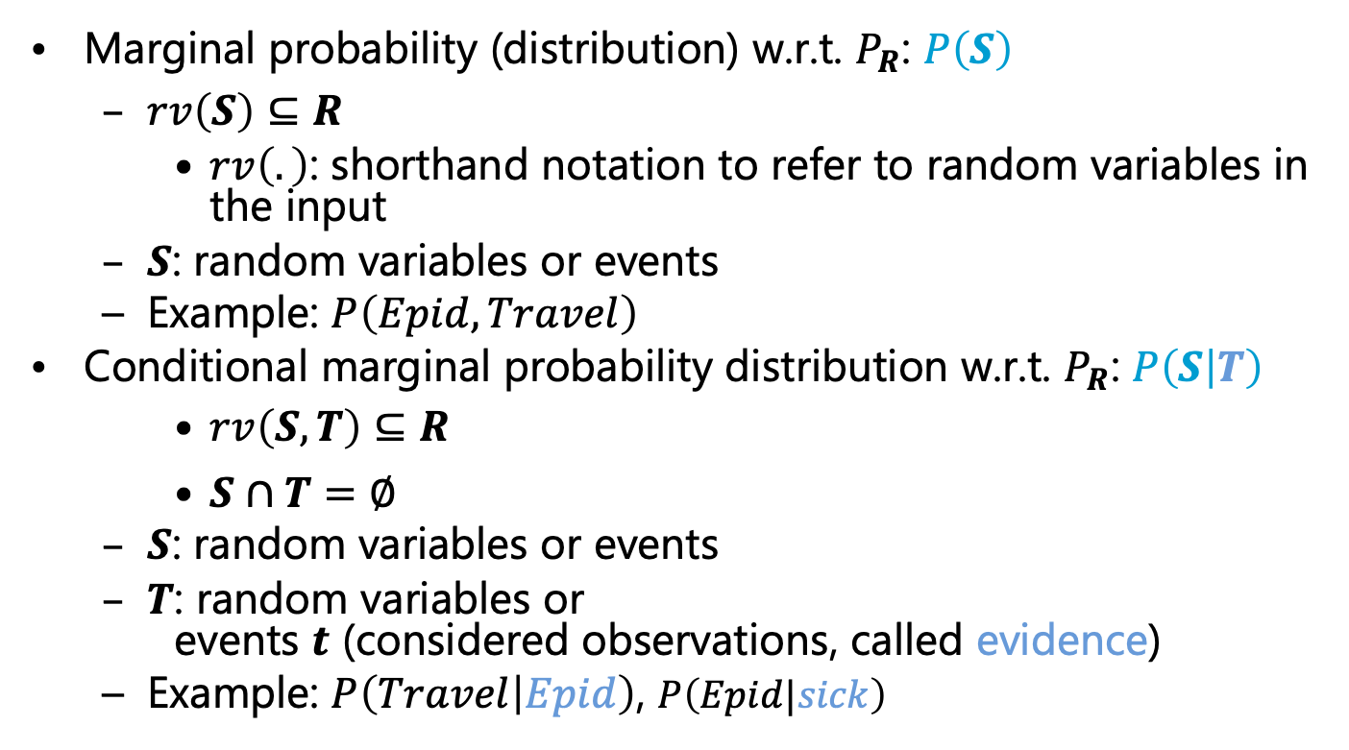
Query Syntax
$$Epid$$ | $$Travel$$ | $$Sick$$ | $$P$$
$$false$$ | $$false$$ | $$false$$ | $$0.20$$
$$false$$ | $$false$$ | $$true$$ | $$0.24$$
$$false$$ | $$true$$ | $$false$$ | $$0.28$$
$$false$$ | $$true$$ | $$true$$ | $$0.08$$
$$true$$ | $$false$$ | $$false$$ | $$0.05$$
$$true$$ | $$false$$ | $$true$$ | $$0.06$$
$$true$$ | $$true$$ | $$false$$ | $$0.07$$
$$true$$ | $$true$$ | $$true$$ | $$0.02$$
Marginal probability (distribution) w.r.t. $P_{R}$: $P\left(S\right)$
  $rv\left(S\right)⊆R$
    $rv\left(.\right)$: shorthand notation to refer to random variables in the input
  $S$: random variables or events
  Example: $P\left(Epid,Travel\right)$
Conditional marginal probability distribution w.r.t. $P_{R}$: $P\left(S | T\right)$
    $rv\left(S,T\right)⊆R$
    $S∩T=∅$
  $S$: random variables or events
  $T$: random variables or
  events $t$ (considered observations, called evidence)
  Example: $P\left(Travel | Epid\right)$, $P\left(Epid|sick\right)$
$$Epid$$
$$P_{R}$$
$$Travel$$
$$Sick$$

Slide 11
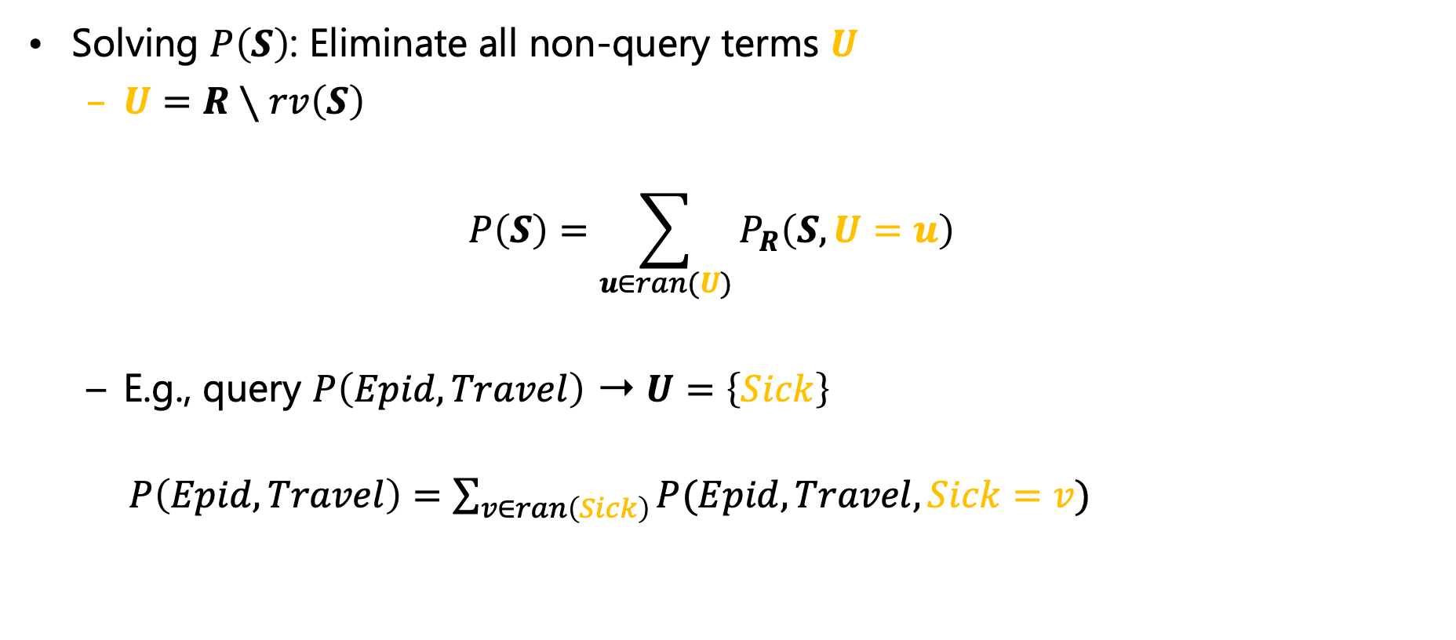

Answering Marginal Queries
$$Epid$$ | $$Travel$$ | $$Sick$$ | $$P$$
$$false$$ | $$false$$ | $$false$$ | $$0.20$$
$$false$$ | $$false$$ | $$true$$ | $$0.24$$
$$false$$ | $$true$$ | $$false$$ | $$0.28$$
$$false$$ | $$true$$ | $$true$$ | $$0.08$$
$$true$$ | $$false$$ | $$false$$ | $$0.05$$
$$true$$ | $$false$$ | $$true$$ | $$0.06$$
$$true$$ | $$true$$ | $$false$$ | $$0.07$$
$$true$$ | $$true$$ | $$true$$ | $$0.02$$
Solving $P\left(S\right)$: Eliminate all non-query terms $U$
  $U=R∖rv\left(S\right)$
  $$P\left(S\right)=\sum_{u∈ran(U)}{P_{R}\left(S,U=u\right)}$$
  E.g., query $P\left(Epid,Travel\right)$ ➝ $U=\left\{Sick\right\}$
    $P\left(Epid,Travel\right)=\sum_{v∈ran\left(Sick\right)}{P(Epid,Travel,Sick=v)}$
$$Epid$$
$$P_{R}$$
$$Travel$$
$$Sick$$

Slide 12


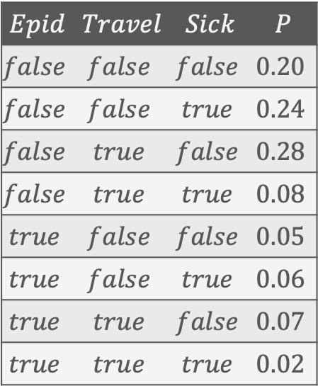

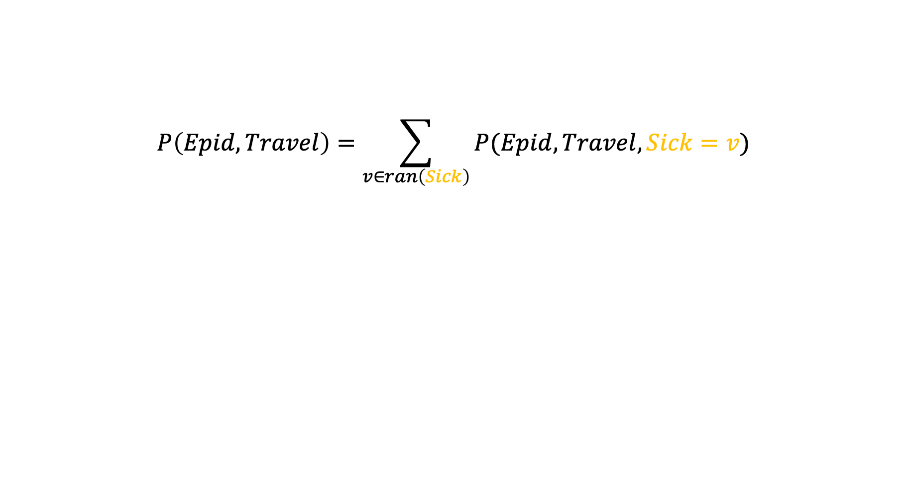




Answering Marginal Queries
$$P\left(Epid,Travel\right)=\sum_{v∈ran\left(Sick\right)}{P(Epid,Travel,Sick=v)}$$
$$Epid$$ | $$Travel$$ | $$Sick$$ | $$P$$
$$false$$ | $$false$$ | $$false$$ | $$0.20$$
$$false$$ | $$false$$ | $$true$$ | $$0.24$$
$$false$$ | $$true$$ | $$false$$ | $$0.28$$
$$false$$ | $$true$$ | $$true$$ | $$0.08$$
$$true$$ | $$false$$ | $$false$$ | $$0.05$$
$$true$$ | $$false$$ | $$true$$ | $$0.06$$
$$true$$ | $$true$$ | $$false$$ | $$0.07$$
$$true$$ | $$true$$ | $$true$$ | $$0.02$$
$$Epid$$ | $$Travel$$ | $$P$$
+
$$false$$ | $$false$$ | $$0.44$$
$$Epid$$
+
$$false$$ | $$true$$ | $$0.36$$
$$P\left(Epid, Travel\right)$$
$$Travel$$
+
$$true$$ | $$false$$ | $$0.11$$
$$Epid$$
+
$$true$$ | $$true$$ | $$0.09$$
$$P_{R}$$
$$Travel$$
$$Sick$$

Slide 13












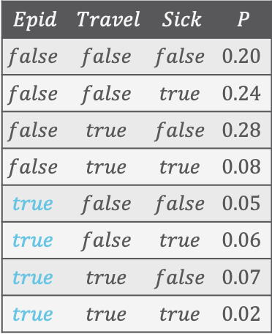


Answering Marginal Queries
If $S$ in $P\left(S\right)$ consists of events, consider only the worlds that are consistent with the events
  E.g., query $P\left(epid\right)$ with $U=\left\{Travel,Sick\right\}$
$$Epid$$
$$P\left(epid\right)=\sum_{v_{t}∈ran\left(Travel\right)}{\sum_{v_{s}∈ran\left(Sick\right)}{P(epid,Travel=v_{t},Sick=v_{s})}}$$
$$P\left(epid\right)$$
$$Epid$$ | $$Travel$$ | $$Sick$$ | $$P$$
$$false$$ | $$false$$ | $$false$$ | $$0.20$$
$$false$$ | $$false$$ | $$true$$ | $$0.24$$
$$false$$ | $$true$$ | $$false$$ | $$0.28$$
$$false$$ | $$true$$ | $$true$$ | $$0.08$$
$$true$$ | $$false$$ | $$false$$ | $$0.05$$
$$true$$ | $$false$$ | $$true$$ | $$0.06$$
$$true$$ | $$true$$ | $$false$$ | $$0.07$$
$$true$$ | $$true$$ | $$true$$ | $$0.02$$
$$Epid$$
No probability distribution at this point (in the middle of the computation)
$$φ\left(epid, Travel\right)$$
$$Travel$$
$$Epid$$ | $$Travel$$ | $$φ$$
$$Epid$$ | $$P$$
$$Epid$$
+
$$true$$ | $$false$$ | $$0.11$$
+
$$true$$ | $$0.20$$
+
$$true$$ | $$true$$ | $$0.09$$
$$P_{R}$$
$$Travel$$
$$Sick$$
Notes:
Sum over range values of random variables in $U$

Slide 14
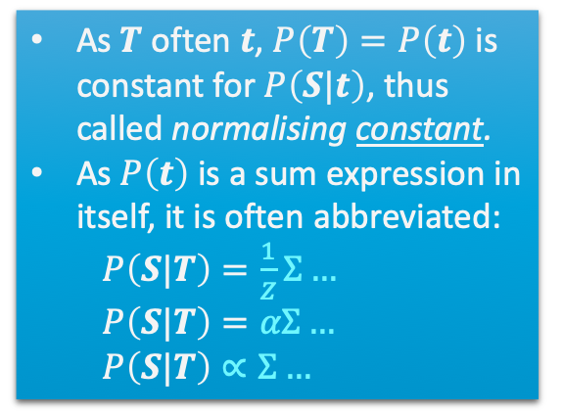
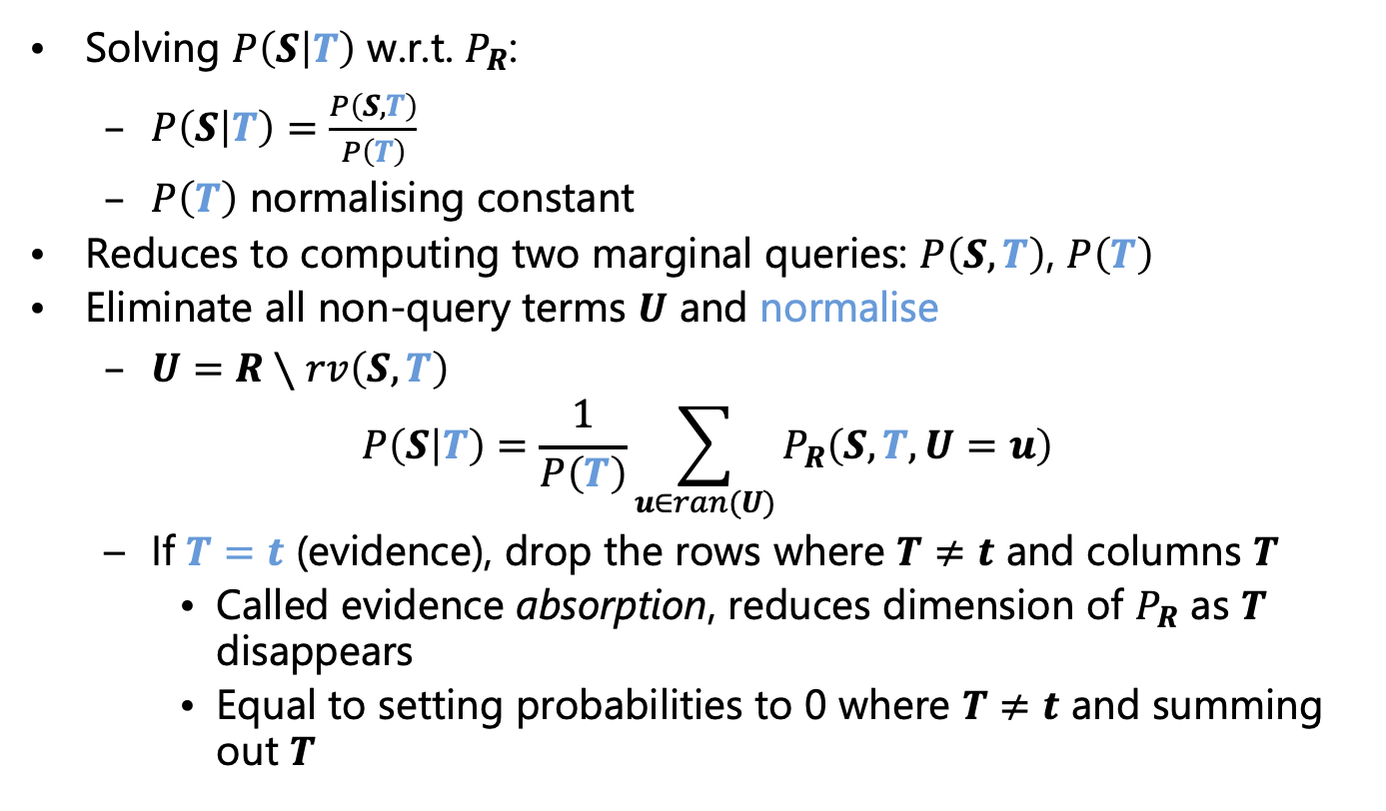
Answering Conditional Queries
Solving $P\left(S | T\right)$ w.r.t. $P_{R}$:
  $P\left(S | T\right)=\frac{P\left(S,T\right)}{P\left(T\right)}$
  $P\left(T\right)$ normalising constant
Reduces to computing two marginal queries: $P\left(S,T\right)$, $P\left(T\right)$
Eliminate all non-query terms $U$ and normalise
  $U=R∖rv\left(S,T\right)$
  $$P\left(S | T\right)=\frac{1}{P\left(T\right)}\sum_{u∈ran(U)}{P_{R}\left(S,T,U=u\right)}$$
  If $T=t$ (evidence), drop the rows where $T≠t$ and columns $T$
    Called evidence absorption, reduces dimension of $P_{R}$ as $T$ disappears
    Equal to setting probabilities to 0 where $T≠t$ and summing out $T$
As $T$ often $t$, $P\left(T\right)=P\left(t\right)$ is constant for $P\left(S|t\right)$, thus called normalising constant.
As $P\left(t\right)$ is a sum expression in itself, it is often abbreviated:
$P\left(S|T\right)=\frac{1}{Z}Σ…$
$P\left(S|T\right)=αΣ…$
$P\left(S|T\right)∝Σ…$
(partition function)
(proportional to)
$$Epid$$
$$P_{R}$$
$$Travel$$
$$Sick$$

Slide 15





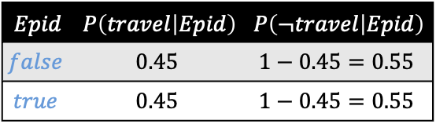

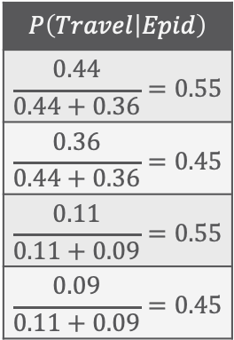

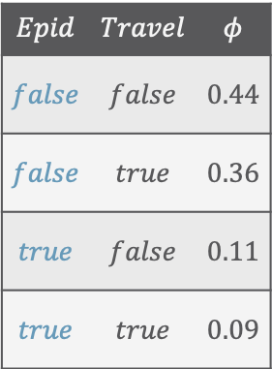

Answering Conditional Queries: Normalisation
Normalise by $P\left(T\right)$: for each $t∈ran\left(T\right)$, for each $s∈ran\left(S\right)$, compute $\frac{P\left(s,t\right)}{P\left(t\right)}$
  $P\left(Travel | Epid\right)=\frac{1}{P\left(Epid\right)}\sum_{v_{s}∈ran\left(Sick\right)}{P(Epid,Travel,Sick=v_{s})}$
    for each $e∈ran\left(Epid\right)$: for each $t∈ran\left(Travel\right)$:
    divide $φ\left(e,t\right)$ by $P\left(e\right)=φ\left(e,t\right)+φ\left(e,¬t\right)$
$$φ$$
$$Epid$$
What do we need to do?
$$P\left(Travel | Epid\right)$$
$$\frac{0.44}{0.44+0.36}=0.55$$
$$\frac{0.36}{0.44+0.36}=0.45$$
$$\frac{0.11}{0.11+0.09}=0.55$$
$$\frac{0.09}{0.11+0.09}=0.45$$
$$Epid$$ | $$Travel$$ | $$φ$$
$$false$$ | $$false$$ | $$0.44$$
$$false$$ | $$true$$ | $$0.36$$
$$true$$ | $$false$$ | $$0.11$$
$$true$$ | $$true$$ | $$0.09$$
$$P\left(Travel | Epid\right)$$
$$Travel$$
$$φ\left(Epid, Travel\right)$$
$$Epid$$ | $$P\left(travel | Epid\right)$$ | $$P\left(¬travel | Epid\right)$$
$$false$$ | $$0.45$$ | $$1−0.45=0.55$$
$$true$$ | $$0.45$$ | $$1−0.45=0.55$$
$$Epid$$
$$P_{R}$$
$$Travel$$
$$Sick$$
Notes:
Sum over range values of random variables in $U$

Slide 16


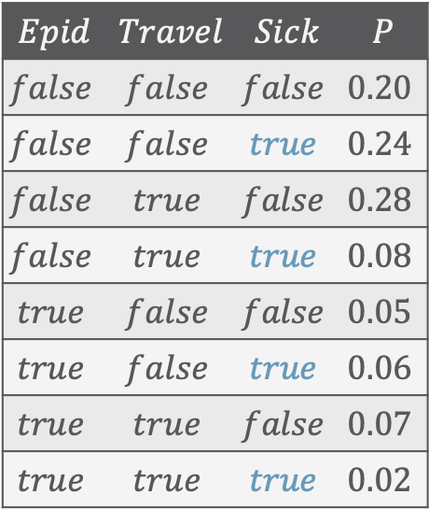









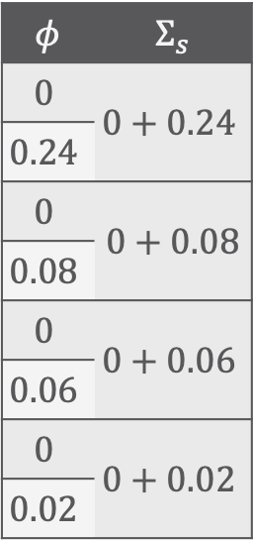


Answering Conditional Queries: Evidence – Absorption
$$P\left(Epid|sick\right)∝\sum_{v∈ran(Travel)}{P\left(Epid,Travel=v,sick\right)}$$
$$Epid$$
$$φ^{′}$$
$$Travel$$
$$Epid$$ | $$Travel$$ | $$Sick$$ | $$P$$
$$false$$ | $$false$$ | $$false$$ | $$0.20$$
$$false$$ | $$false$$ | $$true$$ | $$0.24$$
$$false$$ | $$true$$ | $$false$$ | $$0.28$$
$$false$$ | $$true$$ | $$true$$ | $$0.08$$
$$true$$ | $$false$$ | $$false$$ | $$0.05$$
$$true$$ | $$false$$ | $$true$$ | $$0.06$$
$$true$$ | $$true$$ | $$false$$ | $$0.07$$
$$true$$ | $$true$$ | $$true$$ | $$0.02$$
$$Epid$$ | $$Travel$$ | $$φ^{′}$$
$$φ$$ | $$Σ_{s}$$
$$0$$ | $$0+0.24$$
$$0.24$$
$$0$$ | $0+0.$08
$$0.08$$
$$0$$ | $$0+0.06$$
$$0.06$$
$$0$$ | $$0+0.02$$
$$0.02$$
$$Epid$$
$$false$$ | $$false$$ | $$0.24$$
$$φ$$
$$Travel$$
$$sick$$
$$false$$ | $$true$$ | $$0.08$$
$$Epid$$
$$true$$ | $$false$$ | $$0.06$$
$$P_{R}$$
$$true$$ | $$true$$ | $$0.02$$
$$Travel$$
$$sick$$
select + project
set to $0$ + sum out

Slide 17


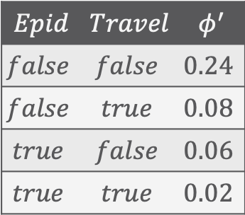


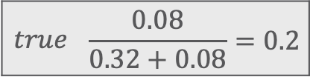


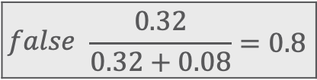


Answering Conditional Queries: Evidence – Normalisation
$$P\left(Epid|sick\right)∝\sum_{v∈ran(Travel)}{P\left(Epid,Travel=v,sick\right)}$$
$$Epid$$
normalise
$$P\left(Epid|sick\right)$$
$$Epid$$ | $$Travel$$ | $$φ^{′}$$
$$false$$ | $$false$$ | $$0.24$$
$$false$$ | $$true$$ | $$0.08$$
$$true$$ | $$false$$ | $$0.06$$
$$true$$ | $$true$$ | $$0.02$$
$$Epid$$ | $$φ^{′}′$$
$$Epid$$ | $$P$$
$$Epid$$
+
$$false$$ | $$0.32$$
$$false$$ | $$\frac{0.32}{0.32+0.08}=0.8$$
$$true$$ | $$\frac{0.08}{0.32+0.08}=0.2$$
$$φ^{′′}$$
+
$$true$$ | $$0.08$$
$$Epid$$
for each $t∈ran\left(T\right)$, for each $s∈ran\left(S\right)$, compute $\frac{P\left(s,t\right)}{P\left(t\right)}$
$$φ^{′}$$
with $T=t$, only one case $t$
$$Travel$$

Slide 18
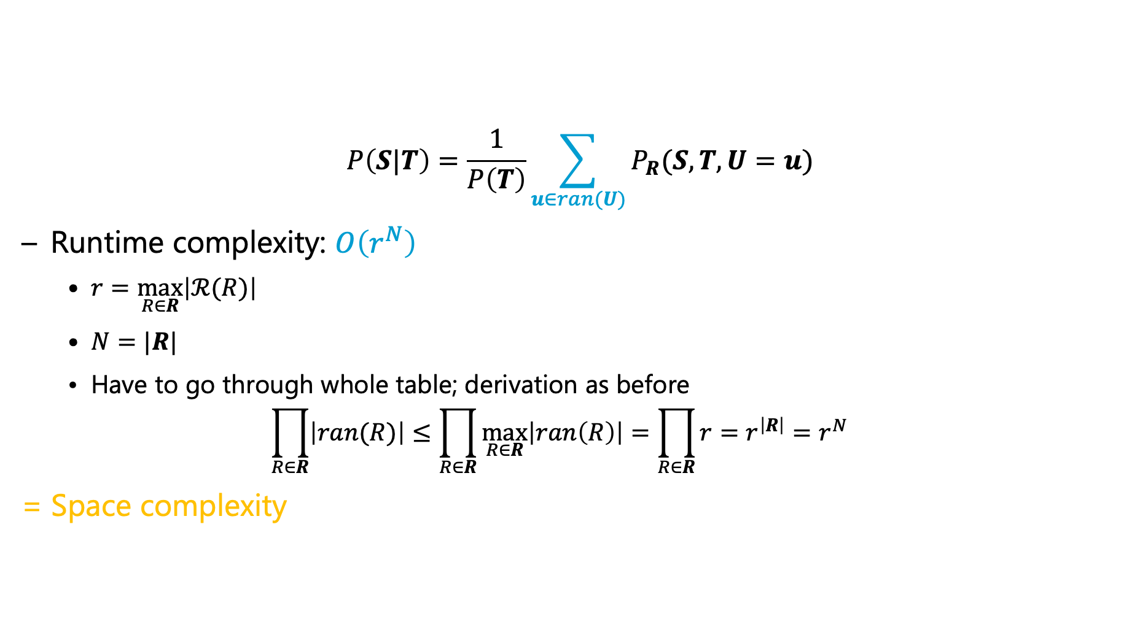
Runtime Complexity
$$Epid$$ | $$Travel$$ | $$Sick$$ | $$P$$
$$false$$ | $$false$$ | $$false$$ | $$0.20$$
$$false$$ | $$false$$ | $$true$$ | $$0.24$$
$$false$$ | $$true$$ | $$false$$ | $$0.28$$
$$false$$ | $$true$$ | $$true$$ | $$0.08$$
$$true$$ | $$false$$ | $$false$$ | $$0.05$$
$$true$$ | $$false$$ | $$true$$ | $$0.06$$
$$true$$ | $$true$$ | $$false$$ | $$0.07$$
$$true$$ | $$true$$ | $$true$$ | $$0.02$$
  $$P\left(S|T\right)=\frac{1}{P\left(T\right)}\sum_{u∈ran(U)}{P_{R}(S,T,U=u)}$$
  Runtime complexity: $O\left(r^{N}\right)$
    $r=\max_{R∈R}\left|ℛ(R)\right|$
    $N=|R|$
    Have to go through whole table; derivation as before
    $$\prod_{R∈R}{\left|ran(R)\right|}≤\prod_{R∈R}{\max_{R∈R}\left|ran\left(R\right)\right|}=\prod_{R∈R}{r}=r^{\left|R\right|}=r^{N}$$
  = Space complexity
$$Epid$$
Exponential in $N$!
$$P_{R}$$
$$Travel$$
$$Sick$$
Notes:
As in example: ${r=2, n=3, r^{n}=2}^{3}=8, 2∙2∙2=8$
If one variable range size 3: ${r=3, n=3, r^{n}=3}^{3}=27, 3∙2∙2=12$

Slide 19

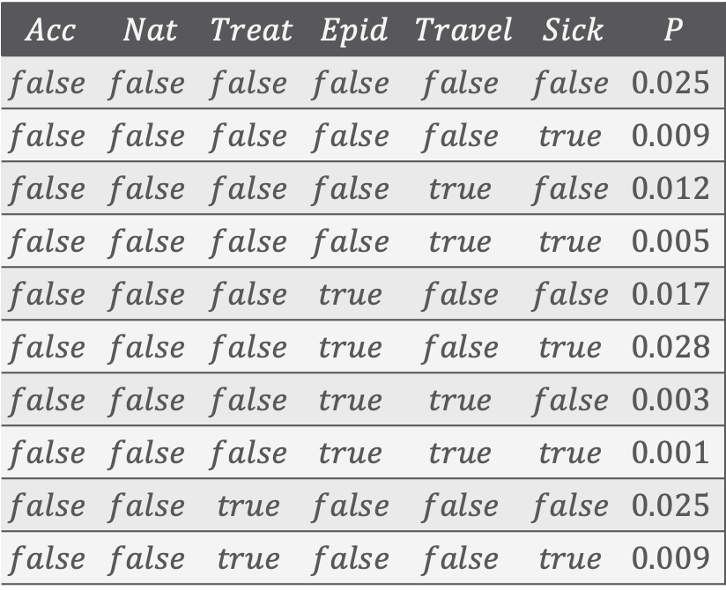






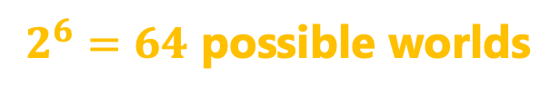

Exponential Blowup!
$$Acc$$ | $$Nat$$ | $$Treat$$ | $$Epid$$ | $$Travel$$ | $$Sick$$ | $$P$$
$$false$$ | $$false$$ | $$false$$ | $$false$$ | $$false$$ | $$false$$ | $$0.025$$
$$false$$ | $$false$$ | $$false$$ | $$false$$ | $$false$$ | $$true$$ | $$0.009$$
$$false$$ | $$false$$ | $$false$$ | $$false$$ | $$true$$ | $$false$$ | $$0.012$$
$$false$$ | $$false$$ | $$false$$ | $$false$$ | $$true$$ | $$true$$ | $$0.005$$
$$false$$ | $$false$$ | $$false$$ | $$true$$ | $$false$$ | $$false$$ | $$0.017$$
$$false$$ | $$false$$ | $$false$$ | $$true$$ | $$false$$ | $$true$$ | $$0.028$$
$$false$$ | $$false$$ | $$false$$ | $$true$$ | $$true$$ | $$false$$ | $$0.003$$
$$false$$ | $$false$$ | $$false$$ | $$true$$ | $$true$$ | $$true$$ | $$0.001$$
$$false$$ | $$false$$ | $$true$$ | $$false$$ | $$false$$ | $$false$$ | $$0.025$$
$$false$$ | $$false$$ | $$true$$ | $$false$$ | $$false$$ | $$true$$ | $$0.009$$
$$Acc$$
$$Nat$$
$$Epid$$
$$P_{R}$$
$$Travel$$
$$Sick$$
$$Treat$$
$2^{6}=64$ possible worlds
Adding relations means adding $Sick$, $Treat$, $Travel$ variables for each person, blowing up the model further
Notes:
Vocabulary

Slide 20



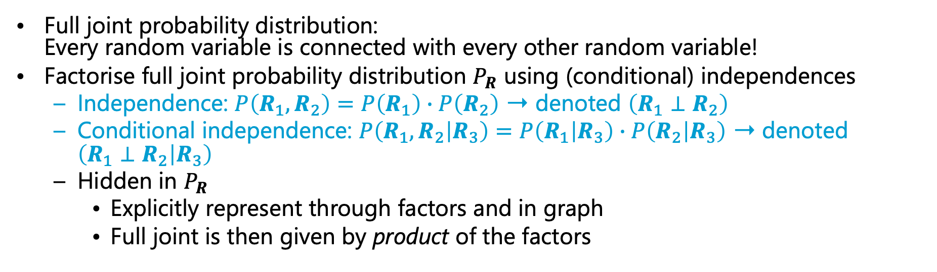


Compact Encoding
Full joint probability distribution:
Every random variable is connected with every other random variable!
Factorise full joint probability distribution $P_{R}$ using (conditional) independences
  Independence: $P\left(R_{1},R_{2}\right)=P\left(R_{1}\right)∙P\left(R_{2}\right)$ ➝ denoted $\left(R_{1}⊥R_{2}\right)$
  Conditional independence: $P\left(R_{1},R_{2} | R_{3}\right)=P\left(R_{1} | R_{3}\right)∙P\left(R_{2} | R_{3}\right)$ ➝ denoted $\left(R_{1}⊥R_{2} | R_{3}\right)$
  Hidden in $P_{R}$
    Explicitly represent through factors and in graph
    Full joint is then given by product of the factors
$$Epid$$
$$Epid$$
$$P_{R}$$
$$Travel$$
$$Sick$$
$$Travel$$
$$Sick$$

Slide 21
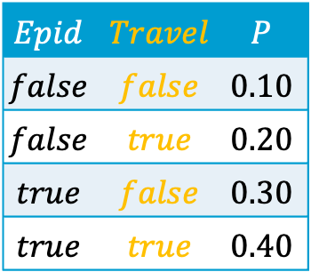

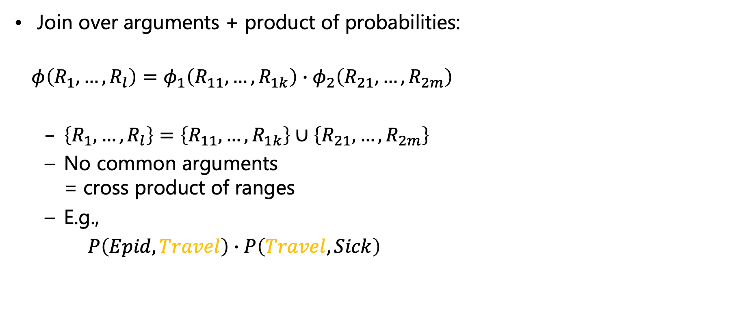


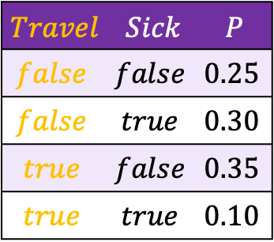
Excursion: Multiplication
Join over arguments + product of probabilities:
  $$φ\left(R_{1},…,R_{l}\right)=φ_{1}\left(R_{11},…, R_{1k}\right)∙φ_{2}\left(R_{21},…, R_{2m}\right)$$
  $\left\{R_{1},…,R_{l}\right\}=\left\{R_{11},…, R_{1k}\right\}∪\left\{R_{21},…, R_{2m}\right\}$
  No common arguments
  = cross product of ranges
  E.g.,
  $P\left(Epid,Travel\right)∙P\left(Travel,Sick\right)$
$$Epid$$ | $$Travel$$ | $$P$$
$$false$$ | $$false$$ | $$0.10$$
$$false$$ | $$true$$ | $$0.20$$
$$true$$ | $$false$$ | $$0.30$$
$$true$$ | $$true$$ | $$0.40$$
$$Travel$$ | $$Sick$$ | $$P$$
$$false$$ | $$false$$ | $$0.25$$
$$false$$ | $$true$$ | $$0.30$$
$$true$$ | $$false$$ | $$0.35$$
$$true$$ | $$true$$ | $$0.10$$
$$∙$$
$$Epid$$ | $$Travel$$ | $$Sick$$ | $$P$$
$$false$$ | $$false$$ | $$false$$ | $$0.10∙0.25$$

Slide 22
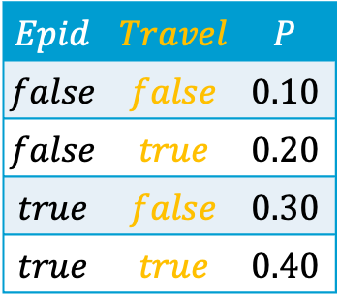

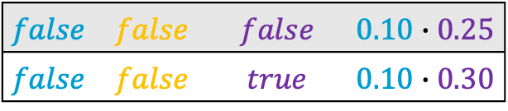
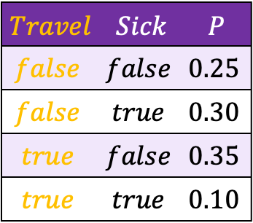
Excursion: Multiplication
Join over arguments + product of probabilities:
  $$φ\left(R_{1},…,R_{l}\right)=φ_{1}\left(R_{11},…, R_{1k}\right)∙φ_{2}\left(R_{21},…, R_{2m}\right)$$
  $\left\{R_{1},…,R_{l}\right\}=\left\{R_{11},…, R_{1k}\right\}∪\left\{R_{21},…, R_{2m}\right\}$
  No common arguments
  = cross product of ranges
  E.g.,
  $P\left(Epid,Travel\right)∙P\left(Travel,Sick\right)$
$$Epid$$ | $$Travel$$ | $$P$$
$$false$$ | $$false$$ | $$0.10$$
$$false$$ | $$true$$ | $$0.20$$
$$true$$ | $$false$$ | $$0.30$$
$$true$$ | $$true$$ | $$0.40$$
$$Travel$$ | $$Sick$$ | $$P$$
$$false$$ | $$false$$ | $$0.25$$
$$false$$ | $$true$$ | $$0.30$$
$$true$$ | $$false$$ | $$0.35$$
$$true$$ | $$true$$ | $$0.10$$
$$∙$$
$$Epid$$ | $$Travel$$ | $$Sick$$ | $$P$$
$$false$$ | $$false$$ | $$false$$ | $$0.10∙0.25$$
$$false$$ | $$false$$ | $$true$$ | $$0.10∙0.30$$

Slide 23


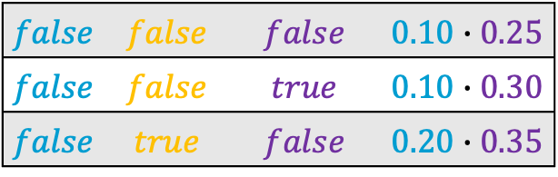
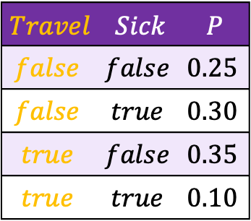
Excursion: Multiplication
Join over arguments + product of probabilities:
  $$φ\left(R_{1},…,R_{l}\right)=φ_{1}\left(R_{11},…, R_{1k}\right)∙φ_{2}\left(R_{21},…, R_{2m}\right)$$
  $\left\{R_{1},…,R_{l}\right\}=\left\{R_{11},…, R_{1k}\right\}∪\left\{R_{21},…, R_{2m}\right\}$
  No common arguments
  = cross product of ranges
  E.g.,
  $P\left(Epid,Travel\right)∙P\left(Travel,Sick\right)$
$$Epid$$ | $$Travel$$ | $$P$$
$$false$$ | $$false$$ | $$0.10$$
$$false$$ | $$true$$ | $$0.20$$
$$true$$ | $$false$$ | $$0.30$$
$$true$$ | $$true$$ | $$0.40$$
$$Travel$$ | $$Sick$$ | $$P$$
$$false$$ | $$false$$ | $$0.25$$
$$false$$ | $$true$$ | $$0.30$$
$$true$$ | $$false$$ | $$0.35$$
$$true$$ | $$true$$ | $$0.10$$
$$∙$$
$$Epid$$ | $$Travel$$ | $$Sick$$ | $$P$$
$$false$$ | $$false$$ | $$false$$ | $$0.10∙0.25$$
$$false$$ | $$false$$ | $$true$$ | $$0.10∙0.30$$
$$false$$ | $$true$$ | $$false$$ | $$0.20∙0.35$$
$$⋮$$

Slide 24
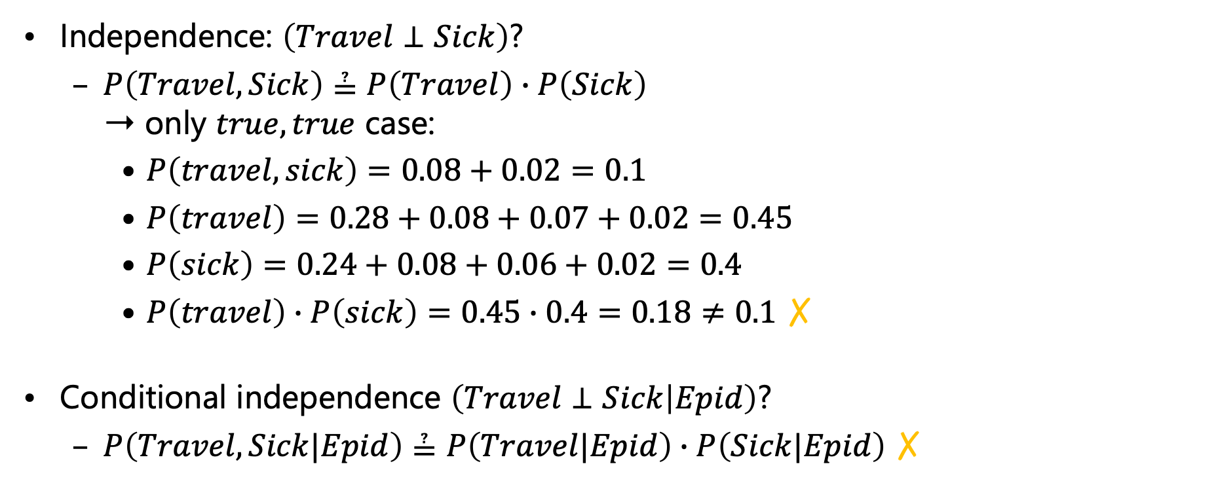
Independences: Examples
$$Epid$$ | $$Travel$$ | $$Sick$$ | $$P$$
$$false$$ | $$false$$ | $$false$$ | $$0.20$$
$$false$$ | $$false$$ | $$true$$ | $$0.24$$
$$false$$ | $$true$$ | $$false$$ | $$0.28$$
$$false$$ | $$true$$ | $$true$$ | $$0.08$$
$$true$$ | $$false$$ | $$false$$ | $$0.05$$
$$true$$ | $$false$$ | $$true$$ | $$0.06$$
$$true$$ | $$true$$ | $$false$$ | $$0.07$$
$$true$$ | $$true$$ | $$true$$ | $$0.02$$
Independence: $\left(Travel⊥Sick\right)$?
  $P\left(Travel, Sick\right)≟P\left(Travel\right)∙P\left(Sick\right)$
  ➝ only $true,true$ case:
    $P\left(travel, sick\right)=0.08+0.02=0.1$
    $P\left(travel\right)=0.28+0.08+0.07+0.02=0.45$
    $P\left(sick\right)=0.24+0.08+0.06+0.02=0.4$
    $P\left(travel\right)∙P\left(sick\right)=0.45∙0.4=0.18≠0.1$ ✗
Conditional independence $\left(Travel⊥Sick | Epid\right)$?
  $P\left(Travel, Sick|Epid\right)≟P\left(Travel|Epid\right)∙P\left(Sick|Epid\right)$ ✗
$$Epid$$
$$P_{R}$$
$$Travel$$
$$Sick$$

Slide 25
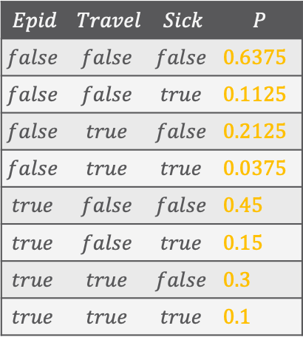
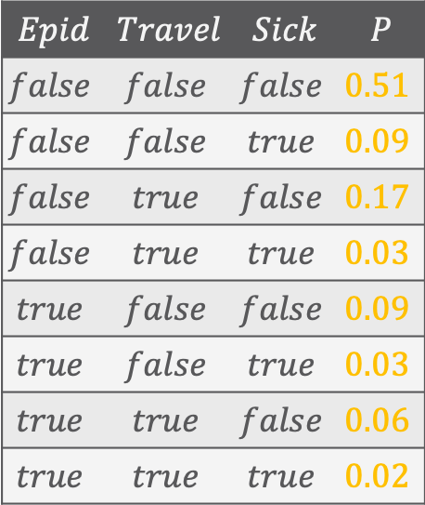

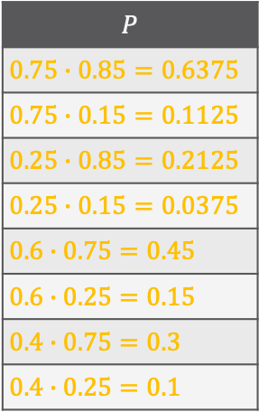

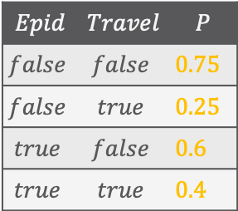
Independences: Examples
$$Epid$$ | $$Travel$$ | $$Sick$$ | $$P$$
$$false$$ | $$false$$ | $$false$$ | $$0.51$$
$$false$$ | $$false$$ | $$true$$ | $$0.09$$
$$false$$ | $$true$$ | $$false$$ | $$0.17$$
$$false$$ | $$true$$ | $$true$$ | $$0.03$$
$$true$$ | $$false$$ | $$false$$ | $$0.09$$
$$true$$ | $$false$$ | $$true$$ | $$0.03$$
$$true$$ | $$true$$ | $$false$$ | $$0.06$$
$$true$$ | $$true$$ | $$true$$ | $$0.02$$
$Travel⊥Sick | Epid$?
  $P\left(Travel, Sick | Epid\right)≟P\left(Travel | Epid\right)∙P\left(Sick | Epid\right)$ ✓
$$Epid$$ | $$Travel$$ | $$Sick$$ | $$P$$
$$false$$ | $$false$$ | $$false$$ | $0.6375$
$$false$$ | $$false$$ | $$true$$ | $0.1125$
$$false$$ | $$true$$ | $$false$$ | $0.2125$
$$false$$ | $$true$$ | $$true$$ | $0.0375$
$$true$$ | $$false$$ | $$false$$ | $0.45$
$$true$$ | $$false$$ | $$true$$ | $0.15$
$$true$$ | $$true$$ | $$false$$ | $0.3$
$$true$$ | $$true$$ | $$true$$ | $0.1$
$$Epid$$ | $$Travel$$ | $$P$$
$$false$$ | $$false$$ | $0.75$
$$false$$ | $$true$$ | $0.25$
$$true$$ | $$false$$ | $0.6$
$$true$$ | $$true$$ | $0.4$
$$Epid$$ | $$Sick$$ | $$P$$
$$false$$ | $$false$$ | $0.85$
$$false$$ | $$true$$ | $0.15$
$$true$$ | $$false$$ | $0.75$
$$true$$ | $$true$$ | $0.25$
$$P$$
$0.75∙0.85=0.6375$
$0.75∙0.15=0.1125$
$0.25∙0.85=0.2125$
$0.25∙0.15=0.0375$
$0.6∙0.75=0.45$
$0.6∙0.25=0.15$
$0.4∙0.75=0.3$
$0.4∙0.25=0.1$
$$Epid$$
$$P_{R}$$
$$Travel$$
$$Sick$$

Slide 26
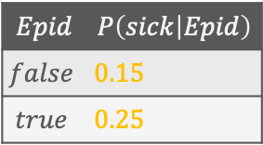

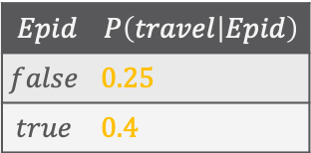






Independences: Examples
$$Epid$$ | $$Travel$$ | $$Sick$$ | $$P$$
$$false$$ | $$false$$ | $$false$$ | $$0.51$$
$$false$$ | $$false$$ | $$true$$ | $$0.09$$
$$false$$ | $$true$$ | $$false$$ | $$0.17$$
$$false$$ | $$true$$ | $$true$$ | $$0.03$$
$$true$$ | $$false$$ | $$false$$ | $$0.09$$
$$true$$ | $$false$$ | $$true$$ | $$0.03$$
$$true$$ | $$true$$ | $$false$$ | $$0.06$$
$$true$$ | $$true$$ | $$true$$ | $$0.02$$
Factorise the full joint into its factors based on independences:
  $P\left(Epid,Travel,Sick\right)=P\left(Epid\right)∙P\left(Travel|Epid\right)∙P\left(Sick|Epid\right)$
  Usually fewer entries to store
$$Epid$$
$$Epid$$ | $$P$$
$$false$$ | $0.8$
$$true$$ | $0.2$
$$Epid$$ | $$Travel$$ | $$P$$
$$false$$ | $$false$$ | $0.75$
$$false$$ | $$true$$ | $0.25$
$$true$$ | $$false$$ | $0.6$
$$true$$ | $$true$$ | $0.4$
$$Epid$$ | $$Sick$$ | $$P$$
$$false$$ | $$false$$ | $0.85$
$$false$$ | $$true$$ | $0.15$
$$true$$ | $$false$$ | $0.75$
$$true$$ | $$true$$ | $0.25$
$$Travel$$
$$Sick$$
$$P\left(epid\right)$$
$0.2$
$$Epid$$ | $$P\left(travel | Epid\right)$$
$$false$$ | $0.25$
$$true$$ | $0.4$
$$Epid$$ | $$P\left(sick | Epid\right)$$
$$false$$ | $0.15$
$$true$$ | $0.25$
$$Epid$$
$$P_{R}$$
$$Travel$$
$$Sick$$
Notes:
$2+4+4=10$ entries instead of $8$
Because probability distributions sum up to $1$:
$1+2+2=5$ entries instead of $7$, which is less

Slide 27

Finding a Compact Encoding
At beginning: Everything connected with everything in full joint
Find (conditional) independences in $P_{R}$
  Check every possible combination ➝ Combinatorial explosion!
    E.g., (many more)
      $\left(Epid⊥Travel,Sick\right)$, $\left(Travel⊥Epid,Sick\right)$, $\left(Sick⊥Travel,Epid\right)$
  Partitions $P_{R}$ into a set of factors
    Deletes connections between random variables
Alternative:
  Start with no connections, add factors
  More later (➝ Section 8: Lifted Learning)
For now, assume that we have a factorised model
$$Acc$$
$$Nat$$
$$Epid$$
$$P_{R}$$
$$Travel$$
$$Sick$$
$$Treat$$
$$Epid$$
$$P_{R}$$
$$Travel$$
$$Sick$$

Slide 28














Exponential Blowup! ➝ Sparse Encoding
$$Acc$$ | $$Nat$$ | $$Treat$$ | $$Epid$$ | $$Travel$$ | $$Sick$$ | $$P$$
$$false$$ | $$false$$ | $$false$$ | $$false$$ | $$false$$ | $$false$$ | $$0.025$$
$$false$$ | $$false$$ | $$false$$ | $$false$$ | $$false$$ | $$true$$ | $$0.009$$
$$false$$ | $$false$$ | $$false$$ | $$false$$ | $$true$$ | $$false$$ | $$0.012$$
$$false$$ | $$false$$ | $$false$$ | $$false$$ | $$true$$ | $$true$$ | $$0.005$$
$$false$$ | $$false$$ | $$false$$ | $$true$$ | $$false$$ | $$false$$ | $$0.017$$
$$false$$ | $$false$$ | $$false$$ | $$true$$ | $$false$$ | $$true$$ | $$0.028$$
$$false$$ | $$false$$ | $$false$$ | $$true$$ | $$true$$ | $$false$$ | $$0.003$$
$$false$$ | $$false$$ | $$false$$ | $$true$$ | $$true$$ | $$true$$ | $$0.001$$
$$false$$ | $$false$$ | $$true$$ | $$false$$ | $$false$$ | $$false$$ | $$0.025$$
$$false$$ | $$false$$ | $$true$$ | $$false$$ | $$false$$ | $$true$$ | $$0.009$$
$$Nat$$
$$Acc$$
$$Acc$$
$$f_{1}$$
$$Nat$$
$$Epid$$
$$Epid$$
$$P_{R}$$
$$f_{0}$$
$$Travel$$
$$Treat$$
$$Travel$$
$$Sick$$
$$f_{2}$$
$$f_{3}$$
$$Sick$$
$$Treat.m_{2}$$
$$3∙2^{3}+2$$
$=26$ entries
$2^{6}=64$ possible worlds
Adding relations means adding $Sick$, $Treat$, $Travel$ variables for each person, blowing up the model further
Notes:
Vocabulary

Slide 29











Model Representation: Factors
Given set of random variables $R=\left\{R_{1}, …, R_{N}\right\}$
Syntax:
Set of factors $F={\left\{f_{i}\right\}}_{i=1}^{n^{′}}$
= model
Factor $f=φ\left(R_{1},…, R_{k}\right)$
  Arguments $R_{1},…, R_{k}∈R$
  Potential function
  $φ: ×_{i=1}^{k}ran\left(R_{i}\right)⟶ℝ^{0,+}$
    At least one potential $>0$
    Write as table, list, …
    Not required to be a probability distribution
$$Nat$$
$$Acc$$
$$f_{1}$$
$$Epid$$
$$f_{0}$$
$$Travel$$
$$Treat$$
$$f_{2}$$
$$f_{3}$$
$$Sick$$

Slide 30

Model Representation: Factors
Given model $F={\left\{f_{i}\right\}}_{i=1}^{n}$ over random variables $R=\left\{R_{1}, …, R_{N}\right\}$
  $f_{i}=φ_{i}\left(R_{1},…, R_{k}\right)$
Semantics:
Build full joint probability distribution $P_{F}$
  $$P_{F}= \frac{1}{Z}\prod_{i=1}^{n}{φ_{i}\left(R_{1},…, R_{k}\right)}$$
  $$Z=\sum_{r_{1}∈ran(R_{1})}{\sum_{r_{n}∈ran(R_{n})}{\prod_{i=1}^{n}{φ_{i}\left(r_{1},…, r_{k}\right)}}}$$
$$Nat$$
$$Acc$$
$$f_{1}$$
$$Epid$$
$$f_{0}$$
$$Travel$$
$$Treat$$
$$f_{2}$$
$$f_{3}$$
$$Sick$$

Slide 31

Model Representation: Factors
Given model $F={\left\{f_{i}\right\}}_{i=1}^{n}$ over random variables $R=\left\{R_{1}, …, R_{N}\right\}$
  $f_{i}=φ_{i}\left(R_{1},…, R_{k}\right)$
Graphical representation: Factor graph (FG)
  Each $R∈R$: variable node in FG (ellipse)
  Each $f∈F$: factor node in FG (box)
  For each argument $R$ in $f∈F$: edge between variable
  node for $R$ and factor node for $f$
$$Nat$$
$$Acc$$
$$f_{1}$$
$$Epid$$
$$f_{0}$$
$$Travel$$
$$Treat$$
$$f_{2}$$
$$f_{3}$$
$$Sick$$

Slide 32

Other Model Representations
Markov network (MN)
  Alternative graphical representation of a factor-based model
  Undirected graph
  Factors: potential function for each clique in graph
    If given a set of factors: add an edge between all random variables that occur together in a factor
    With further information or the factors themselves, not clear what factors a model actually has just from an MN ➝ disadvantage!
  Semantics: Product of all factors, normalisation to get full joint
  Neighbourhood directly defined between variables (not with factor nodes in between) ➝ easier analysis (advantage)
MNs and factor graphs have equivalent expressiveness
$$Epid$$
$$Travel$$
$$Sick$$
$$Epid$$
$$Travel$$
$$Sick$$

Slide 33




Other Model Representations
Bayesian network (BN)
  Directed acyclic graph
    Explicit representation of (conditional) independences
    Cannot model bidirectional influences ➝ disadvantage!
  Factors: set of probability distributions, one for each node
    Prior probability tables for roots $R$: $P\left(R\right)$
    Conditional probability tables (CPTs) for all other nodes $N$ given its parents: $P\left(N | pa\left(N\right)\right)$
  Semantics
    Product of tables, $Z=1$ as tables are all probability distributions ➝ advantage!
Compared to undirected variants: independences readable in graph structure ➝ advantage!
Which distributions does the BN have
$$P\left(Epid\right)$$
$$Epid$$
$$Travel$$
$$Sick$$
$$P\left(Travel | Epid\right)$$
$$P\left(Sick | Epid\right)$$
$$Epid$$
$$Travel$$
$$Sick$$

Slide 34

Space Complexity
Given model $F={\left\{f_{i}\right\}}_{i=1}^{n}$ over random variables $R$
Space complexity: $O\left(n∙r^{k}\right)$
  $r=\max_{R∈R}\left|ran(R)\right|$
  $k=\max_{f∈F}\left|rv\left(f\right)\right|$
  Derivation:
  $\sum_{f∈F}{\prod_{R∈rv\left(f\right)}{\left|ran\left(R\right)\right|}}≤\sum_{f∈F}{\prod_{R∈rv\left(f\right)}{r}}=\sum_{f∈F}{r^{\left|rv\left(f\right)\right|}}≤\sum_{f∈F}{r^{\max_{f∈F}\left|rv\left(f\right)\right|}}=\sum_{f∈F}{r^{k}}=n∙r^{k}$
  No longer exponential in $N=\left|R\right|$, but in $k$
    If $k≪N$, $n$ not depending exponentially on $N$: $O\left(n∙r^{k}\right)≪O\left(r^{N}\right)$
$$Nat$$
$$Acc$$
$$f_{1}$$
$$Epid$$
$$f_{0}$$
$$Travel$$
$$Treat$$
$$f_{2}$$
$$f_{3}$$
$$Sick$$
Notes:
As in example: ${r=2, n=3, r^{n}=2}^{3}=8, 2∙2∙2=8$
If one variable range size 3: ${r=3, n=3, r^{n}=3}^{3}=27, 3∙2∙2=12$

Slide 35

Compact Encoding for Faster Inference
Use factorisation for query answering
  Sum out all non-query variables from a product
    Distributive law holds
    ➝ Move factors from the inner sums outwards if inputs not affected by sum
    Sum out variable from smaller sub-products
    Basic idea of variable elimination
Focus for the remainder of the lecture: queries $P\left(S | t\right)$
  Evidence $t$ = set of observations; may be empty:
  $t=∅$ ➝ $P\left(S\right)$
$$Nat$$
$$Acc$$
$$f_{1}$$
$$Epid$$
$$f_{0}$$
$$Travel$$
$$Treat$$
$$f_{2}$$
$$f_{3}$$
$$Sick$$

Slide 36




Variable Elimination (VE)
Outline:
  Absorb evidence $t$ in each factor covered by $t$, i.e., $rv\left(f\right)∩t≠∅$,
  Sum out non-query variables $U=R∖rv\left(S,t\right)$ using factorisation in model $F$
  Factor out factors from sums if arguments not covered by sum
  Divide by $P\left(t\right)$ = Normalise $P\left(S,t\right)$
Example: $P\left(Travel\right)$ in $F={\left\{f_{i}\right\}}_{i=0}^{3}$
$$P\left(S | t\right)=\frac{1}{P\left(t\right)}\sum_{u∈ran\left(U\right)}{P_{F}\left(S,t,U=u\right)} \\ =\frac{1}{P\left(t\right)}\sum_{u∈ran\left(U\right)}{\prod_{f∈F}{φ_{f}\left(R_{1},…, R_{k}\right)}}$$
$$Nat$$
$$Acc$$
$$f_{1}$$
$$π_{rv\left(f\right)}\left(S,t,U=u\right)$$
$$Epid$$
$$f_{0}$$
$$Travel$$
$$Treat$$
$$f_{2}$$
$$f_{3}$$
$$Sick$$

Slide 37






Variable Elimination (VE): Example
$$P\left(Travel\right)$$
$$∝\sum_{e∈Val\left(E\right)}{\sum_{n∈Val\left(N\right)}{\sum_{a∈Val\left(A\right)}{\sum_{s∈Val\left(S\right)}{\sum_{t∈Val\left(T\right)}{P_{R}\left(E=e,N=n,A=a,S=s,Travel,T=t\right)}}}}}$$
$$∝\sum_{e∈Val\left(E\right)}{\sum_{n∈Val\left(N\right)}{\sum_{a∈Val\left(A\right)}{\sum_{s∈Val\left(S\right)}{\sum_{t∈Val\left(T\right)}{\prod_{i=0}^{3}{φ_{i}}\left(R_{i}=r_{i}\right)}}}}}$$
$$Nat$$
$$Acc$$
$$∝\sum_{e∈Val\left(E\right)}{\sum_{n∈Val\left(N\right)}{\sum_{a∈Val\left(A\right)}{\sum_{s∈Val\left(S\right)}{\sum_{t∈Val\left(T\right)}{φ_{0}\left(e\right)φ_{1}\left(e,n,a\right)φ_{2}\left(Travel,e,s\right)φ_{3}\left(e,s,t\right)}}}}}$$
$$f_{1}$$
$$Epid$$
$$f_{0}$$
$$∝\sum_{e∈Val\left(E\right)}{φ_{0}\left(e\right)\sum_{n∈Val\left(N\right)}{\sum_{a∈Val\left(A\right)}{φ_{1}\left(e,n,a\right)\sum_{s∈Val\left(S\right)}{φ_{2}\left(Travel,e,s\right)\sum_{t∈Val\left(T\right)}{φ_{3}\left(e,s,t\right)}}}}}$$
$$Travel$$
$$Treat$$
$$f_{2}$$
$$f_{3}$$
Sums can be computed independently ➝ could be done in parallel
$$Sick$$
$$E≜Epid,N≜Nat,A≜Acc,S≜Sick,T≜Treat$$

Slide 38














Variable Elimination (VE): Example
$$Nat$$
$$Acc$$
$$f_{1}$$
$$P\left(Travel\right)$$
$$∝\sum_{e∈Val\left(E\right)}{φ_{0}\left(e\right)\sum_{n∈Val\left(N\right)}{\sum_{a∈Val\left(A\right)}{φ_{1}\left(e,n,a\right)\sum_{s∈Val\left(S\right)}{φ_{2}\left(Travel,e,s\right)\sum_{t∈Val\left(T\right)}{φ_{3}\left(e,s,t\right)}}}}}$$
$$Epid$$
$$f_{0}$$
$$Travel$$
$$∝\sum_{e∈Val\left(E\right)}{φ_{0}\left(e\right)\sum_{n∈Val\left(N\right)}{\sum_{a∈Val\left(A\right)}{φ_{1}\left(e,n,a\right)\sum_{s∈Val\left(S\right)}{φ_{2}\left(Travel,e,s\right)φ_{3}^{′}\left(e,s\right)}}}}$$
$$f_{2}$$
$$f_{3}^{′}$$
$$Sick$$
$$Epid$$ | $$Sick$$ | $$Treat$$ | $$φ_{3}$$
$$false$$ | $$false$$ | $$false$$ | $$5$$
$$false$$ | $$false$$ | $$true$$ | $$1$$
$$false$$ | $$true$$ | $$false$$ | $$3$$
$$false$$ | $$true$$ | $$true$$ | $$2$$
$$true$$ | $$false$$ | $$false$$ | $$5$$
$$true$$ | $$false$$ | $$true$$ | $$4$$
$$true$$ | $$true$$ | $$false$$ | $$1$$
$$true$$ | $$true$$ | $$true$$ | $$7$$
$$Epid$$ | $$Sick$$ | $$φ_{3}^{′}$$
$$Nat$$
$$Acc$$
+
$$false$$ | $$false$$ | $$6$$
$$f_{1}$$
+
$$false$$ | $$true$$ | $$5$$
$$Epid$$
$$f_{0}$$
+
$$true$$ | $$false$$ | $$9$$
$$Travel$$
$$Treat$$
+
$$true$$ | $$true$$ | $$8$$
$$f_{2}$$
$$f_{3}$$
$$Sick$$
$$E≜Epid,N≜Nat,A≜Acc,S≜Sick,T≜Treat$$

Slide 39










Variable Elimination (VE): Example
$$P\left(Travel\right)$$
$$∝\sum_{e∈Val\left(E\right)}{φ_{0}\left(e\right)\sum_{n∈Val\left(N\right)}{\sum_{a∈Val\left(A\right)}{φ_{1}\left(e,n,a\right)\sum_{s∈Val\left(S\right)}{φ_{2}\left(Travel,e,s\right)\sum_{t∈Val\left(T\right)}{φ_{3}\left(e,s,t\right)}}}}}$$
$$Travel$$
$$∝\sum_{e∈Val\left(E\right)}{φ_{0}\left(e\right)\sum_{n∈Val\left(N\right)}{\sum_{a∈Val\left(A\right)}{φ_{1}\left(e,n,a\right)\sum_{s∈Val\left(S\right)}{φ_{2}\left(Travel,e,s\right)φ_{3}^{′}\left(e,s\right)}}}}$$
$$P\left(Travel\right)$$
$$∝\sum_{e∈Val\left(E\right)}{φ_{0}\left(e\right)\sum_{n∈Val\left(N\right)}{\sum_{a∈Val\left(A\right)}{φ_{1}\left(e,n,a\right)\sum_{s∈Val\left(S\right)}{φ_{23}\left(Travel,e,s\right)}}}}$$
$$Nat$$
$$Acc$$
$$∝\sum_{e∈Val\left(E\right)}{φ_{0}\left(e\right)φ_{23}^{′}\left(Travel,e\right)\sum_{n∈Val\left(N\right)}{\sum_{a∈Val\left(A\right)}{φ_{1}\left(e,n,a\right)}}}$$
$$f_{1}$$
$$∝\sum_{e∈Val\left(E\right)}{φ_{0}\left(e\right)φ_{23}^{′}\left(Travel,e\right)φ_{1}^{′′}\left(e\right)}$$
$$=\sum_{e∈Val\left(E\right)}{φ\left(Travel,e\right)}$$
$$Epid$$
$$f_{0}$$
$$Travel$$
$$Treat$$
$$=φ^{′}\left(Travel\right)$$
$$f_{2}$$
$$f_{3}$$
$$=φ^{n}\left(Travel\right)=P\left(Travel\right)$$
Intermediate results never larger than $2^{3}<2^{6}$
$$Sick$$
$$E≜Epid,N≜Nat,A≜Acc,S≜Sick,T≜Treat$$

Slide 40


















VE with Evidence
$$Nat$$
$$Acc$$
$$f_{1}$$
Absorb each observation $t∈t$ in each factor $f,t∩rv\left(f\right)≠∅$
    Drop rows with $T≠t$ ➝ select all row with $T=t$: $f←σ_{T=t}\left(f\right)$
    Drop $T$ ➝ project result onto $rv\left(f\right)∖\left\{T\right\}$: $f←π_{rv\left(f\right)∖\left\{T\right\}}\left(f\right)$
  Example: $P\left(Travel | sick\right)$ ➝ $f_{2},f_{3}$ have to absorb $sick$
$$Epid$$
$$f_{0}$$
$$Travel$$
$$Treat$$
$$f_{2}^{s}$$
$$f_{3}^{s}$$
$$Epid$$ | $$Sick$$ | $$Treat$$ | $$φ_{3}$$
$$false$$ | $$false$$ | $$false$$ | $$5$$
$$false$$ | $$false$$ | $$true$$ | $$1$$
$$false$$ | $$true$$ | $$false$$ | $$3$$
$$false$$ | $$true$$ | $$true$$ | $$2$$
$$true$$ | $$false$$ | $$false$$ | $$5$$
$$true$$ | $$false$$ | $$true$$ | $$4$$
$$true$$ | $$true$$ | $$false$$ | $$1$$
$$true$$ | $$true$$ | $$true$$ | $$7$$
$$Epid$$ | $$Treat$$ | $$φ_{3}^{s}$$
$$Travel$$ | $$Epid$$ | $$Sick$$ | $$φ_{2}$$
$$false$$ | $$false$$ | $$false$$ | $$20$$
$$false$$ | $$false$$ | $$true$$ | $$24$$
$$false$$ | $$true$$ | $$false$$ | $$5$$
$$false$$ | $$true$$ | $$true$$ | $$6$$
$$true$$ | $$false$$ | $$false$$ | $$28$$
$$true$$ | $$false$$ | $$true$$ | $$8$$
$$true$$ | $$true$$ | $$false$$ | $$7$$
$$true$$ | $$true$$ | $$true$$ | $$2$$
$$Travel$$ | $$Epid$$ | $$φ_{2}^{s}$$
$$Nat$$
$$Acc$$
$$f_{1}$$
$$false$$ | $$false$$ | $$24$$
$$false$$ | $$false$$ | $$3$$
$$false$$ | $$true$$ | $$2$$
$$false$$ | $$true$$ | $$6$$
$$Epid$$
$$f_{0}$$
$$Travel$$
$$Treat$$
$$true$$ | $$false$$ | $$8$$
$$true$$ | $$false$$ | $$1$$
$$true$$ | $$true$$ | $$7$$
$$f_{2}$$
$$f_{3}$$
$$true$$ | $$true$$ | $$2$$
$$Sick$$
Model $F=\left\{f_{0},f_{1},f_{2},f_{3}\right\}$ with query $P\left(Travel | sick\right)$ is turned into model $F^{′}=\left\{f_{0},f_{1},f_{2}^{s},f_{3}^{s}\right\}$ with query $P\left(Travel\right)$
Notes:
Alternative: Nur Schritt a. in einem Faktor $f$ mit $T∈rv\left(f\right)$ durchführen und $T$ später aussummieren
Evidenz wird durch Multiplikation mit $0$ weitergegeben (propagiert)

Slide 41

















VE with Evidence: Example
$$Nat$$
$$Acc$$
$$f_{1}$$
$$Epid$$
$$f_{0}$$
$$P\left(Travel | sick\right)$$
$$Travel$$
$$Treat$$
$$∝\sum_{e∈Val\left(E\right)}{\sum_{n∈Val\left(N\right)}{\sum_{a∈Val\left(A\right)}{\sum_{t∈Val\left(T\right)}{P_{R}\left(E=e,N=n,A=a,sick,Travel,T=t\right)}}}}$$
$$f_{2}^{s}$$
$$f_{3}^{s}$$
$$∝\sum_{e∈Val\left(E\right)}{\sum_{n∈Val\left(N\right)}{\sum_{a∈Val\left(A\right)}{\sum_{t∈Val\left(T\right)}{\prod_{i=0}^{3}{φ_{i}}\left(R_{i}=r_{i}\right)}}}}$$
$$Nat$$
$$Acc$$
$$∝\sum_{e∈Val\left(E\right)}{\sum_{n∈Val\left(N\right)}{\sum_{a∈Val\left(A\right)}{\sum_{t∈Val\left(T\right)}{φ_{0}\left(e\right)φ_{1}\left(e,n,a\right)φ_{2}\left(Travel,e,sick\right)φ_{3}\left(e,sick,t\right)}}}}$$
$$f_{1}$$
$$Epid$$
$$f_{0}$$
$$∝\sum_{e∈Val\left(E\right)}{\sum_{n∈Val\left(N\right)}{\sum_{a∈Val\left(A\right)}{\sum_{t∈Val\left(T\right)}{φ_{0}\left(e\right)φ_{1}\left(e,n,a\right)φ_{2}^{s}\left(Travel,e\right)φ_{3}^{s}\left(e,t\right)}}}}$$
$$Travel$$
$$Treat$$
$$∝\sum_{e∈Val\left(E\right)}{φ_{0}\left(e\right)φ_{2}^{s}\left(Travel,e\right)\sum_{n∈Val\left(N\right)}{\sum_{a∈Val\left(A\right)}{φ_{1}\left(e,n,a\right)\sum_{t∈Val\left(T\right)}{φ_{3}^{s}\left(e,t\right)}}}}$$
$$f_{2}$$
$$f_{3}$$
$$Sick$$
$$E≜Epid,N≜Nat,A≜Acc,S≜Sick,T≜Treat$$

Slide 42


Elimination Order & Complexity
Elimination order important
  Wrong order ➝ large intermediate result: consider eliminating $Epid$ first
  Finding the best order not easier than inference using full joint
  A lot of research has gone into finding a good order
Online greedy heuristic: Variable $R$ with smallest intermediate result
  For each possible $R$ to sum out
    Collect all factors $F_{R}$ containing $R$ (would need to be multiplied before elimination)
    Take number of arguments $\left|rv\left(F_{R}\right)\right|$ (Intermediate result size before elimination)
  Decision criterion: $\underset{R}{arg min}\left|rv\left(F_{R}\right)\right|$ ➝ one-step VE simulation
Complexity depends exponentially on largest intermediate result:
  $O\left(N∙r^{w}\right)$, $w$ called tree width
$$Nat$$
$$Acc$$
$$f_{1}$$
$$Epid$$
$$f_{0}$$
$$Travel$$
$$Treat$$
$$f_{2}$$
$$f_{3}$$
$$Sick$$

Slide 43

Interim Summary
Inference tasks: Answer query for (conditional) marginal probability (distribution)
  Full joint: Exponential dependence on number of random variables (space, runtime) ➝ $O\left(r^{N}\right)$
Factorised model
  Use (conditional) independences for factorisation: $P\left(R,S|T\right)=P\left(R|T\right)∙P\left(S|T\right)$
    Independence: $T=∅$
  Model = set of factors
    Factor graphs, Markov network, Bayesian network, Markov properties (briefly)
  Reduces space complexity ➝ $O\left(n∙r^{k}\right)$
Variable elimination (VE): inference algorithm to solve query answering problems
  Absorb evidence, multiply factors, sum-out variables
  Good elimination order required (heuristics), complexity possibly reduced to $O\left(N∙r^{w}\right)$

Slide 44
Overview: 2. Foundations
Logic
  Propositional logic: alphabet, grammar, normal forms, rules
  First-order logic: introducing quantifiers, domain constraints
Probability theory
  Modelling: (conditional) probability distributions, random variables, marginal and joint distributions
  Inference: axioms and basic rules, Bayes theorem, independence
Probabilistic graphical models
  Syntax, semantics
  Inference problems
➝ Probabilistic Relational Models (PRMs)

Slide 45
Appendix
Formal Definitions of Absorption, Multiplication, Summing out, as well as VE
Full VE Example Calculations

Slide 46

Absorption: Formal Definition
Operator: absorb
  Inputs:
    Factor $f=φ\left(R_{1},…,R_{n}\right)∈F$
    Variable $R∈\left\{R_{1},…,R_{n}\right\}$ at position $i$
    Factor $f^{r}=φ\left(R\right)$ with mappings $r⟼1$ and $∀r^{′}≠r∈ran\left(R\right) :r^{′}⟼0$ for observation $R=r,$
  Precondition: none
  Output: Factor $φ^{′}\left(R_{1},…,R_{i−1},R_{i+1},…,R_{n}\right)$
    For all possible valuations$r_{1},…,r_{i−1},r_{i+1},…,r_{n}$ of $R_{1},…,R_{i−1},R_{i+1},…,R_{n}$
      $\text{I}\text{.}\text{e}\text{., }r_{1},…,r_{i−1},r_{i+1},…,r_{n}∈ran\left(R_{1},…,R_{i−1},R_{i+1},…,R_{n}\right)\text{, }\text{with}$
    $$φ^{′}\left(r_{1},…,r_{i−1},r_{i+1},…,r_{n}\right)=φ\left(r_{1},…,r_{i−1},r,r_{i+1},…,r_{n}\right)$$
  Postcondition: $F∪\left\{f^{r}\right\} \sim F∖\left\{f\right\}∪\left\{f^{r}, \text{absorb}\left(f,R,f^{r}\right)\right\}$

Slide 47

Factor Multiplication: Formal Definition
Operator: multiply
  Inputs:
    Factor $f_{1}=φ_{1}\left(R_{1},…,R_{n}\right)∈F$
    Factor $f_{2}=φ_{2}\left(S_{1},…,S_{m}\right)∈F$
  Precondition: none
  Output: Factor $φ\left(T_{1},…,T_{k}\right)$
    $\left\{\left(T_{1},…,T_{k}\right)\right\}=\left\{\left(R_{1},…,R_{n}\right)\right\}⋈\left\{\left(S_{1},…,S_{m}\right)\right\}$ (ordered union)
    For all possible valuations $t_{1},…,t_{k}$ of $T_{1},…,T_{k}$, i.e., $t_{1},…,t_{k}∈ran\left(T_{1},…,T_{k}\right)$, with
      $r_{1},…,r_{n}=π_{R_{1},…,R_{n}}\left(t_{1},…,t_{k}\right)$ and $s_{1},…,s_{m}=π_{S_{1},…,S_{m}}\left(t_{1},…,t_{k}\right)$ (select corresponding values from $t_{1},…,t_{k}$)
      $$φ\left(t_{1},…,t_{k}\right)=φ_{1}\left(r_{1},…,r_{n}\right)∙φ_{2}\left(s_{1},…,s_{m}\right)$$
  Postcondition: $F \sim F∖\left\{f_{1},f_{2}\right\}∪\text{multiply}\left(f_{1},f_{2}\right)$

Slide 48

Summing out Variables: Formal Definition
Operator: sum-out
  Inputs:
    Factor $f=φ\left(R_{1},…,R_{n}\right)∈F$
    Variable $R∈\left\{R_{1},…,R_{n}\right\}$ at position $i$ to sum out
  Precondition: $∀f^{′}∈F∖\left\{f\right\}:R∉rv\left(f^{′}\right)$
  Output: Factor $φ^{′}\left(R_{1},…,R_{i−1},R_{i+1},…,R_{n}\right)$
    For each possible valuation $r_{1},…,r_{i−1},r_{i+1},…,r_{n}$ of $R_{1},…,R_{i−1},R_{i+1},…,R_{n}$
      I.e., $r_{1},…,r_{i−1},r_{i+1},…,r_{n}∈ran\left(R_{1},…,R_{i−1},R_{i+1},…,R_{n}\right)$
    $$φ^{′}\left(r_{1},…,r_{i−1},r_{i+1},…,r_{n}\right)=\sum_{r∈ran\left(R\right)}{φ\left(r_{1},…,r_{i−1},r,r_{i+1},…,r_{n}\right)}$$
  Postcondition: $\sum_{r∈ran\left(R\right)}{P_{F}}≡P_{F∖\left\{f\right\}∪\text{sum}\text{−}\text{out}\left(f,R\right)}$

Slide 49

VE Algorithm Using a Heuristics $h$
$\text{VE}\left(F, S,{\left\{φ_{t}\left(T_{t}\right)\right\}}_{t=1}^{m},h\right)$
  for $t=1,…,m$ do
  while $∃f∈F :T_{t}∈rv\left(f\right)$ do ▹Absorb $φ_{t}\left(T_{t}\right)$ in $F$
  $F←F∖\left\{f\right\}∪\left\{\text{absorb}\left(f, T,φ_{t}\left(T\right)\right)\right\}$
  while $rv\left(F\right)∖S≠∅$ do
  $U←{arg min}_{R}{h\left(F\right)}$ ▹Choose next $U$ to eliminate
  while $∃f_{1},f_{2}∈F :U∈rv\left(f_{1}\right)∧rv\left(f_{2}\right)$ do
  $F←F∖\left\{f_{1}, f_{2}\right\}∪\left\{\text{multiply}\left(f_{1},f_{2}\right)\right\}$ ▹Multiply $f_{1},f_{2}$ in $F$
  $F←F∖\left\{f\right\}∪\left\{\text{sum}\text{−}\text{out}\left(f, U\right)\right\}$ ▹Sum out $U$ in $F$
  while $∃f_{1},f_{2}∈F$ do ▹Multiply $f_{1},f_{2}$ in $F$, until $\left|F\right|=1$
  $F←F∖\left\{f_{1}, f_{2}\right\}∪\left\{\text{multiply}\left(f_{1},f_{2}\right)\right\}$
  Normalise the potentials in the one remaining $f∈F$
  return $f$
Handle evidence
Eliminate non-query variables
Normalise
Notes:
Letzte Schleife, weil mehrere Faktoren übrig bleiben können, bei P(Epid) z.B.

Slide 50

$$Nat$$
$$Acc$$
$$P\left(Travel\right)$$
$$f_{1}$$
$$∝\sum_{e∈Val\left(E\right)}{φ_{0}\left(e\right)\sum_{n∈Val\left(N\right)}{\sum_{a∈Val\left(A\right)}{φ_{1}\left(e,n,a\right)\sum_{s∈Val\left(S\right)}{φ_{2}\left(Travel,e,s\right)\sum_{t∈Val\left(T\right)}{φ_{3}\left(e,s,t\right)}}}}}$$
$$Epid$$
$$f_{0}$$
$$Travel$$
$$∝\sum_{e∈Val\left(E\right)}{φ_{0}\left(e\right)\sum_{n∈Val\left(N\right)}{\sum_{a∈Val\left(A\right)}{φ_{1}\left(e,n,a\right)\sum_{s∈Val\left(S\right)}{φ_{2}\left(Travel,e,s\right)φ_{3}^{′}\left(e,s\right)}}}}$$
$$f_{2}$$
$$f_{3}^{′}$$
$$Sick$$
$$Epid$$ | $$Sick$$ | $$Treat$$ | $$φ_{3}$$
$$false$$ | $$false$$ | $$false$$ | $$5$$
$$false$$ | $$false$$ | $$true$$ | $$1$$
$$false$$ | $$true$$ | $$false$$ | $$3$$
$$false$$ | $$true$$ | $$true$$ | $$2$$
$$true$$ | $$false$$ | $$false$$ | $$5$$
$$true$$ | $$false$$ | $$true$$ | $$4$$
$$true$$ | $$true$$ | $$false$$ | $$1$$
$$true$$ | $$true$$ | $$true$$ | $$7$$
$$Epid$$ | $$Sick$$ | $$φ_{3}^{′}$$
$$Nat$$
$$Acc$$
+
$$false$$ | $$false$$ | $$6$$
$$f_{1}$$
+
$$false$$ | $$true$$ | $$5$$
$$Epid$$
$$f_{0}$$
+
$$true$$ | $$false$$ | $$9$$
$$Travel$$
$$Treat$$
+
$$true$$ | $$true$$ | $$8$$
$$f_{2}$$
$$f_{3}$$
$$Sick$$
$$E≜Epid,N≜NatDis,A≜Artif,S≜Sick,T≜Treat$$

Slide 51









$$Nat$$
$$Acc$$
$$P\left(Travel\right)$$
$$f_{1}$$
$$∝\sum_{e∈Val\left(E\right)}{φ_{0}\left(e\right)\sum_{n∈Val\left(N\right)}{\sum_{a∈Val\left(A\right)}{φ_{1}\left(e,n,a\right)\sum_{s∈Val\left(S\right)}{φ_{2}\left(Travel,e,s\right)φ_{3}^{′}\left(e,s\right)}}}}$$
$$Epid$$
$$f_{0}$$
$$Travel$$
$$∝\sum_{e∈Val\left(E\right)}{φ_{0}\left(e\right)\sum_{n∈Val\left(N\right)}{\sum_{a∈Val\left(A\right)}{φ_{1}\left(e,n,a\right)\sum_{s∈Val\left(S\right)}{φ_{23}\left(Travel,e,s\right)}}}}$$
$$f_{23}$$
$$Sick$$
$$Travel$$ | $$Epid$$ | $$Sick$$ | $$φ_{2}$$
$$false$$ | $$false$$ | $$false$$ | $$20$$
$$false$$ | $$false$$ | $$true$$ | $$24$$
$$false$$ | $$true$$ | $$false$$ | $$5$$
$$false$$ | $$true$$ | $$true$$ | $$6$$
$$true$$ | $$false$$ | $$false$$ | $$28$$
$$true$$ | $$false$$ | $$true$$ | $$8$$
$$true$$ | $$true$$ | $$false$$ | $$7$$
$$true$$ | $$true$$ | $$true$$ | $$2$$
$$Epid$$ | $$Sick$$ | $$φ_{3}^{′}$$
$$false$$ | $$false$$ | $$6$$
$$false$$ | $$true$$ | $$5$$
$$true$$ | $$false$$ | $$9$$
$$true$$ | $$true$$ | $$8$$
$$Travel$$ | $$Epid$$ | $$Sick$$ | $$φ_{23}$$
$$false$$ | $$false$$ | $$false$$ | $$20∙6=120$$
$$false$$ | $$false$$ | $$true$$ | $$24∙5=120$$
$$false$$ | $$true$$ | $$false$$ | $$5∙9=45$$
$$false$$ | $$true$$ | $$true$$ | $$6∙8=48$$
$$true$$ | $$false$$ | $$false$$ | $$28∙6=168$$
$$true$$ | $$false$$ | $$true$$ | $$8∙5=40$$
$$true$$ | $$true$$ | $$false$$ | $$7∙9=63$$
$$true$$ | $$true$$ | $$true$$ | $$2∙8=16$$
$$Nat$$
$$Acc$$
$$f_{1}$$
$$Epid$$
$$f_{0}$$
$$Travel$$
$$f_{2}$$
$$f_{3}^{′}$$
$$Sick$$
$$E≜Epid,N≜NatDis,A≜Artif,S≜Sick,T≜Treat$$

Slide 52













$$Nat$$
$$Acc$$
$$P\left(Travel\right)$$
$$f_{1}$$
$$∝\sum_{e∈Val\left(E\right)}{φ_{0}\left(e\right)\sum_{n∈Val\left(N\right)}{\sum_{a∈Val\left(A\right)}{φ_{1}\left(e,n,a\right)\sum_{s∈Val\left(S\right)}{φ_{23}\left(Travel,e,s\right)}}}}$$
$$Epid$$
$$f_{0}$$
$$Travel$$
$$∝\sum_{e∈Val\left(E\right)}{φ_{0}\left(e\right)\sum_{n∈Val\left(N\right)}{\sum_{a∈Val\left(A\right)}{φ_{1}\left(e,n,a\right)}}φ_{23}^{′}\left(Travel,e\right)}$$
$$f_{23}^{′}$$
$$Travel$$ | $$Epid$$ | $$Sick$$ | $$φ_{23}$$
$$false$$ | $$false$$ | $$false$$ | $$120$$
$$false$$ | $$false$$ | $$true$$ | $$120$$
$$false$$ | $$true$$ | $$false$$ | $$45$$
$$false$$ | $$true$$ | $$true$$ | $$48$$
$$true$$ | $$false$$ | $$false$$ | $$168$$
$$true$$ | $$false$$ | $$true$$ | $$40$$
$$true$$ | $$true$$ | $$false$$ | $$63$$
$$true$$ | $$true$$ | $$true$$ | $$16$$
$$Travel$$ | $$Epid$$ | $$φ_{23}^{′}$$
$$Nat$$
$$Acc$$
+
$$false$$ | $$false$$ | $$240$$
$$f_{1}$$
+
$$false$$ | $$true$$ | $$93$$
$$Epid$$
$$f_{0}$$
+
$$true$$ | $$false$$ | $$208$$
$$Travel$$
+
$$f_{23}$$
$$true$$ | $$true$$ | $$79$$
$$Sick$$
$$E≜Epid,N≜NatDis,A≜Artif,S≜Sick,T≜Treat$$

Slide 53


$$Nat$$
$$Acc$$
$$P\left(Travel\right)$$
$$f_{1}$$
$$∝\sum_{e∈Val\left(E\right)}{φ_{0}\left(e\right)\sum_{n∈Val\left(N\right)}{\sum_{a∈Val\left(A\right)}{φ_{1}\left(e,n,a\right)}}φ_{23}^{′}\left(Travel,e\right)}$$
$$Epid$$
$$f_{0}$$
$$Travel$$
$$∝\sum_{e∈Val\left(E\right)}{φ_{0}\left(e\right)φ_{23}^{′}\left(Travel,e\right)\sum_{n∈Val\left(N\right)}{\sum_{a∈Val\left(A\right)}{φ_{1}\left(e,n,a\right)}}}$$
$$f_{23}^{′}$$
$$Nat$$
$$Acc$$
$$f_{1}$$
$$Epid$$
$$f_{0}$$
$$Travel$$
$$f_{23}$$
$$Sick$$
$$E≜Epid,N≜NatDis,A≜Artif,S≜Sick,T≜Treat$$

Slide 54














$$P\left(Travel\right)$$
$$f_{1}^{′′}$$
$$∝\sum_{e∈Val\left(E\right)}{φ_{0}\left(e\right)φ_{23}^{′}\left(Travel,e\right)\sum_{n∈Val\left(N\right)}{\sum_{a∈Val\left(A\right)}{φ_{1}\left(e,n,a\right)}}}$$
$$Epid$$
$$f_{0}$$
$$Travel$$
$$∝\sum_{e∈Val\left(E\right)}{φ_{0}\left(e\right)φ_{23}^{′}\left(Travel,e\right)φ_{1}^{′′}\left(e\right)}$$
$$f_{23}^{′}$$
$$Epid$$ | $$NatDis$$ | $$Artif$$ | $$φ_{1}$$
$$false$$ | $$false$$ | $$false$$ | $$12$$
$$false$$ | $$false$$ | $$true$$ | $$2$$
$$false$$ | $$true$$ | $$false$$ | $$3$$
$$false$$ | $$true$$ | $$true$$ | $$1$$
$$true$$ | $$false$$ | $$false$$ | $$7$$
$$true$$ | $$false$$ | $$true$$ | $$4$$
$$true$$ | $$true$$ | $$false$$ | $$5$$
$$true$$ | $$true$$ | $$true$$ | $$1$$
$$Epid$$ | $$NatDis$$ | $$φ_{1}^{′}$$
$$Epid$$ | $$φ_{1}^{′′}$$
$$Nat$$
$$Acc$$
+
$$false$$ | $$false$$ | $$14$$
+
$$f_{1}$$
$$false$$ | $$18$$
+
$$false$$ | $$true$$ | $$4$$
$$Epid$$
$$f_{0}$$
+
$$true$$ | $$false$$ | $$11$$
$$Travel$$
+
$$true$$ | $$17$$
+
$$f_{23}^{′}$$
$$true$$ | $$true$$ | $$6$$
$$E≜Epid,N≜NatDis,A≜Artif,S≜Sick,T≜Treat$$

Slide 55








$$P\left(Travel\right)$$
$$∝\sum_{e∈Val\left(E\right)}{φ_{0}\left(e\right)φ_{23}^{′}\left(Travel,e\right)φ_{1}^{′′}\left(e\right)}$$
$$Epid$$
$$Travel$$
$$∝\sum_{e∈Val\left(E\right)}{φ\left(Travel,e\right)}$$
$$f$$
$$Travel$$ | $$Epid$$ | $$φ_{23}^{′}$$
$$false$$ | $$false$$ | $$240$$
$$false$$ | $$true$$ | $$093$$
$$true$$ | $$false$$ | $$208$$
$$true$$ | $$true$$ | $$079$$
$$Epid$$ | $$φ_{1}^{′′}$$
$$false$$ | $$18$$
$$true$$ | $$17$$
$$Epid$$ | $$φ_{0}$$
$$false$$ | $$50$$
$$true$$ | $$01$$
$$Travel$$ | $$Epid$$ | $$φ$$
$$false$$ | $$false$$ | $$240∙18∙50=216,000$$
$$false$$ | $$true$$ | $$093∙17∙01=001,581$$
$$true$$ | $$false$$ | $$208∙18∙50=187,200$$
$$true$$ | $$true$$ | $$079∙17∙01=001,343$$
$$f_{1}^{′′}$$
$$Epid$$
$$f_{0}$$
$$Travel$$
$$f_{23}^{′}$$
$$E≜Epid,N≜NatDis,A≜Artif,S≜Sick,T≜Treat$$

Slide 56








$$P\left(Travel\right)$$
$$∝\sum_{e∈Val\left(E\right)}{φ\left(Travel,e\right)}$$
$$Travel$$
$$∝φ^{′}\left(Travel\right)$$
$$f^{′}$$
$$Travel$$ | $$Epid$$ | $$φ$$
$$false$$ | $$false$$ | $$216,000$$
$$false$$ | $$true$$ | $$001,581$$
$$true$$ | $$false$$ | $$187,200$$
$$true$$ | $$true$$ | $$001,343$$
$$Travel$$ | $$φ^{′}$$
+
$$false$$ | $$217,581$$
+
$$true$$ | $$188,543$$
$$Epid$$
$$Travel$$
$$f$$
$$E≜Epid,N≜NatDis,A≜Artif,S≜Sick,T≜Treat$$

Slide 57






$$P\left(Travel\right)$$
$$∝φ^{′}\left(Travel\right)$$
$$=φ^{n}\left(Travel\right)=P\left(Travel\right)$$
$$Travel$$
$$f^{n}$$
$$Travel$$ | $$φ$$
$$false$$ | $$217,581$$
$$true$$ | $$188,543$$
$$Travel$$ | $$φ^{n}$$
$$false$$ | $$\frac{217,581}{217,581+188,543}=\frac{217,581}{406,124}=0.54$$
$$true$$ | $$\frac{188,543}{217,581+188,543}=\frac{188,543}{406,124}=0.46$$
$$Travel$$
$$f^{′}$$
$$E≜Epid,N≜NatDis,A≜Artif,S≜Sick,T≜Treat$$

Slide 58










VE with Evidence: Example
$$NatDis$$
$$Artif$$
$$f_{1}$$
$$P\left(Travel | sick\right)$$
$$Epid$$
$$f_{0}$$
$$Travel$$
$$Treat$$
$$∝\sum_{e∈Val\left(E\right)}{\sum_{n∈Val\left(N\right)}{\sum_{a∈Val\left(A\right)}{\sum_{t∈Val\left(T\right)}{P_{R}\left(E=e,N=n,A=a,sick,Travel,T=t\right)}}}}$$
$$f_{2}^{s}$$
$$f_{3}^{s}$$
$$∝\sum_{e∈Val\left(E\right)}{\sum_{n∈Val\left(N\right)}{\sum_{a∈Val\left(A\right)}{\sum_{t∈Val\left(T\right)}{\prod_{i=0}^{3}{φ_{i}}\left(R_{i}=r_{i}\right)}}}}$$
$$NatDis$$
$$Artif$$
$$∝\sum_{e∈Val\left(E\right)}{\sum_{n∈Val\left(N\right)}{\sum_{a∈Val\left(A\right)}{\sum_{t∈Val\left(T\right)}{φ_{0}\left(e\right)φ_{1}\left(e,n,a\right)φ_{2}\left(Travel,e,sick\right)φ_{3}\left(e,sick,t\right)}}}}$$
$$f_{1}$$
$$Epid$$
$$f_{0}$$
$$∝\sum_{e∈Val\left(E\right)}{\sum_{n∈Val\left(N\right)}{\sum_{a∈Val\left(A\right)}{\sum_{t∈Val\left(T\right)}{φ_{0}\left(e\right)φ_{1}\left(e,n,a\right)φ_{2}^{s}\left(Travel,e\right)φ_{3}^{s}\left(e,t\right)}}}}$$
$$Travel$$
$$Treat$$
$$∝\sum_{e∈Val\left(E\right)}{φ_{0}\left(e\right)φ_{2}^{s}\left(Travel,e\right)\sum_{n∈Val\left(N\right)}{\sum_{a∈Val\left(A\right)}{φ_{1}\left(e,n,a\right)\sum_{t∈Val\left(T\right)}{φ_{3}^{s}\left(e,t\right)}}}}$$
$$f_{2}$$
$$f_{3}$$
$$sick$$
$$E≜Epid,N≜NatDis,A≜Artif,S≜Sick,T≜Treat$$

Slide 59







VE with Evidence: Example
$$NatDis$$
$$Artif$$
$$f_{1}$$
$$P\left(Travel | sick\right)$$
$$Epid$$
$$f_{0}$$
$$Travel$$
$$∝\sum_{e∈Val\left(E\right)}{φ_{0}\left(e\right)φ_{2}^{s}\left(Travel,e\right)\sum_{n∈Val\left(N\right)}{\sum_{a∈Val\left(A\right)}{φ_{1}\left(e,n,a\right)\sum_{t∈Val\left(T\right)}{φ_{3}^{s}\left(e,t\right)}}}}$$
$$f_{2}^{s}$$
$$f_{3}^{s′}$$
$$∝\sum_{e∈Val\left(E\right)}{φ_{0}\left(e\right)φ_{2}^{s}\left(Travel,e\right)φ_{3}^{s′}\left(e\right)\sum_{n∈Val\left(N\right)}{\sum_{a∈Val\left(A\right)}{φ_{1}\left(e,n,a\right)}}}$$
$$NatDis$$
$$Artif$$
$$f_{1}$$
$$Epid$$ | $$Treat$$ | $$φ_{3}^{s}$$
$$false$$ | $$false$$ | $$3$$
$$false$$ | $$true$$ | $$2$$
$$true$$ | $$false$$ | $$1$$
$$true$$ | $$true$$ | $$7$$
$$Epid$$ | $$φ_{3}^{s′}$$
$$false$$ | $$5$$
$$true$$ | $$8$$
+
$$Epid$$
$$f_{0}$$
+
$$Travel$$
$$Treat$$
$$f_{2}^{s}$$
$$f_{3}^{s}$$
$$E≜Epid,N≜NatDis,A≜Artif,S≜Sick,T≜Treat$$

Slide 60






VE with Evidence: Example
$$f_{1}^{′′}$$
$$P\left(Travel | sick\right)$$
$$Epid$$
$$f_{0}$$
Wie vorher
$$Travel$$
$$∝\sum_{e∈Val\left(E\right)}{φ_{0}\left(e\right)φ_{2}^{s}\left(Travel,e\right)φ_{3}^{s′}\left(e\right)\sum_{n∈Val\left(N\right)}{\sum_{a∈Val\left(A\right)}{φ_{1}\left(e,n,a\right)}}}$$
$$f_{2}^{s}$$
$$f_{3}^{s′}$$
$$∝\sum_{e∈Val\left(E\right)}{φ_{0}\left(e\right)φ_{2}^{s}\left(Travel,e\right)φ_{3}^{s′}\left(e\right)φ_{1}\left(e^{′′}\right)}$$
$$Epid$$ | $$NatDis$$ | $$Artif$$ | $$φ_{1}$$
$$false$$ | $$false$$ | $$false$$ | $$12$$
$$false$$ | $$false$$ | $$true$$ | $$2$$
$$false$$ | $$true$$ | $$false$$ | $$3$$
$$false$$ | $$true$$ | $$true$$ | $$1$$
$$true$$ | $$false$$ | $$false$$ | $$7$$
$$true$$ | $$false$$ | $$true$$ | $$4$$
$$true$$ | $$true$$ | $$false$$ | $$5$$
$$true$$ | $$true$$ | $$true$$ | $$1$$
$$Epid$$ | $$φ_{1}^{′′}$$
$$false$$ | $$18$$
$$true$$ | $$17$$
$$NatDis$$
$$Artif$$
$$f_{1}$$
$$Epid$$
$$f_{0}$$
$$Travel$$
$$f_{2}^{s}$$
$$f_{3}^{s′}$$
$$E≜Epid,N≜NatDis,A≜Artif,S≜Sick,T≜Treat$$

Slide 61













VE with Evidence: Example
$$P\left(Travel | sick\right)$$
$$Epid$$
$$Travel$$
$$∝\sum_{e∈Val\left(E\right)}{φ_{0}\left(e\right)φ_{2}^{s}\left(Travel,e\right)φ_{3}^{s′}\left(e\right)φ_{1}^{′′}\left(e\right)}$$
$$f^{s}$$
$$∝\sum_{e∈Val\left(E\right)}{φ^{s}\left(Travel,e\right)}$$
$$f_{1}^{′′}$$
$$Travel$$ | $$Epid$$ | $$φ_{2}^{s}$$
$$false$$ | $$false$$ | $$24$$
$$false$$ | $$true$$ | $$6$$
$$true$$ | $$false$$ | $$8$$
$$true$$ | $$true$$ | $$2$$
$$Epid$$ | $$φ_{0}$$
$$false$$ | $$50$$
$$true$$ | $$1$$
$$Epid$$ | $$φ_{3}^{s′}$$
$$false$$ | $$5$$
$$true$$ | $$8$$
$$Epid$$ | $$φ_{1}^{′′}$$
$$false$$ | $$18$$
$$true$$ | $$17$$
$$Travel$$ | $$Epid$$ | $$φ$$
$$false$$ | $$false$$ | $$24∙50∙5∙18=108.000$$
$$false$$ | $$true$$ | $$6∙1∙8∙17=816$$
$$true$$ | $$false$$ | $$8∙50∙5∙18=36.000$$
$$true$$ | $$true$$ | $$2∙1∙8∙17=272$$
$$Epid$$
$$f_{0}$$
$$Travel$$
$$f_{2}^{s}$$
$$f_{3}^{s′}$$
$$E≜Epid,N≜NatDis,A≜Artif,S≜Sick,T≜Treat$$

Slide 62










VE with Evidence: Example
$$P\left(Travel | sick\right)$$
$$Travel$$
$$Travel$$
$$∝\sum_{e∈Val\left(E\right)}{φ^{s}\left(Travel,e\right)}$$
$$f^{sn}$$
$$f^{s′}$$
$$∝φ^{s}′\left(Travel\right)$$
$$=φ^{sn}\left(Travel\right)=P\left(Travel | sick\right)$$
$$Travel$$ | $$Epid$$ | $$φ^{s}$$
$$false$$ | $$false$$ | $$108.000$$
$$false$$ | $$true$$ | $$816$$
$$true$$ | $$false$$ | $$36.000$$
$$true$$ | $$true$$ | $$272$$
$$Travel$$ | $$φ^{s′}$$
$$false$$ | $$108.816$$
$$true$$ | $$36.272$$
$$Travel$$ | $$φ^{sn}$$
$$false$$ | $$\frac{108.816}{108.816+36.272}=\frac{108.816}{145.088}=0.75$$
$$true$$ | $$\frac{36.272}{108.816+36.272}=\frac{36.272}{145.088}=0.25$$
+
$$Epid$$
+
$$Travel$$
$$f^{s}$$
$$E≜Epid,N≜NatDis,A≜Artif,S≜Sick,T≜Treat$$

