Slide 1




































Dynamic Probabilistic Relational Models
$$Epid$$
root
$$∅$$
$$∅$$
$$∀x :⊤$$
$$T_{X}$$
$$Acc\left(I\right)$$
$$∀d :⊤$$
$$T_{D}$$
$$Epid$$
$$Epid$$
Lifted Exact Inference:
Lifted Variable Elimination
$$Sick\left(x\right)$$
$$T_{x}$$
$$Nat\left(d\right)$$
$$T_{d}$$
$$Epid$$
$$Acc\left(I\right),Epid$$
$$Travel\left(x\right)$$
$$∅$$
$$∀m :⊤$$
$$∅$$
$$∀i :⊤$$
$$Sick\left(x\right)$$
$$Epid$$
$$Sick\left(x\right)$$
$$Epid$$
$$T_{M}$$
$$Nat\left(d\right)$$
$$Acc\left(I\right),Epid$$
$$T_{I}$$
$$Treat\left(x,m\right)$$
$$∅$$
$$Sick\left(x\right)$$
$$Epid$$
$$T_{m}$$
$$Nat\left(d\right)$$
$$Acc\left(i\right),Epid$$
$$T_{i}$$
$$g_{2}$$
$$g_{3}$$
$$g_{0}$$
$$g_{1}$$

Slide 2
Contents
Introduction
  StaRAI: Agent, context, motivation
Foundations
  Logic
  Probability theory
  Probabilistic graphical models (PGMs)
Probabilistic Relational Models (PRMs)
  Parfactor models, Markov logic networks
  Semantics, inference tasks
Exact Lifted Inference
  Lifted Variable Elimination
  Lifted Junction Tree Algorithm
  First-Order Knowledge Compilation
Lifted Sequential Models and Inference
  Parameterised models
  Semantics, inference tasks, algorithm
Lifted Decision Making
  Preferences, utility
  Decision-theoretic models, tasks, algorithm
Approximate Lifted Inference
Lifted Learning
  Parameter learning
  Relation learning
  Approximating symmetries

Slide 3


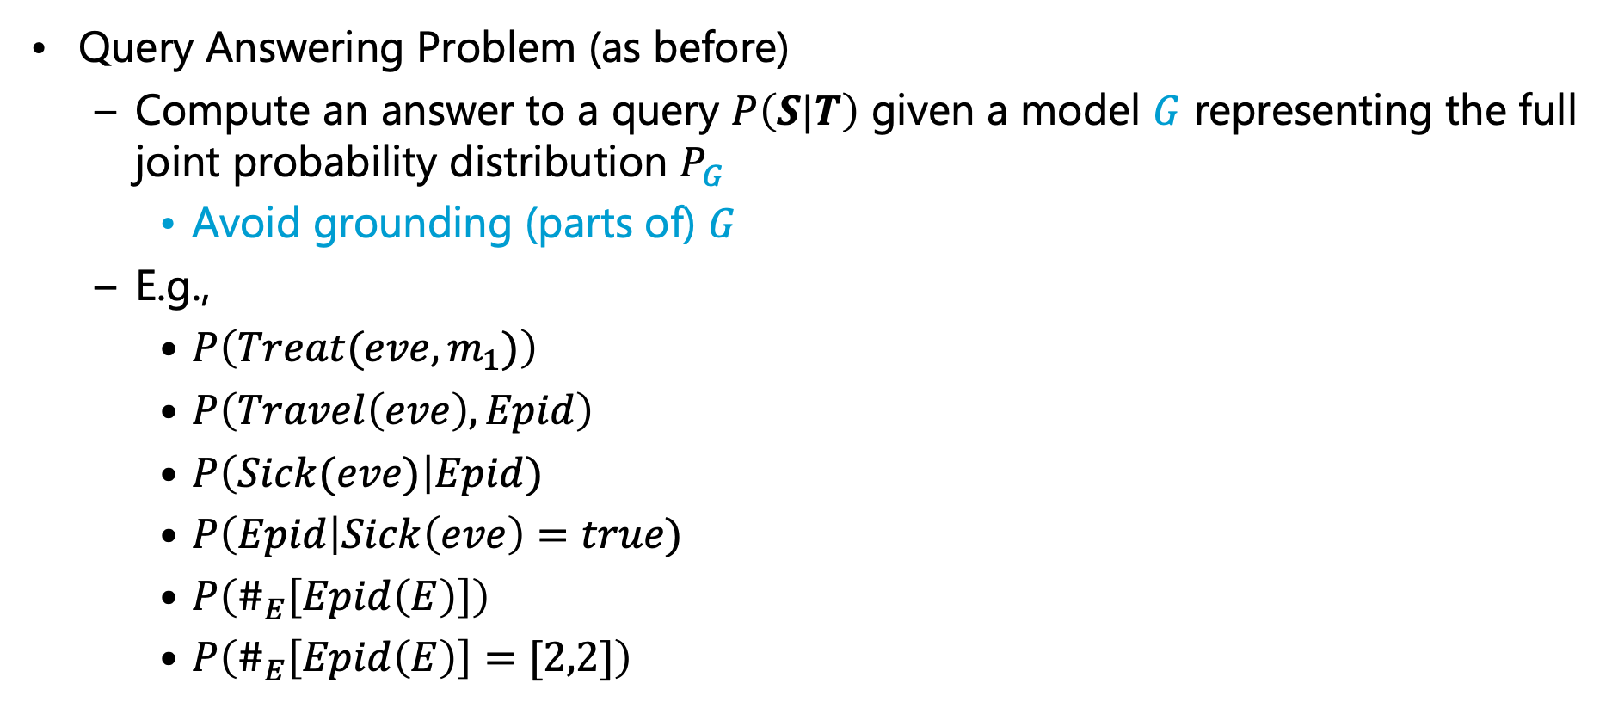









Inference Tasks
Query Answering Problem (as before)
  Compute an answer to a query $P\left(S|T\right)$ given a model $G$ representing the full joint probability distribution $P_{G}$
    Avoid grounding (parts of) $G$
  E.g.,
    $P\left(Treat(eve,m_{1})\right)$
    $P\left(Travel\left(eve\right),Epid\right)$
    $P\left(Sick(eve)\right|Epid)$
    $P\left(Epid\right|Sick\left(eve\right)=true)$
    $P\left(\#_{E}\left[Epid\left(E\right)\right]\right)$
    $P\left(\#_{E}\left[Epid\left(E\right)\right]=[2,2]\right)$
$$10 Presents\left(X, P, C\right)⇒Attends\left(X, C\right)$$
$$3.75 Publishes\left(X, C\right)∧FarAway\left(C\right)⇒Attends\left(X, C\right)$$
Model: either parfactor model or MLN
$$Nat\left(D\right)$$
$$Acc\left(I\right)$$
$$g_{1}$$
$$Epid$$
$$g_{0}$$
$$Travel\left(X\right)$$
$$Treat\left(X,M\right)$$
$$g_{2}$$
$$g_{3}$$
$$Sick\left(X\right)$$
Notes:
Argmax and sum not commutative

Slide 4
Outline: 4. Lifted Inference
Exact Inference
  Lifted Variable Elimination for Parfactor Models
    Idea, operators, algorithm, complexity
  Lifted Junction Tree Algorithm
    Idea, helper structure: junction tree, algorithm
  First-order Knowledge Compilation for MLNs
    Idea, helper structure: circuit, algorithm

Slide 5

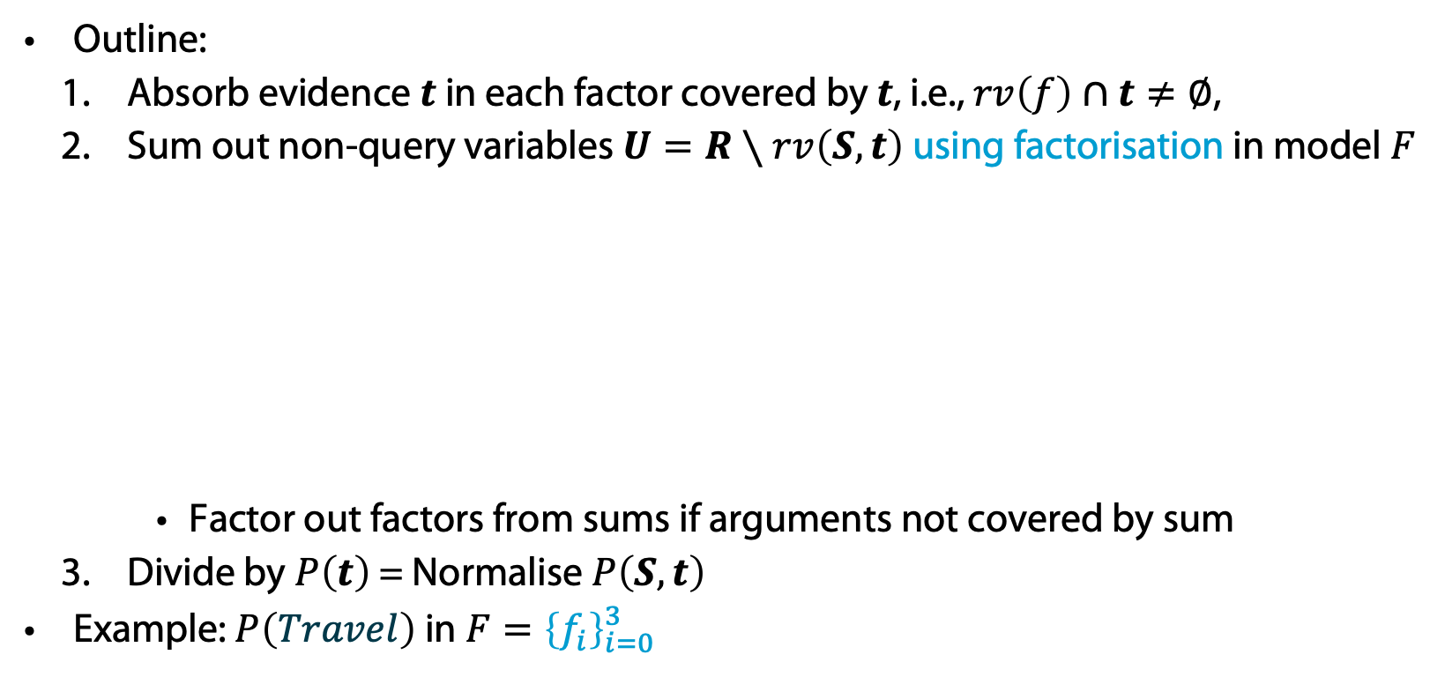






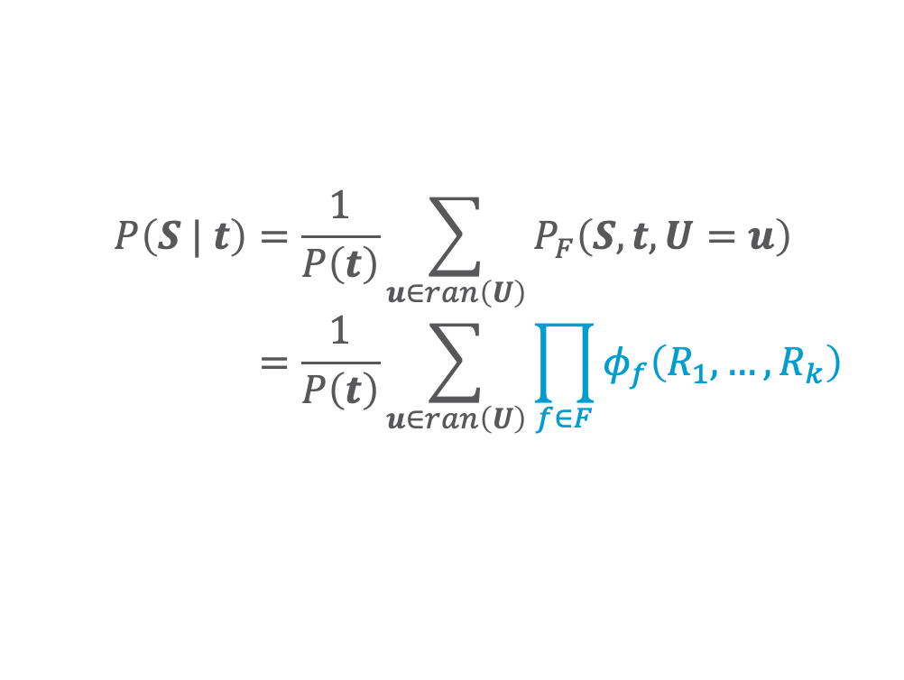




Remember: Variable Elimination (VE)
Outline:
  Absorb evidence $t$ in each factor covered by $t$, i.e., $rv\left(f\right)∩t≠∅$,
  Sum out non-query variables $U=R∖rv\left(S,t\right)$ using factorisation in model $F$
    Factor out factors from sums if arguments not covered by sum
  Divide by $P\left(t\right)$ = Normalise $P\left(S,t\right)$
Example: $P\left(Travel\right)$ in $F={\left\{f_{i}\right\}}_{i=0}^{3}$
$$P\left(S | t\right)=\frac{1}{P\left(t\right)}\sum_{u∈ran\left(U\right)}{P_{F}\left(S,t,U=u\right)} \\ =\frac{1}{P\left(t\right)}\sum_{u∈ran\left(U\right)}{\prod_{f∈F}{φ_{f}\left(R_{1},…, R_{k}\right)}}$$
$$Nat$$
$$Acc$$
$$f_{1}$$
$$π_{rv\left(f\right)}\left(S,t,U=u\right)$$
$$Epid$$
$$f_{0}$$
$$Travel$$
$$Treat$$
$$f_{2}$$
$$f_{3}$$
$$Sick$$

Slide 6
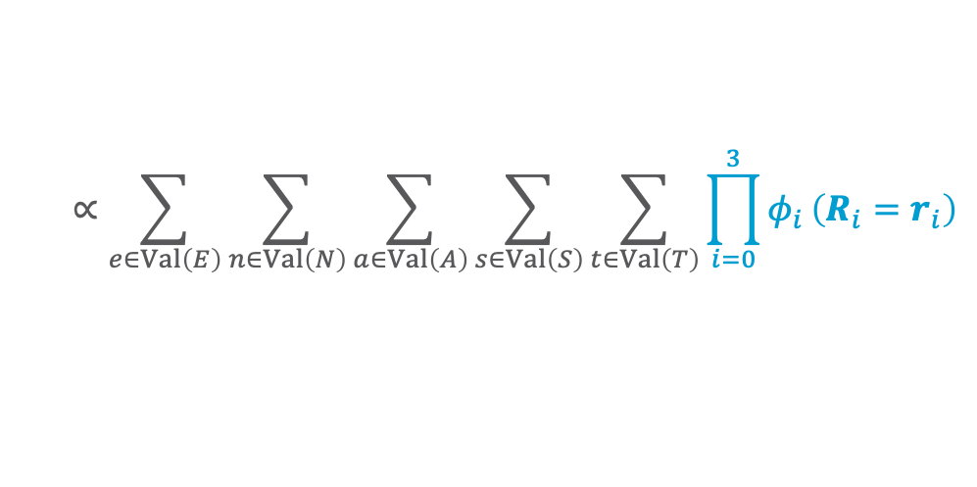
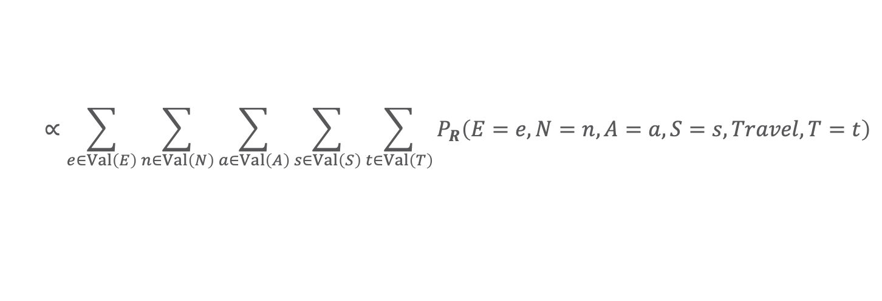

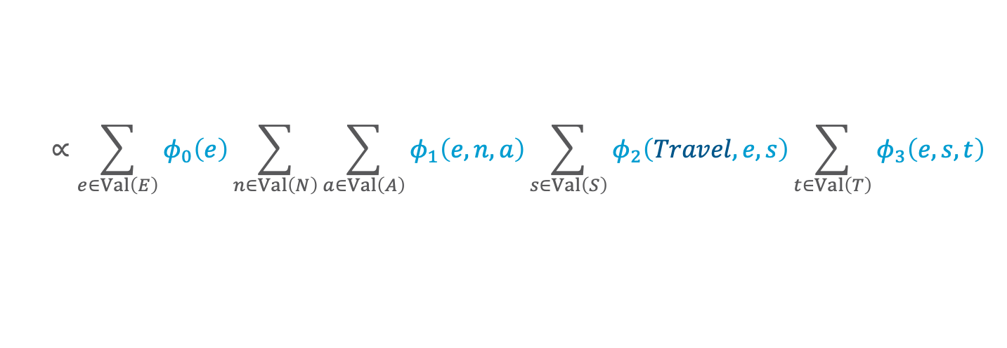
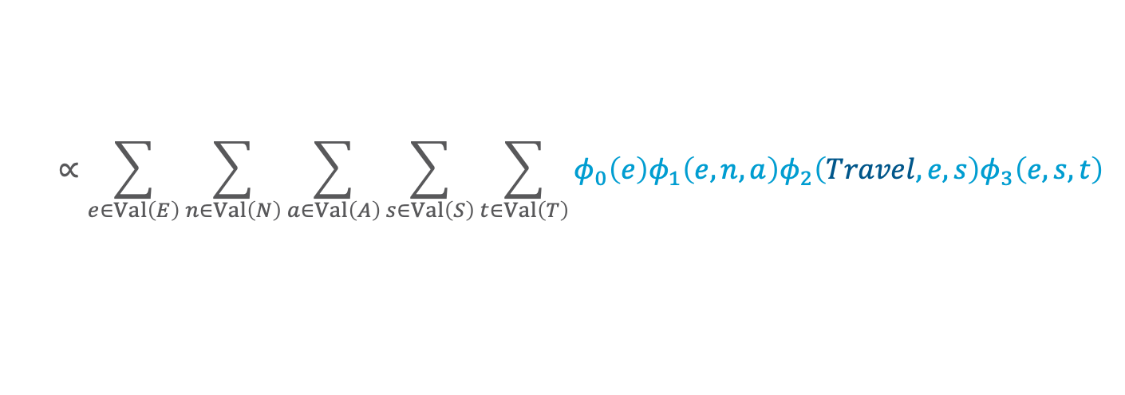

Remember: Variable Elimination (VE): Example
$$P\left(Travel\right)$$
$$∝\sum_{e∈Val\left(E\right)}{\sum_{n∈Val\left(N\right)}{\sum_{a∈Val\left(A\right)}{\sum_{s∈Val\left(S\right)}{\sum_{t∈Val\left(T\right)}{P_{R}\left(E=e,N=n,A=a,S=s,Travel,T=t\right)}}}}}$$
$$∝\sum_{e∈Val\left(E\right)}{\sum_{n∈Val\left(N\right)}{\sum_{a∈Val\left(A\right)}{\sum_{s∈Val\left(S\right)}{\sum_{t∈Val\left(T\right)}{\prod_{i=0}^{3}{φ_{i}}\left(R_{i}=r_{i}\right)}}}}}$$
$$Nat$$
$$Acc$$
$$∝\sum_{e∈Val\left(E\right)}{\sum_{n∈Val\left(N\right)}{\sum_{a∈Val\left(A\right)}{\sum_{s∈Val\left(S\right)}{\sum_{t∈Val\left(T\right)}{φ_{0}\left(e\right)φ_{1}\left(e,n,a\right)φ_{2}\left(Travel,e,s\right)φ_{3}\left(e,s,t\right)}}}}}$$
$$f_{1}$$
$$Epid$$
$$f_{0}$$
$$∝\sum_{e∈Val\left(E\right)}{φ_{0}\left(e\right)\sum_{n∈Val\left(N\right)}{\sum_{a∈Val\left(A\right)}{φ_{1}\left(e,n,a\right)\sum_{s∈Val\left(S\right)}{φ_{2}\left(Travel,e,s\right)\sum_{t∈Val\left(T\right)}{φ_{3}\left(e,s,t\right)}}}}}$$
$$Travel$$
$$Treat$$
$$f_{2}$$
$$f_{3}$$
Sums can be computed independently ➝ could be done in parallel
$$Sick$$
$$E≜Epid,N≜Nat,A≜Acc,S≜Sick,T≜Treat$$

Slide 7

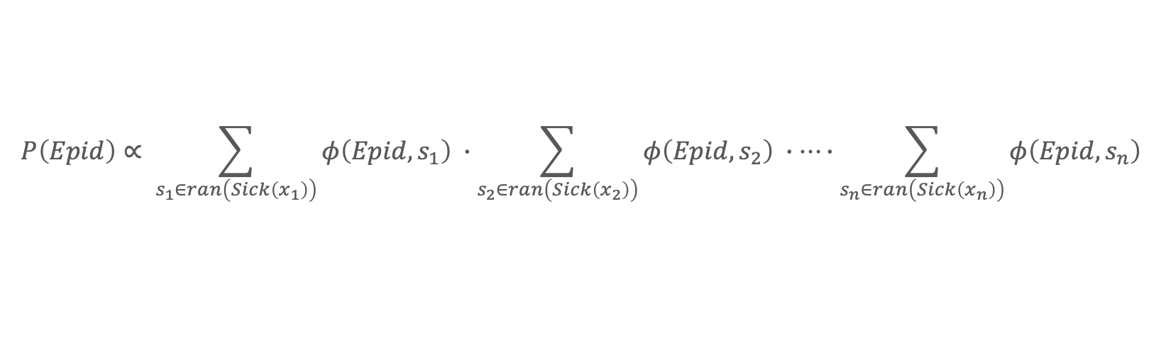












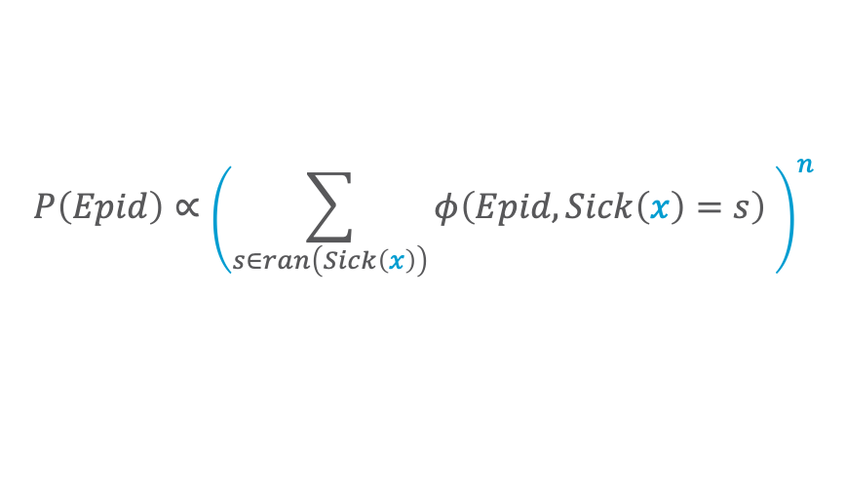



What Happens During Variable Elimination Given Relations?
$$P\left(Epid\right)∝ \sum_{s_{1}∈ran\left(Sick\left(x_{1}\right)\right)}{φ\left(Epid, s_{1}\right) }∙\sum_{s_{2}∈ran\left(Sick\left(x_{2}\right)\right)}{φ\left(Epid, s_{2}\right) }∙…∙\sum_{s_{n}∈ran\left(Sick\left(x_{n}\right)\right)}{φ\left(Epid,s_{n}\right) }$$
$$Epid$$
$$=φ^{′}\left(Epid\right)∙φ^{′}\left(Epid\right)∙…∙φ^{′}\left(Epid\right)$$
$$={\left(φ^{′}\left(Epid\right)\right)}^{n}$$
$n$ times
$$φ$$
$$φ$$
$$φ$$
$$Sick\left(x_{1}\right)$$
$$Sick\left(x_{2}\right)$$
$$…$$
$$Sick\left(x_{n}\right)$$
$$P\left(Epid\right)∝{\left(\sum_{s∈ran\left(Sick\left(x\right)\right)}{φ\left(Epid,Sick\left(x\right)=s\right) }\right)}^{n}$$
$$={\left(φ^{′}\left(Epid\right)\right)}^{n}$$
$$Epid$$
# of $X$ relative to $Epid$
$$φ$$
Representative for $X$ in $φ\left(Epid,Sick\left(X\right)\right)$
$$Sick\left(X\right)$$

Slide 8

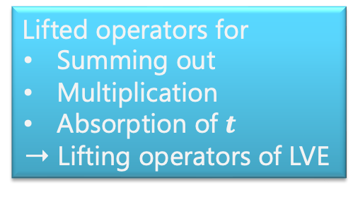
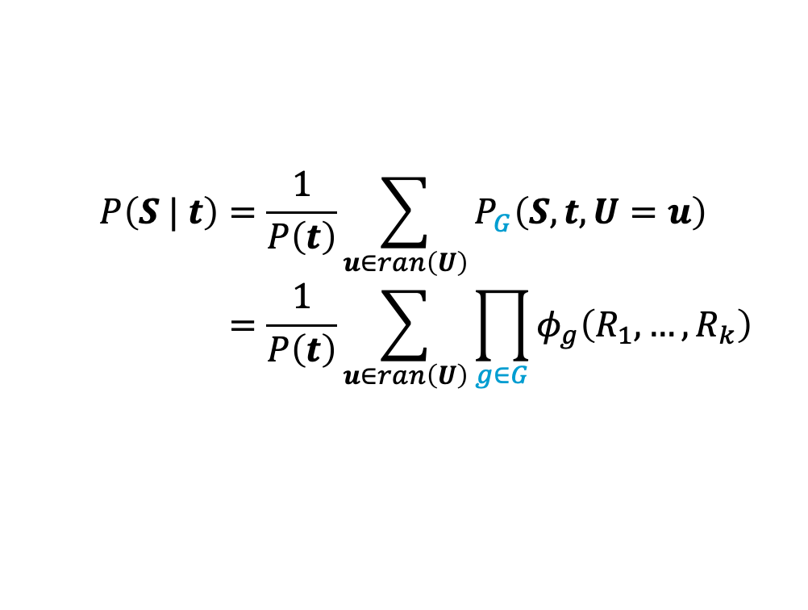
Lifted Variable Elimination (LVE)
Outline:
  Absorb evidence $t$ in each parfactor $g$ covered by $t$, i.e., $rv\left(g\right)∩t≠∅$, in a lifted way,
  Eliminate non-query PRVs $U=R∖rv\left(S,t\right)$ in a lifted way in model $G$
    Factor out parfactors from sums if arguments not covered by sum
    May require manipulation of constraints as at least constants
    appearing in query are distinguishable
  Divide by $P\left(t\right)$ = Normalise $P\left(S,t\right)$
$$P\left(S | t\right)=\frac{1}{P\left(t\right)}\sum_{u∈ran\left(U\right)}{P_{G}\left(S,t,U=u\right)} \\ =\frac{1}{P\left(t\right)}\sum_{u∈ran\left(U\right)}{\prod_{g∈G}{φ_{g}\left(R_{1},…, R_{k}\right)}}$$
Lifted operators for
  Summing out
  Multiplication
  Absorption of $t$
  ➝ Lifting operators of LVE
$$π_{rv\left(f\right)}\left(S,t,U=u\right)$$
Lifting operators to enable the main operators above necessary
Notes:
No probability queries (special case)
No conjunctive queries

Slide 9













LVE in Detail
Example: $P\left(Travel\left(eve\right)\right)$ in $G={\left\{g_{i}\right\}}_{i=0}^{3}$
  Pre-processing:
  Split all parfactors whose constraint contains constants occurring in query terms: $eve$
    If parameterised query $P\left(A_{|C}\right)$: split parfactors based on $C$
Called shattering
$$Travel\left(eve\right)$$
$$Nat\left(D\right)$$
$$Acc\left(I\right)$$
$$g_{1}$$
$$Sick\left(eve\right)$$
$$g_{2}$$
$$Epid$$
$$g_{0}$$
$$Treat\left(eve,M\right)$$
$$g_{3}$$
$$Travel\left(X\right)$$
$$Treat\left(X,M\right)$$
$$g_{2}$$
$$g_{3}$$
So, we need a formal split operation to split of (set of) constants
$$X∈\{alice, bob)$$
$$Sick\left(X\right)$$

Slide 10


































Equivalent Ground
Eliminations
$$Travel\left(eve\right)$$
$$Nat\left(D\right)$$
$$Acc\left(I\right)$$
$$g_{1}$$
$$Sick\left(eve\right)$$
$$g_{2}$$
$$Epid$$
$$g_{0}$$
Let us concentrate
on $alice,bob$ parts
first
$$Treat\left(eve,M\right)$$
$$g_{3}$$
$$Travel\left(X\right)$$
$$Treat\left(X,M\right)$$
$$Acc\text{.}chem$$
$$g_{2}$$
$$g_{3}$$
$$Sick\left(X\right)$$
$$X∈\{alice, bob)$$
$$Acc\text{.}nucl$$
$$f_{1}$$
$$Nat\text{.}flood$$
$$f_{1}$$
$$f_{1}$$
$$Nat\text{.}fire$$
$$f_{1}$$
$$f_{2}$$
$$Epid$$
$$f_{0}$$
$$f_{2}$$
$$f_{3}$$
$$f_{3}$$
$$Treat\text{.}alice\text{.}m_{1}$$
$$Treat\text{.}bob\text{.}m_{1}$$
$$Travel\text{.}alice$$
$$f_{2}$$
$$f_{3}$$
$$f_{3}$$
$$Travel.bob$$
$$f_{3}$$
$$Treat\text{.}eve\text{.}m_{1}$$
$$f_{3}$$
$$Sick\text{.}alice$$
$$Sick\text{.}bob$$
$$Sick\text{.}eve$$
$$Treat\text{.}alice\text{.}m_{2}$$
$$Travel\text{.}eve$$
$$Treat\text{.}eve\text{.}m_{2}$$
$$Treat\text{.}bob\text{.}m_{2}$$

Slide 11












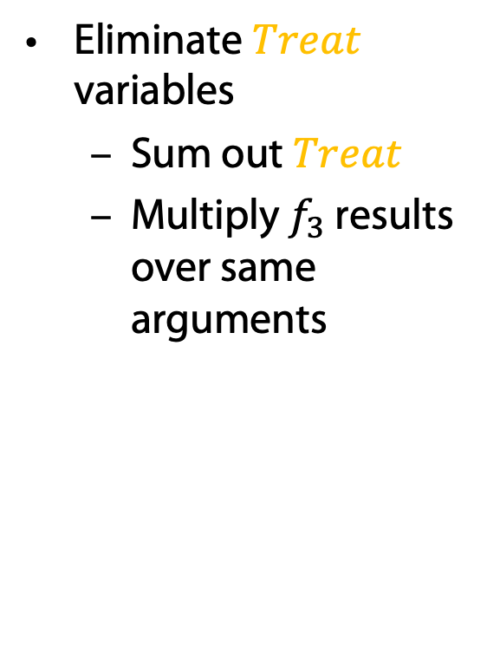





Equivalent Ground
Eliminations
$$Travel\left(eve\right)$$
$$Nat\left(D\right)$$
$$Acc\left(I\right)$$
$$g_{1}$$
$$Sick\left(eve\right)$$
$$g_{2}$$
$$Epid$$
$$g_{0}$$
Eliminate $Treat$
variables
  Sum out $Treat$
  Multiply $f_{3}$ results
  over same arguments
$$Treat\left(eve,M\right)$$
$$g_{3}$$
$$Travel\left(X\right)$$
$$Treat\left(X,M\right)$$
$$Acc\text{.}chem$$
$$g_{2}$$
$$g_{3}$$
$$Sick\left(X\right)$$
$$X∈\{alice, bob)$$
$$Acc\text{.}nucl$$
$$f_{1}$$
$$Nat\text{.}flood$$
$$f_{1}$$
$$f_{1}$$
$$Nat\text{.}fire$$
$$f_{1}$$
$$f_{2}$$
$$Epid$$
$$f_{0}$$
$$f_{2}$$
$$f_{3}^{′}$$
$$f_{3}^{′}$$
$$f_{3}$$
$$f_{3}$$
$$Treat\text{.}alice\text{.}m_{1}$$
$$Treat\text{.}bob\text{.}m_{1}$$
$$Travel\text{.}alice$$
$$f_{2}$$
$$f_{3}$$
$$f_{3}$$
$$Travel.bob$$
$$f_{3}^{′}$$
$$Treat\text{.}eve\text{.}m_{1}$$
$$f_{3}$$
$$f_{3}^{′}$$
$$Sick\text{.}alice$$
$$f_{3}$$
$$Sick\text{.}bob$$
$$Sick\text{.}eve$$
$$Treat\text{.}alice\text{.}m_{2}$$
$$Travel\text{.}eve$$
$$Treat\text{.}eve\text{.}m_{2}$$
$$Treat\text{.}bob\text{.}m_{2}$$

Slide 12







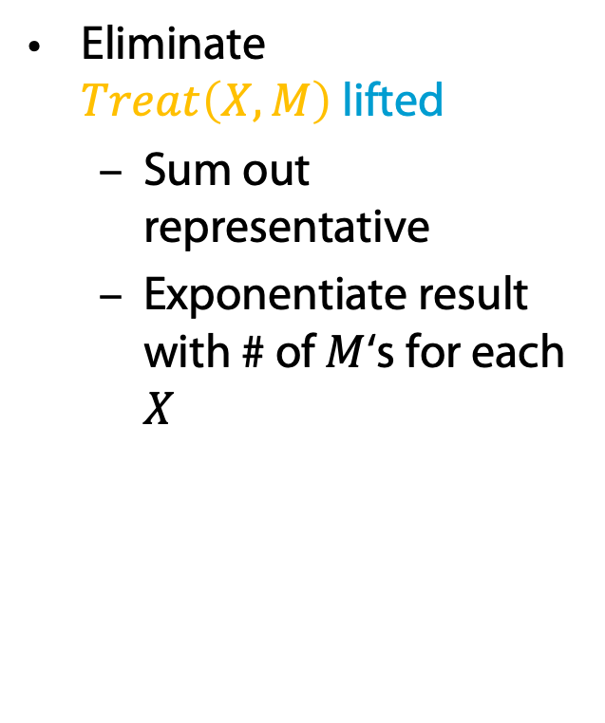

Equivalent Ground
Eliminations
$$Travel\left(eve\right)$$
$$Nat\left(D\right)$$
$$Acc\left(I\right)$$
$$g_{1}$$
$$Sick\left(eve\right)$$
$$g_{2}$$
$$Epid$$
$$g_{0}$$
Eliminate $Treat\left(X,M\right)$lifted
  Sum out representative
  Exponentiate result
  with # of $M$‘s for each $X$
$$Treat\left(eve,M\right)$$
$$g_{3}$$
$$Travel\left(X\right)$$
$$Treat\left(X,M\right)$$
$$g_{2}$$
$$g_{3}^{′}$$
$$Acc\text{.}chem$$
$$g_{3}$$
$$Sick\left(X\right)$$
$$X∈\{alice, bob)$$
$$Acc\text{.}nucl$$
$$f_{1}$$
$$Nat\text{.}flood$$
$$f_{1}$$
$$f_{1}$$
$$Nat\text{.}fire$$
$$f_{1}$$
$$f_{2}$$
$$Epid$$
$$f_{0}$$
$$f_{2}$$
$$f_{3}^{′′}={\left(f_{3}^{′}\right)}^{2}$$
$$f_{3}^{′′}={\left(f_{3}^{′}\right)}^{2}$$
$$Travel\text{.}alice$$
$$f_{2}$$
$$f_{3}$$
$$f_{3}$$
$$Travel.bob$$
$$Treat\text{.}eve\text{.}m_{1}$$
$$Sick\text{.}alice$$
$$Sick\text{.}bob$$
$$Sick\text{.}eve$$
$$Travel\text{.}eve$$
$$Treat\text{.}eve\text{.}m_{2}$$

Slide 13
Equivalent Ground
Eliminations
$$Travel\left(eve\right)$$
$$Nat\left(D\right)$$
$$Acc\left(I\right)$$
$$g_{1}$$
$$Sick\left(eve\right)$$
$$g_{2}$$
$$Epid$$
$$g_{0}$$
$$Treat\left(eve,M\right)$$
$$g_{3}$$
Preconditions for lifted sum-out operator
PRV contained in only one parfactor (like in VE)
Operation eliminates the same number of instances for each remaining instance
(then all have the same exponent; otherwise: split operation as for shattering)
PRV must contain all logical variables of parfactor
$$Travel\left(X\right)$$
$$Treat\left(X,M\right)$$
$$Acc\text{.}chem$$
$$g_{2}$$
$$g_{3}$$
$$Sick\left(X\right)$$
$$X∈\{alice, bob)$$
$$Acc\text{.}nucl$$
$$f_{1}$$
$$Nat\text{.}flood$$
$$f_{1}$$
$$f_{1}$$
$$Nat\text{.}fire$$
$$f_{1}$$
$$f_{2}$$
$$Epid$$
$$f_{0}$$
$$f_{2}$$
Why?
$$f_{3}$$
$$f_{3}$$
$$Treat\text{.}alice\text{.}m_{1}$$
$$Treat\text{.}bob\text{.}m_{1}$$
$$Travel\text{.}alice$$
$$f_{2}$$
$$f_{3}$$
$$f_{3}$$
$$Travel.bob$$
$$f_{3}$$
$$Treat\text{.}eve\text{.}m_{1}$$
$$f_{3}$$
$$Sick\text{.}alice$$
$$Sick\text{.}bob$$
$$Sick\text{.}eve$$
$$Treat\text{.}alice\text{.}m_{2}$$
$$Travel\text{.}eve$$
$$Treat\text{.}eve\text{.}m_{2}$$
$$Treat\text{.}bob\text{.}m_{2}$$
Notes:
Essentially sums out variables without a proper multiplication before (on chalk board)

Slide 14










Equivalent Ground
Eliminations
$$Travel\left(eve\right)$$
$$Nat\left(D\right)$$
$$Acc\left(I\right)$$
$$g_{1}$$
$$Sick\left(eve\right)$$
$$g_{2}$$
$$Epid$$
$$g_{0}$$
Eliminate $Travel$
variables
  Sum out $Travel$
Eliminate $Travel\left(X\right)$
lifted
  Sum out representative
$$Treat\left(eve,M\right)$$
$$g_{3}$$
$$Travel\left(X\right)$$
$$g_{2}$$
$$Acc\text{.}chem$$
$$g_{2}^{′}$$
$$g_{3}^{′}$$
$$Sick\left(X\right)$$
$$X∈\{alice, bob)$$
$$Acc\text{.}nucl$$
$$f_{1}$$
$$Nat\text{.}flood$$
$$f_{1}$$
$$f_{1}$$
$$Nat\text{.}fire$$
$$f_{1}$$
$$f_{0}$$
$$f_{2}$$
$$f_{2}^{′}$$
$$f_{2}^{′}$$
$$f_{2}$$
$$Epid$$
$$f_{3}^{′′}={\left(f_{3}^{′}\right)}^{2}$$
$$f_{3}^{′′}={\left(f_{3}^{′}\right)}^{2}$$
$$Travel\text{.}alice$$
$$f_{2}$$
$$f_{3}$$
$$f_{3}$$
$$Travel.bob$$
$$Treat\text{.}eve\text{.}m_{1}$$
$$Sick\text{.}alice$$
$$Sick\text{.}bob$$
$$Sick\text{.}eve$$
$$Travel\text{.}eve$$
$$Treat\text{.}eve\text{.}m_{2}$$

Slide 15












Equivalent Ground
Eliminations
$$Travel\left(eve\right)$$
$$Nat\left(D\right)$$
$$Acc\left(I\right)$$
$$g_{1}$$
$$Sick\left(eve\right)$$
$$g_{2}$$
$$Epid$$
$$g_{0}$$
Eliminate $Sick$
  Multiply $f_{2}^{′},f_{3}^{′′}$ into $f_{23}$
  Sum out $Sick$ from $f_{23}$
  Multiply $f_{23}^{′}$ results
$$Treat\left(eve,M\right)$$
$$g_{3}$$
$$Acc\text{.}chem$$
$$g_{2}^{′}$$
$$g_{3}^{′}$$
$$Sick\left(X\right)$$
$$X∈\{alice, bob)$$
$$Acc\text{.}nucl$$
$$f_{1}$$
$$Nat\text{.}flood$$
$$f_{1}$$
$$f_{1}$$
$$Nat\text{.}fire$$
$$f_{1}$$
$$f_{2}^{′}$$
$$f_{23}^{′′}={\left(f_{23}^{′}\right)}^{2}$$
$$Epid$$
$$f_{0}$$
$$f_{2}^{′}$$
$$f_{23}^{′}$$
$$f_{23}$$
$$f_{3}^{′′}={\left(f_{3}^{′}\right)}^{2}$$
$$f_{23}^{′}$$
$$f_{23}$$
$$f_{3}^{′′}={\left(f_{3}^{′}\right)}^{2}$$
$$f_{2}$$
$$f_{3}$$
$$Treat\text{.}eve\text{.}m_{1}$$
$$f_{3}$$
$$Sick\text{.}alice$$
$$Sick\text{.}bob$$
$$Sick\text{.}eve$$
$$Travel\text{.}eve$$
$$Treat\text{.}eve\text{.}m_{2}$$

Slide 16


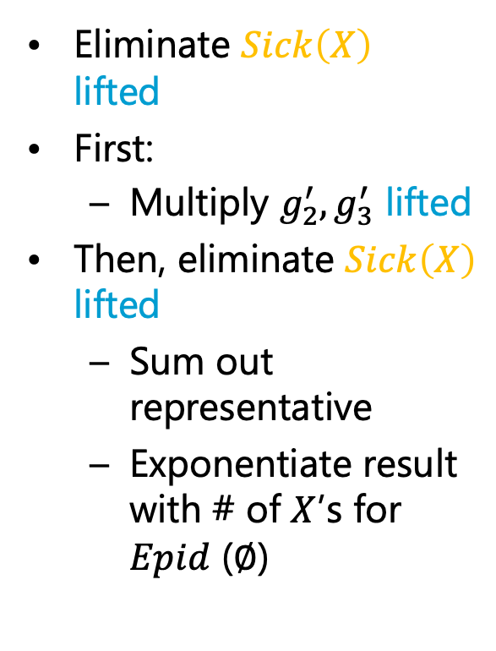
Equivalent Ground
Eliminations
$$Travel\left(eve\right)$$
$$Nat\left(D\right)$$
$$Acc\left(I\right)$$
$$g_{1}$$
$$Sick\left(eve\right)$$
$$g_{2}$$
$$Epid$$
$$g_{0}$$
Eliminate $Sick\left(X\right)$
lifted
First:
  Multiply $g_{2}^{′},g_{3}^{′}$ lifted
Then, eliminate $Sick\left(X\right)$
lifted
  Sum out representative
  Exponentiate result
  with # of $X$’s for $Epid$ ($∅$)
$$Treat\left(eve,M\right)$$
$$g_{3}$$
$$g_{23}^{′}$$
$$g_{2}^{′}$$
$$Acc\text{.}chem$$
$$g_{23}$$
$$g_{3}^{′}$$
$$Sick\left(X\right)$$
$$X∈\{alice, bob)$$
$$Acc\text{.}nucl$$
$$f_{1}$$
$$Nat\text{.}flood$$
$$f_{1}$$
$$f_{1}$$
$$Nat\text{.}fire$$
$$f_{1}$$
Formal lifted multiply operator
Open question: What happens if both parfactors represent different number of groundings?
$$f_{23}^{′′}={\left(f_{23}^{′}\right)}^{2}$$
$$Epid$$
$$f_{0}$$
$$f_{2}$$
$$f_{3}$$
$$Treat\text{.}eve\text{.}m_{1}$$
$$f_{3}$$
$$Sick\text{.}eve$$
$$Travel\text{.}eve$$
$$Treat\text{.}eve\text{.}m_{2}$$

Slide 17














Equivalent Ground
Eliminations
$$Travel\left(eve\right)$$
$$Nat\left(D\right)$$
$$Acc\left(I\right)$$
$$g_{1}$$
$$Sick\left(eve\right)$$
$$g_{2}$$
$$Epid$$
$$g_{0}$$
Eliminate $Treat.eve$,
$Sick.eve$ variables
  Sum out $Treat.eve$ variables
  Multiply results over
  same arguments
  Multiply $f_{2},f_{3}^{′′}$ for $eve$
  Sum out $Sick.eve$
$$Treat\left(eve,M\right)$$
$$g_{3}$$
$$Acc\text{.}chem$$
$$g_{23}^{′}$$
$$Acc\text{.}nucl$$
$$f_{1}$$
$$Nat\text{.}flood$$
$$f_{1}$$
$$f_{1}$$
$$Nat\text{.}fire$$
$$f_{1}$$
$$f_{23}^{′′}={\left(f_{23}^{′}\right)}^{2}$$
$$Epid$$
$$f_{0}$$
$$f_{23}^{eve}$$
$$f_{2}$$
$$f_{3}$$
$$Treat\text{.}eve\text{.}m_{1}$$
$$f_{3}$$
$$Sick\text{.}eve$$
$$Travel\text{.}eve$$
$$Treat\text{.}eve\text{.}m_{2}$$

Slide 18




Equivalent Ground
Eliminations
$$Travel\left(eve\right)$$
$$Nat\left(D\right)$$
$$Acc\left(I\right)$$
$$g_{1}$$
$$g_{23}^{eve}$$
$$Sick\left(eve\right)$$
$$g_{2}$$
$$Epid$$
$$g_{0}$$
Eliminate
$Treat\left(eve,M\right)$ lifted,
$Sick\left(eve\right)$
  Sum out representative of
  $Treat\left(eve,M\right)$
  Exponentiate with $2$
  Multiply $g_{2},g_{3}^{′}$
  Sum out $Sick\left(eve\right)$
$$Treat\left(eve,M\right)$$
$$g_{3}$$
$$Acc\text{.}chem$$
$$g_{23}^{′}$$
$$Acc\text{.}nucl$$
$$f_{1}$$
$$Nat\text{.}flood$$
$$f_{1}$$
$$f_{1}$$
$$Nat\text{.}fire$$
$$f_{1}$$
$$f_{23}^{′′}={\left(f_{23}^{′}\right)}^{2}$$
$$Epid$$
$$f_{0}$$
$$f_{23}^{eve}$$
$$Travel\text{.}eve$$

Slide 19

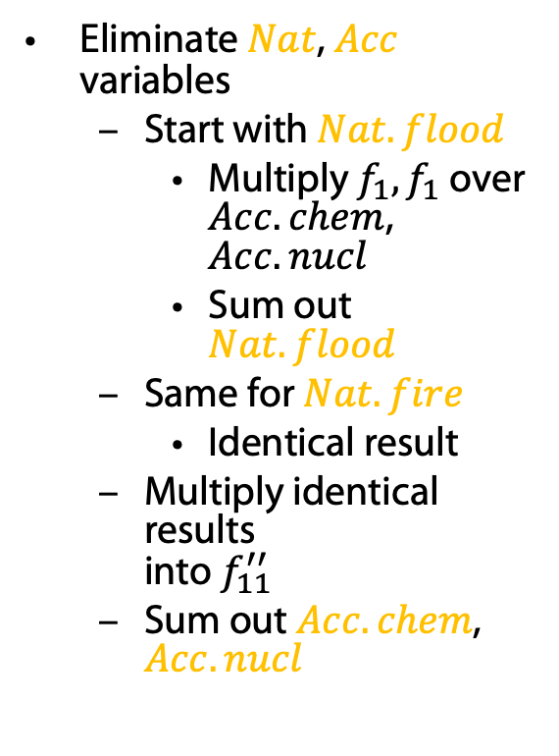







Equivalent Ground
Eliminations
$$Travel\left(eve\right)$$
$$Nat\left(D\right)$$
$$Acc\left(I\right)$$
$$g_{1}$$
$$g_{23}^{eve}$$
$$Epid$$
$$g_{0}$$
Eliminate $Nat$, $Acc$
variables
  Start with $Nat.flood$
    Multiply $f_{1},f_{1}$ over
    $Acc.chem$, $Acc.nucl$
    Sum out $Nat.flood$
  Same for $Nat.fire$
    Identical result
  Multiply identical results
  into $f_{11}^{′′}$
  Sum out $Acc.chem$,
  $Acc.nucl$
$$Acc\text{.}chem$$
$$g_{23}^{′}$$
$$Acc\text{.}nucl$$
$$f_{1}$$
$$Nat\text{.}flood$$
$$f_{1}$$
$$f_{1}$$
$$Nat\text{.}fire$$
$$f_{1}$$
$$f_{11}^{′′′′}$$
$$f_{23}^{′′}={\left(f_{23}^{′}\right)}^{2}$$
$$Epid$$
$$f_{0}$$
$$f_{2}$$
$$Travel\text{.}eve$$

Slide 20
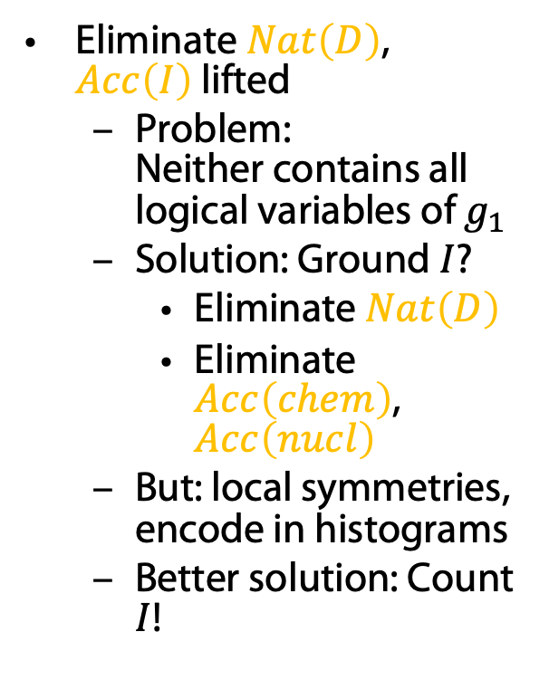
Equivalent Ground
Eliminations
$$Travel\left(eve\right)$$
$$Nat\left(D\right)$$
$$Acc\left(I\right)$$
$$g_{1}$$
$$g_{23}^{eve}$$
$$Epid$$
$$g_{0}$$
Eliminate $Nat\left(D\right)$,
$Acc\left(I\right)$ lifted
  Problem:
  Neither contains all
  logical variables of $g_{1}$
  Solution: Ground $I$?
    Eliminate $Nat\left(D\right)$
    Eliminate $Acc\left(chem\right)$,
    $Acc\left(nucl\right)$
  But: local symmetries,
  encode in histograms
  Better solution: Count $I$!
$$Acc\text{.}chem$$
$$g_{23}^{′}$$
$$Acc\text{.}nucl$$
$$f_{1}$$
$$Nat\text{.}flood$$
$$f_{1}$$
$$f_{1}$$
$$Nat\text{.}fire$$
$$f_{1}$$
Formal ground-logical variable operation
As a last resort operation
Form of split operation, splitting off all constants
$$f_{23}^{′′}={\left(f_{23}^{′}\right)}^{2}$$
$$Epid$$
$$f_{0}$$
$$f_{2}$$
$$Travel\text{.}eve$$

Slide 21
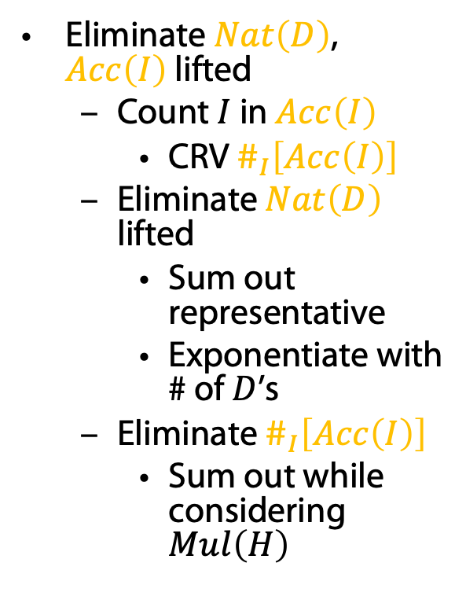

Equivalent Ground
Eliminations
$$Travel\left(eve\right)$$
$$Nat\left(D\right)$$
$$\#_{I}\left[Acc\left(I\right)\right]$$
$$g_{1}$$
$$g_{23}^{eve}$$
$$Epid$$
$$g_{0}$$
Eliminate $Nat\left(D\right)$,
$Acc\left(I\right)$ lifted
  Count $I$ in $Acc\left(I\right)$
    CRV $\#_{I}\left[Acc\left(I\right)\right]$
  Eliminate $Nat\left(D\right)$
  lifted
    Sum out representative
    Exponentiate with
    # of $D$’s
  Eliminate $\#_{I}\left[Acc\left(I\right)\right]$
    Sum out while
    considering $Mul\left(H\right)$
$$Acc\text{.}chem$$
$$g_{23}^{′}$$
$$Acc\text{.}nucl$$
Lifted sum-out operator addendum
Sum-out operation needs to be able to handle CRVs correctly
$$f_{1}$$
$$Nat\text{.}flood$$
$$f_{1}$$
$$f_{1}$$
$$Nat\text{.}fire$$
$$f_{1}$$
Formal count conversion operator
Number of instances of logical variable to count identical for all instances of other logical variables in parfactor
(to have identical histograms)
Logical variable to count appears in only one PRV
$$f_{23}^{′′}={\left(f_{23}^{′}\right)}^{2}$$
$$Epid$$
$$f_{0}$$
$$f_{2}$$
$$Travel\text{.}eve$$

Slide 22
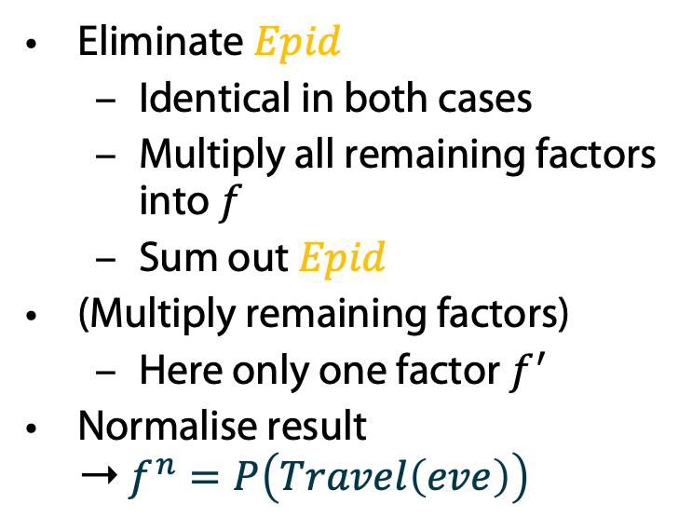








Equivalent Ground
Eliminations
$$Travel\left(eve\right)$$
$$g_{1}^{\#′′}$$
$$f$$
$$g_{23}^{eve}$$
$$f^{′}$$
$$Epid$$
$$g_{0}$$
Eliminate $Epid$
  Identical in both cases
  Multiply all remaining factors into $f$
  Sum out $Epid$
(Multiply remaining factors)
  Here only one factor $f^{′}$
Normalise result
➝ $f^{n}=P\left(Travel\left(eve\right)\right)$
$$g_{23}^{′}$$
$$f_{11}^{′′′′}$$
$$f_{23}^{′′}={\left(f_{23}^{′}\right)}^{2}$$
$$Epid$$
$$f_{0}$$
$$f^{n}$$
$$f$$
$$f_{2}$$
$$f^{′}$$
$$Travel\text{(}eve)$$
$$Travel\text{.}eve$$

Slide 23


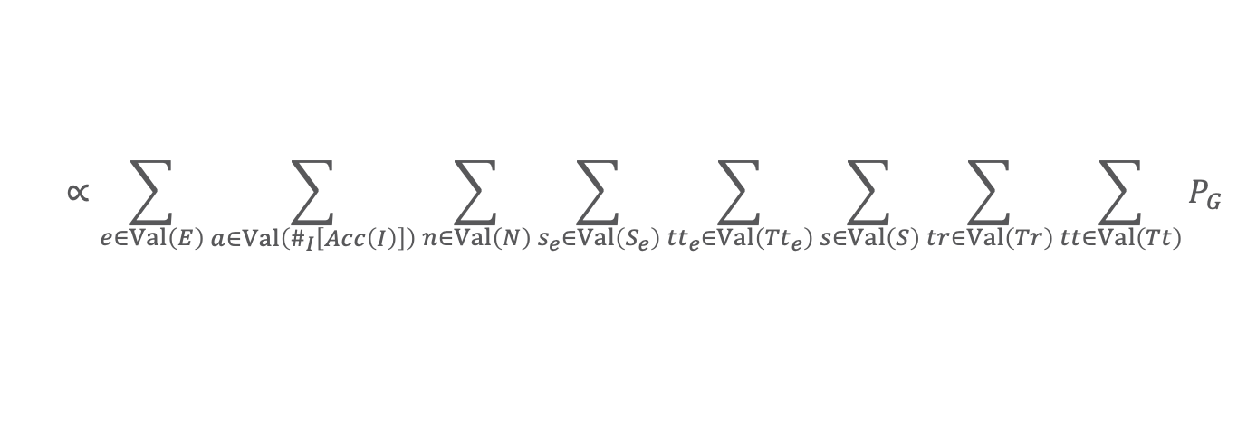
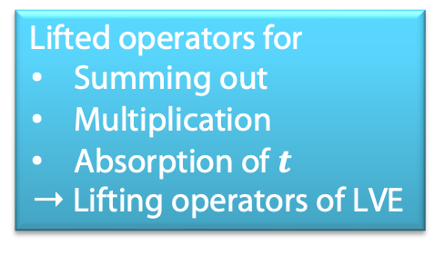
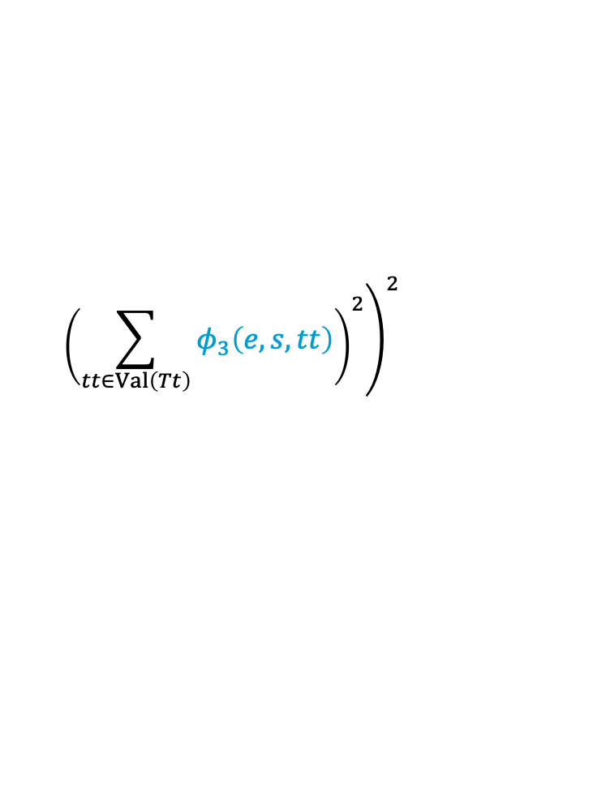
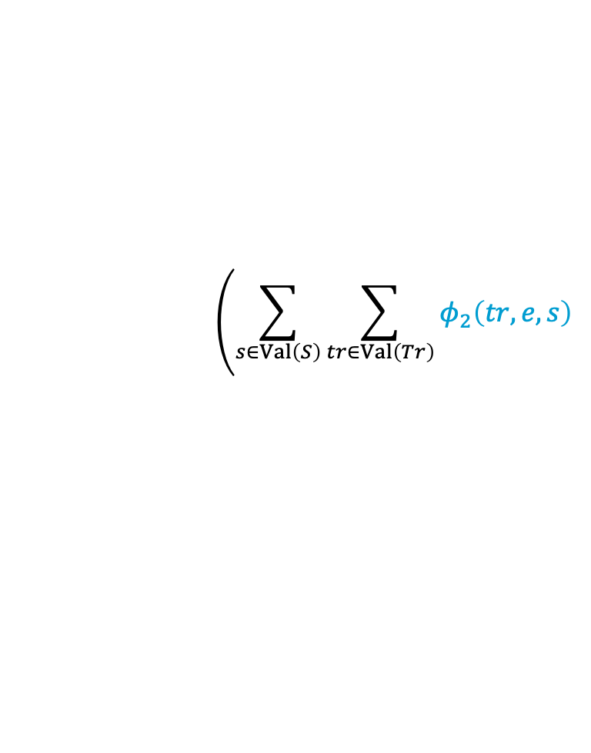

$$Travel\left(eve\right)$$
$$Nat\left(D\right)$$
$$Acc\left(I\right)$$
$$g_{1}$$
$$Sick\left(eve\right)$$
$$g_{2}$$
$$Epid$$
$$g_{0}$$
$$Treat\left(eve,M\right)$$
$$g_{3}$$
$$Travel\left(X\right)$$
$$Treat\left(X,M\right)$$
$$P\left(Travel\left(eve\right)\right)$$
$$g_{2}$$
$$g_{3}$$
$$∝\sum_{e∈Val\left(E\right)}{\sum_{a∈Val\left(\#_{I}\left[Acc\left(I\right)\right]\right)}{\sum_{n∈Val\left(N\right)}{\sum_{s_{e}∈Val\left(S_{e}\right)}{\sum_{{tt}_{e}∈Val\left({Tt}_{e}\right)}{\sum_{s∈Val\left(S\right)}{\sum_{tr∈Val\left(Tr\right)}{\sum_{tt∈Val\left(Tt\right)}{P_{G}}}}}}}}}$$
$$Sick\left(X\right)$$
$$X∈\{alice, bob)$$
$$∝\sum_{e∈Val\left(E\right)}{φ_{0}\left(e\right)\sum_{a∈Val\left(\#_{I}\left[Acc\left(I\right)\right]\right)}{{\left(\sum_{n∈Val\left(N\right)}{φ_{1}\left(e,n,a\right)}\right)}^{2}}}$$
Lifted operators for
  Summing out
  Multiplication
  Absorption of $t$
  ➝ Lifting operators of LVE
$$\sum_{s_{e}∈Val\left(S_{e}\right)}{φ_{2}\left(Travel,e,s_{e}\right){\left(\sum_{{tt}_{e}∈Val\left({Tt}_{e}\right)}{φ_{3}\left(e,s_{e},tt_{e}\right)}\right)}^{2}}$$
$$\left(\sum_{s∈Val\left(S\right)}{\sum_{tr∈Val\left(Tr\right)}{φ_{2}\left(tr,e,s\right)}}\right.$$
Lifting operators to enable the main operators above necessary
$${\left.{\left(\sum_{tt∈Val\left(Tt\right)}{φ_{3}\left(e,s,tt\right)}\right)}^{2}\right)}^{2}$$
$E≜Epid,N≜Nat\left(D\right),A≜Acc\left(I\right),S≜Sick\left(X\right),Tt≜Treat\left(X,M\right),Tr≜Travel\left(X\right);$ subscript $e$ for $eve$

Slide 24
Lifted Operators and
Their Preconditions
$$Travel\left(eve\right)$$
$$Nat\left(D\right)$$
$$Acc\left(I\right)$$
$$g_{1}$$
$$Sick\left(eve\right)$$
$$g_{2}$$
$$Epid$$
$$g_{0}$$
$$Treat\left(eve,M\right)$$
$$g_{3}$$
$$Travel\left(X\right)$$
$$Treat\left(X,M\right)$$
$$g_{2}$$
$$g_{3}$$
Preconditions for lifted sum-out operator
PRV contained in only one parfactor (like in VE)
PRV must contain all logical variables of parfactor
Operation eliminates the same number of instances for each remaining instance
(then all have the same exponent; otherwise: split operation as for shattering)
Formal lifted multiply operator
Open question: What happens if both parfactors represent different number of groundings?
$$X∈\{alice, bob)$$
Formal count conversion operator
Number of instances of logical variable to count identical for all instances of other logical variables in parfactor
(to have identical histograms)
Logical variable to count appears in only one PRV
$$Sick\left(X\right)$$
Lifted sum-out operator addendum
Sum-out operation needs to be able to handle CRVs correctly
Formal ground-logical variable operation
As a last resort operation
Form of split operation, splitting off all constants
So, we need a formal split operation to split of (set of) constants

Slide 25
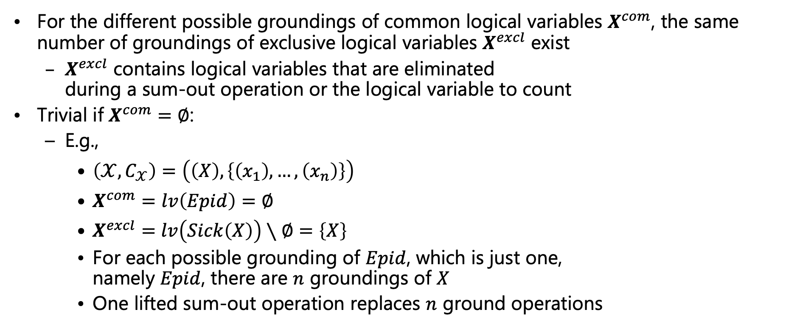
Count Normalisation
For the different possible groundings of common logical variables $X^{com}$, the same number of groundings of exclusive logical variables $X^{excl}$ exist
  $X^{excl}$ contains logical variables that are eliminated
  during a sum-out operation or the logical variable to count
Trivial if $X^{com}=∅$:
  E.g.,
    $\left(𝒳,C_{𝒳}\right)=\left(\left(X\right),\left\{\left(x_{1}\right),…,\left(x_{n}\right)\right\}\right)$
    $X^{com}=lv\left(Epid\right)=∅$
    $X^{excl}=lv\left(Sick\left(X\right)\right)∖∅=\left\{X\right\}$
    For each possible grounding of $Epid$, which is just one,
    namely $Epid$, there are $n$ groundings of $X$
    One lifted sum-out operation replaces $n$ ground operations
$$Epid$$
$$φ$$
$$φ$$
$$φ$$
$$Sick\left(x_{1}\right)$$
$$Sick\left(x_{2}\right)$$
$$…$$
$$Sick\left(x_{n}\right)$$
$$Epid$$
$$φ$$
$$Sick\left(X\right)$$
Notes:
Also used in absorption, multiplication

Slide 26
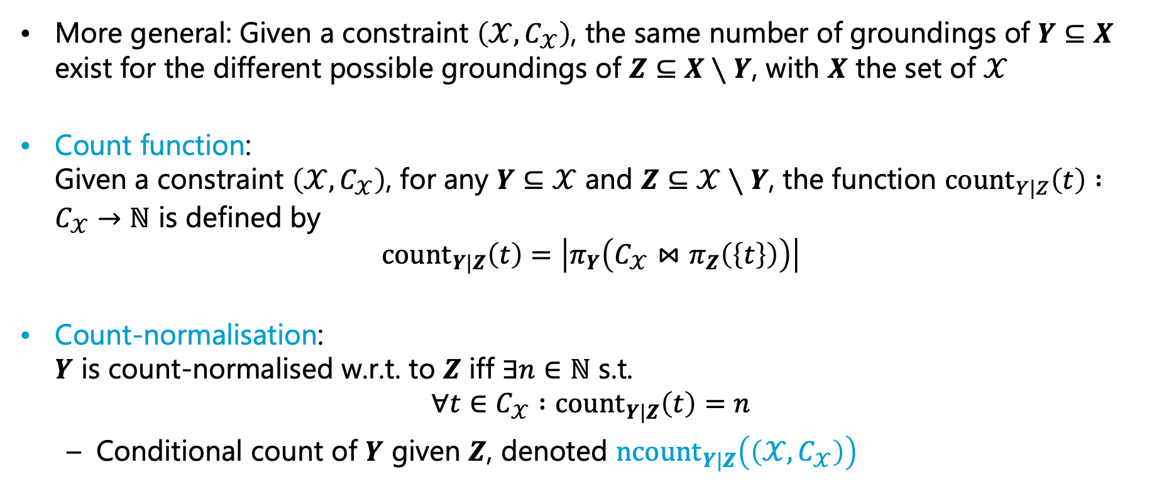
Formal Definition
More general: Given a constraint $\left(𝒳,C_{𝒳}\right)$, the same number of groundings of $Y⊆X$ exist for the different possible groundings of $Z⊆X∖Y$, with $X$ the set of $𝒳$
Count function:
Given a constraint $\left(𝒳,C_{𝒳}\right)$, for any $Y⊆𝒳$ and $Z⊆𝒳∖Y$, the function ${\text{count}}_{Y|Z}\left(t\right) :C_{𝒳}→ℕ$ is defined by
$${\text{coun}\text{t}}_{Y|Z}\left(t\right)=\left|π_{Y}\left(C_{𝒳}⋈π_{Z}\left(\left\{t\right\}\right)\right)\right|$$
Count-normalisation:
$Y$ is count-normalised w.r.t. to $Z$ iff $∃n∈ℕ$ s.t.
$$∀t∈C_{𝒳} :{\text{count}}_{Y|Z}\left(t\right)=n$$
  Conditional count of $Y$ given $Z$, denoted $n{\text{count}}_{Y|Z}\left(\left(𝒳,C_{𝒳}\right)\right)$
Notes:
I denoted that as #M|X on the chalk board

Slide 27






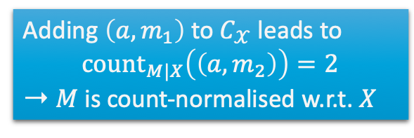
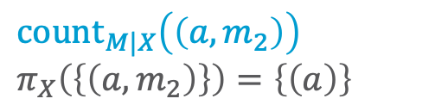

Example
${\text{count}}_{Y|Z}\left(t\right)=\left|π_{Y}\left(C_{𝒳}⋈π_{Z}\left(\left\{t\right\}\right)\right)\right|$
  E.g.,
    $𝒳=\left(X,M\right)$
    $Y=\left\{M\right\}$
    $Z=𝒳∖Y=\left\{X\right\}$
    With $a=alice,e=eve,b=bob :C_{𝒳}=\left\{\left(a,m_{2}\right),\left(e,m_{1}\right),\left(e,m_{2}\right),\left(b,m_{1}\right),\left(b,m_{2}\right)\right\}$
  Not count-normalised: $1≠2$
  ${\text{count}}_{M|X}\left(\left(a,m_{2}\right)\right)$
      $$π_{X}\left(\left\{\left(a,m_{2}\right)\right\}\right)=\left\{\left(a\right)\right\}$$
  ${\text{count}}_{M|X}\left(\left(e,m_{1}\right)\right)$
  $π_{X}\left(\left\{\left(e,m_{1}\right)\right\}\right)=\left\{\left(e\right)\right\}$
  $$C_{X,M}⋈\left\{\left(a\right)\right\}=\left\{\left(a,m_{2}\right)\right\}$$
  $$C_{X,M}⋈\left\{\left(e\right)\right\}=\left\{\left(e,m_{1}\right),\left(e,m_{2}\right)\right\}$$
  $$π_{M}\left(\left\{\left(a,m_{2}\right)\right\}\right)=\left\{(m_{2})\right\}$$
  $$π_{M}\left(\left\{\left(e,m_{1}\right),\left(e,m_{2}\right)\right\}\right)=\left\{\left(m_{1}\right),(m_{2})\right\}$$
  $$\left|\left\{\left(m_{2}\right)\right\}\right|=1$$
  $$\left|\left\{\left(m_{1}\right), \left(m_{2}\right)\right\}\right|=2$$
Adding $\left(a,m_{1}\right)$ to $C_{𝒳}$ leads to
$${\text{count}}_{M|X}\left(\left(a,m_{2}\right)\right)=2$$
➝ $M$ is count-normalised w.r.t. $X$

Slide 28
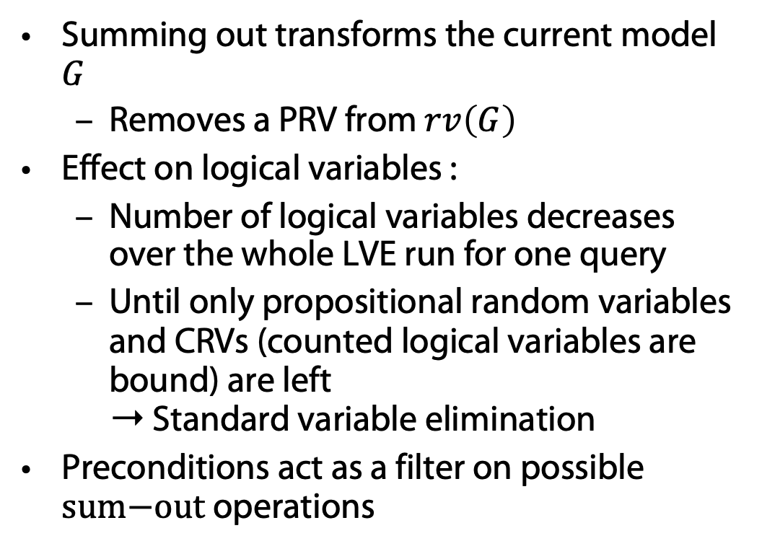
Lifted Summing Out
Summing out transforms the current model $G$
  Removes a PRV from $rv\left(G\right)$
Effect on logical variables :
  Number of logical variables decreases over the whole LVE run for one query
  Until only propositional random variables and CRVs (counted logical variables are bound) are left
  ➝ Standard variable elimination
Preconditions act as a filter on possible $\text{sum}\text{−}\text{out}$ operations
Preconditions for lifted sum-out operator
PRV contained in only one parfactor (like in VE)
PRV must contain all logical variables of parfactor
Operation eliminates the same number of instances for each remaining instance
(then all have the same exponent; otherwise: split operation as for shattering)
Lifted sum-out operator addendum
Sum-out operation needs to be able to handle CRVs correctly

Slide 29
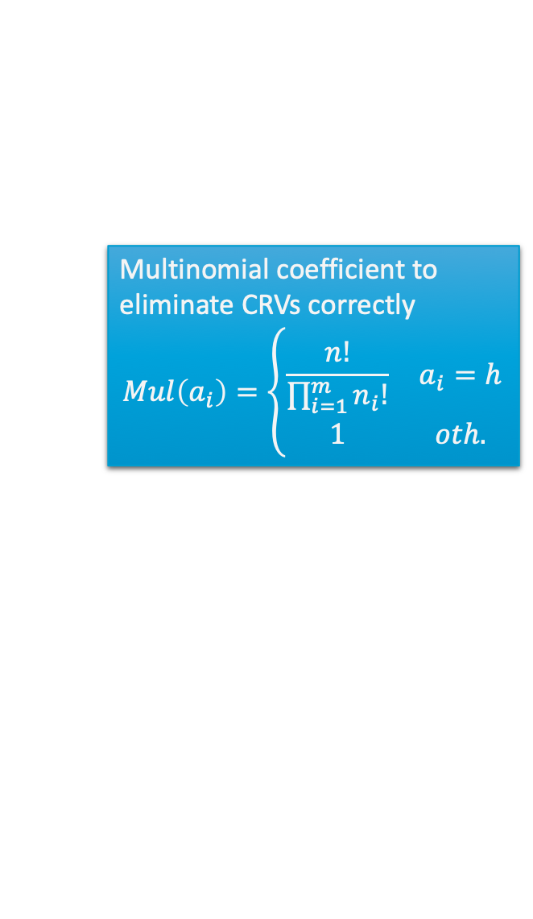
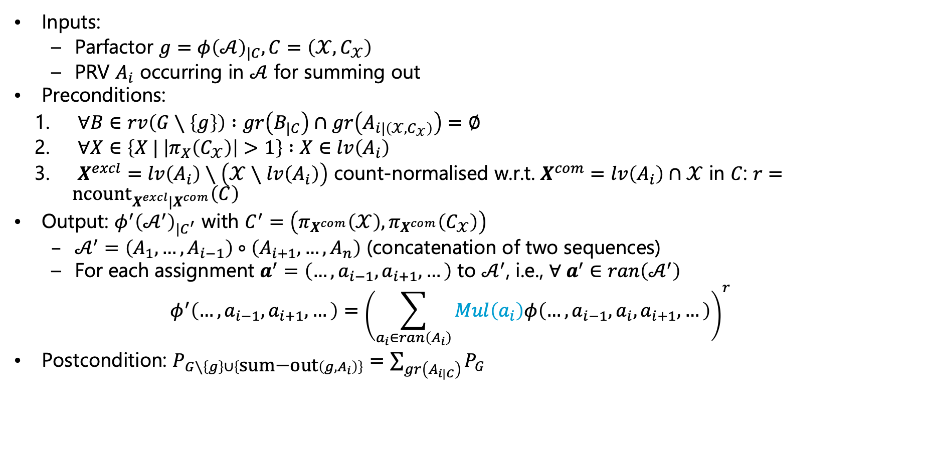
Lifted Summing Out: Operator
Inputs:
  Parfactor $g=φ{\left(𝒜\right)}_{|C}, C=\left(𝒳,C_{𝒳}\right)$
  PRV $A_{i}$ occurring in $𝒜$ for summing out
Preconditions:
  $∀B∈rv\left(G∖\left\{g\right\}\right) :gr\left(B_{|C}\right)∩gr\left(A_{i|\left(𝒳,C_{𝒳}\right)}\right)=∅$
  $∀X∈\left\{X | \left|π_{X}\left(C_{𝒳}\right)\right|>1\right\} :X∈lv\left(A_{i}\right)$
  $X^{excl}=lv\left(A_{i}\right)∖\left(𝒳∖lv\left(A_{i}\right)\right)$ count-normalised w.r.t. $X^{com}=lv\left(A_{i}\right)∩𝒳$ in $C$: $r=n{\text{count}}_{X^{excl}|X^{com}}\left(C\right)$
Output: $φ^{′}{\left(𝒜^{′}\right)}_{|C^{′}}$ with $C^{′}=\left(π_{X^{com}}\left(𝒳\right),π_{X^{com}}\left(C_{𝒳}\right)\right)$
  $𝒜^{′}=\left(A_{1},…, A_{i−1}\right)∘\left(A_{i+1},…, A_{n}\right)$ (concatenation of two sequences)
  For each assignment $a^{′}=\left(…,a_{i−1},a_{i+1},…\right)$ to $𝒜^{′}$, i.e., $∀ a^{′}∈ran\left(𝒜^{′}\right)$
  $$φ^{′}\left(…,a_{i−1},a_{i+1},…\right)={\left(\sum_{a_{i}∈ran\left(A_{i}\right)}{Mul\left(a_{i}\right)φ\left(…,a_{i−1},a_{i},a_{i+1},…\right)}\right)}^{r}$$
Postcondition: $P_{G∖\left\{g\right\}∪\left\{\text{sum}\text{−}\text{out}\left(g,A_{i}\right)\right\}}=\sum_{gr\left(A_{i|C}\right)}{P_{G}}$
Multinomial coefficient to eliminate CRVs correctly
$$Mul\left(a_{i}\right)=\left\{\begin{matrix}\frac{n!}{\prod_{i=1}^{m}{n_{i}!}} & a_{i}=h \\ 1 & oth.\end{matrix}\right.$$

Slide 30
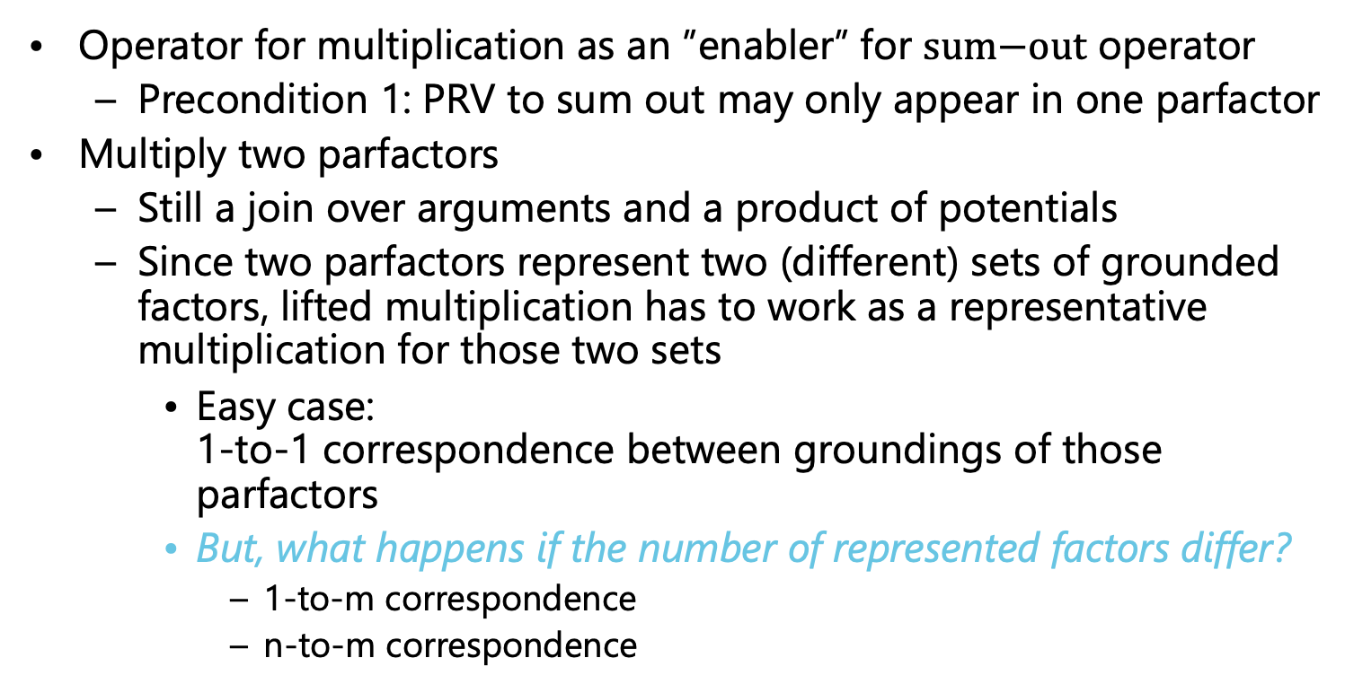
Lifted Multiplication
Operator for multiplication as an ”enabler” for $\text{sum}\text{−}\text{out}$ operator
  Precondition 1: PRV to sum out may only appear in one parfactor
Multiply two parfactors
  Still a join over arguments and a product of potentials
  Since two parfactors represent two (different) sets of grounded factors, lifted multiplication has to work as a representative multiplication for those two sets
    Easy case:
    1-to-1 correspondence between groundings of those parfactors
    But, what happens if the number of represented factors differ?
      1-to-m correspondence
      n-to-m correspondence
Formal lifted multiply operator
Open question: What happens if both parfactors represent different number of groundings?

Slide 31
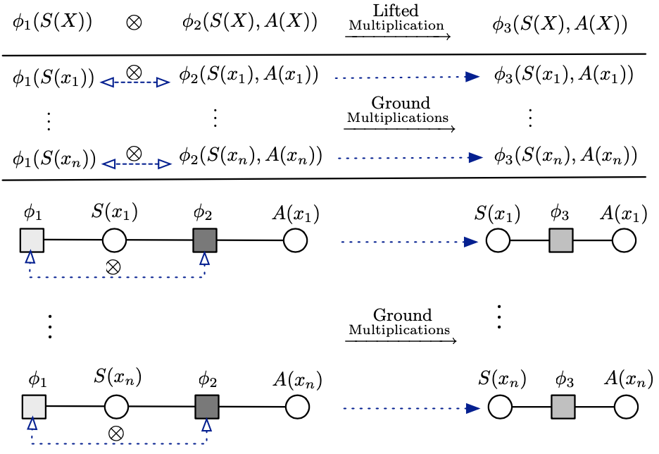






Lifted Multiplication: Trivial Case
1-to-1 correspondence between the ground factors of each parfactor
  E.g., $φ_{1}\left(S\left(X\right)\right)∙φ_{2}\left(S\left(X\right),A\left(X\right)\right)$
$$∙$$
$$∙$$
    Each grounding of $X$ in $gr\left(φ_{1}\left(S\left(X\right)\right)\right)$ interacts with $1$ corresponding grounding of $X$ in $gr\left(φ_{2}\left(S\left(X\right),A\left(X\right)\right)\right)$
$$∙$$
$$∙$$
$$∙$$
Figure taken from: Nima Taghipour, Daan Fierens, Jesse Davis, and Hendrik Blockeel: Lifted Variable Elimination: Decoupling the Operators from the Constraint Language. In: Journal of Artificial Intelligence Research, 2013.

Slide 32
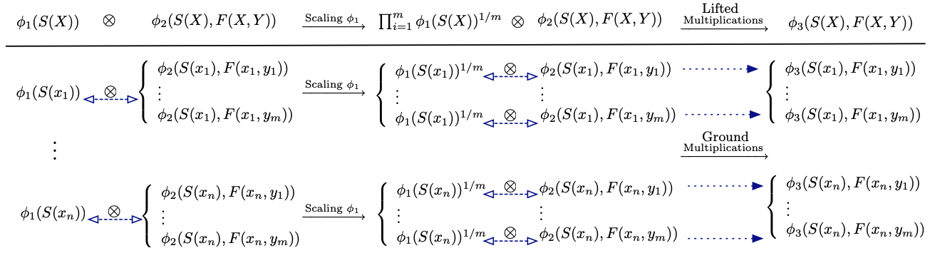









Lifted Multiplication: More General
$1$-to-$m$ correspondence between the ground factors of each parfactor
  Scaling necessary
  E.g., $φ_{1}\left(S\left(X\right)\right)∙φ_{2}\left(S\left(X\right),F\left(X,Y\right)\right)$
Distribute $φ_{1}\left(S\left(X\right)\right)$ into $m$ factors proportionally
$$∙$$
$$∙$$
    Each grounding of $X$ in $gr\left(φ_{1}\left(S\left(X\right)\right)\right)$ interacts with $m$ corresponding groundings of $X,Y$ in $gr\left(φ_{2}\left(S\left(X\right),F\left(X,Y\right)\right)\right)$
$$∙$$
$$∙$$
$$∙$$
$$∙$$
$$∙$$
$$∙$$
Figure taken from: Nima Taghipour, Daan Fierens, Jesse Davis, and Hendrik Blockeel: Lifted Variable Elimination: Decoupling the Operators from the Constraint Language. In: Journal of Artificial Intelligence Research, 2013.

Slide 33
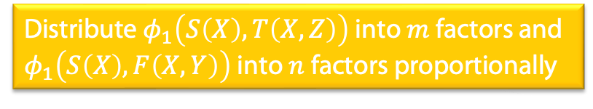
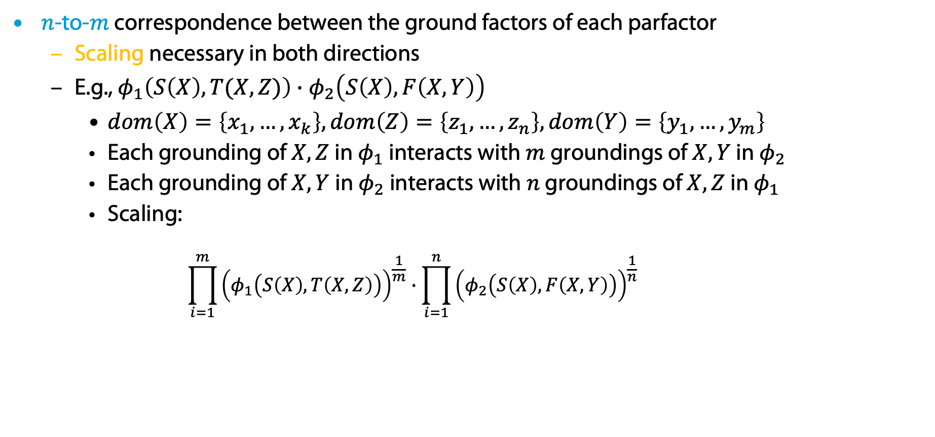
Lifted Multiplication: General Case
$n$-to-$m$ correspondence between the ground factors of each parfactor
  Scaling necessary in both directions
  E.g., $φ_{1}\left(S\left(X\right),T(X,Z)\right)∙φ_{2}\left(S\left(X\right),F\left(X,Y\right)\right)$
    $dom\left(X\right)=\left\{x_{1},…,x_{k}\right\},dom\left(Z\right)=\left\{z_{1},…,z_{n}\right\}, dom\left(Y\right)=\left\{y_{1},…,y_{m}\right\}$
    Each grounding of $X,Z$ in $φ_{1}$ interacts with $m$ groundings of $X,Y$ in $φ_{2}$
    Each grounding of $X,Y$ in $φ_{2}$ interacts with $n$ groundings of $X,Z$ in $φ_{1}$
    Scaling:
      $$\prod_{i=1}^{m}{{\left(φ_{1}\left(S\left(X\right),T\left(X,Z\right)\right)\right)}^{\frac{1}{m}}}∙\prod_{i=1}^{n}{{\left(φ_{2}\left(S\left(X\right),F\left(X,Y\right)\right)\right)}^{\frac{1}{n}} }$$
Distribute $φ_{1}\left(S\left(X\right),T\left(X,Z\right)\right)$ into $m$ factors and $φ_{1}\left(S\left(X\right),F\left(X,Y\right)\right)$ into $n$ factors proportionally

Slide 34
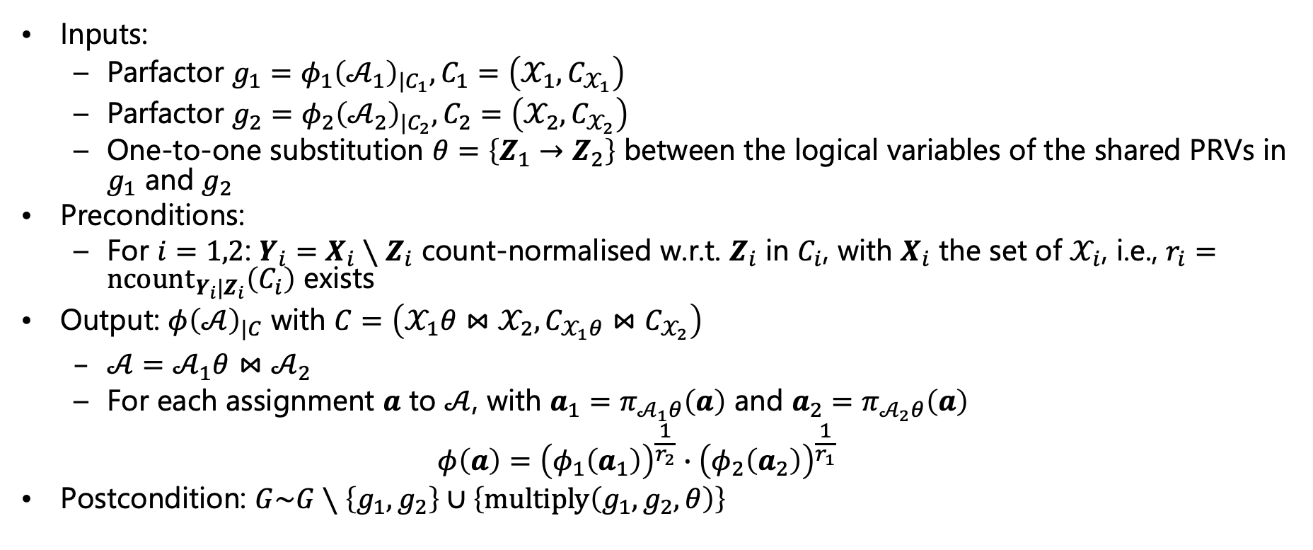
Lifted Multiplication: Operator
Operator does not assume that logical variables with the same applicable constants share the same name
Inputs:
  Parfactor $g_{1}=φ_{1}{\left(𝒜_{1}\right)}_{|C_{1}}, C_{1}=\left(𝒳_{1},C_{𝒳_{1}}\right)$
  Parfactor $g_{2}=φ_{2}{\left(𝒜_{2}\right)}_{|C_{2}}, C_{2}=\left(𝒳_{2},C_{𝒳_{2}}\right)$
  One-to-one substitution $θ=\left\{Z_{1}→Z_{2}\right\}$ between the logical variables of the shared PRVs in $g_{1}$ and $g_{2}$
Preconditions:
  For $i=1,2$: $Y_{i}=X_{i}∖Z_{i}$ count-normalised w.r.t. $Z_{i}$ in $C_{i}$, with $X_{i}$ the set of $𝒳_{i}$, i.e., $r_{i}=n{\text{count}}_{Y_{i}|Z_{i}}\left(C_{i}\right)$ exists
Output: $φ{\left(𝒜\right)}_{|C}$ with $C=\left(𝒳_{1}θ⋈𝒳_{2},C_{𝒳_{1}θ}⋈C_{𝒳_{2}}\right)$
  $𝒜=𝒜_{1}θ⋈𝒜_{2}$
  For each assignment $a$ to $𝒜$, with $a_{1}=π_{𝒜_{1}θ}\left(a\right)$ and $a_{2}=π_{𝒜_{2}θ}\left(a\right)$
  $$φ\left(a\right)={\left(φ_{1}\left(a_{1}\right)\right)}^{\frac{1}{r_{2}}}∙{\left(φ_{2}\left(a_{2}\right)\right)}^{\frac{1}{r_{1}}}$$
Postcondition: $G\sim G∖\left\{g_{1},g_{2}\right\}∪\left\{\text{multiply}\left(g_{1},g_{2},θ\right)\right\}$

Slide 35









Lifted Multiplication: Example
$$g_{1}∙g_{2}=φ_{1}\left(Sick\left(X\right)\right)∙φ_{2}\left(Sick\left(X\right), Treat\left(X,M\right)\right)=φ\left(Sick\left(X\right), Treat\left(X,M\right)\right)$$
  $⊤$ constraints with $\left|𝒟\left(M\right)\right|=2$
$1$-to-$m$
  $X_{1}=lv\left(g_{1}\right)=\left\{X\right\}$
  $X_{2}=lv\left(g_{2}\right)=\left\{X,M\right\}$
  $Z_{1}=lv\left(Sick\left(X\right)\right)=\left\{X\right\}=Z_{2}$
    No alignment necessary
  $Y_{1}=X_{1}∖Z_{1}=∅$
  count-normalised w.r.t. $Z_{1}=\left\{X\right\}$
  $Y_{2}=X_{2}∖Z_{2}=\left\{M\right\}$
  count-normalised w.r.t. $Z_{2}=\left\{X\right\}$
    Scaling necessary: $r_{2}=n{\text{count}}_{Y_{2}|Z_{2}}\left(C_{2}\right)=2$
$$Sick\left(X\right)$$ | $$φ_{1}$$
$$false$$ | $$1$$
$$true$$ | $$4$$
$$π_{Sick\left(X\right)}$$
$$1^{\frac{1}{2}}=\sqrt[2]{1}=1$$
$$Sick\left(X\right)$$ | $$Treat\left(X,M\right)$$ | $$φ$$
$$false$$ | $$false$$ | $$1∙5$$
$$false$$ | $$true$$ | $$1∙6$$
$$true$$ | $$false$$ | $$2∙7$$
$$true$$ | $$true$$ | $$2∙8$$
$$4^{\frac{1}{2}}=\sqrt[2]{4}=2$$
$$∙$$
$$Sick\left(X\right)$$ | $$Treat\left(X,M\right)$$ | $$φ_{2}$$
$$false$$ | $$false$$ | $$5$$
$$false$$ | $$true$$ | $$6$$
$$true$$ | $$false$$ | $$7$$
$$true$$ | $$true$$ | $$8$$
$$π_{Sick\left(X\right), Treat\left(X,M\right)}$$
Notes:
Argmax and sum not commutative

Slide 36

Count Conversion
Counting a logical variable binds a logical variable, i.e., removes logical variable from the logical variables of the parfactor
  E.g.,
    $g_{1}=φ_{1}(Epid,Nat\left(D\right),Acc\left(I\right))$ ➝ $lv\left(g_{1}\right)=\left\{D,I\right\}$
    $g_{1}^{′}=φ_{1}^{′}(Epid,Nat\left(D\right),\#_{I}\left[Acc\left(I\right)\right])$ ➝ $lv\left(g_{1}^{′}\right)=\left\{D\right\}$
  Helps with Precondition 2 of summing out!
    Precondition 2: PRV to sum out has to contain all logical variables of parfactor
Operator $\text{count}\text{−}\text{convert}$
  Count a logical variable ➝ convert a PRV into a (P)CRV
  Works as an ”enabler” for $\text{sum}\text{−}\text{out}$ operator
  Preconditions for $\text{count}\text{−}\text{convert}$ as well
Formal count conversion operator
Number of instances of logical variable to count identical for all instances of other logical variables in parfactor
(to have identical histograms)
Logical variable to count appears in only one PRV

Slide 37


Count Conversion: Operator
Inputs:
  Parfactor $g=φ{\left(𝒜\right)}_{|C}, C=\left(𝒳,C_{𝒳}\right)$
  Logical variable $X$ occurring in $𝒳$ for counting
Preconditions:
  There is exactly one PRV $A_{i}∈rv\left(g\right)$ s.t. $X∈lv\left(A\right)$
  $X$ is count-normalised w.r.t. $𝒳∖\left\{X\right\}$ in $C$
  For all counted logical variables $X^{\#}$ in $g$: $π_{X,X^{\#}}\left(C_{𝒳}\right)=π_{X }\left(C_{𝒳}\right)×π_{X^{\#}}\left(C_{𝒳}\right)$
Output: $φ^{′}{\left(𝒜^{′}\right)}_{|C}$
  $𝒜^{′}=\left(A_{1},…, A_{i−1}\right)∘\left(A_{i}^{′}\right)∘\left(A_{i+1},…, A_{n}\right),A_{i}^{′}=\#_{X}[A_{i}]$
  For each assignment $a^{′}=\left(…,a_{i−1},h,a_{i+1},…\right)$ to $𝒜^{′}$,
  $$φ^{′}\left(…,a_{i−1},{h,a}_{i+1},…\right)=\prod_{a_{i}∈ran\left(A_{i}\right)}{φ{\left(…, a_{i−1},a_{i},a_{i+1},…\right)}^{h\left(a_{i}\right)}}$$
    With $h\left(a_{i}\right)$ denoting the count of $a_{i}$ in histogram $h$
Postcondition: $G\sim G∖\left\{g \right\}∪\left\{\text{count}\text{−}\text{convert}\left(g,X\right)\right\}$
No inequality constraint between $X$ and any other counted logical variable $X^{\#}$

Slide 38



Count Conversion: Example
$$Epid$$ | $$Nat\left(D\right)$$ | $$\#_{I}[Acc\left(I\right)]$$ | $$φ_{1}^{′}$$
$$false$$ | $$false$$ | $$[0,2]$$ | $$2^{0}∙1^{2}$$
$$false$$ | $$false$$ | $$[1,1]$$ | $$2^{1}∙1^{1}$$
$$false$$ | $$false$$ | $$[2,0]$$ | $$2^{2}∙1^{0}$$
$$false$$ | $$true$$ | $$[0,2]$$ | $$4^{0}∙3^{2}$$
$$false$$ | $$true$$ | $$[1,1]$$ | $$4^{1}∙3^{1}$$
$$false$$ | $$true$$ | $$[2,0]$$ | $$4^{2}∙3^{0}$$
$$true$$ | $$false$$ | $$[0,2]$$ | $$6^{0}∙5^{2}$$
$$true$$ | $$false$$ | $$[1,1]$$ | $$6^{1}∙5^{1}$$
$$true$$ | $$false$$ | $$[2,0]$$ | $$6^{2}∙5^{0}$$
$$true$$ | $$true$$ | $$[0,2]$$ | $$8^{0}∙7^{2}$$
$$true$$ | $$true$$ | $$[1,1]$$ | $$8^{1}∙7^{1}$$
$$true$$ | $$true$$ | $$[2,0]$$ | $$8^{2}∙7^{0}$$
From $φ_{1}\left(Epid,Nat\left(D\right),Acc\left(I\right)\right)$
To $φ_{1}^{′}\left(Epid, Nat\left(D\right), \#_{I}\left[Acc\left(I\right)\right]\right)$
Preconditions fulfilled
  $I$ occurs only in $Acc\left(I\right)$
  $I$ is count-normalised w.r.t. $D$ in $\left(\left(D,I\right), dom\left(D\right)×dom\left(I\right)\right)$
  No other counted logical variable
Converting $Acc\left(I\right)$ into $\#_{I}\left[Acc\left(I\right)\right]$
$$φ^{′}\left(…,a_{i−1},{h,a}_{i+1},…\right)=\prod_{a_{i}∈ran\left(A_{i}\right)}{φ{\left(…, a_{i−1},a_{i},a_{i+1},…\right)}^{h\left(a_{i}\right)}}$$
$$Epid$$ | $$Nat\left(D\right)$$ | $$Acc\left(I\right)$$ | $$φ_{1}$$
$$false$$ | $$false$$ | $$false$$ | $$1$$
$$false$$ | $$false$$ | $$true$$ | $$2$$
$$false$$ | $$true$$ | $$false$$ | $$3$$
$$false$$ | $$true$$ | $$true$$ | $$4$$
$$true$$ | $$false$$ | $$false$$ | $$5$$
$$true$$ | $$false$$ | $$true$$ | $$6$$
$$true$$ | $$true$$ | $$false$$ | $$7$$
$$true$$ | $$true$$ | $$true$$ | $$8$$

Slide 39

Generalised Counting
Count conversion as discussed here, first introduced by Milch et al. (2008)
Generalised counting by Nima Taghipour et al. (2013)
  Count logical variables that appear in more than one PRV
    E.g., $φ\left(Q\left(X\right),R\left(X\right),S\left(Y\right),T\left(Y\right)\right)$
    ➝ $φ\left(\#_{X}\left[Q\left(X\right),R\left(X\right)\right],S\left(Y\right),T\left(Y\right)\right)$
  Merge CRVs with counted logical variables of the same domain
    E.g., $φ{\left(\#_{X}\left[Q\left(X\right),R\left(X\right)\right]\right)}_{C^{X}}$ and $φ{\left(\#_{Y}\left[Q\left(Y\right),R\left(Y\right)\right]\right)}_{|C^{Y}}$ with $gr\left(X_{|C^{X}}\right)=gr\left(Y_{|C^{Y}}\right)$
    ➝ $φ{\left(\#_{X}\left[Q\left(X\right),R\left(X\right)\right]\right)}_{C}$
  Merge-count a PRV and a CRV with an inequality constraint
    E.g., $φ{\left(\#_{X}\left[Q\left(X\right)\right],R\left(Y\right)\right)}_{C}$ with $C$ encoding $X≠Y$
    ➝ $φ{\left(\#_{X}\left[Q\left(X\right),R\left(X\right)\right] \right)}_{C}$
Brian Milch, Luke S. Zettelmoyer, Kristian Kersting, Michael Haimes, and Leslie Pack Kaelbling: Lifted Probabilistic Inference with Counting Formulas. In: AAAI-08 Proceedings of the 23rd AAAI Conference on Artificial Intelligence, 2008.
Nima Taghipour and Jesse Davis: Generalised Counting for Lifted Variable Elimination. In: ILP-13 Proceedings of the International Conference on Inductive Logic Programming, 2013. (or in Nima Taghipour’s PhD thesis)

Slide 40

Splitting
So, we need a formal split operation to split of (set of) constants
Need splitting for
  Shattering of query terms and evidence
  Precondition 1 of $\text{sum}\text{−}\text{out}$ operator: PRV $A$ under $\left(𝒳,C_{𝒳}\right)$ only occurs in $g$
    Formalism is very flexible in terms of constraints
      E.g., $φ_{1}{\left(R\left(X\right)\right)}_{\left(X,\left\{x_{1},x_{2},x_{3}\right\}\right)}$ vs. $φ_{2}{\left(R\left(X\right)\right)}_{\left(X,\left\{x_{1},x_{2},x_{3},x_{4}x_{5}\right\}\right)}$
Split parfactor s.t. the set of constants occurring in constraints for a logical variable are
either identical or disjoint
  I.e., no overlaps between sets of constants per logical variable
  E.g., split $φ_{2}{\left(R\left(X\right)\right)}_{\left(X,\left\{x_{1},x_{2},x_{3},x_{4}x_{5}\right\}\right)}$ into
    $φ_{2}{\left(R\left(X\right)\right)}_{\left(X,\left\{x_{1},x_{2},x_{3} \right\}\right)}$
    $φ_{2}{\left(R\left(X\right)\right)}_{\left(X,\left\{x_{4}x_{5}\right\}\right)}$

Slide 41


Splitting on Overlap
Splitting a constraint $C_{1}=\left(𝒳_{1},C_{𝒳_{1}}\right)$ on its $Y$-overlap with a constraint $C_{2}=\left(𝒳_{2},C_{𝒳_{2}}\right)$, denoted $C_{1}/_{Y}C_{2}$, partitions $C_{𝒳_{1}}$ into two subsets containing all tuples for which the $Y$ part occurs or does not occur, respectively
$$C_{1}/_{Y}C_{2}=\left\{\begin{aligned}\left(\left(𝒳_{1}\right),\left\{t∈C_{𝒳_{1}} | π_{Y}\left(\left\{t\right\}\right)∈π_{Y}\left(C_{𝒳_{2}}\right)\right\}\right) \\ \left(\left(𝒳_{1}\right),\left\{t∈C_{𝒳_{1}} | π_{Y}\left(\left\{t\right\}\right)∉π_{Y}\left(C_{𝒳_{2}}\right)\right\}\right)\end{aligned}\right\}$$
Parfactor partitioning
Given a parfactor $g=φ{\left(𝒜\right)}_{|C}$ and a partition $ℂ={\left\{C_{i}\right\}}_{i=1}^{n}$ of $C$,
$$\text{partition}\left(g,ℂ\right)={\left\{φ{\left(𝒜\right)}_{|C_{i}}\right\}}_{i=1}^{n}$$
Part shared with $C_{2}$
Remaining part

Slide 42




Splitting on Overlap: Example
Consider $φ{\left(R\left(X\right), T\left(X,Y\right)\right)}_{{|C}_{1}}$
  $C_{1}= \left(\left(X,Y\right),\left\{x_{1},x_{2},x_{3},x_{4},x_{5}\right\}×\left\{y_{1},y_{2}\right\}\right)$
  $C_{2}=\left(\left(X\right),\left\{x_{1},x_{2},x_{3}\right\}\right)$
Splitting $C_{1}$ on its $Y=\left\{X\right\}$-overlap with $C_{2}$
Partitioning
$$C_{1}/_{Y}C_{2}=\left\{\begin{aligned}\left(\left(X,Y\right),\left\{t∈C_{\left(X,Y\right)} | π_{X}\left(\left\{t\right\}\right)∈\left\{x_{1},x_{2},x_{3}\right\}\right\}\right) \\ \left(\left(X,Y\right),\left\{t∈C_{\left(X,Y\right)} | π_{X}\left(\left\{t\right\}\right)∉\left\{x_{1},x_{2},x_{3}\right\}\right\}\right)\end{aligned}\right\}$$
$$=\left\{\begin{aligned}\left(\left(X,Y\right),\left\{x_{1},x_{2},x_{3}\right\}×\left\{y_{1},y_{2}\right\}\right) \\ \left(\left(X,Y\right),\left\{x_{4},x_{5} \right\}×\left\{y_{1},y_{2}\right\}\right)\end{aligned}\right\}$$
$$\text{partition}\left(g,C_{1}/_{Y}C_{2}\right)=\left\{\begin{aligned}φ{\left(R\left(X\right), T\left(X,Y\right)\right)}_{|\left(\left(X,Y\right),\left\{x_{1},x_{2},x_{3}\right\}×\left\{y_{1},y_{2}\right\}\right)} \\ φ{\left(R\left(X\right), T\left(X,Y\right)\right)}_{|\left(\left(X,Y\right),\left\{x_{4},x_{5} \right\}×\left\{y_{1},y_{2}\right\}\right)} \end{aligned}\right\}$$

Slide 43

Splitting: Operator
Inputs:
  Parfactor $g=φ{\left(𝒜\right)}_{|C}, C=\left(𝒳,C_{𝒳}\right)$
  PRV $A=R\left(Y\right)$ occurring in $𝒜$
  PRV $A^{′}=R{\left(Y\right)}_{|C^{′}}$ or $\#_{Y}\left[R{\left(Y\right)}_{|C^{′}}\right]$
Precondition: none
Output:
  $$\text{partition}\left(g,ℂ\right),ℂ=C/_{Y}C^{′}∖∅$$
Postcondition:
$$G\sim G∖\left\{g\right\}∪\text{split}\left(g,A,A^{′}\right)$$

Slide 44

Splitting: Example
Inputs:
  Parfactor $φ{\left(R\left(X\right), T\left(X,Y\right)\right)}_{{|C}_{1}}$
    $C_{1}= \left(\left(X,Y\right),\left\{x_{1},x_{2},x_{3},x_{4},x_{5}\right\}×\left\{y_{1},y_{2}\right\}\right)$
  $R\left(X\right)$
  $R{\left(X\right)}_{|C_{2}}, C_{2}=\left(\left(X\right),\left\{x_{1},x_{2},x_{3}\right\}\right)$
Output:
  $$\text{partition}\left(g,C_{1}/_{Y}C_{2}\right)=\left\{\begin{aligned}φ{\left(R\left(X\right), T\left(X,Y\right)\right)}_{|\left(\left(X,Y\right),\left\{x_{1},x_{2},x_{3}\right\}×\left\{y_{1},y_{2}\right\}\right)} \\ φ{\left(R\left(X\right), T\left(X,Y\right)\right)}_{|\left(\left(X,Y\right),\left\{x_{4},x_{5} \right\}×\left\{y_{1},y_{2}\right\}\right)} \end{aligned}\right\}$$

Slide 45

Other Operators
Further “enablers” of lifted summing out all are variants of splitting on overlap and partitioning
Splitting of CRVs: Operator called $\text{expand}$
  More complex as histograms have to be split
    E.g., a histogram $\left[1,3\right]$ for $\left\{x_{1},x_{2},x_{3},x_{4}\right\}$ may have to be split on $\left\{x_{1},x_{2}\right\}$
Count-normalisation: Operator called $\text{count}\text{−}\text{normalise}$
  Split a constraint s.t. in the set of resulting constraints, each constraint is count-normalised w.r.t. to desired $Y_{i}|Z_{i}$ property
    Group sets of constants by the different counts $n{\text{count}}_{Y_{i}|Z_{i}}\left(C_{i}\right)$ they yield
Grounding – the last resort: Operator $\text{ground}$ as expected
  Splitting on individual constants
More information:
Nima Taghipour, Daan Fierens, Jesse Davis, and Hendrik Blockeel: Lifted Variable Elimination: Decoupling the Operators from the Constraint Language. In: Journal of Artificial Intelligence Research, 2013. (or in Nima Taghipour’s PhD thesis)

Slide 46





Lifted Absorption
Remember:
Observations for groundings of a PRV can be
  One of the range values
  Not available (N/A)
Compactly encode evidence with PRVs and parfactors
  Within each group:
  instances are indistinguishable again
Absorb evidence for each group at once using the parfactors
  Observations for $Sick\left(X\right)$
    $$Sick\left(x_{1}\right)=Sick\left(x_{2}\right)=…=Sick\left(x_{10}\right)=true$$
    $$Sick\left(x_{11}\right)=Sick\left(x_{12}\right)=…=Sick\left(x_{20}\right)=false$$
$$Sick\left(X\right)$$ | $$φ_{e}^{T}$$
$$false$$ | $$0$$
$$true$$ | $$1$$
$$Sick\left(X\right)$$ | $$φ_{e}^{F}$$
$$false$$ | $$1$$
$$true$$ | $$0$$
$$Nat\left(D\right)$$
$$Acc\left(I\right)$$
$$g_{1}$$
$$Epid$$
$$g_{0}$$
$$Travel\left(X\right)$$
$$Treat\left(X,M\right)$$
$$g_{2}$$
$$g_{3}$$
$$Sick\left(X\right)$$
$$g_{e}^{T}$$
$$g_{e}^{F}$$

Slide 47














Lifted Absorption: Shattering on Evidence
$$Nat\left(D\right)$$
$$Acc\left(I\right)$$
$$g_{1}$$
$$Epid$$
$$g_{0}$$
As observations are seldom for all constants in a constraint, parfactors have to be split based on the constants that occur in the observations
  Only then: absorb applicable evidence in each parfactor individually
  E.g., given evidence parfactors $g_{e}^{T}$, $g_{e}^{F}$, every parfactor containing $Sick\left(X\right)$has to be split on the constraints: $g_{2},g_{3}$
After shattering, absorb each evidence parfactor $g_{e}$ in each applicable parfactor $g_{i}$
  Possible to interleave shattering and absorption
$$Travel\left(X\right)$$
$$Treat\left(X,M\right)$$
$$g_{2}$$
$$g_{3}$$
$$Sick\left(X\right)$$
$$Travel\left(X^{T}\right)$$
$$Treat\left(X^{T},M\right)$$
$$g_{2}$$
$$g_{3}$$
$$Sick\left(X^{T}\right)$$
$$g_{e}^{T}$$
$$Travel\left(X^{F}\right)$$
$$Treat\left(X^{F},M\right)$$
$$g_{2}$$
$$g_{3}$$
$$Nat\left(D\right)$$
$$Sick\left(X^{F}\right)$$
$$Acc\left(I\right)$$
$$g_{1}$$
$$g_{e}^{F}$$
$$Epid$$
$$g_{0}$$
$$Travel\left(X\right)$$
$$Treat\left(X,M\right)$$
$$g_{2}$$
$$g_{3}$$
$$Sick\left(X\right)$$
$$g_{e}^{T}$$
$$g_{e}^{F}$$

Slide 48




Lifted Absorption: Example
$$Nat\left(D\right)$$
$$Acc\left(I\right)$$
$$g_{1}$$
$$Epid$$
$$g_{0}$$
$$Travel\left(X\right)$$
$$Treat\left(X,M\right)$$
Absorb $g_{e}^{T}$ in $g_{2}$:
Same for $g_{e}^{T}$ in $g_{3}$, $g_{e}^{F}$ in $g_{2}$, $g_{e}^{F}$ in $g_{3}$
$$g_{2}$$
$$g_{3}$$
$$Sick\left(X\right)$$
$$Travel\left(X\right)$$ | $$Epid$$ | $$Sick\left(X\right)$$ | $$φ_{2}$$
$$false$$ | $$false$$ | $$false$$ | $$5$$
$$false$$ | $$false$$ | $$true$$ | $$0$$
$$false$$ | $$true$$ | $$false$$ | $$4$$
$$false$$ | $$true$$ | $$true$$ | $$6$$
$$true$$ | $$false$$ | $$false$$ | $$4$$
$$true$$ | $$false$$ | $$true$$ | $$6$$
$$true$$ | $$true$$ | $$false$$ | $$2$$
$$true$$ | $$true$$ | $$true$$ | $$9$$
$$Sick\left(X\right)$$ | $$φ_{e}^{T}$$
$$false$$ | $$0$$
$$true$$ | $$1$$
$$Travel\left(X^{T}\right)$$
$$Treat\left(X^{T},M\right)$$
$$g_{2}$$
$$g_{3}$$
$$Sick\left(X^{T}\right)$$
$$g_{e}^{T}$$
$$Travel\left(X^{F}\right)$$
$$Treat\left(X^{F},M\right)$$
$$Travel\left(X\right)$$ | $$Epid$$ | $$φ_{2}^{T}$$
$$false$$ | $$false$$ | $$0$$
$$false$$ | $$true$$ | $$6$$
$$true$$ | $$false$$ | $$6$$
$$true$$ | $$true$$ | $$9$$
$$g_{2}$$
$$g_{3}$$
$$Sick\left(X^{F}\right)$$
$$g_{e}^{F}$$

Slide 49

Lifted Absorption: Operator
Inputs:
  Parfactor $g=φ{\left(𝒜\right)}_{|C}, C=\left(𝒳,C_{𝒳}\right)$
  PRV $A_{i}=R\left(Y\right)$ or (P)CRV $A_{i}=\#_{X}\left[R\left(Y\right)\right]$ occurring in $𝒜$
  Evidence parfactor $g_{e}=φ{\left(R\left(Y\right)\right)}_{|C_{e}}$ with $o=$ observed value of $R\left(Y\right)$ in $g_{e}$
Let
  $X^{excl}=Y∖lv\left(A∖\left\{A_{i}\right\}\right)$ (exclusive to $A_{i}$), $X^{nce}=lv\left(A_{i}\right)∖lv\left(A∖\left\{A_{i}\right\}\right)$ (not-counted exclusive to $A_{i}$)
  $X^{rem}=lv\left(𝒳\right)∖X^{excl}$ (remaining in $g$), $X^{ncr}=lv\left(𝒜\right)∖X^{excl}$ (not-counted remaining in $g$)
Preconditions:
  $gr\left(A_{i|C}\right)⊆gr\left(A_{{i|C}_{e}}\right)$
  $X^{nce}$ is count-normalised w.r.t. $X^{ncr}$ in $C$, i.e., $r=n{\text{count}}_{X^{nce}|X^{ncr}}\left(C\right)$ exists
Output: $g^{′}=φ^{′}{\left(𝒜^{′}\right)}_{|C^{′}}, C^{′}=\left(π_{X^{rem}}\left(𝒳\right),π_{X^{rem}}\left(C_{𝒳}\right)\right)$
  $𝒜^{′}=\left(A_{1},…, A_{i−1}\right)∘\left(A_{i+1},…,A_{n}\right)$
  $$φ^{′}\left(…,a_{i−1},a_{i+1},…\right)=φ{\left(…,a_{i−1},e,a_{i+1},…\right)}^{r}$$
    with $e=o$ if $A_{i}=R\left(Y\right)$ and
    otherwise $e=$ a histogram with $e\left(o\right)=$ $n{\text{count}}_{X|lv\left(𝒜\right)}\left(C\right)$ and $e\left(o^{′}\right)=0$, $o^{′}≠o$
Postcondition: $G∪\left\{g_{e}\right\} \sim G∖\left\{g\right\}∪\left\{g_{e}\text{, }\text{absor}b\left(g,A_{i},g_{e}\right)\right\}$
Notes:
Only one logical variable can be counted at a time

Slide 50




Lifted Absorption: Evidence for CRVs
Output: $g^{′}=φ^{′}{\left(𝒜^{′}\right)}_{|C^{′}}$
  $$φ^{′}\left(…,a_{i−1},a_{i+1},…\right)=φ{\left(…,a_{i−1},e,a_{i+1},…\right)}^{r}$$
    $e=$ a histogram with $e\left(o\right)=$ $n{\text{count}}_{X|lv\left(𝒜\right)}\left(C\right)$ and $e\left(o^{′}\right)=0$, $o^{′}≠o$
Evidence PRV appears as inner PRV of a (P)CRV
  Turn observations into histogram
    All groundings have the same observation in evidence parfactor
    Peak-shaped histogram with $n{\text{count}}_{X|lv\left(𝒜\right)}\left(C\right)$ at position $o$ and $0$ otherwise
  E.g., $Nat\left(D\right)=false$ for all $gr\left(Nat\left(D\right)\right)$ ➝ $o=false$ in $g_{e}$
    Given parfactor: $g=φ\left(Epid,\#_{D}\left[Nat\left(D\right)\right]\right)$
      $n{\text{count}}_{D|∅}\left(⊤\right)=2$
      Forms histogram: $\left[0,2\right]$
    Output: $g^{′}=φ^{′}\left(Epid\right)$
$$Nat\left(D\right)$$ | $$φ_{e}$$
$$false$$ | $$1$$
$$true$$ | $$0$$
$$Epid$$ | $$\#_{D}\left[Nat\left(D\right)\right]$$ | $$φ^{\#}$$
$$false$$ | $$\left[0,2\right]$$ | $$1$$
$$false$$ | $$\left[1,1\right]$$ | $$2$$
$$false$$ | $$\left[2,0\right]$$ | $$3$$
$$true$$ | $$\left[0,2\right]$$ | $$4$$
$$true$$ | $$\left[1,1\right]$$ | $$5$$
$$true$$ | $$\left[2,0\right]$$ | $$6$$
$$Epid$$ | $$φ_{e}$$
$$false$$ | $$1$$
$$true$$ | $$4$$

Slide 51


Lifted Absorption: Eliminating a Logical variable
Output: $g^{′}=φ^{′}{\left(𝒜^{′}\right)}_{|C^{′}}$
  $$φ^{′}\left(…,a_{i−1},a_{i+1},…\right)=φ{\left(…,a_{i−1},e,a_{i+1},…\right)}^{r}$$
    with $e=o$ if $A_{i}=R\left(Y\right)$
E.g., $Treat\left(X,M\right)=true ∀\left(x, m\right)∈⊤$
  Parfactor $g_{3}$ contains $Treat\left(X,M\right)$
  Output: $φ^{′}\left(Epid, Sick\left(X\right)\right)$
    Absorbing $Treat\left(X,M\right)=true$ eliminates $M$
    $r=n{\text{count}}_{M|X}\left(C\right)=2$
    Potentials in selected lines have
    to be raised to the power of $2$
$$Nat\left(D\right)$$
$$Acc\left(I\right)$$
$$g_{1}$$
$$Epid$$
$$g_{0}$$
$$Travel\left(X\right)$$
$$g_{2}$$
$$g_{3}^{T}$$
$$Sick\left(X\right)$$
After lifted absorb
$$Nat\left(D\right)$$
$$Acc\left(I\right)$$
$$g_{1}$$
$$Epid$$
$$g_{0}$$
$$Travel\left(X\right)$$
$$Treat\left(X,M\right)$$
$$g_{2}$$
$$g_{3}$$
$$Sick\left(X\right)$$

Slide 52














Lifted Absorption: Eliminating a Logical variable
Equivalent ground case:
  Absorb $Treat\left(x,m\right)=true$ in $r$ propositional factors for each $x$
  Output: $φ^{∗}\left(Epid, Sick\left(x\right)\right)$ $r$ times for each $x$
  Multiply all $φ^{∗}\left(Epid, Sick\left(x\right)\right)$ into one factor $φ^{′}\left(Epid, Sick\left(x\right)\right)$, i.e., raise to the power of $r$
$$Epid$$
$$Epid$$
$$Epid$$
$$Treat(x,m_{2})$$
$$φ_{3}$$
$$φ^{∗}$$
$$Treat(x,m_{1})$$
$$φ^{′}$$
$$φ_{3}$$
$$φ^{∗}$$
$$Sick(x)$$
$$Sick(x)$$
$$Sick(x)$$
Initial model
After absorb
After multiply

Slide 53

Shattering on Evidence & Absorption
Given a set of evidence parfactors ${\left\{g_{e}\right\}}_{e=1}^{m}$ and a model $G={\left\{g_{i}\right\}}_{i=1}^{n}$
For each $g_{e}={φ_{e}\left(A_{e}\right)}_{|C_{e}}$:
  For each $g_{i}=φ_{i}{\left(𝒜\right)}_{|C_{i}}$:
    If $A_{e}∈rv\left(g_{i}\right)$:
      Split $g_{i}$ on $C_{e}$, i.e.,
      $$G←G∖\left\{g_{i}\right\}∪\text{split}\left(g_{i},A_{e},A_{e|C_{e}}\right)$$
For each $g_{e}={φ_{e}\left(A_{e}\right)}_{|C_{e}}$:
  For each $g_{i}=φ_{i}{\left(𝒜\right)}_{|C_{i}}$:
    If $A_{e}∈rv\left(g_{i}\right)$:
      Absorb $g_{e}$ in $g_{i}$
      $$G←G∖\left\{g_{i}\right\}∪\text{absorb}\left(g_{i},A_{e},g_{e}\right)$$
Shattering
Absorption

Slide 54

Types of Shattering
So far considered: Pre-emptive shattering
  Recursively shattering the model on evidence, query terms, and itself before starting with any calculations
    Shattering a model on itself: Ensure that all sets of constants for logical variables occurring in constraints are either identical or disjoint
        Allows for introducing one logical variable for each set of constants and $⊤$ constraints except when an inequality is encoded
        Avoids splitting during LVE and makes PRV comparisons easier
On-demand shattering
  Splitting on constraints only if the application
  of an LVE operator requires it
  In initial example calculation for $P\left(Travel\left(eve\right)\right)$:
  Eliminate $Treat\left(X,M\right)$ before splitting of $Sick\left(eve\right)$
Does not change complexity of the problem
  May be hard to determine when to shatter + extra work for checking
$$Nat\left(D\right)$$
$$Acc\left(I\right)$$
$$g_{1}$$
$$Epid$$
$$g_{0}$$
$$Travel\left(X\right)$$
$$Treat\left(X,M\right)$$
$$g_{2}$$
$$g_{3}$$
$$Sick\left(X\right)$$
Notes:
Example on chalk board

Slide 55

LVE: Algorithm
Assumption:
  Pre-emptive shattering
  Ground query terms
    Set of propositional random variables, instances (groundings) of PRVs,
Inputs:
  Model $G={\left\{g_{i}\right\}}_{i=1}^{n}$
  Query terms $Q$
  Evidence $e$ encoded in evidence parfactors ${\left\{g_{e}\right\}}_{e=1}^{m}$
Output:
  Parfactor $g=φ\left(Q\right)$
    Encodes the a-posteriori probability distribution of $Q$ given $e$: $P\left(Q | e\right)$

Slide 56


LVE: Algorithm
$\text{LVE}\left(G, Q,{\left\{g_{e}\right\}}_{e=1}^{m}\right)$
  $G←$ Shatter $G$ on $Q$, ${\left\{g_{e}\right\}}_{e=1}^{m}$, and on itself
  $G←$Absorb ${\left\{g_{e}\right\}}_{e=1}^{m}$ in $G$
  while $G$ contains non-query terms do
    if a PRV $A$ fulfils the preconditions of $\text{sum}\text{−}\text{out}$ then
      $G←$Apply $\text{sum}\text{−}\text{out}$ to $A$ in $G$
    else
      $G←$ Apply an enabling operator ($\text{multiply}\text{, }\text{count}\text{−}\text{convert}\text{, }\text{expand}\text{, }$
      $\text{count}\text{−}\text{normalise}\text{, }\text{split}\text{, }\text{ground}$) on some parfactors in $G$
  $g←$Multiply all parfactors in $G$ into one parfactor
  $g←$ Normalise the potentials in $g$
  return $g$
How to choose?
$G$ may contain several
parfactors $φ_{i}\left(Q\right)$

Slide 57

LVE: Heuristics
Important for an implementation
  Cannot search all possible permutations of all possible operator applications
Preconditions of lifted operators already restrict possible elimination order
One possible greedy heuristics (as used in the upcoming implementation):
  Choose sum-out operations over any other operation
    Explicitly written down in algorithm
  Only consider multiplication if the arguments of the two parfactors are the same or ground
    Avoid scaling
  Choose operation that results into the smallest parfactor(s) to be added to $G$
    If same size: choose at random
    May result in sub-optimal application order or unnecessary applications
      E.g., if a grounding is unavoidable, the heuristics may lead to various count conversions being applied before grounding as the result of a count conversion is usually smaller in size than the result of grounding the same logical variable

Slide 58

LVE: Implementation
Available at:
  https://dtai.cs.kuleuven.be/software/gcfove
  Includes a VE implementation for comparison
Input: BLOG files
  Based on Bayesian Logic Programming Language
    https://bayesianlogic.github.io
Differences
  Constraint language and domains:
    Intensional language: all domain constants apply except those explicitly excluded via $≠$
    Domains cannot be subsets of other domains
  No explicit multiplication operator
    Merged into sum-out operator

Slide 59





BLOG Input
BLOG file
type Person;
guaranteed Person x[3];
random Boolean Epid;
random Boolean Sick(Person);
factor MultiArrayPotential[[0.1, 0.9]] Epid;
parfactor Person X. MultiArrayPotential
[[0.5,0.6,0.7,0.8,0.9,0.7,0.5,0.3]]
(Epid, Sick(X));
query Sick(x3); // query
obs Sick(x1)=true; // observation
Components
  Logical variables
  Domain definitions
  Ground random variables
  PRVs
  Factors
  Parfactors
Potential lists
  Start at all $true$
  End at all $false$
    If you think of the assignments as binary numbers, then the numbers are decreasing
$$Epid$$
$$Sick(X)$$
$$φ_{0}$$
$$φ_{1}$$
Slide based on a talk by Tristan Potten at the ICCS-2020 International Conference on Conceptual Structures.

Slide 60













Runtimes: Increasing Domain Sizes
$$Nat\left(D\right)$$
$$Acc\left(I\right)$$
Running example model with all domain sizes 2, except
$\left|dom\left(X\right)\right|∈\{2,4,…, 20, 30,…, 100,200, …,1000\}$
Query: $P\left(Travel\left(x_{1}\right)\right)$
$$g_{1}$$
$$Epid$$
$$g_{0}$$
$$Travel\left(X\right)$$
$$Treat\left(X,M\right)$$
$$g_{2}$$
$$g_{3}$$
  Linear scale
Log scale
$$Sick\left(X\right)$$
Runtimes in milliseconds
Domain size $\left|𝒟\left(X\right)\right|$
Domain size $\left|𝒟\left(X\right)\right|$

Slide 61



What About Parameterised Queries?
Logical variables allowed in query terms: $P\left(A_{|C}|T\right)$
  Represents a conjunctive query $P\left(gr\left(A_{|C}\right)|T\right)$
E.g., $P\left(Sick{\left(X\right)}_{|⊤}\right)$ for $P\left(Sick\left(alice\right), Sick\left(eve\right), Sick\left(bob\right)\right)$
$$Nat\left(D\right)$$
$$Acc\left(I\right)$$
$$g_{1}$$
$$Epid$$
$$g_{0}$$
$$Travel\left(X\right)$$
$$Treat\left(X,M\right)$$
$$g_{2}$$
$$g_{3}$$
$$Sick\left(X\right)$$
Tanya Braun and Ralf Möller: Parameterised Queries and Lifted Query Answering. In: IJCAI-18 Proceedings of the 27th International Joint Conference on Artificial Intelligence, 2018.

Slide 62















Indistinguishable Query Terms
$$Nat\left(D\right)$$
$$Acc\left(I\right)$$
$$g_{1}$$
Indistinguishable instances in query:
  $P\left(Sick\left(alice\right), Sick\left(eve\right), Sick\left(bob\right)\right)$
Standard LVE:
  Shattering leads to groundings w.r.t. constants in query
$$Epid$$
$$g_{0}$$
$$Travel\left(X\right)$$
$$Treat\left(X,M\right)$$
$$g_{2}$$
$$g_{3}$$
$$Sick\left(X\right)$$
$$Nat\left(D\right)$$
$$Acc\left(I\right)$$
$$g_{1}$$
$$f_{2}$$
$$Epid$$
$$f_{2}$$
$$g_{0}$$
$$f_{3}$$
$$f_{3}$$
$$Treat\text{.}alice\text{.}m_{1}$$
$$Treat\text{.}bob\text{.}m_{1}$$
$$Travel\text{.}alice$$
$$f_{2}$$
$$f_{3}$$
$$f_{3}$$
$$Travel.bob$$
$$f_{3}$$
$$Treat\text{.}eve\text{.}m_{1}$$
$$f_{3}$$
$$Sick\text{.}alice$$
$$Sick\text{.}bob$$
$$Sick\text{.}eve$$
$$Treat\text{.}alice\text{.}m_{2}$$
$$Travel\text{.}eve$$
$$Treat\text{.}eve\text{.}m_{2}$$
$$Treat\text{.}bob\text{.}m_{2}$$
Notes:
Eliminate: identical calculations, possibly larger interim results, counting symmetries in result

Slide 63







… And Their Effect
$$Nat\left(D\right)$$
$$Acc\left(I\right)$$
$$g_{1}$$
Query: $P\left(Sick\left(alice\right), Sick\left(eve\right), Sick\left(bob\right)\right)$
After shattering, eliminate all non-query terms
  Identical computations in eliminations
  Large intermediate results
  Symmetries in result
    Encode with CRV
$$Epid$$
$$g_{0}$$
$$Travel\left(X\right)$$
$$Treat\left(X,M\right)$$
$$g_{2}$$
$$g_{3}$$
$$Sick(alice)$$ | $$Sick(eve)$$ | $$Sick(bob)$$ | $$g^{′}$$
$$false$$ | $$false$$ | $$false$$ | $$1$$
$$false$$ | $$false$$ | $$true$$ | $$2$$
$$false$$ | $$true$$ | $$false$$ | $$2$$
$$false$$ | $$true$$ | $$true$$ | $$3$$
$$true$$ | $$false$$ | $$false$$ | $$2$$
$$true$$ | $$false$$ | $$true$$ | $$3$$
$$true$$ | $$true$$ | $$false$$ | $$3$$
$$true$$ | $$true$$ | $$true$$ | $$4$$
$$Sick\left(X\right)$$
$$\#_{X}[Sick\left(X\right)]$$ | $$g$$
$$[0,3]$$ | $$1$$
$$[1,2]$$ | $$2$$
$$[2,1]$$ | $$3$$
$$[3,0]$$ | $$4$$
$$g^{′}$$
$$Sick\text{(}alice)$$
$$Sick\text{(}bob)$$
$$Sick\text{(}eve)$$

Slide 64

LVE for Parameterised Queries
To avoid grounding, take PRV representation of query terms and apply LVE as before
  Shatter model on constraint of query terms ➝ maximum of two groups per parfactor and logical variable
  Eliminate all non-query terms
    If logical variable prevents application of operator ➝ count or ground logical variable from query
  After all non-query terms eliminated, count or ground remaining logical variables to make logical variables explicit
    Otherwise only in representative form but not a joint over all groundings
At the end, the result contains the logical variables counted (or grounded)
  If counting the logical variables of $A_{|C}$ is not possible, then LVE needs to ground them to ensure a distribution over $A_{|C}$
Tanya Braun and Ralf Möller: Parameterised Queries and Lifted Query Answering. In: IJCAI-18 Proceedings of the 27th International Joint Conference on Artificial Intelligence, 2018.

Slide 65


LVE for Parameterised Queries
$\text{LVE}\left(G, Q_{|C},{\left\{g_{e}\right\}}_{e=1}^{m}\right)$
  $G←$ Shatter $G$ on $Q_{|C}$, ${\left\{g_{e}\right\}}_{e=1}^{m}$, and on itself
  $G←$Absorb ${\left\{g_{e}\right\}}_{e=1}^{m}$ in $G$
  while $G$ contains non-query terms do
    if a PRV $A$ fulfils the preconditions of $\text{sum}\text{−}\text{out}$ then
      $G←$Apply $\text{sum}\text{−}\text{out}$ to $A$ in $G$
    else
      $G←$ Apply an enabling operator on some parfactors in $G$
  while $lv\left(G\right)≠∅$ do
    if $∃X∈lv\left(G\right)$ s.t. $X$ is countable in $g∈G$ then
      $G←$Apply $\text{count}\text{−}\text{convert}$ to $X$ in $g$
    else
      $G←$ Apply an enabling operator on some parfactors in $G$
  $g←$Multiply all parfactors in $G$ into one parfactor
  $g←$ Normalise the potentials in $g$
  return $g$
At this point, $G$ contains only $Q_{|C}$ terms but the logical variables in $Q_{|C}$ may still be uncounted; the next loop counts them if possible
Normalisation changes to account for histograms encoding multiple assignments
Tanya Braun and Ralf Möller: Parameterised Queries and Lifted Query Answering. In: IJCAI-18 Proceedings of the 27th International Joint Conference on Artificial Intelligence, 2018.

Slide 66


Normalisation
Histogram $h$ may encode multiple assignments ${\left\{a_{i}\right\}}_{i=1}^{Mul\left(h\right)}$
  $Mul\left(h\right)$ assignments have the potential $φ\left(h\right)$
  Incorporate into normalisation (just like we needed to incorporate that into $\text{sum}\text{−}\text{out}$)
To get the probability of one assignment $a$ behind histogram $h$ in parfactor $φ\left(\#_{X}\left[R\left(X\right)\right]\right)$:
  $$p_{a|h}=\frac{φ\left(h\right)}{\sum_{h∈ran\left(\#_{X}\left[R\left(X\right)\right]\right)}{Mul\left(h\right)∙φ\left(h\right)}}$$
  Probability of $Mul\left(h\right)$ assignments
  $p_{h}=Mul\left(h\right)∙p_{a|h}$
  Distribution:
  $$\sum_{h∈ran\left(\#_{X}\left[R\left(X\right)\right]\right)}{p_{h}}=\sum_{h∈ran\left(\#_{X}\left[R\left(X\right)\right]\right)}{Mul\left(h\right)∙p_{a|h}}=1$$
$$\#_{X}[Sick\left(X\right)]$$ | $$g$$
$$[0,3]$$ | $$1$$
$$[1,2]$$ | $$2$$
$$[2,1]$$ | $$3$$
$$[3,0]$$ | $$4$$
Tanya B. Rescued from a Sea of Queries: Exact Inference in Probabilistic Relational Models. PhD Thesis, 2020.

Slide 67













Example
$$\#_{X}[Sick\left(X\right)]$$ | $$φ^{′}$$
$$[0,3]$$ | $$1$$
$$[1,2]$$ | $$2$$
$$[2,1]$$ | $$3$$
$$[3,0]$$ | $$4$$
$$g_{1}^{′′}$$
Query: $P\left(Sick\left(X\right)\right)$
No shattering necessary with $⊤$ constraints
Elimination:
  Eliminate $Treat\left(X,M\right)$
  Eliminate $Travel\left(X\right)$
  Count-convert $Acc\left(I\right)$
  Eliminate $Nat\left(D\right)$
  Eliminate $\#_{I}\left[Acc\left(I\right)\right]$
  Eliminate $Epid$
    Multiply parfactors (fulfil precondition 1)
    Count-convert $X$ (fulfil precondition 2)
    Sum out $Epid$
$$Epid$$
$$Epid$$
Here, count conversion as part of elimination, but if logical variables remaining after elimination, count conversions afterwards (trivially possible):
$$g_{2}^{′}$$
$$g_{3}^{′}$$
$$g_{123}^{\#}$$
$$g^{′}$$
$$Sick\left(X\right)$$
$$\#_{X}\left[Sick\left(X\right)\right]$$
$$\#_{X}\left[Sick\left(X\right)\right]$$
$$Nat\left(D\right)$$
$$Acc\left(I\right)$$
$$g_{1}$$
$$Sick\left(X\right)$$
$$\#_{X}\left[Sick\left(X\right)\right]$$
$$Epid$$
$$g_{0}$$
$$Travel\left(X\right)$$
$$Treat\left(X,M\right)$$
$$g_{2}$$
$$g_{3}$$
$$Sick\left(X\right)$$
Notes:
Chalk board

Slide 68










Example
single
assignment
all
assignments
$$\#_{X}[Sick\left(X\right)]$$ | $$φ^{′}$$
$$[0,3]$$ | $$1$$
$$[1,2]$$ | $$2$$
$$[2,1]$$ | $$3$$
$$[3,0]$$ | $$4$$
$$→1/{20}$$
$$→1/{20}$$
Query: $P\left(Sick\left(X\right)\right)$
Elimination: Finished
Normalisation:
  $$p_{a|h}=\frac{φ\left(h\right)}{\sum_{h∈ran\left(\#_{X}\left[R\left(X\right)\right]\right)}{Mul\left(h\right)∙φ\left(h\right)}}=\frac{φ\left(h\right)}{1∙1+3∙2+3∙3+1∙4}$$
  Probability distribution:
  $$\sum_{h∈ran\left(\#_{X}\left[R\left(X\right)\right]\right)}{{Mul\left(h\right)∙p}_{a|h}}$$
  $$=1∙\frac{1}{20}+3∙\frac{2}{20}+3∙\frac{3}{20}+1∙\frac{4}{20}=\frac{1+6+9+4}{20}=\frac{20}{20}=1$$
$$g^{′}$$
$$→2/{20}$$
$$→6/{20}$$
$$\#_{X}\left[Sick\left(X\right)\right]$$
$$→3/{20}$$
$$→9/{20}$$
$$→4/{20}$$
$$→4/{20}$$

Slide 69

Splits Affecting Query Logical Variables
Logical variables $X$ in query terms may be split (or grounded) in result
  If splits of the model affect the query logical variables
Prominent case: evidence; three cases given query PRV ${R\left(X\right)}_{|C}$, evidence PRV ${E\left(Y\right)}_{|C_{e}}$
  Overlap of instances (i.e., $R\left(X\right)=E\left(Y\right)$): $gr\left({R\left(X\right)}_{|C}\right)∩gr\left({E\left(X\right)}_{|C_{e}}\right)≠∅$
    Split $C$ on the overlap with $C_{e}$, i.e., $C/_{X}C_{e}$ ➝ instances of $C_{e}$ will be absorbed
    Result has ${R\left(X\right)}_{|C}$ partitioned into $C/_{X}C_{e}∖C_{e}$ (absorbed instances: probability $1$ of observed value)
  Overlap of constants ($Z$ shared logical variables): $gr\left(π_{Z}\left(X_{|C}\right)\right)∩gr\left(π_{Z}\left(Y_{|C_{e}}\right)\right)≠∅$
    Split $C$ on the overlap with $C_{e}$, i.e., $C/_{Z}C_{e}$
    Answer has ${R\left(X\right)}_{|C}$ partitioned into $C/_{X}C_{e}$ in the result (different evidence applies)
  No overlap (more of a non-case): $gr\left({R\left(X\right)}_{|C}\right)∩gr\left({E\left(Y\right)}_{|C_{e}}\right)=∅∧no shared logvars Z$
    ${R\left(X\right)}_{|C}$ is not partitioned in the result because of evidence (maybe partitioned for other reasons)
Tanya B. Rescued from a Sea of Queries: Exact Inference in Probabilistic Relational Models. PhD Thesis, 2020.
Notes:
Chalk board example

Slide 70

Splits Affecting Query Logical Variables: Examples
Given query $P\left(Sick{\left(X\right)}_{|\left(X,{\left\{x_{i}\right\}}_{i=1}^{20}\right)}\right)$:
  Overlap of instances:
  evidence $φ_{e}{\left(Sick\left(X\right)\right)}_{|\left(X,{\left\{x_{i}\right\}}_{i=1}^{10}\right)}$
      Result: $φ{\left(\#_{X}\left[Sick\left(X\right)\right]\right)}_{|\left(X,{\left\{x_{i}\right\}}_{i=11}^{20}\right)}$
  Overlap of constants:
  evidence $φ_{e}{\left(Travel\left(X\right)\right)}_{|\left(X,{\left\{x_{i}\right\}}_{i=1}^{10}\right)}$
      Result: $φ{\left(\#_{X^{′}}\left[Sick\left(X^{′}\right)\right],\#_{X^{′′}}\left[Sick\left(X^{′′}\right)\right]\right)}_{|\left(\left(X^{′},X^{′′}\right),{\left\{x_{i}\right\}}_{i=1}^{10}×{\left\{x_{i}\right\}}_{i=11}^{20}\right)}$
  No overlap:
  evidence $φ_{e}{\left(Nat\left(D\right)\right)}_{|\left(D,{\left\{d_{i}\right\}}_{i=1}^{2}\right)}$
      Result: $φ{\left(\#_{X}\left[Sick\left(X\right)\right] \right)}_{|\left(X,{\left\{x_{i}\right\}}_{i=1}^{20}\right)}$
$$Nat\left(D\right)$$
$$Acc\left(I\right)$$
$$g_{1}$$
$$Epid$$
$$g_{0}$$
$$Travel\left(X\right)$$
$$Treat\left(X,M\right)$$
$$g_{2}$$
$$g_{3}$$
$$Sick\left(X\right)$$
Tanya B. Rescued from a Sea of Queries: Exact Inference in Probabilistic Relational Models. PhD Thesis, 2020.
Notes:
Chalk board example

Slide 71
Interim Summary
LVE lifted operators
  Eliminate PRVs: lifted summing out, lifted absorption
  Enable elimination: lifted multiplication, count conversion, splitting
    Other based on splitting: expand, ground, count-normalise
Shattering = splitting on query terms, evidence, model constraints
  Pre-emptive, on-demand
LVE algorithm
  Heuristics
  Implementation
  Version for parameterised queries
    Effect of evidence: possibly partitioned result

Slide 72
Theoretical Analysis
$$Epid$$
root
$$∅$$
$$∅$$
$$∀x :⊤$$
$$T_{X}$$
$$Acc\left(I\right)$$
$$∀d :⊤$$
$$T_{D}$$
$$Epid$$
$$Epid$$
$$Sick\left(x\right)$$
$$T_{x}$$
$$Nat\left(d\right)$$
$$T_{d}$$
Lifted Variable Elimination
$$Epid$$
$$Acc\left(I\right),Epid$$
$$Travel\left(x\right)$$
$$∅$$
$$∀m :⊤$$
$$∅$$
$$∀i :⊤$$
$$Sick\left(x\right)$$
$$Epid$$
$$Sick\left(x\right)$$
$$Epid$$
$$T_{M}$$
$$Nat\left(d\right)$$
$$Acc\left(I\right),Epid$$
$$T_{I}$$
$$Treat\left(x,m\right)$$
$$∅$$
$$Sick\left(x\right)$$
$$Epid$$
$$T_{m}$$
$$Nat\left(d\right)$$
$$Acc\left(i\right),Epid$$
$$T_{i}$$
$$g_{2}$$
$$g_{3}$$
$$g_{0}$$
$$g_{1}$$

Slide 73

Runtime Complexity of Probabilistic Inference Using PGMs
Informal
Worst-case size of interim result times number of eliminations
Decomposition tree (dtree)
  Data structure to characterise runtime complexity
  Represents a VE run for a query
    Most representative query: empty query $P\left(.\right)$, i.e., the normalisation constant
  Acyclic tree with factors or interim results associated with nodes
    Leaves: Factors of model
    Inner nodes: interim results after an elimination of a variable
      Root: final result (query answer)
      Edge between an inner node $T_{i}$ and a child node $T_{j}$ if factor / interim of $T_{j}$ involved in elimination of variable
      If variable appears in more than one factor, then more than one child
Without actually realising the interim results, a dtree allows for determining a worst-case size based on the variables involved
  More details: Adnan Darwiche, “Modelling and Reasoning with Bayesian Networks” (2009), Chs. 8.3 + 9.5
Notes:
Elimination has to go through whole factor ➝ worst case size

Slide 74



















Example: Dtree – Bottom-up Construction as VE Representation
$$P\left(.\right)=\sum_{e∈Val\left(E\right)}{φ_{0}\left(e\right)\sum_{n∈Val\left(N\right)}{\sum_{a∈Val\left(A\right)}{φ_{1}\left(e,n,a\right)}}}$$
$$NatDis$$
$$Artif$$
$$φ_{1}$$
$$Epid$$
$$Epid$$
$$NatDis$$
$$\sum_{s∈Val\left(S\right)}{\begin{aligned}\sum_{tr∈Val\left(Tr\right)}{φ_{2}\left(tr,e,s\right)} \\ \sum_{tt∈Val\left(Tt\right)}{φ_{3}\left(e,s,tt\right)}\end{aligned}}$$
$$Epid$$
$$φ_{0}$$
$$Travel$$
$$NatDis$$
$$Artif$$
$$φ_{2}$$
$$Sick$$
$$Epid$$
$$Sick$$
$$f_{1}$$
$$Epid$$
$$Treat$$
$$Epid$$
$$φ_{3}$$
$$f_{0}$$
$$Epid$$
$$Sick$$
$$Travel$$
$$Treat$$
Computations in different subtrees can be parallelised, as they are independent from each other
$$f_{2}$$
$$f_{3}$$
$$Sick$$
$$E≜Epid,N≜NatDis,A≜Artif,S≜Sick,Tr≜Travel,Tt≜Treat$$

Slide 75

















Example: Dtree – Top-down Interpretation
$$NatDis$$
$$Artif$$
At beginning: Root node with model $F={\left\{f_{i}\right\}}_{i=1}^{n}$ as current model $F^{′}$
Recursively partition $F^{′}$ at node $k$ such that
  Each partition $F_{i}⊆F^{′}$ contains random variables $U_{i}$ that do not appear in other partitions
    Maximise size of $U_{i}$ over all partitions
    $U_{i}$ can be eliminated without considering factors of other partitions
For each partition $F_{i}$, add a child node $i$ to $k$
with $F_{i}$ as current model $F^{′}$
Stop at a node if current model $F^{′}$ contains only one factor
$$f_{1}$$
Why is it reasonable to not put $φ_{0}$ in another subtree?
$$Epid$$
$$f_{0}$$
$$Travel$$
$$Treat$$
Where else can we put $φ_{0}$?
$$f_{2}$$
$$f_{3}$$
$$Sick$$
$$Epid$$
$$Epid$$
$$Sick$$
$$Epid$$
$$NatDis$$
$$Epid$$
$$Sick$$
$$Treat$$
$$Epid$$
$$Sick$$
$$Travel$$
$$Epid$$
$$NatDis$$
$$Artif$$
$$φ_{3}$$
$$φ_{2}$$
$$φ_{0}$$
$$φ_{1}$$
Notes:
Aufteilung in Partitionen erklären
Gelb: kommt an diesem Knoten neuerdings in allen Kindern vor (kam also nicht in den Vorfahren schon mal an allen Kindern vor)

Slide 76

















Cutset, Context, Cluster
Cutset
  What gets eliminated at this node (cut from the model)
$$cutset\left(T\right)=\left(\bigcup_{T_{i},T_{j}∈Ch(T)}{rv\left(T_{i}\right)∩rv\left(T_{j}\right)}\right)∖acutset\left(T\right) \\ acutset\left(T\right)= \bigcup_{T^{′}∈Anc\left(T\right)}{cutset\left(T^{′}\right)}$$
Context
  What is set during elimination (what else appears)
$$context\left(T\right)=rv\left(T\right)∩acutset\left(T\right)$$
Cluster
  Cutset and context together
$$cluster\left(T\right)=cutset(T)∪context\left(T\right)$$
    If $T$ is a leaf, then $cluster\left(T\right)=context\left(T\right)=rv\left(f\right)$
$rv\left(T\right)$ returns the random variables, which appear in the factors of this subtree
$$Epid$$
$$Epid$$
$$Sick$$
$$Epid$$
$$NatDis$$
$$Epid$$
$$Sick$$
$$Treat$$
$$Epid$$
$$Sick$$
$$Travel$$
$$Epid$$
$$NatDis$$
$$Artif$$
$$φ_{3}$$
$$φ_{2}$$
$$φ_{0}$$
$$φ_{1}$$

Slide 77

Cutset, Context, Cluster
Largest cluster in tree $T$ = tree width $w$
  $$w=\max_{T_{i}∈Desc\left(T\right)}{|cluster\left(T_{i}\right)|}$$
  Induces a worst-case factor size
    Cluster specifies, which random variables involved in an elimination
      Appear together in a factor
    Largest cluster ➝ largest number of arguments of a factor
    Example:
      $w=3$, worst-case factor size $2^{w}=2^{3}$
  $w$ bounded from below by largest input factor size:
  $$w≥m=\max_{f∈F}\left|rv\left(f\right)\right|$$
      When learning a model, avoid factors with many arguments
      (e.g., bound degree in FG / MN)
$$Epid$$
$$Epid$$
$$Sick$$
$$Epid$$
$$NatDis$$
$$Epid$$
$$Sick$$
$$Treat$$
$$Epid$$
$$Sick$$
$$Travel$$
$$Epid$$
$$NatDis$$
$$Artif$$
$$φ_{3}$$
$$φ_{2}$$
$$φ_{0}$$
$$φ_{1}$$

Slide 78

Back to Runtime Complexity of Probabilistic Inference in PGMs
Informal
Worst-case size of interim result times number of eliminations
Decomposition tree (dtree)
  Tree width $w$ = worst-case number of arguments
  Number of inner nodes $n_{T}$ = Number of eliminations $≤\left|rv\left(F\right)\right|$
    $n_{T}=\left|rv\left(F\right)\right|$ as upper bound, i.e., asking the empty query
Formal:
Runtime complexity of VE
$$O\left(n_{T}∙r^{w}\right)$$
  $r=\max_{R∈rv\left(F\right)}\left|ran(R)\right|$
  Compare with inference using full joint $P_{F}$: $O\left(r^{n_{T}}\right)$
$$Epid$$
$$Epid$$
$$Sick$$
$$Epid$$
$$NatDis$$
$$Epid$$
$$Sick$$
$$Treat$$
$$Epid$$
$$Sick$$
$$Travel$$
$$Epid$$
$$NatDis$$
$$Artif$$
$$φ_{3}$$
$$φ_{2}$$
$$φ_{0}$$
$$φ_{1}$$

Slide 79



Complexity and Tractability
Query answering problem is tractable IF
  it is solved by an efficient algorithm in time polynomial w.r.t. the number of random variables
Query answering problem in general is intractable
  No guarantees that $w≪n_{T}$
Exceptions make assumptions about model structure
  E.g., polytree BNs $B$
    Directed graph with $P\left(R | pa\left(R\right)\right)$ at each node $R$
    Ensures that $w=\max_{R∈rv\left(B\right)}\left|pa\left(R\right)\right|+1$
    Also holds for tree-shaped FGs and their MN representation
    Assumes that degree is not in order of $n_{T}$
  E.g., PRMs ➝ how? Upcoming…
Polytree
(no cycles in undirected version)
$$Nat\left(D\right)$$
$$Acc\left(I\right)$$
$$g_{1}$$
$$Epid$$
$$g_{0}$$
$$Travel\left(X\right)$$
$$Treat\left(X,M\right)$$
$$g_{2}$$
$$g_{3}$$
$$Sick\left(X\right)$$

Slide 80

Complexity of Probabilistic Inference in PRMs
Informally, LVE complexity still
worst case size of an interim result $times$ number of eliminations
Use a so-called first-order dtree (FO dree), to get worst case size of an interim result characterised by so-called lifted width
  In dtree representation of VE for $gr\left(G\right)$,
  duplicate subtrees whenever a lifted sum-out applicable in $G$
  In FO dtree of LVE for $G$,
  representative subtree for lifted sum-out (compactly encode duplicate subtrees)

Slide 81

































Dtree with Repeating Structures
Aim for a node that basically says:
$∀x$ in this submodel
Decomposition of $gr\left(G\right)$
  $a≜alice$
  $e≜eve$
  $b≜bob$
Duplicated for $alice, bob$, i.e., for each $x$ that is indistinguishable
Duplicated for each $m_{i}$, i.e., for each $m$ that is indistinguishable
$$Epid$$
$$Sick.a$$
$$Epid$$
$$Sick.e$$
$$Epid$$
$$Sick.b$$
$$Epid$$
$$Acc.chem$$
$$Epid$$
$$Acc.nucl$$
$$Epid$$
$$Acc.chem$$
$$Travel.a$$
$$Epid$$
$$Sick.a$$
$$Treat.a.m_{1}$$
$$Epid$$
$$Sick.a$$
$$Treat.a.m_{2}$$
$$Epid$$
$$Sick.a$$
$$Travel.e$$
$$Epid$$
$$Sick.e$$
$$Treat.e.m_{1}$$
$$Epid$$
$$Sick.e$$
$$Treat.e.m_{2}$$
$$Epid$$
$$Sick.e$$
$$Travel.b$$
$$Epid$$
$$Sick.b$$
$$Treat.b.m_{1}$$
$$Epid$$
$$Sick.b$$
$$Treat.b.m_{2}$$
$$Epid$$
$$Sick.b$$
$$Nat.fire$$
$$Epid$$
$$Acc.chem$$
$$Acc.nucl$$
$$Nat.flood$$
$$Epid$$
$$Acc.chem$$
$$Acc.nucl$$
$$f_{2}$$
$$f_{3}$$
$$f_{3}$$
$$f_{2}$$
$$f_{3}$$
$$f_{3}$$
$$f_{2}$$
$$f_{3}$$
$$f_{3}$$
$$f_{0}$$
$$f_{1}$$
$$f_{1}$$
$$f_{1}$$
$$f_{1}$$

Slide 82

Decomposition into Partial Groundings
Introduce a new inner node: DPG node denoted $∀ x :C$
  DPG = Decomposition into partial groundings
    Replaces a logical variable with a representative constant
    The resulting model/subtree is identical for each constant represented
      Allows for considering the resulting model without the grounded logical variable for further decomposition (top-down)
  E.g., submodel below $Epid$ in the graph
    Logical variable $X$ appears in each parfactor
    Grounding $X$ leads to copies of the same submodel
    Replace $X$ with representative $x$ ➝ partial grounding
      Whatever you do to $x$ applies to all constants represented
  Represent that $∀ x :C$, $C$ a constraint,
  the subtree below would be identical
$$Nat\left(D\right)$$
$$Acc\left(I\right)$$
$$g_{1}$$
$$Epid$$
$$g_{0}$$
$$Travel\left(X\right)$$
$$Treat\left(X,M\right)$$
$$g_{2}$$
$$g_{3}$$
$$Sick\left(X\right)$$

Slide 83

DPG Definition
Assume that (sub)model $G$ fulfils a normal form* where
    * possible to rewrite any model in polynomial time into normal form
  Domains are either disjoint or identical
  Logical variables share the same name if they refer to the same domain over different parfactors
  Constraints are $⊤$
    Formal definition by Taghipour includes inequality constraints
  No further splitting operations necessary (split, expand, count-normalise)
Decomposition into partial groundings of $G$ by logical variable $X$ with $∀g∈G:X∈lv\left(g\right)$
  $$DPG\left(G,X\right)=\bigcup_{g∈G}{gθ},θ=\left\{X→x\right\}$$

Slide 84

FO Dtree Construction
Recursively, starting with $G$ as the current model $G^{′}$ at the root
  Check if there exists logical variable $X$ that allows for a DPG in $G^{′}$
    If so, make current node a DPG node $T_{X}$ for $X$, replace $X$ with representative $x$, i.e., apply $θ=\left\{X→x\right\}$ to $G^{′}$, add child node $T_{x}$with $G^{′}=Gθ$ as current model
      If parent node is a DPG node $T_{X^{′}}$ as well, with current node being $T_{x^{′}}$, add new DPG node $T_{X}$ as child of $T_{x^{′}}$
  Otherwise: Partition $G^{′}$ on logical variables (if exist) or random variables into ${\left\{G_{i}^{′}\right\}}_{i=1}^{n}$
    Add a child node for each $G_{i}^{′}$ with $G_{i}^{′}$ as current model
Until
  All logical variables replaced by representatives
  and
  Only one parfactor per partition
$$Nat\left(D\right)$$
$$Acc\left(I\right)$$
$$g_{1}$$
$$Epid$$
$$g_{0}$$
$$Travel\left(X\right)$$
$$Treat\left(X,M\right)$$
$$g_{2}$$
$$g_{3}$$
$$Sick\left(X\right)$$

Slide 85












FO dtree: Example
$$Nat\left(D\right)$$
$$Acc\left(I\right)$$
$$d$$
$$g_{1}$$
$$i$$
$$Epid$$
Root: In $G$, no logical variable for a DPG
Partition based on, e.g., $X$ ➝ $G_{0}=\left\{g_{2},g_{3}\right\}$, $G_{1}=\left\{g_{1}\right\}$, $G_{2}=\left\{g_{0}\right\}$
Left: $G_{0}=\left\{g_{2},g_{3}\right\}$
  DPG with $X$ ➝ Replace $X$ with $x$
  No logical variable for DPG
  Partition based on $M$ ➝ $G_{01}=\left\{g_{2}\right\},G_{02}=\left\{g_{3}\right\}$
  Left: $G_{01}=\left\{g_{2}\right\}$
    No logical variables and only one parfactor left
  Right: $G_{02}=\left\{g_{3}\right\}$
    DPG with $M$ ➝ Replace $M$ with $m$
        No logical variables and only one parfactor left
Right: $G_{1}=\left\{g_{1}\right\}$
  DPG with $D$ ➝ Replace $D$ with $d$
  DPG with $I$ ➝ Replace $I$ with $i$
    No logical variables and only one parfactor left
$$g_{0}$$
$$Travel\left(X\right)$$
$$Treat\left(X,M\right)$$
$$x$$
$$g_{2}$$
$$g_{3}$$
$$x$$
$$m$$
$$Sick\left(X\right)$$
$$x$$
root
$$∀x :⊤$$
$$T_{X}$$
$$∀d :⊤$$
$$T_{D}$$
$$T_{x}$$
$$T_{d}$$
$$∀m :⊤$$
$$T_{M}$$
$$∀i :⊤$$
$$T_{I}$$
$$T_{m}$$
$$T_{i}$$
$$g_{2}$$
$$g_{3}$$
$$g_{0}$$
$$g_{1}$$

Slide 86

FO Dtree Definition
$$Nat\left(D\right)$$
$$Acc\left(I\right)$$
$$g_{1}$$
$$Epid$$
An FO dtree has three node types
  DPG node $T_{X}$
    Represents a DPG (top-down)
    Given by a tuple $\left(X,x,C\right)$ with $X$ a logical variable, $x$ a representative constant, and $C$ a constraint
      In this lecture: $C=⊤$
      Denoted $\left(∀x :C\right)$ in graphical representation of the tree
  VE node $T$
    Represents a partitioning
    All inner nodes that are not DPG nodes
  Leaf node $L$
    Contains a parfactor, grounded with representative constants
$$g_{0}$$
$$Travel\left(X\right)$$
$$Treat\left(X,M\right)$$
$$g_{2}$$
$$g_{3}$$
$$Sick\left(X\right)$$
root
$$∀x :⊤$$
$$T_{X}$$
$$∀d :⊤$$
$$T_{D}$$
$$T_{x}$$
$$T_{d}$$
$$∀m :⊤$$
$$T_{M}$$
$$∀i :⊤$$
$$T_{I}$$
$$T_{m}$$
$$T_{i}$$
$$g_{2}$$
$$g_{3}$$
$$g_{0}$$
$$g_{1}$$

Slide 87

FO Dtree Definition
$$Nat\left(D\right)$$
$$Acc\left(I\right)$$
$$g_{1}$$
$$Epid$$
Let $DPG,VE,Leaf$ be the sets of all DPG, VE, leaf nodes each
Then, an FO dtree $T$ for a model $G$ is given by $T=\left(V,E\right)$ where
  $V=$ $DPG∪VE∪Leaf$
  $E=\left(DPG×VE\right)∪\left(VE×DPG\right)∪\left(VE×VE\right)∪\left(VE×Leaf\right)$
    VE can follow DPG / VE nodes, DPG / leaf can follow VE nodes
  Each DPG node $T_{X}$ has a child VE node $T_{x}$ whose model $G_{x}$ is a representative model of $G_{X}$ with $G_{x}=G_{X}θ,θ=\left\{X→x\right\}$
  Each leaf with representative constant $x$ in its parfactor descends from exactly one DPG node $T_{X}=\left(X,x,C\right)$
  Each leaf descending from DPG node $T_{X}=\left(X,x,C\right)$ has representative constant $x$ in its parfactor
    Effect: At beginning of construction, one has to partition initial model $G$ into one partition of parfactors containing only random variables and one partition of parfactors containing logical variables
$$g_{0}$$
$$Travel\left(X\right)$$
$$Treat\left(X,M\right)$$
$$g_{2}$$
$$g_{3}$$
$$Sick\left(X\right)$$
root
$$∀x :⊤$$
$$T_{X}$$
$$∀d :⊤$$
$$T_{D}$$
$$T_{x}$$
$$T_{d}$$
$$∀m :⊤$$
$$T_{M}$$
$$∀i :⊤$$
$$T_{I}$$
$$T_{m}$$
$$T_{i}$$
$$g_{2}$$
$$g_{3}$$
$$g_{0}$$
$$g_{1}$$

Slide 88

FO Dtree Properties (as before)
$$Nat\left(D\right)$$
$$Acc\left(I\right)$$
$$g_{1}$$
$$Epid$$
Cutset
  $$cutset\left(T\right)=\left(\bigcup_{T_{i},T_{j}∈Ch(T)}{rv\left(T_{i}\right)∩rv\left(T_{j}\right)}\right)∖acutset\left(T\right)$$
  Ancestor cutset: $acutset\left(T\right)= \bigcup_{T^{′}∈Anc\left(T\right)}{cutset\left(T^{′}\right)}$
  Definitions of $Ch$ if DPG nodes $T_{X}$ involved
    $Θ_{X}$ all grounding substitutions of $X$
    $Ch\left(T_{X}\right)=\left\{T_{xθ}|T_{x} \text{is} \text{child} \text{of} T_{X}∧θ∈Θ_{X}\right\}$
    $Ch\left(T_{y}\right)=\left\{T_{Xθ}|T_{X} \text{is} \text{child} \text{of} T_{y}∧θ∈Θ_{X}\right\}$
Context
  $$context\left(T\right)=rv\left(T\right)∩acutset\left(T\right)$$
Cluster
  $$cluster\left(T\right)=cutset(T)∪context\left(T\right)$$
$$g_{0}$$
$$Travel\left(X\right)$$
$$Treat\left(X,M\right)$$
$$g_{2}$$
$$g_{3}$$
$$Sick\left(X\right)$$
$$Epid$$
root
$$∅$$
$$∅$$
$$∀x :⊤$$
$$T_{X}$$
$$Acc\left(I\right)$$
$$∀d :⊤$$
$$T_{D}$$
$$Epid$$
$$Epid$$
$$Sick\left(x\right)$$
$$T_{x}$$
$$Nat\left(d\right)$$
$$T_{d}$$
$$Epid$$
$$Acc\left(I\right),Epid$$
$$Travel\left(x\right)$$
$$∅$$
$$∀m :⊤$$
$$∅$$
$$∀i :⊤$$
$$Sick\left(x\right)$$
$$Epid$$
$$Sick\left(x\right)$$
$$Epid$$
$$T_{M}$$
$$Nat\left(d\right)$$
$$Acc\left(I\right),Epid$$
$$T_{I}$$
$$Treat\left(x,m\right)$$
$$∅$$
$$Sick\left(x\right)$$
$$Epid$$
$$T_{m}$$
$$Nat\left(d\right)$$
$$Acc\left(i\right),Epid$$
$$T_{i}$$
$$g_{2}$$
$$g_{3}$$
$$g_{0}$$
$$g_{1}$$

Slide 89
FO dtree: Bottom-up Interpretation
$$Nat\left(D\right)$$
$$Acc\left(I\right)$$
$$g_{1}$$
$$Epid$$
If only lifted summing out and multiplication involved
  VE node: (Multiplication), elimination
  DPG node: Exponentiation
  Cutset and context interpretation
    Cutset of DPG child VE node:
    PRV summed out in representative summing out
    Cutset of DPG node:
    Exponentiation for logical variable of DPG node
    Context:
    All other PRVs involved at this point in operation
$$g_{0}$$
$$Travel\left(X\right)$$
$$Treat\left(X,M\right)$$
$$g_{2}$$
$$g_{3}$$
$$Sick\left(X\right)$$
$$Epid$$
root
$$∅$$
$$∅$$
$$∀x :⊤$$
$$T_{X}$$
$$Acc\left(I\right)$$
$$∀d :⊤$$
$$T_{D}$$
$$Epid$$
$$Epid$$
$$Sick\left(x\right)$$
$$T_{x}$$
$$Nat\left(d\right)$$
$$T_{d}$$
$$Epid$$
$$Acc\left(I\right),Epid$$
$$Travel\left(x\right)$$
$$∅$$
$$∀m :⊤$$
$$∅$$
$$∀i :⊤$$
$$Sick\left(x\right)$$
$$Epid$$
$$Sick\left(x\right)$$
$$Epid$$
$$T_{M}$$
$$Nat\left(d\right)$$
$$Acc\left(I\right),Epid$$
$$T_{I}$$
$$Treat\left(x,m\right)$$
$$∅$$
$$Sick\left(x\right)$$
$$Epid$$
$$T_{m}$$
$$Nat\left(d\right)$$
$$Acc\left(i\right),Epid$$
$$T_{i}$$
$$g_{2}$$
$$g_{3}$$
$$g_{0}$$
$$g_{1}$$
Notes:
If only lifted summing out and multiplication involved
Cutset interpretation works as before
VE node: cutset holds the PRV eliminated in a representative summing out
DPG node above: cutset empty as no sum-out involved but exponentiation w.r.t. the logical variable of the DPG

Slide 90











FO dtree: Bottom-up Interpretation
$$Nat\left(D\right)$$
$$Acc\left(I\right)$$
$$g_{1}$$
$$Epid$$
If DPG logical variable occurs in the context of its DPG node:
Count conversion necessary!
  E.g., $Acc\left(I\right)$ in context of DPG node $T_{I}$
  Shows “only” that PRV not directly eliminable
    Occurs when eliminating
    $Nat\left(d\right)$ at $T_{d}$
    No direct interpretation
    in terms of LVE operations
  Rework FO dtree to represent
  calculations in count-
  converted model
    E.g., consider model with
    $\#_{I}\left[Acc\left(I\right)\right]$ instead of $Acc\left(I\right)$
$$g_{0}$$
$$Travel\left(X\right)$$
$$Treat\left(X,M\right)$$
$$g_{2}$$
$$g_{3}$$
$$Sick\left(X\right)$$
$$Epid$$
root
$$∅$$
$$∅$$
$$∀x :⊤$$
$$T_{X}$$
$$Acc\left(I\right)$$
$$∀d :⊤$$
$$T_{D}$$
$$Epid$$
$$Epid$$
$$\#_{I}\left[Acc\left(I\right)\right]$$
$$Sick\left(x\right)$$
$$Nat\left(d\right)$$
$$Epid$$
$$Epid$$
$$T_{x}$$
$$Acc\left(I\right),Epid$$
$$T_{d}$$
$$∅$$
$$∀d :⊤$$
$$T_{D}$$
$$Travel\left(x\right)$$
$$∅$$
$$∀m :⊤$$
$$∅$$
$$∀i :⊤$$
$$\#_{I}\left[Acc\left(I\right)\right]$$
$$Epid$$
$$Sick\left(x\right)$$
$$Epid$$
$$Sick\left(x\right)$$
$$Epid$$
$$T_{M}$$
$$Nat\left(d\right)$$
$$Acc\left(I\right),Epid$$
$$T_{I}$$
$$Nat\left(d\right)$$
$$Treat\left(x,m\right)$$
$$∅$$
$$\#_{I}\left[Acc\left(I\right)\right]$$
$$Epid$$
$$T_{d}$$
$$Sick\left(x\right)$$
$$Epid$$
$$T_{m}$$
$$Nat\left(d\right)$$
$$Acc\left(i\right),Epid$$
$$T_{i}$$
$$g_{1}$$
$$g_{2}$$
$$g_{3}$$
$$g_{0}$$
$$g_{1}$$
Notes:
If only lifted summing out and multiplication involved
Cutset interpretation works as before
VE node: cutset holds the PRV eliminated in a representative summing out
DPG node above: cutset empty as no sum-out involved but exponentiation w.r.t. the logical variable of the DPG

Slide 91

Liftability
Given an FO dtree $T$ for a model $G$
  If the clusters of $T$ only consist of PRVs with representative constants and PRVs with one logical variable, then $G$ has a lifted solution
    Lifted solution: no groundings necessary; only lifted calculations ($\text{sum}\text{−}\text{out}\text{, }\text{multiply}\text{, }\text{count}\text{−}\text{convert}$)
    PRVs only with representative constants ➝ lifted summing out possible
    PRVs with one logical variable ➝ count conversion necessary (and possible)
      Called countable
  $T$ is called liftable
  Apply the count conversions to the countable logical variables, transforming $G$ ➝ resulting FO dtree $T^{′}$ called counted
For complexity analysis: Concentrate on models with liftable (counted) FO dtrees
  Otherwise: the worst case is grounding $G$ and performing VE

Slide 92
















































Liftability: Example FO Dtree
$$Nat\left(D\right)$$
$$Acc\left(I\right)$$
$$g_{1}$$
Only PRVs with representative constants or one logical variable in the clusters
➝ liftable
If counting $I$ and reworking the FO dtree
➝ counted, liftable
$$Epid$$
$$g_{0}$$
$$Travel\left(X\right)$$
$$Treat\left(X,M\right)$$
$$g_{2}$$
$$g_{3}$$
$$Sick\left(X\right)$$
$$Epid$$
root
$$Epid$$
root
$$∅$$
$$∅$$
$$∅$$
$$∀x :⊤$$
$$T_{X}$$
$$∅$$
$$∀x :⊤$$
$$T_{X}$$
$$Acc\left(I\right)$$
$$∀d :⊤$$
$$T_{D}$$
$$Epid$$
$$Epid$$
$$Epid$$
$$Sick\left(x\right)$$
$$T_{x}$$
$$\#_{I}\left[Acc\left(i\right)\right]$$
$$Sick\left(x\right)$$
$$T_{x}$$
$$Nat\left(d\right)$$
$$T_{d}$$
$$Epid$$
$$Epid$$
$$Epid$$
$$Acc\left(I\right),Epid$$
$$Travel\left(x\right)$$
$$∅$$
$$∀m :⊤$$
$$∅$$
$$∀d :⊤$$
$$Travel\left(x\right)$$
$$∅$$
$$∀m :⊤$$
$$∅$$
$$∀i :⊤$$
$$Sick\left(x\right)$$
$$Epid$$
$$Sick\left(x\right)$$
$$Epid$$
$$T_{M}$$
$$\#_{I}\left[Acc\left(i\right)\right]$$
$$Epid$$
$$T_{D}$$
$$Sick\left(x\right)$$
$$Epid$$
$$Sick\left(x\right)$$
$$Epid$$
$$T_{M}$$
$$Nat\left(d\right)$$
$$Acc\left(I\right),Epid$$
$$T_{I}$$
$$Treat\left(x,m\right)$$
$$Nat\left(d\right)$$
$$Treat\left(x,m\right)$$
$$∅$$
$$Sick\left(x\right)$$
$$Epid$$
$$T_{m}$$
$$T_{d}$$
$$Sick\left(x\right)$$
$$Epid$$
$$T_{m}$$
$$Nat\left(d\right)$$
$$Acc\left(i\right),Epid$$
$$T_{i}$$
$$\#_{I}\left[Acc\left(i\right)\right]$$
$$Epid$$
$$g_{2}$$
$$g_{3}$$
$$g_{0}$$
$$g_{1}$$
$$g_{2}$$
$$g_{3}$$
$$g_{0}$$
$$g_{1}$$
counted, liftable
liftable

Slide 93












Lifted Width
$$Nat\left(D\right)$$
$$Acc\left(I\right)$$
$$g_{1}$$
$$Epid$$
Lifted notion of tree width
  Bound worst-case parfactor size
Given liftable, counted FO dtree $T$
  Clusters for each node in $T$
Lifted width $w_{T}=\left(w_{g},w_{\#}\right)$
  $w_{g}$ largest ground width
    Largest number of PRVs with representative constants in any cluster
  $w_{\#}$ largest counting width
    Largest number of CRVs in any cluster
  E.g., $w_{T}=\left(w_{g},w_{\#}\right)$ with $w_{g}=3$, $w_{\#}=1$
$$g_{0}$$
$$Travel\left(X\right)$$
$$Treat\left(X,M\right)$$
$$g_{2}$$
$$g_{3}$$
$$Sick\left(X\right)$$
$$Epid$$
root
$$∅$$
$$∅$$
$$∀x :⊤$$
$$T_{X}$$
$$Epid$$
$$Sick\left(x\right)$$
$$T_{x}$$
$$\#_{I}\left[Acc\left(i\right)\right]$$
$$Epid$$
$$Epid$$
$$Travel\left(x\right)$$
$$∅$$
$$∀m :⊤$$
$$∅$$
$$∀d :⊤$$
$$Sick\left(x\right)$$
$$Epid$$
$$Sick\left(x\right)$$
$$Epid$$
$$T_{M}$$
$$\#_{I}\left[Acc\left(i\right)\right]$$
$$Epid$$
$$T_{D}$$
$$Treat\left(x,m\right)$$
$$Nat\left(d\right)$$
$$Sick\left(x\right)$$
$$Epid$$
$$T_{m}$$
$$\#_{I}\left[Acc\left(i\right)\right]$$
$$Epid$$
$$T_{d}$$
$$g_{2}$$
$$g_{3}$$
$$g_{0}$$
$$g_{1}$$

Slide 94


Worst-case Parfactor Size
  E.g., with $w_{g}=3$, $w_{\#}=1$
  $$=2^{3}∙{\left|dom\left(I\right)\right|}^{2∙1} \\ =2^{3}∙2^{2}=8∙4=32$$
  $32>12$ (actual largest size)
$$Nat\left(D\right)$$
$$Acc\left(I\right)$$
$$g_{1}$$
$$Epid$$
Given lifted width $w_{T}=\left(w_{g},w_{\#}\right)$
Worst-case parfactor size:
  Worst case: $w_{g}+w_{\#}$ variables in one parfactor
  Worst-case range size for the $w_{g}$ PRVs:
    $$r=\max_{A∈rv\left(G\right)}\left|ran\left(A\right)\right|$$
  Worst-case range size for the $w_{\#}$ CRVs:
    $$\left(\begin{aligned}n_{\#}+r_{\#}−1 \\ n_{\#}−1\end{aligned}\right)≤{n_{\#}}^{r_{\#}}$$
    $n_{\#}$ largest domain size of any counted logical variable
    $r_{\#}$ largest range size of any of the PRVs in the CRVs
  Number of mappings by $w_{g}$ and $w_{\#}$:
    $$r^{w_{g}}∙{\left({n_{\#}}^{r_{\#}}\right)}^{w_{\#}}=r^{w_{g}}∙{n_{\#}}^{r_{\#}w_{\#}}$$
$$g_{0}$$
$$Travel\left(X\right)$$
$$Treat\left(X,M\right)$$
$$g_{2}$$
$$g_{3}$$
$$Sick\left(X\right)$$
$$Epid$$
root
$$∅$$
$$∅$$
$$∀x :⊤$$
$$T_{X}$$
$$Epid$$
$$Sick\left(x\right)$$
$$T_{x}$$
$$\#_{I}\left[Acc\left(i\right)\right]$$
$$Epid$$
$$Epid$$
$$Travel\left(x\right)$$
$$∅$$
$$∀m :⊤$$
$$∅$$
$$∀d :⊤$$
$$Sick\left(x\right)$$
$$Epid$$
$$Sick\left(x\right)$$
$$Epid$$
$$T_{M}$$
$$\#_{I}\left[Acc\left(i\right)\right]$$
$$Epid$$
$$T_{D}$$
$$Treat\left(x,m\right)$$
$$Nat\left(d\right)$$
$$Sick\left(x\right)$$
$$Epid$$
$$T_{m}$$
$$\#_{I}\left[Acc\left(i\right)\right]$$
$$Epid$$
$$T_{d}$$
$$g_{2}$$
$$g_{3}$$
$$g_{0}$$
$$g_{1}$$

Slide 95


Complexity
  E.g., with $w_{g}=3$, $w_{\#}=1$
  $$r^{w_{g}}∙{n_{\#}}^{r_{\#}w_{\#}}=32$$
  $\log_{2}\left(\left|dom\left(X\right)\right|\right)∙32$
  $\log_{2}\left(\left|dom\left(I\right)\right|\right)∙32$
$$Nat\left(D\right)$$
$$Acc\left(I\right)$$
$$g_{1}$$
$$Epid$$
Worst-case parfactor size $r^{w_{g}}∙{n_{\#}}^{r_{\#}w_{\#}}$
Complexity of lifted operations
  Multiplication (goes through each line of each parfactor):
    $$O\left(r^{w_{g}}∙{n_{\#}}^{r_{\#}w_{\#}}\right)$$
  Summation (goes through each line):
    $$O\left(r^{w_{g}}∙{n_{\#}}^{r_{\#}w_{\#}}\right)$$
  Exponentiation (goes through each line):
    $$O\left(\log_{2}\left(n\right)∙r^{w_{g}}∙{n_{\#}}^{r_{\#}w_{\#}}\right)$$
    $n$ largest overall domain size
  Count conversion (goes through each line of parfactor):
    Multiplication and exponentiation:
      $$O\left(\log_{2}\left(n_{\#}\right)∙r^{w_{g}}∙{n_{\#}}^{r_{\#}w_{\#}}\right)$$
  Bounded by $O\left(\log_{2}\left(n\right)∙r^{w_{g}}∙{n_{\#}}^{r_{\#}w_{\#}}\right)$
$$g_{0}$$
$$Travel\left(X\right)$$
$$Treat\left(X,M\right)$$
$$g_{2}$$
$$g_{3}$$
$$Sick\left(X\right)$$
$$Epid$$
root
$$∅$$
$$∅$$
$$∀x :⊤$$
$$T_{X}$$
$$Epid$$
$$Sick\left(x\right)$$
$$T_{x}$$
$$\#_{I}\left[Acc\left(i\right)\right]$$
$$Epid$$
$$Epid$$
$$Travel\left(x\right)$$
$$∅$$
$$∀m :⊤$$
$$∅$$
$$∀d :⊤$$
$$Sick\left(x\right)$$
$$Epid$$
$$Sick\left(x\right)$$
$$Epid$$
$$T_{M}$$
$$\#_{I}\left[Acc\left(i\right)\right]$$
$$Epid$$
$$T_{D}$$
$$Treat\left(x,m\right)$$
$$Nat\left(d\right)$$
$$Sick\left(x\right)$$
$$Epid$$
$$T_{m}$$
$$\#_{I}\left[Acc\left(i\right)\right]$$
$$Epid$$
$$T_{d}$$
$$g_{2}$$
$$g_{3}$$
$$g_{0}$$
$$g_{1}$$

Slide 96


Complexity
  E.g., with $w_{g}=3$, $w_{\#}=1$
  $$r^{w_{g}}∙{n_{\#}}^{r_{\#}w_{\#}}=32$$
  $\log_{2}\left(\left|dom\left(X\right)\right|\right)∙32$
  $9∙\log_{2}\left(\left|dom\left(X\right)\right|\right)∙32$
$$Nat\left(D\right)$$
$$Acc\left(I\right)$$
$$g_{1}$$
$$Epid$$
Worst-case parfactor size $r^{w_{g}}∙{n_{\#}}^{r_{\#}w_{\#}}$
Complexity of lifted operations
  Bounded by $O\left(\log_{2}\left(n\right)∙r^{w_{g}}∙{n_{\#}}^{r_{\#}w_{\#}}\right)$
Complexity of LVE given a liftable FO dtree $T$
$$O\left(n_{T}∙\log_{2}\left(n\right)∙r^{w_{g}}∙n^{r_{\#}w_{\#}}\right)$$
  $n_{T}$: number of inner nodes in $T$
  $w_{g}$: bounded from below by $\max_{g∈G}\left|rv\left(g\right)\right|$
$$g_{0}$$
$$Travel\left(X\right)$$
$$Treat\left(X,M\right)$$
$$g_{2}$$
$$g_{3}$$
$$Sick\left(X\right)$$
$$Epid$$
root
$$∅$$
$$∅$$
$$∀x :⊤$$
$$T_{X}$$
$$Epid$$
$$Sick\left(x\right)$$
$$T_{x}$$
$$\#_{I}\left[Acc\left(i\right)\right]$$
$$Epid$$
$$Epid$$
$$Travel\left(x\right)$$
$$∅$$
$$∀m :⊤$$
$$∅$$
$$∀d :⊤$$
$$Sick\left(x\right)$$
$$Epid$$
$$Sick\left(x\right)$$
$$Epid$$
$$T_{M}$$
$$\#_{I}\left[Acc\left(i\right)\right]$$
$$Epid$$
$$T_{D}$$
$$Treat\left(x,m\right)$$
$$Nat\left(d\right)$$
$$Sick\left(x\right)$$
$$Epid$$
$$T_{m}$$
$$\#_{I}\left[Acc\left(i\right)\right]$$
$$Epid$$
$$T_{d}$$
$$g_{2}$$
$$g_{3}$$
$$g_{0}$$
$$g_{1}$$

Slide 97

Evidence
$$Nat\left(D\right)$$
$$Acc\left(I\right)$$
$$g_{1}$$
$$Epid$$
$$g_{0}$$
Absorption complexity: $O\left(\log_{2}\left(n\right)∙r^{w_{g}}∙{n_{\#}}^{r_{\#}w_{\#}}\right)$
  Collects a subset of lines that still depends exponentially on the largest parfactor size
  Exponentiates result
Evidence can yield $\left|ran\left(A\right)\right|$ groups per PRV
  Multiplies the number of PRVs in a model
  Does not change the lifted width of a model
CAUTION: Evidence on PRVs with more than one logical variable can lead to groundings
If considering evidence handling as an offline pre-processing step, one could also analyse the model after handling evidence
$$Travel\left(X\right)$$
$$Treat\left(X,M\right)$$
$$g_{2}$$
$$g_{3}$$
$$Sick\left(X\right)$$
$$Travel\left(X^{T}\right)$$
$$Treat\left(X^{T},M\right)$$
$$g_{2}$$
$$g_{3}$$
$$Travel\left(X^{F}\right)$$
$$Treat\left(X^{F},M\right)$$
$$g_{2}$$
$$g_{3}$$
$$Nat\left(D\right)$$
$$Acc\left(I\right)$$
$$g_{1}$$
$$Epid$$
$$g_{0}$$
$$Travel\left(X\right)$$
$$Treat\left(X,M\right)$$
$$g_{2}$$
$$g_{3}$$
$$Sick\left(X\right)$$
$$g_{e}^{T}$$
$$g_{e}^{F}$$

Slide 98

Comparison
$$Nat\left(D\right)$$
$$Acc\left(I\right)$$
$$g_{1}$$
$$Epid$$
Complexity of LVE given a liftable,
counted FO dtree $T$ for a counted model $G$:
$$O\left(n_{T}∙\log_{2}\left(n\right)∙r^{w_{g}}∙n^{r_{\#}w_{\#}}\right)$$
  $n_{T}=\left|rv\left(G\right)\right|+\left|lv\left(G\right)\right|$
Complexity of VE: $O\left(n_{gr\left(T\right)}∙r^{w}\right)$
  $n_{gr\left(T\right)}=\left|gr\left(rv\left(G\right)\right)\right|$
If no count conversions involved, i.e., $w_{\#}=0$,
  $n^{r_{\#}∙0}=1$ ➝ $O\left(n_{T}∙\log_{2}\left(n\right)∙r^{w_{g}}\right)$
  $w=w_{g}$
  Difference in $\log_{2}\left(n\right)$ for lifted computations and $n_{gr\left(T\right)},n_{T}$
    More noticeable if domain sizes increase ($n_{gr\left(T\right)}≫n_{T}$)
$$g_{0}$$
$$Travel\left(X\right)$$
$$Treat\left(X,M\right)$$
$$g_{2}$$
$$g_{3}$$
$$Sick\left(X\right)$$
$$Epid$$
root
$$∅$$
$$∅$$
$$∀x :⊤$$
$$T_{X}$$
$$Epid$$
$$Sick\left(x\right)$$
$$T_{x}$$
$$\#_{I}\left[Acc\left(i\right)\right]$$
$$Epid$$
$$Epid$$
$$Travel\left(x\right)$$
$$∅$$
$$∀m :⊤$$
$$∅$$
$$∀d :⊤$$
$$Sick\left(x\right)$$
$$Epid$$
$$Sick\left(x\right)$$
$$Epid$$
$$T_{M}$$
$$\#_{I}\left[Acc\left(i\right)\right]$$
$$Epid$$
$$T_{D}$$
$$Treat\left(x,m\right)$$
$$Nat\left(d\right)$$
$$Sick\left(x\right)$$
$$Epid$$
$$T_{m}$$
$$\#_{I}\left[Acc\left(i\right)\right]$$
$$Epid$$
$$T_{d}$$
$$g_{2}$$
$$g_{3}$$
$$g_{0}$$
$$g_{1}$$

Slide 99




Comparison
$$Nat\left(D\right)$$
$$Acc\left(I\right)$$
$$g_{1}$$
$$Epid$$
If count conversions involved, i.e., $w_{\#}>0$,
  $w≫\left(w_{g}+w_{\#}\right)$
    CRV with counted logical variable of domain size $n$ appears grounded in a factor
    With one count conversion, $O\left(n_{T}∙\log_{2}\left(n\right)∙r^{w_{g}}∙n^{r_{\#}}\right)$ vs. $O\left(n_{gr\left(T\right)}∙r^{n+c}\right)$
      $c$ the number of random variables also occurring in the cluster
      E.g., with $c=2$:
$$g_{0}$$
$$Travel\left(X\right)$$
$$Treat\left(X,M\right)$$
$$g_{2}$$
$$g_{3}$$
$$Sick\left(X\right)$$
      $φ_{1}\left(E, Nat\left(D\right),Acc\left(I\right)\right)$ $\underset{→}{\#} φ_{1}^{\#}\left(E,Nat\left(D\right), \#_{I}\left[Acc\left(I\right)\right] \right) \underset{→}{Σ}φ_{1}\left(E,\#_{I}\left[Acc\left(I\right)\right]\right)$
In the lifted case, domain size $n$ no longer occurs in an exponent whereas it does in the propositional case thanks to count conversion
      $$\left.\begin{aligned}φ_{1}\left(E, Nat\left(d_{1}\right),Acc\left(i_{1}\right)\right) \\ ⋮ \\ φ_{1}\left(E, Nat\left(d_{1}\right),Acc\left(i_{n}\right)\right) \end{aligned}\right\}\underset{→}{∙}φ_{1}^{1}\left(E,Nat\left(d_{1}\right), Acc\left(i_{1}\right),…,Acc\left(i_{n}\right)\right) \underset{→}{Σ}φ_{1}^{1}\left(E,Acc\left(i_{1}\right),…,Acc\left(i_{n}\right)\right)$$
      $⋮$
      $$\left.\begin{aligned}φ_{1}\left(E, Nat\left(d_{m}\right),Acc\left(i_{n}\right)\right) \\ ⋮ \\ φ_{1}\left(E, Nat\left(d_{m}\right),Acc\left(i_{n}\right)\right)\end{aligned}\right\}\underset{→}{∙}φ_{1}^{1}\left(E,Nat\left(d_{m}\right), Acc\left(i_{1}\right),…,Acc\left(i_{n}\right)\right)\underset{→}{Σ}φ_{1}^{1}\left(E,Acc\left(i_{1}\right),…,Acc\left(i_{n}\right)\right)$$
$$E=Epid$$

Slide 100



Comparison: Runtime
$$Nat\left(D\right)$$
$$Acc\left(I\right)$$
$$g_{1}$$
$$Epid$$
One count conversion, i.e., $w_{\#}=1$,
  $O\left(n_{T}∙\log_{2}\left(n\right)∙r^{w_{g}}∙n^{r_{\#}}\right)$ vs. $O\left(n_{gr\left(T\right)}∙r^{n+c}\right)$
  Consider domain size of counted logical variable constant:
$$g_{0}$$
$$Travel\left(X\right)$$
$$Treat\left(X,M\right)$$
$$g_{2}$$
$$g_{3}$$
$$Sick\left(X\right)$$
  Linear scale
Log scale
Runtimes in milliseconds
Domain size $\left|dom\left(X\right)\right|$
Domain size $\left|dom\left(X\right)\right|$

Slide 101



Comparison: Runtime
$$Nat\left(D\right)$$
$$Acc\left(I\right)$$
$$g_{1}$$
$$Epid$$
One count conversion, i.e., $w_{\#}=1$,
  $O\left(n_{T}∙\log_{2}\left(n\right)∙r^{w_{g}}∙n^{r_{\#}}\right)$ vs. $O\left(n_{gr\left(T\right)}∙r^{n+c}\right)$
  With domain size of $D$ and $I$ (in $g_{1}$) increasing
$$g_{0}$$
$$Travel\left(X\right)$$
$$Treat\left(X,M\right)$$
$$g_{2}$$
$$g_{3}$$
$$Sick\left(X\right)$$
  Linear scale
Log scale
Runtimes in milliseconds
Domain size $\left|dom\left(D\right)\right|=\left|dom\left(I\right)\right|$
Domain size $\left|dom\left(D\right)\right|=\left|dom\left(I\right)\right|$

Slide 102

Tractability
A query answering problem is tractable
  if it is solved by an efficient algorithm, running in time polynomial in the number of random variables
Assume that the number of random variables is characterised by domain size $n$ and
  In LVE, $n$ does not occur in the exponent: $O\left(n_{T}∙\log_{2}\left(n\right)∙r^{w_{g}}∙n^{r_{\#}w_{\#}}\right)$
  Solving a query answering problem is tractable under liftability
  Runtime still exponential in other terms ($w_{g},w_{\#},r_{\#}$)
More general results by
Mathias Niepert and Guy Van den Broeck. Tractability through Exchangeability: A New Perspective on Efficient Probabilistic Inference. In AAAI-14 Proceedings of the 28th AAAI Conference on Artificial Intelligence, 2014.
  Tractability through Exchangeability

Slide 103


Completeness
Class of models $ℳ$
  Set of all possible models given some model characteristic
An algorithm is complete for a class of models $ℳ$ iff
  No groundings necessary in all models of $ℳ$
    All models allow for a liftable FO dtree
  Then, class called liftable
Existing liftable classes
  $ℳ^{2lv}$:
    Two logical variables per parfactor max
    $$g\left(A\left(X,Y\right),B\left(X,Y\right)\right)$$
    $$g\left(A\left(X,Y\right),C\left(X\right),C(Y)\right), X≠Y$$
    $$g\left(A\left(X,Y\right),D\left(X\right), E(Y)\right)$$
  $ℳ^{1prv}$:
    One logical variable per PRV (arbitrarily many logical variables per parfactor)
    $$g\left(A\left(X\right), B\left(Y\right),C\left(Z\right)\right)$$
  Holds for various lifted algorithms
    E.g., LVE, LJT, FOKC

Slide 104


Completeness
LVE is complete for $ℳ^{1prv}$ with generalised counting
  $ℳ^{1prv}$: One logical variable per PRV
Proof:
  Fact: Only PRVs with one logical variable to eliminate
  Perform count conversion on all logical variables in the model; possible scenarios in each parfactor
    Logical variable is the only one with a particular domain ➝ Standard count conversion applies
    Logical variable occurs in several PRVs without inequality constraints ➝ Generalised Counting 1 applies
    Logical variable occurs in several PRVs with inequality constraints ➝ After count-converting PRVs of Scenario B, Generalised Counting 3 applies
    Afterwards: No uncounted logical variables remain
  Multiply all parfactors into one large parfactor and merge CRVs (Generalised Counting 2)
  Eliminate all merged CRVs (possible since the different CRVs do not overlap after Step 2)
  Eliminate all propositional random variables

Slide 105


Completeness
$$Nat\left(D\right)$$
$$Acc\left(I\right)$$
$$g_{1}$$
$$Epid$$
LVE is complete for $ℳ^{2lv}$
  $ℳ^{2lv}$: Maximum of two logical variables per parfactor
Requires another operator: Group Inversion
  For the case $φ{\left(F\left(X,Y\right),F\left(Y,X\right)\right)}_{|C}$, $C$ encodes $X≠Y$
    Cannot sum out $F\left(X,Y\right)$ independently of $F\left(Y,X\right)$ as they refer to same grounded random variables
    Sums out PRVs $\left\{A_{1},…, A_{k}\right\}$ from $φ{\left(𝒜\right)}_{|C}$ at once where
      $lv\left(A_{1}\right)=…=lv\left(A_{k}\right)=lv(𝒜)$
      $C$ encodes $X_{i}≠X_{j}$for each
      pair of logical variables
      $X_{i},X_{j}$, $dom\left(X_{i}\right)=dom\left(X_{j}\right)$
$$g_{0}$$
$$Travel\left(X\right)$$
$$Treat\left(X,M\right)$$
$$g_{2}$$
$$g_{3}$$
$$Sick\left(X\right)$$
Figure taken from: Nima Taghipour: Lifted Probabilistic Inference by Variable Elimination. PhD Thesis, 2013.
Group Inversion: Nima Taghipour, Daan Fierens, Guy Van den Broeck, Jesse Davis, and Hendrik Blockeel: Completeness Results for Lifted Variable Elimination. In: AISTATS-13 Proceedings of the 16th International Conference on Artificial Intelligence and Statistics, 2013. (or Nima Taghipour’s PhD thesis)

Slide 106

Completeness
$$Nat\left(D\right)$$
$$Acc\left(I\right)$$
$$g_{1}$$
$$Epid$$
LVE is complete for $ℳ^{2lv}$
  $ℳ^{2lv}$: Maximum of two logical variables per parfactor
Proof idea:
  Fact 1: Each parfactor has two logical variables $X,Y$ at most
  Fact 2: Once PRVs with two logical variables are eliminated, model is in $ℳ^{1prv}$
  Multiply all parfactors together that share PRVs with two logical variables
    Preserves the number of logical variables per parfactor, namely, two
  Eliminate each PRV with two logical variables in each parfactor; possible scenarios
    Only PRVs with two logical variables and no inequality constraint ➝ Eliminate using summing out
    PRVs with two logical variables with an inequality constraint ➝ Eliminate using group inversion
    Afterwards: Only PRVs with one logical variable and propositional random variables remain (Fact 2)
  Count logical variables in all parfactors, multiply the parfactors and merge CRVs, eliminate CRVs and propositional random variables (compare proof for completeness of $ℳ^{1prv}$)
$$g_{0}$$
$$Travel\left(X\right)$$
$$Treat\left(X,M\right)$$
$$g_{2}$$
$$g_{3}$$
$$Sick\left(X\right)$$

Slide 107

Completeness
Models with other constellations may be computed without groundings but not all possible models
  E.g., for lifted variable elimination, models with three logical variables
  $$g\left(A\left(X,Y,Z\right), B\left(X,Y\right),C\left(X\right)\right) → liftable$$
  $$g\left(F\left(X,Y\right), F\left(Y,Z\right),K\left(X,Z\right)\right) →not liftable$$
  Not complete for class $ℳ^{3lv}$, i.e., models with three logical variables per parfactor
Completeness results assume a liftable class of queries $𝒬$ and a liftable class of evidence $ℰ$

Slide 108

Completeness Beyond Models: Queries
$$Nat\left(D\right)$$
$$Acc\left(I\right)$$
$$g_{1}$$
$$Epid$$
Queries $𝒬$:
  Class of one ground query term $Q$ liftable
    As argued on earlier slide, one query term does not
    influence complexity and cannot cause groundings
  Class of sets of ground query terms $Q$ not liftable
    Proof by counter example
      $P\left(Sick\left(eve\right), Travel\left(alice\right), Treat\left(bob,m_{1}\right)\right)$ grounds $X$
      LVE no longer polynomial in domain size
  Class of query terms $Q$ containing at most one constant for each logical variable in $lv\left(G\right)$ liftable
    Argument: Splits do not lead to a set of parfactors whose size depends on the domain size of logical variables
    Examples: $P\left(Travel\left(eve\right)\right), P\left(Travel\left(eve\right),Sick\left(eve\right)\right),P\left(Travel\left(eve\right), Nat\left(chem\right)\right)$
$$g_{0}$$
$$Travel\left(X\right)$$
$$Treat\left(X,M\right)$$
$$g_{2}$$
$$g_{3}$$
$$Sick\left(X\right)$$
  Guy Van den Broeck and Jesse Davis: Conditioning in First-Order Knowledge Compilation and Lifted Probabilistic Inference. In: AAAI-12 Proceedings of the 26th AAAI Conference on Artificial Intelligence, 2012.

Slide 109

Completeness Beyond Models: Queries
$$Nat\left(D\right)$$
$$Acc\left(I\right)$$
$$g_{1}$$
$$Epid$$
Queries $𝒬$:
  Class of all parameterised queries not liftable
    Proof by counter example, using constraints or logical variables :
      $P{\left(Sick\left(X^{′}\right),Travel\left(X^{′′}\right)\right)}_{|\left(\left(X^{′},X^{′′}\right),\left\{alice,eve\right\}×\left\{eve,bob\right\}\right)}$
      Query $P\left(B\left(X,Y\right)\right)$ in model $g\left(A\left(X\right),B\left(X,Y\right),C\left(Y\right)\right)$
  Parameterised query terms with only one parameter per term and one subset of constants per domain liftable
    Proof along the lines of proving completeness for $ℳ^{1prv}$
    Example: $P{\left(Sick\left(X\right),Travel\left(X\right)\right)}_{|⊤}$
Corollary
  CRVs compactly represent the result of liftable queries
$$g_{0}$$
$$Travel\left(X\right)$$
$$Treat\left(X,M\right)$$
$$g_{2}$$
$$g_{3}$$
$$Sick\left(X\right)$$
  Guy Van den Broeck and Jesse Davis: Conditioning in First-Order Knowledge Compilation and Lifted Probabilistic Inference. In: AAAI-12 Proceedings of the 26th AAAI Conference on Artificial Intelligence, 2012.

Slide 110

Completeness Beyond Models: Evidence
$$Nat\left(D\right)$$
$$Acc\left(I\right)$$
$$g_{1}$$
$$Epid$$
$$g_{0}$$
Evidence $ℰ$:
  Liftable class: Evidence on propositional random variables
    Example: $Epid=true$
  Liftable class: Evidence on instances of PRVs with one logical variable
    Example: $Sick\left(X\right)=true,dom\left(X\right)=\left\{alice, eve, bob\right\}$
  General evidence on PRVs with two logical variables not liftable in all cases
    Lifted calculations possible for some cases but not for all
    Proof by reduction to #2SAT problem
$$Travel\left(X\right)$$
$$Treat\left(X,M\right)$$
$$g_{2}$$
$$g_{3}$$
$$Sick\left(X\right)$$
  Guy Van den Broeck and Jesse Davis: Conditioning in First-Order Knowledge Compilation and Lifted Probabilistic Inference. In: AAAI-12 Proceedings of the 26th AAAI Conference on Artificial Intelligence, 2012.

Slide 111

Complexity
Given liftable query over query terms $Q$
  Class of query terms $Q$ containing at most one constant for each logical variable in $lv\left(G\right)$ if ground or one set of constants if parameterised
Assumption is that $q=|Q|$ is reasonably small
  Especially if comparing $r^{q}$ to $r^{w_{g}}∙{n_{\#}}^{r_{\#}w_{\#}}$
s.t. we can consider it outweighed by $O\left(n_{T}∙\log_{2}\left(n\right)∙r^{w_{g}}∙n^{r_{\#}w_{\#}}\right)$
Liftable parameterised queries require only at most $q$ additional count conversions, which are bounded by $O\left(\log_{2}\left(n\right)∙r^{w_{g}}∙n^{r_{\#}w_{\#}}\right)$, and hopefully, $q≪n_{T}$
I.e., LVE complexity given a liftable model, a liftable query, and liftable evidence remains at
$$O\left(n_{T}∙\log_{2}\left(n\right)∙r^{w_{g}}∙n^{r_{\#}w_{\#}}\right)$$
Tanya B. Rescued from a Sea of Queries: Exact Inference in Probabilistic Relational Models. PhD Thesis, 2020.

Slide 112
Interim Summary
(FO) dtrees
  Cutset, context, cluster ➝ (lifted) tree width
  Liftable models
Complexity
  No longer exponential in domain sizes given liftable model ➝ tractability
Completeness
  No groundings for
    Models with two logical variables per parfactor
    Models with one-logical variable PRVs and propositional random variables
  Liftable query terms, liftable evidence

Slide 113

Contents in this Lecture Related to Utility-based Agents
Further topics
  (Episodic) PRMs
  Lifted inference (in episodic PRMs)
  Lifted learning (of episodic PRMs)
  Lifted sequential PRMs and inference
  Lifted decision making
Agent
Environment
Sensors
State
What the world
is like now
How the world evolves
What my actions do
What it will be like
if I do action $A$
Utility
How happy I will be
in such a state
Unlikely to have just one query!
Query answering algorithms for solving multiple instances of the query answering problem:
Lifted Junction Tree Algorithm (LJT)
First-order Knowledge Compilation (FOKC)
What action I
should do now
Actuators

Slide 114
Outline: 4. Lifted Inference
Exact Inference
  Lifted Variable Elimination for Parfactor Models
    Idea, operators, algorithm, complexity
  Lifted Junction Tree Algorithm
    Idea, helper structure: junction tree, algorithm
  First-order Knowledge Compilation for MLNs
    Idea, helper structure: circuit, algorithm

Slide 115

Appendix
Example Calculation with a Greedy Size-based Heuristics
Example Model without $g_{0}$

Slide 116














LVE: Example
Model: $G={\left\{g_{i}\right\}}_{i=1}^{3}$
  $⊤$ constraints
Query term: $Travel(eve)$
Evidence: $Sick\left(eve\right)=true$
After shattering:
$$Travel\left(eve\right)$$
$$Nat\left(D\right)$$
$$Acc\left(I\right)$$
$$φ_{2}$$
$$φ_{1}$$
$$Sick\left(eve\right)$$
$$Epid$$
$$φ_{3}$$
$$Treat\left(eve,M\right)$$
$$Travel\left(X\right)$$
$$Treat\left(X,M\right)$$
$$φ_{2}$$
$$φ_{3}$$
$$Sick\left(X\right)$$

Slide 117





LVE: Example
Absorbing evidence $Sick\left(eve\right)=true$:
  Absorb evidence in $φ_{2}\left(Epid, Sick\left(eve\right),Travel\left(eve\right)\right)$
    Yields $φ_{2}^{e}\left(Epid, Travel\left(eve\right)\right)$
  Absorb evidence in $φ_{3}\left(Epid, Sick\left(eve\right),Treat\left(eve,M\right)\right)$
    Yields $φ_{3}^{e}\left(Epid, Treat\left(eve,M\right)\right)$
$$Travel\left(eve\right)$$
$$Nat\left(D\right)$$
$$Acc\left(I\right)$$
$$φ_{2}$$
$$φ_{1}$$
$$Sick\left(eve\right)$$
$$Epid$$
$$φ_{3}$$
$$Treat\left(eve,M\right)$$
$$Travel\left(X\right)$$
$$Treat\left(X,M\right)$$
$$φ_{2}$$
$$φ_{3}$$
$$Sick\left(X\right)$$

Slide 118





LVE: Example
Eliminate all non-query terms
  PRVs fulfilling $\text{sum}\text{−}\text{out}$ preconditions:
    $Treat\left(eve,M\right)$
      Yields $φ_{3}^{e′}\left(Epid\right)$ ➝ size: $2^{1}=2$
    $Travel\left(X\right)$
      Yields $φ_{2}^{′}\left(Epid, Sick\left(X\right)\right)$ ➝ size: $2^{2}=4$
    $Treat\left(X,M\right)$
      Yields $φ_{3}^{′}\left(Epid, Sick\left(X\right)\right)$ ➝ size: $2^{2}=4$
Smallest size
$$Travel\left(eve\right)$$
$$Nat\left(D\right)$$
$$Acc\left(I\right)$$
$$φ_{2}^{e}$$
$$φ_{1}$$
$$Epid$$
$$φ_{3}^{e}$$
$$Treat\left(eve,M\right)$$
$$Travel\left(X\right)$$
$$Treat\left(X,M\right)$$
$$φ_{2}$$
$$φ_{3}$$
$$Sick\left(X\right)$$

Slide 119








LVE: Example
Eliminate all non-query terms
  PRVs fulfilling $\text{sum}\text{−}\text{out}$ preconditions:
    $Travel\left(X\right)$
      Yields $φ_{2}^{′}\left(Epid, Sick\left(X\right)\right)$ ➝ size: $2^{2}=4$
    $Treat\left(X,M\right)$
      Yields $φ_{3}^{′}\left(Epid, Sick\left(X\right)\right)$ ➝ size: $2^{2}=4$
Chosen at random
$$Travel\left(eve\right)$$
$$Nat\left(D\right)$$
$$Acc\left(I\right)$$
$$φ_{2}^{e}$$
$$φ_{1}$$
$$Epid$$
$$φ_{3}^{e′}$$
$$Travel\left(X\right)$$
$$Treat\left(X,M\right)$$
$$φ_{2}$$
$$φ_{3}$$
$$Sick\left(X\right)$$

Slide 120


LVE: Example
Eliminate all non-query terms
  PRVs fulfilling $\text{sum}\text{−}\text{out}$ preconditions:
    $Treat\left(X,M\right)$
      Yields $φ_{3}^{′}\left(Epid, Sick\left(X\right)\right)$ ➝ size: $2^{2}=4$
Only one
$$Travel\left(eve\right)$$
$$Nat\left(D\right)$$
$$Acc\left(I\right)$$
$$φ_{2}^{e}$$
$$φ_{1}$$
$$Epid$$
$$φ_{3}^{e′}$$
$$Treat\left(X,M\right)$$
$$φ_{2}^{′}$$
$$φ_{3}$$
$$Sick\left(X\right)$$

Slide 121


LVE: Example
Eliminate all non-query terms
  No PRVs fulfilling $\text{sum}\text{−}\text{out}$ preconditions; others:
    Multiply $φ_{2}^{′}$ and $φ_{3}^{′}$
      Yields $φ_{23}^{′}\left(Epid, Sick\left(X\right)\right)$ ➝ size: $2^{2}=4$
    Multiply $φ_{2}^{e}$ and $φ_{3}^{e′}$
      Yields $φ_{23}^{′}\left(Epid, Travel\left(eve\right)\right)$ ➝ size: $2^{2}=4$
    Count-convert $Nat\left(D\right)$
      Yields $φ_{1}^{D}\left(Epid,\#_{D}\left[Nat\left(D\right)\right],Acc\left(I\right)\right)$
      ➝ size: $2∙3∙2=12$
    Count-convert $Man\left(W\right)$
      Yields $φ_{1}^{I}\left(Epid,Nat\left(D\right),\#_{I}\left[Acc\left(I\right)\right]\right)$
      ➝ size: $2^{2}∙3=12$
Chosen at random
$$Travel\left(eve\right)$$
$$Nat\left(D\right)$$
$$Acc\left(I\right)$$
$$φ_{2}^{e}$$
$$φ_{1}$$
$$Epid$$
$$φ_{3}^{e′}$$
$$φ_{2}^{′}$$
$$φ_{3}^{′}$$
$$Sick\left(X\right)$$

Slide 122



LVE: Example
Eliminate all non-query terms
  PRVs fulfilling $\text{sum}\text{−}\text{out}$ preconditions:
    $Sick\left(X\right)$
      Yields $φ_{23}^{′′}\left(Epid\right)$ ➝ size: $2$
Only one
$$Travel\left(eve\right)$$
$$Nat\left(D\right)$$
$$Acc\left(I\right)$$
$$φ_{2}^{e}$$
$$φ_{1}$$
$$Epid$$
$$φ_{3}^{e′}$$
$$φ_{23}^{′}$$
$$Sick\left(X\right)$$

Slide 123


LVE: Example
Eliminate all non-query terms
  No PRVs fulfilling $\text{sum}\text{−}\text{out}$ preconditions; others:
    Multiply $φ_{3}^{e′}$ and $φ_{23}^{′′}$
      Yields $φ_{23}^{e′′}\left(Epid\right)$ ➝ size: $2$
    Multiply $φ_{2}^{e}$ and $φ_{3}^{e′}$
      Yields $φ_{23}^{′}\left(Epid, Travel\left(eve\right)\right)$ ➝ size: $2^{2}=4$
    Count-convert $Nat\left(D\right)$
      Yields $φ_{1}^{D}\left(Epid,\#_{D}\left[Nat\left(D\right)\right],Acc\left(I\right)\right)$
      ➝ size: $2∙3∙2=12$
    Count-convert $Man\left(W\right)$
      Yields $φ_{1}^{I}\left(Epid,Nat\left(D\right),\#_{I}\left[Acc\left(I\right)\right]\right)$
      ➝ size: $2^{2}∙3=12$
Smallest size
$$Travel\left(eve\right)$$
$$Nat\left(D\right)$$
$$Acc\left(I\right)$$
$$φ_{2}^{e}$$
$$φ_{1}$$
$$Epid$$
$$φ_{3}^{e′}$$
$$φ_{23}^{′′}$$

Slide 124


LVE: Example
Eliminate all non-query terms
  No PRVs fulfilling $\text{sum}\text{−}\text{out}$ preconditions; others:
    Multiply $φ_{2}^{e}$ and $φ_{23}^{e′′}$
      Yields $φ_{23}^{e′}\left(Epid, Travel\left(eve\right)\right)$ ➝ size: $2^{2}=4$
    Count-convert $Nat\left(D\right)$
      Yields $φ_{1}^{D}\left(Epid,\#_{D}\left[Nat\left(D\right)\right],Acc\left(I\right)\right)$
      ➝ size: $2∙3∙2=12$
    Count-convert $Man\left(W\right)$
      Yields $φ_{1}^{I}\left(Epid,Nat\left(D\right),\#_{I}\left[Acc\left(I\right)\right]\right)$
      ➝ size: $2^{2}∙3=12$
Smallest size
$$Travel\left(eve\right)$$
$$Nat\left(D\right)$$
$$Acc\left(I\right)$$
$$φ_{23}^{e′′}$$
$$φ_{1}$$
$$Epid$$
$$φ_{23}^{′′}$$

Slide 125


LVE: Example
Eliminate all non-query terms
  No PRVs fulfilling $\text{sum}\text{−}\text{out}$ preconditions; others:
    Count-convert $Nat\left(D\right)$
      Yields $φ_{1}^{D}\left(Epid,\#_{D}\left[Nat\left(D\right)\right],Man\left(W\right)\right)$ ➝ size: $2∙3∙2=12$
    Count-convert $Acc\left(I\right)$
      Yields $φ_{1}^{I}\left(Epid,Nat\left(D\right),\#_{I}\left[Acc\left(I\right)\right]\right)$ ➝ size: $2^{2}∙3=12$
Chosen at random
$$Travel\left(eve\right)$$
$$Nat\left(D\right)$$
$$Acc\left(I\right)$$
$$φ_{23}^{e′}$$
$$φ_{1}$$
$$Epid$$

Slide 126


LVE: Example
Eliminate all non-query terms
  PRVs fulfilling $\text{sum}\text{−}\text{out}$ preconditions:
    $Acc\left(I\right)$
      Yields $φ_{1}^{′}\left(Epid,\#_{D}\left[Nat\left(D\right)\right]\right)$ ➝ size: $2∙3=6$
Only one
$$Travel\left(eve\right)$$
$$\#_{D}\left[Nat\left(D\right)\right]$$
$$Acc\left(I\right)$$
$$φ_{23}^{e′}$$
$$φ_{1}$$
$$Epid$$

Slide 127


LVE: Example
Eliminate all non-query terms
  PRVs fulfilling $\text{sum}\text{−}\text{out}$ preconditions:
    $\#_{D}\left[Nat\left(D\right)\right]$
      Yields $φ_{1}^{′′}\left(Epid\right)$ ➝ size: $2$
Only one
$$Travel\left(eve\right)$$
$$\#_{D}\left[Nat\left(D\right)\right]$$
$$φ_{23}^{e′}$$
$$φ_{1}^{′}$$
No uncounted logvars left
(basically standard VE + CRVs)
$$Epid$$

Slide 128


LVE: Example
Eliminate all non-query terms
  No PRVs fulfilling $\text{sum}\text{−}\text{out}$ preconditions; others:
    Multiply $φ_{1}^{′′}$ and $φ_{23}^{e′}$
      Yields $φ_{123}^{e′′}\left(Travel\left(eve\right),Epid\right)$ ➝ size: $4$
Only one
Only propositional and ground random variables left (standard VE)
$$Travel\left(eve\right)$$
$$φ_{23}^{e′}$$
$$φ_{1}^{′′}$$
$$Epid$$

Slide 129


LVE: Example
Eliminate all non-query terms
  PRVs fulfilling $\text{sum}\text{−}\text{out}$ preconditions:
    $Epid$
      Yields $φ\left(Travel\left(eve\right)\right)$ ➝ size: $2$
Only one
$$Travel\left(eve\right)$$
$$φ_{123}^{e′′}$$
$$Epid$$

Slide 130


LVE: Example
No non-query terms left
Multiply all parfactors in $G$ together
  Only one parfactor $g=φ\left(Travel\left(eve\right)\right)$
Normalise $g$
  Yields $g^{′}=φ^{′}\left(Travel\left(eve\right)\right)$ containing the probability distribution over $Travel\left(eve\right)$
Return $g^{′}$
$$Travel\left(eve\right)$$
$$φ$$

Slide 131














LVE: Example – Complete Derivation
$$P\left(Travel\left(eve\right) | sick\left(eve\right)\right)=\frac{1}{Z}\sum_{e∈ℛ\left(Epid\right)}{φ_{2}^{e}\left(Travel\left(eve\right),e\right)}\sum_{h_{n}∈ℛ\left(\#_{D}\left[Nat\left(D\right)\right]\right)}{Mul\left(h_{n}\right)}{\left(\sum_{m∈ℛ\left(Man\left(W\right)\right)}{φ_{1}\left(e,m,h_{n}\right)}\right)}^{\left|𝒟\left(W\right)\right|}$$
$${\left(\sum_{a∈ran\left(Acc\left(I\right)\right)}{φ_{1}\left(e,h_{n},a\right)}\right)}^{\left|dom\left(I\right)\right|}$$
After shattering, absorption, and
the required count conversion
$$\sum_{e∈ran\left(Epid\right)}{φ_{2}^{e}\left(Travel\left(eve\right),e\right)}$$
$$\frac{1}{Z}$$
$$\sum_{h_{n}∈ran\left(\#_{D}\left[Nat\left(D\right)\right]\right)}{Mul\left(h_{n}\right)}$$
$${\left(\sum_{\begin{aligned}s∈ \\ ran\left(Sick\left(X\right)\right)\end{aligned}}{{\left(\sum_{\begin{aligned}tt∈ \\ ran\left(Treat\left(X,M\right)\right)\end{aligned}}{φ_{3}\left(e,s,tt\right)}\right)}^{\left|𝒟\left(M\right)\right|}\sum_{\begin{aligned}t∈ \\ ran\left(Travel\left(X\right)\right)\end{aligned}}{φ_{2}\left(e,s,t\right)}}\right)}^{\left|dom\left(X\right)\right|}$$
$$\sum_{\begin{aligned}s∈ \\ ran\left(Sick\left(X\right)\right)\end{aligned}}{ }$$
$${\left(\sum_{\begin{aligned}tt∈ \\ ran\left(Treat\left(X,M\right)\right)\end{aligned}}{φ_{3}\left(e,s,tt\right)}\right)}^{\left|𝒟\left(M\right)\right|}$$
$$\sum_{\begin{aligned}t∈ \\ ran\left(Travel\left(X\right)\right)\end{aligned}}{φ_{2}\left(e,s,t\right)}$$
$$\sum_{\begin{aligned}te∈ \\ ran\left(Treat\left(eve,M\right)\right)\end{aligned}}{φ_{3}\left(e,te\right)}$$
$$Travel\left(eve\right)$$
$$\#_{D}\left[Nat\left(D\right)\right]$$
$$Acc\left(I\right)$$
$$φ_{2}^{e}$$
$$φ_{1}$$
$$Epid$$
$$φ_{3}^{e}$$
$$Treat\left(eve,M\right)$$
$$Travel\left(X\right)$$
$$Treat\left(X,M\right)$$
$$φ_{2}$$
$$φ_{3}$$
$$Sick\left(X\right)$$

