Slide 1
Dynamic Probabilistic Relational Models
Lifted Exact Inference:
Lifted Junction Tree Algorithm
$$Epid Acc\left(I\right)$$
$$Nat\left(D\right)$$
$$Epid Sick\left(X\right)$$
$$Travel\left(X\right)$$
$$Epid Sick\left(X\right)$$
$$Treat\left(X,M\right)$$
$$C_{1}$$
$$Epid$$
$$C_{2}$$
$$Epid$$
$$Sick\left(X\right)$$
$$C_{3}$$
$$g_{0},g_{1}$$
$$g_{2}$$
$$g_{3}$$

Slide 2
Contents
Introduction
  StaRAI: Agent, context, motivation
Foundations
  Logic
  Probability theory
  Probabilistic graphical models (PGMs)
Probabilistic Relational Models (PRMs)
  Parfactor models, Markov logic networks
  Semantics, inference tasks
Exact Lifted Inference
  Lifted Variable Elimination
  Lifted Junction Tree Algorithm
  First-Order Knowledge Compilation
Lifted Sequential Models and Inference
  Parameterised models
  Semantics, inference tasks, algorithm
Lifted Decision Making
  Preferences, utility
  Decision-theoretic models, tasks, algorithm
Approximate Lifted Inference
Lifted Learning
  Parameter learning
  Relation learning
  Approximating symmetries

Slide 3
Outline: 4. Lifted Inference
  Exact Inference
  Lifted Variable Elimination for Parfactor Models
    Idea, operators, algorithm, complexity
  Lifted Junction Tree Algorithm
    Idea, helper structure: junction tree, algorithm
  First-order Knowledge Compilation for MLNs
    Idea, helper structure: circuit, algorithm

Slide 4

Problem: Many Queries
Set of queries
  $P\left(Travel(eve)\right)$
  $P\left(Sick(bob)\right)$
  $P\left(Treat(eve,m_{1}\right))$
  $P\left(Epid\right)$
  $P\left(Nat(flood)\right)$
  $P\left(Acc(chem)\right)$
  Combinations of variables
Under evidence
  $Sick\left(X^{′}\right)=true$
  $X^{′}∈\{alice, eve\}$
LVE restarts with initial model for each query
Build a helper structure to precompute parts
$$Nat\left(D\right)$$
$$Acc\left(I\right)$$
$$g_{1}$$
$$Epid$$
$$g_{0}$$
$$Travel\left(X\right)$$
$$Treat\left(X,M\right)$$
$$g_{2}$$
$$g_{3}$$
$$Sick\left(X\right)$$

Slide 5

Clustering of Models
Idea: Find subsets (clusters) of PRVs that are “enough” for certain queries
  E.g.,
    For queries about instances of
    $Nat\left(D\right)$, $Acc\left(I\right)$, $Epid$
      $Nat\left(D\right)$, $Acc\left(I\right)$, $Epid$ enough
    For queries about instances of
    $Travel\left(X\right)$, $Sick\left(X\right)$, $Epid$
      $Travel\left(X\right)$, $Sick\left(X\right)$, $Epid$ enough
    For queries about instances of
    $Treat\left(X,M\right)$, $Sick\left(X\right)$, $Epid$
      $Treat\left(X,M\right)$, $Sick\left(X\right)$, $Epid$ enough
$$Nat\left(D\right)$$
$$Acc\left(I\right)$$
$$g_{1}$$
$$Epid$$
$$g_{0}$$
$$Travel\left(X\right)$$
$$Treat\left(X,M\right)$$
$$g_{2}$$
$$g_{3}$$
$$Sick\left(X\right)$$

Slide 6

Clustering of Models
But: If only parfactors used that contain the PRVs of a cluster, information stored in all other parfactors ignored
  E.g.,
    $Nat\left(D\right)$, $Acc\left(I\right)$, $Epid$: $g_{1}$
    ➝ misses $g_{2}$, $g_{3}$
    $Travel\left(X\right)$, $Sick\left(X\right)$, $Epid$: $g_{2}$
    ➝ misses $g_{1}$, $g_{3}$
    $Treat\left(X,M\right)$, $Sick\left(X\right)$, $Epid$: $g_{3}$
    ➝ misses $g_{1}$, $g_{2}$
    Whatever we do with $g_{0}$…
Only correct if clusters are independent
from each other
  How can we achieve independence?
$$Nat\left(D\right)$$
$$Acc\left(I\right)$$
$$g_{1}$$
$$Epid$$
$$g_{0}$$
$$Travel\left(X\right)$$
$$Treat\left(X,M\right)$$
$$g_{2}$$
$$g_{3}$$
$$Sick\left(X\right)$$

Slide 7
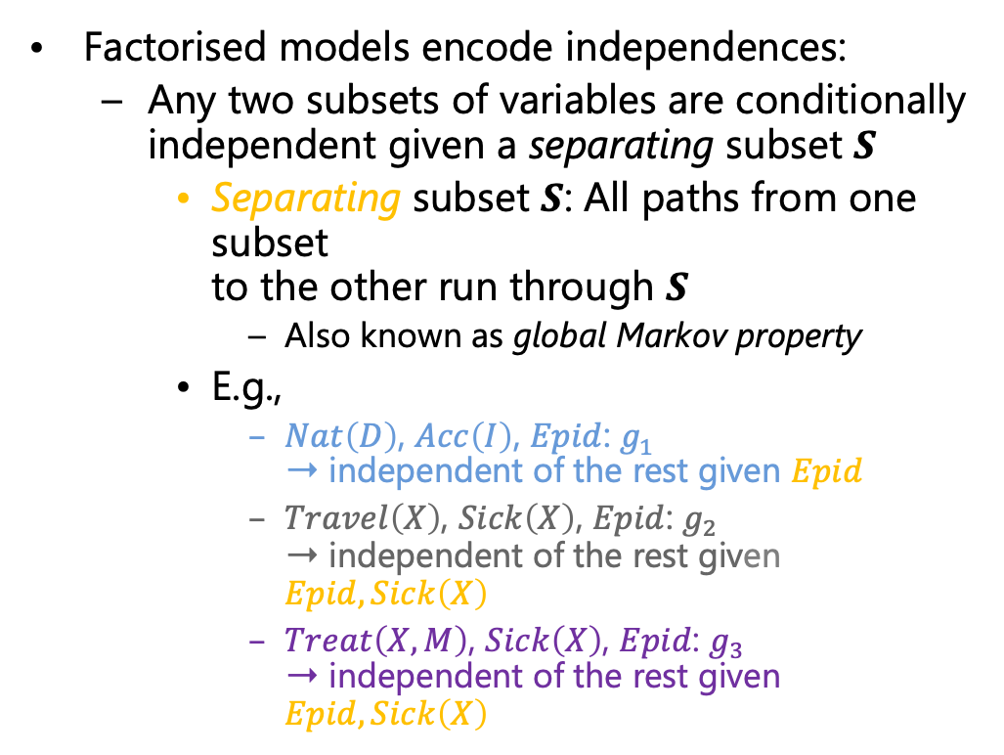
Clustering of Models
Factorised models encode independences:
  Any two subsets of variables are conditionally independent given a separating subset $S$
    Separating subset $S$: All paths from one subset
    to the other run through $S$
      Also known as global Markov property
    E.g.,
      $Nat\left(D\right)$, $Acc\left(I\right)$, $Epid$: $g_{1}$
      ➝ independent of the rest given $Epid$
      $Travel\left(X\right)$, $Sick\left(X\right)$, $Epid$: $g_{2}$
      ➝ independent of the rest given $Epid,Sick\left(X\right)$
      $Treat\left(X,M\right)$, $Sick\left(X\right)$, $Epid$: $g_{3}$
      ➝ independent of the rest given $Epid,Sick\left(X\right)$
$$Nat\left(D\right)$$
$$Acc\left(I\right)$$
$$g_{1}$$
$$Epid$$
$$g_{0}$$
$$Travel\left(X\right)$$
$$Treat\left(X,M\right)$$
$$g_{2}$$
$$g_{3}$$
$$Sick\left(X\right)$$

Slide 8
Clustering of Models
Put clusters and their separators into a graph structure where
  Nodes are clusters with parfactors assigned containing the cluster PRVs (local model)
  Edges are labelled with the separator (separating subset) between neighbouring nodes
  If two nodes contain the same PRV, every node on the path between the two nodes contain the PRV (running intersection property)
$$Epid Acc\left(I\right)$$
$$Nat\left(D\right)$$
$$Epid Sick\left(X\right)$$
$$Travel\left(X\right)$$
$$Epid Sick\left(X\right)$$
$$Treat\left(X,M\right)$$
$$Epid$$
$$Epid$$
$$Sick\left(X\right)$$
$$g_{0},g_{1}$$
$$g_{2}$$
$$g_{3}$$
$$Nat\left(D\right)$$
$$Acc\left(I\right)$$
$$g_{1}$$
$$Epid$$
$$g_{0}$$
$$Travel\left(X\right)$$
$$Treat\left(X,M\right)$$
$$g_{2}$$
$$g_{3}$$
$$Sick\left(X\right)$$

Slide 9
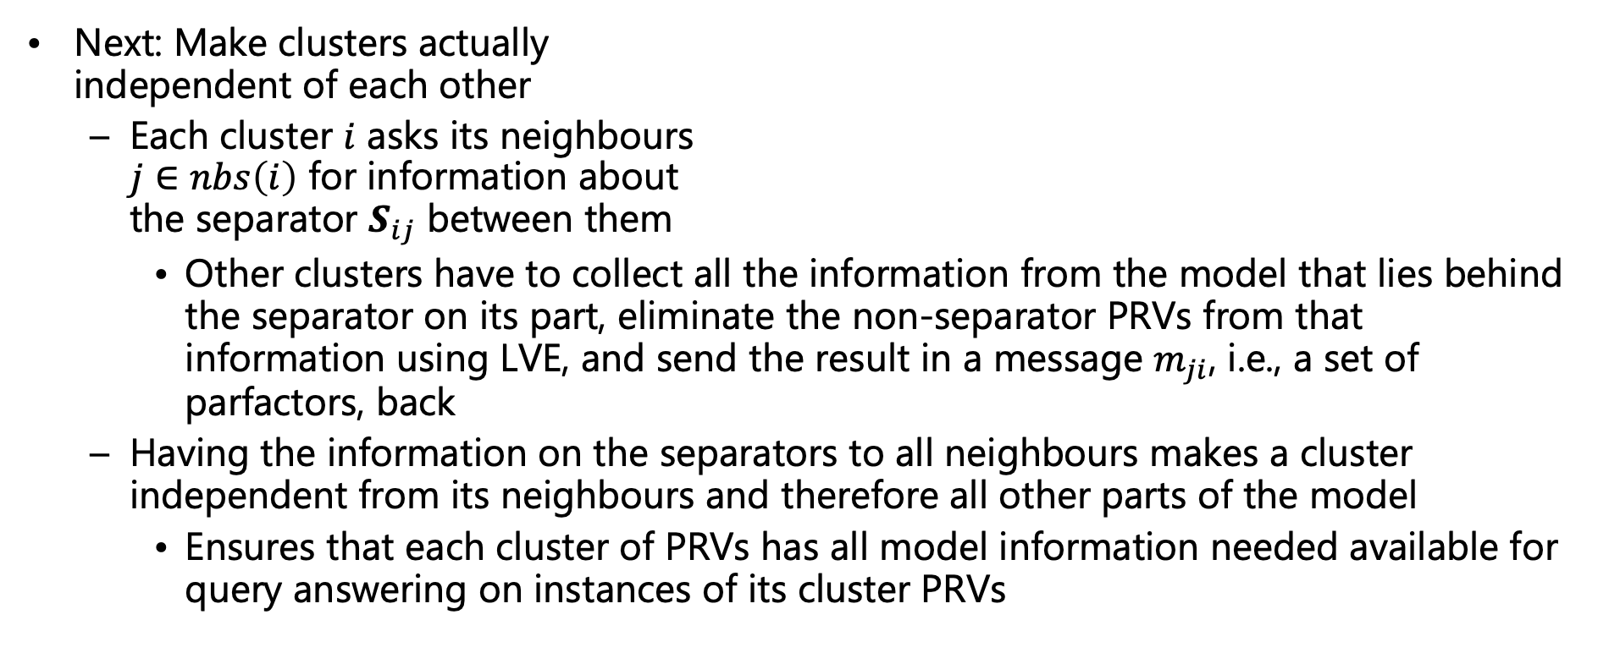
Clustering of Models
Next: Make clusters actually
independent of each other
  Each cluster $i$ asks its neighbours
  $j∈nbs\left(i\right)$ for information about
  the separator $S_{ij}$ between them
    Other clusters have to collect all the information from the model that lies behind the separator on its part, eliminate the non-separator PRVs from that information using LVE, and send the result in a message $m_{ji}$, i.e., a set of parfactors, back
  Having the information on the separators to all neighbours makes a cluster independent from its neighbours and therefore all other parts of the model
    Ensures that each cluster of PRVs has all model information needed available for query answering on instances of its cluster PRVs
$$Epid Acc\left(I\right)$$
$$Nat\left(D\right)$$
$$Epid Sick\left(X\right)$$
$$Travel\left(X\right)$$
$$Epid Sick\left(X\right)$$
$$Treat\left(X,M\right)$$
$$C_{1}$$
$$Epid$$
$$C_{2}$$
$$Epid$$
$$Sick\left(X\right)$$
$$C_{3}$$
$$g_{0},g_{1}$$
$$g_{2}$$
$$g_{3}$$

Slide 10

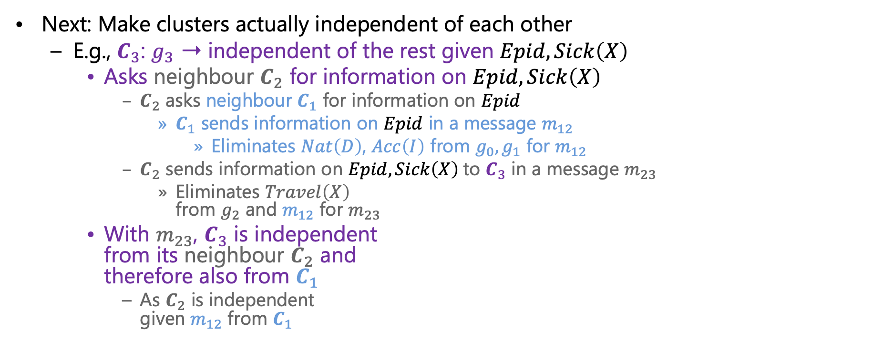
Clustering of Models
Next: Make clusters actually independent of each other
  E.g., $C_{3}$: $g_{3}$ ➝ independent of the rest given $Epid,Sick\left(X\right)$
    Asks neighbour $C_{2}$ for information on $Epid,Sick\left(X\right)$
      $C_{2}$ asks neighbour $C_{1}$ for information on $Epid$
        $C_{1}$ sends information on $Epid$ in a message $m_{12}$
          Eliminates $Nat\left(D\right)$, $Acc\left(I\right)$ from $g_{0},g_{1}$ for $m_{12}$
      $C_{2}$ sends information on $Epid,Sick\left(X\right)$to $C_{3}$ in a message $m_{23}$
        Eliminates $Travel\left(X\right)$
        from $g_{2}$ and $m_{12}$ for $m_{23}$
    With $m_{23}$, $C_{3}$ is independent
    from its neighbour $C_{2}$ and
    therefore also from $C_{1}$
      As $C_{2}$ is independent
      given $m_{12}$ from $C_{1}$
$Epid$?
$Epid,Sick\left(X\right)$?
$$Epid Acc\left(I\right)$$
$$Nat\left(D\right)$$
$$Epid Sick\left(X\right)$$
$$Travel\left(X\right)$$
$$Epid Sick\left(X\right)$$
$$Treat\left(X,M\right)$$
$$C_{1}$$
$$Epid$$
$$C_{2}$$
$$Epid$$
$$Sick\left(X\right)$$
$$C_{3}$$
$$g_{0},g_{1}$$
$$m_{12}$$
$$g_{2}$$
$$m_{23}$$
$$g_{3}$$
Eliminate
$$Nat\left(D\right),Man\left(W\right)$$
Eliminate
$$Travel\left(X\right)$$
The same has to be done for $C_{2}$ and $C_{1}$
$$m_{12}$$
$Epid$!
$$m_{23}$$
$Epid,Sick\left(X\right)$!

Slide 11
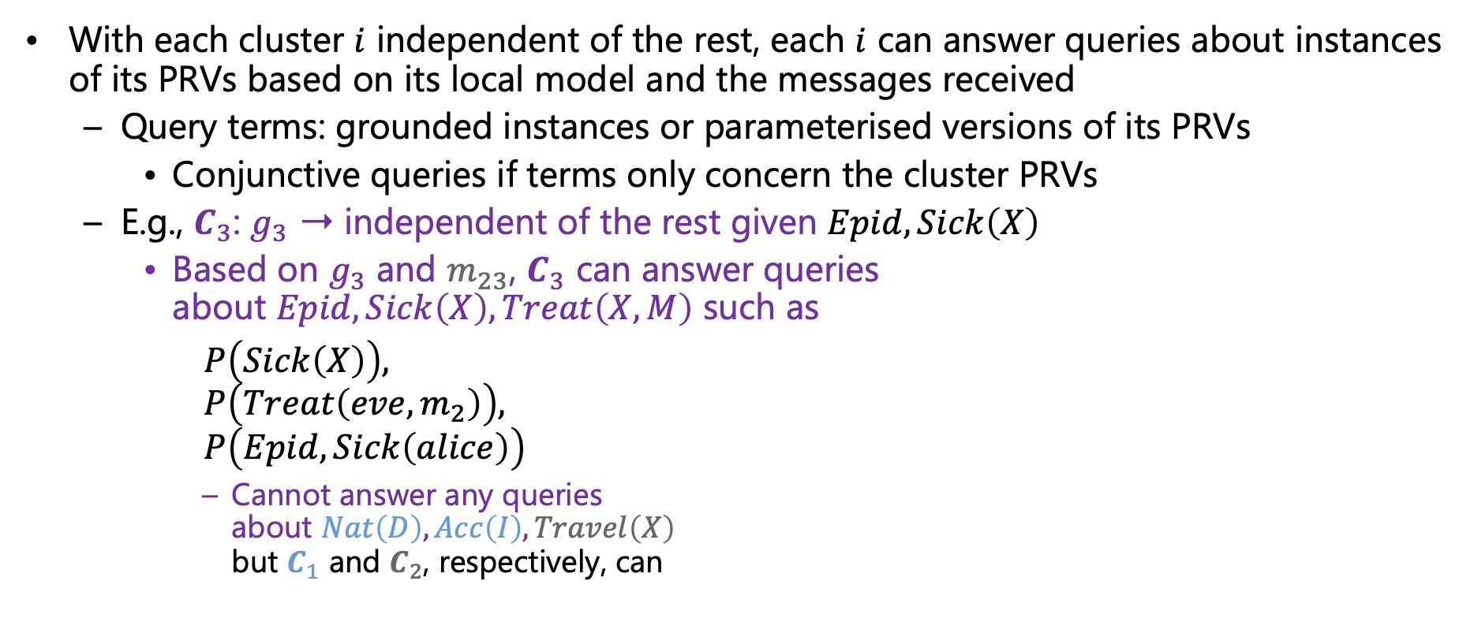
Clustering of Models
With each cluster $i$ independent of the rest, each $i$ can answer queries about instances of its PRVs based on its local model and the messages received
  Query terms: grounded instances or parameterised versions of its PRVs
    Conjunctive queries if terms only concern the cluster PRVs
  E.g., $C_{3}$: $g_{3}$ ➝ independent of the rest given $Epid,Sick\left(X\right)$
    Based on $g_{3}$ and $m_{23}$, $C_{3}$ can answer queries
    about $Epid, Sick\left(X\right),Treat\left(X,M\right)$ such as
    $P\left(Sick\left(X\right)\right),$
    $P\left(Treat\left(eve,m_{2}\right)\right),$
    $P\left(Epid,Sick\left(alice\right)\right)$
      Cannot answer any queries
      about $Nat\left(D\right),Acc\left(I\right),Travel\left(X\right)$
      but $C_{1}$ and $C_{2}$, respectively, can
$$Epid Acc\left(I\right)$$
$$Nat\left(D\right)$$
$$Epid Sick\left(X\right)$$
$$Travel\left(X\right)$$
$$Epid Sick\left(X\right)$$
$$Treat\left(X,M\right)$$
$$C_{1}$$
$$Epid$$
$$C_{2}$$
$$Epid$$
$$Sick\left(X\right)$$
$$C_{3}$$
$$m_{21}$$
$$m_{12}$$
$$m_{32}$$
$$m_{23}$$
$$g_{0},g_{1}$$
$$g_{2}$$
$$g_{3}$$

Slide 12
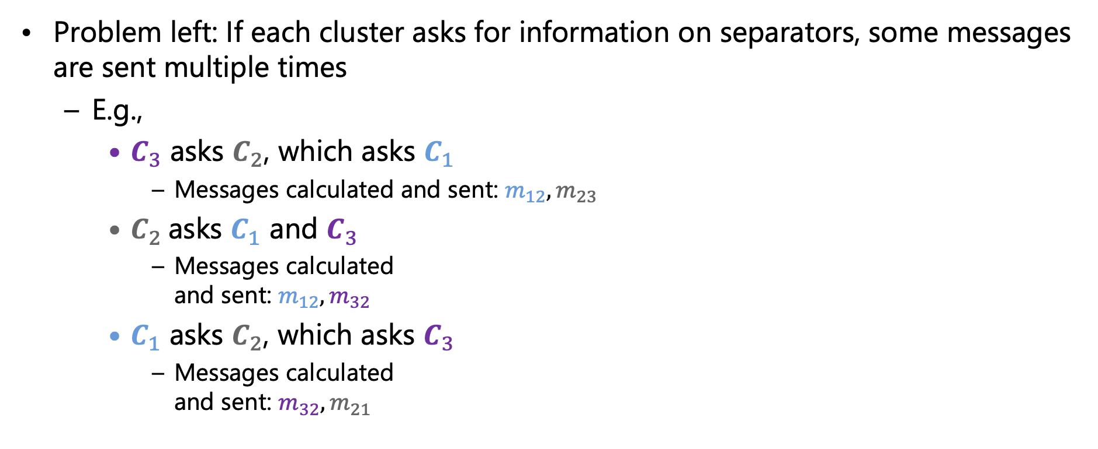
Clustering of Models
Problem left: If each cluster asks for information on separators, some messages are sent multiple times
  E.g.,
    $C_{3}$ asks $C_{2}$, which asks $C_{1}$
      Messages calculated and sent: $m_{12},m_{23}$
    $C_{2}$asks $C_{1}$ and $C_{3}$
      Messages calculated
      and sent: $m_{12},m_{32}$
    $C_{1}$ asks $C_{2}$, which asks $C_{3}$
      Messages calculated
      and sent: $m_{32},m_{21}$
$Epid$?
$Epid,Sick\left(X\right)$?
$Epid$?
$Epid,Sick\left(X\right)$?
$Epid$?
$Epid,Sick\left(X\right)$?
$$Epid Acc\left(I\right)$$
$$Nat\left(D\right)$$
$$Epid Sick\left(X\right)$$
$$Travel\left(X\right)$$
$$Epid Sick\left(X\right)$$
$$Treat\left(X,M\right)$$
$$C_{1}$$
$$Epid$$
$$C_{2}$$
$$Epid$$
$$Sick\left(X\right)$$
$$C_{3}$$
$$m_{12}$$
$$m_{23}$$
$$m_{12}$$
$$m_{32}$$
Organise in way that messages are calculated only once
$$m_{21}$$
$$m_{32}$$

Slide 13
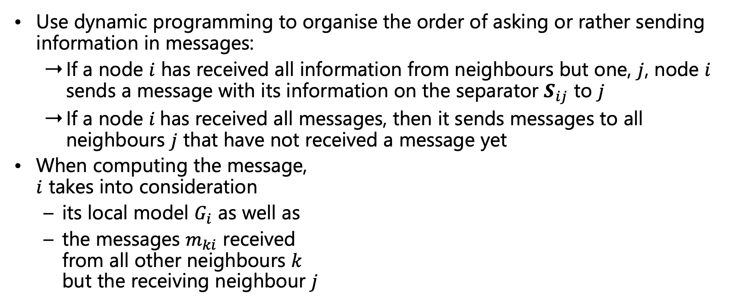
Clustering of Models
Use dynamic programming to organise the order of asking or rather sending information in messages:
  If a node $i$ has received all information from neighbours but one, $j$, node $i$ sends a message with its information on the separator $S_{ij}$ to $j$
  If a node $i$has received all messages, then it sends messages to all neighbours $j$ that have not received a message yet
When computing the message,
$i$ takes into consideration
  its local model $G_{i}$ as well as
  the messages $m_{ki}$ received
  from all other neighbours $k$
  but the receiving neighbour $j$
$$Epid Acc\left(I\right)$$
$$Nat\left(D\right)$$
$$Epid Sick\left(X\right)$$
$$Travel\left(X\right)$$
$$Epid Sick\left(X\right)$$
$$Treat\left(X,M\right)$$
$$C_{1}$$
$$Epid$$
$$C_{2}$$
$$Epid$$
$$Sick\left(X\right)$$
$$C_{3}$$
$$m_{12}$$
$$m_{32}$$
$$m_{21}$$
$$m_{23}$$

Slide 14
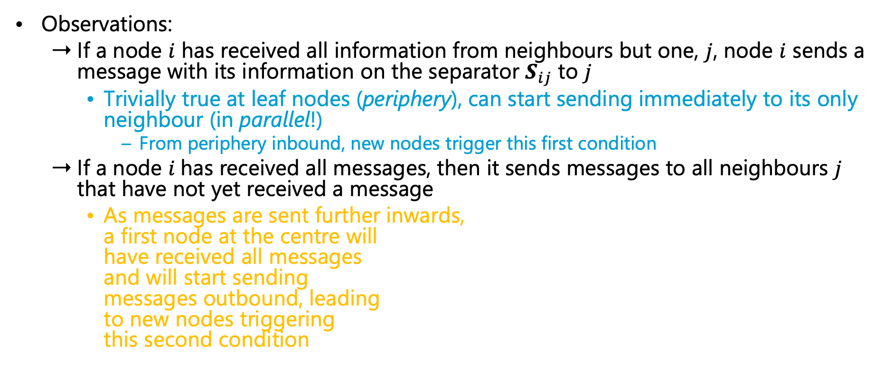
Clustering of Models
Graph structured called (first-order) junction tree
and algorithm called (lifted) junction tree algorithm
Observations:
  If a node $i$ has received all information from neighbours but one, $j$, node $i$ sends a message with its information on the separator $S_{ij}$ to $j$
    Trivially true at leaf nodes (periphery), can start sending immediately to its only neighbour (in parallel!)
      From periphery inbound, new nodes trigger this first condition
  If a node $i$has received all messages, then it sends messages to all neighbours $j$ that have not yet received a message
    As messages are sent further inwards,
    a first node at the centre will
    have received all messages
    and will start sending
    messages outbound, leading
    to new nodes triggering
    this second condition
$$Epid Acc\left(I\right)$$
$$Nat\left(D\right)$$
$$Epid Sick\left(X\right)$$
$$Travel\left(X\right)$$
$$Epid Sick\left(X\right)$$
$$Treat\left(X,M\right)$$
$$C_{1}$$
$$Epid$$
$$C_{2}$$
$$Epid$$
$$Sick\left(X\right)$$
$$C_{3}$$
Two passes from periphery to centre and back suffice to distribute all information and make the clusters independent from each other*
* Shown by Steffen L. Lauritzen and David J. Spiegelhalter: Local Computations with Probabilities on Graphical Structures and Their Application to Expert Systems. In: Journal of the Royal Statistical Society. Series B: Methodological, 1988.

Slide 15
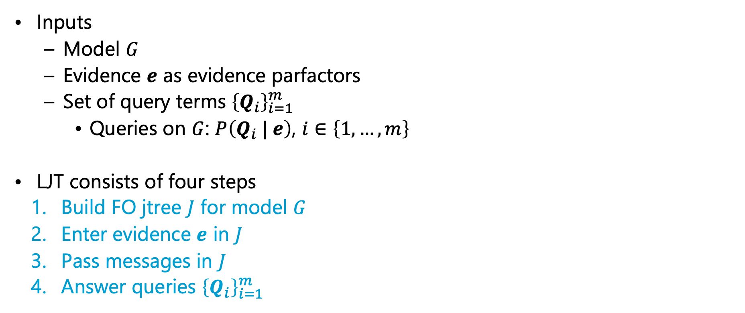
Lifted Junction Tree Algorithm (LJT)
$$Nat\left(D\right)$$
$$Acc\left(I\right)$$
$$g_{1}$$
$$Epid$$
Inputs
  Model $G$
  Evidence $e$ as evidence parfactors
  Set of query terms ${\left\{Q_{i}\right\}}_{i=1}^{m}$
    Queries on $G$: $P\left(Q_{i} | e\right)$, $i∈\left\{1,…,m\right\}$
LJT consists of four steps
  Build FO jtree $J$ for model $G$
  Enter evidence $e$ in $J$
  Pass messages in $J$
  Answer queries ${\left\{Q_{i}\right\}}_{i=1}^{m}$
$$g_{0}$$
$$Travel\left(X\right)$$
$$Treat\left(X,M\right)$$
$$g_{2}$$
$$g_{3}$$
$$Sick\left(X\right)$$
Evidence:
$$sick\left(eve\right)$$
Queries:
$$\left\{\left\{Epid\right\}, \left\{Travel\left(eve\right) ,Treat\left(eve,m_{1}\right)\right\}\right\}$$
$$Epid Acc\left(I\right)$$
$$Nat\left(D\right)$$
$$Epid Sick\left(X\right)$$
$$Travel\left(X\right)$$
$$Epid Sick\left(X\right)$$
$$Treat\left(X,M\right)$$
$$C_{1}$$
$$Epid$$
$$C_{2}$$
$$Epid$$
$$Sick\left(X\right)$$
$$C_{3}$$
$$g_{0},g_{1},m_{21}$$
$$g_{2}$$
$$g_{3}$$

Slide 16
First-order Jtree (FO Jtree)
As seen on the earlier slides
  Acyclic graph
  Nodes contain PRVs, which form clusters
  Edges are based on the separators between the clusters
  Nodes have parfactors assigned
Next slides:
  Formal definition
  Construction
    Get an acyclic structure
    with valid separators and
    each parfactor of a model
    assigned to a local model
$$Epid Acc\left(I\right)$$
$$Nat\left(D\right)$$
$$Epid Sick\left(X\right)$$
$$Travel\left(X\right)$$
$$Epid Sick\left(X\right)$$
$$Treat\left(X,M\right)$$
$$C_{1}$$
$$Epid$$
$$C_{2}$$
$$Epid$$
$$Sick\left(X\right)$$
$$C_{3}$$
$$g_{0},g_{1}$$
$$g_{2}$$
$$g_{3}$$

Slide 17
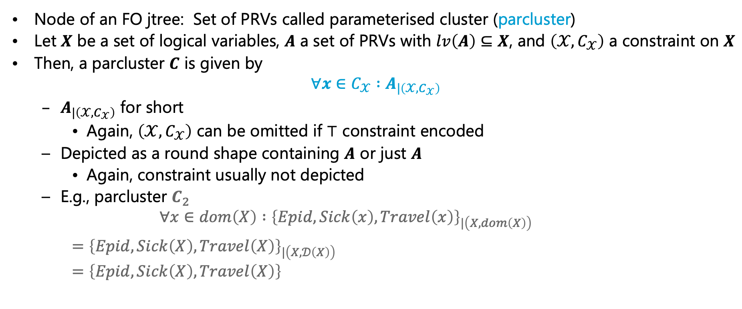
Parameterised Clusters
Node of an FO jtree: Set of PRVs called parameterised cluster (parcluster)
Let $X$ be a set of logical variables, $A$ a set of PRVs with $lv\left(A\right)⊆X$, and $\left(𝒳,C_{𝒳}\right)$ a constraint on $X$
Then, a parcluster $C$ is given by
$$∀x∈C_{𝒳} :A_{|\left(𝒳,C_{𝒳}\right)}$$
  $A_{|\left(𝒳,C_{𝒳}\right)}$ for short
    Again, $\left(𝒳,C_{𝒳}\right)$ can be omitted if $⊤$ constraint encoded
  Depicted as a round shape containing $A$ or just $A$
    Again, constraint usually not depicted
  E.g., parcluster $C_{2}$
    $$∀x∈dom\left(X\right) :{\left\{Epid,Sick\left(x\right),Travel\left(x\right)\right\}}_{|\left(X,dom\left(X\right)\right)}$$
    $=$ ${\left\{Epid,Sick\left(X\right),Travel\left(X\right)\right\}}_{|\left(X,𝒟\left(X\right)\right)}$
    $=$ $\left\{Epid,Sick\left(X\right),Travel\left(X\right)\right\}$
$$Epid Sick\left(X\right)$$
$$Travel\left(X\right)$$
$$Epid Sick\left(X\right)$$
$$Travel\left(X\right)$$
$$C_{2}$$

Slide 18
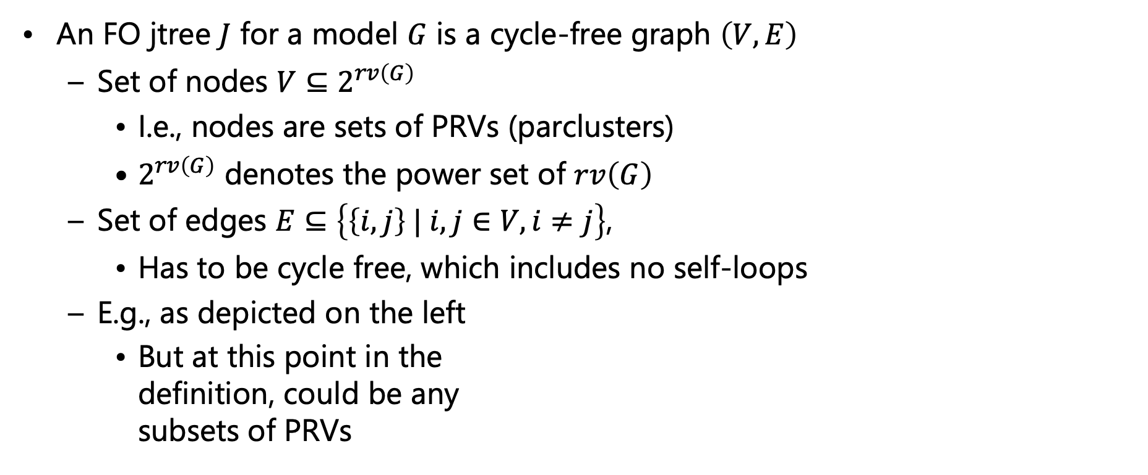
FO Jtree
An FO jtree $J$ for a model $G$ is a cycle-free graph $\left(V,E\right)$
  Set of nodes $V⊆2^{rv\left(G\right)}$
    I.e., nodes are sets of PRVs (parclusters)
    $2^{rv\left(G\right)}$ denotes the power set of $rv\left(G\right)$
  Set of edges $E⊆\left\{\left\{i,j\right\} | i,j∈V, i≠j\right\}$,
    Has to be cycle free, which includes no self-loops
  E.g., as depicted on the left
    But at this point in the
    definition, could be any
    subsets of PRVs
$$Nat\left(D\right)$$
$$Acc\left(I\right)$$
$$g_{1}$$
$$Epid$$
$$g_{0}$$
$$Travel\left(X\right)$$
$$Treat\left(X,M\right)$$
$$g_{2}$$
$$g_{3}$$
$$Sick\left(X\right)$$
$$Epid Acc\left(I\right)$$
$$Nat\left(D\right)$$
$$Epid Sick\left(X\right)$$
$$Travel\left(X\right)$$
$$Epid Sick\left(X\right)$$
$$Treat\left(X,M\right)$$
$$C_{1}$$
$$Epid$$
$$C_{2}$$
$$Epid$$
$$Sick\left(X\right)$$
$$C_{3}$$

Slide 19
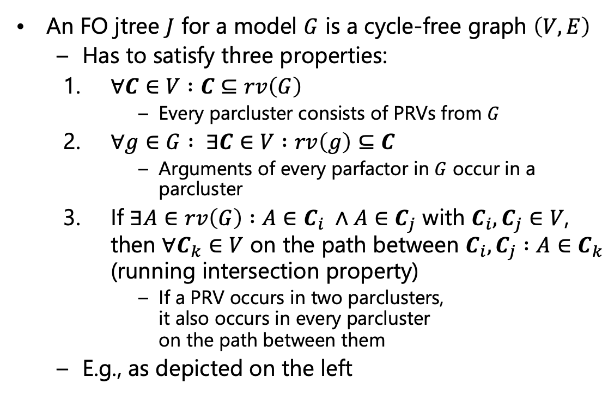
FO Jtree
Other valid FO jtrees to build?
An FO jtree $J$ for a model $G$ is a cycle-free graph $\left(V,E\right)$
  Has to satisfy three properties:
    $∀C∈V :C⊆rv\left(G\right)$
      Every parcluster consists of PRVs from $G$
    $∀g∈G : ∃C∈V :rv\left(g\right)⊆C$
      Arguments of every parfactor in $G$ occur in a parcluster
    If $∃A∈rv\left(G\right) :A∈C_{i} ∧A∈C_{j}$ with $C_{i},C_{j}∈V$,
    then $∀C_{k}∈V$ on the path between $C_{i},C_{j} :A∈C_{k}$
    (running intersection property)
      If a PRV occurs in two parclusters,
      it also occurs in every parcluster
      on the path between them
  E.g., as depicted on the left
$$Nat\left(D\right)$$
$$Acc\left(I\right)$$
$$g_{1}$$
$$Epid$$
$$g_{0}$$
$$Travel\left(X\right)$$
$$Treat\left(X,M\right)$$
$$g_{2}$$
$$g_{3}$$
$$Sick\left(X\right)$$
$$Epid Acc\left(I\right)$$
$$Nat\left(D\right)$$
$$Epid Sick\left(X\right)$$
$$Travel\left(X\right)$$
$$Epid Sick\left(X\right)$$
$$Treat\left(X,M\right)$$
$$C_{1}$$
$$Epid$$
$$C_{2}$$
$$Epid$$
$$Sick\left(X\right)$$
$$C_{3}$$
$$g_{0},g_{1}$$
$$g_{2}$$
$$g_{3}$$
Notes:
Exchange C2 and C3 or put g0 in one of the other local models

Slide 20
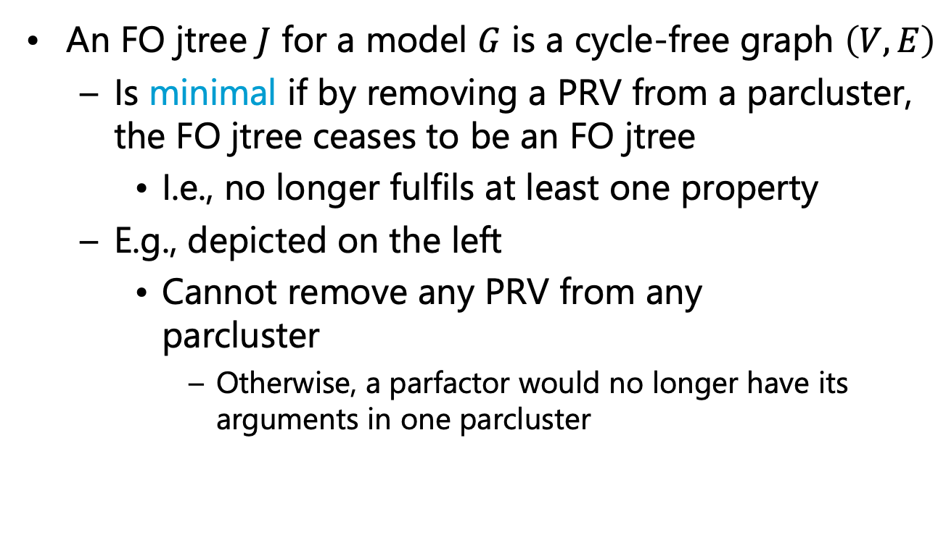
FO Jtree
An FO jtree $J$ for a model $G$ is a cycle-free graph $\left(V,E\right)$
  Is minimal if by removing a PRV from a parcluster,
  the FO jtree ceases to be an FO jtree
    I.e., no longer fulfils at least one property
  E.g., depicted on the left
    Cannot remove any PRV from any
    parcluster
      Otherwise, a parfactor would no longer have its arguments in one parcluster
$$Nat\left(D\right)$$
$$Acc\left(I\right)$$
$$g_{1}$$
$$Epid$$
$$g_{0}$$
$$Travel\left(X\right)$$
$$Treat\left(X,M\right)$$
$$g_{2}$$
$$g_{3}$$
$$Sick\left(X\right)$$
$$Epid Acc\left(I\right)$$
$$Nat\left(D\right)$$
$$Epid Sick\left(X\right)$$
$$Travel\left(X\right)$$
$$Epid Sick\left(X\right)$$
$$Treat\left(X,M\right)$$
$$C_{1}$$
$$Epid$$
$$C_{2}$$
$$Epid$$
$$Sick\left(X\right)$$
$$C_{3}$$
$$g_{0},g_{1}$$
$$g_{2}$$
$$g_{3}$$

Slide 21
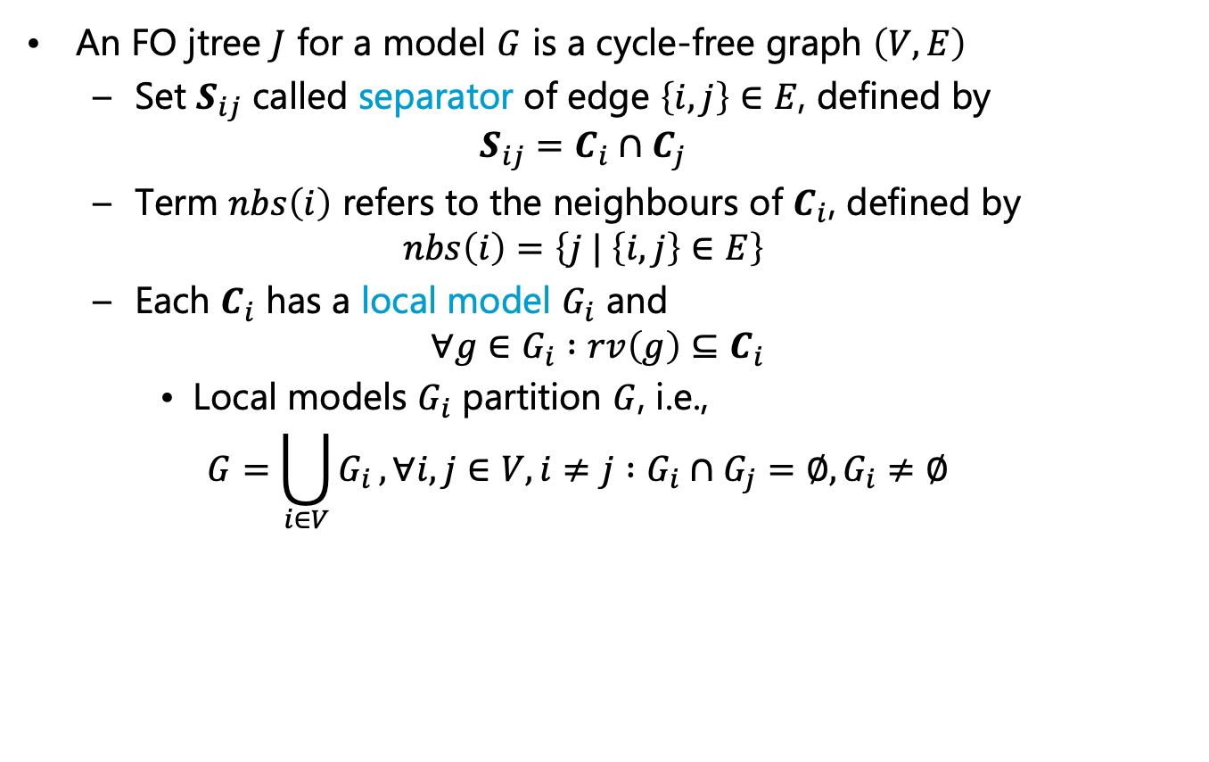
FO Jtree
An FO jtree $J$ for a model $G$ is a cycle-free graph $\left(V,E\right)$
  Set $S_{ij}$ called separator of edge $\left\{i,j\right\}∈E$, defined by
  $$S_{ij}=C_{i}∩C_{j}$$
  Term $nbs\left(i\right)$ refers to the neighbours of $C_{i}$, defined by
  $$nbs\left(i\right)=\left\{j | \left\{i,j\right\}∈E\right\}$$
  Each $C_{i}$ has a local model $G_{i}$ and
  $$∀g∈G_{i} :rv\left(g\right)⊆C_{i}$$
    Local models $G_{i}$ partition $G$, i.e.,
    $$G=\bigcup_{i∈V}{G_{i}}, ∀i,j∈V,i≠j :G_{i}∩G_{j}=∅,G_{i}≠∅$$
$$Nat\left(D\right)$$
$$Acc\left(I\right)$$
$$g_{1}$$
$$Epid$$
$$g_{0}$$
$$Travel\left(X\right)$$
$$Treat\left(X,M\right)$$
$$g_{2}$$
$$g_{3}$$
$$Sick\left(X\right)$$
$$Epid Acc\left(I\right)$$
$$Nat\left(D\right)$$
$$Epid Sick\left(X\right)$$
$$Travel\left(X\right)$$
$$Epid Sick\left(X\right)$$
$$Treat\left(X,M\right)$$
$$C_{1}$$
$$Epid$$
$$C_{2}$$
$$Epid$$
$$Sick\left(X\right)$$
$$C_{3}$$
$$g_{0},g_{1}$$
$$g_{2}$$
$$g_{3}$$

Slide 22
Construction
$$Nat\left(D\right)$$
$$Acc\left(I\right)$$
$$g_{1}$$
$$Epid$$
Where do we get the FO jtree from s.t. the jtree
  is acyclic
  fulfils the three FO jtree properties
  has the model parfactors automatically assigned to fitting parclusters?
Clusters of an FO dtree
+ undirected dtree edges
+ minimisation
= FO jtree
$$g_{0}$$
$$Travel\left(X\right)$$
$$Treat\left(X,M\right)$$
$$g_{2}$$
$$g_{3}$$
$$Sick\left(X\right)$$
$$Epid$$
root
$$∅$$
$$∅$$
$$∀x :⊤$$
$$T_{X}$$
$$Acc\left(I\right)$$
$$∀d :⊤$$
$$T_{D}$$
$$Epid$$
$$Epid$$
$$Sick\left(x\right)$$
$$T_{x}$$
$$Nat\left(d\right)$$
$$T_{d}$$
$$Epid$$
$$Acc\left(I\right),Epid$$
$$Travel\left(x\right)$$
$$∅$$
$$∀m :⊤$$
$$∅$$
$$∀i :⊤$$
$$Sick\left(x\right)$$
$$Epid$$
$$Sick\left(x\right)$$
$$Epid$$
$$T_{M}$$
$$Nat\left(d\right)$$
$$Acc\left(I\right),Epid$$
$$T_{I}$$
$$Epid Acc\left(I\right)$$
$$Nat\left(D\right)$$
$$Epid Sick\left(X\right)$$
$$Travel\left(X\right)$$
$$Epid Sick\left(X\right)$$
$$Treat\left(X,M\right)$$
$$Treat\left(x,m\right)$$
$$∅$$
$$Sick\left(x\right)$$
$$Epid$$
$$T_{m}$$
$$Nat\left(d\right)$$
$$Acc\left(i\right),Epid$$
$$T_{i}$$
$$C_{1}$$
$$Epid$$
$$C_{2}$$
$$Epid$$
$$Sick\left(X\right)$$
$$C_{3}$$
$$g_{0},g_{1}$$
$$g_{2}$$
$$g_{3}$$
$$g_{2}$$
$$g_{3}$$
$$g_{0}$$
$$g_{1}$$

Slide 23
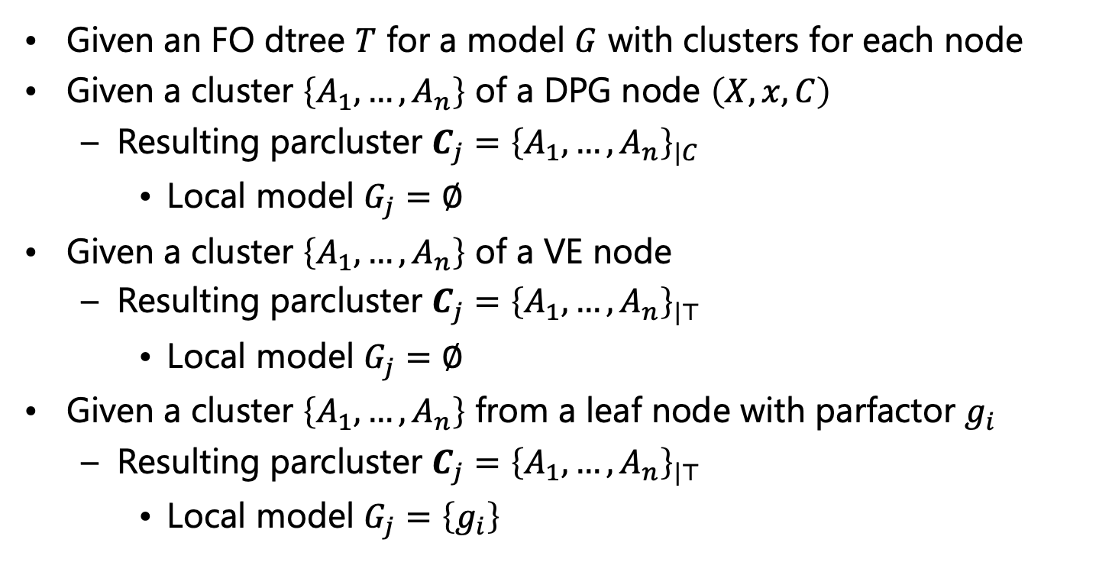
Clusters ➝ Parclusters
Given an FO dtree $T$ for a model $G$ with clusters for each node
Given a cluster $\left\{A_{1},…,A_{n}\right\}$ of a DPG node $\left(X,x,C\right)$
  Resulting parcluster $C_{j}={\left\{A_{1},…,A_{n}\right\}}_{|C}$
    Local model $G_{j}=∅$
Given a cluster $\left\{A_{1},…,A_{n}\right\}$ of a VE node
  Resulting parcluster $C_{j}={\left\{A_{1},…,A_{n}\right\}}_{|⊤}$
    Local model $G_{j}=∅$
Given a cluster $\left\{A_{1},…,A_{n}\right\}$ from a leaf node with parfactor $g_{i}$
  Resulting parcluster $C_{j}={\left\{A_{1},…,A_{n}\right\}}_{|⊤}$
    Local model $G_{j}=\left\{g_{i}\right\}$
Let’s carry the constraint around for a bit to make it explicit
$$∀x :⊤$$
$$Epid$$
$$Epid_{|⊤}$$
$$Sick\left(x\right)$$
$$Epid$$
$$Epid,Sick\left(x\right)$$
$$Epid,Sick\left(x\right),$$
$$Travel\left(x\right)$$
$$g_{2}$$
$$g_{2}$$

Slide 24
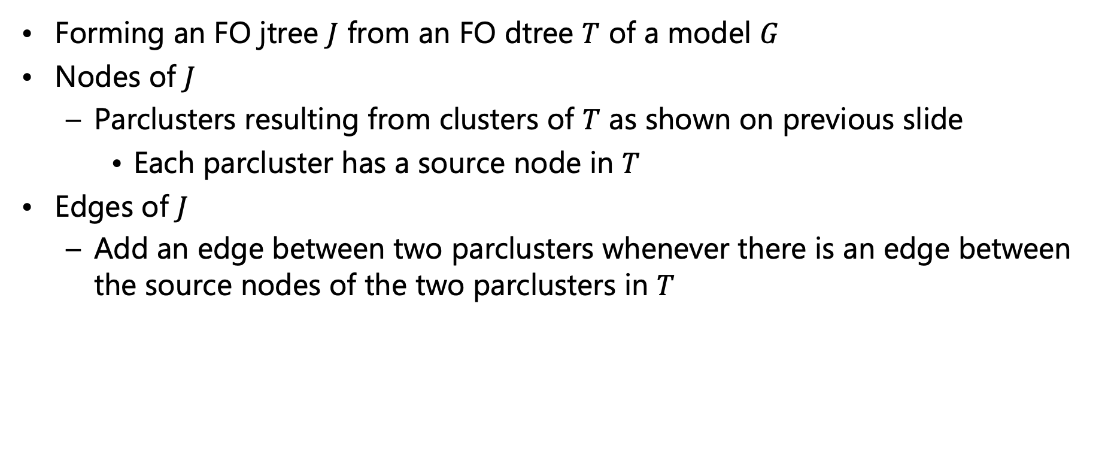
FO Dtree ➝ FO Jtree
Forming an FO jtree $J$ from an FO dtree $T$ of a model $G$
Nodes of $J$
  Parclusters resulting from clusters of $T$ as shown on previous slide
    Each parcluster has a source node in $T$
Edges of $J$
  Add an edge between two parclusters whenever there is an edge between the source nodes of the two parclusters in $T$

Slide 25
FO Dtree ➝ FO Jtree
$$Nat\left(D\right)$$
$$Acc\left(I\right)$$
$$g_{1}$$
$$Epid$$
Result after transformation
  Fulfils the three jtree properties
  But is not minimal
$$g_{0}$$
$$Travel\left(X\right)$$
$$Treat\left(X,M\right)$$
$$g_{2}$$
$$g_{3}$$
$$Sick\left(X\right)$$
$$Epid$$
$$Epid$$
root
$$∅$$
$${Epid}_{|dom\left(X\right)}$$
$${Epid,Acc\left(I\right)}_{|dom\left(D\right)}$$
$$∅$$
$$∀x :⊤$$
$$T_{X}$$
$$Acc\left(I\right)$$
$$∀d :⊤$$
$$T_{D}$$
$$Epid$$
$$Epid$$
$$Epid,Sick\left(x\right)$$
$$Epid,Acc\left(I\right),Nat\left(d\right)$$
$$Sick\left(x\right)$$
$$T_{x}$$
$$Nat\left(d\right)$$
$$T_{d}$$
$$Epid$$
$$Acc\left(I\right),Epid$$
$$Travel\left(x\right)$$
$$∅$$
$$∀m :⊤$$
$$∅$$
$$∀i :⊤$$
$$Epid,Sick\left(x\right),Travel\left(x\right)$$
$${Epid,Sick\left(x\right)}_{|dom\left(M\right)}$$
$${Epid,Acc\left(I\right),Nat\left(d\right)}_{|dom\left(I\right)}$$
$$Sick\left(x\right)$$
$$Epid$$
$$Sick\left(x\right)$$
$$Epid$$
$$T_{M}$$
$$Nat\left(d\right)$$
$$Acc\left(I\right),Epid$$
$$T_{I}$$
$$Treat\left(x,m\right)$$
$$∅$$
$$Epid,Sick\left(x\right),Treat\left(x,m\right)$$
$$Epid,Acc\left(i\right),Nat\left(d\right)$$
$$Sick\left(x\right)$$
$$Epid$$
$$T_{m}$$
$$Nat\left(d\right)$$
$$Acc\left(i\right),Epid$$
$$T_{i}$$
$$Epid,Sick\left(x\right),Travel\left(x\right)$$
$$Epid,Sick\left(x\right),Treat\left(x,m\right)$$
$$Epid$$
$$Epid,Acc\left(i\right),Nat\left(d\right)$$
$$g_{2}$$
$$g_{3}$$
$$g_{0}$$
$$g_{1}$$
$$g_{2}$$
$$g_{3}$$
$$g_{0}$$
$$g_{1}$$

Slide 26
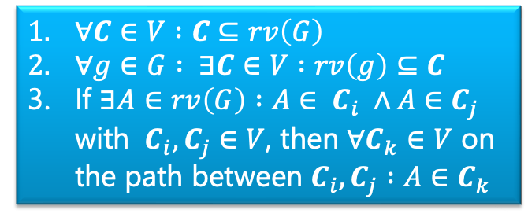
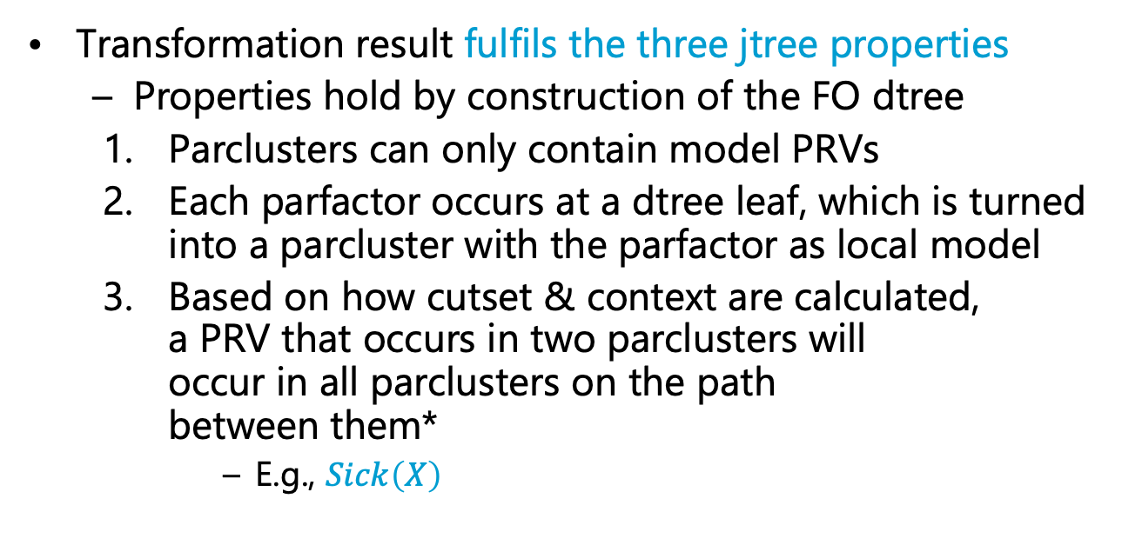
FO Dtree ➝ FO Jtree
  $∀C∈V :C⊆rv\left(G\right)$
  $∀g∈G : ∃C∈V :rv\left(g\right)⊆C$
  If $∃A∈rv\left(G\right) :A∈ C_{i} ∧A∈C_{j}$ with $C_{i},C_{j}∈V$, then $∀C_{k}∈V$ on the path between $C_{i},C_{j} :A∈C_{k}$
Transformation result fulfils the three jtree properties
  Properties hold by construction of the FO dtree
    Parclusters can only contain model PRVs
    Each parfactor occurs at a dtree leaf, which is turned into a parcluster with the parfactor as local model
    Based on how cutset & context are calculated,
    a PRV that occurs in two parclusters will
    occur in all parclusters on the path
    between them*
      E.g., $Sick\left(X\right)$
$$Epid$$
$${Epid}_{|dom\left(X\right)}$$
$${Epid,Acc\left(I\right)}_{|dom\left(D\right)}$$
$$Epid,Sick\left(x\right)$$
$$Epid,Acc\left(I\right),Nat\left(d\right)$$
$$Epid,Sick\left(x\right),Travel\left(x\right)$$
$${Epid,Sick\left(x\right)}_{|dom\left(M\right)}$$
$${Epid,Acc\left(I\right),Nat\left(d\right)}_{|dom\left(I\right)}$$
$$Epid,Sick\left(x\right),Treat\left(x,m\right)$$
$$Epid,Acc\left(i\right),Nat\left(d\right)$$
$$Epid,Sick\left(x\right),Travel\left(x\right)$$
$$Epid,Sick\left(x\right),Treat\left(x,m\right)$$
$$Epid$$
$$Epid,Acc\left(i\right),Nat\left(d\right)$$
$$g_{2}$$
$$g_{3}$$
$$g_{0}$$
$$g_{1}$$
* Proof for jtrees: Adnan Darwiche: Recursive Conditioning. In: Artificial Intelligence, 2001.
Proof for FO jtrees: Tanya B: Rescued from a Sea of Queries: Exact Inference in Probabilistic Relational Models. PhD thesis, 2020.

Slide 27
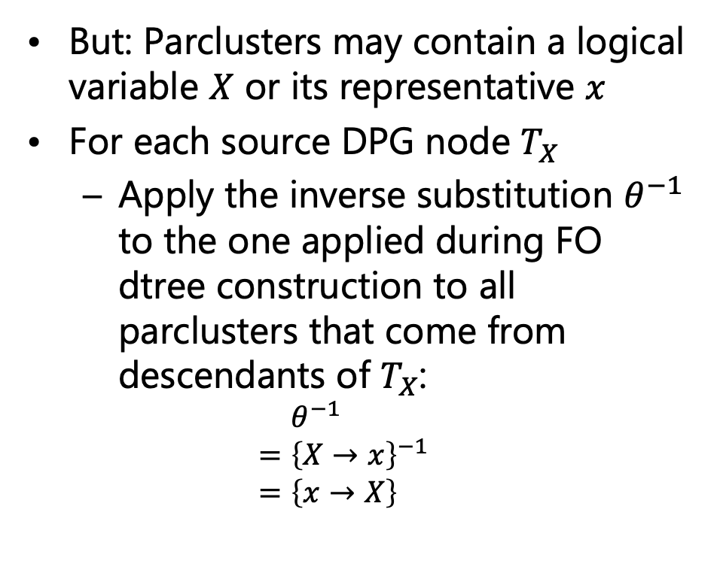
FO Dtree ➝ FO Jtree
But: Parclusters may contain a logical variable $X$ or its representative $x$
For each source DPG node $T_{X}$
  Apply the inverse substitution $θ^{−1}$ to the one applied during FO dtree construction to all parclusters that come from descendants of $T_{X}$:
  $$=θ^{−1} \\ ={\left\{X→x\right\}}^{−1} \\ =\left\{x→X\right\}$$
$$Epid$$
root
$${Epid}_{|dom\left(X\right)}$$
$$T_{X}$$
$${Epid,Acc\left(I\right)}_{|dom\left(D\right)}$$
$$T_{D}$$
$$Epid,Sick\left(x\right)$$
$$T_{x}$$
$$Epid,Acc\left(I\right),Nat\left(d\right)$$
$$T_{d}$$
$$Epid,Sick\left(x\right),Travel\left(x\right)$$
$${Epid,Sick\left(x\right)}_{|dom\left(M\right)}$$
$$T_{M}$$
$${Epid,Acc\left(I\right),Nat\left(d\right)}_{|dom\left(I\right)}$$
$$T_{I}$$
$$Epid,Sick\left(x\right),Treat\left(x,m\right)$$
$$T_{m}$$
$$Epid,Acc\left(i\right),Nat\left(d\right)$$
$$T_{i}$$
$$Epid,Sick\left(x\right),Travel\left(x\right)$$
$$Epid,Sick\left(x\right),Treat\left(x,m\right)$$
$$Epid$$
$$Epid,Acc\left(i\right),Nat\left(d\right)$$
$$g_{2}$$
$$g_{3}$$
$$g_{0}$$
$$g_{1}$$

Slide 28
FO Dtree ➝ FO Jtree
Result after transformation not minimal
  Can remove complete parclusters and still have an FO jtree
    Even if we keep parclusters that carry constraint information that we would otherwise lose
  E.g.,
    Parclusters marked
Observation
  Parclusters are subsets of other parclusters
    Use for minimisation
$$Epid$$
$${Epid}_{|dom\left(X\right)}$$
$${Epid,Acc\left(I\right)}_{|dom\left(D\right)}$$
$$Epid,Sick\left(X\right)$$
$$Epid,Acc\left(I\right),Nat\left(D\right)$$
$$Epid,Sick\left(X\right),Travel\left(X\right)$$
$${Epid,Sick\left(X\right)}_{|dom\left(M\right)}$$
$${Epid,Acc\left(I\right),Nat\left(D\right)}_{|dom\left(I\right)}$$
$$Epid,Sick\left(X\right),Treat\left(X,M\right)$$
$$Epid,Acc\left(I\right),Nat\left(D\right)$$
$$Epid,Sick\left(X\right),Travel\left(X\right)$$
$$Epid,Sick\left(X\right),Treat\left(X,M\right)$$
$$Epid$$
$$Epid,Acc\left(I\right),Nat\left(D\right)$$
$$g_{2}$$
$$g_{3}$$
$$g_{0}$$
$$g_{1}$$

Slide 29

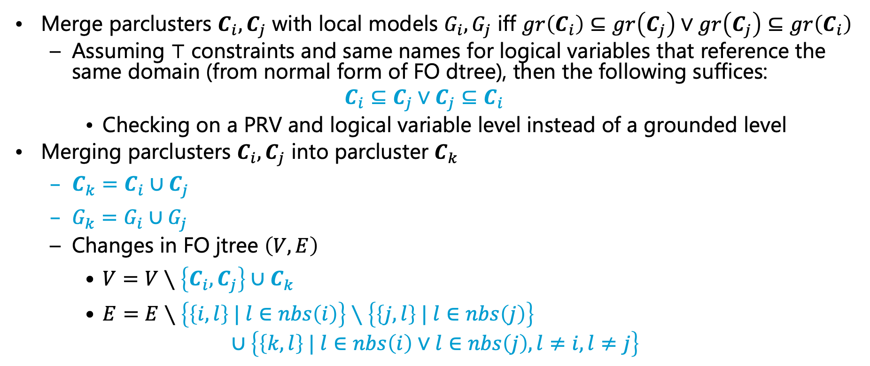
Minimisation
Merge parclusters $C_{i},C_{j}$ with local models $G_{i},G_{j}$ iff $gr\left(C_{i}\right)⊆gr\left(C_{j}\right)∨gr\left(C_{j}\right)⊆gr\left(C_{i}\right)$
  Assuming $⊤$ constraints and same names for logical variables that reference the same domain (from normal form of FO dtree), then the following suffices:
  $$C_{i}⊆C_{j}∨C_{j}⊆C_{i}$$
    Checking on a PRV and logical variable level instead of a grounded level
Merging parclusters $C_{i},C_{j}$ into parcluster $C_{k}$
  $C_{k}=C_{i}∪C_{j}$
  $G_{k}=G_{i}∪G_{j}$
  Changes in FO jtree $\left(V,E\right)$
    $V=V∖\left\{C_{i},C_{j}\right\}∪C_{k}$
    $E=E∖\left\{\left\{i,l\right\} | l∈nbs\left(i\right)\right\}∖\left\{\left\{j,l\right\} | l∈nbs\left(j\right)\right\}$
    $∪\left\{\left\{k,l\right\} | l∈nbs\left(i\right)∨l∈nbs\left(j\right),l≠i,l≠j\right\}$
Reassigns all neighbours of $C_{i},C_{j}$ to $C_{k}$

Slide 30
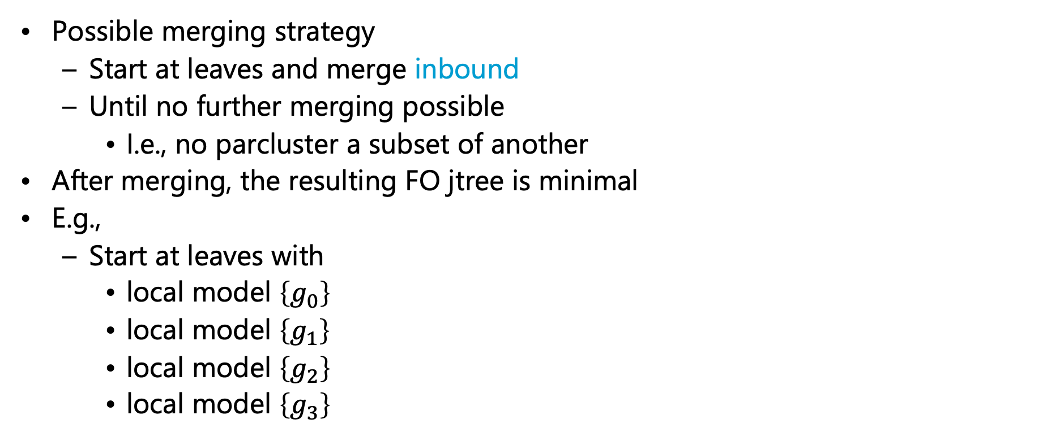
Minimisation
Possible merging strategy
  Start at leaves and merge inbound
  Until no further merging possible
    I.e., no parcluster a subset of another
After merging, the resulting FO jtree is minimal
E.g.,
  Start at leaves with
    local model $\left\{g_{0}\right\}$
    local model $\left\{g_{1}\right\}$
    local model $\left\{g_{2}\right\}$
    local model $\left\{g_{3}\right\}$
$$Epid$$
root
$${Epid}_{|dom\left(X\right)}$$
$$T_{X}$$
$${Epid,Acc\left(I\right)}_{|dom\left(D\right)}$$
$$T_{D}$$
$$Epid,Sick\left(X\right)$$
$$T_{x}$$
$$Epid,Acc\left(I\right),Nat\left(D\right)$$
$$T_{d}$$
$$Epid,Sick\left(X\right),Travel\left(X\right)$$
$${Epid,Sick\left(X\right)}_{|dom\left(M\right)}$$
$$T_{M}$$
$${Epid,Acc\left(I\right),Nat\left(D\right)}_{|dom\left(I\right)}$$
$$T_{I}$$
$$Epid,Sick\left(X\right),Treat\left(X,M\right)$$
$$T_{m}$$
$$Epid,Acc\left(I\right),Nat\left(D\right)$$
$$T_{i}$$
$$Epid,Sick\left(X\right),Travel\left(X\right)$$
$$Epid,Sick\left(X\right),Treat\left(X,M\right)$$
$$Epid$$
$$Epid,Acc\left(I\right),Nat\left(D\right)$$
$$g_{2}$$
$$g_{3}$$
$$g_{0}$$
$$g_{1}$$

Slide 31

Minimisation: Example Continued
Consider leaf parcluster with local model $\left\{g_{1}\right\}$
  Let us call it $C_{1}$
  Merge inbound
    $C_{1}$ and $T_{i}$ parcluster identical
    ➝ merge (call result $C_{1}$again)
$$Epid$$
root
$${Epid}_{|dom\left(X\right)}$$
$$T_{X}$$
$${Epid,Acc\left(I\right)}_{|dom\left(D\right)}$$
$$T_{D}$$
$$Epid,Sick\left(X\right)$$
$$T_{x}$$
$$Epid,Acc\left(I\right),Nat\left(D\right)$$
$$T_{d}$$
$$Epid,Sick\left(X\right),Travel\left(X\right)$$
$${Epid,Sick\left(X\right)}_{|dom\left(M\right)}$$
$$T_{M}$$
$${Epid,Acc\left(I\right),Nat\left(D\right)}_{|dom\left(I\right)}$$
$$T_{I}$$
$$Epid,Sick\left(X\right),Treat\left(X,M\right)$$
$$T_{m}$$
$$Epid,Acc\left(I\right),Nat\left(D\right)$$
$$T_{i}$$
$$Epid,Sick\left(X\right),Travel\left(X\right)$$
$$Epid,Sick\left(X\right),Treat\left(X,M\right)$$
$$Epid$$
$$Epid,Acc\left(I\right),Nat\left(D\right)$$
$$C_{1}$$
$$g_{2}$$
$$g_{3}$$
$$g_{0}$$
$$g_{1}$$

Slide 32
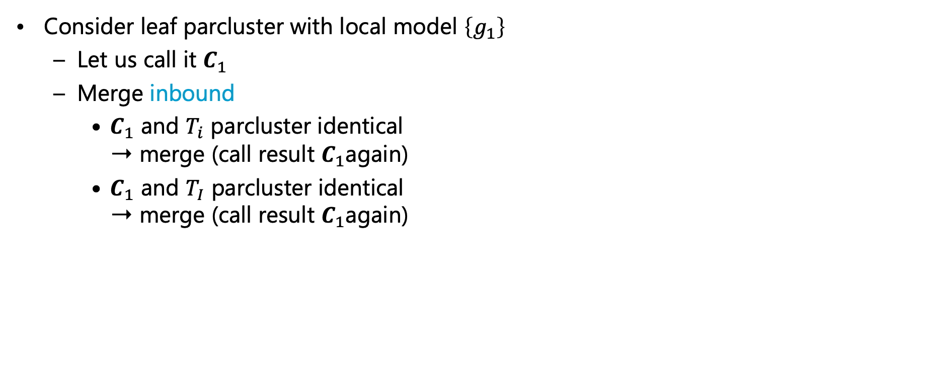
Minimisation: Example Continued
Consider leaf parcluster with local model $\left\{g_{1}\right\}$
  Let us call it $C_{1}$
  Merge inbound
    $C_{1}$ and $T_{i}$ parcluster identical
    ➝ merge (call result $C_{1}$again)
    $C_{1}$ and $T_{I}$ parcluster identical
    ➝ merge (call result $C_{1}$again)
$$Epid$$
root
$${Epid}_{|dom\left(X\right)}$$
$$T_{X}$$
$${Epid,Acc\left(I\right)}_{|dom\left(D\right)}$$
$$T_{D}$$
$$Epid,Sick\left(X\right)$$
$$T_{x}$$
$$Epid,Acc\left(I\right),Nat\left(D\right)$$
$$T_{d}$$
$$Epid,Sick\left(X\right),Travel\left(X\right)$$
$${Epid,Sick\left(X\right)}_{|dom\left(M\right)}$$
$$T_{M}$$
$${Epid,Acc\left(I\right),Nat\left(D\right)}_{|dom\left(I\right)}$$
$$T_{I}$$
$$Epid,Sick\left(X\right),Treat\left(X,M\right)$$
$$T_{m}$$
$$Epid,Acc\left(I\right),Nat\left(D\right)$$
$$C_{1}$$
$$g_{1}$$
$$Epid,Sick\left(X\right),Travel\left(X\right)$$
$$Epid,Sick\left(X\right),Treat\left(X,M\right)$$
$$Epid$$
$$g_{2}$$
$$g_{3}$$
$$g_{0}$$

Slide 33
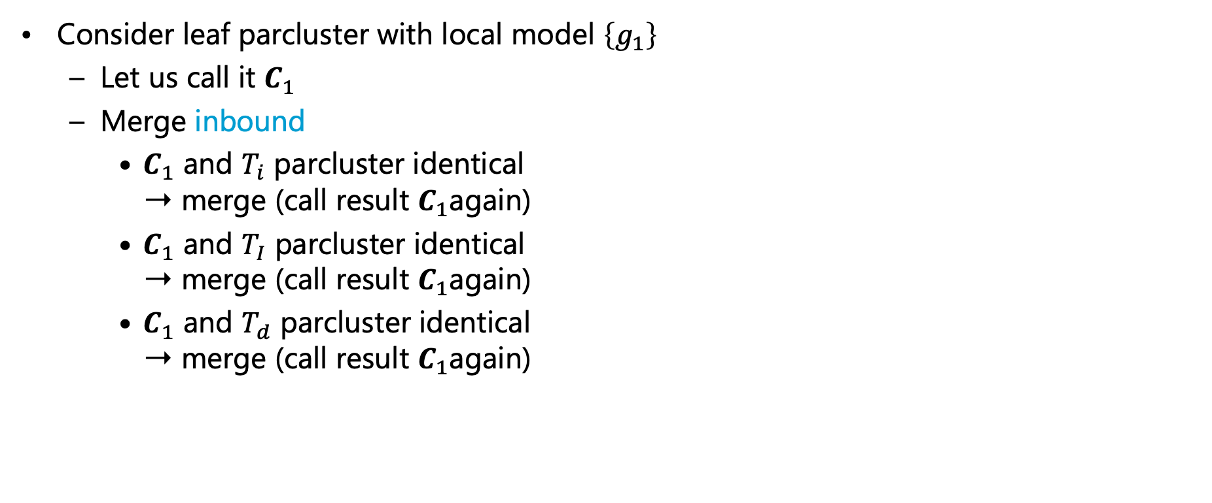
Minimisation: Example Continued
Consider leaf parcluster with local model $\left\{g_{1}\right\}$
  Let us call it $C_{1}$
  Merge inbound
    $C_{1}$ and $T_{i}$ parcluster identical
    ➝ merge (call result $C_{1}$again)
    $C_{1}$ and $T_{I}$ parcluster identical
    ➝ merge (call result $C_{1}$again)
    $C_{1}$ and $T_{d}$ parcluster identical
    ➝ merge (call result $C_{1}$again)
$$Epid$$
root
$${Epid}_{|dom\left(X\right)}$$
$$T_{X}$$
$${Epid,Acc\left(I\right)}_{|dom\left(D\right)}$$
$$T_{D}$$
$$Epid,Sick\left(X\right)$$
$$T_{x}$$
$$Epid,Acc\left(I\right),Nat\left(D\right)$$
$$T_{d}$$
$$Epid,Sick\left(X\right),Travel\left(X\right)$$
$${Epid,Sick\left(X\right)}_{|dom\left(M\right)}$$
$$T_{M}$$
$${Epid,Acc\left(I\right),Nat\left(D\right)}_{|dom\left(I\right)}$$
$$C_{1}$$
$$g_{1}$$
$$Epid,Sick\left(X\right),Treat\left(X,M\right)$$
$$T_{m}$$
$$Epid,Sick\left(X\right),Travel\left(X\right)$$
$$Epid,Sick\left(X\right),Treat\left(X,M\right)$$
$$Epid$$
$$g_{2}$$
$$g_{3}$$
$$g_{0}$$

Slide 34
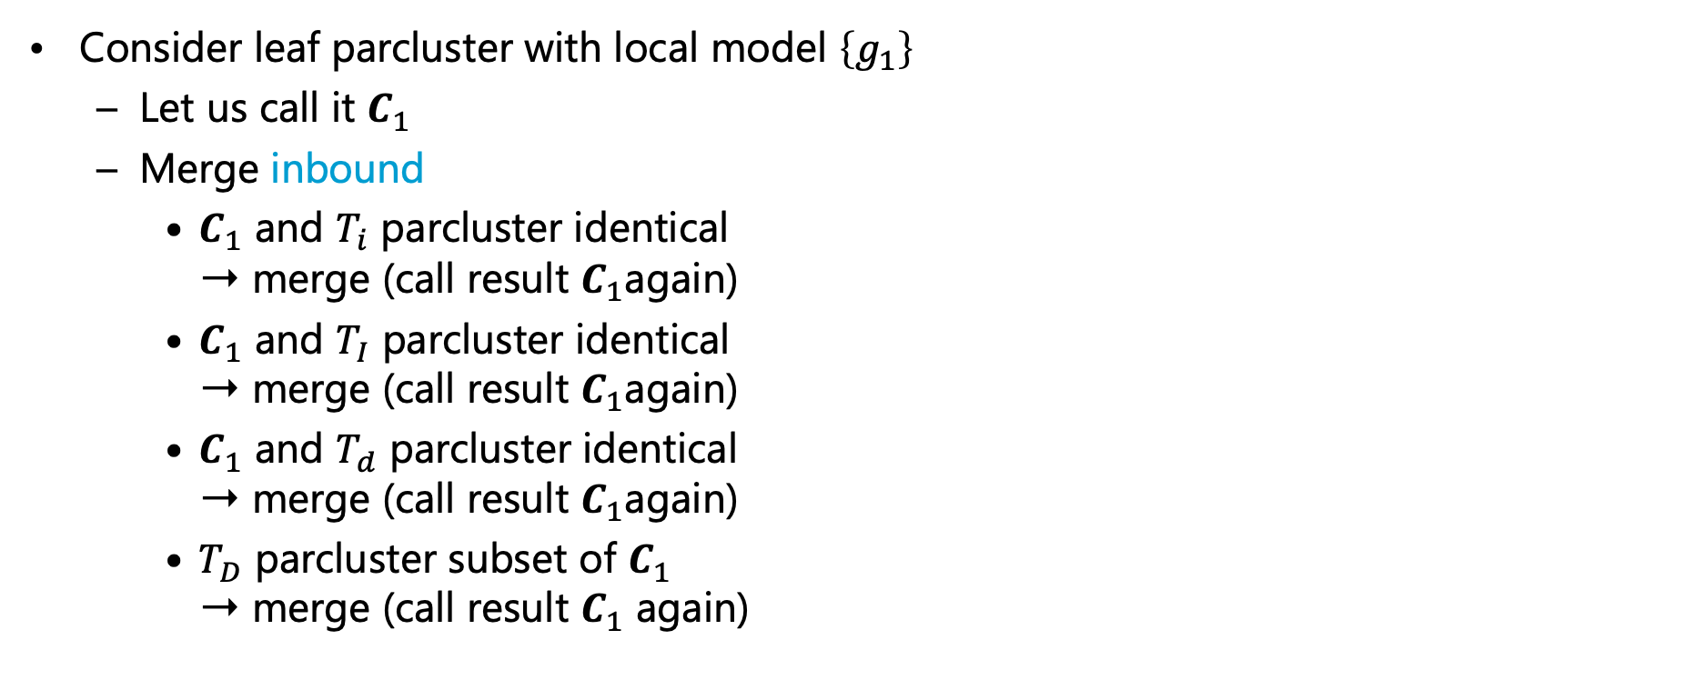
Minimisation: Example Continued
Consider leaf parcluster with local model $\left\{g_{1}\right\}$
  Let us call it $C_{1}$
  Merge inbound
    $C_{1}$ and $T_{i}$ parcluster identical
    ➝ merge (call result $C_{1}$again)
    $C_{1}$ and $T_{I}$ parcluster identical
    ➝ merge (call result $C_{1}$again)
    $C_{1}$ and $T_{d}$ parcluster identical
    ➝ merge (call result $C_{1}$again)
    $T_{D}$ parcluster subset of $C_{1}$
    ➝ merge (call result $C_{1}$ again)
$$Epid$$
root
$${Epid}_{|dom\left(X\right)}$$
$$T_{X}$$
$${Epid,Acc\left(I\right)}_{|dom\left(D\right)}$$
$$T_{D}$$
$$Epid,Sick\left(X\right)$$
$$T_{x}$$
$$Epid,Acc\left(I\right),Nat\left(D\right)$$
$$C_{1}$$
$$g_{1}$$
$$Epid,Sick\left(X\right),Travel\left(X\right)$$
$${Epid,Sick\left(X\right)}_{|dom\left(M\right)}$$
$$T_{M}$$
$$Epid,Sick\left(X\right),Treat\left(X,M\right)$$
$$T_{m}$$
$$Epid,Sick\left(X\right),Travel\left(X\right)$$
$$Epid,Sick\left(X\right),Treat\left(X,M\right)$$
$$Epid$$
$$g_{2}$$
$$g_{3}$$
$$g_{0}$$

Slide 35
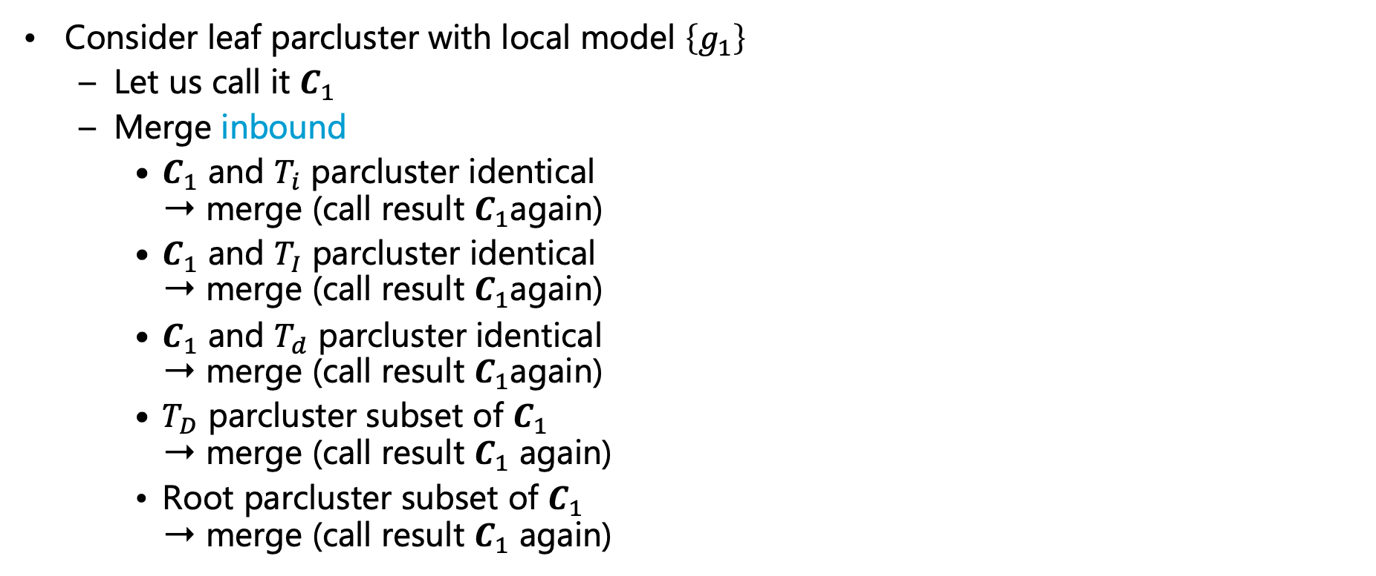
Minimisation: Example Continued
Consider leaf parcluster with local model $\left\{g_{1}\right\}$
  Let us call it $C_{1}$
  Merge inbound
    $C_{1}$ and $T_{i}$ parcluster identical
    ➝ merge (call result $C_{1}$again)
    $C_{1}$ and $T_{I}$ parcluster identical
    ➝ merge (call result $C_{1}$again)
    $C_{1}$ and $T_{d}$ parcluster identical
    ➝ merge (call result $C_{1}$again)
    $T_{D}$ parcluster subset of $C_{1}$
    ➝ merge (call result $C_{1}$ again)
    Root parcluster subset of $C_{1}$
    ➝ merge (call result $C_{1}$ again)
$$Epid$$
root
$${Epid}_{|dom\left(X\right)}$$
$$T_{X}$$
$${Epid,Acc\left(I\right),Nat\left(D\right) }_{|dom\left(D\right)}$$
$$C_{1}$$
$$g_{1}$$
$$Epid,Sick\left(X\right)$$
$$T_{x}$$
$$Epid,Sick\left(X\right),Travel\left(X\right)$$
$${Epid,Sick\left(X\right)}_{|dom\left(M\right)}$$
$$T_{M}$$
$$Epid,Sick\left(X\right),Treat\left(X,M\right)$$
$$T_{m}$$
$$Epid,Sick\left(X\right),Travel\left(X\right)$$
$$Epid,Sick\left(X\right),Treat\left(X,M\right)$$
$$Epid$$
$$g_{2}$$
$$g_{3}$$
$$g_{0}$$

Slide 36
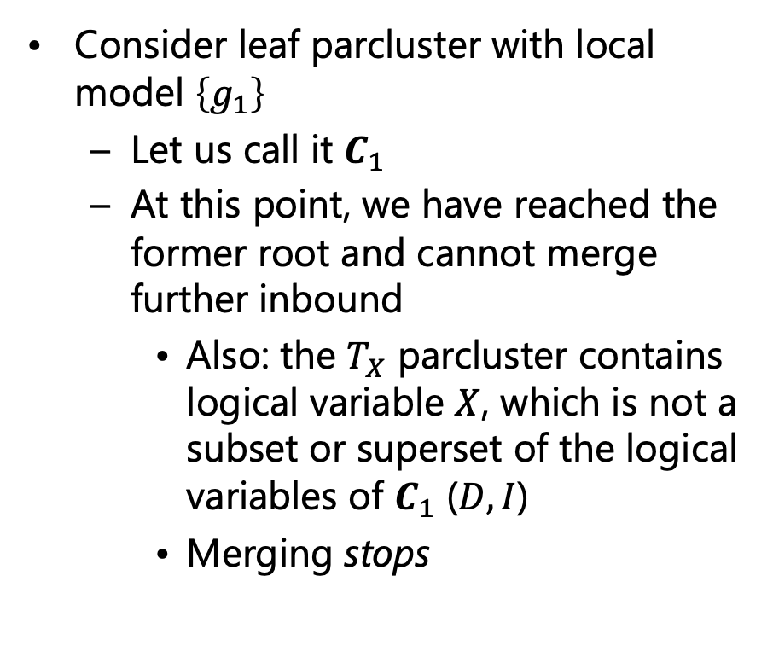
Minimisation: Example Continued
Consider leaf parcluster with local model $\left\{g_{1}\right\}$
  Let us call it $C_{1}$
  At this point, we have reached the former root and cannot merge further inbound
    Also: the $T_{X}$ parcluster contains logical variable $X$, which is not a subset or superset of the logical variables of $C_{1}$ ($D,I$)
    Merging stops
root
$$C_{1}$$
$${Epid,Acc\left(I\right),Nat\left(D\right) }_{|dom\left(D\right)}$$
$$g_{1}$$
$${Epid}_{|dom\left(X\right)}$$
$$T_{X}$$
$$Epid,Sick\left(X\right)$$
$$T_{x}$$
$$Epid,Sick\left(X\right),Travel\left(X\right)$$
$${Epid,Sick\left(X\right)}_{|dom\left(M\right)}$$
$$T_{M}$$
$$Epid,Sick\left(X\right),Treat\left(X,M\right)$$
$$T_{m}$$
$$Epid,Sick\left(X\right),Travel\left(X\right)$$
$$Epid,Sick\left(X\right),Treat\left(X,M\right)$$
$$Epid$$
$$g_{2}$$
$$g_{3}$$
$$g_{0}$$

Slide 37
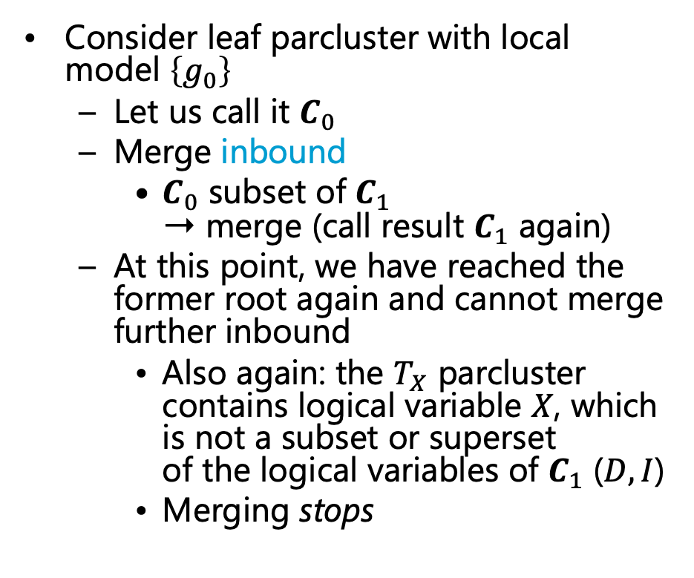
Minimisation: Example Continued
Consider leaf parcluster with local model $\left\{g_{0}\right\}$
  Let us call it $C_{0}$
  Merge inbound
    $C_{0}$ subset of $C_{1}$
    ➝ merge (call result $C_{1}$ again)
  At this point, we have reached the former root again and cannot merge further inbound
    Also again: the $T_{X}$ parcluster contains logical variable $X$, which is not a subset or superset
    of the logical variables of $C_{1}$ ($D,I$)
    Merging stops
root
$$C_{1}$$
$${Epid,Acc\left(I\right),Nat\left(D\right) }_{|dom\left(D\right)}$$
$$g_{1}$$
$${Epid}_{|dom\left(X\right)}$$
$$T_{X}$$
$$Epid,Sick\left(X\right)$$
$$T_{x}$$
$$Epid,Sick\left(X\right),Travel\left(X\right)$$
$${Epid,Sick\left(X\right)}_{|dom\left(M\right)}$$
$$T_{M}$$
$$Epid,Sick\left(X\right),Treat\left(X,M\right)$$
$$T_{m}$$
$$Epid,Sick\left(X\right),Travel\left(X\right)$$
$$Epid,Sick\left(X\right),Treat\left(X,M\right)$$
$$Epid$$
$$g_{2}$$
$$g_{3}$$
$$g_{0}$$

Slide 38

Minimisation: Example Continued
Consider leaf parcluster with local model $\left\{g_{2}\right\}$
  Let us call it $C_{2}$
  Merge inbound
    $C_{2}$ and neighbouring parcluster identical
    ➝ merge (call result $C_{2}$ again)
root
$$C_{1}$$
$${Epid,Acc\left(I\right),Nat\left(D\right) }_{|dom\left(D\right)}$$
$$g_{0},g_{1}$$
$${Epid}_{|dom\left(X\right)}$$
$$T_{X}$$
$$Epid,Sick\left(X\right)$$
$$T_{x}$$
$$Epid,Sick\left(X\right),Travel\left(X\right)$$
$${Epid,Sick\left(X\right)}_{|dom\left(M\right)}$$
$$T_{M}$$
$$Epid,Sick\left(X\right),Treat\left(X,M\right)$$
$$T_{m}$$
$$C_{2}$$
$$Epid,Sick\left(X\right),Travel\left(X\right)$$
$$Epid,Sick\left(X\right),Treat\left(X,M\right)$$
$$g_{2}$$
$$g_{3}$$

Slide 39
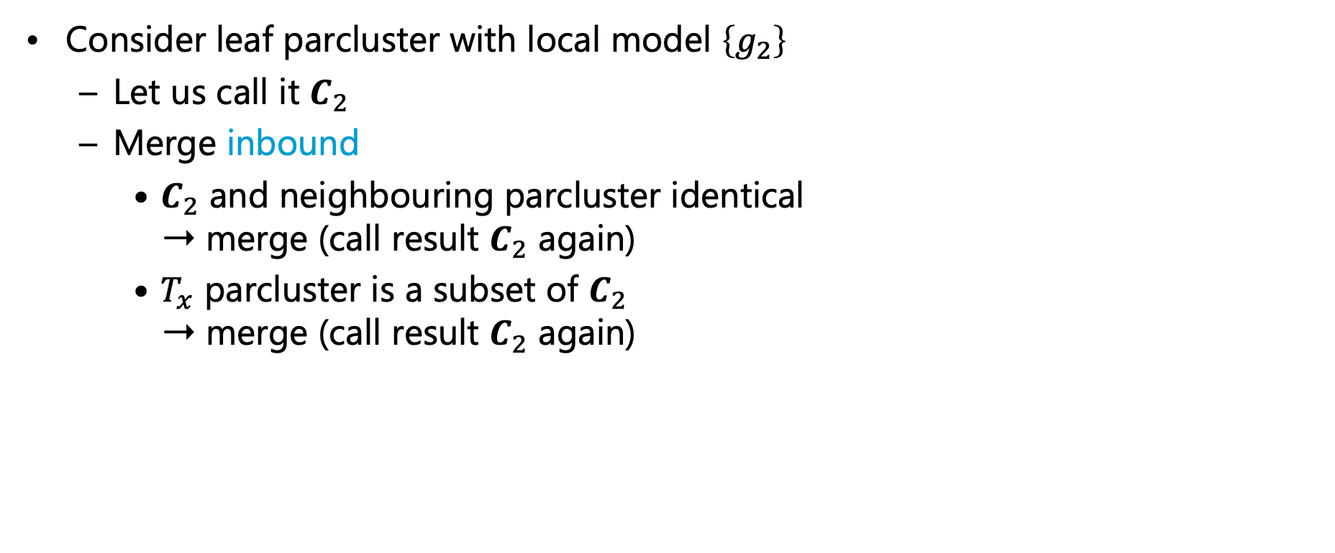
Minimisation: Example Continued
Consider leaf parcluster with local model $\left\{g_{2}\right\}$
  Let us call it $C_{2}$
  Merge inbound
    $C_{2}$ and neighbouring parcluster identical
    ➝ merge (call result $C_{2}$ again)
    $T_{x}$ parcluster is a subset of $C_{2}$
    ➝ merge (call result $C_{2}$ again)
root
$$C_{1}$$
$${Epid,Acc\left(I\right),Nat\left(D\right) }_{|dom\left(D\right)}$$
$$g_{0},g_{1}$$
$${Epid}_{|dom\left(X\right)}$$
$$T_{X}$$
$$Epid,Sick\left(X\right)$$
$$T_{x}$$
$$C_{2}$$
$$Epid,Sick\left(X\right),Travel\left(X\right)$$
$${Epid,Sick\left(X\right)}_{|dom\left(M\right)}$$
$$T_{M}$$
$$g_{2}$$
$$Epid,Sick\left(X\right),Treat\left(X,M\right)$$
$$T_{m}$$
$$Epid,Sick\left(X\right),Treat\left(X,M\right)$$
$$g_{3}$$

Slide 40
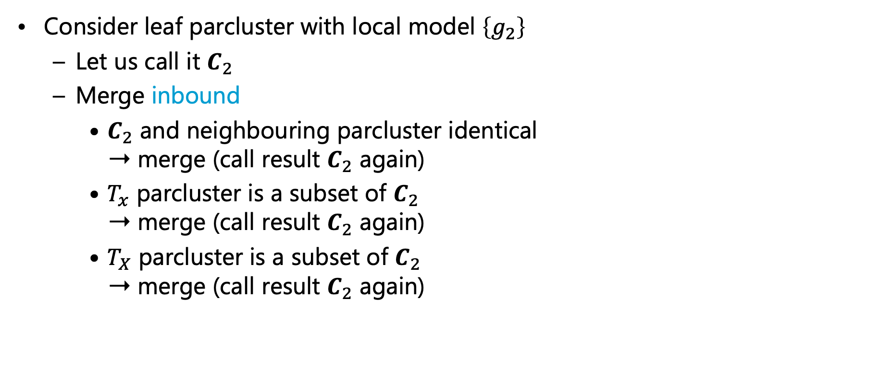
Minimisation: Example Continued
Consider leaf parcluster with local model $\left\{g_{2}\right\}$
  Let us call it $C_{2}$
  Merge inbound
    $C_{2}$ and neighbouring parcluster identical
    ➝ merge (call result $C_{2}$ again)
    $T_{x}$ parcluster is a subset of $C_{2}$
    ➝ merge (call result $C_{2}$ again)
    $T_{X}$ parcluster is a subset of $C_{2}$
    ➝ merge (call result $C_{2}$ again)
root
$$C_{1}$$
$${Epid,Acc\left(I\right),Nat\left(D\right) }_{|dom\left(D\right)}$$
$$g_{0},g_{1}$$
$${Epid}_{|dom\left(X\right)}$$
$$T_{X}$$
$$C_{2}$$
$$Epid,Sick\left(X\right),Travel\left(X\right)$$
$$g_{2}$$
$${Epid,Sick\left(X\right)}_{|dom\left(M\right)}$$
$$T_{M}$$
$$Epid,Sick\left(X\right),Treat\left(X,M\right)$$
$$T_{m}$$
$$Epid,Sick\left(X\right),Treat\left(X,M\right)$$
$$g_{3}$$

Slide 41
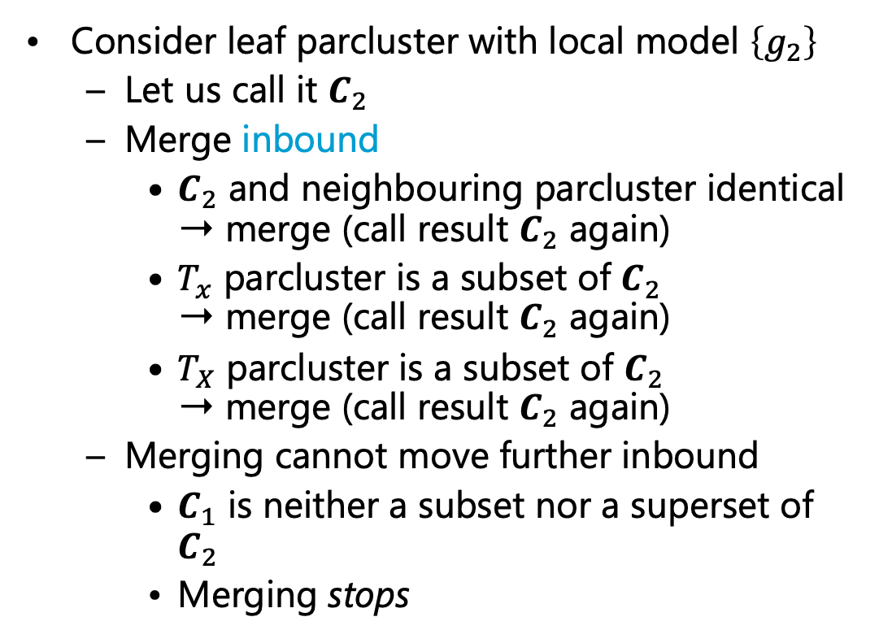
Minimisation: Example Continued
Consider leaf parcluster with local model $\left\{g_{2}\right\}$
  Let us call it $C_{2}$
  Merge inbound
    $C_{2}$ and neighbouring parcluster identical
    ➝ merge (call result $C_{2}$ again)
    $T_{x}$ parcluster is a subset of $C_{2}$
    ➝ merge (call result $C_{2}$ again)
    $T_{X}$ parcluster is a subset of $C_{2}$
    ➝ merge (call result $C_{2}$ again)
  Merging cannot move further inbound
    $C_{1}$ is neither a subset nor a superset of $C_{2}$
    Merging stops
root
$$C_{1}$$
$${Epid,Acc\left(I\right),Nat\left(D\right) }_{|dom\left(D\right)}$$
$$g_{0},g_{1}$$
$$C_{2}$$
$${Epid,Sick\left(X\right),Travel\left(X\right)}_{|dom\left(X\right)}$$
$$g_{2}$$
$${Epid,Sick\left(X\right)}_{|dom\left(M\right)}$$
$$T_{M}$$
$$Epid,Sick\left(X\right),Treat\left(X,M\right)$$
$$T_{m}$$
$$Epid,Sick\left(X\right),Treat\left(X,M\right)$$
$$g_{3}$$

Slide 42

Minimisation: Example Continued
Consider leaf parcluster with local model $\left\{g_{3}\right\}$
  Let us call it $C_{3}$
  Merge inbound
    $C_{3}$ and $T_{m}$ parcluster identical
    ➝ merge (call result $C_{3}$ again)
root
$$C_{1}$$
$${Epid,Acc\left(I\right),Nat\left(D\right) }_{|dom\left(D\right)}$$
$$g_{0},g_{1}$$
$$C_{2}$$
$${Epid,Sick\left(X\right),Travel\left(X\right)}_{|dom\left(X\right)}$$
$$g_{2}$$
$${Epid,Sick\left(X\right)}_{|dom\left(M\right)}$$
$$T_{M}$$
$$Epid,Sick\left(X\right),Treat\left(X,M\right)$$
$$T_{m}$$
$$Epid,Sick\left(X\right),Treat\left(X,M\right)$$
$$C_{3}$$
$$g_{3}$$

Slide 43

Minimisation: Example Continued
Consider leaf parcluster with local model $\left\{g_{3}\right\}$
  Let us call it $C_{3}$
  Merge inbound
    $C_{3}$ and $T_{m}$ parcluster identical
    ➝ merge (call result $C_{3}$ again)
    $T_{M}$ parcluster is a subset of $C_{3}$
    ➝ merge
root
$$C_{1}$$
$${Epid,Acc\left(I\right),Nat\left(D\right) }_{|dom\left(D\right)}$$
$$g_{0},g_{1}$$
$$C_{2}$$
$${Epid,Sick\left(X\right),Travel\left(X\right)}_{|dom\left(X\right)}$$
$$g_{2}$$
$${Epid,Sick\left(X\right)}_{|dom\left(M\right)}$$
$$T_{M}$$
$$Epid,Sick\left(X\right),Treat\left(X,M\right)$$
$$C_{3}$$
$$g_{3}$$

Slide 44
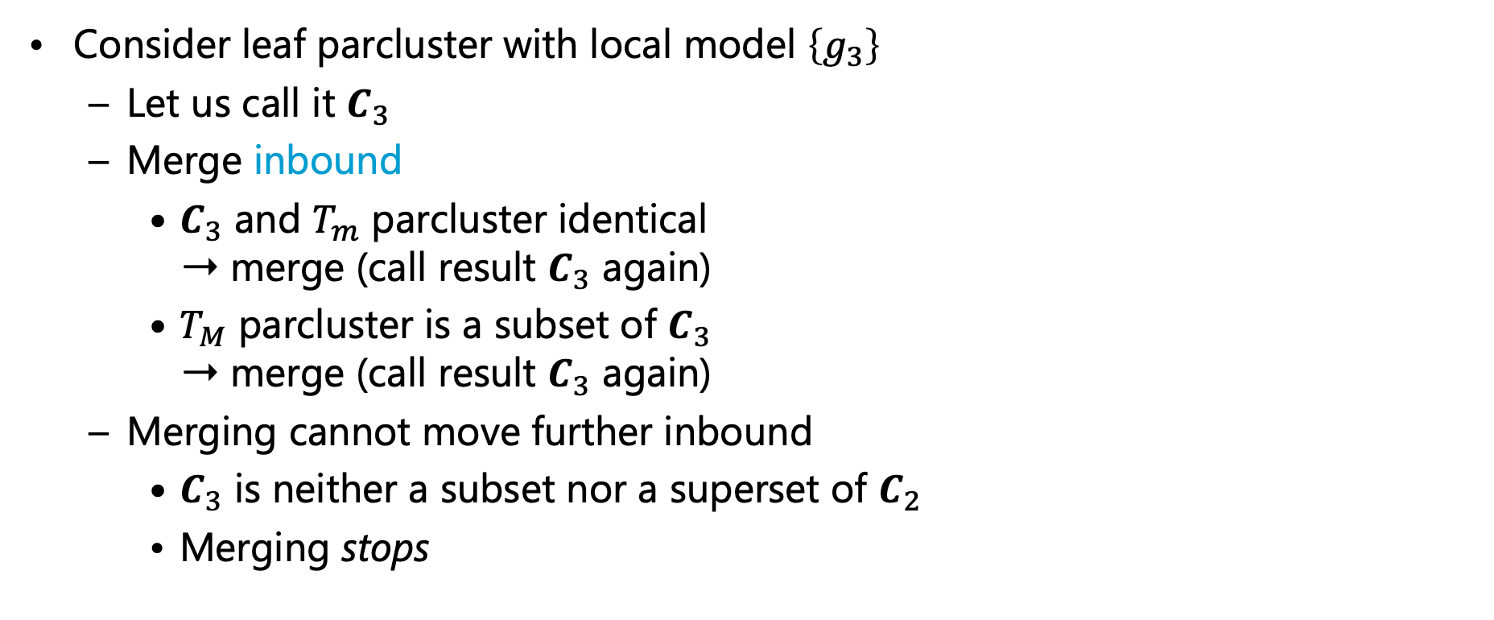
Minimisation: Example Continued
Consider leaf parcluster with local model $\left\{g_{3}\right\}$
  Let us call it $C_{3}$
  Merge inbound
    $C_{3}$ and $T_{m}$ parcluster identical
    ➝ merge (call result $C_{3}$ again)
    $T_{M}$ parcluster is a subset of $C_{3}$
    ➝ merge (call result $C_{3}$ again)
  Merging cannot move further inbound
    $C_{3}$ is neither a subset nor a superset of $C_{2}$
    Merging stops
root
$$C_{1}$$
$${Epid,Acc\left(I\right),Nat\left(D\right) }_{|dom\left(D\right)}$$
$$g_{0},g_{1}$$
$$C_{2}$$
$${Epid,Sick\left(X\right),Travel\left(X\right)}_{|dom\left(X\right)}$$
$$g_{2}$$
$${Epid,Sick\left(X\right),Treat\left(X,M\right)}_{|dom\left(M\right)}$$
$$C_{3}$$
$$g_{3}$$

Slide 45
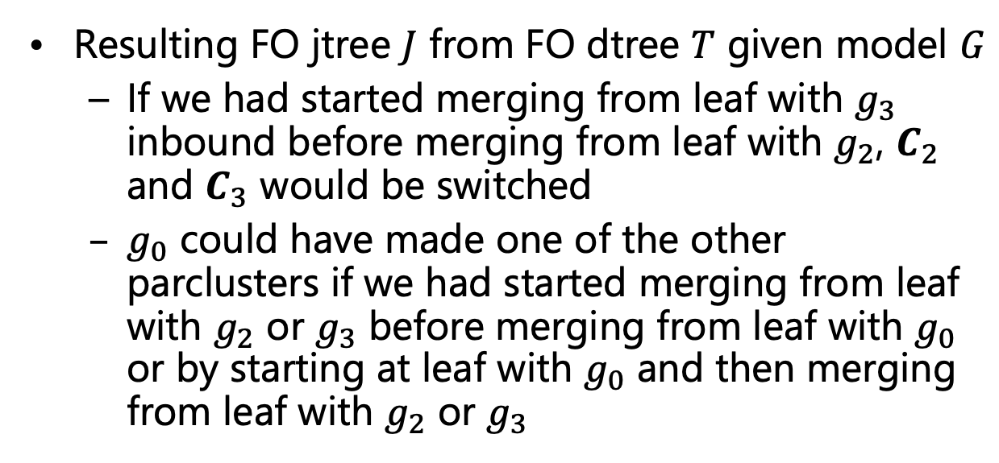
Minimisation: Example Continued
$$Nat\left(D\right)$$
$$Acc\left(I\right)$$
$$g_{1}$$
$$Epid$$
Resulting FO jtree $J$ from FO dtree $T$ given model $G$
  If we had started merging from leaf with $g_{3}$ inbound before merging from leaf with $g_{2}$, $C_{2}$ and $C_{3}$ would be switched
  $g_{0}$ could have made one of the other parclusters if we had started merging from leaf with $g_{2}$ or $g_{3}$ before merging from leaf with $g_{0}$ or by starting at leaf with $g_{0}$ and then merging from leaf with $g_{2}$ or $g_{3}$
$$g_{0}$$
$$Travel\left(X\right)$$
$$Treat\left(X,M\right)$$
$$g_{2}$$
$$g_{3}$$
$$Sick\left(X\right)$$
$$Epid$$
root
$$∅$$
$$∅$$
$$∀x :⊤$$
$$T_{X}$$
$$Acc\left(I\right)$$
$$∀d :⊤$$
$$T_{D}$$
$$Epid$$
$$Epid$$
$$Sick\left(x\right)$$
$$T_{x}$$
$$Nat\left(d\right)$$
$$T_{d}$$
$$Epid$$
$$Acc\left(I\right),Epid$$
$$Travel\left(x\right)$$
$$∅$$
$$∀m :⊤$$
$$∅$$
$$∀i :⊤$$
$$Sick\left(x\right)$$
$$Epid$$
$$Sick\left(x\right)$$
$$Epid$$
$$T_{M}$$
$$Nat\left(d\right)$$
$$Acc\left(I\right),Epid$$
$$T_{I}$$
$$Epid Acc\left(I\right)$$
$$Nat\left(D\right)$$
$$Epid Sick\left(X\right)$$
$$Travel\left(X\right)$$
$$Epid Sick\left(X\right)$$
$$Treat\left(X,M\right)$$
$$Treat\left(x,m\right)$$
$$∅$$
$$Sick\left(x\right)$$
$$Epid$$
$$T_{m}$$
$$Nat\left(d\right)$$
$$Acc\left(i\right),Epid$$
$$T_{i}$$
$$C_{1}$$
$$Epid$$
$$C_{2}$$
$$Epid$$
$$Sick\left(X\right)$$
$$C_{3}$$
$$g_{0},g_{1}$$
$$g_{2}$$
$$g_{3}$$
$$g_{2}$$
$$g_{3}$$
$$g_{0}$$
$$g_{1}$$

Slide 46

FO Jtree Construction
Given a model $G$, the following steps are necessary
  Bring $G$ into the required normal form for FO dtree construction
  Construct an FO dtree $T$ for $G$
  Translate $T$ into an FO jtree $J$
  Apply inverse substitutions to parclusters of descendants of DPG nodes in $J$
  Minimise $J$
Next?
FO jtrees for query answering
  Messages need to be passed to ensure independence
  What about evidence?
Construction

Slide 47
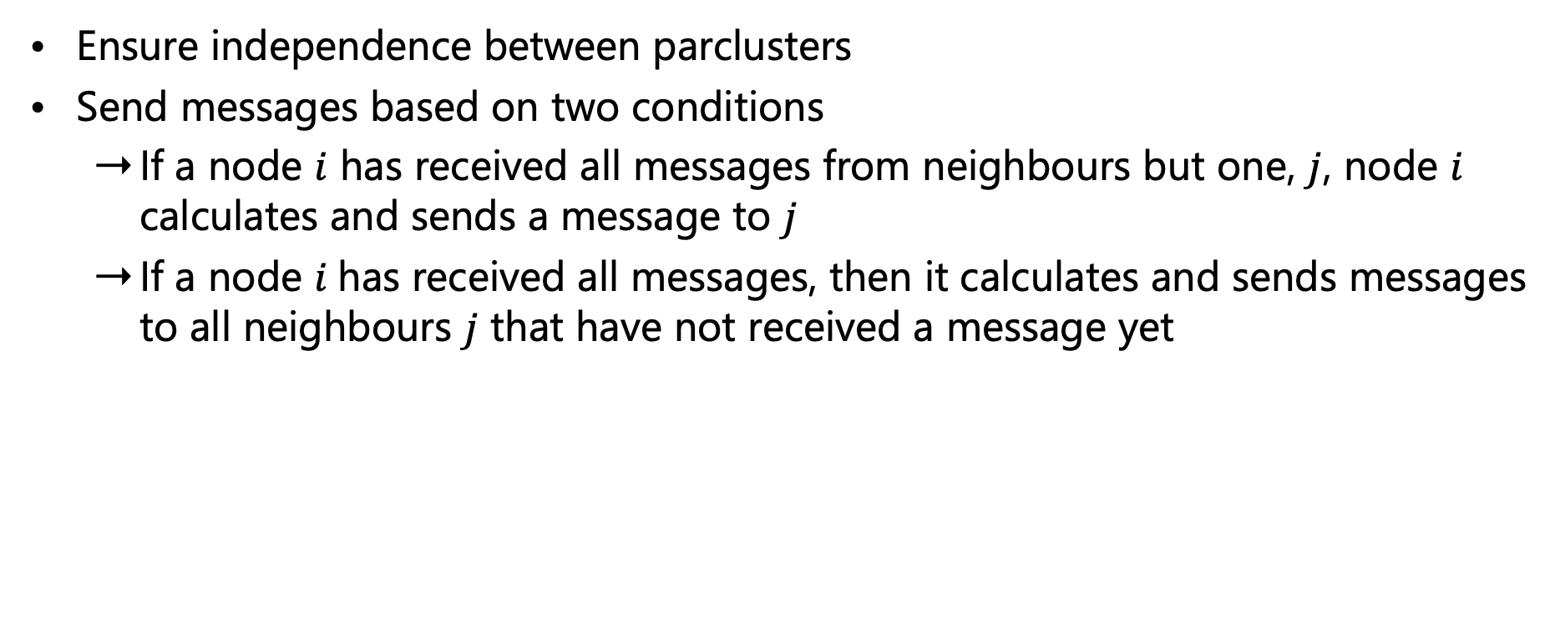
Message Passing in FO Jtrees
Ensure independence between parclusters
Send messages based on two conditions
  If a node $i$ has received all messages from neighbours but one, $j$, node $i$ calculates and sends a message to $j$
  If a node $i$has received all messages, then it calculates and sends messages to all neighbours $j$ that have not received a message yet
$$Epid Acc\left(I\right)$$
$$Nat\left(D\right)$$
$$Epid Sick\left(X\right)$$
$$Travel\left(X\right)$$
$$Epid Sick\left(X\right)$$
$$Treat\left(X,M\right)$$
$$C_{1}$$
$$Epid$$
$$C_{2}$$
$$Epid$$
$$Sick\left(X\right)$$
$$C_{3}$$
$$g_{0},g_{1}$$
$$g_{2}$$
$$g_{3}$$

Slide 48
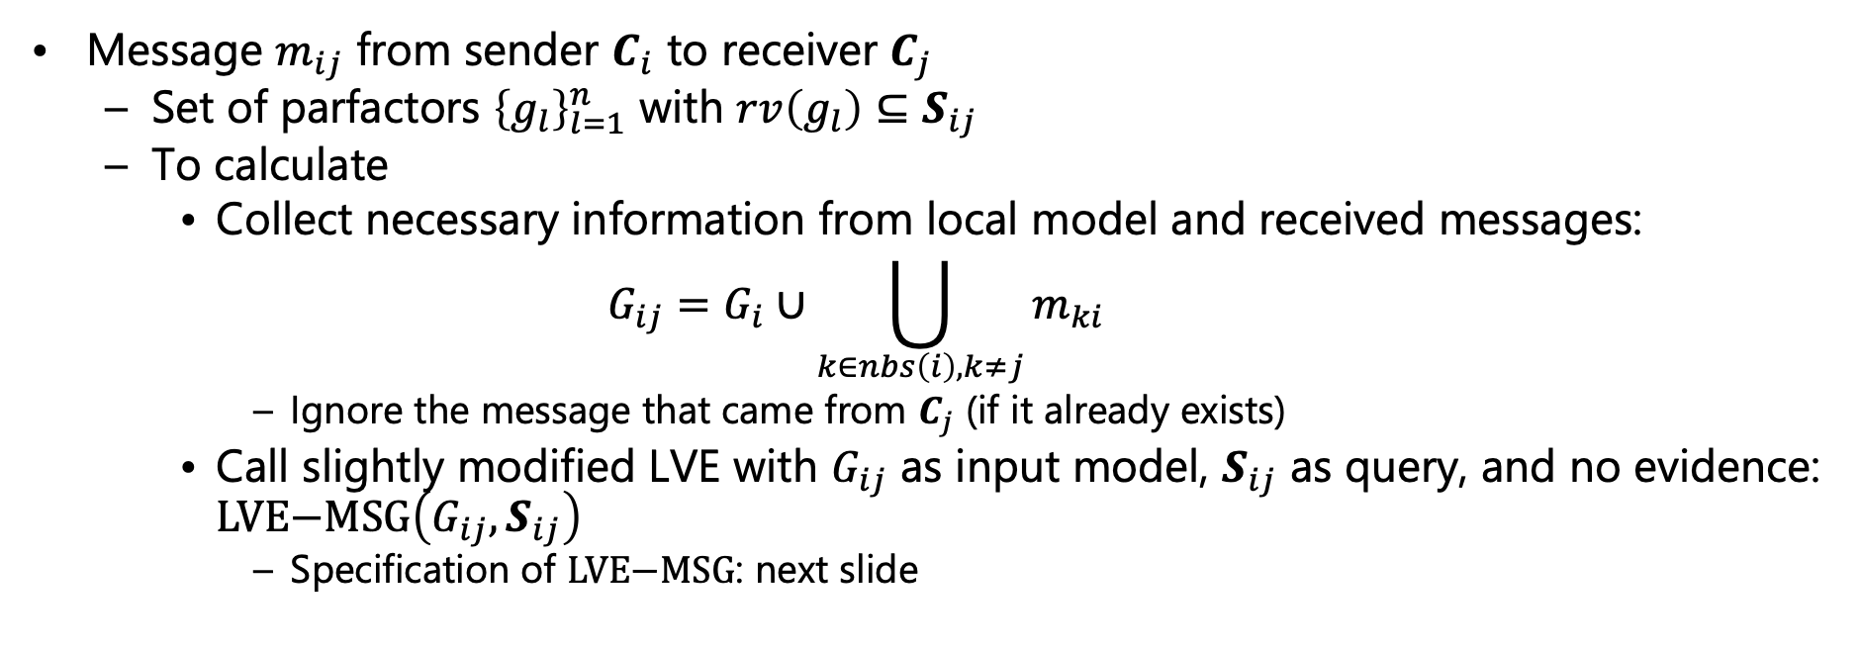
Message Passing in FO Jtrees
Message $m_{ij}$ from sender $C_{i}$ to receiver $C_{j}$
  Set of parfactors ${\left\{g_{l}\right\}}_{l=1}^{n}$ with $rv\left(g_{l}\right)⊆S_{ij}$
  To calculate
    Collect necessary information from local model and received messages:
    $$G_{ij}=G_{i}∪\bigcup_{k∈nbs\left(i\right),k≠j}{m_{ki}}$$
      Ignore the message that came from $C_{j}$ (if it already exists)
    Call slightly modified LVE with $G_{ij}$ as input model, $S_{ij}$ as query, and no evidence: $\text{LVE}\text{−}\text{MSG}\left(G_{ij},S_{ij}\right)$
      Specification of $\text{LVE}\text{−}\text{MSG}$: next slide
$$Epid Acc\left(I\right)$$
$$Nat\left(D\right)$$
$$Epid Sick\left(X\right)$$
$$Travel\left(X\right)$$
$$Epid Sick\left(X\right)$$
$$Treat\left(X,M\right)$$
$$C_{1}$$
$$Epid$$
$$C_{2}$$
$$Epid$$
$$Sick\left(X\right)$$
$$C_{3}$$
$$g_{0},g_{1}$$
$$g_{2}$$
$$g_{3}$$

Slide 49
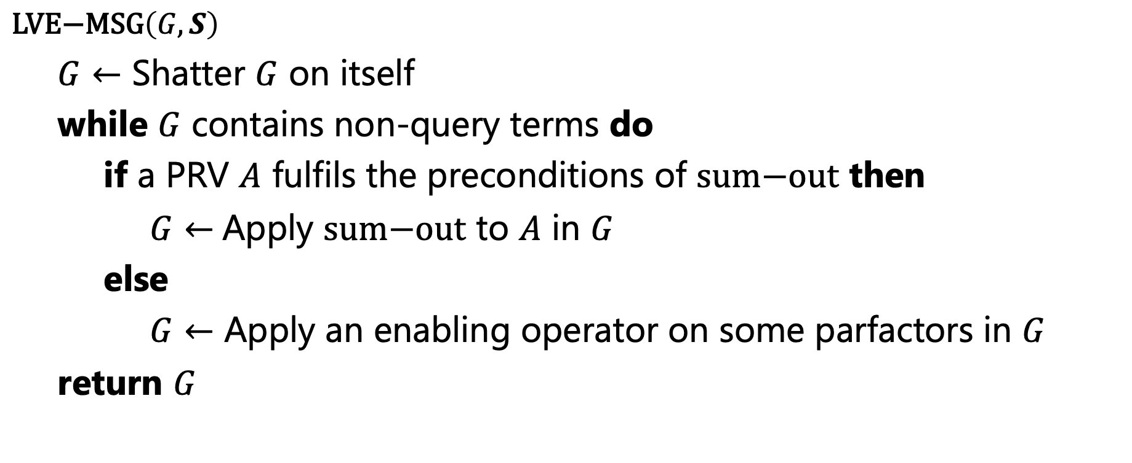
LVE for Message Passing
No shattering on separator (due to construction) or evidence, no absorption (will have been handled)
Model might need to be shattered on itself because of splits introduced by messages
$\text{LV}\text{E}\text{−}\text{MSG}\left(G, S\right)$
  $G←$ Shatter $G$ on itself
  while $G$ contains non-query terms do
    if a PRV $A$ fulfils the preconditions of $\text{sum}\text{−}\text{out}$ then
      $G←$Apply $\text{sum}\text{−}\text{out}$ to $A$ in $G$
    else
      $G←$ Apply an enabling operator on some parfactors in $G$
  return $G$
No normalisation (and multiplication of the remaining factors to be able to normalise) at the end
Interim result returned

Slide 50
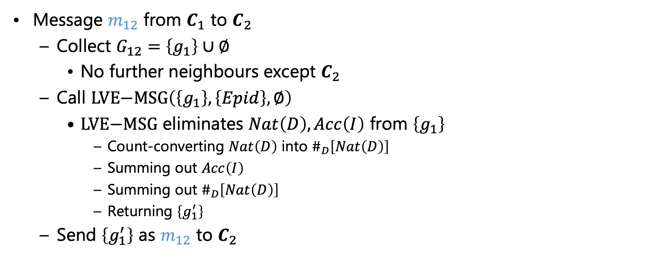
Message Passing in FO Jtrees: Example
Message $m_{12}$ from $C_{1}$ to $C_{2}$
  Collect $G_{12}=\left\{g_{1}\right\}∪∅$
    No further neighbours except $C_{2}$
  Call $\text{LVE}\text{−}\text{MSG}\left(\left\{g_{1}\right\},\left\{Epid\right\},∅\right)$
    $\text{LVE}\text{−}\text{MSG}$ eliminates $Nat\left(D\right),Acc\left(I\right)$ from $\left\{g_{1}\right\}$
      Count-converting $Nat\left(D\right)$ into $\#_{D}\left[Nat\left(D\right)\right]$
      Summing out $Acc\left(I\right)$
      Summing out $\#_{D}\left[Nat\left(D\right)\right]$
      Returning $\left\{g_{1}^{′}\right\}$
  Send $\left\{g_{1}^{′}\right\}$ as $m_{12}$ to $C_{2}$
$$Epid Acc\left(I\right)$$
$$Nat\left(D\right)$$
$$Epid Sick\left(X\right)$$
$$Travel\left(X\right)$$
$$Epid Sick\left(X\right)$$
$$Treat\left(X,M\right)$$
$$C_{1}$$
$$Epid$$
$$C_{2}$$
$$Epid$$
$$Sick\left(X\right)$$
$$C_{3}$$
$$g_{0},g_{1}$$
$$g_{2}$$
$$g_{3}$$
$$m_{12}$$

Slide 51
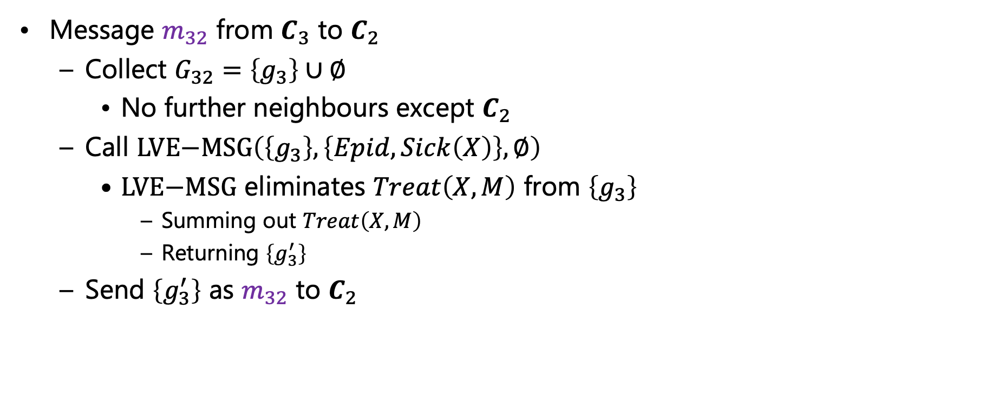
Message Passing in FO Jtrees: Example
Message $m_{32}$ from $C_{3}$ to $C_{2}$
  Collect $G_{32}=\left\{g_{3}\right\}∪∅$
    No further neighbours except $C_{2}$
  Call $\text{LVE}\text{−}\text{MSG}\left(\left\{g_{3}\right\},\left\{Epid,Sick\left(X\right)\right\},∅\right)$
    $\text{LVE}\text{−}\text{MSG}$ eliminates $Treat\left(X,M\right)$ from $\left\{g_{3}\right\}$
      Summing out $Treat\left(X,M\right)$
      Returning $\left\{g_{3}^{′}\right\}$
  Send $\left\{g_{3}^{′}\right\}$ as $m_{32}$ to $C_{2}$
$$Epid Acc\left(I\right)$$
$$Nat\left(D\right)$$
$$Epid Sick\left(X\right)$$
$$Travel\left(X\right)$$
$$Epid Sick\left(X\right)$$
$$Treat\left(X,M\right)$$
$$C_{1}$$
$$Epid$$
$$C_{2}$$
$$Epid$$
$$Sick\left(X\right)$$
$$C_{3}$$
$$g_{0},g_{1}$$
$$m_{12}$$
$$g_{2}$$
$$g_{3}$$
$$m_{32}$$

Slide 52
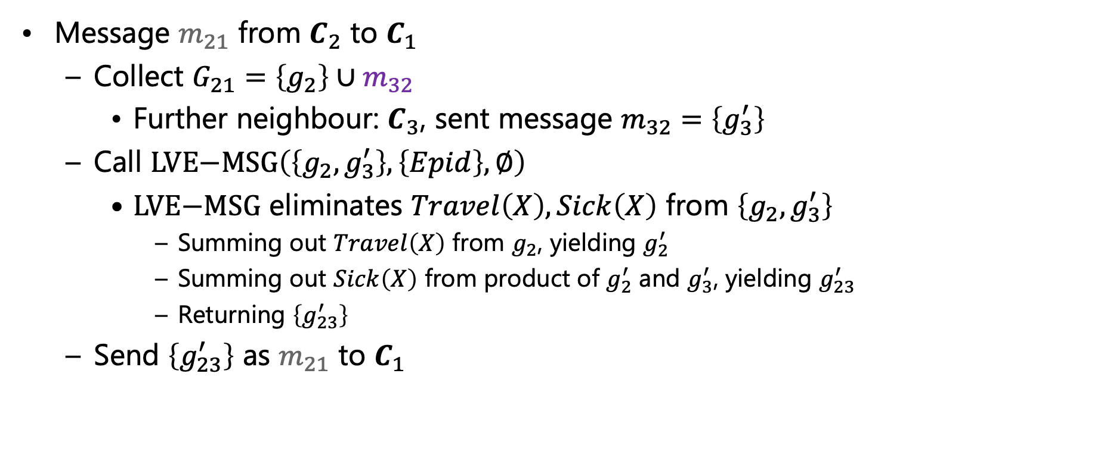
Message Passing in FO Jtrees: Example
Message $m_{21}$ from $C_{2}$ to $C_{1}$
  Collect $G_{21}=\left\{g_{2}\right\}∪m_{32}$
    Further neighbour: $C_{3}$, sent message $m_{32}=\left\{g_{3}^{′}\right\}$
  Call $\text{LVE}\text{−}\text{MSG}\left(\left\{g_{2},g_{3}^{′}\right\},\left\{Epid\right\},∅\right)$
    $\text{LVE}\text{−}\text{MSG}$ eliminates $Travel\left(X\right),Sick\left(X\right)$ from $\left\{g_{2},g_{3}^{′}\right\}$
      Summing out $Travel\left(X\right)$ from $g_{2}$, yielding $g_{2}^{′}$
      Summing out $Sick\left(X\right)$ from product of $g_{2}^{′}$ and $g_{3}^{′}$, yielding $g_{23}^{′}$
      Returning $\left\{g_{23}^{′}\right\}$
  Send $\left\{g_{23}^{′}\right\}$ as $m_{21}$ to $C_{1}$
$$Epid Acc\left(I\right)$$
$$Nat\left(D\right)$$
$$Epid Sick\left(X\right)$$
$$Travel\left(X\right)$$
$$Epid Sick\left(X\right)$$
$$Treat\left(X,M\right)$$
$$C_{1}$$
$$Epid$$
$$C_{2}$$
$$Epid$$
$$Sick\left(X\right)$$
$$C_{3}$$
$$g_{0},g_{1}$$
$$m_{12}$$
$$m_{32}$$
$$g_{2}$$
$$g_{3}$$
$$m_{21}$$

Slide 53
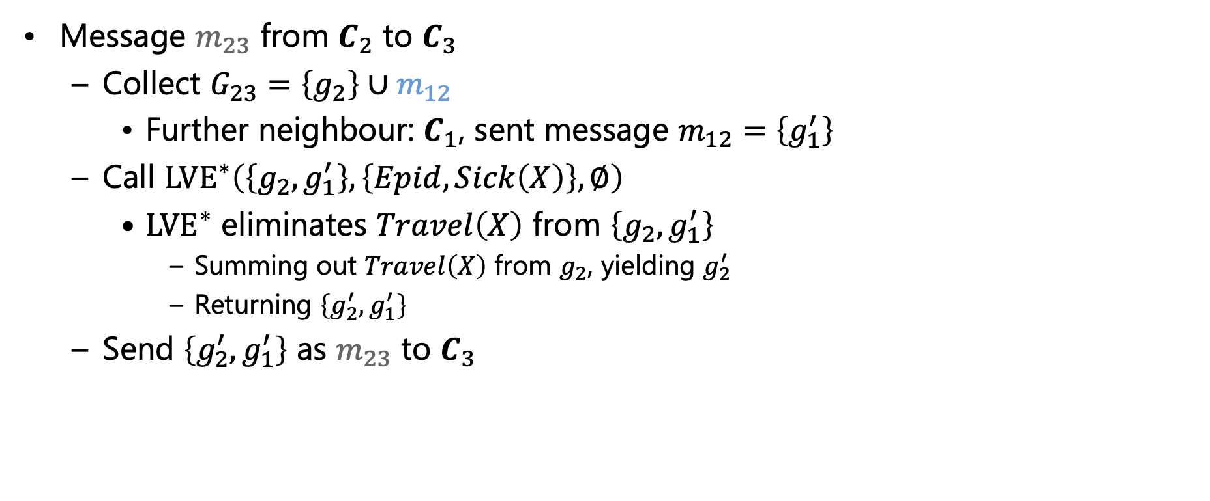
Message Passing in FO Jtrees: Example
Message $m_{23}$ from $C_{2}$ to $C_{3}$
  Collect $G_{23}=\left\{g_{2}\right\}∪m_{12}$
    Further neighbour: $C_{1}$, sent message $m_{12}=\left\{g_{1}^{′}\right\}$
  Call ${\text{LVE}}^{∗}\left(\left\{g_{2},g_{1}^{′}\right\},\left\{Epid,Sick\left(X\right)\right\},∅\right)$
    ${\text{LVE}}^{∗}$ eliminates $Travel\left(X\right)$ from $\left\{g_{2},g_{1}^{′}\right\}$
      Summing out $Travel\left(X\right)$ from $g_{2}$, yielding $g_{2}^{′}$
      Returning $\left\{g_{2}^{′},g_{1}^{′}\right\}$
  Send $\left\{g_{2}^{′},g_{1}^{′}\right\}$ as $m_{23}$ to $C_{3}$
$$Epid Acc\left(I\right)$$
$$Nat\left(D\right)$$
$$Epid Sick\left(X\right)$$
$$Travel\left(X\right)$$
$$Epid Sick\left(X\right)$$
$$Treat\left(X,M\right)$$
$$C_{1}$$
$$Epid$$
$$C_{2}$$
$$Epid$$
$$Sick\left(X\right)$$
$$C_{3}$$
$$g_{0},g_{1}$$
$$m_{21}$$
$$m_{12}$$
$$m_{32}$$
$$g_{2}$$
$$g_{3}$$
$$m_{23}$$

Slide 54
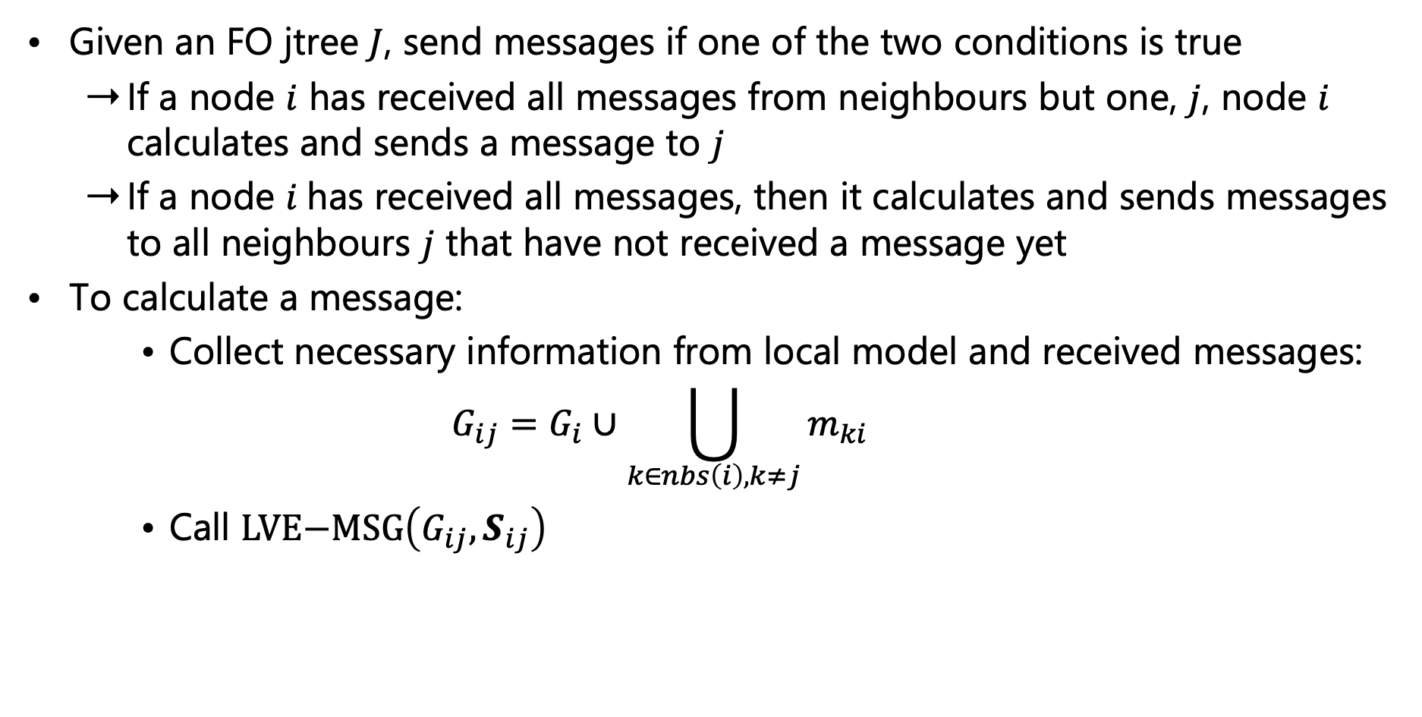
Message Passing: Overview
Given an FO jtree $J$, send messages if one of the two conditions is true
  If a node $i$ has received all messages from neighbours but one, $j$, node $i$ calculates and sends a message to $j$
  If a node $i$has received all messages, then it calculates and sends messages to all neighbours $j$ that have not received a message yet
To calculate a message:
    Collect necessary information from local model and received messages:
    $$G_{ij}=G_{i}∪\bigcup_{k∈nbs\left(i\right),k≠j}{m_{ki}}$$
    Call $\text{LVE}\text{−}\text{MSG}\left(G_{ij},S_{ij}\right)$
Message Passing

Slide 55
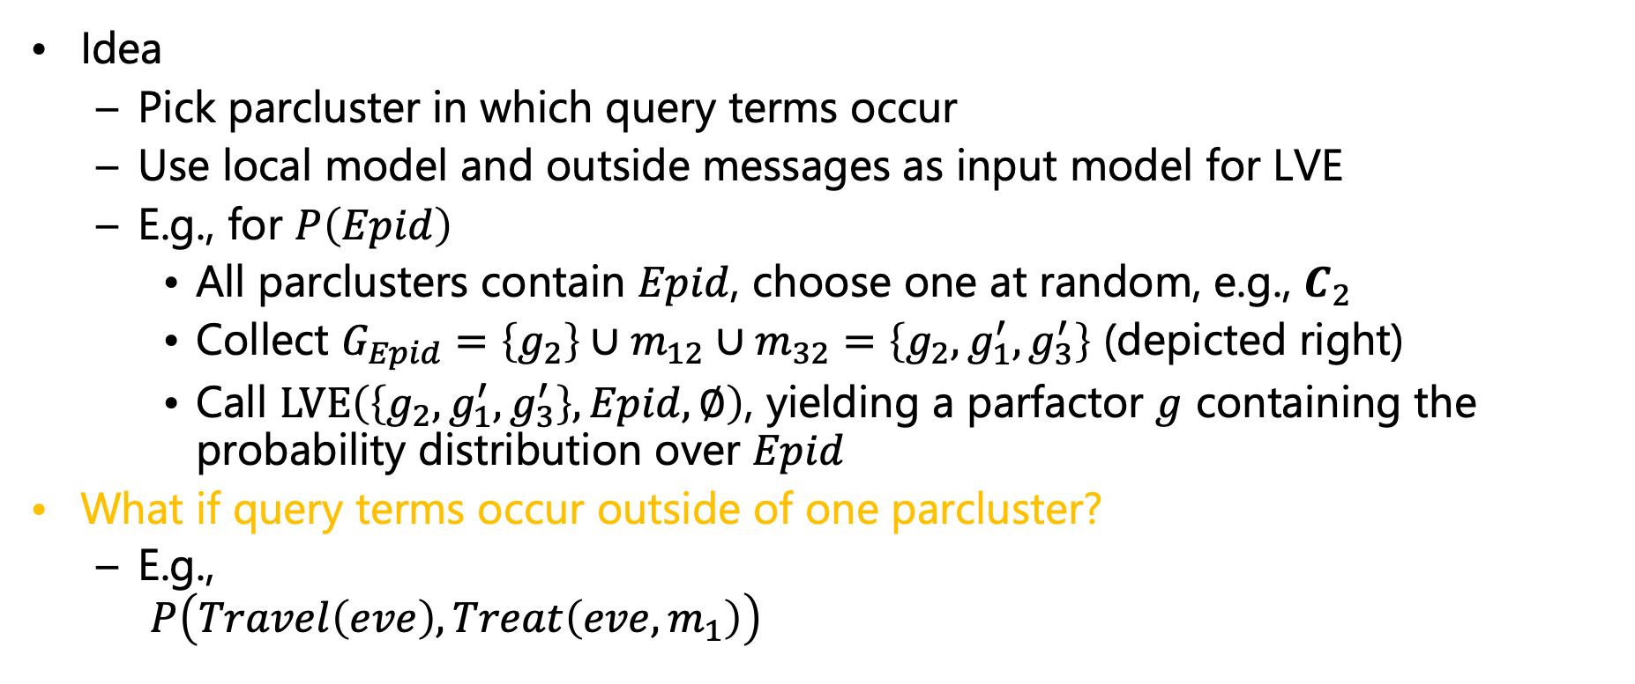
Query Answering in FO Jtrees
Idea
  Pick parcluster in which query terms occur
  Use local model and outside messages as input model for LVE
  E.g., for $P\left(Epid\right)$
    All parclusters contain $Epid$, choose one at random, e.g., $C_{2}$
    Collect $G_{Epid}=\left\{g_{2}\right\}∪m_{12}∪m_{32}=\left\{g_{2},g_{1}^{′},g_{3}^{′}\right\}$ (depicted right)
    Call $\text{LVE}\left(\left\{g_{2},g_{1}^{′},g_{3}^{′}\right\},Epid,∅\right)$, yielding a parfactor $g$ containing the probability distribution over $Epid$
What if query terms occur outside of one parcluster?
  E.g.,
  $P\left(Travel\left(eve\right),Treat\left(eve,m_{1}\right)\right)$
$$g_{1}^{′′}$$
$$Epid$$
$$g_{0}$$
$$Travel\left(X\right)$$
$$g_{2}$$
$$g_{3}^{′}$$
$$Sick\left(X\right)$$
$$Epid Acc\left(I\right)$$
$$Nat\left(D\right)$$
$$Epid Sick\left(X\right)$$
$$Travel\left(X\right)$$
$$Epid Sick\left(X\right)$$
$$Treat\left(X,M\right)$$
$$C_{1}$$
$$Epid$$
$$C_{2}$$
$$Epid$$
$$Sick\left(X\right)$$
$$C_{3}$$
$$g_{0},g_{1},m_{21}$$
$$g_{2},m_{12},m_{32}$$
$$g_{3},m_{23}$$

Slide 56
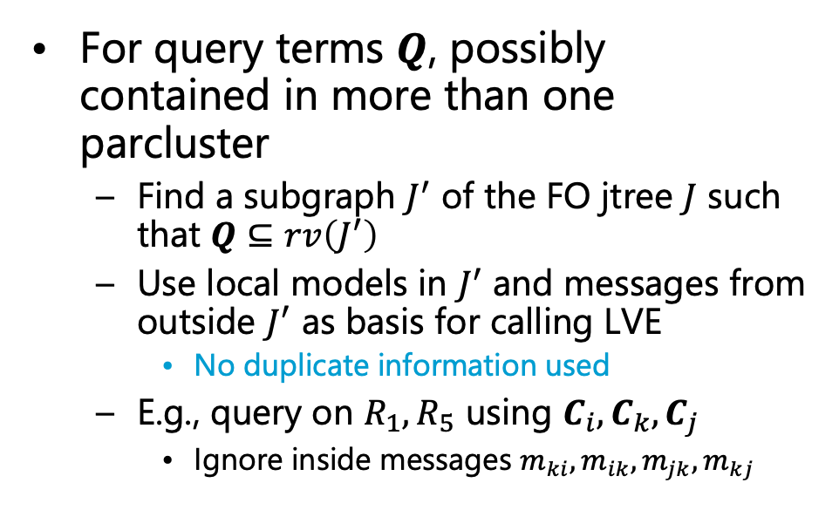
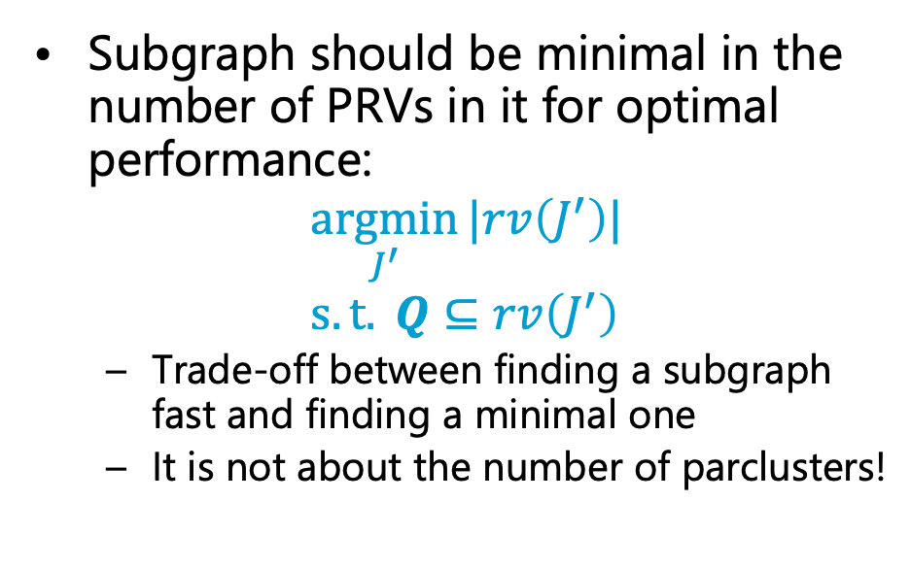
Query Answering in FO Jtrees
How can we find a subgraph?
For query terms $Q$, possibly contained in more than one parcluster
  Find a subgraph $J^{′}$ of the FO jtree $J$ such that $Q⊆rv\left(J^{′}\right)$
  Use local models in $J^{′}$ and messages from outside $J^{′}$ as basis for calling LVE
    No duplicate information used
  E.g., query on $R_{1},R_{5}$ using $C_{i}, C_{k}, C_{j}$
    Ignore inside messages $m_{ki},m_{ik},m_{jk},m_{kj}$
Subgraph should be minimal in the number of PRVs in it for optimal performance:
$$\underset{J^{′}}{argmin}{|rv\left(J^{′}\right)|} \\ s.t. Q⊆rv\left(J^{′}\right)$$
  Trade-off between finding a subgraph fast and finding a minimal one
  It is not about the number of parclusters!
$$m_{1i}$$
$$m_{2i}$$
$$m_{1k}$$
$$m_{2k}$$
$$m_{1j}$$
$$m_{2j}$$
$$m_{5i}$$
$$m_{3j}$$
$$R_{1}, R_{2}, R_{3}$$
$$R_{2}, R_{3},R_{4}$$
$$R_{3}, R_{4}, R_{5}$$
$$m_{4i}$$
$$m_{ki}$$
$$m_{ik}$$
$$m_{jk}$$
$$m_{kj}$$
$$m_{4j}$$
$$g_{i}$$
$$g_{k}$$
$$g_{j}$$

Slide 57
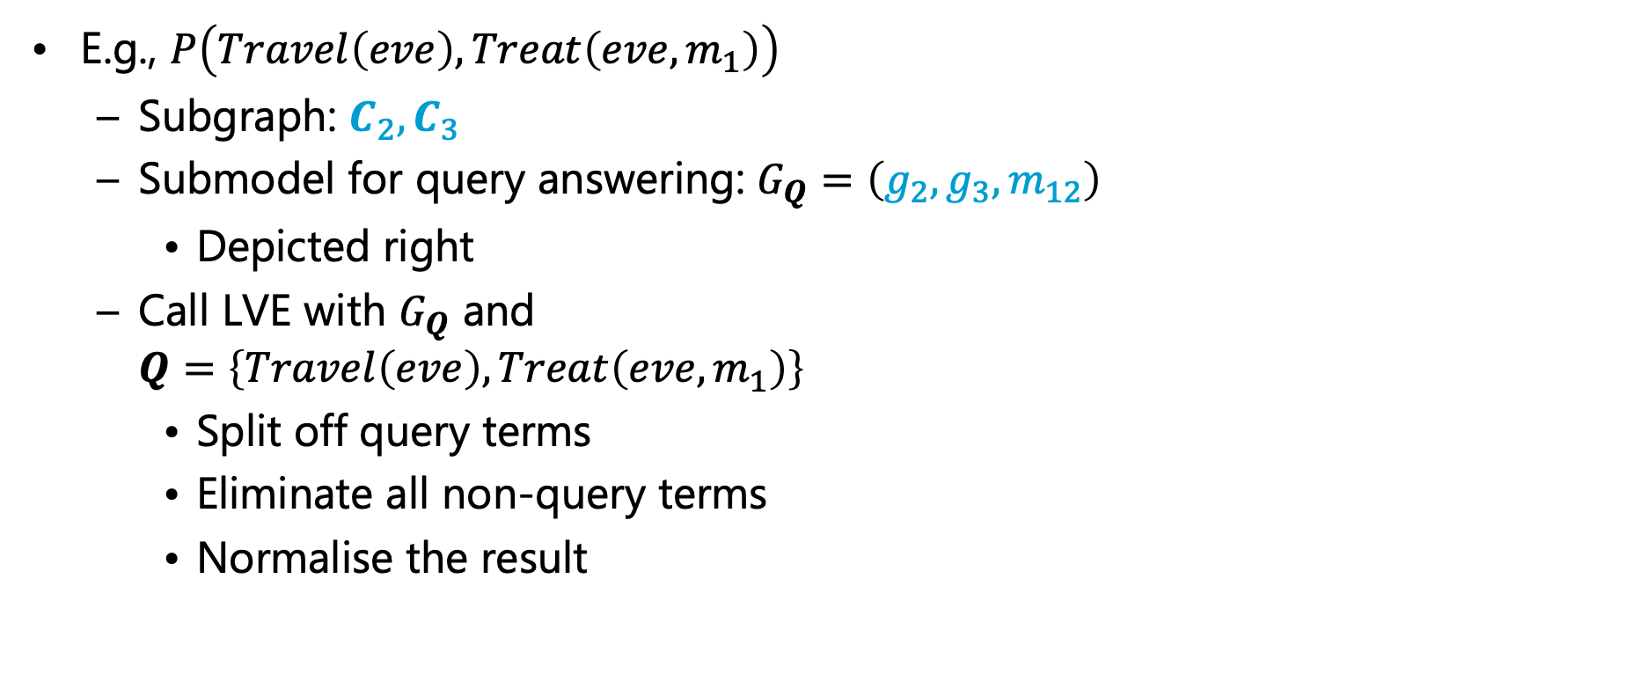
Query Answering in FO Jtrees: Example
E.g., $P\left(Travel\left(eve\right),Treat\left(eve,m_{1}\right)\right)$
  Subgraph: $C_{2},C_{3}$
  Submodel for query answering: $G_{Q}=\left(g_{2},g_{3},m_{12}\right)$
    Depicted right
  Call LVE with $G_{Q}$ and
  $Q=\left\{Travel\left(eve\right),Treat\left(eve,m_{1}\right)\right\}$
    Split off query terms
    Eliminate all non-query terms
    Normalise the result
$$g_{1}^{′′}$$
$$Epid$$
$$g_{0}$$
$$Travel\left(X\right)$$
$$Treat\left(X,M\right)$$
$$g_{2}$$
$$g_{3}$$
$$Sick\left(X\right)$$
$$Epid Acc\left(I\right)$$
$$Nat\left(D\right)$$
$$Epid Sick\left(X\right)$$
$$Travel\left(X\right)$$
$$Epid Sick\left(X\right)$$
$$Treat\left(X,M\right)$$
$$C_{1}$$
$$Epid$$
$$C_{2}$$
$$Epid$$
$$Sick\left(X\right)$$
$$C_{3}$$
$$g_{0},g_{1},m_{21}$$
$$g_{2},m_{12},m_{32}$$
$$g_{3},m_{23}$$

Slide 58

Query Answering in FO Jtrees
After message passing, parclusters independent from each other given messages
  Prepared for query answering
For each query with query terms $Q$
  Find subtree $J^{′}=\left(V^{′},E^{′}\right)$ s.t. $Q⊆rv\left(J^{′}\right)$
  Collect information from local model and messages, i.e,
  $$G_{Q}=\bigcup_{i∈V^{′}}{G_{i}∪\bigcup_{\begin{aligned}j∈nbs\left(i\right) \\ j∉V^{′}\end{aligned}}{m_{ji}}}$$
  Call $\text{LVE}\left(G_{Q},Q,∅\right)$ and return or store result of the call
What about evidence?
Query Answering
$$Epid Acc\left(I\right)$$
$$Nat\left(D\right)$$
$$Epid Sick\left(X\right)$$
$$Travel\left(X\right)$$
$$Epid Sick\left(X\right)$$
$$Treat\left(X,M\right)$$
$$C_{1}$$
$$Epid$$
$$C_{2}$$
$$Epid$$
$$Sick\left(X\right)$$
$$C_{3}$$
$$g_{0},g_{1},m_{21}$$
$$g_{2},m_{12},m_{32}$$
$$g_{3},m_{23}$$

Slide 59

Evidence in FO Jtrees
Evidence applies to PRVs in some parclusters
  Changes the distributions in local models
  Information sent in messages might change
    Even if summed out and therefore hidden from the other parclusters
Therefore, handle evidence before sending messages
  Only then send messages
Given a set of evidence parfactors ${\left\{{φ_{e}\left(A_{e}\right)}_{|C_{e}}\right\}}_{e=1}^{m}$
For each ${φ_{e}\left(A_{e}\right)}_{|C_{e}}$
  For each parcluster $C_{i}$ where $A_{e}∈C_{i}$
    Shatter $G_{i}$ on $C_{e}$
    Absorb ${φ_{e}\left(A_{e}\right)}_{|C_{e}}$ in $G_{i}$
Evidence Entering
$$Epid Acc\left(I\right)$$
$$Nat\left(D\right)$$
$$Epid Sick\left(X\right)$$
$$Travel\left(X\right)$$
$$Epid Sick\left(X\right)$$
$$Treat\left(X,M\right)$$
$$C_{1}$$
$$Epid$$
$$C_{2}$$
$$Epid$$
$$Sick\left(X\right)$$
$$C_{3}$$
$$g_{0},g_{1}$$
$$g_{2}$$
$$g_{3}$$

Slide 60



Evidence in FO Jtrees: Example
Given $Sick\left(eve\right)=true$ as evidence $g_{e}$
  In $C_{2}$
    Shatter $G_{2}=\left\{g_{2}\right\}$ on $Sick\left(eve\right)$, yielding $\left\{g_{2}^{e}, g_{2}^{′}\right\}$
    Absorb $g_{e}$ in $g_{2}^{e}$, yielding $g_{2}^{e′}$
    Result: $G_{2}=\left\{g_{2}^{e′}, g_{2}^{′}\right\}$
  In $C_{3}$
    Shatter $G_{3}=\left\{g_{3}\right\}$ on $Sick\left(eve\right)$, yielding $\left\{g_{3}^{e}, g_{3}^{′}\right\}$
    Absorb $g_{e}$ in $g_{3}^{e}$, yielding $g_{3}^{e′}$
    Result: $G_{3}=\left\{g_{3}^{e′}, g_{3}^{′}\right\}$
After evidence handling, send messages based on the local models that have absorbed the evidence
  $G_{0}=\left\{g_{0},g_{1}\right\}$ (unchanged)
  $G_{2}=\left\{g_{2}^{e′}, g_{2}^{′}\right\}$
  $G_{3}=\left\{g_{3}^{e′}, g_{3}^{′}\right\}$
$$Epid Acc\left(I\right)$$
$$Nat\left(D\right)$$
$$Epid Sick\left(X\right)$$
$$Travel\left(X\right)$$
$$Epid Sick\left(X\right)$$
$$Treat\left(X,M\right)$$
$$C_{1}$$
$$Epid$$
$$C_{2}$$
$$Epid$$
$$Sick\left(X\right)$$
$$C_{3}$$
$$g_{0},g_{1}$$
$$g_{2}$$
$$g_{3}$$
$$g_{2}^{e′}, g_{2}^{′}$$
$$g_{3}^{e′}, g_{3}^{′}$$

Slide 61


Evidence in FO Jtrees
E.g., given $Sick\left(eve\right)=true$ as evidence in $g_{e}$
  Message $m_{12}$ does not change compared to previous example
  Message $m_{32}$ calculated based on $\left\{g_{3}^{e′}, g_{3}^{′}\right\}$
    Call $\text{LVE}\text{−}\text{MSG}\left(\left\{g_{3}^{e′}, g_{3}^{′}\right\},\left\{Epid,Sick\left(X\right)\right\},∅\right)$, yielding $\left\{g_{3}^{e′′}, g_{3}^{′′}\right\}$
  Message $m_{23}$ calculated based on $\left\{g_{2}^{e′}, g_{2}^{′}\right\}∪m_{12}$
    Call $\text{LVE}\text{−}\text{MSG}\left(\left\{g_{2}^{e′}, g_{2}^{′},g_{1}^{′}\right\},\left\{Epid,Sick\left(X\right)\right\},∅\right)$, yielding $\left\{g_{2}^{e′′}, g_{2}^{′′},g_{1}^{′}\right\}$
  Message $m_{21}$ calculated based on $\left\{g_{2}^{e′}, g_{2}^{′}\right\}∪m_{32}$
    Call $\text{LVE}\text{−}\text{MSG}\left(\left\{g_{2}^{e′}, g_{2}^{′},g_{3}^{e′′}, g_{3}^{′′}\right\},\left\{Epid \right\},∅\right)$, yielding $\left\{g_{2}^{e′′}, g_{2}^{′′},g_{3}^{e′′}, g_{3}^{′′′}\right\}$
$$Epid Acc\left(I\right)$$
$$Nat\left(D\right)$$
$$Epid Sick\left(X\right)$$
$$Travel\left(X\right)$$
$$Epid Sick\left(X\right)$$
$$Treat\left(X,M\right)$$
$$C_{1}$$
$$Epid$$
$$C_{2}$$
$$Epid$$
$$Sick\left(X\right)$$
$$C_{3}$$
$$g_{0},g_{1},m_{21}$$
$$g_{2}$$
$$g_{3}$$
$$g_{2}^{e′}, g_{2}^{′},m_{12},m_{32}$$
$$g_{3}^{e′}, g_{3}^{′},m_{23}$$

Slide 62

Evidence and Queries in FO Jtrees
After evidence handling
  All queries are answered in an FO jtree with handled evidence ${\left\{g_{e}\right\}}_{e=1}^{m}$ yield results conditional on ${\left\{g_{e}\right\}}_{e=1}^{m}$
  So, given evidence ${\left\{g_{e}\right\}}_{e=1}^{m}$ and query terms ${\left\{Q_{i}\right\}}_{i=1}^{n}$ for a model $G$
    The posed queries are $P\left(Q_{i} |{\left\{g_{e}\right\}}_{e=1}^{m}\right), 1≤i≤n$, w.r.t. $P_{G}$
FO jtree constructed without specific evidence
  Reuse for different evidence sets
    As long as model stays the same
  Reset the local models before entering new evidence
$$Epid Acc\left(I\right)$$
$$Nat\left(D\right)$$
$$Epid Sick\left(X\right)$$
$$Travel\left(X\right)$$
$$Epid Sick\left(X\right)$$
$$Treat\left(X,M\right)$$
$$C_{1}$$
$$Epid$$
$$C_{2}$$
$$Epid$$
$$Sick\left(X\right)$$
$$C_{3}$$
$$g_{0},g_{1},m_{21}$$
$$g_{2}$$
$$g_{3}$$
$$g_{2}^{e′}, g_{2}^{′},m_{12},m_{32}$$
$$g_{3}^{e′}, g_{3}^{′},m_{21}$$

Slide 63

LJT: Algorithm
$LJT\left(G, {\left\{Q_{i}\right\}}_{i=1}^{n},{\left\{g_{e}\right\}}_{e=1}^{m}\right)$
  Construct an FO jtree $J$ for $G$
  Enter evidence ${\left\{g_{e}\right\}}_{e=1}^{m}$ into $J$
  Pass message in $J$
  Answer queries with query terms ${\left\{Q_{i}\right\}}_{i=1}^{n}$ in $J$
Look for blue boxes on the previous slides to find the descriptions of each step
Constant overhead for FO jtree construction
Payoff if given multiple queries
Step Name

Slide 64
Foundations of Clustering
History in propositional probabilistic inference:
  Based on probability propagation introduced by Pearl (1988)
    If a BN is a polytree, i.e., the underlying undirected graph has no trivial cycles, then
      Treat each node in a BN as a cluster with the random variables of the accompanying conditional probability table as the cluster random variables
      Send messages along the edges (to parents and children), eliminating random variables not occurring in the parent or child nodes
$$S_{1}$$
$$S_{2}$$
$$π_{S_{1}R}\left(S_{1}\right)$$
$$π_{S_{2}R}\left(S_{2}\right)$$
$$λ_{RS_{1}}\left(S_{1}\right)$$
$$λ_{RS_{2}}\left(S_{2}\right)$$
$$π\left(R\right),λ\left(R\right)$$
$$R$$
$$P\left(R | S_{1},…,S_{p}\right)$$
$$π_{RT_{1}}\left(R\right)$$
$$π_{RT_{2}}\left(R\right)$$
$$λ_{T_{1}R}\left(R\right)$$
$$λ_{T_{2}R}\left(R\right)$$
$$T_{1}$$
$$T_{2}$$
Judea Pearl: Reverend Bayes on Inference Engines: A Distributed Hierarchical Approach. In: AAAI-82 Proceedings of the 2nd National Conference on Artificial Intelligence, 1982.

Slide 65
Foundations of Clustering
History in propositional probabilistic inference:
  If no polytree, the cycles mess up the message passing along the edges (information arrives multiple times)
    Send messages nonetheless (exact if polytree, approximate otherwise): called belief propagation as an algorithm for approximate inference
    Exact inference required ➝ put the cycles into one cluster
    Graph formed called a junction tree (jtree)
      A first-order version of a jtree was induced on the previous slides
      Also known as clique tree (since the cycles often form cliques in the model graph) or join tree
      Propositional version introduced by Lauritzen and Spiegelhalter (1988)
      Shenoy and Shafer (1989) introduce three axioms of local computations to show correctness of doing computations locally
Steffen L. Lauritzen and David J. Spiegelhalter: Local Computations with Probabilities on Graphical Structures and Their Application to Expert Systems. In: Journal of the Royal Statistical Society. Series B: Methodological, 1988.
Prakash P. Shenoy and Glenn R. Shafer: Axioms for Probability and Belief-Function Propagation. In: Uncertainty in Artificial Intelligence 4, 1990.

Slide 66

Comparison to Ground Inference
$$Epid Acc\left(I\right)$$
$$Nat\left(D\right)$$
$$g_{0},g_{1}$$
$$C_{1}$$
Propositional Junction Tree Algorithm (JT)
  Same algorithm,
  only with propositional model
  E.g., $gr\left(G\right)$
$$Epid$$
$$Epid Acc.chem$$
$$Nat.fire Nat.flood$$
$$f_{1}^{3}$$
$$f_{1}^{4}$$
$$Epid Sick\left(X\right)$$
$$Travel\left(X\right)$$
$$g_{2}$$
$$C_{2}$$
$$Epid Nat.fire Nat.flood$$
$$Epid Sick\left(X\right)$$
$$Epid Acc.nucl$$
$$Nat.fire Nat.flood$$
$$f_{1}^{1}$$
$$f_{1}^{2}$$
$$Epid Sick\left(X\right)$$
$$Treat\left(X,M\right)$$
$$g_{3}$$
$$Epid$$
$$Epid$$
$$C_{3}$$
$$Epid Sick.alice$$
$$Travel.alice$$
$$f_{2}^{2}$$
$$Epid Sick.eve$$
$$Travel.eve$$
$$f_{2}^{1}$$
$$Epid Sick.bob$$
$$Travel.bob$$
$$f_{2}^{3}$$
$$Epid$$
$$Sick.alice$$
$$Epid$$
$$Sick.alice$$
$$Epid$$
$$Sick.bob$$
$$Epid$$
$$Sick.bob$$
$$Epid Sick.alice$$
$$Treat.alice.m1$$
$$f_{3}^{3}$$
$$Epid Sick.alice$$
$$Treat.alice.m2$$
$$f_{3}^{4}$$
$$Epid$$
$$Sick.eve$$
$$Epid$$
$$Sick.eve$$
$$Epid Sick.bob$$
$$Treat.bob.m1$$
$$f_{3}^{5}$$
$$Epid Sick.bob$$
$$Treat.bob.m2$$
$$f_{3}^{6}$$
$$Epid Sick.eve$$
$$Treat.eve.m1$$
$$f_{3}^{1}$$
$$Epid Sick.eve$$
$$Treat.eve.m2$$
$$f_{3}^{2}$$

Slide 67
Junction Tree: Messages
From periphery to centre and back
  Inbound
  Outbound
$$Epid Acc.chem$$
$$Nat.fire Nat.flood$$
$$f_{1}^{3}$$
$$f_{1}^{4}$$
$$m_{chem}$$
$$m_{a,b}$$
$$m_{c,b}$$
$$Epid Acc.nucl$$
$$Nat.fire Nat.flood$$
$$f_{1}^{1}$$
$$f_{1}^{2}$$
$$m_{e,b}$$
$$m_{b,b}$$
$$m_{alice}$$
$$m_{eve}$$
$$m_{bob}$$
$$m_{m_{1},b}$$
$$Epid Sick.alice$$
$$Travel.alice$$
$$f_{2}^{2}$$
$$m_{m_{1},b}$$
$$Epid Sick.eve$$
$$Travel.eve$$
$$f_{2}^{1}$$
$$m_{m_{1},b}$$
$$Epid Sick.bob$$
$$Travel.bob$$
$$f_{2}^{3}$$
$$m_{m_{2},b}$$
$$m_{m_{2},b}$$
$$m_{m_{2},b}$$
$$m_{m_{1}}$$
$$m_{m_{2}}$$
$$m_{m_{1}}$$
$$m_{m_{2}}$$
$$Epid Sick.alice$$
$$Treat.alice.m1$$
$$f_{3}^{3}$$
$$Epid Sick.alice$$
$$Treat.alice.m2$$
$$f_{3}^{4}$$
$$Epid Sick.bob$$
$$Treat.bob.m1$$
$$f_{3}^{5}$$
$$Epid Sick.bob$$
$$Treat.bob.m2$$
$$f_{3}^{6}$$
$$m_{m_{1}}$$
$$m_{m_{2}}$$
$$Epid Sick.eve$$
$$Treat.eve.m1$$
$$f_{3}^{1}$$
$$Epid Sick.eve$$
$$Treat.eve.m2$$
$$f_{3}^{2}$$
Notes:
E.g., answer P(Travel.eve)

Slide 68



Junction Tree: Symmetry ➝ Inefficiency
Identical messages incoming
Information already present
Calculating identical messages
+ sending information partially present
$$Epid Acc.chem$$
$$Nat.fire Nat.flood$$
$$f_{1}^{3}$$
$$f_{1}^{4}$$
$$m_{chem}$$
$$Epid Acc.nucl$$
$$Nat.fire Nat.flood$$
$$f_{1}^{1}$$
$$f_{1}^{2}$$
$$m_{a,back}$$
$$m_{alice}$$
$$m_{eve}$$
$$m_{bob}$$
$$m_{b,back}$$
$$m_{e,back}$$
$$Epid Sick.alice$$
$$Travel.alice$$
$$f_{2}^{2}$$
$$Epid Sick.eve$$
$$Travel.eve$$
$$f_{2}^{1}$$
$$Epid Sick.bob$$
$$Travel.bob$$
$$f_{2}^{3}$$
  $m_{eve}:$Eliminate $Travel\text{.}eve, Sick\text{.}eve$ from $f_{2}^{1}, m_{m_{1}},m_{m_{2}}$
$${m_{m_{1}} m}_{m_{2}}$$
$$Epid Sick.alice$$
$$Treat.alice.m1$$
$$f_{3}^{3}$$
$$Epid Sick.alice$$
$$Treat.alice.m2$$
$$f_{3}^{4}$$
$$Epid Sick.bob$$
$$Treat.bob.m1$$
$$f_{3}^{5}$$
$$Epid Sick.bob$$
$$Treat.bob.m2$$
$$f_{3}^{6}$$
$$m_{m_{1},back}$$
$$m_{m_{2},back}$$
$m_{m_{1}}:$Eliminate$Treat\text{.}eve\text{.}m_{1}$
from $f_{3}^{1}$
$$Epid Sick.eve$$
$$Treat.eve.m1$$
$$f_{3}^{1}$$
$$Epid Sick.eve$$
$$Treat.eve.m2$$
$$f_{3}^{2}$$
  $m_{m_{2}}:$Eliminate $Treat\text{.}eve\text{.}m_{2}$
  from $f_{3}^{2}$

Slide 69

Message Calculation Strategies
There is also a lifted version of Hugin using a lifted division operator
[Hoffmann et al., 2022]
Strategy used so far: so-called Shafer-Shenoy architecture
[Shafer and Shenoy, 1989]
  Disadvantage: many operations (multiplications) duplicated
    Especially in (FO) jtrees with high degree
      Even if only one factor per parlcuster and message
      Example right: for each outgoing message, only one incoming message changes
Alternative: Hugin architecture [Jensen et al., 1989]
  Hugin factor $h_{i}=φ_{i}\left(C_{i}\right)$ per parcluster $C_{i}$ as a product of $G_{i}$
  Incoming messages $m_{ji}$ multiplied into $h_{i}$ (and stored): $h_{i}←h_{i}∙m_{ji}$
  When calculating message $m_{ij}$ back: $VE\text{−}JT\left(f_{i}∕m_{ji},S_{ij},∅,.\right)$
    Divide $h_{i}$ by message $m_{ji}$, then sum out non-separators
      One multiplication and one division instead of multiple multiplications
$$m_{i1}←VE\text{−}JT\left(\left\{f_{i},m_{2i},m_{3i},m_{4i}, m_{5i}, m_{6i}\right\},.,.,.\right)$$
$$m_{i2}←VE\text{−}JT\left(\left\{f_{i},m_{1i},m_{3i},m_{4i}, m_{5i}, m_{6i}\right\},.,.,.\right)$$
$$m_{i3}←VE\text{−}JT\left(\left\{f_{i},m_{1i},m_{2i},m_{4i}, m_{5i}, m_{6i}\right\},.,.,.\right)$$
$$m_{i4}←VE\text{−}JT\left(\left\{f_{i},m_{1i},m_{2i},m_{3i}, m_{5i}, m_{6i}\right\},.,.,.\right)$$
$$m_{i5}←VE\text{−}JT\left(\left\{f_{i},m_{1i},m_{2i},m_{3i}, m_{4i}, m_{6i}\right\},.,.,.\right)$$
$$m_{i6}←VE\text{−}JT\left(\left\{f_{i},m_{1i},m_{2i},m_{3i}, m_{4i}, m_{5i}\right\},.,.,.\right)$$
$$m_{1i}$$
$$m_{2i}$$
$$m_{6i}$$
$$m_{3i}$$
$$R, S, T$$
$$m_{5i}$$
$$f_{i}$$
$$m_{4i}$$
$$h_{i}←f_{i}$$
$$h_{i}←h_{i}∙m_{1i}$$
$$h_{i}←h_{i}∙m_{2i}$$
$$h_{i}←h_{i}∙m_{3i}$$
$$h_{i}←h_{i}∙m_{4i}$$
$$h_{i}←h_{i}∙m_{5i}$$
$$h_{i}←h_{i}∙m_{6i}$$
$h_{i}∕m_{1i}$ ➝ VE-JT
$h_{i}∕m_{2i}$ ➝ VE-JT
$h_{i}∕m_{3i}$ ➝ VE-JT
$h_{i}∕m_{4i}$ ➝ VE-JT
$h_{i}∕m_{5i}$ ➝ VE-JT
$h_{i}∕m_{6i}$ ➝ VE-JT
Glenn R. Shafer and Prakash P. Shenoy: Probability Propagation. In: Annals of Mathematics and Artificial Intelligence, 1990.
Finn V. Jensen and Steffen L. Lauritzen and Kristian G. Olesen: Bayesian Updating in Recursive Graphical Models by Local Computations. In: Computational Statistics Quarterly, 1990.
Moritz Hoffmann, Tanya B, and Ralf Möller: Lifted Division for Lifted Hugin Belief Propagation. In: AISTATS-22 Proceedings of the 25th International Conference on Artificial Intelligence and Statistics, 2022

Slide 70


In terms of Lifting: Is it that simple?
Algorithm-induced groundings due to message passing
  For message calculation, non-separator PRVs are eliminated
    Separator as the query terms containing logical variables
  Non-separator PRVs have to fulfil $\text{sum}\text{−}\text{out}$ preconditions
    Preconditions 1 + 3 fulfilled by construction
    May be that Precondition 2 is not fulfilled ➝ can cause groundings
  E.g., logical variable $E$ added to PRVs $Epid,Sick\left(X\right),Treat\left(X,M\right)$
    When calculating $m_{23}$, one has to eliminate $Travel\left(X\right)$
      But: does not contain both $X$ and $E$, count conversion does not apply ($E$ occurs in two PRVs) ➝ ground $E$
$$Epid\left(E\right) Acc\left(I\right)$$
$$Nat\left(D\right)$$
$$Epid\left(E\right)Sick\left(X,E\right)$$
$$Travel\left(X\right)$$
$$Epid\left(E\right)Sick\left(X,E\right)$$
$$Treat\left(X,M,E\right)$$
$$C_{1}$$
$$Epid\left(E\right)$$
$$C_{2}$$
$$Epid\left(E\right)$$
$$Sick\left(X,E\right)$$
$$C_{3}$$
$$g_{0},g_{1}$$
$$g_{2}$$
$$m_{23}$$
$$g_{3}$$

Slide 71

Conditions on Groundings
For a lifted calculation of message $m_{ij}$, it necessarily has to hold that
  for each PRV $A∈\left(C_{i}∖S_{ij}\right)$, i.e., $A$ has to be eliminated:
    for each separator PRV $S∈S_{ij} :lv\left(S\right)⊆lv\left(A\right)$ (Cond. 1)
If Cond. 1 does not hold, i.e., $lv\left(S\right)⊈lv\left(A\right)$, one may induce Cond. 1 by count conversion
  If $lv\left(S\right)∖lv\left(A\right)$ are countable in $G_{ij}$ (Cond. 2)
✓
✓
✓
✓
$$Epid Acc\left(I\right)$$
$$Nat\left(D\right)$$
$$Epid Sick\left(X\right)$$
$$Travel\left(X\right)$$
$$Epid Sick\left(X\right)$$
$$Treat\left(X,M\right)$$
$$C_{1}$$
$$Epid$$
$$C_{2}$$
$$Epid$$
$$Sick\left(X\right)$$
$$C_{3}$$
$$g_{0},g_{1}$$
$$g_{2}$$
$$g_{3}$$
✓
✓
✗
✗
✗
✓
$$Epid\left(E\right) Acc\left(I\right)$$
$$Nat\left(D\right)$$
$$Epid\left(E\right)Sick\left(X,E\right)$$
$$Travel\left(X\right)$$
$$Epid\left(E\right)Sick\left(X,E\right)$$
$$Treat\left(X,M,E\right)$$
$$C_{1}$$
$$Epid\left(E\right)$$
$$C_{2}$$
$$Epid\left(E\right)$$
$$Sick\left(X,E\right)$$
$$C_{3}$$
$$g_{0},g_{1}$$
$$g_{2}$$
$$g_{3}$$

Slide 72

Conditions on Groundings
Problem with Cond. 1 induced using count conversions on logical variables $lv\left(S\right)∖lv\left(A\right)$:
  Logical variables that were previously not counted are now counted
  All receiving parclusters need to be able to handle counted versions, which needs to be checked
    If newly counted logical variable arrives at parcluster $C_{k}$, it does not directly lead to groundings in $G_{k}$ as well (Cond. 3)
      For further calculations, since they refer to the same set of randvars, they have to occur in the same form, i.e., at one point the logical variable has to be counted in $G_{k}$ as well
✓
✓
✓
✓
$$Epid Acc\left(I\right)$$
$$Nat\left(D\right)$$
$$Epid Sick\left(X\right)$$
$$Travel\left(X\right)$$
$$Epid Sick\left(X\right)$$
$$Treat\left(X,M\right)$$
$$C_{1}$$
$$Epid$$
$$C_{2}$$
$$Epid$$
$$Sick\left(X\right)$$
$$C_{3}$$
$$g_{0},g_{1}$$
$$g_{2}$$
$$g_{3}$$
✓
✓
✗
✓
$$Epid\left(E\right) Acc\left(I\right)$$
$$Nat\left(D\right)$$
$$Epid\left(E\right)Sick\left(X,E\right)$$
$$Travel\left(X\right)$$
$$Epid\left(E\right)Sick\left(X,E\right)$$
$$Treat\left(X,M,E\right)$$
$$C_{1}$$
$$Epid\left(E\right)$$
$$C_{2}$$
$$Epid\left(E\right)$$
$$Sick\left(X,E\right)$$
$$C_{3}$$
$$g_{0},g_{1}$$
$$g_{2}$$
$$g_{3}$$

Slide 73


Fusion
Test each message $m_{ij}$ for each PRV $A$ to eliminate and each separator PRV $S$
  If Cond. 1 holds: continue (no groundings)
  Else if Cond. 2 and Cond. 3 holds: continue
  Else: mark $m_{ij}$ (grounding); continue with next $m_{ij}$
For each message $m_{ij}$ marked:
  Merge parclusters $C_{i},C_{j}$
Fusion an additional step after construction to guarantee lifted calculations for liftable models
E.g., testing marks $m_{23}$
➝ merge $C_{2},C_{3}$ (as in minimisation)
$$Epid\left(E\right) Sick\left(X,E\right)$$
$$Travel\left(X\right)$$
$$Treat\left(X,M,E\right)$$
$$Epid\left(E\right) Acc\left(I\right)$$
$$Nat\left(D\right)$$
$$C_{1}$$
Fusion
$$C_{2}^{′}$$
✓
✓
✗
✓
$$Epid\left(E\right) Acc\left(I\right)$$
$$Nat\left(D\right)$$
$$Epid\left(E\right)Sick\left(X,E\right)$$
$$Travel\left(X\right)$$
$$Epid\left(E\right)Sick\left(X,E\right)$$
$$Treat\left(X,M,E\right)$$
$$C_{1}$$
$$Epid\left(E\right)$$
$$C_{2}$$
$$Epid\left(E\right)$$
$$Sick\left(X,E\right)$$
$$C_{3}$$
$$g_{0},g_{1}$$
$$g_{2}$$
$$g_{3}$$

Slide 74

LJT: Complexity
Uses also the notion of lifted width $w_{T}=\left(w_{g},w_{\#}\right)$
  $w_{g}$ largest ground width
  $w_{\#}$ largest counting width
  As FO jtree constructed from FO dtree, $w_{T}$ identical between LVE and LJT
    Fusion may change $w_{T}$ in terms of the FO jtree
      But in terms of the LVE calculations in the merged parcluster, $w_{T}$ is still the same with multiple nodes being combined into one
      For simplicity, let us consider models that all fulfil Cond. 1 in fusion such that $w_{T}$ is identical for both LJT and LVE

Slide 75

LJT: Complexity
LJT complexity based on complexity of LVE:
$$O\left(n_{T}∙\log_{2}\left(n\right)∙r^{w_{g}}∙n^{r_{\#}w_{\#}}\right)$$
Complexity of individual steps
  Construction: linear in number of nodes, no calculations; negligible compared to later steps
  Evidence entering: $O\left(n_{J}∙\log_{2}\left(n\right)∙r^{w_{g}}∙n^{r_{\#}w_{\#}}\right)$
    Absorbing evidence complexity: $O\left(\log_{2}\left(n\right)∙r^{w_{g}−1}∙n^{r_{\#}w_{\#}}\right)$
      Visits $\frac{1}{r}∙r^{w_{g}}∙n^{r_{\#}w_{\#}}$ lines, possibly exponentiates the potentials
    At each node ➝ $n_{J}∙O\left(\log_{2}\left(n\right)∙r^{w_{g}−1}∙n^{r_{\#}w_{\#}}\right)$
      $n_{J}$ number of nodes in FO jtree $J$
    For each $e$ evidence parfactors ➝ $e∙O\left(n_{J}∙\log_{2}\left(n\right)∙r^{w_{g}−1}∙n^{r_{\#}w_{\#}}\right)$
      Assuming $e≪n_{J}$ ➝ $O\left(n_{J}∙\log_{2}\left(n\right)∙r^{w_{g}−1}∙n^{r_{\#}w_{\#}}\right)$
  First two steps accumulated: $O\left(n_{J}∙\log_{2}\left(n\right)∙r^{w_{g}−1}∙n^{r_{\#}w_{\#}}\right)$

Slide 76

LJT: Complexity
Complexity of individual steps
  First two steps accumulated: $O\left(n_{J}∙\log_{2}\left(n\right)∙r^{w_{g}−1}∙n^{r_{\#}w_{\#}}\right)$
  Message passing: $O\left(n_{J}∙\log_{2}\left(n\right)∙r^{w_{g}}∙n^{r_{\#}w_{\#}}\right)$
    Calculating one message = answering one query on a parcluster
      Worst-case parfactor size at parcluster: $r^{w_{g}}∙n^{r_{\#}w_{\#}}$
      Elimination of $\left|C_{i}∖S_{ij}\right|$ PRVs goes through each line, potentials may be exponentiated ➝ $O\left(\log_{2}\left(n\right)∙r^{w_{g}}∙n^{r_{\#}w_{\#}}\right)$
    Two messages per edge, $n_{J}−1$ edges in $J$ ➝ $n_{J}∙O\left(\log_{2}\left(n\right)∙r^{w_{g}}∙n^{r_{\#}w_{\#}}\right)$
  Query answering: $O\left(m∙\log_{2}\left(n\right)∙r^{w_{g}}∙n^{r_{\#}w_{\#}}\right)$
    Each query answered in one parcluster ➝ $O\left(\log_{2}\left(n\right)∙r^{w_{g}}∙n^{r_{\#}w_{\#}}\right)$
    With $m$ query terms ➝ $m∙O\left(\log_{2}\left(n\right)∙r^{w_{g}}∙n^{r_{\#}w_{\#}}\right)$
All four steps accumulated:
$$O\left(\left(n_{J}+m\right)∙\log_{2}\left(n\right)∙r^{w_{g}}∙n^{r_{\#}w_{\#}}\right)$$

Slide 77


Comparison to LVE
LVE complexity of one query = LJT complexity of message passing
  $O\left(n_{T}∙\log_{2}\left(n\right)∙r^{w_{g}}∙n^{r_{\#}w_{\#}}\right)$ vs. $O\left(n_{J}∙\log_{2}\left(n\right)∙r^{w_{g}}∙n^{r_{\#}w_{\#}}\right)$
  Actual number of calculations:
    In LVE: $c_{LVE}$
    For message pass: $2∙c_{LVE}$
For $m$ queries
  LVE: $O\left(m∙n_{T}∙\log_{2}\left(n\right)∙r^{w_{g}}∙n^{r_{\#}w_{\#}}\right)$
  LJT: $O\left(\left(n_{J}+m\right)∙\log_{2}\left(n\right)∙r^{w_{g}}∙n^{r_{\#}w_{\#}}\right)$
  Difference in $m∙n_{T}$ vs. $\left(n_{J}+m\right)$
    LVE has complexity of $O\left(n_{T}∙\log_{2}\left(n\right)∙r^{w_{g}}∙n^{r_{\#}w_{\#}}\right)$ for one query
    LJT only complexity of $O\left(\log_{2}\left(n\right)∙r^{w_{g}}∙n^{r_{\#}w_{\#}}\right)$ for one query
LJT only pays off if $m>1$, most likely, starting with third query (two queries in LVE = one message pass)

Slide 78
LJT: Implementation
Available at:
  https://www.ifis.uni-luebeck.de/index.php?id=518&L=2
  Based on the LVE implementation by Taghipour
    Available at:
      https://dtai.cs.kuleuven.be/software/gcfove
  Includes an implementation of the propositional junction tree algorithm for comparison
Input: BLOG files
  Based on Bayesian Logic Programming Language
    https://bayesianlogic.github.io

Slide 79


Runtimes: Increasing Domain Sizes
$$Nat\left(D\right)$$
$$Acc\left(I\right)$$
$$g_{1}$$
$$Epid$$
Example model with all domain sizes $∈\{2,4,…,20, 30, …,100, 200, …,1000\}$
No evidence
Queries:
  $P\left(Travel\left(x_{1}\right)\right)$
  $P\left(Sick\left(x_{1}\right)\right)$
  $P\left(Treat\left(x_{1},m_{1}\right)\right)$
  $P\left(Nat\left(d_{1}\right)\right)$
  $P\left(Man\left(w_{1}\right)\right)$
  $P\left(Epid\right)$
$$g_{0}$$
Test
  Increasing
    Ground width $w_{g}$
      Default: 3
    Counting width $w_{\#}$
      Default: 1
    Number of nodes $n_{J}$
      Default: 3
    Domain size $n$
      Default: 1000
    Based on $O\left(n_{J}∙\log_{2}\left(n\right)∙r^{w_{g}}∙n^{r_{\#}w_{\#}}\right)$
$$Travel\left(X\right)$$
$$Treat\left(X,M\right)$$
$$g_{2}$$
$$g_{3}$$
$$Sick\left(X\right)$$

Slide 80

Step-wise
$O\left(n_{J}∙\log_{2}\left(n\right)∙r^{w_{g}}∙n^{r_{\#}w_{\#}}\right)$
$n$ ranging from $2$ to $1000$
$n_{J}$ ranging from $2$ to $11$
$w_{g}$ ranging from $2$ to $11$
$w_{\#}$ ranging from $0$ to $9$
Runtimes in milliseconds
Default: $n=1000,n_{J}=3,w_{g}=3, w_{\#}=1$

Slide 81


Changing Inputs
$$Nat\left(D\right)$$
$$Acc\left(I\right)$$
$$g_{1}$$
$$Epid$$
Known as adaptive inference
  Goal: do not start from scratch
New queries ${\left\{Q_{i}^{′}\right\}}_{i=1}^{m}$
  Restart query answering step: Answer queries in $J$
    JLT supports online query answering
      Queries not known beforehand ➝ Stream of queries
Changed evidence $e^{′}$
  Restart with evidence handling: take original local models, handle $e^{′}$, pass messages, answer queries
Changed model $G^{′}$
  Restart at beginning: Build new
  FO jtree, ...
$$g_{0}$$
If only local changes in $e$ or $G$, proceed adaptively
$$Travel\left(X\right)$$
$$Treat\left(X,M\right)$$
$$g_{2}$$
$$g_{3}$$
$$Sick\left(X\right)$$
Evidence:
$$sick\left(eve\right)$$
Queries:
$$\left\{\left\{Epid\right\}, \left\{Travel\left(eve\right) ,Treat\left(eve,m_{1}\right)\right\}\right\}$$
$$¬travel\left(eve\right),¬sick\left(eve\right)$$
$$\left\{\left\{sick\left(alice\right)\right\},\left\{Treat\left(eve,m_{2}\right)\right\}\right\}$$
$$Epid Acc\left(I\right)$$
$$Nat\left(D\right)$$
$$Epid Sick\left(X\right)$$
$$Travel\left(X\right)$$
$$Epid Sick\left(X\right)$$
$$Treat\left(X,M\right)$$
$$C_{1}$$
$$Epid$$
$$C_{2}$$
$$Epid$$
$$Sick\left(X\right)$$
$$C_{3}$$
$$g_{0},g_{1},m_{21}$$
$$g_{2}$$
$$g_{3}$$
$$g_{2}^{e′}, g_{2}^{′},m_{12},m_{32}$$
$$g_{3}^{e′}, g_{3}^{′},m_{21}$$

Slide 82

Changing Inputs and Adaptive Message Passing
$$Nat\left(D\right)$$
$$Acc\left(I\right)$$
$$g_{1}$$
$$Epid$$
Local changes in $G$
  Different potentials in parfactors
  Changes in domain sizes (special to relational modelling)
  Parfactors are removed or added
    Maintain FO jtree properties!
    Only worth it given local changes, otherwise build anew
Local changes in $e$
  Only reset local models of parclusters covered by evidence
Adaptive message passing
  If changes in local model or incoming
  message, calculate new message
    Otherwise: send empty message
  Save up to half of the messages
$$g_{0}$$
$$Travel\left(X\right)$$
$$Treat\left(X,M\right)$$
$$g_{2}$$
$$g_{3}$$
$$Sick\left(X\right)$$
Evidence:
$$sick\left(eve\right)$$
Queries:
$$\left\{\left\{Epid\right\}, \left\{Travel\left(eve\right) ,Treat\left(eve,m_{1}\right)\right\}\right\}$$
$$Epid Acc\left(I\right)$$
$$Nat\left(D\right)$$
$$Epid Sick\left(X\right)$$
$$Travel\left(X\right)$$
$$Epid Sick\left(X\right)$$
$$Treat\left(X,M\right)$$
$$C_{1}$$
$$Epid$$
$$C_{2}$$
$$Epid$$
$$Sick\left(X\right)$$
$$C_{3}$$
$$g_{0},g_{1},m_{21}$$
$$g_{2}$$
$$g_{3}$$
$$g_{2}^{e′}, g_{2}^{′},m_{12},m_{32}$$
$$g_{3}^{e′}, g_{3}^{′},m_{21}$$
Notes:
Examples on board

Slide 83
Interim Summary
Motivation: Find clusters that are enough for query answering
FO jtree: From FO dtree clusters to FO jtree parclusters
LJT algorithm
  Evidence handling before message passing
  Propagation/message passing: Dynamic programming
  Query answering: Find subgraph covering the query terms
Runtime behaviour
  Overhead for construction, message passing
  Savings during query answering
  Trade-off between those two
Adaptive inference for local changes: adaptive message passing

Slide 84
Outline: 4. Lifted Inference
Exact Inference
  Lifted Variable Elimination for Parfactor Models
    Idea, operators, algorithm, complexity
  Lifted Junction Tree Algorithm
    Idea, helper structure: junction tree, algorithm
  First-order Knowledge Compilation for MLNs
    Idea, helper structure: circuit, algorithm

