Slide 1
Einführung in
Web- und Data-Science
Community Analysis
Dr. Marcel Gehrke
Universität zu Lübeck
Institut für Informationssysteme

Slide 2
Today’s lecture
Social Network Analysis
Anchor text
Link analysis for ranking
  PageRank and variants
  Hyperlink-Induced Topic Search (HITS)

Slide 3
Acknowledgements
Slides are based on material provided for
  CS276A, Stanford Univ.,
  Text Information Retrieval, Mining, and Exploitation
  Chr. Manning, P. Raghavan, H. Schütze
Thanks also to other lecturers who provided their teaching material on the web

Slide 4
Social Network Analysis
Community Analysis

Slide 5
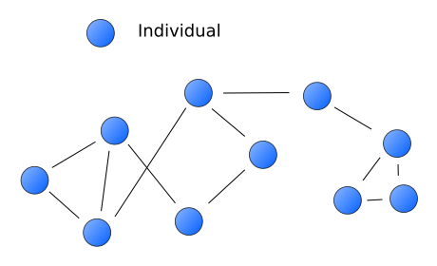
Social Network Analysis (SNA)
Mapping and measuring of relationships and flows between people, groups, organizations, computers or other information/knowledge processing entities.
The nodes in the network are the people and groups while the links show relationships or flows between the nodes.

Slide 6
Kite Network
Carol
Andre
Fernando
Diane
Heather
Ike
Jane
Beverly
Garth
Ed
Who are connecters or hubs in the network?
Who has control over what flows in the network?
Who has best visibility of what is happening in the network?
Who are peripheral players? Are they important?

Slide 7
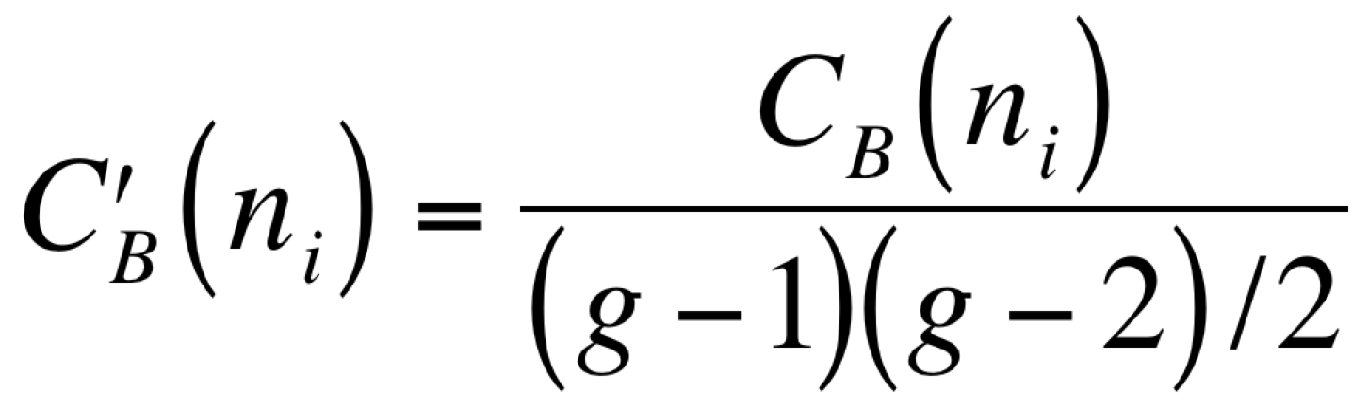
Measures
1. Degree Centrality:
The number of direct connections a node has. What really matters is where
those connections lead to and how they connect the otherwise unconnected.
2. Betweenness Centrality:
A node with high betweenness has great influence over what flows in the
network indicating important links and single points of failure.
3. Closeness Centrality:
The measure of closeness of a node to everyone else.
Determined by the sum of the length of the shortest paths between
the node and all other nodes in the graph.
Rescaling by dividing through by the number of pairs of nodes not including n_{i}
Undirected graph

Slide 8
Legend
g = size of graph (number of nodes)
d(.) = (in)degree
g_{jk} = number of minimal paths between nodes j and k
g_{jk}(n) = number of minimal paths between nodes j and k that contain n
(g-1)(g-2)/2 = number of potential paths
𝛴_{x=1}^{u} x = (u+1)u/2 für u=(g-2)
d(.,.)= distance between two nodes
Scaling with (g - 1)(g - 2): For every node n except n_{i} pair the node with all other nodes except n and n_{i}

Slide 9
Example: Kite-Network
Carol
Andre
Fernando
Diane
Heather
Ike
Jane
Beverly
Garth
 | C_{D}
C | 3
A | 4
F | 5
D | 6
B | 4
G | 5
E | 3
H | 3
I | 2
J | 1
 | C | A | F | D | B | G | E | H | I | J
C | 0 | 1 | 1 | 1 | 0 | 0 | 0 | 0 | 0 | 0
A | 1 | 0 | 1 | 1 | 1 | 0 | 0 | 0 | 0 | 0
F | 1 | 1 | 0 | 1 | 0 | 1 | 0 | 1 | 0 | 0
D | 1 | 1 | 1 | 0 | 1 | 1 | 1 | 0 | 0 | 0
B | 0 | 1 | 0 | 1 | 0 | 1 | 1 | 0 | 0 | 0
G | 0 | 0 | 1 | 1 | 1 | 0 | 1 | 1 | 0 | 0
E | 0 | 0 | 0 | 1 | 1 | 1 | 0 | 0 | 0 | 0
H | 0 | 0 | 1 | 0 | 0 | 1 | 0 | 0 | 1 | 0
I | 0 | 0 | 0 | 0 | 0 | 0 | 0 | 1 | 0 | 1
J | 0 | 0 | 0 | 0 | 0 | 0 | 0 | 0 | 1 | 0
Ed
Notes:
Diane hat die meisten direkten Verbindungen was sie zum aktivstem Knoten macht. Sie ist ein Konnektor oder Hub in dem Netzwerk Man geht immer davon aus, dass mehr Verbindungen besser sind, aber Diane hat nur Verbindungen zu ihrem Cluster, ihrer Clique. Sie verbindet nur die, die schon miteinander verbunden sind.
Betweenness: Heather hat eine wichtige Position im Netzwerk, ohne Sie sind Ike und Jane nicht mehr mit dem Netzwerk verbunden
Closeness:
Fernando und Garth haben weniger Verbindungen als Diane, aber ihre direkten und indirekten Verbindungen erlauben ihnen auf alle Knoten des Netzwerkes schneller Zugriff zu gelangen als alle anderen. Sie sind in einer exzellenten Position um den Informationsfluss im Netzwerk zu beobachten.

Slide 10
Example
 | A | B | C | D | E
A | 0 | 1 | 1 | 0 | 0
B | 1 | 0 | 0 | 1 | 1
C | 1 | 0 | 0 | 1 | 0
D | 0 | 1 | 1 | 0 | 1
E | 0 | 1 | 0 | 1 | 0
E
B
A
D
C
Adjacency
 | C_{B} | C_{C} | C_{D}
A | 1 | 1/6 | 2
B | 3 | 1/5 | 3
C | 1 | 1/6 | 2
D | 3 | 1/5 | 3
E | 0 | 1/6 | 2
 | A | B | C | D | E
A | 0 | 1 | 1 | 2 | 2
B | 1 | 0 | 2 | 1 | 1
C | 1 | 2 | 0 | 1 | 2
D | 2 | 1 | 1 | 0 | 1
E | 2 | 1 | 2 | 1 | 0
 | A | B | C | D | E
A | 0 | A | A | BC | B
B | B | 0 | AD | B | B
C | C | AD | 0 | C | D
D | BC | D | D | 0 | D
E | B | E | D | E | 0
Distance
Paths

Slide 11
Anchor Text
Community Analysis

Slide 12
The Web as a Directed Graph
Page A
Page B
hyperlink
Anchor
Assumption 1: A hyperlink between pages denotes author perceived relevance (quality signal)
Assumption 2: The anchor of the hyperlink
describes the target page (textual context)

Slide 13
Anchor Text
For IBM how to distinguish between:
  IBM’s home page (mostly graphical)
  IBM’s copyright page (high term freq. for ‘ibm’)
  Rival’s spam page (arbitrarily high term freq.)
“ibm.com”
“IBM home page”
“ibm”
A million pieces of anchor text with “ibm” send a strong signal
www.ibm.com
Oliver A. McBryan. GENVL and WWWW: Tools for Taming the Web. Research explained at First International Conference on the World Wide Web. CERN, Geneva (Switzerland), May 25-26-27 1994
(WWWW=World Wide Web Worm, first serach engine for the web)

Slide 14
Indexing anchor text
When indexing a document D, include anchor text from links pointing to D.
Armonk, NY-based computer
giant IBM announced today
www.ibm.com
Big Blue today announced
record profits for the quarter
Joe’s computer hardware links
Compaq
HP
IBM

Slide 15
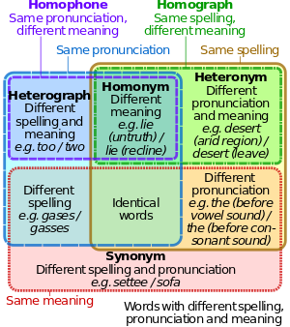
The Web as a Resource for NLP
[Wikipedia]

Slide 16
Page Rank
Community Analysis

Slide 17
The Web as a Resource for Ranking
First generation: using link counts as simple measures of popularity.
Two basic suggestions:
  Undirected popularity:
    Each page gets a score = the number of in-links plus the number of out-links (3+2=5).
  Directed popularity:
    Score of a page = number of its in-links (3).

Slide 18
Query processing
First retrieve all pages matching the text query
(say venture capital).
Order these by their link popularity
(either variant on the previous page).
How to organize for "Search Engine Optimization”?

Slide 19
PageRank scoring
Imagine a browser doing a random walk on web pages:
  Start at a random page
  At each step, go out of the current page along one of the links on that page, equiprobably
Each page has a long-term visit rate - use this as the page’s score
1/3
1/3
1/3

Slide 20
Not quite enough
The web is full of dead-ends.
  Random walk can get stuck in dead-ends.
  Makes no sense to talk about long-term visit rates.
??

Slide 21
Teleporting / damping
At a dead end, jump to a random web page.
At any non-dead end, with probability 10%, jump to a random web page.
  With remaining probability (90%), go out on a random link.
  10% - a parameter.
There is a long-term rate at which any page is visited.
  How do we compute this visit rate?

Slide 22
Markov chains
A Markov chain consists of n states, plus an n×n transition matrix P.
At each step, we are in exactly one of the states.
For 1 ≤ i,j ≤ n, the matrix entry P_{ij} tells us the relative frequency of j being the next state, given we are currently in state i.
P_{ii}>0
is OK.
i
j
P_{ij}

Slide 23
Ergodic Markov chains
A Markov chain is ergodic if
  you have a path from any state to any other (reducibility)
  returns to states occur at irregular times (aperiodicity)
  For any start state, after a finite transient time T₀, the probability of being in any state at a fixed time T>T₀ is nonzero. (positive recurrence)
Not
ergodic
(even/
odd).

Slide 24
Ergodic Markov chains
For any ergodic Markov chain, there is a unique long-term visit rate for each state.
  "Steady-state" distribution.
Over a long time-period, we visit each state in proportion to this rate.
It doesn’t matter where we start.

Slide 25
State vectors
A (row) vector (state vector) x = (x₁, … x_{n}) tells us where the walk is at any point.
E.g., (000…1…000) means we’re in state i.
1
i
n
More generally, the vector x = (x₁, … x_{n}) means the walk is in state i with relative frequency x_{i}.

Slide 26
Change in state vector
If the state vector is
x = (x₁, … x_{n}) at this step, what is it at the next step?
Recall that row i of the transition matrix P tells us where we go next from state i
So from x, our next state is distributed as xP.

Slide 27
Steady state example
The steady state looks like a vector of probabilities a = (a₁, … a_{n}):
  a_{i} is the relative frequency that we are in state i.
3/4
1/4
1
2
3/4
1/4
For this example, a₁=1/4 and a₂=3/4.

Slide 28
How do we compute this vector?
Let a = (a₁, … a_{n}) denote the row vector of steady-state rates.
If we our current position is described by a, then the next step is described as aP.
But a is the steady state, so a=aP.
Solving this matrix equation gives us a.
  So a is the (left) eigenvector for P.
  (Corresponds to the “principal” eigenvector of P with the largest eigenvalue)
  Transition matrices always have largest eigenvalue 1.

Slide 29
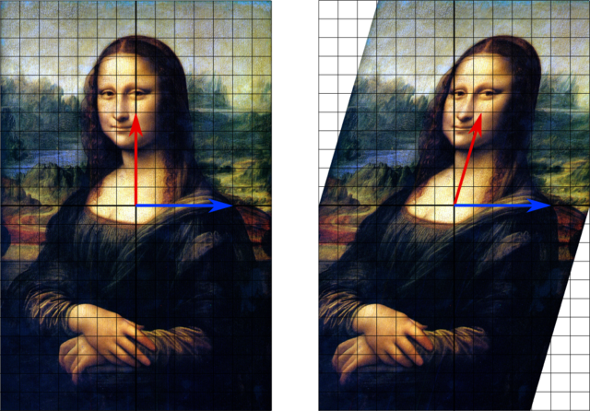
Eigenvectors and Eigenvalues Mx = 𝜆x
[Wikipedia]

Slide 30
One way of computing a
Recall, regardless of where we start, we eventually reach the steady state a.
Start with any distribution (say x=(10…0)).
After one step, we’re at xP;
after two steps at xP² , then xP³ and so on.
“Eventually” means for “large” k, xP^{k} = a.
Algorithm: multiply x by increasing powers of P until the product looks stable.

Slide 31
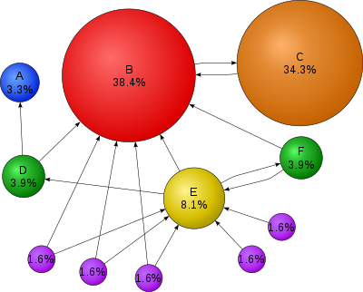
A Note on Google PageRank
Instead of linear rates, Google uses a logarithmic scale
Links are also weighted according to the importance of the source node
  Page C has a higher
  PageRank than Page E,
  even though there
  are fewer links to C;
  the one link to C
  comes from an
  important page
  and hence is
  of high value.
[Wikipedia]

Slide 32
PageRank Summary
Preprocessing:
  Given graph of links, build matrix P
  From it compute a
  The entry a_{i} is a number between 0 and 1: the pagerank of page i.
Query processing:
  Retrieve pages meeting query
  Rank them by their pagerank
  Order is query-independent
A variant of PageRank is used in Google,
but also many other clever heuristics

Slide 33
PageRank: Issues and Variants
How realistic is the random surfer model?
  What if we modeled the back button?
  Surfer behavior sharply skewed towards short paths
  Search engines, bookmarks & directories
  make jumps non-random
Biased Surfer Models
  Weight edge traversal probabilities based on match with topic/query (non-uniform edge selection)
  Bias jumps to pages on topic (e.g., based on personal bookmarks & categories of interest)

Slide 34
Google PageRank
Links are also weighted according to the importance of the source node
  Page C has a higher
  PageRank than Page E,
  even though there
  are fewer links to C;
  the one link to C
  comes from an
  important page
  and hence is
  of high value.
[Wikipedia]

Slide 35
Hyperlink-Induced Topic Search
Community Analysis

Slide 36
Hyperlink-Induced Topic Search (HITS)
In response to a query, instead of an ordered list of pages each matching the query, find two sets of inter-related pages:
  Hub pages are good lists of links on a subject
    e.g., “Bob’s list of cancer-related links.”
  Authority pages occur recurrently on good hubs for the subject
Best suited for “broad topic” queries rather than for page-finding queries
Jon M. Kleinberg, Hubs, Authorities, and Communities,
ACM Computing Surveys 31(4), December 1999

Slide 37
Hubs and Authorities
Thus, a good hub page for a topic points to many authoritative pages for that topic
A good authority page for a topic is pointed to by many good hubs for that topic
Circular definition - will turn this into an iterative computation

Slide 38
The hope
Authorities
Hubs
Long distance telephone companies

Slide 39
High-level scheme
Extract from the web a base set of pages that could be good hubs or authorities
From these, identify a small set of top hub and authority pages;
  iterative algorithm

Slide 40
Base set
Given text query (say “browser”), use a text index to get all pages containing “browser”
  Call this the root set of pages
Add in any page that either
  points to a page in the root set, or
  is pointed to by a page in the root set
Call this the base set

Slide 41
Visualization
Root
set
Base set
41

Slide 42
Assembling the base set
Root set typically 200-1000 nodes
Base set may have up to 5000 nodes
How do you find the base set nodes?
  Follow out-links by parsing root set pages
  Get in-links (and out-links) from a connectivity server
  Actually, suffices to text-index strings of the form href=“URL” to get in-links to URL

Slide 43
Distilling hubs and authorities
Compute, for each page x in the base set,
a hub score h(x) and an authority score a(x)
Initialize: for all x, h(x)←1; a(x) ←1;
Iteratively update all h(x), a(x);
After iterations output pages with
  highest h() scores as top hubs
  highest a() scores as top authorities
x
x

Slide 44
Scaling
To prevent the h() and a() values from getting too big, can scale down after each iteration
Scaling factor doesn’t really matter:
  we only care about the relative values of the scores

Slide 45
How many iterations?
Claim: relative values of scores will converge after a few iterations:
  In fact, suitably scaled, h() and a() scores settle into a steady state!
We only require the relative orders of the h() and a() scores - not their absolute values
In practice, ~5 iterations get you close to stability

Slide 46
Deeper understanding
Determination of conditional dependencies between attribute values of objects in a social network
Identification of clusters
…

Slide 47
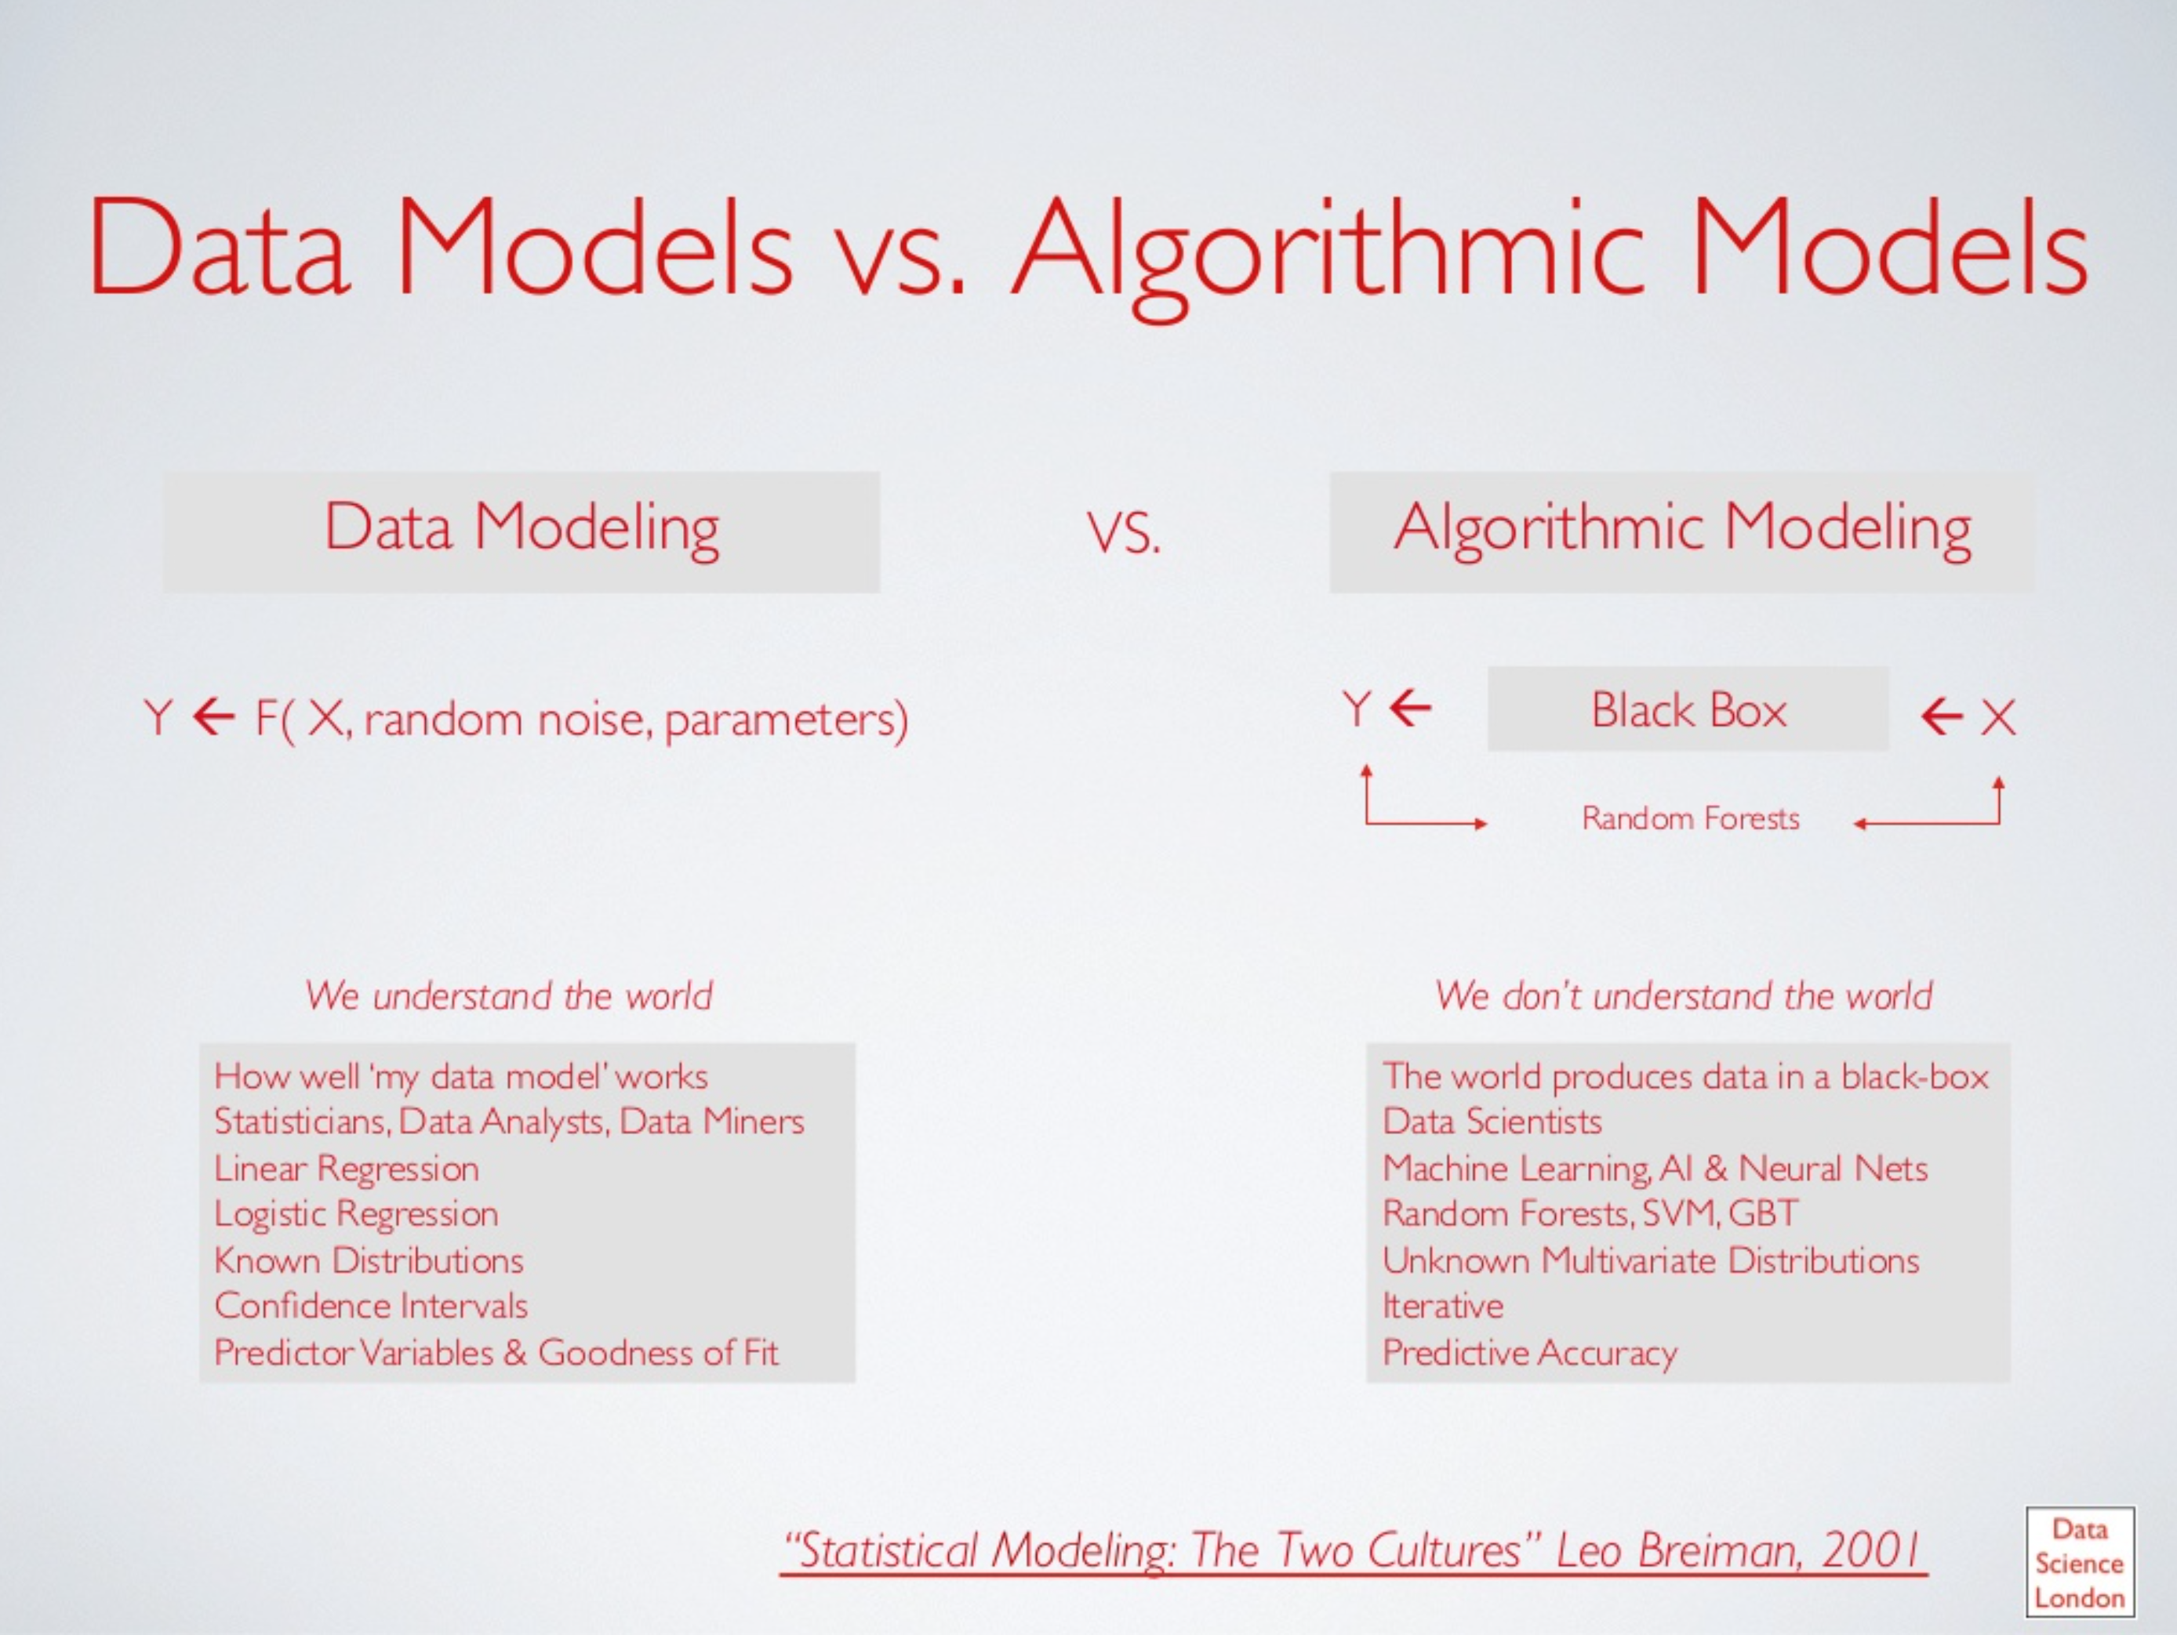
Data Science
AI

