Slide 1
Einführung in
Web- und Data-Science
Link Prediction
Dr. Marcel Gehrke
Universität zu Lübeck
Institut für Informationssysteme

Slide 2
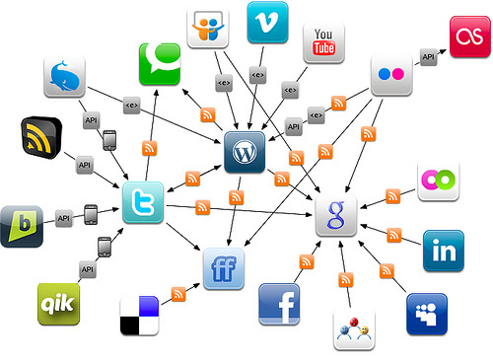
Acknowledgment
Hong Kong University of Science
and Technology
Advanced Data Mining
COMP 4332 / RMBI 4310
Computer Science and Engineering
IIT Kharagpur
Link Prediction in Social Networks
Pabitra Mitra
University of Southern California
CS 599: Social Media Analysis
Social Ties and Link Prediction
Kristina Lerman
A Theoretical Justification of Link Prediction Heuristics
Deepayan Chakrabarti, Purnamrita Sarkar, Andrew Moore
Stanford University
Graph Representation Learning
Jure Leskovec

Slide 3
Applications of Link Prediction on Graphs
Who are/will become friends?
Who will collaborate in drug racketeering?
Which products to recommend to which persons?
Are there unknown commonalities between species?
Where will new protein interactions show up?

Slide 4
Informal Definitions
Link Prediction Problem
  Given a snapshot of a network, can we infer which new interactions among its nodes are likely to occur in the near future?
Link Completion Problem
  If the network is known to be incomplete, can we infer which interactions are possibly missing (and should be added)?
  Then, solve link prediction problem on completed data
Both problems to be formalized based on
“proximity” of nodes in a network

Slide 5
The Intuition
In many networks, people who are “close” belong to the same social circles and will inevitably encounter one another and become linked themselves.
Link prediction heuristics measure how “close” people are
x
x
y
y
Red nodes are close to each other
Red nodes are more distant

Slide 6
Challenges
Data is usually sparse
  Missing data/relationships
Imbalance
  So many possibilities, so few choices
  Ill-posed problem
  Low accuracy in practice
Accuracy vs. scalability
  Modeling (unobserved/unknown factors)
  Tasks of approximation/optimization

Slide 7

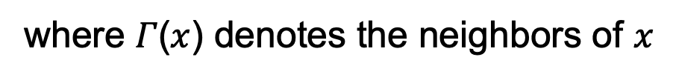
Graph distance & Common Neighbors
Graph distance: (Negated) length
of shortest path between x and y
E
B
D
(A, C) | -2
(C, D) | -2
(A, E) | -3
A
C
Common Neighbors: A and C have 2 common neighbors, more likely to collaborate
E
B
D
score (x, y) :=
A
where 𝛤($x$) denotes the neighbors of $x$
C

Slide 8

Preferential Attachment
Preferential Attachment: Probability that a new collaboration involves x is proportional to 𝛤(x), the current neighbors of x
score (x, y) :=

Slide 9

Hitting time, PageRank
Hitting time: expected number of steps for a random
walk starting at x to reach y
Commute time:
If y has a large stationary probability, Hx,y is small. To counterbalance, we can normalize
Rooted PageRank: to cut down on long random walks, walk can return to x with a probablity α at every step y

Slide 10

SimRank
Defined by this recursive definition: two nodes are similar to the extent that they are joined by similar neighbors

Slide 11
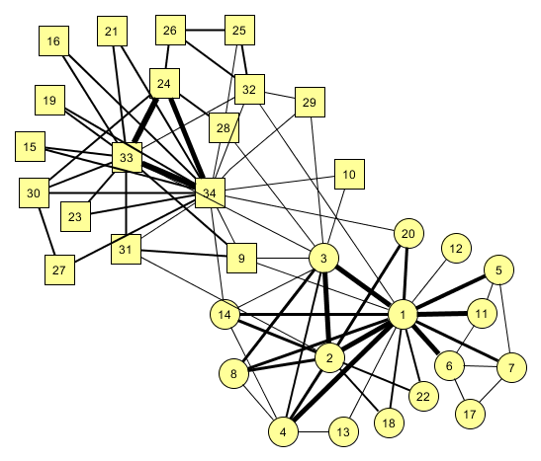
Link Prediction
Will nodes 33 and 28 become friends in the future?
Does network structure contain enough information to predict what new links will form in the future?
What about nodes 27 and 4?

Slide 12
Link Prediction using Collaborative Filtering
 | Item 1 | Item 2 | Item 3 | Item 4 | Item 5
User 1 | 8 | 1 | ? | 2 | 7
User 2 | 2 | ? | 5 | 7 | 5
User 3 | 5 | 4 | 7 | 4 | 7
User 4 | 7 | 1 | 7 | 3 | 8
User 5 | 1 | 7 | 4 | 6 | ?
User 6 | 8 | 3 | 8 | 3 | 7

Slide 13
Link Prediction using Collaborative Filtering
Memory-based Approach
  User-based approach [Twitter]
  Item-based approach [Amazon & Youtube]
Model-based Approach
  Latent Factor Model [Google News]
Hybrid Approach

Slide 14
Memory-based Approach
Few modeling assumptions
Few tuning parameters to learn
Easy to explain to users
  Dear Amazon.com Customer, We've noticed that customers who have purchased or rated How Does the Show Go On: An Introduction to the Theater by Thomas Schumacher have also purchased Princess Protection Program #1: A Royal Makeover (Disney Early Readers).

Slide 15

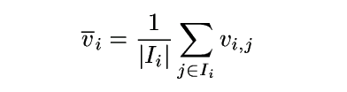
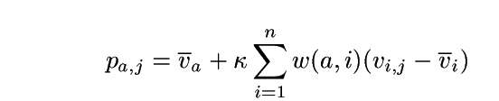
Algorithms: User-Based Algorithms (Breese et al, UAI98)
v_{i,j}= vote of user i on item j
I_{i} = items for which user i has voted
Mean vote for i is
Predicted vote for “active user” a is weighted sum
normalizer
weights of n similar users

Slide 16
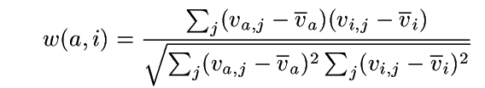
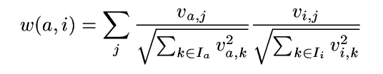
Algorithms: User-Based Algorithms (Breese et al, UAI98)
K-nearest neighbor
Pearson correlation coefficient (Resnick ’94, Grouplens):
Cosine distance (from IR)

Slide 17
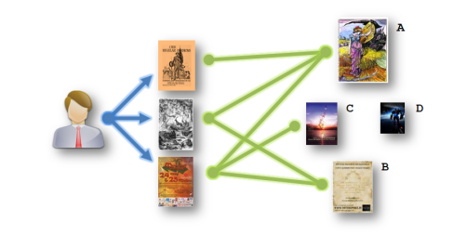
Algorithm: Amazon’s Method
Item-based Approach
  Similar with user-based approach but is on the item side

Slide 18
Item-based CF Example: infer (user 1, item 3)
 | Item 1 | Item 2 | Item 3 | Item 4 | Item 5
User 1 | 8 | 1 | ? | 2 | 7
User 2 | 2 | ? | 5 | 7 | 5
User 3 | 5 | 4 | 7 | 4 | 7
User 4 | 7 | 1 | 7 | 3 | 8
User 5 | 1 | 7 | 4 | 6 | ?
User 6 | 8 | 3 | 8 | 3 | 7

Slide 19
How to Calculate Similarity (Item 3 and Item 5)?
 | Item 1 | Item 2 | Item 3 | Item 4 | Item 5
User 1 | 8 | 1 | ? | 2 | 7
User 2 | 2 | ? | 5 | 7 | 5
User 3 | 5 | 4 | 7 | 4 | 7
User 4 | 7 | 1 | 7 | 3 | 8
User 5 | 1 | 7 | 4 | 6 | ?
User 6 | 8 | 3 | 8 | 3 | 7

Slide 20
Similarity between Items
Item 3 | Item 4 | Item 5
? | 2 | 7
5 | 7 | 5
7 | 4 | 7
7 | 3 | 8
4 | 6 | ?
8 | 3 | 7
How similar are items
3 and 5?
  How to calculate
  their similarity?
Notes:
Each row in the table are the ratings one user on the items
20

Slide 21
Similarity between items
Item 3 | Item 5
? | 7
5 | 5
7 | 7
7 | 8
4 | ?
8 | 7
Only consider users who have rated
both items
For each user:
Calculate difference in ratings for the
two items
Take the average of this difference over
the users
Can also use Pearson Correlation
Coefficients as in user-based approaches
sim(item 3, item 5) = cosine( (5, 7, 7, 8), (5, 7, 8, 7))
= (5*5 + 7*7 + 7*8 + 8*7)/
(sqrt(5²+7²+7²+8²)* sqrt(5²+7²+8²+7²))
Notes:
Each row in the table are the ratings one user on the items
21

Slide 22
Prediction: Calculating ranking r(user1,item3)
Item 2
8
1
Item 1
Item 3
Item 5
7
Where α is a normalization factor, which is
1/[the sum of all sim(item_{i},item₃)].
Item 4
2
Notes:
Showing five items, Item 3 is the one we need to know for User 1. Distances to Item 3 indicate similarity. Numbers in yellow boxes give ratings for User 1 for other items.
Blue area shows nearest neighbours, items that are most similar to Item 3 based on past ratings by other users.
22

Slide 23

Algorithm: Youtube’s Method
Youtube also adopt item-based approach
Adding more useful features
  Num. of views
  Num. of likes
  etc.

Slide 24
Link Prediction: Summary
Link prediction is the underlying problem in many applications
No methods fits all purposes
Need to carefully evaluate a method in a practical setting
Methods are hard to analyze theoretically, but see
Purnamrita Sarkar, Deepayan Chakrabarti, and Andrew W. Moore. Theoretical justification of popular link prediction heuristics.
In: Proc. IJCAI-11. pp. 2722–2727. 2011.

