Slide 1
Intelligent Agents :
Automated Planning and Acting
  $$\left[t_{s}, t_{e}\right]bring\left(r,c,p\right)$$
Temporal
pile(c) = p′
freight(r) = empty
move
move
t₁
uncover
load
unload
t₂
t_{s} t₃ t₄ t₅ t₆ t₇ t_{e}

Slide 2
Content: Planning and Acting
With Deterministic Models
Planning and Acting with Temporal Models
  Temporal Representation
  Planning with Temporal Refinement Methods
  Constraint Management
  Acting with Temporal Models
With Nondeterministic Models
With Probabilistic Models
By Decision Making
  Foundations
  Extensions
  Structure
With Human-awareness
Notes:
1-4, 6: Planning book
5, 7: AIMA
8: Rao

Slide 3
Temporal Models
Durations of actions
Delayed effects and preconditions
  E.g., resources borrowed or consumed during an action
Time constraints on goals
  Relative or absolute
Exogenous events expected to occur in the future
  When?
Maintenance actions:
  Maintain a property (≠ changing a value)
  E.g., track a moving target, keep a spring latch in position
Concurrent actions
  Interacting effects, joint effects
Delayed commitment
  Instantiation at acting time

Slide 4
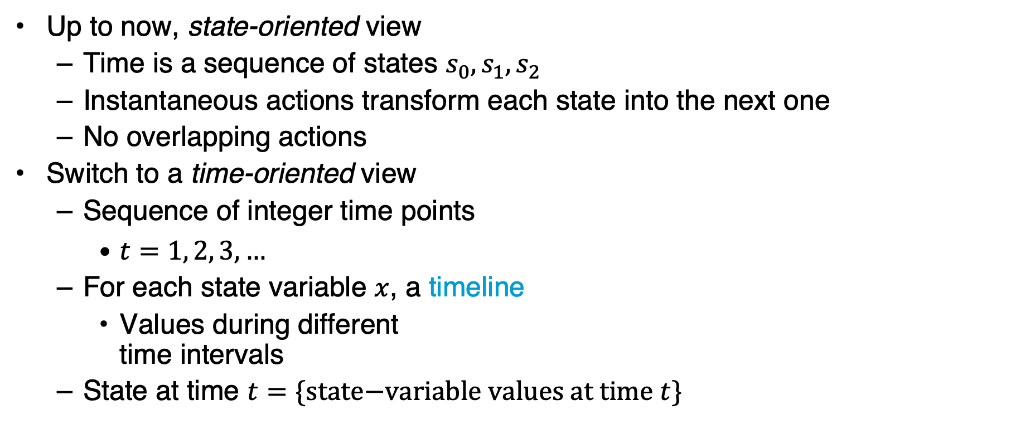
Timelines
Up to now, state-oriented view
  Time is a sequence of states $s_{0}, s_{1}, s_{2}$
  Instantaneous actions transform each state into the next one
  No overlapping actions
Switch to a time-oriented view
  Sequence of integer time points
    $t=1, 2, 3, …$
  For each state variable $x$, a timeline
    Values during different
    time intervals
  State at time $t=\{\text{state}\text{−}\text{variable} \text{values} \text{at} \text{time} t\}$
t
t+1
x
state variables
y
time
Notes:
Not yet continuous time

Slide 5
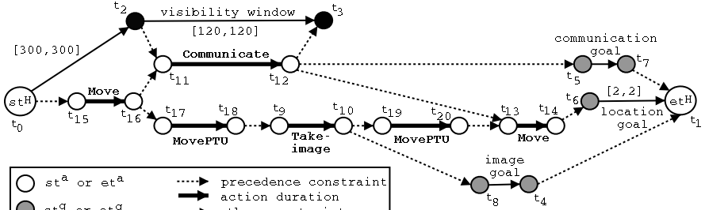
Timelines
Sets of constraints on state variables and events
  Reflect predicted actions and events
Planning is constraint-based
Notes:
Timeline planning: constraint-based planning

Slide 6
Outline per the Book
4.2 Representation
  Timelines
  Actions and tasks
  Chronicles
4.3 Temporal Planning
  Resolvers and flaws
  Search space
4.4 Constraint Management
  Consistency of object constraints and time constraints
  Controlling the actions when we do not know how long they will take
4.5 Acting with Temporal Models
  Acting with atemporal refinement
  Dispatching
  Observation actions
Notes:
4.1 Intro

Slide 7
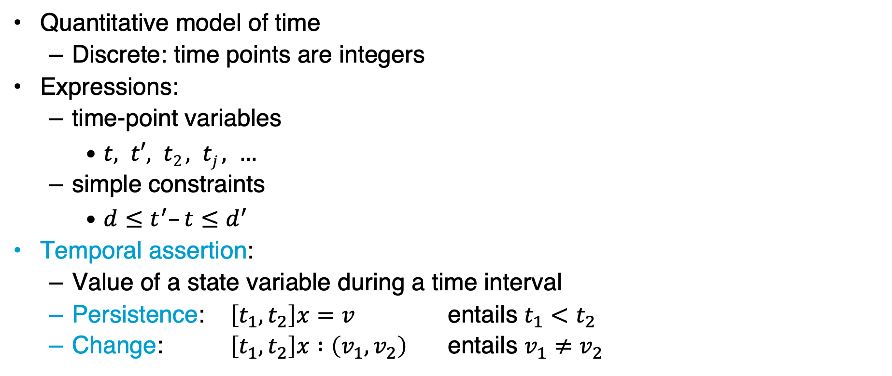
Representation
Quantitative model of time
  Discrete: time points are integers
Expressions:
  time-point variables
    $t, t′, t2 , tj , …$
  simple constraints
    $d≤t^{′}–t≤d^{′}$
Temporal assertion:
  Value of a state variable during a time interval
  Persistence: $\left[t_{1}, t_{2}\right]x=v$ entails $t_{1}<t_{2}$
  Change: $\left[t_{1}, t_{2}\right]x :\left(v_{1}, v_{2}\right)$ entails $v_{1}≠v_{2}$

Slide 8

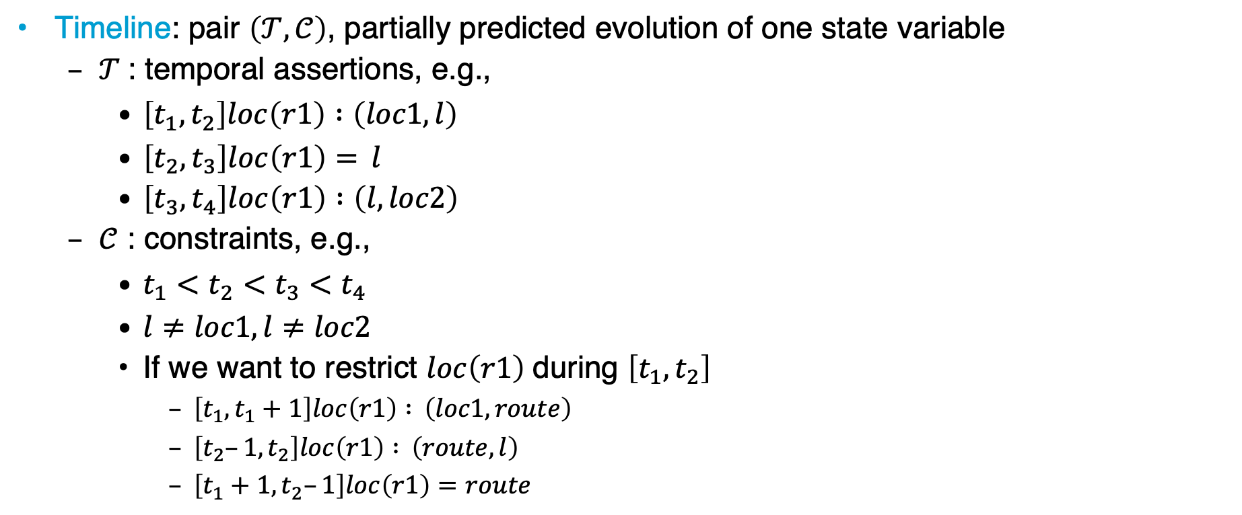







Timeline
Timeline: pair $\left(𝒯,𝒞\right)$, partially predicted evolution of one state variable
  $𝒯$: temporal assertions, e.g.,
    $\left[t_{1}, t_{2}\right]loc\left(r1\right) :\left(loc1, l\right)$
    $\left[t_{2}, t_{3}\right]loc\left(r1\right)= l$
    $\left[t_{3}, t_{4}\right]loc\left(r1\right) :\left(l, loc2\right)$
  $𝒞$ : constraints, e.g.,
    $t_{1}<t_{2}<t_{3}<t_{4}$
    $l≠loc1,l≠loc2$
    If we want to restrict $loc\left(r1\right)$ during $\left[t_{1}, t_{2}\right]$
      $\left[t_{1}, t_{1}+1\right]loc\left(r1\right) : \left(loc1, route\right)$
      $\left[t_{2}–1, t_{2}\right]loc\left(r1\right) : \left(route,l\right)$
      $\left[t_{1}+1, t_{2}–1\right]loc\left(r1\right)=route$
$$l$$
Persistence
$$loc\left(r1\right)$$
$$loc1$$
Change
$$loc2$$
$$t_{1}$$
$$t_{2}$$
$$t_{3}$$
$$t_{4}$$
Notes:
A timeline does not say anything about when it happens and how much time passes between the ti’s
Constraints with route make it that r1 leaves loc1 at t1 and arrives at l at t2 and is in some intermediate state route in between

Slide 9


Timeline
Instance of $\left(𝒯,𝒞\right)$ = temporal and object variables instantiated
An instance is consistent if it satisfies all constraints in $𝒞$ and does not specify two different values for a state variable at the same time
A timeline is secure if its set of consistent instances is not empty
$$l$$
Persistence
$$loc\left(r1\right)$$
$$loc1$$
Change
$$loc2$$
$$t_{1}$$
$$t_{2}$$
$$t_{3}$$
$$t_{4}$$
Notes:
A timeline does not say anything about when it happens and how much time passes between the ti’s
Constraints with route make it that r1 leaves loc1 at t1 and arrives at l at t2 and is in some intermediate state route in between

Slide 10

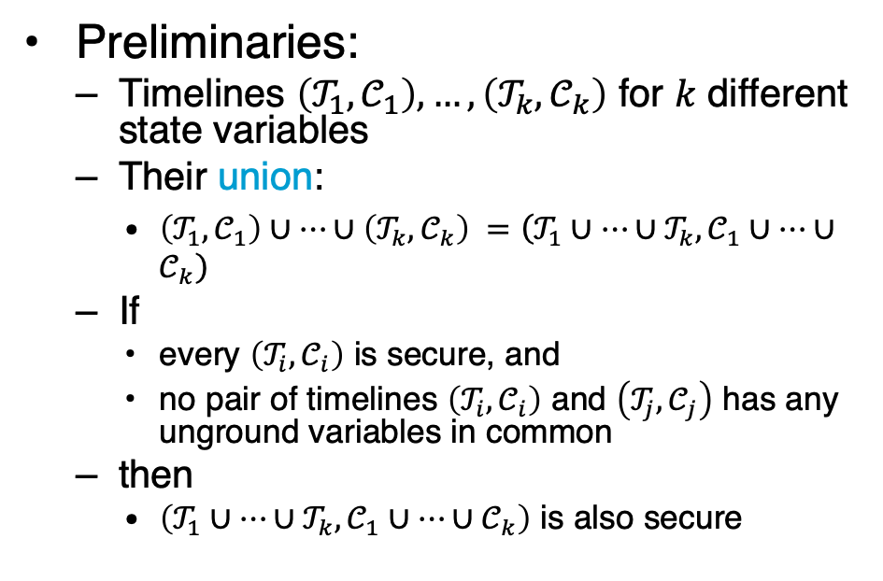
Actions
Preliminaries:
  Timelines $\left(𝒯_{1},𝒞_{1}\right), …,\left(𝒯_{k},𝒞_{k}\right)$ for $k$ different state variables
  Their union:
    $\left(𝒯_{1},𝒞_{1}\right)∪…∪\left(𝒯_{k},𝒞_{k}\right) =\left(𝒯_{1}∪…∪𝒯_{k}, 𝒞_{1}∪…∪𝒞_{k}\right)$
  If
    every $\left(𝒯_{i},𝒞_{i}\right)$ is secure, and
    no pair of timelines $\left(𝒯_{i},𝒞_{i}\right)$ and $\left(𝒯_{j},𝒞_{j}\right)$ has any unground variables in common
  then
    $\left(𝒯_{1}∪…∪𝒯_{k}, 𝒞_{1}∪…∪𝒞_{k}\right)$ is also secure
Action or primitive task (or just primitive):
  a triple $\left(head,𝒯,𝒞\right)$
    $head$ is the name and arguments
    $\left(𝒯,𝒞\right)$ is the union of a set of timelines

Slide 11

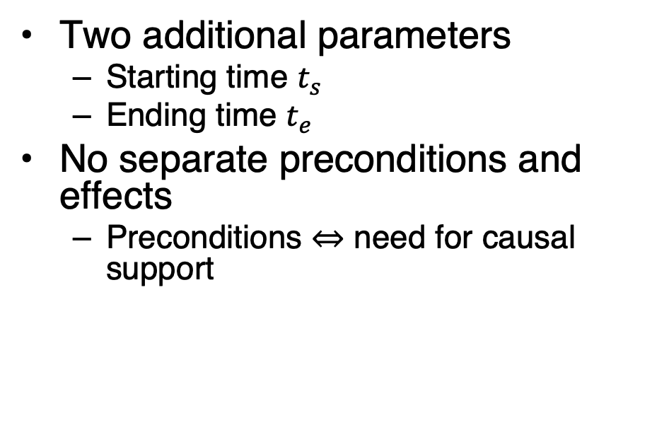
Actions
$leave\left(r,d,w\right)$
  Robot $r$ leaves dock $d$,
  goes to adjacent waypoint $w$
$loc(r)$ changes to $w$ with delay $≤δ_{1}$
Dock $d$ becomes empty
Two additional parameters
  Starting time $t_{s}$
  Ending time $t_{e}$
No separate preconditions and effects
  Preconditions ⇔ need for causal support
leave(r,d,w)
  assertions:
    [t_{s},t_{e}] loc(r): (d,w)
    [t_{s},t_{e}] occupant(d): (r,empty)
  constraints:
    t_{e} ≤ t_{s} + δ₁
    adj(d,w)
• w
r
d

Slide 12
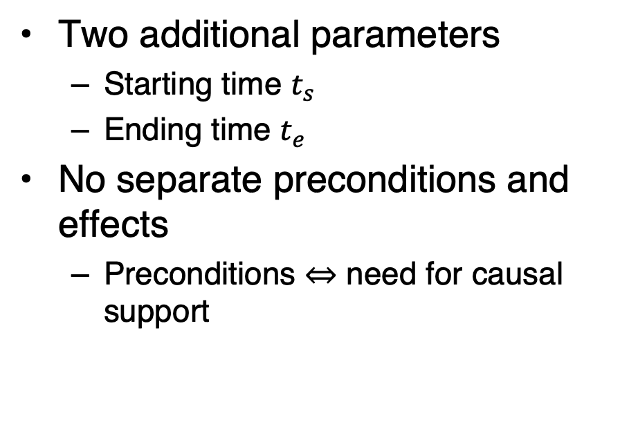

Actions
$enter\left(r,d,w\right)$
  $r$ enters $d$ from an adjacent waypoint $w$
$loc(r)$ changes to $d$ with delay $≤δ_{2}$
Dock $d$ becomes occupied by $r$
Two additional parameters
  Starting time $t_{s}$
  Ending time $t_{e}$
No separate preconditions and effects
  Preconditions ⇔ need for causal support
    enter(r,d,w)
    assertions:
    [t_{s},t_{e}] loc(r): (w,d)
    [t_{s},t_{e}] occupant(d): (empty,r)
    constraints:
    t_{e} ≤ t_{s} + δ₂
    adj(d,w)
r
• w
d

Slide 13

Actions
$take\left(k,c,r,d\right)$
  Action: crane $k$ takes container $c$ from $r$ on dock $d$
Two additional parameters
  Starting time $t_{s}$
  Ending time $t_{e}$
No separate preconditions and effects
  Preconditions ⇔ need for causal support
book omits d
take(k,c,r,d)
assertions:
[t_{s},t_{e}] pos(c): (r, k) // where container c is
[t_{s},t_{e}] grip(k): (empty, c) // what crane k’s gripper is holding
[t_{s},t_{e}] freight(r): (c,empty) // what r is carrying
[t_{s},t_{e}] loc(r) = d // where r is
constraints:
attached(k,d)
k
c
r
d

Slide 14
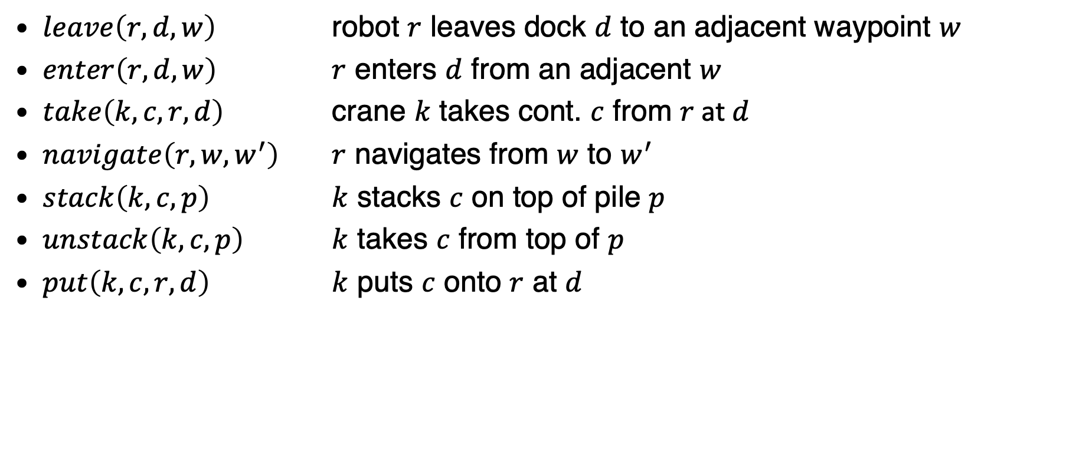
Actions
$leave\left(r,d,w\right)$ robot $r$ leaves dock $d$ to an adjacent waypoint $w$
$enter\left(r,d,w\right)$ $r$ enters $d$ from an adjacent $w$
$take\left(k,c,r,d\right)$ crane $k$ takes cont. $c$ from $r$ at $d$
$navigate\left(r,w,w^{′}\right)$ $r$ navigates from $w$ to $w^{′}$
$stack\left(k,c,p\right)$ $k$ stacks $c$ on top of pile $p$
$unstack\left(k,c,p\right)$ $k$ takes $c$ from top of $p$
$put\left(k,c,r,d\right)$ $k$ puts $c$ onto $r$ at $d$
k
book omits d
c
• w
r
d

Slide 15

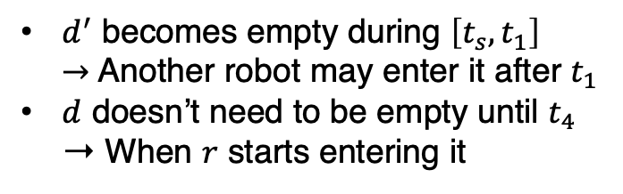
Tasks and Methods
Task: move robot r to dock d
  $\left[t_{s},t_{e}\right]move\left(r,d\right)$
Method:
  $$\left[t_{s},t_{e}\right]move\left(r,d\right)$$
navigate
leave
enter
  m-move1(r,d,d′,w,w′)
  task: move(r,d)
  refinement: [t_{s},t₁] leave(r,d′,w′)
  [t₂,t₃] navigate(r,w′,w)
  [t₄,t_{e}] enter(r,d,w)
  assertions: [t_{s},t_{s}+1] loc(r) = d′
  constraints: adj(d,w),
  adj(d′,w′), d ≠ d′,
  connected(w,w′),
  t₁ ≤ t₂, t₃ ≤ t₄
t_{s} t₁ t₂ t₃ t₄ t_{e}
  $d^{′}$ becomes empty during $\left[t_{s},t_{1}\right]$
  $→$Another robot may enter it after $t_{1}$
  $d$ doesn’t need to be empty until $t_{4}$ ➝ When $r$ starts entering it
• w2
d2
• w1
r1
d1
Notes:
Refinements: all actions

Slide 16

Tasks and Methods
Task: remove everything above container $c$ in pile $p$
  $\left[t_{s},t_{e}\right]uncover\left(c,p\right)$
Method:
  $$\left[t_{s},t_{e}\right]uncover\left(c,p\right)$$
stack
unstack
uncover
  m-uncover(c,p,k,d,p′)
  task: uncover(c,p)
refinement: [t_{s},t₁] unstack(k,c′,p) // action
[t₂,t₃] stack(k,c′,p′) // action
[t₄,t_{e}] uncover(c,p) // recursion
  assertions: [t_{s},t_{s}+1] pile(c) = p
  [t_{s},t_{s}+1] top(p) = c′
  [t_{s}, t_{s}+1] grip(k) = empty
constraints: attached(k,d), attached(p,d),
attached(p′,d),
p ≠ p′, c′ ≠ c,
t₁ ≤ t₂, t₃ ≤ t₄
t_{s} t₁ t₂ t₃ t₄ t_{e}
k1
c1
c2
c3
p1
p2
Notes:
Refinements: actions + another task/method

Slide 17



Tasks and Methods
  $$\left[t_{s}, t_{e}\right]bring\left(r,c,p\right)$$
pile(c) = p′
freight(r) = empty
Task: robot $r$ brings container $c$ to pile $p$
  $\left[t_{s}, t_{e}\right]bring\left(r,c,p\right)$
Method:
move
move
t₁
uncover
load
unload
t₂
m-bring(r,c,p,p′,d,d′)
task: bring(r,c,p)
  refinement: [t_{s},t₁] move(r,d′)
  [t_{s},t₂] uncover(c,p′)
  [t₃,t₄] load(k′,r,c,p′)
  [t₅,t₆] move(r,d)
  [t₇,t_{e}] unload(k,r,c,p)
  assertions: [t_{s},t₃] pile(c) = p′
  [t_{s},t₃] freight(r) = empty
constraints: attached(p′,d′), attached(p,d), d ≠ d′
attached(k′,d′), attached(k,d), k ≠ k′
t₁ ≤ t₃, t₂ ≤ t₃, t₄ ≤ t₅, t₆ ≤ t₇
t_{s} t₃ t₄ t₅ t₆ t₇ t_{e}
Refine into $unstack$ and $put$ primitives
k2
r1
Refine into $take$ and $stack$ primitives
• w2
d2
k1
p3
• w1
c1
d1
p1
p2
Notes:
Refinements: parallel actions

Slide 18
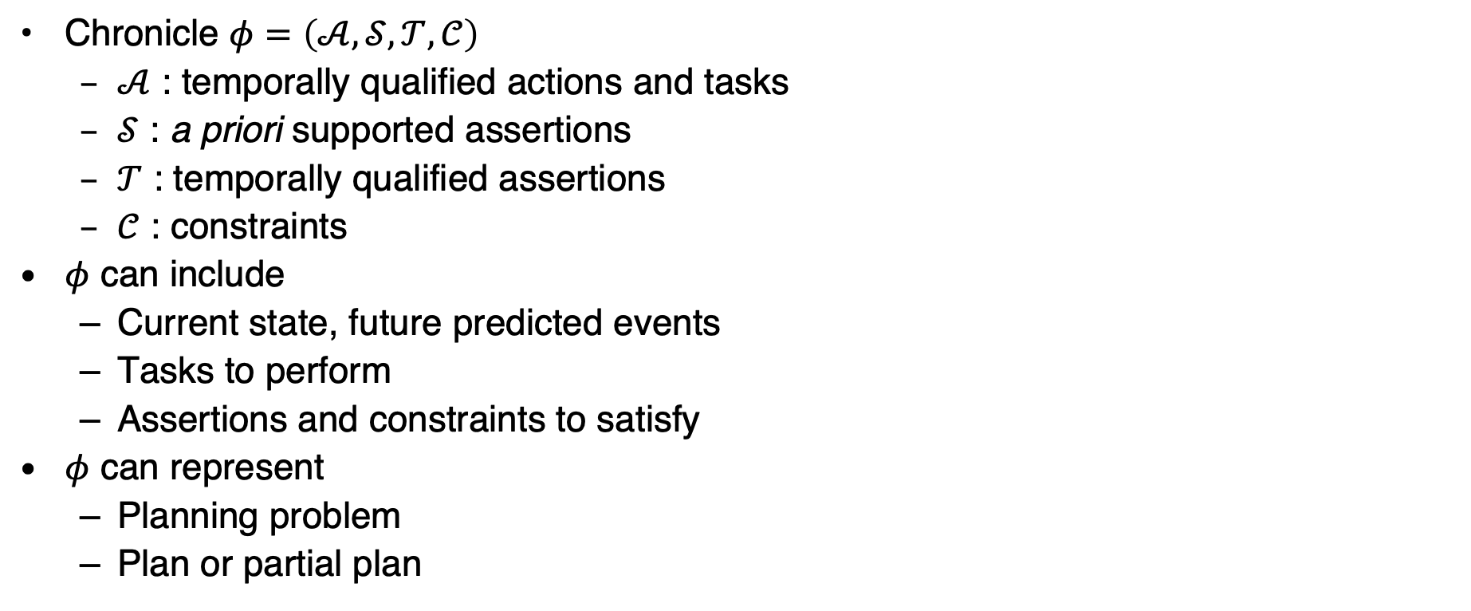
Chronicles: Unions of Timelines
  $$\left[t_{s}, t_{e}\right]bring\left(r,c1,d4\right)$$
loc(r1) = d1
top(pile-ship1) = c1
docked(ship1) = d3
Chronicle $φ=\left(𝒜,𝒮,𝒯,𝒞\right)$
  $𝒜$ : temporally qualified actions and tasks
  $𝒮$ : a priori supported assertions
  $𝒯$ : temporally qualified assertions
  $𝒞$ : constraints
$φ$ can include
  Current state, future predicted events
  Tasks to perform
  Assertions and constraints to satisfy
$φ$ can represent
  Planning problem
  Plan or partial plan
loc(r1) = d1
t_{s} t t_{s}+10 t_{s}+𝛿 t’ t_{e}
ϕ₀:
tasks: [t,t’] bring(r,c1,d4)
supported: [t_{s}] loc(r1)=d1
[t_{s}] loc(r2)=d2
[t_{s}+10,t_{s}+δ] docked(ship1)=d3
[t_{s}] top(pile-ship1)=c1
[t_{s}] pos(c1)=pallet
assertions: [t_{e}] loc(r1)=d1
[t_{e}] loc(r2)=d2
constraints: t_{s} = 0 < t < t' < t_{e} , 20 ≤ δ ≤ 30
Notes:
Problem representation that has flaws that need to be resolved ➝ turns problem into plan representation

Slide 19
Intermediate Summary
Timelines
  Temporal assertions (change, persistence), constraints
  Conflicts, consistency, security, causal support
Chronicle: union of several timelines
  Consistency, security, causal support
Actions represented by chronicles
  No separate preconditions and effects
    Preconditions ⇔ need for causal support

Slide 20
Outline per the Book
4.2 Representation
  Timelines
  Actions and tasks
  Chronicles
4.3 Temporal Planning
  Resolvers and flaws
  Search space
4.4 Constraint Management
  Consistency of object constraints and time constraints
  Controlling the actions when we do not know how long they will take
4.5 Acting with Temporal Models
  Acting with atemporal refinement
  Dispatching
  Observation actions
Notes:
4.1 Intro

Slide 21



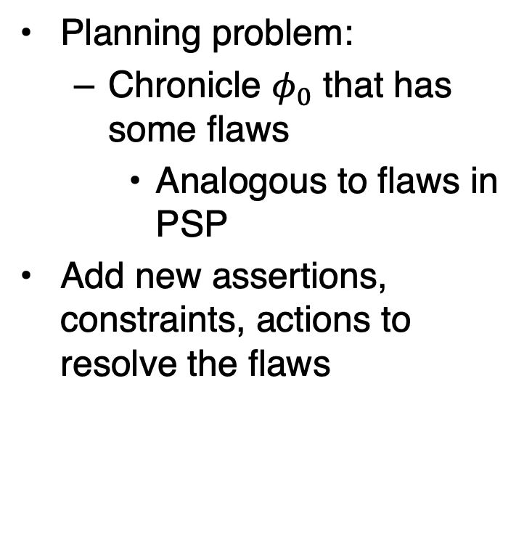













Planning
Planning problem:
  Chronicle $φ_{0}$ that has some flaws
    Analogous to flaws in PSP
Add new assertions, constraints, actions to resolve the flaws
  ϕ₀: tasks: (none)
  supported: (none)
assertions: [t₁,t₂] loc(r1) = l
[t₃,t₄] loc(r1) : (loc3,loc4)
constraints: adj(loc3,w1)
adj(w1,loc3)
adj(loc4,w2)
adj(w2,loc4)
connected(w1,w2)
  ϕ₀: tasks: [t₂,t₃] move(r1,loc3)
  supported: (none)
assertions: [t₁,t₂] loc(r1) = l
[t₃,t₄] loc(r1) : (loc3,loc4)
constraints: adj(loc3,w1)
adj(w1,loc3)
adj(loc4,w2)
adj(w2,loc4)
connected(w1,w2)
$$l$$
$$loc4$$
$$l$$
$$loc4$$
$$loc\left(r1\right)$$
$$loc\left(r1\right)$$
move
$$loc3$$
$$loc3$$
$$t_{1}$$
$$t_{2}$$
$$t_{3}$$
$$t_{4}$$
$$t_{1}$$
$$t_{2}$$
$$t_{3}$$
$$t_{4}$$
Notes:
Keep constraints consistent

Slide 22



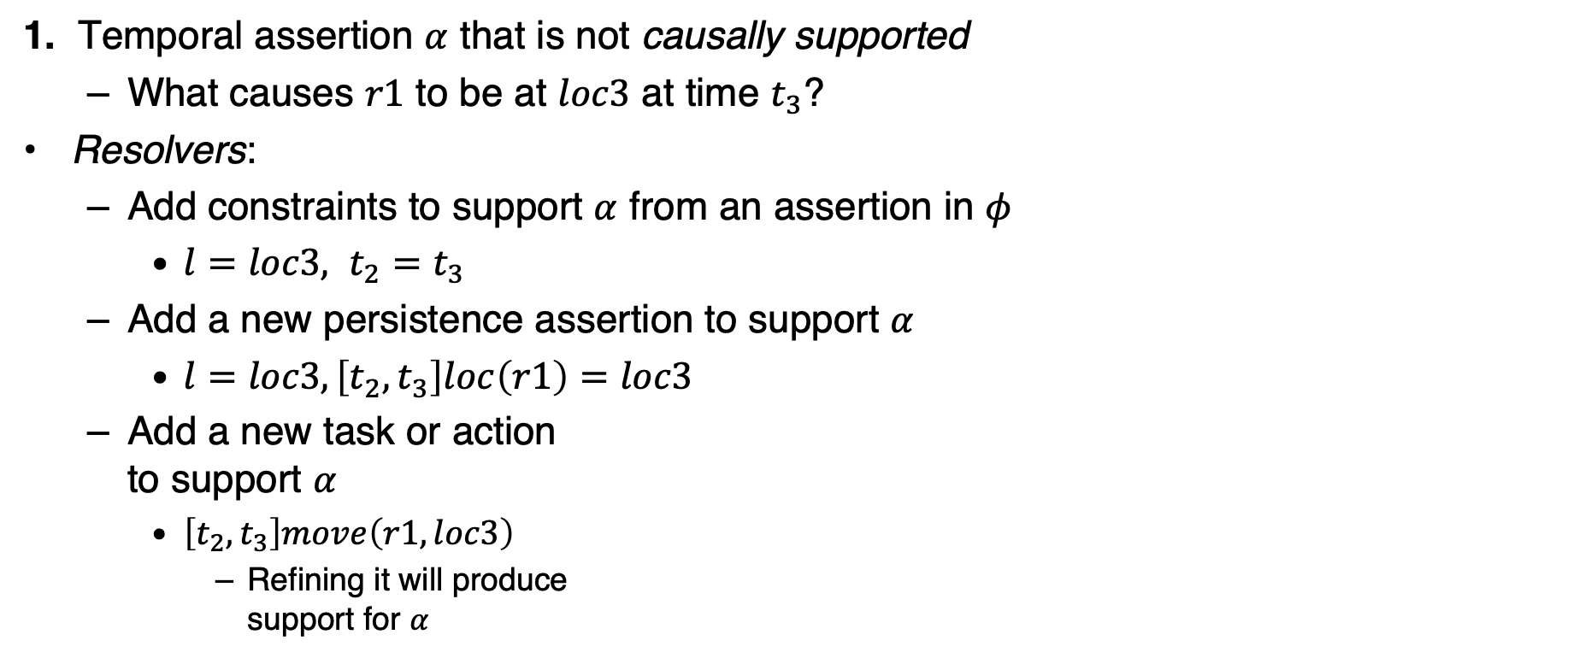
























Flaws (1)
1. Temporal assertion $α$ that is not causally supported
  What causes $r1$ to be at $loc3$ at time $t_{3}$?
Resolvers:
  Add constraints to support $α$ from an assertion in $φ$
    $l=loc3, t_{2}=t_{3}$
  Add a new persistence assertion to support $α$
    $l=loc3, \left[t_{2},t_{3}\right]loc\left(r1\right)=loc3$
  Add a new task or action
  to support $α$
    $\left[t_{2},t_{3}\right]move\left(r1,loc3\right)$
      Refining it will produce
      support for $α$
Like an open goal in PSP
$$l$$
$$loc4$$
$$loc\left(r1\right)$$
$$loc3$$
$$t_{1}$$
$$t_{2}$$
$$t_{3}$$
$$t_{4}$$
$$loc4$$
$$loc4$$
$$l$$
$$loc4$$
$$loc\left(r1\right)$$
$$l=loc3$$
$$loc\left(r1\right)$$
$$loc\left(r1\right)$$
move
$$l=loc3$$
$$loc3$$
$$t_{1}$$
$$t_{2}=t_{3}$$
$$t_{4}$$
$$t_{1}$$
$$t_{2}$$
$$t_{3}$$
$$t_{4}$$
$$t_{1}$$
$$t_{2}$$
$$t_{3}$$
$$t_{4}$$

Slide 23


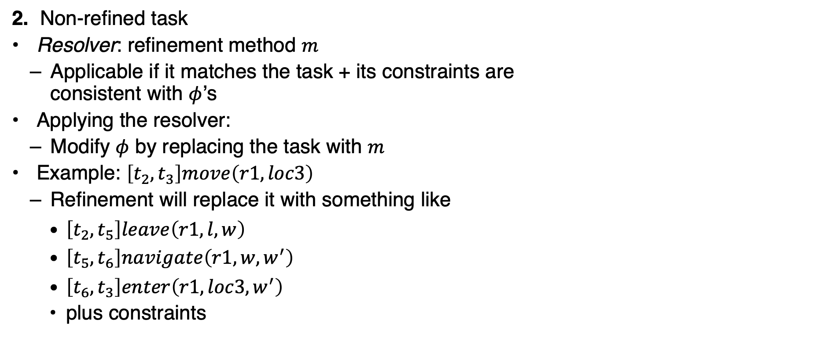




Flaws (2)
2. Non-refined task
Resolver: refinement method $m$
  Applicable if it matches the task + its constraints are
  consistent with $φ$’s
Applying the resolver:
  Modify $φ$ by replacing the task with $m$
Example: $\left[t_{2},t_{3}\right]move\left(r1,loc3\right)$
  Refinement will replace it with something like
    $\left[t_{2},t_{5}\right]leave\left(r1,l,w\right)$
    $\left[t_{5},t_{6}\right]navigate\left(r1, w, w^{′}\right)$
    $\left[t_{6},t_{3}\right]enter\left(r1,loc3,w^{′}\right)$
    plus constraints
Like a task in SeRPE
$$l$$
$$loc4$$
$$loc\left(r1\right)$$
move
$$loc3$$
$$t_{1}$$
$$t_{2}$$
$$t_{3}$$
$$t_{4}$$

Slide 24


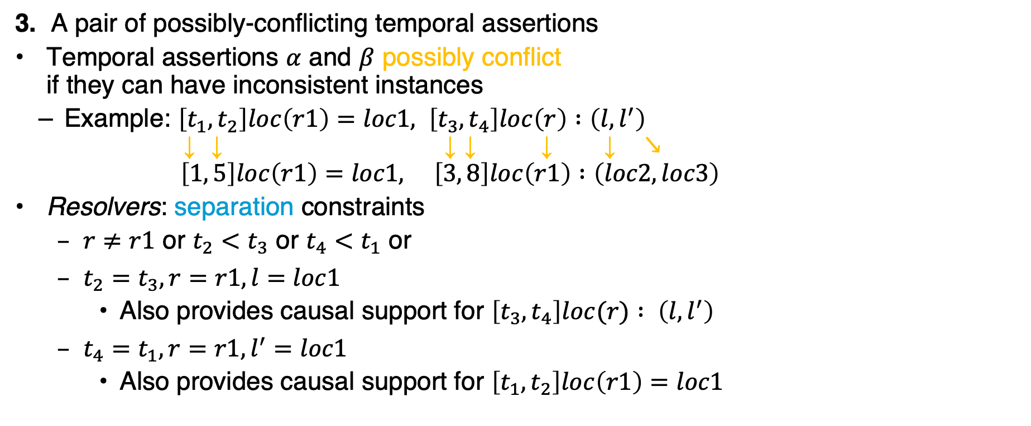














Flaws (3)
3. A pair of possibly-conflicting temporal assertions
Temporal assertions $α$ and $β$ possibly conflict
if they can have inconsistent instances
  Example: $\left[t_{1},t_{2}\right]loc\left(r1\right)=loc1, \left[t_{3},t_{4}\right]loc\left(r\right) :\left(l, l^{′}\right)$
  ↓ ↓ ↓ ↓ ↓ ↓ ↘︎
  $\left[1, 5\right]loc\left(r1\right)=loc1, \left[3, 8\right]loc\left(r1\right) :\left(loc2,loc3\right)$
Resolvers: separation constraints
  $r≠r1$ or $t_{2}<t_{3}$ or $t_{4}<t_{1}$ or
  $t_{2}=t_{3}, r=r1, l=loc1$
    Also provides causal support for $\left[t_{3},t_{4}\right]loc(r) : \left(l, l^{′}\right)$
  $t_{4}=t_{1}, r=r1, l^{′}=loc1$
    Also provides causal support for $\left[t_{1},t_{2}\right]loc\left(r1\right)=loc1$
Like a threat in PSP
$$loc1$$
$$l^{′}$$
$$loc\left(r1\right)$$
$$loc\left(r\right)$$
$$l$$
$$t_{1}$$
$$t_{2}$$
$$t_{3}$$
$$t_{4}$$
$$loc1$$
$$loc3$$
$$loc\left(r1\right)$$
$$loc2$$
$$t_{1}=1$$
$$t_{2}=5$$
$$t_{4}=8$$
$$t_{3}=3$$

Slide 25
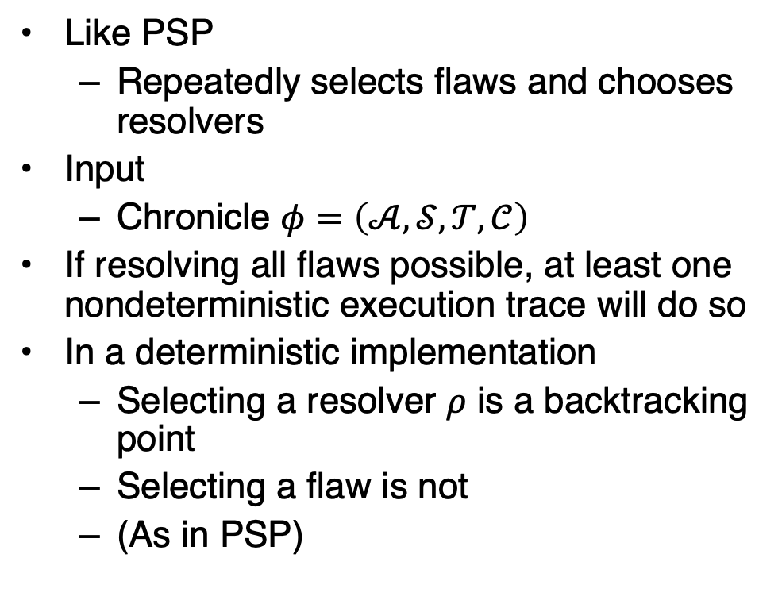
Planning Algorithm
TemPlan(𝜙) // recursive version (book)
Flaws ← set of flaws of 𝜙
if Flaws = ∅ then
return 𝜙
arbitrarily select f ∈ Flaws
Resolvers ← set of resolvers of f
if Resolvers = ∅ then
return failure
nondeterministically choose 𝜌 ∈ Resolvers
𝜙 ← Transform(𝜙, 𝜌)
TemPlan(𝜙,Σ)
Like PSP
  Repeatedly selects flaws and chooses resolvers
Input
  Chronicle $φ=\left(𝒜,𝒮,𝒯,𝒞\right)$
If resolving all flaws possible, at least one nondeterministic execution trace will do so
In a deterministic implementation
  Selecting a resolver $ρ$ is a backtracking point
  Selecting a flaw is not
  (As in PSP)
TemPlan(𝜙) // iterative version
loop
Flaws ← set of flaws of 𝜙
if Flaws = ∅ then
return 𝜙
arbitrarily select f ∈ Flaws
Resolvers ← set of resolvers of f
if Resolvers = ∅ then
return failure
nondeterministically choose 𝜌 ∈ Resolvers
𝜙 ← Transform(𝜙, 𝜌)

Slide 26
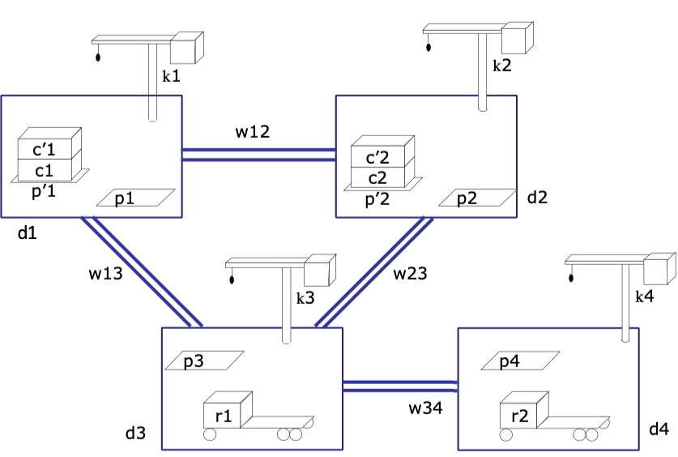

Example
  ϕ₀: tasks: bring(r,c1,p3)
  bring(r′,c2,p4)
  supported: [0] loc(r1)=d3
  [0] freight(r1)=empty
  [0] pile(c1)=p′1
  [0] pile(c′1)=p′1
  [0] pos(c1)=pallet
  [0] pos(c′1)=c1
  . . .
assertions: (none)
constraints:
adj(d1,w12)
adj(d1,w13)
. . .
$φ=\left(𝒜,𝒮,𝒯,𝒞\right)$
  Establishes state-variable values at time $t=0$
  Flaws: two
  unrefined tasks
    bring(r,c1,p3)
    bring(r′,c2,p4)

Slide 27
Example
  ϕ₀: tasks: bring(r,c1,p3)
  bring(r′,c2,p4)
  supported: [0] loc(r1)=d3
  [0] freight(r1)=empty
  [0] pile(c1)=p′1
  [0] pile(c′1)=p′1
  [0] pos(c1)=pallet
  [0] pos(c′1)=c1
  . . .
assertions: (none)
constraints:
adj(d1,w12)
adj(d1,w13)
. . .
Flaws: two unrefined tasks
  bring(r,c1,p3), bring(r′,c2,p4)
Refinement for
both:
m-bring(r,c,p,p′,d,d′,k,k′)
task: bring(r,c,p)
refinement: [t_{s},t₁] move(r,d′)
[t_{s},t₂] uncover(c,p′)
[t₃,t₄] load(k′,r,c,p′)
[t₅,t₆] move(r,d)
[t₇,t_{e}] unload(k,r,c,p)
assertions: [t_{s},t₃] pile(c) = p′
[t_{s},t₃] freight(r) = empty
constraints: attached(p′,d′),
attached(p,d), d ≠ d′
attached(k′,d′),
attached(k,d), k ≠ k′
t₁ ≤ t₃, t₂ ≤ t₃, t₄ ≤ t₅, t₆ ≤ t₇

Slide 28

Method Instance
  ϕ₀: tasks: bring(r,c1,p3)
  bring(r′,c2,p4)
  supported: [0] loc(r1)=d3
  [0] freight(r1)=empty
  [0] pile(c1)=p′1
  [0] pile(c′1)=p′1
  [0] pos(c1)=pallet
  [0] pos(c′1)=c1
  . . .
assertions: (none)
constraints:
adj(d1,w12)
adj(d1,w13)
. . .
Instantiate $c=c1$ and $p=p3$ to
match $bring\left(r,c1,p3\right)$
  $p^{′},d,d^{′},k,k^{′}$
  instantiated
  to match
  book
  Needed later to
  satisfy action
  preconditions
m-bring(r,c1,p3,p′1,d3,d1,k3,k1)
task: bring(r,c1,p3)
refinement: [t_{s},t₁] move(r,d1)
[t_{s},t₂] uncover(c1,p′1)
[t₃,t₄] load(k1,r,c1,p′1)
[t₅,t₆] move(r, d3)
[t₇,t_{e}] unload(k3,r,c1,p3)
assertions: [t_{s},t₃] pile(c1) = p′1
[t_{s},t₃] freight(r) = empty
constraints: attached(p′1,d1),
attached(p3,d3), d3 ≠ d1
attached(k1,d1),
attached(k3,d3), k3 ≠ k1
t₁ ≤ t₃, t₂ ≤ t₃, t₄ ≤ t₅, t₆ ≤ t₇
Notes:
Instantiation not yet needed

Slide 29
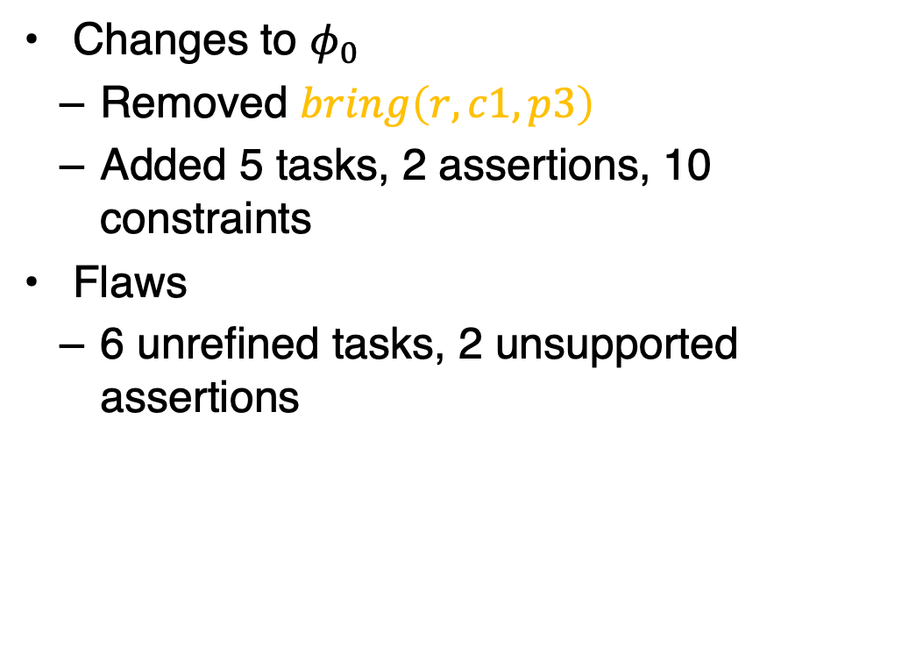
Modified Chronicle
  ϕ₁: tasks: [t_{s},t₁] move(r,d1)
  [t_{s},t₂] uncover(c1,p′1)
  [t₃,t₄] load(k1,r,c1,p′1)
  [t₅,t₆] move(r,d3)
  [t₇,t_{e}] unload(k3,r,c1,p3)
  bring(r′,c2,p4)
  supported: [0] loc(r1)=d3
  [0] freight(r1)=empty
  [0] pile(c1)=p′1
  [0] pile(c′1)=p′1
  [0] pos(c1)=pallet
  [0] pos(c′1)=c1
  . . .
assertions:[t_{s},t₃] pile(c1) = p′1
[t_{s},t₃] freight(r) = empty
constraints: t_{s}<t₁≤t₃, t_{s}<t₂≤t₃, t₄≤t₅, t₆≤t₇,
adj(d1,w12), adj(d1,w13),
. . .
Changes to $φ_{0}$
  Removed $bring\left(r,c1,p3\right)$
  Added 5 tasks, 2 assertions, 10 constraints
Flaws
  6 unrefined tasks, 2 unsupported assertions

Slide 30

Method Instance
  ϕ₁: tasks: [t_{s},t₁] move(r,d1)
  [t_{s},t₂] uncover(c1,p′1)
  [t₃,t₄] load(k1,r,c1,p′1)
  [t₅,t₆] move(r,d3)
  [t₇,t_{e}] unload(k3,r,c1,p3)
  bring(r′,c2,p4)
  supported: [0] loc(r1)=d3
  [0] freight(r1)=empty
  [0] pile(c1)=p′1
  [0] pile(c′1)=p′1
  [0] pos(c1)=pallet
  [0] pos(c′1)=c1
  . . .
assertions:[t_{s},t₃] pile(c1) = p′1
[t_{s},t₃] freight(r) = empty
constraints: t_{s}<t₁≤t₃, t_{s}<t₂≤t₃, t₄≤t₅, t₆≤t₇,
adj(d1,w12), adj(d1,w13),
. . .
Instantiate $r=r^{′}, c=c2, p=p4$ to
match $bring\left(r^{′},c2,p4\right)$
  $p^{′},d,d^{′},k,k^{′}$
  instantiated
  to match
  book
  again
m-bring(r’,c2,p4,p′2,d4,d2,k4,k2)
task: bring(r’,c2,p4)
refinement: [t_{s},t₁] move(r’,d2)
[t_{s},t₂] uncover(c2,p′2)
[t₃,t₄] load(k2,r’,c2,p′2)
[t₅,t₆] move(r’, d4)
[t₇,t_{e}] unload(k4,r’,c2,p4)
assertions: [t_{s},t₃] pile(c2) = p′2
[t_{s},t₃] freight(r’) = empty
constraints: attached(p′2,d2),
attached(p4,d4), d4 ≠ d2
attached(k2,d2),
attached(k4,d4), k4 ≠ k2
t₁ ≤ t₃, t₂ ≤ t₃, t₄ ≤ t₅, t₆ ≤ t₇
Notes:
Instantiation not yet needed
Is it ok to instantiate $r=r^{′}$?

Slide 31
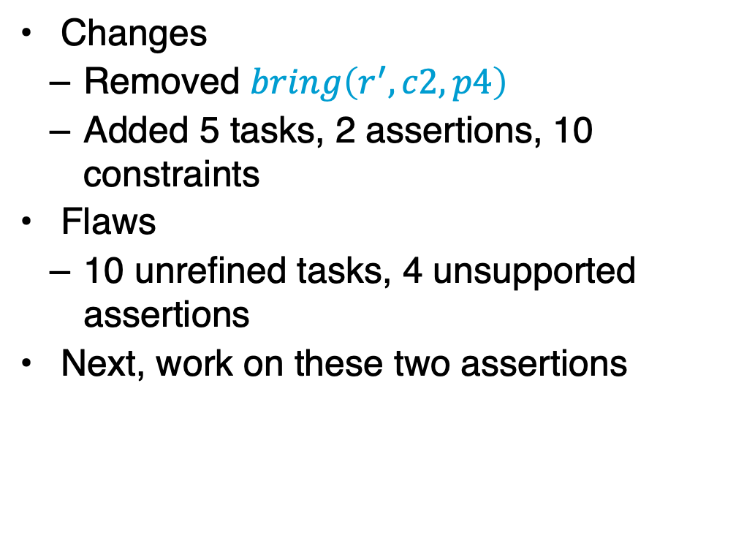
Modified Chronicle
  ϕ₂: tasks: [t_{s},t₁] move(r,d1)
  [t_{s},t₂] uncover(c1,p′1)
  [t₃,t₄] load(k1,r,c1,p′1)
  [t₅,t₆] move(r,d3)
  [t₇,t_{e}] unload(k3,r,c1,p3)
[t′_{s},t′₁] move(r′,d2)
[t′_{s},t′₂] uncover(c2,p′2)
[t′₃,t′₄] load(k4,r′,c2,p′2)
[t′₅,t′₆] move(r′,d4)
[t′₇,t′_{e}] unload(k2,r′,c2,p′2)
  supported: [0] loc(r1)=d3
  [0] freight(r1)=empty
  [0] pile(c1)=p′1
  . . .
assertions:[t_{s},t₃] pile(c1) = p′1
[t_{s},t₃] freight(r) = empty [t′_{s},t′₃] pile(c2) = p′2
[t′_{s},t′₁] freight(r′) = empty
constraints: t_{s}<t₁≤t₃, t_{s}<t₂≤t₃, t₄≤t₅, t₆≤t₇,
t′_{s}<t′₁≤t′₃, t′_{s}<t′₂≤t′₃, t′₄≤t′₅, t′₆≤t′₇,
adj(d1,w12), adj(d1,w13), . . .
Changes
  Removed $bring\left(r^{′},c2,p4\right)$
  Added 5 tasks, 2 assertions, 10 constraints
Flaws
  10 unrefined tasks, 4 unsupported assertions
Next, work on these two assertions

Slide 32
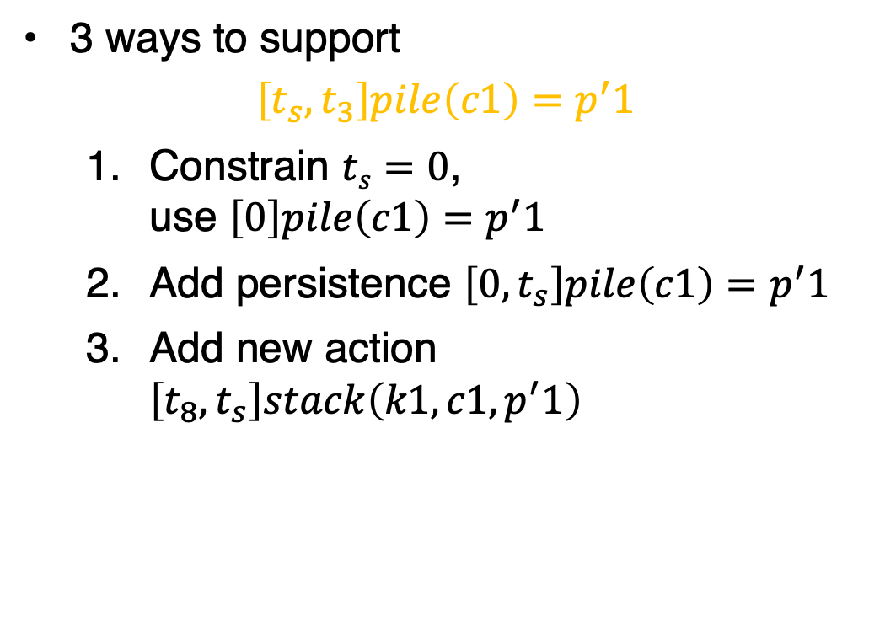
Supporting the Assertions
  ϕ₂: tasks: [t_{s},t₁] move(r,d1)
  [t_{s},t₂] uncover(c1,p′1)
  [t₃,t₄] load(k1,r,c1,p′1)
  [t₅,t₆] move(r,d3)
  [t₇,t_{e}] unload(k3,r,c1,p3)
[t′_{s},t′₁] move(r′,d2)
[t′_{s},t′₂] uncover(c2,p′2)
[t′₃,t′₄] load(k4,r′,c2,p′2)
[t′₅,t′₆] move(r′,d4)
[t′₇,t′_{e}] unload(k2,r′,c2,p′2)
  supported: [0] loc(r1)=d3
  [0] freight(r1)=empty
  [0] pile(c1)=p′1
  . . .
assertions:[t_{s},t₃] pile(c1) = p′1
[t_{s},t₃] freight(r) = empty [t′_{s},t′₃] pile(c2) = p′2
[t′_{s},t′₁] freight(r′) = empty
constraints: t_{s}<t₁≤t₃, t_{s}<t₂≤t₃, t₄≤t₅, t₆≤t₇,
t′_{s}<t′₁≤t′₃, t′_{s}<t′₂≤t′₃, t′₄≤t′₅, t′₆≤t′₇,
adj(d1,w12), adj(d1,w13), . . .
3 ways to support
$$\left[t_{s},t_{3}\right]pile\left(c1\right)=p^{′}1$$
  Constrain $ts=0$,
  use $\left[0\right]pile\left(c1\right)=p^{′}1$
  Add persistence $\left[0,t_{s}\right]pile\left(c1\right)=p^{′}1$
  Add new action $\left[t_{8},t_{s}\right]stack\left(k1,c1, p^{′}1\right)$
Will any of them also provide support for
[t_{s},t₃] freight(r) = empty
?
Notes:
No

Slide 33
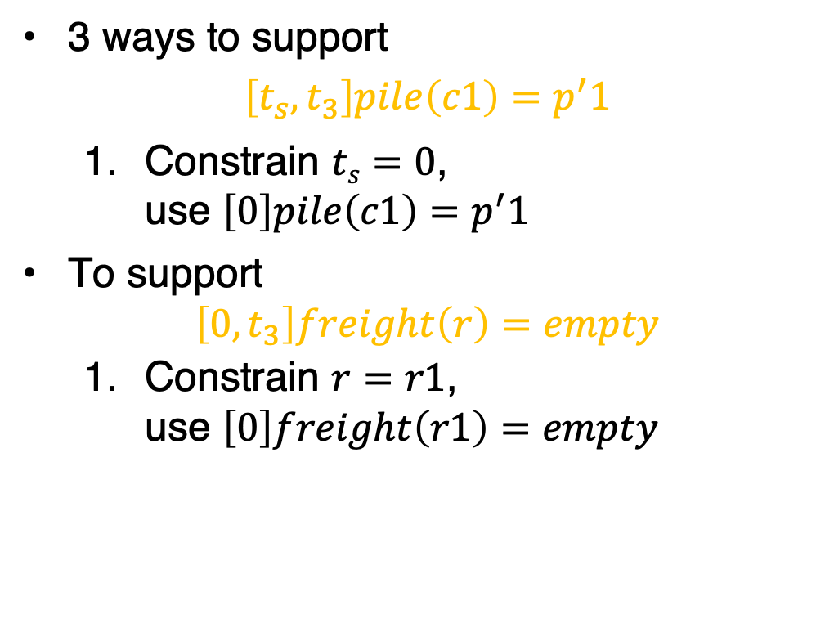
Supporting the Assertions
  ϕ₂: tasks: [0,t₁] move(r,d1)
  [0,t₂] uncover(c1,p′1)
  [t₃,t₄] load(k1,r,c1,p′1)
  [t₅,t₆] move(r,d3)
  [t₇,t_{e}] unload(k3,r,c1,p3)
[t′_{s},t′₁] move(r′,d2)
[t′_{s},t′₂] uncover(c2,p′2)
[t′₃,t′₄] load(k4,r′,c2,p′2)
[t′₅,t′₆] move(r′,d4)
[t′₇,t′_{e}] unload(k2,r′,c2,p′2)
  supported: [0] loc(r1)=d3
  [0] freight(r1)=empty
  [0] pile(c1)=p′1
  . . .
  [0,t₃] pile(c1) = p′1
  assertions:[0,t₃] freight(r) = empty
  [t′_{s},t′₃] pile(c2) = p′2
  [t′_{s},t′₁] freight(r′) = empty
constraints: 0<t₁≤t₃, 0<t₂≤t₃, t₄≤t₅, t₆≤t₇,
t′_{s}<t′₁≤t′₃, t′_{s}<t′₂≤t′₃, t′₄≤t′₅, t′₆≤t′₇,
adj(d1,w12),
adj(d1,w13), . . .
3 ways to support
$$\left[t_{s},t_{3}\right]pile\left(c1\right)=p^{′}1$$
  Constrain $ts=0$,
  use $\left[0\right]pile\left(c1\right)=p^{′}1$
To support
$$\left[0,t_{3}\right]freight\left(r\right)=empty$$
  Constrain $r=r1$,
  use $\left[0\right]freight\left(r1\right)=empty$
Notes:
Should 0<t1, 0<t2 have been there already?

Slide 34
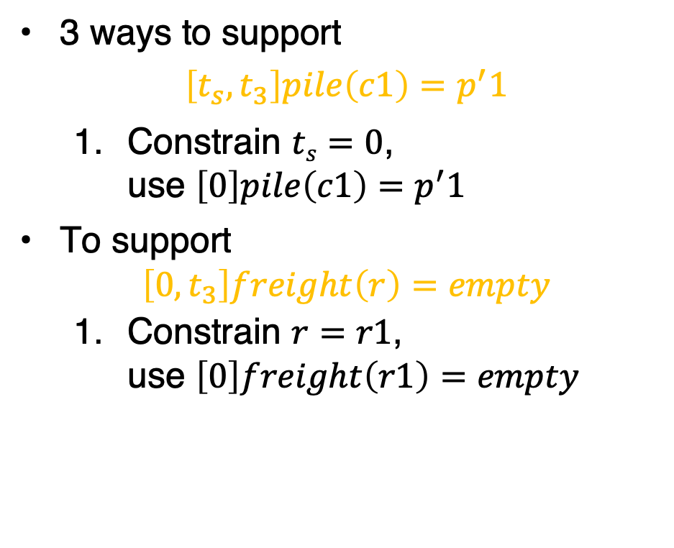
Supporting the Assertions
  ϕ₂: tasks: [0,t₁] move(r1,d1)
  [0,t₂] uncover(c1,p′1)
  [t₃,t₄] load(k1,r1,c1,p′1)
  [t₅,t₆] move(r1,d3)
  [t₇,t_{e}] unload(k3,r1,c1,p3)
[t′_{s},t′₁] move(r′,d2)
[t′_{s},t′₂] uncover(c2,p′2)
[t′₃,t′₄] load(k4,r′,c2,p′2)
[t′₅,t′₆] move(r′,d4)
[t′₇,t′_{e}] unload(k2,r′,c2,p′2)
  supported: [0] loc(r1)=d3
  [0] freight(r1)=empty
  [0] pile(c1)=p′1
  . . .
  [0,t₃] pile(c1) = p′1
  [0,t₃] freight(r1) = empty
assertions: [t′_{s},t′₃] pile(c2) = p′2
[t′_{s},t′₁] freight(r′) = empty
constraints: 0<t₁≤t₃, 0<t₂≤t₃, t₄≤t₅, t₆≤t₇,
t′_{s}<t′₁≤t′₃, t′_{s}<t′₂≤t′₃, t′₄≤t′₅, t′₆≤t′₇,
adj(d1,w12),
adj(d1,w13), . . .
3 ways to support
$$\left[t_{s},t_{3}\right]pile\left(c1\right)=p^{′}1$$
  Constrain $ts=0$,
  use $\left[0\right]pile\left(c1\right)=p^{′}1$
To support
$$\left[0,t_{3}\right]freight\left(r\right)=empty$$
  Constrain $r=r1$,
  use $\left[0\right]freight\left(r1\right)=empty$
Notes:
Should 0<t1, 0<t2 have been there already?

Slide 35
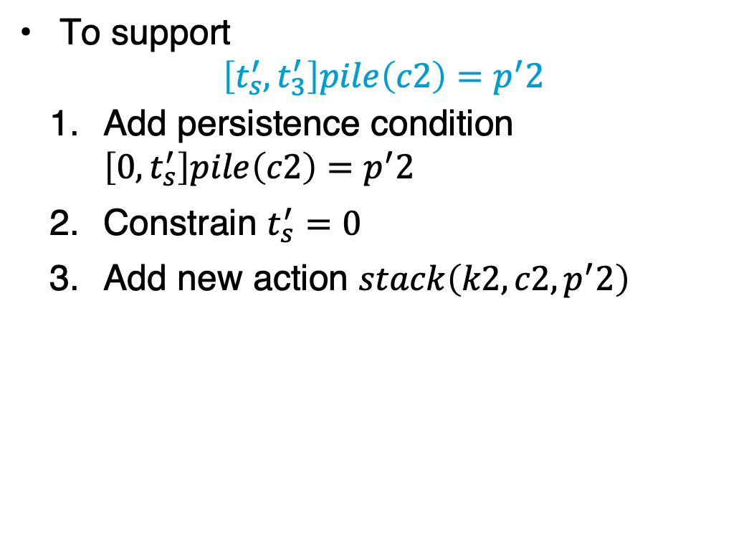
Supporting the Assertions
  ϕ₂: tasks: [0,t₁] move(r1,d1)
  [0,t₂] uncover(c1,p′1)
  [t₃,t₄] load(k1,r1,c1,p′1)
  [t₅,t₆] move(r1,d3)
  [t₇,t_{e}] unload(k3,r1,c1,p3)
[t′_{s},t′₁] move(r′,d2)
[t′_{s},t′₂] uncover(c2,p′2)
[t′₃,t′₄] load(k4,r′,c2,p′2)
[t′₅,t′₆] move(r′,d4)
[t′₇,t′_{e}] unload(k2,r′,c2,p′2)
  supported:[0] loc(r1)=d3
  [0] freight(r1)=empty
  [0] pile(c1)=p′1
  . . .
  [0,t₃] pile(c1) = p′1
  [0,t₃] freight(r1) = empty
assertions:[t′_{s},t′₃] pile(c2) = p′2
[t′_{s},t′₁] freight(r′) = empty
constraints: 0<t₁≤t₃, 0<t₂≤t₃, t₄≤t₅, t₆≤t₇,
t′_{s}<t′₁≤t′₃, t′_{s}<t′₂≤t′₃, t′₄≤t′₅, t′₆≤t′₇,
adj(d1,w12), adj(d1,w13), . . .
To support
$$\left[t_{s}^{′},t_{3}^{′}\right]pile\left(c2\right)=p^{′}2$$
  Add persistence condition $\left[0,t_{s}^{′}\right]pile\left(c2\right)=p^{′}2$
  Constrain $t_{s}^{′}=0$
  Add new action $stack\left(k2,c2, p^{′}2\right)$
Notes:
Different choice to see effect

Slide 36
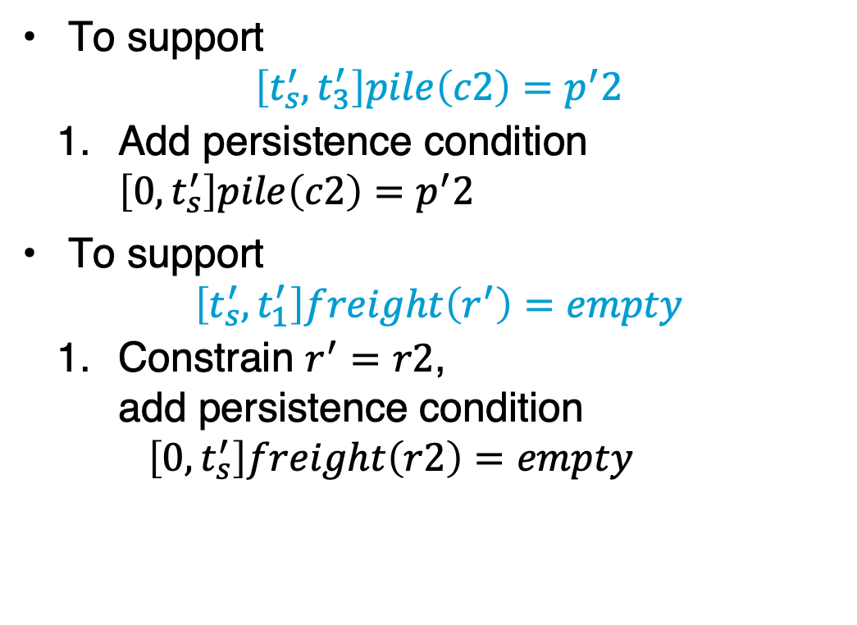
Supporting the Assertions
  ϕ₂: tasks: [0,t₁] move(r1,d1)
  [0,t₂] uncover(c1,p′1)
  [t₃,t₄] load(k1,r1,c1,p′1)
  [t₅,t₆] move(r1,d3)
  [t₇,t_{e}] unload(k3,r1,c1,p3)
[t′_{s},t′₁] move(r′,d2)
[t′_{s},t′₂] uncover(c2,p′2)
[t′₃,t′₄] load(k4,r′,c2,p′2)
[t′₅,t′₆] move(r′,d4)
[t′₇,t′_{e}] unload(k2,r′,c2,p′2)
  supported:[0] loc(r1)=d3
  [0] freight(r1)=empty
  [0] pile(c1)=p′1 . . .
  [0,t₃] pile(c1) = p′1
  [0,t₃] freight(r1) = empty
  [0,t′_{s}] pile(c2)=p′2
  [t′_{s},t′₃] pile(c2) = p′2
assertions:[t′_{s},t′₁] freight(r′) = empty
constraints: 0<t₁≤t₃, 0<t₂≤t₃, t₄≤t₅, t₆≤t₇,
t′_{s}<t′₁≤t′₃, t′_{s}<t′₂≤t′₃, t′₄≤t′₅, t′₆≤t′₇,
adj(d1,w12), adj(d1,w13), . . .
To support
$$\left[t_{s}^{′},t_{3}^{′}\right]pile\left(c2\right)=p^{′}2$$
  Add persistence condition $\left[0,t_{s}^{′}\right]pile\left(c2\right)=p^{′}2$
To support
$$\left[t_{s}^{′},t_{1}^{′}\right]freight\left(r^{′}\right)=empty$$
  Constrain $r^{′}=r2$,
  add persistence condition
  $\left[0,t_{s}^{′}\right]freight\left(r2\right)=empty$
Notes:
Persistence condition [0,t′_{s}] freight(r2)=empty because ts’ not constrained to 0 (compare to ts)

Slide 37
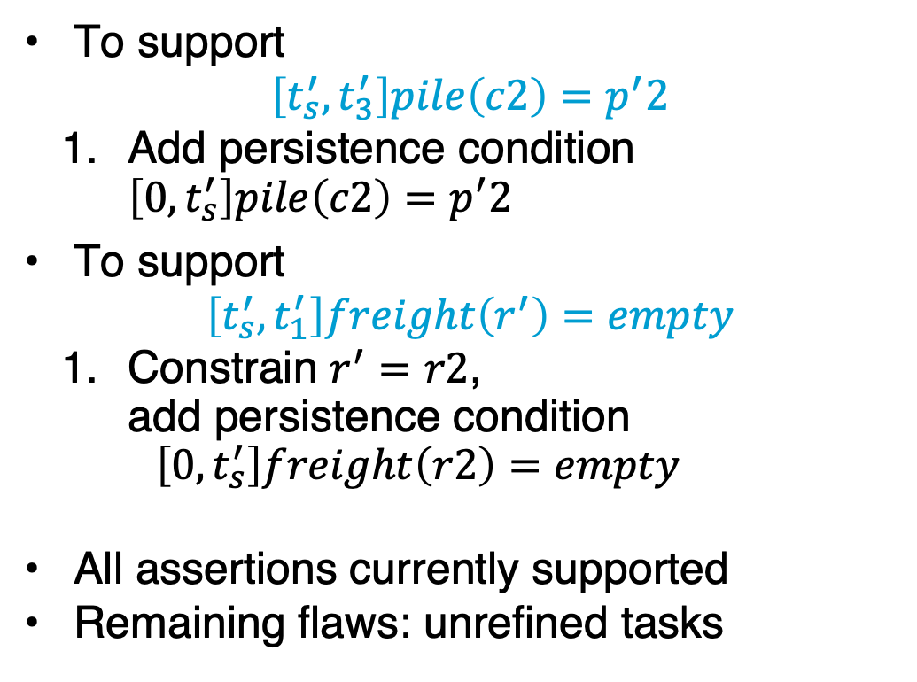
Supporting the Assertions
  ϕ₂: tasks: [0,t₁] move(r1,d1)
  [0,t₂] uncover(c1,p′1)
  [t₃,t₄] load(k1,r1,c1,p′1)
  [t₅,t₆] move(r1,d3)
  [t₇,t_{e}] unload(k3,r1,c1,p3)
[t′_{s},t′₁] move(r2,d2)
[t′_{s},t′₂] uncover(c2,p′2)
[t′₃,t′₄] load(k4,r2,c2,p′2)
[t′₅,t′₆] move(r2,d4)
[t′₇,t′_{e}] unload(k2,r2,c2,p′2)
  supported:[0] loc(r1)=d3
  [0] freight(r1)=empty
  [0] pile(c1)=p′1 . . .
  [0,t₃] pile(c1) = p′1
  [0,t₃] freight(r1) = empty
[0,t′_{s}] pile(c2)=p′2
[t′_{s},t′₃] pile(c2) = p′2
[0,t′_{s}] freight(r2)=empty
[t′_{s},t′₁] freight(r2) = empty
assertions: (none)
constraints: 0<t₁≤t₃, 0<t₂≤t₃, t₄≤t₅, t₆≤t₇,
t′_{s}<t′₁≤t′₃, t′_{s}<t′₂≤t′₃, t′₄≤t′₅, t′₆≤t′₇,
adj(d1,w12),adj(d1,w13), . . .
To support
$$\left[t_{s}^{′},t_{3}^{′}\right]pile\left(c2\right)=p^{′}2$$
  Add persistence condition $\left[0,t_{s}^{′}\right]pile\left(c2\right)=p^{′}2$
To support
$$\left[t_{s}^{′},t_{1}^{′}\right]freight\left(r^{′}\right)=empty$$
  Constrain $r^{′}=r2$,
  add persistence condition
  $\left[0,t_{s}^{′}\right]freight\left(r2\right)=empty$
All assertions currently supported
Remaining flaws: unrefined tasks
Notes:
Persistence condition [0,t′_{s}] freight(r2)=empty because ts’ not constrained to 0 (compare to ts)

Slide 38
Example of Conflicts
  ϕ₂: tasks: [0,t₁] move(r1,d1)
  [0,t₂] uncover(c1,p′1)
  [t₃,t₄] load(k1,r1,c1,p′1)
  [t₅,t₆] move(r1,d3)
  [t₇,t_{e}] unload(k3,r1,c1,p3)
[t′_{s},t′₁] move(r2,d2)
[t′_{s},t′₂] uncover(c2,p′2)
[t′₃,t′₄] load(k4,r2,c2,p′2)
[t′₅,t′₆] move(r2,d4)
[t′₇,t′_{e}] unload(k2,r2,c2,p′2)
  supported:[0] loc(r1)=d3
  [0] freight(r1)=empty
  [0] pile(c1)=p′1 . . .
  [0,t₃] pile(c1) = p′1
  [ 0,t₃] freight(r1) = empty
[0,t′_{s}] pile(c2)=p′2
[t′_{s},t′₃] pile(c2) = p′2
[0,t′_{s}] freight(r2)=empty
[t′_{s},t′₁] freight(r2) = empty
assertions: (none)
constraints: 0<t₁≤t₃, 0<t₂≤t₃, t₄≤t₅, t₆≤t₇,
t′_{s}<t′₁≤t′₃, t′_{s}<t′₂≤t′₃, t′₄≤t′₅, t′₆≤t′₇,
adj(d1,w12),adj(d1,w13), . . .
Refining tasks into actions will produce possibly-conflicting assertions
  move(r2,d4) must go from d2 through d3
  Conflict: occupant(d3)=r1, occupant(d3)=r2
Resolvers:
  Separation constraints to ensure r2 only goes through d3 while r1 away from d3
    E.g., by ensuring move(r1,d1) has happened

Slide 39
Heuristics for Guiding TemPlan
TemPlan(𝜙)
Flaws ← set of flaws of 𝜙
if Flaws = ∅ then
return 𝜙
arbitrarily select f ∈ Flaws
Resolvers ← set of resolvers of f
if Resolvers = ∅ then
return failure
nondeterministically choose 𝜌 ∈ Resolvers
𝜙 ← Transform(𝜙, 𝜌)
TemPlan(𝜙)
Flaw selection, resolver selection heuristics
similar to those in PSP
  Select the flaw with the
  smallest number of resolvers
  Choose the resolver that rules out the fewest resolvers for the other flaws
There is also a problem with constraint management
  We ignored it when discussing PSP
  We discuss it next
PSP(Σ,𝜋)
loop
if Flaws(𝜋) = ∅ then
return 𝜋
arbitrarily select f ∈ Flaws(𝜋)
R ←{all feasible resolvers for f}
if R = ∅ then
return failure
nondeterministically choose ρ ∈ R
𝜋 ← ρ(𝜋)
return 𝜋

Slide 40
Intermediate Summary
Planning problems
  Three kinds of flaws and their resolvers:
    tasks (that need to be refined),
    causal support (for assertions),
    security (of instantiations)
  Partial plans, solution plans
Planning: TemPlan
  Like PSP but with tasks, temporal assertions, temporal constraints

Slide 41
Outline per the Book
4.2 Representation
  Timelines
  Actions and tasks
  Chronicles
4.3 Temporal Planning
  Resolvers and flaws
  Search space
4.4 Constraint Management
  Consistency of object constraints and time constraints
  Controlling the actions when we do not know how long they will take
4.5 Acting with Temporal Models
  Acting with atemporal refinement
  Dispatching
  Observation actions
Notes:
4.1 Intro

Slide 42
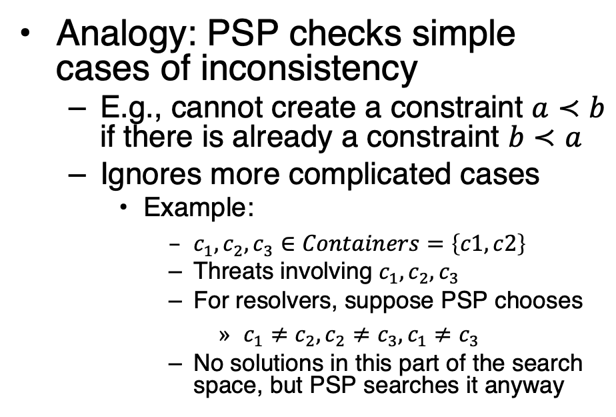
Constraint Management
Each time TemPlan applies a resolver, it modifies $(𝒯,𝒞)$
  Some resolvers will make $(𝒯,𝒞)$ inconsistent
    No solution in this part
    of the search space
      Detect inconsistency
      ➝ prune this part of
      the search space
      Do not detect it
      ➝ waste time
      looking for a
      solution
Analogy: PSP checks simple cases of inconsistency
  E.g., cannot create a constraint $a≺b$ if there is already a constraint $b≺a$
  Ignores more complicated cases
    Example:
      $c_{1},c_{2}, c_{3}∈Containers=\left\{c1, c2\right\}$
      Threats involving $c_{1},c_{2}, c_{3}$
      For resolvers, suppose PSP chooses
        $c_{1}≠c_{2}, c_{2}≠c_{3}, c_{1}≠c_{3}$
      No solutions in this part of the search space, but PSP searches it anyway
Notes:
Example: Because only two different containers c1 and c2 exist

Slide 43
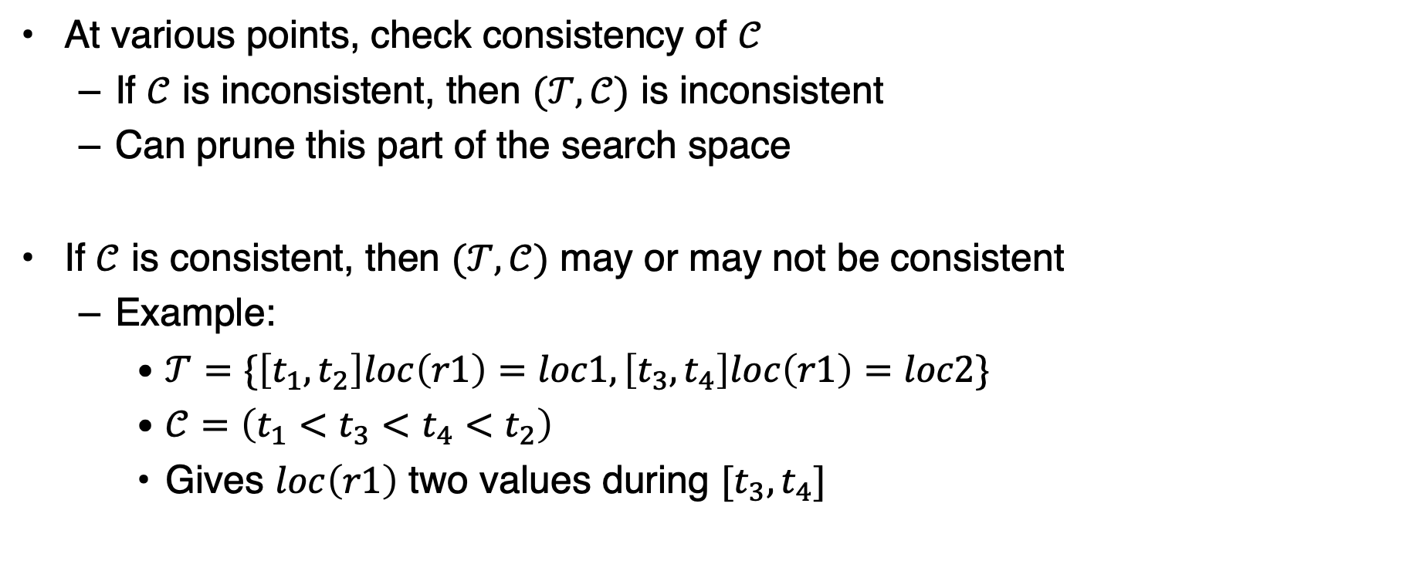
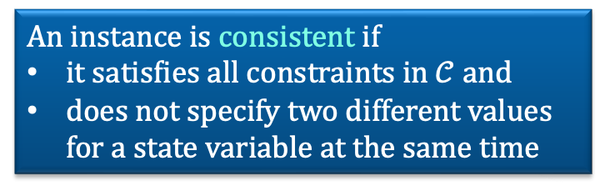
Constraint Management in TemPlan
At various points, check consistency of $𝒞$
  If $𝒞$ is inconsistent, then $(𝒯,𝒞)$ is inconsistent
  Can prune this part of the search space
If $𝒞$ is consistent, then $(𝒯,𝒞)$ may or may not be consistent
  Example:
    $𝒯=\{\left[t_{1},t_{2}\right]loc\left(r1\right)=loc1,\left[t_{3},t_{4}\right]loc\left(r1\right)=loc2\}$
    $𝒞=\left(t_{1}<t_{3}<t_{4}<t_{2}\right)$
    Gives $loc\left(r1\right)$ two values during $[t_{3},t_{4}]$
An instance is consistent if
it satisfies all constraints in $𝒞$ and
does not specify two different values for a state variable at the same time

Slide 44
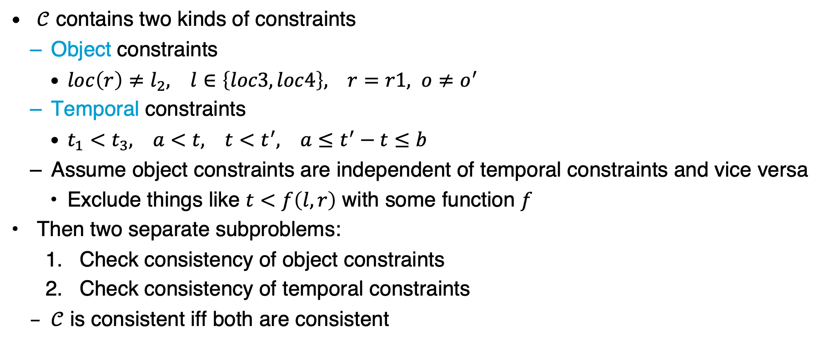
Consistency of $𝒞$
$𝒞$ contains two kinds of constraints
  Object constraints
    $loc\left(r\right)≠l_{2}, l∈\left\{loc3, loc4\right\}, r=r1, o≠o^{′}$
  Temporal constraints
    $t_{1}<t_{3}, a<t, t<t^{′}, a≤t^{′}−t≤b$
  Assume object constraints are independent of temporal constraints and vice versa
    Exclude things like $t<f\left(l,r\right)$ with some function $f$
Then two separate subproblems:
  Check consistency of object constraints
  Check consistency of temporal constraints
  $𝒞$ is consistent iff both are consistent

Slide 45
Object Constraints
Constraint-satisfaction problem – NP-complete
Can write an algorithm that is complete but runs in exponential time
  If there is an inconsistency, always finds it
  Might prune a lot, but spends lots of time at each node
Instead, use a technique that is incomplete but takes polynomial time
  Detects some inconsistencies but not others
    Runs much faster, but prunes fewer nodes

Slide 46




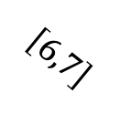
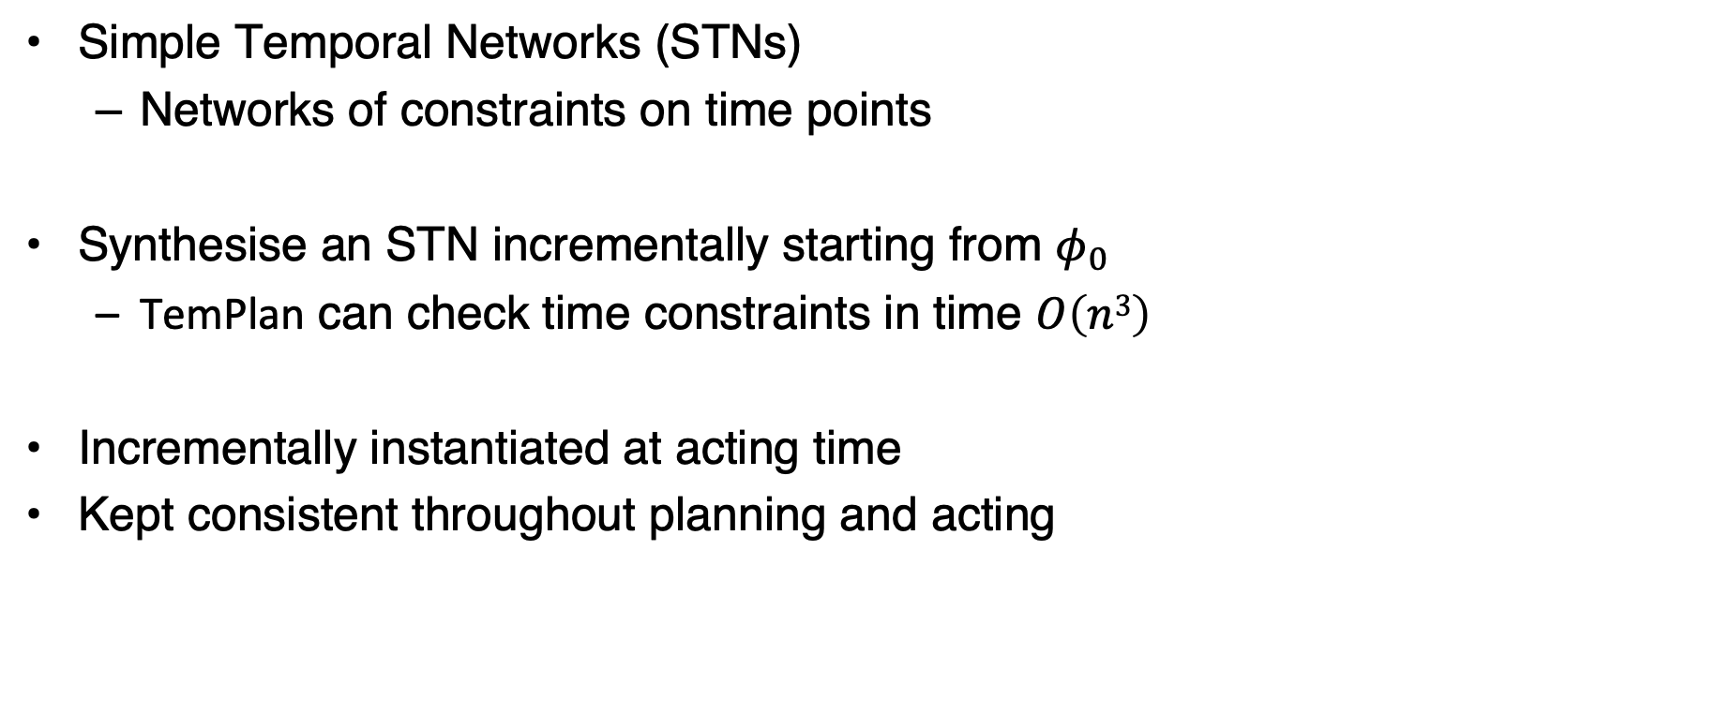






Time Constraints: Representation
Simple Temporal Networks (STNs)
  Networks of constraints on time points
Synthesise an STN incrementally starting from $φ_{0}$
  TemPlan can check time constraints in time $O\left(n3\right)$
Incrementally instantiated at acting time
Kept consistent throughout planning and acting
$$t_{2}$$
$$\left[3,4\right]$$
$$\left[1,2\right]$$
$$t_{4}$$
$$t_{1}$$
$$\left[1,7\right]$$
$$t_{3}$$
$$\left[1,2\right]$$
$$\left[6,7\right]$$
$$\left[4,5\right]$$
$$t_{5}$$

Slide 47
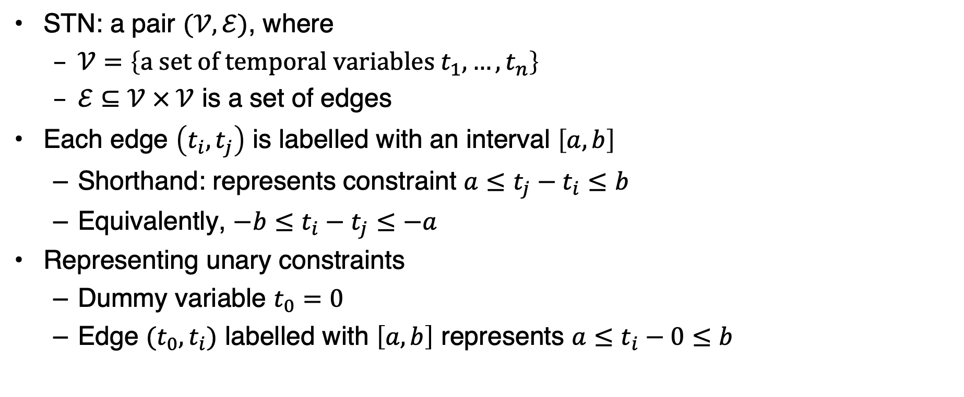
Simple Temporal Networks
STN: a pair $(𝒱,ℰ)$, where
  $𝒱=\left\{\text{a} \text{set} \text{of} \text{temporal} \text{variables} t_{1}, …, t_{n}\right\}$
  $ℰ⊆𝒱 × 𝒱$ is a set of edges
Each edge $\left(t_{i},t_{j}\right)$ is labelled with an interval $\left[a,b\right]$
  Shorthand: represents constraint $a≤t_{j}−t_{i}≤b$
  Equivalently, $−b≤t_{i}−t_{j}≤−a$
Representing unary constraints
  Dummy variable $t_{0}=0$
  Edge $(t_{0},t_{i})$ labelled with $\left[a,b\right]$ represents $a≤t_{i}−0≤b$
t₂
[1,2]
[3,4]
t₁
t₃
[2,3]
t₂
[1,2]
[3,4]
t₁
t₃
[–3,–2]
Notes:
[x,y] before it was an interval in an assertion, now it is a [min,max] duration in a constraint
Minimum duration t1, t2 + t2, t3 : 4 vs. duration between 2 and 3 => inconsistent
Complete calculation:
t1 = x
1 <= t2 - x <= 2 -> t2 = x+1 or t2 = x+2
2 <= t3 - x <= 3 -> t3 = x+2 or t2 = x+3
3 <= t3 - t2 <= 4 -> 3 <= (x + 2 oder 3) – (x + 1 oder 2) <= 4 -> 3 <= 2 oder 3 – 1 oder 2 <= 4
3 <= 2 – 1 <= 4 -> 3 <= 1 <= 4 X
3 <= 2 – 2 <= 4 -> 3 <= 0 <= 4 X
3 <= 3 – 1 <= 4 -> 3 <= 2 <= 4 X
3 <= 3 – 2 <= 4 -> 3 <= 1 <= 4 X
No

Slide 48
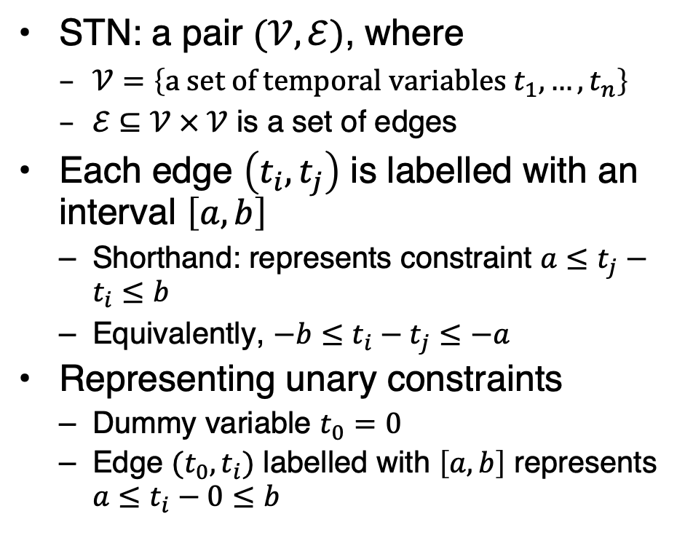

Simple Temporal Networks
STN: a pair $(𝒱,ℰ)$, where
  $𝒱=\left\{\text{a} \text{set} \text{of} \text{temporal} \text{variables} t_{1}, …, t_{n}\right\}$
  $ℰ⊆𝒱 × 𝒱$ is a set of edges
Each edge $\left(t_{i},t_{j}\right)$ is labelled with an interval $\left[a,b\right]$
  Shorthand: represents constraint $a≤t_{j}−t_{i}≤b$
  Equivalently, $−b≤t_{i}−t_{j}≤−a$
Representing unary constraints
  Dummy variable $t_{0}=0$
  Edge $(t_{0},t_{i})$ labelled with $\left[a,b\right]$ represents $a≤t_{i}−0≤b$
!
Solution to an STN
  Integer value for each $t_{i}$
  All constraints satisfied
Consistent STN
  Has a solution
Book says:
Solution
  Integer value for each $t_{i}$
Consistent:
  Has a solution
  All constraints satisfied
Is this network consistent?
t₂
t₂
[1,2]
[3,4]
[1,2]
[3,4]
t₁
t₃
t₁
t₃
[–3,–2]
[2,3]
Notes:
[x,y] before it was an interval in an assertion, now it is a [min,max] duration in a constraint
Minimum duration t1, t2 + t2, t3 : 4 vs. duration between 2 and 3 => inconsistent
Complete calculation:
t1 = x
1 <= t2 - x <= 2 -> t2 = x+1 or t2 = x+2
2 <= t3 - x <= 3 -> t3 = x+2 or t2 = x+3
3 <= t3 - t2 <= 4 -> 3 <= (x + 2 oder 3) – (x + 1 oder 2) <= 4 -> 3 <= 2 oder 3 – 1 oder 2 <= 4
3 <= 2 – 1 <= 4 -> 3 <= 1 <= 4 X
3 <= 2 – 2 <= 4 -> 3 <= 0 <= 4 X
3 <= 3 – 1 <= 4 -> 3 <= 2 <= 4 X
3 <= 3 – 2 <= 4 -> 3 <= 1 <= 4 X
No

Slide 49
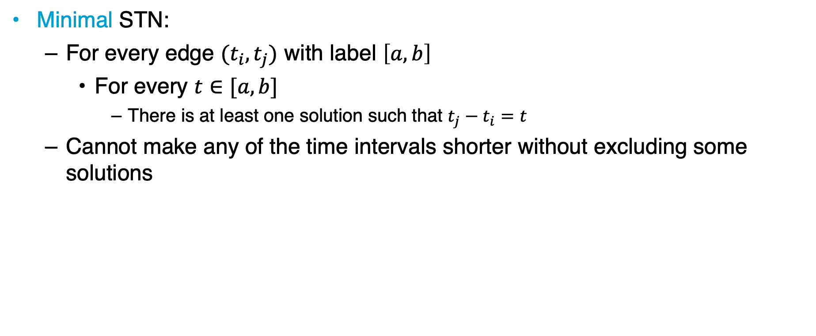
Time Constraints
Minimal STN:
  For every edge $(t_{i},t_{j})$ with label $\left[a,b\right]$
    For every $t∈[a,b]$
      There is at least one solution such that $t_{j}−t_{i}=t$
  Cannot make any of the time intervals shorter without excluding some solutions
t₂
[1,2]
[3,4]
t₁
t₃
[3,7]
Is this network minimal?
Notes:
Every value in interval belongs to a solution
Minimum duration t1, t2 + t2, t3 : 4 vs. duration of 3 in [3,7] => not minimal
Maximum duration t1, t2 + t2, t3 : 6 vs. duration of 7 in [3,7] => not minimal
Minimal with [4,6]
Complete calculation
t1 = x
1 <= t2 - x <= 2 -> t2 = x+1 or t2 = x+2
3 <= t3 - x <= 7 -> t3 = x+3 to t3 = x+7
3 <= t3 - t2 <= 4 -> 3 <= (x + 3 bis 7) – (x + 1 oder 2) <= 4 -> 3 <= 3 bis 7 – 1 oder 2 <= 4
3 <= 3 – 1 <= 4 -> 3 <= 2 <= 4 X
3 <= 4 – 1 <= 4 -> 3 <= 3 <= 4 v
3 <= 5 – 1 <= 4 -> 3 <= 4 <= 4 v
3 <= 7 – 1 <= 4 -> 3 <= 6 <= 4 X
3 <= 3 – 2 <= 4 -> 3 <= 1 <= 4 X
3 <= 5 – 2 <= 4 -> 3 <= 3 <= 4 v
3 <= 6 – 2 <= 4 -> 3 <= 4 <= 4 v
3 <= 7 – 2 <= 4 -> 3 <= 5 <= 4 X
t1 = x, t2 = x+1, t3=x+4 or t3=x+5
t1 = x, t2 = x+2, t3=x+5 or t3=x+6
t2-t1 in [1,2] : x+1-x = 1 or x+2-x = 2 v
t3-t1 in [3,7] : x+4-x = 4 or x+5-x = 5 or x+6-x=6 but no 3 or 7 X -> not minimal
t3-t2 in [3,4] : x+(4 or 5) – (x+1) = (3 or 4) or x+(5 or 6) – (x+2) = (3 or 4) v
No

Slide 50
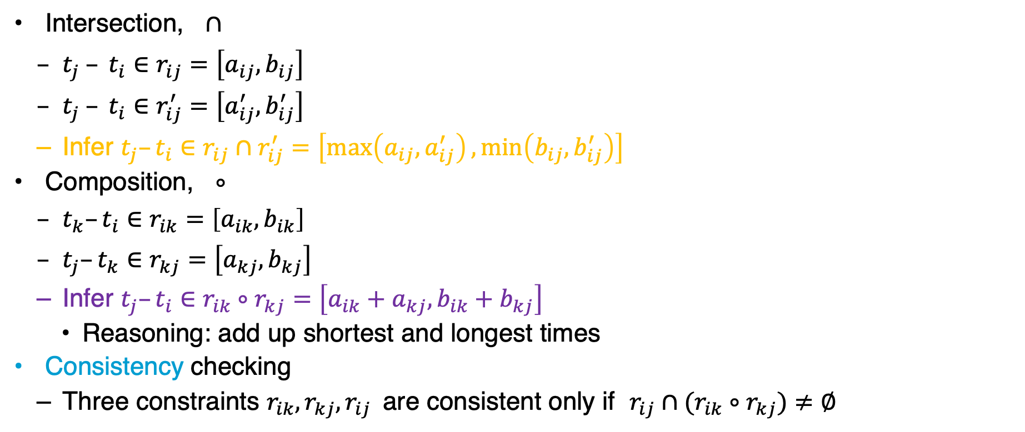




Operations on STNs
r_{ij}
Intersection, $∩$
  $t_{j} – t_{i}∈r_{ij}=\left[a_{ij},b_{ij}\right]$
  $t_{j} – t_{i}∈r_{ij}^{′}=\left[a_{ij}^{′},b_{ij}^{′}\right]$
  Infer $t_{j}–t_{i}∈r_{ij}∩r_{ij}^{′}=\left[\max\left(a_{ij},a_{ij}^{′}\right),\min\left(b_{ij},b_{ij}^{′}\right)\right]$
Composition, $∘$
  $t_{k}–t_{i}∈r_{ik}=\left[a_{ik},b_{ik}\right]$
  $t_{j}–t_{k}∈r_{kj}=\left[a_{kj},b_{kj}\right]$
  Infer $t_{j}–t_{i}∈r_{ik}∘r_{kj}=\left[a_{ik}+a_{kj}, b_{ik}+b_{kj}\right]$
    Reasoning: add up shortest and longest times
Consistency checking
  Three constraints $r_{ik}, r_{kj}, r_{ij}$are consistent only if $r_{ij}∩(r_{ik}∘r_{kj})≠∅$
t_{j}
t_{i}
r′_{ij}
$$r_{ij}∩r_{ij}^{′}$$
r_{ik}
t_{k}
r_{kj}
t_{i}
t_{j}
$$r_{ik}∘r_{kj}$$
t_{k}
r_{kj}
r_{ik}
r_{ij}
t_{j}
t_{i}
$$r_{ik}∘r_{kj}$$
$$r_{ij}∩\left(r_{ik}∘r_{kj}\right)$$

Slide 51
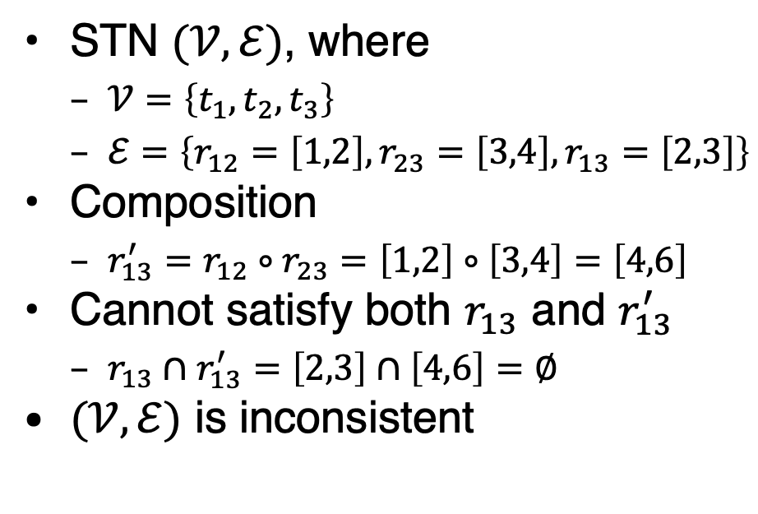
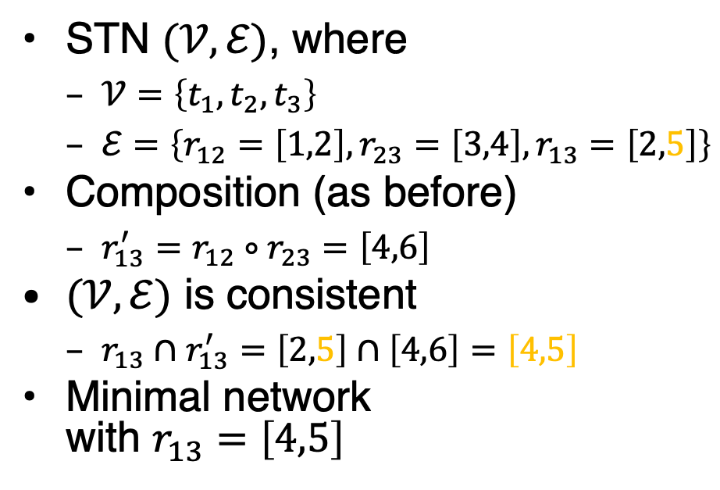
Two Examples
STN $(𝒱,ℰ)$, where
  $𝒱=\left\{t_{1}, t_{2}, t_{3}\right\}$
  $ℰ=\left\{r_{12}=\left[1,2\right], r_{23}=\left[3,4\right],r_{13}=\left[2,3\right]\right\}$
Composition
  $r_{13}^{′}=r_{12}∘r_{23}=\left[1,2\right]∘\left[3,4\right]=\left[4,6\right]$
Cannot satisfy both $r_{13}$ and $r_{13}^{′}$
  $r_{13}∩r_{13}^{′}=\left[2,3\right]∩\left[4,6\right]=∅$
$(𝒱,ℰ)$ is inconsistent
STN $(𝒱,ℰ)$, where
  $𝒱=\left\{t_{1}, t_{2}, t_{3}\right\}$
  $ℰ=\left\{r_{12}=\left[1,2\right],r_{23}=\left[3,4\right], r_{13}=\left[2,5\right]\right\}$
Composition (as before)
  $r_{13}^{′}=r_{12}∘r_{23}=\left[4,6\right]$
$(𝒱,ℰ)$ is consistent
  $r_{13}∩r_{13}^{′}=\left[2,5\right]∩\left[4,6\right]=\left[4,5\right]$
Minimal network
with $r_{13}=\left[4,5\right]$
t₂
t₂
[1,2]
[3,4]
[1,2]
[3,4]
t₁
t₃
t₁
t₃
[2,3]
[2,5]
Notes:
$r_{13}∩r_{13}^{′}=\left[2,3\right]∩\left[4,6\right]=[4,3]$ = empty

Slide 52











Operations on STNs
PC (Path Consistency) algorithm:
  Consistency checking on all triples
  Input: STN $(𝒱,ℰ)$
  If an edge has no constraint, use $\left[−∞, +∞\right]$
  $n$ constraints ➝ $n^{3}$ triples ➝ time $O\left(n^{3}\right)$
Example: $k=2, i=1, j=4$
  $r_{12}=\left[1,2\right]$
  $r_{24}=\left[3,4\right]$
  $r_{14}=\left[–∞,∞\right]$
  $r_{12}∘r_{24}=[1+3, 2+4]=[4,6]$
  $r_{14}← \left[\max\left(–∞,4\right),\min\left(∞,6\right)\right]=\left[4,6\right]$
PC(𝒱,ℰ)
for 1 ≤ k ≤ n do
for 1 ≤ i < j ≤ n, i ≠ j, j ≠ k do
r_{ij} ← r_{ij} ∩ [r_{ik} ∘ r_{kj}]
if r_{ij} = ∅ then
return inconsistent
return consistent
$$k$$
$$t_{2}$$
$$\left[3,4\right]$$
$$\left[1,2\right]$$
$$t_{4}$$
$$t_{1}$$
$$j$$
$$i$$
$$t_{3}$$
$$\left[1,2\right]$$
$$\left[6,7\right]$$
$$\left[4,5\right]$$
$$t_{5}$$
Notes:
Use in TemPlan

Slide 53











Operations on STNs
PC makes network minimal
  Shrinks each $r_{ij}$ to exclude values not in any solution
  Doing so, it detects inconsistent networks
    $r_{ij}=[a_{ij},b_{ij}]$ empty ➝ inconsistent
Graph: dashed lines
  Constraints that were shrunk
Can modify PC to make it incremental
  Input
    A consistent, minimal STN
    A new constraint $r_{ij}^{′}$
  Incorporate $r_{ij}^{′}$ in time $O\left(n^{2}\right)$
PC(𝒱,ℰ)
for 1 ≤ k ≤ n do
for 1 ≤ i < j ≤ n, i ≠ j, j ≠ k do
r_{ij} ← r_{ij} ∩ [r_{ik} ∘ r_{kj}]
if r_{ij} = ∅ then
return inconsistent
return consistent
$$t_{1}$$
bring&move
$$t_{2}$$
$$\left[30,50\right]$$
$$\left[25,55\right]$$
$$\left[−5,5\right]$$
$$\left[15,50\right]$$
$$\left[0,15\right]$$
$$t_{3}$$
$$\left[5,10\right]$$
$$t_{4}$$
uncover
Notes:
Shrunk: at least those with no constraints get an infinity constraint that gets most likely shrunk

Slide 54

Pruning TemPlan’s search space
Take the time constraints in $𝒞$
  Write them as an STN
  Use PC to check whether STN is consistent
  If it is inconsistent, TemPlan can backtrack

Slide 55
Controllability
Constraint Management with Uncertain Durations

Slide 56






Controllability
Suppose TemPlan gives you a chronicle and you want to execute it
  Constraints on time points
  Need to reason about these to decide when to start each action
$$t_{1}$$
bring&move
$$t_{2}$$
$$\left[30,50\right]$$
$$\left[−5,5\right]$$
$$t_{3}$$
$$\left[5,10\right]$$
$$t_{4}$$
uncover

Slide 57
Controllability
Solid lines: duration constraints
  Robot will do bring&move, will take 30 to 50 time-units
  Crane will do uncover, will take 5 to 10 time-units
Dashed line: synchronisation constraint
  Do not want either the crane or robot to wait long
  At most 5 seconds between the two ending times
Objective
  Choose time points that will satisfy all the constraints
$$t_{1}$$
bring&move
$$t_{2}$$
$$\left[30,50\right]$$
$$\left[−5,5\right]$$
$$t_{3}$$
$$\left[5,10\right]$$
$$t_{4}$$
uncover

Slide 58


















Controllability
Suppose we run PC
  PC returns a minimal and consistent network
    There exist time points that satisfy all the constraints
Would work if we could choose all four time points
  But we cannot choose $t_{2}$ and $t_{4}$
$t_{1}$ and $t_{3}$ are controllable
  Actor can control when each action starts
$t_{2}$ and $t_{4}$ are contingent
  Cannot control how long the actions take
  Random variables that are known to satisfy the duration constraints
    $t_{2}∈\left[t_{1}+30, t_{1}+50\right]$
    $t_{4}∈\left[t_{3}+5, t_{3}+10\right]$
$$t_{1}$$
bring&move
$$t_{2}$$
$$\left[30,50\right]$$
$$\left[−5,5\right]$$
$$t_{3}$$
$$\left[5,10\right]$$
$$t_{4}$$
uncover
$$t_{1}$$
bring&move
$$t_{2}$$
$$\left[30,50\right]$$
$$\left[25,55\right]$$
$$\left[−5,5\right]$$
$$\left[15,50\right]$$
$$\left[0,15\right]$$
$$t_{3}$$
$$\left[5,10\right]$$
$$t_{4}$$
uncover
Notes:
STN below: minimal network

Slide 59












Controllability
Cannot guarantee all constraints satisfied
Start bring&move at time $t_{1}=0$
Suppose the durations are
  bring&move $30$, uncover $10$
    $t_{2}=t_{1}+30=30$
    $t_{4}=t_{3}+10$
    $t_{4}–t_{2}=t_{3}–20$
  Constraint $r_{24}$:
    $–5≤t_{4}– t_{2}≤5$
    $–5≤t_{3}–20≤5$
    $15 ≤ t_{3} ≤25$
Must start uncover at $t_{3}≤25$
But if we start uncover at $t_{3}≤25$, neither action has finished yet
  We do not yet know how long they will take
Durations might instead be
  bring&move $50$, uncover $5$
    $t_{2}=t_{1}+50=50$
    $t_{4}=t_{3}+5≤25+5=30$
    $t_{4}–t_{2}≤30–50= –20$
      Violates $r_{24}$
$$t_{1}$$
bring&move
$$t_{2}$$
$$\left[30,50\right]$$
$$\left[25,55\right]$$
$$\left[−5,5\right]$$
$$\left[15,50\right]$$
$$\left[0,15\right]$$
$$t_{3}$$
$$\left[5,10\right]$$
$$t_{4}$$
uncover
Notes:
$t_{4}–t_{2}$ plug in values for t4 and t2
t3<= 25: bring&move running

Slide 60

STNUs
STNU (Simple Temporal Network with Uncertainty):
  A 4-tuple $\left(𝒱,\tilde{𝒱},ℰ,\tilde{ℰ}\right)$
    $𝒱$ ={controllable time points}
      E.g., starting times of actions
    $\tilde{𝒱}$ ={contingent time points}
      E.g., ending times of actions
    $ℰ$ ={controllable constraints}
      Next slide
    $\tilde{ℰ}$ ={contingent constraints}
      Next slide

Slide 61

STNUs
Controllable and contingent constraints:
  Synchronization between two starting times: controllable
  Duration of an action: contingent
  Synchronization between ending points of two actions: contingent
  Synchronization between end of one action, start of another:
    Controllable if the new action starts after the old one ends
    Contingent if the new action starts before the old one ends
Want a way for the actor to choose time points in $𝒱$ (starting times) that guarantee that constraints are satisfied

Slide 62

Three kinds of controllability
$\left(𝒱,\tilde{𝒱},ℰ,\tilde{ℰ}\right)$ is strongly controllable if the actor can choose values for $𝒱$ such that success will occur for all values of $\tilde{𝒱}$ that satisfy $\tilde{ℰ}$
  Actor can choose the values for $𝒱$ offline
  The right choice will work regardless of $\tilde{𝒱}$
$\left(𝒱,\tilde{𝒱},ℰ,\tilde{ℰ}\right)$ is weakly controllable if the actor can choose values for $𝒱$ such that success will occur for at least one combination of values for $\tilde{𝒱}$
  Actor can choose the values for $𝒱$ only if the actor knows in advance what the values of $\tilde{𝒱}$ will be

Slide 63

Three kinds of controllability
Dynamic controllability:
  Game-theoretic model: actor vs. environment
  A player’s strategy: a function $σ$ telling what to do in every situation
    Choices may differ depending on what has happened so far
  $\left(𝒱,\tilde{𝒱},ℰ,\tilde{ℰ}\right)$ is dynamically controllable if ∃ strategy for an actor that will guarantee success regardless of the environment’s strategy

Slide 64


Dynamic Execution
For $t=0, 1, 2, …$
  Actor chooses an unassigned set of variables $𝒱_{t}⊆𝒱$ that all can be assigned the value $t$ without violating any constraints in $ℰ$
    ≈ actions the actor chooses to start at time $t$
  Simultaneously, environment chooses an unassigned set of variables ${\tilde{𝒱}}_{t}\text{⊆}\tilde{𝒱}$ that all can be assigned the value $t$ without violating any constraints in $\tilde{ℰ}$
    ≈ actions that finish at time $t$
  Each chosen time point $v$ is assigned $v←t$
  Failure if any of the constraints in $ℰ∪\tilde{ℰ}$ are violated
    There might be violations that neither $𝒱_{t}$ nor ${\tilde{𝒱}}_{t}$ caused individually
  Success if all variables in $𝒱∪\tilde{𝒱}$ have values and
  no constraints are violated
$r_{ij}=\left[l,u\right]$ is violated
if $t_{i}$ and $t_{j}$ have values
and $t_{j}−t_{i}∉\left[l,u\right]$

Slide 65

Dynamic Execution
Dynamic execution strategies $σ_{A}$ for actor, $σ_{E}$ for environment
  $σ_{A}(h_{t−1})$ = {what events in $𝒱$ to trigger at time $t$, given $h_{t−1}$}
  $σ_{E}(h_{t−1})$ = {what events in $\tilde{𝒱}$ to trigger at time $t$, given $h_{t−1}$}
    $h_{t}=h_{t−1}⋅\left(σ_{A}\left(h_{t−1}\right)∪σ_{E}\left(h_{t−1}\right)\right)$
$\left(𝒱,\tilde{𝒱},ℰ,\tilde{ℰ}\right)$ is dynamically controllable if $∃ σ_{A}$ that will guarantee success $∀ σ_{E}$

Slide 66











Example
Instead of a single bring&move task, two separate bring and move tasks
Actor’s dynamic execution strategy
  Trigger $t_{1}$ at whatever time you want
  Wait and observe $t$
  Trigger $t^{′}$ at any time from $t$ to $t+5$
  Trigger $t_{3}=t^{′}+10$
  For every $t_{2}∈\left[t^{′}+15, t^{′}+20\right]$ and $t_{4}∈[t_{3}+5, t_{3}+10]$
    $t_{4}∈\left[t^{′}+15, t^{′}+20\right]$
    So, $t_{4}–t_{2}∈\left[–5, 5\right]$
  Thus, all constraints are satisfied
$$t_{1}$$
bring
$$t$$
$$t^{′}$$
move
$$t_{2}$$
$$\left[15,25\right]$$
$$\left[0,5\right]$$
$$\left[15,20\right]$$
$$\left[−5,5\right]$$
$$t_{3}$$
$$\left[5,10\right]$$
$$t_{4}$$
uncover
Notes:
replace t₃ with t’ in $t_{4}∈[t_{3}+5, t_{3}+10]$
Shortest time of t4 - longest time of t2
Longest time of t4 - shortest time of t2

Slide 67


Dynamic Controllability Checking
For a chronicle $φ=\left(𝒜,𝒮,𝒯,𝒞\right)$
  Temporal constraints in $𝒞$ correspond to an STNU
  Adapt TemPlan to test not only consistency but also dynamic controllability (*) of the STNU
  If we detect cases where it is not dynamically controllable, then backtrack
Use PC as well
  If PC($𝒱∪\tilde{𝒱}$, $ℰ∪\tilde{ℰ}$) reduces a contingent constraint, $\left(𝒱,\tilde{𝒱},ℰ,\tilde{ℰ}\right)$ not dyn. controllable
    Can prune this branch
  Otherwise: unknown if $\left(𝒱,\tilde{𝒱},ℰ,\tilde{ℰ}\right)$ dynamically controllable
    Only necessary, not sufficient condition
    Two options
      Continue down this branch and backtrack later if necessary
      Extend PC to detect more cases where $\left(𝒱,\tilde{𝒱},ℰ,\tilde{ℰ}\right)$ is not dynamically controllable
      (additional constraint propagation rules)
Notes:
Contingent constraints not controllable, reduction implies controllability

Slide 68



Additional Constraint Propagation Rules
Case 1: $u≥0$
  $t$ must come before $t_{e}$
Add a composition constraint $\left[a^{′},b^{′}\right]$
  Find $\left[a^{′},b^{′}\right]$ such that
  $\left[a^{′},b^{′}\right]∘\left[u,v\right]=\left[a,b\right]$
    $\left[a^{′}+u, b^{′}+v\right]=\left[a,b\right]$
    $a^{′}=a–u, b^{′}=b–v$
Should be $\left[a^{′},b^{′}\right]$
if I am not mistaken
t_{s}
[a, b]
t_{e}
[u, v]
t
⟹ contingent ⟶ controllable $a^{′}=a–u, b^{′}=b–v$

Slide 69


Additional Constraint Propagation Rules
Case 2: $u<0$ and $v≥0$
  $t$ may be before or after $t_{e}$
Add a wait constraint $\left\langle t_{e}, α\right\rangle$
  $α$ defined w.r.t.
  some controllable time point $t_{s}$
  Wait until either $t_{e}$ occurs or current time is $t_{s}+α$, whichever comes first
t_{s}
[a, b]
t_{e}
[u, v]
t
⟹ contingent ⟶ controllable $a^{′}=a–u, b^{′}=b–v$

Slide 70
Extended Version of PC
We want a fast algorithm that TemPlan can run at each node, to decide whether to backtrack
There is an extended version of PC that runs in polynomial time, but it has high overhead
Possible compromise:
use ordinary PC
most of the time
  Run extended version
  occasionally, or at end
  of search before
  returning plan
⟹ contingent ⟶ controllable $a^{′}=a–u, b^{′}=b–v$

Slide 71
Intermediate Summary
Constraint management
  Consistency of object constraints
    Constraint-satisfaction problem
  Consistency of time constraints
    STN, solution, minimality, consistency
    PC
Controllability
  STNU, controllable, contingent
  Dynamic controllability

Slide 72
Outline per the Book
4.2 Representation
  Timelines
  Actions and tasks
  Chronicles
4.3 Temporal Planning
  Resolvers and flaws
  Search space
4.4 Constraint Management
  Consistency of object constraints and time constraints
  Controlling the actions when we do not know how long they will take
4.5 Acting with Temporal Models
  Acting with atemporal refinement
  Dispatching
  Observation actions
Notes:
4.1 Intro

Slide 73
Atemporal Refinement of Primitive Actions
TemPlan’s action templates may correspond to compound tasks
  In RAE, refine into commands with refinement methods
  TemPlan’s
  action template
  (descriptive model)
  RAE’s
  refinement method
  (operational model)
leave(r,d,w)
  assertions: [t_{s},t_{e}] loc(r): (d,w)
    [t_{s},t_{e}] occupant(d): (r,empty)
  constraints: t_{e} ≤ t_{s} + δ₁
  adj(d,w)
m-leave(r,d,w,e)
  task: leave(r,d,w)
  pre: loc(r)=d, adj(d,w), exit(e,d,w)
  body: until empty(e)
  wait(1)
    goto(r,e)

Slide 74
Discussion
Pros
  Simple online refinement with RAE
  Avoids breaking down uncertainty of contingent duration
  Can be augmented with temporal monitoring functions in RAE
    E.g., watchdogs, methods with duration preferences
Cons
  Does not handle temporal requirements at the command level,
    E.g., synchronise two robots that must act concurrently
Can augment RAE to include temporal reasoning
  Call it eRAE
  One essential component: a dispatching function
Notes:
E.g, useful to account for time needed to open door, assessed from statistics.
However, breaking this duration into how long it takes to reach for the handle and how long to turn the handle introduces more noise in operational models.
Still RAE requires some temporal reasoning
Dispatching takes into account past occurrences and the current time; these are propagated into the temporal network to keep it dynamically controllable

Slide 75

Acting With Temporal Models
Dispatching procedure: a dynamic execution strategy
  Controls when to start each action
  Given a dynamically controllable plan with executable primitives,
  it triggers corresponding commands from online observations
Example
  robot $r2$ needs to leave
  dock $d2$ before
  robot $r1$ can
  enter $d2$
  crane $k$ needs to uncover $c$
  then put $c$ onto $r1$
k
r2
c′
w2
c
q
p
d2
w1
r1
$$t_{3}$$
leave(r2,d2)
d1
$$t_{1}$$
$$t_{2}$$
$$t_{5}$$
leave(r1,d1)
navigate(r1)
enter(r1,d2)
$$t_{7}$$
$$t_{8}$$
$$t_{9}$$
$$t_{4}$$
$$t_{6}$$
unstack(k,c,p)
putdown(k,c,r1)
leave(r1,d2)
unstack(k,c′,p)
stack(k,c′,q)

Slide 76

Dispatching
Let $\left(𝒱,\tilde{𝒱},ℰ,\tilde{ℰ}\right)$ be a controllable STNU
that is grounded
  Different from a grounded expression in logic
  At least one time point $t^{∗}$ is instantiated
    Bounds each time point $t$ within an interval $\left[l_{t},u_{t}\right]$
Controllable time point $t$ in the future:
  $t$ is alive if current time $now∈\left[l_{t},u_{t}\right]$
  $t$ is enabled if
    It is alive
    For every precedence constraint $t^{′}<t$, $t^{′}$ has occurred
    For every wait constraint $⟨t_{e}, α⟩$, $t_{e}$ has occurred or $α$ has expired
      $α$ has expired if $t_{s}$ has occurred and $t_{s}+α≤now$
Dispatch(𝒱,Ṽ,ℰ,Ẽ)
initialise the network
while there are time points in 𝒱 that
have not been triggered do
update now
update the time points in Ṽ that have
been newly observed
update enabled
trigger every t ∈ enabled s.t. now=u_{t}
arbitrarily choose other time points
in enabled and trigger them
propagate values of triggered
timepoints (change [l_{t},u_{t}] for
each future timepoint t)
Notes:
trigger elements of V at the right moment, given the observation of elements of V ̃, and given the progress of current time, denoted now
As time goes by, some time points have occurred: triggered by the actor for controllable points or observed for contingent ones
Trigger those points that cannot wait any longer
Arbitrary choice to trigger any other enabled point (consider domain specific considerations)

Slide 77

Example
Trigger $t_{1}$, observe leave finish
Enable and trigger $t_{2}$, enables $t_{3}$, $t_{4}$
Trigger $t_{3}$ soon enough to allow $enter\left(r1,d2\right)$
at time $t_{5}$
Trigger $t_{4}$ soon enough to allow $stack\left(k,c^{′}\right)$
at time $t_{6}$
Rest of plan is linear:
  Choose each
  $t_{i}$ after the
  previous
  action ends
Dispatch(𝒱,Ṽ,ℰ,Ẽ)
initialise the network
while there are time points in 𝒱 that
have not been triggered do
update now
update the time points in Ṽ that have
been newly observed
update enabled
trigger every t ∈ enabled s.t. now=u_{t}
arbitrarily choose other time points
in enabled and trigger them
propagate values of triggered
timepoints (change [l_{t},u_{t}] for
each future timepoint t)
$$t_{3}$$
leave(r2,d2)
$$t_{1}$$
$$t_{2}$$
$$t_{5}$$
leave(r1,d1)
navigate(r1)
enter(r1,d2)
$$t_{7}$$
$$t_{8}$$
$$t_{9}$$
$$t_{4}$$
$$t_{6}$$
unstack(k,c,p)
putdown(k,c,r1)
leave(r1,d2)
unstack(k,c′,p)
stack(k,c′,q)

Slide 78












Example from Slide 61
Trigger $t_{1}$ at time $0$
Wait and observe $t$; this enables $t^{′}$
Trigger $t^{′}$ at any time from $t$ to $t+5$
Trigger $t_{3}$ at time $t^{′}+10$
  $t_{2}∈\left[t^{′}+15, t^{′}+20\right]$
  $t_{4}∈[t_{3}+5, t_{3}+10]=[t^{′}+15, t^{′}+20]$
  so $t_{4}–t_{2}∈\left[–5, 5\right]$
Dispatch(𝒱,Ṽ,ℰ,Ẽ)
initialise the network
while there are time points in 𝒱 that
have not been triggered do
update now
update the time points in Ṽ that have
been newly observed
update enabled
trigger every t ∈ enabled s.t. now=u_{t}
arbitrarily choose other time points
in enabled and trigger them
propagate values of triggered
timepoints (change [l_{t},u_{t}] for
each future timepoint t)
$$t_{1}$$
bring
$$t$$
$$t^{′}$$
move
$$t_{2}$$
$$\left[15,25\right]$$
$$\left[0,5\right]$$
$$\left[15,20\right]$$
$$\left[−5,5\right]$$
$$t_{3}$$
$$\left[5,10\right]$$
$$t_{4}$$
uncover

Slide 79

Dispatching
Propagation step most costly one
  $O\left(n^{3}\right)$
  $n$ the number of remaining future time points in network
Ideally propagation fast enough to allow iterations and updates of $now$ consistent with temporal granularity of plan
Dispatch(𝒱,Ṽ,ℰ,Ẽ)
initialise the network
while there are time points in 𝒱 that
have not been triggered do
update now
update the time points in Ṽ that have
been newly observed
update enabled
trigger every t ∈ enabled s.t. now=u_{t}
arbitrarily choose other time points
in enabled and trigger them
propagate values of triggered
timepoints (change [l_{t},u_{t}] for
each future timepoint t)
Notes:
trigger elements of V at the right moment, given the observation of elements of V ̃, and given the progress of current time, denoted now
As time goes by, some time points have occurred: triggered by the actor for controllable points or observed for contingent ones
Trigger those points that cannot wait any longer
Arbitrary choice to trigger any other enabled point (consider domain specific considerations)

Slide 80
Deadline Failures
Suppose something makes it impossible to start an action on time
Do one of the following:
  Stop the delayed action, and look for new plan
  Let the delayed action finish, try to repair the plan by resolving violated constraints at the STNU propagation level
    E.g., accommodate a delay in navigate by delaying the whole plan
  Let the delayed action finish,
  try to repair the plan
  some other way
$$t_{3}$$
leave(r2,d2)
$$t_{1}$$
$$t_{2}$$
$$t_{5}$$
leave(r1,d1)
navigate(r1)
enter(r1,d2)
$$t_{7}$$
$$t_{8}$$
$$t_{9}$$
$$t_{4}$$
$$t_{6}$$
unstack(k,c,p)
putdown(k,c,r1)
leave(r1,d2)
unstack(k,c′,p)
stack(k,c′,q)

Slide 81
Partial Observability
Tacit assumption: All occurrences of contingent events are observable
  Observation needed for dynamic controllability
In general, not all events are observable
POSTNU (Partially Observable STNU)
  STNU where the contingent time points are given by
  a set of invisible and a set of observable timepoints
    POSTNU = STNU if Invisible = ∅
  Dynamically controllable?
Controllable
Timepoints Invisible
Contingent
Observable
Arthur Bit-Monnot, Malik Ghallab, Félix Ingrand: “Which Contingent Events to Observe for the Dynamic Controllability of a Plan”, IJCAI-16

Slide 82









Observation Actions
Example
$$\left[19:00,19:30\right]$$
$$t_{1}$$
$$t$$
$$t^{′}$$
driving
$$t_{2}$$
$$\left[1,2\right]$$
$$\left[20,25\right]$$
working
$$\left[−5,10\right]$$
$$t_{3}$$
$$\left[25,30\right]$$
$$t_{4}$$
Controllable
Contingent
cooking
Invisible
observable
Arthur Bit-Monnot, Malik Ghallab, Félix Ingrand: “Which Contingent Events to Observe for the Dynamic Controllability of a Plan”, IJCAI-16

Slide 83
Dynamic Controllability
A POSTNU is dynamically controllable if
  there exists an execution strategy that chooses future controllable points to meet all the constraints, given the observation of past visible points
Check dynamic controllability
  Map an POSTNU to an STNU by deleting invisible time points and adding corresponding constraints on controllable and observable time points
  Check dynamic controllability of the mapped STNU
    E.g., using the extended PC algorithm
  More details in the paper
Arthur Bit-Monnot, Malik Ghallab, Félix Ingrand: “Which Contingent Events to Observe for the Dynamic Controllability of a Plan”, IJCAI-16

Slide 84
Dynamic Controllability
A POSTNU is dynamically controllable if
  there exists an execution strategy that chooses future controllable points to meet all the constraints, given the observation of past visible points
Observable ≠ visible
  Observable means it will be known when observed
    It can be temporarily hidden
  Aim: Find out which time points
  need to be observed for the plan
  to be dynamically controllable
  (details in paper)
Controllable
Timepoints Invisible
Contingent Visible
Observable
Hidden
Arthur Bit-Monnot, Malik Ghallab, Félix Ingrand: “Which Contingent Events to Observe for the Dynamic Controllability of a Plan”, IJCAI-16

Slide 85
Intermediate Summary
Acting
  atemporal refinement
    eRAE
    Dispatching
      Alive, enabled
  Deadline failures
  Partial observability
    Invisible, observable (hidden/visible)

Slide 86
Outline per the Book
4.2 Representation
  Timelines
  Actions and tasks
  Chronicles
4.3 Temporal Planning
  Resolvers and flaws
  Search space
4.4 Constraint Management
  Consistency of object constraints and time constraints
  Controlling the actions when we do not know how long they will take
4.5 Acting with Temporal Models
  Acting with atemporal refinement
  Dispatching
  Observation actions
⟹ Next: Planning and Acting with Nondeterministic Models
Notes:
4.1 Intro

