Slide 1
Intelligent Agents :
Automated Planning and Acting
d5
c = 1
0.2
Probabilistic Models
d2
0.8
d3
c = 100
c = 100
Start:
s₀= d1
d1
0.5
c = 1
d4
Goal:
S_{g}= {d4}
0.5

Slide 2
Content: Planning and Acting
With Deterministic Models
With Temporal Models
With Nondeterministic Models
With Probabilistic Models
  Stochastic Shortest-Path Problems
  Heuristic Search Algorithms
  Online Approaches Including Reinforcement Learning
By Decision Making
  Foundations
  Extensions
  Structure
With Human-awareness
Notes:
1-4, 6: Planning book
5, 7: AIMA
8: Rao

Slide 3
Outline per the Book
6.2 Stochastic shortest path problems
  Safe/unsafe policies
  Optimality
  Policy iteration, value iteration
6.3 Heuristic search algorithms
  Best-first search
  Determinisation
6.4 Online probabilistic planning
  Lookahead

Slide 4
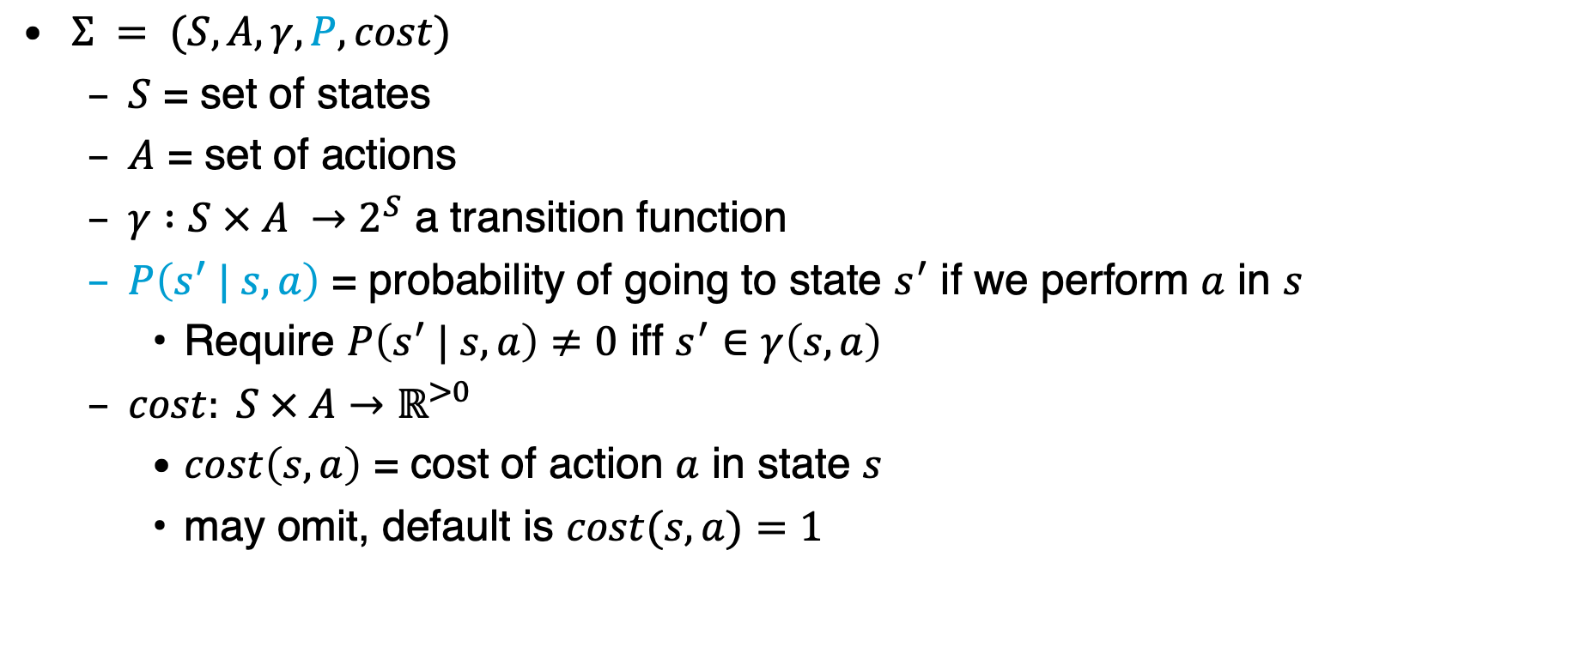
Probabilistic Planning Domain
$Σ = (S, A, γ, P, cost)$
  $S$ = set of states
  $A$ = set of actions
  $γ :S × A →2^{S}$ a transition function
  $P\left(s^{′} | s, a\right)$ = probability of going to state $s^{′}$ if we perform $a$ in $s$
    Require $P\left(s^{′} | s, a\right)≠0$ iff $s^{′}∈γ\left(s,a\right)$
  $cost: S × A→ℝ^{>0}$
    $cost\left(s,a\right)$ = cost of action $a$ in state $s$
    may omit, default is $cost(s,a)=1$

Slide 5
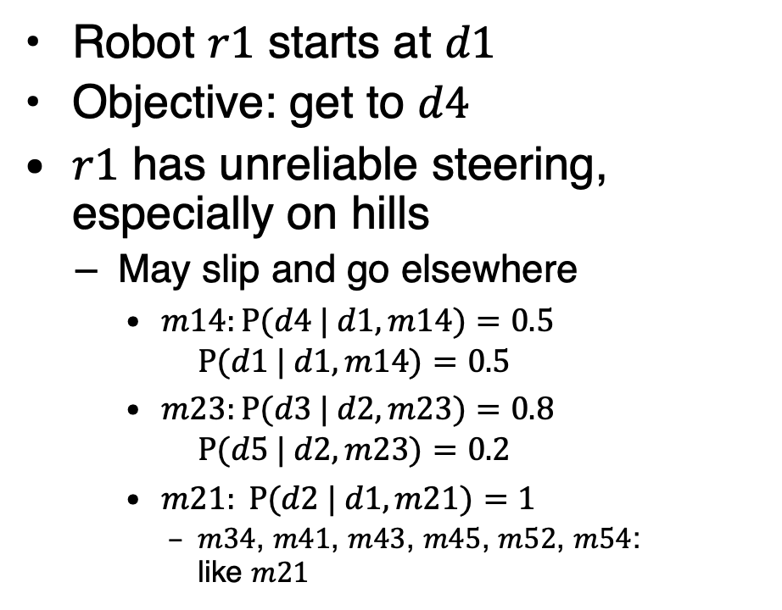

Example
Robot $r1$ starts at $d1$
Objective: get to $d4$
$r1$ has unreliable steering,
especially on hills
  May slip and go elsewhere
    $m14:P⁡(d4 | d1,m14)=0.5$
    $P⁡(d1 | d1,m14)=0.5$
    $m23:P⁡(d3 | d2,m23)=0.8$
    $P⁡(d5 | d2,m23)=0.2$
    $m21: P⁡(d2 | d1,m21)=1$
      $m34$, $m41$, $m43$, $m45$, $m52$, $m54$:
      like $m21$
Simplified state names:
  Write $\left\{loc\left(r1\right)=d2\right\}$ as $d2$
Simplified action names:
  Write $move\left(r1,d2,d3\right)$ as $m23$
←
→
d5
d2
→
→
↔
↔
d3
↔
d4
Start:
s₀= d1
r1
→
d4
→
→
Goal:
S_{g}= {d4}
→
←
d1

Slide 6
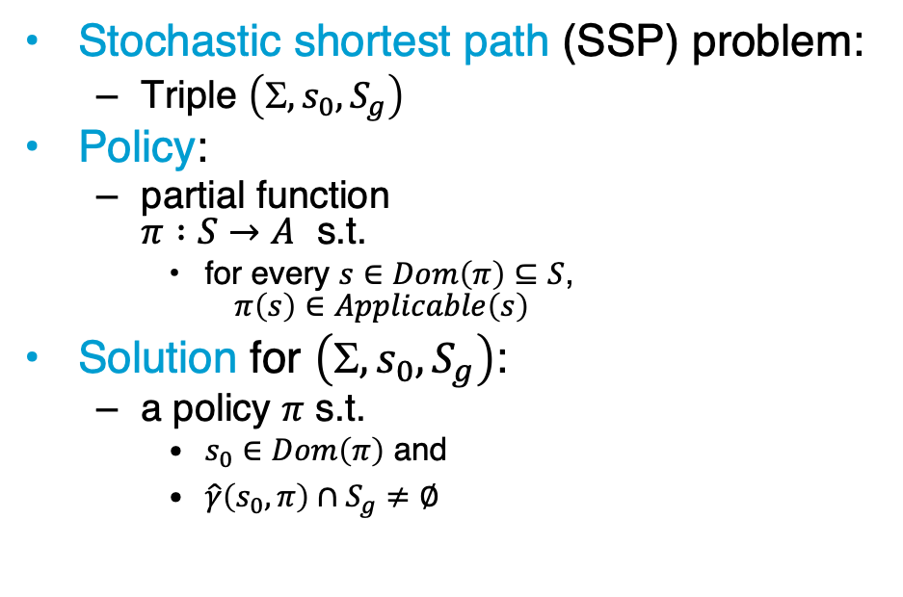

Policies, Problems, Solutions
Stochastic shortest path (SSP) problem:
  Triple $\left(, s_{0}, S_{g}\right)$
Policy:
  partial function
  $π :S→A$ s.t.
    for every $s∈Dom\left(π\right)⊆S$,
    $π\left(s\right)∈Applicable\left(s\right)$
Solution for $\left(, s_{0}, S_{g}\right)$:
  a policy $π$ s.t.
    $s_{0}∈Dom\left(π\right)$ and
    $\hat{γ}\left(s_{0},π\right)∩S_{g}≠∅$
      $$m14 :P(d4 | d1,m14)=0.5, P(d1 | d1,m14)=0.5$$
        $$m23 :P(d3 | d1,m23)=0.8, P(d5 | d1,m23)=0.2$$
m52
d5
0.2
d2
m23
0.8
d3
m32
m12
m21
m54
m43
m34
m45
d1
m41
d4
Start:
s₀= d1
0.5
Goal:
S_{g}= {d4}
0.5
m14

Slide 7
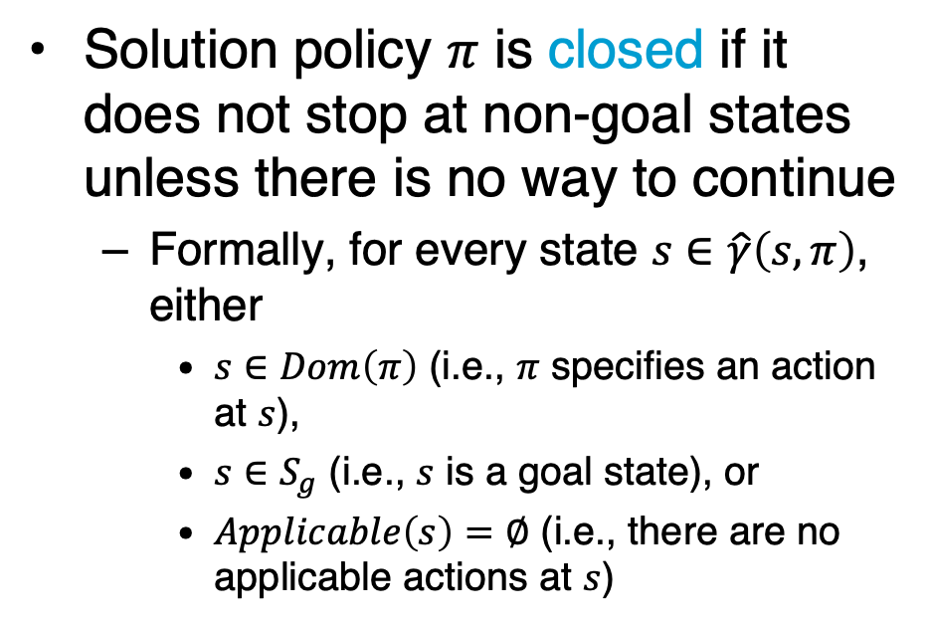
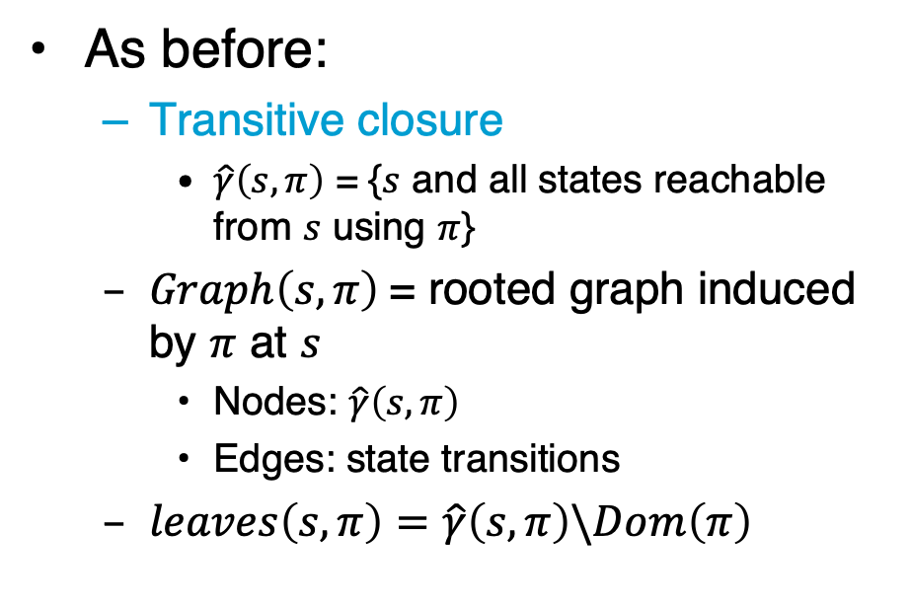
Notation and Terminology
As before:
  Transitive closure
    $\hat{γ}\left(s,π\right)$ = {$s$ and all states reachable from $s$ using $π$}
  $Graph\left(s,π\right)$= rooted graph induced by $π$ at $s$
    Nodes: $\hat{γ}\left(s,π\right)$
    Edges: state transitions
  $leaves\left(s,π\right)=\hat{γ}\left(s,π\right)\backslash Dom\left(π\right)$
Solution policy $π$ is closed if it does not stop at non-goal states unless there is no way to continue
  Formally, for every state $s∈\hat{γ}\left(s,π\right)$, either
    $s∈Dom\left(π\right)$ (i.e., $π$ specifies an action at $s$),
    $s∈S_{g}$ (i.e., $s$ is a goal state), or
    $Applicable\left(s\right)=∅$ (i.e., there are no applicable actions at $s$)

Slide 8
Dead Ends
Dead end
  A state or set of states from which the goal is unreachable
Explicit dead end
Implicit dead end
d5
d5
d6
0.2
0.2
d2
d3
d2
0.8
0.8
d3
d6
d6
0.5
0.5
Start:
s₀= d1
d1
0.5
d4
Start:
s₀= d1
d1
0.5
Goal:
S_{g}= {d4}
d4
Goal:
S_{g}= {d4}

Slide 9
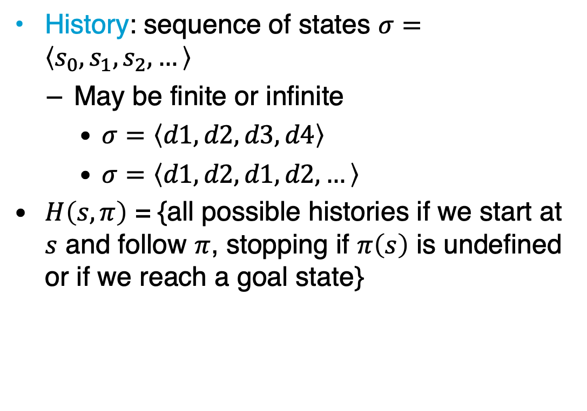
Histories
History: sequence of states $σ=\left\langle s_{0}, s_{1}, s_{2}, …\right\rangle$
  May be finite or infinite
    $σ=\left\langle d1, d2, d3, d4\right\rangle$
    $σ=\left\langle d1,d2, d1, d2,…\right\rangle$
$H\left(s,π\right)$ = {all possible histories if we start at $s$ and follow $π$, stopping if $π\left(s\right)$ is undefined or if we reach a goal state}
m52
d5
0.2
d2
m23
0.8
d3
m32
m12
m21
m54
m43
m34
m45
d1
m41
d4
Start:
s₀= d1
0.5
Goal:
S_{g}= {d4}
0.5
m14
Notes:
Same as MDPs
Markov property!

Slide 10
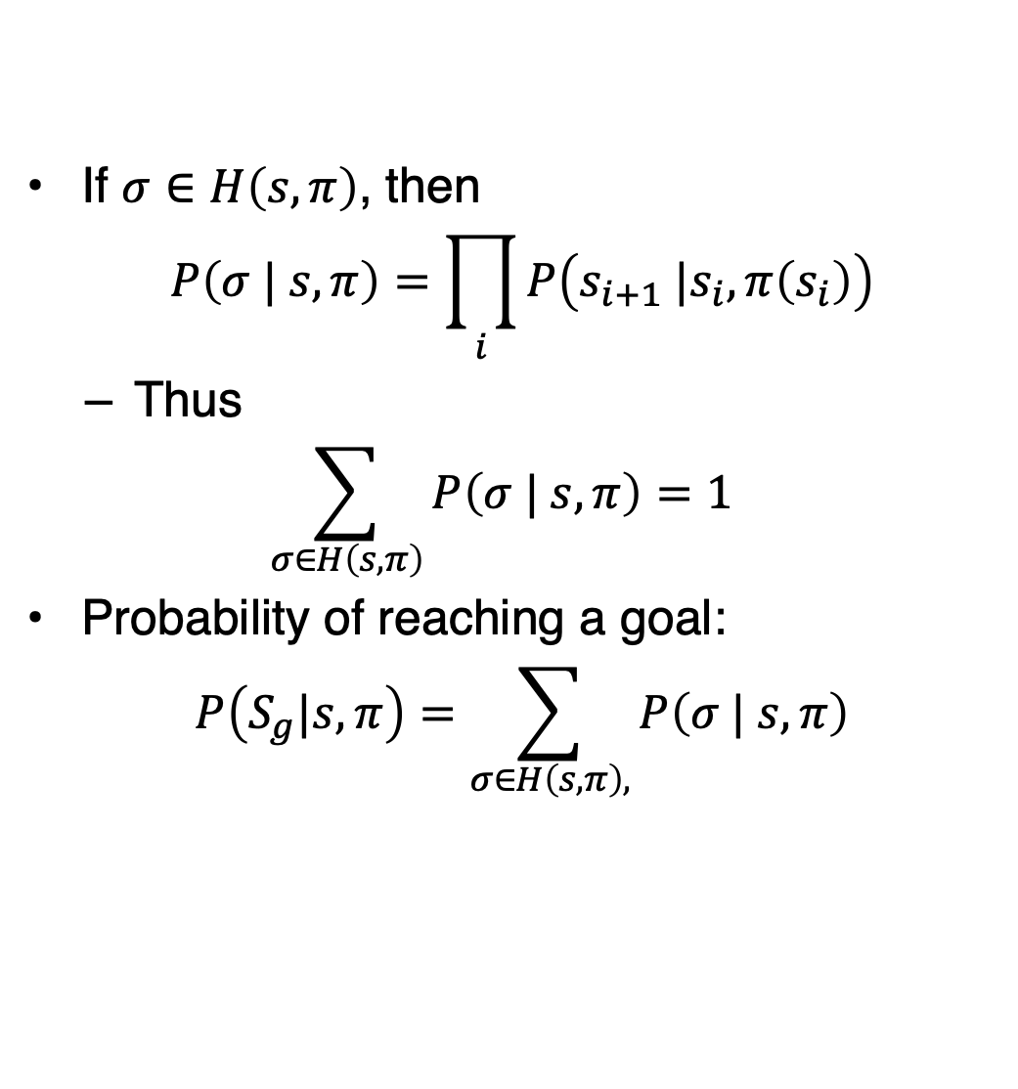

Histories
If $σ∈H\left(s,π\right)$, then
$$P\left(σ | s,π\right)=\prod_{i}{P\left(s_{i+1} |s_{i},π\left(s_{i}\right)\right)}$$
  Thus
  $$\sum_{σ∈H\left(s,π\right)}{P\left(σ | s,π\right)}=1$$
Probability of reaching a goal:
$$P\left(S_{g}|s, π\right)=\sum_{σ∈H\left(s,π\right),}{P\left(σ | s,π\right)}$$
m52
d5
0.2
d2
m23
0.8
d3
m32
m12
m21
m54
m43
m34
m45
d1
m41
d4
$$σ \text{ends} \text{at} s∈S_{g}$$
Start:
s₀= d1
0.5
Goal:
S_{g}= {d4}
0.5
m14
Notes:
Same as MDPs
Markov property!

Slide 11

Unsafe Solutions
Unsafe solution: $0<P\left(S_{g}|s_{0},π\right)<1$
Example:
  $π_{1}=\{\left(d1, m12\right), \left(d2, m23\right), \left(d3, m34\right)\}$
  $H\left(s_{0},π_{1}\right)$ contains two histories:
    $σ_{1}=\left\langle d1, d2, d3, d4\right\rangle$
    $P\left(σ_{1} | s_{0},π_{1}\right)$
    $=1∙0.8∙1=0.8$
    $σ_{2}=\left\langle d1, d2, d5\right\rangle$
    $P\left(σ_{2} | s_{0},π_{1}\right)$
    $=1∙0.2=0.2$
  $P\left(S_{g} | s_{0}, π_{1}\right)$
  $=0.8$
d5
0.2
d2
0.8
d3
d1
d4
Start:
s₀= d1
0.5
Goal:
S_{g}= {d4}
0.5

Slide 12

Unsafe Solutions
Unsafe solution: $0<P\left(S_{g}|s_{0},π\right)<1$
Example:
  $π_{2}=\{\left(d1, m12\right), \left(d2, m23\right), \left(d3, m34\right),$
  $\left(d5, m56\right),$ $\left(d6, m65\right)\}$
  $H\left(s_{0},π_{2}\right)$ contains two histories:
    $σ_{1}=\left\langle d1, d2, d3, d4\right\rangle$
    $P\left(σ_{1} | s_{0},π_{2}\right)$ $=1∙0.8∙1=0.8$
    $σ_{3}=\left\langle d1, d2, d5,d6,…\right\rangle$
    $P\left(σ_{3} | s_{0},π_{2}\right)$ $=1∙0.2∙1∙…=0.2$
  $P\left(S_{g} | s_{0}, π_{2}\right)=0.8$
d6
d5
0.2
d2
0.8
d3
d1
d4
Start:
s₀= d1
0.5
Goal:
S_{g}= {d4}
0.5

Slide 13
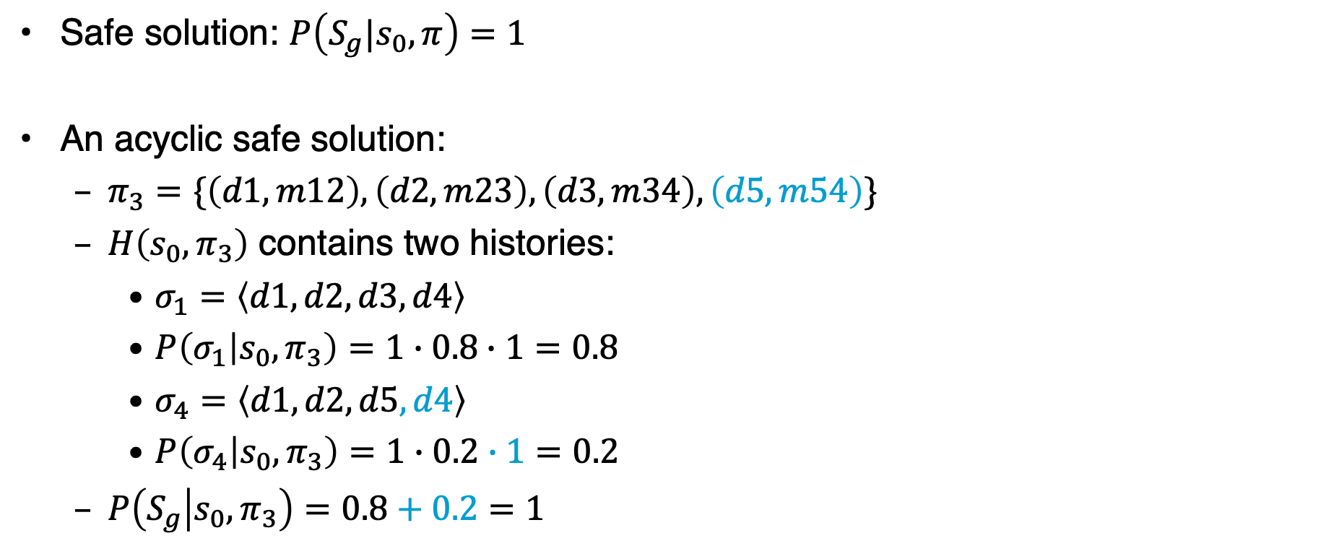
Safe Solutions
Safe solution: $P\left(S_{g}|s_{0},π\right)=1$
An acyclic safe solution:
  $π_{3}=\{\left(d1, m12\right), \left(d2, m23\right), \left(d3, m34\right),\left(d5,m54\right)\}$
  $H\left(s_{0},π_{3}\right)$ contains two histories:
    $σ_{1}=\left\langle d1, d2, d3, d4\right\rangle$
    $P\left(σ_{1} | s_{0},π_{3}\right)=1∙0.8∙1=0.8$
    $σ_{4}=\left\langle d1, d2, d5,d4\right\rangle$
    $P\left(σ_{4} | s_{0},π_{3}\right)=1∙0.2∙1=0.2$
  $P\left(S_{g} | s_{0}, π_{3}\right)=0.8+0.2=1$
d5
0.2
d2
0.8
d3
d1
d4
Start:
s₀= d1
0.5
Goal:
S_{g}= {d4}
0.5

Slide 14
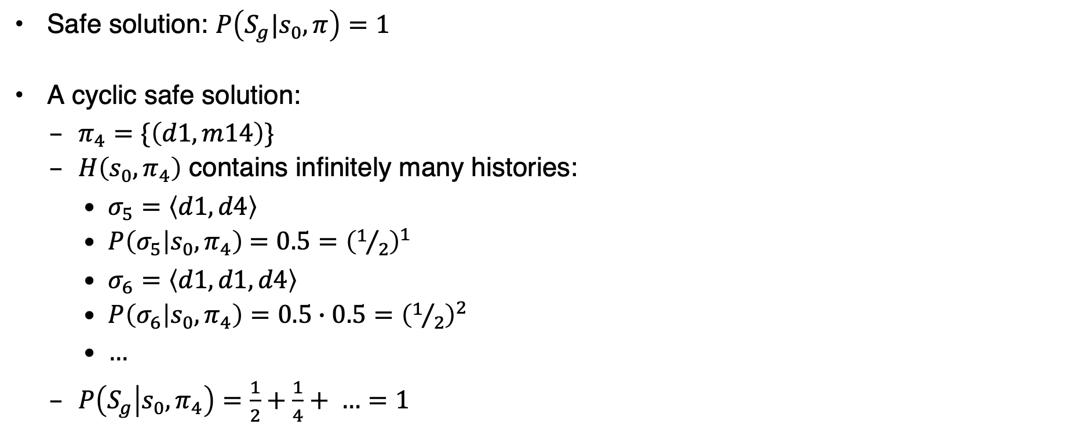
Safe Solutions
Safe solution: $P\left(S_{g}|s_{0},π\right)=1$
A cyclic safe solution:
  $π_{4}=\{\left(d1, m14\right)\}$
  $H\left(s_{0},π_{4}\right)$ contains infinitely many histories:
    $σ_{5}=\left\langle d1, d4\right\rangle$
    $P\left(σ_{5} | s_{0},π_{4}\right)$ $=0.5={\left(1/2\right)}^{1}$
    $σ_{6}=\left\langle d1, d1, d4\right\rangle$
    $P\left(σ_{6} | s_{0},π_{4}\right)=0.5∙0.5=$ ${\left(1/2\right)}^{2}$
    $…$
  $P\left(S_{g} | s_{0}, π_{4}\right)=\frac{1}{2}+\frac{1}{4}+ …=1$
d5
0.2
d2
0.8
d3
d1
d4
Start:
s₀= d1
0.5
Goal:
S_{g}= {d4}
0.5

Slide 15

Safe Solutions
Safe solution: $P\left(S_{g}|s_{0},π\right)=1$
Another cyclic safe solution:
  $π_{5}=\{\left(d1, m14\right),\left(d4,m41\right)\}$
  $H\left(s_{0},π_{5}\right)=H\left(s_{0},π_{4}\right)$:
    $σ_{5}=\left\langle d1, d4\right\rangle$
    $P\left(σ_{5} | s_{0},π_{5}\right)$ $=0.5={\left(1/2\right)}^{1}$
    $σ_{6}=\left\langle d1, d1, d4\right\rangle$
    $P\left(σ_{6} | s_{0},π_{6}\right)=0.5∙0.5=$ ${\left(1/2\right)}^{2}$
    …
  $P\left(S_{g} | s_{0}, π_{5}\right)=\frac{1}{2}+\frac{1}{4}+ …=1$
d5
0.2
d2
0.8
d3
d1
d4
Start:
s₀= d1
0.5
Goal:
S_{g}= {d4}
0.5
Notes:
d4 mapping never used, as we stop when we reach goal state

Slide 16
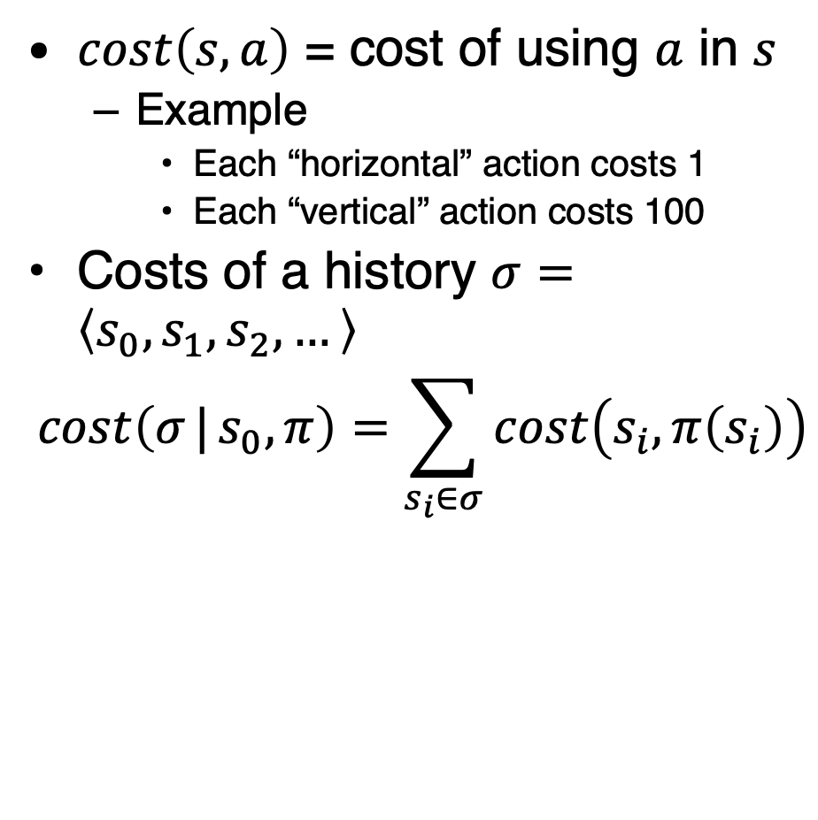
Expected Cost
$cost\left(s,a\right)$ = cost of using $a$ in $s$
  Example
    Each “horizontal” action costs 1
    Each “vertical” action costs 100
Costs of a history $σ=\left\langle s_{0}, s_{1}, s_{2}, …\right\rangle$
$$cost\left(σ | s_{0},π\right)=\sum_{s_{i}∈σ}{cost\left(s_{i},π\left(s_{i}\right)\right)}$$
d5
c = 1
0.2
d2
0.8
d3
c = 100
c = 100
d1
d4
Start:
s₀= d1
0.5
c = 1
Goal:
S_{g}= {d4}
0.5

Slide 17
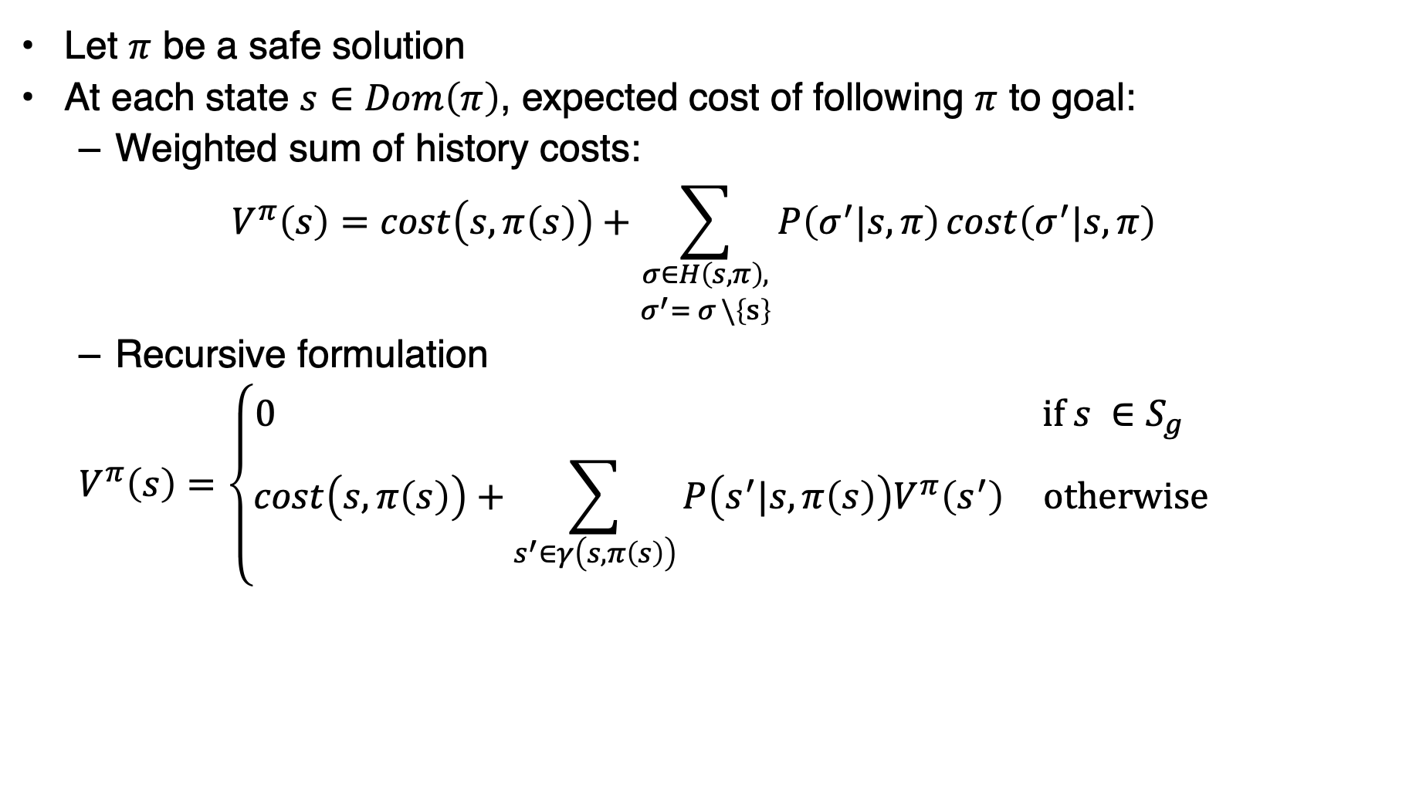
Expected Cost
Let $π$ be a safe solution
At each state $s∈Dom\left(π\right)$, expected cost of following $π$ to goal:
  Weighted sum of history costs:
  $$V^{π}\left(s\right)=cost\left(s,π\left(s\right)\right)+\sum_{\begin{aligned}σ∈H\left(s,π\right), \\ σ^{′}= σ \backslash \left\{s\right\}\end{aligned}}{P\left(σ^{′}|s,π\right)cost\left(σ^{′}|s,π\right)}$$
  Recursive formulation
  $$V^{π}\left(s\right)=\left\{\begin{matrix}0 & \text{if} s ∈S_{g} \\ cost\left(s,π\left(s\right)\right)+\sum_{s^{′}∈γ\left(s,π\left(s\right)\right)}{P\left(s^{′}|s,π\left(s\right)\right)V^{π}\left(s^{′}\right)} & \text{otherwise}\end{matrix}\right.$$

Slide 18

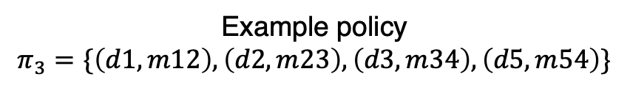
Example
Weighted sum of history cost:
  $σ_{1}=\left\langle d1, d2, d3, d4\right\rangle$
    $P\left(σ_{1} | s_{0},π_{3}\right)=0.8$
    $cost\left(σ_{1} | s_{0},π_{3}\right)$ $=100+1+100=201$
  $σ_{4}=\left\langle d1, d2, d5,d4\right\rangle$
    $P\left(σ_{4} | s_{0},π_{3}\right)=0.2$
    $cost\left(σ_{4} | s_{0},π_{3}\right)$ $=100+1+100=201$
  $V^{π_{3}}\left(d1\right)=0.8\left(201\right)+0.2\left(201\right)=201$
  Recursive equation
    $V^{π_{3}}\left(d1\right)$
    $=100+V^{π_{3}}\left(d2\right)$
    $=100+1+0.8V^{π_{3}}\left(d3\right)+0.2V^{π_{3}}\left(d5\right)$
    $=100+1+0.8\left(100\right)+0.2\left(100\right)=201$
Example policy
$$π_{3}=\{\left(d1, m12\right), \left(d2, m23\right), \left(d3, m34\right),\left(d5,m54\right)\}$$
d5
c = 1
0.2
d2
0.8
d3
c = 100
c = 100
d1
d4
Start:
s₀= d1
0.5
c = 1
Goal:
S_{g}= {d4}
0.5

Slide 19

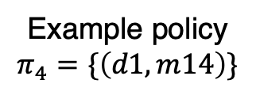
Safe Solutions
Weighted sum of history cost:
  $σ_{5}=\left\langle d1, d4\right\rangle$
    $P\left(σ_{5} | s_{0},π_{4}\right)={\left(1/2\right)}^{1}$
    $\operatorname{cost}\left(σ_{5} | s_{0},π_{4}\right)=1$
  $σ_{6}=\left\langle d1, d1, d4\right\rangle$
    $P\left(σ_{6} | s_{0},π_{4}\right)=$ ${\left(1/2\right)}^{2}$
    $\operatorname{cost}\left(σ_{6} | s_{0},π_{4}\right)=2$
  …
  $V^{π_{4}}\left(d1\right)=\frac{1}{2}\left(1\right)+\frac{1}{4}\left(2\right)+…=2$
  Recursive equation
    $V^{π_{4}}\left(d1\right)=1+0.5\left(0\right)+0.5\left(V^{π_{4}}\left(d1\right)\right)$
    $⇔0.5V^{π_{4}}\left(d1\right)=1⇔ V^{π_{4}}\left(d1\right)=2$
Example policy
$$π_{4}=\{\left(d1, m14\right)\}$$
d5
c = 1
0.2
d2
0.8
d3
c = 100
c = 100
d1
d4
Start:
s₀= d1
0.5
c = 1
Goal:
S_{g}= {d4}
0.5

Slide 20
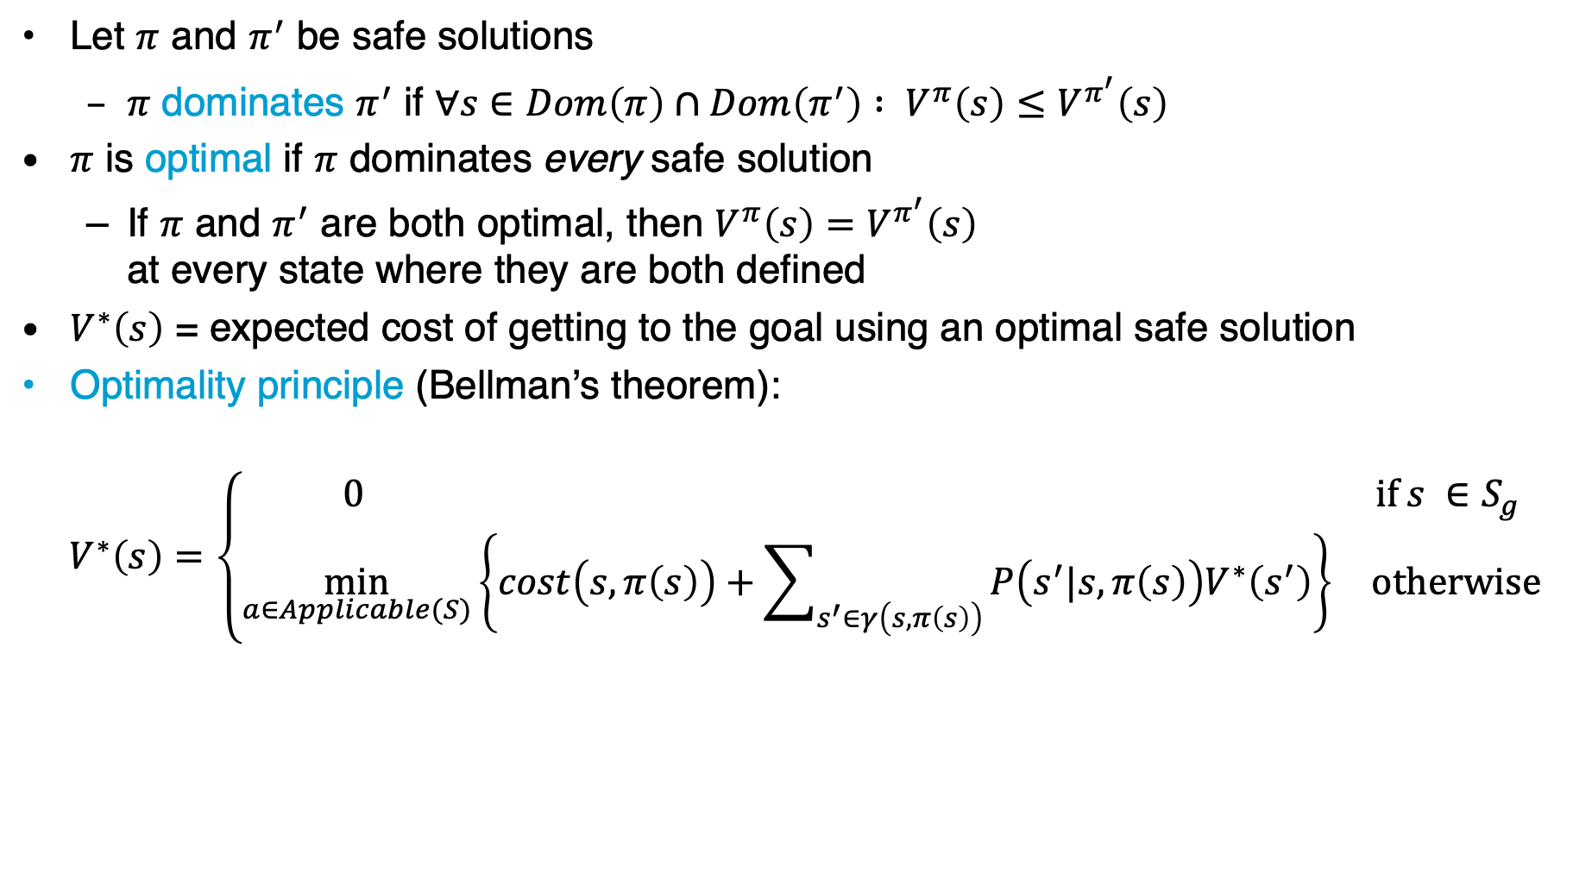
Planning as Optimisation
Let $π$ and $π^{′}$ be safe solutions
  $π$ dominates $π^{′}$ if $∀s∈Dom\left(π\right)∩Dom\left(π^{′}\right) : V^{π}\left(s\right)≤V^{π^{′}}\left(s\right)$
$π$ is optimal if $π$ dominates every safe solution
  If $π$ and $π^{′}$ are both optimal, then $V^{π}\left(s\right)=V^{π^{′}}\left(s\right)$
  at every state where they are both defined
$V^{∗}\left(s\right)$ = expected cost of getting to the goal using an optimal safe solution
Optimality principle (Bellman’s theorem):
  $$V^{∗}\left(s\right)=\left\{\begin{matrix}0 & \text{if} s ∈S_{g} \\ \min_{a∈Applicable(S)}\left\{cost\left(s,π\left(s\right)\right)+\sum_{s^{′}∈γ\left(s,π\left(s\right)\right)}{P\left(s^{′}|s,π\left(s\right)\right)V^{∗}\left(s^{′}\right)}\right\} & \text{otherwise}\end{matrix}\right.$$
s₁
a
s₂
s
s₃
b
s₄

Slide 21
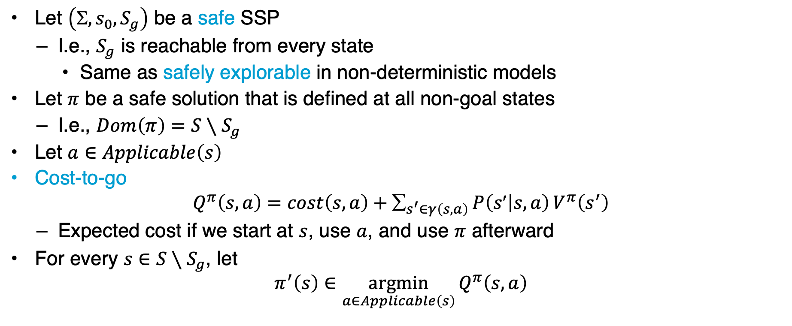
Cost to Go
Let $\left(, s_{0}, S_{g}\right)$ be a safe SSP
  I.e., $S_{g}$ is reachable from every state
    Same as safely explorable in non-deterministic models
Let $π$ be a safe solution that is defined at all non-goal states
  I.e., $Dom\left(π\right)=S∖S_{g}$
Let $a∈Applicable\left(s\right)$
Cost-to-go
$$Q^{π}\left(s,a\right)=cost\left(s,a\right)+_{s^{′}∈γ\left(s,a\right)}P\left(s | s,a\right)V^{π}\left(s^{′}\right)$$
  Expected cost if we start at $s$, use $a$, and use $π$ afterward
For every $s∈S∖S_{g}$, let
$$π^{′}\left(s\right)∈\underset{a∈Applicable\left(s\right)}{argmin}{Q^{π}\left(s,a\right)}$$
s₁
a
s₂
s
s₃
b
s₄

Slide 22

Policy Iteration
Inputs
  SSP problem $\left(, s_{0}, S_{g}\right)$
  Initial policy $π_{0}$
Finds an optimal policy
Converges in a finite number of steps
policy-iteration(𝛴,s₀,S_{g},𝜋₀)
𝜋 ← 𝜋₀
loop
compute{V^{𝜋}(s)|s ∈ S}
for every state s ∈ S \ S_{g} do
A ← argmin_{a∈Applicable(s)} Q^{𝜋}(s,a)
if 𝜋(s) ∈ A then
𝜋’(s) ← 𝜋(s)
else
𝜋’(s) ← any action in A
if 𝜋’ = 𝜋 then
return 𝜋
𝜋 ← 𝜋’
$n$ equations,
$n$ unknowns, where $n=|S|$

Slide 23
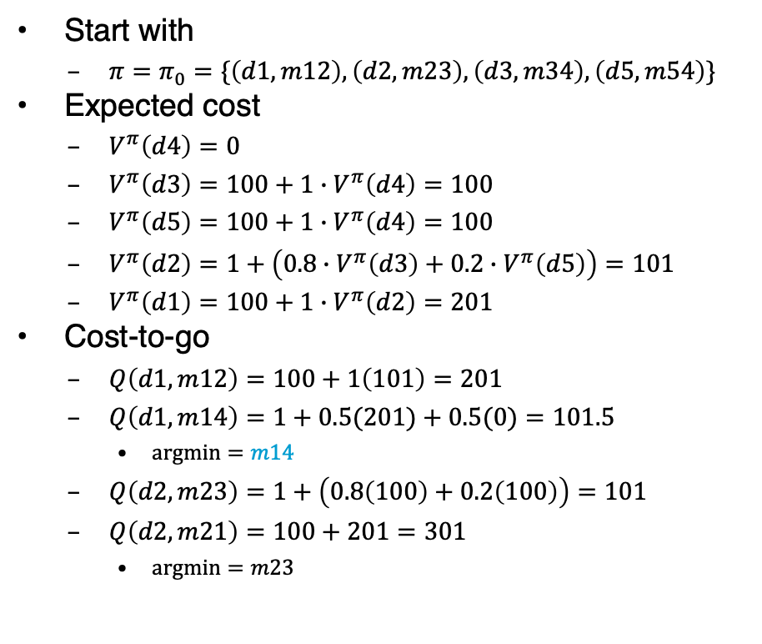

Example
Cost-to-go continued
  $Q\left(d3,m34\right)=100+0=100$
  $Q\left(d3,m32\right)=1+101=102$
    $argmin=m34$
  $Q\left(d5,m54\right)=100+0=100$
  $Q\left(d5,m52\right)=1+101=102$
    $argmin=m54$
Start with
  $π=π_{0}=\{\left(d1, m12\right),\left(d2, m23\right),\left(d3, m34\right),\left(d5,m54\right)\}$
Expected cost
  $V^{π}\left(d4\right)=0$
  $V^{π}\left(d3\right)=100+1∙V^{π}\left(d4\right)=100$
  $V^{π}\left(d5\right)=100+1∙V^{π}\left(d4\right)=100$
  $V^{π}\left(d2\right)=1+\left(0.8∙V^{π}\left(d3\right)+0.2∙V^{π}\left(d5\right)\right)=101$
  $V^{π}\left(d1\right)=100+1∙V^{π}\left(d2\right)=201$
Cost-to-go
  $Q\left(d1,m12\right)=100+1\left(101\right)=201$
  $Q\left(d1,m14\right)=1+0.5(201)+0.5(0)=101.5$
    $argmin=m14$
  $Q\left(d2,m23\right)=1+\left(0.8\left(100\right)+0.2\left(100\right)\right)=101$
  $Q\left(d2,m21\right)=100+201=301$
    $argmin=m23$
d5
c = 1
0.2
d2
0.8
d3
c = 100
c = 100
d1
d4
Start:
s₀= d1
0.5
c = 1
Goal:
S_{g}= {d4}
0.5

Slide 24
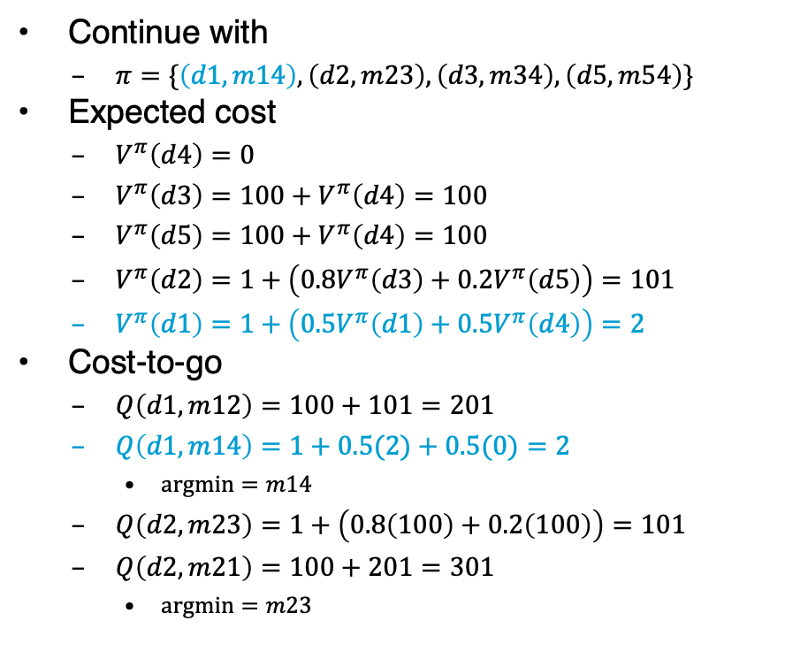

Example
Cost-to-go continued
  $Q\left(d3,m34\right)=100+0=100$
  $Q\left(d3,m32\right)=100+101=201$
    $argmin=m34$
  $Q\left(d5,m54\right)=100+0=100$
  $Q\left(d5,m54\right)=100+101=201$
    $argmin=m54$
Continue with
  $π=\{\left(d1, m14\right),\left(d2, m23\right),\left(d3, m34\right),\left(d5,m54\right)\}$
Expected cost
  $V^{π}\left(d4\right)=0$
  $V^{π}\left(d3\right)=100+V^{π}\left(d4\right)=100$
  $V^{π}\left(d5\right)=100+V^{π}\left(d4\right)=100$
  $V^{π}\left(d2\right)=1+\left(0.8V^{π}\left(d3\right)+0.2V^{π}\left(d5\right)\right)=101$
  $V^{π}\left(d1\right)=1+\left(0.5V^{π}\left(d1\right)+0.5V^{π}\left(d4\right)\right)=2$
Cost-to-go
  $Q\left(d1,m12\right)=100+101=201$
  $Q\left(d1,m14\right)=1+0.5(2)+0.5(0)=2$
    $argmin=m14$
  $Q\left(d2,m23\right)=1+\left(0.8\left(100\right)+0.2\left(100\right)\right)=101$
  $Q\left(d2,m21\right)=100+201=301$
    $argmin=m23$
d5
c = 1
0.2
d2
0.8
d3
c = 100
c = 100
d1
d4
Start:
s₀= d1
0.5
c = 1
Goal:
S_{g}= {d4}
0.5
$π$unchanged

Slide 25
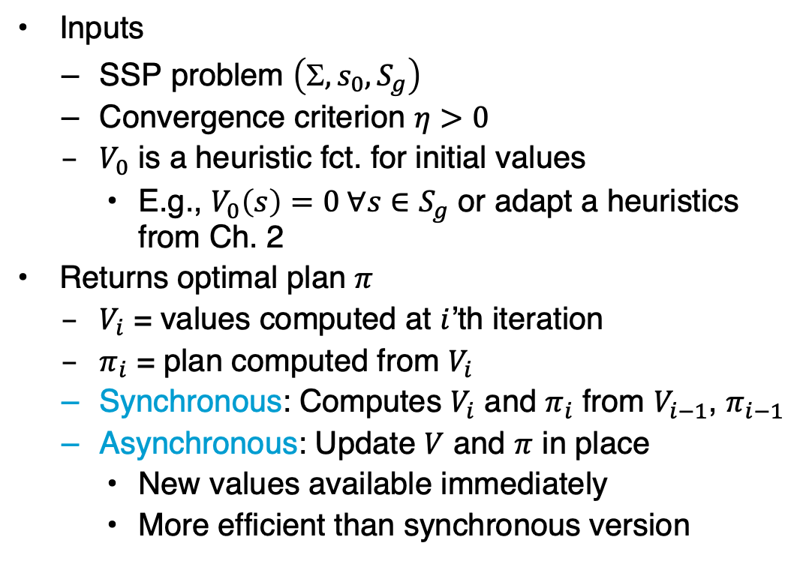
Value Iteration
sync-value-iteration(𝛴,s₀,S_{g},V₀,𝜂)
for i = 1,2,… do
for every state s ∈ S \ S_{g} do
for every a ∈ Applicable(s) do
Q(s,a) ← cost(s,a)+𝛴_{s’∈S}P(s’|s,a)V_{i-1}(s’)
V_{i}(s) ← min_{a∈Applicable(s)} Q(s,a)
𝜋_{i}(s) ← argmin_{a∈Applicable(s)} Q(s,a)
if max_{s∈S}|V_{i}(s)- V_{i-1}(s)| ≤ 𝜂 then
return 𝜋_{i}
Inputs
  SSP problem $\left(, s_{0}, S_{g}\right)$
  Convergence criterion $η>0$
  $V_{0}$ is a heuristic fct. for initial values
    E.g., $V_{0}\left(s\right)=0 ∀s∈S_{g}$ or adapt a heuristics from Ch. 2
Returns optimal plan $π$
  $V_{i}$ = values computed at $i$’th iteration
  $π_{i}$ = plan computed from $V_{i}$
  Synchronous: Computes $V_{i}$ and $π_{i}$ from $V_{i−1}$, $π_{i−1}$
  Asynchronous: Update $V$ and $π$ in place
    New values available immediately
    More efficient than synchronous version
async-value-iteration(𝛴,s₀,S_{g},V₀,𝜂)
global 𝜋 ← ∅
global V(s) ← V₀(s) ∀ s
loop
r ← max_{s∈S\Sg}Bellman-Update(s)
if r ≤ 𝜂 then
return 𝜋
Bellman-Update(s)
𝜈_{old} ← V(s)
for every a ∈ Applicable(s) do
Q(s,a) ← cost(s,a)+𝛴_{s’∈S}P(s’|s,a)V(s’)
V(s) ← min_{a∈Applicable(s)} Q(s,a)
𝜋(s) ← argmin_{a∈Applicable(s)} Q(s,a)
return |V(s)-𝜈_{old}|
Notes:
Convergence criterion based on epsilon and gamma possible

Slide 26
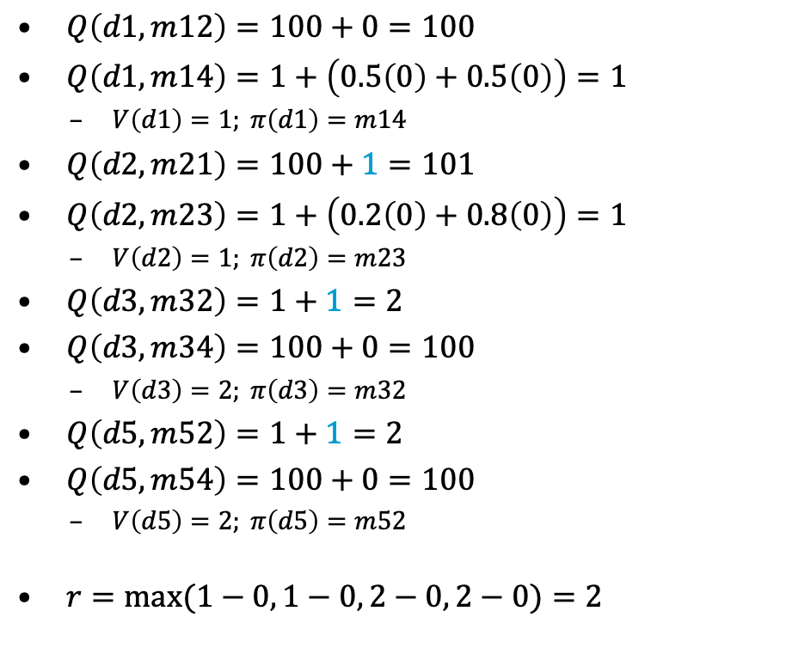
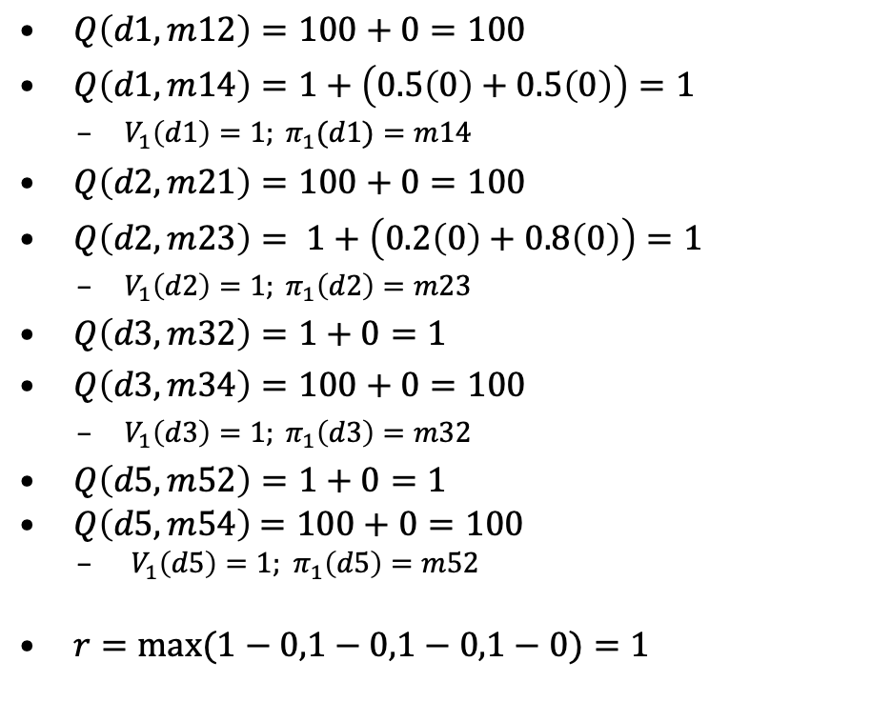
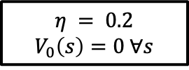
Synchronous Asynchronous
c = 1
d5
$$η = 0.2$$
$$V_{0}\left(s\right)=0 ∀s$$
0.2
d2
0.8
d3
c = 100
c = 100
$Q\left(d1,m12\right)=100+0=100$
$Q\left(d1,m14\right)=1+\left(0.5\left(0\right)+0.5\left(0\right)\right)=1$
  $V_{1}\left(d1\right)=1; π_{1}(d1)=m14$
$Q\left(d2,m21\right)=100+0=100$
$Q\left(d2,m23\right)= 1+\left(0.2\left(0\right)+0.8\left(0\right)\right)=1$
  $V_{1}\left(d2\right)=1; π_{1}\left(d2\right)=m23$
$Q\left(d3,m32\right)=1+0=1$
$Q\left(d3,m34\right)=100+0=100$
  $V_{1}\left(d3\right)=1; π_{1}\left(d3\right)=m32$
$Q\left(d5,m52\right)=1+0=1$
$Q\left(d5,m54\right)$ $=100+0=100$
  ${ V}_{1}\left(d5\right)=1;$ $π_{1}\left(d5\right)=m52$
$r=max(1−0,1−0,1−0,1−0)=1$
d1
$Q\left(d1,m12\right)=100+0=100$
$Q\left(d1,m14\right)=1+\left(0.5\left(0\right)+0.5\left(0\right)\right)=1$
  $V\left(d1\right)=1; π\left(d1\right)=m14$
$Q\left(d2,m21\right)=100+1=101$
$Q\left(d2,m23\right)=1+\left(0.2\left(0\right)+0.8\left(0\right)\right)=1$
  $V\left(d2\right)=1; π\left(d2\right)=m23$
$Q\left(d3,m32\right)=1+1=2$
$Q\left(d3,m34\right)=100+0=100$
  $V\left(d3\right)=2; π\left(d3\right)=m32$
$Q\left(d5,m52\right)=1+1=2$
$Q\left(d5,m54\right)=100+0=100$
  $V\left(d5\right)=2; π\left(d5\right)=m52$
$r=max⁡(1−0, 1−0, 2−0, 2−0)=2$
d4
Start:
s₀= d1
0.5
0.5
c = 1
Goal:
S_{g}= {d4}

Slide 27
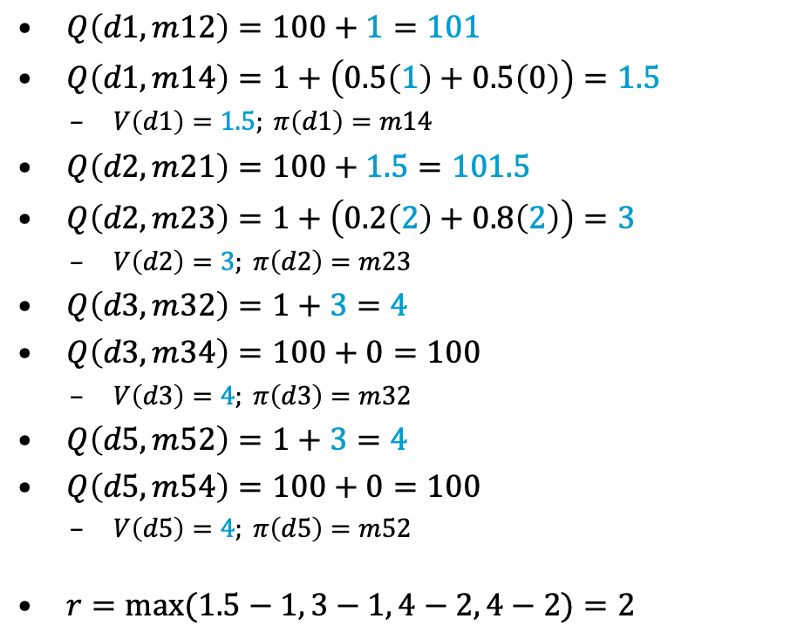
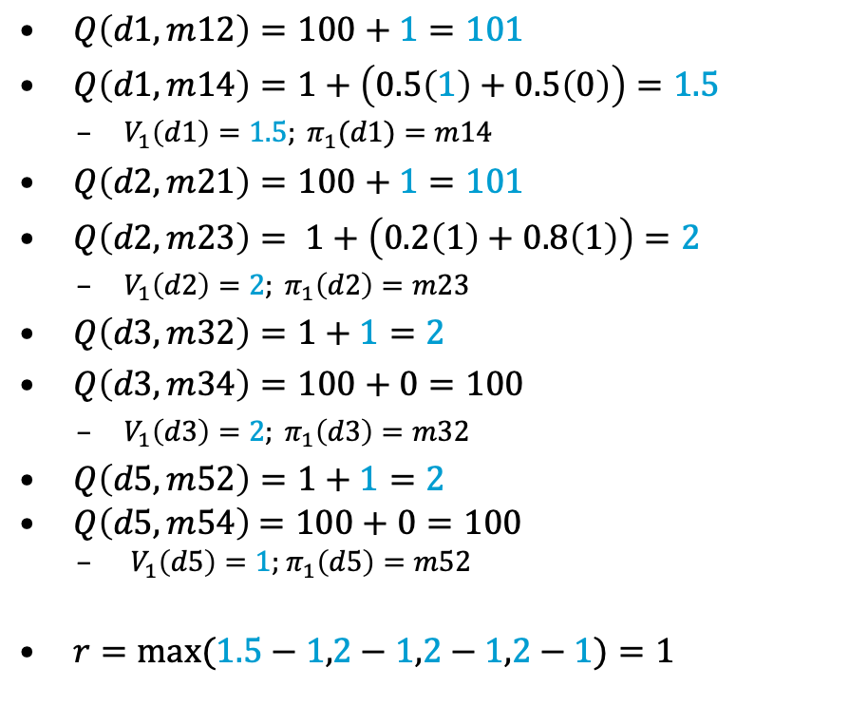


Synchronous Asynchronous
$$η = 0.2$$
c = 1
d5
0.2
d2
0.8
d3
c = 100
c = 100
$Q\left(d1,m12\right)=100+1=101$
$Q\left(d1,m14\right)=1+\left(0.5\left(1\right)+0.5\left(0\right)\right)=1.5$
  $V_{1}\left(d1\right)=1.5; π_{1}(d1)=m14$
$Q\left(d2,m21\right)=100+1=101$
$Q\left(d2,m23\right)= 1+\left(0.2\left(1\right)+0.8\left(1\right)\right)=2$
  $V_{1}\left(d2\right)=2; π_{1}\left(d2\right)=m23$
$Q\left(d3,m32\right)=1+1=2$
$Q\left(d3,m34\right)=100+0=100$
  $V_{1}\left(d3\right)=2; π_{1}\left(d3\right)=m32$
$Q\left(d5,m52\right)=1+1=2$
$Q\left(d5,m54\right)$ $=100+0=100$
  ${ V}_{1}\left(d5\right)=1;$ $π_{1}\left(d5\right)=m52$
$r=max(1.5−1,2−1,2−1,2−1)=1$
d1
$Q\left(d1,m12\right)=100+1=101$
$Q\left(d1,m14\right)=1+\left(0.5\left(1\right)+0.5\left(0\right)\right)=1.5$
  $V\left(d1\right)=1.5; π\left(d1\right)=m14$
$Q\left(d2,m21\right)=100+1.5=101.5$
$Q\left(d2,m23\right)=1+\left(0.2\left(2\right)+0.8\left(2\right)\right)=3$
  $V\left(d2\right)=3; π\left(d2\right)=m23$
$Q\left(d3,m32\right)=1+3=4$
$Q\left(d3,m34\right)=100+0=100$
  $V\left(d3\right)=4; π\left(d3\right)=m32$
$Q\left(d5,m52\right)=1+3=4$
$Q\left(d5,m54\right)=100+0=100$
  $V\left(d5\right)=4; π\left(d5\right)=m52$
$r=max⁡(1.5−1, 3−1, 4−2, 4−2)=2$
d4
Start:
s₀= d1
0.5
0.5
c = 1
Goal:
S_{g}= {d4}
$$V\left(d1\right)=1$$
$$V\left(d2\right)=1$$
$$V\left(d3\right)=1$$
$$V\left(d5\right)=1$$
$$V\left(d1\right)=1$$
$$V\left(d2\right)=1$$
$$V\left(d3\right)=2$$
$$V\left(d5\right)=2$$

Slide 28
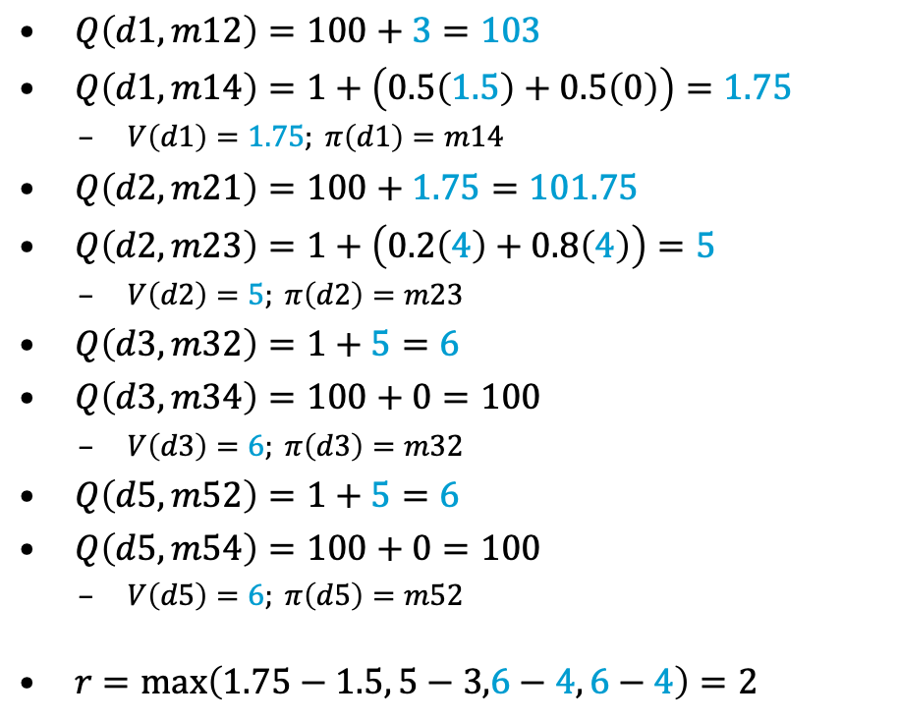
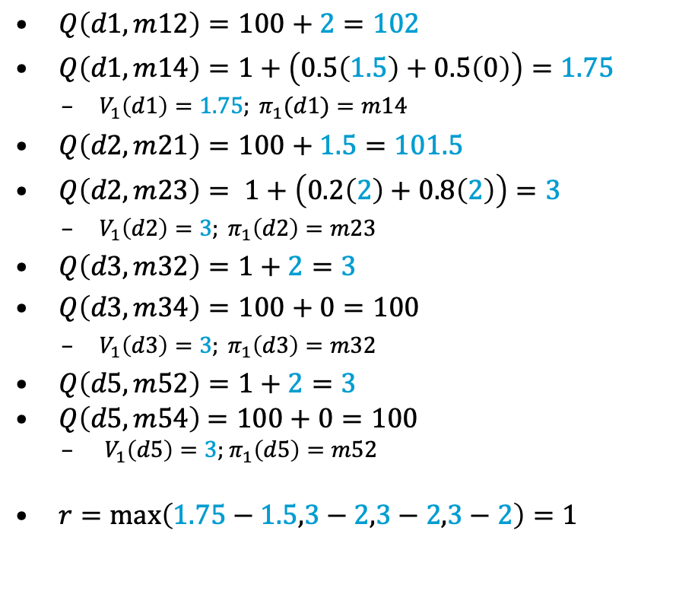
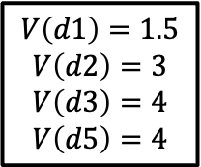
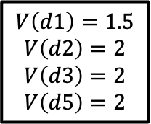
Synchronous Asynchronous
$$η = 0.2$$
c = 1
d5
0.2
d2
0.8
d3
c = 100
c = 100
$Q\left(d1,m12\right)=100+2=102$
$Q\left(d1,m14\right)=1+\left(0.5\left(1.5\right)+0.5\left(0\right)\right)=1.75$
  $V_{1}\left(d1\right)=1.75; π_{1}(d1)=m14$
$Q\left(d2,m21\right)=100+1.5=101.5$
$Q\left(d2,m23\right)= 1+\left(0.2\left(2\right)+0.8\left(2\right)\right)=3$
  $V_{1}\left(d2\right)=3; π_{1}\left(d2\right)=m23$
$Q\left(d3,m32\right)=1+2=3$
$Q\left(d3,m34\right)=100+0=100$
  $V_{1}\left(d3\right)=3; π_{1}\left(d3\right)=m32$
$Q\left(d5,m52\right)=1+2=3$
$Q\left(d5,m54\right)$ $=100+0=100$
  ${ V}_{1}\left(d5\right)=3;$ $π_{1}\left(d5\right)=m52$
$r=max\left(1.75−1.5,3−2,3−2,3−2\right)=1$
d1
$Q\left(d1,m12\right)=100+3=103$
$Q\left(d1,m14\right)=1+\left(0.5\left(1.5\right)+0.5\left(0\right)\right)=1.75$
  $V\left(d1\right)=1.75; π\left(d1\right)=m14$
$Q\left(d2,m21\right)=100+1.75=101.75$
$Q\left(d2,m23\right)=1+\left(0.2\left(4\right)+0.8\left(4\right)\right)=5$
  $V\left(d2\right)=5; π\left(d2\right)=m23$
$Q\left(d3,m32\right)=1+5=6$
$Q\left(d3,m34\right)=100+0=100$
  $V\left(d3\right)=6; π\left(d3\right)=m32$
$Q\left(d5,m52\right)=1+5=6$
$Q\left(d5,m54\right)=100+0=100$
  $V\left(d5\right)=6; π\left(d5\right)=m52$
$r=\max\left(1.75−1.5, 5−3,6−4, 6−4\right)=2$
Start:
s₀= d1
0.5
c = 1
d4
Goal:
S_{g}= {d4}
0.5
$$V\left(d1\right)=1.5$$
$$V\left(d2\right)=2$$
$$V\left(d3\right)=2$$
$$V\left(d5\right)=2$$
$$V\left(d1\right)=1.5$$
$$V\left(d2\right)=3$$
$$V\left(d3\right)=4$$
$$V\left(d5\right)=4$$

Slide 29

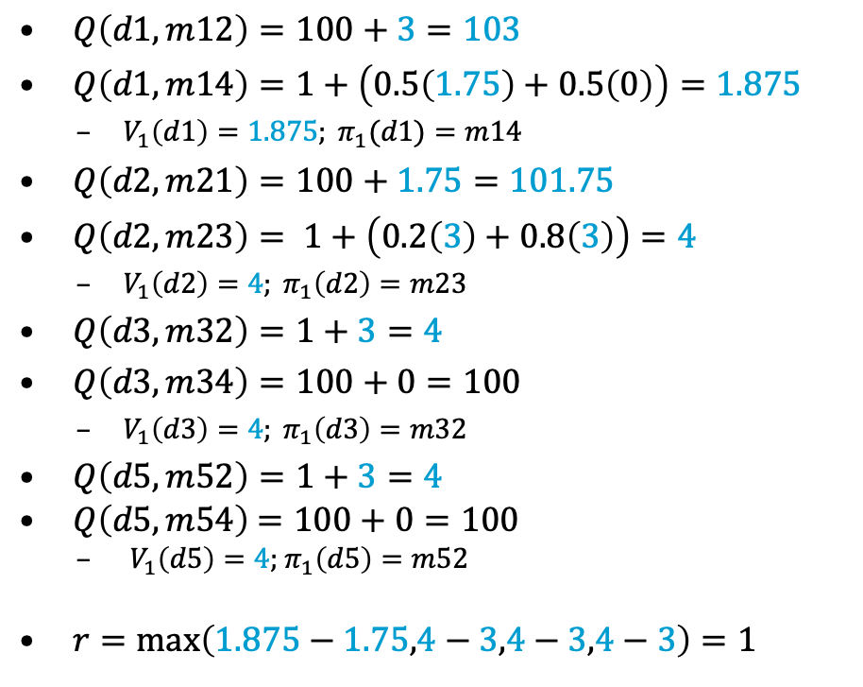
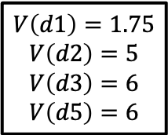
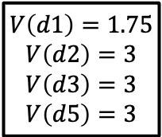
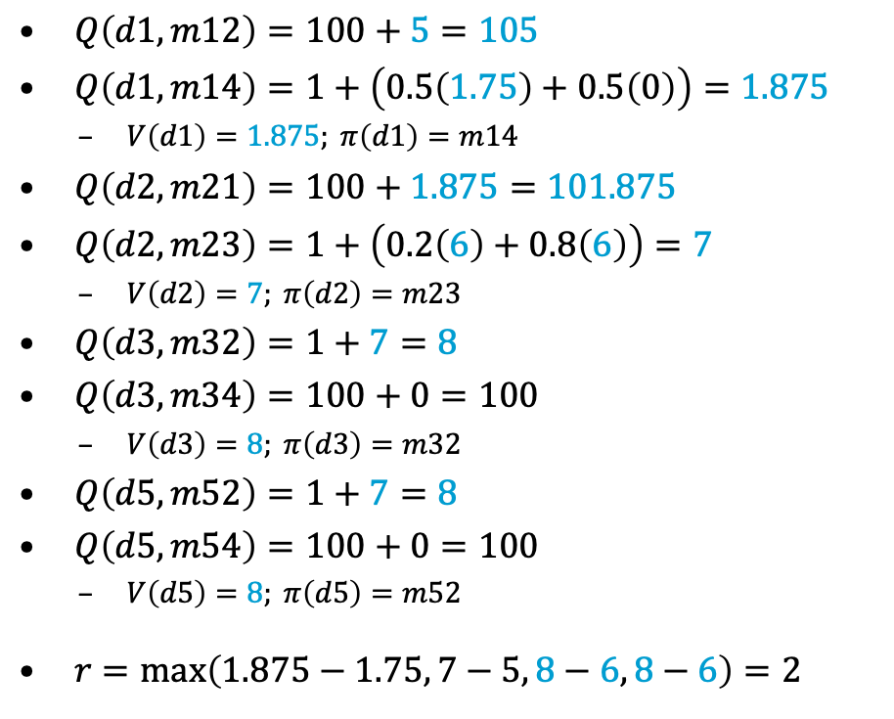
Synchronous Asynchronous
$$η = 0.2$$
c = 1
d5
0.2
d2
0.8
d3
  How long before $r ≤ η$?
  How long, if the “vertical” actions cost 10 instead of 100?
c = 100
c = 100
$Q\left(d1,m12\right)=100+3=103$
$Q\left(d1,m14\right)=1+\left(0.5\left(1.75\right)+0.5\left(0\right)\right)=1.875$
  $V_{1}\left(d1\right)=1.875; π_{1}(d1)=m14$
$Q\left(d2,m21\right)=100+1.75=101.75$
$Q\left(d2,m23\right)= 1+\left(0.2\left(3\right)+0.8\left(3\right)\right)=4$
  $V_{1}\left(d2\right)=4; π_{1}\left(d2\right)=m23$
$Q\left(d3,m32\right)=1+3=4$
$Q\left(d3,m34\right)=100+0=100$
  $V_{1}\left(d3\right)=4; π_{1}\left(d3\right)=m32$
$Q\left(d5,m52\right)=1+3=4$
$Q\left(d5,m54\right)$ $=100+0=100$
  ${ V}_{1}\left(d5\right)=4;$ $π_{1}\left(d5\right)=m52$
$r=max\left(1.875−1.75,4−3,4−3,4−3\right)=1$
d1
$Q\left(d1,m12\right)=100+5=105$
$Q\left(d1,m14\right)=1+\left(0.5\left(1.75\right)+0.5\left(0\right)\right)=1.875$
  $V\left(d1\right)=1.875; π\left(d1\right)=m14$
$Q\left(d2,m21\right)=100+1.875=101.875$
$Q\left(d2,m23\right)=1+\left(0.2\left(6\right)+0.8\left(6\right)\right)=7$
  $V\left(d2\right)=7; π\left(d2\right)=m23$
$Q\left(d3,m32\right)=1+7=8$
$Q\left(d3,m34\right)=100+0=100$
  $V\left(d3\right)=8; π\left(d3\right)=m32$
$Q\left(d5,m52\right)=1+7=8$
$Q\left(d5,m54\right)=100+0=100$
  $V\left(d5\right)=8; π\left(d5\right)=m52$
$r=\max\left(1.875−1.75, 7−5, 8−6, 8−6\right)=2$
Start:
s₀= d1
0.5
c = 1
d4
Goal:
S_{g}= {d4}
0.5
$$V\left(d1\right)=1.75$$
$$V\left(d2\right)=3$$
$$V\left(d3\right)=3$$
$$V\left(d5\right)=3$$
$$V\left(d1\right)=1.75$$
$$V\left(d2\right)=5$$
$$V\left(d3\right)=6$$
$$V\left(d5\right)=6$$
Notes:
52 iterations
7 iterations

Slide 30
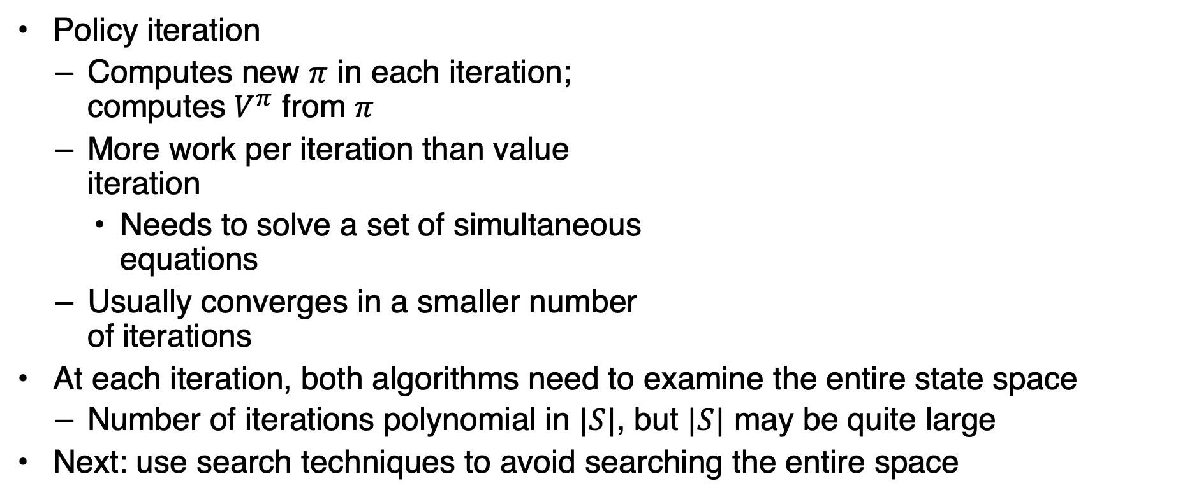

Discussion
Policy iteration
  Computes new $π$ in each iteration;
  computes $V^{π}$ from $π$
  More work per iteration than value
  iteration
    Needs to solve a set of simultaneous
    equations
  Usually converges in a smaller number
  of iterations
At each iteration, both algorithms need to examine the entire state space
  Number of iterations polynomial in $|S|$, but $|S|$ may be quite large
Next: use search techniques to avoid searching the entire space
Value iteration
  Computes new $V$ in each iteration;
  chooses $π$ based on $V$
  New $V$ is a revised set of heuristic estimates
    Not $V^{π}$ for $π$ or any other policy
  Less work per iteration: does not need to solve a set of equations
  Usually takes more iterations to converge

Slide 31
Summary
SSPs
Solutions, closed solutions, histories
Unsafe solutions, acyclic safe solutions, cyclic safe solutions
Expected cost, planning as optimization
Policy iteration
Value iteration (synchronous, asynchronous)
  Bellman-update

Slide 32
Outline
6.2 Stochastic shortest path problems
  Safe/unsafe policies
  Optimality
  Policy iteration, value iteration
6.3 Heuristic search algorithms
  Best-first search
  Determinisation
6.4 Online probabilistic planning
  Lookahead
  Reinforcement learning

Slide 33

AO*
Best-first search for acyclic domains
Inputs: SSP problem $\left(, s_{0}, S_{g}\right)$, initial values $V_{0}$
Envelope: set of states that have been generated
no $π$-descendants in $Z$ but $s$ itself
• ensures bottom-up updates
the states “just above” $s$
Requires acyclic $Σ$
not in book
AO-Update(s)
  Z ← {s} // nodes that need updating
  while Z ≠ ∅ do
    select s ∈ Z s.t. $\hat{\text{γ}}$(s,π(s)) ∩ Z = {s}
    remove s from Z
      Bellman-Update(s)
      Z ← Z ∪ {s′ ∈ Envelope | s ∈ γ(s′,𝜋)}
AO∗(Σ,s₀,S_{g},V₀)
  global π ← ∅; V(s₀) ← V₀(s₀); Envelope ← {s₀}
  while leaves(s₀,π) ∖ S_{g} ≠ ∅ do
  select s ∈ leaves(s₀,π) ∖ S_{g}
    for all a ∈ Applicable(s) do
      for all s′ ∈ 𝛾(s,a) ∖ Envelope do
      V(s′) ← V₀(s′)
      Add s′ to Envelope
    AO-Update(s)
    return π
Bellman-Update(s)
for every a ∈ Applicable(s) do
Q(s,a) ← cost(s,a)+𝛴_{s’∈S}PR(s’|s,a)V(s’)
V(s) ← min_{a∈Applicable(s)}Q(s,a)
𝜋(s) ← argmin_{a∈Applicable(s)}Q(s,a)
Notes:
Envelope: set of states that have been generated at some point (goal states, fringe states – successor states unknown, interior states – successor states in envelope)
AO-update: bottom-up stage by stage update of state s back to the initial starting state (not possible for cyclic domains)

Slide 34

LAO*
Different compared to AO*
Best-first search for both cyclic and acyclic domains
Inputs: SSP problem $\left(, s_{0}, S_{g}\right)$, initial values $V_{0}$
Asynchronous value iteration,
restricted to $Z$
$Σ$ may be cyclic or acyclic
not in book
all $π$-ancestors of $s$ in $Envelope$
LAO∗(Σ,s₀,S_{g},V₀)
  global π ← ∅; V(s₀) ← V₀(s₀); Envelope ← {s₀}
  loop
  if leaves(s₀,π) ⊆ S_{g} ≠ ∅ then
  return π
  select s ∈ leaves(s₀,π) ∖ S_{g}
    for all a ∈ Applicable(s) do
      for all s′ ∈ 𝛾(s,a) ∖ Envelope do
      V(s′) ← V₀(s′)
      Add s′ to Envelope
    LAO-Update(s)
    return π
LAO-Update(s)
  Z ← {s}∪{s′ ∈ Envelope | s ∈ 𝛾(s′,𝜋)}
  loop
    r ← max_{s∈Z} Bellman-Update(s)
    if leaves(s₀,π) changed or r ≤ η then
    break
Bellman-Update(s)
𝜈_{old} ← V(s)
for every a ∈ Applicable(s) do
Q(s,a) ← cost(s,a)+𝛴_{s’∈S}PR(s’|s,a)V(s’)
V(s) ← min_{a∈Applicable(s)} Q(s,a)
𝜋(s) ← argmin_{a∈Applicable(s)} Q(s,a)
return |V(s)-𝜈_{old}|
Notes:
LAO update: Update the states on which the expansion of s may have an effect

Slide 35
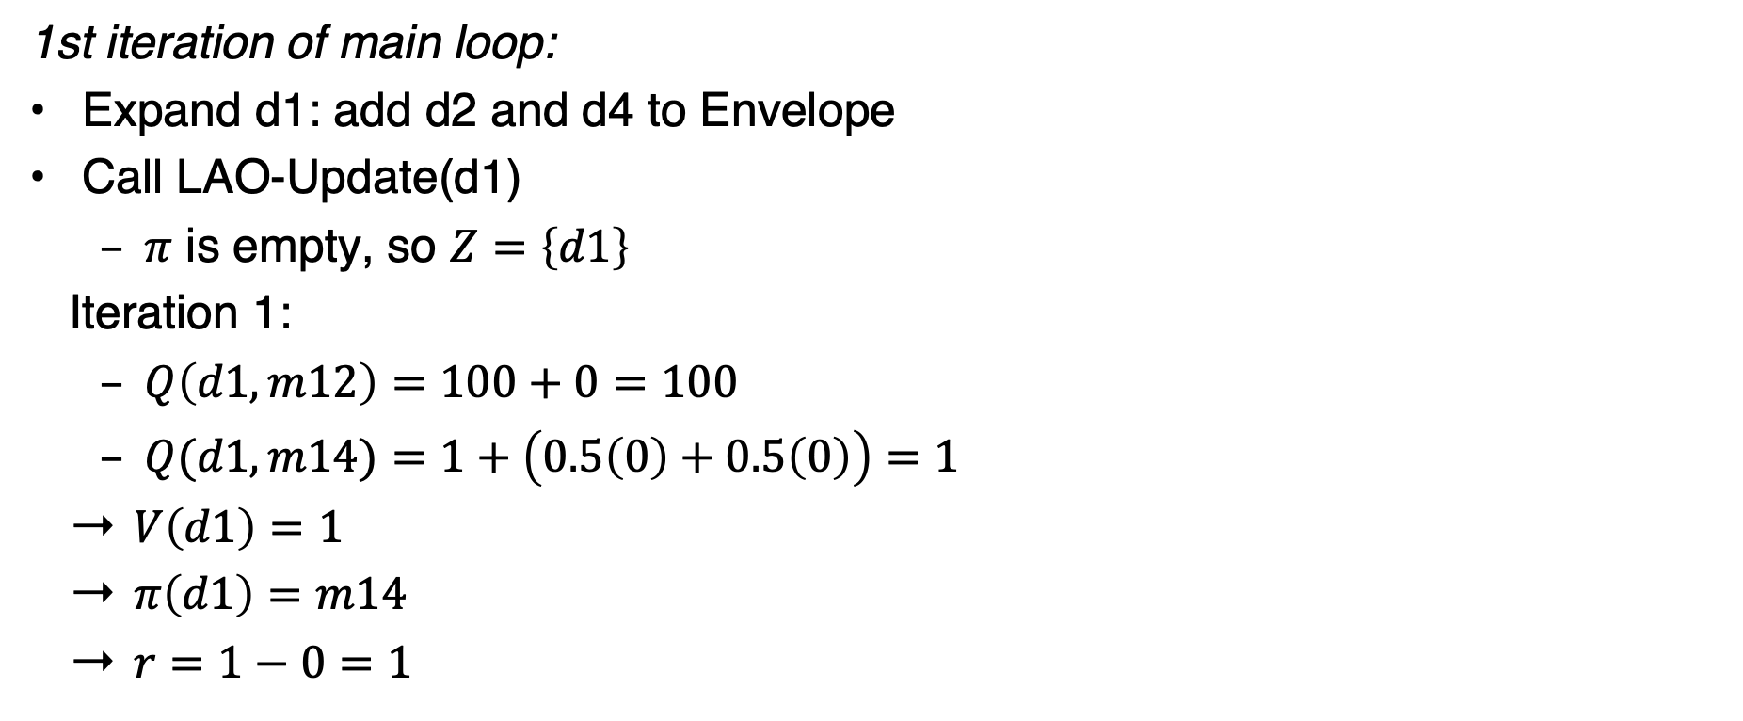
LAO* Example
$$η=0.2$$
$$V_{0}\left(s\right)=0 ∀s$$
1st iteration of main loop:
Expand d1: add d2 and d4 to Envelope
Call LAO-Update(d1)
  $π$ is empty, so $Z=\left\{d1\right\}$
  Iteration 1:
  $Q\left(d1,m12\right)=100+0=100$
  $Q(d1,m14)=1+\left(0.5\left(0\right)+0.5\left(0\right)\right)=1$
  $V\left(d1\right)=1$
  $π\left(d1\right)=m14$
  $r=1−0=1$
d5
c = 1
0.2
d2
0.8
d3
c = 100
c = 100
d1
d4
0.5
c = 1
Goal:
S_{g}= {d4}
0.5
Start:
s₀= d1

Slide 36
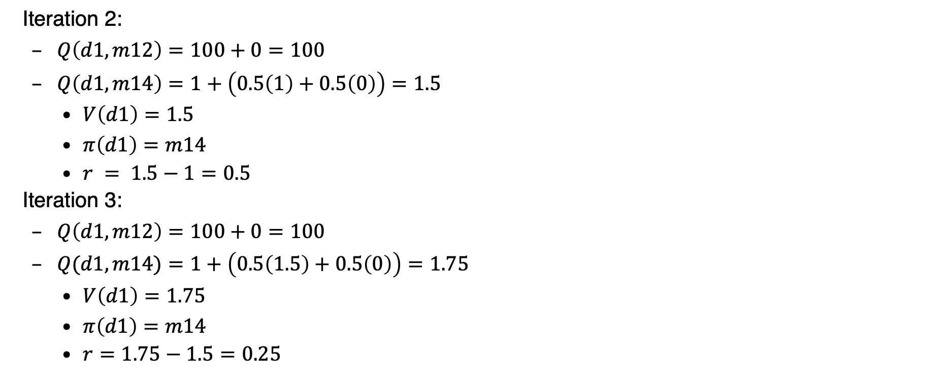
LAO* Example
$$η=0.2$$
$$V_{0}\left(s\right)=0 ∀s$$
  Iteration 2:
  $Q\left(d1,m12\right)=100+0=100$
  $Q\left(d1,m14\right)=1+\left(0.5\left(1\right)+0.5\left(0\right)\right)=1.5$
    $V\left(d1\right)=1.5$
    $π\left(d1\right)=m14$
    $r = 1.5−1=0.5$
  Iteration 3:
  $Q\left(d1,m12\right)=100+0=100$
  $Q(d1,m14)=1+\left(0.5\left(1.5\right)+0.5\left(0\right)\right)=1.75$
    $V\left(d1\right)=1.75$
    $π\left(d1\right)=m14$
    $r=1.75−1.5=0.25$
d5
c = 1
0.2
d2
0.8
d3
c = 100
c = 100
d1
d4
0.5
c = 1
Goal:
S_{g}= {d4}
0.5
Start:
s₀= d1

Slide 37
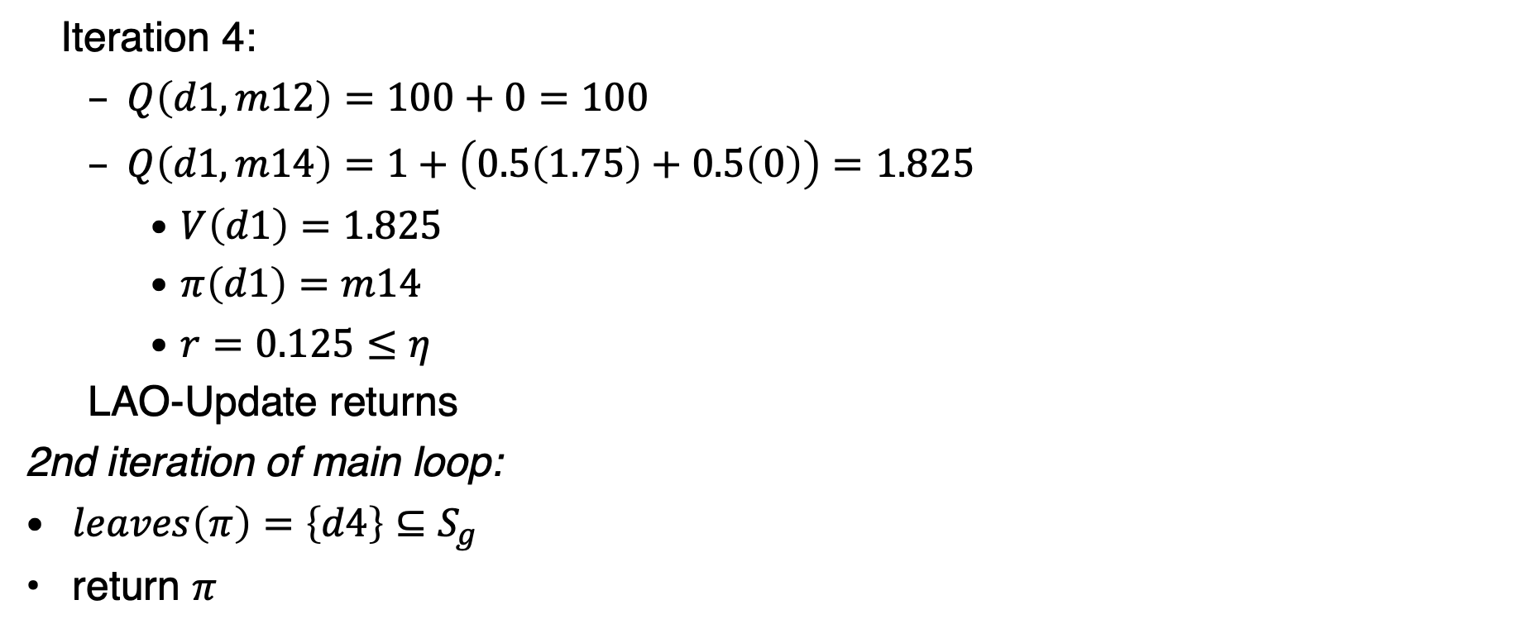
LAO* Example
$$η=0.2$$
$$V_{0}\left(s\right)=0 ∀s$$
  Iteration 4:
  $Q\left(d1,m12\right)=100+0=100$
  $Q\left(d1,m14\right)=1+\left(0.5\left(1.75\right)+0.5\left(0\right)\right)=1.825$
    $V\left(d1\right)=1.825$
    $π\left(d1\right)=m14$
    $r=0.125≤η$
  LAO-Update returns
2nd iteration of main loop:
$leaves\left(π\right)=\left\{d4\right\}⊆S_{g}$
return $π$
d5
c = 1
0.2
d2
0.8
d3
c = 100
c = 100
d1
d4
0.5
c = 1
Goal:
S_{g}= {d4}
0.5
Start:
s₀= d1

Slide 38
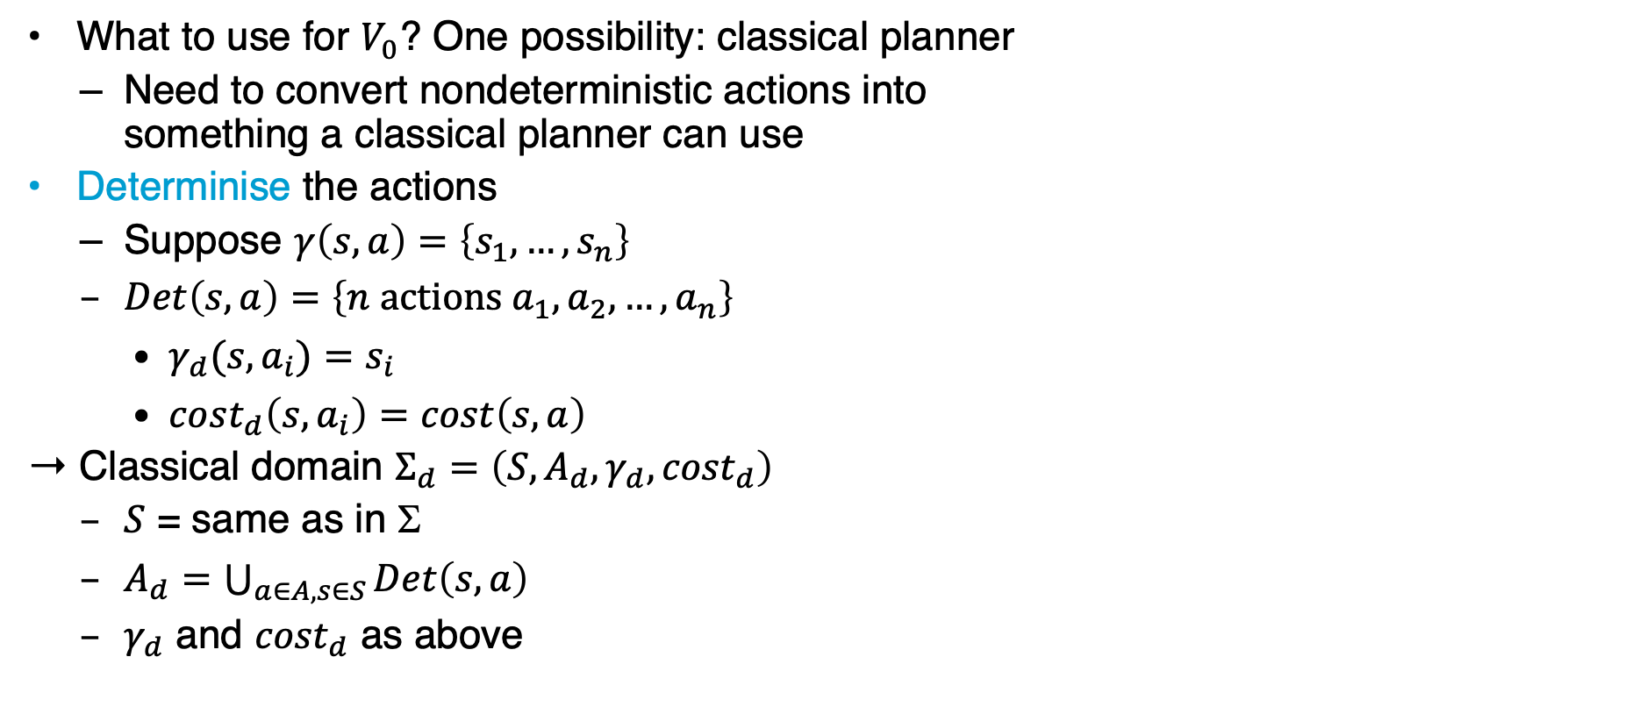
Heuristics through Determinisation
d5
m23
0.2
d2
d3
c = 1
0.8
What to use for $V_{0}$? One possibility: classical planner
  Need to convert nondeterministic actions into
  something a classical planner can use
Determinise the actions
  Suppose $γ\left(s,a\right)=\left\{s_{1}, …, s_{n}\right\}$
  $Det\left(s,a\right)=\left\{n \text{actions} a_{1}, a_{2}, …, a_{n}\right\}$
    $γ_{d}(s,a_{i})=s_{i}$
    $cost_{d}\left(s,a_{i}\right)=cost\left(s,a\right)$
Classical domain $Σ_{d}=\left(S, A_{d}, γ_{d}, {cost}_{d}\right)$
  $S$ = same as in $$
  $A_{d}=\bigcup_{a∈A,s∈S}{Det\left(s,a\right)}$
  $γ_{d}$ and ${cost}_{d}$ as above
m12
m34
c = 100
c = 10
c = 1
d6
m54
0.5
m64
d1
0.5
c = 20
m14
d4
d5
m23₂
d2
d3
c = 1
m23₁
m12
m34
c = 100
c = 10
c = 1
d6
m54
m14₂
m64
d1
c = 20
m14₁
d4

Slide 39

Heuristics through Determinisation
d5
m23
0.2
d2
d3
c = 1
0.8
Call classical planner on $(Σ_{d}, s, S_{g})$
  Get plan $p=⟨a_{1}, a_{2}, …, a_{n}⟩$
  Return $V_{0}\left(s\right)=cost\left(p\right)=\sum_{i=1}^{n}{cost\left(a_{i}\right)}$
If the classical planner always returns optimal plans $p$, then $V_{0}$ is admissible
  Outline of proof:
    Let $π$ be a safe solution in $Σ$ and $p$ be an optimal plan in $Σ_{d}$ with $cost\left(p\right)=V_{0}\left(s\right)$
    Every acyclic execution of $π$ corresponds to a plan $p^{′}$ in $Σ_{d}$
      $p^{′}$ must have cost ≥ $V_{0}(s)$
      Otherwise the classical planner would have chosen $p^{′}$ instead of $p$
m12
m34
c = 100
c = 10
c = 1
d6
m54
0.5
m64
d1
0.5
c = 20
m14
d4
d5
m23₂
d2
d3
c = 1
m23₁
m12
m34
c = 100
c = 10
c = 1
d6
m54
m14₂
m64
d1
c = 20
m14₁
d4

Slide 40
Summary
AO*
  Acyclic
LAO*
  (A)cyclic
Heuristics through determinisation

Slide 41
Outline
6.2 Stochastic shortest path problems
  Safe/unsafe policies
  Optimality
  Policy iteration, value iteration
6.3 Heuristic search algorithms
  Best-first search
  Determinisation
6.4 Online probabilistic planning
  Lookahead
  Reinforcement learning

Slide 42

Planning and Acting
Same as in Ch. 2, except $s$ instead of $ξ$
  Could use $s$ ← abstraction of $ξ$ as in Ch. 2
  Inputs:
    SSP problem $\left(, s_{0}, S_{g}\right)$
    Vector of parameters $θ$
Could also use Run-Lazy-Lookahead or Run-Concurrent-Lookahead
What to use for Lookahead?
  AO*, LAO*, … ➝ Modify to search part of the space
  Classical planner running on determinised domain
  Stochastic sampling algorithms
Run-Lookahead(Σ,s₀,S_{g},θ)
  s ← s₀
  while s ∉ S_{g} and Applicable(s) ≠ ∅ do
    a ←Lookahead(s,θ)
    perform action a
    s ← observe resulting state

Slide 43
Planning and Acting
If Lookahead = classical planner on determinized domain
  FS-Replan (Ch. 5)
Problem: Forward-search may choose a plan that depends on low-probability outcome
RFF algorithm (see book) attempts to alleviate this
Pointer to the next chapter:
Acting as Reinforcement learning
  Learning to act / finding the optimal policy in an unknown environment (no model available)
Run-Lookahead(Σ,s₀,S_{g},θ)
  s ← s₀
  while s ∉ S_{g} and Applicable(s) ≠ ∅ do
    a ←Lookahead(s,θ)
    perform action a
    s ← observe resulting state
FS-Replan(Σ,s,S_{g})
𝜋_{d} ← ∅
while s ∉ S_{g} and Applicable(s) ≠ ∅ do
if 𝜋_{d} undefined for s then
𝜋_{d} ← Forward-Search(Σ_{d},s,S_{g})
if 𝜋_{d} = failure then
return failure
perform action 𝜋_{d}(s)
s ← observe resulting state

Slide 44
Outline per the Book
6.2 Stochastic shortest path problems
  Safe/unsafe policies
  Optimality
  Policy iteration, value iteration
6.3 Heuristic search algorithms
  Best-first search
  Determinisation
6.4 Online probabilistic planning
  Lookahead
  Reinforcement learning
⇒ Next: Decision Making

