Slide 2
Learning Statistical Models From Relational Data
Slides taken from the presentation (subset only)
Lise Getoor
University of Maryland,
College Park
Includes work done by:
Nir Friedman, Hebrew U.
Daphne Koller, Stanford
Avi Pfeffer, Harvard
Ben Taskar, Stanford

Slide 3
Outline
Motivation and Background
PRMs w/ Attribute Uncertainty
PRMs w/ Link Uncertainty
PRMs w/ Class Hierarchies

Slide 4
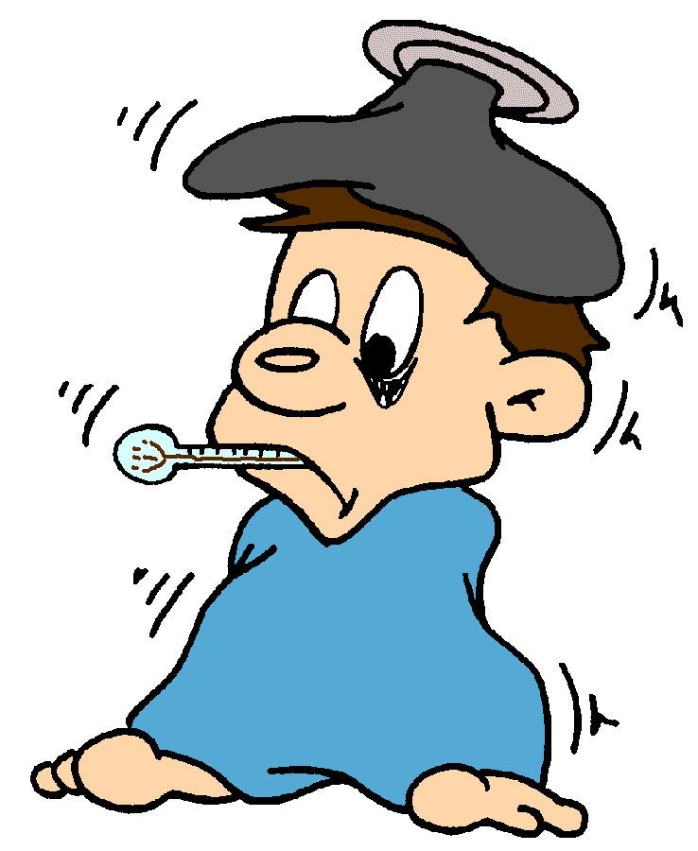
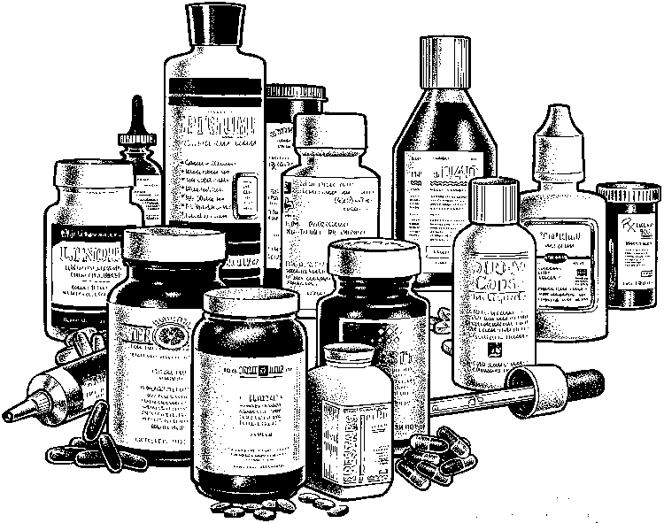
Discovering Patterns in Structured Data
Strain
Contact
Patient
Treatment

Slide 5
Learning Statistical Models
Contact
Patient
Traditional approaches
work well with flat representations
fixed length attribute-value vectors
assume independent (IID) sample
flatten
Problems:
introduces statistical skew
loses relational structure
incapable of detecting link-based patterns
must fix attributes in advance

Slide 6
Probabilistic Relational Models
Combine advantages of relational logic & Bayesian networks:
natural domain modeling: objects, properties, relations;
generalization over a variety of situations;
compact, natural probability models.
Integrate uncertainty with relational model:
properties of domain entities can depend on properties of related entities;
uncertainty over relational structure of domain.
Notes:
How these are different from BNs

Slide 7
Relational Schema
Author
Review
Good Writer
Mood
Smart
Length
Paper
Quality
Accepted
Has Review
Author of
Describes the types of objects and relations in the database

Slide 8
Probabilistic Relational Model
Author
Review
Smart
Mood
Good Writer
Length
Paper
Quality
Accepted
Notes:
Anotation of relationships

Slide 9
Probabilistic Relational Model
Author
Review
Smart
Mood
Good Writer
Length
Paper
⎛
Paper.Accepted |
⎞
Quality
⎜
Paper.Quality,
P
⎜
⎜
Accepted
⎝
Paper.Review.Mood
⎠

Slide 10
Probabilistic Relational Model
Author
Review
Smart
Mood
Good Writer
Length
Paper
Q
,
P(A | Q, M)
M
f
,
f
0
.
1
0
.
9
Quality
f
,
t
0
.
2
0
.
8
t
,
f
0
.
6
0
.
4
Accepted
t
,
t
0
.
7
0
.
3

Slide 11
Relational Skeleton
Paper P1
Author: A1
Review: R1
Primary Keys
Author A1
Review R1
Paper P2
Author: A1
Review: R2
Review R2
Author A2
Paper P3
Author: A2
Review: R2
Review R2
Foreign Keys
Fixed relational skeleton σ:
set of objects in each class
relations between them

Slide 12
PRM w/ Attribute Uncertainty
Paper P1
Author: A1
Review: R1
Author A1
Review R1
Smart
Quality
Mood
Good Writer
Accepted
Length
Paper P2
Author: A1
Review: R2
Author A2
Review R2
Smart
Mood
Quality
Good Writer
Accepted
Length
Paper P3
Author: A2
Review: R2
Review R3
Quality
Mood
Accepted
Length
PRM defines distribution over instantiations of attributes

Slide 13
A Portion of the BN
P(A | Q, M)
Bad
P(A | Q, M)
r2.Mood
Q
Q
,
,
M
P2.Quality
M
Low
f
f
,
,
f
f
0
0
.
.
1
1
0
0
.
.
9
9
P2.Accepted
f
f
,
,
t
t
0
0
.
.
2
2
0
0
.
.
8
8
t
t
,
,
f
f
0
0
.
.
6
6
0
0
.
.
4
4
P3.Quality
r3.Mood
t
t
,
,
t
t
0
0
.
.
7
7
0
0
.
.
3
3
P3.Accepted

Slide 14
A Portion of the BN
Q
,
P(A | Q, M)
Bad
M
P2.Quality
r2.Mood
Low
f
,
f
0
.
1
0
.
9
P2.Accepted
f
,
t
0
.
2
0
.
8
t
,
f
0
.
6
0
.
4
Bad
P3.Quality
r3.Mood
High
t
,
t
0
.
7
0
.
3
P3.Accepted

Slide 15
A Portion of the BN
P(A | Q, M)
Pissy
P(A | Q, M)
r2.Mood
Q
Q
,
,
M
P2.Quality
M
Low
f
f
,
,
f
f
0
0
.
.
1
1
0
0
.
.
9
9
P2.Accepted
f
f
,
,
t
t
0
0
.
.
2
2
0
0
.
.
8
8
t
t
,
,
f
f
0
0
.
.
6
6
0
0
.
.
4
4
P3.Quality
t
t
,
,
t
t
0
0
.
.
7
7
0
0
.
.
3
3
P3.Accepted

Slide 16
A Portion of the BN
Q
,
P(A | Q, M)
Pissy
M
P2.Quality
r2.Mood
Low
f
,
f
0
.
1
0
.
9
P2.Accepted
f
,
t
0
.
2
0
.
8
t
,
f
0
.
6
0
.
4
P3.Quality
High
t
,
t
0
.
7
0
.
3
P3.Accepted

Slide 17
PRM: Aggregate Dependencies
Paper
Review
Quality
Mood
Accepted
Length
Review R1
Mood
Review R2
Length
Paper P1
Mood
Quality
Review R3
Length
Accepted
Mood
Length

Slide 18
PRM: Aggregate Dependencies
Paper
Review
Quality
Mood
Accepted
Length
Q
,
M
P(A | Q, M)
Review R1
f
,
f
0
.
1
0
.
9
Mood
f
,
t
0
.
2
0
.
8
Review R2
t
,
f
0
.
6
0
.
4
Length
Paper P1
Mood
t
,
t
0
.
7
0
.
3
Quality
Review R3
Length
Accepted
mode
Mood
sum, min, max,
avg, mode, count
Length
Notes:
May have more relations, Probabilistc is also possible, agreggates of sets of set and logic is possible

Slide 19
PRM with AU Semantics
Author
Author
A1
Review
R1
Paper
Paper
P1
Review
R2
Author
A2
Review
Paper
P2
Review
R3
Paper
P3
PRM
+
relational skeleton σ
=
probability distribution over completions I:
Objects
Attributes
Notes:
Remember to say that this is just like
the chain rule used in BNs

Slide 20
Learning PRMs w/ AU
Strain
Database
Patient
Contact
Strain
PRM
Patient
Contact
Parameter estimation
Structure selection
Relational
Schema

Slide 21
Parameter Estimation in PRMs
Assume known dependency structure S
Goal: estimate PRM parameters θ
entries in local probability models,
θ is good if it is likely to generate the observed data, instance I .
MLE Principle: Choose θ∗ so as to maximize l

Slide 22
Learning PRMs w/ AU
Author
Database
Paper
Review
Author
PRM
Paper
Review
Parameter estimation
Structure selection
Relational
Schema

Slide 23
ML Parameter Estimation
Review
Mood
Paper
Q
,
P(A | Q, M)
M
Length
Quality
f
,
f
?
?
Accepted
?
?
f
,
t
t
,
f
?
?
t
,
t
?
?
θ∗ =
where
is the number of accepted,
low quality papers
whose reviewer was in a poor mood

Slide 24
ML Parameter Estimation
Review
Mood
Paper
Q
,
P(A | Q, M)
M
Length
Quality
f
,
f
?
?
Accepted
?
?
f
,
t
t
,
f
?
?
t
,
t
?
?
θ∗ =
Query for counts:
Count
Review
table
Paper
table

Slide 25
Structure Selection
Idea:
define scoring function
do local search over legal structures
Key Components:
legal models
scoring models
searching model space

Slide 26
Structure Selection
Idea:
define scoring function
do local search over legal structures
Key Components:
legal models
scoring models
searching model space

Slide 27
Legal Models
PRM defines a coherent probability model over a skeleton σ if the dependencies between object attributes are acyclic (prop. BN).
Paper
P1
Accepted
yes
author-of
Researcher
Prof. Gump
Reputation
high
Paper
P2
Accepted
yes
sum
How do we guarantee that a PRM is acyclic
for every skeleton?

Slide 28
Attribute Stratification
PRM
dependency
structure S
dependency
graph
Paper.Accecpted
if Researcher.Reputation
depends directly on Paper.Accepted
Researcher.Reputation
Attribute stratification:
dependency graph acyclic ⇒ acyclic for any σ
Algorithm more flexible; allows certain cycles along guaranteed acyclic relations
Notes:
Temporary Relations, Time, Parent … we can assure that its acylcix

Slide 29
(Father)
(Mother)
Person
Blood Type
Blood Type
Person
P-chromosome
P-chromosome
M-chromosome
M-chromosome
P-chromosome
Person
M-chromosome
Blood Type
Contaminated
Result
Blood Test

Slide 30
Structure Selection
Idea:
define scoring function
do local search over legal structures
Key Components:
legal models
scoring models
searching model space

Slide 31
Scoring Models
Bayesian approach:
Standard approach to scoring models; used in Bayesian network learning
Notes:
Say there are a number of approaches we could use;
ML, MDL, here we use Bayesian

Slide 32
Structure Selection
Idea:
define scoring function
do local search over legal structures
Key Components:
legal models
scoring models
searching model space

Slide 33
Searching Model Space
Phase 0: consider only dependencies within a class
Author
Paper
Review
Add A.S→A.W
Δscore
Author
Paper
Review
Delete R.M→R.L
Δscore
Author
Paper
Review
Notes:
Mention relation to BN structure learning
Say to compute the new networks score we need only calculate
the new local score. To do this , requires that we make
a pass through the database to compute the required sufficient statistics
Mention that these are just a few of the potential changes
Mention also detleting and reversing arcs
we evaluate changes one edge at a time
dominant cost: passes over database

Slide 34
Phased Structure Search
Phase 1: consider dependencies from “neighboring”
classes, via schema relations
Author
Paper
Review
Add A.S→P.A
Δ score
Author
Paper
Review
Add P.A→R.M
Δ score
Author
Paper
Review
Notes:
Say to compute the new networks score we need only calculate
the new local score. To do this , requires that we make
a pass through the database to compute the required sufficient statistics
Mention that these are just a few of the potential changes
Mention also detleting and reversing arcs
we evaluate changes one edge at a time
dominant cost: passes over database

Slide 35
Phased Structure Search
Phase 2: consider dependencies from “further”
classes, via relation chains
Author
Paper
Review
Add A.S→R.M
Δ score
Author
Paper
Review
Add R.M→A.W
Author
Paper
Review
Δ score
Notes:
Say to compute the new networks score we need only calculate
the new local score. To do this , requires that we make
a pass through the database to compute the required sufficient statistics
Mention that these are just a few of the potential changes
Mention also detleting and reversing arcs
we evaluate changes one edge at a time
dominant cost: passes over database

Slide 36
Issue
PRM w/ AU applicable only in domains where we have full knowledge of the relational structure
Next we introduce PRMs which allow uncertainty over relational structure…

Slide 37
Kinds of structural uncertainty
How many objects does an object relate to?
how many Authors does Paper1 have?
Which object is an object related to?
does Paper1 cite Paper2 or Paper3?
Which class does an object belong to?
is Paper1 a JournalArticle or a ConferencePaper?
Does an object actually exist?
Are two objects identical?

Slide 38
Structural Uncertainty
Motivation: PRM with AU only well-defined when the skeleton structure is known
May be uncertain about relational structure itself
Construct probabilistic models of relational structure that capture structural uncertainty
Mechanisms:
Reference uncertainty
Existence uncertainty
Number uncertainty
Type uncertainty
Identity uncertainty

Slide 39
PRMs w/ Link Uncertainty
Advantages:
Applicable in cases where we do not have full knowledge of relational structure
Incorporating uncertainty over relational structure into probabilistic model can improve predictive accuracy
Two approaches:
Reference uncertainty
Existence uncertainty
Different probabilistic models; varying amount of background knowledge required for each

Slide 40
Citation Relational Schema
Author
Institution
Research Area
Wrote
Paper
Paper
Topic
Topic
Word1
Word1
Cites
Word2
Word2
…
…
Citing Paper
Count
Cited Paper
WordN
WordN

Slide 41
Attribute Uncertainty
Author
Institution
P( Institution |
Research Area)
Research Area
Wrote
P( Topic |
Paper.Author.Research Area
Paper
Topic
P( WordN | Topic)
Word1
...
WordN

Slide 42
Reference Uncertainty
`
Bibliography
1. -----
2. -----
3. -----
?
?
?
Scientific Paper
Document Collection
Notes:
Patents. Using topic hierarchy. But Knowing the number of possible instantiations

Slide 43
PRM w/ Reference Uncertainty
Paper
Paper
Topic
Topic
Cites
Words
Words
Cited
Citing
Dependency model for foreign keys
Naïve Approach: multinomial over primary key
noncompact
limits ability to generalize
Notes:
Use properties and ratings of one person to rech conclusions about the properites of a program
(how funny it is) reach conclusions about how likely another person is to like it
Generalize over primary keys so we have to learn rel. between existing papers. What about a new one.

Slide 44
Reference Uncertainty Example
Paper
P5
Topic
AI
Paper
P4
Topic
AI
Paper
P3
Topic
AI
Paper
M2
Topic
AI
Paper
P5
Topic
AI
C1
Paper
P4
Topic
Theory
Paper
P1
Topic
Theory
Paper
P2
Topic
Theory
Paper
P3
Topic
AI
Paper
P1
Topic
Theory
C2
Paper.Topic = AI
Paper.Topic = Theory
Cites
C1
C2
Citing
0
.
3
0
.
7
Cited
Notes:
Gather papers under topics (one possibility). But only takes into account the general distribution of cited papers

Slide 45
Reference Uncertainty Example
Paper
P5
Topic
AI
Paper
P4
Topic
AI
Paper
P3
Topic
AI
Paper
M2
Topic
AI
Paper
P5
Topic
AI
P1
Paper
P4
Topic
Theory
Paper
P1
Topic
Theory
Paper
P2
Topic
Theory
Paper
P3
Topic
AI
Paper
P1
Topic
Theory
P2
Paper.Topic = AI
Paper.Topic = Theory
Paper
Topic
Cites
Cited.Topic
P1
P2
Words
P1
P2
Citing
Theory
0
.
1
0
.
9
0
.
3
0
.
7
0
.
99
0
.
01
Cited
AI
Notes:
The dependency goes from the topic of the citing paper. Have to anotate relation

Slide 46
Introduce Selector RVs
P2.Topic
Cites1.Selector
Cites1.Cited
P3.Topic
P1.Topic
P4.Topic
Cites2.Selector
P5.Topic
Cites2.Cited
P6.Topic
Introduce Selector RV, whose domain is {C1,C2}
The distribution over Cited depends on all of the topics, and the selector

Slide 47
PRMs w/ RU Semantics
Paper
Paper
Paper
P2
Topic
Theory
Paper
P2
Topic
Theory
Paper
P5
Topic
AI
Paper
P5
Topic
AI
Topic
Paper
P4
Topic
Theory
Paper
P4
Topic
Theory
Cites
Topic
Paper
P3
Topic
AI
Reg
Paper
P3
Topic
AI
Words
Paper
P1
Topic
???
Reg
Paper
P1
Topic
???
Cited
Words
Reg
Reg
Citing
Cites
PRM RU
entity skeleton σ
PRM-RU + entity skeleton σ
⇒ probability distribution over full instantiations I
Notes:
Remember to say that this is just like
the chain rule used in BNs

Slide 48
Learning PRMs w/ RU
Idea: just like in PRMs w/ AU
define scoring function
do greedy local structure search
Issues:
expanded search space
construct partitions
new operators

Slide 49
Learning
PRMs w/ RU
Idea:
define scoring function
do phased local search over legal structures
Key Components:
legal models
scoring models
searching model space
model new dependencies
unchanged
new operators

Slide 50
Legal Models
Review
Mood
Paper
Paper
Important
Important
Accepted
Cites
Accepted
Citing
Cited
Notes:
Depends on whether the cited paper is important. The mood depends on wheter the reviewed paper cites important paepers
Have to resolve the potential cited papers (can have uncertainty) before computing the mood.
Before the reviewer decides he scan scans the „potential“ SITED papers which influences his mood.

Slide 51
Legal Models
Cites1.Selector
Cites1.Cited
P2.Important
R1.Mood
P3.Important
P1.Accepted
P4.Important
When a node’s parent is defined using an uncertain relation, the reference RV must be a parent of the node as well.
Notes:
All Papers have influence on the mood, but the new selector will push the probability of some papers. Therefore we must include cites.cited
Ordering of random variables.

Slide 52
Structure Search
Paper
Paper
Paper
Paper
Paper
Paper
Paper
Topic
Cites
Topic
Author
Paper
Paper
Words
Citing
Words
Paper
Paper
Institution
Paper
Paper
Cited
Cited
Papers
1.0

Slide 53
Structure Search: New Operators
Paper
Paper
Paper
Paper
Paper
Paper
Paper
Topic
Cites
Topic
Author
Paper
Paper
Words
Citing
Words
Paper
Paper
Cited
Institution
Paper
Paper
Refine on Topic
Cited
Δscore
Paper
Paper
Topic
Paper
Paper
Paper
Paper
Paper
Paper
Paper
Paper

Slide 54
Structure Search: New Operators
Paper
Paper
Paper
Paper
Paper
Paper
Paper
Topic
Cites
Topic
Author
Paper
Paper
Words
Cited
Words
Paper
Paper
Institution
Paper
Paper
Citing
Refine on Topic
Δscore
Citing
Paper
Paper
Topic = AI
Paper
Paper
Paper
Paper
Paper
Paper
Paper
Paper
Institution = MIT
Refine on Author.Instition
Δscore
Paper
Paper
Paper
Paper
Paper
Paper
Paper
Paper

Slide 55
PRMs w/ RU Summary
Define semantics for uncertainty over foreign-key values
Search now includes operators Refine and Abstract for constructing foreign-key dependency model
Provides one simple mechanism for link uncertainty

Slide 56
Existence Uncertainty
?
?
?
Document Collection
Document Collection
Notes:
Patents. Using topic hierarchy

Slide 57
PRM w/ Exists Uncertainty
Paper
Paper
Topic
Topic
Cites
Words
Words
Exists
Dependency model for existence of relationship

Slide 58
Exists Uncertainty Example
Paper
Paper
Topic
Topic
Cites
Words
Words
Exists
Citer.Topic
Cited.Topic
False
True
Theory
Theory
0.995
0.005
Theory
AI
0.999
0.001
AI
Theory
0.997
0.003
AI
AI
0.992
0.008
Notes:
Remember to say that this is just like
the chain rule used in BNs

Slide 59
Introduce Exists RVs
Author #1
Author #2
Inst
Area
Inst
Area
Paper#1
Paper#2
Topic
Paper#3
Topic
Topic
Word1
WordN
WordN
Word1
...
...
...
Word1
WordN
Exists
Exists
Exists
Exists
Exists
Exists
#1-#3
#1-#2
#2-#1
#3-#1
#2-#3
#3-#2

Slide 60
Introduce Exists RVs
Author #1
Author #2
Inst
Area
Inst
Area
Paper#1
Paper#2
Topic
Paper#3
Topic
Topic
WordN
WordN
WordN
Word1
WordN
Word1
Word1
Word1
Word1
...
...
...
Word1
WordN
WordN
Exists
Exists
Exists
Exists
Exists
Exists
Exists
Exists
Exists
Exists
Exists
Exists
#1-#3
#1-#2
#2-#1
#3-#1
#2-#3
#3-#2
Notes:
Given words and citation do collective inference on the topic

Slide 61
PRMs w/ EU Semantics
Paper
P5
Topic
AI
Paper
P2
Topic
Theory
Paper
P2
Topic
Theory
Paper
Paper
Paper
P5
Topic
AI
Paper
P4
Topic
Theory
Paper
P4
Topic
Theory
Paper
P3
Topic
AI
Paper
P3
Topic
AI
Topic
Cites
Topic
Paper
P1
Topic
???
???
Paper
P1
Topic
???
Words
Words
Exists
PRM EU
object skeleton σ
PRM-EU + object skeleton σ
⇒ probability distribution over full instantiations I
Notes:
Remember to say that this is just like
the chain rule used in BNs

Slide 62
Learning PRMs w/ EU
Idea: just like in PRMs w/ AU
define scoring function
do greedy local structure search
Issues:
efficiency
Computation of sufficient statistics for exists attribute
Do not explicitly consider relations that do not exist

Slide 63
Structure Selection
PRMs w/ EU
Idea:
define scoring function
do phased local search over legal structures
Key Components:
legal models
scoring models
searching model space
model new dependencies
unchanged
unchanged
Notes:
Have to take care about new dependencies. Prior to follow a relation(s) one has to figure out which potential candidates we have to be able to depend on a distant attribute

Slide 64
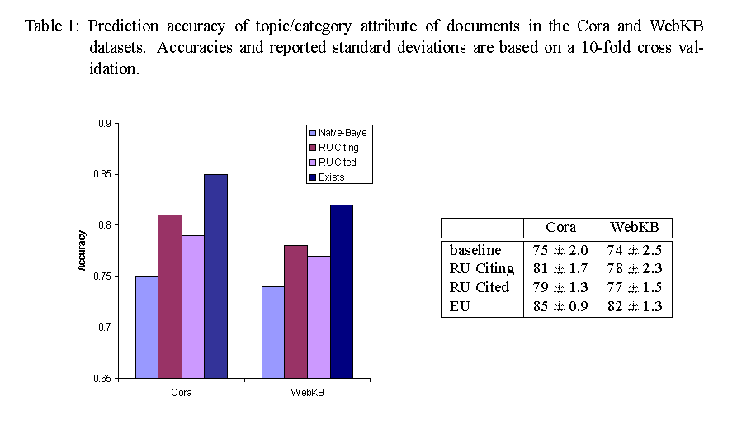
Results

Slide 65
PRMs w/ Class Hierarchies
Allows us to:
Refine a “heterogenous” class into more coherent subclasses
Refine probabilistic model along class hierarchy
Can specialize/inherit CPDs
Construct new dependencies that were originally “acyclic”
Provides bridge from class-based model
to instance-based model

Slide 66
Learning PRM-CHs
Vote
Database:
TVProgram
Person
Instance I
PRM-CH
Vote
Class hierarchy provided
TVProgram
Person
Relational
Schema
Learn class hierarchy

Slide 67
Guaranteeing Acyclicity w/ Subclasses
Journal
Paper
Topic
Topic
Quality
Quality
Accepted
Conf-Paper
Accepted
Topic
Quality
Accepted
Journal.Accepted
Paper.Accepted
Paper.Class
Conf-Paper.Accepted
Notes:
At first glance, increase in representational power is deceptively small.
Extra type variable, could just as well be exploited using structured CPTs

Slide 68
Learning PRM-CH
Scenario 1: Class hierarchy is provided
New Operators
Specialize/Inherit
Accepted_{Paper}
Accepted_{Journal}
Accepted_{Conference}
Accepted_{Workshop}
Accepted_{Workshop}

Slide 69
Learning Class Hierarchy
Issue: partially observable data set
Construct decision tree for class defined over attributes observed in training set
New operator
Split on class attribute
Related class attribute
Paper.Venue
journal
workshop
conference
class1
class3
class2
Paper.Author.Fame
high
medium
low
class4
class5
class6

Slide 70
PRM-CH Summary
PRMs with class hierarchies are a natural extension of PRMs:
Specialization/Inheritance of CPDs
Allows new dependency structures
Provide bridge from class-based to instance-based models
Learning techniques proposed
Need efficient heuristics
Empirical validation on real-world domains

Slide 71
Conclusions
PRMs can represent distribution over attributes from multiple tables
PRMs can capture link uncertainty
PRMs allow inferences about individuals while taking into account relational structure (they do not make inappropriate independence assumptions)

Slide 72
Selected Publications
“Learning Probabilistic Models of Link Structure”, L. Getoor, N. Friedman, D. Koller and B. Taskar, JMLR 2002.
“Probabilistic Models of Text and Link Structure for Hypertext Classification”, L. Getoor, E. Segal, B. Taskar and D. Koller, IJCAI WS ‘Text Learning: Beyond Classification’, 2001.
“Selectivity Estimation using Probabilistic Models”, L. Getoor, B. Taskar and D. Koller, SIGMOD-01.
“Learning Probabilistic Relational Models”, L. Getoor, N. Friedman, D. Koller, and A. Pfeffer, chapter in Relation Data Mining, eds. S. Dzeroski and N. Lavrac, 2001.
see also N. Friedman, L. Getoor, D. Koller, and A. Pfeffer, IJCAI-99.
“Learning Probabilistic Models of Relational Structure”, L. Getoor, N. Friedman, D. Koller, and B. Taskar, ICML-01.
“From Instances to Classes in Probabilistic Relational Models”, L. Getoor, D. Koller and N. Friedman, ICML Workshop on Attribute-Value and Relational Learning: Crossing the Boundaries, 2000.
Notes from AAAI Workshop on Learning Statistical Models from Relational Data, eds. L.Getoor and D. Jensen, 2000.
Notes from IJCAI Workshop on Learning Statistical Models from Relational Data, eds. L.Getoor and D. Jensen, 2003.
See http://www.cs.umd.edu/~getoor

