Slide 1
Augmenting Probabilistic Graphical Models with Ontology Information: Object Classification
R. Möller
Institute of Information Systems
University of Luebeck

Slide 2
Large-Scale Object Recognition using Label Relation Graphs
Based on:
Jia Deng^{1,2}, Nan Ding², Yangqing Jia², Andrea Frome², Kevin Murphy²,
Samy Bengio², Yuan Li², Hartmut Neven², Hartwig Adam²
University of Michigan¹, Google²

Slide 3
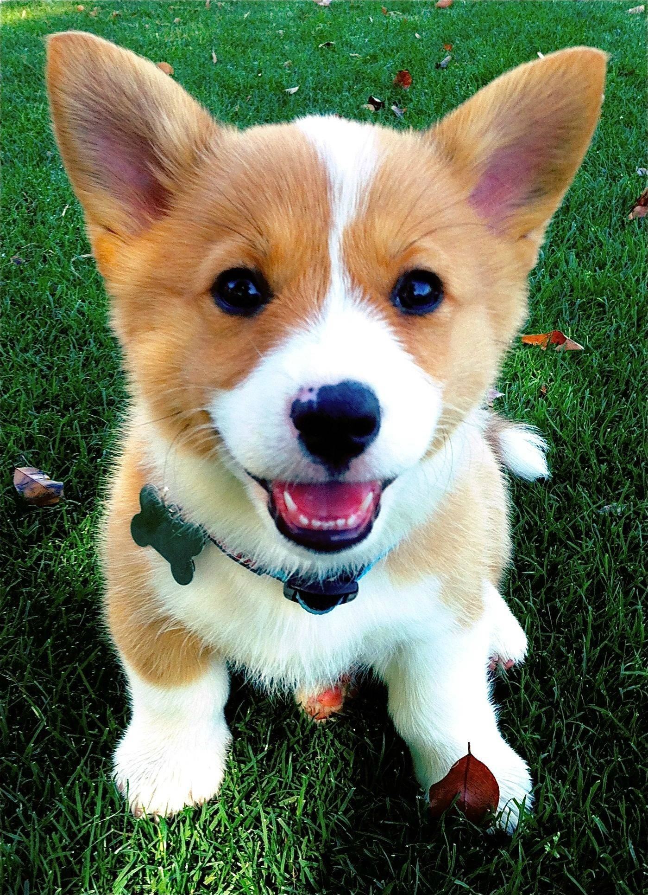
Object Classification
Assign semantic labels to objects
Dog
✔
Corgi
✔
Puppy
✔
Cat
✖

Slide 4
Object Classification
Assign semantic labels to objects
Probabilities
Dog
0.9
Corgi
0.8
Puppy
0.9
Cat
0.1

Slide 5
Object Classification
Assign semantic labels to objects
Features
Classifier
Probabilities
Feature Extractor
Dog
0.9
Corgi
0.8
Puppy
0.9
Cat
0.1

Slide 6
Object Classification
Independent binary classifiers: Logistic Regression
Dog
0.4
No assumptions about relations.
Corgi
0.8
Puppy
0.6
Cat
0.2
Multiclass classifier: Softmax
Dog
/
0.2
Corgi
Assumes mutual exclusive labels.
/
0.4
Puppy
/
0.3
/
Cat
0.1
+

Slide 7
Object labels have rich relations
Exclusion
Hierarchical
Dog
Dog
Cat
Corgi
Puppy
Cat
Corgi
Puppy
Overlap
Softmax: all labels are mutually exclusive ☹
Logistic Regression: all labels overlap ☹

Slide 8
Goal: A new classification model
Respects real world label relations
Dog
Cat
Dog
0.9
Corgi
0.8
Puppy
0.9
Cat
0.1
Corgi
Puppy

Slide 9
Visual Model + Knowledge Graph
Visual
Model
Knowledge
Graph
Dog
0.9
Joint Inference
Corgi
0.8
Puppy
0.9
Cat
0.1
Assumption in this work:
Knowledge graph is given and fixed.

Slide 10
Agenda
Encoding prior knowledge (HEX graph)
Classification model
Efficient Exact Inference

Slide 11
Agenda
Encoding prior knowledge (HEX graph)
Classification model
Efficient Exact Inference

Slide 12
Hierarchy and Exclusion (HEX) Graph
Exclusion
Hierarchical
Dog
Cat
Corgi
Puppy
Hierarchical edges (directed)
Exclusion edges (undirected)

Slide 13
Examples of HEX graphs
Person
Dog
Cat
Red
Shiny
Male
Female
Child
Car
Bird
Round
Thick
Boy
Girl
Mutually exclusive
All overlapping
Combination

Slide 14
State Space: Legal label configurations
Each edge defines a constraint.
Dog
Cat
Dog | Cat | Corgi | Puppy
0 | 0 | 0 | 0
0 | 0 | 0 | 1
0 | 0 | 1 | 0
0 | 0 | 1 | 1
1 | 0 | 0 | 0
…
1 | 1 | 0 | 0
1 | 1 | 0 | 1
…
Corgi
Puppy

Slide 15
State Space: Legal label configurations
Each edge defines a constraint.
Dog
Cat
Dog | Cat | Corgi | Puppy
0 | 0 | 0 | 0
0 | 0 | 0 | 1
0 | 0 | 1 | 0
0 | 0 | 1 | 1
1 | 0 | 0 | 0
…
1 | 1 | 0 | 0
1 | 1 | 0 | 1
…
Corgi
Puppy
Hierarchy: (dog, corgi) can’t be (0,1)

Slide 16
State Space: Legal label configurations
Each edge defines a constraint.
Dog
Cat
Dog | Cat | Corgi | Puppy
0 | 0 | 0 | 0
0 | 0 | 0 | 1
0 | 0 | 1 | 0
0 | 0 | 1 | 1
1 | 0 | 0 | 0
…
1 | 1 | 0 | 0
1 | 1 | 0 | 1
…
Corgi
Puppy
Hierarchy: (dog, corgi) can’t be (0,1)
Exclusion: (dog, cat) can’t be (1,1)

Slide 17
Agenda
Encoding prior knowledge (HEX graph)
Classification model
Efficient Exact Inference

Slide 18
HEX Classification Model
Pairwise Conditional Random Field (CRF)
Input scores
Binary Label vector

Slide 19
HEX Classification Model
Pairwise Conditional Random Field (CRF)
Input scores
Binary Label vector
Unary: same as logistic regression

Slide 20
HEX Classification Model
Pairwise Conditional Random Field (CRF)
Input scores
Binary Label vector
If violates constraints
0
Otherwise
Unary: same as logistic regression
Pairwise: set illegal configuration to zero
→ All illegal configurations have probability zero.

Slide 21
HEX Classification Model
Pairwise Conditional Random Field (CRF)
Input scores
Binary Label vector
Partition function: Sum over all (legal) configurations

Slide 22
HEX Classification Model
Pairwise Conditional Random Field (CRF)
Input scores
Binary Label vector
Probability of a single label: marginalize all other labels.

Slide 23
Special Case of HEX Model
Softmax
Logistic Regressions
Dog
Cat
Red
Shiny
Car
Bird
Round
Thick
Mutually exclusive
All overlapping

Slide 24
Learning
Dog
1
Corgi
?
Puppy
?
Cat
?
Label: Dog
DNN
Dog
Cat
Puppy
Corgi
Back Propagation
Maximize marginal probability of observed labels
DNN = Deep Neural Network

Slide 25
Agenda
Encoding prior knowledge (HEX graph)
Classification model
Efficient Exact Inference

Slide 26
Naïve Exact Inference is Intractable
Inference:
Computing partition function
Perform marginalization
HEX-CRF can be densely connected (large treewidth)

Slide 27
Observation 1: Exclusions are good
Dog
Cat
Car
Bird
Number of legal states is O(n), not O(2^{n}).
Lots of exclusions → Small state space → Efficient inference
Realistic graphs have lots of exclusions.
Rigorous analysis in paper.

Slide 28
Observation 2: Equivalent graphs
Dog
Cat
Dog
Cat
Corgi
Corgi
Puppy
Puppy
Cardigan Welsh Corgi
Pembroke Welsh Corgi
Cardigan Welsh Corgi
Pembroke Welsh Corgi

Slide 29
Observation 2: Equivalent graphs
Dog
Cat
Dog
Cat
Dog
Cat
Corgi
Corgi
Corgi
Puppy
Puppy
Puppy
Cardigan Welsh Corgi
Pembroke Welsh Corgi
Cardigan Welsh Corgi
Pembroke Welsh Corgi
Cardigan Welsh Corgi
Pembroke Welsh Corgi
Sparse equivalent
Small Treewidth ☺
Dynamic programming
Dense equivalent
Prune states ☺
Can brute force

Slide 30
HEX Graph Inference
C
2.Build Junction Tree (offline)
B
A
F
A
B
C
F
1. Sparsify (offline)
B
G
B
C
D
A
F
G
C
E
D
E
F
B
G
5. Message Passing on legal states (online)
D
4.Prune Clique States (offline)
E
F
C
3.Densify (offline)
B
A
F
A
B
F
C
B
B
C
G
G
D
F
D
E
F
E

Slide 31
Digression: Polytrees
A network is singly connected (a polytree) if it contains no undirected loops.
D
C
Theorem: Inference in a singly connected network can be done in linear time*.
Main idea: in variable elimination, need only maintain distributions over single nodes.
* in network size including table sizes.
© Jack Breese (Microsoft) & Daphne Koller (Stanford)

Slide 32
The problem with loops
P(c)
0.5
Cloudy
c
c
c
c
Rain
Sprinkler
P(r)
P(s)
0.01
0.99
0.99
0.01
Grass-wet
deterministic or
The grass is dry only if no rain and no sprinklers.
P(g) = P(r, s) ~ 0
© Jack Breese (Microsoft) & Daphne Koller (Stanford)

Slide 33
The problem with loops contd.
0
0
P(g) =
P(g | r, s) P(r, s) + P(g | r, s) P(r, s)
+ P(g | r, s) P(r, s) + P(g | r, s) P(r, s)
0
1
= P(r, s)
~ 0
= P(r) P(s) ~ 0.5 ·0.5 = 0.25
problem
© Jack Breese (Microsoft) & Daphne Koller (Stanford)

Slide 34
Variable elimination
A
P(c) = Σ P(c | b) Σ P(b | a) P(a)
b
a
P(b)
B
P(A)
P(B | A)
C
x
Σ
P(B, A)
P(B)
P(C | B)
A
x
Σ
P(C, B)
P(C)
B
© Jack Breese (Microsoft) & Daphne Koller (Stanford)

Slide 35
Inference as variable elimination
A factor over X is a function from val(X) to numbers in [0,1]:
A CPT is a factor
A joint distribution is also a factor
BN inference:
factors are multiplied to give new ones
variables in factors summed out
A variable can be summed out as soon as all factors mentioning it have been multiplied.
© Jack Breese (Microsoft) & Daphne Koller (Stanford)

Slide 36
Variable Elimination with loops
P(A)
P(G)
P(S | A,G)
Age
Gender
x
P(E | A)
Σ
P(A,G,S)
P(A,S)
x
P(A,E,S)
Exposure
to Toxics
Smoking
G
Σ
P(E,S)
P(C | E,S)
A
Cancer
x
Σ
P(E,S,C)
P(C)
E,S
Serum
Calcium
Lung
Tumor
P(L | C)
x
P(C,L)
Σ
P(L)
C
Complexity is exponential in the size of the factors
© Jack Breese (Microsoft) & Daphne Koller (Stanford)

Slide 37
Join trees*
A join tree is a partially precompiled factorization
Age
Gender
P(A)
x
P(G)
x
A, G, S
P(S | A,G)
x
P(A,S)
Exposure
to Toxics
Smoking
A, E, S
Cancer
E, S, C
Serum
Calcium
Lung
Tumor
C, S-C
C, L
* aka Junction Tree, Lauritzen-Spiegelhalter, or Hugin algorithm, …
© Jack Breese (Microsoft) & Daphne Koller (Stanford)

Slide 38
Junction Tree Algorithm
Converts Bayes Net into an undirected tree
Joint probability remains unchanged
Exact marginals can be computed
Why ???
Uniform treatment of Bayes Net and MRF
Efficient inference is possible for undirected trees

