Slide 1
Web-Mining Agents:
Transfer Learning
TrAdaBoost
R. Möller
Institute of Information Systems
University of Lübeck

Slide 2
Based on an excerpt of:
Transfer for Supervised Learning Tasks
by: HAITHAM BOU AMMAR
MAASTRICHT UNIVERSITY

Slide 3
Traditional Machine Learning vs. Transfer
Different Tasks
Source Task
Target Task
Learning System
Learning System
Knowledge
Learning System
Learning System
Traditional Machine Learning
Transfer Learning

Slide 4
Transfer Learning Definition
Notation:
  Domain :
    Feature Space:
    Marginal Probability Distribution:
      with
  Given a domain then a task is :
Label Space
P(Y|X)

Slide 5
Transfer Learning Definition
  Given a source domain and source learning task, a target domain and a target learning task, transfer learning aims to help improve the learning of the target predictive function using the source knowledge, where
  or

Slide 6
Transfer Definition
Therefore, if either :
Domain Differences
Task Differences

Slide 7
Questions to answer when transferring
When to Transfer ?
What to Transfer ?
Model ?
Features ?
Instances ?
How to Transfer ?
Unify Features ?
Map Model ?
In which Situations
Weight Instances ?

Slide 8
Algorithms: TrAdaBoost
Assumptions:
  Source and Target task have same feature space:
  Marginal distributions are different:
Not all source data might be helpful !

Slide 9
Algorithm: TrAdaBoost
Idea:
  Iteratively reweight source samples such that:
    reduce effect of “bad” source instances
    encourage effect of “good” source instances
Requires:
  Source task labeled data set
  Very small Target task labeled data set
  Unlabeled Target data set
  Base Learner

Slide 10
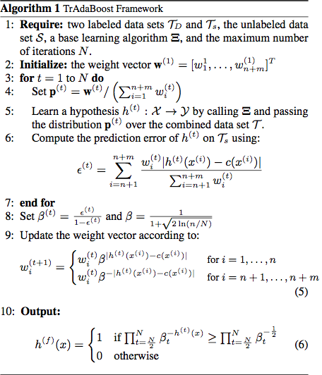
Algorithm: TrAdaBoost
Weights Initialization
Hypothesis Learning and error calculation
Weights Update

Slide 11








Algorithms: Self-Taught Learning
Problem Targeted is :
Little labeled data
A lot of unlabeled data
  Build a model on the labeled data
Car
Motorcycle
Natural scenes

Slide 12
Algorithms: Self-Taught Learning
Assumptions:
  Source and Target task have different feature space:
  Marginal distributions are different:
  Label Space is different:

Slide 13
Algorithms: Self-Taught Learning
Framework:
  Source Unlabeled data set:
  Target Labeled data set:
Natural scenes
Build classifier for cars and Motorbikes

Slide 14
Algorithms: Self-Taught Learning
Step One: Discover high level features from Source data by
Re-construction Error
Regularization Term
Constraint on the Bases

Slide 15
Algorithm: Self-Taught Learning
High Level Features
Unlabeled Data Set

Slide 16
Algorithm: Self-Taught Learning
Step Two: Project target data onto the attained features by
Informally, find the activations in the attained bases such that:
Re-construction is minimized
Attained vector is sparse

Slide 17
Algorithms: Self-Taught Learning
High Level Features

Slide 18
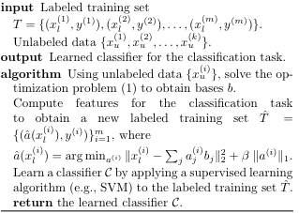
Algorithms: Self-Taught Learning
Step Three: Learn a Classifier with the new features
Target Task
Source Task
Learn new features (Step 1)
Project target data (Step 2)
Learn Model (Step 3)

Slide 19
Conclusions
Transfer learning is to re-use source knowledge to help a target learner
Transfer learning is not generalization
TrAdaBoost transfers instances
Self-Taught Learning transfers unlabeled features

Slide 20
Next in Web-Mining Agents:
Unlabeled Features Revisited
Unsupervised Learning: Clustering

