Slide 1
Web-Mining Agents
Probabilistic Information Retrieval
Prof. Dr. Ralf Möller
Universität zu Lübeck
Institut für Informationssysteme
Karsten Martiny (Übungen)

Slide 2
Acknowledgements
Slides taken from:
  Introduction to Information Retrieval
  Christopher Manning and Prabhakar Raghavan

Slide 3
How exact is the
representation of the document ?
How well is query
matched to data?
How exact is the
representation of the query ?
How relevant is the result
to the query ?
Query
representation
Query
Document Representation
TYPICAL IR
PROBLEM
Query
Answer
Document collection
3

Slide 4
Why probabilities in IR?
User
Information Need
Query
Representation
Understanding
of user need is
uncertain
How to match?
Document
Representation
Uncertain guess of
whether document has relevant content
Documents
In traditional IR systems, matching between each document and
query is attempted in a semantically imprecise space of index terms.
Probabilities provide a principled foundation for uncertain reasoning.
Can we use probabilities to quantify our uncertainties?

Slide 5
Probabilistic Approaches to IR
Probability Ranking Principle (Robertson, 70ies;
Maron, Kuhns, 1959)
Information Retrieval as Probabilistic Inference (van Rijsbergen & co, since 70ies)
Probabilistic Indexing (Fuhr & Co.,late 80ies-90ies)
Bayesian Nets in IR (Turtle, Croft, 90ies)
Success : varied

Slide 6
Probability Ranking Principle
Collection of Documents
User issues a query
A set of documents needs to be returned
Question: In what order to present documents to user ?

Slide 7
Probability Ranking Principle
Question: In what order to present documents to user ?
Intuitively, want the “best” document to be first, second best - second, etc…
Need a formal way to judge the
“goodness” of documents w.r.t. queries.
Idea: Probability of relevance of the document w.r.t. query

Slide 8
Let us recap probability theory
Bayesian probability formulas
Odds:

Slide 9
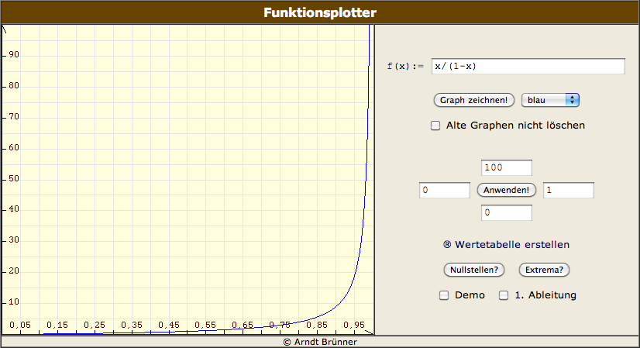
Odds vs. Probabilities

Slide 10
Probability Ranking Principle
Let x be a document in the retrieved collection.
Let R represent relevance of a document w.r.t. given (fixed)
query and let NR represent non-relevance.
Need to find p(R|x) - probability that a retrieved document x
is relevant.
p(R),p(NR) - prior probability
of retrieving a relevant or non-
relevant document, respectively
p(x|R), p(x|NR) - probability that if a relevant (non-relevant)
document is retrieved, it is x.
10

Slide 11
Probability Ranking Principle
Ranking Principle (Bayes’ Decision Rule):
If p(R|x) > p(NR|x) then x is relevant,
otherwise x is not relevant
Note:
11

Slide 12
Probability Ranking Principle
Claim: PRP minimizes the average probability of error
If we decide NR
If we decide R
p(error) is minimal when all p(error|x) are minimimal.
Bayes’ decision rule minimizes each p(error|x).
12

Slide 13
Probability Ranking Principle
More complex case: retrieval costs.
  C - cost of retrieval of relevant document
  C’ - cost of retrieval of non-relevant document
  let d, be a document
Probability Ranking Principle: if
for all d’ not yet retrieved, then d is the next document to be retrieved

Slide 14
PRP: Issues (Problems?)
How do we compute all those probabilities?
  Cannot compute exact probabilities, have to use estimates.
  Binary Independence Retrieval (BIR)
    See below
Restrictive assumptions
  “Relevance” of each document is independent of relevance of other documents.
  Most applications are for Boolean model.

Slide 15
Bayesian Nets in IR
Bayesian Nets is the most popular way of doing probabilistic inference.
What is a Bayesian Net ?
How to use Bayesian Nets in IR?
J. Pearl, “Probabilistic Reasoning in Intelligent Systems:
Networks of Plausible Inference”, Morgan-Kaufman, 1988

Slide 16
Bayesian Nets for IR: Idea
Document Network
d1
d2
di -documents
dn
Large, but
Compute once for each
document collection
ti - document representations
ri - “concepts”
t1
t2
tn’
tn
r1
r2
rk
r3
ci - query concepts
Small, compute once for
every query
c1
c2
cm
qi - high-level concepts
q2
q1
Query Network
I
I - goal node
16

Slide 17
Example: “reason trouble –two”
Hamlet
Macbeth
Document
Network
reason
trouble
double
reason
trouble
two
Query
Network
OR
NOT
User query

Slide 18
Bayesian Nets for IR: Roadmap
Construct Document Network (once !)
For each query
  Construct best Query Network
  Attach it to Document Network
  Find subset of di’s which maximizes the probability value of node I (best subset).
  Retrieve these di’s as the answer to query.

Slide 19
Bayesian Nets in IR: Pros / Cons
Pros
Cons
More of a cookbook solution
Flexible:create-your- own Document (Query) Networks
Relatively easy to update
Generalizes other Probabilistic approaches
  PRP
  Probabilistic Indexing
Best-Subset computation is NP-hard
  have to use quick approximations
  approximated Best Subsets may not contain best documents
Where do we get the numbers ?
19

Slide 20
Relevance models
Given: PRP
Goal: Estimate probability P(R|q,d)
Binary Independence Retrieval (BIR):
  Many documents D - one query q
  Estimate P(R|q,d) by considering whether d in D is relevant for q
Binary Independence Indexing (BII):
  One document d - many queries Q
  Estimate P(R|q,d) by considering whether a document d is relevant for a query q in Q

Slide 21
Binary Independence Retrieval
Traditionally used in conjunction with PRP
“Binary” = Boolean: documents are represented as binary vectors of terms:
  iff term i is present in document x.
“Independence”: terms occur in documents independently
Different documents can be modeled as same vector.

Slide 22
Binary Independence Retrieval
Queries: binary vectors of terms
Given query q,
  for each document d need to compute
  p(R|q,d).
  replace with computing p(R|q,x) where x is vector representing d
Interested only in ranking
Will use odds:

Slide 23
Binary Independence Retrieval
Constant for each query
Needs estimation
Using Independence Assumption:
So :
23

Slide 24

Binary Independence Retrieval
Since xi is either 0 or 1:
Let
Assume, for all terms not occuring in the query (qi=0)
Then...
24

Slide 25
Binary Independence Retrieval
All matching terms
Non-matching query terms
All matching terms
All query terms
25

Slide 26
Binary Independence Retrieval
Constant for
each query
Only quantity to be estimated
for rankings
Retrieval Status Value:
26

Slide 27
Binary Independence Retrieval
All boils down to computing RSV.
So, how do we compute ci’s from our data ?
27

Slide 28
Binary Independence Retrieval
Estimating RSV coefficients.
For each term i look at the following table:
Estimates:
28

Slide 29
Binary Independence Indexing
“Learning” from queries
  More queries: better results
p(q|x,R) - probability that if document x had been deemed relevant, query q had been asked
The rest of the framework is similar to BIR

Slide 30
Binary Independence Indexing vs.
Binary Independence Retrieval
BIR
BII
Many Documents,
One Query
Bayesian Probability:
Varies: document representation
Constant: query (representation)
One Document,
Many Queries
Bayesian Probability
Varies: query
Constant: document
30

Slide 31
Estimation – key challenge
If non-relevant documents are approximated by the whole collection, then r_{i} (prob. of occurrence in non-relevant documents for query) is n/N and
  log (1– r_{i})/r_{i} = log (N– n)/n ≈ log N/n = IDF!
p_{i} (probability of occurrence in relevant documents) can be estimated in various ways:
  from relevant documents if know some
    Relevance weighting can be used in feedback loop
  constant (Croft and Harper combination match) – then just get idf weighting of terms
  proportional to prob. of occurrence in collection
    more accurately, to log of this (Greiff, SIGIR 1998)
We have a nice theoretical foundation of wTD.IDF

Slide 32
Iteratively estimating p_{i}
Assume that p_{i} constant over all x_{i} in query
  p_{i} = 0.5 (even odds) for any given doc
Determine guess of relevant document set:
  V is fixed size set of highest ranked documents on this model (note: now a bit like tf.idf!)
We need to improve our guesses for p_{i} and r_{i}, so
  Use distribution of x_{i} in docs in V. Let V_{i} be set of documents containing x_{i}
    p_{i} = |V_{i}| / |V|
  Assume if not retrieved then not relevant
    r_{i} = (n_{i} – |V_{i}|) / (N – |V|)
Go to 2. until converges then return ranking

Slide 33
Probabilistic Relevance Feedback
Guess a preliminary probabilistic description of R and use it to retrieve a first set of documents V, as above.
Interact with the user to refine the description: learn some definite members of R and NR
Reestimate p_{i} and r_{i} on the basis of these
  Or can combine new information with original guess (use Bayesian prior):
Repeat, thus generating a succession of approximations to R.
κ is
prior
weight
Notes:
explicit Bayesian smoothing with a prior

Slide 34
PRP and BIR: The lessons
Getting reasonable approximations of probabilities is possible.
Simple methods work only with restrictive assumptions:
  term independence
  terms not in query do not affect the outcome
  boolean representation of documents/queries
  document relevance values are independent
Some of these assumptions can be removed

Slide 35
Food for thought
Think through the differences between standard tf.idf and the probabilistic retrieval model in the first iteration
Think through the differences between vector space (pseudo) relevance feedback and probabilistic (pseudo) relevance feedback

Slide 36
Good and Bad News
Standard Vector Space Model
  Empirical for the most part; success measured by results
  Few properties provable
Probabilistic Model Advantages
  Based on a firm theoretical foundation
  Theoretically justified optimal ranking scheme
Disadvantages
  Binary word-in-doc weights (not using term frequencies)
  Independence of terms (can be alleviated)
  Amount of computation
  Has never worked convincingly better in practice

