Slide 1
Web-Mining Agents Probabilistic Reasoning over Time
Prof. Dr. Ralf Möller
Universität zu Lübeck
Institut für Informationssysteme
Karsten Martiny (Übungen)

Slide 2
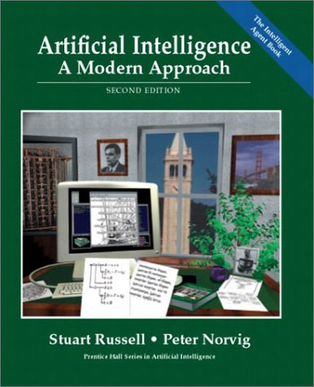
Literature
http://aima.cs.berkeley.edu

Slide 3
Temporal Probabilistic Agent
sensors
?
environment
agent
actuators
t₁, t₂, t₃, …

Slide 4
Probabilistic Temporal Models
Dynamic Bayesian Networks (DBNs)
Hidden Markov Models (HMMs)
Kalman Filters

Slide 5
Time and Uncertainty
The world changes, we need to track and predict it
Examples: diabetes management, traffic monitoring
Basic idea: copy state and evidence variables for each time step
X_{t} – set of unobservable state variables at time t
e.g., BloodSugar_{t}, StomachContents_{t}
E_{t} – set of evidence variables at time t
e.g., MeasuredBloodSugar_{t}, PulseRate_{t}, FoodEaten_{t}
Assumes discrete time steps

Slide 6
States and Observations
Process of change is viewed as series of snapshots, each describing the state of the world at a particular time
Each time slice involves a set of random variables indexed by t:
the set of unobservable state variables X_{t}
the set of observable evidence variable E_{t}
The observation at time t is E_{t} = e_{t} for some set of values e_{t}
The notation X_{a:b} denotes the set of variables from X_{a} to X_{b}

Slide 7
Dynamic Bayesian Networks
How can we model dynamic situations with a Bayesian network?
Example: Is it raining today?
next step: specify dependencies among the variables.
The term “dynamic” means we are modeling a dynamic system, not that
the network structure changes over time.

Slide 8
DBN - Representation
Problem:
Necessity to specify an unbounded number of conditional probability tables, one for each variable in each slice,
Each one might involve an unbounded number of parents.
Solution:
Assume that changes in the world state are caused by a stationary process (unmoving process over time).
is the same for all t

Slide 9
DBN - Representation
Solution cont.:
2. Use Markov assumption - The current state depends on only in a finite history of previous states. Using the first-order Markov process:
Transition Model
In addition to restricting the parents of the state variable Xt, we must restrict the parents of the evidence variable Et
Sensor Model

Slide 10
Stationary Process/Markov Assumption
Markov Assumption: X_{t} depends on some previous X_{i}s
First-order Markov process: P(X_{t}|X_{0:t-1}) = P(X_{t}|X_{t-1})
kth order: depends on previous k time steps
Sensor Markov assumption: P(E_{t}|X_{0:t}, E_{0:t-1}) = P(E_{t}|X_{t})
Assume stationary process: transition model P(X_{t}|X_{t-1}) and sensor model P(E_{t}|X_{t}) are the same for all t
In a stationary process, the changes in the world state are governed by laws that do not themselves change over time

Slide 11
Dynamic Bayesian Networks
There are two possible fixes if the approximation is too inaccurate:
Increasing the order of the Markov process model. For example, adding as a parent of , which might give slightly more accurate predictions.
Increasing the set of state variables. For example, adding to allow to incorporate historical records of rainy seasons, or adding , and Pressure to allow to use a physical model of rainy conditions.

Slide 12
Dynamic Bayesian Network
Bayesian network structure corresponding to a first-order of Markov process with state defined by the variables Xt.
A second order of Markov process

Slide 13
Complete Joint Distribution
Given:
Transition model: P(X_{t}|X_{t-1})
Sensor model: P(E_{t}|X_{t})
Prior probability: P(X₀)
Then we can specify complete joint distribution:

Slide 14
Example
R_{t-1} | P(R_{t}|R_{t-1})
T F | 0.7 0.3
Rain_{t-1}
Rain_{t}
Rain_{t+1}
Umbrella_{t-1}
Umbrella_{t}
Umbrella_{t+1}
R_{t} | P(U_{t}|R_{t})
T F | 0.9 0.2

Slide 15
Inference Tasks
Filtering: What is the probability that it is raining today, given all the umbrella observations up through today?
Prediction: What is the probability that it will rain the day after tomorrow, given all the umbrella observations up through today?
Smoothing: What is the probability that it rained yesterday, given all the umbrella observations through today?
Most likely explanation: if the umbrella appeared the first three days but not on the fourth, what is the most likely weather sequence to produce these umbrella sightings?

Slide 16
DBN – Basic Inference
Filtering or Monitoring:
Compute the belief state - the posterior distribution over the current state, given all evidence to date.
Filtering is what a rational agent needs to do in order to keep track of the current state so that the rational decisions can be made.

Slide 17
DBN – Basic Inference
Filtering cont.
Given the results of filtering up to time t, one can easily compute the result for t+1 from the new evidence
(for some function f)
(dividing up the evidence)
(using Bayes’ Theorem)
(by the Markov property of evidence)
α is a normalizing constant used to make probabilities sum up to 1.

Slide 18
DBN – Basic Inference
Filtering cont.
The second term represents a one-step prediction of the next step, and the first term updates this with the new evidence.
Now we obtain the one-step prediction for the next step by conditioning on the current state Xt:
(using the Markov property)

Slide 19
Forward Messages

Slide 20
Example
R_{t-1} | P(R_{t}|R_{t-1})
T F | 0.7 0.3
Rain_{t-1}
Rain_{t}
Rain_{t+1}
Umbrella_{t-1}
Umbrella_{t}
Umbrella_{t+1}
R_{t} | P(U_{t}|R_{t})
T F | 0.9 0.2

Slide 21
DBN – Basic Inference
Illustration for two steps in the Umbrella example:
On day 1, the umbrella appears so U1=true. The prediction from t=0 to t=1 is
and updating it with the evidence for t=1 gives
On day 2, the umbrella appears so U2=true. The prediction from t=1 to t=2 is
and updating it with the evidence for t=2 gives

Slide 22
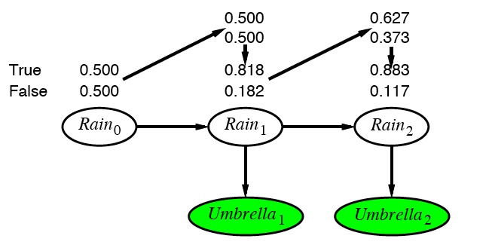
Example cntd.

Slide 23
DBN – Basic Inference
Prediction:
Compute the posterior distribution over the future state, given all evidence to date.
for some k>0
The task of prediction can be seen simply as filtering without the addition of new evidence.

Slide 24
DBN – Basic Inference
Smoothing or hindsight:
Compute the posterior distribution over the past state, given all evidence up to the present.
for some k such that 0 ≤ k < t.
Hindsight provides a better estimate of the state than was available at the time, because it incorporates more evidence.

Slide 25
Smoothing

Slide 26
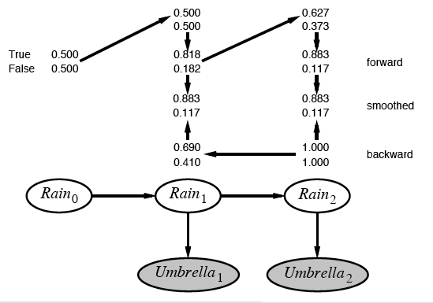
Example contd.

Slide 27
DBN – Basic Inference
Most likely explanation:
Compute the sequence of states that is most likely to have generated a given sequence of observation.
Algorithms for this task are useful in many applications, including, e.g., speech recognition.

Slide 28
Most-likely explanation

Slide 29
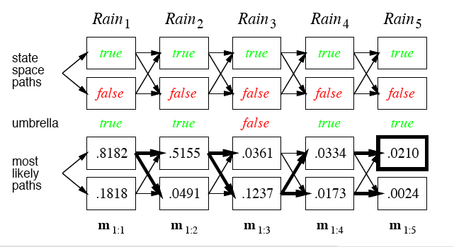
Rain/Umbrella Example

Slide 30
The occasionally dishonest casino
A casino uses a fair die most of the time, but occasionally switches to a loaded one
Fair die: Prob(1) = Prob(2) = . . . = Prob(6) = 1/6
Loaded die: Prob(1) = Prob(2) = . . . = Prob(5) = 1/10, Prob(6) = ½
These are the emission probabilities
Transition probabilities
Prob(Fair → Loaded) = 0.01
Prob(Loaded → Fair) = 0.2
Transitions between states modeled by a Markov process
Slide by Changui Yan

Slide 31
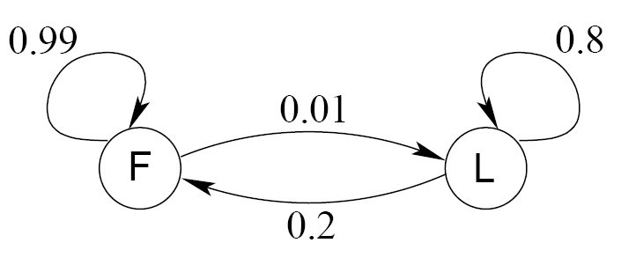
Transition model for the casino
Slide by Changui Yan

Slide 32
The occasionally dishonest casino
Known:
The structure of the model
The transition probabilities
Hidden: What the casino did
FFFFFLLLLLLLFFFF...
Observable: The series of die tosses
3415256664666153...
What we must infer:
When was a fair die used?
When was a loaded one used?
The answer is a sequence FFFFFFFLLLLLLFFF...
Slide by Changui Yan

Slide 33
Making the inference
Model assigns a probability to each explanation of the observation: P(326|FFL) = P(3|F)·P(F→F)·P(2|F)·P(F→L)·P(6|L) = 1/6 · 0.99 · 1/6 · 0.01 · ½
Maximum Likelihood: Determine which explanation is most likely
Find the path most likely to have produced the observed sequence
Total probability: Determine probability that observed sequence was produced by the model
Consider all paths that could have produced the observed sequence
Slide by Changui Yan

Slide 34
Notation
x is the sequence of symbols emitted by model
x_{i} is the symbol emitted at time i
A path, π, is a sequence of states
The i-th state in π is π_{i}
a_{kr} is the probability of making a transition from state k to state r:
e_{k}(b) is the probability that symbol b is emitted when in state k
Slide by Changui Yan

Slide 35
A “parse” of a sequence
1
1
1
1
…
1
2
2
2
2
2
…
2
0
0
…
…
…
…
K
K
K
K
…
K
x₁
x₂
x₃
x_{L}
Slide by Changui Yan

Slide 36
The occasionally dishonest casino
Slide by Changui Yan

Slide 37
The most probable path
The most likely path π* satisfies
To find π*, consider all possible ways the last symbol of x could have been emitted
Let
Then
Slide by Changui Yan

Slide 38
The Viterbi Algorithm
Initialization (i = 0)
Recursion (i = 1, . . . , L): For each state k
Termination:
To find π*, use trace-back, as in dynamic programming
Slide by Changui Yan

Slide 39
Viterbi: Example
x
2
ε
6
6
0
B
1
0
0
(1/6)×(1/2)
= 1/12
(1/6)×max{(1/12)×0.99,
(1/4)×0.2}
= 0.01375
(1/6)×max{0.01375×0.99,
0.02×0.2}
= 0.00226875
F
0
π
(1/2)×(1/2)
= 1/4
(1/10)×max{(1/12)×0.01,
(1/4)×0.8}
= 0.02
(1/2)×max{0.01375×0.01,
0.02×0.8}
= 0.08
L
0
Slide by Changui Yan

Slide 40
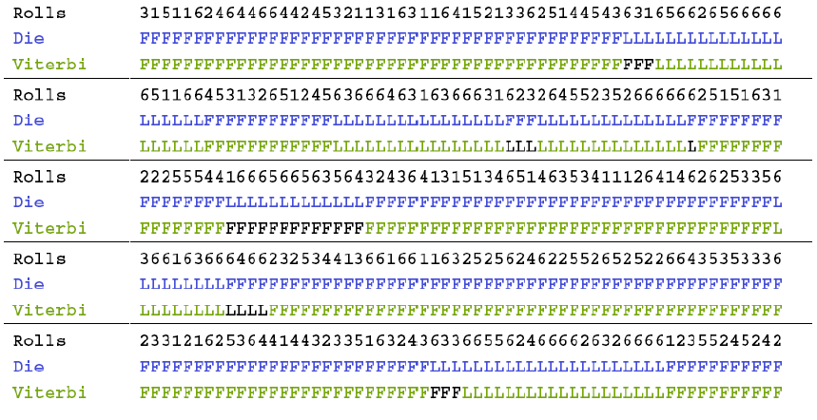
Viterbi gets it right more often than not
Slide by Changui Yan

Slide 41
Dynamic Bayesian Networks
Learning requires the full smoothing inference, rather than filtering, because it provides better estimates of the state of the process.
Learning the parameters of a BN is done using Expectation – Maximization (EM) Algorithms. Iterative optimization method to estimate some unknowns parameters.

Slide 42
Acknowledgements: The following slides are taken from CS 388 Natural Language Processing: Part-Of-Speech Tagging, Sequence Labeling, and Hidden Markov Models (HMMs)
Raymond J. Mooney
University of Texas at Austin
Notes:
42

Slide 43
Part Of Speech Tagging
Annotate each word in a sentence with a part-of-speech marker.
Lowest level of syntactic analysis.
Useful for subsequent syntactic parsing and word sense disambiguation.
John saw the saw and decided to take it to the table.
NNP VBD DT NN CC VBD TO VB PRP IN DT NN

Slide 44
English Parts of Speech
Noun (person, place or thing)
Singular (NN): dog, fork
Plural (NNS): dogs, forks
Proper (NNP, NNPS): John, Springfields
Personal pronoun (PRP): I, you, he, she, it
Wh-pronoun (WP): who, what
Verb (actions and processes)
Base, infinitive (VB): eat
Past tense (VBD): ate
Gerund (VBG): eating
Past participle (VBN): eaten
Non 3rd person singular present tense (VBP): eat
3rd person singular present tense: (VBZ): eats
Modal (MD): should, can
To (TO): to (to eat)

Slide 45
English Parts of Speech (cont.)
Adjective (modify nouns)
Basic (JJ): red, tall
Comparative (JJR): redder, taller
Superlative (JJS): reddest, tallest
Adverb (modify verbs)
Basic (RB): quickly
Comparative (RBR): quicker
Superlative (RBS): quickest
Preposition (IN): on, in, by, to, with
Determiner:
Basic (DT) a, an, the
WH-determiner (WDT): which, that
Coordinating Conjunction (CC): and, but, or,
Particle (RP): off (took off), up (put up)

Slide 46
Sequence Labeling Problem
Many NLP problems can viewed as sequence labeling.
Each token in a sequence is assigned a label.
Labels of tokens are dependent on the labels of other tokens in the sequence, particularly their neighbors (not i.i.d).
foo bar blam zonk zonk bar blam

Slide 47
Information Extraction
Identify phrases in language that refer to specific types of entities and relations in text.
Named entity recognition is task of identifying names of people, places, organizations, etc. in text.
people organizations places
Michael Dell is the CEO of Dell Computer Corporation and lives in Austin Texas.
Extract pieces of information relevant to a specific application, e.g. used car ads:
make model year mileage price
For sale, 2002 Toyota Prius, 20,000 mi, $15K or best offer. Available starting July 30, 2006.

Slide 48
Semantic Role Labeling
For each clause, determine the semantic role played by each noun phrase that is an argument to the verb.
agent patient source destination instrument
John drove Mary from Austin to Dallas in his Toyota Prius.
The hammer broke the window.
Also referred to a “case role analysis,” “thematic analysis,” and “shallow semantic parsing”

Slide 49
Bioinformatics
Sequence labeling also valuable in labeling genetic sequences in genome analysis.
extron intron
AGCTAACGTTCGATACGGATTACAGCCT

Slide 50
Sequence Labeling as Classification
Classify each token independently but use as input features, information about the surrounding tokens (sliding window).
John saw the saw and decided to take it to the table.
classifier
NNP

Slide 51
Sequence Labeling as Classification
Classify each token independently but use as input features, information about the surrounding tokens (sliding window).
John saw the saw and decided to take it to the table.
classifier
VBD

Slide 52
Sequence Labeling as Classification
Classify each token independently but use as input features, information about the surrounding tokens (sliding window).
John saw the saw and decided to take it to the table.
classifier
DT

Slide 53
Sequence Labeling as Classification
Classify each token independently but use as input features, information about the surrounding tokens (sliding window).
John saw the saw and decided to take it to the table.
classifier
NN

Slide 54
Sequence Labeling as Classification
Classify each token independently but use as input features, information about the surrounding tokens (sliding window).
John saw the saw and decided to take it to the table.
classifier
CC

Slide 55
Sequence Labeling as Classification
Classify each token independently but use as input features, information about the surrounding tokens (sliding window).
John saw the saw and decided to take it to the table.
classifier
VBD

Slide 56
Sequence Labeling as Classification
Classify each token independently but use as input features, information about the surrounding tokens (sliding window).
John saw the saw and decided to take it to the table.
classifier
TO

Slide 57
Sequence Labeling as Classification
Classify each token independently but use as input features, information about the surrounding tokens (sliding window).
John saw the saw and decided to take it to the table.
classifier
VB

Slide 58
Sequence Labeling as Classification
Classify each token independently but use as input features, information about the surrounding tokens (sliding window).
John saw the saw and decided to take it to the table.
classifier
PRP

Slide 59
Sequence Labeling as Classification
Classify each token independently but use as input features, information about the surrounding tokens (sliding window).
John saw the saw and decided to take it to the table.
classifier
IN

Slide 60
Sequence Labeling as Classification
Classify each token independently but use as input features, information about the surrounding tokens (sliding window).
John saw the saw and decided to take it to the table.
classifier
DT

Slide 61
Sequence Labeling as Classification
Classify each token independently but use as input features, information about the surrounding tokens (sliding window).
John saw the saw and decided to take it to the table.
classifier
NN

Slide 62
Sequence Labeling as Classification
Using Outputs as Inputs
Better input features are usually the categories of the surrounding tokens, but these are not available yet.
Can use category of either the preceding or succeeding tokens by going forward or back and using previous output.

Slide 63
Forward Classification
John saw the saw and decided to take it to the table.
classifier
NNP

Slide 64
Forward Classification
NNP
John saw the saw and decided to take it to the table.
classifier
VBD

Slide 65
Forward Classification
NNP VBD
John saw the saw and decided to take it to the table.
classifier
DT

Slide 66
Forward Classification
NNP VBD DT
John saw the saw and decided to take it to the table.
classifier
NN

Slide 67
Forward Classification
NNP VBD DT NN
John saw the saw and decided to take it to the table.
classifier
CC

Slide 68
Forward Classification
NNP VBD DT NN CC
John saw the saw and decided to take it to the table.
classifier
VBD

Slide 69
Forward Classification
NNP VBD DT NN CC VBD
John saw the saw and decided to take it to the table.
classifier
TO

Slide 70
Forward Classification
NNP VBD DT NN CC VBD TO
John saw the saw and decided to take it to the table.
classifier
VB

Slide 71
Forward Classification
NNP VBD DT NN CC VBD TO VB
John saw the saw and decided to take it to the table.
classifier
PRP

Slide 72
Forward Classification
NNP VBD DT NN CC VBD TO VB PRP
John saw the saw and decided to take it to the table.
classifier
IN

Slide 73
Forward Classification
NNP VBD DT NN CC VBD TO VB PRP IN
John saw the saw and decided to take it to the table.
classifier
DT

Slide 74
Forward Classification
NNP VBD DT NN CC VBD TO VB PRP IN DT
John saw the saw and decided to take it to the table.
classifier
NN

Slide 75
Backward Classification
Disambiguating “to” in this case would be even easier backward.
John saw the saw and decided to take it to the table.
classifier
NN

Slide 76
Backward Classification
Disambiguating “to” in this case would be even easier backward.
NN
John saw the saw and decided to take it to the table.
classifier
DT

Slide 77
Backward Classification
Disambiguating “to” in this case would be even easier backward.
DT NN
John saw the saw and decided to take it to the table.
classifier
IN

Slide 78
Backward Classification
Disambiguating “to” in this case would be even easier backward.
IN DT NN
John saw the saw and decided to take it to the table.
classifier
PRP

Slide 79
Backward Classification
Disambiguating “to” in this case would be even easier backward.
PRP IN DT NN
John saw the saw and decided to take it to the table.
classifier
VB

Slide 80
Backward Classification
Disambiguating “to” in this case would be even easier backward.
VB PRP IN DT NN
John saw the saw and decided to take it to the table.
classifier
TO

Slide 81
Backward Classification
Disambiguating “to” in this case would be even easier backward.
TO VB PRP IN DT NN
John saw the saw and decided to take it to the table.
classifier
VBD

Slide 82
Backward Classification
Disambiguating “to” in this case would be even easier backward.
VBD TO VB PRP IN DT NN
John saw the saw and decided to take it to the table.
classifier
CC

Slide 83
Backward Classification
Disambiguating “to” in this case would be even easier backward.
CC VBD TO VB PRP IN DT NN
John saw the saw and decided to take it to the table.
classifier
NN

Slide 84
Backward Classification
Disambiguating “to” in this case would be even easier backward.
VBD CC VBD TO VB PRP IN DT NN
John saw the saw and decided to take it to the table.
classifier
DT

Slide 85
Backward Classification
Disambiguating “to” in this case would be even easier backward.
DT VBD CC VBD TO VB PRP IN DT NN
John saw the saw and decided to take it to the table.
classifier
VBD

Slide 86
Backward Classification
Disambiguating “to” in this case would be even easier backward.
VBD DT VBD CC VBD TO VB PRP IN DT NN
John saw the saw and decided to take it to the table.
classifier
NNP

Slide 87
Web-Mining Agents Probabilistic Reasoning over Time
Prof. Dr. Ralf Möller
Universität zu Lübeck
Institut für Informationssysteme

Slide 88
Dynamic Bayesian Networks
R_{t-1} | P(R_{t}|R_{t-1})
T F | 0.7 0.3
Rain_{t-1}
Rain_{t}
Rain_{t+1}
Umbrella_{t-1}
Umbrella_{t}
Umbrella_{t+1}
R_{t} | P(U_{t}|R_{t})
T F | 0.9 0.2

Slide 89
Rain/Umbrella Example

Slide 90
DBN – Special Cases
Hidden Markov Model (HMMs):
Temporal probabilistic model in which the state of the process is described by a single discrete random variable. (The simplest kind of DBN )
Kalman Filter Models (KFMs):
Estimate the state of a physical system from noisy observations over time. Also known as linear dynamical systems (LDSs).

Slide 91
DBN – Basic Inference
Filtering
Smoothing
Most likely sequence

Slide 92
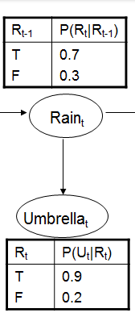
Hidden Markov Models
new state
old state
(
0.1 | 0
0 | 0.8
)
U₃ = false O₃ =

Slide 93
Country Dance Algorithm

Slide 94
Country Dance Algorithm

Slide 95
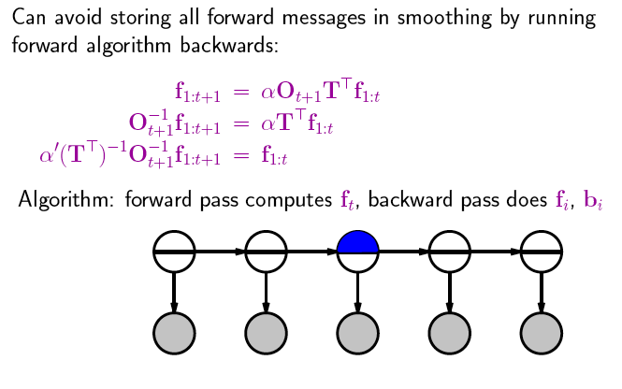
Country Dance Algorithm

Slide 96
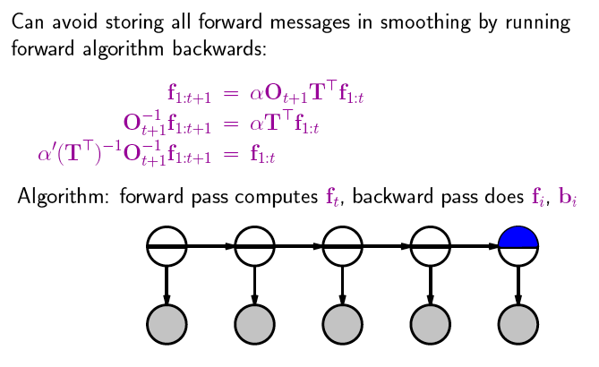
Country Dance Algorithm

Slide 97
Country Dance Algorithm

Slide 98
Country Dance Algorithm

Slide 99
Example
(
)
U₂ = true O₂ =
0.9 | 0
0 | 0.2
(
)
(
)
O₂⁻¹ =
0.2 | 0
0 | 0.9
1.1 | 0
0 | 4.95
(
)
5.5
=
T^{T} =
0.7 | 0.3
0.3 | 0.7
(
)
(
)
(T^{T})⁻¹ =
0.7 | -0.3
-0.3 | 0.7
=
1.75 | -0,75
-0,75 | 1.75
2.5
(
)
(
)
(
)
(
)
1,925 | -3.7125
-0,825 | 8.6625
0.883
0.117
1.265
0,285
0.817
0,183
=
α = 0,64497
→

Slide 100
(
)
0.817
0,183

Slide 101
State View: Hidden Markov models
Set of states:
Process moves from one state to another generating a sequence of states :
Markov chain property: probability of each subsequent state depends only on what was the previous state:
States are not visible, but each state randomly generates one of M observations (or visible states)

Slide 102
State View: Hidden Markov models
To define a hidden Markov model, the following probabilities have to be specified:
Matrix of transition probabilities A=(a_{ij}), a_{ij}= P(s_{j} | s_{i}) ,
Matrix of observation probabilities B=(b_{i} (v_{m} )), b_{i}(v_{m} ) = P(v_{m} | s_{i}) and a
Vector of initial probabilities π=(π_{i}), π_{i} = P(s_{i}) .
Model is represented by M=(A, B, π).

Slide 103
Example of Hidden Markov Model
0.3
0.7
Low
High
0.2
0.8
0.6
0.6
0.4
0.4
Rain
Dry

Slide 104
State View: Learning problem (1)
Given some training observation sequences O=o₁ o₂ ... o_{K} and general structure of HMM (numbers of hidden and visible states), determine HMM parameters M=(A, B, π) that best fit training data, that is maximizes P(O | M) .

Slide 105
State View: Learning problem (2)
If training data has information about sequence of hidden states, then use maximum likelihood estimation of parameters:
a_{ij}= P(s_{j} | s_{i}) =
Number of transitions from state s_{i} to state s_{j}
Number of transitions out of state s_{i}
Number of times observation v_{m} occurs in state s_{i}
Number of times in state s_{i}
b_{i}(v_{m} ) = P(v_{m} | s_{i})=
Otherwise: Use iterative expectation-maximization algorithm to find local maximum of P(O | M): Baum-Welch Algorithm.

Slide 106
Baum-Welch algorithm
General idea:
Expected number of transitions from state s_{i} to state s_{j}
Expected number of transitions out of state s_{i}
a_{ij}= P(s_{j} | s_{i}) =
Expected number of times observation v_{m} occurs in state s_{i}
Expected number of times in state s_{i}
b_{i}(v_{m} ) = P(v_{m} | s_{i})=
π_{i} = P(s_{i}) = Expected frequency in state s_{i} at time k=1.

Slide 107
Baum-Welch algorithm: Expectation step(1)
Define variable ξ_{k}(i,j) as the probability of being in state s_{i} at time k and in state s_{j} at time k+1, given the observation sequence o₁ o₂ ... o_{T} with k < T
ξ_{k}(i,j) = P(q_{k}= s_{i} , q_{k+1}= s_{j} | o₁ o₂ ... o_{T})
P(q_{k}= s_{i} , q_{k+1}= s_{j} , o₁ o₂ ... o_{T})
P(o₁ o₂ ... o_{T})
ξ_{k}(i,j) =
=
P(q_{k}= s_{i} , o₁ o₂ ... o_{k}) a_{ij} b_{j} (o_{k+1} ) P(o_{k+2} ... o_{T} | q_{k+1}= s_{j} )
P(o₁ o₂ ... o_{T})
=
α forward_{k}(i) a_{ij} b_{j} (o_{k+1} ) backward_{k+1}(j)

Slide 108
Baum-Welch algorithm: Expectation step(2)
Define variable γ_{k}(i) as the probability of being in state s_{i} at time k, given the observation sequence o₁ o₂ ... o_{T} .
γ_{k}(i)= P(q_{k}= s_{i} | o₁ o₂ ... o_{T})
P(q_{k}= s_{i} , o₁ o₂ ... o_{T})
P(o₁ o₂ ... o_{T})
γ_{k}(i)=
=
α forward_{k}(i) backward_{k}(i)

Slide 109
Baum-Welch algorithm: Expectation step(3)
We calculated ξ_{k}(i,j) = P(q_{k}= s_{i} , q_{k+1}= s_{j} | o₁ o₂ ... o_{T})
and γ_{k}(i)= P(q_{k}= s_{i} | o₁ o₂ ... o_{T})
Expected number of transitions from state s_{i} to state s_{j} =
= Σ_{k} ξ_{k}(i,j)
Expected number of transitions out of state s_{i} = Σ_{k} γ_{k}(i)
Expected number of times observation v_{m} occurs in state s_{i} =
= Σ_{k} γ_{k}(i) , k is such that o_{k}= v_{m}
Expected frequency in state s_{i} at time k=1 : γ₁(i) .

Slide 110
Baum-Welch algorithm: Maximization step
Expected number of transitions from state s_{j} to state s_{i}
Expected number of transitions out of state s_{j}
Σ_{k} ξ_{k}(i,j)
Σ_{k} γ_{k}(i)
a_{ij} =
=
Σ_{k} ξ_{k}(i,j)
Σk,o_{k}= v_{m} γ_{k}(i)
b_{i}(v_{m} ) =
Expected number of times observation v_{m} occurs in state s_{i}
Expected number of times in state s_{i}
=
π_{i} = (Expected frequency in state s_{i} at time k=1) = γ₁(i).

Slide 111
DBN – Special Cases
Hidden Markov Model (HMMs):
Temporal probabilistic model in which the state of the process is described by a single discrete random variable. (The simplest kind of DBN )
Kalman Filter Models (KFMs):
Estimate the state of a physical system from noisy observations over time. Also known as linear dynamical systems (LDSs).

Slide 112
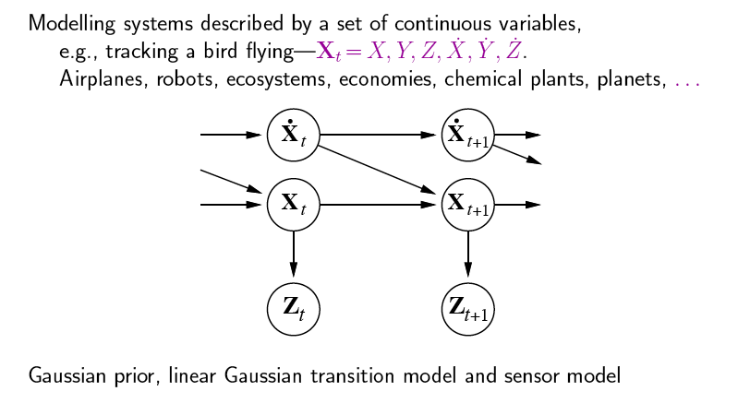
Kalman Filters

Slide 113
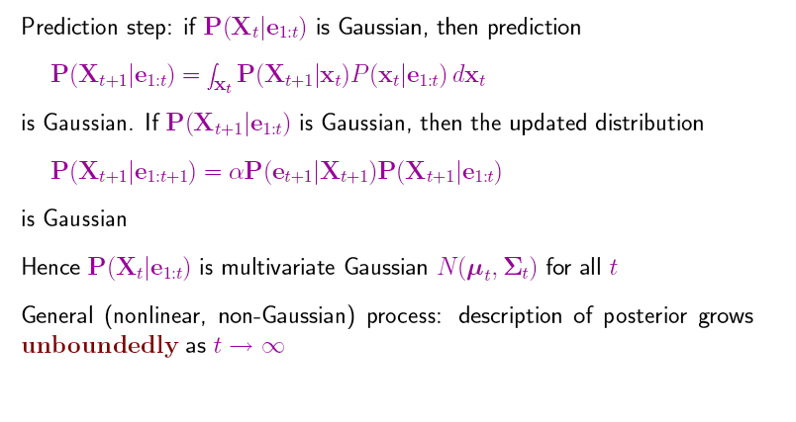
Updating Gaussian Distributions

Slide 114
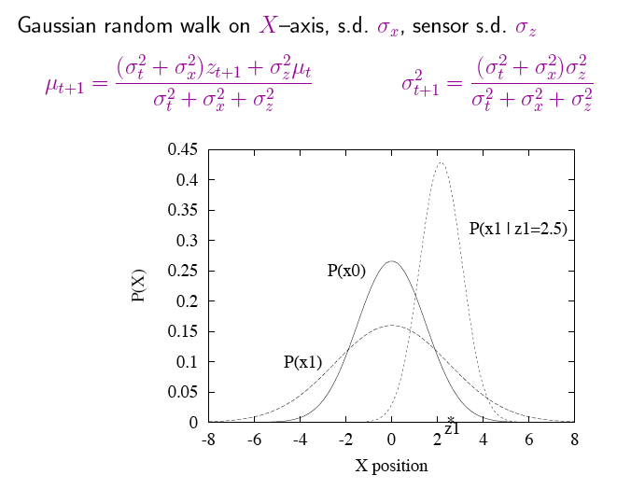
Simple 1-D Example
z1: first observation
s.d.= standard deviation

Slide 115
General Kalman Update
Left for your studies

Slide 116
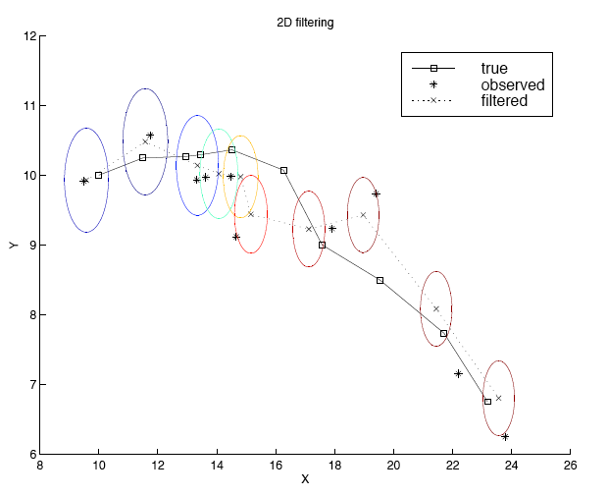
2-D Tracking: Filtering
Notes:
Radar tracking of planes or missles any phsiyal systems ocean currents from sattelite surface measurments

Slide 117
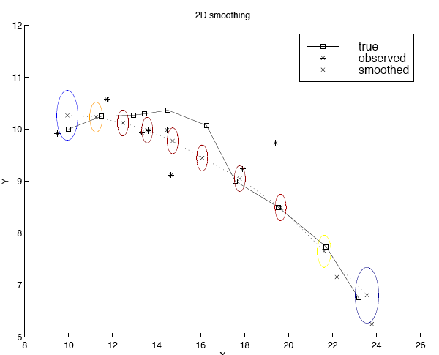
2-D Tracking: Smoothing

Slide 118
Where it breaks
Standard solution: switching Kalman filter
Keeping track of many objects: Identity uncertainty

Slide 119
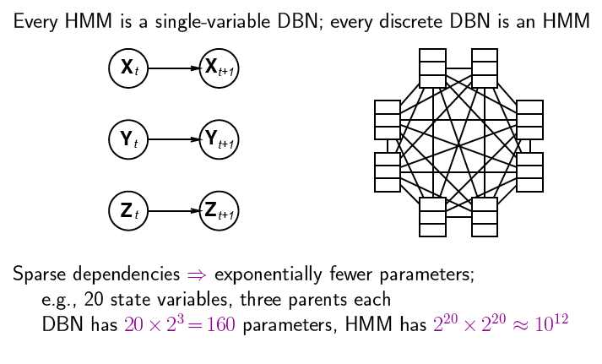
DBNs vs. HMMs
Consider the transition model
Notes:
2 hoch 20 zustände

Slide 120
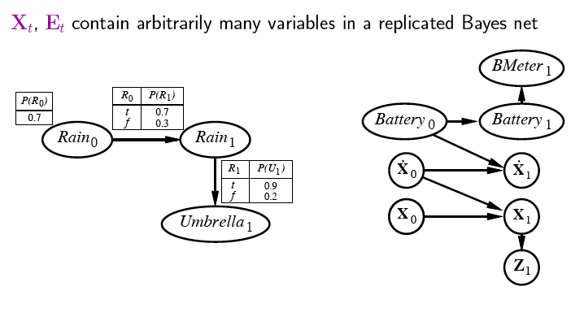
Constructing Dynamic Bayesian Networks
Battery-powered robot on x-y plane
X_{t} = (X_{t}, Y_{t}), Z_{t} = measurements

Slide 121
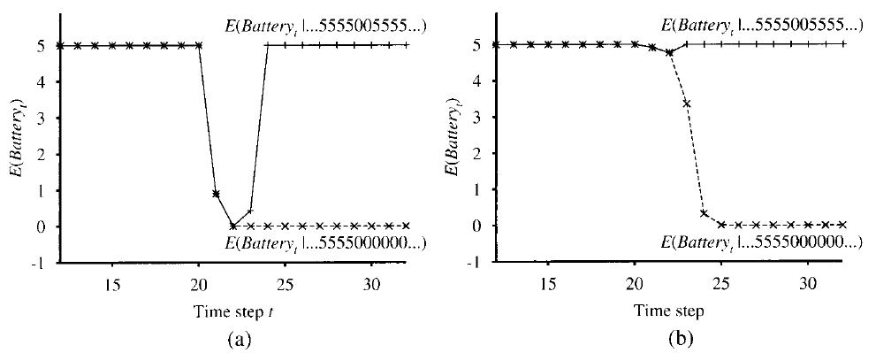
DBNs transient failure
For simplicity we assume that BMeter_{t} and Battery_{t} are taken from 0..5.
Generic gaussian error model
produces “overreaction“
Explicit transient failure model required:

Slide 122
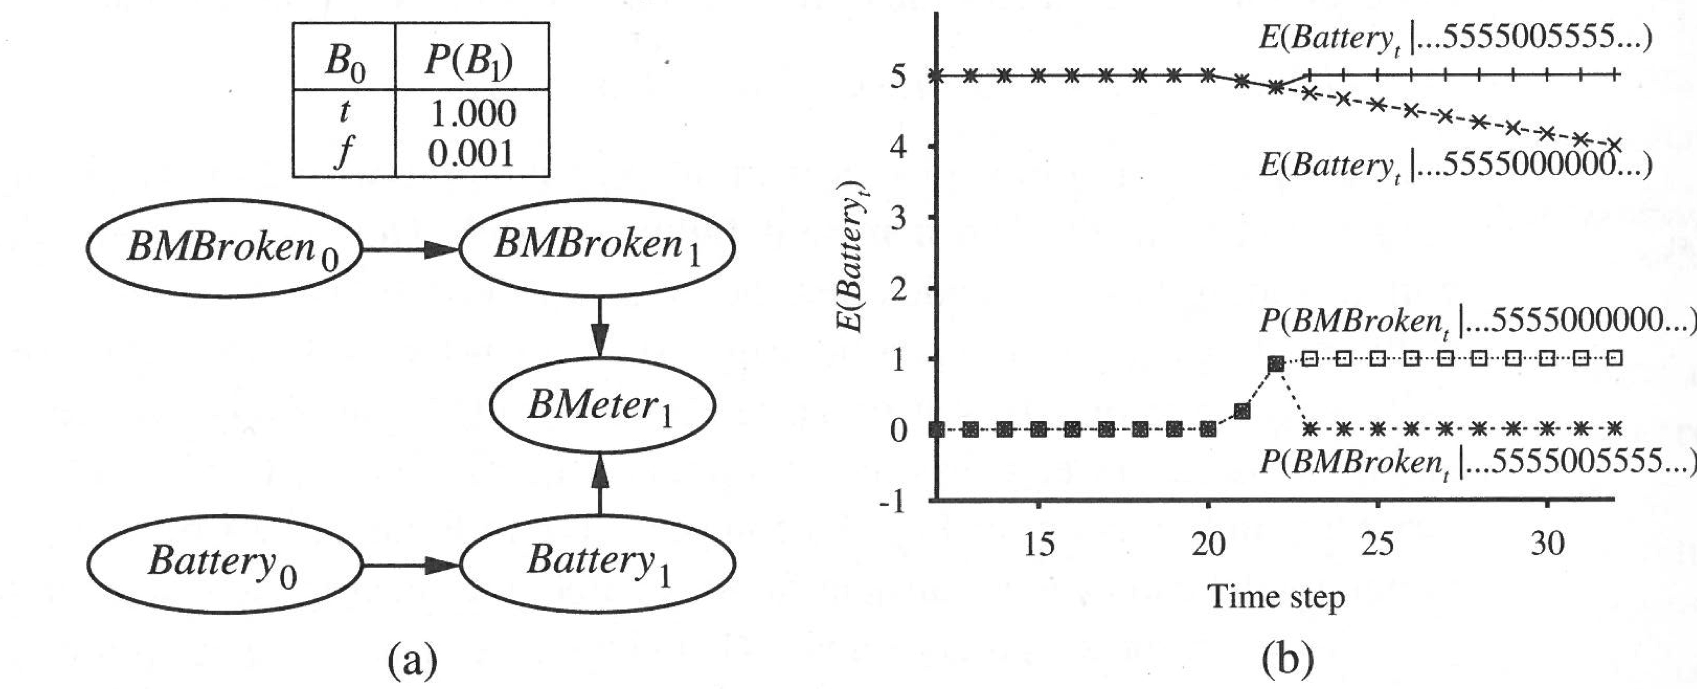
DBNs persistent failure
Additional variable required: BMBroken_{t}
Upper curve: transient failure with different observation sequences
Lower curve: persistent failure with two different observation sequences

Slide 123
Learning DBN pattern structures?
Difficult
Need “deep” domain knowledge

Slide 124
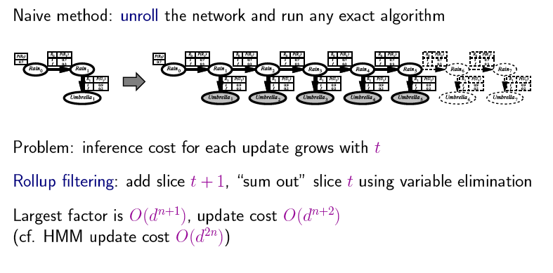
Recap: Exact Inference in DBNs
for the whole BN
Example: 20 state variables with 4 values each means 4²⁰⁺¹ =4.398.046.511.104
d = possible values for variables n = number of states
Employ forward chaining (constant per time update but exponential in the number of variables per state)

Slide 125
Approximate inference in DBNs
Central idea:
Create N initial-state examples (from prior dist P(X₀))
Based on the transition model, each sample is propagated forward by sampling the next state value x_{t+1} given the current value x_{t}
Each sample is weighted by the likelihood it assigns to the new evidence P(e_{t+1} | x_{t+1})
Resample to generate new population of N samples
Select new sample based on its weight
Samples are called particles (→ Particle Filtering)

Slide 126
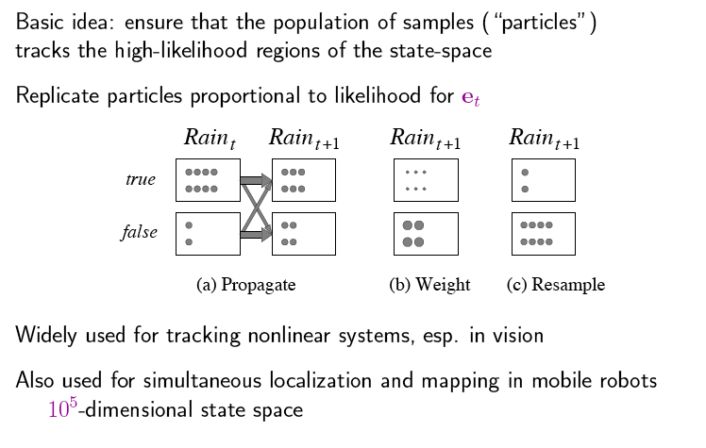
Particle Filtering

Slide 127
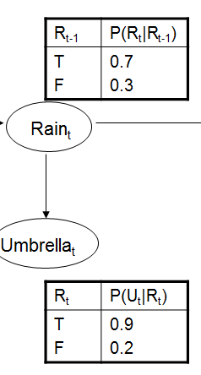
Example
N(r_{t+1}|e) = Σ _{xt} P(x_{t+1}|x_{t}) N(x_{t}|e) For rain = 0.7*8+0.3*2= 6.2 => 6 For not rain = 0.3 *8 + 0.7*2= 3.8 => 4
Suppose no umbrella for t+1 total weight(rain particles) = 0.1 * 6= 0.6
total weight(not rain) = 0.8 * 4= 3.2
Normalized =<0.17, 0.83>

Slide 128
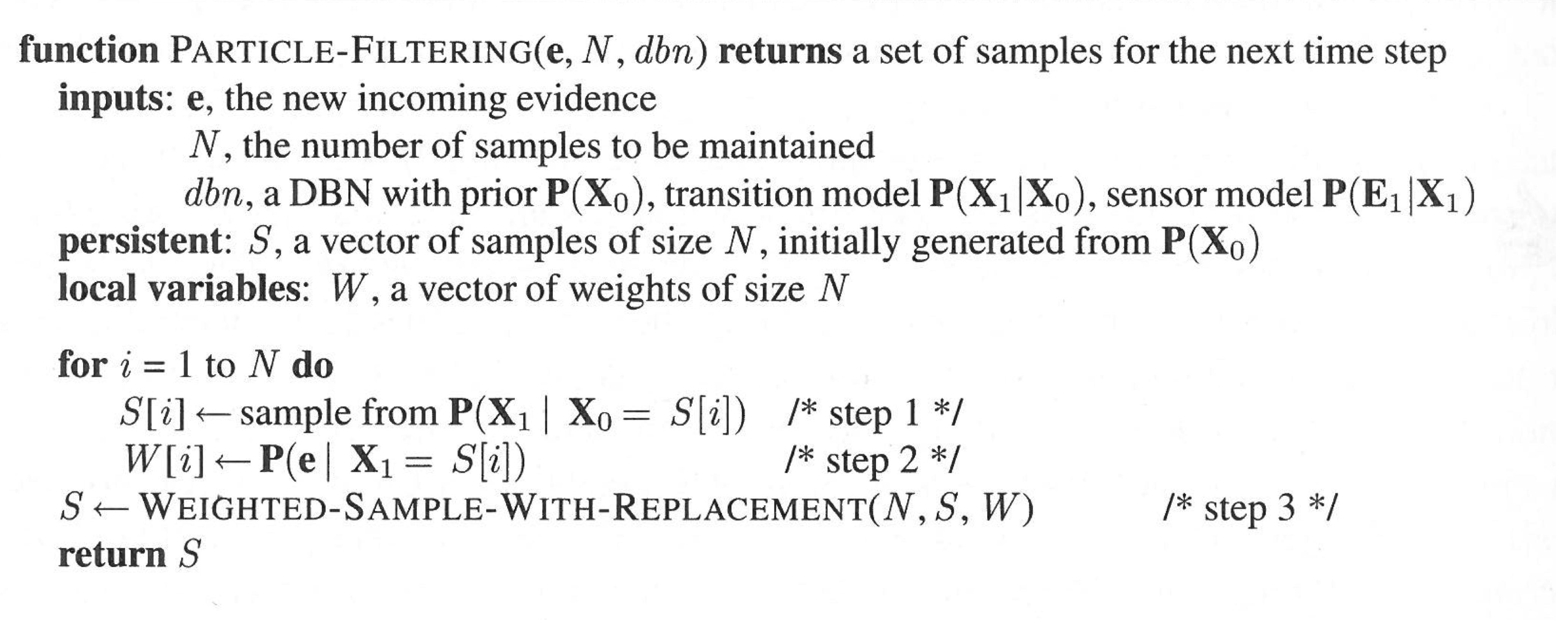
Particle Filtering

Slide 129
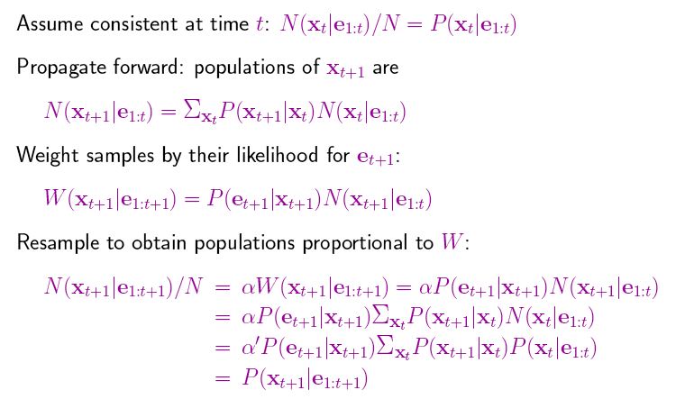
Particle Filtering (cntd.)

Slide 130
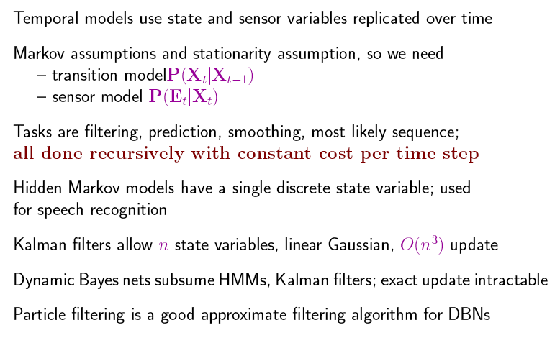
Summary

