Slide 1
Web-Mining Agents Cooperating Agents for Information Retrieval
Prof. Dr. Ralf Möller
Universität zu Lübeck
Institut für Informationssysteme
Tanya Braun (Übungen)

Slide 2
Organizational Issues: Assignments
Start: Wed, 19.10., 2-4pm, AM S 1 (thereafter IFIS 2032), Class also Thu 2-4pm, Seminar room 2/3 (Cook/Karp) or IFIS 2032
Lab: Fr. 2-4pm, Building 64, IFIS 2035 (3rd floor) (registration via Moodle right after this class)
Assignments provided via Moodle after class on Thu.
Submission of solutions by Wed 2pm, small kitchen IFIS (one week after provision of assignments)
Work on assignments can/should be done in groups of 2 (pls. indicate name&group on submitted solution sheets)
In lab classes on Friday, we discuss assignments from current week and understand solutions for assignments from previous week(s)

Slide 3
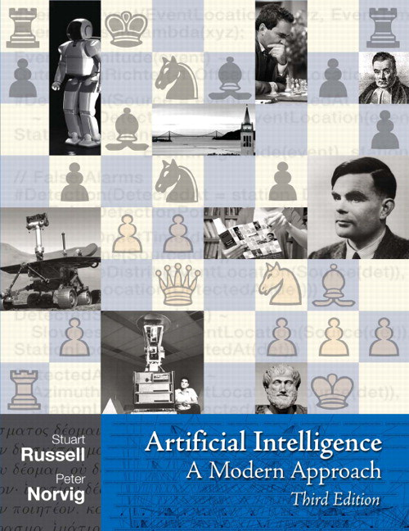
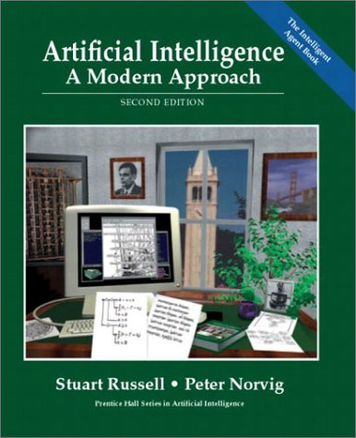
Literature
Chapters 2, 6, 13, 15- 17
http://aima.cs.berkeley.edu

Slide 4
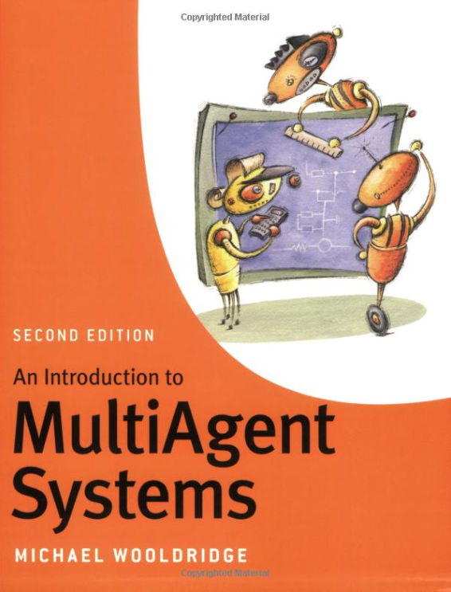
Literature

Slide 5
Literature

Slide 6
What is an Agent?
An agent is anything that can be viewed as perceiving its environment through sensors and acting upon that environment through actuators
Human agent: eyes, ears, and other organs for sensors; hands, legs, mouth, and other body parts for actuators
Robotic agent: cameras and infrared range finders for sensors; various motors for actuators

Slide 7
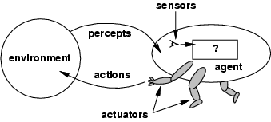
Agents and environments
The agent function maps from percept histories to actions:
[f: P* → A]
The agent program runs on the physical architecture to produce f
Agent = architecture + program

Slide 8
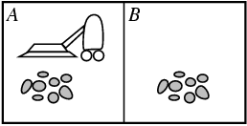
Vacuum-Cleaner World
Percepts: location and contents, e.g., [A,Dirty]
Actions: Left, Right, Suck, NoOp

Slide 9
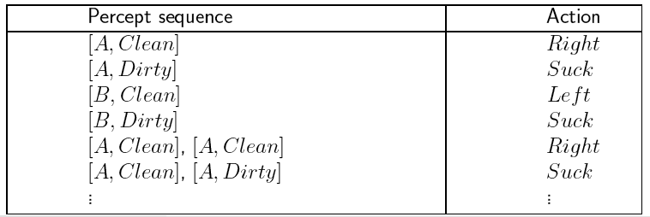
A Vacuum-Cleaner Agent

Slide 10
Capabilities
An agent is capable of flexible action in some environment
By flexible, we mean:
reactive
pro-active
social
10
Notes:
Xbiff?

Slide 11
Reactivity
If a program’s environment is guaranteed to be fixed, the program need never worry about its own success or failure – program just executes blindly
Example of fixed environment: compiler
The real world is not like that: things change, information is incomplete. Many (most?) interesting environments are dynamic
A reactive system is one that maintains an ongoing interaction with its environment, and responds to changes that occur in it (in time for the response to be useful)
11

Slide 12
Proactiveness
Reacting to an environment is easy (e.g., stimulus → response rules)
But we generally want agents to do things for us
Hence goal directed behavior
Pro-activeness = generating and attempting to achieve goals
Not driven solely by events
Taking the initiative
Recognizing opportunities

Slide 13
Balancing Reactive and Goal-Oriented Behavior
We want our agents to be reactive, responding to changing conditions in an appropriate (timely) fashion
We want our agents to systematically work towards long-term goals
These two considerations can be at odds with one another
Designing an agent that can balance the two remains an open research problem

Slide 14
Social Ability
The real world is a multi-agent environment: we cannot go around attempting to achieve goals without taking others into account
Some goals can only be achieved with the cooperation of others
Social ability in agents is the ability to interact with other agents (and possibly humans) via some kind of agent-communication language with the goal to let other agents to make commitments

Slide 15
Rational Agents
An agent should strive to "do the right thing", based on what it can perceive and the actions it can perform. The right action is the one that will cause the agent to be most successful
Success to be measured w.r.t. an agent-local perspective
Performance measure: An objective criterion for success of an agent's behavior
E.g., performance measure of a vacuum-cleaner agent could be amount of dirt cleaned up, amount of time taken, amount of electricity consumed, amount of noise generated, etc.

Slide 16
Rational Agents
Rational Agent: For each possible percept sequence, a rational agent
should select an action
that is expected to maximize its local performance measure,
given the evidence provided by the percept sequence and
whatever built-in knowledge the agent has.
Rational = Intelligent

Slide 17
Autonomous Agents
Rationality is distinct from omniscience (all-knowing with infinite knowledge)
Agents can perform actions in order to modify future percepts so as to obtain useful information (information gathering, exploration)
An agent is autonomous if its behavior is determined by its own experience (with ability to learn and adapt)
Notes:
Omnisience= allwissend; crossing a street because of an interesting shop (no traffic) meanwhile an small stone (Gewicht) comes down from an balloon (see what the name is) and flattens me. Was it not rational to cross the street?

Slide 18
Other Properties
Mobility: the ability of an agent to move around an electronic network, real environment
(Veracity: an agent will not knowingly communicate false information)
Benevolence: agents do not have conflicting goals, and every agent will therefore always try to do what is asked
Learning/adaption: agents improve performance over time

Slide 19
Agents and Objects
Are agents just objects by another name?
Object:
Encapsulates some state
Interacts synchronously with other objects
communicates via message passing
call methods / generic functions
Has methods, corresponding to operations that may be performed on this state

Slide 20
Agents and Objects
Main differences:
Agents are autonomous: agents embody stronger notion of autonomy than objects, and in particular, they decide for themselves whether or not to perform an action on request from another agent
Agents are capable of flexible (reactive, pro-active, social) behavior, and the standard object model has nothing to say about such types of behavior
Agents are inherently multi-threaded, in that each agent is assumed to have at least one thread of active control

Slide 21
Main Features
Performance measure
Environment
Actuators
Sensors
Must first specify the setting for
intelligent agent design

Slide 22
PEAS
Consider, e.g., the task of designing an automated taxi driver:
Performance measure: Safe, fast, legal, comfortable trip, maximize profits
Environment: Roads, other traffic, pedestrians, customers
Actuators: Steering wheel, accelerator, brake, signal, horn
Sensors: Cameras, sonar, speedometer, GPS, odometer, engine sensors

Slide 23
PEAS
Agent: Medical diagnosis system
Performance measure: Healthy patient, minimize costs, avoid lawsuits
Environment: Patient, hospital, staff
Actuators: Screen display (questions, tests, diagnoses, treatments, referrals)
Sensors: Keyboard (entry of symptoms, findings, patient's answers)

Slide 24
PEAS
Agent: Part-picking robot
Performance measure: Percentage of parts in correct bins relative to number of parts on the ground
Environment: Area with parts, bins
Actuators: Jointed arm and hand
Sensors: Camera, joint angle sensors

Slide 25
Environment Types
Fully observable (vs. partially observable)
Agent's sensors give it access to complete state of the environment at each point in time.
Deterministic (vs. stochastic):
Next state of the environment completely determined by the current state and executed action
If the environment is deterministic except for the actions of other agents, then the environment is strategic
Episodic (vs. sequential):
Agent's experience divided into atomic "episodes"
Episode consists of the agent perceiving and then performing a single action
Choice of action in each episode depends only on the episode itself.

Slide 26
Environment Types
Static (vs. dynamic):
Environment unchanged while agent is deliberating
Environment is semidynamic if the environment itself does not change with the passage of time but the agent's performance score does
Discrete (vs. continuous):
There is a limited number of distinct, clearly defined percepts and actions
Single agent (vs. multiagent):
An agent operating by itself in an environment

Slide 27
Environment Types
Chess with Chess without Taxi driving
a clock a clock
Fully observable Yes Yes No
Deterministic Strategic Strategic No
Episodic No No No
Static Semi Yes No
Discrete Yes Yes No
Single agent No No No

Slide 28
Environment Types
Chess with Chess without Taxi driving
a clock a clock
Fully observable Yes Yes No
Deterministic Strategic Strategic No
Episodic No No No
Static Semi Yes No
Discrete Yes Yes No
Single agent No No No

Slide 29
Environment Types
Chess with Chess without Taxi driving
a clock a clock
Fully observable Yes Yes No
Deterministic Strategic Strategic No
Episodic No No No
Static Semi Yes No
Discrete Yes Yes No
Single agent No No No

Slide 30
Environment Types
Chess with Chess without Taxi driving
a clock a clock
Fully observable Yes Yes No
Deterministic Strategic Strategic No
Episodic No No No
Static Semi Yes No
Discrete Yes Yes No
Single agent No No No
Environment type largely determines the agent design
Real world is (of course) partially observable, stochastic, sequential, dynamic, continuous, multi-agent

Slide 31
Agent Functions and Programs
An agent is completely specified by the agent function mapping percept sequences to actions
One agent function (or a small equivalence class) is rational
Aim: find a way to implement the rational agent function concisely

Slide 32
Table-Lookup Agent
Drawbacks:
Huge table
Take a long time to build the table
No autonomy
Even with learning, need a long time to learn the table entries

Slide 33
Agent Types
Four basic types in order of increasing generality:
Simple reflex agents
Model-based reflex agents
Goal-based agents
Utility-based agents

Slide 34
Simple Reflex Agents

Slide 35
Model-Based Reflex Agents

Slide 36
Goal-Based Agents

Slide 37
Utility-Based Agents

Slide 38
Learning Agents

