Slide 1
Web-Mining Agents
Cooperating Agents for Information Retrieval
Prof. Dr. Ralf Möller
Universität zu Lübeck
Institut für Informationssysteme
Tanya Braun (Übungen)

Slide 2
Recap
Agents
  Rationality (satisfy goals, maximize utility value)
  Autonomy
Agent design
  Let the goal/max utility be defined
  such that an agent carries out a task for its “creator”
  Example task: Information retrieval

Slide 3
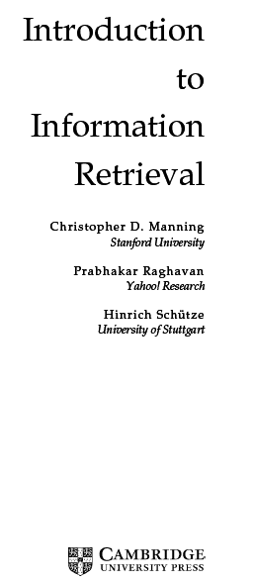
Information Retrieval
Slides taken
from presentation
material for
the following book:

Slide 4
This lecture
Parametric and field searches
  Zones in documents
Scoring documents: zone weighting
  Index support for scoring
Term weighting

Slide 5
Parametric search
Most documents have, in addition to text, some “meta-data” in fields e.g.,
  Language = French
  Format = pdf
  Subject = Physics etc.
  Date = Feb 2000
A parametric search interface allows the user to combine a full-text query with selections on these field values e.g.,
  language, date range, etc.
Fields
Values

Slide 6
Parametric/field search
In these examples, we select field values
  Values can be hierarchical, e.g.,
  Geography: Continent → Country → State → City
A paradigm for navigating through the document collection, e.g.,
  “Aerospace companies in Brazil” can be arrived at first by selecting Geography then Line of Business, or vice versa
  Filter docs and run text searches scoped to subset

Slide 7
Index support for parametric search
Must be able to support queries of the form
  Find pdf documents that contain “stanford university”
  A field selection (on doc format) and a phrase query
Field selection – use inverted index of
field values → docids
  Organized by field name

Slide 8
Parametric index support
Optional – provide richer search on field values – e.g., wildcards
  Find books whose Author field contains s*trup
Range search – find docs authored between September and December
  Inverted index doesn’t work (as well)
  Use techniques from database range search
  (e.g., B-trees as explained before)
Use query optimization heuristics as usual

Slide 9
Field retrieval
In some cases, must retrieve field values
  E.g., ISBN numbers of books by s*trup
Maintain “forward” index – for each doc, those field values that are “retrievable”
  Indexing control file specifies which fields are retrievable (and can be updated)
  Storing primary data here, not just an index
(as opposed to “inverted”)

Slide 10
Zones
A zone is an identified region within a doc
  E.g., Title, Abstract, Bibliography
  Generally culled from marked-up input or document metadata (e.g., powerpoint)
Contents of a zone are free text
  Not a “finite” vocabulary
Indexes for each zone - allow queries like
  “sorting” in Title AND “smith” in Bibliography AND “recur*” in Body
Not queries like “all papers whose authors cite themselves”
Why?

Slide 11
So we have a database now?
Not really.
Databases do lots of things we don’t need
  Transactions
  Recovery (our index is not the system of record; if it breaks, simply reconstruct from the original source)
  Indeed, we never have to store text in a
  search engine – only indexes
We’re focusing on optimized indexes for text-oriented queries, not an SQL engine.

Slide 12
Scoring
Thus far, our queries have all been Boolean
  Docs either match or not
Good for expert users with precise understanding of their needs and the corpus
Applications can consume 1000’s of results
Not good for (the majority of) users with poor Boolean formulation of their needs
Most users don’t want to wade through 1000’s of
results – cf. use of web search engines

Slide 13
Scoring
We wish to return in order the documents most likely to be useful to the searcher
How can we rank order the docs in the corpus with respect to a query?
Assign a score – say in [0,1]
  for each doc on each query

Slide 14
Linear zone combinations
First generation of scoring methods: use a linear combination of Booleans:
  E.g., Score =
  0.6*<“sorting “in Title> + 0.3*<“sorting” in Abstract> + 0.05*<“sorting” in Body> + 0.05*<“sorting” in Boldface>
  Each expression such as <sorting in Title> takes on a value in {0,1}.
  Then the overall score is in [0,1].
For this example the scores can only take
on a finite set of values – what are they?

Slide 15
Linear zone combinations
In fact, the expressions between <> on the last slide could be any Boolean query
Who generates the Score expression (with weights such as 0.6 etc.)?
  In uncommon cases – the user, in the UI
  Most commonly, a query parser that takes the user’s Boolean query and runs it on the indexes for each zone

Slide 16
Exercise
On the query bill OR rights suppose that we retrieve the following docs from the various zone indexes:
Author
1
2
bill
Compute the score
for each doc based on the weightings 0.6,0.3,0.1
rights
Title
3
5
8
bill
rights
3
5
9
Body
1
2
5
9
bill
rights
3
5
8
9

Slide 17
General idea
We are given a weight vector whose components
sum up to 1.
  There is a weight for each zone/field.
Given a Boolean query, we assign a score to each doc by adding up the weighted contributions of the zones/fields
Typically – users want to see the K highest-scoring docs.

Slide 18
Index support for zone combinations
In the simplest version we have a separate inverted index for each zone
Variant: have a single index with a separate dictionary entry for each term and zone
E.g.,
bill.author
1
2
bill.title
3
5
8
bill.body
1
2
5
9
Of course, compress zone names
like author/title/body.

Slide 19
Zone combinations index
The above scheme is still wasteful: each term is potentially replicated for each zone
In a slightly better scheme, we encode the zone in the postings:
At query time, accumulate contributions to the total score of a document from the various postings, e.g.,
bill
1.author, 1.body
2.author, 2.body
3.title
As before, the zone names get compressed.

Slide 20
Score accumulation
0.7
1
2
3
5
0.7
0.4
0.4
As we walk the postings for the query bill OR rights, we accumulate scores for each doc in a linear merge as before.
Note: we get both bill and rights in the Title field of doc 3, but score it no higher.
Should we give more weight to more hits?
bill
1.author, 1.body
2.author, 2.body
3.title
rights
3.title, 3.body
5.title, 5.body

Slide 21
Where do these weights come from?
Machine learned relevance
Given
  A test corpus
  A suite of test queries
  A set of relevance judgments
Learn a set of weights such that relevance judgments matched
Can be formulated as ordinal regression
(see lecture part on data mining/machine learning)

Slide 22
Full text queries
We just scored the Boolean query bill OR rights
Most users more likely to type bill rights or bill of rights
  How do we interpret these full text queries?
  No Boolean connectives
  Of several query terms some may be missing in a doc
  Only some query terms may occur in the title, etc.

Slide 23
Full text queries
To use zone combinations for free text queries, we need
  A way of assigning a score to a pair <free text query, zone>
  Zero query terms in the zone should mean a zero score
  More query terms in the zone should mean a higher score
  Scores don’t have to be Boolean
Will look at some alternatives now

Slide 24
Incidence matrices
Bag-of-words model
Document (or a zone in it) is binary vector X in {0,1}^{v}
Query is a vector Y
Score: Overlap measure:

Slide 25
Example
On the query ides of march, Shakespeare’s Julius Caesar has a score of 3
All other Shakespeare plays have a score of 2 (because they contain march) or 1
Thus in a rank order, Julius Caesar would come out tops

Slide 26
Overlap matching
What’s wrong with the overlap measure?
It doesn’t consider:
  Term frequency in document
  Term scarcity in collection
  (document mention frequency)
    of is more common than ides or march
  Length of documents
    (and queries: score not normalized)

Slide 27
Overlap matching
One can normalize in various ways:
  Jaccard coefficient:
  Cosine measure:
What documents would score best using Jaccard against a typical query?
Does the cosine measure fix this problem?

Slide 28
Scoring: density-based
Thus far: position and overlap of terms in a doc – title, author etc.
Obvious next idea: If a document talks more about a topic, then it is a better match
This applies even when we only have a single query term.
Document is relevant if it has a lot of the terms
This leads to the idea of term weighting.

Slide 29
Term-document count matrices
Consider the number of occurrences of a term in a document:
  Bag of words model
  Document is a vector in ℕ^{v}: a column below

Slide 30
Bag of words view of a doc
Thus the doc
  John is quicker than Mary.
is indistinguishable from the doc
  Mary is quicker than John.
Which of the indexes discussed
so far distinguish these two docs?

Slide 31
Counts vs. frequencies
Consider again the ides of march query.
  Julius Caesar has 5 occurrences of ides
  No other play has ides
  march occurs in over a dozen
  All the plays contain of
By this scoring measure, the top-scoring play is likely to be the one with the most ofs

Slide 32
Digression: terminology
WARNING: In a lot of IR literature, “frequency” is used to mean “count”
  Thus term frequency in IR literature is used to mean number of occurrences in a doc
  Not divided by document length (which would actually make it a frequency)
We will conform to this misnomer

Slide 33
Term frequency tf
Long docs are favored because they’re more likely to contain query terms
Can fix this to some extent by normalizing for document length
But is raw tf the right measure?

Slide 34
Weighting term frequency: tf
What is the relative importance of
  0 vs. 1 occurrence of a term in a doc
  1 vs. 2 occurrences
  2 vs. 3 occurrences …
Unclear: While it seems that more is better,
a lot isn’t proportionally better than a few
  Can just use raw tf
  Another option commonly used in practice:
Notes:
(The Kandy-Kolored Tangerine-Flake Streamline Baby)
You’d have to let me know!

Slide 35
Score computation
Score for a query q = sum over terms t in q:
[Note: 0 if no query terms in document]
This score can be zone-combined
Can use wf instead of tf in the above
Still doesn’t consider term scarcity in collection
(ides is rarer than of)

Slide 36
Weighting should depend on the term overall
Which of these tells you more about a doc?
  10 occurrences of hernia?
  10 occurrences of the?
Would like to attenuate the weight of a common term
  But what is “common”?
Suggest looking at collection frequency (cf )
  The total number of occurrences of the term in the entire collection of documents

Slide 37
Document frequency
But document frequency (df ) may be better:
df = number of docs in the corpus containing the term
Word cf df
ferrari 10422 17
insurance 10440 3997
Document/collection frequency weighting is only possible in known (static) collection.
So how do we make use of df ?

Slide 38
tf x idf term weights
tf x idf measure combines:
  term frequency (tf )
    or wf, some measure of term density in a doc
  inverse document frequency (idf )
    measure of informativeness of a term: its rarity across the whole corpus
    could just be raw count of number of documents the term occurs in (idf_{i} = n/df_{i})
    but by far the most commonly used version is:
See Kishore Papineni, NAACL 2, 2002 for theoretical justification
K. Spärck Jones. A Statistical Interpretation of Term Specificity and Its Application in Retrieval. Journal of Documentation 28: 11–21, 1972
Notes:
Papineni shows the above usually used scaled IDF is optimal for document self retrieval.

Slide 39
Summary: tf x idf (or tf.idf)
Assign a tf.idf weight to each term i in each document d
Increases with the number of occurrences within a doc
Increases with the rarity of the term across the whole corpus
What is the wt
of a term that
occurs in all
of the docs?

Slide 40
Real-valued term-document matrices
Function (scaling) of count of a word in a document:
  Bag of words model
  Each is a vector in ℝ^{v}
  Here log-scaled tf.idf
Note can be >1!

Slide 41
Documents as vectors
Each doc d can now be viewed as a vector of wf×idf values, one component for each term
So we have a vector space
  terms are axes
  docs live in this space
  even with stemming, may have 20,000+ dimensions
(The corpus of documents gives us a matrix, which we could also view as a vector space in which words live – transposable data)

Slide 42
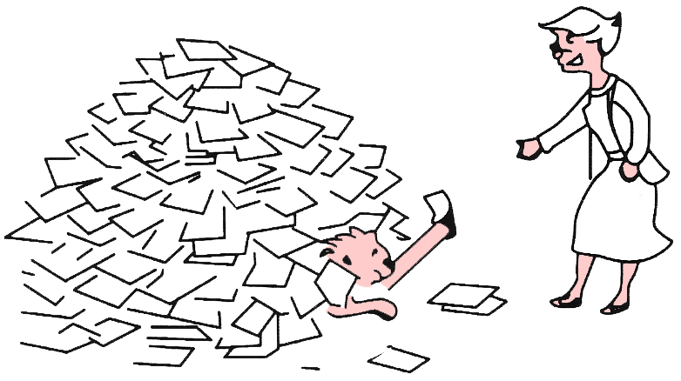
Web-Mining Agents

Slide 43
Recap: tf x idf (or tf.idf)
Assign a tf.idf weight to each term i in each document d
Instead of tf, sometimes wf is used:

Slide 44
Documents as vectors
At the end of the last lecture we said:
Each doc d can now be viewed as a vector of tf*idf values, one component for each term
So we have a vector space
  terms are axes
  docs live in this space
  even with stemming, may have 50,000+ dimensions
First application: Query-by-example
  Given a doc d, find others “like” it.
Now that d is a vector, find vectors (docs) “near” it.

Slide 45
Intuition
t₃
d₂
d₃
d₁
θ
φ
t₁
d₅
t₂
d₄
Postulate: Documents that are “close together”
in the vector space talk about the same things.
45

Slide 46
Desiderata for proximity/distance
If d₁ is near d₂, then d₂ is near d₁.
If d₁ near d₂, and d₂ near d₃, then d₁ is not far from d₃.
No doc is closer to d than d itself.
Triangle inequality

Slide 47
First cut
Idea: Distance between d₁ and d₂ is the length of the vector d₁ – d₂.
  Euclidean distance:
Why is this not a great idea?
We still haven’t dealt with the issue of length normalization
  Short documents would be more similar to each other by virtue of length, not topic
However, we can implicitly normalize by looking at angles instead

Slide 48
Cosine similarity
Distance between vectors d₁ and d₂ captured by the cosine of the angle x between them.
Note – this is similarity, not distance
  No triangle inequality for similarity.
t ₃
d ₂
d ₁
θ
t ₁
t ₂

Slide 49
Cosine similarity
A vector can be normalized (given a length of 1) by dividing each of its components by its length – here we use
the L₂ norm
This maps vectors onto the unit sphere:
Then,
Longer documents don’t get more weight

Slide 50
Cosine similarity
Cosine of angle between two vectors
The denominator involves the lengths of the vectors.
For normalized vectors, the cosine is simply the dot product:
Normalization

Slide 51
Queries in the vector space model
Central idea: the query as a vector:
We regard the query as short document
We return the documents ranked by the closeness of their vectors to the query, also represented as a vector.
Note that d_{q} is very sparse!

Slide 52
What’s the point of using vector spaces?
A well-formed algebraic space for retrieval
Key: A user’s query can be viewed as a (very) short document.
Query becomes a vector in the same space as the docs.
Can measure each doc’s proximity to it.
Natural measure of scores/ranking – no longer Boolean.
  Queries are expressed as bags of words
  Clean metaphor for similar-document queries
Not a good combination with Boolean, wild-card, positional query operators
But …

Slide 53
Efficient cosine ranking
Find the k docs in the corpus “nearest” to the query ⇒ Compute k best query-doc cosines
  Nearest neighbor problem for a query vector
  Multidimensional Index-Structures (see Non-Standard DBs lecture)
    For a “reasonable” number of dimensions (say 10-100)
    Otherwise space almost empty (curse of dimensionality)
  What about zoning?
    Compute k best solutions
    with different zone-specific vectors for each doc
    Can we do this without testing all combinations w.r.t. all zones?
    Fagin’s algorithm (see Non-Standard Databases lecture)
Ronald Fagin. Combining Fuzzy Information from Multiple Systems. PODS-96, 216-226., 1996
Ronald Fagin: Fuzzy Queries in Multimedia Database Systems. Proc. PODS-98, 1-10, 1998

Slide 54
Dimensionality reduction
What if we could take our vectors and “pack” them into fewer dimensions (say 50,000→100) while preserving distances?
Two methods:
  Random projection.
  “Latent semantic indexing”.

Slide 55
Random projection onto k<<m axes
Choose a random direction x₁ in the vector space.
For i = 2 to k,
  Choose a random direction x_{i} that is orthogonal to x₁, x₂, … x_{i–1}.
Project each document vector into the subspace spanned by {x₁, x₂, …, x_{k}}.

Slide 56
E.g., from 3 to 2 dimensions
t ₃
d₂
x₂
x₂
d₂
d₁
d₁
t ₁
x₁
x₁
t ₂
x₁ is a random direction in (t₁,t₂,t₃) space.
x₂ is chosen randomly but orthogonal to x₁.
Dot product of x₁ and x₂ is zero.
56

Slide 57
Guarantee
With high probability, relative distances are (approximately) preserved by projection
But: expensive computations

Slide 58
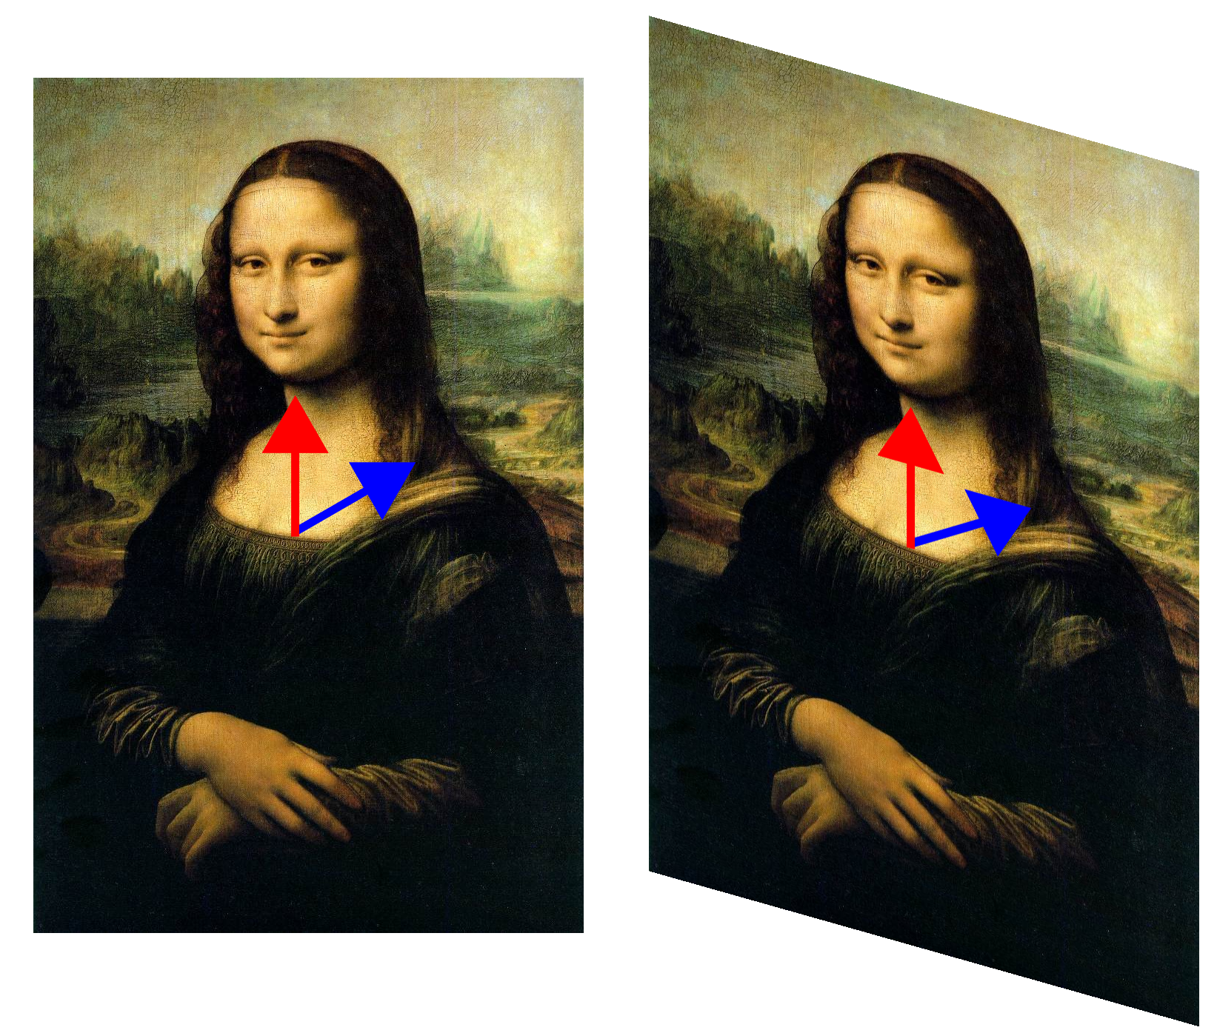

Mapping Data
Red arrow
not changed in sheer mapping
Eigenvector
[Wikipedia]

Slide 59
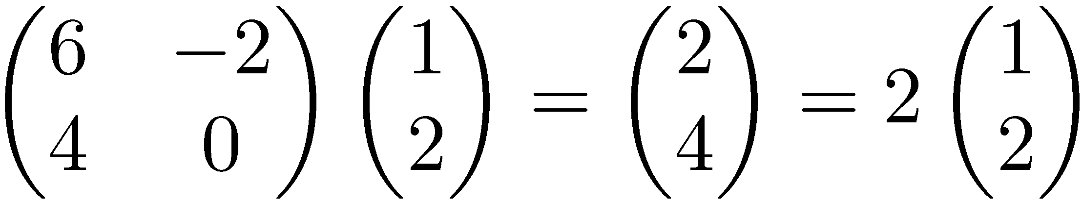
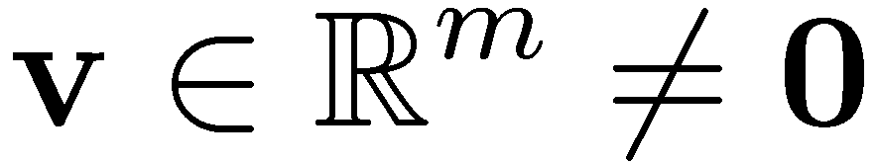

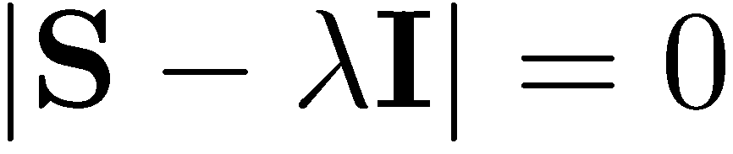
Eigenvalues & Eigenvectors
Eigenvectors (for a square m×m matrix S)
How many eigenvalues are there at most?
Example
(right) eigenvector
eigenvalue
only has a non-zero solution if
This is a m-th order equation in λ which can have at most m distinct solutions (roots of the characteristic polynomial) – can be complex even though S is real.

Slide 60
Singular Value Decomposition
For an m×n matrix A of rank r there exists a factorization
(Singular Value Decomposition = SVD) as follows:
m×m
m×n
V is n×n
The columns of U are orthogonal eigenvectors of AA^{T}.
The columns of V are orthogonal eigenvectors of A^{T}A.
Eigenvalues λ₁ … λ_{r} of AA^{T} are the eigenvalues of A^{T}A.
Singular values.

Slide 61
SVD example
Let
Thus m=3, n=2. Its SVD is
As opposed to the presentation in the example,
typically, the singular values arranged in decreasing order.

Slide 62

Low-rank Approximation
SVD can be used to compute optimal low-rank approximations for a Matrix A of rank r
Approximation problem: Find A_{k} of rank k such that
A_{k} and X are both m×n matrices
Typically, want k << r
Frobenius norm

Slide 63
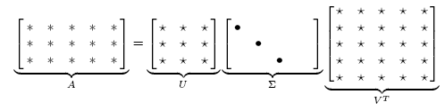
Low-rank Approximation
Solution via SVD
set smallest r-k
singular values to zero
k

Slide 64
SVD Low-rank approximation
A term-doc matrix A may have m=50000, n=10 million (and rank close to 50000)
We can construct an approximation A₁₀₀ with rank 100.
  Of all rank 100 matrices, it would have the lowest Frobenius error.
Great … but why would we??
Answer: Latent Semantic Indexing
C. Eckart, G. Young, The approximation of a matrix by another of lower rank. Psychometrika, 1, 211-218, 1936

Slide 65
What it is
From term-doc matrix A, we compute the approximation A_{k.}
There is a row for each term and a column for each doc in A_{k}
Thus docs live in a space of k<<r dimensions
  These dimensions are not the original axes
But why?

Slide 66
Vector Space Model: Pros
Automatic selection of index terms
Partial matching of queries and documents (dealing with the case where no document contains all search terms)
Ranking according to similarity score (dealing with large result sets)
Term weighting schemes (improves retrieval performance)
Geometric foundation

Slide 67
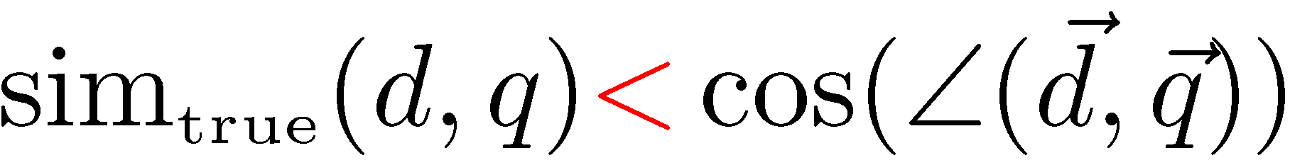
Problems with Lexical Semantics
Ambiguity and association in natural language
  Polysemy: Words often have a multitude of meanings and different types of usage (more severe in very heterogeneous collections).
  The vector space model is unable to discriminate between different meanings of the same word.

Slide 68
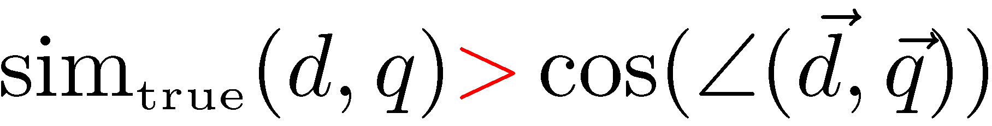
Problems with Lexical Semantics
  Synonymy: Different terms may have an identical or a similar meaning (weaker: words indicating the same topic).
  No associations between words are made in the vector space representation.

Slide 69
Polysemy and Context
Document similarity on single word level: polysemy and context
ring
jupiter
•••
space
voyager
meaning 1
…
planet
...
…
saturn
...
meaning 2
car
company
•••
dodge
ford
contribution to similarity, if used in 1st meaning, but not if in 2nd

Slide 70
Latent Semantic Indexing (LSI)
Perform a low-rank approximation of document-term matrix (typical rank 100-300)
General idea
  Map documents (and terms) to a low-dimensional representation.
  Design a mapping such that the low-dimensional space reflects semantic associations (latent semantic space).
  Compute document similarity based on the inner product in this latent semantic space

Slide 71
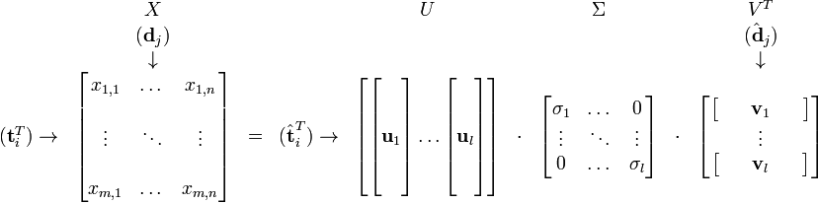
Goals of LSI
Similar terms map to similar locations in low dimensional space
Noise reduction by dimension reduction

Slide 72

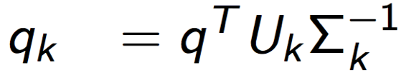
Performing the maps
Each row and column of A gets mapped into the k-dimensional LSI space, by the SVD
Claim – this is not only the mapping with the best (Frobenius error) approximation to A, but in fact improves retrieval
Terms in the approximation do not have to be related to comprehensible concepts
A query q need to be mapped into this space, by
  Query NOT a sparse vector.

Slide 73
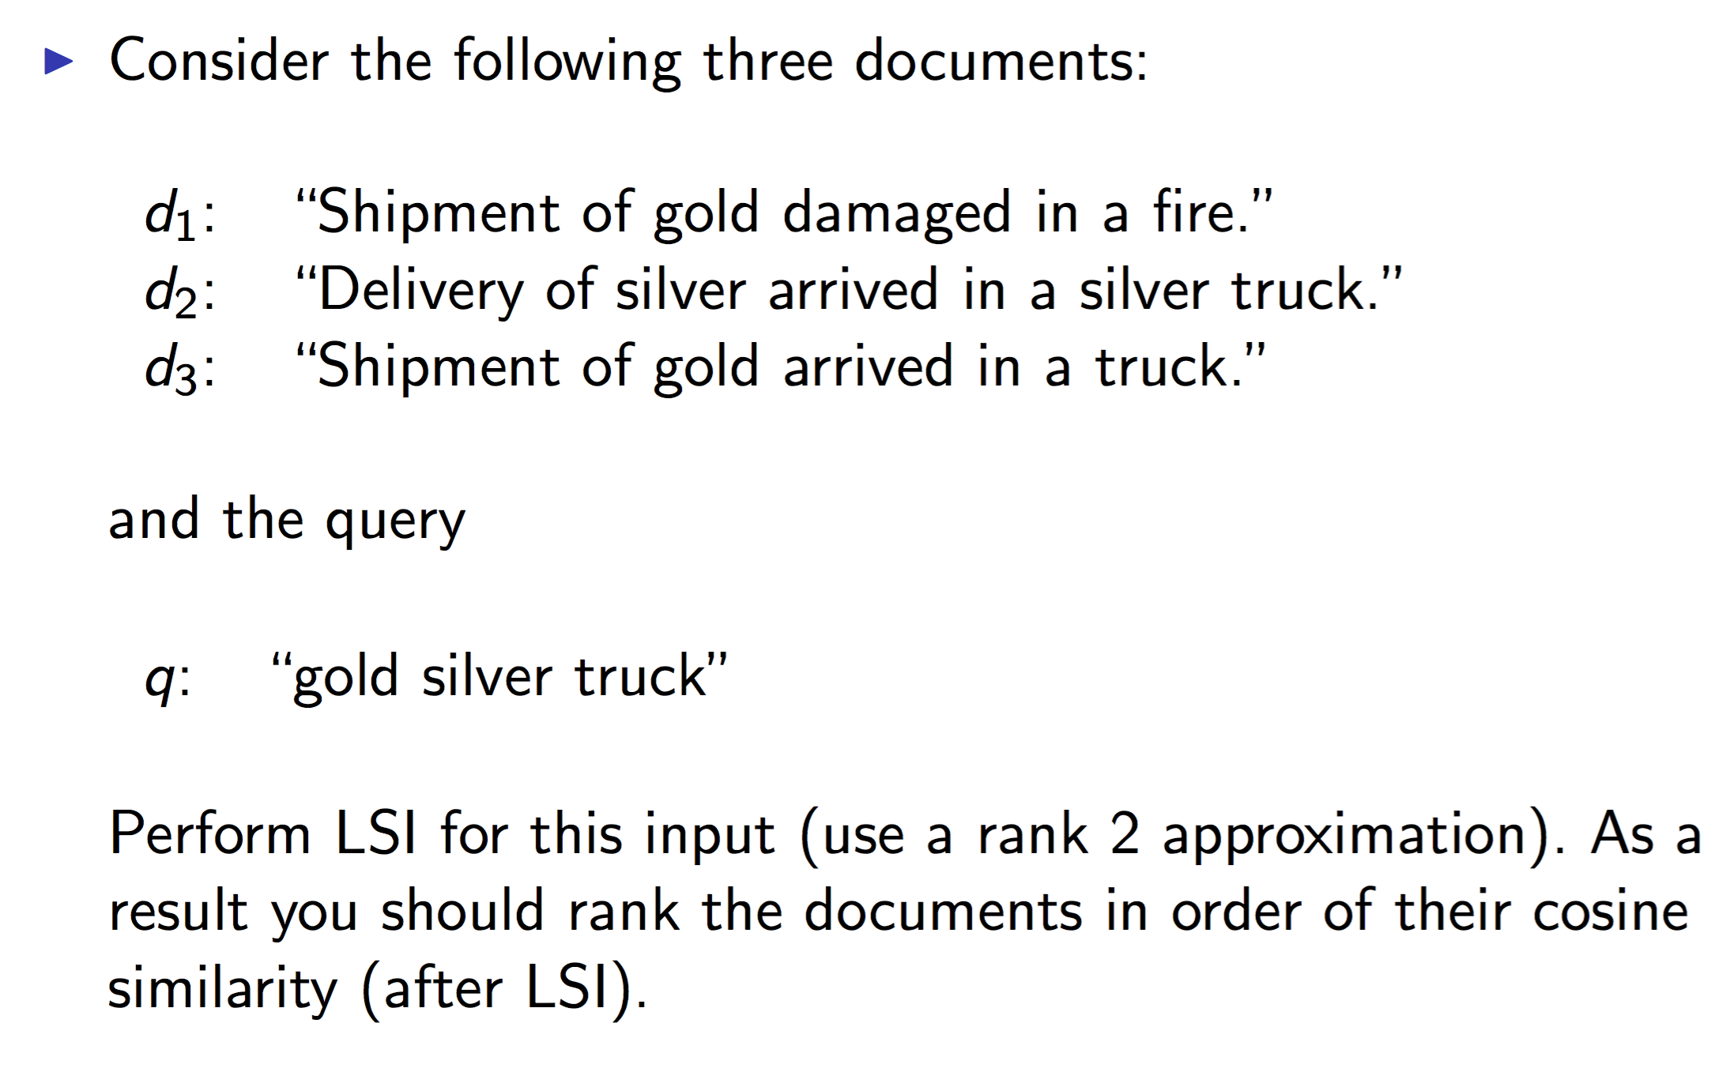
LSI: An example

Slide 74
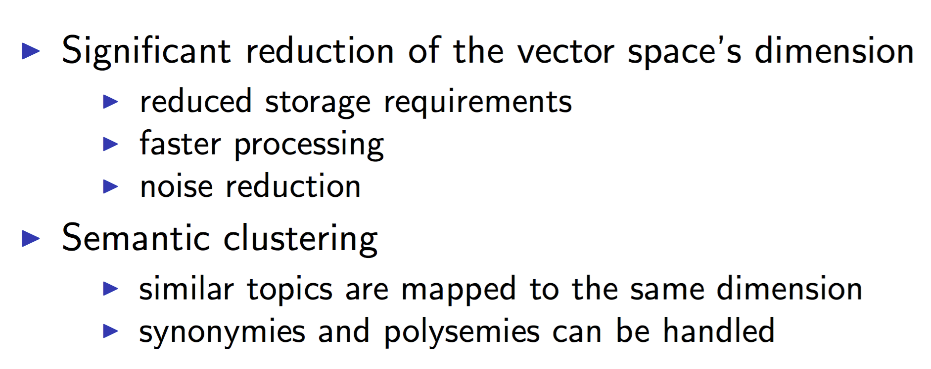
LSI: Goal

Slide 75
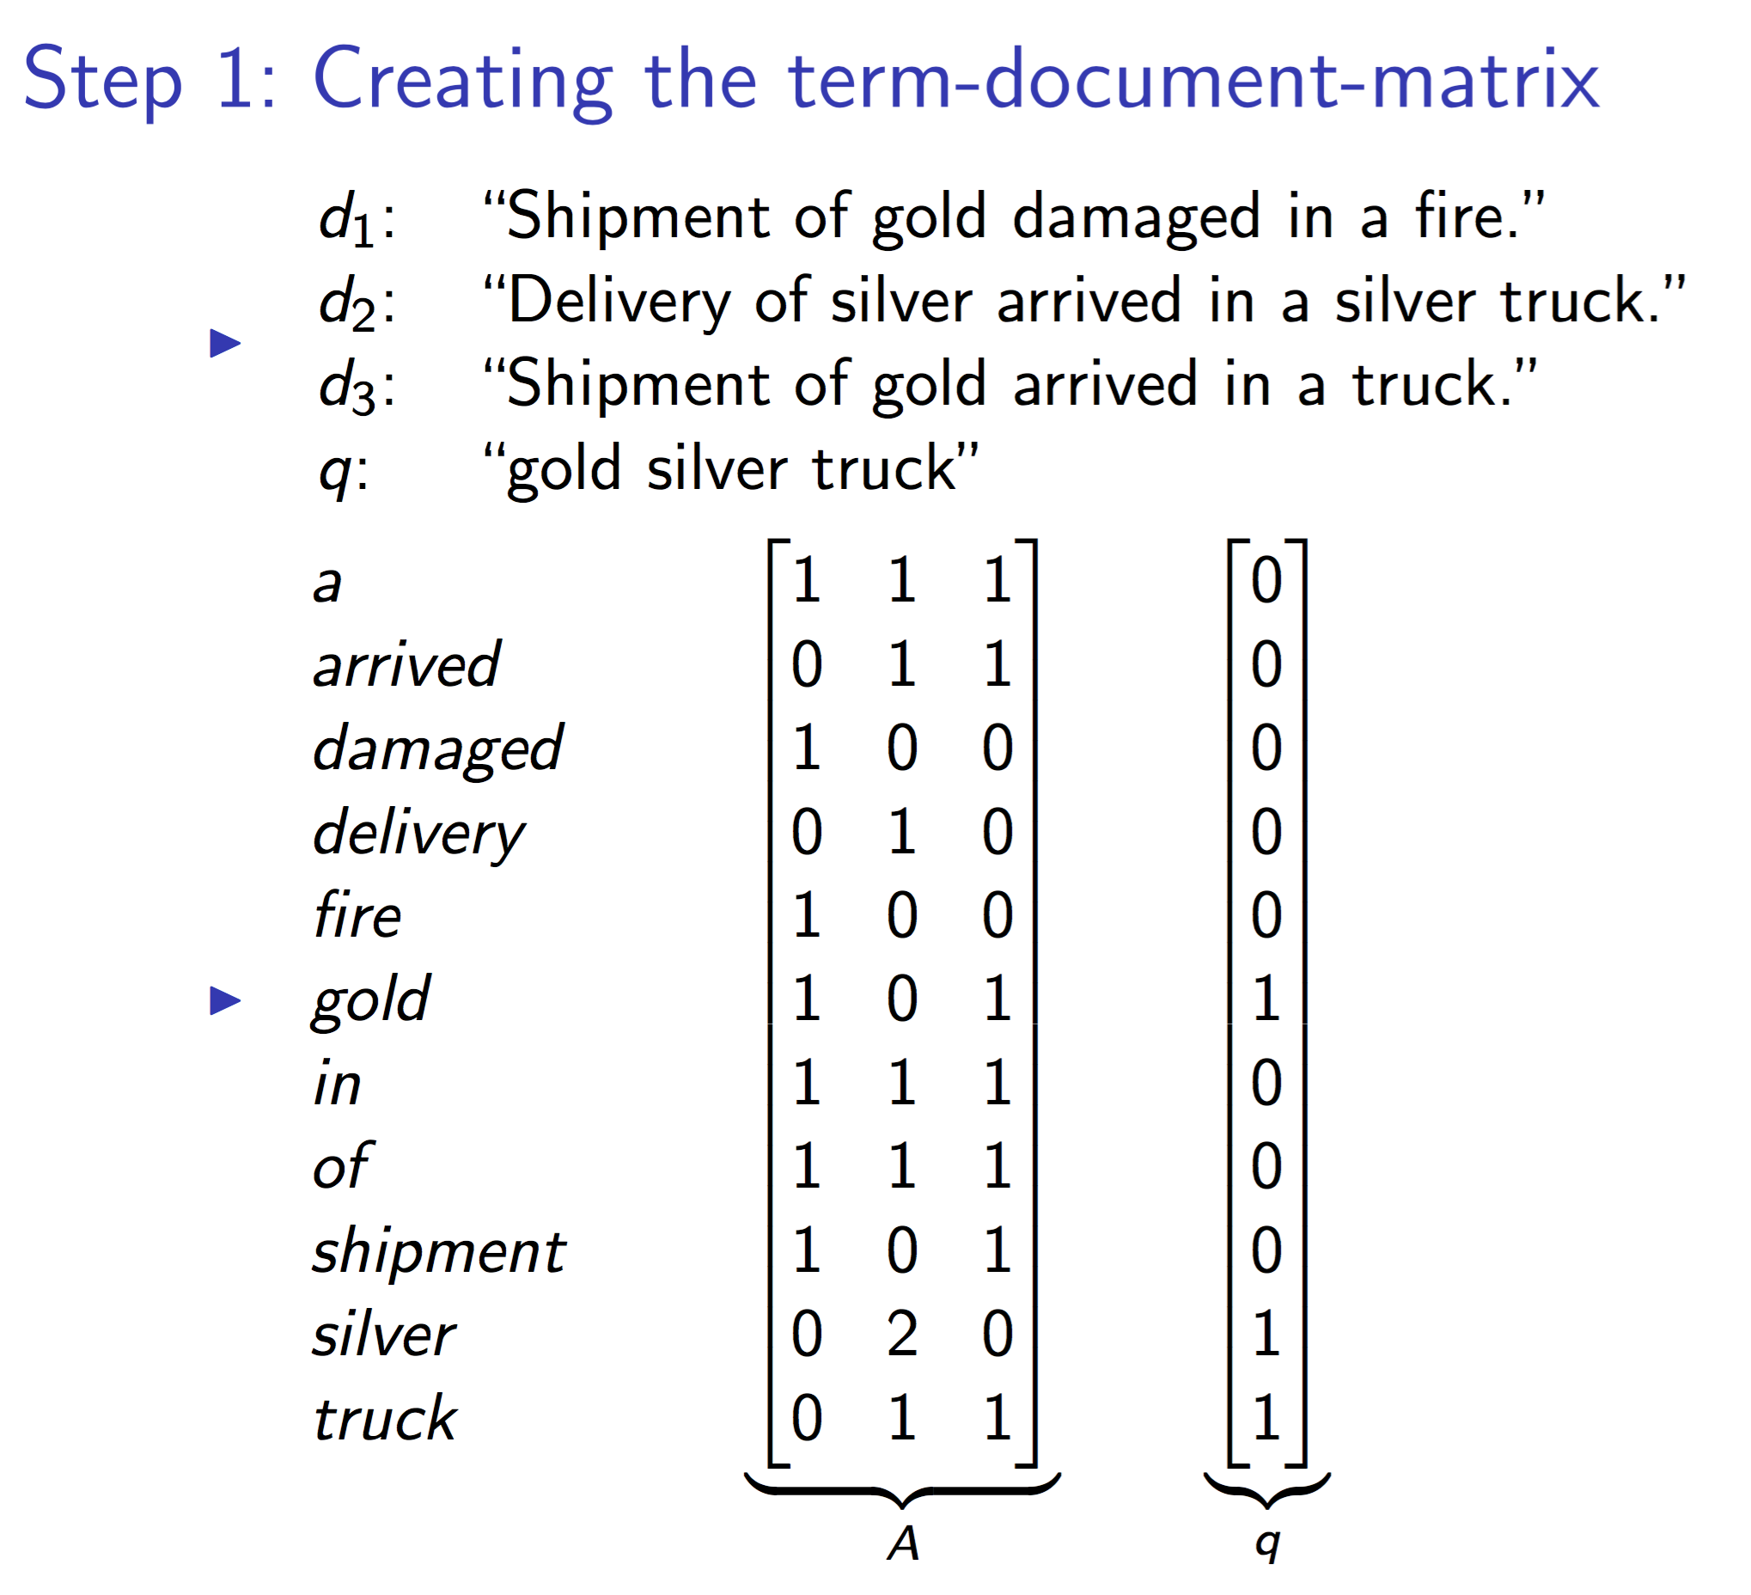

Slide 76
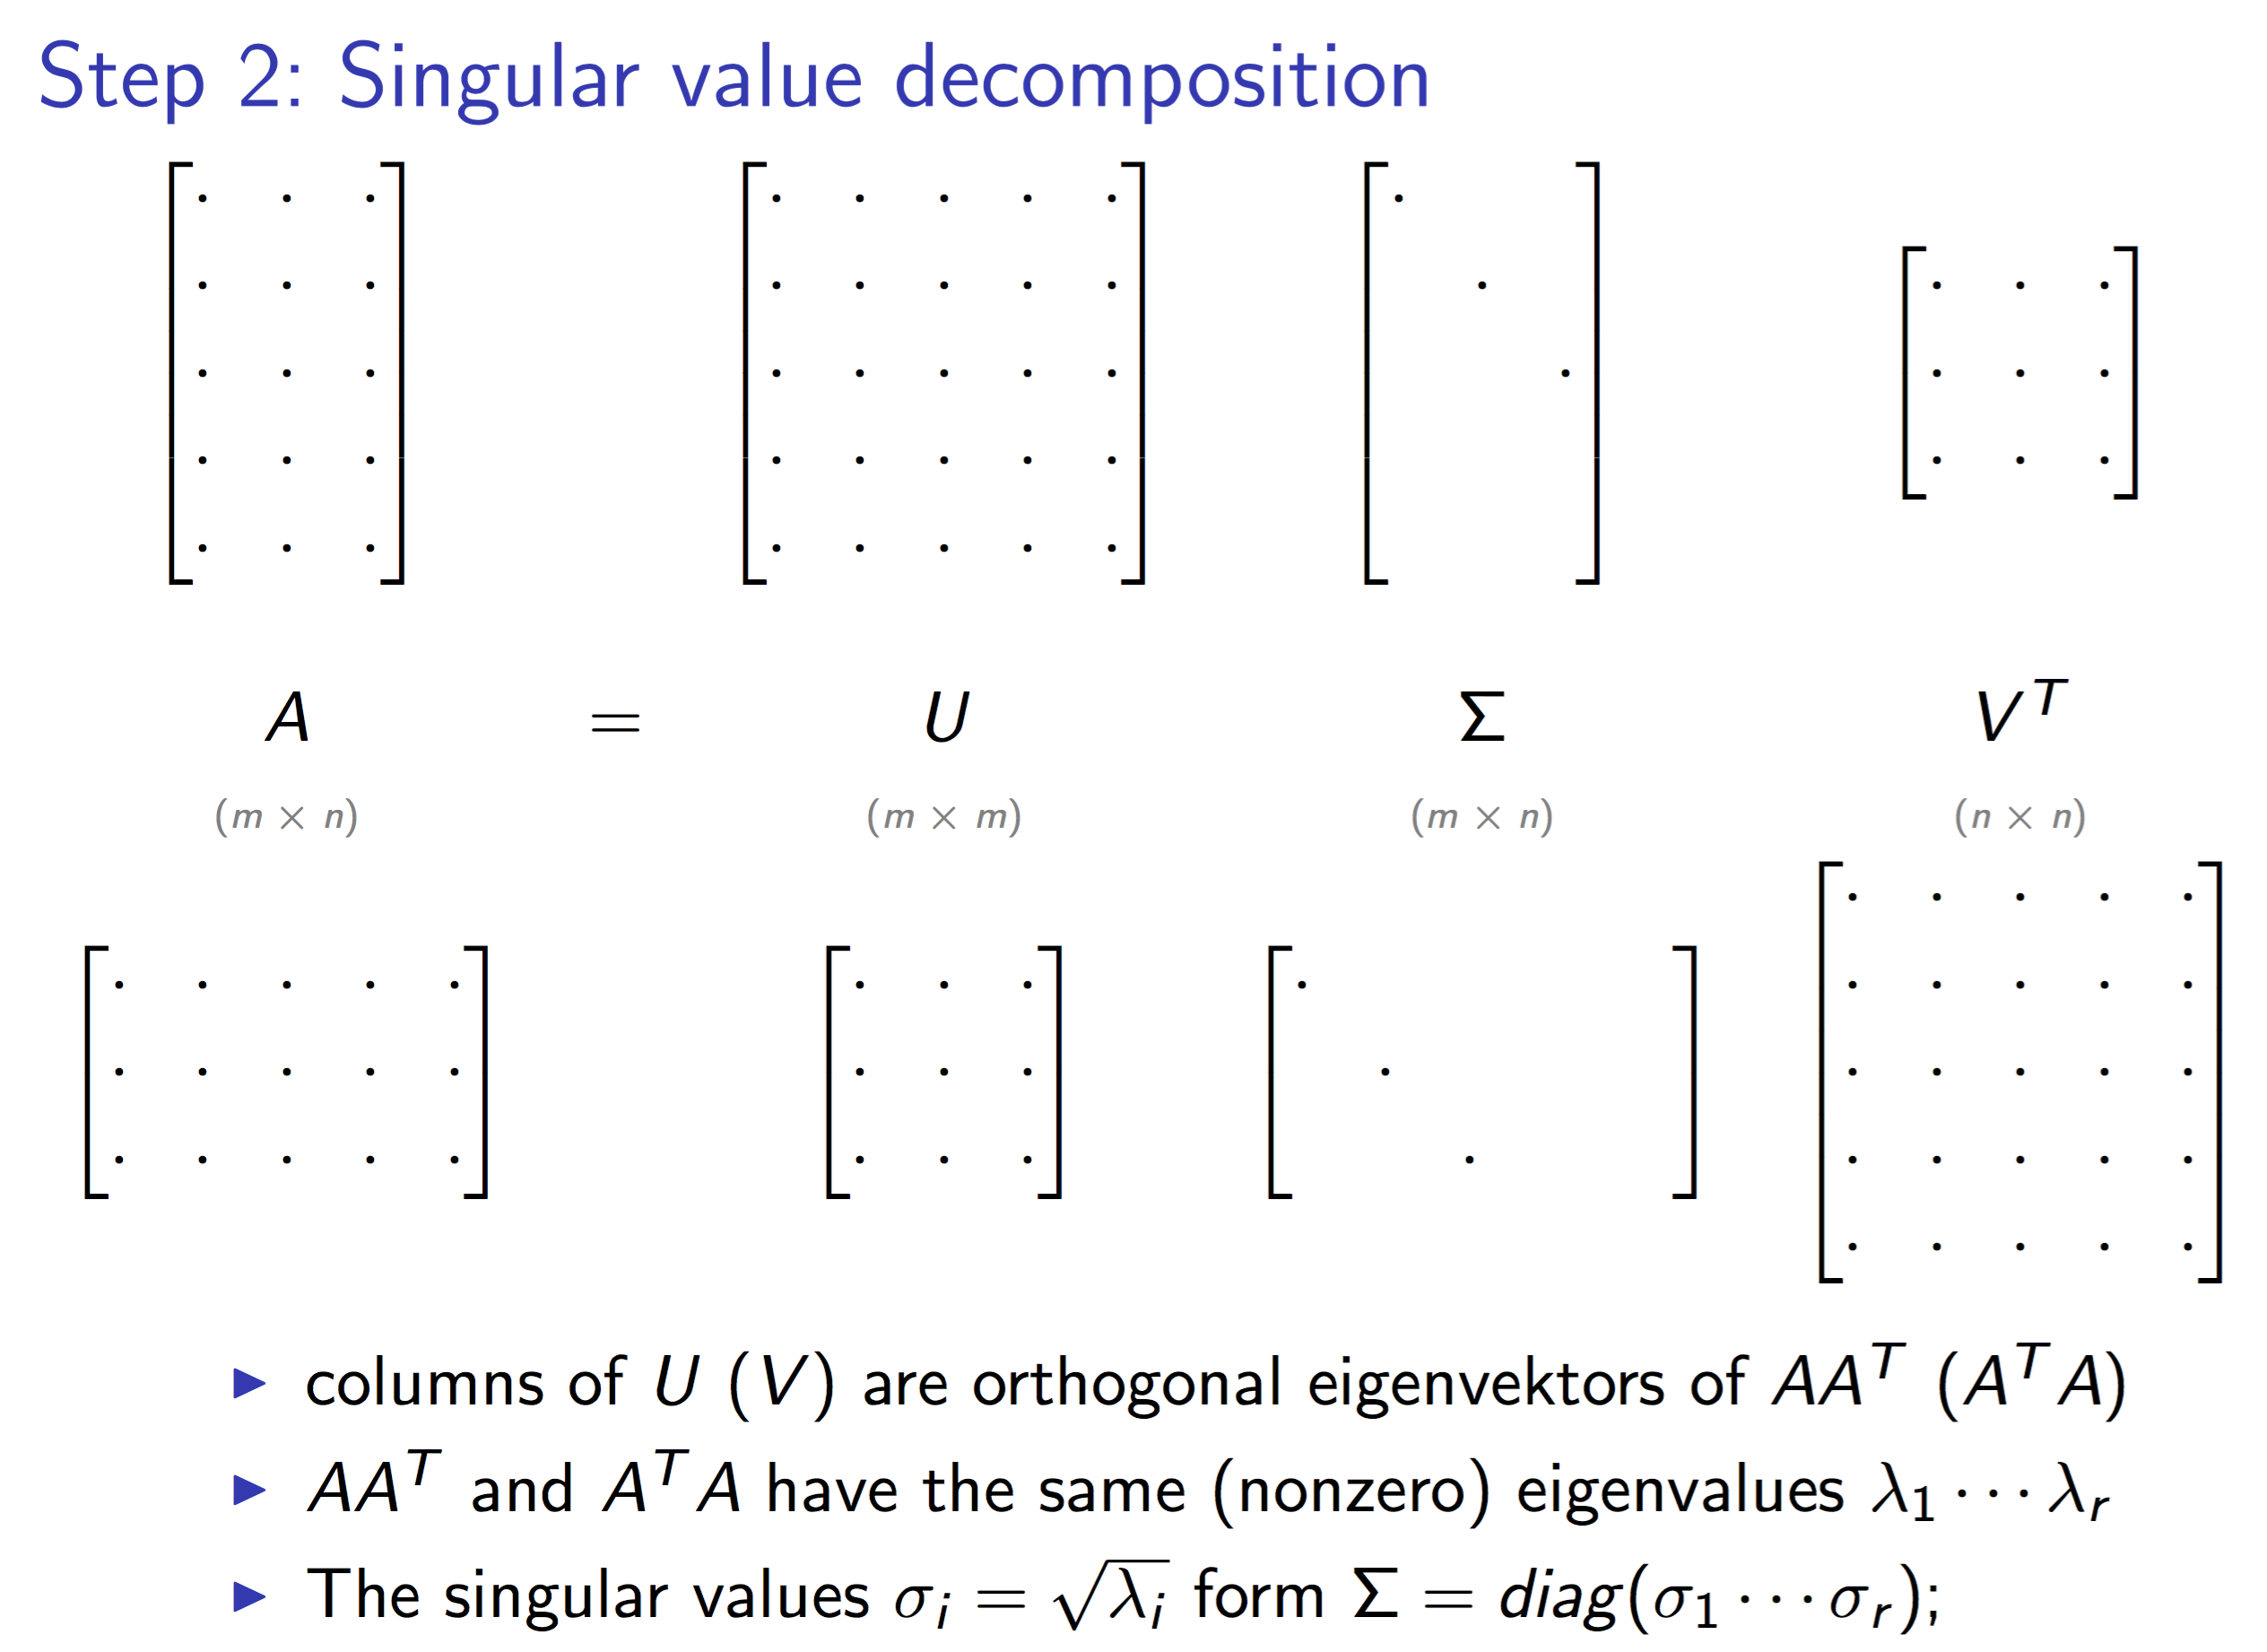

Slide 77
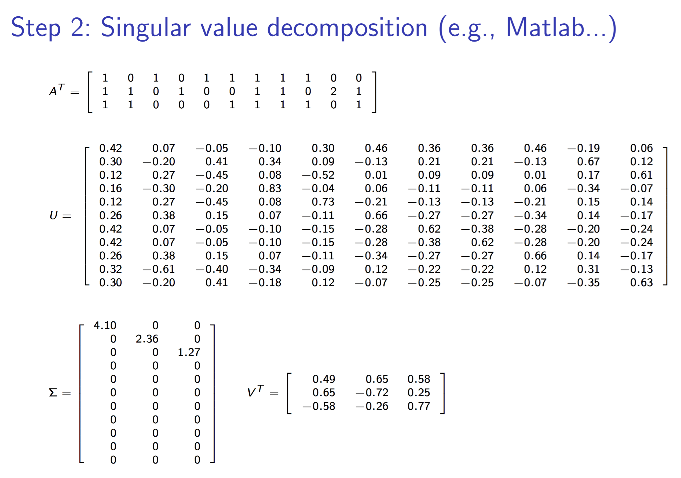

Slide 78
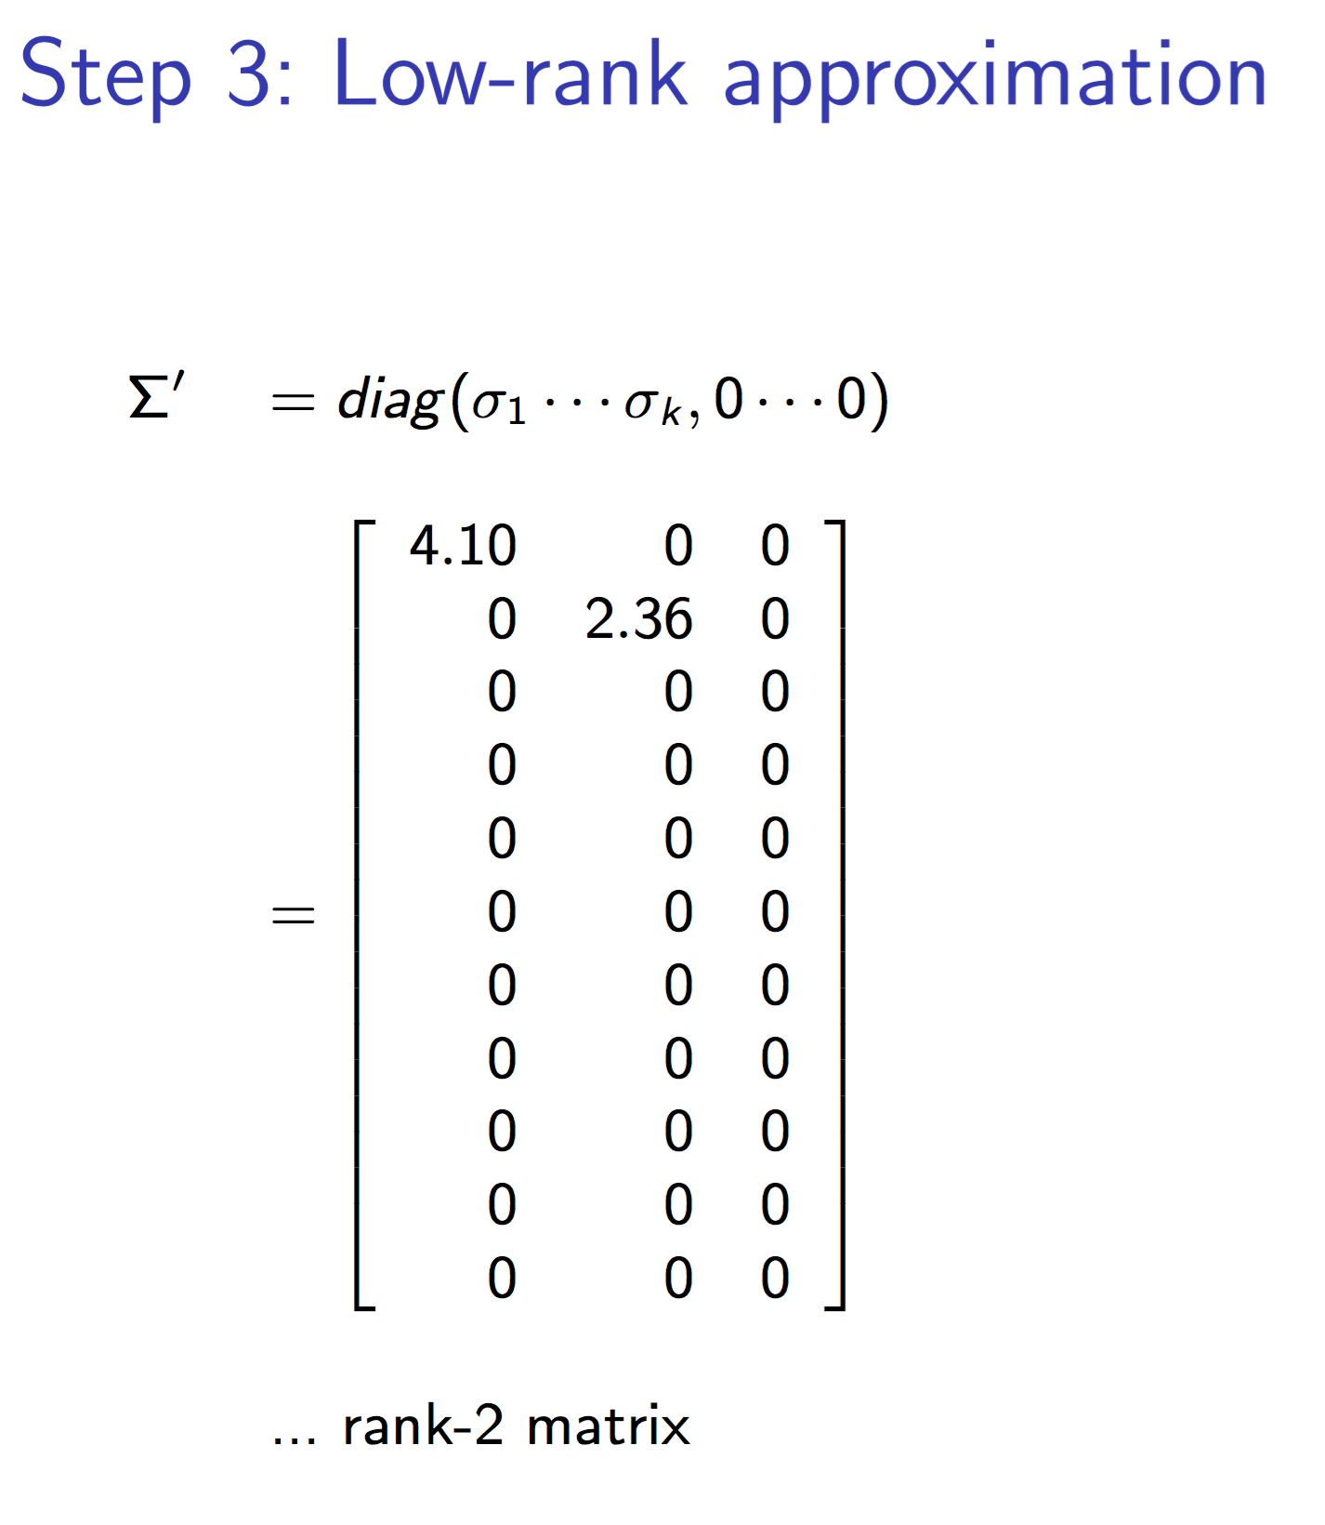

Slide 79
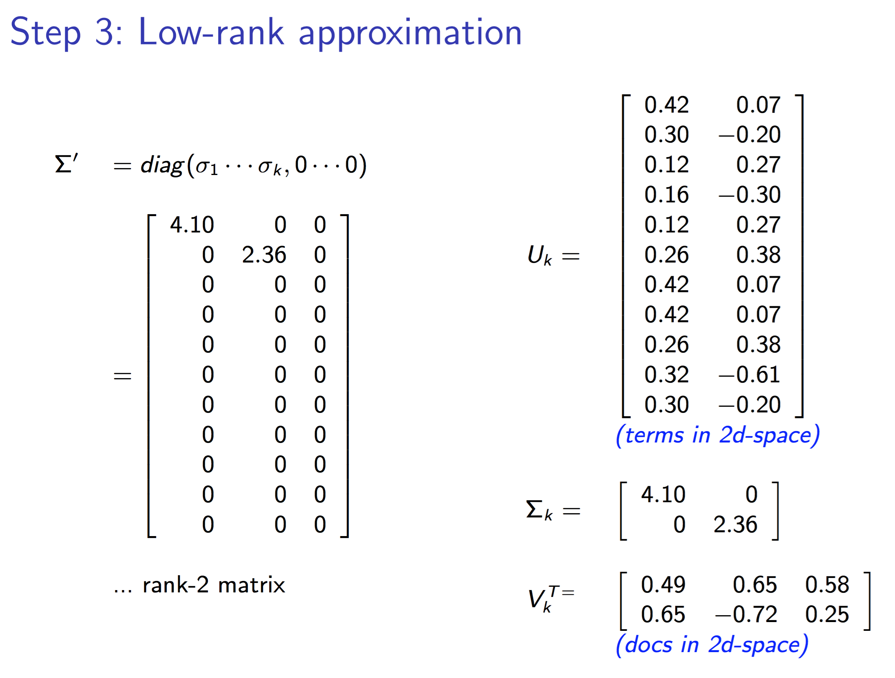

Slide 80
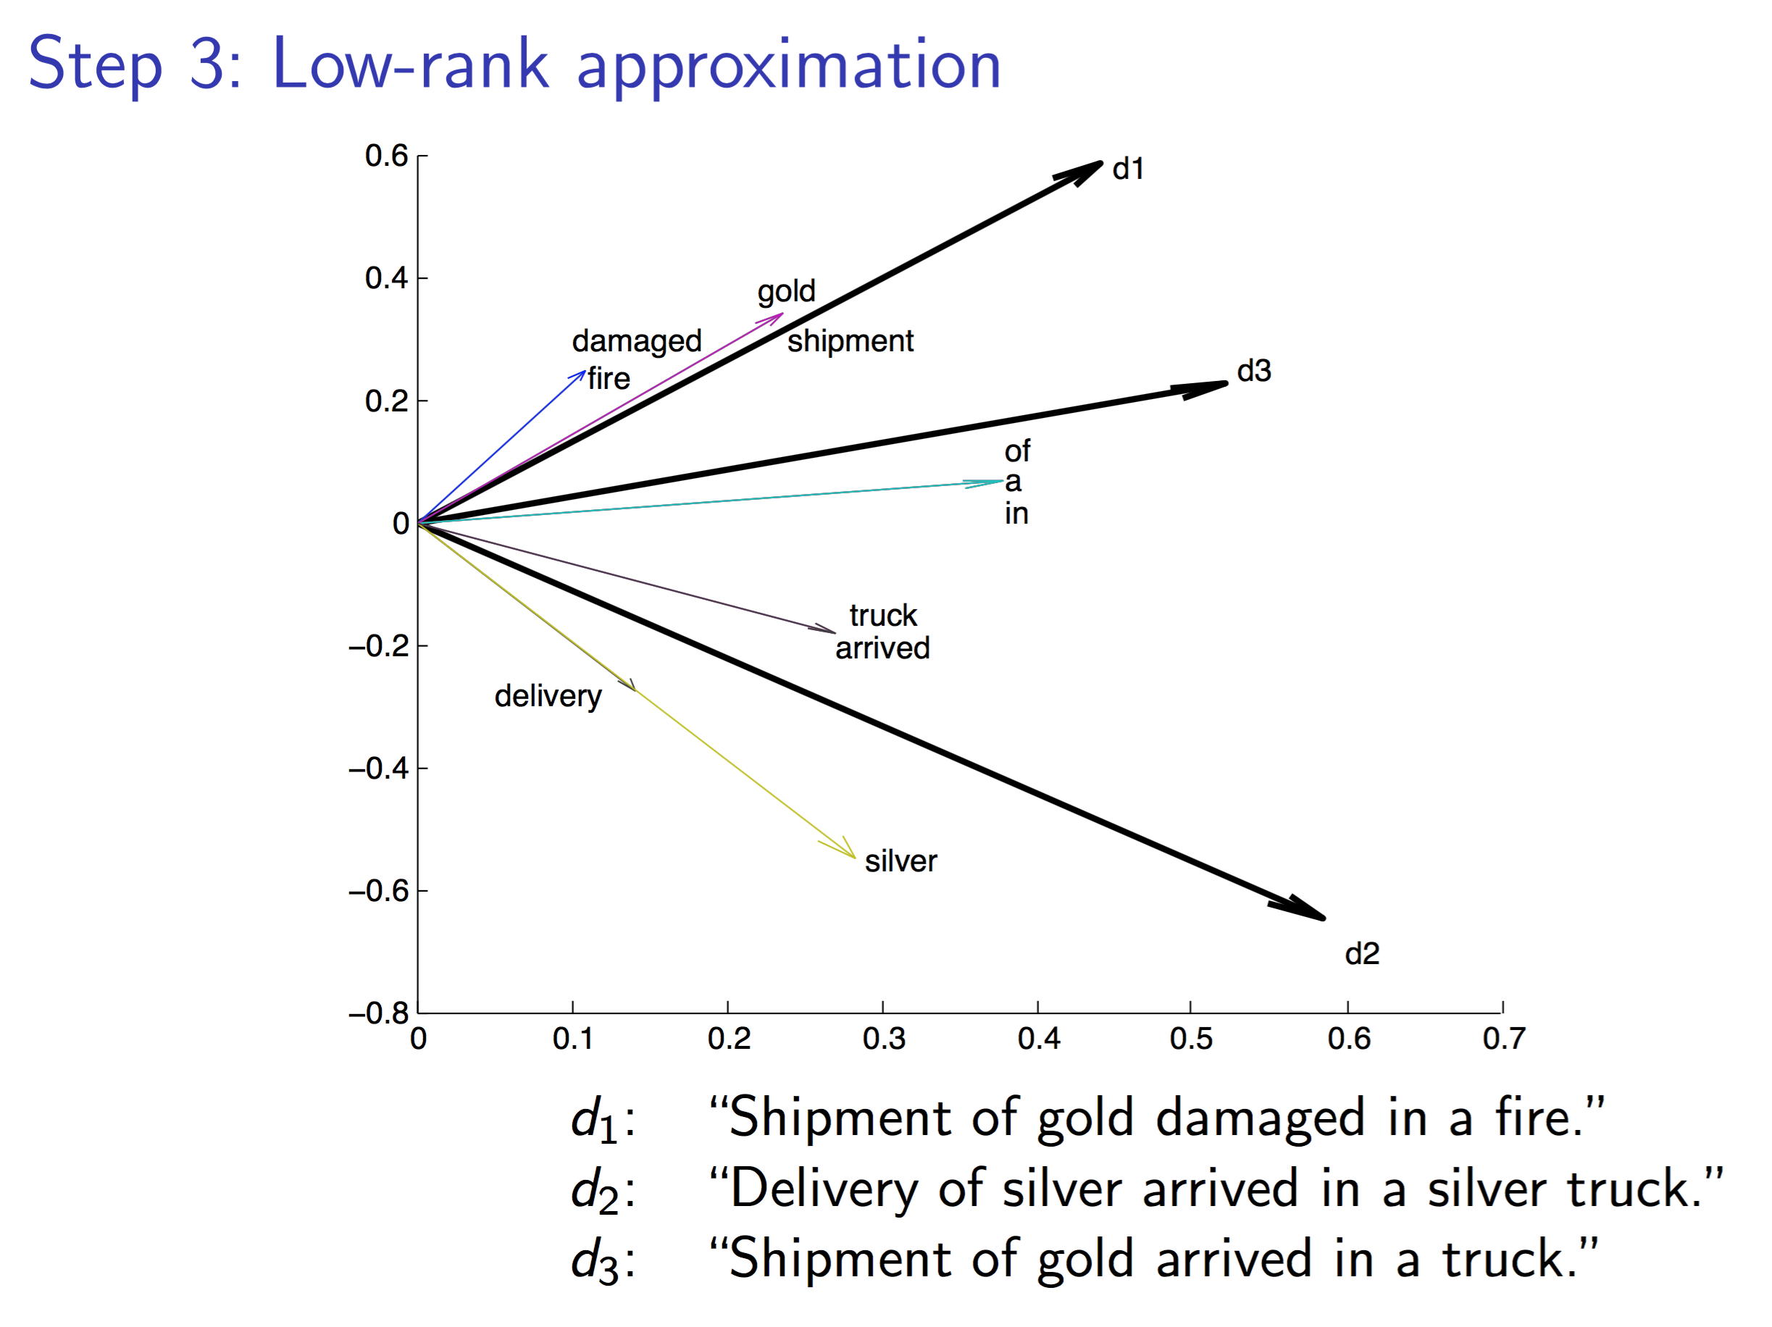

Slide 81
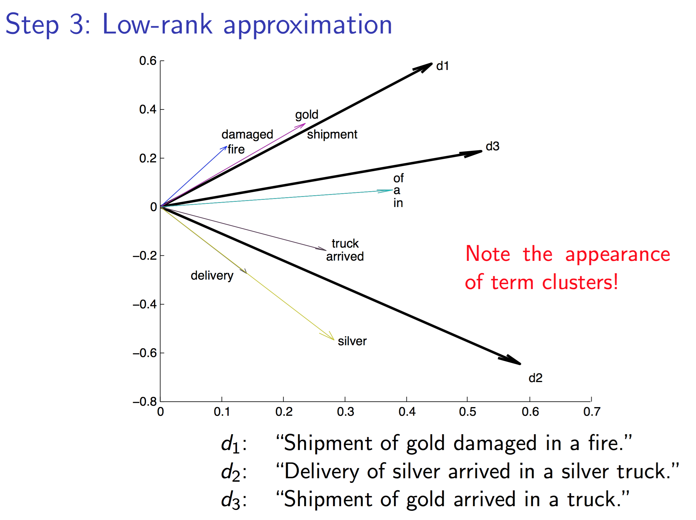

Slide 82
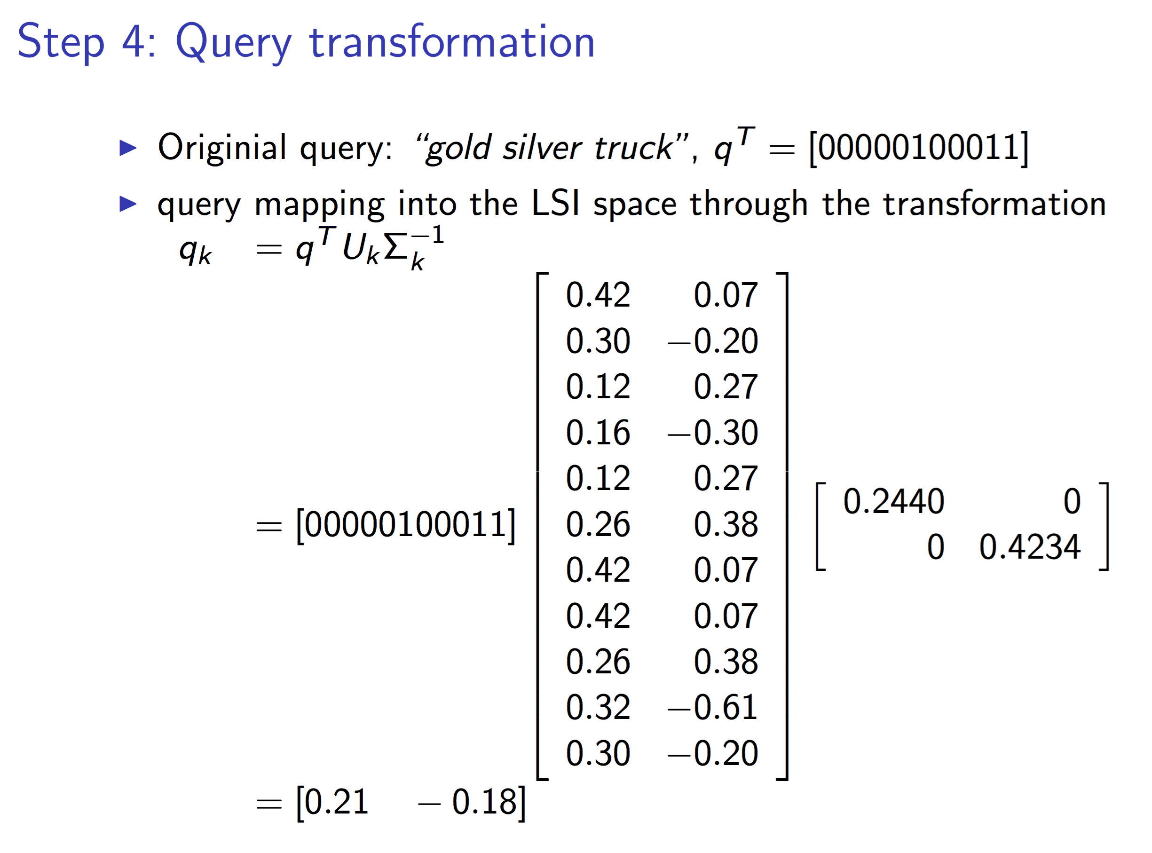

Slide 83
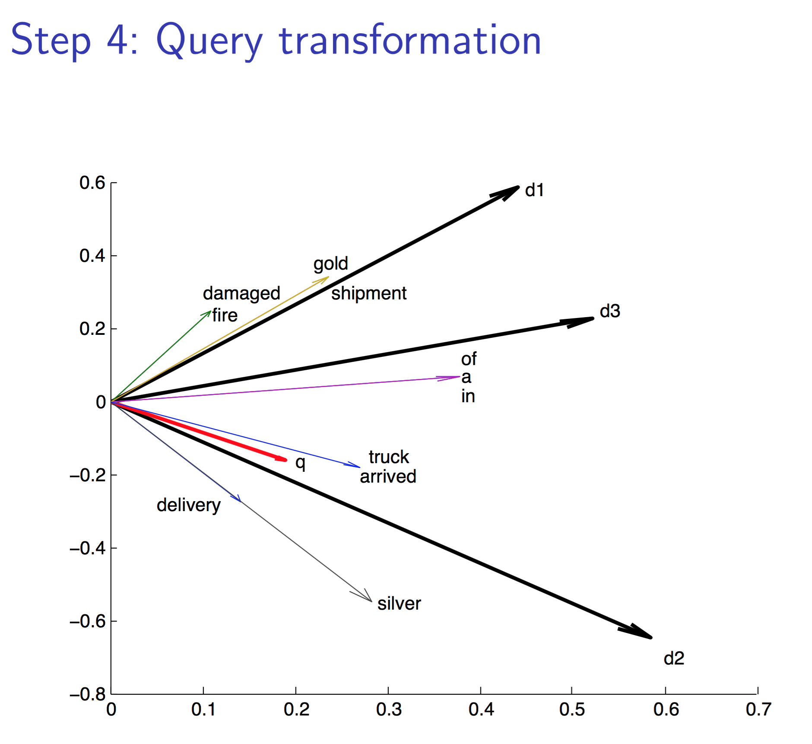

Slide 84
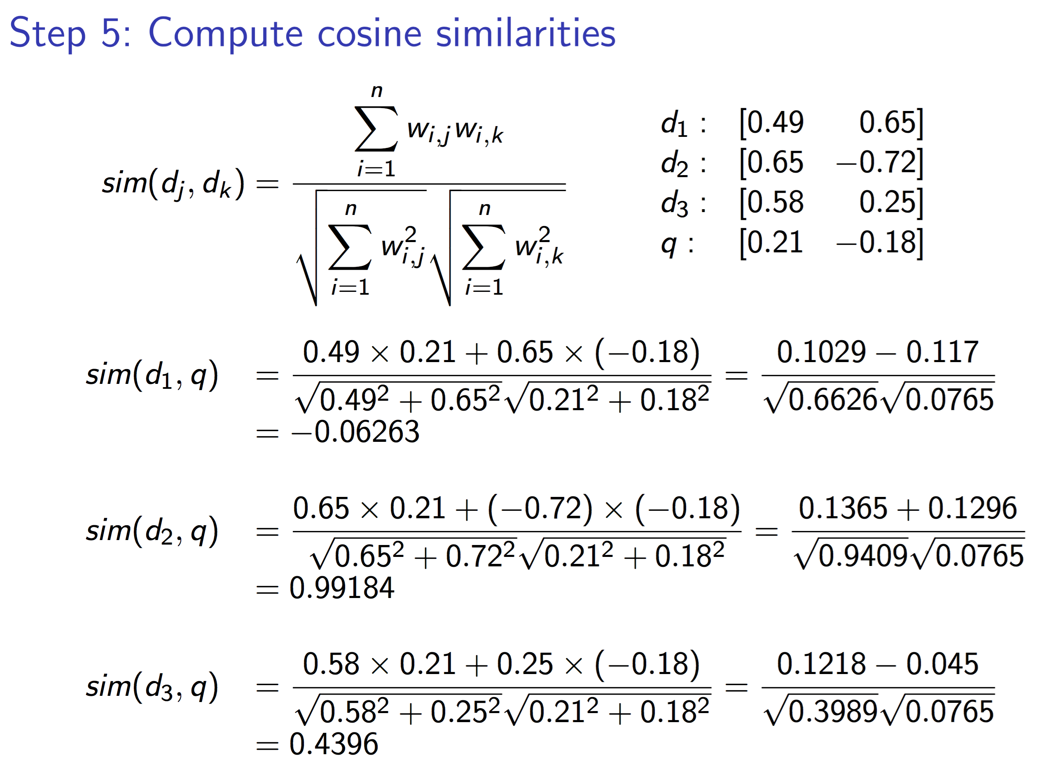

Slide 85
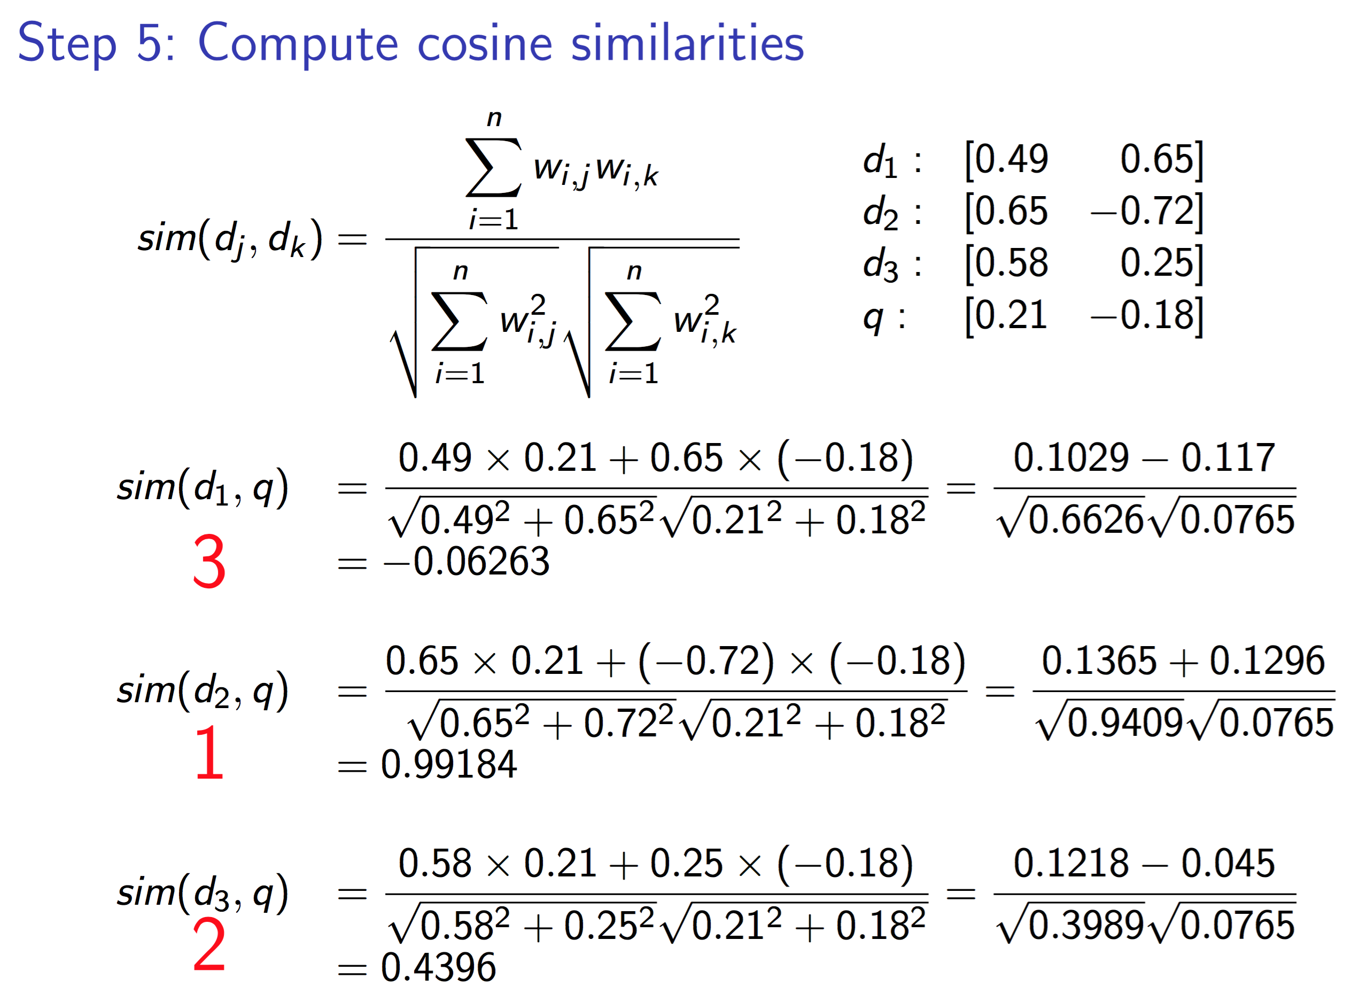

Slide 86
Back to IR agents
Agents make decisions about which documents to select and report to the agents‘ creators
  Recommend the k top-ranked documents
How to evaluate an agent‘s performance
  Externally (creator satisfaction)
  Internally (relevance feedback, reinforcement)

Slide 87



External evaluation of query results
Precision/Recall
87

Slide 88
Unranked retrieval evaluation
Precision: fraction of retrieved docs that are relevant = P(retr&rel|retrieved)
Recall: fraction of relevant docs that are retrieved = P(retr&rel|relevant in repos)
Precision: P = tp/(tp + fp)
Recall: R = tp/(tp + fn)
 | Relevant | Not Relevant
Retrieved | true positives (tp) | false positives (fp)
Not Retrieved | false negatives (fn) | true negatives (tn)
88

Slide 89
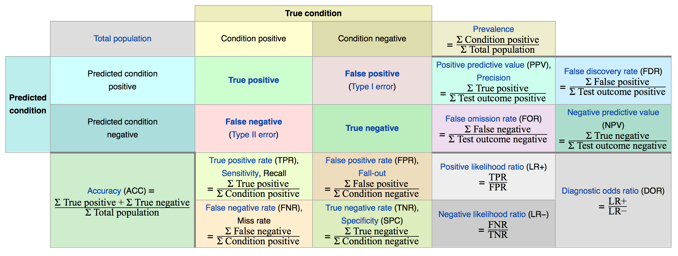
Overview on evaluation measures
[Wikipedia]

Slide 90
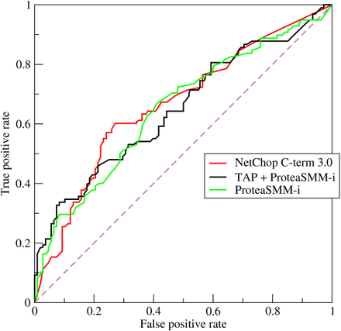
Relative operating characteristic (ROC)
Compare TP rate and FP rate
Example w three
classifiers
Wikipedia

Slide 91
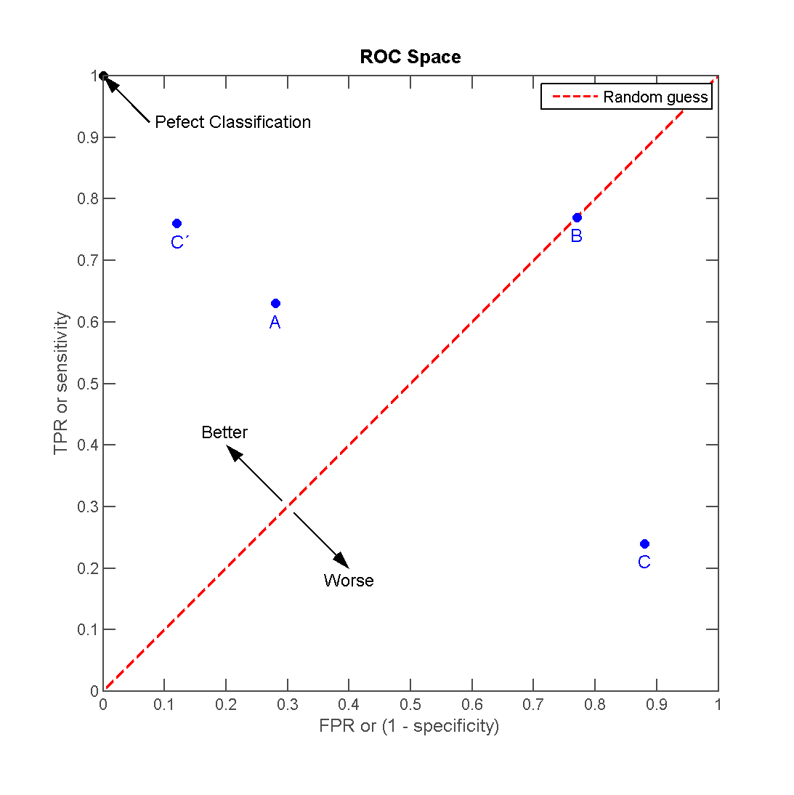
ROC Space
Area under curve
(AUC) as a
performance
measure

Slide 92
Back to IR agents
Still need
  Test queries
  Relevance assessments
Test queries
  Must be adequate to docs available
  Best designed by domain experts
  Random query terms generally not a good idea
Relevance assessments?
  Consider classification results of other agents
  Need a measure to compare different „judges“

Slide 93
Measure for inter-judge (dis)agreement
Kappa measure
  Agreement measure among judges
  Designed for categorical judgments
  Corrects for chance agreement
𝜅 = [ P(A) – P(E) ] / [ 1 – P(E) ]
P(A) – proportion of time judges agree (observed)
P(E) – what agreement would be by chance (hypothetical)
𝜅 = 0 for chance agreement, 1 for total agreement
In statistics many other measures are defined
Cohen, Jacob, "A coefficient of agreement for nominal scales". Educational and Psychological Measurement 20 (1): 37–46, 1960
93
Notes:
93

Slide 94
Kappa Measure: Example
P(A)? P(E)?
Number of docs | Judge 1 | Judge 2
300 | Relevant | Relevant
70 | Nonrelevant | Nonrelevant
20 | Relevant | Nonrelevant
10 | Nonrelevant | relevant
94
Notes:
94

Slide 95
Kappa Example
P(A) = 370/400 = 0.925
P(nonrelevant) = (10+20+70+70)/800 = 0.2125
P(relevant) = (10+20+300+300)/800 = 0.7878
P(E) = 0.2125² + 0.7878² = 0.665
𝜅 = (0.925 – 0.665)/(1-0.665) = 0.776
𝜅 > 0.8 = good agreement
0.67 < 𝜅 < 0.8 -> “tentative conclusions”
Depends on purpose of study
For >2 judges: average pairwise 𝜅s
Carletta, J. C., Assessing agreement on classification tasks:
The kappa statistic. Computational Linguistics, 22(2), 249-254, 1996
95
Notes:
95

Slide 96
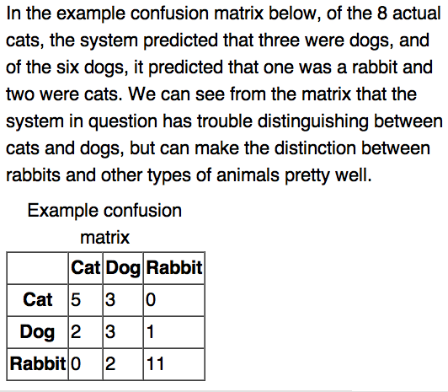
Confusion Matrix
96

Slide 97
Relevance Feedback: Rocchio Algorithm
The Rocchio algorithm incorporates relevance feedback information into the vector space model.
Want to maximize sim(Q, C_{r}) - sim(Q, C_{nr}) where C_{r} and C_{nr} denote relevant and non-relevant doc vectors, respectively
The optimal query vector for separating relevant and non-relevant documents (with cosine sim.):
Q_{opt} = optimal query; C_{r} = set of rel. doc vectors in corpus; N = collection size
Unrealistic definition:
We don’t know relevant documents in corpus
97
Notes:
97
Q = query, Cr = relevant documents Cnr = not relevant documents

Slide 98
The Theoretically Best Query
x
x
x
x
o
x
x
x
x
x
x
x
x
o
x
o
x
o
x
x
Δ
o
o
x
x
x non-relevant documents
o relevant documents
Optimal query
98

Slide 99
Rocchio 1971 Algorithm (SMART)
Used in practice:
q_{m} = modified query vector; q₀ = original query vector; α,β,γ: weights (hand-chosen or set empirically); D_{r} = set of known relevant doc vectors; D_{nr} = set of known irrelevant doc vectors
New query moves toward relevant documents and away from irrelevant documents
Tradeoff α vs. β/γ : If we have a lot of judged documents, we want a higher β/γ.
Term weight can go negative
  Negative term weights are ignored (set to 0)
Wikipedia: The SMART (System for the Mechanical Analysis and Retrieval of Text) Information Retrieval System is an information retrieval system
developed at Cornell University in the 1960s. Many important concepts in information retrieval were developed as part of research
on the SMART system, including the vector space model, relevance feedback, and Rocchio classification.
99
Notes:
99
SMART: Cornell (Salton) IR system of 1970s to 1990s.

Slide 100
Relevance feedback on initial query
Initial query
x
x
x
o
x
x
x
x
Δ
x
x
x
o
x
o
x
Δ
x
o
x
o
o
x
x
x
x
Revised query
x known non-relevant documents
o known relevant documents
100

Slide 101
Relevance Feedback in vector spaces
We can modify the query based on relevance feedback and apply standard vector space model.
Use only the docs that were marked.
Relevance feedback can improve recall and precision
Relevance feedback is most useful for increasing recall in situations where recall is important
  Users can be expected to review results and to take time to iterate
101
Notes:
101
Just as we modified the query in the vector space model, we can also modify it here. I’m not aware of work that uses language model based Ir this way.

Slide 102
Positive vs Negative Feedback
Positive feedback is more valuable than negative feedback (so, set 𝛾 < 𝛽;
e.g. 𝛾 = 0.25, 𝛽 = 0.75).
Why?
  Many systems only allow positive feedback (𝛾=0).
102
Notes:
102
It’s harder for user to give negative feedback (absence of evidence is not evidence of absence). It’s also harder to use since relevant documents can often form tight cluster, but non-relevant documents rarely do.

Slide 103
High-dimensional Vector Spaces
The queries “cholera” and “john snow” are far from each other in vector space.
How can the document “John Snow and Cholera” be close to both of them?
Our intuitions for 2- and 3-dimensional space don't work in >10,000 dimensions.
3 dimensions: If a document is close to many queries, then some of these queries must be close to each other.
Doesn't hold for a high-dimensional space.
103
Notes:
103
Q = query, Cr = relevant documents Cnr = not relevant documents

Slide 104
Relevance Feedback: Assumptions
A1: User has sufficient knowledge for initial query.
A2: Relevance prototypes are “well-behaved”.
  Term distribution in relevant documents will be similar
  Term distribution in non-relevant documents will be different from those in relevant documents
Possible violations?
104
Notes:
104

Slide 105
Violation of A1
User does not have sufficient initial knowledge.
Examples:
  Misspellings (Brittany Speers).
  Cross-language information retrieval (hígado).
  Mismatch of searcher’s vocabulary vs. collection vocabulary
    Cosmonaut/astronaut
105
Notes:
105

Slide 106
Violation of A2
There are several relevance prototypes.
Examples:
  Burma/Myanmar
  Contradictory government policies
  Pop stars that worked at Burger King
Often: instances of a general concept
Good editorial content can address problem
  Report on contradictory government policies
106
Notes:
106

Slide 107
Relevance Feedback: Problems
Users are often reluctant to provide explicit feedback
It’s often harder to understand why a particular document was retrieved after apply relevance feedback
107
Notes:
107
A long vector space query is like a disjunction: you have to consider documents with any of the words, and sum partial cosine similarities over the various terms.

Slide 108
Multimodal information retrieval
What about images, videos, audio data?
Compute feature vectors from data representations in a data-driven fashion
Which features?
  Example: MPEG-7 General information descriptors
Define respective vector spaces
Use vector space retrieval model with cosine similarity
Texts, images, videos, audio data are called documents

Slide 109
MPEG-7 Standardized information descriptors
COLOR
Dominant Color Descriptor (DCD)
Scalable Color Descriptor (SCD)
Color Structure Descriptor (CSD)
Color Layout Descriptor (CLD)
Group of frame (GoF) or Group-of-pictures (GoP)
TEXTURE
Homogeneous Texture Descriptor (HTD)
Texture Browsing Descriptor (TBD)
Edge Histogram Descriptor (EHD)
SHAPE
Region-based Shape Descriptor (RSD)
Contour-based Shape Descriptor (CSD)
3-D Shape Descriptor (3-D SD)
MOTION
Motion Activity Descriptor (MAD)
Camera Motion Descriptor (CMD)
Motion Trajectory Descriptor (MTD)
Warping and Parametric Motion Descriptor (WMD and PMD)
LOCATION
Region Locator Descriptor (RLD)
Spatio Temporal Locator Descriptor (STLD)
[Wikipedia: MPEG-7 Visual descriptors]

Slide 110
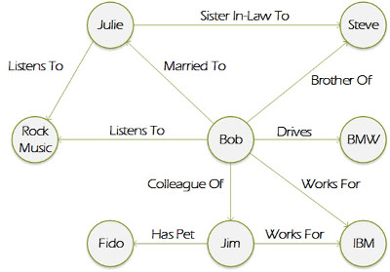
Collective Learning on Multi-Relational Data

Slide 111
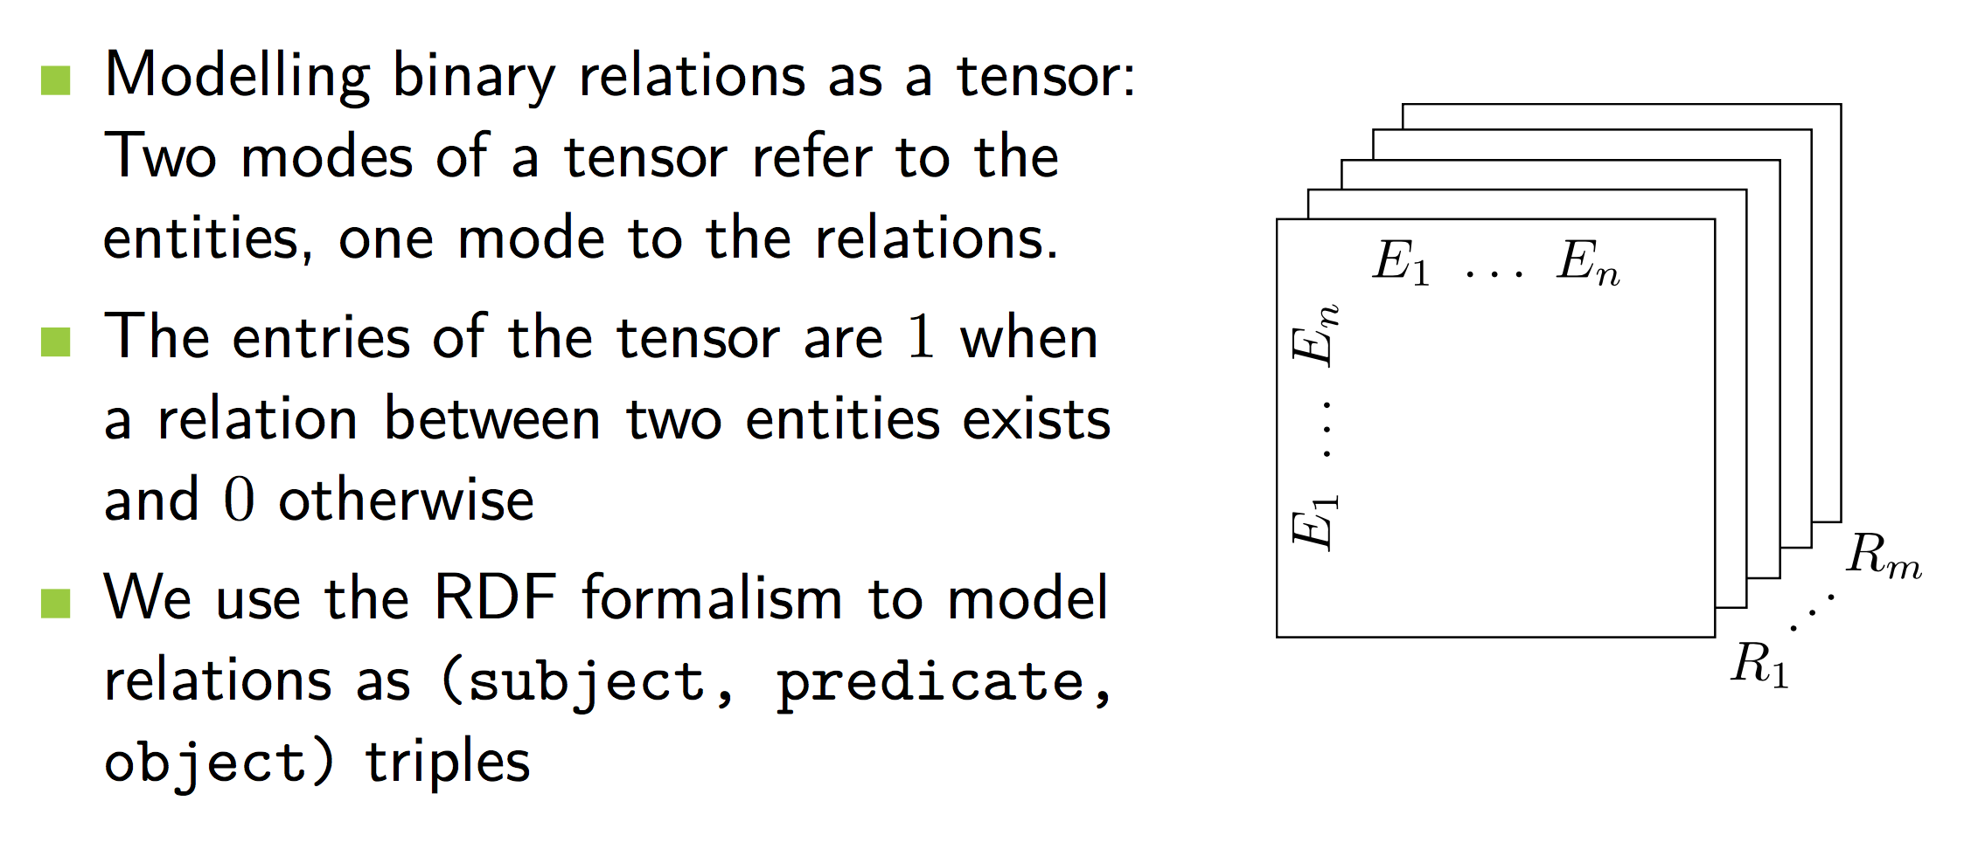
Idea
Maximilian Nickel, Volker Tresp, Hans-Peter Kriegel
A Three-Way Model for Collective Learning on Multi-Relational Data
In Proc. 28th International Conference on Machine Learning, 2011

Slide 112
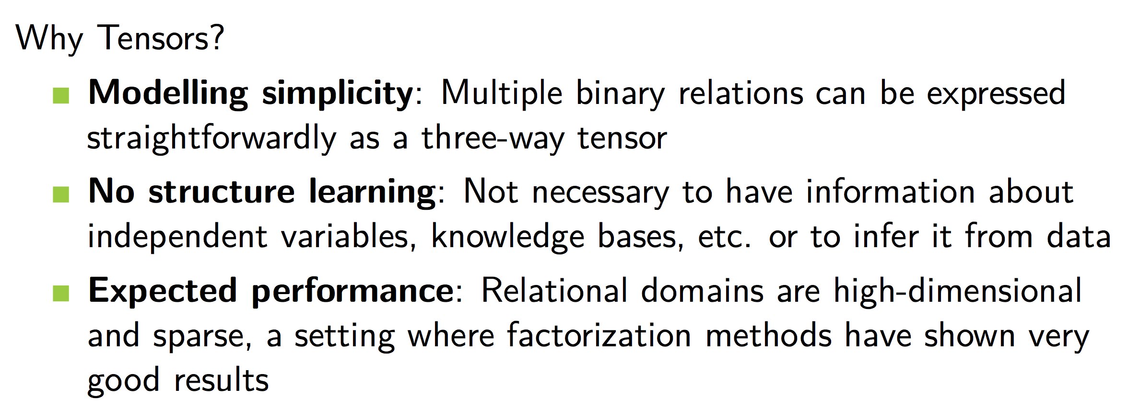
Motivation
© M. Nickel

Slide 113
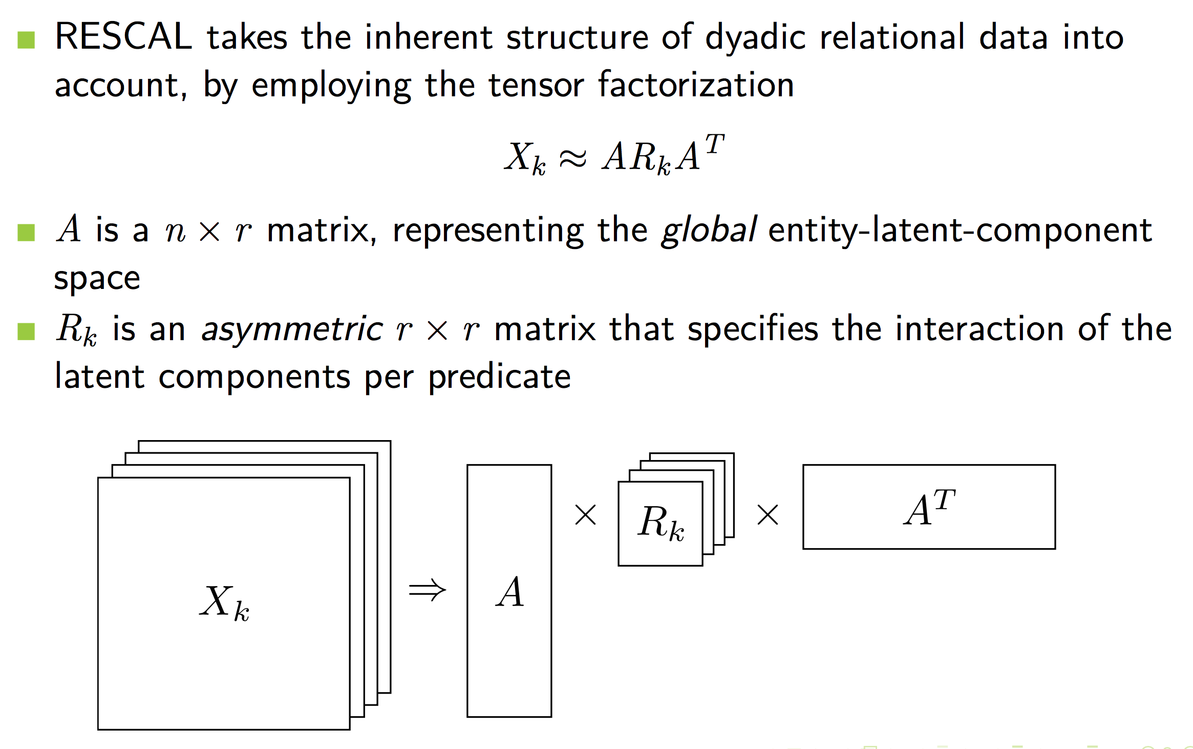
Tensor Factorization with Rescal
© M. Nickel

Slide 114
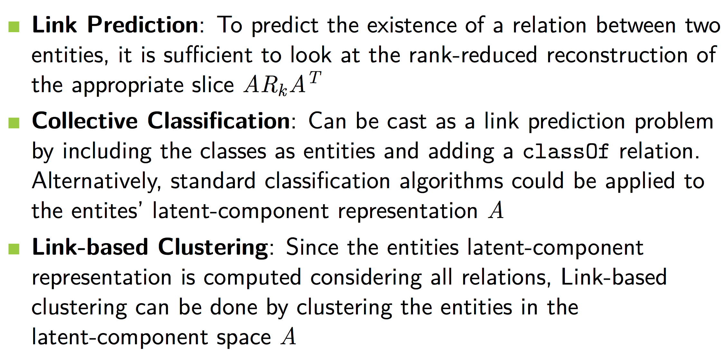
Solving Relational Learning Tasks
© M. Nickel

Slide 115
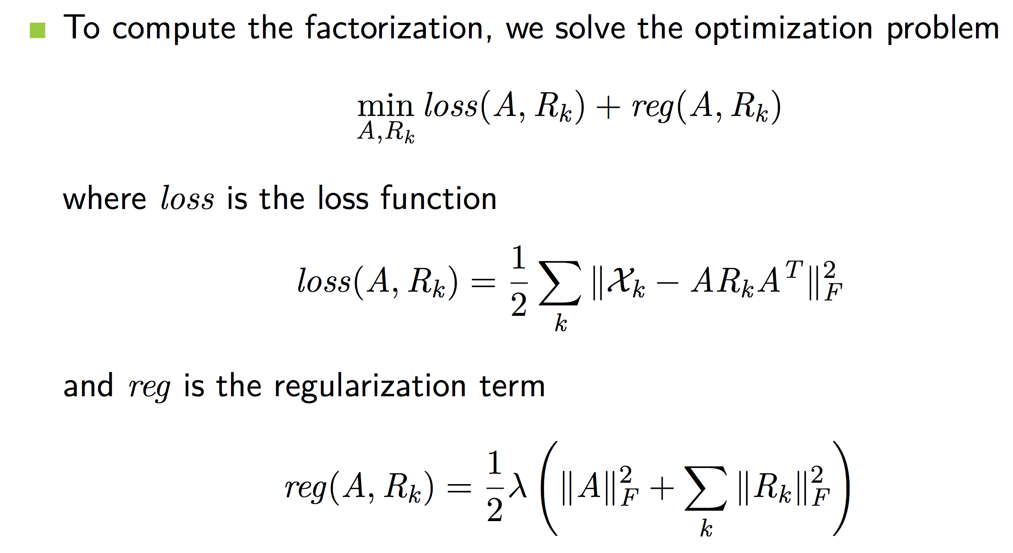
Compute the Factorization
© M. Nickel https://github.com/mnick/rescal.py

Slide 116
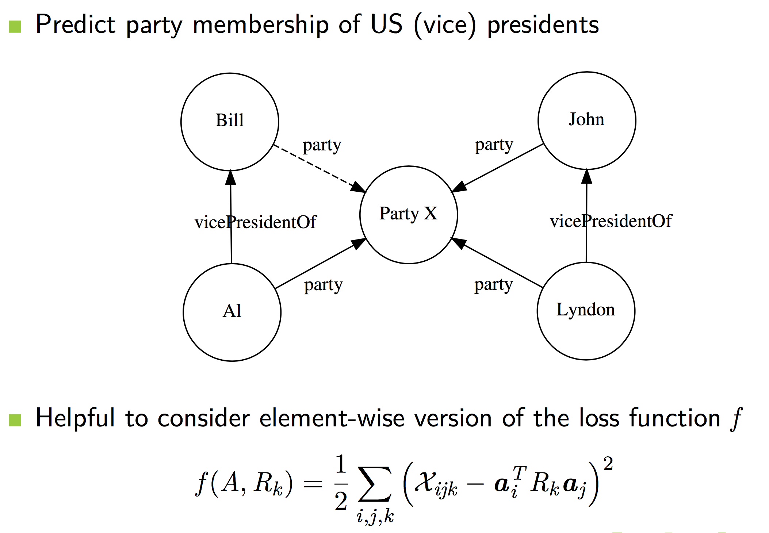
Collective Learning

Slide 117
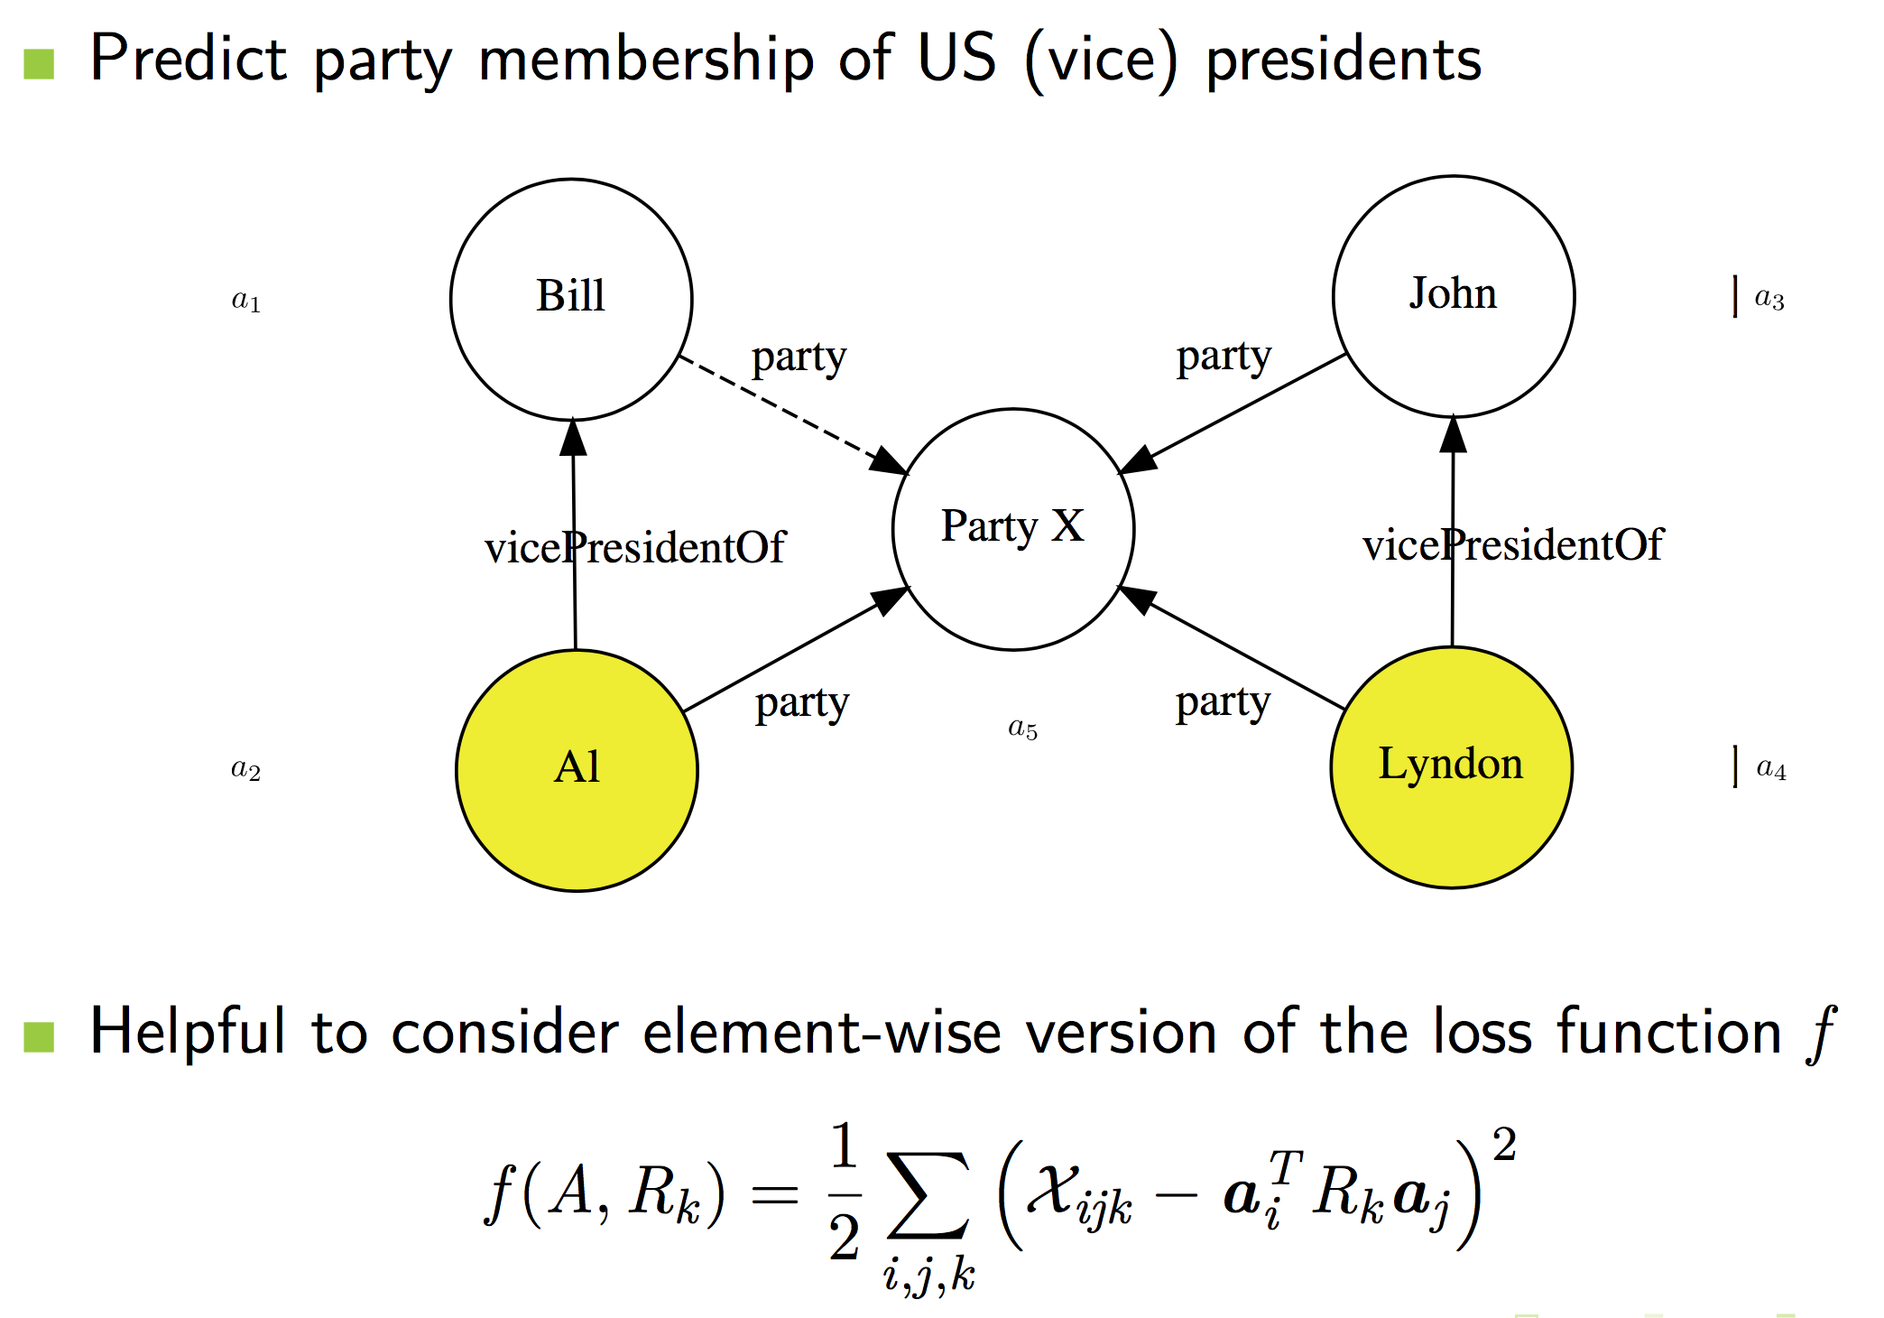
Collective Learning

Slide 118
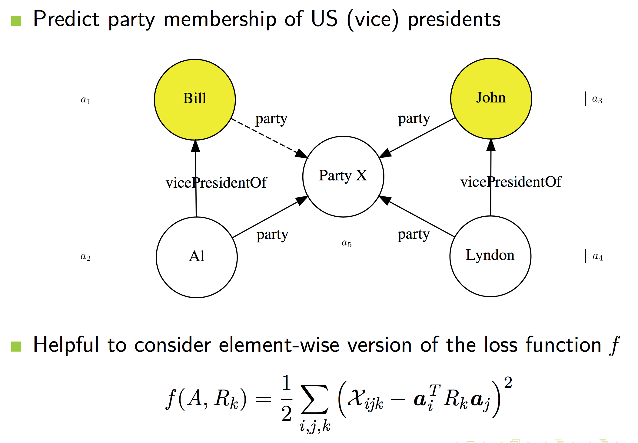
Collective Learning

Slide 119
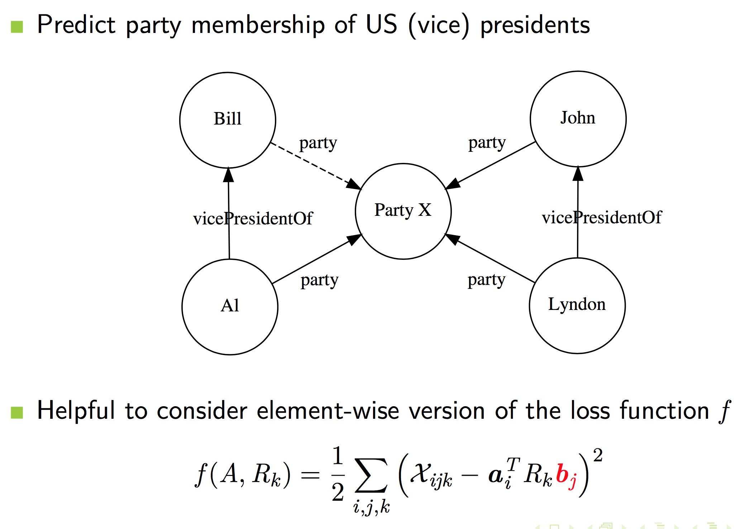
Collective Learning

Slide 120
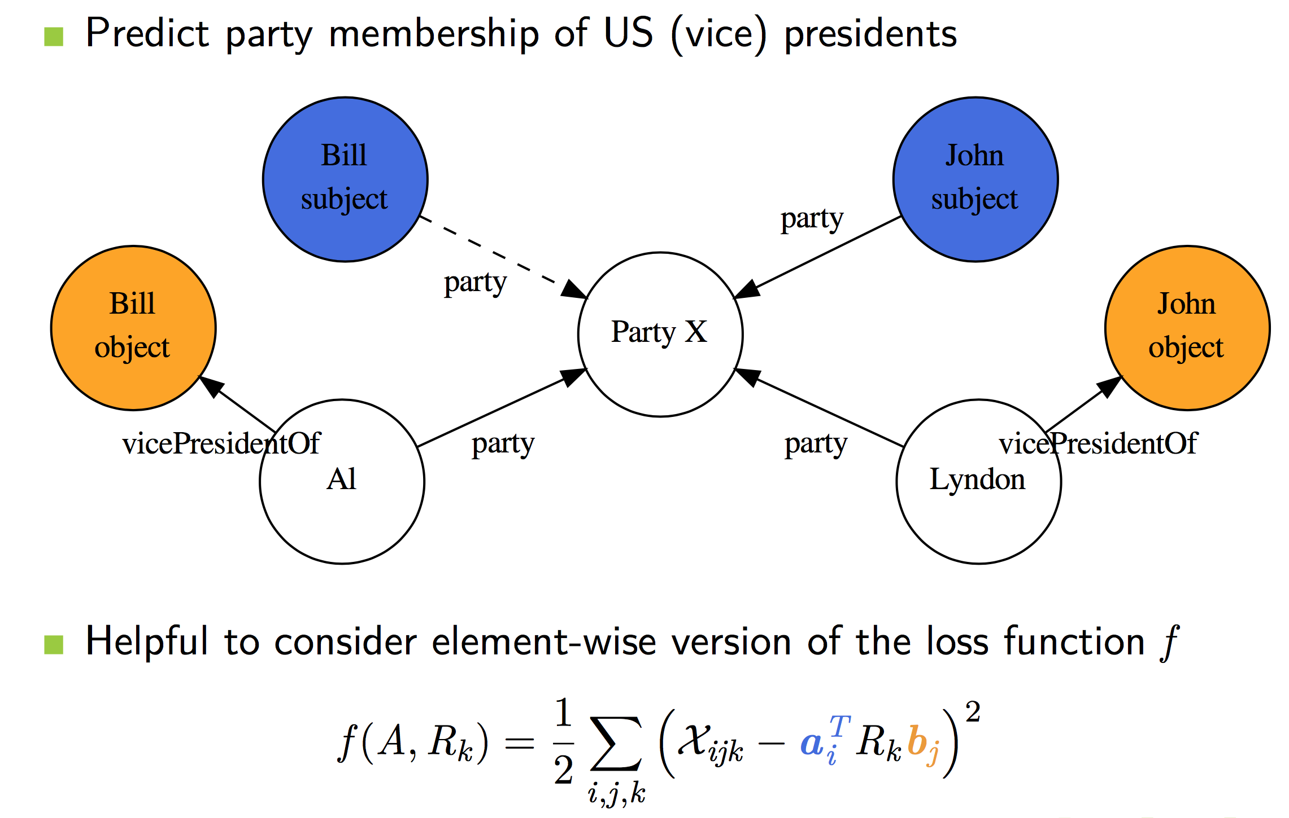
Collective Learning

Slide 121
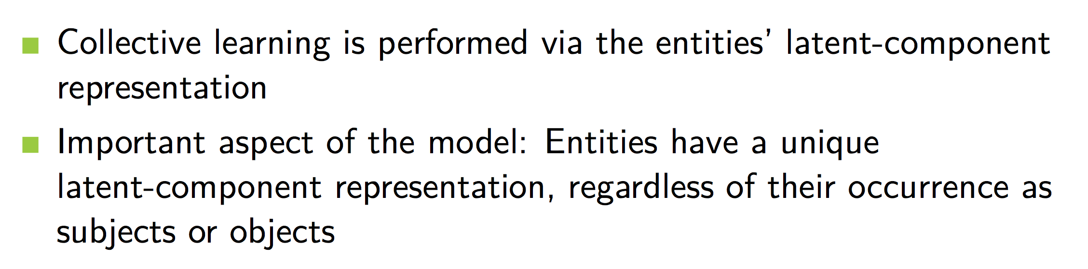
Collective Learning
© M. Nickel

