Slide 1
Web-Mining Agents
Community Analysis
Tanya Braun
Universität zu Lübeck
Institut für Informationssysteme

Slide 2

Literature
Christopher D. Manning, Prabhakar Raghavan and Hinrich Schütze, Introduction to Information Retrieval, Cambridge University Press. 2008.
http://nlp.stanford.edu/IR-book/information-retrieval-book.html

Slide 3
Retrieving & Ranking Documents With Links
Use links
  As source of information
  As means to rank relevant documents
Notes:
Additional source of information: links/hyperlinks
With anchortext to scour for information
With perceived meaning behind existence of links
First: WEB, later other networks

Slide 4
Today’s Lecture
Anchor text
Link analysis for ranking in the web
  PageRank and variants
  Hyperlink-Induced Topic Search (HITS)
Links in topic modeling

Slide 5
The Web as a Directed Graph
Page A
Page B
hyperlink
Anchor
Assumption 1: A hyperlink between pages denotes author perceived relevance (quality signal)
Assumption 2: The anchor of the hyperlink
describes the target page (textual context)
Notes:
main premise: anchor text behaves very much like real user queries/titles
anchor text provides boost to quality of results for site finding (previous research: little impact for the TREC subject finding (or ad hoc query) tasks)

Slide 6
Indexing anchor text
When indexing a document D, include anchor text from links pointing to D.
Armonk, NY-based computer
giant IBM announced today
www.ibm.com
Big Blue today announced
record profits for the quarter
Joe’s computer hardware links
Compaq
HP
IBM

Slide 7
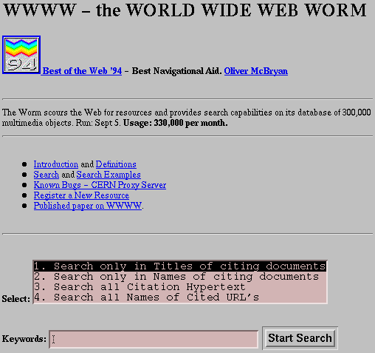
WWWW – World Wide Web Worm (1994)
  Oliver A. McBryan, GENVL and WWWW: Tools for Taming the Web, Proceedings of the First International World Wide Web Conference, 1994
Notes:
WWWW: one of first web search engines, resource location tool, uses anchor text
Search in zones

Slide 8
Analysis of Anchor-based Retrieval
For IBM how to distinguish between:
  IBM’s home page (mostly graphical)
  IBM’s copyright page (high term freq. for ‘ibm’)
  Rival’s spam page (arbitrarily high term freq.)
“ibm.com”
“IBM home page”
“ibm”
A million pieces of anchor text with “ibm” send a strong signal
www.ibm.com
  Nadav Eiron and Kevin S. McCurley, Analysis of Anchor Text for Web Search, Proceedings of the Twenty-Sixth Annual International Conference on Research and Development in Information Retrieval (SIGIR), 2003
Notes:
Graphical elements in site, few words, but anchor texts
traditional text search engines have found titles to be a very useful feature of a document, we have found titles to be far less useful than anchor text
titles are typically longer than individual anchor text, many pages (especially highly relevant pages) have many individual anchor texts pointing to them
This provides for a much better indication of the summarization of the page in different contexts, by different people, than that afforded by a single title which is authored by one author

Slide 9
Analysis of Anchor-based Retrieval
Better than titles as an indicator
  Summaries from different contexts and different people
  Multi-word query matched by anchor text of higher value
  Own set of stop words
Works well for page-finding queries
“ibm.com”
“IBM home page”
“ibm”
A million pieces of anchor text with “ibm” send a strong signal
www.ibm.com
  Nadav Eiron and Kevin S. McCurley, Analysis of Anchor Text for Web Search, Proceedings of the Twenty-Sixth Annual International Conference on Research and Development in Information Retrieval (SIGIR), 2003
Notes:
When matching a multi-word query against a long document, the various words of the query may match in different parts of the document. These parts may talk of only distantly related subjects, and therefore, while each one of the words queries on indeed appears, they never appear within the same context. Hence, the document is not a good match for the concept represented by the query. Anchor text, on the other hand, is short enough that if multiple words from the query appear in it, they always appear in great proximity, and will therefore tend to have the same meaning as they have in the query itself. One might expect the same to be true of titles, however, titles are not rich enough to be useful for multi-word queries.
Own set of stop words: next, home, click here

Slide 10
Links for Query-independent Ordering
First generation: using link counts as simple measures of popularity
Two basic suggestions (each page gets a score):
  Undirected popularity:
    Score of a page = the number of in-links plus the number of out-links (3+2=5)
  Directed popularity:
    Score of a page = number of its in-links (3)
Notes:
Moving on to links only (no anchor text)
Page is important if many pages link to it

Slide 11
Query Processing
First retrieve all pages meeting the text query
(say venture capital).
Order these by their link popularity (either variant on the previous page).

Slide 12
Spamming Simple Popularity
Exercise: How do you spam each of the following heuristics so your page gets a high score?
  Undirected popularity:
    Score of a page = the number of in-links plus the number of out-links
  Directed popularity:
    Score of a page = number of its in-links
Notes:
Undirected: link to many pages, set helper pages up to link to page
Directed: set helper pages up for in-links

Slide 13
PageRank Scoring
Imagine a browser doing a random walk on web pages:
  Start at a random page
  At each step, go out of the current page along one of the links on that page, equiprobably
“In the steady state”, each page has a long-term visit rate - use this as the page’s score
1/3
1/3
1/3
  Lawrence Page et.al., The PageRank Citation Ranking: Bringing Order to the Web, 1999
Notes:
Idea of scoring: Page is important if many important pages point to it
If many links going to a page, page visited often

Slide 14
Not Quite Enough
The web is full of dead-ends.
  Random walk can get stuck in dead-ends
  Makes no sense to talk about long-term visit rates
??
  Lawrence Page et.al., The PageRank Citation Ranking: Bringing Order to the Web, 1999

Slide 15
Teleporting
At a dead end, jump to a random web page
At any non-dead end, with probability 10%, jump to a random web page.
  With remaining probability (90%), go out on a random link
  10% - a parameter
There is a long-term rate at which any page is visited.
  How do we compute this visit rate?
  Lawrence Page et.al., The PageRank Citation Ranking: Bringing Order to the Web, 1999
Notes:
1/n, n=#nodes in graph (web)

Slide 16
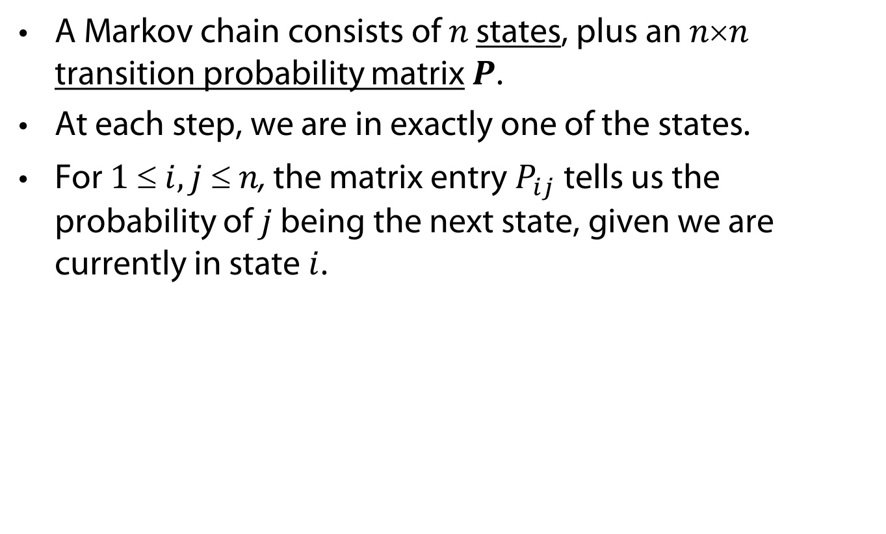



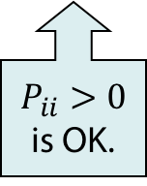
Mathematical Background: Markov Chains
A Markov chain consists of $n$ states, plus an $nn$ transition probability matrix $P$.
At each step, we are in exactly one of the states.
For $1  i,j  n$, the matrix entry $P_{ij}$ tells us the probability of $j$ being the next state, given we are currently in state $i$.
$$P_{ii}>0$$
is OK.
$$i$$
$$j$$
$$P_{ij}$$
Notes:
State view

Slide 17
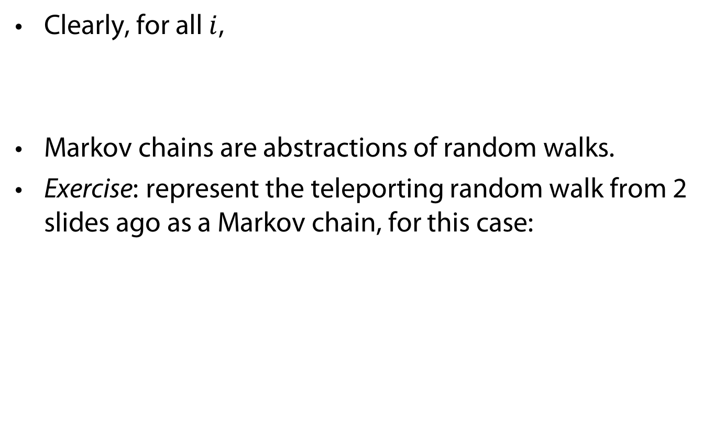

Markov Chains
Clearly, for all $i$,
Markov chains are abstractions of random walks.
Exercise: represent the teleporting random walk from 2 slides ago as a Markov chain, for this case:
$$\sum_{j=1}^{n}{P_{ij}}=1$$

Slide 18
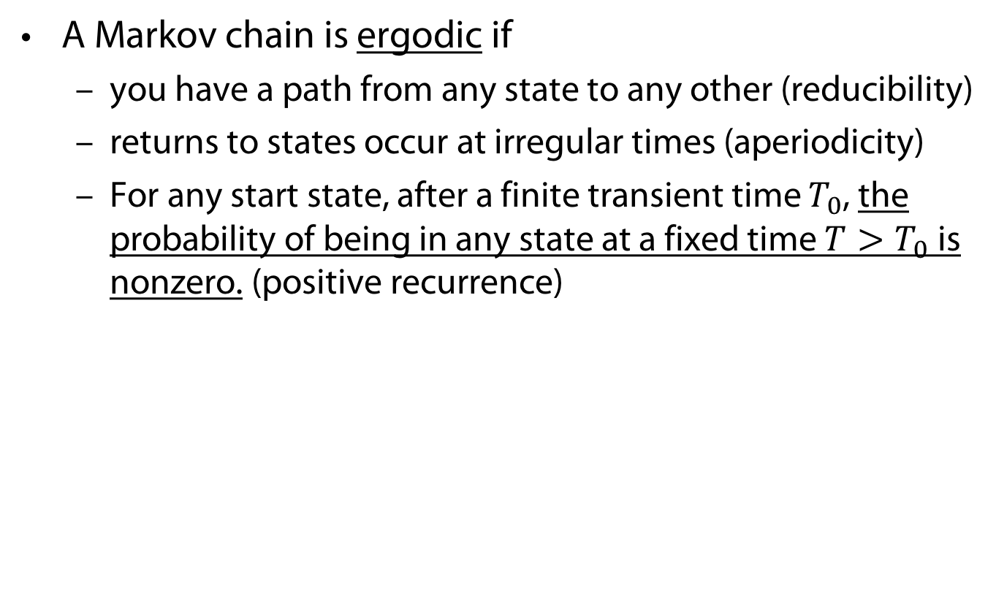
Ergodic Markov Chains
A Markov chain is ergodic if
  you have a path from any state to any other (reducibility)
  returns to states occur at irregular times (aperiodicity)
  For any start state, after a finite transient time $T_{0}$, the probability of being in any state at a fixed time $T>T_{0}$ is nonzero. (positive recurrence)
Not
ergodic
(even/
odd).

Slide 19
Ergodic Markov Chains
For any ergodic Markov chain, there is a unique long-term visit rate for each state.
  Steady-state probability distribution.
Over a long time-period, we visit each state in proportion to this rate.
It does not matter where we start.

Slide 20
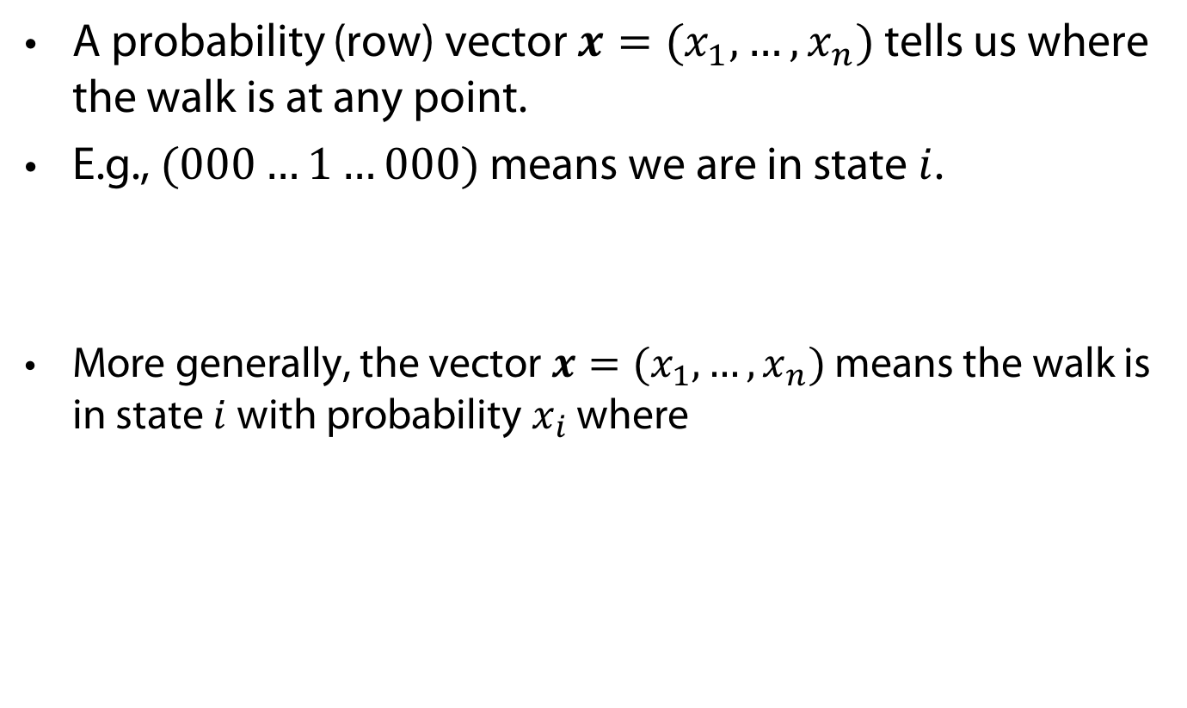
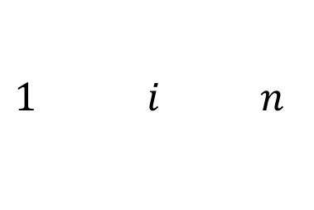

Probability Vectors
A probability (row) vector $x=(x_{1},…, x_{n})$ tells us where the walk is at any point.
E.g., $(000…1…000)$ means we are in state $i$.
More generally, the vector $x=(x_{1},…, x_{n})$ means the walk is in state $i$ with probability $x_{i}$ where
$$1 i n$$
$$\sum_{i=1}^{n}{x_{i}}=1$$
Notes:
White board for next three slides

Slide 21

Change in Probability Vector
If the probability vector is $x=(x_{1},…, x_{n})$ at this step,
what is it at the next step?
Recall that row $i$ of the transition prob. matrix $P$ tells us where we go next from state $i$.
So from $x$, our next state is distributed as $xP$.

Slide 22
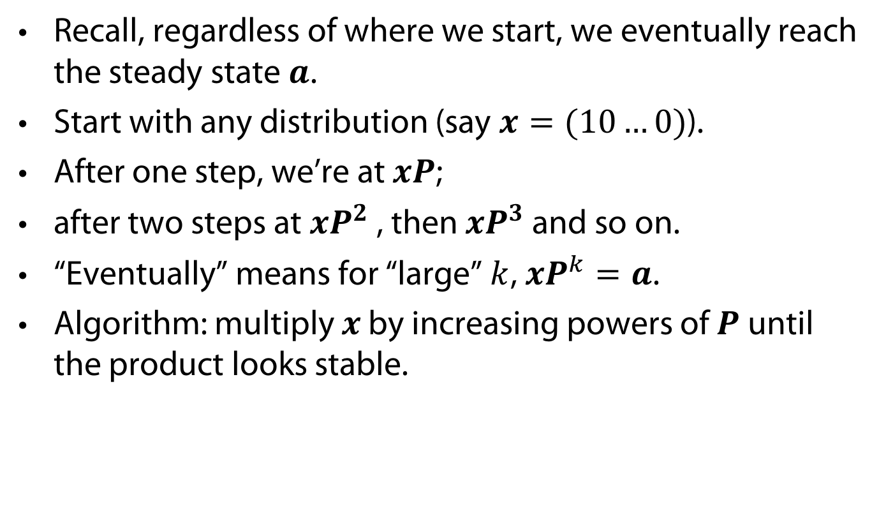
Reaching the Steady State
Recall, regardless of where we start, we eventually reach the steady state $a$.
Start with any distribution (say $x=(10…0)$).
After one step, we’re at $xP$;
after two steps at $xP^{2}$ , then $xP^{3}$ and so on.
“Eventually” means for “large” $k$, $xP^{k}=a$.
Algorithm: multiply $x$ by increasing powers of $P$ until the product looks stable.

Slide 23
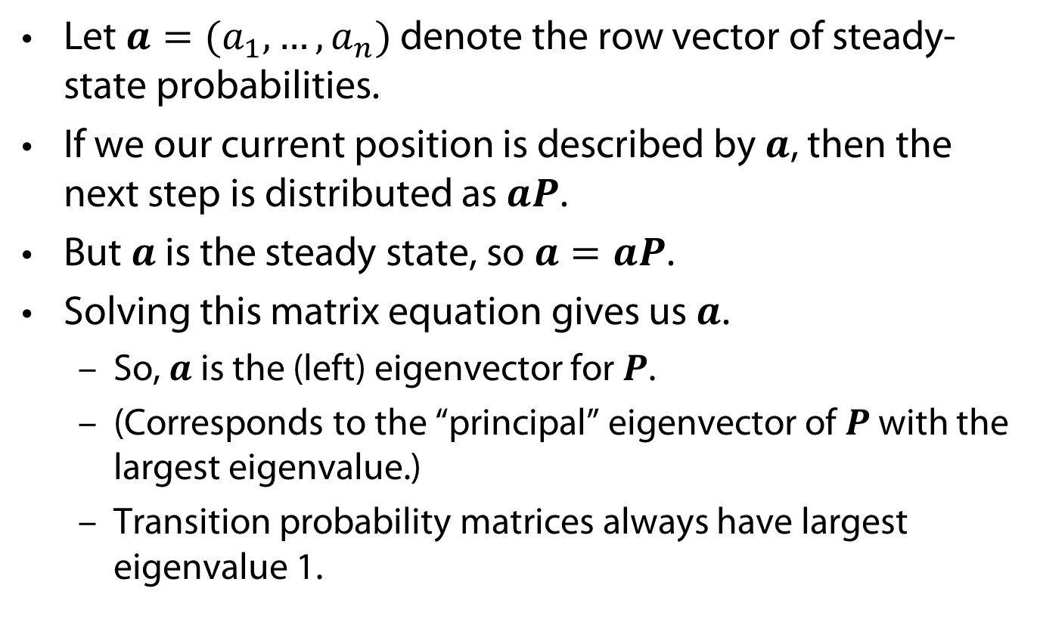
How Do We Compute This Vector?
Let $a=(a_{1},…, a_{n})$ denote the row vector of steady-state probabilities.
If we our current position is described by $a$, then the next step is distributed as $aP$.
But $a$ is the steady state, so $a=aP$.
Solving this matrix equation gives us $a$.
  So, $a$ is the (left) eigenvector for $P$.
  (Corresponds to the “principal” eigenvector of $P$ with the largest eigenvalue.)
  Transition probability matrices always have largest eigenvalue 1.

Slide 24

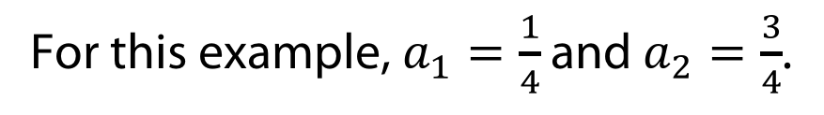
Steady State Example
The steady state looks like a vector of probabilities
$a=(a_{1},…, a_{n})$:
  $a_{i}$ is the probability that we are in state $i$.
3/4
1/4
1
2
3/4
1/4
For this example, $a_{1}=\frac{1}{4}$ and $a_{2}=\frac{3}{4}$.

Slide 25
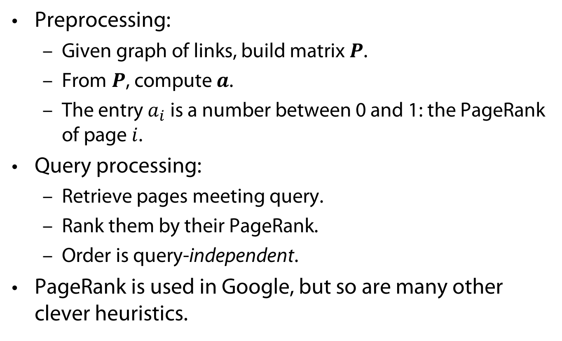
PageRank Summary
Preprocessing:
  Given graph of links, build matrix $P$.
  From $P$, compute $a$.
  The entry $a_{i}$ is a number between 0 and 1: the PageRank of page $i$.
Query processing:
  Retrieve pages meeting query.
  Rank them by their PageRank.
  Order is query-independent.
PageRank is used in Google, but so are many other clever heuristics.
  Lawrence Page et.al., The PageRank Citation Ranking: Bringing Order to the Web, 1999
Notes:
Google announced PageRank toolbar no longer updated; real scores not available to public; now, even the ”unreal” scores hidden

Slide 26
PageRank: Issues and Variants
How realistic is the random surfer model?
  What if we modeled the back button? [Fagi00]
  Surfer behavior sharply skewed towards short paths [Hube98]
  Search engines, bookmarks & directories make non-random jumps.
Biased Surfer Models
  Weight edge traversal probabilities based on match with topic/query (non-uniform edge selection)
  Bias jumps to pages on topic (e.g., based on personal bookmarks & categories of interest)

Slide 27
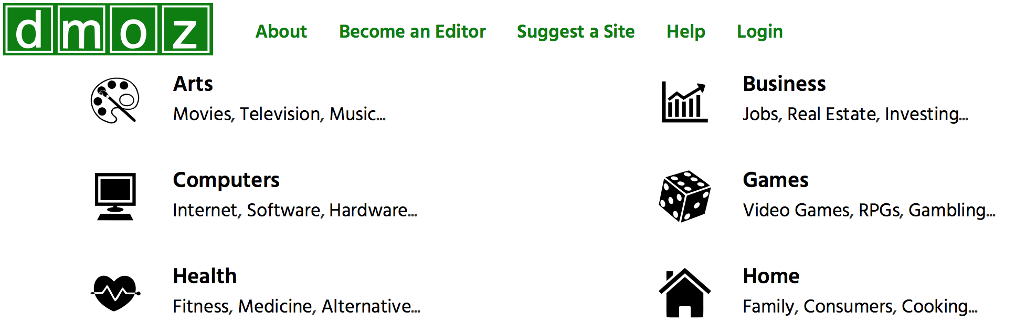
Topic-specific PageRank [Have02]
Conceptually, we use a random surfer who teleports, with say 10% probability, using the following rule:
  Selects a category (e.g., one of the 16 top level ODP categories) based on a query & user-specific distribution over the categories
ODP = Open Directory Project, now: dmoz
  Taher H. Haveliwala, Topic-sensitive PageRank, Proceedings of the Eleventh International World Wide Web Conference, 2002
Notes:
“Page is important if many important pages point to it, and btw, the following are by definition important pages.

Slide 28
Topic-specific PageRank [Have02]
Conceptually, we use a random surfer who teleports, with say 10% probability, using the following rule:
  Selects a category (e.g., one of the 16 top level ODP categories) based on a query & user-specific distribution over the categories
  Teleport to a page uniformly at random within the chosen category
  Taher H. Haveliwala, Topic-sensitive PageRank, Proceedings of the Eleventh International World Wide Web Conference, 2002

Slide 29
Non-uniform Teleportation
Sports
Teleport with 10% probability to a Sports page

Slide 30
Topic-specific PageRank [Have02]
Conceptually, we use a random surfer who teleports, with say 10% probability, using the following rule:
  Selects a category (e.g., one of the 16 top level ODP categories) based on a query & user-specific distribution over the categories
  Teleport to a page uniformly at random within the chosen category
Sounds hard to implement: cannot compute PageRank at query time!
  Taher H. Haveliwala, Topic-sensitive PageRank, Proceedings of the Eleventh International World Wide Web Conference, 2002

Slide 31
Topic-specific PageRank [Have02]
Implementation
  Offline: Compute PageRank distributions w.r.t. to individual categories
    Query-independent model as before
    Each page has multiple PageRank scores – one for each ODP category, with teleportation only to that category
  Online: Distribution of weights over categories computed by query context classification
    Generate a dynamic PageRank score for each page - weighted sum of category-specific PageRanks
  Taher H. Haveliwala, Topic-sensitive PageRank, Proceedings of the Eleventh International World Wide Web Conference, 2002
Notes:
Need to do both parts

Slide 32
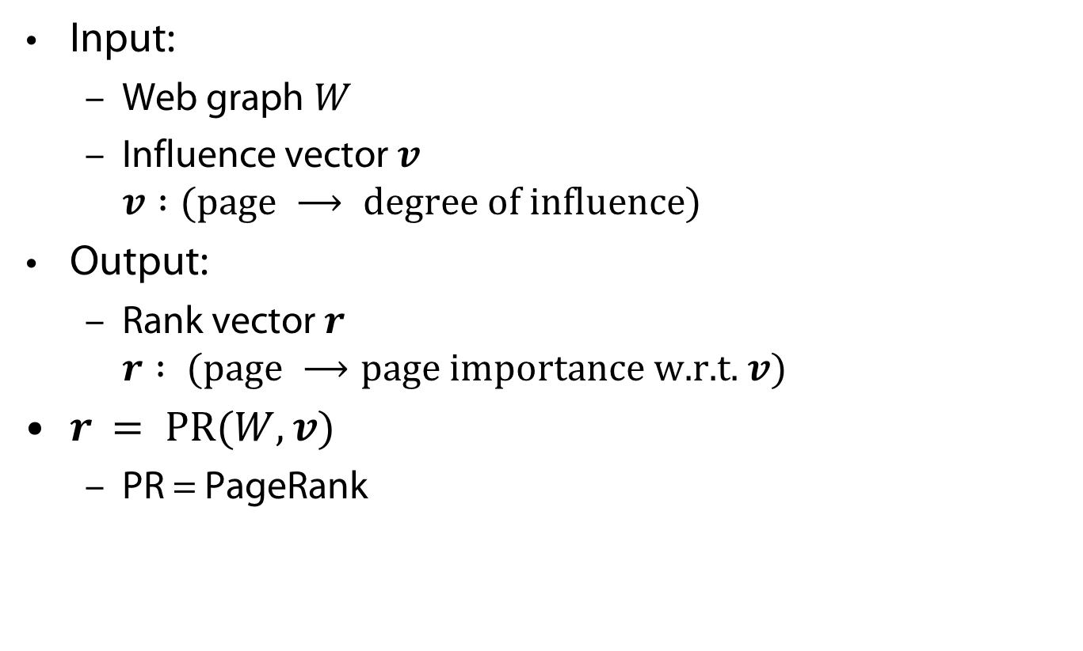
Influencing PageRanks
Input:
  Web graph $W$
  Influence vector $v$
  $v :(\text{page} ⟶ \text{degree} \text{of} \text{influence}\text{)}$
Output:
  Rank vector $r$
  $r : \text{(}\text{page} ⟶\text{page} \text{importance} \text{w}\text{.}\text{r}\text{.}\text{t}\text{. }v\text{)}$
$r = \text{PR}(W, v)$
  PR = PageRank
  Taher H. Haveliwala, Topic-sensitive PageRank, Proceedings of the Eleventh International World Wide Web Conference, 2002
Notes:
basis
web graph!!
Change in teleporting part: 1/n if no topic involved for all pages; 1/#pages_in_topic if page belongs to topic, 0 otherwise
Compute steady state for that state transition distribution

Slide 33
Interest in Sports
Sports
10% Sports teleportation
  Taher H. Haveliwala, Topic-sensitive PageRank, Proceedings of the Eleventh International World Wide Web Conference, 2002

Slide 34
Interest in Health
Health
10% Health teleportation
  Taher H. Haveliwala, Topic-sensitive PageRank, Proceedings of the Eleventh International World Wide Web Conference, 2002

Slide 35
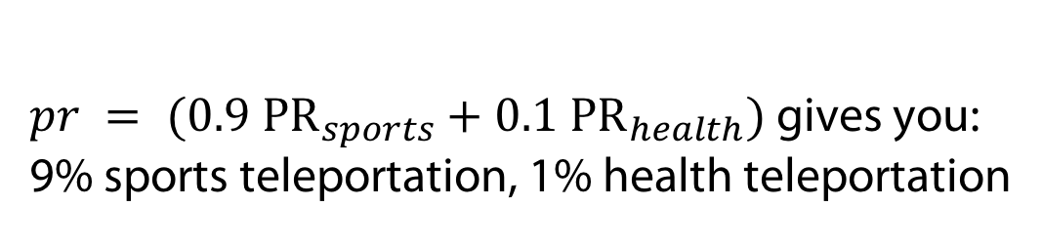
What If Many Interests?
Health
Sports
$pr = (0.9 {\text{P}\text{R}}_{sports}+0.1 {\text{PR}}_{health})$gives you:
9% sports teleportation, 1% health teleportation
  Taher H. Haveliwala, Topic-sensitive PageRank, Proceedings of the Eleventh International World Wide Web Conference, 2002

Slide 36
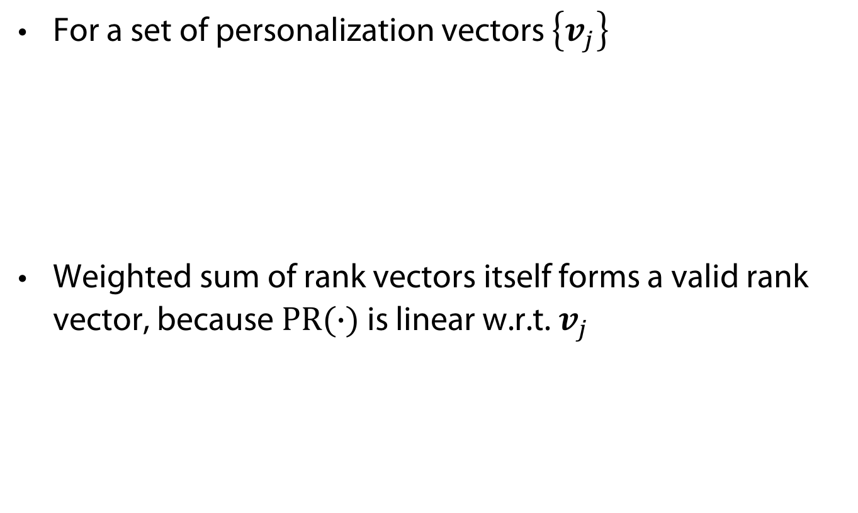
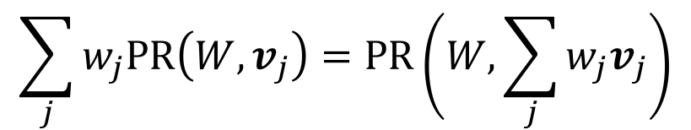
Composite Scores
For a set of personalization vectors $\left\{v_{j}\right\}$
Weighted sum of rank vectors itself forms a valid rank vector, because $\text{PR}(∙)$ is linear w.r.t. $v_{j}$
$$\sum_{j}{w_{j}\text{PR}\left(W,v_{j}\right)=\text{PR}\left(W,\sum_{j}{w_{j}v_{j}}\right)}$$
  Taher H. Haveliwala, Topic-sensitive PageRank, Proceedings of the Eleventh International World Wide Web Conference, 2002

Slide 37
Query Answering
Classify query (+ context) to choose topic(s)
  User interaction?
  Context: search history, words surrounding search phrase
Find set of relevant documents
Rank them according to composite score given topics
  Taher H. Haveliwala, Topic-sensitive PageRank, Proceedings of the Eleventh International World Wide Web Conference, 2002
Notes:
Context from query alone, words surrounding query words in text

Slide 38
Example Query Answering
Possible topic weight distribution for query “golf”
  No additional context
  How to get?
  Taher H. Haveliwala, Topic-sensitive PageRank, Proceedings of the Eleventh International World Wide Web Conference, 2002

Slide 39
Example Query Answering
Possible topic weight distribution for query “golf”
  Context: previous query “financial services investments”
  Still: How to get?
  Taher H. Haveliwala, Topic-sensitive PageRank, Proceedings of the Eleventh International World Wide Web Conference, 2002

Slide 40
Hyperlink-induced Topic Search
A
H
A
A
H
A
A
H
Hubs
Authorities
Notes:
Hubs: Lists of links
Authorities: Pool of good information

Slide 41
Hyperlink-Induced Topic Search (HITS)
In response to a query, instead of an ordered list of pages each meeting the query, find two sets of inter-related pages:
  Hub pages are good lists of links on a subject.
    e.g., “Bob’s list of cancer-related links.”
  Authority pages occur recurrently on good hubs for the subject.
Best suited for “broad topic” queries rather than for page-finding queries.
Gets at a broader slice of common opinion.
Jon M. Kleinberg, Hubs, Authorities, and Communities,
ACM Computing Surveys 31(4), December 1999

Slide 42
Hubs and Authorities
Thus, a good hub page for a topic points to many authoritative pages for that topic.
A good authority page for a topic is pointed to by many good hubs for that topic.
Circular definition - will turn this into an iterative computation.

Slide 43
The Hope
Authorities
Hubs
Long distance telephone companies

Slide 44
High-level Scheme
Extract from the web a base set of pages that could be good hubs or authorities.
From these, identify a small set of top hub and authority pages;
  Iterative algorithm.

Slide 45
Base Set
Given text query (say browser), use a text index to get all pages containing browser.
  Call this the root set of pages.
Add in any page that either
  points to a page in the root set, or
  is pointed to by a page in the root set.
Call this the base set.

Slide 46
Visualization
Root
set
Base set
46

Slide 47
Assembling the Base Set
Root set typically 200-1000 nodes.
Base set may have up to 5000 nodes.
How do you find the base set nodes?
  Follow out-links by parsing root set pages.
  Get in-links (and out-links) from a connectivity server.
  (Actually, suffices to text-index strings of the form href=“URL” to get in-links to URL.)

Slide 48
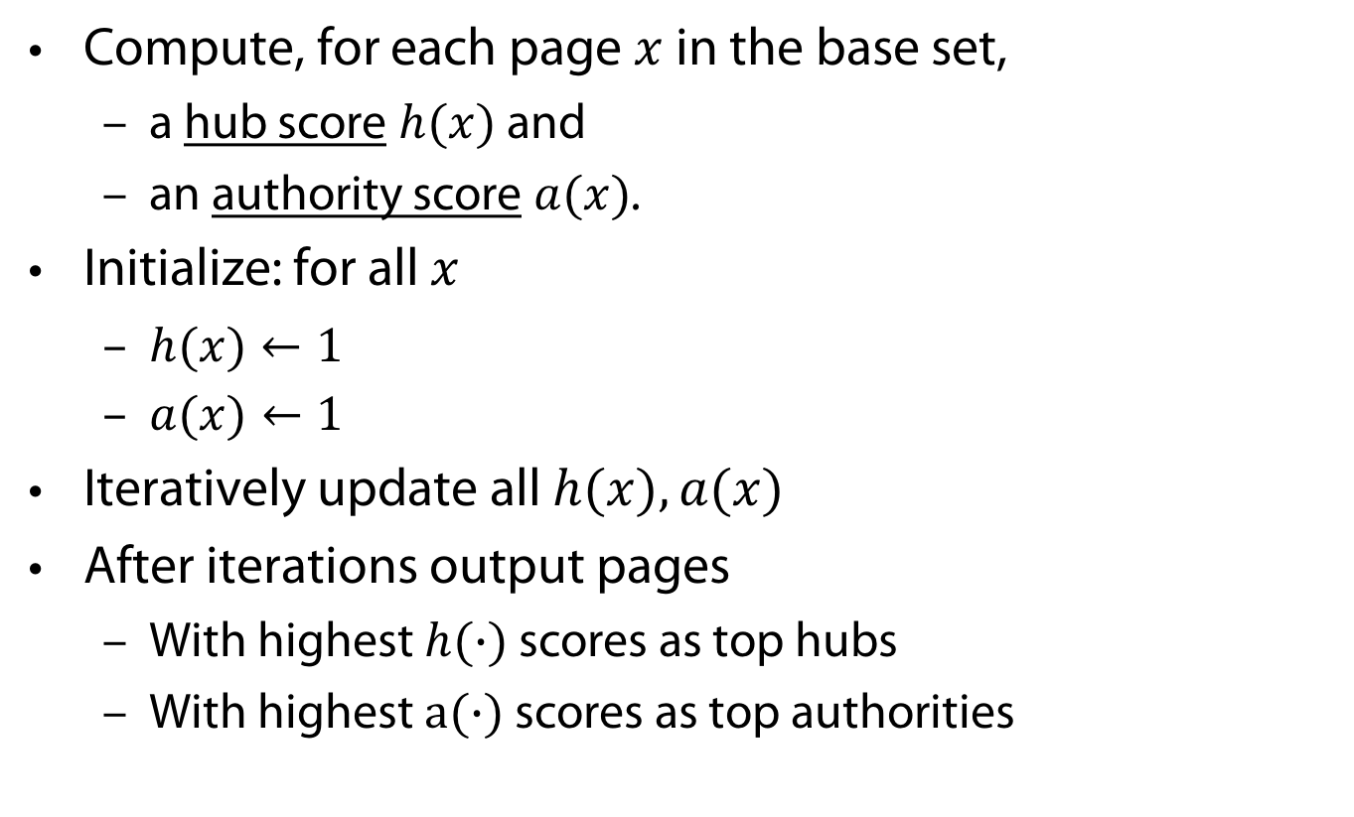
Distilling Hubs and Authorities
Compute, for each page $x$ in the base set,
  a hub score $h(x)$ and
  an authority score $a(x)$.
Initialize: for all $x$
  $h(x)←1$
  $a(x)←1$
Iteratively update all $h(x), a(x)$
After iterations output pages
  With highest $h(∙)$ scores as top hubs
  With highest $a(∙)$ scores as top authorities

Slide 49



Iterative Update
Repeat the following updates, for all $x$:
  Hub scores update
  Authority scores update
$$h(x)←\sum_{x⟶y}{a(y)}$$
x
$$a(x)←\sum_{x⟶y}{h(y)}$$
x

Slide 50

Scaling
To prevent the $h(∙)$ and $a(∙)$ values from getting too big, can scale down after each iteration.
Scaling factor does not really matter:
  We only care about the relative values of the scores.

Slide 51
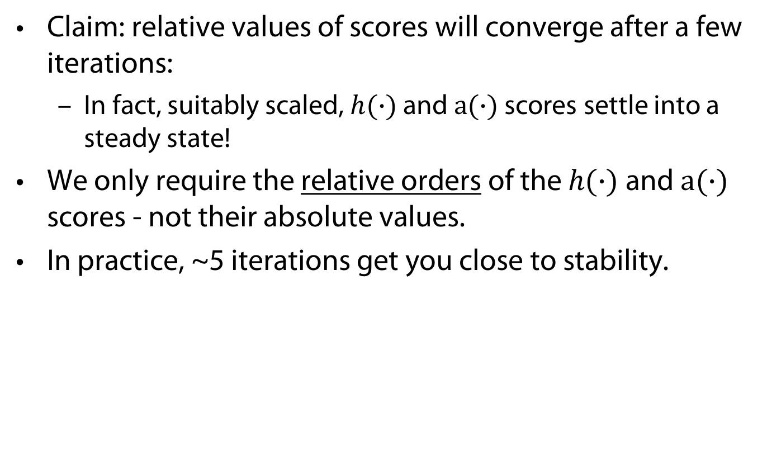
How Many Iterations?
Claim: relative values of scores will converge after a few iterations:
  In fact, suitably scaled, $h(∙)$ and $a(∙)$ scores settle into a steady state!
We only require the relative orders of the $h(∙)$ and $a(∙)$ scores - not their absolute values.
In practice, ~5 iterations get you close to stability.

Slide 52
Things to Note
Pulled together good pages regardless of language of page content.
Use only link analysis after base set assembled
  Iterative scoring is query-independent.
Iterative computation after text index retrieval - significant overhead.

Slide 53
Issues
Topic Drift
  Off-topic pages can cause off-topic “authorities” to be returned
    E.g., the neighborhood graph can be about a “super topic”
Mutually Reinforcing Affiliates
  Affiliated pages/sites can boost each others’ scores
    Linkage between affiliated pages is not a useful signal

Slide 54
Generative Topic Models for Community Analysis
Pilfered from: Ramesh Nallapati
http://www.cs.cmu.edu/~wcohen/10-802/lda-sep-18.ppt
&
Arthur Asuncion, Qiang Liu, Padhraic Smyth:
Statistical Approaches to Joint Modeling of Text and Network Data

Slide 55
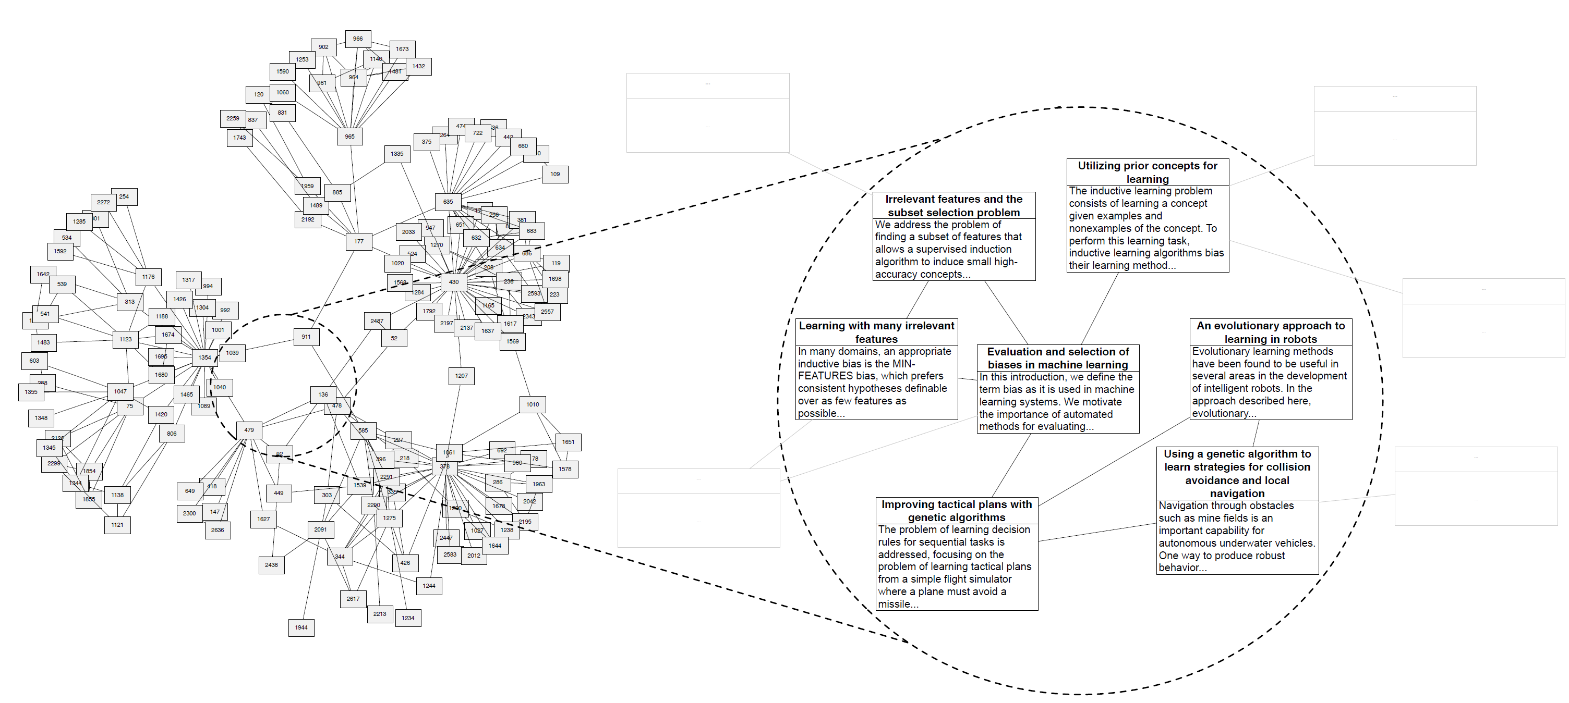
What if the corpus has network structure?
CORA citation network. Figure from [Chang, Blei, AISTATS 2009]
Notes:
Example data appropriate for the relational topic model. Each document is represented as a bag of words and linked to other documents via citation. The RTM defines a joint distribution over the words in each document and the citation links between them.

Slide 56
Citations As Links
Pioneered by Eugene Garfield since the 1960s
Citation frequency
Co-citation coupling frequency
  Cocitations with a given author measures “impact”
  Cocitation analysis
Bibliographic coupling frequency
  Articles that co-cite the same articles are related
Citation indexing
  Who is cited by author x?
PageRank (preview: Pinski and Narin ’60s)
E. Garfield, Citation analysis as a tool in journal evaluation.
Science. Nov 3;178(4060):471-9. 1972
G. Pinski, F. Narin. Citation aggregates for journal aggregates of scientific publications: Theory, with application to the literature of physics. Information Processing & Management, 12 (5), 297- 312. 1976

Slide 57
Outline
Topic Models for Community Analysis
  Citation Modeling
    with pLSA
    with LDA
  Modeling influence of citations
  Relational Topic Models

Slide 58
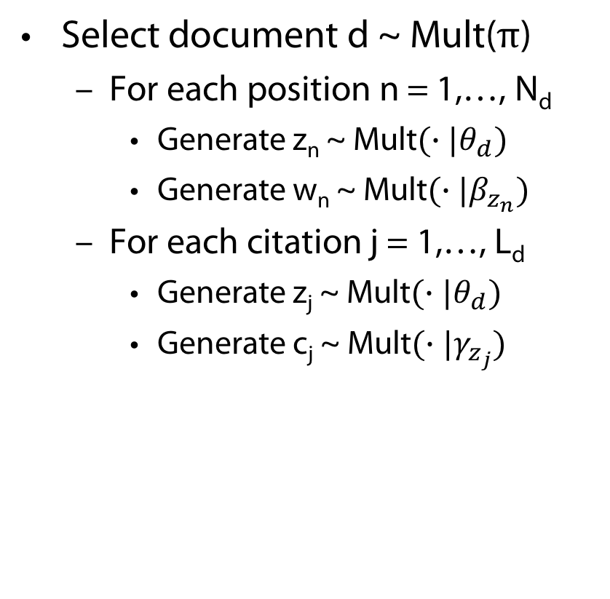
Hyperlink Modeling Using pLSA
π
Select document d ~ Mult($π$)
  For each position n = 1,…, N_{d}
    Generate z_{n} ~ Mult$(∙|θ_{d})$
    Generate w_{n} ~ Mult$(∙|β_{z_{n}})$
  For each citation j = 1,…, L_{d}
    Generate z_{j} ~ Mult$(∙|θ_{d})$
    Generate c_{j} ~ Mult$(∙|γ_{z_{j}})$
d
θ_{d}
z
z
w
c
N
L
M
β
γ
D. A. Cohn, Th. Hofmann, The Missing Link - A Probabilistic Model of Document Content and Hypertext Connectivity, In: Proc. NIPS, pp. 430-436, 2000

Slide 59


Hyperlink Modeling Using pLSA
π
pLSA likelihood
New likelihood
Learning using EM
$$\prod_{d=1}^{M}{P\left(w_{1},…,w_{N_{d}},d | θ,β,π\right)}$$
$$= \prod_{d=1}^{M}{π_{d}\left(\prod_{i=1}^{N_{d}}{\sum_{k=1}^{K}{θ_{dk}β_{kw_{n}}}}\right)}$$
d
θ_{d}
z
z
w
c
$$\prod_{d=1}^{M}{P\left(w_{1},…,w_{N_{d}},c_{1},…,c_{L_{d}},d | θ,β,γ,π\right)}$$
$$= \prod_{d=1}^{M}{π_{d}\left(\prod_{i=1}^{N_{d}}{\sum_{k=1}^{K}{θ_{dk}β_{kw_{n}}}}\right)\left(\prod_{j=1}^{L_{d}}{\sum_{k=1}^{K}{θ_{dk}γ_{kc_{j}}}}\right)}$$
N
L
M
β
γ

Slide 60

Hyperlink Modeling Using pLSA
Heuristic
  0 < α < 1 determines the relative importance of content and hyperlinks
$$\prod_{d=1}^{M}{P\left(w_{1},…,w_{N_{d}},c_{1},…,c_{L_{d}},d | θ,β,γ,π\right)}$$
$$= \prod_{d=1}^{M}{π_{d}{\left(\prod_{i=1}^{N_{d}}{\sum_{k=1}^{K}{θ_{dk}β_{kw_{n}}}}\right)}^{α}{\left(\prod_{j=1}^{L_{d}}{\sum_{k=1}^{K}{θ_{dk}γ_{kc_{j}}}}\right)}^{1−α}}$$

Slide 61
Hyperlink Modeling Using pLSA
Classification performance
Hyperlink
Content
Hyperlink
Content

Slide 62
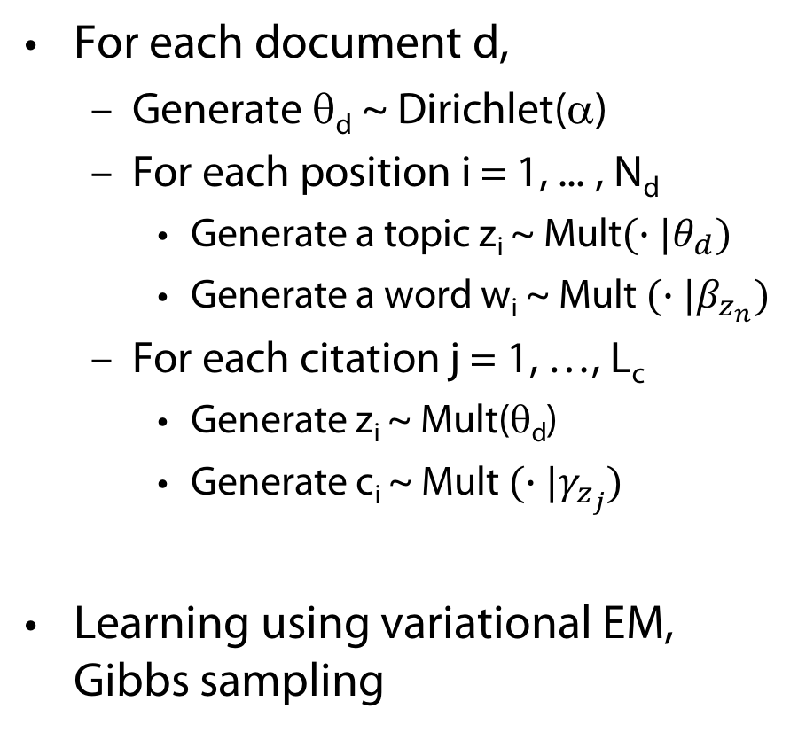
Hyperlink modeling using LDA
α
For each document d,
  Generate θ_{d} ~ Dirichlet(α)
  For each position i = 1, ... , N_{d}
    Generate a topic z_{i} ~ Mult$(∙|θ_{d})$
    Generate a word w_{i} ~ Mult $(∙|β_{z_{n}})$
  For each citation j = 1, …, L_{c}
    Generate z_{i} ~ Mult(θ_{d})
    Generate c_{i} ~ Mult $(∙|γ_{z_{j}})$
Learning using variational EM, Gibbs sampling
θ
z
z
w
c
N
L
M
β
γ
E. Erosheva, S Fienberg, J. Lafferty, Mixed-membership models of scientific publications. Proc National Academy Science U S A. 2004 Apr 6;101 Suppl 1:5220-7. Epub 2004 Mar 12.
Notes:
So far, little dependency between topic for words and for citations

Slide 63
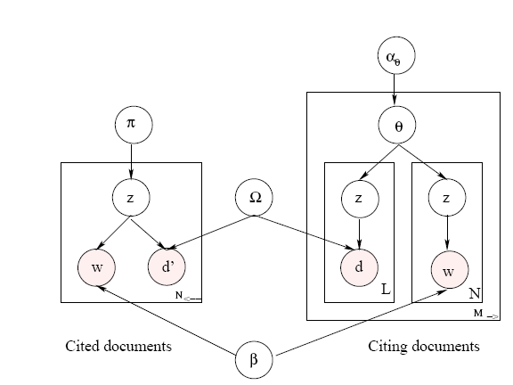

Link-PLSA-LDA: Topic Influence in Blogs
$$γ$$
R. Nallapati, A. Ahmed, E. Xing, W.W. Cohen, Joint Latent Topic Models for Text and Citations, In: Proc. KDD, 2008.
63
Notes:
2 sets of documents (blogs + links to other sites)
bipartite graph with all links emerging from the set of citing documents and pointing to the set of cited documents
i.e., assume each document can either be cited or be a citing document, but not both.
Citing documents -> LDA + citation modeling
Cited documents -> pLSA (variant after Bayes Rule transformation depicted)
set of cited documents as bins that are to be filled with words.
topic mixing proportions π for the entire set of cited documents.
words are filled into the bins N← times, where N← is the sum total of the document lengths of the set of cited documents, as follows: each time, we first sample a topic k from the mixing proportions π, then pick a bin d′ from Ωk and fill a word occurrence from β into the bin.

Slide 64
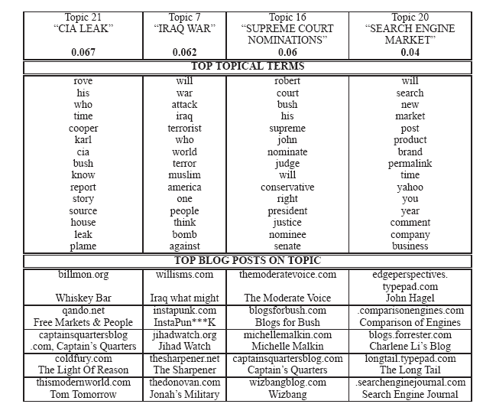
64

Slide 65
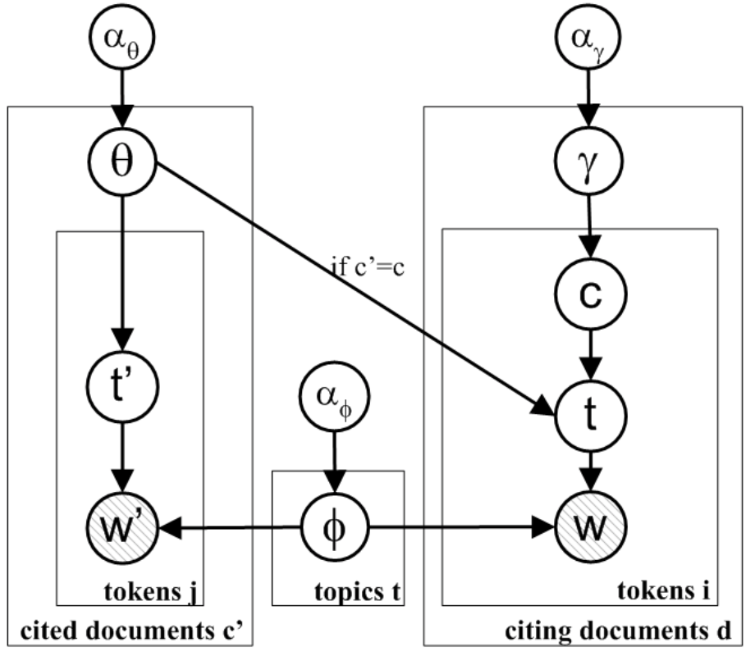
Modeling Citation Influences - Copycat Model
Each topic in a citing document is drawn from one of the topic mixtures of cited publications
L. Dietz, St. Bickel, and T. Scheffer, Unsupervised Prediction of Citation Influences, In: Proc. ICML 2007.
Notes:
Assumption: topics of a document are a mixture of the topics of its citations

Slide 66
Modeling Citation Influences
Citation influence model: Combination of LDA and Copycat model
L. Dietz, St. Bickel, and T. Scheffer, Unsupervised Prediction of Citation Influences, In: Proc. ICML 2007.
Notes:
S: Innovation (1) or inheritance (0)
Documents can be a mixture of the topics of the citations (inheritance)
Documents can be a new mixture of topics (innovation)

Slide 67
Modeling Citation Influences
Citation influence graph for LDA paper
Notes:
Subset of CiteSeer data set
Citational vicinity of the LDA paper (Blei et al., 2003) with the citation influence model.
input document collection consists of the paper along with two levels of citations in each direction.
trained with hyper parameters αφ =0.01,αθ =αψ =0.1,αλθ =3.0,αλψ =0.1, αγ = 1.0 and 30 topics.
Citation graph is filtered to only contain edges with an influence value γd(c) > 0.05.
Topic proportions are included in the visualization via a topic spectrum bar. Each of the 30 topics is represented by a unique color.
Model correctly identifies the influencing work on Dirichlet processes and variational inference as well as the relatedness to pLSA, PCA, and variational methods. It also yields possible application areas such as querying music and taxonomy learning.

Slide 68
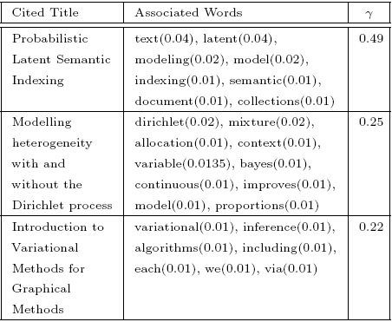
Modeling Citation Influences
Words in LDA paper assigned to citations
Notes:
lists the three most influential cites and the words assigned to them

Slide 69
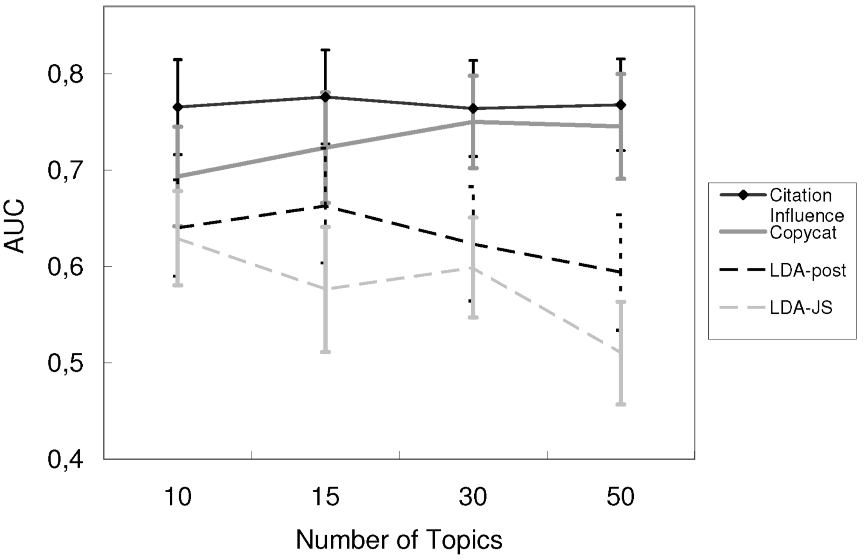
Modeling Citation Influences
Predictive Performance
Notes:
Predictive performance of the models. The error bars indicate the standard error of the AUC values averaged over the citing publications.
Experiments are conducted for 10, 15, 30, and 50 topics with the following hyper parameters tuned on a hold-out set.
Citation influence model: αφ = 0.01, αθ = αψ = 0.1,αλθ =3.0,αλψ =0.1,αγ =1.0
Copycat model: αφ = 0.01, αθ = 0.1, αγ = 1.0
LDA-JS: αφ = 0.01, αθ = 0.1
LDA-post: αφ = 0.01, αθ = 0.1
We also evaluated an approach based on the PageRank of cited nodes (with γd(c) ∝ PageRank(c)) and an approach based on the cosine similarity of TF- IDF vectors of citing and cited publications (γd(c) ∝ cos(TF IDF(d), TF IDF(c))).
AUC = Area under the ROC curve
Error bars indicate the standard error. We perform paired-t-tests for models with 15 topics with a significance level α = 5%. This reveals that the cita- tion influence model is always significantly better than the LDA-post heuristic (even for 15 topics). In con- trast to this, the citation influence model is not signifi- cantly better than the copycat model, and the copycat model is not significantly better than the LDA-post heuristic. For 30 and 50 topics, where LDA starts to degenerate, the copycat model shows a significant improvement compared to the LDA-post heuristic. Furthermore, the LDA-JS heuristic is always slightly below the LDA-post heuristic in predicting citation influences.
The approaches based on TF-IDF (AUC 0.45) and on PageRank (AUC 0.55) are not able to predict the strength of influence.

Slide 70

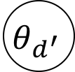

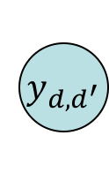
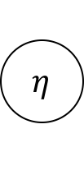








Relational Topic Model (RTM) [ChangBlei 2009]
Same setup as LDA, except now we have observed network information across documents
$$α$$
$$y_{d,d^{′}} \sim ψ\left(y_{d,d^{′}}\right|z_{d},z_{d^{′}},η)$$
“Link probability function”
$$θ_{d}$$
$$η$$
$$θ_{d^{′}}$$
$$z_{d,n}$$
$$y_{d,d^{′}}$$
$$z_{d^{′},n}$$
Documents with similar topics are more likely to be linked.
$$w_{d,n}$$
$$β_{k}$$
$$w_{d^{′},n}$$
$$N_{d}$$
K
$$N_{d^{′}}$$
M
Notes:
A two-document segment of the RTM.
The variable y indicates whether the two documents are linked.
The complete model contains this variable for each pair of documents

Slide 71
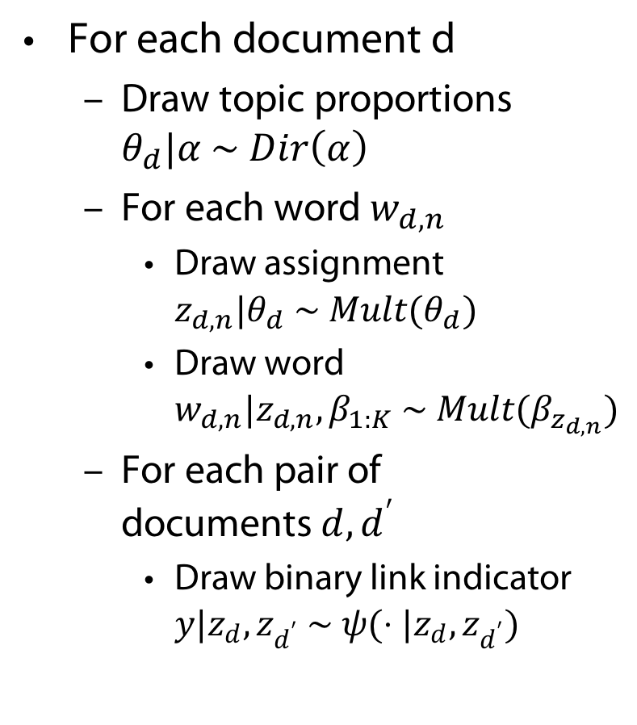
Relational Topic Model (RTM) [ChangBlei 2009]
For each document d
  Draw topic proportions $θ_{d}|α \sim Dir\left(α\right)$
  For each word $w_{d,n}$
    Draw assignment $z_{d,n}|θ_{d} \sim Mult(θ_{d})$
    Draw word $w_{d,n}|z_{d,n},β_{1:K} \sim Mult(β_{z_{d,n}})$
  For each pair of documents $d,d^{′}$
    Draw binary link indicator $y|z_{d},z_{d^{′}} \sim ψ(⋅|z_{d},z_{d^{′}})$
$$α$$
$$θ_{d}$$
$$η$$
$$θ_{d^{′}}$$
$$z_{d,n}$$
$$y_{d,d^{′}}$$
$$z_{d^{′},n}$$
$$w_{d,n}$$
$$β_{k}$$
$$w_{d^{′},n}$$
$$N_{d}$$
K
$$N_{d^{′}}$$
Notes:
true generative model for text and citations; capable of modeling arbitrary link structure
requires explicit modeling of the presence or absence of links between each pair of documents, becomes prohibitively expensive to model large scale document collections
LDA model from before more scalable

Slide 72
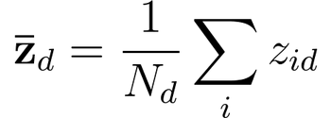
Link probability functions
Exponential:
Sigmoid:
Normal CDF:
Normal:
  where
0/1 vector of size K
Element-wise (Hadamard) product
Note: The formulation above is similar to “cosine distance”, but since we don’t divide by the magnitude, this is not a true notion of “distance”.
Notes:
\psi(y_{d,d'} = 1) = \exp(-\eta^T ({\bf \bar z}_d - {\bf \bar z}_{d'}) \circ ({\bf \bar z}_d - {\bf \bar z}_{d'}) - \nu) \quad.
8% of the time, a document is closer to another document than itself.

Slide 73
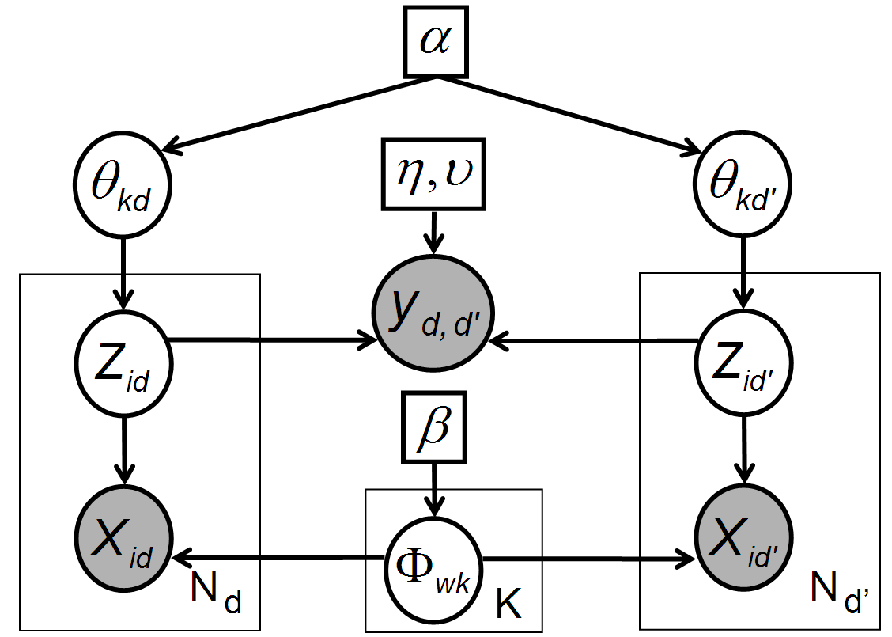
Approximate inference techniques
(because exact inference is intractable)
Collapsed Gibbs sampling (CGS):
  Integrate out Θ and Φ
  Sample each z_{id} from the conditional
  CGS for LDA: [Griffiths, Steyvers, 2004]
Fast collapsed variational Bayesian inference (“CVB0”):
  Integrate out Θ and Φ
  Update variational distribution for each z_{id} using the conditional
  CVB0 for LDA: [Asuncion, Welling, Smyth, Teh, 2009]
Other options:
  ML/MAP estimation, non-collapsed GS, non-collapsed VB, etc.

Slide 74


Collapsed Gibbs Sampling for RTM
Conditional distribution of each $z$:
Using the exponential link probability function, it is computationally efficient to calculate the “edge” term.
It is very costly to compute the “non-edge” term exactly.
$$P\left(z_{d,n}=k | z^{¬d,n},⋅\right)∝\left(N_{dk}^{¬d,n}+α\right)\frac{N_{kw}^{¬d,n}+β}{N_{k}^{¬d,n}+Wβ}$$
$$\prod_{d^{′}≠d:y_{d,d^{′}}=1}{ψ_{e}\left(y_{d,d^{′}}=1|z_{d},z_{d^{′}},η\right)}$$
$$\prod_{d^{′}≠d:y_{d,d^{′}}=0}{ψ_{e}\left(y_{d,d^{′}}=0|z_{d},z_{d^{′}},η\right)}$$
LDA term
“Edge” term
“Non-edge” term
Notes:
p(z_{id} = k | {\bf z}^{\neg id},-)
\propto & (N^{\neg id}_{dk} + \alpha) \frac{ (N^{\neg id}_{kw} + \beta) } {(N^{\neg id}_{k} + W\beta) } \\
& \prod_{d' \neq d: y_{d,d'} = 1}{\psi_e(y_{d,d'} = 1 | {\bf z}_d, {\bf z}_{d'}, \eta, \nu)} \\
& \prod_{d' \neq d: y_{d,d'} = 0}{\psi_e(y_{d,d'} = 0 | {\bf z}_d, {\bf z}_{d'}, \eta, \nu)}

Slide 75


Approximating the Non-edges
Assume non-edges are “missing” and ignore the term entirely (Chang/Blei)
Make the following fast approximation:
Subsample non-edges and exactly calculate the term over subset.
Subsample non-edges but instead of recalculating statistics for every $z_{d,n}$ token, calculate statistics once per document and cache them over each Gibbs sweep.
$$\prod_{i}{\left(1−exp⁡\left(c_{i}\right)\right)}≈{\left(1−\exp\left({\overline{c}}_{i}\right)\right)}^{N}, \text{where} {\overline{c}}_{i}= \frac{1}{N}\sum_{i}{c_{i}}$$

Slide 76
Variational inference
Minimize Kullback-Leibler (KL) divergence between true posterior and “variational” posterior (equivalent to maximizing “evidence lower bound”):
Typically we use a factorized variational posterior for computational reasons:
Jensen’s inequality.
Gap = KL [q, p(h|y)]
By maximizing this lower bound, we are implicitly minimizing KL (q, p)

Slide 77



CVB0 inference for topic models
[Asuncion, Welling, Smyth, Teh, 2009]
Collapsed Gibbs sampling:
Collapsed variational inference (0th-order approx):
Statistics affected by q(z_{id}):
  Counts in LDA term:
  Counts in Hadamard product:
“Soft” Gibbs update
Deterministic
Very similar to ML/MAP estimation

Slide 78



Parameter estimation
Step-size
We learn the parameters of the link function (γ = [η, ν]) via gradient ascent:
We learn parameters (α, β) via a fixed-point algorithm [Minka 2000].
  Also possible to Gibbs sample α, β
Notes:
78

Slide 79
Document networks
 | # Docs | # Links | Ave. Doc-Length | Vocab-Size | Link Semantics
CORA | 4,000 | 17,000 | 1,200 | 60,000 | Paper citation (undirected)
Netflix Movies | 10,000 | 43,000 | 640 | 38,000 | Common actor/director
Enron (Undirected) | 1,000 | 16,000 | 7,000 | 55,000 | Communication between person i and person j
Enron (Directed) | 2,000 | 21,000 | 3,500 | 55,000 | Email from person i to person j

Slide 80
Link Rank
“Link rank” on held-out data as evaluation metric
  Lower is better
How to compute link rank (simplified):
  Train model with {d_{train}}.
  Given the model, calculate probability that d_{test} would link to each d_{train}. Rank {d_{train}} according to these probabilities.
  For each observed link between d_{test} and {d_{train}}, find the “rank”, and average all these ranks to obtain the “link rank”
d_{test}
{d_{train}}
Black-box predictor
Ranking over {d_{train}}
Link ranks
Edges among {d_{train}}
Edges between d_{test} and {d_{train}}

Slide 81
Link Rank
“Link rank” on held-out data as evaluation metric
  Lower is better
How to compute link rank:
  Run RTM Gibbs sampler on {d_{train}} and obtain {Φ, Θ_{train}, η, ν}
  Given Φ, fold in d_{test} to obtain Θ_{test}
  Given {Θ_{train}, Θ_{test}, η, ν}, calculate probability that d_{test} would link to each d_{train}. Rank {d_{train}} according to these probabilities.
  For each observed link between d_{test} and {d_{train}}, find the “rank”, and average all these ranks to obtain the “link rank”
d_{test}
{d_{train}}
Black-box predictor
Ranking over {d_{train}}
Link ranks
Edges among {d_{train}}
Edges between d_{test} and {d_{train}}

Slide 82
Results on CORA data
8-fold cross-validation. Random guessing gives link rank = 2000.

Slide 83
Results on CORA data
Model does better with more topics
Model does better with more words in each document

Slide 84
Timing Results on CORA
“Subsampling (20%) without caching” not shown since it takes 62,000 seconds for D=1000 and 3,720,150 seconds for D=4000

Slide 85
CGS vs. CVB0 inference
Total time:
CGS = 5285 seconds
CVB0 = 4191 seconds
CVB0 converges more quickly. Also, each iteration is faster due to clumping of data points.

Slide 86
Results on Netflix
 | NETFLIX, K=20
Random Guessing | 5000
Baseline (TF-IDF / Cosine) | 541
LDA + Regression | 2321
Ignoring Non-Edges | 1955
Fast Approximation | 2089 (Note K=50: 1256)
Subsampling 5% + Caching | 1739
Baseline does very well!
Needs more investigation…

Slide 87
Some Netflix topics
POLICE: [t2] police agent kill gun action escape car film
DISNEY: [t4] disney film animated movie christmas cat animation story
AMERICAN: [t5] president war american political united states government against
CHINESE: [t6] film kong hong chinese chan wong china link
WESTERN: [t7] western town texas sheriff eastwood west clint genre
SCI-FI: [t8] earth science space fiction alien bond planet ship
AWARDS: [t9] award film academy nominated won actor actress picture
WAR: [t20] war soldier army officer captain air military general
FRENCH: [t21] french film jean france paris fran les link
HINDI: [t24] film hindi award link india khan indian music
MUSIC: [t28] album song band music rock live soundtrack record
JAPANESE: [t30] anime japanese manga series english japan retrieved character
BRITISH: [t31] british play london john shakespeare film production sir
FAMILY: [t32] love girl mother family father friend school sister
SERIES: [t35] series television show episode season character episodes original
SPIELBERG: [t36] spielberg steven park joe future marty gremlin jurassic
MEDIEVAL [t37] king island robin treasure princess lost adventure castle
GERMAN: [t38] film german russian von germany language anna soviet
GIBSON: [t41] max ben danny gibson johnny mad ice mel
MUSICAL: [t42] musical phantom opera song music broadway stage judy
BATTLE: [t43] power human world attack character battle earth game
MURDER: [t46] death murder kill police killed wife later killer
SPORTS: [t47] team game player rocky baseball play charlie ruth
KING: [t48] king henry arthur queen knight anne prince elizabeth
HORROR: [t49] horror film dracula scooby doo vampire blood ghost

Slide 88



Some movie examples
'Sholay'
  Indian film, 45% of words belong to topic 24 (Hindi topic)
  Top 5 most probable movie links in training set:
    'Laawaris‘
    'Hote Hote Pyaar Ho Gaya‘
    'Trishul‘
    'Mr. Natwarlal‘
    'Rangeela‘
‘Cowboy’
  Western film, 25% of words belong to topic 7 (western topic)
  Top 5 most probable movie links in training set:
    'Tall in the Saddle‘
    'The Indian Fighter'
    'Dakota'
    'The Train Robbers'
    'A Lady Takes a Chance‘
‘Rocky II’
  Boxing film, 40% of words belong to topic 47 (sports topic)
  Top 5 most probable movie links in training set:
    'Bull Durham‘
    '2003 World Series‘
    'Bowfinger‘
    'Rocky V‘
    'Rocky IV'

Slide 89
Directed vs. Undirected RTM on ENRON emails
Undirected: Aggregate incoming & outgoing emails into 1 document
Directed: Aggregate incoming emails into 1 “receiver” document and outgoing emails into 1 “sender” document
Directed RTM performs better than undirected RTM
Random guessing: link rank=500
Notes:
.\quad \psi(y_{d\rightarrow d'} = 1) = \exp(\eta^T ({\bf \bar z}_{d_{\text{sender}}} \circ {\bf \bar z}_{d'_{\text{receiver}}}) + \nu) \quad.

Slide 90


Discussion
RTM is similar to latent space models:
Topic mixtures (the “topic space”) can be combined with the other dimensions (the “social space”) to create a combined latent position z.
Other extensions:
  Include other attributes in the link probability (e.g. timestamp of email, language of movie)
  Use non-parametric prior over dimensionality of latent space (e.g. use Dirichlet processes)
  Place a hierarchy over {θ_{d}} to learn clusters of documents – similar to latent position cluster model [Handcock, Raftery, Tantrum, 2007]
Projection model
[Hoff, Raftery, Handcock, 2002]
Multiplicative latent factor model
[Hoff, 2006]
RTM

Slide 91
Conclusion
Relational topic modeling provides a useful start for combining text and network data in a single statistical framework
RTM can improve over simpler approaches for link prediction
Opportunities for future work:
  Faster algorithms for larger data sets
  Better understanding of non-edge modeling
  Extended models

