Slide 1
Web-Mining Agents Agents and Rational Behavior Decision-Making under Uncertainty
Ralf Möller
Universität zu Lübeck
Institut für Informationssysteme

Slide 2
Decision Networks
Extend BNs to handle actions and utilities
Also called influence diagrams
Use BN inference methods to solve
Perform Value of Information calculations

Slide 3
Decision Networks cont.
Chance nodes: random variables, as in BNs
Decision nodes: actions that decision maker can take
Utility/value nodes: the utility of the outcome state.

Slide 4
Umbrella Network
take/don’t take
P(rain) = 0.4
umbrella
weather
have umbrella
P(have|take) = 1.0
P(~have|~take)=1.0
forecast
happiness
f w p(f|w)
sunny rain 0.3
rainy rain 0.7
sunny no rain 0.8
rainy no rain 0.2
U(have,rain) = -25
U(have,~rain) = 0
U(~have, rain) = -100
U(~have, ~rain) = 100

Slide 5
Evaluating Decision Networks
Set the evidence variables for current state
For each possible value of the decision node:
Set decision node to that value
Calculate the posterior probability of the parent nodes of the utility node, using BN inference
Calculate the resulting utility for action
Return the action with the highest utility

Slide 6
Decision Making: Umbrella Network
Should I take my umbrella??
take/don’t take
P(rain) = 0.4
umbrella
weather
have umbrella
P(have|take) = 1.0
P(~have|~take)=1.0
forecast
happiness
f w p(f|w)
sunny rain 0.3
rainy rain 0.7
sunny no rain 0.8
rainy no rain 0.2
U(have,rain) = -25
U(have,~rain) = 0
U(~have, rain) = -100
U(~have, ~rain) = 100

Slide 7
Value of information

Slide 8
General formula

Slide 9
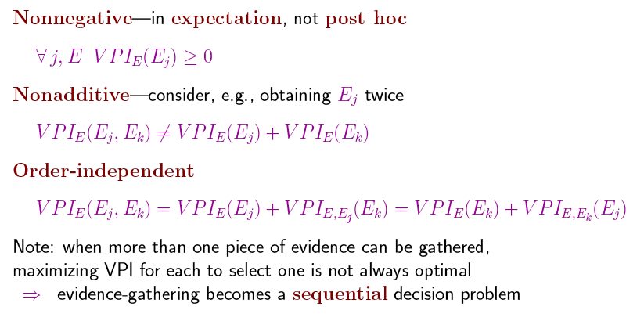
Properties of VPI

Slide 10
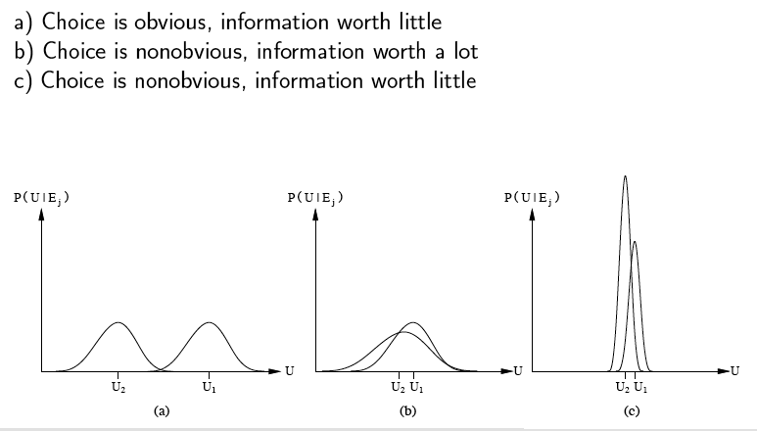
Qualitative behaviors
Three generic cases for the value of information. In (a), a1 will almost certainly remain superior to a2, so the information is not needed. In (b), the choice is unclear and the information is crucial. In (c), the choice is unclear, but because it makes little difference, the information is less valuable. (Note: The fact that U2 has a high peak in (c) means that its expected value is known with higher certainty than U1.)

Slide 11
Information Gathering Agent
Ask questions Request(E_{j}) in a reasonable order
Avoid irrelevant questions
Take into account imporance of piece of information j in relation to Cost(E_{j})

Slide 12
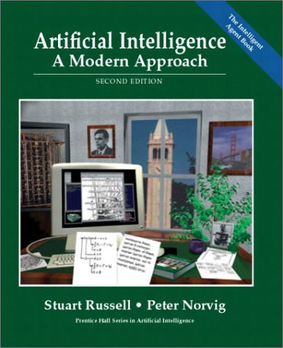
Literature
Chapter 17
Material from Lise Getoor, Jean-Claude Latombe, Daphne Koller, and Stuart Russell

Slide 13
Simple Robot Navigation Problem
In each state, the possible actions are U, D, R, and L

Slide 14
Probabilistic Transition Model
In each state, the possible actions are U, D, R, and L
The effect of U is as follows (transition model):
With probability 0.8 the robot moves up one square (if the robot is already in the top row, then it does not move)

Slide 15
Probabilistic Transition Model
In each state, the possible actions are U, D, R, and L
The effect of U is as follows (transition model):
With probability 0.8 the robot moves up one square (if the robot is already in the top row, then it does not move)
With probability 0.1 the robot moves right one square (if the robot is already in the rightmost row, then it does not move)

Slide 16
Probabilistic Transition Model
In each state, the possible actions are U, D, R, and L
The effect of U is as follows (transition model):
With probability 0.8 the robot moves up one square (if the robot is already in the top row, then it does not move)
With probability 0.1 the robot moves right one square (if the robot is already in the rightmost row, then it does not move)
With probability 0.1 the robot moves left one square (if the robot is already in the leftmost row, then it does not move)

Slide 17
Markov Property
The transition properties depend only on the current state, not on previous history (how that state was reached)

Slide 18
Sequence of Actions
[3,2]
3
2
1
1
2
3
4
Planned sequence of actions: (U, R)

Slide 19
Sequence of Actions
[3,2]
3
2
[3,2]
[3,3]
[4,2]
1
1
2
3
4
Planned sequence of actions: (U, R)
U is executed

Slide 20
Histories
[3,2]
3
2
[3,2]
[3,3]
[4,2]
1
[3,1]
[3,2]
[3,3]
[4,1]
[4,2]
[4,3]
1
2
3
4
Planned sequence of actions: (U, R)
U has been executed
R is executed
There are 9 possible sequences of states – called histories – and 6 possible final states for the robot!

Slide 21
Probability of Reaching the Goal
3
Note importance of Markov property
in this derivation
2
1
1
2
3
4
P([4,3] | (U,R).[3,2]) =
P([4,3] | R.[3,3]) x P([3,3] | U.[3,2]) + P([4,3] | R.[4,2]) x P([4,2] | U.[3,2])
P([4,3] | R.[3,3]) = 0.8
P([4,3] | R.[4,2]) = 0.1
P([3,3] | U.[3,2]) = 0.8
P([4,2] | U.[3,2]) = 0.1
P([4,3] | (U,R).[3,2]) = 0.65

Slide 22
Utility Function
3
+1
2
-1
1
1
2
3
4
[4,3] provides power supply
[4,2] is a sand area from which the robot cannot escape

Slide 23
Utility Function
3
+1
2
-1
1
1
2
3
4
[4,3] provides power supply
[4,2] is a sand area from which the robot cannot escape
The robot needs to recharge its batteries

Slide 24
Utility Function
3
+1
2
-1
1
1
2
3
4
[4,3] provides power supply
[4,2] is a sand area from which the robot cannot escape
The robot needs to recharge its batteries
[4,3] or [4,2] are terminal states

Slide 25
Utility of a History
3
+1
2
-1
1
1
2
3
4
[4,3] provides power supply
[4,2] is a sand area from which the robot cannot escape
The robot needs to recharge its batteries
[4,3] or [4,2] are terminal states
The utility of a history is defined by the utility of the last state (+1 or –1) minus n/25, where n is the number of moves

Slide 26
Utility of an Action Sequence
3
+1
2
-1
1
1
2
3
4
Consider the action sequence (U,R) from [3,2]

Slide 27
Utility of an Action Sequence
+1
[3,2]
3
2
-1
[3,2]
[3,3]
[4,2]
1
[3,1]
[3,2]
[3,3]
[4,1]
[4,2]
[4,3]
1
2
3
4
Consider the action sequence (U,R) from [3,2]
A run produces one among 7 possible histories, each with some probability

Slide 28
Utility of an Action Sequence
+1
[3,2]
3
2
-1
[3,2]
[3,3]
[4,2]
1
[3,1]
[3,2]
[3,3]
[4,1]
[4,2]
[4,3]
1
2
3
4
Consider the action sequence (U,R) from [3,2]
A run produces one among 7 possible histories, each with some probability
The utility of the sequence is the expected utility of the histories: U = Σ_{h}U_{h} P(h)

Slide 29
Optimal Action Sequence
+1
[3,2]
3
2
-1
[3,2]
[3,3]
[4,2]
1
[3,1]
[3,2]
[3,3]
[4,1]
[4,2]
[4,3]
1
2
3
4
Consider the action sequence (U,R) from [3,2]
A run produces one among 7 possible histories, each with some probability
The utility of the sequence is the expected utility of the histories
The optimal sequence is the one with maximal utility

Slide 30
Optimal Action Sequence
+1
[3,2]
3
2
-1
[3,2]
[3,3]
[4,2]
1
[3,1]
[3,2]
[3,3]
[4,1]
[4,2]
[4,3]
1
2
3
4
Consider the action sequence (U,R) from [3,2]
A run produces one among 7 possible histories, each with some probability
The utility of the sequence is the expected utility of the histories
The optimal sequence is the one with maximal utility
But is the optimal action sequence what we want to compute?
only if the sequence is executed blindly!

Slide 31
Reactive Agent Algorithm
Repeat:
s ← sensed state
If s is terminal then exit
a ← choose action (given s)
Perform a
Accessible or
observable state

Slide 32
Policy (Reactive/Closed-Loop Strategy)
3
+1
2
-1
1
1
2
3
4
A policy Π is a complete mapping from states to actions

Slide 33
Reactive Agent Algorithm
Repeat:
s ← sensed state
If s is terminal then exit
a ← Π(s)
Perform a

Slide 34
Optimal Policy
3
+1
2
-1
1
1
2
3
4
Note that [3,2] is a “dangerous”
state that the optimal policy
tries to avoid
A policy Π is a complete mapping from states to actions
The optimal policy Π* is the one that always yields a history (ending at a terminal state) with maximal
expected utility
Makes sense because of Markov property

Slide 35
Optimal Policy
3
+1
2
-1
1
1
2
3
4
This problem is called a
Markov Decision Problem (MDP)
A policy Π is a complete mapping from states to actions
The optimal policy Π* is the one that always yields a history with maximal expected utility
How to compute Π*?

Slide 36
Additive Utility
History H = (s₀,s₁,…,s_{n})
The utility of H is additive iff: U(s₀,s₁,…,s_{n}) = R(0) + U(s₁,…,s_{n}) = Σ R(i)
Reward

Slide 37
Web-Mining Agents Agents and Rational Behavior Decision-Making under Uncertainty
Ralf Möller
Universität zu Lübeck
Institut für Informationssysteme

Slide 38
Additive Utility
History H = (s₀,s₁,…,s_{n})
The utility of H is additive iff: U(s₀,s₁,…,s_{n}) = R(0) + U(s₁,…,s_{n}) = Σ R(i)
Robot navigation example:
R(n) = +1 if s_{n} = [4,3]
R(n) = -1 if s_{n} = [4,2]
R(i) = -1/25 if i = 0, …, n-1

Slide 39
Principle of Max Expected Utility
History H = (s₀,s₁,…,s_{n})
Utility of H: U(s₀,s₁,…,s_{n}) = Σ R(i)
First-step analysis →
U(i) = R(i) + max_{a} Σ_{j}P(j | a.i) U(j)
Π*(i) = arg max_{a} Σ_{k}P(k | a.i) U(k)
+1
-1
Some authors use a so-called discounting factor 𝛾 ∈ [0, 1] in front of the summation

Slide 40
Value Iteration
Initialize the utility of each non-terminal state s_{i} to U₀(i) = 0
For t = 0, 1, 2, …, do: U_{t+1}(i) ← R(i) + max_{a} Σ_{k}P(k | a.i) U_{t}(k)
3
+1
2
-1
1
1
2
3
4

Slide 41
Value Iteration
Note the importance
of terminal states and
connectivity of the
state-transition graph
Initialize the utility of each non-terminal state s_{i} to U₀(i) = 0
For t = 0, 1, 2, …, do: U_{t+1}(i) ← R(i) + max_{a} Σ_{k}P(k | a.i) U_{t}(k)
U_{t}([3,1])
0.812
0.868
0.918
+1
3
0.611
0.5
0.762
0.660
-1
2
0
1
0.705
0.655
0.611
0.388
1
2
3
4
0
10
20
30
t

Slide 42
Policy Iteration
Pick a policy Π at random

Slide 43
Policy Iteration
Pick a policy Π at random
Repeat:
Compute the utility of each state for Π U_{t+1}(i) ← R(i) + Σ_{k}P(k | Π(i).i) U_{t}(k)

Slide 44
Policy Iteration
Pick a policy Π at random
Repeat:
Compute the utility of each state for Π U_{t+1}(i) ← R(i) + Σ_{k}P(k | Π(i).i) U_{t}(k)
Compute the policy Π’ given these utilities Π’(i) = arg max_{a} Σ_{k}P(k | a.i) U(k)

Slide 45
Policy Iteration
Pick a policy Π at random
Repeat:
Compute the utility of each state for Π U_{t+1}(i) ← R(i) + Σ_{k}P(k | Π(i).i) U_{t}(k)
Compute the policy Π’ given these utilities Π’(i) = arg max_{a} Σ_{k}P(k | a.i) U(k)
If Π’ = Π then return Π
Or solve the set of linear equations:
U(i) = R(i) + Σ_{k}P(k | Π(i).i) U(k)
(often a sparse system)

Slide 46
New Problems
Uncertainty about the action outcome
Uncertainty about the world state due to imperfect (partial) information

Slide 47
POMDP (Partially Observable Markov Decision Problem)
A sensing operation returns multiple states, with a probability distribution
Choosing the action that maximizes the
expected utility of this state distribution assuming “state utilities” computed as
above is not good enough, and actually
does not make sense (is not rational)

Slide 48
Literature
Chapter 17
Material from Xin Lu

Slide 49
Outline
POMDP agent
Constructing a new MDP in which the current probability distribution over states plays the role of the state variable
Decision-theoretic Agent Design for POMDP
A limited lookahead using the technology of decision networks

Slide 50
Decision cycle of a POMDP agent
Action
World
Observation
b
SE
Agent
Given the current belief state b, execute the action
Receive observation o
Set the current belief state to SE(b,a,o) and repeat (SE = State Estimation)

Slide 51
Belief state
b(s) is the probability assigned to the actual state s by belief state b.
0.111 | 0.111 | 0.111 | 0.000
0.111 |  | 0.111 | 0.000
0.111 | 0.111 | 0.111 | 0.111
Notes:
I think there is only one belief state. Having more means ad distribution over belief states. What should this be?
But this one belief state distribution is orthogonal to Utilities, these are the same for all belief states.

Slide 52
Belief MDP
A belief MDP is a tuple <B, A, ρ, P>:
B = infinite set of belief states
A = finite set of actions
ρ(b) = ∑_{s} b(s)R(s) (reward function)
P(b’|b, a) = (transition function) (see SE(b,a,o))
Where P(b’|b, a, o) = 1 if SE(b, a, o) = b’, P(b’|b, a, o) = 0 otherwise;
b
Move West once
b’
0.111 | 0.111 | 0.111 | 0.000
0.111 |  | 0.111 | 0.000
0.111 | 0.111 | 0.111 | 0.111
0.222 | 0.111 | 0.000 | 0.000
0.111 |  | 0.111 | 0.000
0.222 | 0.111 | 0.111 | 0.000

Slide 53
Example Scenario

Slide 54
Detailed view
Probability of an observation e P(e|a,b) = ∑_{s’} P(e|a,s’,b) P(s’|a,b) = ∑_{s’} P(e|s’) P(s’|a,b) = ∑_{s’} P(e|s’) ∑_{s} P(s’|s,a) b(s)
Probability of reaching b’ from b, given action a P(b’|b,a) = ∑_{e} P(b’|e,a,b) P(e|a,b) = ∑_{e} P(b’|e,a,b) ∑_{s’} P(e|s’) ∑_{s} P(s’|s,a) b(s) Where P(b’|e,a,b) = 1 if SE(b, a, e) = b’ and P(b’|b, a, e) = 0 otherwise
P(b’|b,a) and ρ(b) define an observable MDP on the space of belief states.
Solving a POMDP on a physical state space is reduced to solving an MDP on the corresponding belief-state space.

Slide 55
Conditional Plans
Example: Two state world 0,1
Example: Two actions: stay(p), go(p)
Actions achieve intended effect with some probability p
One-step plan [go], [stay]
Two-step plans are conditional
[a1, IF percept = 0 THEN a2 ELSE a3]
Shorthand notation: [a1, a2/a3]
n-step plans are trees with
nodes attached with actions and
edges attached with percepts

Slide 56
Value Iteration for POMDPs
Cannot compute a single utility value for each state of all belief states.
Consider an optimal policy π* and its application in belief state b.
For this b the policy is a “conditional plan”
Let the utility of executing a fixed conditional plan p in s be u_{p}(s). Expected utility U_{p}(b) = ∑_{s} b(s) u_{p}(s) It varies linearly with b, a hyperplane in a belief space
At any b, the optimal policy will choose the conditional plan with the highest expected utility U(b) = U _{π*} (b) π* = argmax_{p} b*u_{p} (summation as dot-prod.)
U(b) is the maximum of a collection of hyperplanes and will be piecewise linear and convex

Slide 57
Example
Utility of two one-step plans as a function of b(1)
We can compute the utilities for conditional plans of depth-2 by considering each possible first action, each possible subsequent percept and then each way of choosing a depth-1 plan to execute for each percept

Slide 58
Example
Two state world 0,1. R(0)=0, R(1)=1
Two actions: stay (0.9), go (0.9)
The sensor reports the correct state with prob. 0.6
Consider the one-step plans [stay] and [go]
u_{[stay]}(0)=R(0) + 0.9R(0)+0.1R(1) = 0.1
u_{[stay]} (1)=R(1) + 0.9R(1)+0.1R(0) = 1.9
u_{[go]} (0)=R(0) + 0.9R(1)+0.1R(0) = 0.9
u_{[go]} (1)=R(1) + 0.9R(0)+0.1R(1) = 1.1
This is just the direct reward function (taken into account the probabilistic transitions)

Slide 59
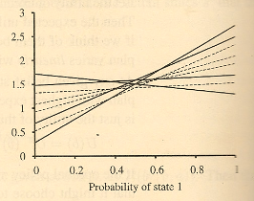
Example
8 distinct depth-2 plans. 4 are suboptimal across the entire belief space (dashed lines).
u_{stay}(0)
u_{stay}(1)
u_{[stay,stay/stay]}(0)=R(0) + (0.9*(0.6*0.1 + 0.4*0.1) + 0.1*(0.6*1.9 + 0.4*1.9))=0.28
u_{[stay,stay/stay]}(1)=R(1) + (0.9*(0.6*1.9 + 0.4*1.9) + 0.1*(0.6*0.1 + 0.4*0.1))=2.72
u_{[go,stay/stay]}(0)=R(0) + (0.9*(0.6*1.9 + 0.4*1.9) + 0.1*(0.6*0.1 + 0.4*0.1))=1.72
u_{[go,stay/stay]}(1)=R(1) + (0.9*(0.6*0.1 + 0.4*0.1) + 0.1*(0.6*1.9 + 0.4*1.9))=1.28
u_{stay}(1)
u_{stay}(0)

Slide 60
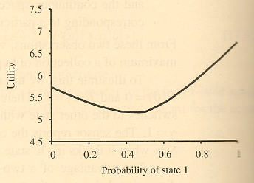
Example
Utility of four undominated two-step plans
Utility function for optimal eight step plans

Slide 61
General formula
Let p be a depth-d conditional plan whose initial action is a and whose depth-d-1 subplan for percept e is p.e, then u_{p}(s) = R(s) + ∑_{s’} P(s’| s,a) ∑_{e} P(e|s’) u_{p.e}(s’)
This gives us a value iteration algorithm
The elimination of dominated plans is essential for reducing doubly exponential growth: the number of undominated plans with d=8 is just 144, otherwise 2²⁵⁵ (|A| ^{O(|E|d-1)})
For large POMDPs this approach is highly inefficient

Slide 62
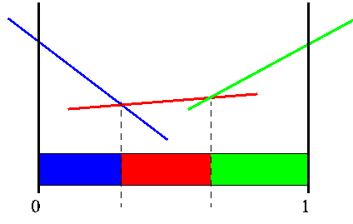
Solutions for POMDP
Belief MDP has reduced POMDP to MDP, the MDP obtained has a multidimensional continuous state space.
Methods based on value and policy iteration:
A policy can be represented as a set of regions of belief state space, each of which is associated with a particular optimal action. The value function associates a distinct linear function of b with each region. Each value or policy iteration step refines the boundaries of the regions and may introduce new regions.
Notes:
Methods based on value and policy iteration focus on finding optimal policies. For some POMDPs, the optimal policy has infinitely many regions , so the simple list-of-regions approach fails and more ingenious methods are needed.
The policy is a sequence which gives the mapping from all states to all corresponding actions. So the agents using these methods have to memorize all the possible states from the very beginning of solving the problem. If the problems are more complex with observations and with a few dozen states, the methods will not work or work inefficiently. That means maybe sometimes the agent update policy with some states they will hardly get into.
Method based on lookahead search which we will describe next is a different, approximate method for solving those complex POMDPs.

Slide 63
Agent Design: Decision Theory
= probability theory + utility theory
The fundamental idea of decision theory is that an agent is rational if and only if it chooses the action that yields the highest expected utility, averaged over all possible outcomes of the action.

Slide 64
A Decision-Theoretic Agent
function DECISION-THEORETIC-AGENT(percept) returns action
calculate updated probabilities for current state based on available evidence including current percept and previous action
calculate outcome probabilities for actions
given action descriptions and probabilities of current states
select action with highest expected utility
given probabilities of outcomes and utility information
return action

Slide 65
Dynamic Bayesian Decision Networks
U.t+3
D.t-1
D.t
D.t+1
D.t+2
State.t
State.t+1
State.t+2
State.t+3
R.t
R.t+1
R.t+2
Sense.t
Sense.t+1
Sense.t+2
Sense.t+3
The decision problem involves calculating the value of that maximizes the agent’s expected utility over the remaining state sequence.
Notes:
Dt-1 is treated as evidence because it has already happened.

Slide 66
Search Tree of the Lookahead DDN
in
in
in
10 -4 -6 3
Notes:
Each of the triangular nodes is a belief state in which the agent make a decision Dt+i.
The round nodes correspond to choices by the environment as to what observation Et+i occurs.
There are no chance nodes corresponding to the action outcomes. This is because the belief state update for an action is deterministic regardless of the actual outcome.
A decision can be extracted from the search tree by backing up the utility values from the leaves, taking an average at the chances nodes and taking the maximum at the decision nodes.
What’s the difference between this search tree and policy tree?

Slide 67
Discussion of DDNs
DDNs provide a general, concise representation for large POMDPs
Agent systems moved from
static, accessible, and simple environments to
dynamic, inaccessible, and complex environments that are closer to the real world
However, exact algorithms are exponential

Slide 68
Perspectives of DDNs to Reduce Complexity
Combined with a heuristic estimate for the utility of the remaining steps
Incremental pruning techniques
Many approximation techniques:
Using less detailed state variables for states in the distant future.
Using a greedy heuristic search through the space of decision sequences.
Assuming “most likely” values for future percept sequences rather than considering all possible values
…

Slide 69
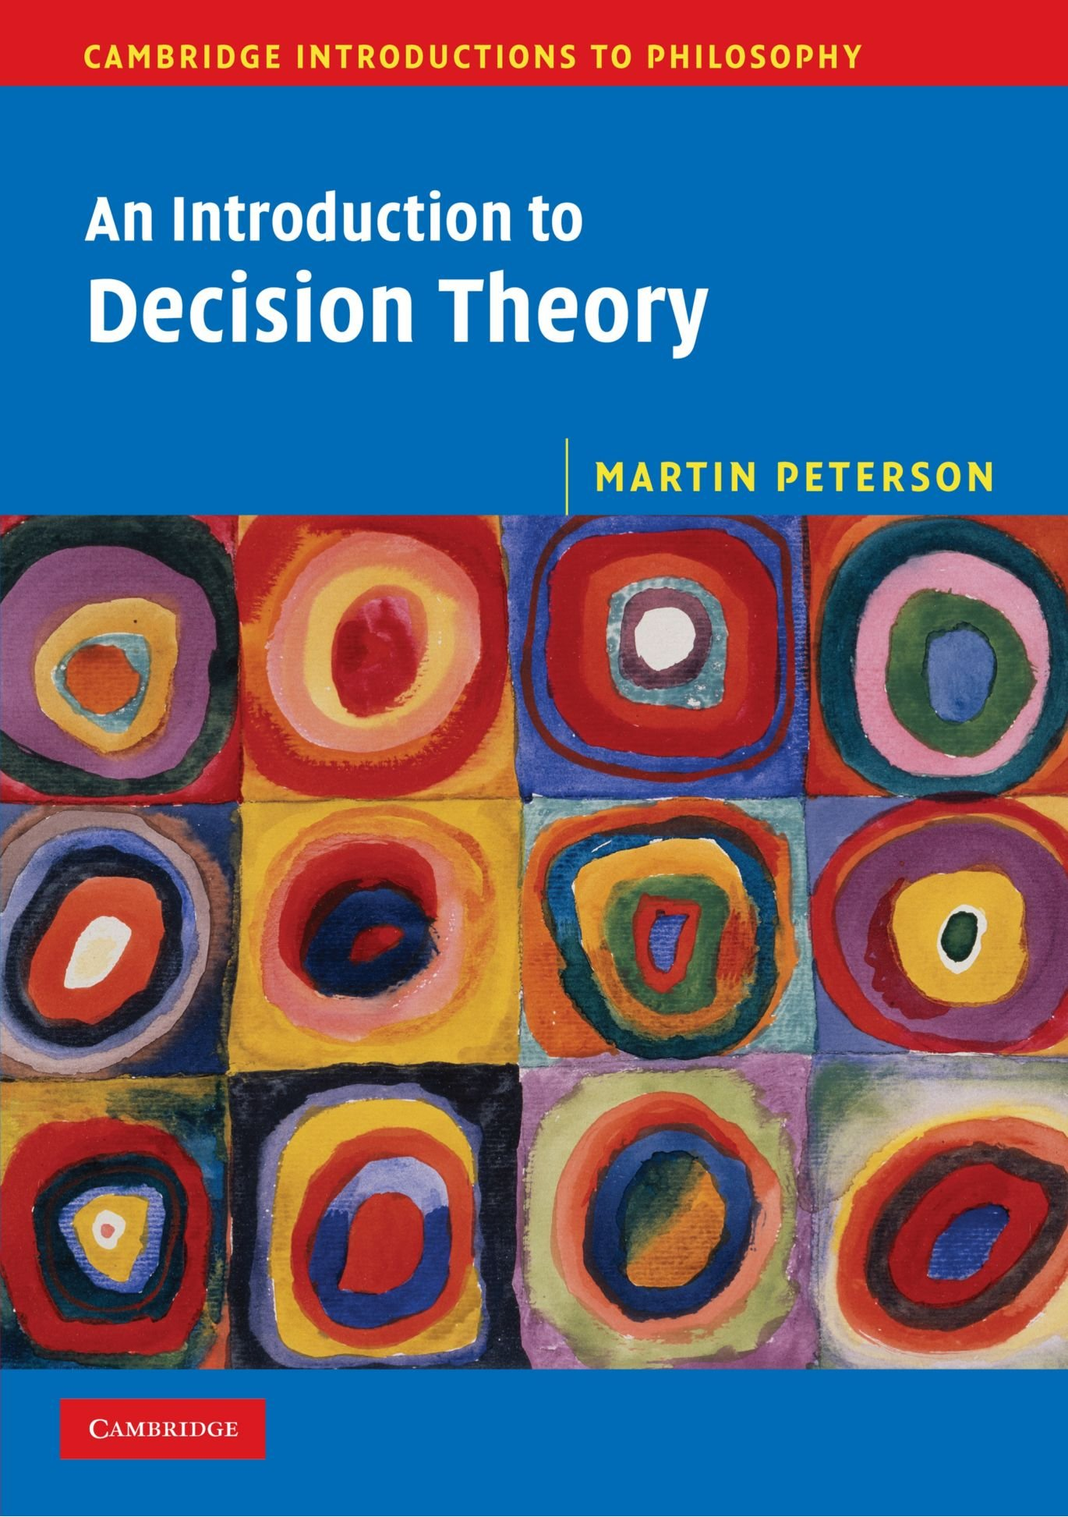
Summary
Decision making under uncertainty
Utility function
Optimal policy
Maximal expected utility
Value iteration
Policy iteration

