Slide 1
Einführung in Web und Data Science
Prof. Dr. Ralf Möller
Universität zu Lübeck
Institut für Informationssysteme
Tanya Braun (Übungen)

Slide 2
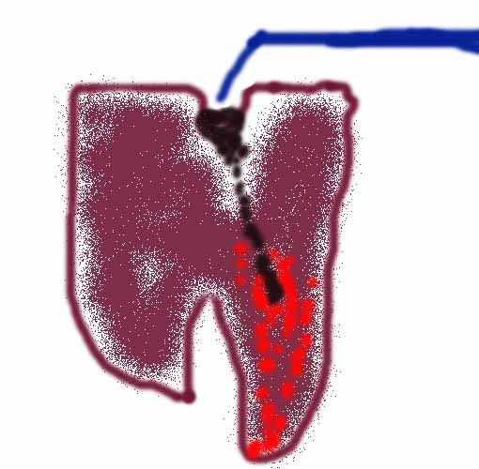

Example world
Example: Dentist problem with four variables:
Toothache (I have a toothache)
Cavity (I have a cavity)
Catch (steel probe catches in my tooth)
Weather (sunny,rainy,cloudy,snow)
Subsequent slides contain material from Chapter 14
(Section 1 and 2)

Slide 3
Prior probability
Prior or unconditional probabilities of propositions
  e.g., P(Cavity = true) = 0.1 and P(Weather = sunny) = 0.72 correspond to belief prior to arrival of any (new) evidence
Probability distribution
gives values for all possible assignments:
  P(Weather) = <0.72, 0.1, 0.08, 0.1>
  (normalized, i.e., sums to 1 because one must be the case)
Notes:
Prior can come from statistical date or other insights e.g. dice (computational)

Slide 4
Full joint probability distribution
Joint probability distribution for a set of random variables gives the probability of every atomic event on those random variables
  P(Weather,Cavity) is a 4 × 2 matrix of values:
Weather = sunny rainy cloudy snow
Cavity = true 0.144 0.02 0.016 0.02
Cavity = false 0.576 0.08 0.064 0.08
Full joint probability distribution: all random variables involved
  P(Toothache, Catch, Cavity, Weather)
Every query about a domain can be answered by the full joint distribution

Slide 5
Discrete random variables: Notation
Dom(Weather) = {sunny, rainy, cloudy, snow} and Dom(Weather) disjoint from domain of other random variables:
  Atomic event Weather=rainy often written as rainy
  Example: P(rainy), the random variable Weather is implicitly defined by the value rainy
Boolean variable Cavity
  Atomic event Cavity=true written as cavity
  Atomic event Cavity=false written as ¬cavity
  Examples: P(cavity) or P(¬cavity)

Slide 6
Conditional probability
Conditional or posterior probabilities
  e.g., P(cavity | toothache) = 0.8
  or: <0.8>
  i.e., given that toothache is all I know
(Notation for conditional distributions:
  P(Cavity | Toothache) is a 2-element vector of 2-element vectors
If we know more, e.g., cavity is also given, then we have
  P(cavity | toothache, cavity) = 1
New evidence may be irrelevant, allowing simplification, e.g.,
  P(cavity | toothache, sunny) = P(cavity | toothache) = 0.8
This kind of inference, sanctioned by domain knowledge, is crucial

Slide 7
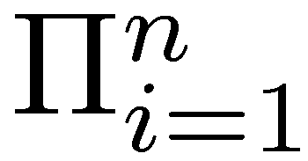
Conditional probability
Definition of conditional probability (in terms of uncond. prob.):
  P(a | b) = P(a ∧ b) / P(b) if P(b) > 0
Product rule gives an alternative formulation (∧ is commutative):
  P(a ∧ b) = P(a | b) P(b) = P(b | a) P(a)
A general version holds for whole distributions, e.g.,
  P(Weather,Cavity) = P(Weather | Cavity) P(Cavity)
View as a set of 4 × 2 equations, not matrix mult.
(1,1) P(Weather=sunny |Cavity=true) P(Cavity=true)
(1,2) P(Weather=sunny |Cavity=false) P(Cavity=false), ….
Chain rule is derived by successive application of product rule:
  P(X₁, …,X_{n}) = P(X₁,...,X_{n-1}) P(X_{n} | X₁,...,X_{n-1})
  = P(X₁,...,X_{n-2}) P(X_{n-1} | X₁,...,X_{n-2}) P(X_{n} | X₁,...,X_{n-1})
  = …
  = P(X_{i} | X₁, … ,X_{i-1})
Notes:
Proofable Rules are important for algorithmically rewriting of statements.
First rules makes sense because we know that b=true we can rule out other worlds. Reduce view of the world sum also to one because
Sum must be one.Therefore the fraction.

Slide 8

Inference by enumeration
Start with the joint probability distribution:
For any proposition φ, sum the probability
where it is true: P(φ) = Σ_{ω:ω╞φ} P(ω)
P(toothache) = 0.108 + 0.012 + 0.016 + 0.064 = 0.2
Unconditional or marginal probability of toothache
Process is called marginalization or summing out
  Ax₃: P(A ∪ B) = P(A) + P(B)
  für disjunkte Ereignisse A, B ⊆ Ω

Slide 9
Marginalization and conditioning
Let Y, Z be sequences of random variables s.th.
Y ∪ Z denotes all random variables describing the world
Marginalization
  P(Y) = Σ_{z ∈ Z}P(Y,z)
Conditioning
  P(Y) = Σ_{z ∈ Z}P(Y|z)P(z)

Slide 10

Inference by enumeration
Start with the joint probability distribution:
For any proposition φ, sum the atomic events where it is true:
P(φ) = Σ_{ω:ω⊨φ} P(ω)
P(cavity ∨ toothache) = 0.108 + 0.012 + 0.072 + 0.008+ 0.016 + 0.064 = 0.28
(P(cavity ∨ toothache) = P(cavity) + P(toothache) – P(cavity ∧ toothache))

Slide 11

Inference by enumeration
Start with the joint probability distribution:
Can also compute conditional probabilities:
P(¬cavity | toothache) = P(¬cavity ∧ toothache)
P(toothache)
= 0.016+0.064
0.108 + 0.012 + 0.016 + 0.064
= 0.08/0.2 = 0.4
P(cavity | toothache) = (0.108+0.012)/0.2 = 0.6
Product rule

Slide 12
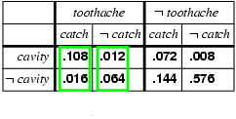
Normalization
Denominator P(z) (or P(toothache) in the example before) can be viewed as a normalization constant α
P(Cavity | toothache) = α P(Cavity,toothache)
  = α [P(Cavity,toothache,catch) + P(Cavity,toothache,¬ catch)]
  = α [<0.108,0.016> + <0.012,0.064>]
  = α <0.12,0.08> = <0.6,0.4>
General idea: compute distribution on query variable by fixing evidence variables (Toothache) and summing over hidden variables (Catch)

Slide 13
Inference by enumeration, contd.
Typically, we are interested in
the posterior joint distribution of the query variables Y
given specific values e for the evidence variables E
(X are all variables of the modeled world)
Let the hidden variables be H = X - Y – E then the required summation of joint entries is done by summing out the hidden variables:
  P(Y | E = e) = αP(Y,E = e) = αΣ_{h}P(Y,E= e, H = h)
The terms in the summation are joint entries because Y, E and H together exhaust the set of random variables (X)
Obvious problems:
  Worst-case time complexity O(d^{n}) where d is the largest arity and n denotes the number of random variables
  Space complexity O(d^{n}) to store the joint distribution
  How to find the numbers for O(d^{n}) entries?

Slide 14
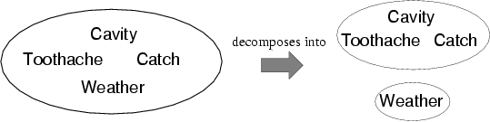
Independence
A and B are independent iff
P(A|B) = P(A) or P(B|A) = P(B) or P(A, B) = P(A) P(B)
  P(Toothache, Catch, Cavity, Weather)
  = P(Toothache, Catch, Cavity) P(Weather)
32 entries reduced to 12;
Absolute independence powerful but rare
Dentistry is a large field with hundreds of variables, none of which are independent. What to do?

Slide 15
Conditional independence
P(Toothache, Cavity, Catch) has 2³ – 1 = 7 independent entries
If I have a cavity, the probability that the probe catches in it doesn't depend on whether I have a toothache:
  (1) P(catch | toothache, cavity) = P(catch | cavity)
The same independence holds if I haven't got a cavity:
  (2) P(catch | toothache,¬cavity) = P(catch | ¬cavity)
Catch is conditionally independent of Toothache given Cavity:
  P(Catch | Toothache,Cavity) = P(Catch | Cavity)
Equivalent statements:
  P(Toothache | Catch, Cavity) = P(Toothache | Cavity)
  P(Toothache, Catch | Cavity) = P(Toothache | Cavity) P(Catch | Cavity)

Slide 16
Conditional independence contd.
Write out full joint distribution using chain rule:
P(Toothache, Catch, Cavity)
  = P(Toothache | Catch, Cavity) P(Catch, Cavity)
  = P(Toothache | Catch, Cavity) P(Catch | Cavity) P(Cavity)
  conditional independence
  = P(Toothache | Cavity) P(Catch | Cavity) P(Cavity)
i.e., 2 + 2 + 1 = 5 independent numbers
In most cases, the use of conditional independence reduces the size of the representation of the joint distribution from exponential in n to linear in n.
Conditional independence is our most basic and robust form of knowledge about uncertain environments.

Slide 17
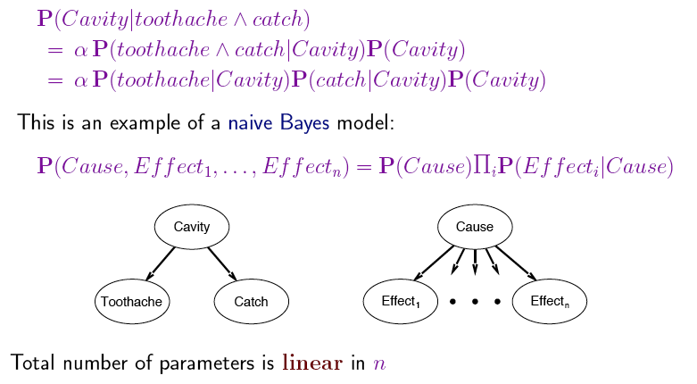
Naïve Bayes Model
Usually, the assumption that effects are independent is wrong,
but works well in practice

Slide 18
Issues
If a state is described by n propositions, then a belief space contains 2^{n} states for boolean domains (possibly, some have probability 0)
→ Modeling difficulty: many numbers must be entered in the first place
→ Computational issue: memory size and time

Slide 19
 | pcatch | ¬pcatch | pcatch | ¬pcatch
cavity | 0.108 | 0.012 | 0.072 | 0.008
¬cavity | 0.016 | 0.064 | 0.144 | 0.576
toothache
¬toothache
Toothache and Pcatch are independent given cavity (or ¬cavity), but this relation is hidden in the numbers ! [we will verify this]
Bayesian networks explicitly represent independence among propositions to reduce the number of probabilities defining a belief state

Slide 20
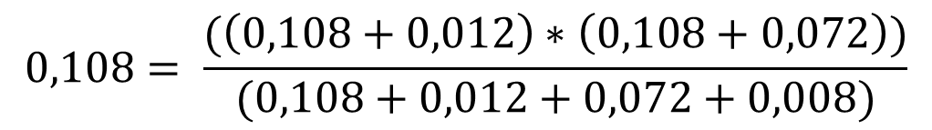
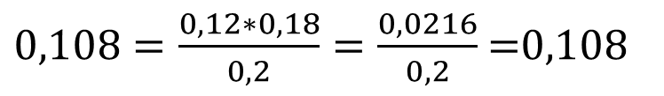
 | pcatch | ¬pcatch | pcatch | ¬pcatch
cavity | 0.108 | 0.012 | 0.072 | 0.008
¬cavity | 0.016 | 0.064 | 0.144 | 0.576
toothache
¬toothache

Slide 21
Bayesian networks
A simple, graphical notation for conditional independence assertions and hence for compact specification of full joint distributions
Syntax:
  a set of nodes, one per variable
  a directed, acyclic graph (link ≈ "directly influences")
  a conditional distribution for each node given its parents:
    P (X_{i} | Parents (X_{i}))
In the simplest case, conditional distribution represented as a conditional probability table (CPT) giving the distribution over X_{i} for each combination of parent values

Slide 22
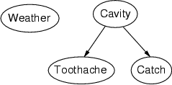
Example
Topology of network encodes conditional independence assertions:
Weather is independent of the other variables
Toothache and Catch are conditionally independent given Cavity

Slide 23
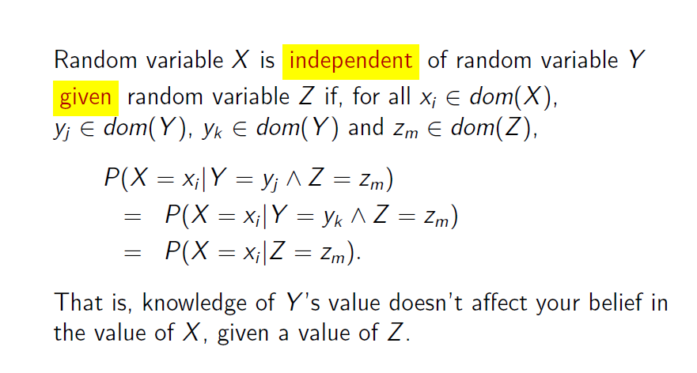
Remember: Conditional Independence

Slide 24
Example
I'm at work, neighbor John calls to say my alarm is ringing, but neighbor Mary doesn't call. Sometimes it's set off by minor earthquakes. Is there a burglar?
Variables: Burglary, Earthquake, Alarm, JohnCalls, MaryCalls
Network topology reflects "causal" knowledge:
  A burglar can set the alarm off
  An earthquake can set the alarm off
  The alarm can cause Mary to call
  The alarm can cause John to call
Notes:
Burglar alarm system installed. Judea Pearl researcher and living in LA

Slide 25
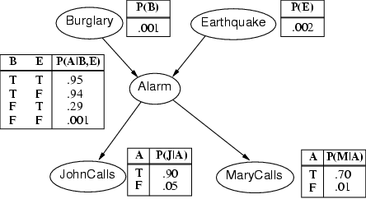
Example contd.
Notes:
John nearly calls ervery time the alarm is ringing but sometimes confuses whether it is the telephone or the alarm.
Mary often hears loud music. J & M only Alarm means we assume that they can not directly observe burglars and minor earthquakes.
Rows sum up to one because they represent all the cases for a variable. One must be the case. Any irrelevant attributes are encoded in prob-> laziness, ignorance

Slide 26
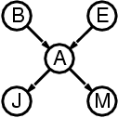
Compactness
A CPT for Boolean X_{i} with k Boolean parents has 2^{k} rows for the combinations of parent values
Each row requires one number p for X_{i} = true
(the number for X_{i} = false is just 1-p)
If each variable has no more than k parents,
the complete network requires n · 2^{k} numbers
i.e., grows linearly with n, vs. 2^{n} for the full joint distribution
For burglary net, 1 + 1 + 4 + 2 + 2 = 10 numbers (vs. 2⁵-1 = 31)

Slide 27
Semantics
The full joint distribution is defined as the product of the local conditional distributions:
P (X₁, … ,X_{n}) = π_{i = 1} P (X_{i} | Parents(X_{i}))
e.g., P(j ∧ m ∧ a ∧ ¬b ∧ ¬e)
= P (j | a) P (m | a) P (a | ¬b, ¬e) P (¬b) P (¬e)
= 0.90x0.7x0.001x0.999x0.998
≈ 0.00063
n

Slide 28
Noisy-OR-Representation
A
B
A
B
0.8
0.1
C
Meaning
C
A
B
c
f
f
0.0
f
t
0.1
t
f
0.8
t
t
0.1+0.8 - 0.1*0.8
Substantial reduction of the probabilities to be stored

Slide 29
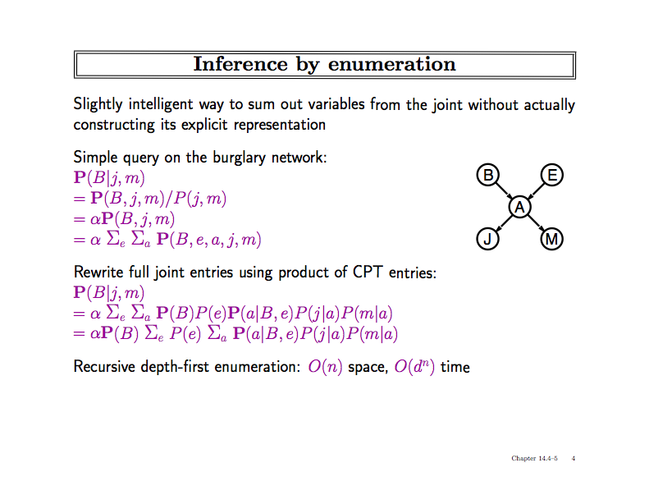
(almost) linear space, dn time

Slide 30
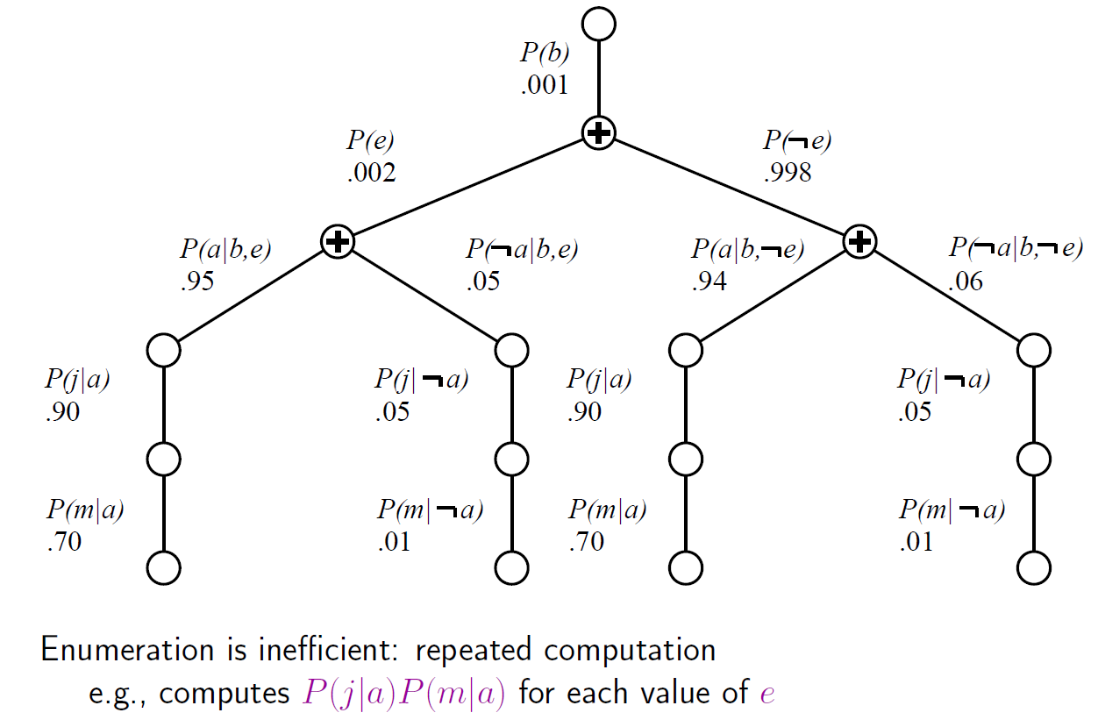
Evaluation Tree

Slide 31
Acknowledgements
Slides from AIMA book provided by Cristina Conati, UBC

Slide 32
Overview
Full Bayesian Learning
MAP learning
Maximun Likelihood Learning
Learning Bayesian Networks
  Fully observable
  With hidden (unobservable) variables

Slide 33
Full Bayesian Learning
In the learning methods we have seen so far, the idea was always to find the best model that could explain some observations
In contrast, full Bayesian learning sees learning as Bayesian updating of a probability distribution over the hypothesis space, given data
  H is the hypothesis variable
  Possible hypotheses (values of H) h₁…, h_{n}
  P(H) = prior probability distribution over hypothesis space
j_{th} observation d_{j} gives the outcome of random variable D_{j}
  training data d= d₁,..,d_{k}

Slide 34
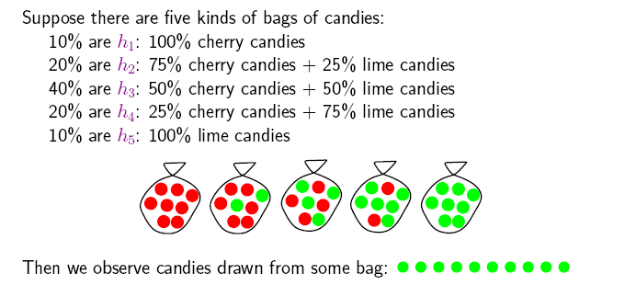
Example
Suppose we have 5 types of candy bags
  10% are 100% cherry candies (h₁₀₀)
  20% are 75% cherry + 25% lime candies (h₇₅)
  40% are 50% cherry + 50% lime candies (h₅₀)
  20% are 25% cherry + 75% lime candies (h₂₅)
  10% are 100% lime candies (h₀)
Then we observe candies drawn from some bag
Let‘s call θ the parameter that defines the fraction of cherry candy in a bag, and h_{θ} the corresponding hypothesis
Which of the five kinds of bag has generated my 10 observations? P(h _{θ} |d).
What flavour will the next candy be? Prediction P(X|d)

Slide 35
Full Bayesian Learning
Given the data so far, each hypothesis h_{i} has a posterior probability:
  P(h_{i} |d) = αP(d| h_{i}) P(h_{i}) (Bayes theorem)
  where P(d| h_{i}) is called the likelihood of the data under each hypothesis
Predictions over a new entity X are a weighted average over the prediction of each hypothesis:
  P(X|d) =
  = ∑_{i} P(X, h_{i} |d)
  = ∑_{i} P(X| h_{i},d) P(h_{i} |d)
  = ∑_{i} P(X| h_{i}) P(h_{i} |d)
  ~ ∑_{i} P(X| h_{i}) P(d| h_{i}) P(h_{i})
  The weights are given by the data likelihood and prior of each h
No need to pick one
best-guess hypothesis!
The data does not add anything to a prediction given an hp

Slide 36
Example
If we re-wrap each candy and return it to the bag, our 10 observations are independent and identically distributed, i.i.d, so
  P(d| h_{θ}) = ∏_{j} P(d_{j}| h_{θ}) for j=1,..,10
For a given h_{θ} , the value of P(d_{j}| h_{θ}) is
  P(d_{j} = cherry| h_{θ}) = θ; P(d_{j} = lime|h_{θ}) = (1-θ)
And given N observations, of which c are cherry and l = N-c lime
  Binomial distribution: probability of # of successes in a sequence of N independent trials with binary outcome, each of which yields success with probability θ.
For instance, after observing 3 lime candies in a row:
  P([lime, lime, lime] | h ₅₀) = 0.5³ because the probability of seeing lime for each observation is 0.5 under this hypotheses

Slide 37
All-limes: Posterior Probability of H
P(h₁₀₀|d)
P(h₇₅|d)
P(h₅₀|d)
P(h₂₅|d)
P(h₀|d)
P(h_{i} |d) = αP(d| h_{i}) P(h_{i})
Initially, the h_{p} with higher priors dominate (h₅₀ with prior = 0.4)
As data comes in, the finally best hypothesis (h₀) starts dominating, as the probability of seeing this data given the other hypotheses gets increasingly smaller
  After seeing three lime candies in a row, the probability that the bag is the all-lime one starts taking off

Slide 38
Prediction Probability
∑_{i} P(next candy is lime| h_{i}) P(h_{i} |d)
The probability that the next candy is lime increases with the probability that the bag is an all-lime one

Slide 39
Overview
Full Bayesian Learning
MAP learning
Maximun Likelihood Learning
Learning Bayesian Networks
  Fully observable
  With hidden (unobservable) variables

Slide 40
MAP approximation
Full Bayesian learning seems like a very safe bet, but unfortunately it does not work well in practice
  Summing over the hypothesis space is often intractable (e.g., 18,446,744,073,709,551,616 Boolean functions of 6 attributes)
Very common approximation: Maximum a posterior (MAP) learning:
  Instead of doing prediction by considering all possible hypotheses , as in
    P(X|d) = ∑_{i} P(X| h_{i}) P(h_{i} |d)
  Make predictions based on h_{MAP} that maximises P(h_{i} |d)
    I.e., maximize P(d| h_{i}) P(h_{i})
    P(X|d) ≈ P(X| h_{MAP} )

Slide 41
MAP approximation
MAP is a good approximation when P(X |d) ≈ P(X| h_{MAP})
  In our example, h_{MAP} is the all-lime bag after only 3 candies, predicting that the next candy will be lime with p =1
  The Bayesian learner gave a prediction of 0.8, safer after seeing only 3 candies
P(h₁₀₀|d)
P(h₇₅|d)
P(h₅₀|d)
P(h₂₅|d)
P(h₀|d)

Slide 42
Bias
As more data arrive, MAP and Bayesian prediction become closer, as MAP’s competing hypotheses become less likely
Often easier to find MAP (optimization problem) than deal with a large summation problem
P(H) plays an important role in both MAP and Full Bayesian Learning (defines learning bias)
Used to define a tradeoff between model complexity and its ability to fit the data
  More complex models can explain the data better => higher P(d| h_{i}) danger of overfitting
  But they are less likely a priory because there are more of them than simpler model => lower P(h_{i})
  I.e. common learning bias is to penalize complexity

Slide 43
Overview
Full Bayesian Learning
MAP learning
Maximun Likelihood Learning
Learning Bayesian Networks
  Fully observable
  With hidden (unobservable) variables

Slide 44
Maximum Likelihood (ML)Learning
Further simplification over full Bayesian and MAP learning
  Assume uniform priors over the space of hypotheses
  MAP learning (maximize P(d| h_{i}) P(h_{i})) reduces to maximize P(d| h_{i})
When is ML appropriate?
Howard, R.: Decision analysis: Perspectives on inference, decision, and experimentation. Proceedings of the IEEE 58(5), 632-643, 1970

Slide 45
Maximum Likelihood (ML) Learning
Further simplification over Full Bayesian and MAP learning
  Assume uniform prior over the space of hypotheses
  MAP learning (maximize P(d| h_{i}) P(h_{i})) reduces to maximize P(d| h_{i})
When is ML appropriate?
  Used in statistics as the standard (non-bayesian) statistical learning method by those who distrust subjective nature of hypotheses priors
  When the competing hypotheses are indeed equally likely (e.g. have same complexity)
  With very large datasets, for which P(d| h_{i}) tends to overcome the influence of P(h_{i})

Slide 46
Overview
Full Bayesian Learning
MAP learning
Maximun Likelihood Learning
Learning Bayesian Networks
  Fully observable (complete data)
  With hidden (unobservable) variables

Slide 47
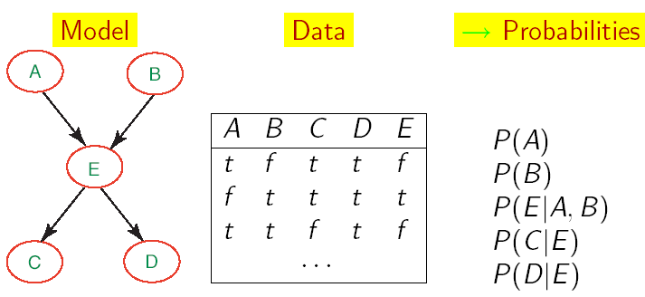
Learning BNets: Complete Data
We will start by applying ML to the simplest type of BNets learning:
  known structure
  Data containing observations for all variables
    All variables are observable, no missing data
The only thing that we need to learn are the network’s parameters

Slide 48
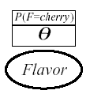
ML learning: Example
Back to the candy example:
  New candy manufacturer that does not provide data on the probability of fraction θ of cherry candy in its bags
  Any θ is possible: continuum of hypotheses h_{θ}
  Reasonable to assume that all θ are equally likely (we have no evidence of the contrary): uniform distribution P(h_{θ})
  θ is a parameter for this simple family of models, that we need to learn
Simple network to represent this problem
  Flavor represents the event of drawing a cherry vs. lime candy from the bag
  P(F=cherry), or P(cherry) for brevity, is equivalent to the fraction θ of cherry candies in the bag
We want to infer θ by unwrapping N candies from the bag

Slide 49
ML learning: example (cont’d)
Unwrap N candies, c cherries and l = N-c lime (and return each candy in the bag after observing flavor)
As we saw earlier, this is described by a binomial distribution
  P(d| h _{θ}) = ∏_{j} P(d_{j}| h _{θ}) = θ ^{c} (1- θ) ^{l}
With ML we want to find θ that maximizes this expression, or equivalently its log likelihood (L)
  L(P(d| h _{θ}))
  = log (∏_{j} P(d_{j}| h _{θ}))
  = log (θ ^{c} (1- θ) ^{l} )
  = clogθ + l log(1- θ)

Slide 50
ML learning: example (cont’d)
To maximise, we differentiate L(P(d| h _{θ}) with respect to θ and set the result to 0
Doing the math gives

Slide 51
Frequencies as Priors
So this says that the proportion of cherries in the bag is equal to the proportion (frequency) of cherries in the data
Now we have justified why this approach provides a reasonable estimate of node priors

Slide 52
Wiederholung: Bayessches Lernen
Gegeben sei ein Hypothesenraum H (Menge von Hypothesen h_{i}) und Evidenz d (Daten, Beobachtungen):
  P(h_{i}|d) = α P(d|h_{i}) P(h_{i})
Wir nehmen an, dass Beobachtungen unabhängig sind, wenn das zugrundeliegende Modell fixiert wird:
  P(h_{i}|d) = α ∏_{j} P(d_{j}|h_{i}) P(h_{i})
Um unbekannte Daten X vorauszusagen, schreiben wir:
  P(X|d) = ∑_{i} P(X|d, h_{i}) P(h_{i}|d) = ∑_{i} P(X|h_{i}) P(h_{i}|d)
Hier greift die
Unabhängigkeitsannahme
52

Slide 53
Bayessches Lernen
Bayessches Lernen in drei Formen:
  BMA (Bayesian Model Averaging): Wähle nicht eine Hypothese, sondern mache Vorhersagen auf Basis eines gewichteten Mittels aller Hopythesen (oder einer Menge von guten Hypothesen)
  MAP (Maximum A Posteriori) hypothesis: Wähle die Hypothese mit der besten A-Posterio-Wahrscheinlichkeit bei gegebenen Daten
  MLE (Maximum Likelihood Estimate): Nehme an, alle Hypothesen sind a priori gleichwahrscheinlich. Dann maximiert die beste Hypothese die Likelihood der Daten (d.h. die W'keit der Daten unter der Annahme die Hypothese ist korrekt)
MDL (Minimum Description Length) Prinzip:
  Verwende eine Kodierung zur Darstellung der Komplexität einer Hypothese
  Minimiere dann die Beschreibungslänge von h_{i} + D
53

Slide 54
Maximum-Likelihood-Parameterschätzung
Nehme an, die Struktur eines BNs sei bekannt
Ziel: Schätze BN-Parameter θ
  Einträge in CPTs, P(X | Parents(X))
Eine Parametrierung θ ist gut, falls hierdurch die beobachteten Daten wahrscheinlich generiert werden:
Maximum Likelihood Estimation
(MLE) Prinzip: Wähle θ* so,
dass P(D| θ*) maximiert wird
Gleichverteilte, unabhängige Stichprobem
(i.i.d. samples)
54

Slide 55
Generelle Maximum-Likelihood-Prozedur
Drücke Likelihood der Daten als Funktion der zu lernenden Parameter aus
Bestimme die Ableitung der Log-Likelihood-Funktion in Bezug auf jeden Parameter
Finde den Parameterwert, der eine Nullstelle der Ableitungsfunktion darstellt (je nach Funktion extrem aufwendig)

Slide 56
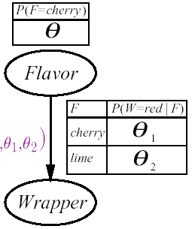
Anwendungsbeispiel Bonbonfabrik
Ein Hersteller wählt die Farbe des Bonbonpapiers mit einer bestimmten Wahrscheinlichkeit je nach Geschmack, wobei die entsprechende Verteiltung nicht bekannt sei
  Wenn Geschmack=cherry, wähle rotes Papier mit W'keit θ₁
  Wenn Geschmack=lime, wähle rotes Papier mit W'keit θ₂
Das Bayessche Netzwerk enthält drei zu lernende Parameter
  θ θ ₁ θ ₂

Slide 57
Anwendungsbeispiel Bonbonfabrik
P( W=green, F = cherry| h_{θθ1θ2}) = (*)
= P( W=green|F = cherry, h_{θθ1θ2}) P( F = cherry| h_{θθ1θ2})
= θ (1-θ ₁)
Wir packen N Bonbons aus
  c sind cherry und l sind lime
  r^{c} cherry mit rotem Papier, g^{c} cherry mit grünem Papier
  r^{l} lime mit rotem Papier, g ^{l} lime mit grünem Papier
  Jeder Versuch liefert eine Kombination aus Papier und Geschmack wie bei (*)
P(d| h_{θθ1θ2})
= ∏_{j} P(d_{j}| h_{θθ1θ2}) = θ^{c} (1-θ) ^{l} (θ ₁) ^{rc} (1-θ ₁) ^{gc} (θ ₂) ^{r l} (1-θ ₂) ^{g l}

Slide 58
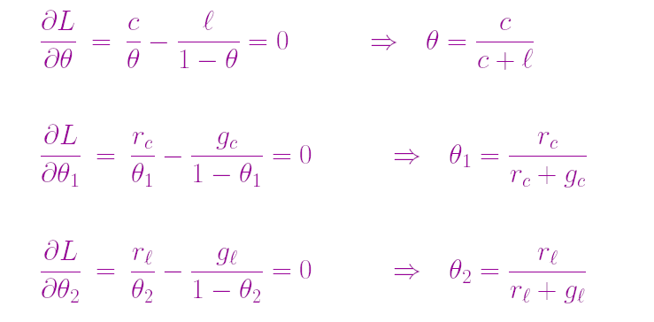
Anwendungsbeispiel Bonbonfabrik
Maximierung des Logarithmus der Zielfunktion
  clogθ + l log(1- θ) + r^{c} log θ ₁ + g^{c} log(1- θ ₁) + r^{l} log θ ₂ + g ^{l} log(1- θ ₂)
Bestimmung der Ableitungen bzgl. θ, θ ₁ ,θ ₂
  Ausdrücke ohne Term, nach dem abgeleitet wird, verschwinden

Slide 59
Maximum-Likelihood-Parameterschätzung
Schätzung durch Bildung relativer Häufigkeiten
Dieser Prozess ist auf jedes voll beobachtbare BN anwendbar
Mit vollständigen Daten und Maximum-Likelihood-Parameterschätzung:
  Parameterlernen zerfällt in separate Lernprobleme für jeden Parameter (CPT) durch Logarithmierung
  Jeder Parameter wird durch die relative Häufigkeit eines Knotenwertes bei gegebenen Werten der Elternknoten bestimmt

Slide 60
Beliebte Anwendung: Naives Bayes-Modell
C
Naïve Bayes-Modell: Sehr einfaches
Bayessches Netzwerk zur Klassifikation
  Klassenvariable C (vorherzusagen) bildet Wurzel
  Attributvariablen X_{i} (Beobachtungen) sind Blätter
Naiv, weil angenommen wird, dass die Attributwerte bedingt unabhängig sind, wenn die Klasse gegeben ist
Deterministische Verhersagen können durch Wahl der wahrscheinlichsten Klasse erreicht werden
Skalierung auf reale Daten sehr gut:
  2n + 1 Parameter benötigt
X_{n}
X₁
X₂

Slide 61
Überblick
Volles Bayessches Lernen (BMA)
MAP-Lernen
Maximum-Likelihood-Lernen
  Vollständig beobachtbar (vollständige Daten)
  Mit versteckten (unbeobachtbaren) Variablen

Slide 62
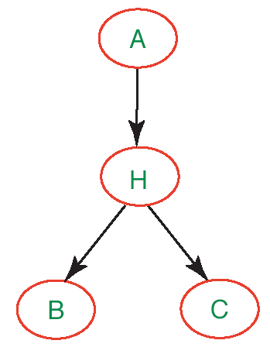
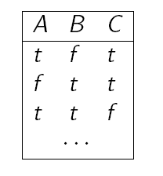
Parameterlernen mit versteckten Variablen
Bisher haben wir angenommen, Daten für jede Variable des BNs stehen zur Verfügung
Was machen wir, wenn das nicht der Fall ist, d.h. es gibt versteckte (hidden) Variablen im Netzwerk?
Den Ansatz mit relativen Häufigkeiten können wir nicht so einfach übernehmen (keine Zähler für Variable H bekannt)

Slide 63
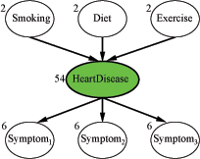
Vermeintliche Lösung
Vermeide versteckte Variablen
Könnte klappen bei kleinen Netzwerken (siehe Tafel)
Doch was machen wir hier?
  Jede Variable habe 3 Werte (low, moderate, high)
  Die Zahlen an den Knoten repräsentieren, wie viele Parameter für die CPT des betreffenden Knotens bestimmt werden müssen
  78 Wahrscheinlichkeitswerte insgesamt

Slide 64
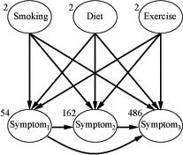
Gar keine gute Lösung!
Die Symptome sind nicht länger bedingt unabhängig
gegeben die Elternknotenwerte
  Sehr viel mehr Kanten, sehr viel mehr Wahrscheinlichkeiten zu spezifizieren: 708 insgesamt
  Wir brauchen sehr viel mehr Daten,
  um diese ganzen Werte vernünftig zu lernen

Slide 65
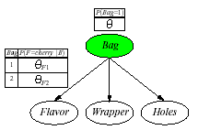
Beispiel: Bonbonfabrik wieder einmal
Zwei Bonbontüten (1 and 2) wurden vermischt
Bonbons werden durch drei Eigenschaften beschrieben: Flavor und Wrapper wie vorher, plus Hole (ob ein Loch in der Mitte ist)
Die Merkmale von Bonbon hängen mit bestimmten Wahrscheinlichkeiten von der Tüte ab, aus der sie kommen
Wir wollen für jedes Bonbon vorhersagen, aus welcher Tüte es kam, je nach vorgefundenen Eigenschaften: Naïve-Bayes-Modell
θ= P(Bag = 1)
θ_{Fj} = P(Flavor = cherry|Bag = j)
θ_{Wj} = P(Wrapper = red|Bag = j)
θ_{Hj} = P(Hole = yes|Bag = j)
j =1,2

Slide 66
Expectation-Maximization (EM)
Wenn wir versteckte Variablen beibehalten und die Netzwerkparameter aus Daten lernen wollen, haben wir eine Form des unüberwachten Lernens (unsupervised learning)
  Die Daten geben nicht über alle Aspekte von Datenpunkten Auskunft
Expectation-Maximization
  Genereller Algorithmus zum Lernen von Modellparametern bei unvollständigen Daten
  Hier für diskrete Datenwerte im BN-Kontext gezeigt

Slide 67
EM: Generelle Idee
Falls wir Daten für alle Variablen im BN hätten, könnten wir die Parameter mit ML- (oder MAP-) Ansätzen lernen
  Relative Häufigkeiten bestimmen, wie vorher besprochen
Falls wir die Parameter hätten, könnten wir die Posterior-Wahrscheinlichkeiten jedes Ereignisses schätzen:
  P(H|A,B,C)
Dempster, A.P., Laird. N.M., Rubin, D.B.: Maximum-Likelihood from incomplete data via the EM algorithm. Journal of the Royal Statistical Society, 1977

Slide 68
EM: Generelle Idee
Der Algorithmus startet mit "erfundenen" (zufällig generierten) Informationen, um das Lernproblem zu lösen:
  Erfundene Netzwerkparameterwerte (virtuell notiert in den CPTs)
Dann werden die Initialwerte in zwei Schritten verfeinert:
  Expectation (E): Aktualisiere die Daten (virtuell) mit aus dem aktuellen Modell hergeleiteten Erwartungen
  Maximization (M): Gegeben die aktualisierten Daten, aktualisieren die Parameter des BNs mitteln Maximum Likelihood (ML) Ansatz
    Das ist der gleiche Schritt, wie im voll beobachtbaren Fall
CPT: Conditional Probability Table

Slide 69
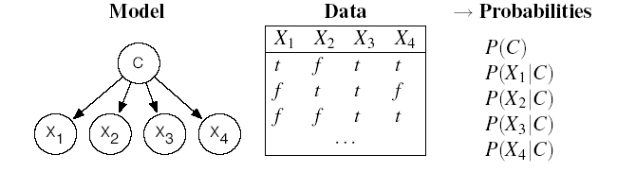
EM: Wie funktioniert das mit Naive Bayes-Modelen
Betrachtet die folgenden Daten, …
  N Beispiele mit Booleschen Attributen X₁, X₂, X₃, X₄
… die wir kategorisieren wollen mit möglichen Werten einer Klasse C = {1,2,3}
Wir verwenden einen naiven Bayes-Klassifikator mit versteckter Variable C
?
?
?
?
?

Slide 70
EM: Initialisierung
Der Algorithmus startet mit "erfundenen" (zufällig generierten) Informationen, um das Lernproblem zu lösen:
  Erfundene Netzwerkparameterwerte (virtuell notiert in den CPTs)
?
?
?
?
?
Definiere
zufällige
Parameter

Slide 71
EM: Expectation-Schritt (Bestimmung der erwarteter Zahlen)
?
?
?
?
?
Was benötigen wir, um die Netzwerkparameter mit dem
Maximum-Likelihood-Ansatz zu lernen?
  Für P(C) = Anzahl(Datenpunkte mit C=i) / Anzahl (alle Datenpunkte) i=1,2,3
  Für P(X_{h}|C) = Anzahl(Daten mit X_{h} = val_{k} und C=i) / Anzahl(Daten mit C=i)
  für alle Werte val_{k} von X_{h} und i=1,2,3

Slide 72
EM: Expectation-Schritt (Bestimmung der erwarteter Zahlen)
Bislang haben wir nur: N = Anzahl(Datenpunkte)
Wir approximieren alle weiteren Zähler mit erwarteten Zählerwerten, die aus dem Modell mit den "erfundenen" Parametern abgeleitet werden
Der erwartete Zähler ist die Summe, über alle N Beispieldaten, der Wahrscheinlichkeiten, dass jedes Beispiel in Kategorie i fällt

Slide 73
EM: Expectation-Schritt (Bestimmung der erwarteter Zahlen)
Wie erhalten wir die notwendigen Werte aus dem Modell?
Leicht mit naivem Bayesschen Netzwerk
Attribute von Beispiel e_{j} )
Auch direkt aus Netzwerk bestimmbar.
Übungsaufgabe
Erfundene Parameter für das Netzwerk

Slide 74
EM: Expectation-Schritt (Bestimmung der erwarteter Zahlen)
Durch einen ähnlichen Schritt erhalten wir die erwarteten Zähler für Beispiele mit Attribut X_{h}= val_{k} und Kategorie i
Diese werden später benötigt zur Schätzung von P(X_{h} | C):
  für alle Werte val_{k} von X_{h} und i=1,2,3
Zum Beispiel
Wiederum erhalten wir diese W'keiten
aus dem aktuellen Modell

Slide 75
EM: Generelle Idee
Der Algorithmus startet mit "erfundenen" (zufällig generierten) Informationen, um das Lernproblem zu lösen:
  Erfundene Netzwerkparameterwerte (virtuell notiert in den CPTs)
Dann werden die Initialwerte in zwei Schritten verfeinert:
  Expectation (E): Aktualisiere die Daten (virtuell) mit aus dem aktuellen Modell hergeleiteten Erwartungen
  Maximization (M): Gegeben die aktualisierten Daten, aktualisieren die Parameter des BNs mitteln Maximum Likelihood (ML) Ansatz
    Das ist der gleiche Schritt, wie im voll beobachtbaren Fall
CPT: Conditional Probability Table

Slide 76
Maximization-Schritt: (Verfeinerung der Parameter)
Nun verfeinern wir die Netzwerkparameter mittels
Maximum-Likelihood-Lernen auf den erwarteten Zählern
  für alle Werte val_{k} von X_{j} und i=1,2,3

Slide 77
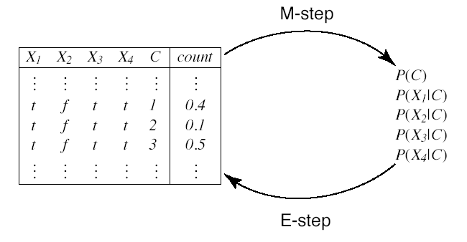
EM-Zyklus
Nun kann der E-Schritt wiederholt werden
Erwartete Zähler
(“Augmented data”)
Wahrscheinlichkeiten

Slide 78
Beispiel: Bonbonfabrik wieder einmal
Zwei Bonbontüten (1 and 2) wurden vermischt
Bonbons werden durch drei Eigenschaften beschrieben: Flavor und Wrapper wie vorher, plus Hole (ob ein Loch in der Mitte ist)
Die Merkmale von Bonbon hängen mit bestimmten Wahrscheinlichkeiten von der Tüte ab, aus der sie kommen
Wir wollen für jedes Bonbon vorhersagen, aus welcher Tüte es kam, je nach vorgefundenen Eigenschaften: Naïve-Bayes-Modell
θ= P(Bag = 1)
θ_{Fj} = P(Flavor = cherry|Bag = j)
θ_{Wj} = P(Wrapper = red|Bag = j)
θ_{Hj} = P(Hole = yes|Bag = j)
j =1,2

Slide 79
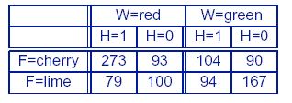
Daten
Nehmen wir an, die wahren Parameter seien:
  θ= 0.5;
  θ_{F1} = θ_{W1} = θ_{H1} = 0.8;
  θ_{F2} = θ_{W2} = θ_{H2} = 0.3;
Annahme: Die folgenden Zähler werden "gesampelt" aus P(C, F, W, H) (N = 1000): Wir haben einen Datensatz
Wir wollen nun die wahren Parameter aus diesen Daten mittels EM rekonstruieren

Slide 80
EM: Initialisierung
Weise Parametern zufällige Initialwerte zu
  Zu Vereinfachung der Darstellung verwenden wir hier:
Nun durchlaufen wir einen EM-Zyklus
zur Berechnung von θ^{(1).}

Slide 81
E-Schritt
Zuerst brauchen wir die erwarteten Zähler für Bonbon von Tüte 1:
  Addiere die Wahrscheinlichkeiten, dass jedes der N Datenpunkte aus Tüte 1 kommt
  Seien flavor_{j}, wrapper_{j}, hole_{j} die Werte der entsprechenden Attribute für den j-ten Datenpunkt

Slide 82
E-step
Die Summation kann in die 8 Bonbongruppen aus der Tabelle
aufgebrochen werden.
  Zum Beispiel ergibt die Summe über 273 cherry-Bonbons mit rotem Papier und einem Loch (erster Eintrag in der Tabelle)

Slide 83
M-Schritt
Mit der Berechnung der anderen 7 Bonbongruppe erhalten wir
Nun führen wir den M-Schritt aus, um θ zu verfeinern. Hierzu nehmen wir den erwarteten Zählerwert der Datenpunkte aus Tüte 1

Slide 84
Noch ein Parameter…
Wir machen das gleiche für den Parameter θ_{F1}
E-Schritt: Bestimme erwarteten Zählerwert von cherry-Bonbons aus Tüte 1
Bestimmbar aus naivem Bayesschen Modell wie vorher besprochen
Als Übung…
M-Schritt: Verfeinere θ_{F1} durch Bestimmung der relativen Häufigkeiten

Slide 85
Lernergebnis
Nach einem vollen Zyklus über alle Parameter haben wir
Für jeden Satz von Parametern können wir die Log-Likelihood bestimmen wie auch schon früher
Man kann zeigen, dass dieser Wert mit jeder EM-Iteration steigt (Konvergenz)
EM mit Maximum-Likelihood bleibt aber bei lokalen Maxima hängen bleiben (ggf. mehrere Startwerte nehmen, Priors berücksichtigen oder MAP nehmen)

Slide 86
Lernergebnis
Nach einem vollen Zyklus über alle Parameter haben wir
Für jeden Satz von Parametern können wir die Log-Likelihood bestimmen wie auch schon früher
Wir können zeigen, das die Log-Likelihood in jeder Iteration ansteigt, so dass die initiale Likelihood schon nach drei Iterationen überflügelt wird

Slide 87
EM: Diskussion
Für komplexere BNs ist der Algorithmus der gleiche
  Im allgemeinen müssen wir die CPT-Einträge für jede Variable X_{i} gegeben die Elternknotenwerte Pa_{i} berechnen
  θ_{ijk}= P(X_{i} = x_{ij}|Pa_{i =} pa_{ik})
Die erwarteten Zählerwerte werden durch Summierung über die Beispiele berechnet, nachdem all notwendigen
P(X_{i} = x_{ij},Pa_{i =} pa_{ik}) mittels BN-Algorithmen bestimmt sind
Das Verfahren kann in eine kombinatorische Explosion laufen (hierfür gibt es dann Approximationstechniken)

