Slide 1
Recap: Inference in Probabilistic Graphical Models
R. Möller
Institute of Information Systems
University of Luebeck

Slide 2
A Simple Example
P(A,B,C) = P(A)P(B,C | A)
= P(A) P(B|A) P(C|B,A)
= P(A) P(B|A) P(C|B)
C is conditionally independent of A given B
Graphical Representation ???

Slide 3
Bayesian Network
Directed Graphical Model
U = (V₁, …, V_{n})
A
P(U) = ∏ P(V_{i} | Pa(V_{i}))
B
P(A,B,C) = P(A) P(B | A) P(C | B)
C

Slide 4
Digression: Polytrees
A network is singly connected (a polytree) if it contains no undirected loops.
D
C
Theorem: Inference in a singly connected network can be done in linear time*.
Main idea: in variable elimination, need only maintain distributions over single nodes.
* in network size including table sizes.
© Jack Breese (Microsoft) & Daphne Koller (Stanford)

Slide 5
The problem with loops
P(c)
0.5
Cloudy
c
c
c
c
Rain
Sprinkler
P(r)
P(s)
0.02
0.99
0.98
0.01
Grass-wet
deterministic or
The grass is dry only if no rain and no sprinklers.
P(g) = P(r, s) ~ 0
© Jack Breese (Microsoft) & Daphne Koller (Stanford)

Slide 6
The problem with loops contd.
0
0
P(g) =
P(g | r, s) P(r, s) + P(g | r, s) P(r, s)
+ P(g | r, s) P(r, s) + P(g | r, s) P(r, s)
0
1
= P(r, s)
~ 0
Propagation
= P(r) P(s) ~ 0.5 ·0.5 = 0.25
problem
© Jack Breese (Microsoft) & Daphne Koller (Stanford)

Slide 7
Variable elimination
A
P(c) = Σ P(c | b) Σ P(b | a) P(a)
b
a
P(b)
B
P(A)
P(B | A)
C
𝚷
Σ
P(B, A)
P(B)
P(C | B)
A
𝚷
Σ
P(C, B)
P(C)
B
© Jack Breese (Microsoft) & Daphne Koller (Stanford)

Slide 8
Inference as variable elimination
A factor over X is a function from val(X) to numbers in [0,1]:
  A CPT is a factor
  A joint distribution is also a factor
BN inference:
  factors are multiplied to give new ones
  variables in factors summed out
A variable can be summed out as soon as all factors mentioning it have been multiplied.
© Jack Breese (Microsoft) & Daphne Koller (Stanford)

Slide 9
Variable Elimination with loops
P(A)
P(G)
P(S | A,G)
Age
Gender
𝚷
P(E | A)
Σ
P(A,G,S)
P(A,S)
𝚷
P(A,E,S)
Exposure
to Toxics
Smoking
G
Σ
P(E,S)
P(C | E,S)
A
Cancer
𝚷
Σ
P(E,S,C)
P(C)
E,S
Serum
Calcium
Lung
Tumor
P(L | C)
𝚷
P(C,L)
Σ
P(L)
C
Complexity is exponential in the size of the factors
© Jack Breese (Microsoft) & Daphne Koller (Stanford)

Slide 10
Join trees*
A join tree is a partially precompiled factorization
Age
Gender
P(A)
x
P(G)
x
A, G, S
P(S | A,G)
x
P(A,S)
Exposure
to Toxics
Smoking
A, E, S
Cancer
E, S, C
Serum
Calcium
Lung
Tumor
C, S-C
C, L
* aka Junction Tree, Lauritzen-Spiegelhalter, or Hugin algorithm, …
© Jack Breese (Microsoft) & Daphne Koller (Stanford)

Slide 11
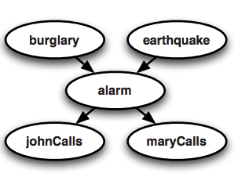
Background: Markov networks
Random variable: B,E,A,J,M
Joint distribution: Pr(B,E,A,J,M)
Undirected graphical models give another way of defining a compact model of the joint distribution…via potential functions.
ϕ(A=a,J=j) is a scalar measuring the “compatibility” of A=a J=j
x
x
x
x
A | J | ϕ(a,j)
F | F | 20
F | T | 1
T | F | 0.1
T | T | 0.4

Slide 12
Background
x
x
x
x
…
…
clique potential
A | J | ϕ(a,j)
F | F | 20
F | T | 1
T | F | 0.1
T | T | 0.4
ϕ(A=a,J=j) is a scalar measuring the “compatibility” of A=a J=j

Slide 13
Another example
Undirected graphical models
[h/t Pedro Domingos]
Smoking
Cancer
Asthma
Cough
x = vector
Smoking | Cancer | Ф(S,C)
False | False | 4.5
False | True | 4.5
True | False | 2.7
True | True | 4.5
x_{c} = short vector
H/T: Pedro Domingos

Slide 14
Markov Networks = Markov Random Fields
Undirected Graphical Model
A
B
C

Slide 15
Markov Random Fields
Undirected Graphical Model
AB
BC
B
Clique
Separator
Clique
P(U) = ∏ P(Clique) / ∏ P(Separator)
P(A,B,C) = P(A,B) P(B,C) / P(B)

Slide 16
Markov Random Fields
A node is conditionally independent of all others
given its neighbours.

Slide 17
Factor Graphs
Example
  Exponential (joint) parameterization
  Pairwise parameterization
A
A
V_{AB}
A
V_{AB}
B
C
B
C
B
C
Markov network
V_{ABC}
V_{AB}
Factor graph for
joint parameterization
Factor graph for
pairwise parameterization

Slide 18
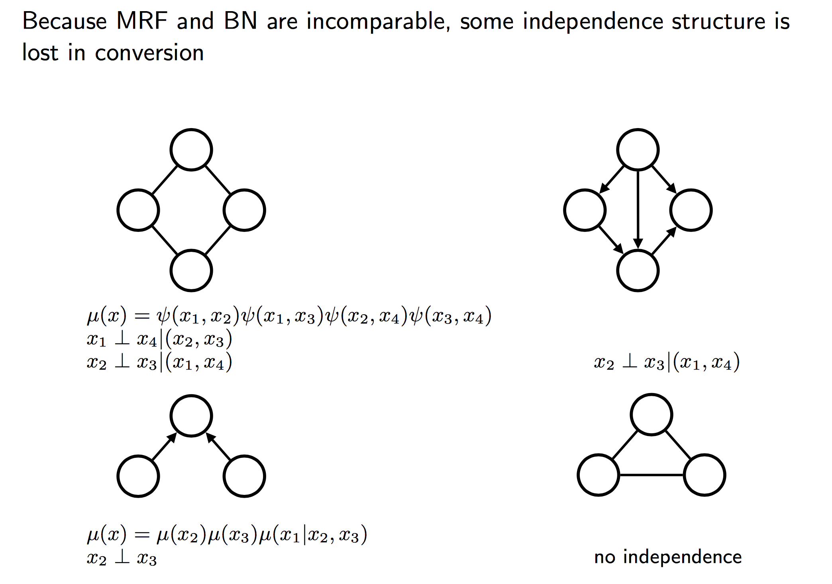
Transforming MRFs into BNs and back

Slide 19
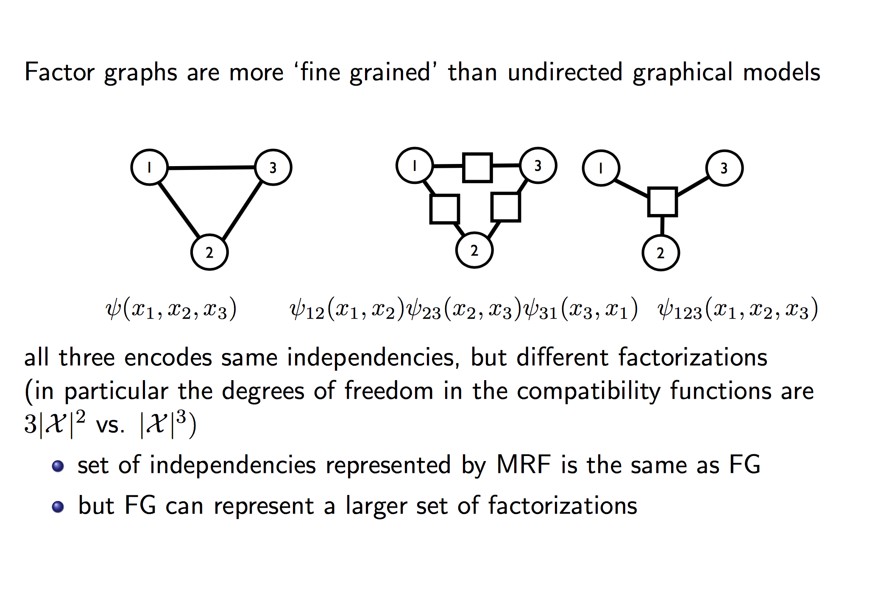
Factor Graphs vs. MRFs

Slide 20
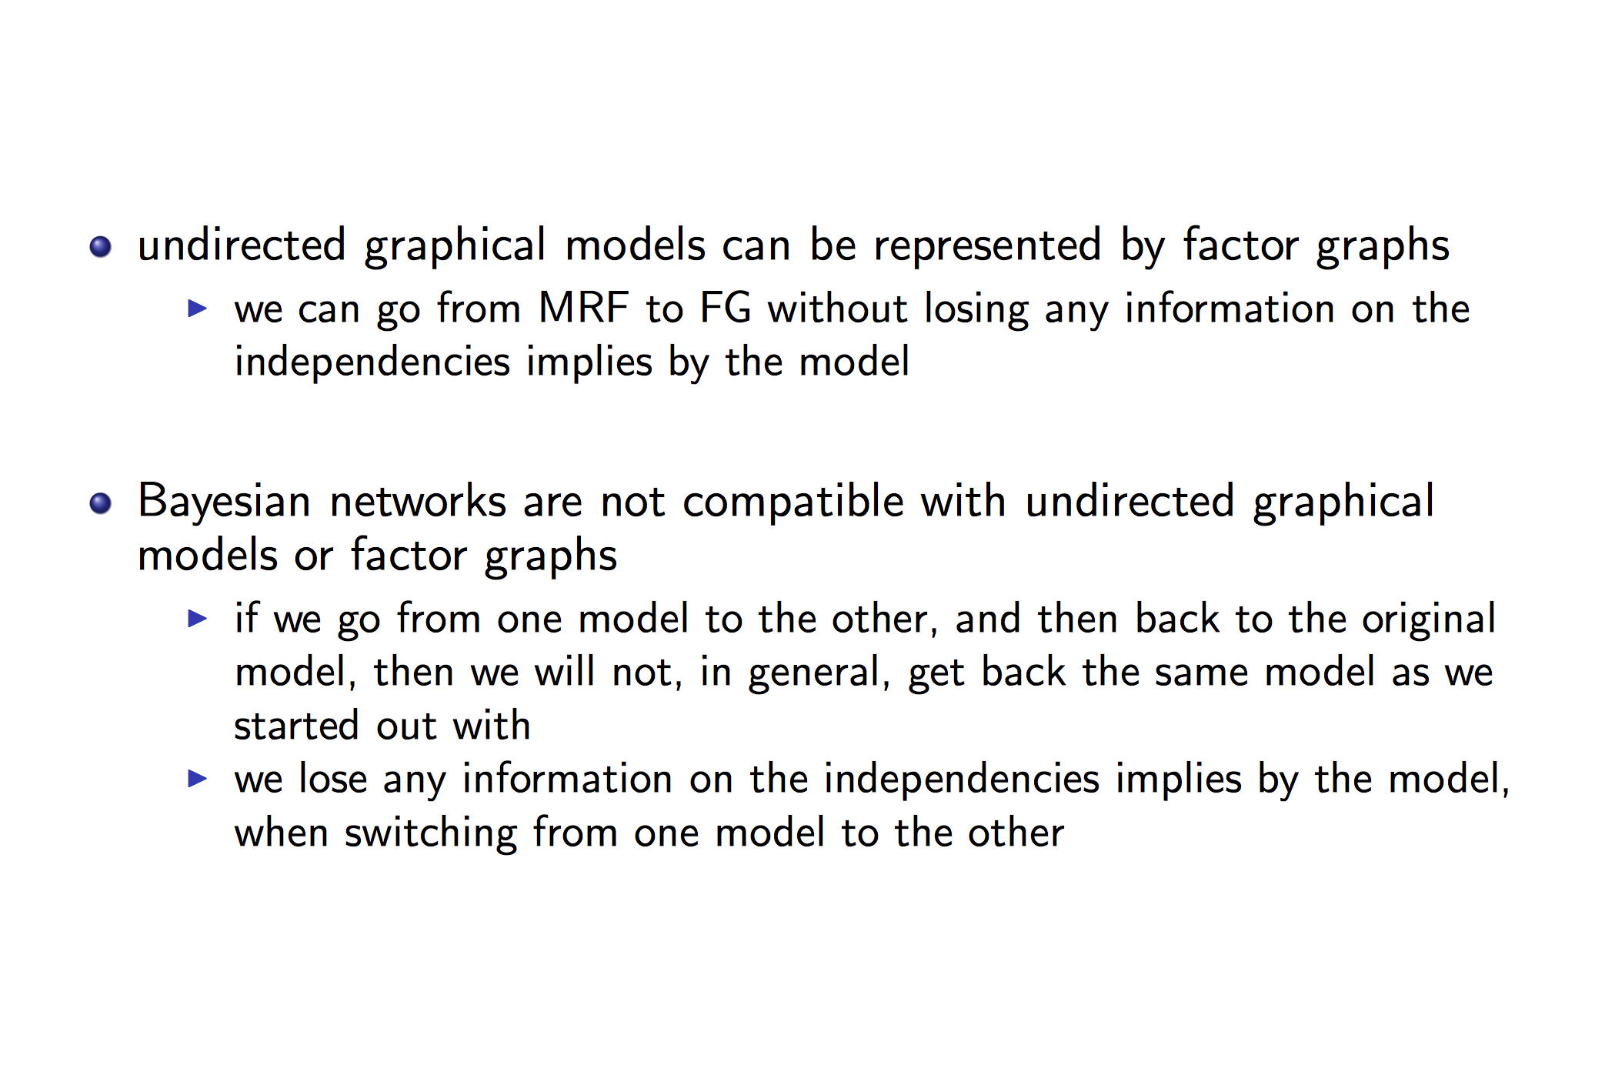
BNs – MRFs – FGs

Slide 21
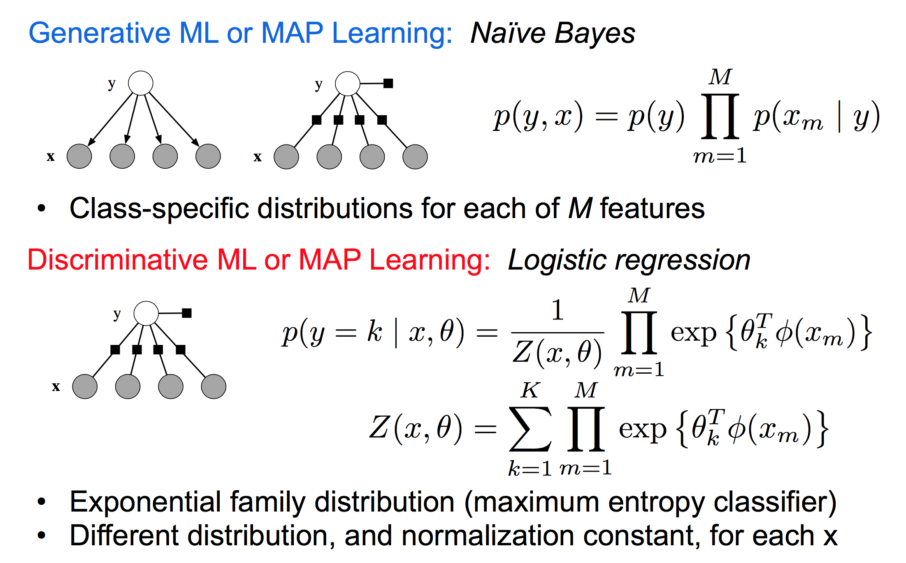
Generative vs. Discriminative

Slide 22
Conditional Random Field
A Conditional random field (CRF) is a Markov random field of unobservables which are globally conditioned on a set of observables (Lafferty et al., 2001)
Lafferty, J., McCallum, A., Pereira, F. "Conditional random fields: Probabilistic models for segmenting and labeling sequence data". Proc. 18th International Conf. on Machine Learning. Morgan Kaufmann. pp. 282–289. 2001

Slide 23
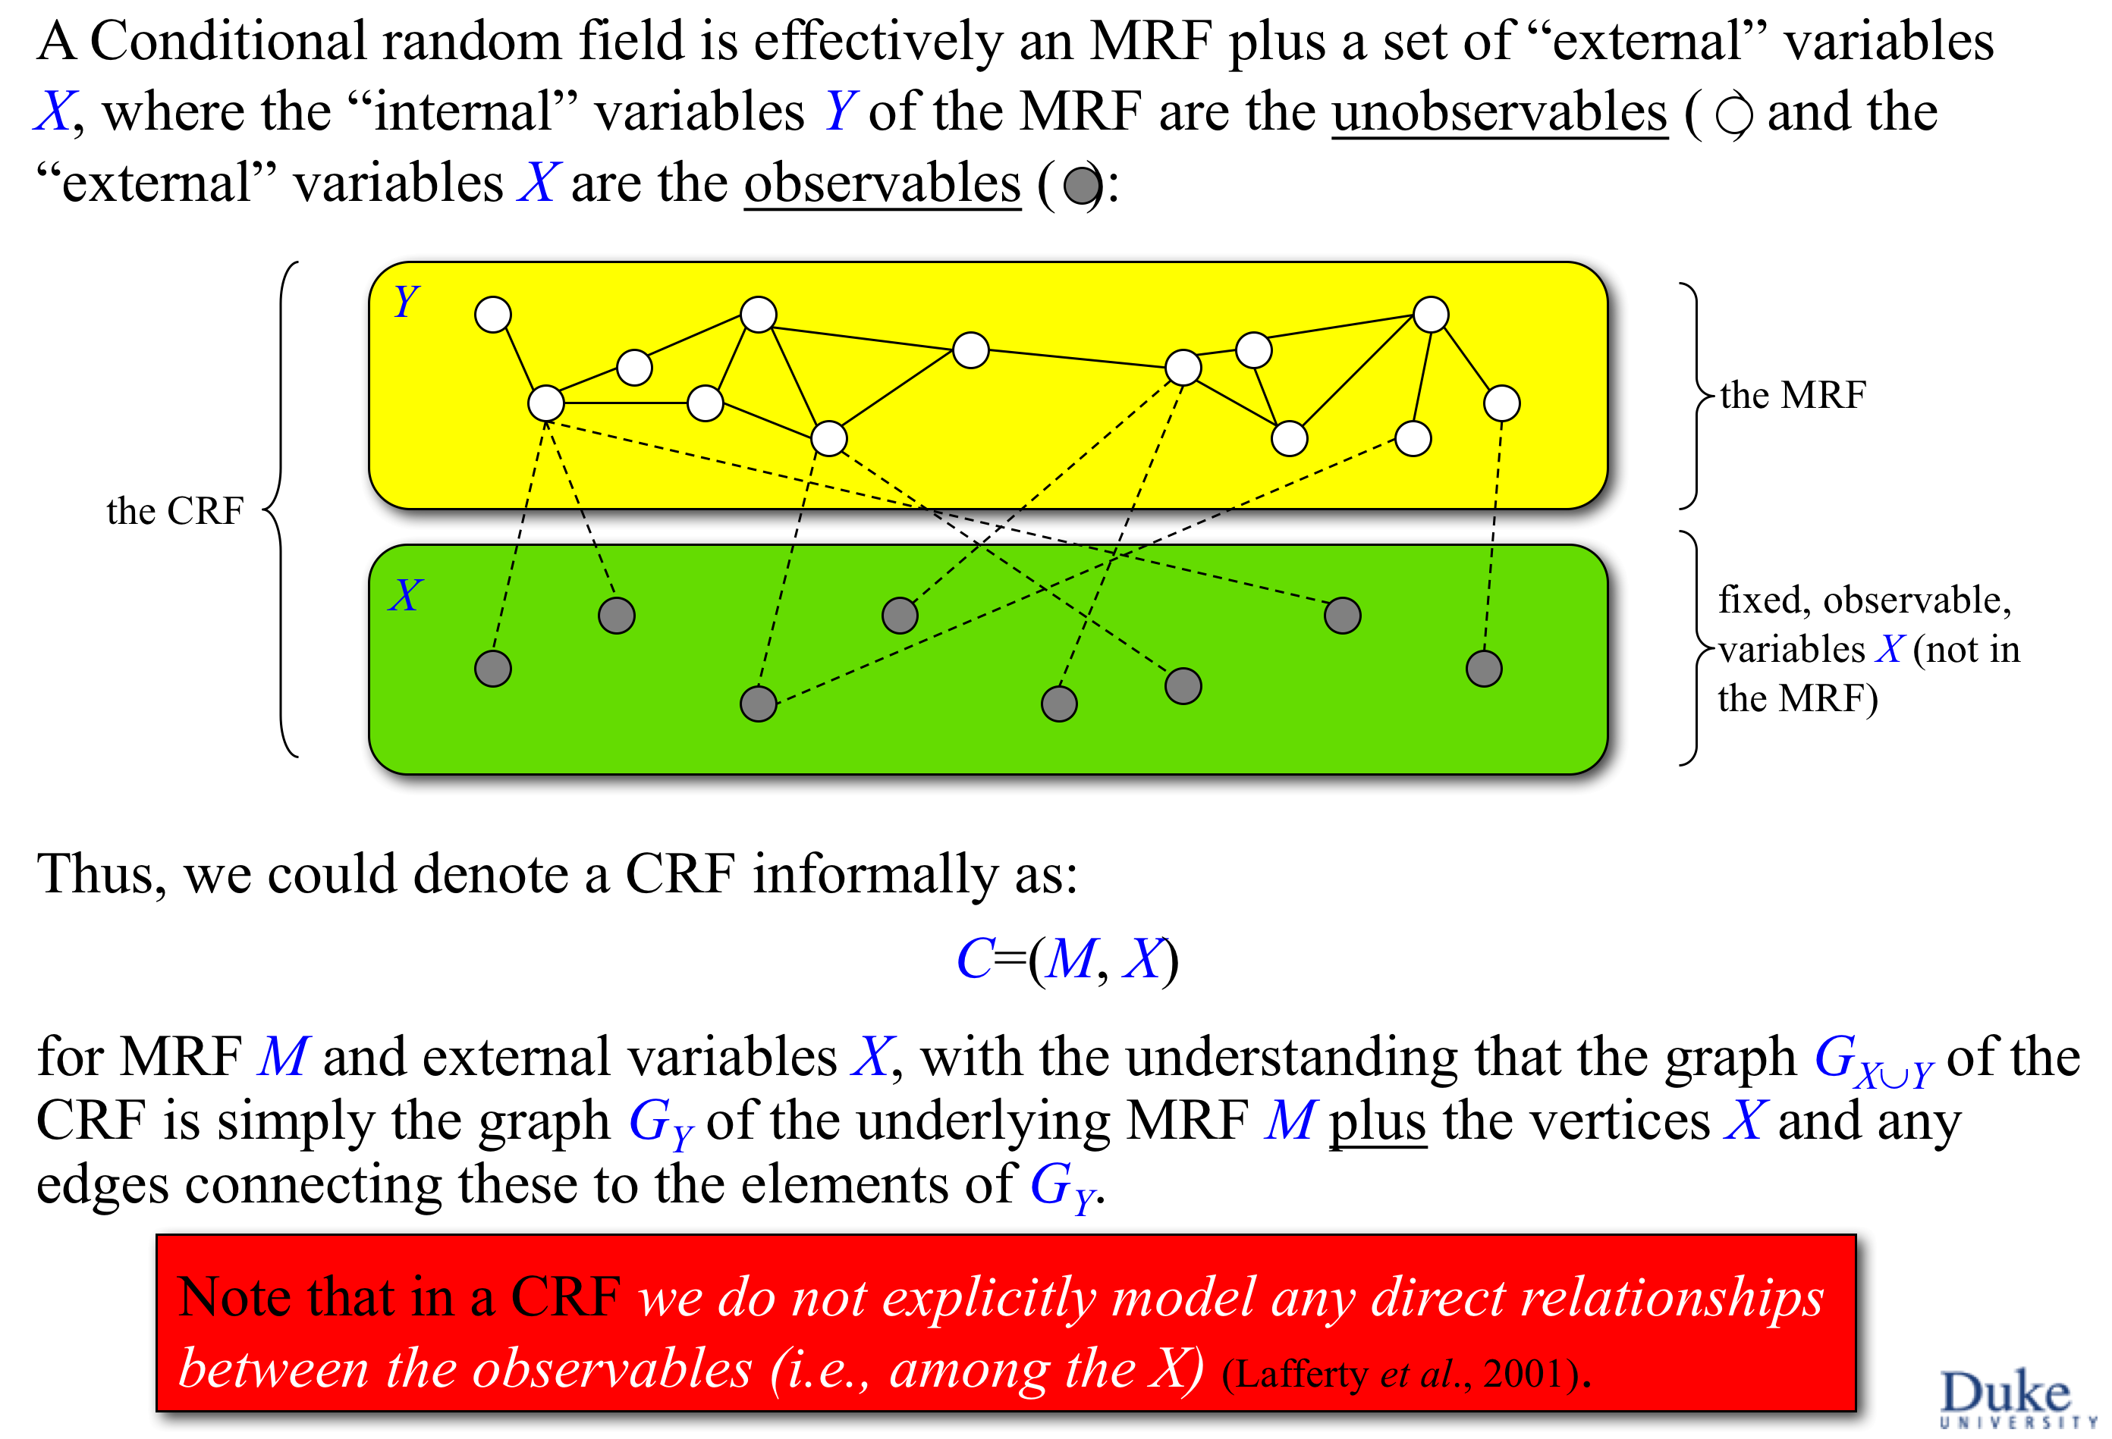
P(Y | X)

Slide 24
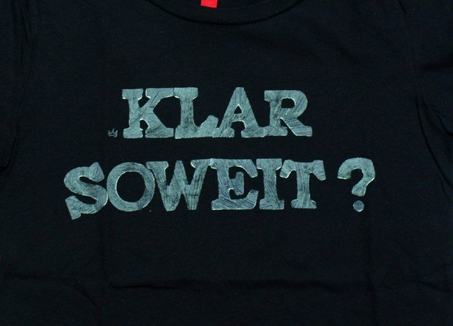

Slide 25
Augmenting Probabilistic Graphical Models with Ontology Information:
Object Classification
R. Möller
Institute of Information Systems
University of Luebeck

Slide 26


Large-Scale Object Recognition using Label Relation Graphs
Based on ECCV14 paper:
Jia Deng^{1,2}, Nan Ding², Yangqing Jia², Andrea Frome², Kevin Murphy²,
Samy Bengio², Yuan Li², Hartmut Neven², Hartwig Adam²
University of Michigan¹, Google²

Slide 27

Object Classification
Assign semantic labels to objects
Dog
✔
Corgi
✔
Puppy
✔
Cat
✖

Slide 28
Object Classification
Assign semantic labels to objects
Probabilities
Dog
0.9
Corgi
0.8
Puppy
0.9
Cat
0.1

Slide 29
Object Classification
Assign semantic labels to objects
Features
Classifier
Probabilities
Feature Extractor
Dog
0.9
Corgi
0.8
Puppy
0.9
Cat
0.1

Slide 30
Object Classification
Independent binary classifiers: Logistic Regression
Dog
0.4
No assumptions about relations.
Corgi
0.8
Puppy
0.6
Cat
0.2
Multiclass classifier: Softmax
Dog
/
0.2
Corgi
Assumes mutual exclusive labels.
/
0.4
Puppy
/
0.3
/
Cat
0.1
+

Slide 31
Object labels have rich relations
Exclusion
Hierarchical
Dog
Dog
Cat
Corgi
Puppy
Cat
Corgi
Puppy
Overlap
Softmax: all labels are mutually exclusive ☹
Logistic Regression: all labels overlap ☹

Slide 32
Goal: A new classification model
  Respects real world label relations
Dog
Cat
Dog
0.9
Corgi
0.8
Puppy
0.9
Cat
0.1
Corgi
Puppy

Slide 33
Visual Model + Knowledge Graph
Visual
Model
Knowledge
Graph
Dog
0.9
Joint Inference
Corgi
0.8
Puppy
0.9
Cat
0.1
Assumption in this work:
Knowledge graph is given and fixed.

Slide 34
Agenda
Encoding prior knowledge (HEX graph)
Classification model
Efficient Exact Inference

Slide 35
Agenda
Encoding prior knowledge (HEX graph)
Classification model
Efficient Exact Inference

Slide 36
Hierarchy and Exclusion (HEX) Graph
Exclusion
Hierarchical
Dog
Cat
Corgi
Puppy
Hierarchical edges (directed)
Exclusion edges (undirected)

Slide 37
Examples of HEX graphs
Person
Dog
Cat
Red
Shiny
Male
Female
Child
Car
Bird
Round
Thick
Boy
Girl
Mutually exclusive
All overlapping
Combination

Slide 38
State Space: Legal label configurations
Each edge defines a constraint.
Dog
Cat
Dog | Cat | Corgi | Puppy
0 | 0 | 0 | 0
0 | 0 | 0 | 1
0 | 0 | 1 | 0
0 | 0 | 1 | 1
1 | 0 | 0 | 0
…
1 | 1 | 0 | 0
1 | 1 | 0 | 1
…
Corgi
Puppy

Slide 39
State Space: Legal label configurations
Each edge defines a constraint.
Dog
Cat
Dog | Cat | Corgi | Puppy
0 | 0 | 0 | 0
0 | 0 | 0 | 1
0 | 0 | 1 | 0
0 | 0 | 1 | 1
1 | 0 | 0 | 0
…
1 | 1 | 0 | 0
1 | 1 | 0 | 1
…
Corgi
Puppy
Hierarchy: (dog, corgi) can’t be (0,1)

Slide 40
State Space: Legal label configurations
Each edge defines a constraint.
Dog
Cat
Dog | Cat | Corgi | Puppy
0 | 0 | 0 | 0
0 | 0 | 0 | 1
0 | 0 | 1 | 0
0 | 0 | 1 | 1
1 | 0 | 0 | 0
…
1 | 1 | 0 | 0
1 | 1 | 0 | 1
…
Corgi
Puppy
Hierarchy: (dog, corgi) can’t be (0,1)
Exclusion: (dog, cat) can’t be (1,1)

Slide 41
Agenda
Encoding prior knowledge (HEX graph)
Classification model
Efficient Exact Inference

Slide 42
HEX Classification Model
Pairwise Conditional Random Field (CRF)
Input scores
Binary Label vector

Slide 43
HEX Classification Model
Pairwise Conditional Random Field (CRF)
Input scores
Binary Label vector
Unary: same as logistic regression

Slide 44
HEX Classification Model
Pairwise Conditional Random Field (CRF)
Input scores
Binary Label vector
If violates constraints
0
Otherwise
Unary: same as logistic regression
Pairwise: set illegal configuration to zero
→ All illegal configurations have probability zero.

Slide 45
HEX Classification Model
Pairwise Conditional Random Field (CRF)
Input scores
Binary Label vector
Partition function: Sum over all (legal) configurations

Slide 46
HEX Classification Model
Pairwise Conditional Random Field (CRF)
Input scores
Binary Label vector
Probability of a single label: marginalize all other labels.

Slide 47
Special Case of HEX Model
Softmax
Logistic Regressions
Dog
Cat
Red
Shiny
Car
Bird
Round
Thick
Mutually exclusive
All overlapping

Slide 48
Learning
Dog
1
Corgi
?
Puppy
?
Cat
?
Label: Dog
DNN
Dog
Cat
Puppy
Corgi
Back Propagation
Maximize marginal probability of observed labels
DNN = Deep Neural Network

Slide 49
Agenda
Encoding prior knowledge (HEX graph)
Classification model
Efficient Exact Inference

Slide 50
Naïve Exact Inference is Intractable
Inference:
  Computing partition function
  Perform marginalization
HEX-CRF can be densely connected (large treewidth)

Slide 51
Observation 1: Exclusions are good
Dog
Cat
Car
Bird
Number of legal states is O(n), not O(2^{n}).
Lots of exclusions → Small state space → Efficient inference
Realistic graphs have lots of exclusions.
Rigorous analysis in paper.

Slide 52
Observation 2: Equivalent graphs
Dog
Cat
Dog
Cat
Corgi
Corgi
Puppy
Puppy
Cardigan Welsh Corgi
Pembroke Welsh Corgi
Cardigan Welsh Corgi
Pembroke Welsh Corgi

Slide 53
Observation 2: Equivalent graphs
Dog
Cat
Dog
Cat
Dog
Cat
Corgi
Corgi
Corgi
Puppy
Puppy
Puppy
Cardigan Welsh Corgi
Pembroke Welsh Corgi
Cardigan Welsh Corgi
Pembroke Welsh Corgi
Cardigan Welsh Corgi
Pembroke Welsh Corgi
Sparse equivalent
Small Treewidth ☺
Dynamic programming
Dense equivalent
Prune states ☺
Can brute force

Slide 54
HEX Graph Inference
C
2.Build
Junction Tree
(offline)
B
A
F
A
B
C
F
1. Sparsify
(offline)
B
G
B
C
D
A
F
G
C
E
D
E
F
B
G
5. Message Passing on legal states (online)
D
4.Prune Clique States
(offline)
E
F
C
3.Densify
(offline)
B
A
F
A
B
F
C
B
B
C
G
G
D
F
D
E
F
E

