Slide 1
Web-Mining Agents
Cooperating Agents for Information Retrieval
Prof. Dr. Ralf Möller
Universität zu Lübeck
Institut für Informationssysteme
Tanya Braun (Übungen)

Slide 2
Organizational Issues
Start: Wed, 19.10., 2-4pm, IFIS 2032
Lab: Fr. 2-4pm, Building 64, IFIS 2035 (3rd floor) (registration via Moodle right after this class)
Assignments provided via Moodle after class on Thu 6pm.
Submission of solutions by Wed 2pm, small kitchen IFIS
(one week after provision of assignments)
Work on assignments can/should be done in groups of 2
(pls. indicate name&group on submitted solution sheets)
In lab classes on Friday, we discuss assignments from current week and understand solutions for assignments from previous week(s)

Slide 3
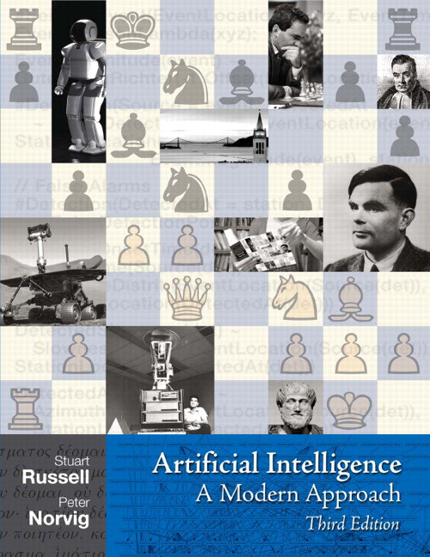
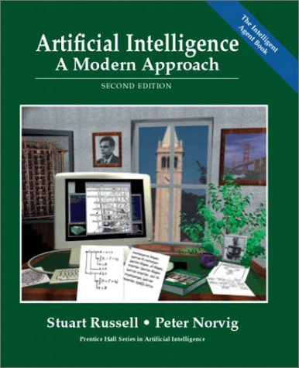
Literature
Chapters 2, 6, 13, 15- 17
http://aima.cs.berkeley.edu

Slide 4

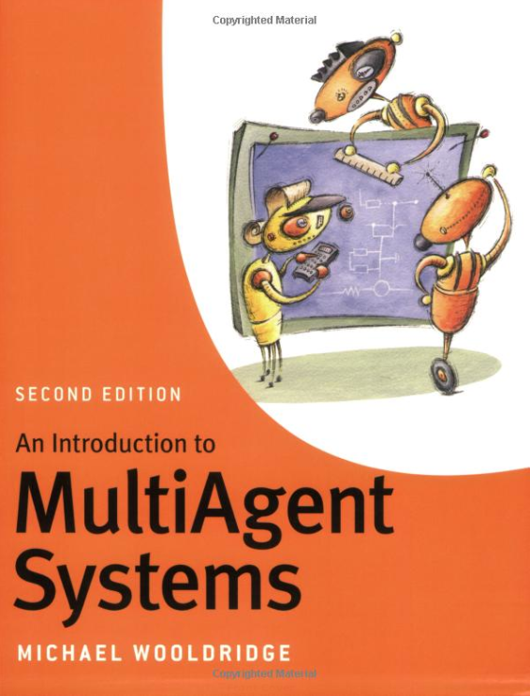
Literature

Slide 5

Literature

Slide 6
What is an Agent?
An agent is anything that can be viewed as perceiving its environment through sensors and acting upon that environment through actuators
Human agent:
eyes, ears, and other organs for sensors; hands, legs, mouth, and other body parts for actuators
Robotic agent:
cameras and infrared range finders for sensors; various motors for actuators
Software agent:
interfaces, data integration, interpretation, …

Slide 7
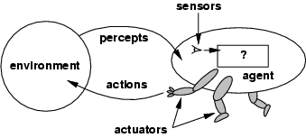
Agents and environments
The agent function maps from percept histories to actions:
[f: P* → A]
The agent program runs on the
physical architecture to produce f
Agent = architecture + program

Slide 8
Balancing Reactive and Goal-Oriented Behavior
We want our agents to be reactive, responding to changing conditions in an appropriate (timely) fashion
We want our agents to systematically work towards long-term goals
These two considerations can be at odds with one another
  Designing an agent that can balance the two remains an open research problem
  E.g.: Achieve maximum freedom of action if there is no specific short-term goal
  (e.g., keep batteries charged)

Slide 9
Social Ability
The real world is a multi-agent environment: we cannot go around attempting to achieve goals without taking others into account
Some goals can only be achieved with the cooperation of others
Social ability in agents is the ability to interact with other agents (and possibly humans) via some kind of agent-communication language …
... with the goal to let other agents to make commitments (of others) or reinforcements (about its own behavior)
Need to represent and reason about
beliefs about other agents

Slide 10
Rational Agents
Rational Agent: For each possible percept sequence, a rational agent
  should select an action
  that is expected to maximize its local performance measure,
  given the evidence provided by the percept sequence and
  whatever built-in knowledge the agent has.
Rational = Intelligent ?

Slide 11
Autonomous Agents
Rationality is distinct from omniscience
(all-knowing with infinite knowledge)
Computing the best action usually intractable
Rationality is bounded
Agents can perform actions in order to modify future percepts so as to obtain useful information (information gathering, exploration)
An agent is autonomous if its behavior is determined by its own "experience" (with ability to learn and adapt)
  What matters for the "experience" is the
    percept sequence (which the agents can determine), the
    state representation, and the
    "computational success" of computing the best action
    as well as learning and adapting for the future

