Slide 1
Web-Mining Agents
Topic Analysis: pLSI and LDA
Tanya Braun
Ralf Möller
Universität zu Lübeck
Institut für Informationssysteme

Slide 2
Acknowledgments
Pilfered from:
Ramesh M. Nallapati
Machine Learning applied to Natural Language Processing
Thomas J. Watson Research Center, Yorktown Heights, NY USA
from his presentation on
Generative Topic Models for Community Analysis
&
David M. Blei
MLSS 2012
from his presentation on Probabilistic Topic Models
&
Sina Miran
CS 290D Paper Presentation on
Probabilistic Latent Semantic Indexing (PLSI)

Slide 3
Recap
Agents
  Task/goal: Information retrieval
  Environment: Document repository
  Means:
    Vector space (bag-of-words)
      Dimension reduction (LSI)
    Probability based retrieval (binary)
      Language models
Today: Topic models as special language models
  Probabilistic LSI (pLSI)
  Latent Dirichlet Allocation (LDA)
Soon: What agents can take with them
  What agents can leave at the repository (win-win)

Slide 4
Objectives
Topic Models: statistical methods that analyze the words of texts in order to:
  Discover the themes that run through them (topics)
  How those themes are connected to each other
  How they change over time

Slide 5
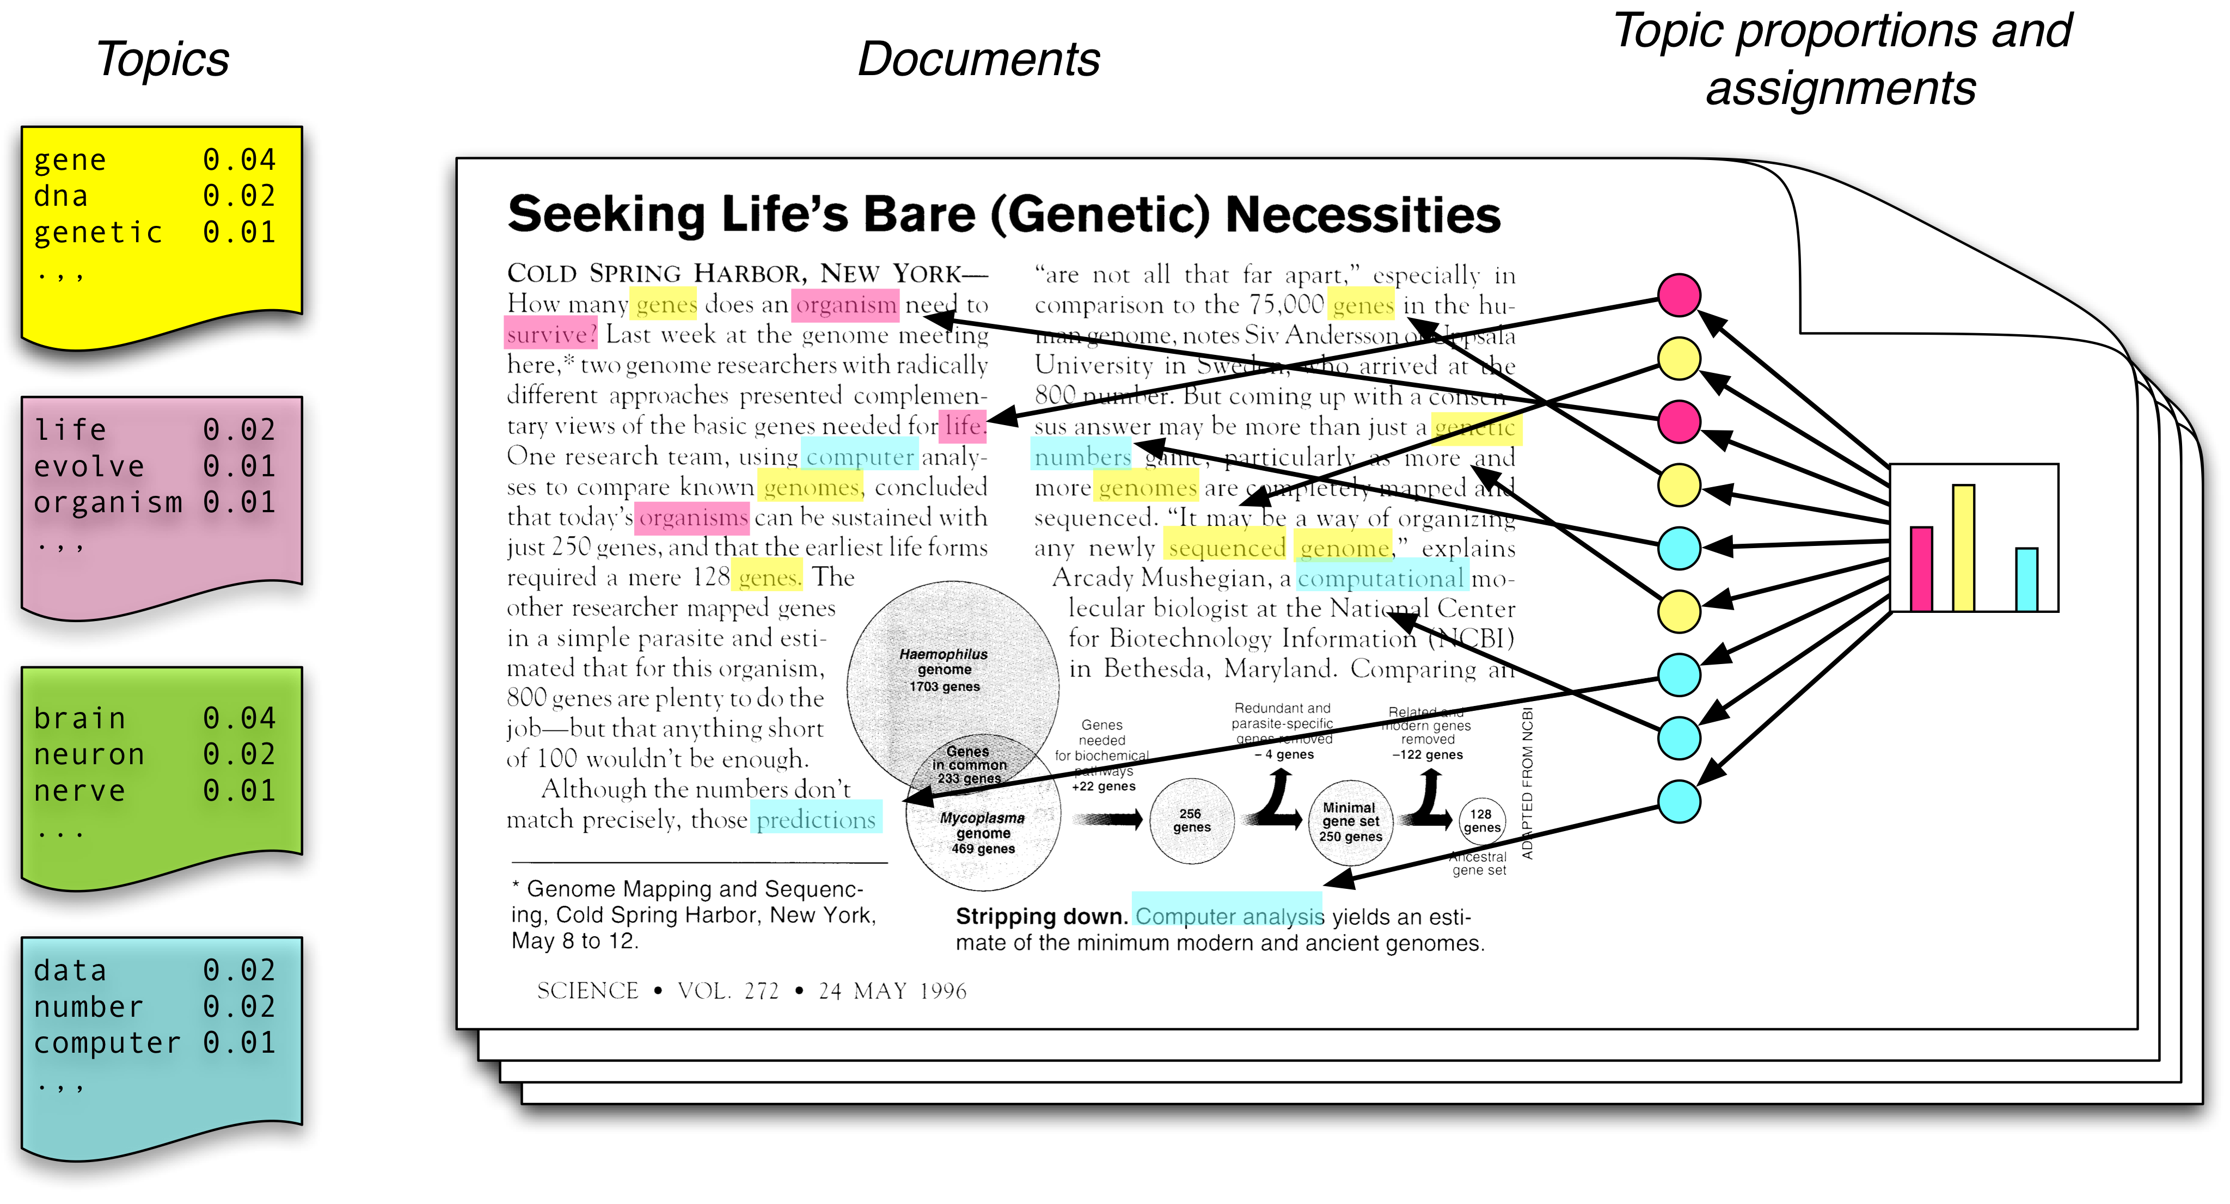
Topic Modeling Scenario
Each topic is a distribution over words
Each document is a mixture of corpus-wide topics
Each word is drawn from one of those topics

Slide 6
Topic Modeling Scenario
In reality, we only observe the documents
The other structures are hidden variables
Topic modeling algorithms infer these variables from data

Slide 7
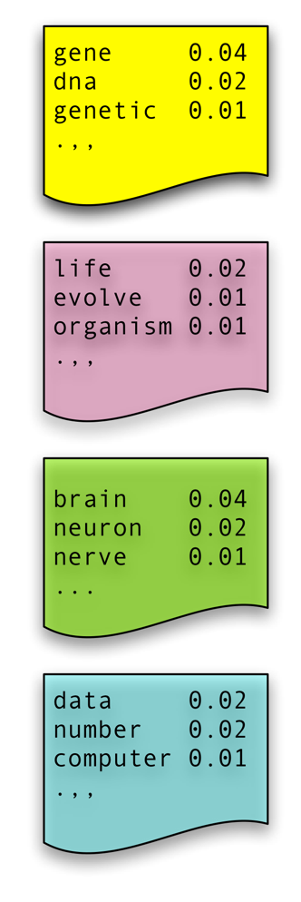
Plate Notation
Naïve Bayes Model: Compact representation
  C = topic/class (name for a word distribution)
  N = number of words in considered document
  W_{i} one specific word in corpus
  M documents, W now words in document
  Idea: Generate doc from P(W, C)
C
C
…..
w₁
w₂
w₃
w_{N}
W
M
N
M

Slide 8
Generative vs. Descriptive Models
Generative models: Learn P(x, y)
  Tasks:
    Transform P(x,y) into P(y | x) for classification
    Use the model to predict (infer) new data
  Advantages
    Assumptions and model are explicit
    Use well-known algorithms (e.g., MCMC, EM)
Descriptive models: Learn P(y | x)
  Task: Classify data
  Advantages
    Fewer parameters to learn
    Better performance for classification
Notes:
So discriminative algorithms try to learn p ( y | x ) directly from the data and then try to classify data. On the other hand, generative algorithms try to learn
p ( x , y ) which can be transformed into p ( y | x ) later to classify the data. One of the advantages of generative algorithms is that you can use p ( x , y ) to generate new data similar to existing data. On the other hand, discriminative algorithms generally give better performance in classification tasks.

Slide 9
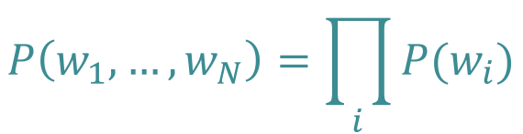
Earlier Topic Models: Topics Known
Unigram
  No context information
W
N
$$P\left(w_{1},…,w_{N}\right)=\prod_{i}{P(w_{i})}$$
Automatically generated sentences from a unigram model
Notes:
Just all words over all documents

Slide 10

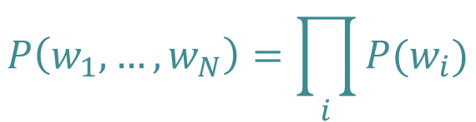
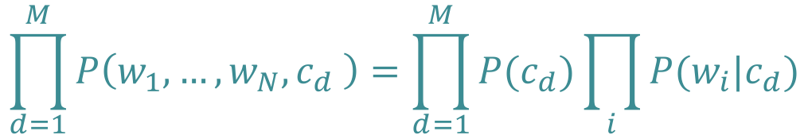
Earlier Topic Models: Topics Known
Unigram
  No context information
Mixture of Unigrams
  One topic per document
  How to specify $P(c_{d})$?
W
N
$$P\left(w_{1},…,w_{N}\right)=\prod_{i}{P(w_{i})}$$
C
$$\prod_{d=1}^{M}{P\left(w_{1},…,w_{N},c_{d} \right)}=\prod_{d=1}^{M}{P(c_{d})}\prod_{i}{P(w_{i}|c_{d})}$$
W
N
M
Notes:
Topic per document ->

Slide 11

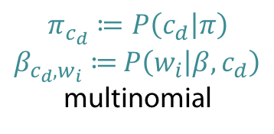
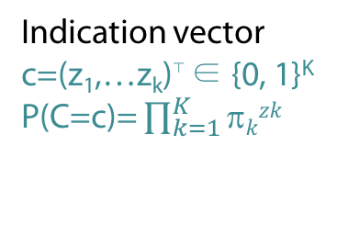
Mixture of Unigrams: Known Topics
Multinomial Naïve Bayes
  For each document d = 1, …, M
    Generate c_{d} ~ Mult( . | π)
    For each position i = 1, ... , N_{d}
      Generate w_{i} ~ Mult( . | β, c_{d})
π
C
Indication vector
c=(z₁,…z_{k})⊤ ∈ {0, 1}^{K}
P(C=c)= $\prod_{k=1}^{K}{\text{π}kzk}$
$$\prod_{d=1}^{M}{P\left(w_{1},…,w_{N_{d}},c_{d} | β,π\right)}$$
$$=\prod_{d=1}^{M}{P(c_{d}|π)}\prod_{i=1}^{N_{d}}{P\left(w_{i} | β,c_{d}\right)}=\prod_{d=1}^{M}{π_{c_{d}}\prod_{i=1}^{N_{d}}{β_{c_{d},w_{i}}}}$$
W
N
M
β
$$π_{c_{d}}≔P\left(c_{d} | π\right)$$
$β_{c_{d},w_{i}}≔$ $P\left(w_{i} | β,c_{d}\right)$
multinomial
Notes:
Binomial distribution, where n experiments, prob p of success (n=1: Bernoulli)
K successes: n over k p^k (1-p)^(n-k)
Multinomial distribution: generalization of binomial with k outcomes instead of 2

Slide 12
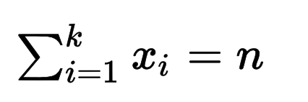
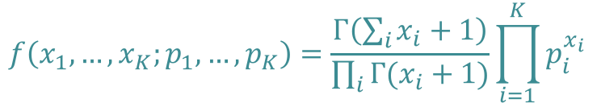

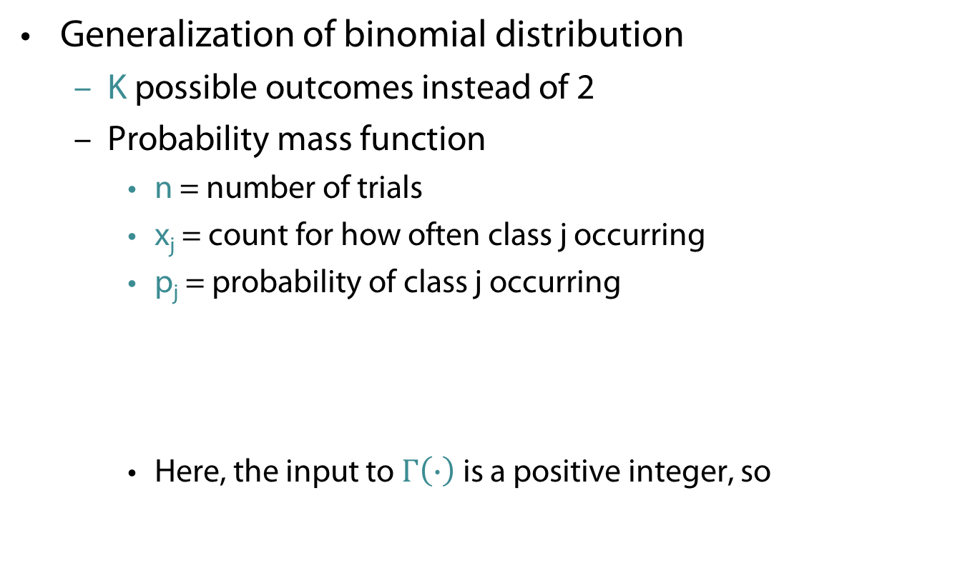
Multinomial Distribution
Generalization of binomial distribution
  K possible outcomes instead of 2
  Probability mass function
    n = number of trials
    x_{j} = count for how often class j occurring
    p_{j} = probability of class j occurring
    Here, the input to $Γ\left(∙\right)$ is a positive integer, so
$$f\left(x_{1},…,x_{K};p_{1},…,p_{K}\right)=\frac{Γ\left(\sum_{i}{x_{i}+1}\right)}{\prod_{i}{Γ(x_{i}+1)}}\prod_{i=1}^{K}{p_{i}^{x_{i}}}$$
$$Γ\left(n\right)=\left(n−1\right)!$$

Slide 13
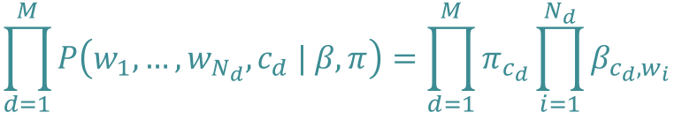
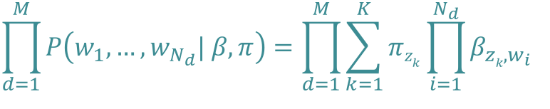
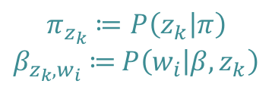
Mixture of Unigrams: Unknown Topics
Topics/classes are hidden
  Joint probability of words and classes
  Sum over topics (K = number of topics)
π
$$\prod_{d=1}^{M}{P\left(w_{1},…,w_{N_{d}},c_{d} | β,π\right)}=\prod_{d=1}^{M}{π_{c_{d}}\prod_{i=1}^{N_{d}}{β_{c_{d},w_{i}}}}$$
Z
W
N
M
$$\prod_{d=1}^{M}{P\left(w_{1},…,w_{N_{d}}| β,π\right)}=\prod_{d=1}^{M}{\sum_{k=1}^{K}{{πz}_{k}\prod_{i=1}^{N_{d}}{β_{zk,w_{i}}}}}$$
β
$$π_{z_{k}}≔P\left(z_{k} | π\right)$$
$β_{z_{k},w_{i}}≔$ $P\left(w_{i} | β,z_{k}\right)$

Slide 14
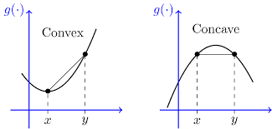




Mixture of Unigrams: Learning
Learn parameters $π$ and $β$
Use likelihood
Solve
  Not a concave/convex function
  Note: a non-concave/non-convex function
  is not necessarily convex/concave
  Possibly no unique max, many saddle or turning points
  No easy way to find roots of derivative
$$\prod_{d=1}^{M}{P\left(w_{1},…,w_{N_{d}}| β,π\right)} =\prod_{d=1}^{M}{\sum_{k=1}^{K}{π_{zk}\prod_{i=1}^{N_{d}}{β_{zk,w_{i}}}}}$$
$$\sum_{d=1}^{M}{\log{P\left(w_{1},…,w_{N_{d}}| β,π\right)}}=\sum_{d=1}^{M}{\log{\sum_{k=1}^{K}{{πz}_{k}\prod_{i=1}^{N_{d}}{β_{zk,w_{i}}}}}}$$
$$argmaxβπ\sum_{d=1}^{M}{\log{\sum_{k=1}^{K}{{πz}_{k}\prod_{i=1}^{N_{d}}{β_{zk,w_{i}}}}}}$$

Slide 15
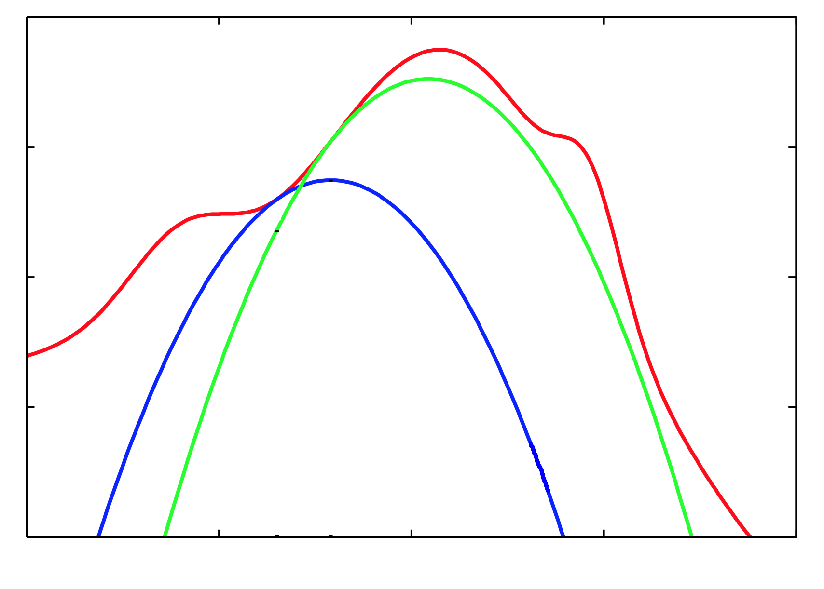

Trick: Optimize Lower Bound
$(γ_{dk}$, 𝜃)

Slide 16
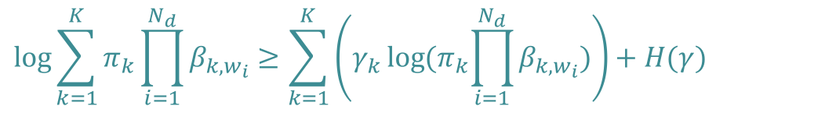
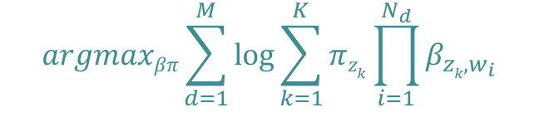

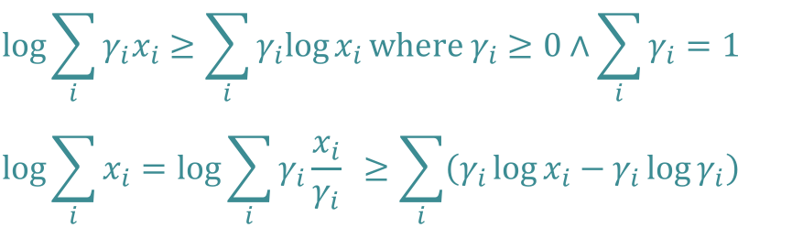
Mixture of Unigrams: Learning
$$argmaxβπ\sum_{d=1}^{M}{\log{\sum_{k=1}^{K}{{πz}_{k}\prod_{i=1}^{N_{d}}{β_{zk,w_{i}}}}}}$$
The problem
Optimize w.r.t. each document
Derive lower bound
$$\log{\sum_{i}{γ_{i}x_{i}}}≥\sum_{i}{γ_{i}log{x_{i}}}\text{where} γ_{i}≥0∧\sum_{i}{γ_{i}=1}$$
$$\log{\sum_{i}{x_{i}}}=\log{\sum_{i}{γ_{i}{\frac{x_{i}}{γ_{i}}}} ≥\sum_{i}{\left(γ_{i}\log{x_{i}−γ_{i}\log{γ_{i}}}\right)}}$$
Jensen's inequality
H(γ)
$$argmaxβπ\sum_{d=1}^{M}{\log{\sum_{k=1}^{K}{{πz}_{k}\prod_{i=1}^{N_{d}}{β_{zk,w_{i}}}}}}$$
The problem again
$$\log{\sum_{k=1}^{K}{π_{k}\prod_{i=1}^{N_{d}}{β_{k,w_{i}}}}}≥\sum_{k=1}^{K}{\left(γ_{k}\log{{(π}_{k}\prod_{i=1}^{N_{d}}{β_{k,w_{i}}}})\right)}+H(γ)$$
16

Slide 17
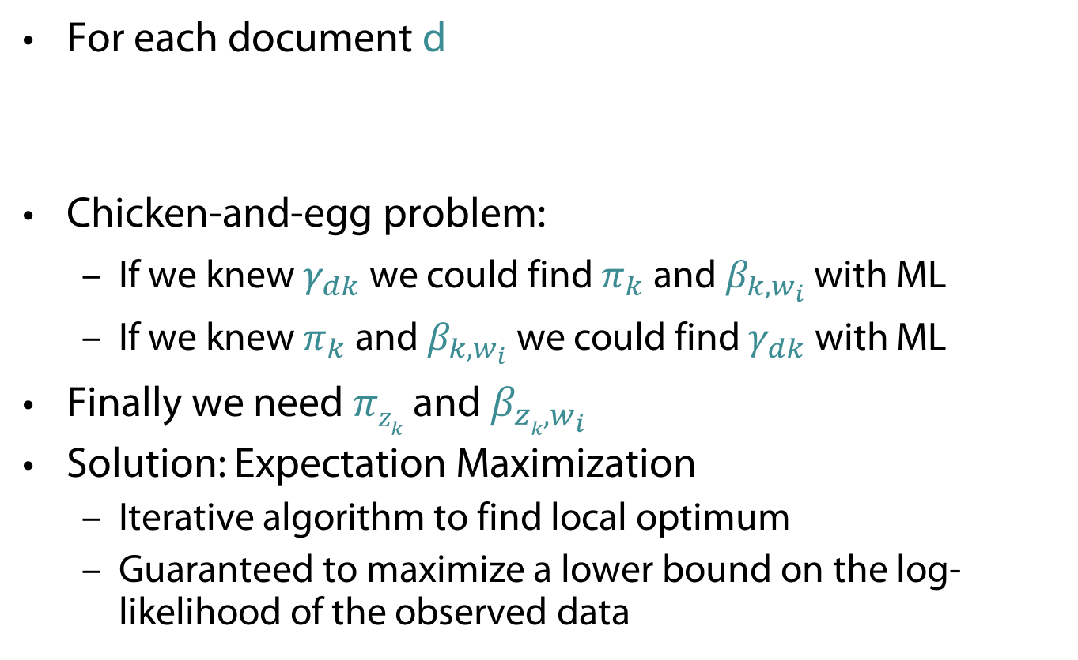
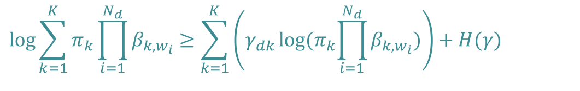
Mixture of Unigrams: Learning
For each document d
Chicken-and-egg problem:
  If we knew $γ_{dk}$ we could find $π_{k}$ and $β_{k,w_{i}}$ with ML
  If we knew $π_{k}$ and $β_{k,w_{i}}$ we could find $γ_{dk}$ with ML
Finally we need ${πz}_{k}$and $β_{zk,w_{i}}$
Solution: Expectation Maximization
  Iterative algorithm to find local optimum
  Guaranteed to maximize a lower bound on the log-likelihood of the observed data
$$\log{\sum_{k=1}^{K}{π_{k}\prod_{i=1}^{N_{d}}{β_{k,w_{i}}}}}≥\sum_{k=1}^{K}{\left(γ_{dk}\log{{(π}_{k}\prod_{i=1}^{N_{d}}{β_{k,w_{i}}}})\right)}+H(γ)$$
Notes:
E: compute gamma based on current model (parameters)
M: update model parameters pi, beta given current gamma

Slide 18
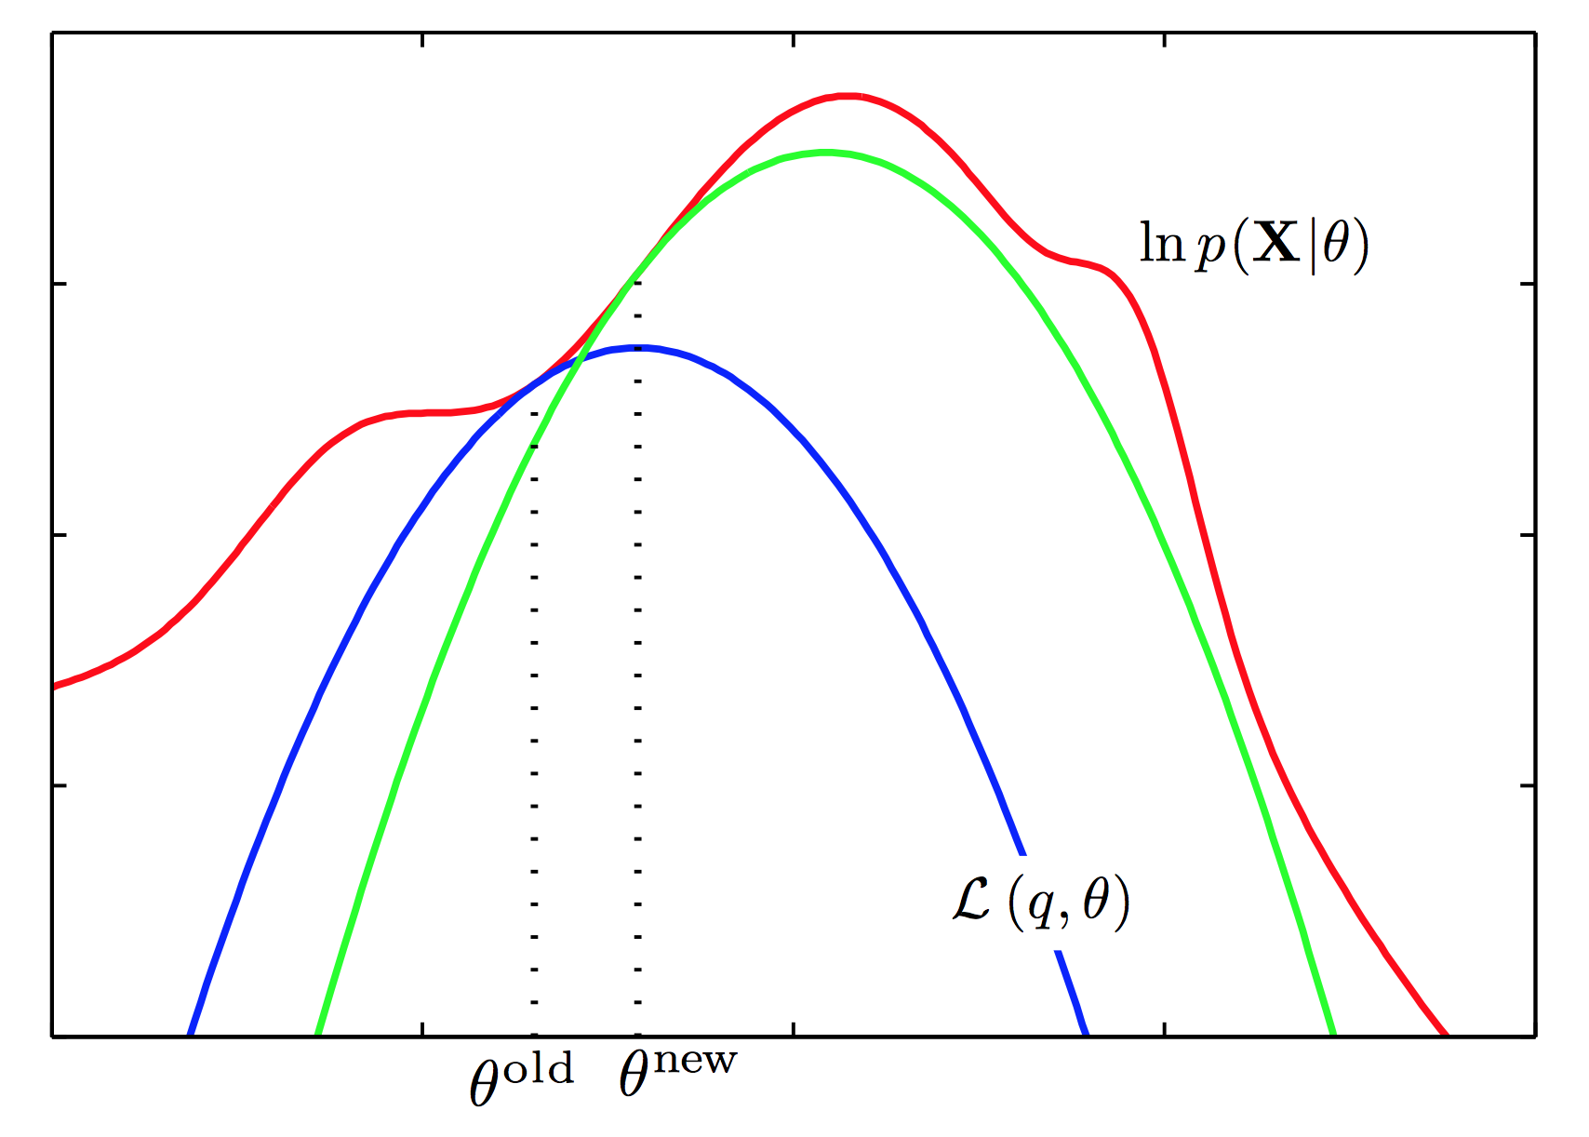

Graphical Idea of the EM Algorithm
$(γ_{dk}$, 𝜃)
$\text{θ}=(π_{k}$, $β_{k,w_{i}})$

Slide 19
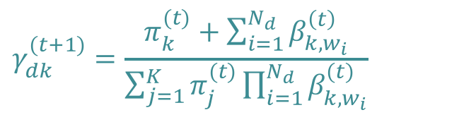

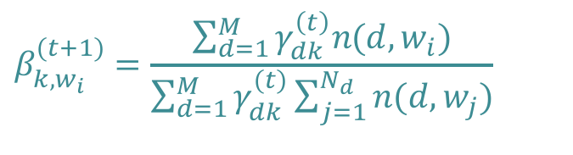
Mixture of Unigrams: Learning
For each document d
EM solution
  E step
  M step
$$\log{\sum_{k=1}^{K}{π_{k}\prod_{i=1}^{N_{d}}{β_{k,w_{i}}}}}≥\sum_{k=1}^{K}{\left(γ_{dk}\log{{(π}_{k}\prod_{i=1}^{N_{d}}{β_{k,w_{i}}}})\right)}+H(γ)$$
$$γ_{dk}^{(t+1)}=\frac{π_{k}^{(t)}+\sum_{i=1}^{N_{d}}{β_{k,w_{i}}^{\left(t\right)}}}{\sum_{j=1}^{K}{π_{j}^{(t)}\prod_{i=1}^{N_{d}}{β_{k,w_{i}}^{(t)}}}}$$
$$π_{k}^{(t+1)}=\frac{\sum_{d=1}^{M}{γ_{dk }^{\left(t\right)}}}{M}$$
$$β_{k,w_{i}}^{(t+1)}=\frac{\sum_{d=1}^{M}{γ_{dk }^{\left(t\right)}n(d,w_{i})}}{\sum_{d=1}^{M}{γ_{dk}^{(t)}\sum_{j=1}^{N_{d}}{n(d,w_{j})}}}$$
Notes:
E: compute gamma based on current model (parameters)
M: update model parameters pi, beta given current gamma

Slide 20
Back to Topic Modeling Scenario

Slide 21
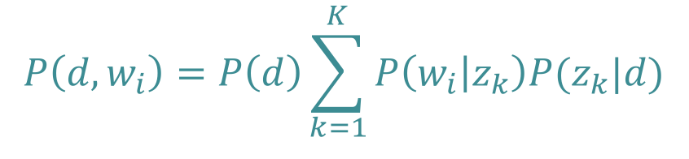
Probabilistic LSI
Select a document d with probability P(d)
For each word of d in the training set
  Choose a topic z with probability
  P(z | d)
  Generate a word with probability
  P(w | z)
Documents can have multiple topics
d
z
w
$$P\left(d,w_{i}\right)=P\left(d\right)\sum_{k=1}^{K}{P\left(w_{i} | z_{k}\right)P(z_{k}|d)}$$
N
M
  Thomas Hofmann, Probabilistic Latent Semantic Indexing, Proceedings of the 22nd Annual International SIGIR Conference on Research and Development in Information Retrieval (SIGIR-99), 1999
Notes:
Joint probability distribution

Slide 22

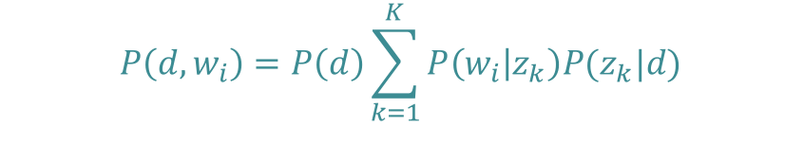
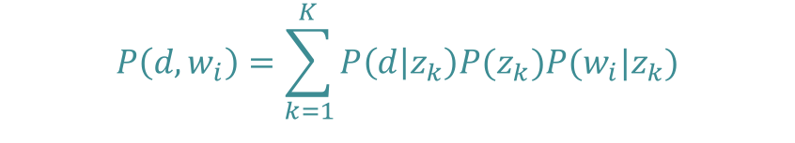

pLSI
d
Joint probability for all documents, words
Distribution for document d, word w_{i}
Reformulate $P(z_{k}|d)$ with Bayes’ Rule
P(d)
$$\prod_{d=1}^{M}{\prod_{i=1}^{N_{d}}{P{\left(d,w_{i}\right)}^{n(d,w_{i})}}}$$
z_{k}
P(z_{k}|d)
$$P\left(d,w_{i}\right)=P\left(d\right)\sum_{k=1}^{K}{P\left(w_{i} | z_{k}\right)P(z_{k}|d)}$$
w_{i}
P(w_{i}|z_{k})
z_{k}
P(z_{k})
$$P\left(d,w_{i}\right)=\sum_{k=1}^{K}{P\left(d | z_{k}\right)P(z_{k})P(w_{i}|z_{k})}$$
d
w_{i}
P(d|z_{k})
P(z_{k}|w_{i})
Notes:
Bayes rule on P(z|d)

Slide 23
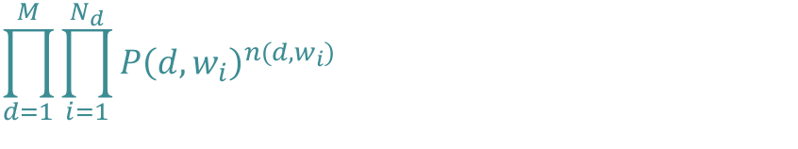
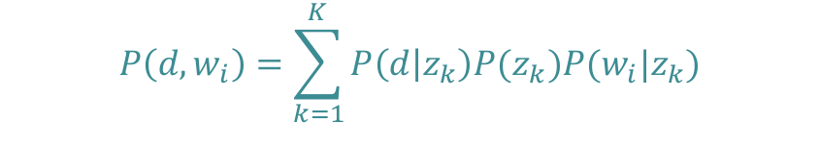




pLSI: Learning Using EM
Model
Likelihood
Parameters to learn (M step)
  (E step)
$$P\left(d,w_{i}\right)=\sum_{k=1}^{K}{P\left(d | z_{k}\right)P(z_{k})P(w_{i}|z_{k})}$$
$$\prod_{d=1}^{M}{\prod_{i=1}^{N_{d}}{P{\left(d,w_{i}\right)}^{n(d,w_{i})}}}$$
$$L= \sum_{d=1}^{M}{\sum_{i=1}^{N_{d}}{n\left(d,w_{i}\right)\log{P(d,w_{i})}}}=\sum_{d=1}^{M}{\sum_{i=1}^{N_{d}}{n(d,w_{i})\log{\sum_{k=1}^{K}{P\left(d | z_{k}\right)P(z_{k})P(w_{i}|z_{k})}}}}$$
  $$P(d|z_{k})$$
  $$P\left(z_{k}\right)$$
$$P\left(w_{i} | z_{k}\right)$$
$$P\left(z_{k} | d,w_{i}\right)$$

Slide 24
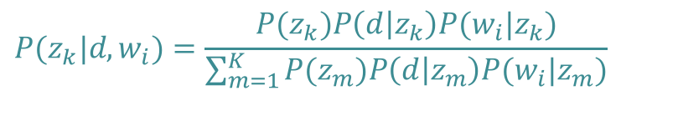

pLSI: Learning Using EM
EM solution
  E step
  M step
$$P(z_{k}|d,w_{i})=\frac{P(z_{k})P\left(d | z_{k}\right)P(w_{i}|z_{k})}{\sum_{m=1}^{K}{P(z_{m})P\left(d | z_{m}\right)P(w_{i}|z_{m})}}$$
$$P\left(w_{i} | z_{k}\right) =\frac{\sum_{d=1}^{M}{n\left(d,w_{i}\right)P\left(z_{k} | d,w_{i}\right)}}{\sum_{d=1}^{M}{\sum_{j=1}^{N_{d}}{n\left(d,w_{j}\right)P\left(z_{k} | d,w_{j}\right)}}}$$
$$P\left(d | z_{k}\right) =\frac{\sum_{i=1}^{N_{d}}{n\left(d,w_{i}\right)P\left(z_{k} | d,w_{i}\right)}}{\sum_{c=1}^{M}{\sum_{i=1}^{N_{c}}{n\left(c,w_{i}\right)P\left(z_{k} | c,w_{i}\right)}}}$$
$$P\left(z_{k}\right) =\frac{1}{R}\sum_{d=1}^{M}{\sum_{i=1}^{N_{d}}{n\left(d,w_{i}\right)P\left(z_{k} | d,w_{i}\right), }}R=\sum_{d=1}^{M}{\sum_{i=1}^{N_{d}}{n\left(d,w_{i}\right)}}$$

Slide 25
pLSI: Overview
More realistic than mixture model
  Documents can discuss multiple topics!
Problems
  Very many parameters
  Danger of overfitting
Notes:
Mixture parameters for each document
Poor generalization

Slide 26
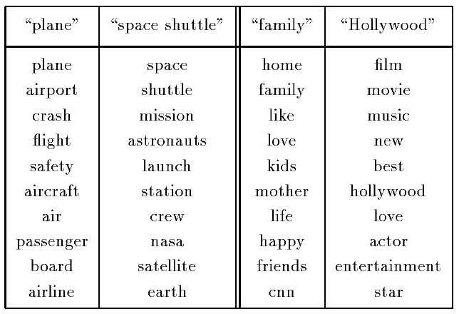
pLSI Testrun
PLSI topics (TDT-1 corpus)
  Approx. 7 million words, 15863 documents, K = 128
The two most probable
topics that generate the
term “flight” (left) and
“love” (right).
List of most probable
words per topic, with
decreasing probability
going down the list.

Slide 27
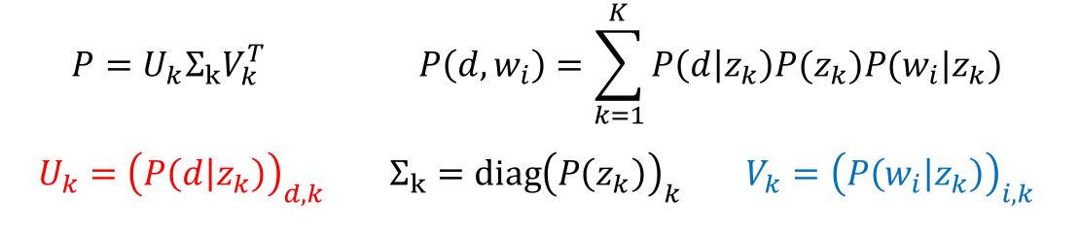
Relation with LSI
Difference:
  LSI: minimize Frobenius (L-2) norm
  pLSI: log-likelihood of training data
$$P=U_{k}Σ_{k}V_{k}^{T} P\left(d,w_{i}\right)=\sum_{k=1}^{K}{P\left(d | z_{k}\right)P(z_{k})P(w_{i}|z_{k})}$$
$$U_{k}={\left(P\left(d | z_{k}\right)\right)}_{d,k} Σ_{k}=diag{\left(P\left(z_{k}\right)\right)}_{k} V_{k}={\left(P\left(w_{i} | z_{k}\right)\right)}_{i,k}$$

Slide 28


pLSI with Multinomials
π
Multinomial Naïve Bayes
  Select document d ~ Mult( ∙ | π)
    For each position i = 1, ... , N_{d}
      Generate z_{i} ~ Mult(∙ | d, $θ_{d}$)
      Generate w_{i} ~ Mult( ∙ | z_{i}, β_{k})
θ_{d}
d
z
$$\prod_{d=1}^{M}{P\left(w_{1},…,w_{N_{d}},d | β,θ,π\right)}$$
$$=\prod_{d=1}^{M}{P(d| π)}\prod_{i=1}^{N_{d}}{\sum_{k=1}^{K}{P(z_{i}=k|d,θ_{d})P\left(w_{i} | β_{k} \right)}}$$
$$=\prod_{d=1}^{M}{π_{d}\prod_{i=1}^{N_{d}}{\sum_{k=1}^{K}{{θ_{d,k}β}_{k,w_{i}}}}}$$
w
N
M
β

Slide 29
Prior Distribution for Topic Mixture
Goal: topic mixture proportions for each document are drawn from some distribution.
  Distribution on multinomials (k-tuples of non-negative numbers that sum to one)
The space is of all of these multinomials can be interpreted geometrically as a (k-1)-simplex
  Generalization of a triangle to (k-1) dimensions
Criteria for selecting our prior:
  It needs to be defined for a (k-1)-simplex
  Should have nice properties
In Bayesian probability theory, if the posterior distributions p(θ|x) are in the same family as the prior probability distribution p(θ), the prior and posterior are then called conjugate distributions, and the prior is called a conjugate prior for the likelihood function.
[Wikipedia]

Slide 30
Latent Dirichlet Allocation
Document = mixture of topics (as in pLSI), but according to a Dirichlet prior
  When we use a uniform Dirichlet prior, pLSI=LDA
D. Blei, A. Ng, and M. Jordan. Latent Dirichlet Allocation.
Journal of Machine Learning Research, 3:993-1022, January 2003

Slide 31
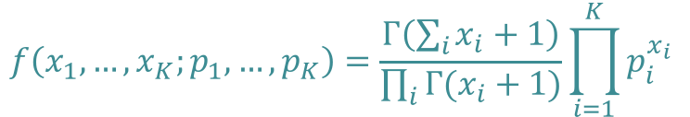
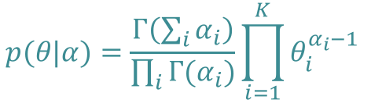
Dirichlet Distributions
$$p(θ|α)=\frac{Γ\left(\sum_{i}{α_{i}}\right)}{\prod_{i}{Γ(α_{i})}}\prod_{i=1}^{K}{θ_{i}^{α_{i}−1}}$$
Defined over a (k-1)-simplex
  Takes K non-negative arguments which sum to one.
  Consequently it is a natural distribution to use over multinomial distributions.
The Dirichlet parameter α_{i} can be thought of as a prior count of the i^{th} class
Conjugate prior to the multinomial distribution
  Conjugate prior: if our likelihood is multinomial with a Dirichlet prior, then the posterior is also a Dirichlet
$$f\left(x_{1},…,x_{K};p_{1},…,p_{K}\right)=\frac{Γ\left(\sum_{i}{x_{i}+1}\right)}{\prod_{i}{Γ(x_{i}+1)}}\prod_{i=1}^{K}{p_{i}^{x_{i}}}$$

Slide 32
LDA Model
α
θ
θ
θ
z₁
z₂
z₃
z₄
z₁
z₂
z₃
z₄
z₁
z₂
z₃
z₄
w₁
w₂
w₃
w₄
w₁
w₂
w₃
w₄
w₁
w₂
w₃
w₄
β

Slide 33
LDA Model – Parameters
α
Proportions parameter
(k-dimensional vector of real numbers)
Per-document topic distribution
(k-dimensional vector of
probabilities summing up to 1)
Per-word topic assignment
(number from 1 to k)
Observed word
(number from 1 to v, where v is the number of words in the vocabulary)
Word “prior”
(v-dimensional)
θ
z
w
N
M
β

Slide 34
Dirichlet Distribution over a 2-Simplex
A panel illustrating probability density functions of a few Dirichlet distributions over a 2-simplex, for the following α vectors (clockwise, starting from the upper left corner): (1.3, 1.3, 1.3), (3,3,3), (7,7,7), (2,6,11), (14, 9, 5), (6,2,6). [Wikipedia]

Slide 35
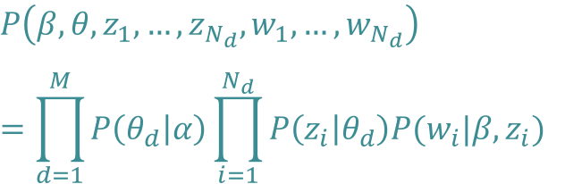
LDA Model – Plate Notation
α
For each document d,
  Generate θ_{d} ~ Dirichlet(∙ | α)
  For each position i = 1, ... , N_{d}
    Generate a topic z_{i} ~ Mult(∙ | θ_{d})
    Generate a word w_{i} ~ Mult(∙ | z_{i},β)
θ
z
$$P\left(β,θ,z_{1},…,z_{N_{d}},w_{1},…,w_{N_{d}}\right)$$
$$=\prod_{d=1}^{M}{P\left(θ_{d} | α\right)\prod_{i=1}^{N_{d}}{P\left(z_{i} | θ_{d}\right)P(w_{i}|β,z_{i}) }}$$
w
N
M
β

Slide 36


Corpus-level Parameter $α$= K⁻¹ 𝛴_{i}$αi$
Let $α=1$
Per-document topic distribution: K = 10, D = 15

Slide 37



Corpus-level Parameter $α$
$α=10$
$α=100$

Slide 38


Corpus-level Parameter $α$
$α=0.1$
$α=0.01$

Slide 39
Back to Topic Modeling Scenario

Slide 40
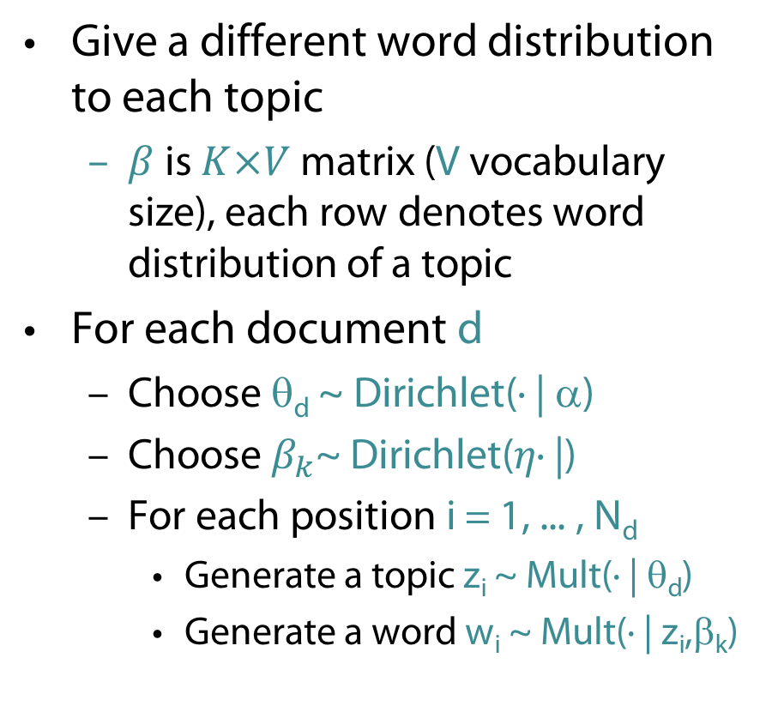
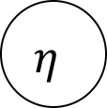

Smoothed LDA Model
Give a different word distribution to each topic
  $β$ is $K×V$ matrix (V vocabulary size), each row denotes word distribution of a topic
For each document d
  Choose θ_{d} ~ Dirichlet(∙ | α)
  Choose $β_{k}$~ Dirichlet($η\text{∙}\text{ |}$)
  For each position i = 1, ... , N_{d}
    Generate a topic z_{i} ~ Mult(∙ | θ_{d})
    Generate a word w_{i} ~ Mult(∙ | z_{i},β_{k})
α
θ
$$η$$
z
w
$$β_{k}$$
N
K
M

Slide 41
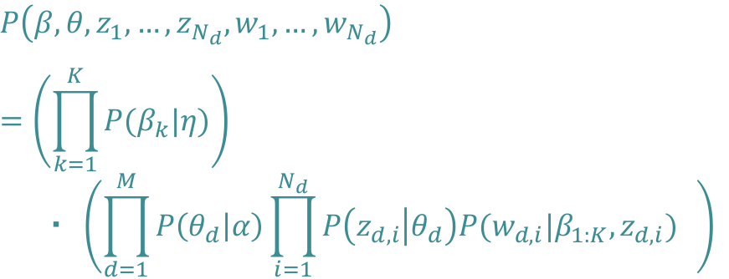
Smoothed LDA Model
α
$$P\left(β,θ,z_{1},…,z_{N_{d}},w_{1},…,w_{N_{d}}\right)$$
$$=\left(\prod_{k=1}^{K}{P(β_{k}|η)}\right)$$
$$・ \left(\prod_{d=1}^{M}{P\left(θ_{d} | α\right)\prod_{i=1}^{N_{d}}{P\left(z_{d,i} | θ_{d}\right)P(w_{d,i}|β_{1:K},z_{d,i}) }} \right)$$
θ
$$η$$
z
w
$$β_{k}$$
N
K
M

Slide 42
Back to Topic Modeling Scenario
But…

Slide 43
Why does LDA “work”?
Trade-off between two goals
  For each document, allocate its words to as few topics as possible.
  For each topic, assign high probability to as few terms as possible.
These goals are at odds.
  Putting a document in a single topic makes #2 hard:
  All of its words must have probability under that topic.
  Putting very few words in each topic makes #1 hard:
  To cover a document’s words, it must assign many topics to it.
Trading off these goals finds groups of tightly co-occurring words

Slide 44

Inference: The Problem (non-smoothed version)
To which topics does a given document belong?
  Compute the posterior distribution of the hidden variables given a document:
$$P\left(θ,z | w,α,β\right)=\frac{P\left(θ,z,w | α,β\right)}{P\left(w | α,β\right)}$$
$$P\left(θ,z,w | α,β\right)=P(θ|α)\prod_{i=1}^{N}{P\left(z_{i} | θ\right)P(w_{i}|z_{i},β)}$$
$$P\left(w | α,β\right)=\frac{Γ\left(\sum_{i}{α_{i}}\right)}{\prod_{i}{Γ(α_{i})}}\int{\left(\prod_{k=1}^{K}{θ_{k}^{α_{k}−1}}\right)\left(\prod_{i=1}^{N}{\sum_{k=1}^{K}{\prod_{j=1}^{V}{{\left(θ_{k}β_{kj}\right)}^{w_{i}^{j}}}}}\right)ⅆθ}$$

Slide 45
LDA Learning
Parameter learning:
  Variational EM
    Numerical approximation using lower-bounds
    Results in biased solutions
    Convergence has numerical guarantees
  Gibbs Sampling
    Stochastic simulation
    Unbiased solutions
    Stochastic convergence
D. Blei, A. Ng, and M. Jordan. Latent Dirichlet allocation.
Journal of Machine Learning Research, 3:993-1022, January 2003

Slide 46

LDA: Variational Inference
Replace LDA model with simpler one
Minimize the Kullback-Leibler divergence between the two distributions.
KL
Notes:
Not a sampling approach where one samples from the posterior distribution, but rather we try to find a tightest lower bound
Coupling between \theta and \beta not present in simpler model

Slide 47

LDA: Gibbs Sampling
MCMC algorithm
  Fix all current values but one and sample that value,
  e.g, for z
  Eventually converges to true posterior
$$P(z_{i}=k|z_{−i},w)$$

Slide 48
Variational Inference vs. Gibbs Sampling
Gibbs sampling is slower (takes days for mod.-sized datasets), variational inference takes a few hours.
Gibbs sampling is more accurate.
Gibbs sampling convergence is difficult to test, although quite a few machine learning approximate inference techniques also have the same problem.

Slide 49
LDA Application: Reuters Data
Setup
  100-topic LDA trained on a 16,000 documents corpus of news articles by Reuters
  Some standard stop words removed
Top words from some of the P(w|z)

Slide 50
LDA Application: Reuters Data
Result

Slide 51

Measuring Performance
Perplexity of a probability model
How well a probability distribution or probability model predicts a sample
  q: Model of an unknown probability distribution p
  based on a training sample drawn from p
  Evaluate q by asking how well it predicts a separate test sample $x_{1},…,x_{N}$ also drawn from p
  Perplexity of q w.r.t. sample $x_{1},…,x_{N}$defined as
  A better model q will tend to assign higher probabilities to $q\left(x_{i}\right)$
  → lower perplexity (“less surprised by sample”)
$$2^{−\frac{1}{N}\sum_{i=1}^{N}{\log_{2}{q\left(x_{i}\right)}}}$$
[Wikipedia]

Slide 52
Perplexity of Various Models
Unigram
Mixture of Unigrams
PLSA
LDA

Slide 53
Use of LDA
A widely used topic model (Griffiths, Steyvers, 04)
Complexity is an issue
Use in IR:
  Ad hoc retrieval (Wei and Croft, SIGIR 06: TREC benchmarks)
  Improvements over traditional LM (e.g., LSI techniques)
  But no consensus on whether there is any improvement over Relevance model, i.e., model with relevance feedback (relevance feedback part of the TREC tests)
  T. Griffiths, M. Steyvers, Finding Scientific Topics.
  Proceedings of the National Academy of Sciences,
  101 (suppl. 1), 5228-5235. 2004
  Xing Wei and W. Bruce Croft. LDA-based document models for ad-hoc retrieval. In Proceedings of the 29th annual international ACM SIGIR conference on Research and development in information retrieval (SIGIR '06). ACM, New York, NY, USA, 178-185. 2006.
TREC=Text REtrieval Conference

Slide 54
Generative Topic Models for Community Analysis
Pilfered from: Ramesh Nallapati
http://www.cs.cmu.edu/~wcohen/10-802/lda-sep-18.ppt
&
Arthur Asuncion, Qiang Liu, Padhraic Smyth:
Statistical Approaches to Joint Modeling of Text and Network Data

Slide 55

What if the corpus has network structure?
CORA citation network. Figure from [Chang, Blei, AISTATS 2009]
J. Chang, and D. Blei. Relational Topic Models for Document Networks.
AISTATS, volume 5 of JMLR Proceedings, page 81-88. JMLR.org, 2009.
Notes:
Example data appropriate for the relational topic model. Each document is represented as a bag of words and linked to other documents via citation. The RTM defines a joint distribution over the words in each document and the citation links between them.

Slide 56
Outline
Topic Models for Community Analysis
  Citation Modeling
    with pLSI
    with LDA
  Modeling influence of citations
  Relational Topic Models

Slide 57

Hyperlink Modeling Using pLSI
π
Select document d ~ Mult($π$)
  For each position n = 1,…, N_{d}
    Generate z_{n} ~ Mult$(∙|θ_{d})$
    Generate w_{n} ~ Mult$(∙|β_{z_{n}})$
  For each citation j = 1,…, L_{d}
    Generate z_{j} ~ Mult$(∙|θ_{d})$
    Generate c_{j} ~ Mult$(∙|γ_{z_{j}})$
d
θ_{d}
z
z
w
c
N
L
M
β
γ
D. A. Cohn, Th. Hofmann, The Missing Link - A Probabilistic Model of Document Content and Hypertext Connectivity, In: Proc. NIPS, pp. 430-436, 2000

Slide 58


Hyperlink Modeling Using pLSI
π
pLSI likelihood
New likelihood
Learning using EM
$$\prod_{d=1}^{M}{P\left(w_{1},…,w_{N_{d}},d | θ,β,π\right)}$$
$$= \prod_{d=1}^{M}{π_{d}\left(\prod_{i=1}^{N_{d}}{\sum_{k=1}^{K}{θ_{dk}β_{kw_{n}}}}\right)}$$
d
θ_{d}
z
z
w
c
$$\prod_{d=1}^{M}{P\left(w_{1},…,w_{N_{d}},c_{1},…,c_{L_{d}},d | θ,β,γ,π\right)}$$
$$= \prod_{d=1}^{M}{π_{d}\left(\prod_{i=1}^{N_{d}}{\sum_{k=1}^{K}{θ_{dk}β_{kw_{n}}}}\right)\left(\prod_{j=1}^{L_{d}}{\sum_{k=1}^{K}{θ_{dk}γ_{kc_{j}}}}\right)}$$
N
L
M
β
γ

Slide 59

Hyperlink Modeling Using pLSI
Heuristic
  0 < α < 1 determines the relative importance of content and hyperlinks
$$\prod_{d=1}^{M}{P\left(w_{1},…,w_{N_{d}},c_{1},…,c_{L_{d}},d | θ,β,γ,π\right)}$$
$$= \prod_{d=1}^{M}{π_{d}{\left(\prod_{i=1}^{N_{d}}{\sum_{k=1}^{K}{θ_{dk}β_{kw_{n}}}}\right)}^{α}{\left(\prod_{j=1}^{L_{d}}{\sum_{k=1}^{K}{θ_{dk}γ_{kc_{j}}}}\right)}^{1−α}}$$

Slide 60
Hyperlink Modeling Using pLSI
Classification performance
Hyperlink
Content
Hyperlink
Content

Slide 61

Hyperlink modeling using LDA
α
For each document d,
  Generate θ_{d} ~ Dirichlet(α)
  For each position i = 1, ... , N_{d}
    Generate a topic z_{i} ~ Mult$(∙|θ_{d})$
    Generate a word w_{i} ~ Mult $(∙|β_{z_{n}})$
  For each citation j = 1, …, L_{c}
    Generate z_{i} ~ Mult(θ_{d})
    Generate c_{i} ~ Mult $(∙|γ_{z_{j}})$
Learning using variational EM, Gibbs sampling
θ
z
z
w
c
N
L
M
β
γ
E. Erosheva, S Fienberg, J. Lafferty, Mixed-membership models of scientific publications. Proc National Academy Science U S A. 2004 Apr 6;101 Suppl 1:5220-7. Epub 2004 Mar 12.
Notes:
So far, little dependency between topic for words and for citations

Slide 62


Link-pLSI-LDA: Topic Influence in Blogs
$$γ$$
R. Nallapati, A. Ahmed, E. Xing, W.W. Cohen, Joint Latent Topic Models for Text and Citations, In: Proc. KDD, 2008.
62
Notes:
2 sets of documents (blogs + links to other sites)
bipartite graph with all links emerging from the set of citing documents and pointing to the set of cited documents
i.e., assume each document can either be cited or be a citing document, but not both.
Citing documents -> LDA + citation modeling
Cited documents -> pLSA (variant after Bayes Rule transformation depicted)
set of cited documents as bins that are to be filled with words.
topic mixing proportions π for the entire set of cited documents.
words are filled into the bins N← times, where N← is the sum total of the document lengths of the set of cited documents, as follows: each time, we first sample a topic k from the mixing proportions π, then pick a bin d′ from Ωk and fill a word occurrence from β into the bin.

Slide 63

63

Slide 64

Modeling Citation Influences - Copycat Model
Each topic in a citing document is drawn from one of the topic mixtures of cited publications
L. Dietz, St. Bickel, and T. Scheffer, Unsupervised Prediction of Citation Influences, In: Proc. ICML 2007.
Notes:
Assumption: topics of a document are a mixture of the topics of its citations

Slide 65
Modeling Citation Influences
Citation influence model: Combination of LDA and Copycat model
L. Dietz, St. Bickel, and T. Scheffer, Unsupervised Prediction of Citation Influences, In: Proc. ICML 2007.
Notes:
S: Innovation (1) or inheritance (0)
Documents can be a mixture of the topics of the citations (inheritance)
Documents can be a new mixture of topics (innovation)

Slide 66
Modeling Citation Influences
Citation influence graph for LDA paper
Notes:
Subset of CiteSeer data set
Citational vicinity of the LDA paper (Blei et al., 2003) with the citation influence model.
input document collection consists of the paper along with two levels of citations in each direction.
trained with hyper parameters αφ =0.01,αθ =αψ =0.1,αλθ =3.0,αλψ =0.1, αγ = 1.0 and 30 topics.
Citation graph is filtered to only contain edges with an influence value γd(c) > 0.05.
Topic proportions are included in the visualization via a topic spectrum bar. Each of the 30 topics is represented by a unique color.
Model correctly identifies the influencing work on Dirichlet processes and variational inference as well as the relatedness to pLSA, PCA, and variational methods. It also yields possible application areas such as querying music and taxonomy learning.

Slide 67

Modeling Citation Influences
Words in LDA paper assigned to citations
Notes:
lists the three most influential cites and the words assigned to them

Slide 68

Modeling Citation Influences
Predictive Performance
Notes:
Predictive performance of the models. The error bars indicate the standard error of the AUC values averaged over the citing publications.
Experiments are conducted for 10, 15, 30, and 50 topics with the following hyper parameters tuned on a hold-out set.
Citation influence model: αφ = 0.01, αθ = αψ = 0.1,αλθ =3.0,αλψ =0.1,αγ =1.0
Copycat model: αφ = 0.01, αθ = 0.1, αγ = 1.0
LDA-JS: αφ = 0.01, αθ = 0.1
LDA-post: αφ = 0.01, αθ = 0.1
We also evaluated an approach based on the PageRank of cited nodes (with γd(c) ∝ PageRank(c)) and an approach based on the cosine similarity of TF- IDF vectors of citing and cited publications (γd(c) ∝ cos(TF IDF(d), TF IDF(c))).
AUC = Area under the ROC curve
Error bars indicate the standard error. We perform paired-t-tests for models with 15 topics with a significance level α = 5%. This reveals that the cita- tion influence model is always significantly better than the LDA-post heuristic (even for 15 topics). In con- trast to this, the citation influence model is not signifi- cantly better than the copycat model, and the copycat model is not significantly better than the LDA-post heuristic. For 30 and 50 topics, where LDA starts to degenerate, the copycat model shows a significant improvement compared to the LDA-post heuristic. Furthermore, the LDA-JS heuristic is always slightly below the LDA-post heuristic in predicting citation influences.
The approaches based on TF-IDF (AUC 0.45) and on PageRank (AUC 0.55) are not able to predict the strength of influence.

Slide 69









Relational Topic Model (RTM) [ChangBlei 2009]
Same setup as LDA, except now we have observed network information across documents
$$α$$
$$y_{d,d^{′}} \sim ψ\left(y_{d,d^{′}}\right|z_{d},z_{d^{′}},η)$$
“Link probability function”
$$θ_{d}$$
$$η$$
$$θ_{d^{′}}$$
$$z_{d,n}$$
$$y_{d,d^{′}}$$
$$z_{d^{′},n}$$
Documents with similar topics are more likely to be linked.
$$w_{d,n}$$
$$β_{k}$$
$$w_{d^{′},n}$$
$$N_{d}$$
K
$$N_{d^{′}}$$
M
J. Chang, and D. Blei. Relational Topic Models for Document Networks.
AISTATS, volume 5 of JMLR Proceedings, page 81-88. JMLR.org, 2009.
Notes:
A two-document segment of the RTM.
The variable y indicates whether the two documents are linked.
The complete model contains this variable for each pair of documents

Slide 70

Relational Topic Model (RTM) [ChangBlei 2009]
For each document d
  Draw topic proportions $θ_{d}|α \sim Dir\left(α\right)$
  For each word $w_{d,n}$
    Draw assignment $z_{d,n}|θ_{d} \sim Mult(θ_{d})$
    Draw word $w_{d,n}|z_{d,n},β_{1:K} \sim Mult(β_{z_{d,n}})$
  For each pair of documents $d,d^{′}$
    Draw binary link indicator $y|z_{d},z_{d^{′}} \sim ψ(⋅|z_{d},z_{d^{′}})$
$$α$$
$$θ_{d}$$
$$η$$
$$θ_{d^{′}}$$
$$z_{d,n}$$
$$y_{d,d^{′}}$$
$$z_{d^{′},n}$$
$$w_{d,n}$$
$$β_{k}$$
$$w_{d^{′},n}$$
$$N_{d}$$
K
$$N_{d^{′}}$$
Notes:
true generative model for text and citations; capable of modeling arbitrary link structure
requires explicit modeling of the presence or absence of links between each pair of documents, becomes prohibitively expensive to model large scale document collections
LDA model from before more scalable

Slide 71


Collapsed Gibbs Sampling for RTM
Conditional distribution of each $z$:
Using the exponential link probability function, it is computationally efficient to calculate the “edge” term.
It is very costly to compute the “non-edge” term exactly.
$$P\left(z_{d,n}=k | z^{¬d,n},⋅\right)∝\left(N_{dk}^{¬d,n}+α\right)\frac{N_{kw}^{¬d,n}+β}{N_{k}^{¬d,n}+Wβ}$$
$$\prod_{d^{′}≠d:y_{d,d^{′}}=1}{ψ_{e}\left(y_{d,d^{′}}=1|z_{d},z_{d^{′}},η\right)}$$
$$\prod_{d^{′}≠d:y_{d,d^{′}}=0}{ψ_{e}\left(y_{d,d^{′}}=0|z_{d},z_{d^{′}},η\right)}$$
LDA term
“Edge” term
“Non-edge” term
Notes:
p(z_{id} = k | {\bf z}^{\neg id},-)
\propto & (N^{\neg id}_{dk} + \alpha) \frac{ (N^{\neg id}_{kw} + \beta) } {(N^{\neg id}_{k} + W\beta) } \\
& \prod_{d' \neq d: y_{d,d'} = 1}{\psi_e(y_{d,d'} = 1 | {\bf z}_d, {\bf z}_{d'}, \eta, \nu)} \\
& \prod_{d' \neq d: y_{d,d'} = 0}{\psi_e(y_{d,d'} = 0 | {\bf z}_d, {\bf z}_{d'}, \eta, \nu)}

Slide 72


Approximating the Non-edges
Assume non-edges are “missing” and ignore the term entirely (Chang/Blei)
Make the following fast approximation:
Subsample non-edges and exactly calculate the term over subset.
Subsample non-edges but instead of recalculating statistics for every $z_{d,n}$ token, calculate statistics once per document and cache them over each Gibbs sweep.
$$\prod_{i}{\left(1−exp⁡\left(c_{i}\right)\right)}≈{\left(1−\exp\left({\overline{c}}_{i}\right)\right)}^{N}, \text{where} {\overline{c}}_{i}= \frac{1}{N}\sum_{i}{c_{i}}$$

Slide 73
Document networks
 | # Docs | # Links | Ave. Doc-Length | Vocab-Size | Link Semantics
CORA | 4,000 | 17,000 | 1,200 | 60,000 | Paper citation (undirected)
Netflix Movies | 10,000 | 43,000 | 640 | 38,000 | Common actor/director
Enron (Undirected) | 1,000 | 16,000 | 7,000 | 55,000 | Communication between person i and person j
Enron (Directed) | 2,000 | 21,000 | 3,500 | 55,000 | Email from person i to person j

Slide 74
Link Rank
“Link rank” on held-out data as evaluation metric
  Lower is better
How to compute link rank (simplified):
  Train model with {d_{train}}.
  Given the model, calculate probability that d_{test} would link to each d_{train}. Rank {d_{train}} according to these probabilities.
  For each observed link between d_{test} and {d_{train}}, find the “rank”, and average all these ranks to obtain the “link rank”
d_{test}
{d_{train}}
Black-box predictor
Ranking over {d_{train}}
Link ranks
Edges among {d_{train}}
Edges between d_{test} and {d_{train}}

Slide 75
Results on CORA data
8-fold cross-validation. Random guessing gives link rank = 2000.

Slide 76
Results on CORA data
Model does better with more topics
Model does better with more words in each document

Slide 77
Timing Results on CORA
“Subsampling (20%) without caching” not shown since it takes 62,000 seconds for D=1000 and 3,720,150 seconds for D=4000

Slide 78
Conclusion
Relational topic modeling provides a useful start for combining text and network data in a single statistical framework
RTM can improve over simpler approaches for link prediction
Opportunities for future work:
  Faster algorithms for larger data sets
  Better understanding of non-edge modeling
  Extended models

