Slide 1
Web-Mining Agents Word Semantics and Latent Relational Structures
Prof. Dr. Ralf Möller
Universität zu Lübeck
Institut für Informationssysteme
Tanya Braun (Übungen)

Slide 2
Word-Word Associations in Document Retrieval
Recap
LSI: Documents as vectors, dimension reduction
Topic Modeling
Topic = Word distribution
From LDA-Model: P(Z | w)
Assumption: Bag of words model (independence, naïve Bayes, unigram distribution)
Words are not independent of each other
Word similarity measures
Extend query with similar words automatically
Extend query with most frequent followers/predecessors
Insert words in anticipated gaps in a string query
Need to represent word semantics

Slide 3
Approaches for Representing Word Semantics
Beyond bags of words
Distributional Semantics (Count)
Used since the 90’s
Sparse word-context PMI/PPMI matrix
Decomposed with SVD
Word Embeddings (Predict)
Inspired by deep learning
word2vec (Mikolov et al., 2013)
GloVe (Pennington et al., 2014)
Underlying Theory: The Distributional Hypothesis (Harris, ’54; Firth, ‘57)
“Similar words occur in similar contexts”
https://www.tensorflow.org/tutorials/word2vec
https://nlp.stanford.edu/projects/glove/
Notes:
There are two approaches for creating these vectors:
First, we’ve got the traditional count-based approach,
where the most common variant is the word-context PMI matrix.
The other, cutting-edge, approach, is word embeddings,
Which has become extremely popular with word2vec.
Now, the interesting thing…
…is that both approaches rely on the same linguistic theory: the distributional hypothesis.
<pause>
Now, in previous work, that I’ll talk about in a minute,
we showed that the two approaches are even more related.

Slide 4
Point(wise) Mutual Information: PMI
Measure of association used in information theory and statistics
Positive PMI: PPMI(x, y) = max( pmi(x, y), 0 )
Quantifies the discrepancy between the probability of their coincidence given their joint distribution and their individual distributions, assuming independence
Finding collocations and associations between words
Countings of occurrences and co-occurrences of words in a text corpus can be used to approximate the probabilities p(x) or p(y) and p(x,y) respectively
[Wikipedia]

Slide 5
PMI – Example
Counts of pairs of words getting the most and the least PMI scores in the first 50 millions of words in Wikipedia (dump of October 2015)
Filtering by 1,000 or more co-occurrences.
The frequency of each count can be obtained by dividing its value by 50,000,952. (Note: natural log is used to calculate the PMI values in this example, instead of log base 2)
[Wikipedia]

Slide 6
The Contributions of Word Embeddings
What’s really improving performance?
Novel Algorithms
(objective + training method)
Skip Grams + Negative Sampling
CBOW + Hierarchical Softmax
Noise Contrastive Estimation
GloVe
…
New Hyperparameters
(preprocessing, smoothing, etc.)
Subsampling
Dynamic Context Windows
Context Distribution Smoothing
Adding Context Vectors
…
Improving Distributional Similarity with Lessons Learned from Word Embeddings, Omer Levy, Yoav Goldberg, Ido Dagan
Notes:
Or maybe a bit of both?
<pause>

Slide 7
Embedding Approaches
Represent each word with a low-dimensional vector
Word similarity = vector similarity
Key idea: Predict surrounding words of every word
Faster and can easily incorporate a new sentence/document or add a word to the vocabulary

Slide 8
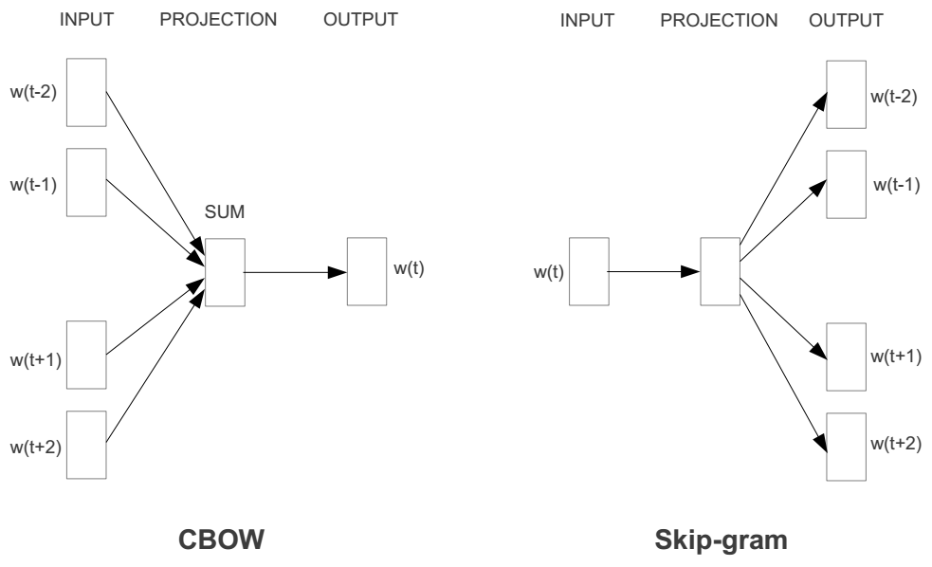
Represent the meaning of word – word2vec
2 basic network models:
Continuous Bag of Word (CBOW): use a window of word to predict the middle word
Skip-gram (SG): use a word to predict the surrounding ones in window.

Slide 9
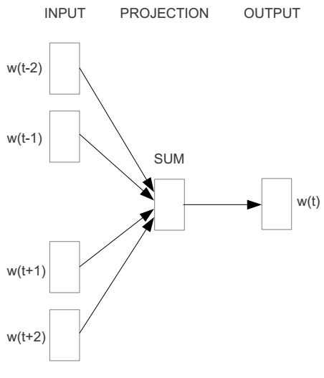
Word2vec – Continuous Bag of Word
E.g. “The cat sat on floor”
Window size = 2
the
cat
sat
on
floor

Slide 10
Input layer
Index of cat in vocabulary
0
1
0
cat
0
Hidden layer
Output layer
0
0
0
0
0
0
…
0
0
0
one-hot
vector
0
sat
one-hot
vector
0
0
0
0
1
0
…
1
0
on
0
0
0
0
…
0

Slide 11
We must learn W and W’
Input layer
0
1
0
cat
0
$$W_{V×N}$$
Hidden layer
Output layer
0
0
0
0
0
0
V-dim
…
0
0
$${W′}_{N×V}$$
0
0
sat
0
0
0
0
1
0
$$W_{V×N}$$
N-dim
…
V-dim
1
0
on
0
0
0
0
V-dim
…
N will be the size of word vector
0

Slide 12
$$W_{V×N}^{T} ×x_{cat}=v_{cat}$$
0.1 | 2.4 | 1.6 | 1.8 | 0.5 | 0.9 | … | … | … | 3.2
0.5 | 2.6 | 1.4 | 2.9 | 1.5 | 3.6 | … | … | … | 6.1
… | … | … | … | … | … | … | … | … | …
… | … | … | … | … | … | … | … | … | …
0.6 | 1.8 | 2.7 | 1.9 | 2.4 | 2.0 | … | … | … | 1.2
0
2.4
2.6
…
…
1.8
Input layer
1
$$×$$
0
$$=$$
0
0
1
0
0
0
x_{cat}
0
0
Output layer
0
0
0
$$W_{V×N}^{T}×x_{cat}=v_{cat}$$
…
0
0
0
0
0
V-dim
…
0
0
$$\hat{v}=\frac{v_{cat}+v_{on}}{2}$$
0
+
0
sat
0
0
0
0
$$W_{V×N}^{T}×x_{on}=v_{on}$$
1
0
…
V-dim
1
Hidden layer
0
x_{on}
0
0
N-dim
0
0
V-dim
…
0

Slide 13
$$W_{V×N}^{T} ×x_{on}=v_{on}$$
0.1 | 2.4 | 1.6 | 1.8 | 0.5 | 0.9 | … | … | … | 3.2
0.5 | 2.6 | 1.4 | 2.9 | 1.5 | 3.6 | … | … | … | 6.1
… | … | … | … | … | … | … | … | … | …
… | … | … | … | … | … | … | … | … | …
0.6 | 1.8 | 2.7 | 1.9 | 2.4 | 2.0 | … | … | … | 1.2
0
1.8
2.9
…
…
1.9
Input layer
0
$$×$$
0
$$=$$
0
1
1
0
0
0
x_{cat}
0
0
Output layer
0
0
0
$$W_{V×N}^{T}×x_{cat}=v_{cat}$$
…
0
0
0
0
0
V-dim
…
0
0
$$\hat{v}=\frac{v_{cat}+v_{on}}{2}$$
0
+
0
sat
0
0
0
0
$$W_{V×N}^{T}×x_{on}=v_{on}$$
1
0
…
V-dim
1
Hidden layer
0
x_{on}
0
0
N-dim
0
0
V-dim
…
0

Slide 14
Input layer
0
1
0
cat
0
$$W_{V×N}$$
Hidden layer
Output layer
0
0
0
0
0
0
V-dim
…
0
0
$$W_{N×V}^{′}×\hat{v}=z$$
0
$$\hat{y}=softmax(z)$$
0
0
0
0
0
$$\hat{v}$$
1
0
$$W_{V×N}$$
…
1
N-dim
0
on
0
${\hat{y}}_{sat}$
0
0
V-dim
0
V-dim
…
N will be the size of word vector
0

Slide 15
Logistic function
[Wikipedia]

Slide 16
softmax(z)
The
[Wikipedia]

Slide 17
Input layer
0
We would prefer $\hat{y}$ close to ${\hat{y}}_{sat}$
1
0
cat
0
$$W_{V×N}$$
Hidden layer
Output layer
0
0
0
0
0.01
0.02
0.00
0.02
0.01
0.02
0.01
0.7
…
0.00
0
0
V-dim
…
0
0
$$W_{N×V}^{′}×\hat{v}=z$$
$$\hat{y}=softmax(z)$$
0
0
0
0
0
0
$$\hat{v}$$
1
0
$$W_{V×N}$$
…
1
N-dim
0
on
0
${\hat{y}}_{sat}$
0
0
V-dim
0
V-dim
…
N will be the size of word vector
$\hat{y}$
0

Slide 18
$$W_{V×N}^{T}$$
0.1 | 2.4 | 1.6 | 1.8 | 0.5 | 0.9 | … | … | … | 3.2
0.5 | 2.6 | 1.4 | 2.9 | 1.5 | 3.6 | … | … | … | 6.1
… | … | … | … | … | … | … | … | … | …
… | … | … | … | … | … | … | … | … | …
0.6 | 1.8 | 2.7 | 1.9 | 2.4 | 2.0 | … | … | … | 1.2
Contain word’s vectors
Input layer
0
1
0
x_{cat}
0
Output layer
0
0
$$W_{V×N}^{}$$
0
0
0
0
V-dim
…
0
0
$$W_{N×V}^{′}$$
0
0
sat
0
0
0
0
1
0
$$W_{V×N}^{}$$
…
1
0
V-dim
x_{on}
0
Hidden layer
0
N-dim
0
0
V-dim
…
0
We can consider either W or W’ as the word’s representation. Or even take the average.
Notes:
W contains input word vectors.
W’ contains output word vectors.
We can consider either W or W’ as the word’s representation. Or even take the average.

Slide 19
Some interesting results

Slide 20
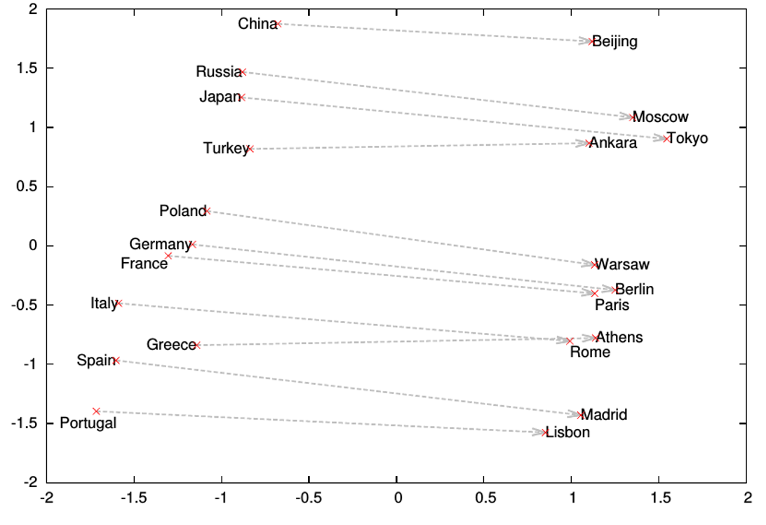
Word analogies

Slide 21
What is word2vec?
word2vec is not a single algorithm
It is a software package for representing words as vectors, containing:
Two distinct models
CBoW
Skip-Gram (SG)
Various training methods
Negative Sampling (NS)
Hierarchical Softmax
A rich preprocessing pipeline
Dynamic Context Windows
Subsampling
Deleting Rare Words
Notes:
Now, we’re going to focus on Skip-Grams with Negative Sampling,
Which is considered the state-of-the-art.

Slide 22
Skip-Grams with Negative Sampling (SGNS)
Marco saw a furry little wampimuk hiding in the tree.
“word2vec Explained…”
Goldberg & Levy, arXiv 2014
Notes:
So, how does SGNS work?
Let’s say we have this sentence,
(This example was shamelessly taken from Marco Baroni)

Slide 23
Skip-Grams with Negative Sampling (SGNS)
Marco saw a furry little wampimuk hiding in the tree.
“word2vec Explained…”
Goldberg & Levy, arXiv 2014
Notes:
And we want to understand what a wampimuk is.

Slide 24
Skip-Grams with Negative Sampling (SGNS)
Marco saw a furry little wampimuk hiding in the tree.
words contexts
wampimuk furry
wampimuk little
wampimuk hiding
wampimuk in
… …
$D$ (data)
“word2vec Explained…”
Goldberg & Levy, arXiv 2014
Notes:
What SGNS does is take the context words around “wampimuk”,
And in this way,
Constructs a dataset of word-context pairs, D.

Slide 25
Skip-Grams with Negative Sampling (SGNS)
SGNS finds a vector $\vec{w}$ for each word $w$ in our vocabulary $V_{W}$
Each such vector has $d$ latent dimensions (e.g. $d=100$)
Effectively, it learns a matrix $W$ whose rows represent $V_{W}$
Key point: it also learns a similar auxiliary matrix $C$ of context vectors
In fact, each word has two embeddings
$$d$$
$$d$$
$$W$$
$w$:wampimuk $=(−3.1, 4.15, 9.2, −6.5,…)$
$$C$$
$$V_{W}$$
$$V_{C}$$
$$≠$$
$c$:wampimuk $=(−5.6, 2.95, 1.4, −1.3,…)$
“word2vec Explained…”
Goldberg & Levy, arXiv 2014
Notes:
Now, using D,
SGNS is going to learn a vector for each word in the vocabulary
A vector of say… 100 latent dimensions.
Effectively, it’s learning a matrix W,
Where each row is a vector that represents a specific word.
Now, a key point in understanding SGNS,
Is that it also learns an auxiliary matrix C of context vectors
So in fact, each word has two different embeddings
Which are not necessarily similar.

Slide 26
Skip-Grams with Negative Sampling (SGNS)
“word2vec Explained…”
Goldberg & Levy, arXiv 2014
Notes:
So to train these vectors…

Slide 27
Skip-Grams with Negative Sampling (SGNS)
Maximize: $σ\left(\vec{w}⋅\vec{c_{ }}\right)$
$c$ was observed with $w$
words contexts
wampimuk furry
wampimuk little
wampimuk hiding
wampimuk in
“word2vec Explained…”
Goldberg & Levy, arXiv 2014
Notes:
…SGNS maximizes the similarity between word and context vectors that were observed together.

Slide 28
Skip-Grams with Negative Sampling (SGNS)
Maximize: $σ\left(\vec{w}⋅\vec{c_{ }}\right)$
$c$ was observed with $w$
words contexts
wampimuk furry
wampimuk little
wampimuk hiding
wampimuk in
Minimize: $σ\left(\vec{w}⋅\vec{c_{ }}′\right)$
$c′$ was hallucinated with $w$
words contexts
wampimuk Australia
wampimuk cyber
wampimuk the
wampimuk 1985
“word2vec Explained…”
Goldberg & Levy, arXiv 2014
Notes:
…and minimizes the similarity between word and context vectors hallucinated together.

Slide 29
Skip-Grams with Negative Sampling (SGNS)
“Negative Sampling”
SGNS samples $k$ contexts $c^{′}$ at random as negative examples
“Random” = unigram distribution
$$P_{ }^{ }\left(c\right)=\frac{\#c}{\left|D\right|}$$
Spoiler: Changing this distribution has a significant effect
Notes:
Now, the way SGNS hallucinates is really important.
It’s actually where it gets its name from.
For each observed word-context pair,
SGNS samples k contexts at random,
As negative examples
Now, when we say random, we mean the unigram distribution
And Spoiler Alert: changing this distribution has quite a significant effect.

Slide 30
What is SGNS learning?
Take SGNS’s embedding matrices ($W$ and $C$)
$$d$$
$$d$$
$$W$$
$$C$$
$$V_{W}$$
$$V_{C}$$
“Neural Word Embeddings as Implicit Matrix Factorization”
Levy & Goldberg, NIPS 2014
Notes:
If we take the embedding matrices

Slide 31
What is SGNS learning?
Take SGNS’s embedding matrices ($W$ and $C$)
Multiply them
What do you get?
$$d$$
$$W$$
$$V_{C}$$
$$V_{W}$$
$$d$$
$$C$$
“Neural Word Embeddings as Implicit Matrix Factorization”
Levy & Goldberg, NIPS 2014
Notes:
And multiply them
What do we get?

Slide 32
What is SGNS learning?
A $V_{W}×V_{C}$ matrix
Each cell describes the relation between a specific word-context pair
$\vec{w}⋅\vec{c}= ?$
$$d$$
$$V_{C}$$
$$W$$
$$V_{C}$$
$$?$$
$$V_{W}$$
$$d$$
$$C$$
$$=$$
$$V_{W}$$
“Neural Word Embeddings as Implicit Matrix Factorization”
Levy & Goldberg, NIPS 2014
Notes:
We get a pretty big, square matrix,
Where each cell describes the relation between a specific word, w,
With a specific context, c.

Slide 33
What is SGNS learning?
We proved that for large enough $d$ and enough iterations
$$d$$
$$V_{C}$$
$$W$$
$$V_{C}$$
$$?$$
$$V_{W}$$
$$d$$
$$C$$
$$=$$
$$V_{W}$$
“Neural Word Embeddings as Implicit Matrix Factorization”
Levy & Goldberg, NIPS 2014
Notes:
So in our NIPS paper, we proved that with enough dimensions and iterations…

Slide 34
What is SGNS learning?
Levy&Goldberg [2014] proved that for large enough $d$ and enough iterations …
… one obtains the word-context PMI matrix
$$d$$
$$V_{C}$$
$$W$$
$$V_{C}$$
$$M^{PMI}$$
$$V_{W}$$
$$d$$
$$C$$
$$=$$
$$V_{W}$$
“Neural Word Embeddings as Implicit Matrix Factorization”
Levy & Goldberg, NIPS 2014
Notes:
…SGNS will converge to the classic word-context PMI matrix…

Slide 35
What is SGNS learning?
Levy&Goldberg [2014] proved that for large enough $d$ and enough iterations …
… one obtains the word-context PMI matrix …
shifted by a global constant
$Opt\left(\vec{w}⋅\vec{c}\right)=PMI\left(w,c\right)−\log{k}$
$$d$$
$$V_{C}$$
$$W$$
$$V_{C}$$
$$M^{PMI}$$
$$V_{W}$$
$$d$$
$$C$$
$$=$$
$$V_{W}$$
$$−\log{k}$$
“Neural Word Embeddings as Implicit Matrix Factorization”
Levy & Goldberg, NIPS 2014
Notes:
…with a little twist.
Now, recall that k is the number of negative samples generated for each positive example (w,c) \in D.
This is of course the optimal value, and not necessarily what we get in practice.

Slide 36
What is SGNS learning?
SGNS is doing something very similar to the older approaches
SGNS factorizes the traditional word-context PMI matrix
So does SVD!
GloVe factorizes a similar word-context matrix
Notes:
So to sum it up, SGNS is doing what we’ve been doing in NLP for a couple of decades:
It’s factorizing the PMI matrix,
Apparently, just like SVD.
And, while I didn’t explain it, GloVe also factorizes a similar matrix.

Slide 37
But embeddings are still better, right?
Plenty of evidence that embeddings outperform traditional methods
“Don’t Count, Predict!” (Baroni et al., ACL 2014)
GloVe (Pennington et al., EMNLP 2014)
How does this fit with our story?
Notes:
But embeddings are still better, right?
There’s plenty of evidence,
Even a couple of papers.
So how does this fit with our story?

Slide 38
The Big Impact of “Small” Hyperparameters
word2vec & GloVe are more than just algorithms…
Introduce new hyperparameters
May seem minor, but make a big difference in practice
Notes:
So like I said at the beginning, word2vec and GloVe are more than just algorithms.
They introduce many new hyperparameters,
Which may seem minor,
but as it turns out, they make a pretty big difference in practice.

Slide 39
New Hyperparameters
Preprocessing (word2vec)
Dynamic Context Windows
Subsampling
Deleting Rare Words
Postprocessing (GloVe)
Adding Context Vectors
Association Metric (SGNS)
Shifted PMI
Context Distribution Smoothing
Notes:
…we’ll look at Context Distribution Smoothing,
and see how we can adapt it to traditional count-based methods.

Slide 40
Dynamic Context Windows
Marco saw a furry little wampimuk hiding in the tree.
Notes:
So dynamic context windows
Let’s say we have our sentence from earlier,
And we want to look at a context window of 4 words around wampimuk.

Slide 41
Dynamic Context Windows
Marco saw a furry little wampimuk hiding in the tree.
Notes:
Now, some of these context words are obviously more related to the meaning of wampimuk than others.
The intuition behind dynamic context windows, is that the closer the context is to the target…

Slide 42
Dynamic Context Windows
Marco saw a furry little wampimuk hiding in the tree.
Word2vec: $\frac{1}{4}$ $\frac{2}{4}$ $\frac{3}{4}$ $\frac{4}{4}$ $\frac{4}{4}$ $\frac{3}{4}$ $\frac{2}{4}$ $\frac{1}{4}$
GloVe: $\frac{1}{4}$ $\frac{1}{3}$ $\frac{1}{2}$ $\frac{1}{1}$ $\frac{1}{1}$ $\frac{1}{2}$ $\frac{1}{3}$ $\frac{1}{4}$
Aggressive: $\frac{1}{8}$ $\frac{1}{4}$ $\frac{1}{2}$ $\frac{1}{1}$ $\frac{1}{1}$ $\frac{1}{2}$ $\frac{1}{4}$ $\frac{1}{8}$
The Word-Space Model (Sahlgren, 2006)
Notes:
…the more relevant it is.
word2vec does just that, by randomly sampling the size of the context window around each token.
What you see here are the probabilities that each specific context word will be included in the training data.
GloVe also does something similar, but in a deterministic manner, and with a slightly different distribution.
There are of course other ways to do this,
And they were all, apparently,
Applied to traditional algorithms about a decade ago.

Slide 43
Adding Context Vectors
SGNS creates word vectors $\vec{w}$
SGNS creates auxiliary context vectors $\vec{c}$
So do GloVe and SVD
Notes:
The second hyperparameter I’d like to discuss is adding context vectors.
So, remember that SGNS doesn’t only create word vectors,
It also creates these auxiliary context vectors.
And, by the way, so do GloVe and SVD.

Slide 44
Adding Context Vectors
SGNS creates word vectors $\vec{w}$
SGNS creates auxiliary context vectors $\vec{c}$
So do GloVe and SVD
Instead of just $\vec{w}$
Represent a word as: $\vec{w}+\vec{c}$
Introduced by Pennington et al. (2014)
Only applied to GloVe
Notes:
So, each word has two representations, right?
So what if instead of using just the word vectors,
We’d also use the information in the context vectors,
to represent our words?
This trick was introduced as part of GloVe,
But it was also only applied to GloVe,
and not to the other methods.

Slide 45
Context Distribution Smoothing
SGNS samples $c^{′}\sim P_{ }$ to form negative $(w,c′)$ examples
Our analysis assumes $P_{ }$ is the unigram distribution
$$P_{ }^{ }\left(c\right)=\frac{\#c}{\sum_{c^{′}∈V_{C}}{\#c^{′}}}$$
Notes:
Let’s talk about context distribution smoothing,
And see how we can adapt it to traditional PMI vectors.
<pause>
So remember that SGNS samples these negative contexts from some distribution?
And that I said that this distribution is the unigram distribution?
Well, I wasn’t completely honest with you…

Slide 46
Context Distribution Smoothing
SGNS samples $c^{′}\sim P_{ }$ to form negative $(w,c′)$ examples
Our analysis assumes $P_{ }$ is the unigram distribution
In practice, it’s a smoothed unigram distribution
$$P_{ }^{0.75}\left(c\right)=\frac{{\left(\#c\right)}^{0.75}}{\sum_{c^{′}∈V_{C}}{{\left(\#c^{′}\right)}^{0.75}}}$$
This little change makes a big difference
Notes:
In practice, it’s actually a smoothed unigram distribution.
And this tiny little change, makes quite a big difference.

Slide 47
Context Distribution Smoothing
We can adapt context distribution smoothing to PMI!
Replace $P(c)$ with $P_{ }^{0.75}(c)$:
$$PMI^{0.75}\left(w,c\right)=\log{\frac{P(w,c)}{P\left(w\right)⋅P^{0.75}\left(c\right)}}$$
Consistently improves PMI on every task
Always use Context Distribution Smoothing!
Notes:
Now, what’s neat about context distribution smoothing
Is that we can adapt it to PMI!
This is done by simply replacing the probability of C with the smoothed probability.
Just like this:
And this tweak consistently improves performance on every task.
So if there’s one technical detail you should remember from this talk, it’s this:
Always use context distribution smoothing!

Slide 48
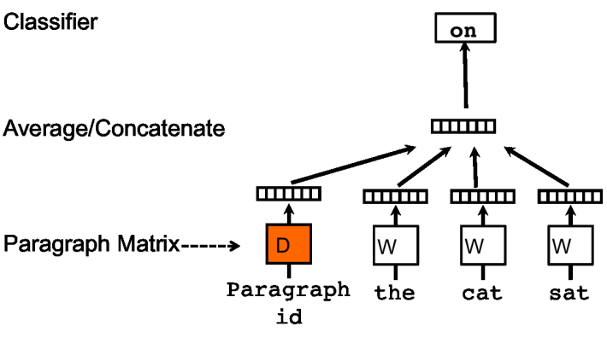
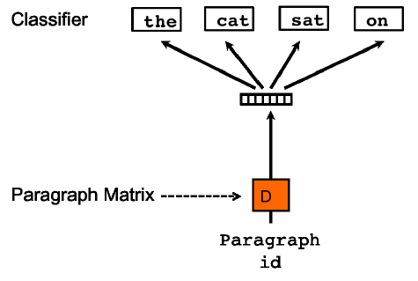
Represent the meaning of sentence/text
Paragraph vector (2014, Quoc Le, Mikolov)
Extend word2vec to text level
Also two models: add paragraph vector as the input

Slide 49
Don’t Count, Predict! [Baroni et al., 2014]
“word2vec is better than count-based methods”
Hyperparameter settings account for most of the reported gaps
Embeddings do not really outperform count-based methods
No unique conclusion available
Notes:
So, in “don’t count, predict”,
The authors show that word2vec is better than count-based methods.
And, while they did tune a lot of different hyperparameters,
Other hyperparameters remained hidden inside the code.
And it turns out,
That these hidden hyperparameters account for most of the reported performance gaps.
In our experiments, we show that embeddings are not really better than count-based methods.

Slide 50
Latent Relational Structures
Processing natural language data:
Tokenization/Sentence Splitting
Part-of-speech (POS) tagging
Phrase chunking
Named entity recognition
Coreference resolution
Semantic role labeling
An Introduction to Machine Learning and Natural Language Processing Tools, V. Srikumar, M. Sammons, N. Rizzolo

Slide 51
Phrase Chunking
Identifies phrase-level constituents in sentences
[NP Boris] [ADVP regretfully] [VP told] [NP his wife] [SBAR that] [NP their child] [VP could not attend] [NP night school] [PP without] [NP permission] .
Useful for filtering: identify e.g. only noun phrases, or only verb phrases
Used as source of features, e.g. distance, (abstracts away determiners, adjectives, for example), sequence,…
More efficient to compute than full syntactic parse
Applications in e.g. Information Extraction – getting (simple) information about concepts of interest from text documents
Hand-crafted chunkers (regular expressions/finite automata)
HMM/CRF-based chunk parsers derived from training data
An Introduction to Machine Learning and Natural Language Processing Tools, V. Srikumar, M. Sammons, N. Rizzolo

Slide 52
Named Entity Recognition
Identifies and classifies strings of characters representing proper nouns
[PER Neil A. Armstrong] , the 38-year-old civilian commander, radioed to earth and the mission control room here: “[LOC Houston] , [ORG Tranquility] Base here; the Eagle has landed."
Useful for filtering documents
“I need to find news articles about organizations in which Bill Gates might be involved…”
Disambiguate tokens: “Chicago” (team) vs. “Chicago” (city)
Source of abstract features
E.g. “Verbs that appear with entities that are Organizations”
E.g. “Documents that have a high proportion of Organizations”
An Introduction to Machine Learning and Natural Language Processing Tools, V. Srikumar, M. Sammons, N. Rizzolo

Slide 53
Named Entity Recogniton: Definition
NE involves identification of proper names in texts, and classification into a set of predefined categories of interest
Three universally accepted categories: person, location and organisation
Other common tasks: recognition of date/time expressions, measures (percent, money, weight etc), email addresses etc.
Other domain-specific entities: names of drugs, medical conditions, names of ships, bibliographic references etc
NER ist not easy
“Introduction to Named Entity Recognition”, University of Sheffield

Slide 54
Named Entity Classification
Category definitions are intuitively quite clear, but there are many grey areas.
Many of these grey area are caused by metonymy.
Person vs. Artefact: “The ham sandwich wants his bill.” vs “Bring me a ham sandwich.”
Organisation vs. Location : “England won the World Cup” vs. “The World Cup took place in England”.
Company vs. Artefact: “shares in MTV” vs. “watching MTV”
Location vs. Organisation: “she met him at Heathrow” vs. “the Heathrow authorities”
“Introduction to Named Entity Recognition”, University of Sheffield

Slide 55
Basic Problems in NE
Variation of NEs – e.g. John Smith, Mr Smith, John.
Ambiguity of NE types
John Smith (company vs. person)
May (person vs. month)
Washington (person vs. location)
1945 (date vs. time)
Ambiguity with common words, e.g. “may”
“Introduction to Named Entity Recognition”, University of Sheffield

Slide 56
More complex problems in NER
Issues of style, structure, domain, genre etc.
Punctuation, spelling, spacing, formatting, ….all have an impact
Dept. of Computing and Maths
Manchester Metropolitan University
Manchester
United Kingdom
> Tell me more about Leonardo
> Da Vinci
“Introduction to Named Entity Recognition”, University of Sheffield

Slide 57
List Lookup Approach
System that recognises only entities stored in its lists (gazetteers).
Advantages - Simple, fast, language independent, easy to retarget
Disadvantages – collection and maintenance of lists, cannot deal with name variants, cannot resolve ambiguity
“Introduction to Named Entity Recognition”, University of Sheffield

Slide 58
Shallow Parsing Approach
Internal evidence – names often have internal structure. These components can be either stored or guessed.
location:
CapWord + {City, Forest, Center}
e.g. Sherwood Forest
Cap Word + {Street, Boulevard, Avenue, Crescent, Road}
e.g. Portobello Street
“Introduction to Named Entity Recognition”, University of Sheffield

Slide 59
Shallow Parsing Approach
External evidence - names are often used in very predictive local contexts
Location:
“to the” COMPASS “of” CapWord
e.g. to the south of Loitokitok
“based in” CapWord
e.g. based in Loitokitok
CapWord “is a” (ADJ)? GeoWord
e.g. Loitokitok is a friendly city
“Introduction to Named Entity Recognition”, University of Sheffield

Slide 60
Difficulties in Shallow Parsing Approach
Ambiguously capitalised words (first word in sentence)
[All American Bank] vs. All [State Police]
Semantic ambiguity
“John F. Kennedy” = airport (location)
“Philip Morris” = organisation
Structural ambiguity
[Cable and Wireless] vs. [Microsoft] and [Dell]
[Center for Computational Linguistics] vs. message from [City Hospital] for [John Smith].
“Introduction to Named Entity Recognition”, University of Sheffield

Slide 61
Coreference
Identify all phrases that refer to each entity of interest – i.e., group mentions of concepts
[Neil A. Armstrong] , [the 38-year-old civilian commander], radioed to [earth]. [He] said the famous words, “[the Eagle] has landed”."
The Named Entity Recognizer only gets us part-way…
…if we ask, “what actions did Neil Armstrong perform?”, we will miss many instances (e.g. “He said…”)
Coreference resolver abstracts over different ways of referring to the same person
Useful in feature extraction, information extraction
An Introduction to Machine Learning and Natural Language Processing Tools, V. Srikumar, M. Sammons, N. Rizzolo

Slide 62
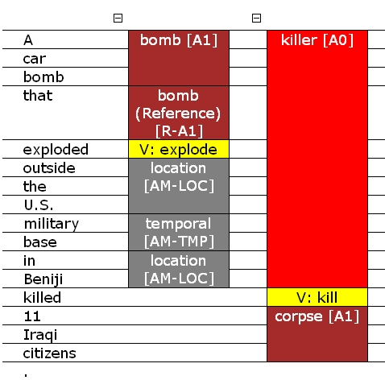
Semantic Role Labeling (SRL)
SRL reveals relations and arguments in the sentence (where relations are expressed as verbs)
Cannot abstract over variability of expressing the relations – e.g. kill vs. murder vs. slay…
An Introduction to Machine Learning and Natural Language Processing Tools, V. Srikumar, M. Sammons, N. Rizzolo

Slide 63
Why is SRL Important – Applications
Question Answering
Q: When was Napoleon defeated?
Look for: [_{PATIENT} Napoleon] [_{PRED} defeat-synset] [_{ARGM-TMP} *ANS*]
Machine Translation
English (SVO) Farsi (SOV)
[_{AGENT} The little boy] [_{AGENT} pesar koocholo] boy-little
[_{PRED} kicked] [_{THEME} toop germezi] ball-red
[_{THEME} the red ball] [_{ARGM-MNR} moqtam] hard-adverb
[_{ARGM-MNR} hard] [_{PRED} zaad-e] hit-past
Document Summarization
Predicates and Heads of Roles summarize content
Information Extraction
SRL can be used to construct useful rules for IE
Automatic Semantic Role Labeling
S. Wen-tau Yih, K. Toutanova

Slide 64
Some History
Minsky 74, Fillmore 1976: Frames describe events or situations
Multiple participants, “props”, and “conceptual roles”
E.g., agent, instrument, target, time, …
Levin 1993: verb class defined by sets of frames (meaning-preserving alternations) a verb appears in
{break,shatter,..}: Glass X’s easily; John Xed the glass, …
Cut is different: The window broke; *The window cut.
FrameNet, late ’90s: based on Levin’s work: large corpus of sentences annotated with frames
PropBank
Automatic Semantic Role Labeling
S. Wen-tau Yih, K. Toutanova

Slide 65
FrameNet [Fillmore et al. 01]
Frame: Hit_target (hit, pick off, shoot)
Agent Target Instrument Manner | Means Place Purpose Subregion Time
Lexical units (LUs): Words that evoke the frame
(usually verbs)
Core
Non-Core
Frame elements (FEs): The involved semantic roles
[_{Agent} Kristina] hit [_{Target} Scott] [_{Instrument} with a baseball] [_{Time} yesterday ].
Notes:
Moving toward statistical approaches for semantic role labeling, the first available corpus is FrameNet, which is developed in UC Berkeley. According to their definition, semantic frames are representations of situation types, such as eating or walking, together with lists of participants and conceptual roles that are components of such situations. For example, the frame shown on this slide is the hit_target situation.
In their terminology, there are two types of components of a frame. One is lexical units, which are words that evoke the frame, such as hit, pick off, and shoot here.
The other component is frame elements, which are the semantic roles involved in this frame.
Frame elements can be further categorized into 2 types, one is core elements, and the other is non-core frame elements.
------------------
http://framenet.icsi.berkeley.edu/index.php?option=com_wrapper&Itemid=118&frame=Hit_target&
What is a frame and how do you know when you've got one? Semantic frames are schematic representations of situation types (eating, spying, removing, classifying, etc.) together with lists of the kinds of participants, props, and other conceptual roles that are seen as components of such situations. The semantic arguments of a predicating word correspond to what we call the frame elements of the frame associated with that word. In principle, work on a new frame begins with the native speaker analyst's intuitive judgment that some particular conceptual pattern underlies one or more lexical units in the language in a systematic way. We are satisfied with such judgments when we see that we can analyze sentences containing the words we've assigned to the frame in terms of the frame elements that we defined in characterizing the frame. In real life, the actual experience is a kind of cognitive zigzag: a frame is proposed, and some words are suggested for illustrating the frame. Frame elements are suggested that the analyst thinks these words would have in common. In the course of doing some initial annotation, however, we often discover distinctions among the words that were not at first noticed, and often a slightly different version of the frame is formulated--one which no longer welcomes some of the words in the original list, but takes in some new ones.

Slide 66
Proposition Bank (PropBank) [Palmer et al. 05]
Transfer sentences to propositions
Kristina hit Scott → hit(Kristina,Scott)
Penn TreeBank → PropBank
Add a semantic layer on Penn TreeBank
Define a set of semantic roles for each verb
Each verb’s roles are numbered
…[A0 the company] to … offer [A1 a 15% to 20% stake] [A2 to the public]
…[A0 Sotheby’s] … offered [A2 the Dorrance heirs] [A1 a money-back guarantee]
…[A1 an amendment] offered [A0 by Rep. Peter DeFazio] …
…[A2 Subcontractors] will be offered [A1 a settlement] …
Notes:
The next corpus, which is the main focused data in this tutorial, is the proposition bank, or PropBank.
PropBank is developed in U Penn by a team led by Martha Palmer. The name of “proposition” comes from the goal of transferring sentences into propositions.

Slide 67
Latent Relational Structures
SRL reveals relations and arguments in the sentence (where relations are expressed as verbs)
Cannot abstract over variability of expressing the relations – e.g. kill vs. murder vs. slay…
An Introduction to Machine Learning and Natural Language Processing Tools, V. Srikumar, M. Sammons, N. Rizzolo

Slide 68
Collective Learning on Multi-Relational Data

Slide 69
Towards Latent Relational Structures
Maximilian Nickel, Volker Tresp, Hans-Peter Kriegel A Three-Way Model for Collective Learning on Multi-Relational Data
In Proc. 28th International Conference on Machine Learning, 2011

Slide 70
Motivation
© M. Nickel

Slide 71
Tensor Factorization with Rescal
© M. Nickel

Slide 72
Solving Relational Learning Tasks
'
© M. Nickel

Slide 73
Compute the Factorization
arg
© M. Nickel https://github.com/mnick/rescal.py

Slide 74
Collective Learning

Slide 75
Collective Learning

Slide 76
Collective Learning

Slide 77
Collective Learning

Slide 78
Collective Learning

Slide 79
Collective Learning
© M. Nickel

Slide 80
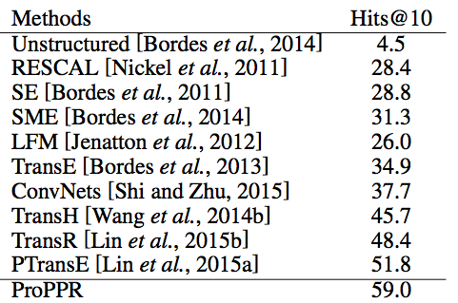
Using Learned Relational Networks for IR
Query answering: indirect queries requiring chains of reasoning
KB Completion: exploits redundancy in the KB + chains to infer missing facts
Freebase 15k benchmark
baseline method
tensor factorization
deep NN
embedding
William W Cohen, Machine Learning Dept. CMU

Slide 81
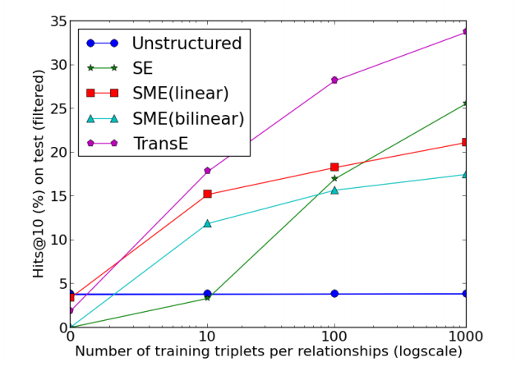
Using Learned Relational Networks for IR
TransE: find an embedding for entitities and relations so that R(X,Y) iff v_{Y}-v_{X} ~= v_{R}
v_{Y}
v_{X}
v_{R}
learned probabilistic
Alternative is explicit inference rules:
uncle(X,Y) :- aunt(X,Z), husband(Z,Y).
^
William W Cohen, Machine Learning Dept. CMU

