Slide 1
Web-Mining Agents
Multi-Relational Latent Semantic Analysis
Prof. Dr. Ralf Möller
Universität zu Lübeck
Institut für Informationssysteme
Tanya Braun (Übungen)

Slide 2


Acknowledgements
Slides by: Scott Wen-tau Yih
Describing joint work of Scott Wen-tau Yih with
Kai-Wei Chang, Bishan Yang,
Chris Meek, Geoff Zweig, John Platt
Microsoft Research

Slide 3
Continuous Semantic Representations
  Text entities are represented as vectors
  Words, phrases, sentences, or documents
  Learned via neural networks
  or matrix/tensor decomposition methods
  Relations are estimated by functions in the vector space
?
=
Search
Learning Similarity Measures
Machine Translation
S2Net [CoNLL-11, SIGIR-11]
DSSM [CIKM-13, ACL-14]
DSSM Deep Structured Semantic Model,
or more general, Deep Semantic Similarity Model

Slide 4
Continuous Semantic Representations
?
=
Search
Learning Similarity Measures
Machine Translation
S2Net [CoNLL-11, SIGIR-11]
DSSM [CIKM-13, ACL-14]

Slide 5

Continuous Semantic Representations
?
=
Search
Learning Similarity Measures
Machine Translation
S2Net [CoNLL-11, SIGIR-11]
DSSM [CIKM-13*, ACL-14]
:
?
:
$$f_{rel}(∎,∎)$$
=
Multi-Relational LSA
Relational Similarity
~
×
×
~
Word Analogy
[NAACL-13 x2]
Word Relation [EMNLP-12, EMNLP-13]
Knowledge Base Embedding [EMNLP-14]

Slide 6

Open-Domain Question Answering
Fulfill user’s information need with direct answers
Answer Sentence Selection [ACL-13]
Q: Who won the best actor Oscar in 1973?
S₁: Jack Lemmon was awarded the Best Actor Oscar for Save the Tiger (1973).
S₂: Academy award winner Kevin Spacey said that Jack Lemmon is remembered as always making time for others.
  Word-alignment based approaches with enhanced lexical semantic models

Slide 7
Continuous Semantic Representations
A lot of popular methods for creating word vectors!
  Vector Space Model [Salton & McGill 83]
  Latent Semantic Analysis [Deerwester+ 90]
  Latent Dirichlet Allocation [Blei+ 01]
  DNN [Collobert & Weston 08]
    Chunking, POS, NER, SRL, (modeling long-distance modeling long-distance dependencies with time-delay networks)
  Word2Vec [Mikolov+ 13]
Encode term co-occurrence information
Measure semantic similarity well

Slide 8
Continuous Semantic Representations
sunny
rainy
cloudy
windy
car
cab
emotion
sad
wheel
joy
feeling

Slide 9


Semantics Needs More Than Similarity
Tomorrow will be rainy.
Tomorrow will be sunny.
$similar($rainy, sunny$)$?
$antonym($rainy, sunny$)$?

Slide 10
Leverage Linguistic Knowledge Bases
Can’t we just use the existing linguistic KBs?
  Knowledge in these resources is never complete
  Often lack of degree of relations
Create a continuous semantic representation that
  Leverages existing rich linguistic knowledge bases
  Discovers new relations
  Enables us to measure the degree of multiple relations (not just similarity)

Slide 11
Roadmap
Two opposite relations:
Polarity Inducing Latent Semantic Analysis (PILSA)
More relations:
Multi-Relational Latent Semantic Analysis (MRLSA)
Relational domain knowledge:
Typed MRLSA (TRESCAL)
Yih, Zweig & Platt. Polarity Inducing Latent Semantic Analysis. In EMNLP-CoNLL-12.
Chang, Yih & Meek. Multi-Relational Latent Semantic Analysis. In EMNLP-13.
Chang, Yih, Yang & Meek. Typed Tensor Decomposition of Knowledge Bases for Relation Extraction. In EMNLP-14.
EMNLP: Empirical Methods in Natural Language Processing
CoNLL: Computational Natural Language Learning
ACL; Annual Meeting of the Association for Computational Linguistics

Slide 12
LSA, word2vec, and friends
Can cope with homonyms due to word context

Slide 13
Problem: Handling Two Opposite Relations
Synonyms & Antonyms
LSA cannot distinguish antonyms [Landauer 2002]
  “Distinguishing synonyms and antonyms is still perceived as a difficult open problem.” [Poon & Domingos 09]
Idea #1: Change the data representation

Slide 14
Polarity Inducing LSA [Yih, Zweig & Platt 2012]
Data representation
  Encode two opposite relations in a matrix using “polarity”
    Synonyms & antonyms (e.g., from a thesaurus)
Factorization
  Apply SVD to the matrix to find latent components
Measuring degree of relation
  Cosine of latent vectors

Slide 15
Encode Synonyms & Antonyms in Matrix
Joyfulness: joy, gladden; sorrow, sadden
Sad: sorrow, sadden; joy, gladden
Target word: row-vector
 | joy | gladden | sorrow | sadden | goodwill
Group 1: “joyfulness” | 1 | 1 | 1 | 1 | 0
Group 2: “sad” | 1 | 1 | 1 | 1 | 0
Group 3: “affection” | 0 | 0 | 0 | 0 | 1

Slide 16

Encode Synonyms & Antonyms in Matrix
Joyfulness: joy, gladden; sorrow, sadden
Sad: sorrow, sadden; joy, gladden
Inducing polarity
Target word: row-vector
 | joy | gladden | sorrow | sadden | goodwill
Group 1: “joyfulness” | 1 | 1 | -1 | -1 | 0
Group 2: “sad” | -1 | -1 | 1 | 1 | 0
Group 3: “affection” | 0 | 0 | 0 | 0 | 1
Cosine Score: $+ Synonyms$

Slide 17
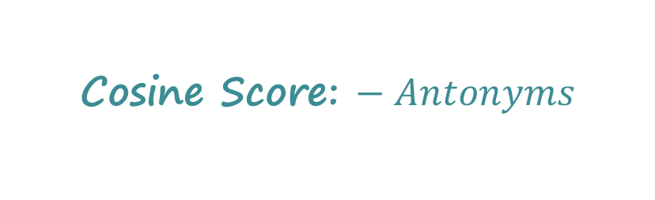
Encode Synonyms & Antonyms in Matrix
Joyfulness: joy, gladden; sorrow, sadden
Sad: sorrow, sadden; joy, gladden
Inducing polarity
Target word: row-vector
 | joy | gladden | sorrow | sadden | goodwill
Group 1: “joyfulness” | 1 | 1 | -1 | -1 | 0
Group 2: “sad” | -1 | -1 | 1 | 1 | 0
Group 3: “affection” | 0 | 0 | 0 | 0 | 1
Cosine Score: $− Antonyms$

Slide 18
Problem: How to Handle More Relations?
Limitation of the matrix representation
  Each entry captures a particular type of relation between two entities, or
  Two opposite relations with the polarity trick
Encoding other binary relations
  Is-A (hyponym) – ostrich is a bird
  Part-whole – engine is a part of car
Idea #2:
Encode multiple relations in a 3-way tensor (3-dim array)!

Slide 19
Multi-Relational LSA (MR-LSA)
Data representation
  Encode multiple relations in a tensor
    Synonyms, antonyms, hyponyms (is-a), … (e.g., from a linguistic knowledge base)
Factorization
  Apply tensor decomposition to the tensor to find latent components (→ RESCAL)
Measuring degree of relation
  Cosine of latent vectors after projection

Slide 20
Encode Multiple Relations in Tensor
Represent word relations using a tensor
  Each slice encodes a relation between terms and target words.
gladden
gladden
joy
sadden
joy
sadden
feeling
feeling
joyfulness
1 | 1 | 0 | 0
1 | 1 | 0 | 0
0 | 0 | 1 | 0
0 | 0 | 0 | 0
joyfulness
0 | 0 | 0 | 0
0 | 0 | 1 | 0
1 | 0 | 0 | 0
0 | 0 | 0 | 0
gladden
gladden
sad
sad
anger
anger
Synonym layer
Antonym layer
Construct a tensor with two slices

Slide 21
Encode Multiple Relations in Tensor
Can encode multiple relations in the tensor
gladden
joy
sadden
feeling
1 | 1 | 0 | 0
1 | 1 | 0 | 0
0 | 0 | 1 | 0
0 | 0 | 0 | 0
1 | 1 | 0 | 0
1 | 1 | 0 | 0
0 | 0 | 1 | 0
0 | 0 | 0 | 0
0 | 0 | 0 | 1
0 | 0 | 0 | 0
0 | 0 | 0 | 1
0 | 0 | 0 | 1
joyfulness
gladden
sad
anger
Hyponym layer

Slide 22



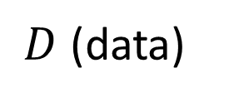

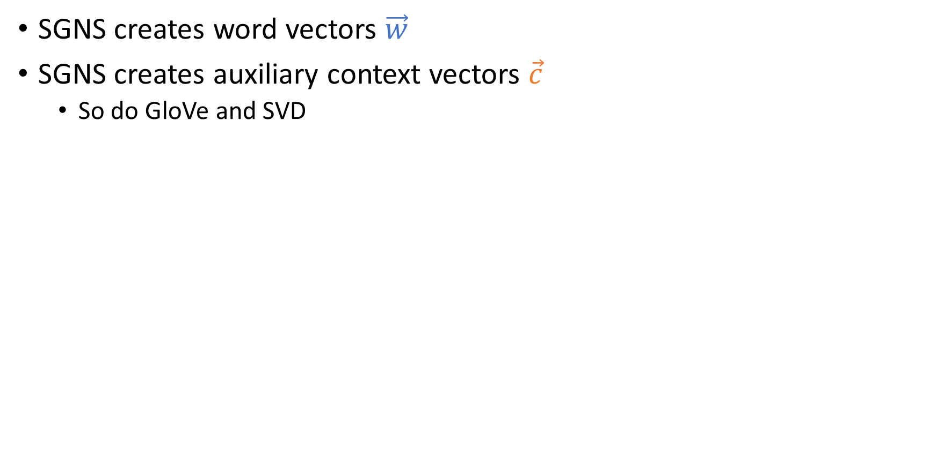
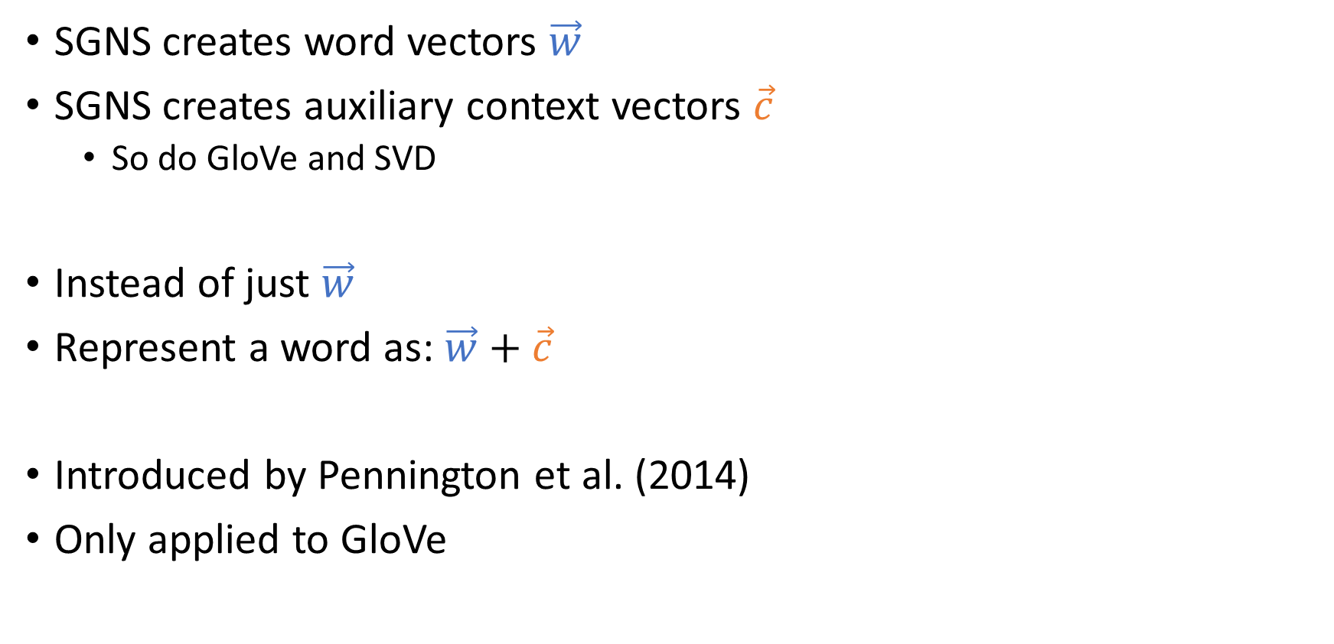

Tensor Decomposition – Analogy to SVD
Derive a low-rank approximation to generalize the data and to discover unseen relations
Apply Tucker decomposition and reformulate the results
$$t_{1},t_{2},…, t_{n}$$
$$r$$
$$r$$
$$t_{1},t_{2},…, t_{n}$$
$$w_{1},w_{2},…, w_{d}$$
~
$$r$$
$$w_{1},w_{2},…, w_{d}$$
×
~
×
$$r$$
latent representation of words

Slide 23


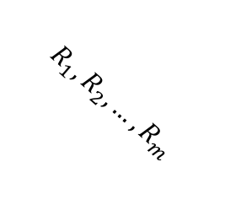

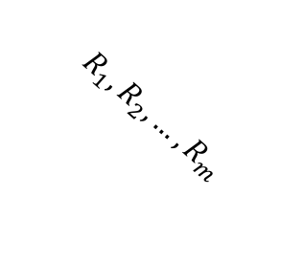


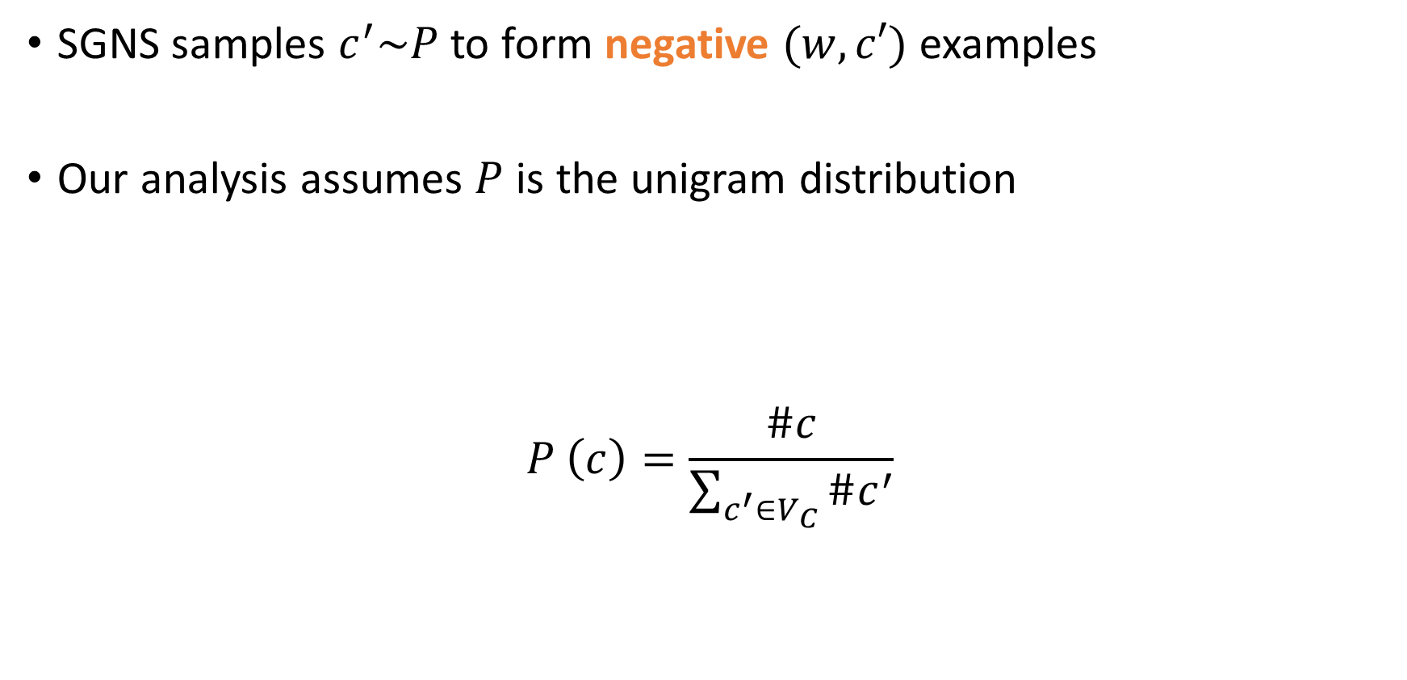




Tensor Decomposition – Analogy to SVD
Derive a low-rank approximation to generalize the data and to discover unseen relations
Apply decomposition and reformulate the results
latent representation of a relation
$$t_{1},t_{2},…, t_{n}$$
$$r$$
$$r$$
$$r$$
$$R_{1},R_{2},…, R_{m}$$
$$t_{1},t_{2},…, t_{n}$$
$$R_{1},R_{2},…, R_{m}$$
$$r$$
$$w_{1},w_{2},…, w_{d}$$
~
$$r$$
~
×
~
×
~
×
×
$$r$$
$$r$$
latent representation of words

Slide 24
Measure Degree of Relation
Similarity
  Cosine of the latent vectors
Other relation (both symmetric and asymmetric)
  Take the latent matrix of the pivot relation (synonym)
  Take the latent matrix of the relation
  Cosine of the latent vectors after projection

Slide 25
Measure Degree of Relation: Raw Representation
$ant\left(\text{joy},\text{sadden}\right)=cos⁡\left(𝓦_{:,\text{joy},syn},𝓦_{:,\text{sadden},ant}\right)$
gladden
gladden
joy
sadden
joy
sadden
felling
felling
joyfulness
1 | 1 | 0 | 0
1 | 1 | 0 | 0
0 | 0 | 1 | 0
0 | 0 | 0 | 0
joyfulness
0 | 0 | 0 | 0
0 | 0 | 1 | 0
1 | 0 | 0 | 0
0 | 0 | 0 | 0
gladden
gladden
sad
sad
anger
anger
Synonym layer
Antonym layer

Slide 26
Measure Degree of Relation: Raw Representation
$ant\left(\text{joy},\text{sadden}\right)=cos⁡\left(𝓦_{:,\text{joy},syn},𝓦_{:,\text{sadden},ant}\right)$
gladden
gladden
joy
sadden
joy
sadden
felling
felling
joyfulness
1 | 1 | 0 | 0
1 | 1 | 0 | 0
0 | 0 | 1 | 0
0 | 0 | 0 | 0
Ω
joyfulness
0 | 0 | 0 | 0
0 | 0 | 1 | 0
1 | 0 | 0 | 0
0 | 0 | 0 | 0
gladden
gladden
sad
sad
anger
anger
Synonym layer
Antonym layer

Slide 27





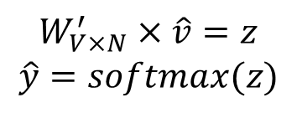
Measure Degree of Relation: Latent Representation
$rel\left({\text{w}}_{i},{\text{w}}_{j}\right)=cos⁡\left(S_{:,:,syn}V_{i,:}^{T},S_{:,:,rel}V_{j,:}^{T}\right)$
Cos ( , )
×
×
$$r$$
$$w_{1},w_{2},…, w_{n}$$
$$R_{1},R_{2},…, R_{m}$$
~
$$r$$
~
~
×
×
~
$$r$$
$$S$$
$$V^{T}$$

Slide 28
Problem: Use Relational Domain Knowledge
Relational domain knowledge – the entity type
  Relation can only hold between the right types of entities
    Words having is-a relation have the same part-of-speech
    For relation born-in, the entity types are: (person, location)
Leverage type information to improve MRLSA
Idea #3: Change the objective function

Slide 29
Typed Multi-Relational LSA (TRESCAL)
Only legitimate entities are included in the objective function of tensor decomposition
Benefits of leveraging the type information
  Faster model training time
  Higher prediction accuracy
Experiments conducted using knowledge base
  Application to Relation Extraction

Slide 30
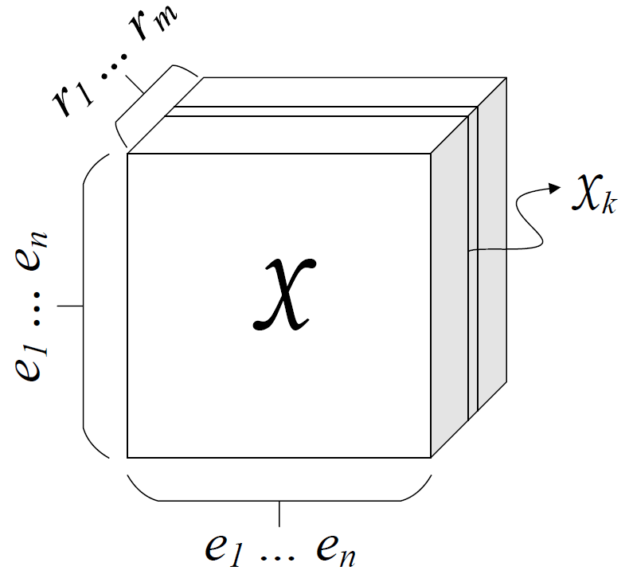

Knowledge Base Representation (1/2)
Collection of subj-pred-obj triples – $(e_{1}, r, e_{2})$
Subject | Predicate | Object
Obama | Born-in | Hawaii
Bill Gates | Nationality | USA
Bill Clinton | Spouse-of | Hillary Clinton
Satya Nadella | Work-at | Microsoft
… | … | …
$n$: # entities, $m$: # relations

Slide 31

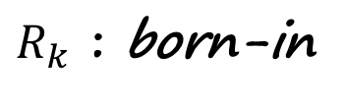
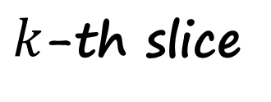
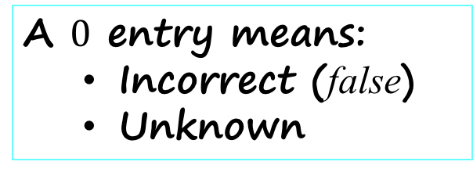
Knowledge Base Representation (2/2)
$k$-th slice
$$𝒳_{k}$$
Hawaii
Obama
1
A $0$ entry means:
  Incorrect (false)
  Unknown
$R_{k}$ : born-in

Slide 32
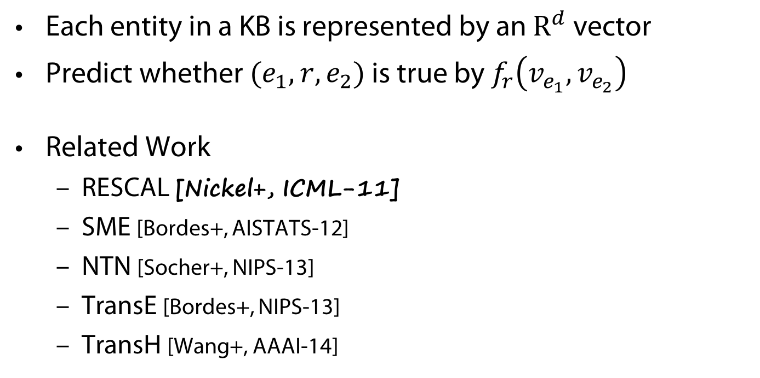
Knowledge Base Embedding
Each entity in a KB is represented by an $R^{d}$ vector
Predict whether $(e_{1}, r, e_{2})$ is true by $f_{r}\left(v_{e_{1}}, v_{e_{2}}\right)$
Related Work
  RESCAL [Nickel+, ICML-11]
  SME [Bordes+, AISTATS-12]
  NTN [Socher+, NIPS-13]
  TransE [Bordes+, NIPS-13]
  TransH [Wang+, AAAI-14]

Slide 33
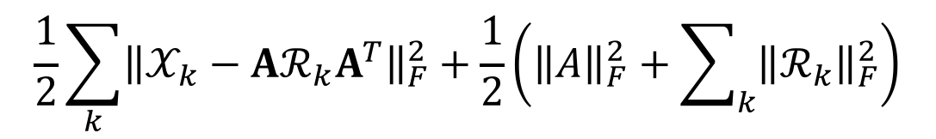




Tensor Decomposition Objective
$$\frac{1}{2}\sum_{k}{{\left\|𝒳_{k}−Aℛ_{k}A^{T}\right\|}_{F}^{2}}+\frac{1}{2}\left({\left\|A\right\|}_{F}^{2}+\sum_{k}{{\left\|ℛ_{k}\right\|}_{F}^{2}}\right)$$
Objective:
$$𝒳_{k}$$
$$A$$
$$ℛ_{k}$$
$$A^{T}$$
~
×
×
~
RESCAL [Nickel+, ICML-11]

Slide 34
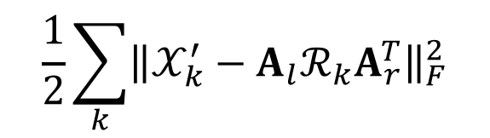




Typed Tensor Decomposition Objective
$$\frac{1}{2}\sum_{k}{{\left\|𝒳_{k}^{′}−A_{l}ℛ_{k}A_{r}^{T}\right\|}_{F}^{2}}$$
Objective:
locations
$$𝒳_{k}$$
$$A$$
$$ℛ_{k}$$
$$A^{T}$$
~
×
×
~
persons
Relation: born-in

Slide 35
Typed Tensor Decomposition Objective
$$\frac{1}{2}\sum_{k}{{\left\|𝒳_{k}^{′}−A_{l}ℛ_{k}A_{r}^{T}\right\|}_{F}^{2}}$$
Objective:
$$𝒳_{k}$$
$$A$$
$$ℛ_{k}$$
$$A^{T}$$
~
×
×
~

Slide 36
Experiments – KB Completion
KB – Never Ending Language Learning (NELL)
  Training: version 165
  Developing: new facts between v.166 and v.533
  Testing: new facts between v.534 and v.745
# Entities | 753k
# Relation Types | 229
# Entity Types | 300
# Entity-Relation Triples | 1.8M

Slide 37
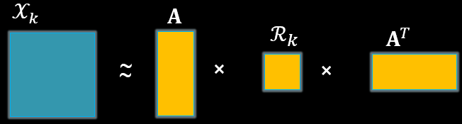
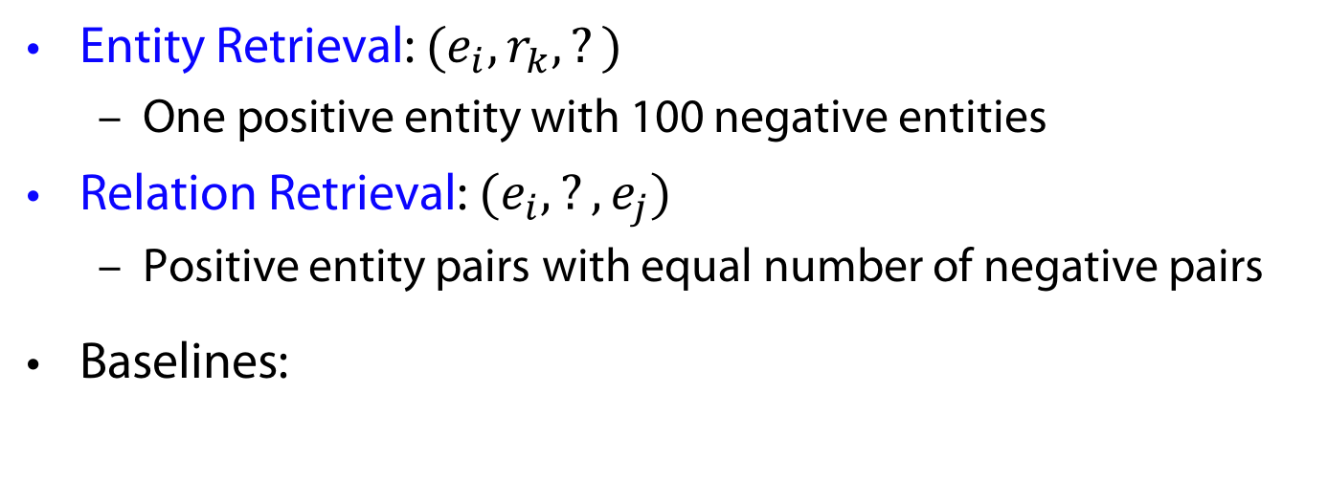



Tasks & Baselines
Entity Retrieval: $(e_{i}, r_{k}, ?)$
  One positive entity with 100 negative entities
Relation Retrieval: $(e_{i}, ?, e_{j})$
  Positive entity pairs with equal number of negative pairs
Baselines:
$$r_{k}$$
$$e_{i}$$
$$e_{j}$$
RESCAL
TransE

Slide 38
Entity Retrieval

Slide 39
Relation Retrieval

Slide 40

Experiments – Relation Extraction
Dan Roth is a professor at UIUC.
(Dan Roth, work-at, UIUC)

Slide 41
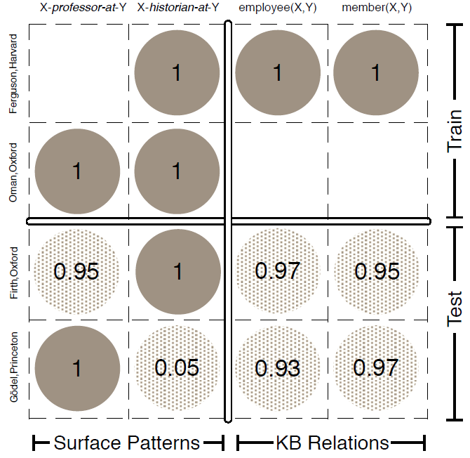
Relation Extraction as Matrix Factorization
[Riedel+ 13]
Row: Entity Pair
Column: Relation
Fig.1 of [Riedel+ 13]

Slide 42
Conclusions
Continuous semantic representation that
  Leverages existing rich linguistic knowledge bases
  Discovers new relations
  Enables us to measure the degree of multiple relations
Approaches
  Better data representation
  Matrix/Tensor decomposition
  Relational domain knowledge
Challenges & Future Work
  Capture more types of knowledge in the model
  Support more sophisticated inferential tasks

Slide 43
Acknowledgements again
Slides by: Scott Wen-tau Yih
(orignal presentation shortened)
Describing joint work of Scott Wen-tau Yih with
Kai-Wei Chang, Bishan Yang,
Chris Meek, Geoff Zweig, John Platt
Microsoft Research

