Slide 1
Logical Foundations for
Interpreting Media Data as Streams of Data Descriptions
Ralf Möller, Institut für Informationssysteme, Universität zu Lübeck

Slide 2
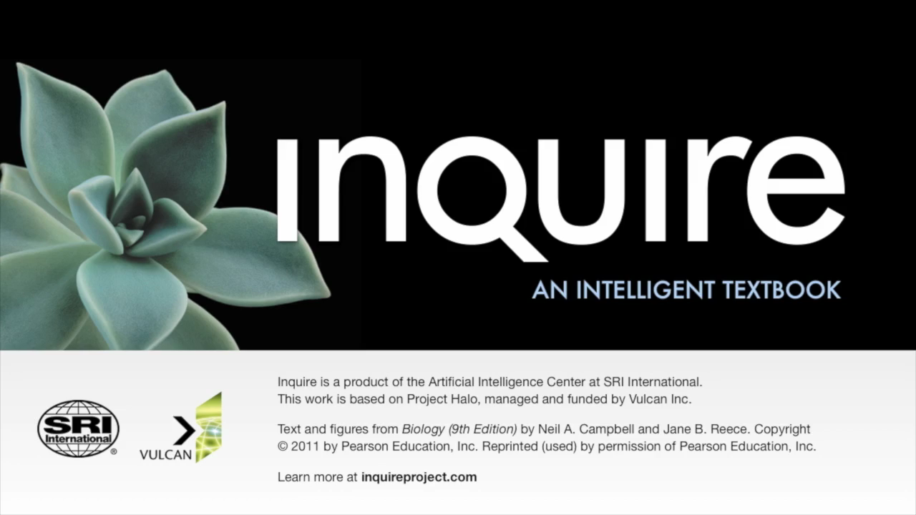
New Ways of Interacting with Media
New Ways of Teaching?
With permission by Vinay Chaudhri, AI Program Director, Stanford Research Institute

Slide 3
Assumptions and Research Goals
Way of interacting with media also relevant for professional environments
  E.g., for tasks in hospitals
Need to make production of interactive media much less expensive
Ensure authors have fun producing apps involving media

Slide 4
Generating Symbolical Semantic Content Descriptions for Multimedia Documents
[ BOEMIE 06-09 ]
Establish relations to external resource such as, e.g., Google Knowledge Graph
Derive relational descriptions of media content
  Automatic „interpretation“ ...
  ... on different layers of abstraction
Ontologies and inference problems
  Deduction (Find implicit descriptions)
  Abduction (Explain „observations“)

Slide 5
Query answering wrt ontologies
1..*
MortgageLender
Example
Anfrage
{ ( X ) | controlledBy( X, Y ) }
?- X=BLB
controlledBy(BLB, HSH)‏
Bank(HRE)‏
controlledBy
Bank
MortgageLender
Bank
controlledBy
HRE
HRE
BLB
HSH
X=HRE, X=HSH
HSH
HSH
HRE
??
BLB
HSH
??
[ Racer 1998 - ... ]
[ TONES 05-08 ]

Slide 6
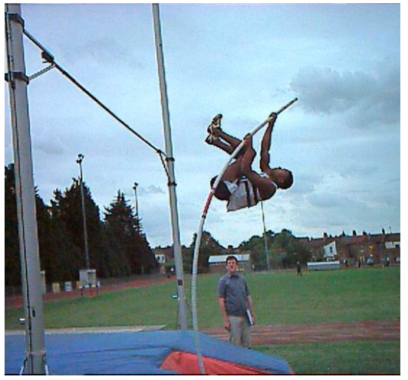
Symbolic representation of interpretation knowledge:
First-order style / deduction
∀y, z : Jumper( y ), touches( y, z ), Pole( z )
→
∃x : PoleVault( x ),
PV_InStartPhase( x ),
hasPart( x, y ),
hasPart( x, z )
Hard to realize...
  No control over first-order prover

Slide 7
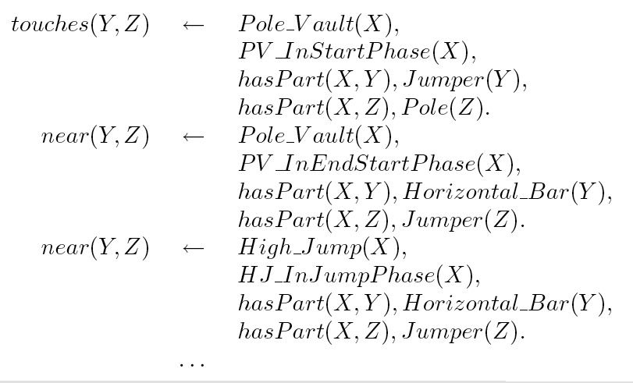
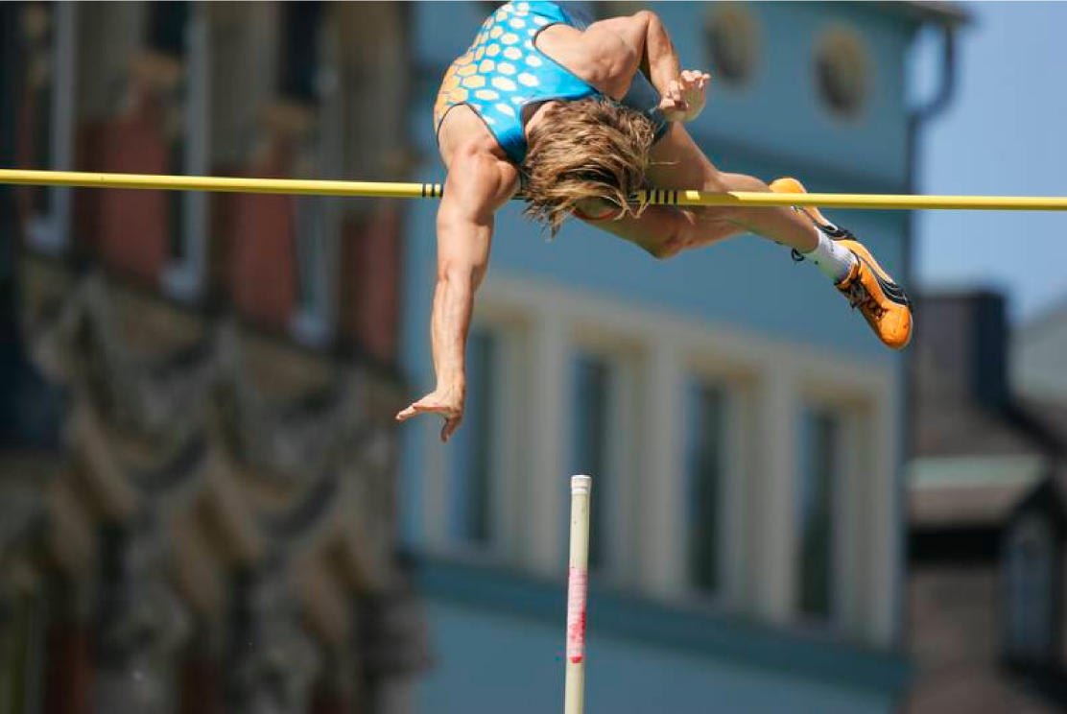
Symbolic representation of interpretation knowledge:
Datalog style / abduction

Slide 8
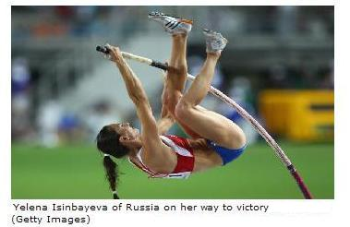
Starting interpretation Spatial association
Yelena Isinbayeva of Russia on her way to victory (Getty Images)
F1:Face
B1:Body
P1:Pole
[ Diss Kaya ]
[ BOEMIE 06-09 ]

Slide 9
Semantic interpretation Abduction
Yelena Isinbayeva of Russia on her way to victory (Getty Images)
N1:Person
F1:Face
B1:Body
P1:Pole
[ Diss Kaya ]
[ BOEMIE 06-09 ]

Slide 10
Semantic interpretation Abduction
Yelena Isinbayeva of Russia on her way to victory (Getty Images)
N2:Pole vault trial
N1:Person
F1:Face
B1:Body
P1:Pole
[ Diss Kaya ]
[ BOEMIE 06-09 ]

Slide 11
Semantic interpretation Abduction Deduction
Yelena Isinbayeva of Russia on her way to victory (Getty Images)
N2:Pole vault trial
N1:Person, Pole vaulter
F1:Face
B1:Body
P1:Pole
[ Diss Kaya ]
[ BOEMIE 06-09 ]

Slide 12
Multimedia interpretation Abduction
Yelena Isinbayeva of Russia on her way to victory (Getty Images)
N2:Pole vault trial
N1:Person, Pole vaulter
N3:Person
F1:Face
B1:Body
P1:Pole
Pn1:Person Name
C1:Country
Name
[ Diss Kaya ]
[ BOEMIE 06-09 ]

Slide 13
Multimedia interpretation Abduction Deduction
Yelena Isinbayeva of Russia on her way to victory (Getty Images)
=
N2:Pole vault trial
N1:Person, Pole vaulter
N3:Person, Pole vaulter
F1:Face
B1:Body
P1:Pole
Pn1:Person Name
C1:Country
Name
[ Diss Kaya ]
[ BOEMIE 06-09 ]

Slide 14
Multimedia interpretation Use case: cf. video
Service 1
Service 2
Service 3
=
N2:Pole vault trial
N1:Person, Pole vaulter
N3:Person, Pole vaulter
F1:Face
B1:Body
P1:Pole
Pn1:Person Name
C1:Country
Name
[ Diss Espinosa ]

Slide 15
Conclusion too unspecific?
Use body atoms as guards!

Slide 16
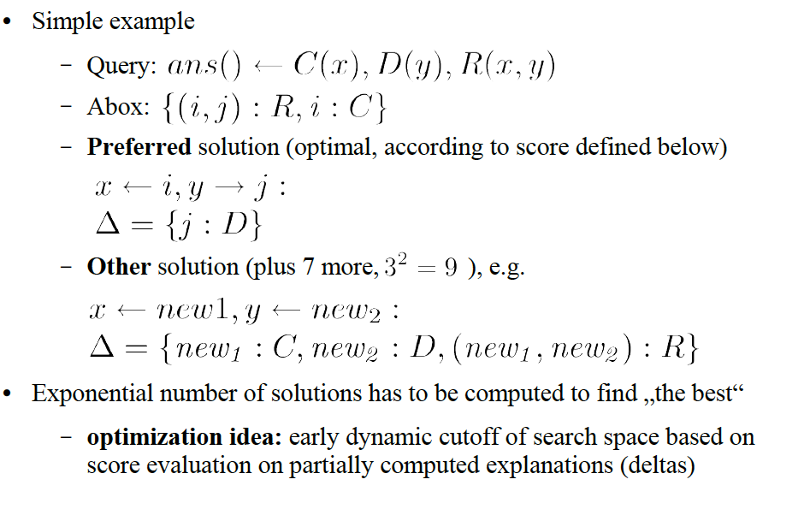
Abductive query answering
[ Diss Wessel: nRQL]

Slide 17
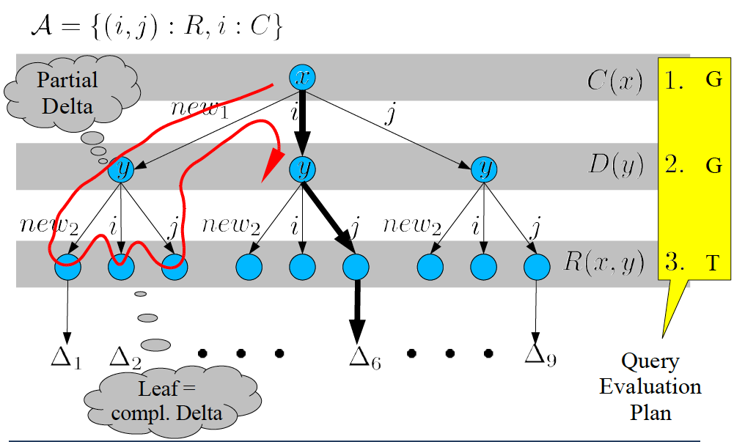
Depth-first abductive query evaluation
[ Diss Wessel: nRQL]

Slide 18
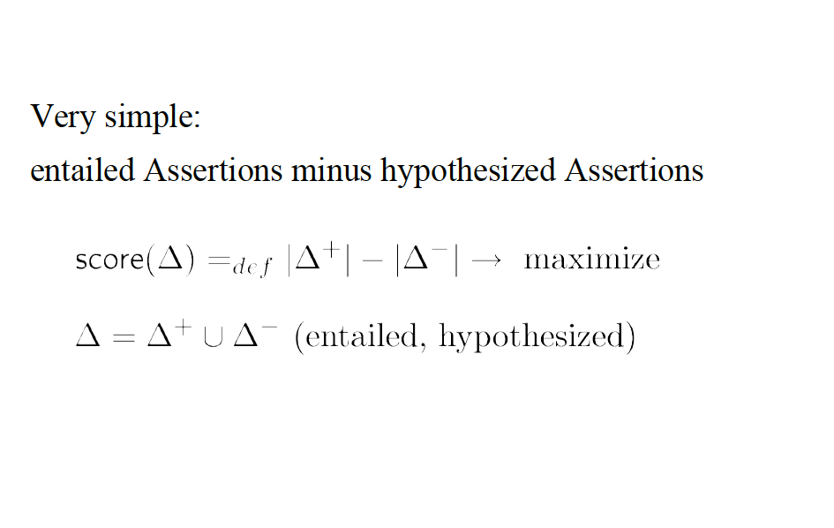
Score for comparing solutions
[ Diss Wessel: nRQL]

Slide 19
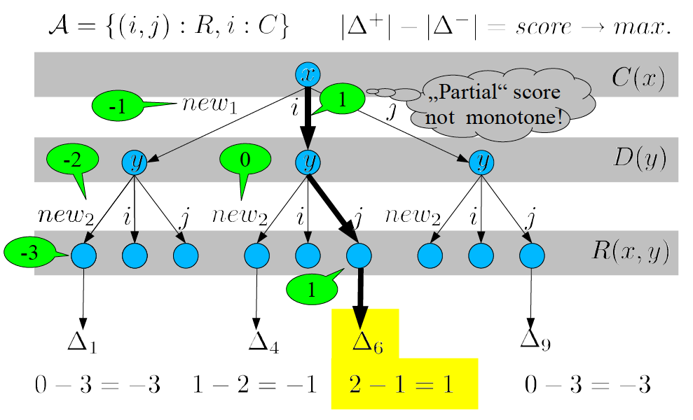
Illustration of partial scores
[ Diss Wessel: nRQL]

Slide 20
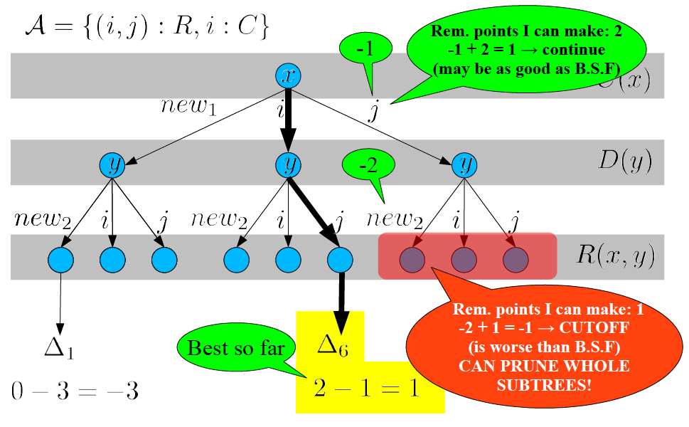
Score-based cutoff
[ Diss Wessel: nRQL]

Slide 21
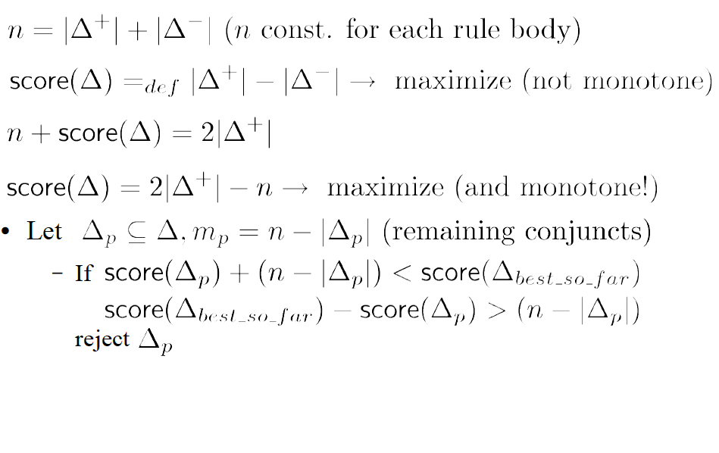
More formally
[ Diss Wessel: nRQL]

Slide 22
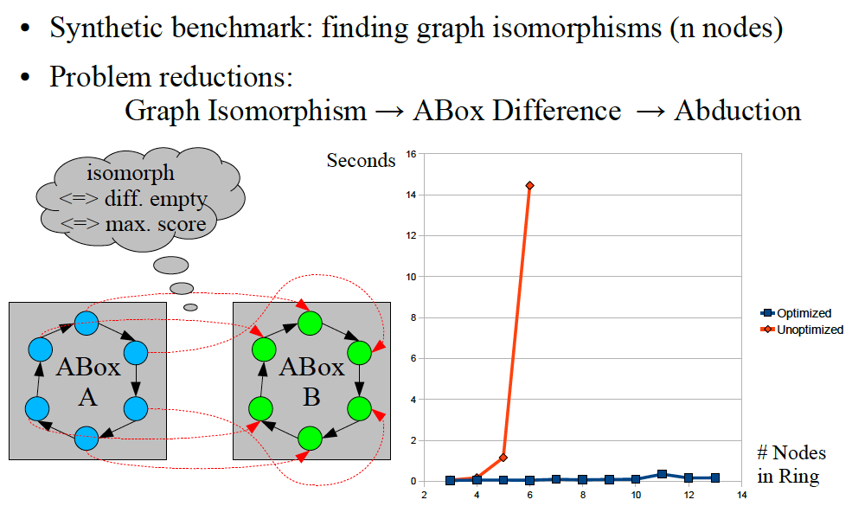
How effective is this?
[ Diss Wessel: nRQL]

Slide 23
Mulimedia interpretation:
Temporal association
Document Layer
Content Layer
...
...
Segment Layer
...
...
...
Locator Layer
Stream-oriented processing (open-world stream)
[ CASAM 08-11 ]
23

Slide 24










Mulimedia interpretation:
Temporal association
Content Layer
[ CASAM 08-11 ]
24

Slide 25
Mulimedia interpretation:
Temporal association
hasLogicalDecomposition
hasLogicalDecomposition
VC(vc)
AC(ac)
hasMediaDecomposition
hasMediaDecomposition
hasMediaDecomposition
hasMediaDecomposition
VS(vs2)
VS(vs1)
AS(as1)
AS(as2)
hasSegmentLocator
depicts
hasSegmentLocator
depicts
hasSegmentLocator
hasSegmentLocator
hasInterviewer(i,p)
hasContent(i,s)
VL(vl2)
VL(vl1)
AL(al1)
AL(al2)
hasStart
hasEnd
hasStart
hasEnd
Interview(i)
00:00:40
00:00:50
00:00:42
00:00:58
Person(p)
personToSpeech(p,s)
Speech(s)
[ CASAM 08-11 ]
25

