Slide 1
Web-Mining Agents Deep Relational Learning
Prof. Dr. Ralf Möller
Universität zu Lübeck
Institut für Informationssysteme
Tanya Braun (Übungen)

Slide 2
Exploiting Foil Results in PRMs
has_aunt(X, W)
has_uncle(X, Y)
is_child_of(X, W)
has_husband(W, Y)
has_brother(W, Y)
status(W, tired)
infant(W)
has_uncle(X, Y) :- is_child_of(X, W), has_brother(W, X).
has_uncle(X, Y) :- has_aunt(X, W), has_husband(W, Y).
status(X, tired) :- is_child_of(W, X), infant(W).

Slide 3
Deep Relational Learning
Deep-latent?
Deep-latent?
Deep-latent?
Deep-latent?
Latent
Latent
Beobachtet
Beobachtet
C=Condition, LT=Living Together, W=Weight, S= Scale works

Slide 4
Deep Interpretation
Extend annotations with new domain objects (and not only relations)
Analysis results
Deep Interpretation
Symbolic descriptions 𝛤
High level symbolic descriptions 𝛥
Model information 𝛴
Hypothesis space for possible explanations 𝛥
𝛥 -Score: Probability Ranking Principle
O. Gries, R. Möller, A. Naﬁssi, M. Rosenfeld, K. Sokolski, and M. Wessel. A Probabilistic Abduction Engine for Media Interpreta(on based on Ontologies.
In Proceedings of 4th Interna9onal Conference on Web Reasoning and Rule Systems, 2010.

Slide 5
Abduction in PRMs
aunt(X, W)
uncle(X, Y)
child(X, W)
X\{a}, Y\{b}, W\{e}
X=a, Y=b, W=e
husband(W, Y)
brother(W, Y)
status(W, tired)
infant(W)
uncle(a, b)

Slide 6
Increasing the Score by Explaining Observations
x = time axis indicated with arrival time of bunch of data y = scoring value of the interpretation
15

Slide 7
Increasing the Score by Explaining Observations
x = time spent for explaining observations
y = number of observations to be explained in a bunch z = scoring value

Slide 8
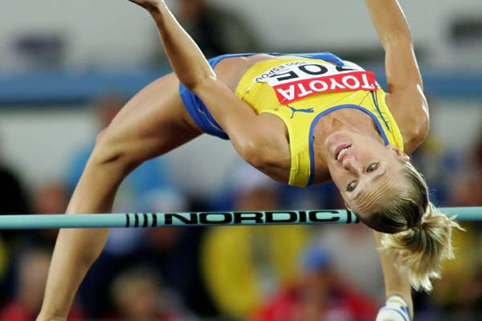
Example: Image modality
Abduction constructs relational structures
Tbox causes new knowledge to be inferred
Highjump
Person
IND-6
hasParticipant
IND-3
hasPart
near
hasPart
hasPart
face₁
near
bar₁
near
body₁
Nodes are somehow associated with media objects

Slide 9
Example: Image modality
Abduction constructs relational structures
Tbox causes new knowledge to be inferred
Highjump
Jumper
IND-6
hasParticipant
IND-3
hasPart
near
hasPart
hasPart
face₁
near
bar₁
near
body₁

Slide 10
Example: Text modality
Kajsa Bergqvist clears 2:06 in Eberstadt
IND-11
Athlete
personToPerformance
pname₁
perf₁
personNameToPerformance
hasValue
hasValue
“Kajsa Bergqvist”
“2.06”

Slide 11
Fusion
Goals:
Desambiguation
Rule out possible interpretations
Information accumulation (for better query answering)‏
Kajsa Bergqvist clears 2:06 in Eberstadt

Slide 12
Explicitly represent the document structure
image₁
caption₁
hasCaption
depicts
depicts
depicts
IND-11
Athlete
IND-6
hasParticipant
IND-3
Jumper
Highjump
hasPart
personToPerformance
isAdjacent
hasPart
hasPart
face₁
pname₁
perf₁
personNameToPerformance
isAdjacent
hasValue
bar₁
isAdjacent
body₁
hasValue
“Kajsa Bergqvist”
“2.06”

Slide 13
Exploit the document structure
Abduction is used to find explanations for the relations between the multimedia objects
We assume the following rule
hasCaption(X,A) ← Image(X), depicts(X,Y), Caption(A), depicts(A,B), same-as(Y,B)‏

Slide 14
Structure identification
image₁
caption₁
hasCaption
depicts
depicts
depicts
IND-11
Jumper
IND-6
hasParticipant
IND-3
Jumper
Highjump
hasPart
personToPerformance
isAdjacent
hasPart
hasPart
face₁
pname₁
perf₁
personNameToPerformance
isAdjacent
hasValue
bar₁
isAdjacent
body₁
hasValue
“Kajsa Bergqvist”
“2.06”

Slide 15
Causality
Reasoning about representations: Intervention (Backdoor, Frontdoor), Counterfactuals, Instruments, ...
image₁
caption₁
hasCaption
depicts
depicts
depicts
IND-11
Jumper
IND-6
hasParticipant
IND-3
Jumper
Highjump
hasPart
personToPerformance
isAdjacent
hasPart
hasPart
face₁
pname₁
perf₁
personNameToPerformance
isAdjacent
hasValue
bar₁
isAdjacent
body₁
hasValue
“Kajsa Bergqvist”
“2.06”

Slide 16
Decision Making: Propositional
Should I take my umbrella??
take/don’t take
P(rain) = 0.4
Take-Umb
weather
have umbrella
P(have|take) = 1.0
P(~have|~take)=1.0
forecast
happiness
f w p(f|w)
sunny rain 0.3
rainy rain 0.7
sunny no rain 0.8
rainy no rain 0.2
U(have,rain) = -25
U(have,~rain) = 0
U(~have, rain) = -100
U(~have, ~rain) = 100

Slide 17
First-Order Decision Making
Should I take my X ∈ {Umb, Raincoat, Taxi, ...}?
take/don’t take
P(rain) = 0.4
take(X)
weather
have (X)
P(have(X)|take(X)) = 1.0
P(~have(X)|~take(X))=1.0
forecast
happiness(X)
f w p(f|w)
sunny rain 0.3
rainy rain 0.7
sunny no rain 0.8
rainy no rain 0.2
More complex definition depending on X

