Slide 1
Einführung in Web- und Data-Science
Prof. Dr. Ralf Möller
Universität zu Lübeck
Institut für Informationssysteme
Tanya Braun (Übungen)

Slide 2
ANOVA: Analysis of Variation
Acknowledgements
This lecture is based on the following presentation:
Math 243 Lecture
R. Pruim
(but contains additions and modifications)

Slide 3
Example
Subjects: 25 patients with blisters
Treatments: Treatment A, Treatment B, Placebo
Measurement: # of days until blisters heal
Data [and means]:
A: 5, 6, 6, 7, 7, 8, 9, 10 [7.25]
B: 7, 7, 8, 9, 9, 10, 10, 11 [8.875]
P: 7, 9, 9, 10, 10, 10, 11, 12, 13 [10.11]
Are these differences significant?
Variation BETWEEN groups vs. variation WITHIN groups
Analysis of variation required: ANOVA

Slide 4
ANOVA and Clustering
Init values
Good result ?
Init values
Bad result ?

Slide 5
The basic ANOVA situation
Two variables: 1 Categorical (type, group), 1 Quantitative (value)
Main Question: Do the (means of) the quantitative variables depend on the group (given by categorical variable) the individual is in?
If categorical variable has only 2 values:
2-sample t-test
ANOVA allows for 3 or more groups

Slide 6
Informal Investigation
Graphical investigation:
side-by-side box plots
multiple histograms
Whether the differences between the groups are significant depends on
the difference in the means
the standard deviations of each group
the sample sizes (aka degrees of freedom df)
Need p-value to make a decision
ANOVA determines p-value from a specific statistic

Slide 7
Side by Side Boxplots

Slide 8
What does ANOVA do?
At its simplest (there are extensions) ANOVA tests the following hypotheses:
H₀: The means of all the groups are equal.
H_{a}: Not all the means are equal
doesn’t say how or which ones differ.
Can follow up with “multiple comparisons”
Note: we usually refer to the sub-populations as “groups” when doing ANOVA.

Slide 9
Assumptions of ANOVA
Each group is approximately normal

Slide 10
Normality Check
We should check for normality using:
Assumptions about population
Histograms for each group
Normal quantile plot for each group

Slide 11
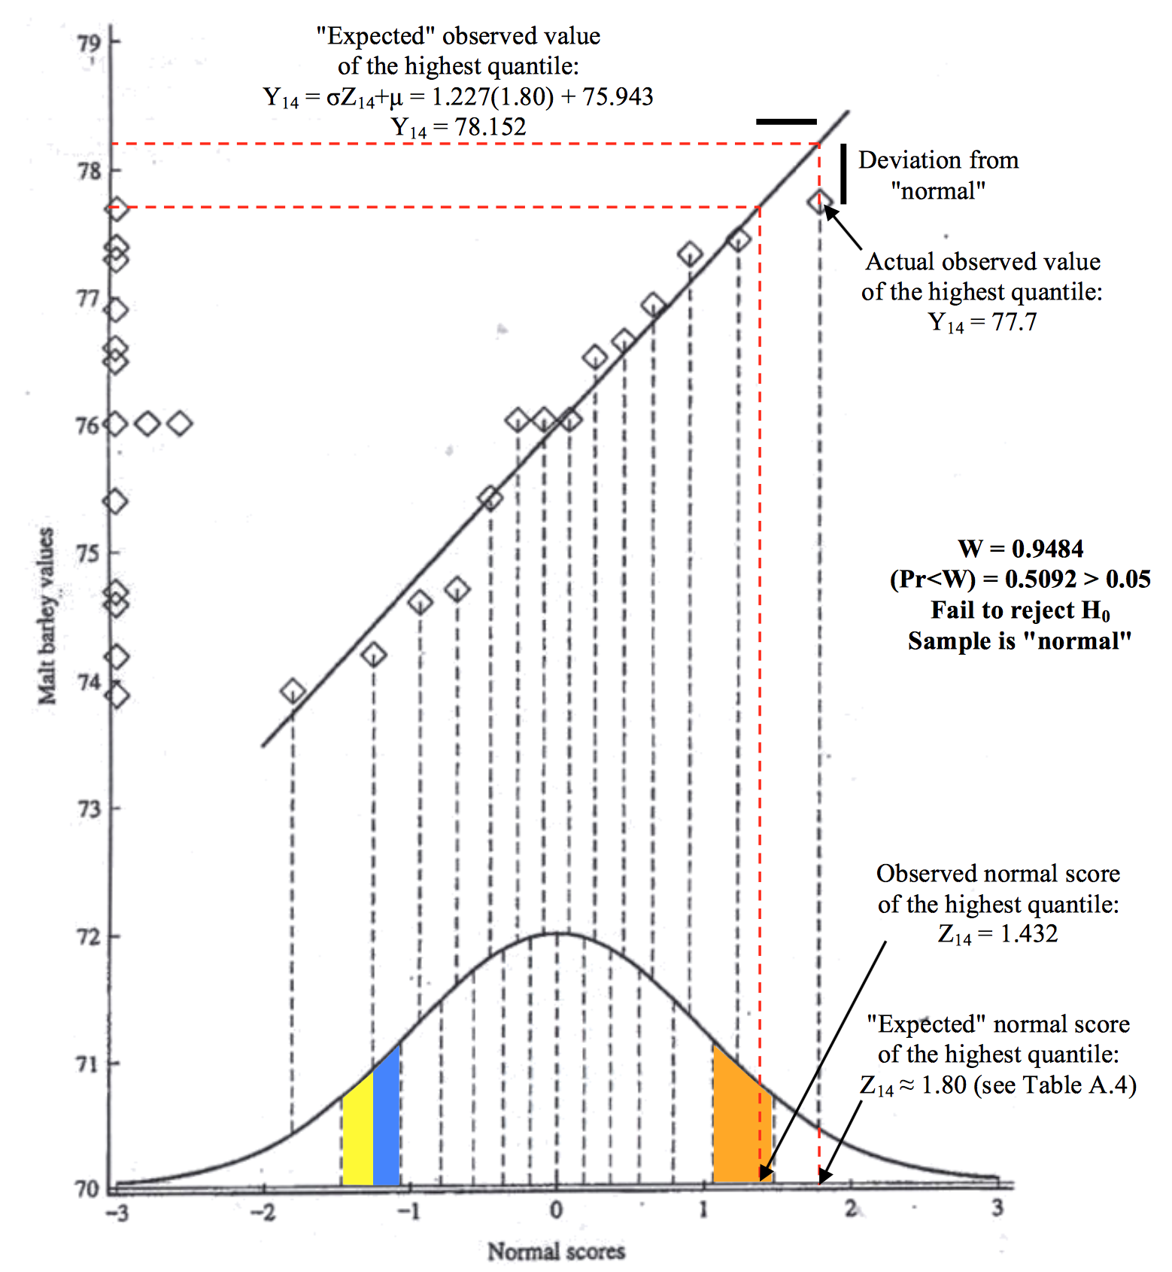

Slide 12
Normality Check
We should check for normality using:
Assumptions about population
Histograms for each group
Normal quantile plot for each group
With small data sets, there really isn’t a really good way to check normality from data, but we make the common assumption that physical measurements of people tend to be normally distributed (but see Kolmogorov-Smirnov-Test)
Useful only for "large" datasets

Slide 13
Assumptions of ANOVA
Each group is approximately normal
Check this by looking at histograms and/or normal quantile plots, or use assumptions
Can handle some non-normality, but not severe outliers
Standard deviations of each group are approximately equal
Rule of thumb: ratio of largest to smallest sample st. dev. must be less than 2:1

Slide 14
Standard Deviation Check
Variable treatment N Mean Median StDev
days A 8 7.250 7.000 1.669
B 8 8.875 9.000 1.458
P 9 10.111 10.000 1.764
Compare largest and smallest standard deviations:
largest: 1.764
smallest: 1.458
1.458 x 2 = 2.916 > 1.764

Slide 15
Notation for ANOVA
n = number of individuals all together
I = number of groups
= mean for entire data set
Group i has
n_{i} = # of individuals in group i
x_{ij} = value for individual j in group i
= mean for group i
s_{i} = standard deviation for group i

Slide 16
How ANOVA works (outline)
ANOVA measures two sources of variation in the data and compares their relative sizes
Variation BETWEEN groups (MSG)
for each group look at the difference between its mean and the overall mean
Variation WITHIN groups (MSE)
for each data value x_{j} of group i we look at the difference between that value and the mean of its group
N⁻¹𝛴_{i}
M⁻¹𝛴_{obsij}

Slide 17
F Statistic
The ANOVA F-statistic is a ratio of the Between Group Variaton divided by the Within Group Variation:
A large F is evidence against H₀, since it indicates that there is more difference between groups than within groups (hence the means between at least two groups differ).
H₀: The means of all the groups are equal.

Slide 18
Computations
We want to measure the amount of variation due to BETWEEN group variation and WITHIN group variation
For each data value, we calculate its contribution to:
BETWEEN group variation:
WITHIN group variation:

Slide 19
An even smaller example
Suppose we have three groups
Group 1: 5.3, 6.0, 6.7
Group 2: 5.5, 6.2, 6.4, 5.7
Group 3: 7.5, 7.2, 7.9
We get the following statistics:

Slide 20
ANOVA Output
1 less than number of groups
number of data values - number of groups
(equals df for each group added together)
1 less than number of individuals
(just like other situations)

Slide 21
Computing ANOVA F statistic
overall mean: 6.44 F = 2.5528/0.25025 = 10.21575

Slide 22
ANOVA Output
Analysis of Variance for days
Source DF SS MS F P
treatment 2 34.74 17.37 6.45 0.006
Error 22 59.26 2.69
Total 24 94.00
# of data values - # of groups
(equals df for each group added together)
1 less than # of groups
1 less than # of individuals
(just like other situations)

Slide 23
ANOVA Output for Drug Example
Analysis of Variance for days
Source DF SS MS F P
treatment 2 34.74 17.37 6.45 0.006
Error 22 59.26 2.69
Total 24 94.00
SS stands for sum of squares
ANOVA splits this into 3 parts

Slide 24
ANOVA Output
Analysis of Variance for days
Source DF SS MS F P
treatment 2 34.74 17.37 6.45 0.006
Error 22 59.26 2.69
Total 24 94.00
MSG = SSG / DFG
MSE = SSE / DFE
P-value
comes from
F(DFG,DFE)
F = MSG / MSE
(P-values for the F statistic are in table as usual)

Slide 25
So How big is F?
Since F is
Mean Square Between / Mean Square Within
= MSG / MSE
A large value of F indicates relatively more
difference between groups than within groups (evidence against H₀)
To get the P-value, we compare to F(I-1,n-I)-distribution
I-1 degrees of freedom in numerator (# groups -1)
n - I degrees of freedom in denominator (rest of df)

Slide 26
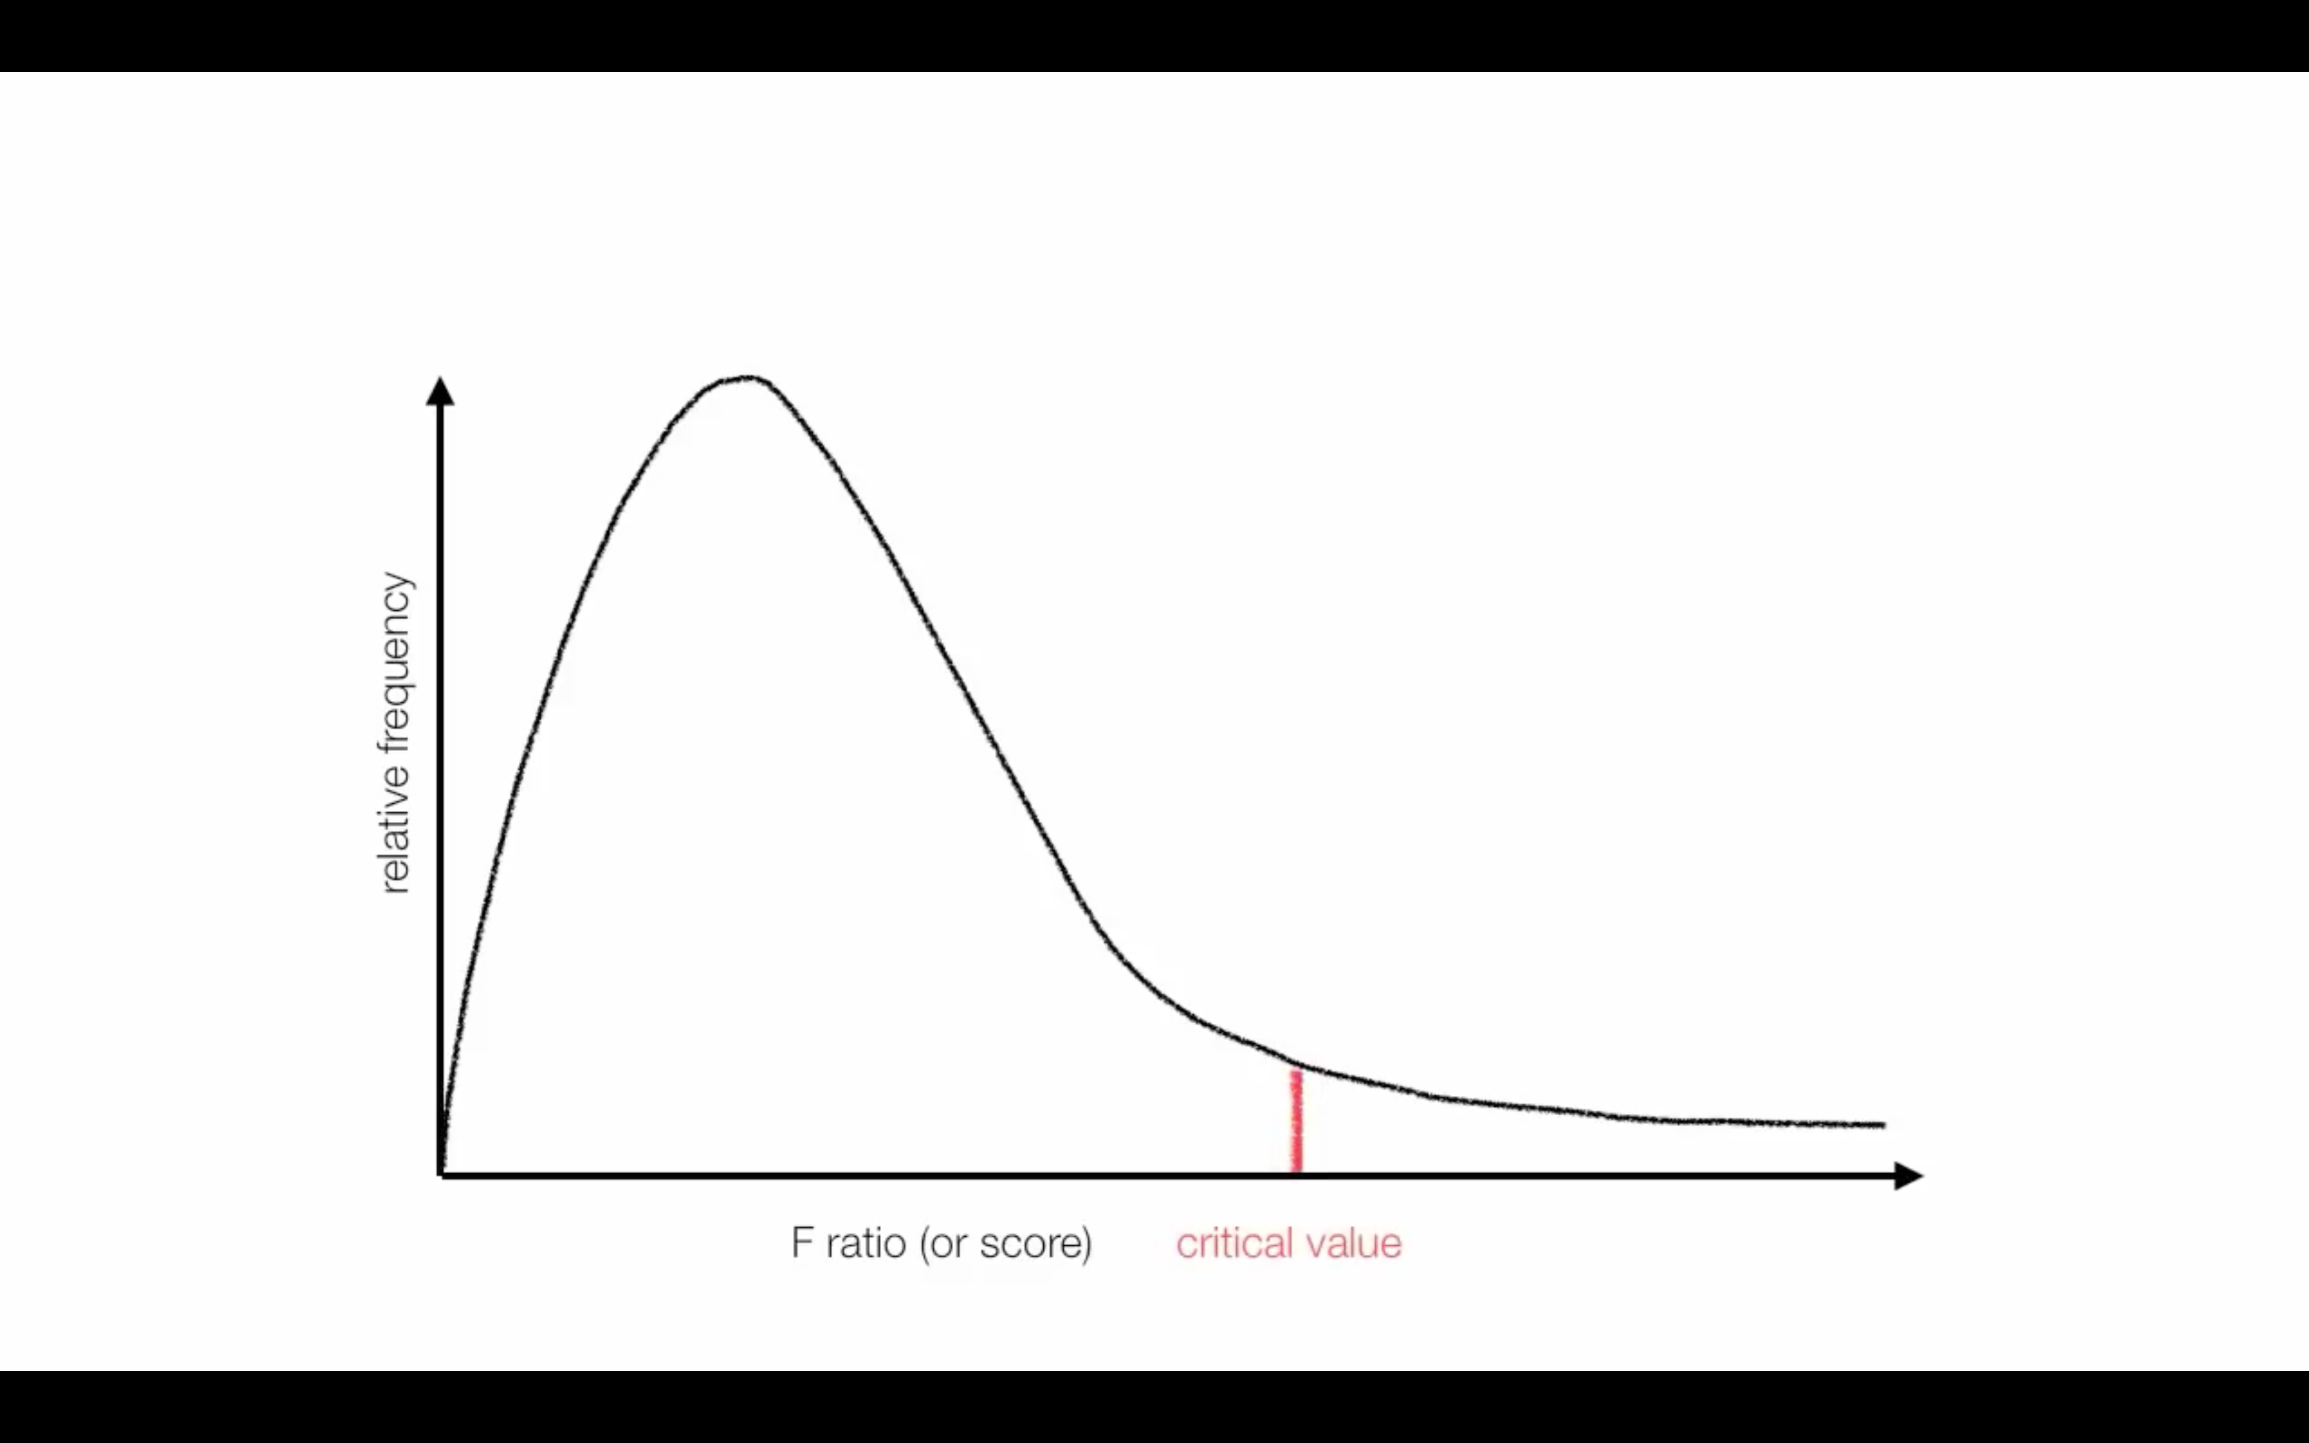
F-Distribution

Slide 27
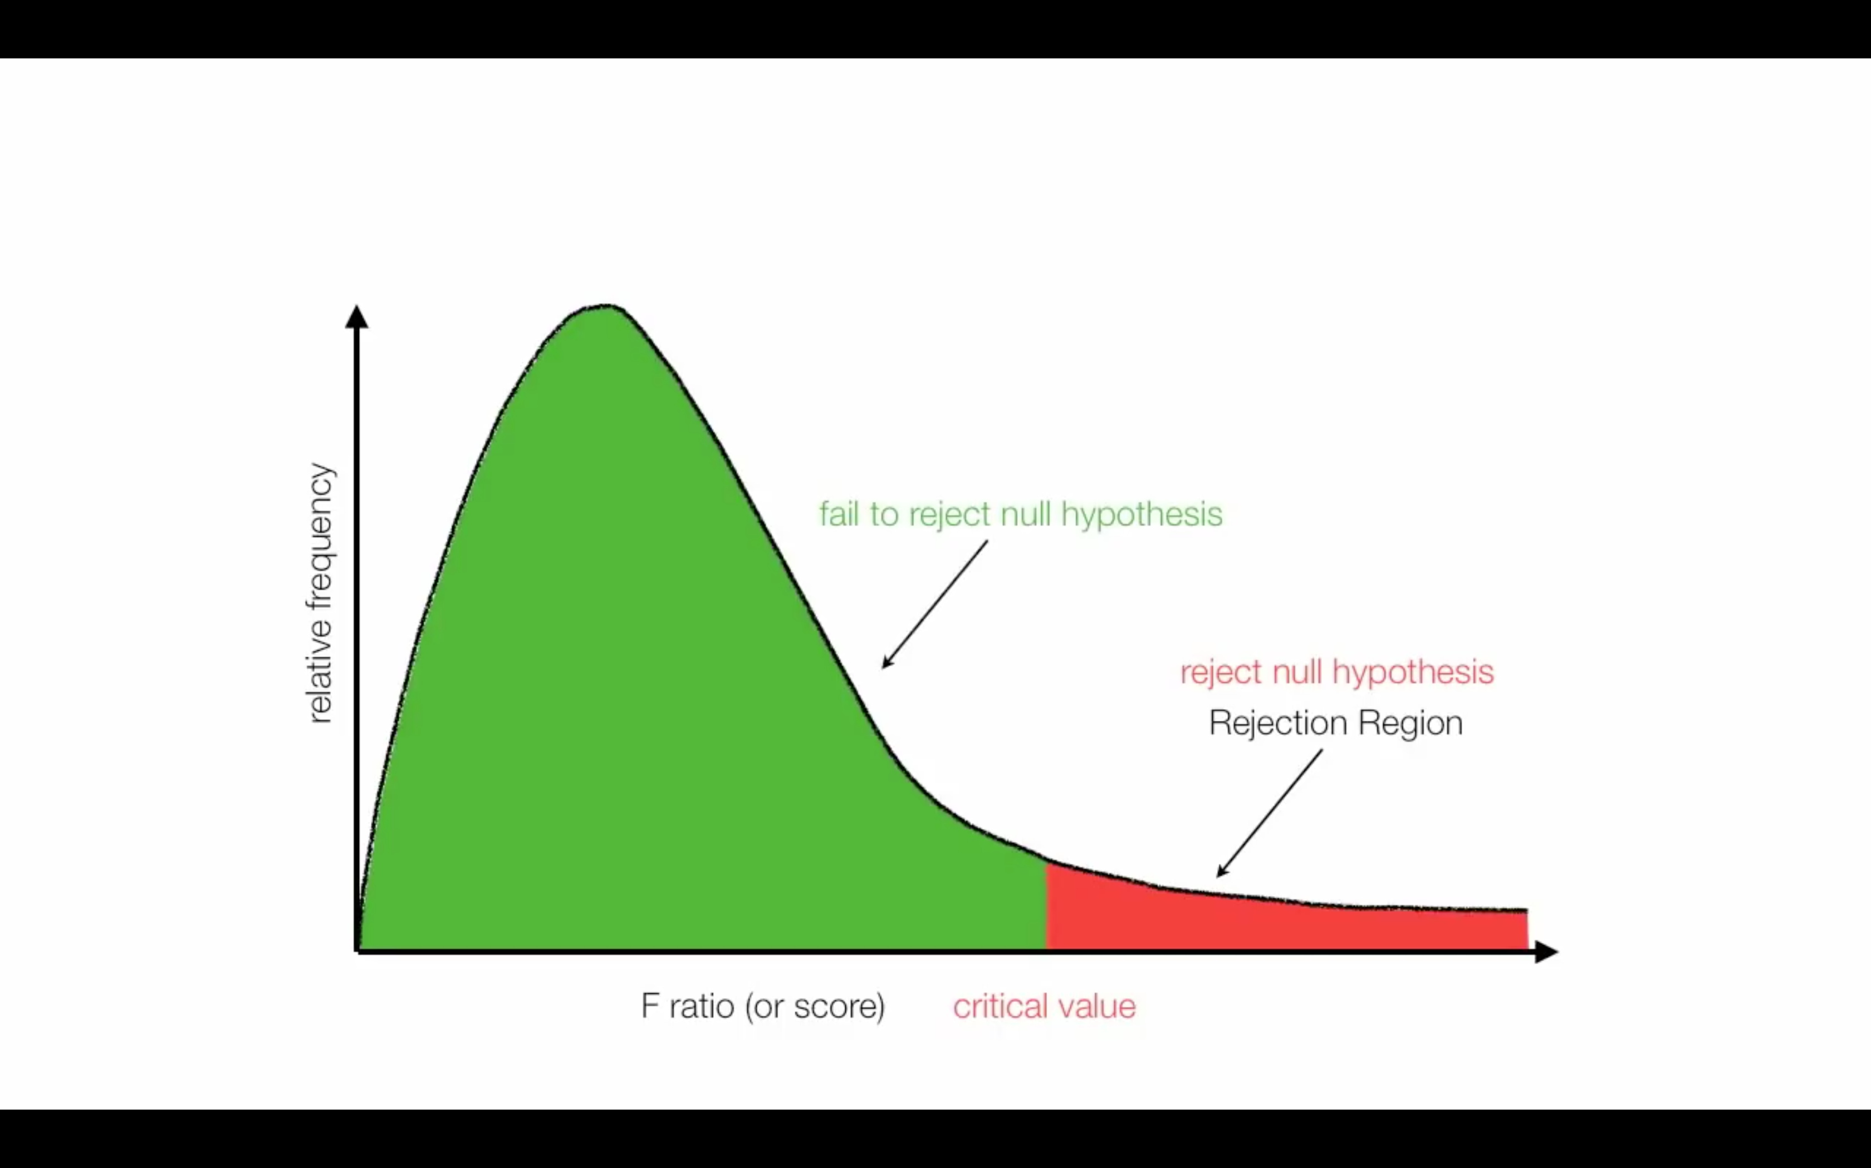
Critical Value

Slide 28
Example: 𝛼 = 0.05

Slide 29
Example: 𝛼 = 0.05

Slide 30
F-Table

Slide 31
Critical Value for 𝛼 = 0.05

Slide 32
Rejection of Null Hypothesis

Slide 33
Connections between SST, MST, and standard deviation
If ignore the groups for a moment and just compute the standard deviation of the entire data set, we see
So SST = (n -1) s², and MST = s². That is, SST and MST measure the TOTAL variation in the data set.
SST: Sum of Squares Total
DFT: Degrees of Freedom Total
MST: Mean Sum of Squares Total

Slide 34
Connections between SSE, MSE, and standard deviation
Remember:
So SS[Within Group i] = (s_{i}²) (df_{i} )
This means that we can compute SSE from the standard deviations and sizes (df) of each group:

Slide 35
Pooled estimate for st. dev
One of the ANOVA assumptions is that all groups have the same standard deviation. We can estimate this with a weighted average:
so MSE is the pooled estimate of variance

Slide 36
In Summary

Slide 37
R² Statistic
R² gives the percent of variance due to between
group variation

Slide 38
Where’s the Difference?
Once ANOVA indicates that the groups do not all appear to have the same means, what do we do?
Analysis of Variance for days
Source DF SS MS F P
treatmen 2 34.74 17.37 6.45 0.006
Error 22 59.26 2.69
Total 24 94.00
Individual 95% CIs For Mean
Based on Pooled StDev
Level N Mean StDev ----------+---------+---------+------
A 8 7.250 1.669 (-------*-------)
B 8 8.875 1.458 (-------*-------)
P 9 10.111 1.764 (------*-------)
----------+---------+---------+------
Pooled StDev = 1.641 7.5 9.0 10.5
Clearest difference: P is worse than A (CI’s don’t overlap)

Slide 39
Multiple Comparisons
Once ANOVA indicates that the groups do not all
have the same means, we can compare them two
by two using the 2-sample t test
We need to adjust our p-value threshold because we are doing multiple tests with the same data.
There are several methods for doing this.
If we really just want to test the difference between one pair of treatments, we should set the study up that way.

Slide 40
Tuckey’s Pairwise Comparisons
Tukey's pairwise comparisons
Family error rate = 0.0500
Individual error rate = 0.0199
Critical value = 3.55
Intervals for (column level mean) - (row level mean)
A B
B -3.685
0.435
P -4.863 -3.238
-0.859 0.766
95% confidence
Use alpha = 0.0199 for
each test.
These give 98.01%
CI’s for each pairwise
difference.
Only P vs A is significant
(both values have same sign)
98% CI for A-P is (-0.86,-4.86)

Slide 41
ANOVA and Clustering
Init values
Good result !
Init values
Bad result !

Slide 42
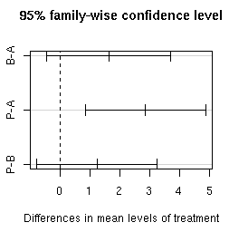
Tukey’s Method in R
Tukey multiple comparisons of means
95% family-wise confidence level
diff lwr upr
B-A 1.6250 -0.43650 3.6865
P-A 2.8611 0.85769 4.8645
P-B 1.2361 -0.76731 3.2395

