Slide 1
Non-Standard-Datenbanken
Dynamische Bayessche Netze
Prof. Dr. Ralf Möller
Universität zu Lübeck
Institut für Informationssysteme

Slide 2
Temporal Probabilistic Agent
Previous and current states (PDBs, Bayesian networks)
From visible probabilistic data to derived probabilistic data
Forecasting (temporal PDBs, dynamic Bayesian networks)
From visible and current estimated environment state to estimation about the next environment state
?
sensors
environment
agent
actuators
t₁, t₂, t₃, …

Slide 3
Time and Uncertainty
The world changes, we need to track and predict it
Examples: diabetes management, traffic monitoring
Basic idea: copy state and evidence variables of Bayesian network for each time step (snapshots)
X_{t}: set of unobservable state variables at time t
e.g., BloodSugar_{t}, StomachContents_{t}
E_{t}: set of evidence variables at time t
e.g., MeasuredBloodSugar_{t}, PulseRate_{t}, FoodEaten_{t}
Observation at time t is E_{t} = e_{t} for some set of values e_{t}
Assumes discrete time steps
Notation: X_{a:b} denotes the set of variables from X_{a} to X_{b}
Dynamic Bayesian Network (DBN)

Slide 4
DBN - Representation
Problem:
Process behavior might change (CPTs of evidence variables change)
Evidence and state variables might depend on all previous states (unbounded number of Parents in CPT)
Solution:
Assume that changes in the world state are caused by a stationary process (unchanging process over time).
is the same for all t
“Dynamic” means we are modeling a dynamic system, not that the structure of a Bayesian network changes over time.

Slide 5
DBN - Representation
Solution cont.:
Use Markov assumption - The current state depends on only in a finite history of previous states. Usually: First-order Markov process (only previous state matters)
Transition Model
In addition to restricting the parents of the state variable X_{t}, we must restrict the parents of the evidence variable E_{t}
Sensor Model

Slide 6
Example
R_{t-1} | P(R_{t}|R_{t-1})
T F | 0.7 0.3
Rain_{t-1}
Rain_{t}
Rain_{t+1}
Umbrella_{t-1}
Umbrella_{t}
Umbrella_{t+1}
R_{t} | P(U_{t}|R_{t})
T F | 0.9 0.2

Slide 7
Complete Joint Distribution
Given:
Transition model: P(X_{t}|X_{t-1})
Sensor model: P(E_{t}|X_{t})
Prior probability: P(X₀)
Then we can specify complete joint distribution:

Slide 8
Inference Tasks
Filtering: What is the probability that it is raining today, given all the umbrella observations up through today?
Prediction: What is the probability that it will rain the day after tomorrow, given all the umbrella observations up through today?
Smoothing: What is the probability that it rained yesterday, given all the umbrella observations through today?
Most likely explanation / most probable explanation: if the umbrella appeared the first three days but not on the fourth, what is the most likely weather sequence to produce these umbrella sightings?

Slide 9
DBN – Basic Inference
Filtering or Monitoring:
Compute the belief state - the posterior distribution over the current state, given all evidence to date.

Slide 10
DBN – Basic Inference
Filtering cont.
Given the results of filtering up to time t, one can easily compute the result for t+1 from the new evidence
(for some function f)
(dividing up the evidence)
(using Bayes’ Theorem)
(by the Markov property of evidence)
α is a normalizing constant used to make probabilities sum up to 1.

Slide 11
DBN – Basic Inference
Filtering cont.
The second term represents a one-step prediction of the next step, and the first term updates this with the new evidence.
Now we obtain the one-step prediction for the next step by conditioning on the current state X_{t}:
(using the Markov property)

Slide 12
Non-Standard-Datenbanken
Anmeldung zur Klausur wird nach der Vorlesung freigeschaltet
Dynamische Bayessche Netze
Prof. Dr. Ralf Möller
Universität zu Lübeck
Institut für Informationssysteme

Slide 13
Example
R_{t-1} | P(R_{t}|R_{t-1})
T F | 0.7 0.3
Rain_{t-1}
Rain_{t}
Rain_{t+1}
Umbrella_{t-1}
Umbrella_{t}
Umbrella_{t+1}
R_{t} | P(U_{t}|R_{t})
T F | 0.9 0.2

Slide 14
Filtering: Forward Messages

Slide 15
DBN – Basic Inference
Illustration for two steps in the Umbrella example:
On day 1, the umbrella appears so U1=true. The prediction from t=0 to t=1 is
and updating it with the evidence for t=1 gives
On day 2, the umbrella appears so U2=true. The prediction from t=1 to t=2 is
and updating it with the evidence for t=2 gives

Slide 16
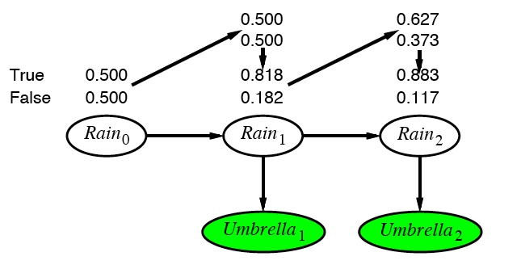
Example cntd.

Slide 17
DBN – Basic Inference
Prediction:
Compute the posterior distribution over the future state, given all evidence to date.
for some k>0
The task of prediction can be seen simply as filtering without the addition of new evidence (e.g., assume uniform distribution for evidence values).

Slide 18
DBN – Basic Inference
Smoothing or hindsight inference:
Compute the posterior distribution over the past state, given all evidence up to the present.
for some k such that 0 ≤ k < t.
Hindsight provides a better estimate of the state than was available at the time, because it incorporates more evidence from the “future”.

Slide 19
Smoothing

Slide 20
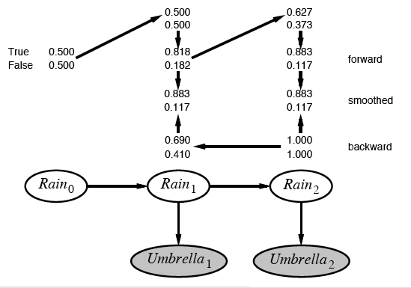
Example contd.

Slide 21
DBN – Basic Inference
Most likely explanation:
Compute the sequence of states that is most likely to have generated a given sequence of observation.
Algorithms for this task are useful in many applications, including, e.g., speech recognition.

Slide 22
Most-likely explanation

Slide 23
Most-likely explanation

Slide 24
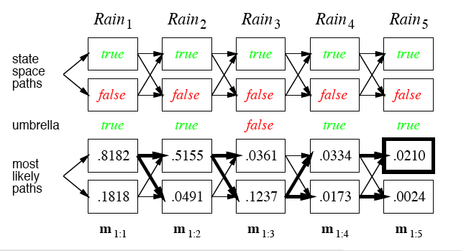
Rain/Umbrella Example

Slide 25
DBN – Special Cases
Hidden Markov Model (HMMs):
Temporal probabilistic model in which the state of the process is described by a single discrete random variable. (The simplest kind of DBN )
Kalman Filter Models (KFMs):
Estimate the state of a physical system from noisy observations over time. Also known as linear dynamical systems (LDSs).

Slide 26
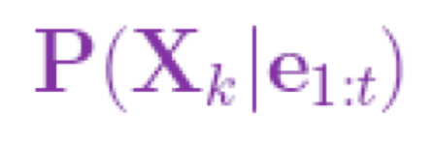
DBN – Basic Inference
Filtering
Smoothing
Most likely sequence

Slide 27
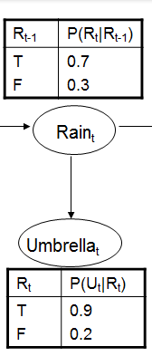
Hidden Markov Models
new state
old state
(
0.1 | 0
0 | 0.8
)
U₃ = false O₃ =

Slide 28
Country Dance Algorithm

Slide 29
Country Dance Algorithm

Slide 30
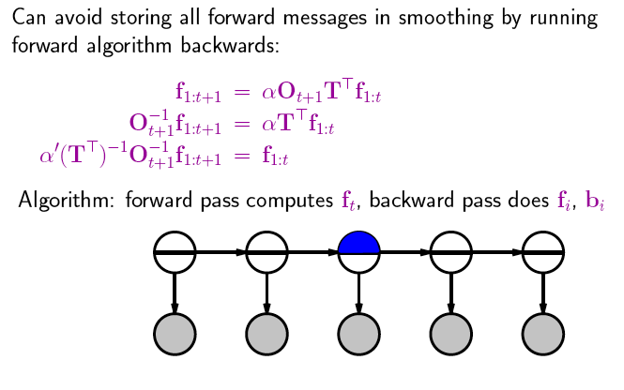
Country Dance Algorithm

Slide 31
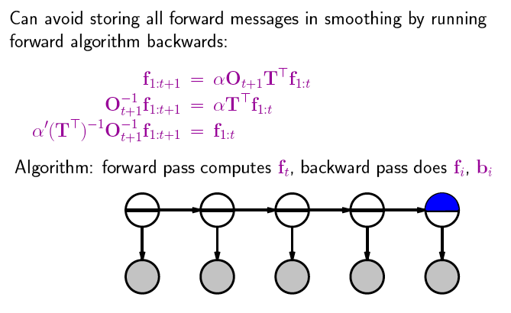
Country Dance Algorithm

Slide 32
Country Dance Algorithm

Slide 33
Country Dance Algorithm

Slide 34
Example
(
)
U₂ = true O₂ =
0.9 | 0
0 | 0.2
(
)
(
)
O₂⁻¹ =
0.2 | 0
0 | 0.9
1.1 | 0
0 | 4.95
(
)
5.5
=
T^{T} =
0.7 | 0.3
0.3 | 0.7
(
)
(
)
(T^{T})⁻¹ =
0.7 | -0.3
-0.3 | 0.7
=
1.75 | -0,75
-0,75 | 1.75
2.5
(
)
(
)
(
)
(
)
1,925 | -3.7125
-0,825 | 8.6625
0.883
0.117
1.265
0,285
0.817
0,183
=
α = 0,64497
→

Slide 35
(
)
0.817
0,183

Slide 36
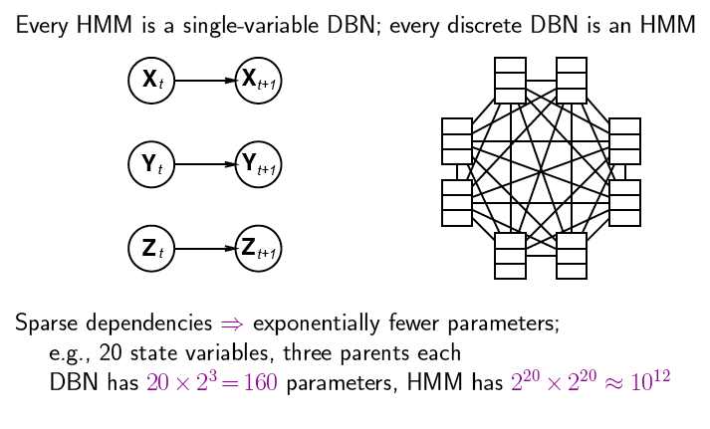
DBNs vs. HMMs
Consider the transition model
Notes:
2 hoch 20 zustände

Slide 37
DBN – Special Cases
Hidden Markov Model (HMMs):
Temporal probabilistic model in which the state of the process is described by a single discrete random variable. (The simplest kind of DBN )
Kalman Filter Models (KFMs):
Estimate the state of a physical system from noisy observations over time. Also known as linear dynamical systems (LDSs).

Slide 38
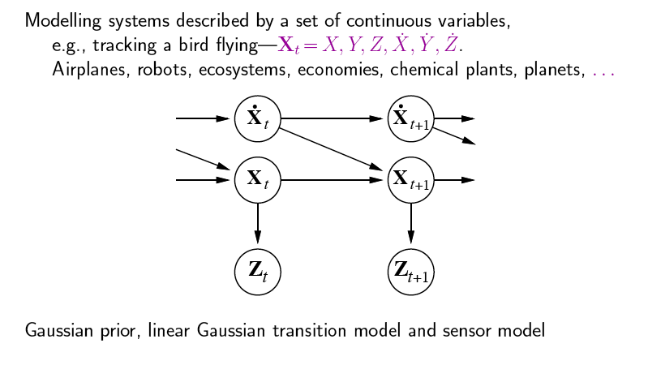
Kalman Filters

Slide 39
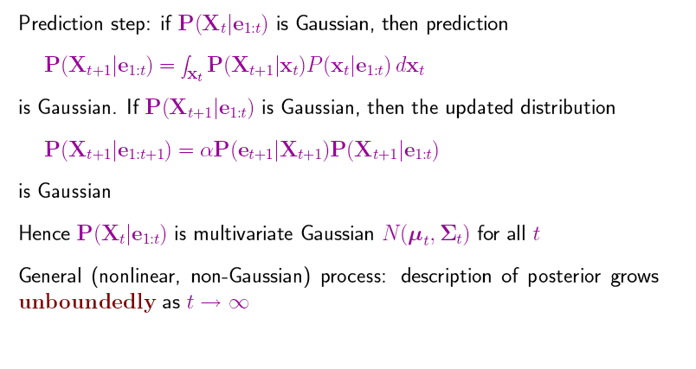
Updating Gaussian Distributions

Slide 40
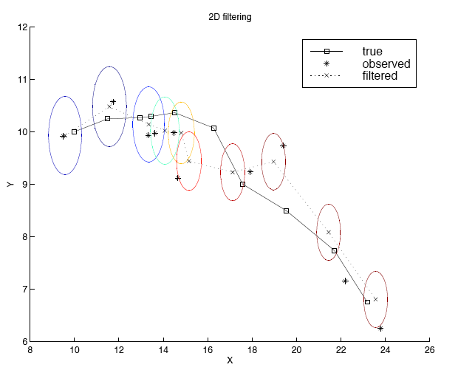
2-D Tracking: Filtering
Notes:
Radar tracking of planes or missles any phsiyal systems ocean currents from sattelite surface measurments

Slide 41
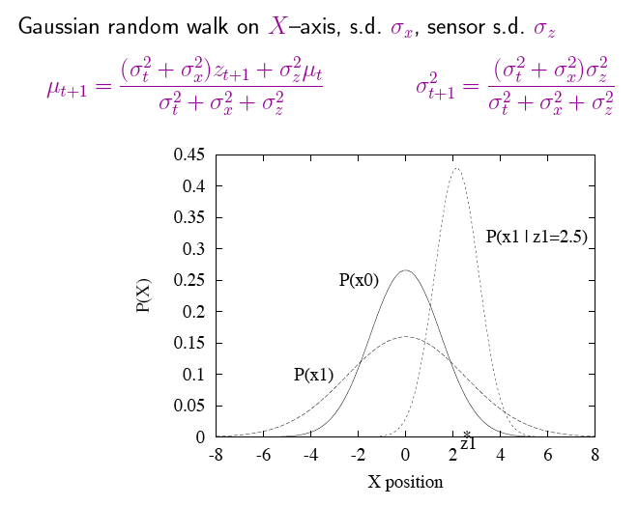
Simple 1-D Example
z1: first observation
s.d.= standard deviation

Slide 42
General Kalman Update
Details left for your studies

Slide 43
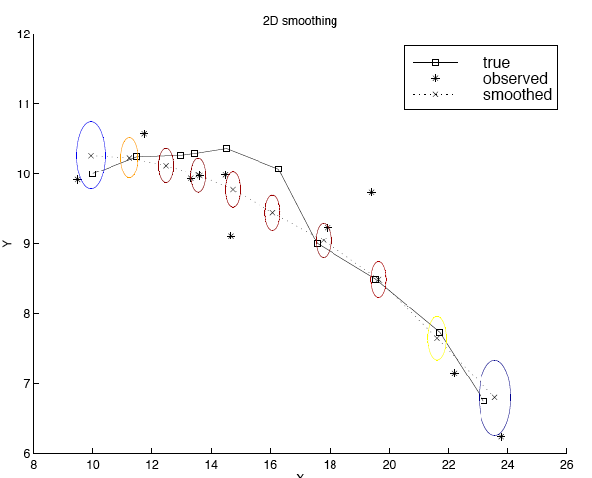
2-D Tracking: Smoothing

Slide 44
Where it breaks
Standard solution: switching Kalman filter
Keeping track of many objects: Identity uncertainty

Slide 45
Non-Standard-Datenbanken
Dynamische Bayessche Netze
Prof. Dr. Ralf Möller
Universität zu Lübeck
Institut für Informationssysteme

Slide 46
Learning Dynamic Bayesian Networks
Learning requires the full smoothing inference, rather than filtering, because it provides better estimates of the state of the process.
Learning the parameters of a BN is done using Expectation – Maximization (EM) Algorithms.
Iterative optimization method to estimate some unknown parameters.

Slide 47
State View: Hidden Markov models
Set of states:
Process moves from one state to another generating a sequence of states :
Markov chain property: probability of each subsequent state depends only on what was the previous state:
States are not visible, but each state generates one of M different observations

Slide 48
Example of Hidden Markov Model
0.3
0.7
Low
High
0.2
0.8
0.6
0.6
0.4
0.4
Rain
Dry

Slide 49
State View: Hidden Markov models
To define a hidden Markov model, the following probabilities have to be specified:
Matrix of transition probabilities A=(a_{ij}), a_{ij}= P(s_{j} | s_{i}) ,
Matrix of observation probabilities B=(b_{i} (v_{m} )), b_{i}(v_{m} ) = P(v_{m} | s_{i}) and a
Vector of initial probabilities π=(π_{i}), π_{i} = P(s_{i}) .
Model is represented by (A, B, π).

Slide 50
State View: Learning problem (1)
Given some training observation sequences O=o₁ o₂ ... o_{t} and general structure of HMM (numbers of hidden and visible states), determine HMM parameters (A, B, π) that best fit training data, i.e., that is maximizes P(O | A, B, π) .

Slide 51
State View: Learning problem (2)
If training data has information about sequence of hidden states, then use maximum likelihood estimation of parameters:
a_{ij}= P(s_{j} | s_{i}) =
Number of transitions from state s_{i} to state s_{j}
Number of transitions out of state s_{i}
Number of times observation v_{m} occurs in state s_{i}
Number of times in state s_{i}
b_{i}(v_{m} ) = P(v_{m} | s_{i})=
Otherwise: Use iterative expectation-maximization algorithm to find local maximum of P(O | A, B, π): Baum-Welch Algorithm
Alternative: Viterbi Path Counting Algorithm
Leonard E. Baum, Ted Petrie, George Soules, and Norman Weiss, A Maximization Technique Occurring in the Statistical Analysis of Probabilistic Functions of Markov Chains, Ann. Math. Statist. Volume 41, Number 1, 164-171, 1970
Leonard E. Baum and Ted Petrie, Statistical Inference for Probabilistic Functions of Finite State Markov Chains, Ann. Math. Statist. Volume 37, Number 6, 1554-1563, 1966.

Slide 52
Baum-Welch algorithm
General idea:
Expected number of transitions from state s_{i} to state s_{j}
Expected number of transitions out of state s_{i}
a_{ij}= P(s_{j} | s_{i}) =
Expected number of times observation v_{m} occurs in state s_{i}
Expected number of times in state s_{i}
b_{i}(v_{m} ) = P(v_{m} | s_{i})=
π_{i} = P(s_{i}) = Expected frequency in state s_{i} at time k=1.

Slide 53
Baum-Welch algorithm: Expectation step(1)
Define variable ξ_{k}(i,j) as the probability of being in state s_{i} at time k and in state s_{j} at time k+1, given the observation sequence o₁ o₂ ... o_{T} with k < t
ξ_{k}(i,j) = P(X_{k}= s_{i} , X_{k+1}= s_{j} | o₁ o₂ ... o_{t})
P(X_{k}= s_{i} , X_{k+1}= s_{j} , o₁ o₂ ... o_{t})
P(o₁ o₂ ... o_{t})
ξ_{k}(i,j) =
=
P(X_{k}= s_{i} , o₁ o₂ ... o_{k}) a_{ij} b_{j} (o_{k+1} ) P(o_{k+2} ... o_{t} | X_{k+1}= s_{j} )
P(o₁ o₂ ... o_{t})
=
α forward_{k}(i) a_{ij} b_{j} (o_{k+1} ) backward_{k+1}(j)

Slide 54
Baum-Welch algorithm: Expectation step(2)
Define variable γ_{k}(i) as the probability of being in state X_{k}=s_{i} at time k, given the observation sequence o₁ o₂ ... o_{t} .
γ_{k}(i)= P(X_{k}= s_{i} | o₁ o₂ ... o_{t})
P(X_{k}= s_{i} , o₁ o₂ ... o_{t})
P(o₁ o₂ ... o_{t})
γ_{k}(i)=
=
α forward_{k}(i) backward_{k}(i)

Slide 55
Baum-Welch algorithm: Expectation step(3)
We calculated ξ_{k}(i,j) = P(X_{k}= s_{i} , X_{k+1}= s_{j} | o₁ o₂ ... o_{t})
and γ_{k}(i)= P(X_{k}= s_{i} | o₁ o₂ ... o_{t})
Expected number of transitions from state s_{i} to state s_{j} =
= Σ_{k} ξ_{k}(i,j)
Expected number of transitions out of state s_{i} = Σ_{k} γ_{k}(i)
Expected number of times observation v_{m} occurs in state s_{i} =
= Σ_{k} γ_{k}(i) , k is such that o_{k}= v_{m}
Expected frequency in state s_{i} at time k=1 : γ₁(i) .

Slide 56
Baum-Welch algorithm: Maximization step
Expected number of transitions from state s_{j} to state s_{i}
Expected number of transitions out of state s_{j}
Σ_{k} ξ_{k}(i,j)
Σ_{k} γ_{k}(i)
a_{ij} =
=
Σ_{k} ξ_{k}(i,j)
Σk,o_{k}= v_{m} γ_{k}(i)
b_{i}(v_{m} ) =
Expected number of times observation v_{m} occurs in state s_{i}
Expected number of times in state s_{i}
=
π_{i} = (Expected frequency in state s_{i} at time k=1) = γ₁(i).

Slide 57
Learning (1)
The techniques for learning DBN are mostly straightforward extensions of the techniques for learning BNs
Parameter learning
The transition model P(X_{t} | X_{t-1}) / The observation model P(Y_{t} | X_{t})
Offline learning
Parameters must be tied across time-slices
The initial state of the dynamic system can be learned independently of the transition matrix
Online learning
Add the parameters to the state space and then do online inference (filtering)
The usual criterion is maximum-likelihood(ML)
The goal of parameter learning is to compute
θ*_{ML} = argmax_{θ}P( Y| θ) = argmax_{θ}log P( Y| θ)
θ*_{MAP} = argmax_{θ}log P( Y| θ) + logP(θ)
Two standard approaches: gradient ascent and EM(Expectation Maximization)

Slide 58
Learning (2)
Structure learning
Intra-slice connectivity: Structural EM
Inter-slice connectivity: For each node in slice t, we must choose its parents from slice t-1
Given structure is unrolled to a certain extent, the inter-slice connectivity is identical for all pairs of slices:
Constraints on Structural EM

Slide 59
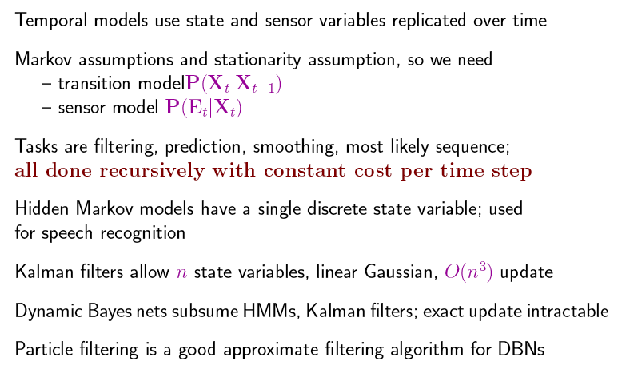
Summary

Slide 60
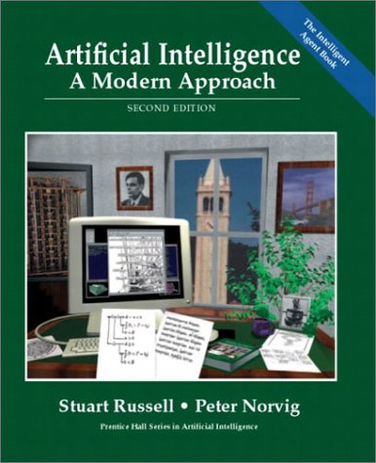
Literature
http://aima.cs.berkeley.edu

