Slide 1
Einführung in Web- und Data-Science
Prof. Dr. Ralf Möller
Universität zu Lübeck
Institut für Informationssysteme
Tanya Braun (Übungen)

Slide 2
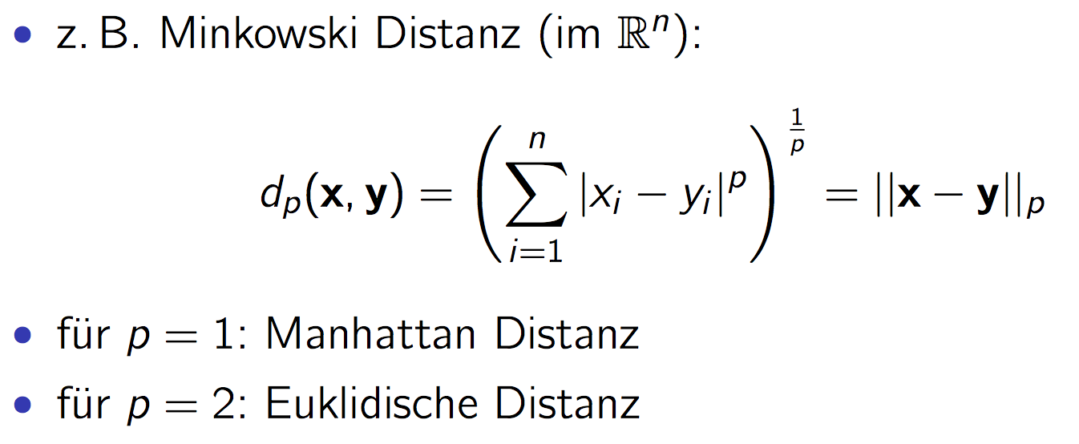
Clustering
Form des unüberwachten Lernens
Suche nach natürlichen Gruppierungen von Objekten
Klassen direkt aus Daten bestimmen
Hohe Intra-Klassen-Ähnlichkeit
Kleine Inter-Klassen-Ähnlichkeit
Ggs.: Klassifikation
Distanzmaße

Slide 3
Partitionierung: K-means Clustering (1)
Distanzmaß: Euklidische Distanz
5
4
c₁
3
c₂
2
1
c₃
0
0
1
2
3
4
5
$$C_{i}^{t}=\left\{x_{j}: {\left\|x_{j}−c_{i}^{t}\right\|}_{2} ≤{\left\|x_{j}−c_{r}^{t}\right\|}_{2} \text{for} \text{all} r=1…k, r ≠i\right\}$$
Notes:
K=3 Cluster; zufällig initialisierte Zentren
Clusterzugehörigkeit: nächstes Clusterzentrum; E-step (erwartete Clusterzugehörigkeit)

Slide 4
K-means Clustering (2)
Distanzmaß: Euklidische Distanz
5
4
c₁
3
c₂
2
1
c₃
0
0
1
2
3
4
5
$$c_{i}^{t+1}=\frac{1}{\left|C_{i}^{t}\right|}\sum_{x_{j}∈C_{i}^{t}}{x_{j}}$$
Notes:
Cluster besteht aus allen Datenpunkten, die dem eigenen Zentrum am nächsten sind
Zentrum neu berechnen: Mittelwert (komponentenweise); M-step: Optimiere Zentrum (Maximierung als Minimierung der Intracluster Varianz)

Slide 5
K-means Clustering (3)
Distanzmaß: Euklidische Distanz
5
4
c₁
3
2
c₃
c₂
1
0
0
1
2
3
4
5
Notes:
Clusterzugehörigkeit prüfen/neu bestimmen (Änderung bei rotem Punkt in der Mitte)

Slide 6
K-means Clustering (4)
Distanzmaß: Euklidische Distanz
5
4
c₁
3
2
c₃
c₂
1
0
0
1
2
3
4
5
Notes:
Zentren neu berechnen

Slide 7
K-means Clustering (5)
Distanzmaß: Euklidische Distanz
5
4
c₁
3
2
c₂
c₃
1
0
0
1
2
3
4
5
Notes:
Clusterzugehörigkeit bestimmen; keine Änderung = keine Änderung in den Zentren -> abbrechen

Slide 8
ANOVA: Analysis of Variation
Acknowledgements
This part is based on the following presentation:
Math 243 Lecture
R. Pruim
(but contains changes and modifications)

Slide 9
Example
Subjects: 25 patients with blisters
Treatments: Treatment A, Treatment B, Placebo
Measurement: # of days until blisters heal
Data [and means]:
A: 5, 6, 6, 7, 7, 8, 9, 10 [7.25]
B: 7, 7, 8, 9, 9, 10, 10, 11 [8.875]
P: 7, 9, 9, 10, 10, 10, 11, 12, 13 [10.11]
Are these differences significant?
Variation BETWEEN groups vs. variation WITHIN groups
Analysis of variation required: ANOVA

Slide 10
ANOVA and Clustering
Init values
Good result ?
Init values
Bad result ?
Difference between clusters less than difference within clusters

Slide 11
The basic ANOVA situation
Two variables: 1 Categorical (type, group), 1 Quantitative (value)
Main Question: Do the (means of) the quantitative variables depend on the group (given by categorical variable) the individual is in?
If categorical variable has only 2 values:
2-sample t-test
ANOVA allows for 3 or more groups

Slide 12
What does ANOVA do?
At its simplest (there are extensions) ANOVA tests the following hypotheses:
H₀: The means of all the groups are equal.
H_{a}: Not all the means are equal
doesn’t say how or which ones differ.
Can follow up with “multiple comparisons”
Note: we usually refer to the sub-populations as “groups” when doing ANOVA.

Slide 13
Assumptions of ANOVA
Each group is approximately normal
Check this by looking at histograms or use assumptions
Can handle some non-normality, but not severe outliers
Standard deviations of each group are approximately equal
Rule of thumb: ratio of largest to smallest sample st. dev. must be less than 2:1

Slide 14
Standard Deviation Check
Variable treatment N Mean Median StDev
days A 8 7.250 7.000 1.669
B 8 8.875 9.000 1.458
P 9 10.111 10.000 1.764
Compare largest and smallest standard deviations:
largest: 1.764
smallest: 1.458
1.458 x 2 = 2.916 > 1.764

Slide 15
Notation for ANOVA
n = number of individuals all together
I = number of groups
= mean for entire data set
Group i has
n_{i} = # of individuals in group i
x_{ij} = value for individual j in group i
= mean for group i
s_{i} = standard deviation for group i

Slide 16
How ANOVA works (outline)
ANOVA measures two sources of variation in the data and compares their relative sizes
Variation BETWEEN groups (MSG)
for each group look at the difference between its mean and the overall mean
Variation WITHIN groups (MSE)
for each data value x_{j} of group i we look at the difference between that value and the mean of its group
N⁻¹𝛴_{obsi}
N: Normalization value (corrected: degrees of freedom)
M⁻¹𝛴_{obsij}
M: Normalization value (corrected: degrees of freedom)

Slide 17
F Statistic
The ANOVA F-statistic is a ratio of the Between Group Variaton divided by the Within Group Variation:
A large F is evidence against H₀, since it indicates that there is more difference between groups than within groups (hence the means between at least two groups differ).
H₀: The means of all the groups are equal.
H₀ in terms of clusters: Clusters are bad (centroids are equal)

Slide 18
An even smaller example
Suppose we have three groups (#groups = l)
Group 1: 5.3, 6.0, 6.7
Group 2: 5.5, 6.2, 6.4, 5.7
Group 3: 7.5, 7.2, 7.9
We get the following statistics:
Group 1
Group 2
Group 3

Slide 19
ANOVA Output
1 less than number of groups: l-1
number of data values - number of groups: n-l
(equals df for each group added together)
1 less than number of individuals
(just like other situations)

Slide 20
Computing ANOVA F statistic
overall mean: 6.44 F = 2.5528/0.25025 = 10.21575

Slide 21
So How big is F?
Since F is
Mean Square Between / Mean Square Within
= MSG / MSE
A large value of F indicates relatively more
difference between groups than within groups (evidence against H₀)
To get the P-value, we compare to F(I-1,n-I)-distribution
I-1 degrees of freedom in numerator (# groups -1)
n - I degrees of freedom in denominator (rest of df)

Slide 22
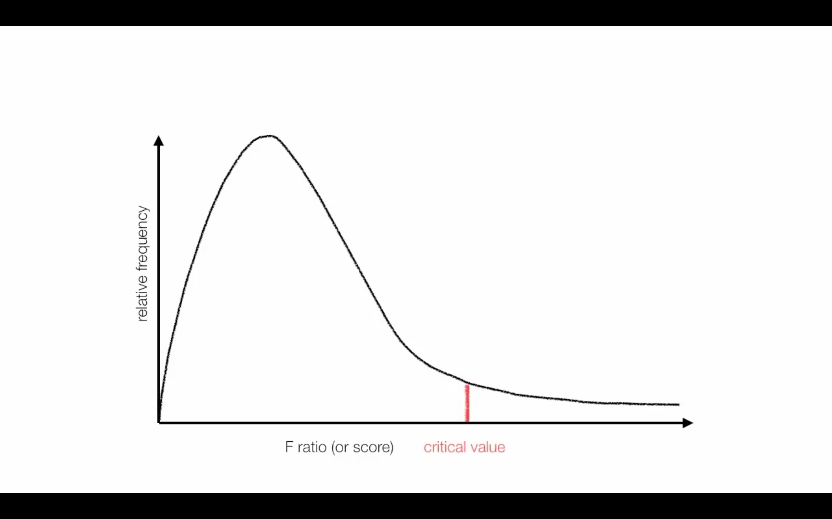
F-Distribution

Slide 23
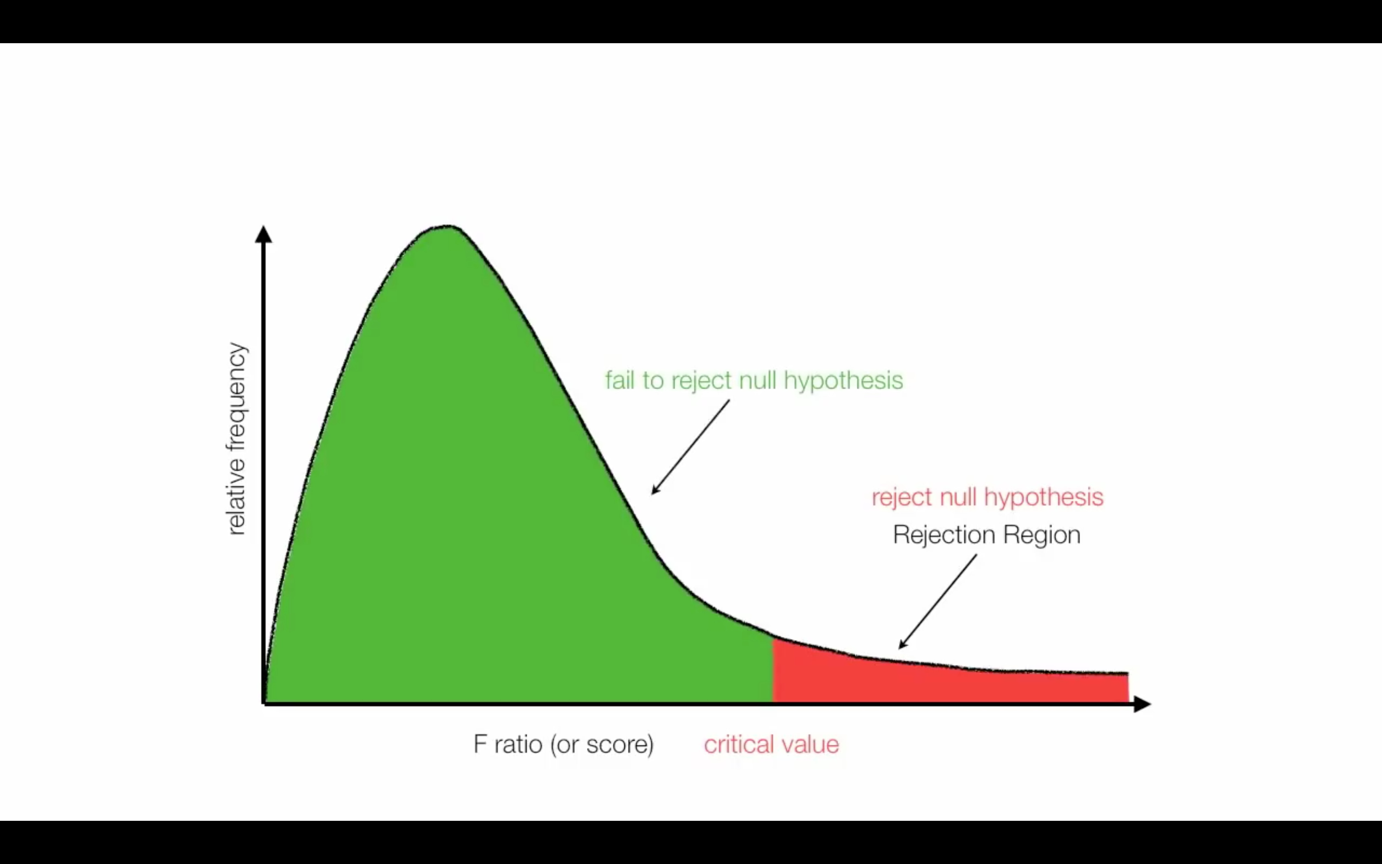
Critical Value

Slide 24
F-Table
𝛼 = 0.05 (use another table for different 𝛼)
Computed F-Value = 10.21
Critical Value F(2, 9) = 4.26

Slide 25
Rejection of Null Hypothesis
Use F-distribution to compute the p-value for F=10.21
4.26
10.21

Slide 26
Why not just do 3 pairwise t-tests?
Answer:
At an error rate of 5% for each test (max p-value), overall chance of type-I error is up to 1-(.95)³= 14%
If all 3 comparisons independent
For 6 groups: ₆C₂ = 15 pairwise t-tests;
High chance of finding something significant just by chance (if all tests were independent with a type-I error rate of 5% each)
Probability of at least one type-I error = 1-(.95)¹⁵=54%.

Slide 27
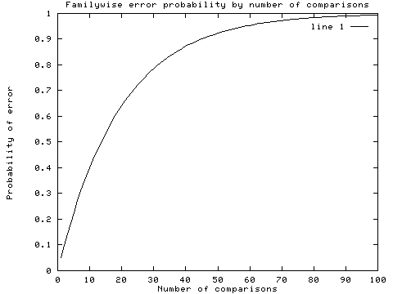
Recall: Multiple comparisons

Slide 28
Correction for multiple comparisons
How to correct for multiple comparisons post-hoc…
Bonferroni correction (adjust 𝛼 by most conservative amount; assuming all tests independent, divide 𝛼 by the number of tests)
...

Slide 29
Bonferroni
For example, to make a Bonferroni correction, divide your desired alpha cut-off level (usually .05) by the number of comparisons you are making. Assumes complete independence between comparisons, which is way too conservative.
Obtained P-value
Original Alpha
# tests
New Alpha
Significant?
.001
.05
5
.010
Yes
.011
.05
4
.013
Yes
.019
.05
3
.017
No
.032
.05
2
.025
No
.048
.05
1
.050
Yes

Slide 30
Multivariate Analysis of Variance: MANOVA
An extension of ANOVA in which main effects and interactions are assessed on a combination of DVs
IV = independent variable, manipulated variable (e.g., Treatment)
DV = dependent variable, measured variable (e.g., Mean)
MANOVA tests whether mean differences among groups on a combination of DVs is likely to occur by chance
New DVs are created that are linear combinations of the individual DVs such that the difference between groups is maximized
The questions are mostly the same as ANOVA just on the linearly combined DVs instead just one DV

Slide 31
Are there any interactions among the IVs?
Does change in the linearly combined DV for one IV depend on the levels of another IV?
For example: Given three types of treatment, does one treatment work better for men and another work better for women?

Slide 32
Basic Requirements
2 or more DVs (Interval, Ratio)
1 or more categorical IVs (Nominal, Ordinal)

Slide 33
MANOVA advantages over ANOVA
By measuring multiple DVs you increase your chances for finding a group difference
With a single DV you “put all of your eggs in one basket”
Multiple measures usually do not “cost” a great deal more and you are more likely to find a difference on at least one

Slide 34
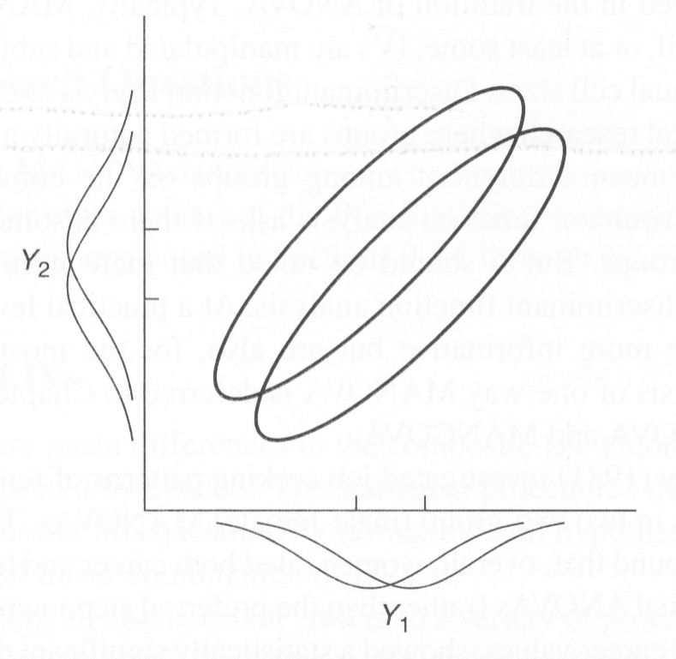
MANOVA advantages over ANOVA
Using multiple ANOVAs inflates type 1 error rates and MANOVA helps control for the inflation
Under certain (rare) conditions MANOVA may find differences that do not show up under ANOVA
The more complex an analysis becomes the less power there is

Slide 35
MANOVA
A new DV is created that is a linear combination of the individual DVs that maximizes the difference between groups.
In factorial designs a different linear combination of the DVs is created for each main effect and interaction that maximizes the group difference separately.
Also when the IVs have more than one level the DVs can be recombined to maximize paired comparisons

Slide 36
Discriminant Function Analysis
Used to predict group membership from a set of continuous predictors
Think of it as MANOVA in reverse – in MANOVA we asked if groups are significantly different on a set of linearly combined DVs. If this is true, than those same “DVs” can be used to predict group membership.
How can continuous variables be linearly combined to best classify a subject into a group?

Slide 37
Basics
MANOVA and disriminant function analysis are mathematically identical but are different in terms of emphasis
discrim is usually concerned with actually putting people into groups (classification) and testing how well (or how poorly) subjects are classified
Essentially, discrim is interested in exactly how the groups are differentiated not just that they are significantly different (as in MANOVA)

Slide 38
Questions
the primary goal is to find a dimension(s) that groups differ on and create classification functions
Can group membership be accurately predicted by a set of predictors?
Essentially the same question as MANOVA

