Slide 1
Non-Standard Datenbanken und Data Mining
From Clustering to Embedding
Prof. Dr. Ralf Möller
Universität zu Lübeck
Institut für Informationssysteme

Slide 2
Übersicht
Semistrukturierte Datenbanken (JSON, XML) und Volltextsuche
Information Retrieval
Mehrdimensionale Indexstrukturen
Cluster-Bildung
Einbettungstechniken
Array-Datenbanken
First-n-, Top-k-, und Skyline-Anfragen
Probabilistische Datenbanken, Anfragebeantwortung, Top-k-Anfragen und Open-World-Annahme
Probabilistische Modellierung, Bayes-Netze, Anfragebeantwortungsalgorithmen, Lernverfahren, Verallgemeinerung: Belief Functions, Dempster-Shafer Theorie der Evidenz, Ensembles
Temporale Datenbanken und das relationale Modell, Zeitreihen in Array-Datenbanken, TimeScaleDB
Data Mining auf Zeitreihen (SAX, Matrix Product), Probabilistische Temporale Datenbanken
Dynamische Bayessche Netze, Inferenzalgorithmen und Lernverfahren
Stromdatenbanken, Prinzipien der Fenster-orientierten inkrementellen Verarbeitung
Approximationstechniken für Stromdatenverarbeitung, Stream-Mining
Probabilistische raum-zeitliche Datenbanken und Stromdatenverarbeitungsssysteme: Anfragen und Indexstrukturen, Raum-zeitliches Data Mining
Von NoSQL- zu NewSQL-Datenbanken, CAP-Theorem, Blockchain-Datenbanken
Analyse von Graphdaten

Slide 3
Acknowledgments
Slides have been taken from
  “Improving Distributional Similarity
  with Lessons Learned from Word Embeddings”
    Omer Levy, Yoav Goldberg, Ido Dagan
  Stanford CS224d: Deep Learning for NLP
    Richard Socher
  Rensselaer: Natural Language Processing
    Heng Li

Slide 4
Word-Word Associations in Document Retrieval
Recap bag-of-words approaches
  LSI: Documents as vectors, dimension reduction
Words are not independent of each other
Word similarity measures
Extend query with similar words automatically
Extend query with most frequent followers/predecessors
Insert words in anticipated gaps in a string query
Need to represent some aspects of word semantics

Slide 5
Approaches for Representing Word Semantics
Beyond bags of words
Distributional Semantics (Count)
Used since the 90’s
Sparse word-context PMI/PPMI matrix
Decomposed with SVD
Word Embeddings (Predict)
Inspired by deep learning
word2vec
(Mikolov et al., 2013)
GloVe
(Pennington et al., 2014)
Underlying Theory: The Distributional Hypothesis (Harris, ’54; Firth, ‘57)
“Similar words occur in similar contexts”
https://www.tensorflow.org/tutorials/word2vec
https://nlp.stanford.edu/projects/glove/
Notes:
There are two approaches for creating these vectors:
First, we’ve got the traditional count-based approach,
where the most common variant is the word-context PMI matrix.
The other, cutting-edge, approach, is word embeddings,
Which has become extremely popular with word2vec.
Now, the interesting thing…
…is that both approaches rely on the same linguistic theory: the distributional hypothesis.
<pause>
Now, in previous work, that I’ll talk about in a minute,
we showed that the two approaches are even more related.

Slide 6
References
Harris 54
Firth 57
Micholov et al. 13
Pennington et al. 14
Harris, Zellig. Distributional structure. Word 10(23). 146–162. 1954.
Tomas Mikolov, Ilya Sutskever, Kai Chen, Greg Corrado, and Jeffrey Dean. Distributed representations of words and phrases and their compositionality. In Proceedings of the 26th International Conference on Neural Information Processing Systems - Volume 2 (NIPS‘13). 2013.
Firth, John R. A synopsis of linguistic theory 1930–1955. In Studies in linguistic analysis, 1–32. Oxford: Blackwell. 1957.
Jeffrey Pennington, Richard Socher, and Christopher D. Manning. GloVe: Global Vectors for Word Representation. 2014.

Slide 7
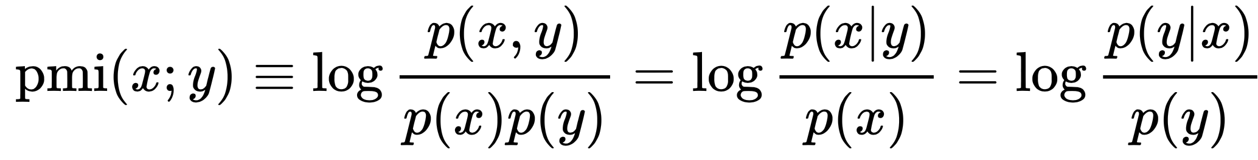
Point(wise) Mutual Information: PMI
Measure of association used in information theory and statistics
Positive PMI: PPMI(x, y) = max( pmi(x, y), 0 )
Quantifies the discrepancy between the probability of their coincidence given their joint distribution and their individual distributions, assuming independence
Finding collocations and associations between words
Countings of occurrences and co-occurrences of words in a text corpus can be used to approximate the probabilities p(x) or p(y) and p(x,y) respectively
[Wikipedia]

Slide 8
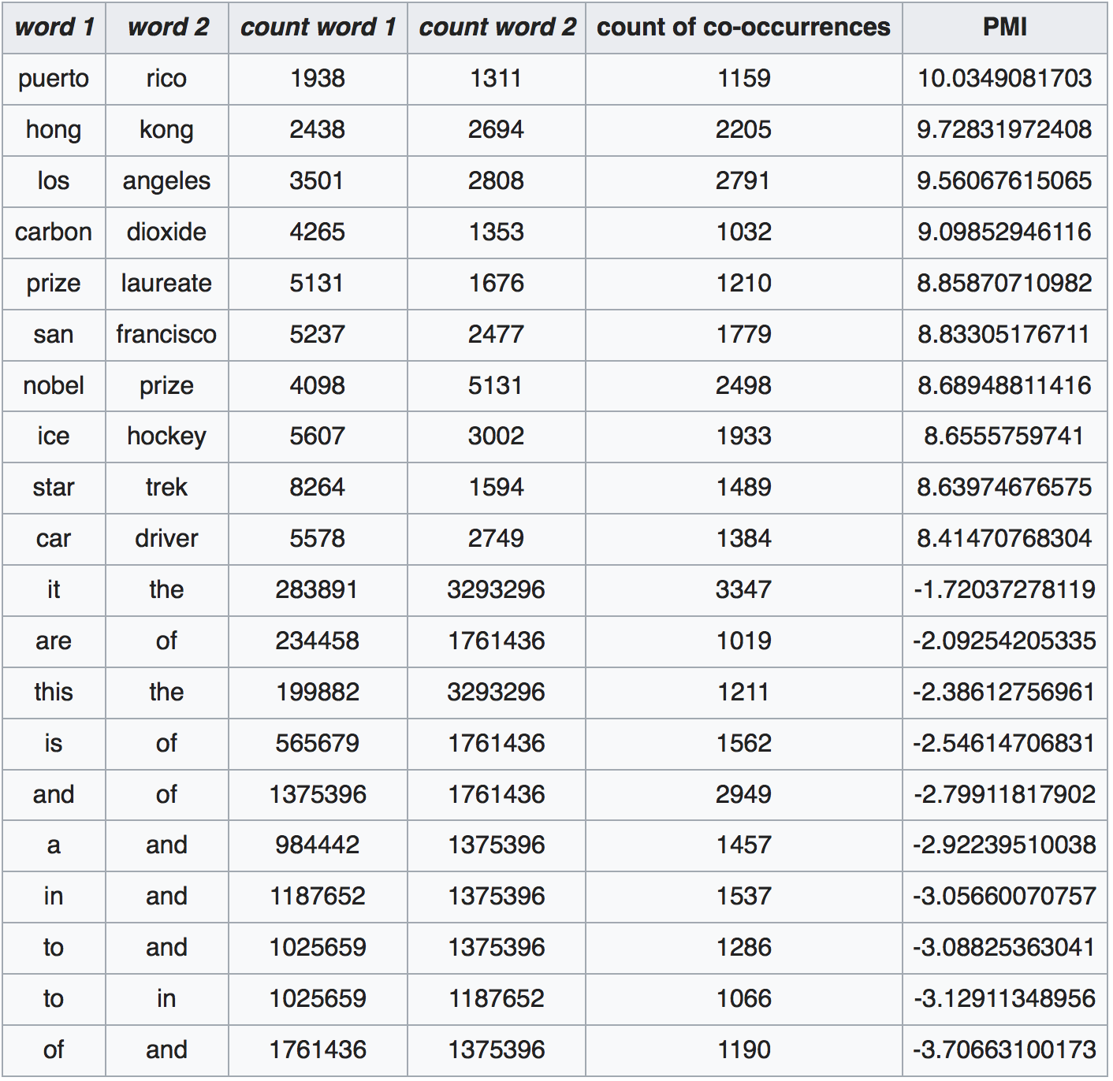
PMI – Example
Counts of pairs of words getting the most and the least PMI scores in the first 50 millions of words in Wikipedia (dump of October 2015)
Filtering by 1,000 or more co-occurrences.
The frequency of each count can be obtained by dividing its value by 50,000,952. (Note: natural log is used to calculate the PMI values in this example, instead of log base 2)
[Wikipedia]

Slide 9
Applications of PMI Data
Extend query with most frequent followers/predecessors
Insert words in anticipated gaps in a string query
Church, K.W., Hanks, P.: Word association norms mutual information, and lexi- cography. Comput. Linguist. 1(1), 22–29, 1990

Slide 10
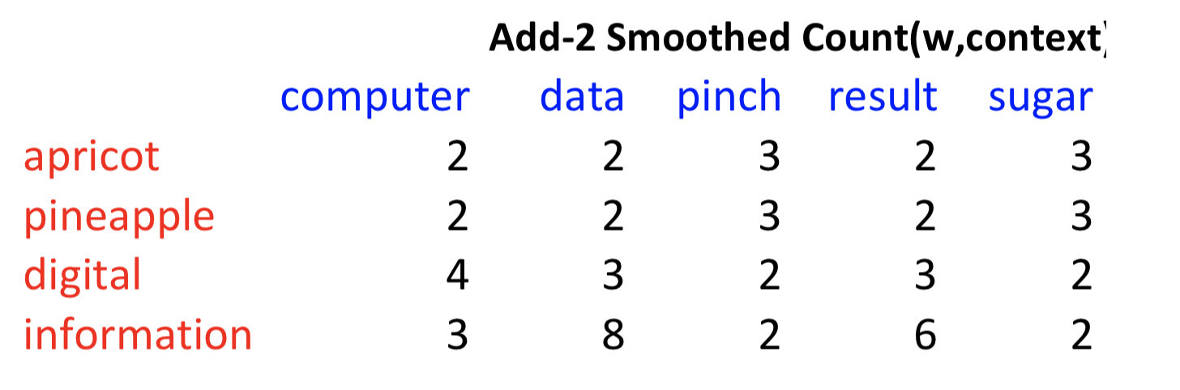
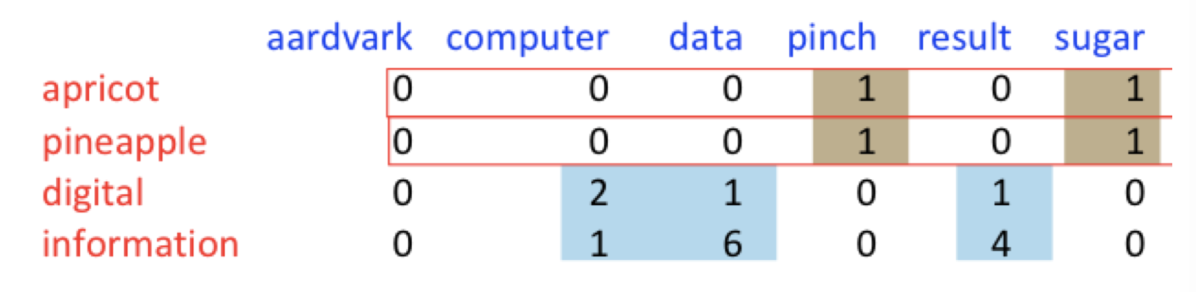
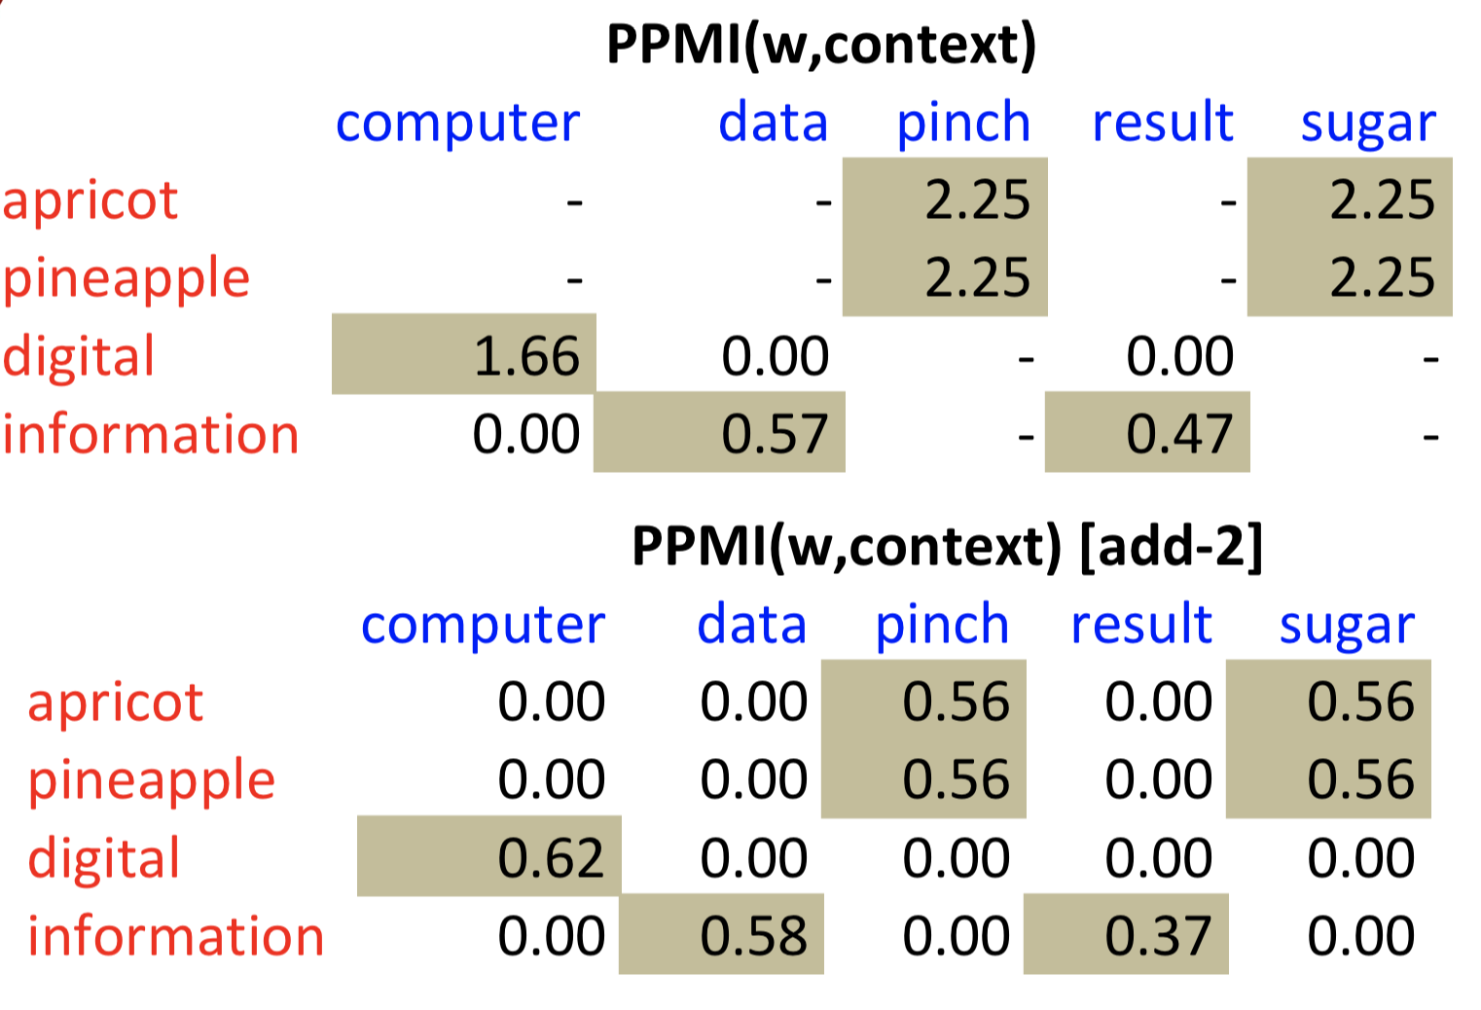
PMI – Co-occurrence Matrix
Count(w, context)

Slide 11
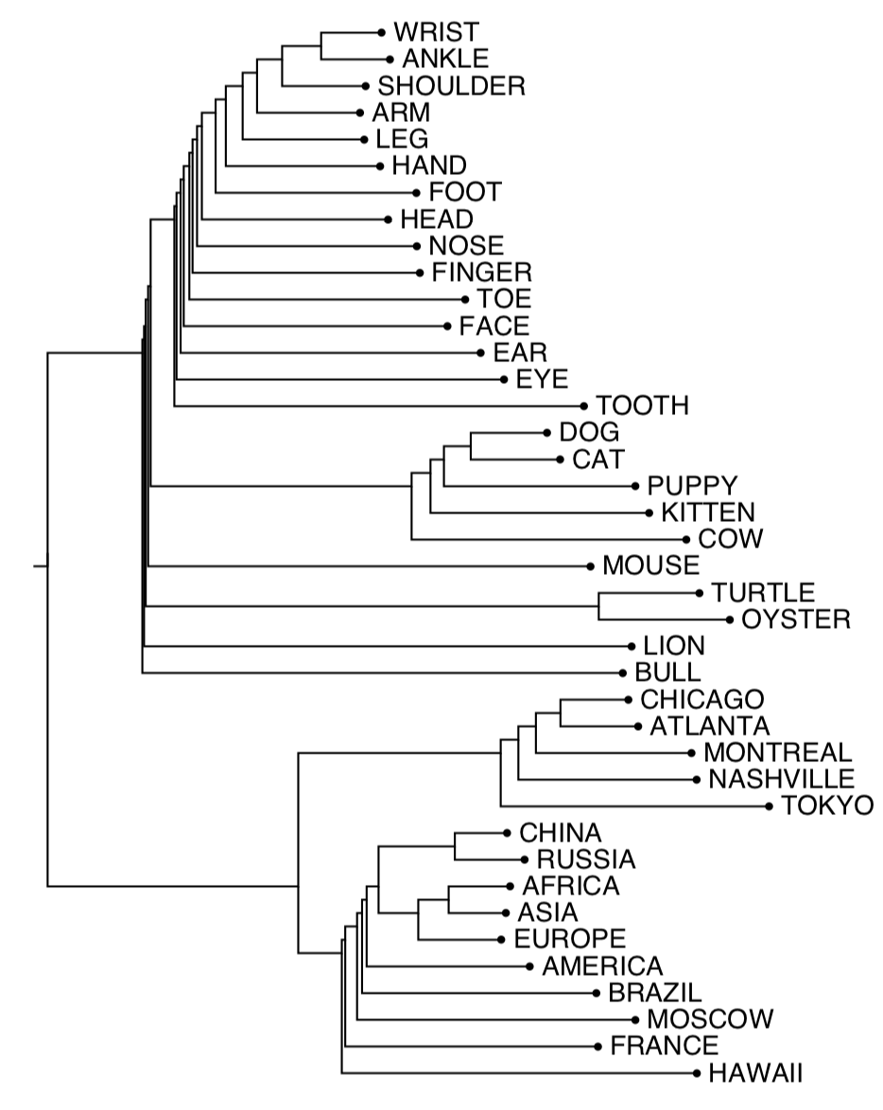
1. Clustering Approach to Word Semantics
Clustering vectors to visualize similarity in co-occurrence matrices
(Rohde et al. 2005)
Use whatever
clustering algorithm
you prefer to determine
”related” words
Application:
Extend query with related words automatically

Slide 12
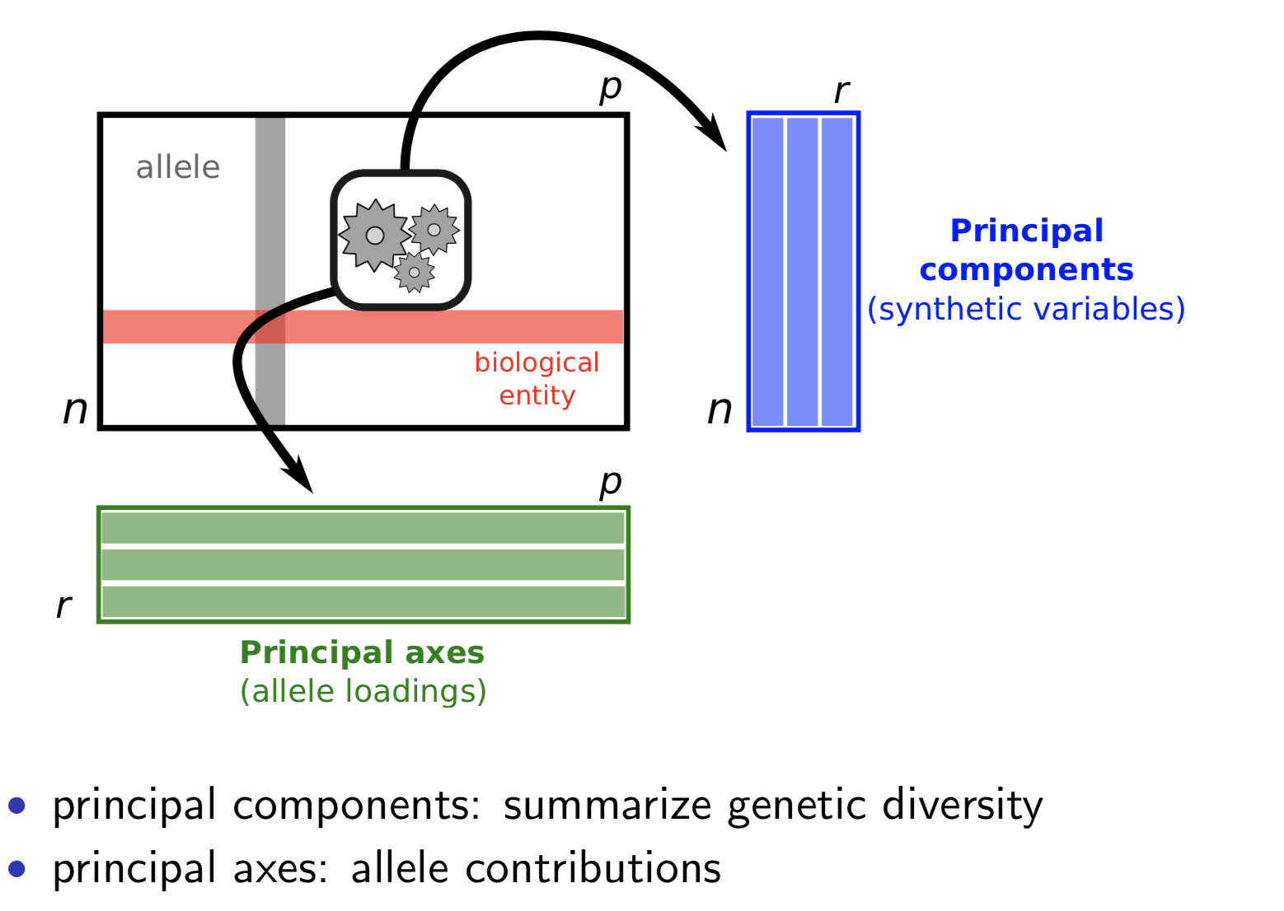
Apply SVD-based Dimension Reduction
Word context vectors
Number of clusters

Slide 13
2. Embedding Approaches to Word Semantics
Represent each word with a low-dimensional vector
Word similarity = vector similarity
Key idea: Predict surrounding words of every word

Slide 14
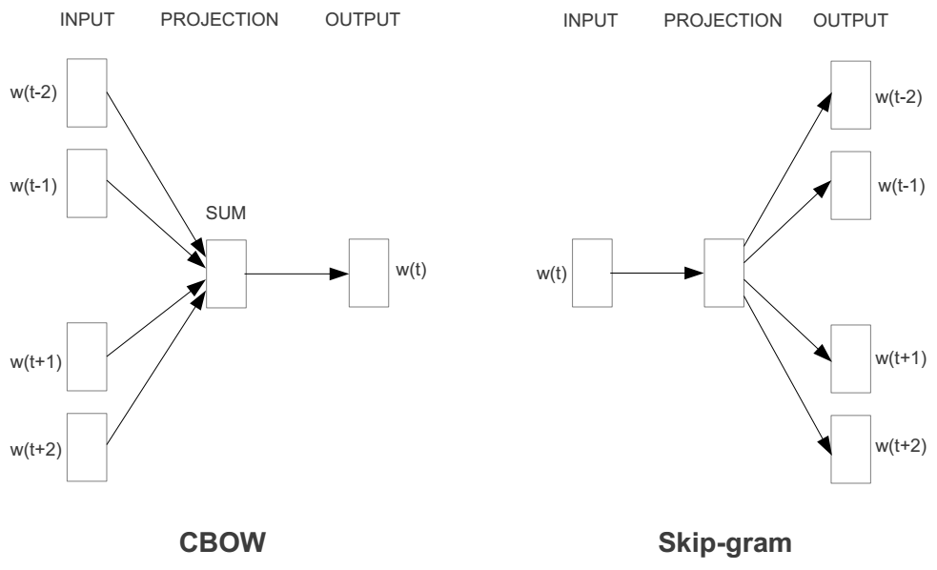
Represent the meaning of words – word2vec
2 basic structural models:
  Continuous Bag of Words (CBOW): use a window of words to predict the middle word
  Skip-gram (SG): use a word to predict the surrounding ones in window.

Slide 15
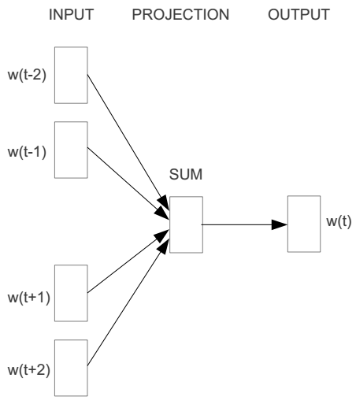
Word2vec – Continuous Bag of Word
E.g. “The cat <sat> on floor”
  Window size = 2
the
cat
sat
on
floor

Slide 16
Input layer
Index of cat in vocabulary
0
1
0
cat
0
Hidden layer
Output layer
0
0
0
0
0
0
…
0
0
0
one-hot
vector
0
sat
one-hot
vector
0
0
0
0
1
0
…
1
0
on
0
0
0
0
…
0

Slide 17



We must learn W and W’
Input layer
0
1
0
cat
0
$$W_{V×N}$$
Hidden layer
Output layer
0
0
0
0
0
0
V-dim
…
0
0
$${W′}_{N×V}$$
0
0
sat
0
0
0
0
1
0
$$W_{V×N}$$
N-dim
…
V-dim
1
0
on
0
0
0
0
V-dim
…
N will be the size of word vector
0

Slide 18
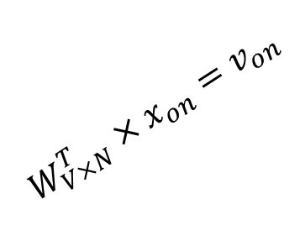

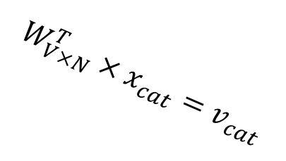


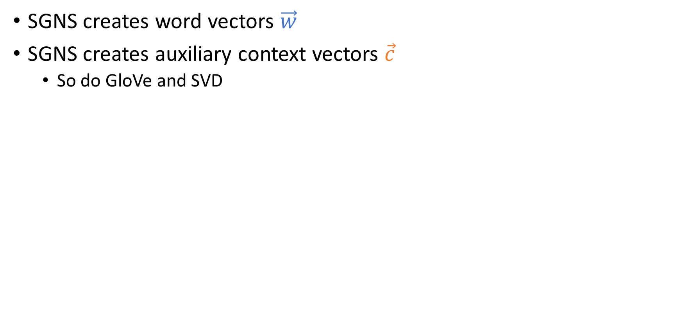
$$W_{V×N}^{T} ×x_{cat}=v_{cat}$$
0.1 | 2.4 | 1.6 | 1.8 | 0.5 | 0.9 | … | … | … | 3.2
0.5 | 2.6 | 1.4 | 2.9 | 1.5 | 3.6 | … | … | … | 6.1
… | … | … | … | … | … | … | … | … | …
… | … | … | … | … | … | … | … | … | …
0.6 | 1.8 | 2.7 | 1.9 | 2.4 | 2.0 | … | … | … | 1.2
0
2.4
2.6
…
…
1.8
Input layer
1
$$×$$
0
$$=$$
0
0
1
0
0
0
x_{cat}
0
0
Output layer
0
0
0
$$W_{V×N}^{T}×x_{cat}=v_{cat}$$
…
0
0
0
0
0
V-dim
…
0
0
$$\hat{v}=\frac{v_{cat}+v_{on}}{2}$$
0
+
0
sat
0
0
0
0
$$W_{V×N}^{T}×x_{on}=v_{on}$$
1
0
…
V-dim
1
Hidden layer
0
x_{on}
0
0
N-dim
0
0
V-dim
…
0

Slide 19

$$W_{V×N}^{T} ×x_{on}=v_{on}$$
0.1 | 2.4 | 1.6 | 1.8 | 0.5 | 0.9 | … | … | … | 3.2
0.5 | 2.6 | 1.4 | 2.9 | 1.5 | 3.6 | … | … | … | 6.1
… | … | … | … | … | … | … | … | … | …
… | … | … | … | … | … | … | … | … | …
0.6 | 1.8 | 2.7 | 1.9 | 2.4 | 2.0 | … | … | … | 1.2
0
1.8
2.9
…
…
1.9
Input layer
0
$$×$$
0
$$=$$
0
1
1
0
0
0
x_{cat}
0
0
Output layer
0
0
0
$$W_{V×N}^{T}×x_{cat}=v_{cat}$$
…
0
0
0
0
0
V-dim
…
0
0
$$\hat{v}=\frac{v_{cat}+v_{on}}{2}$$
0
+
0
sat
0
0
0
0
$$W_{V×N}^{T}×x_{on}=v_{on}$$
1
0
…
V-dim
1
Hidden layer
0
x_{on}
0
0
N-dim
0
0
V-dim
…
0

Slide 20






Input layer
0
1
0
cat
0
$$W_{V×N}$$
Hidden layer
Output layer
0
0
0
0
0
0
V-dim
…
0
0
$$W_{N×V}^{′}×\hat{v}=z$$
0
$$\hat{y}=softmax(z)$$
0
0
0
0
0
$$\hat{v}$$
1
0
$$W_{V×N}$$
…
1
N-dim
0
on
0
${\hat{y}}_{sat}$
0
0
V-dim
0
V-dim
…
N will be the size of word vector
0

Slide 21
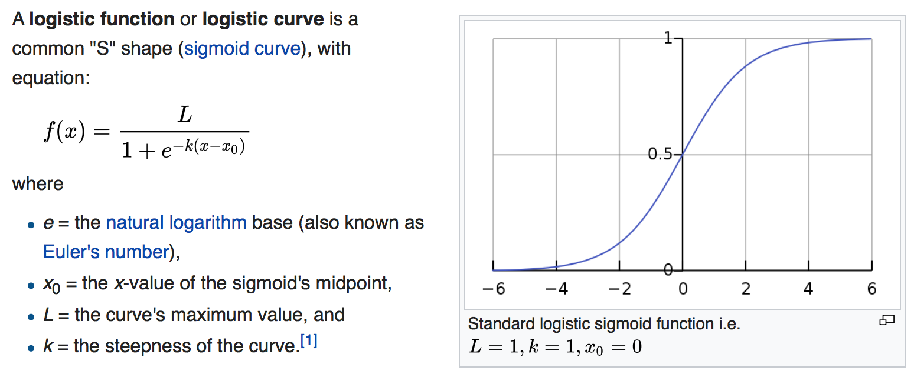
Logistic function
[Wikipedia]

Slide 22
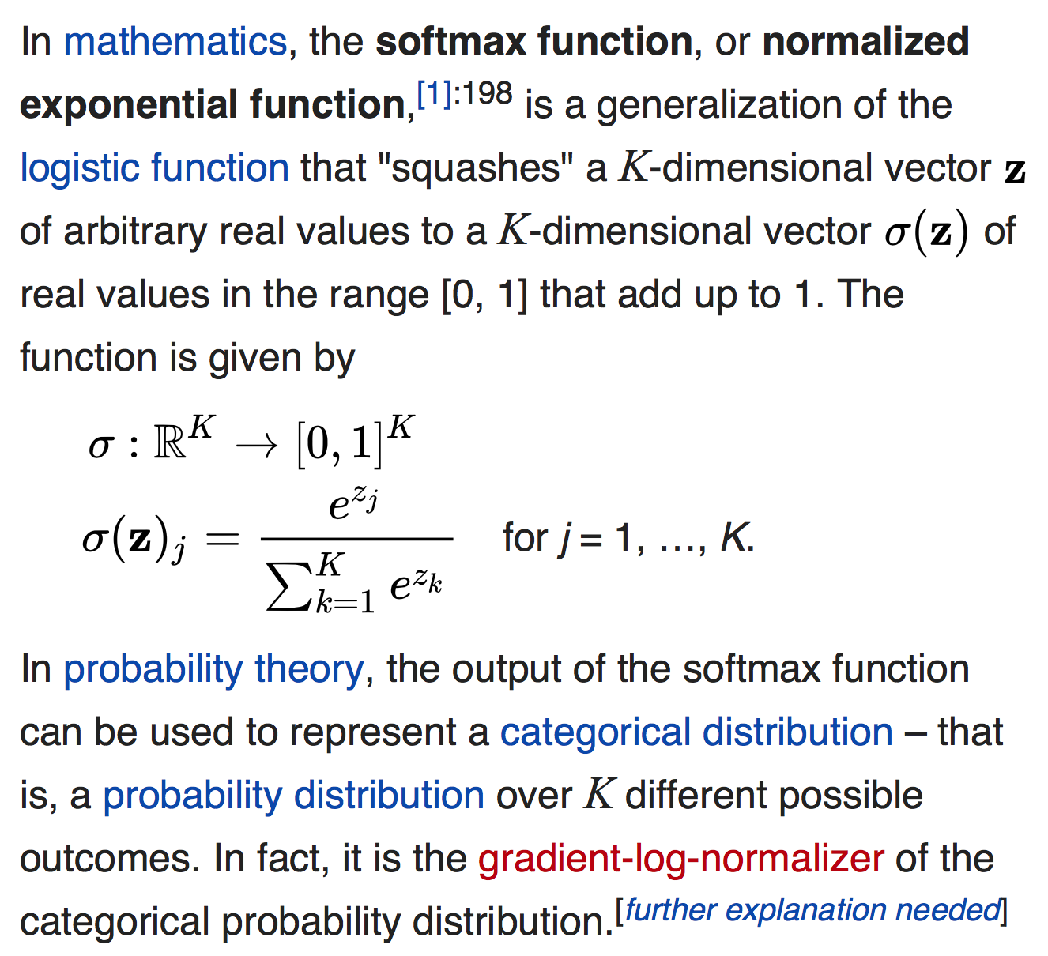
softmax(z)
The
[Wikipedia]

Slide 23


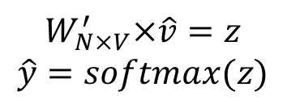
Input layer
0
We would prefer $\hat{y}$ close to ${\hat{y}}_{sat}$
1
0
cat
0
$$W_{V×N}$$
Hidden layer
Output layer
0
0
0
0
0.01
0.02
0.00
0.02
0.01
0.02
0.01
0.7
…
0.00
0
0
V-dim
…
0
0
$$W_{N×V}^{′}×\hat{v}=z$$
$$\hat{y}=softmax(z)$$
0
0
0
0
0
0
$$\hat{v}$$
1
0
$$W_{V×N}$$
…
1
N-dim
0
on
0
${\hat{y}}_{sat}$
0
0
V-dim
0
V-dim
…
N will be the size of word vector
$\hat{y}$
0

Slide 24




$$W_{V×N}^{T}$$
0.1 | 2.4 | 1.6 | 1.8 | 0.5 | 0.9 | … | … | … | 3.2
0.5 | 2.6 | 1.4 | 2.9 | 1.5 | 3.6 | … | … | … | 6.1
… | … | … | … | … | … | … | … | … | …
… | … | … | … | … | … | … | … | … | …
0.6 | 1.8 | 2.7 | 1.9 | 2.4 | 2.0 | … | … | … | 1.2
Contains word vectors
Input layer
0
1
0
x_{cat}
0
Output layer
0
0
$$W_{V×N}^{}$$
0
0
0
0
V-dim
…
0
0
$$W_{N×V}^{′}$$
0
0
sat
0
0
0
0
1
0
$$W_{V×N}^{}$$
…
1
0
V-dim
x_{on}
0
Hidden layer
0
N-dim
0
0
V-dim
…
0
We can consider either W or W’ as the word’s representation.
Notes:
W contains input word vectors.
W’ contains output word vectors.
We can consider either W or W’ as the word’s representation. Or even take the average.

Slide 25
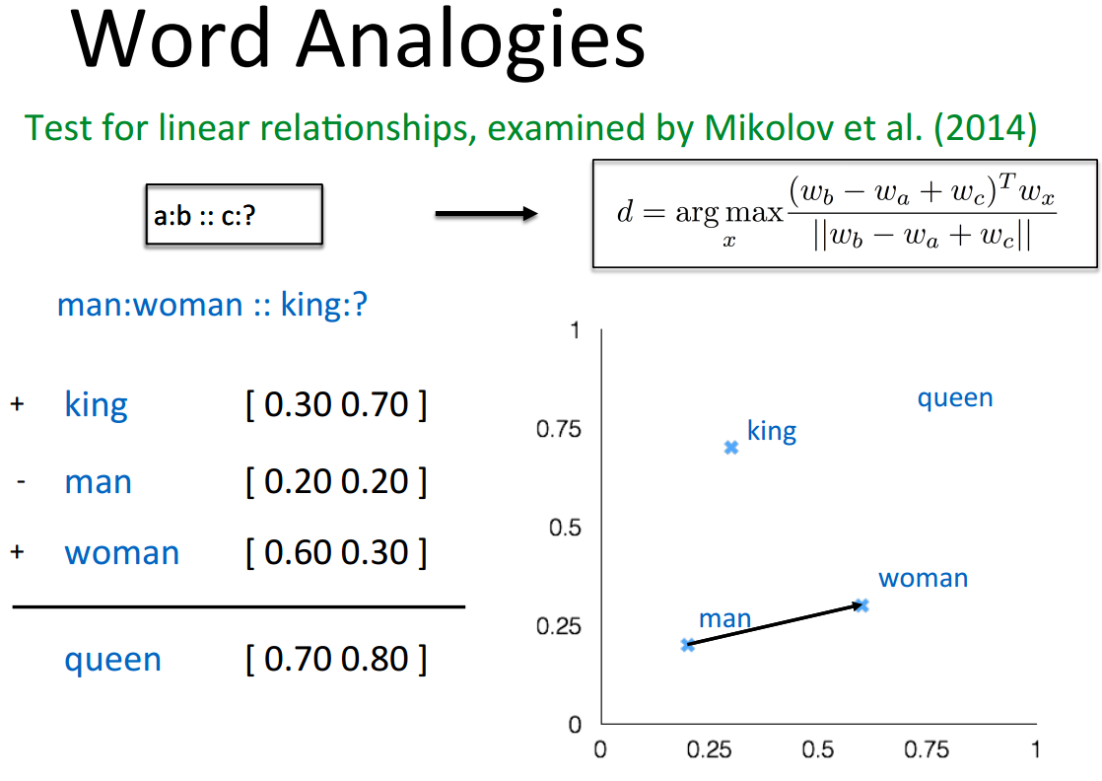
Word Analogies
||w_{x}||

Slide 26
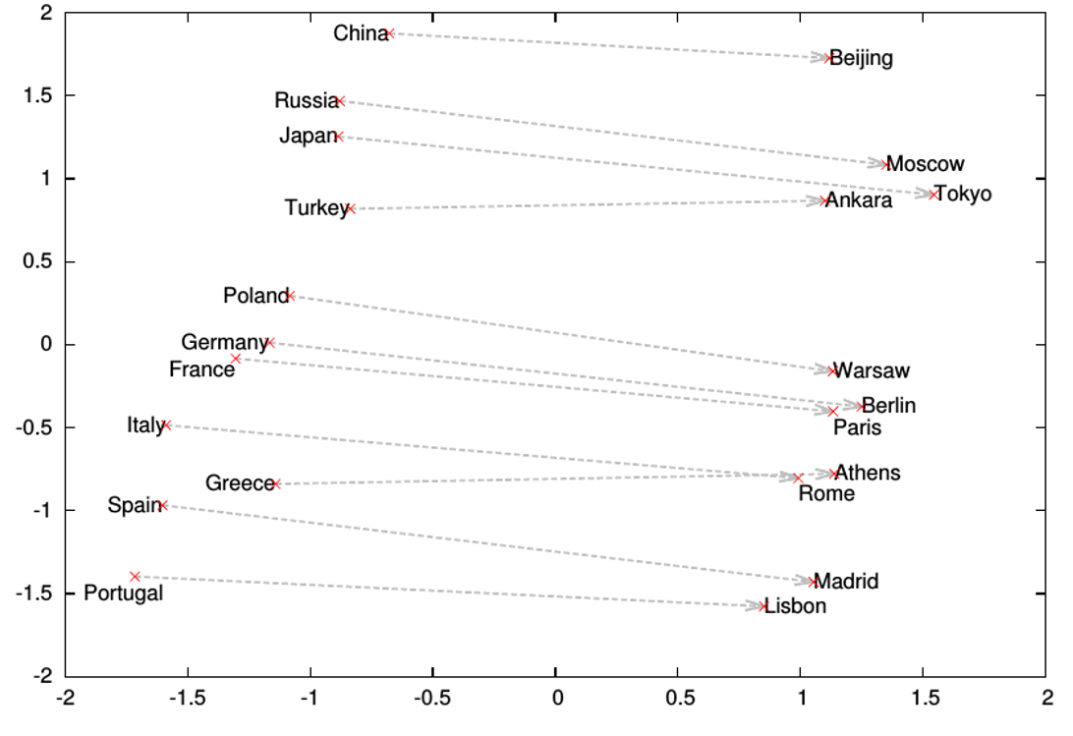
Word Analogies

Slide 27
What is word2vec?
word2vec is not a single algorithm
It is a software package for representing words as vectors, containing:
  Two distinct models
    CBoW
    Skip-Gram (SG)
  Various training methods
    Negative Sampling (NS)
    Hierarchical Softmax
  A rich preprocessing pipeline
    Dynamic Context Windows
    Subsampling
    Deleting Rare Words
Notes:
Now, we’re going to focus on Skip-Grams with Negative Sampling,
Which is considered the state-of-the-art.

Slide 28
Skip-Grams with Negative Sampling (SGNS)
Marco saw a furry little wampimuk hiding in the tree.
“word2vec Explained…”
Goldberg & Levy, arXiv 2014
Notes:
So, how does SGNS work?
Let’s say we have this sentence,
(This example was shamelessly taken from Marco Baroni)

Slide 29
Skip-Grams with Negative Sampling (SGNS)
Marco saw a furry little wampimuk hiding in the tree.
“word2vec Explained…”
Goldberg & Levy, arXiv 2014
Notes:
And we want to understand what a wampimuk is.

Slide 30

Skip-Grams with Negative Sampling (SGNS)
Marco saw a furry little wampimuk hiding in the tree.
words contexts
wampimuk furry
wampimuk little
wampimuk hiding
wampimuk in
… …
$D$ (data)
“word2vec Explained…”
Goldberg & Levy, arXiv 2014
Notes:
What SGNS does is take the context words around “wampimuk”,
And in this way,
Constructs a dataset of word-context pairs, D.

Slide 31

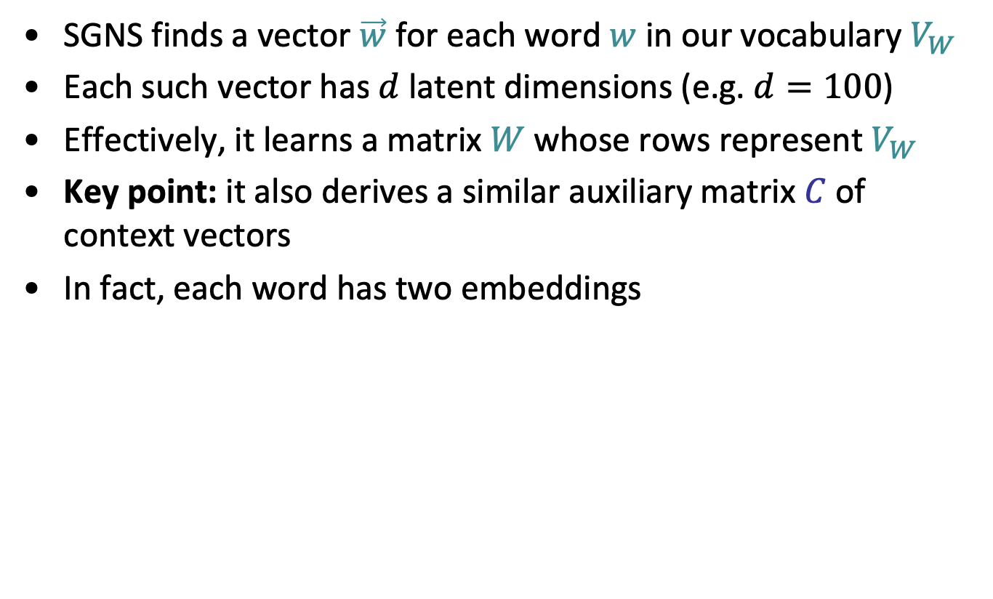
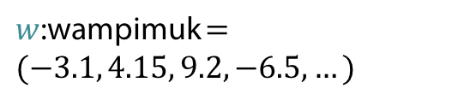







Skip-Grams with Negative Sampling (SGNS)
SGNS finds a vector $\vec{w}$ for each word $w$ in our vocabulary $V_{W}$
Each such vector has $d$ latent dimensions (e.g. $d=100$)
Effectively, it learns a matrix $W$ whose rows represent $V_{W}$
Key point: it also derives a similar auxiliary matrix $C$ of context vectors
In fact, each word has two embeddings
$$d$$
$$d$$
$$W$$
$w$:wampimuk $=(−3.1, 4.15, 9.2, −6.5,…)$
$$C$$
$$V_{W}$$
$$V_{C}$$
$$≠$$
$c$:wampimuk $=(−5.6, 2.95, 1.4, −1.3,…)$
“word2vec Explained…”
Goldberg & Levy, arXiv 2014
Notes:
Now, using D,
SGNS is going to learn a vector for each word in the vocabulary
A vector of say… 100 latent dimensions.
Effectively, it’s learning a matrix W,
Where each row is a vector that represents a specific word.
Now, a key point in understanding SGNS,
Is that it also learns an auxiliary matrix C of context vectors
So in fact, each word has two different embeddings
Which are not necessarily similar.

Slide 32
Skip-Grams with Negative Sampling (SGNS)
“word2vec Explained…”
Goldberg & Levy, arXiv 2014
Notes:
So to train these vectors…

Slide 33
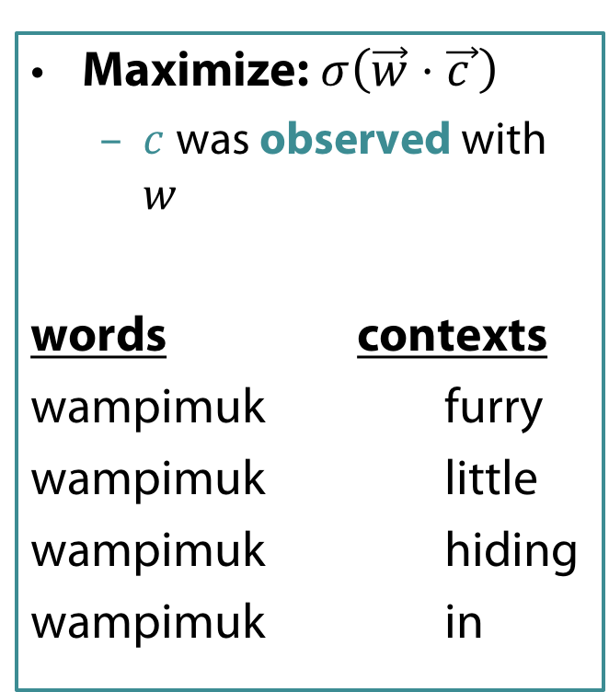
Skip-Grams with Negative Sampling (SGNS)
Maximize: $σ\left(\vec{w}⋅\vec{c_{ }}\right)$
  $c$ was observed with $w$
words contexts
wampimuk furry
wampimuk little
wampimuk hiding
wampimuk in
“word2vec Explained…”
Goldberg & Levy, arXiv 2014
Notes:
…SGNS maximizes the similarity between word and context vectors that were observed together.

Slide 34
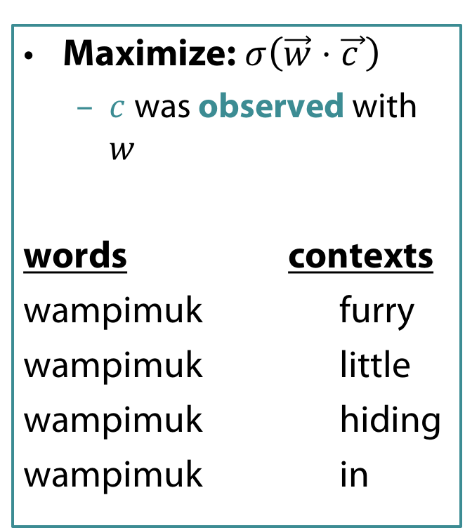
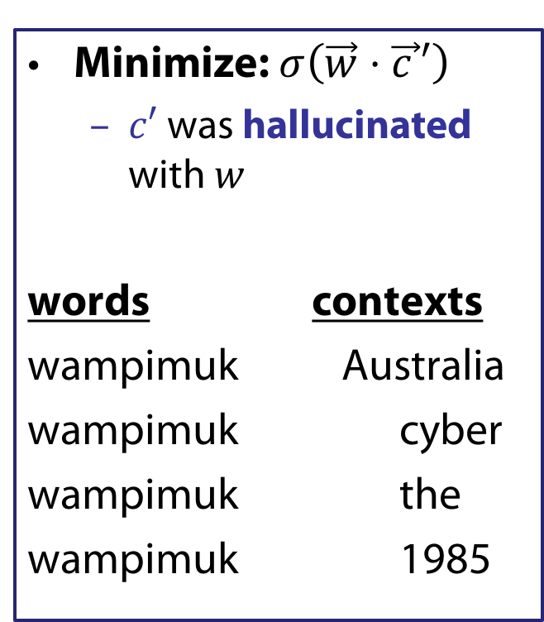
Skip-Grams with Negative Sampling (SGNS)
Maximize: $σ\left(\vec{w}⋅\vec{c_{ }}\right)$
  $c$ was observed with $w$
words contexts
wampimuk furry
wampimuk little
wampimuk hiding
wampimuk in
Minimize: $σ\left(\vec{w}⋅\vec{c_{ }}′\right)$
  $c′$ was hallucinated with $w$
words contexts
wampimuk Australia
wampimuk cyber
wampimuk the
wampimuk 1985
“word2vec Explained…”
Goldberg & Levy, arXiv 2014
Notes:
…and minimizes the similarity between word and context vectors hallucinated together.

Slide 35
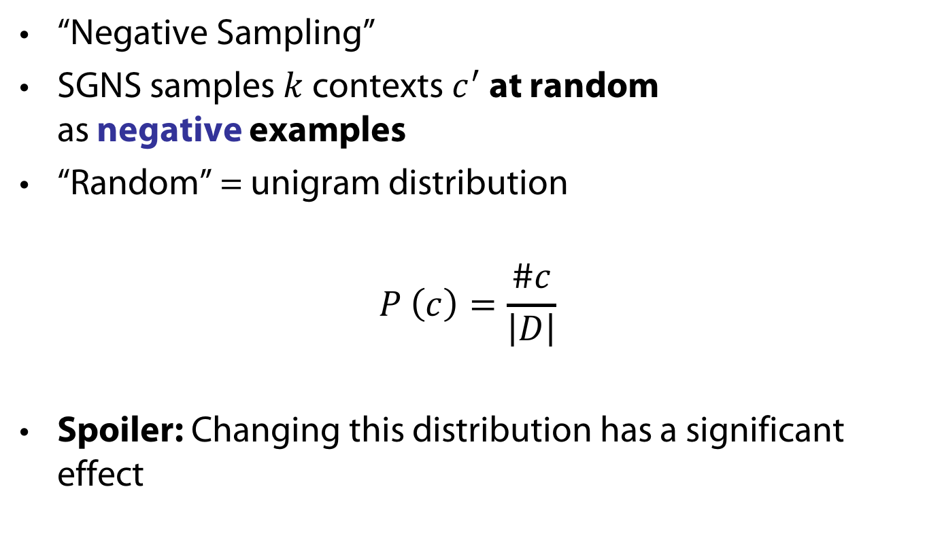
Skip-Grams with Negative Sampling (SGNS)
“Negative Sampling”
SGNS samples $k$ contexts $c^{′}$ at random
as negative examples
“Random” = unigram distribution
$$P_{ }^{ }\left(c\right)=\frac{\#c}{\left|D\right|}$$
Spoiler: Changing this distribution has a significant effect
Notes:
Now, the way SGNS hallucinates is really important.
It’s actually where it gets its name from.
For each observed word-context pair,
SGNS samples k contexts at random,
As negative examples
Now, when we say random, we mean the unigram distribution
And Spoiler Alert: changing this distribution has quite a significant effect.

Slide 36




What is SGNS learning?
Take SGNS’s embedding matrices ($W$ and $C$)
$$d$$
$$d$$
$$W$$
$$C$$
$$V_{W}$$
$$V_{C}$$
“Neural Word Embeddings as Implicit Matrix Factorization”
Levy & Goldberg, NIPS 2014
Notes:
If we take the embedding matrices

Slide 37





What is SGNS learning?
Take SGNS’s embedding matrices ($W$ and $C$)
Multiply them
What do you get?
$$d$$
$$W$$
$$V_{C}$$
$$V_{W}$$
$$d$$
$$C$$
“Neural Word Embeddings as Implicit Matrix Factorization”
Levy & Goldberg, NIPS 2014
Notes:
And multiply them
What do we get?

Slide 38





What is SGNS learning?
A $V_{W}×V_{C}$ matrix
Each cell describes the relation between a specific word-context pair
$\vec{w}⋅\vec{c}= ?$
$$d$$
$$V_{C}$$
$$W$$
$$V_{C}$$
$$?$$
$$V_{W}$$
$$d$$
$$C$$
$$=$$
$$V_{W}$$
“Neural Word Embeddings as Implicit Matrix Factorization”
Levy & Goldberg, NIPS 2014
Notes:
We get a pretty big, square matrix,
Where each cell describes the relation between a specific word, w,
With a specific context, c.

Slide 39


What is SGNS learning?
Levy&Goldberg [2014] proved that for large enough $d$ and enough iterations …
… one obtains the word-context PMI matrix
$$d$$
$$V_{C}$$
$$W$$
$$V_{C}$$
$$M^{PMI}$$
$$V_{W}$$
$$d$$
$$C$$
$$=$$
$$V_{W}$$
“Neural Word Embeddings as Implicit Matrix Factorization”
Levy & Goldberg, NIPS 2014
Notes:
…SGNS will converge to the classic word-context PMI matrix…

Slide 40


What is SGNS learning?
Levy&Goldberg [2014] proved that for large enough $d$ and enough iterations …
… one obtains the word-context PMI matrix …
shifted by a global constant
$Opt\left(\vec{w}⋅\vec{c}\right)=PMI\left(w,c\right)−\log{k}$
$$d$$
$$V_{C}$$
$$W$$
$$V_{C}$$
$$M^{PMI}$$
$$V_{W}$$
$$d$$
$$C$$
$$=$$
$$V_{W}$$
$$−\log{k}$$
“Neural Word Embeddings as Implicit Matrix Factorization”
Levy & Goldberg, NIPS 2014
Notes:
…with a little twist.
Now, recall that k is the number of negative samples generated for each positive example (w,c) \in D.
This is of course the optimal value, and not necessarily what we get in practice.

Slide 41
What is SGNS learning?
SGNS is doing something very similar to the older approaches
SGNS factorizes the traditional word-context PMI matrix
So does SVD!
GloVe factorizes a similar word-context matrix
Notes:
So to sum it up, SGNS is doing what we’ve been doing in NLP for a couple of decades:
It’s factorizing the PMI matrix,
Apparently, just like SVD.
And, while I didn’t explain it, GloVe also factorizes a similar matrix.

Slide 42
But embeddings are still better, right?
Plenty of evidence that embeddings outperform traditional methods
  “Don’t Count, Predict!” (Baroni et al., ACL 2014)
  GloVe (Pennington et al., EMNLP 2014)
How does this fit with our story?
Notes:
But embeddings are still better, right?
There’s plenty of evidence,
Even a couple of papers.
So how does this fit with our story?

Slide 43
The Big Impact of “Small” Hyperparameters
word2vec & GloVe are more than just algorithms…
Introduce new hyperparameters
May seem minor, but make a big difference in practice
Notes:
So like I said at the beginning, word2vec and GloVe are more than just algorithms.
They introduce many new hyperparameters,
Which may seem minor,
but as it turns out, they make a pretty big difference in practice.

Slide 44
New Hyperparameters
Preprocessing (word2vec)
  Dynamic Context Windows
  Subsampling
  Deleting Rare Words
Postprocessing (GloVe)
  Adding Context Vectors
Association Metric (SGNS)
  Shifted PMI
  Context Distribution Smoothing
Notes:
…we’ll look at Context Distribution Smoothing,
and see how we can adapt it to traditional count-based methods.

Slide 45
Dynamic Context Windows
Marco saw a furry little wampimuk hiding in the tree.
Notes:
So dynamic context windows
Let’s say we have our sentence from earlier,
And we want to look at a context window of 4 words around wampimuk.

Slide 46
Dynamic Context Windows
Marco saw a furry little wampimuk hiding in the tree.
Notes:
Now, some of these context words are obviously more related to the meaning of wampimuk than others.
The intuition behind dynamic context windows, is that the closer the context is to the target…

Slide 47
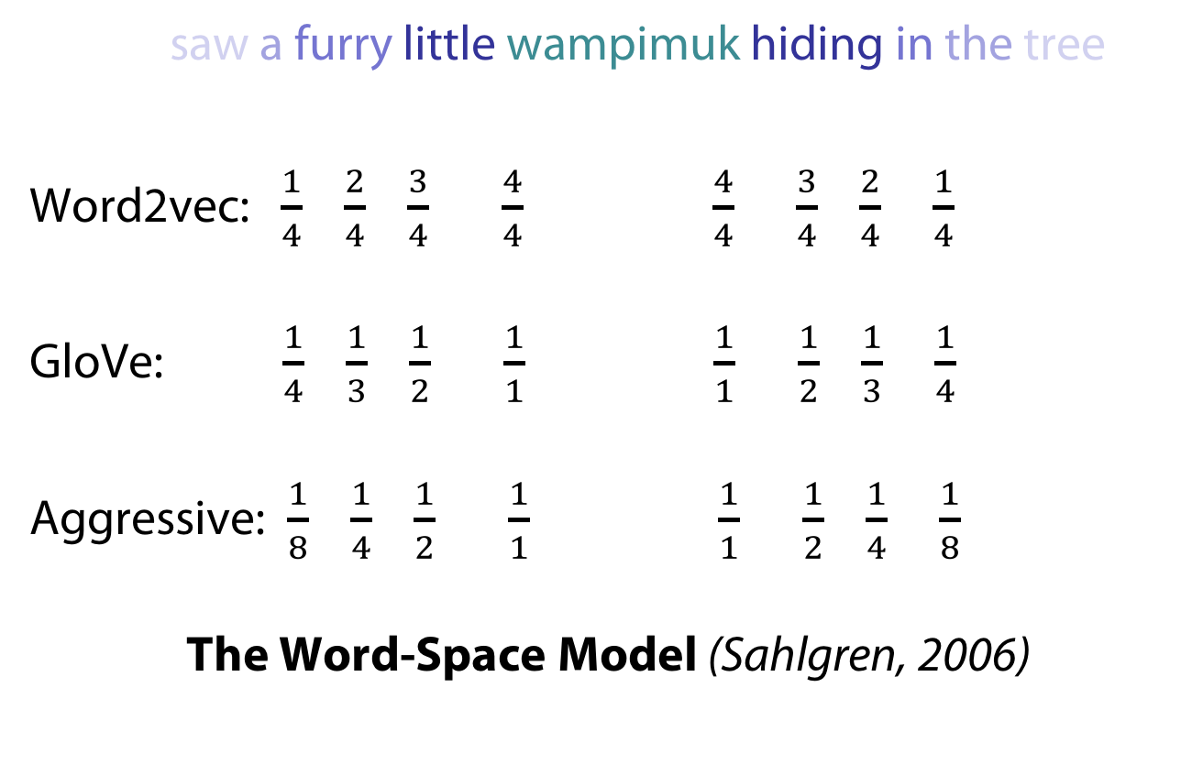
Dynamic Context Windows
Marco saw a furry little wampimuk hiding in the tree.
Word2vec: $\frac{1}{4}$ $\frac{2}{4}$ $\frac{3}{4}$ $\frac{4}{4}$ $\frac{4}{4}$ $\frac{3}{4}$ $\frac{2}{4}$ $\frac{1}{4}$
GloVe: $\frac{1}{4}$ $\frac{1}{3}$ $\frac{1}{2}$ $\frac{1}{1}$ $\frac{1}{1}$ $\frac{1}{2}$ $\frac{1}{3}$ $\frac{1}{4}$
Aggressive: $\frac{1}{8}$ $\frac{1}{4}$ $\frac{1}{2}$ $\frac{1}{1}$ $\frac{1}{1}$ $\frac{1}{2}$ $\frac{1}{4}$ $\frac{1}{8}$
The Word-Space Model (Sahlgren, 2006)
Notes:
…the more relevant it is.
word2vec does just that, by randomly sampling the size of the context window around each token.
What you see here are the probabilities that each specific context word will be included in the training data.
GloVe also does something similar, but in a deterministic manner, and with a slightly different distribution.
There are of course other ways to do this,
And they were all, apparently,
Applied to traditional algorithms about a decade ago.

Slide 48

Adding Context Vectors
SGNS creates word vectors $\vec{w}$
SGNS creates auxiliary context vectors $\vec{c}$
  So do GloVe and SVD
Notes:
The second hyperparameter I’d like to discuss is adding context vectors.
So, remember that SGNS doesn’t only create word vectors,
It also creates these auxiliary context vectors.
And, by the way, so do GloVe and SVD.

Slide 49
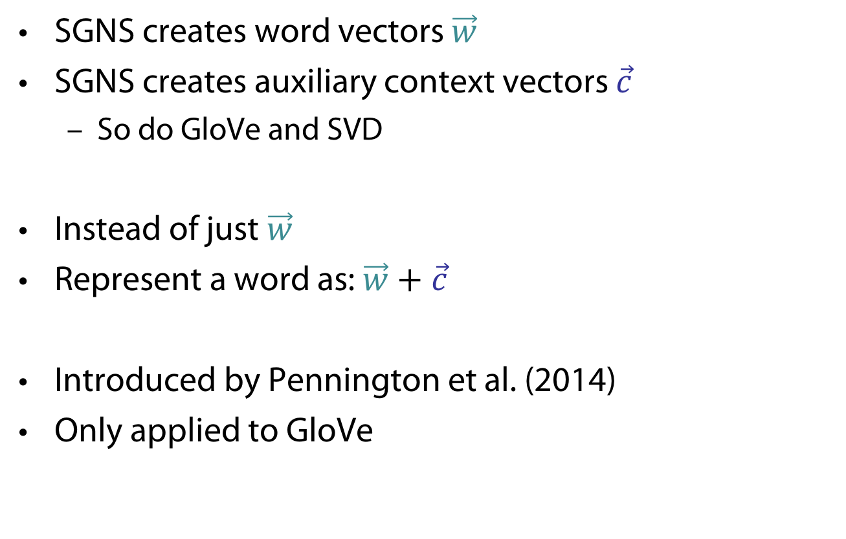
Adding Context Vectors
SGNS creates word vectors $\vec{w}$
SGNS creates auxiliary context vectors $\vec{c}$
  So do GloVe and SVD
Instead of just $\vec{w}$
Represent a word as: $\vec{w}+\vec{c}$
Introduced by Pennington et al. (2014)
Only applied to GloVe
Notes:
So, each word has two representations, right?
So what if instead of using just the word vectors,
We’d also use the information in the context vectors,
to represent our words?
This trick was introduced as part of GloVe,
But it was also only applied to GloVe,
and not to the other methods.

Slide 50
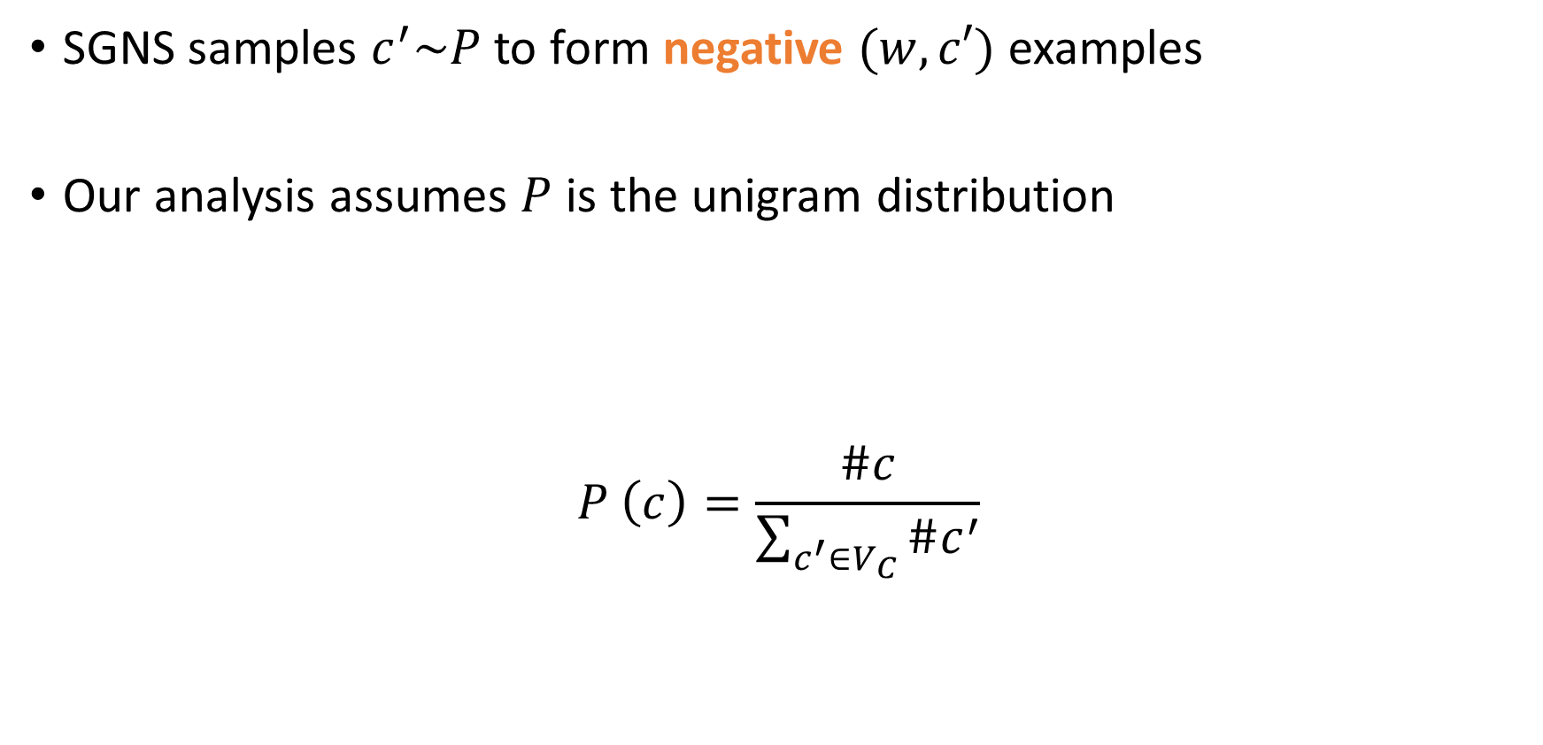
Context Distribution Smoothing
SGNS samples $c^{′}\sim P_{ }$ to form negative $(w,c′)$ examples
Our analysis assumes $P_{ }$ is the unigram distribution
$$P_{ }^{ }\left(c\right)=\frac{\#c}{\sum_{c^{′}∈V_{C}}{\#c^{′}}}$$
Notes:
Let’s talk about context distribution smoothing,
And see how we can adapt it to traditional PMI vectors.
<pause>
So remember that SGNS samples these negative contexts from some distribution?
And that I said that this distribution is the unigram distribution?
Well, I wasn’t completely honest with you…

Slide 51
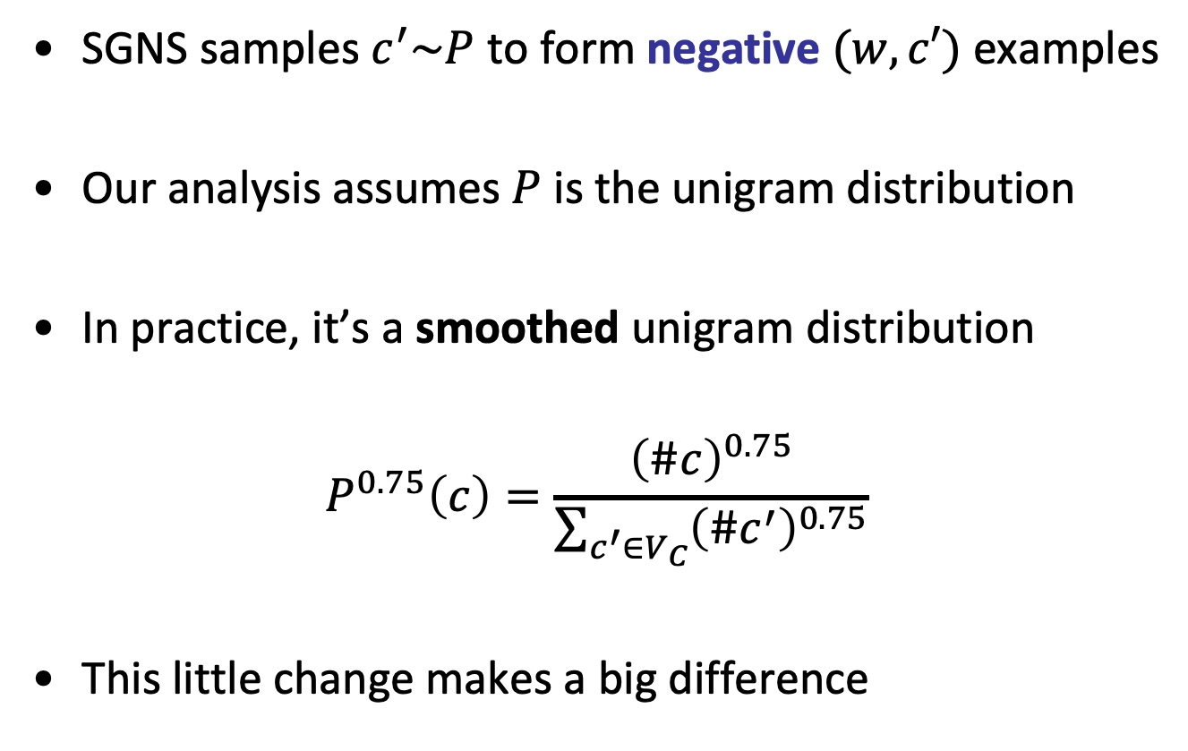
Context Distribution Smoothing
SGNS samples $c^{′}\sim P_{ }$ to form negative $(w,c′)$ examples
Our analysis assumes $P_{ }$ is the unigram distribution
In practice, it’s a smoothed unigram distribution
$$P_{ }^{0.75}\left(c\right)=\frac{{\left(\#c\right)}^{0.75}}{\sum_{c^{′}∈V_{C}}{{\left(\#c^{′}\right)}^{0.75}}}$$
This little change makes a big difference
Notes:
In practice, it’s actually a smoothed unigram distribution.
And this tiny little change, makes quite a big difference.

Slide 52
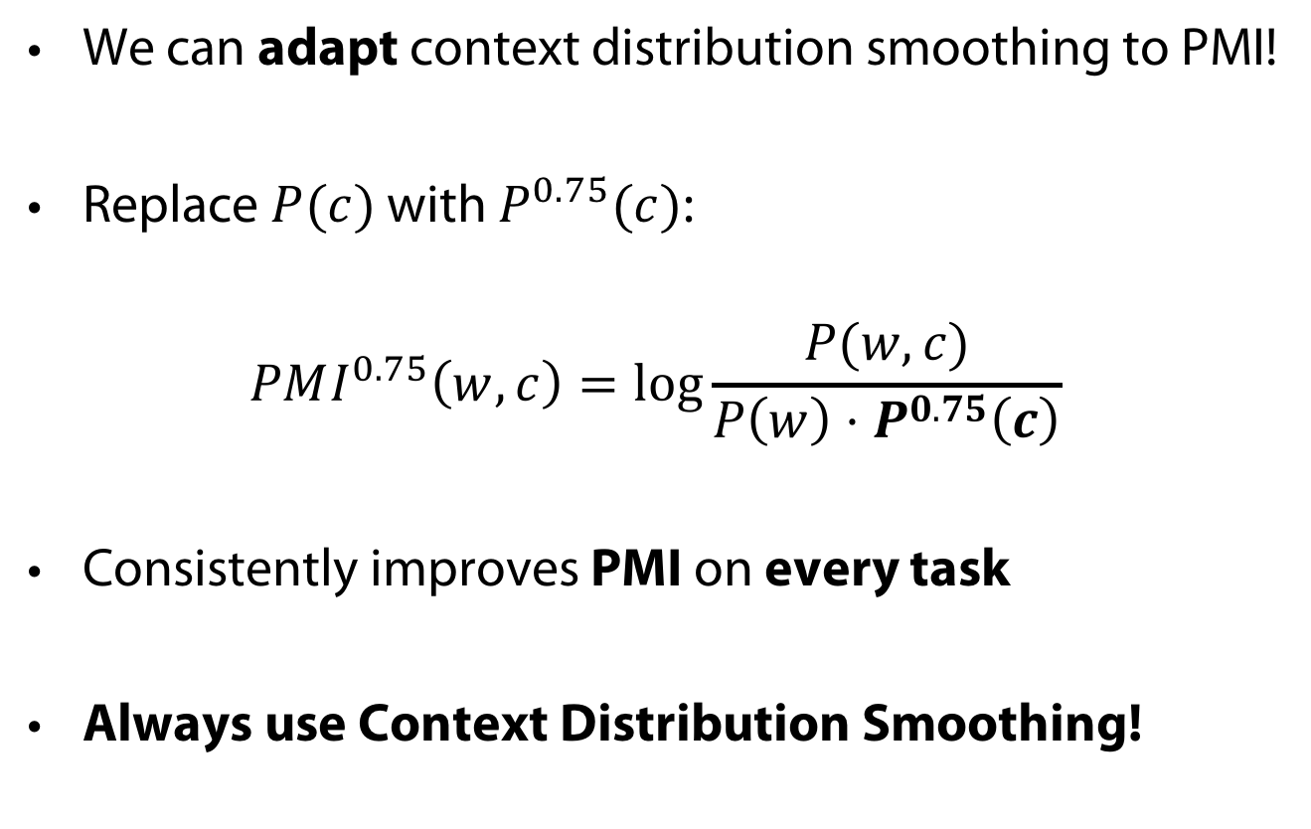
Context Distribution Smoothing
We can adapt context distribution smoothing to PMI!
Replace $P(c)$ with $P_{ }^{0.75}(c)$:
$$PMI^{0.75}\left(w,c\right)=\log{\frac{P(w,c)}{P\left(w\right)⋅P^{0.75}\left(c\right)}}$$
Consistently improves PMI on every task
Always use Context Distribution Smoothing!
Notes:
Now, what’s neat about context distribution smoothing
Is that we can adapt it to PMI!
This is done by simply replacing the probability of C with the smoothed probability.
Just like this:
And this tweak consistently improves performance on every task.
So if there’s one technical detail you should remember from this talk, it’s this:
Always use context distribution smoothing!

Slide 53
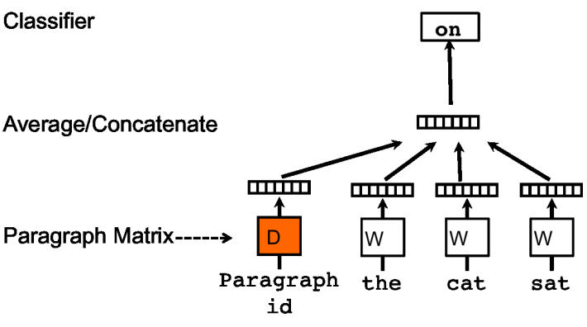
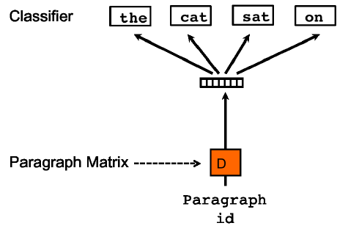
Represent the meaning of sentence/text
Paragraph vector (2014, Quoc Le, Mikolov)
  Extend word2vec to text level
  Also two models: add paragraph vector as the input

Slide 54
Don’t Count, Predict! [Baroni et al., 2014]
“word2vec is better than count-based methods”
Hyperparameter settings account for most of the reported gaps
Embeddings do not really outperform count-based methods
No unique conclusion available
Notes:
So, in “don’t count, predict”,
The authors show that word2vec is better than count-based methods.
And, while they did tune a lot of different hyperparameters,
Other hyperparameters remained hidden inside the code.
And it turns out,
That these hidden hyperparameters account for most of the reported performance gaps.
In our experiments, we show that embeddings are not really better than count-based methods.

Slide 55
The Contributions of Word Embeddings
What’s really improving performance?
Novel Algorithms
(objective + training method)
Skip Grams + Negative Sampling
CBOW + Hierarchical Softmax
Noise Contrastive Estimation
GloVe
…
New Hyperparameters
(preprocessing, smoothing, etc.)
Subsampling
Dynamic Context Windows
Context Distribution Smoothing
Adding Context Vectors
…
Improving Distributional Similarity with Lessons Learned from Word Embeddings, Omer Levy, Yoav Goldberg, Ido Dagan
Notes:
Or maybe a bit of both?
<pause>

