Slide 1
Non-Standard-Datenbanken
Prof. Dr. Ralf Möller
Universität zu Lübeck
Institut für Informationssysteme

Slide 2
Acknowledgements:
This presentation is based on the following two presentations
10 Years of Probabilistic Querying – What Next?
Martin Theobald
University of Antwerp
Temporal Alignment
Anton Dignös¹ Michael H. Böhlen¹ Johann Gamper² ¹University of Zürich, Switzerland
²Free University of Bozen-Bolzano, Italy

Slide 3
Recap: Probabilistic Databases
A probabilistic database D^{p} (compactly) encodes a probability distribution over a finite set of deterministic database instances D_{i}.
D₁: 0.42
D₂: 0.18
D₃: 0.28
D₄: 0.12
WorksAt(Sub, Obj)
Jeff | Stanford
Jeff | Princeton
WorksAt(Sub, Obj)
Jeff | Stanford
WorksAt(Sub, Obj)
Jeff | Princeton
WorksAt(Sub, Obj)
Special Cases:
Query Semantics: (“Marginal Probabilities”)
  Run query Q against each instance D_{i}; for each answer tuple t, sum up the probabilities of all instances D_{i} where t is a result.
(1) D^{p} tuple-independent
(II) D^{p} block-independent
WorksAt(Sub, Obj) |  | p
Jeff | Stanford | 0.6
Jeff | Princeton | 0.7
WorksAt(Sub, Obj) |  | p
Jeff | Stanford | 0.6
 | Princeton | 0.4
Note: (I) and (II)
are not equivalent!

Slide 4
Probabilistic & Temporal Databases
A temporal-probabilistic database D^{Tp} (compactly) encodes a probability distribution over a finite set of deterministic database instances D_{i} at each time point of a finite time domain Ω^{T}.
BornIn(Sub,Obj) |  | T | p
DeNiro | Green- which | [1943, 1944) | 0.9
DeNiro | Tribeca | [1998, 1999) | 0.6
Wedding(Sub,Obj) |  | T | p
DeNiro | Abbott | [1936, 1940) | 0.3
DeNiro | Abbott | [1976, 1977) | 0.7
Divorce(Sub,Obj) |  | T | p
DeNiro | Abbott | [1988, 1989) | 0.8
Sequenced Semantics & Snapshot Reducibility:
  Built-in semantics: reduce temporal-relational operators to their non-temporal counterparts at each snapshot (i.e., time point) of the database.
  Coalesce/split tuples with consecutive time intervals based on their lineages.
Non-Sequenced Semantics
  Queries can freely manipulate timestamps just like regular attributes. Single temporal operator ≤^{T} supports all of Allen’s 13 temporal relations.
  Deduplicate tuples with overlapping time intervals based on their lineages.
[Dignös, Gamper, Böhlen: SIGMOD’12]
marriedTo(x,y)[t_{b1},T_{max}) ⇐ wedding(x,y)[t_{b1},t_{e1}) ∧
¬divorce(x,y)[t_{b2},t_{e2})
[Dylla,Miliaraki,Theobald: PVLDB’13]

Slide 5
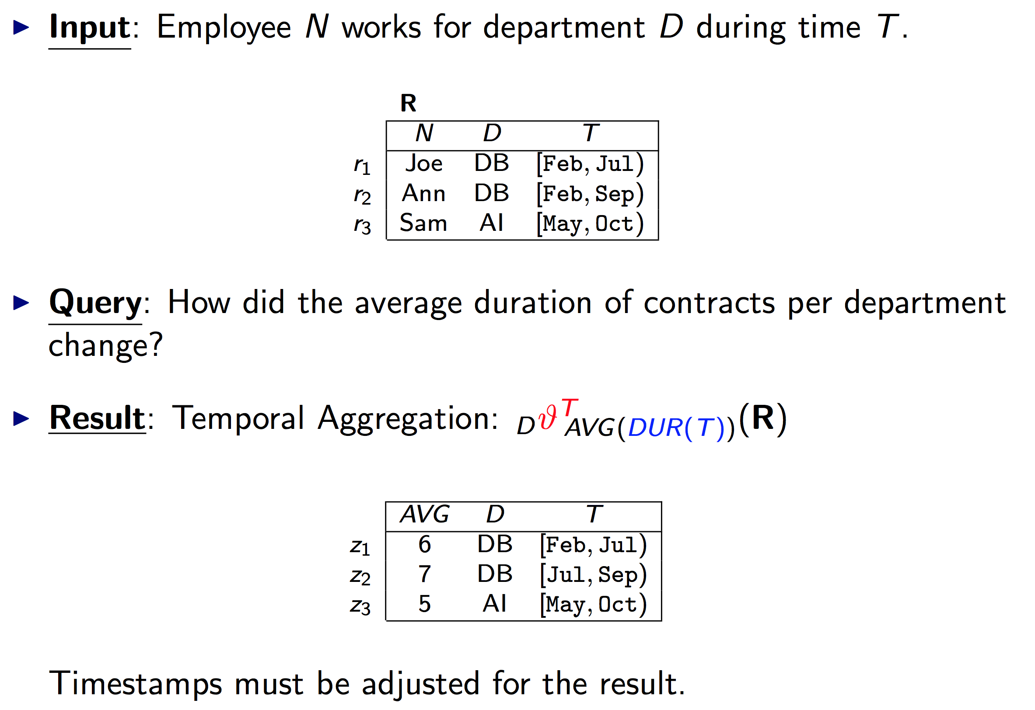
Sequenced Semantics: Example
[Dignös, Gamper, Böhlen: SIGMOD’12]

Slide 6
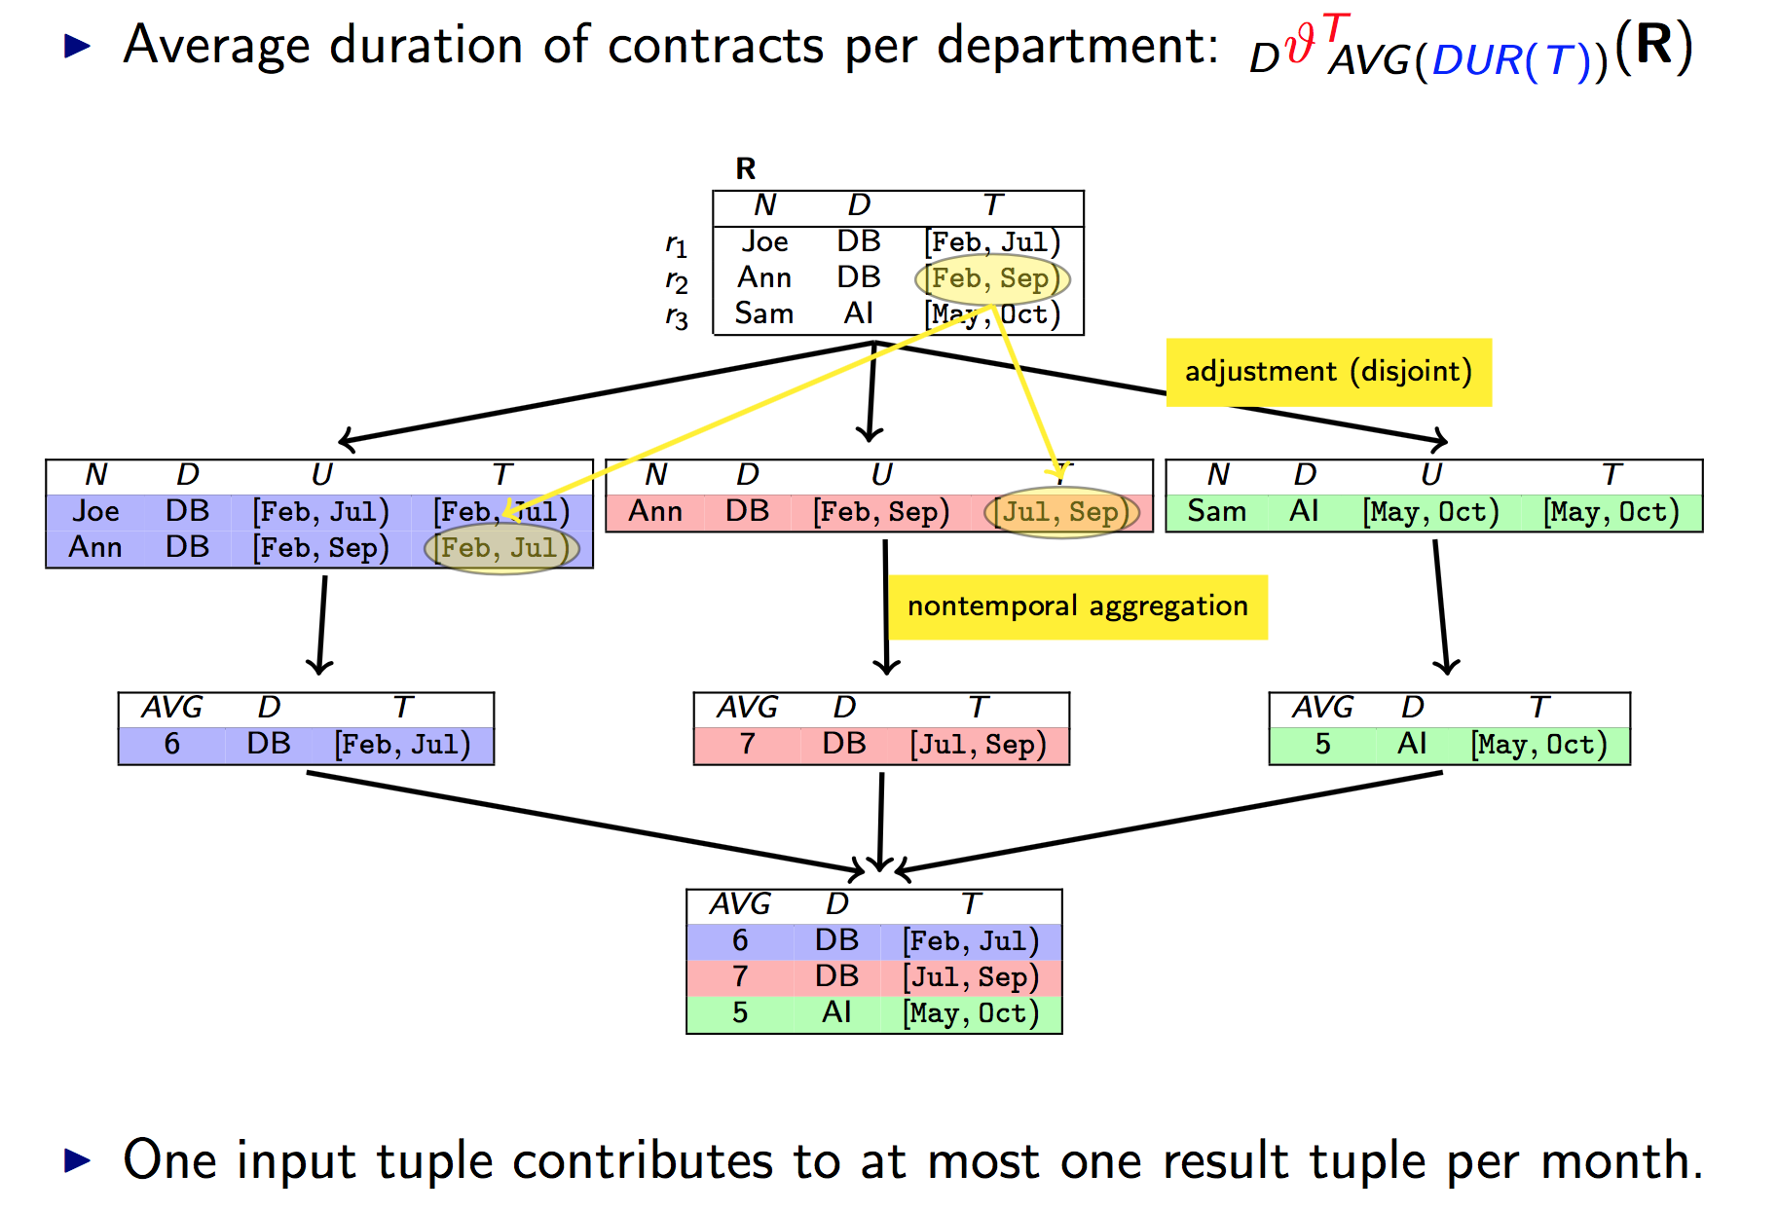
Temporal Splitter / Snapshot Reduction
[Dignös, Gamper, Böhlen: SIGMOD’12]

Slide 7
Temporal Alignment & Deduplication Example
(f₁ ∧ f₃) ∨ (f₁ ∧ ¬f₃) ∨
(f₂ ∧ f₃) ∨ (f₂ ∧ ¬f₃)
Dedupl.
Facts
(f₁ ∧ f₃) ∨ (f₁ ∧ ¬f₃)
(f₁ ∧ ¬f₃) ∨ (f₂ ∧ ¬f₃)
f₁ ∧ f₃
Derived
Facts
f₁ ∧ ¬f₃
f₂ ∧ f₃
f₂ ∧ ¬f₃
f₃
Base
Facts
wedding(DeNiro,Abbott)
f₂
divorce(DeNiro,Abbott)
f₁
wedding(DeNiro,Abbott)
Ω^{T}
T_{min}
1936
1976
1988
T_{max}
Non-Sequenced Semantics:
marriedTo(x,y)[t_{b1},T_{max}) ⇐ wedding(x,y)[t_{b1},t_{e1}) ∧ ¬divorce(x,y)[t_{b2},t_{e2})
marriedTo(x,y)[t_{b1},t_{e2}) ⇐ wedding(x,y)[t_{b1},t_{e1}) ∧ divorce(x,y)[t_{b2},t_{e2}) ∧ t_{e1} ≤^{T} t_{b2}

Slide 8
Inference in Probabilistic-Temporal Databases
[Wang,Yahya,Theobald: MUD’10; Dylla,Miliaraki,Theobald: PVLDB’13]
Derived
Facts
⇐
teamMates(Beckham,
Ronaldo, T₃)
playsFor(Beckham, Real, T₁)
playsFor(Ronaldo, Real, T₂)
overlaps(T₁, T₂, T₃)
0.16
0.08
0.12
‘03
‘04
‘05
‘07
0.6
0.4
0.4
0.2
0.2
0.1
Base
Facts
‘03
‘05
‘07
‘00
‘02
‘04
‘05
‘07
playsFor(Beckham, Real, T₁)
playsFor(Ronaldo, Real, T₂)
Example using the Allen predicate overlaps

Slide 9
Inference in Probabilistic-Temporal Databases
[Wang,Yahya,Theobald: MUD’10; Dylla,Miliaraki,Theobald: PVLDB’13]
Derived
Facts
teamMates(Beckham,
Zidane, T₅)
teamMates(Beckham,
Ronaldo, T₄)
teamMates(Ronaldo,
Zidane, T₆)
0.16
0.08
0.12
‘03
‘04
‘05
‘07
Non-independent
Independent
0.6
0.4
0.4
0.2
0.2
0.1
Base
Facts
playsFor(Zidane, Real, T₃)
‘03
‘05
‘07
‘00
‘02
‘04
‘05
‘07
playsFor(Beckham, Real, T₁)
playsFor(Ronaldo, Real, T₂)

Slide 10
Inference in Probabilistic-Temporal Databases
[Wang,Yahya,Theobald: MUD’10; Dylla,Miliaraki,Theobald: PVLDB’13]
Derived
facts stored
in views
teamMates(Beckham,
Zidane, T₅)
teamMates(Beckham,
Ronaldo, T₄)
teamMates(Ronaldo,
Zidane, T₆)
Need
Lineage!
Non-independent
Independent
Closed and complete representation model (incl. lineage)
Temporal alignment is polyn. in the number of input intervals
Confidence computation per interval remains #P-hard
In general requires Monte Carlo approximations (Luby-Karp for DNF, MCMC-style sampling), decompositions, or top-k pruning
Base
Facts
playsFor(Zidane, Real, T₃)
playsFor(Beckham, Real, T₁)
playsFor(Ronaldo, Real, T₂)

Slide 11
Lineage & Possible Worlds
[Das Sarma,Theobald,Widom: ICDE’08
Dylla,Miliaraki,Theobald: ICDE’13]
Query
graduatedFrom(Surajit, y)
1) Deductive Grounding
  Dependency graph of the query
  Trace lineage of individual query
  answers
2) Lineage DAG (not in CNF),
consisting of
  Grounded soft & hard views
  Probabilistic base facts
3) Probabilistic Inference
  → Compute marginals:
  P(Q): sum up the probabilities of all possible worlds that entail the query answers’ lineage
  P(Q|H): drop “impossible worlds”
0.7x(1-0.888)=0.078
(1-0.7)x0.888=0.266
graduatedFrom
(Surajit, Princeton)
graduatedFrom
(Surajit, Stanford)
Q₁
Q₂
A∧¬(B∨ (C∧D))
¬ A∧(B∨ (C∧D))
⊗
1-(1-0.72)x(1-0.6)
=0.888
\/
0.8x0.9
=0.72
A
B
graduatedFrom
(Surajit, Princeton)[0.7]
graduatedFrom
(Surajit, Stanford)[0.6]
/\
C
D
hasAdvisor
(Surajit,Jeff)[0.8]
worksAt
(Jeff,Stanford)[0.9]

Slide 12
Literature
[Das Sarma,Theobald,Widom: ICDE’08]
Das Sarma, Anish and Theobald, Martin and Widom, Jennifer, Exploiting Lineage for Confidence Computation in Uncertain and Probabilistic Databases. In: 24th International Conference on Data Engineering (ICDE 2008), IEEE Computer Society Press, pp. 1023-1032. 2008
[Wang,Yahya,Theobald: MUD’10]
Wang, Yafang and Yahya, Mohamed and Theobald, Martin, Time-aware Reasoning in Uncertain Knowledge Bases. In: 4th International VLDB Workshop on Management of Uncertain Data, Vol. WP 10-, pp. 51-65, 2010
[Dignös, Gamper, Böhlen: SIGMOD’12]
A. Dignös, M.H. Böhlen, J. Gamper. Temporal alignment. In Proc. of the SIGMOD-12, pages 433-444, Scottsdale, AZ, USA, May 20-24, 2012
[Dylla,Miliaraki,Theobald: PVLDB’13]
Maximilian Dylla, Iris Miliaraki, Martin Theobald, A Temporal-Probabilistic Database Model for Information Extraction, Proceedings of the VLDB Endowment, Volume 6, Issue 14, 2013

Slide 13
Historical Facts vs. Future Facts
Processing uncertain historical data
Estimating probabilities of future facts (increasing T_{max})?
marriedTo(x,y)[t_{b1}, t_{e2}) ⇐ wedding(x,y)[t_{b1},t_{e1}) ∧ ¬divorce(x,y)[t_{b2},t_{e2})
marriedTo(x,y)[t_{b1},t_{e2}) ⇐ wedding(x,y)[t_{b1},t_{e1}) ∧ divorce(x,y)[t_{b2},t_{e2}) ∧ t_{e1} ≤^{T} t_{b2}
marriedTo(x,y)[t_{b1},T_{max}) ⇐ wedding(x,y)[t_{b1},t_{e1}) ∧ ¬divorce(x,y)[t_{b2},t_{e2})
marriedTo(x,y)[t_{b1},t_{e2}) ⇐ wedding(x,y)[t_{b1},t_{e1}) ∧ divorce(x,y)[t_{b2},t_{e2}) ∧ t_{e1} ≤^{T} t_{b2}

