Slide 1
Non-Standard-Datenbanken und Data Mining
Probabilistic Spatio-Temporal
Databases and Streams
Prof. Dr. Ralf Möller
Universität zu Lübeck
Institut für Informationssysteme

Slide 2
Übersicht
Semistrukturierte Datenbanken (JSON, XML) und Volltextsuche
Information Retrieval
Mehrdimensionale Indexstrukturen
Cluster-Bildung
Einbettungstechniken
First-n-, Top-k-, und Skyline-Anfragen
Probabilistische Datenbanken, Anfragebeantwortung, Top-k-Anfragen und Open-World-Annahme
Probabilistische Modellierung, Bayes-Netze, Anfragebeantwortungsalgorithmen, Lernverfahren,
Temporale Datenbanken und das relationale Modell,
Probabilistische Temporale Datenbanken
SQL: neue Entwicklungen (z.B. JSON-Strukturen und Arrays), Zeitreihen (z.B. TimeScaleDB)
Stromdatenbanken, Prinzipien der Fenster-orientierten inkrementellen Verarbeitung
Approximationstechniken für Stromdatenverarbeitung, Stream-Mining
Probabilistische raum-zeitliche Datenbanken und Stromdatenverarbeitungsssysteme: Anfragen und Indexstrukturen, Raum-zeitliches Data Mining
Von NoSQL- zu NewSQL-Datenbanken, CAP-Theorem, CALM-Theorem
Blockchain-Datenbanken
Analyse von Graphdaten

Slide 3
Acknowledgments
Presentation slides are largely taken from
Location-aware Query Processing and Optimization: A Tutorial
Mohamed F. Mokbel
Department of Computer Science and Engineering, University of Minnesota, Minneapolis, MN, USA
mokbel@cs.umn.edu
Walid G. Aref
Department of Computer Science, Purdue University, West Lafayette, Indiana, USA.
aref@cs.purdue.edu
Some slides (indicated) were produced by George Kollios
Slides have been modified or extended. Faults are mine!
  Mohamed F. Mokbel, Thanaa M. Ghanem, and Walid G. Aref. Spatio-temporal Access Methods. IEEE Data Engineering Bulletin, 26(2):40-49, June 2003.

Slide 4
Spatio-Temporal Objects
Moving points (extent does not matter)
  Each object is modeled as a point (e.g., moving vehicles in a GIS based transportation system)
Moving regions (extent matters)
  Each object is represented by an MBR, the MBR can change as the object moves (e.g., thunderstorm, noise)
© George Kollios

Slide 5
Location-aware Queries
Continuously report the number of cars on freeway 71-75
Type: Range query
Time: Present
Duration: Continuous
Query: Stationary
Objects: Moving
What are my nearest McDonalds for the next hour?
Type: Nearest-neighbor query
Time: Future
Duration: Continuous / Snapshot
Query: Moving (reference rectangle)
Objects: Stationary (McDonalds)
Send E-coupons to all cars that I am their nearest gas station
Type: Reverse NN query
Time: Present
Duration: Snapshot
Query: Stationary (gas station)
Objects: Moving
What was the closest distance between Taxi A & me yesterday?
Type: Closest-point query
Time: Past
Duration: Snapshot
Query: Moving
Objects: Moving
Location-aware Query Processing and Optimization: A Tutorial, Mohamed F. Mokbel, Walid G. Aref

Slide 6
Snapshot Querying the Past
Examples:
  Temporal Dimension:
  What was the location of a certain object from 7:00 AM to 10:00 AM yesterday?
  Spatial Dimension:
  Find all objects that were in a certain area at 7:00 AM yesterday
  Spatio-temporal Dimension:
  Find all objects that were close to each other from 7:00 AM to 8:00 AM yesterday
Features:
  Large number of historical trajectories
  Persistent read-only data
  Query spatial and/or temporal dimensions
Location-aware Query Processing and Optimization: A Tutorial, Mohamed F. Mokbel, Walid G. Aref

Slide 7
Indexing the Time Dimension
Historical trajectories are represented by their three-dimensional Minimum Bounding Rectangle (MBR)
Time
3D R-tree can be used to index MBRs
Technique simple and easy to implement
Does not scale well
Does not provide efficient query support for snapshot queries
(aka timestamp queries)
Location-aware Query Processing and Optimization: A Tutorial, Mohamed F. Mokbel, Walid G. Aref

Slide 8
3D R-Tree
Objects are somewhere in the gray rectangular regions.
© George Kollios

Slide 9
Modeling Evolution: Historical R-Trees
Snapshot query
© George Kollios

Slide 10
Multi-Version Index Structures (MVR-Trees)
Maintain an R-tree for each time instance (aka historical r-tree, HR-tree)
R-tree nodes that are not changed across consecutive time instances are linked together (remove redundancies: MVR-tree)
Timestamp 0
Timestamp 1
3D R-tree
A multi-version R-tree can be combined with a 3D-R-tree to support interval queries (combination is called MV3R-Tree)
Yufei Tao and Dimitris Papadias. MV3R-Tree: A Spatio-temporal Access Method for Timestamp and Interval Queries. In Proc. VLDB-01, pp. 431-440, 2001
Location-aware Query Processing and Optimization: A Tutorial, Mohamed F. Mokbel, Walid G. Aref

Slide 11
Historical R-trees (HR-trees)
An R-tree is maintained for each timestamp in history.
Trees at consecutive timestamps may share branches to save space.
o₃
o₄
timestamp 1
o₁
o₆
p₂
o₅
p₁
o₂
p₃
o₇
timestamp 1
p₁
p₂
p₃
o₁
o₂
o₃
o₄
o₅
o₆
o₇
© George Kollios

Slide 12
Historical R-trees
An R-tree is maintained for each timestamp in history.
Trees at consecutive timestamps may share branches to save space.
o₃
o₄
timestamp 2
o₁
o₆
p₂’
o₅’
p₁
o₂
p₃’
o₇
timestamp 1
p₁
p₂
p₃
timestamp 2
p₁
p₂’
p₃’
o₁
o₂
o₃
o₄
o₅
o₆
o₇
o₃
o₄
o₆
o₇
o₅’
© George Kollios

Slide 13
Building a 3D R-tree on the Leaves of the MVR-tree
Size of the 3D R-tree is much smaller than a complete 3D R-tree as the number of leaf nodes is significantly lower than the number of actual objects.
Long interval queries can be processed
with auxiliary 3D R-trees
© George Kollios

Slide 14
Rectangles
Problem of indexing any type of moving objects can be reduced to indexing discrete rectangles
Discrete rectangles
Continuous points
Continuous rectangles
time
t
y
x
© George Kollios

Slide 15
Optimization
If N objects move with linear functions of time:
Minimize total volume by splitting in equidistant points
Given K splits you can decide the best splits in
O(K log N) time.
Yufei Tao and Dimitris Papadias. MV3R-Tree: A Spatio-temporal Access Method for Timestamp and Interval Queries. In Proc. VLDB-01, pp. 431-440, 2001
© George Kollios

Slide 16
Querying the Present
Time is always NOW
Example Queries:
  Find the number of objects in a certain area
  What is the current location of a certain object?
Features:
  Continuously changing data
  Real-time query support is required
  Index structures should be update-tolerant
Present data is always accessed through continuous queries
Location-aware Query Processing and Optimization: A Tutorial, Mohamed F. Mokbel, Walid G. Aref

Slide 17
Updating Index Structures
Traditional R-tree updates are top-down
Updates translated to delete and insert transactions
To support frequent updates:
  Updates can be managed “inline” without the need for deletion or insertions
  Bottom-up approaches through auxiliary index structures to locate the object identifier
Hash based on OID
Location-aware Query Processing and Optimization: A Tutorial, Mohamed F. Mokbel, Walid G. Aref

Slide 18
Querying the Future
Examples:
  What will my nearest restaurant be after 30 minutes?
  Does my path conflict with any other cars for the next hour?
Features:
  Predict the movement through a velocity vector
  Prediction could be valid for only a limited time horizon in the future
Location-aware Query Processing and Optimization: A Tutorial, Mohamed F. Mokbel, Walid G. Aref

Slide 19
Example: Location Prediction
Location prediction seems to be a simple task in some cases:
Subway
station
University
?
Jonas Lüthke. Location Prediction Based on Mobility Patterns in Location Histories. Master thesis, TU Hamburg-Harburg, 2013
https://www.ifis.uni-luebeck.de/~moeller/publist-sts-pw-and-m/source/papers/2013/luethke13.pdf
Master Thesis Jonas Lüthke, TUHH, 2013

Slide 20
Location Prediction - Approach
Location prediction seems to be a simple task in some cases:
Subway
station
University
Home
Previous observations can enable an educated guess
Master Thesis Jonas Lüthke, TUHH, 2013

Slide 21
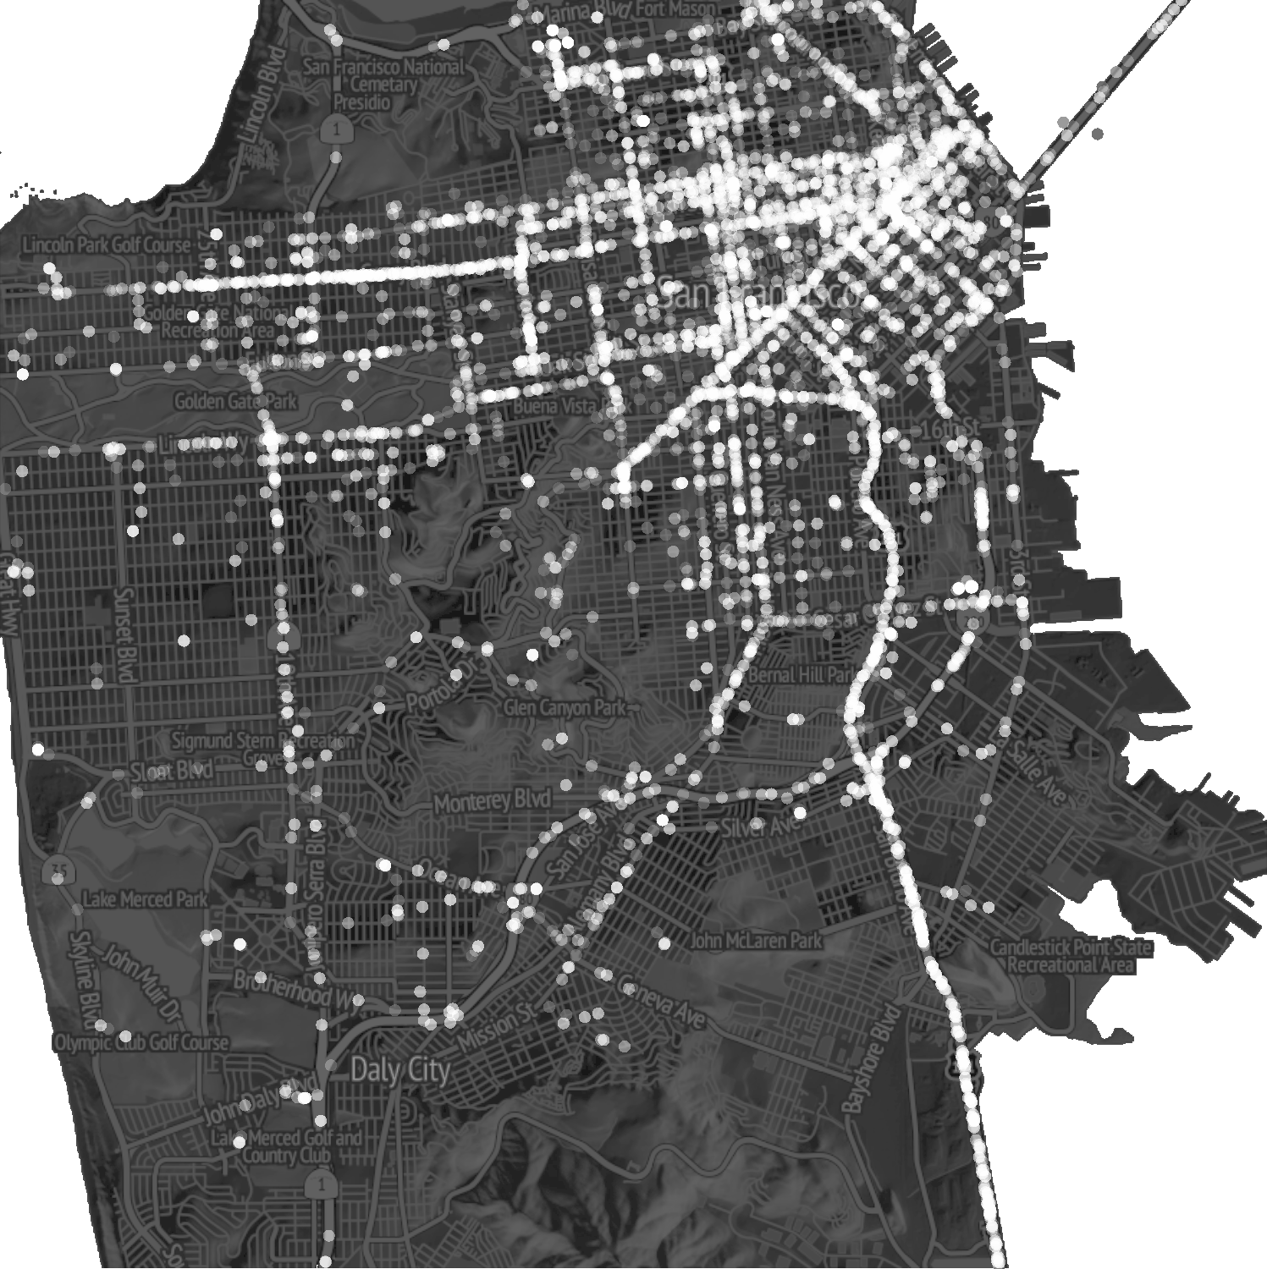
Example: Location History Data
Cabspotting data set:
GPS coordinates collected from 563 cabs in San Francisco over 30 days
Interval between measurements < 60 seconds
Ten taxis selected for testing
(with regard to measurement density, measurement errors)
Spatial probability distribution could be estimated from this (e.g., GMM)
Spatiotemporal probability distribution is needed
21
Master Thesis Jonas Lüthke, TUHH, 2013

Slide 22
Delay Embedding
Embed location time series in 2m-dimensional space using a delay ν:
Time series is iteratively sampled using delay time ν
Every m subsequent locations are combined into one vector (delay vector)
Starting from each location x_{n}, combine x_{n} with m subsequent locations if they were observed at a time interval ν
1 2
x = (x ,x ) location data points, index n ∈ {
n
1, . . . , N }
n n
δ_{n} = [x¹ , x²
, x¹ , x² , . . . ,x¹ , x² ]
n−(m−1) n−(m−1) n−(m−2) n−(m−2) n n
For example:
, x² , x¹ , x² ]
m = 2 : δ_{n} = [x¹
n−1 n−1 n n
Note: Prior sampling with delay ν is omitted for simplification
Master Thesis Jonas Lüthke, TUHH, 2013

Slide 23
Delay Embedding – Benefits
Euclidean distance is a measure for similarity between subsequences
Similar subsequences are close in embedding space
Density is a measure for likelihood of a subsequence
Mobility patterns can be extracted in terms of density
Master Thesis Jonas Lüthke, TUHH, 2013

Slide 24
Prediction Approach
Learn mobility patterns from large amount of history data:
Delay embedding to map mobility patterns to density
Density estimation based on embedding space
P(X_{t} = x, X_{t−1}, . . . , X_{t−(m−1)})
Derive conditional distribution
P(X_{t} = x|X_{t−1}, . . . , X_{t−(m−1)}) = 𝛼 P(X_{t} = x, X_{t−1}, . . . , X_{t−(m−1)})
Predict location given the last m − 1 locations (current context):
Maximization of probability density
to obtain most likely location (MLL problem)
x* = argmax P(X_{t} = x, X_{t−1}, . . . , X_{t−(m−1)})
x
What about m=2?
Assuming (m−1)-th order Markov process
Master Thesis Jonas Lüthke, TUHH, 2013

Slide 25

Density Estimation
Kernel Density Estimation
Optimization problem:
Minimize distance between estimated and unknown underlying distribution (AMISE, asymptotic mean integrated square error)
Master Thesis Jonas Lüthke, TUHH, 2013

Slide 26

Gaussian Mixture Models
P(x) =
𝛴
ω_{m} N(x|µ_{m}, Σ )
m
m∈M
Master Thesis Jonas Lüthke, TUHH, 2013

Slide 27
Online Kernel Density Estimation
Incremental - can be updated as new data arrives
Uses compression to keep memory footprint small
Christoph Heinz, Kernel Density Estimation over Data Streams,
Dissertation Philipps-Universität Marburg, 2007
Matej Kristan, Aleš Leonardis, and Danijel Skočaj. 2011. Multivariate online kernel density estimation with Gaussian kernels. Pattern Recogn. 44, 10-11, 2630-2642, 2011
Master Thesis Jonas Lüthke, TUHH, 2013

Slide 28

Solving MLL: Mode Finding
x* = argmax_{x} P(X_{t} = x, X_{t−1}, . . . , X_{t−(m−1)})
Use hill-climbing search to find position of maximum
Starting points?
Miguel Á. Carreira-Perpiñán. 2000. Mode-Finding for Mixtures of Gaussian Distributions. IEEE Trans. Pattern Anal. Mach. Intell. 22, 11, 1318-1323, 2000
Master Thesis Jonas Lüthke, TUHH, 2013

Slide 29
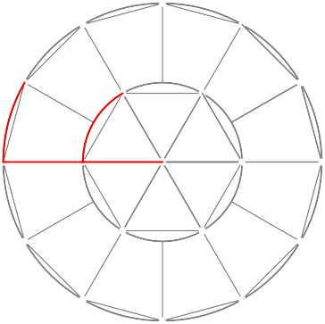
Starting Points for Maxima Search
Define search region around last observed location
If radius large enough, all relevant maxima are found
s
s
s
s
Master Thesis Jonas Lüthke, TUHH, 2013

Slide 30
Summary - Prediction
Delay embedding:
Map mobility patterns to density
Density estimation:
Assigns probability to each possible location sequence
Mode finding:
Searches the most likely future location
Master Thesis Jonas Lüthke, TUHH, 2013

Slide 31
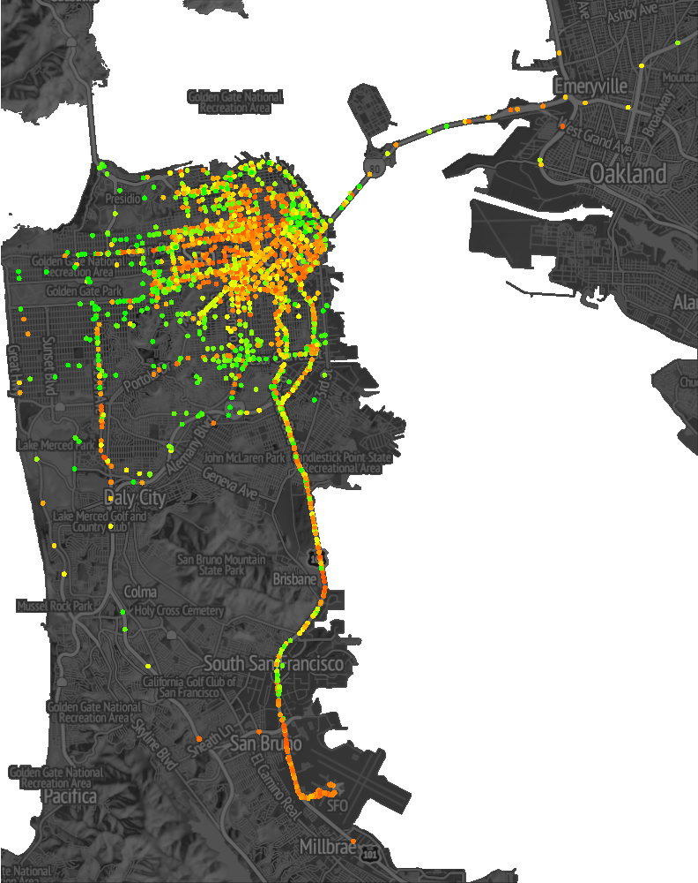
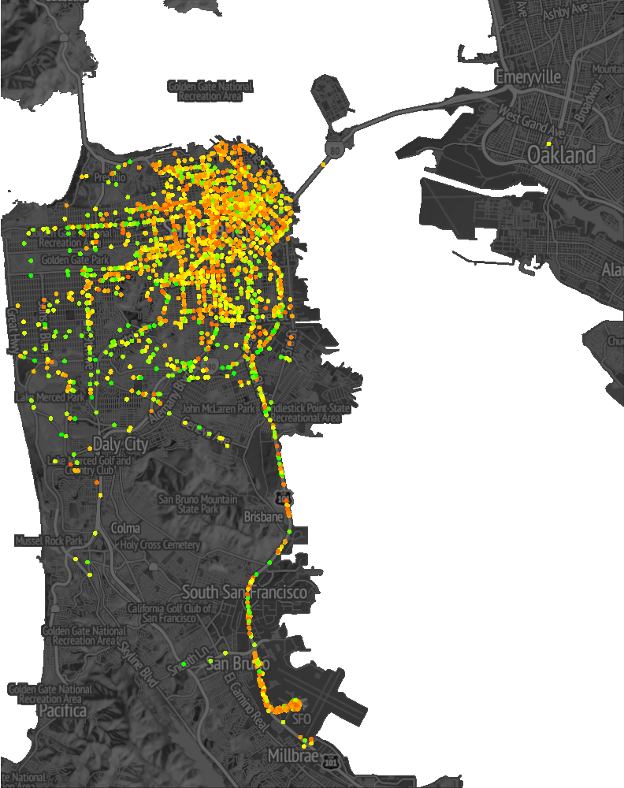
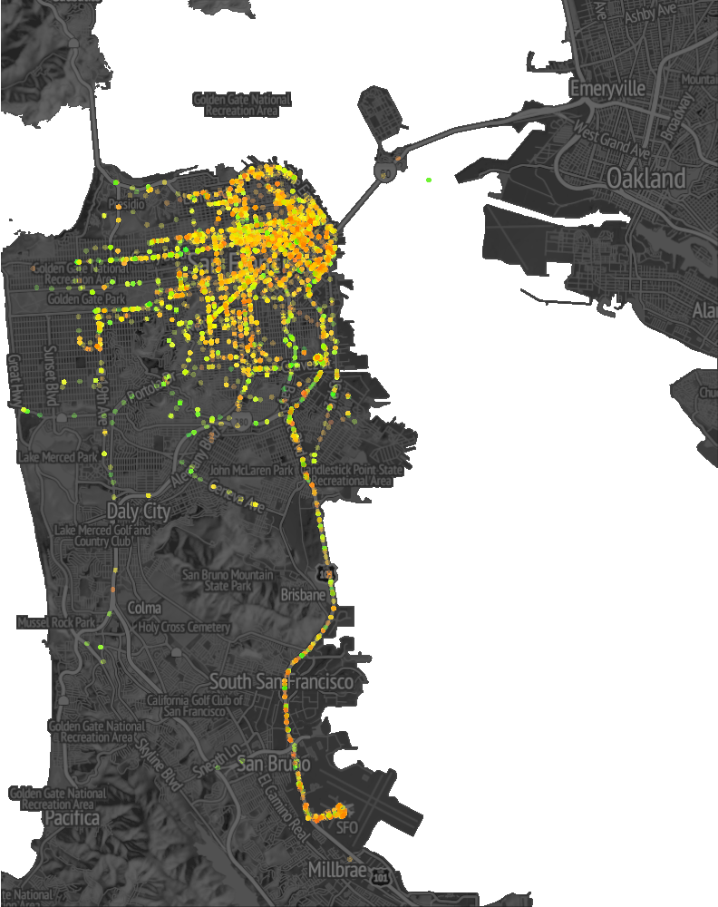
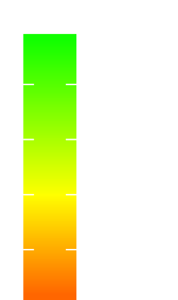
Test Results
Varied m, fixed ν = 6min:
error[m]
4000
3000
2000
1000
3 km
3 km
3 km
m = 2
m = 3
m = 5
Accurate predictions are more uniformly distributed
for m = 3 and m = 5.
Master Thesis Jonas Lüthke, TUHH, 2013

Slide 32
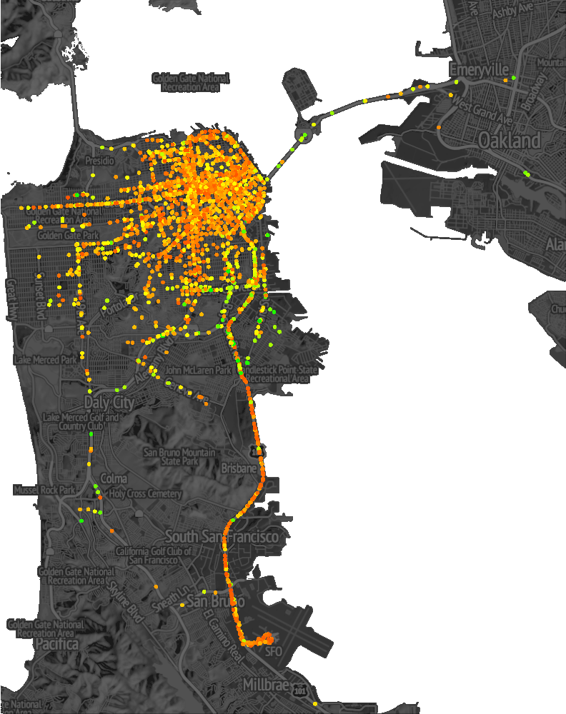
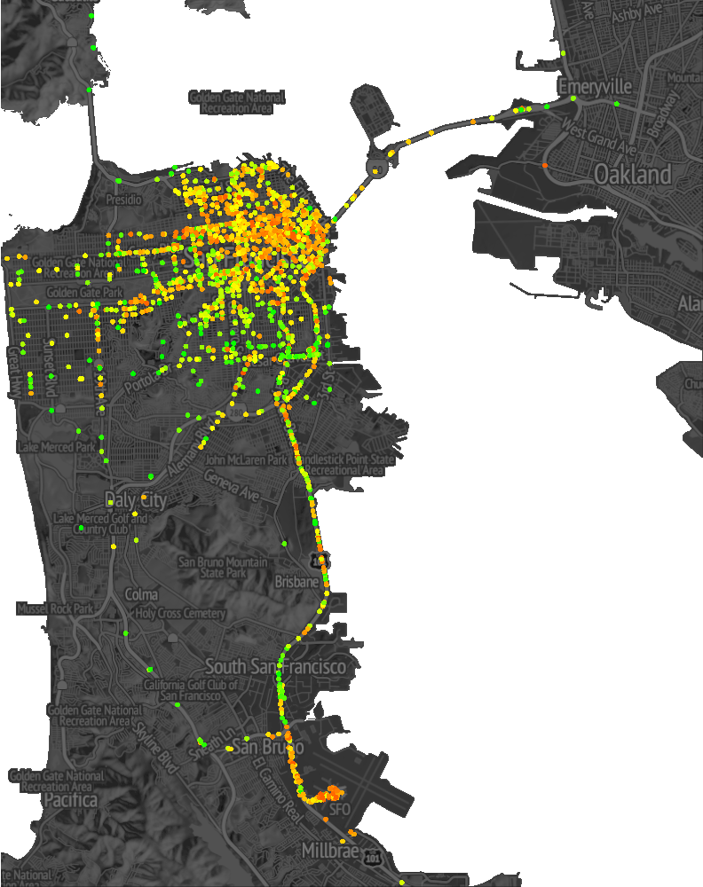
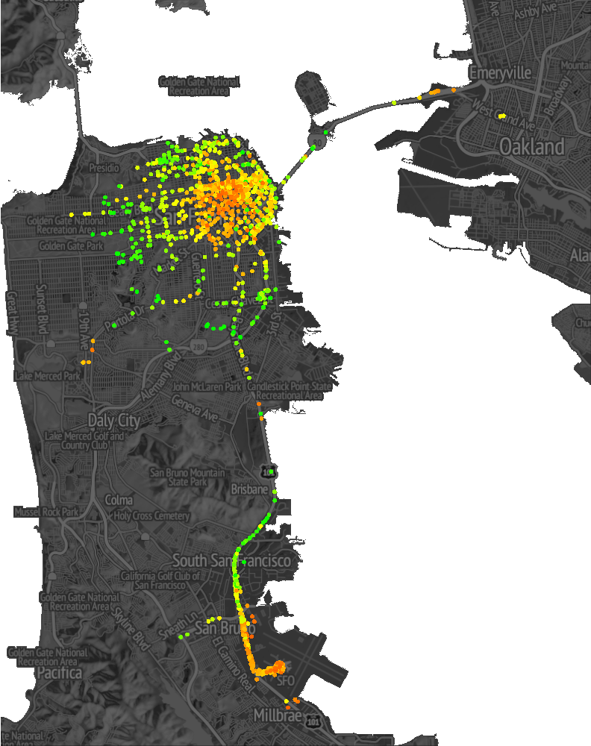
Test Results
Varied ν, fixed m = 3:
error[m]
4000
3000
2000
1000
3 km
3 km
3 km
ν = 3.3min
ν = 10min
ν = 60min
Accurate predictions are increasingly clustered as ν increases.
Master Thesis Jonas Lüthke, TUHH, 2013

Slide 33
Test Result Analysis
Algorithm is based on sequential correlation in data (delay embedding)
Locations in taxi data only correlated if part of same trip
For each trip the client defines new destination
Recurring similar location sequences only observed when
limiting time span to average trip time
Else prediction falls back to m = 2
Similar Approaches:
Song et al. - Markov predictor
Scellato et al. - Nonlinear predictor
L. Song, D. Kotz, R. Jain, and X. He, Evaluating location predictors with extensive with mobility data, In Proc. IEEE Computer and Communications Societies, pp. 1414-1424, 2004
S. Scellato, M. Musolesi, C. Mascolo, V. Latora, and A. T. Campbell, NextPlace: a spatio- temporal prediction framework for pervasive systems, In: Proc. Pervasive Computing, 2011
Master Thesis Jonas Lüthke, TUHH, 2013

Slide 34
Duality Transformation: Avoid 3D-Rtrees?
A linear trajectory in two-dimensional space can be transformed into a point in another dual two-dimensional space
Trajectory: x(t) = vt + a ➔ Point: (v,a)
Embedding in more dimensions
All queries will need to be transformed into the dual space
Location-aware Query Processing and Optimization: A Tutorial, Mohamed F. Mokbel, Walid G. Aref

Slide 35
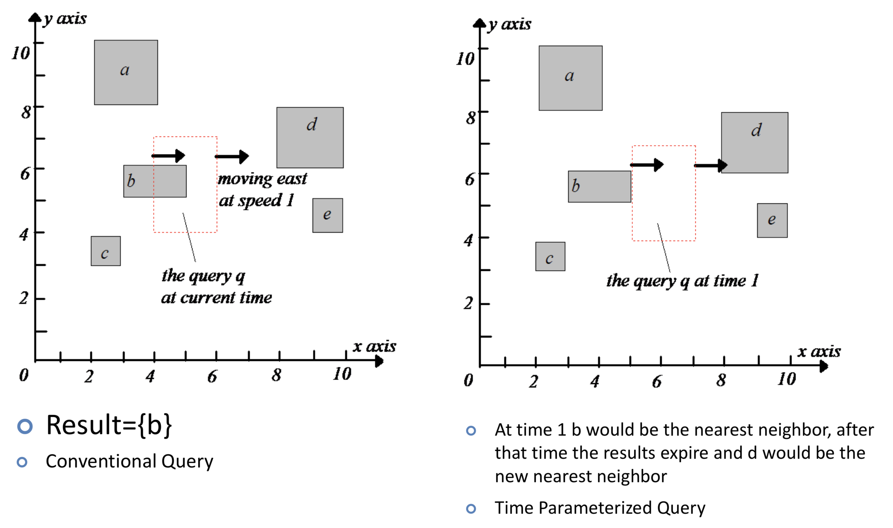
Time Parameterized Queries

Slide 36
Time Parameterized queries (TP queries)
Whenever a query is issued, a TP returns:
  Actual result that satisfies the corresponding spatial query.
  Validity period/expiration time of the result.
  Change that cause the expiration of the results
Can be used for prediction

Slide 37
Time-Parameterized Data Structures
The Time-Parameterized R-tree (TPR-tree) consists of:
  Minimum bounding rectangles (MBR)
  Velocity bounding rectangles (VBR)
A bounding rectangle with MBR & VBR is guaranteed to contain all its moving objects as long as they maintain their velocity vector
Optimization: Minimize
area of the bounding rectangle
Time-Parameterized Bounding Rectangles (TPBRs) for answering TP queries
Location-aware Query Processing and Optimization: A Tutorial, Mohamed F. Mokbel, Walid G. Aref

Slide 38
Indexing Past, Present, and Future
A unified index structure for both past, present, and future data
Makes use of the partial-persistent R-tree for past data and the
TPR-tree for current and future data
Katerina Raptopoulou, Michael Vassilakopoulos, and Yannis Manolopoulos.. Efficient processing of past-future spatiotemporal queries. In Proc. ACM Symposium on Applied Computing (SAC '06). ACM, pp. 68-72, 2006
Location-aware Query Processing and Optimization: A Tutorial, Mohamed F. Mokbel, Walid G. Aref

Slide 39
Outline
Location-aware Environments
Location-aware Snapshot Query Processing
Location-aware Continuous Query Processing
Scalable Execution of Continuous Queries
Location-aware Query Optimizer
Uncertainty in Location-aware Query Processing
Location-aware Query Processing and Optimization: A Tutorial, Mohamed F. Mokbel, Walid G. Aref

Slide 40
Approaches
Straightforward Approach
  Abstract the continuous queries to a series of snapshot queries evaluated periodically (and possibly incrementally)
Result Validation
Result Caching
Result Prediction
Incremental Evaluation
Location-aware Query Processing and Optimization: A Tutorial, Mohamed F. Mokbel, Walid G. Aref

Slide 41
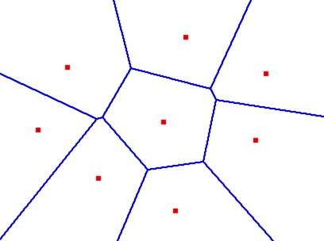
Result Validation
Associate a validation condition with each query answer
Valid time (t):
  The query answer is valid for the next t time units
Valid region (R)
  The query answer is valid as long as you are within a region R
It is challenging to maintain the computation of valid time/region for querying moving objects
Once the associated validation condition expires, the query will be reevaluated
Location-aware Query Processing and Optimization: A Tutorial, Mohamed F. Mokbel, Walid G. Aref

Slide 42
Caching the Result
Observation: Consecutive evaluations of a continuous query yield very similar results
Idea: Upon evaluation of a continuous query, retrieve more data that can be used later
K-NN query
  Initially, retrieve more than k
Range query
  Evaluate the query with a larger range
How much do we need to pre-compute?
How do we do re-caching?
Location-aware Query Processing and Optimization: A Tutorial, Mohamed F. Mokbel, Walid G. Aref

Slide 43
Predicting the Result
Given a future trajectory movement, the query answer can be pre-computed in advance
The trajectory movement is divided into N intervals, each with its own query answers A_{i}
Nearest-Neighbor Query
The query is evaluated once (as a snapshot query). Yet, the answer is valid for longer time periods
Once the trajectory changes, the query will be reevaluated
Location-aware Query Processing and Optimization: A Tutorial, Mohamed F. Mokbel, Walid G. Aref

Slide 44
Incremental Evaluation
The query is evaluated only once. Then, only the updates of the query answer are evaluated
There are two types of updates. Positive and Negative updates
Query Result
Only the objects that cross the query boundary are taken into account
+
_
Need to continuously listen for notifications that someone crosses the query boundary
+
Location-aware Query Processing and Optimization: A Tutorial, Mohamed F. Mokbel, Walid G. Aref

Slide 45
Outline
Location-aware Environments
Location-aware Snapshot Query Processing
Location-aware Continuous Query Processing
Scalable Execution of Continuous Queries
  Location-aware Centralized Database Systems
  Location-aware Distributed Database Systems
  Location-aware Data Stream Management Systems
Location-aware Query Optimizer
Uncertainty in Location-aware Query Processing
Location-aware Query Processing and Optimization: A Tutorial, Mohamed F. Mokbel, Walid G. Aref

Slide 46
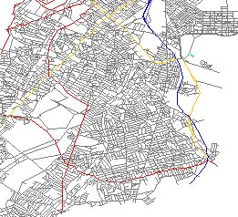
Queries as Data – Motivation
Continuous
Location-aware Database Server
Continuous
K-NN Query
Range Query
Keep me updated by nearest 3 hospitals
How many cars in the highlighted area?
Make sure that the nearest 3 airplanes are FRIENDLY
Alert me if there are less than 3 police cars within 5 miles
Monitor the traffic in the red areas
Continuous
Continuous
Continuous
K-NN Query
Range Query
Range Query
46
Location-aware Query Processing and Optimization: A Tutorial, Mohamed F. Mokbel, Walid G. Aref

Slide 47
Main Concepts
Continuous queries last for long times at the server side
  While a query is active in the server, other queries will be submitted
  Shared execution among multiple queries
Should we index data OR queries?
  Data and queries may be stationary or moving
  Data and queries are of large size
  Data and queries arrive to the system with very high rates
  Treat data and queries similarly
Queries are coming to data OR data are coming to queries?
  Both data and queries are subjected to each other
  Join data with queries
47
Location-aware Query Processing and Optimization: A Tutorial, Mohamed F. Mokbel, Walid G. Aref

Slide 48
Main Concepts (Cont.)
Each query is a single thread
One thread for all continuous queries
. . .
Q₁
Q₂
Q_{N}
. . .
. . .
. . .
Split
. . .
ST Query 1
ST Query 2
ST Query N
Shared ST Join
D-
D-
D-
D-
Q-
Index
Index
Index
Index
Index
Data Objects
Data Objects
Data Objects
Data Objects
ST Queries
Evaluating a large number of concurrent continuous spatio-temporal queries is abstracted as a spatio-temporal join between moving objects and moving queries
Location-aware Query Processing and Optimization: A Tutorial, Mohamed F. Mokbel, Walid G. Aref

Slide 49
Location-aware Data Stream Management Systems
Cache Area
Only significant objects are stored in-memory
An object is considered significant if it is either in the query area or the cache area
Due to the query and object movements, a stored object may become insignificant at any time
Larger cache area indicates more storage overhead and more accurate answer
49
Location-aware Query Processing and Optimization: A Tutorial, Mohamed F. Mokbel, Walid G. Aref

Slide 50
Location-aware Data Stream Management Systems (Cont.)
The first k objects are considered an initial answer
K-NN query is reduced to a circular range query
However, the query area may shrink or grow
K = 3
Location-aware Query Processing and Optimization: A Tutorial, Mohamed F. Mokbel, Walid G. Aref

Slide 51
Location-aware Data Stream Management Systems (Cont.)
Each query is a single thread
One thread for all continuous queries
Q₁
Q₂
Q_{N}
Q₁
Q₂
Q_{N}
. . .
. . .
. . .
. .
. .
. .
+/-
+/-
+/-
+/-
+/-
+/-
Stationary Range
Moving kNN
. . .
Moving Range
Shared Operator
Split
Shared Memory Buffer among all C. Queries
Shared Spatio-temporal Join
Stream of Moving Objects
Stream of Moving Objects
Stream of Moving Queries
Location-aware Query Processing and Optimization: A Tutorial, Mohamed F. Mokbel, Walid G. Aref

Slide 52
Location-aware Data Stream Management Systems (Cont.)
Query Load Shedding
  Reduce the cache area
  Possibly reduce the query area
  Immediately drop insignificant tuples
  Intuitive and simple to implement
Object Load Shedding
  Objects that satisfy less than k queries are insignificant
  Lazily drop insignificant tuples
  Challenge I: How to choose k?
  Challenge II: How to provide a lower bound for the query accuracy?
2
1
6
5
3
4
7
K = 2
Location-aware Query Processing and Optimization: A Tutorial, Mohamed F. Mokbel, Walid G. Aref

Slide 53
Tutorial Outline
Location-aware Environments
Location-aware Snapshot Query Processing
Location-aware Continuous Query Processing
Scalable Execution of Continuous Queries
Location-aware Query Optimization
Uncertainty in Location-aware Query Processing
Location-aware Query Processing and Optimization: A Tutorial, Mohamed F. Mokbel, Walid G. Aref

Slide 54
Location-aware Query Optimization
Spatio-temporal pipelinable query operators
  Range queries
  Nearest-neighbor queries
Selectivity estimation for spatio-temporal queries/operators
  Spatio-temporal histograms
  Sampling
Adaptive query optimization for continuous queries
Location-aware Query Processing and Optimization: A Tutorial, Mohamed F. Mokbel, Walid G. Aref

Slide 55
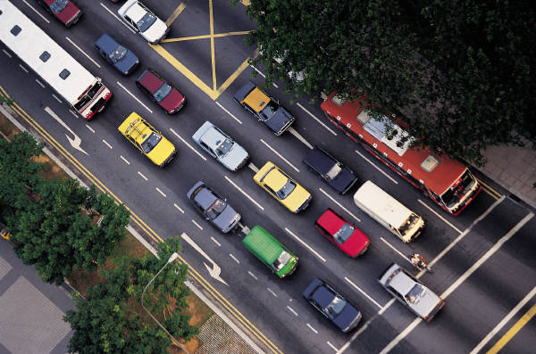
Spatio-temporal Query Operators
Existing Approaches are Built on Top of DBMS (at the Application Level)
Continuously report the trucks in this area
Scalar functions (Stored procedure)
Only produce objects in the areas of interest
SELECT O. ID
FROM Objects O
WHERE O.type = truck
INSIDE Area A
The performance of scalar functions is limited
Database Engine
Database Engine
Spatio-temporal Operators
55
Location-aware Query Processing and Optimization: A Tutorial, Mohamed F. Mokbel, Walid G. Aref

Slide 56
Spatio-temporal Query Operators
“Continuously report the Avis cars in a certain area”
SELECT M.ObjectID
FROM MovingObjects M, AvisCars A
WHERE M.ID = A.ID
INSIDE RegionR
Scalar Function
Spatio-temporal Operators
Scalar Function
+/-
+/-
INSIDE
JOIN
+/-
JOIN
AvisCars
INSIDE
AvisCars
Moving Objects
Moving Objects
Location-aware Query Processing and Optimization: A Tutorial, Mohamed F. Mokbel, Walid G. Aref

Slide 57
Spatio-temporal Selectivity Estimation
Estimating the selectivity of spatio-temporal operators is crucial in determining the best plan for spatio-temporal queries
SELECT ObjectID
FROM MovingObjects M
WHERE Type = Truck
INSIDE Region R
SELECT
INSIDE
INSIDE
SELECT
Location-aware Query Processing and Optimization: A Tutorial, Mohamed F. Mokbel, Walid G. Aref

Slide 58
Spatio-temporal Histograms
Moving objects in D-dimensional space are mapped to 2D-dimensional histogram buckets
x
x
t
t
Location-aware Query Processing and Optimization: A Tutorial, Mohamed F. Mokbel, Walid G. Aref

Slide 59
Spatio-temporal Histograms with Query Feedback
Estimating the selectivity of spatio-temporal operators is crucial in determining the best plan for spatio-temporal queries
10%
6.25%
6.25%
6.25%
6.25%
6.98%
6.98%
6.01%
6.01%
Q1
Query
6.25%
6.25%
6.25%
6.25%
6.98%
6.98%
6.01%
6.01%
Query Optimizer
Spatio-temporal Histogram
6.25%
6.25%
6.25%
6.25%
Query plan
6.01%
6.01%
6.01%
6.01%
Feedback
Query Executer
6.25%
6.25%
6.25%
6.25%
6.01%
6.01%
6.01%
6.01%
Location-aware Query Processing and Optimization: A Tutorial, Mohamed F. Mokbel, Walid G. Aref

Slide 60
Adaptive Query Optimization
Continuous queries last for long time (hours, days, weeks)
  Environment variables are likely to change
  The initial decision for building a query plan may not be valid after a while
Need continuous optimization and ability to change the query plan:
  Training period: Spatio-temporal histogram, periodicity mining
  Online detection of changes
SELECT ObjectID
FROM MovingObjects M
WHERE Type = Truck
INSIDE Region R
SELECT
INSIDE
INSIDE
SELECT
Moving Objects
Moving Objects
Location-aware Query Processing and Optimization: A Tutorial, Mohamed F. Mokbel, Walid G. Aref

Slide 61
Uncertainty in Moving Objects
Location information from moving objects is inherently inaccurate
Sources of uncertainty:
  Sampling. A moving object sends its location information once every t time units. Within any two consecutive locations, we have no clue about the object’s exact location
  Reading accuracy. Location-aware devices do not provide the exact location
  Object movement and network delay. By the time that a certain reading is received by the server, the moving object has already changed its location
Location-aware Query Processing and Optimization: A Tutorial, Mohamed F. Mokbel, Walid G. Aref

Slide 62
Uncertainty in Moving Objects
Historical data (Trajectories)
Current data
T₁
T₀+Є₂
T₀+Є₀
T₀
T₀+Є₁
Location-aware Query Processing and Optimization: A Tutorial, Mohamed F. Mokbel, Walid G. Aref

Slide 63
Error in Query Answer
Range Queries
Nearest Neighbor Queries
Location-aware Query Processing and Optimization: A Tutorial, Mohamed F. Mokbel, Walid G. Aref

Slide 64
Representing Uncertain Data using Ellipses
Given :
  Start point
  End point
  Maximum possible speed ➔ Maximum traveling distance S
If S is greater than the distance between the two end points, then the moving object may have deviated from the given route
Location-aware Query Processing and Optimization: A Tutorial, Mohamed F. Mokbel, Walid G. Aref

Slide 65
Representing Uncertain Data using Cylinders
Given:
  Start and end points
Constraint:
  An object would report its location only if it is deviated by a certain distance r from the predicted trajectory
r
Location-aware Query Processing and Optimization: A Tutorial, Mohamed F. Mokbel, Walid G. Aref

Slide 66
Representing Uncertain Data in Road Networks
Given:
  Start and end points
Constraints :
  Deviation threshold r
  Speed threshold v
Location-aware Query Processing and Optimization: A Tutorial, Mohamed F. Mokbel, Walid G. Aref

Slide 67
Querying Uncertain Data Uncertain Keywords
KEYWORDS:
  Probability: possibly, definitely
  Temporal: sometimes, always
  Spatial: somewhere, everywhere
Examples:
  What are the objects that are possibly sometimes within area R at time interval T?
  What are the objects that definitely passed through a certain region?
  Retrieve all the objects that are always inside a certain region
  Retrieve all the objects that are sometimes definitely inside region R
Location-aware Query Processing and Optimization: A Tutorial, Mohamed F. Mokbel, Walid G. Aref

Slide 68
Querying Uncertain Data Uncertain Keywords (Cont.)
Q₄
Q₂
O
Q₃
Q₁
Object O is definitely always in Q₁
Object O is possibly always in Q₂
Object O is definitely sometimes in Q₃
Object O is possibly sometimes in Q₄
Location-aware Query Processing and Optimization: A Tutorial, Mohamed F. Mokbel, Walid G. Aref

Slide 69
Querying Uncertain Data Probabilistic Queries
With each query answer, associate a probability that this answer is true
The answer set of a query Q is represented as a set of tuples <ID, p> where ID is the tuple identifier and p is the probability that the object ID belongs to the answer set of Q
Assumptions:
  Objects can lie anywhere uniformly within their uncertainty region
Location-aware Query Processing and Optimization: A Tutorial, Mohamed F. Mokbel, Walid G. Aref

Slide 70
Querying Uncertain Data Probabilistic Range Queries
A
E
C
D
F
B
Query Answer:
  (B, 50%)
  (C, 90%)
  D
  E
  (F, 30%)
Location-aware Query Processing and Optimization: A Tutorial, Mohamed F. Mokbel, Walid G. Aref

Slide 71
Querying Uncertain Data Probabilistic NN Queries
A
E
C
D
F
B
Query Answer (k=1):
  (C, p₁)
  (D, p₂)
  (E, p₃)
Location-aware Query Processing and Optimization: A Tutorial, Mohamed F. Mokbel, Walid G. Aref

Slide 72
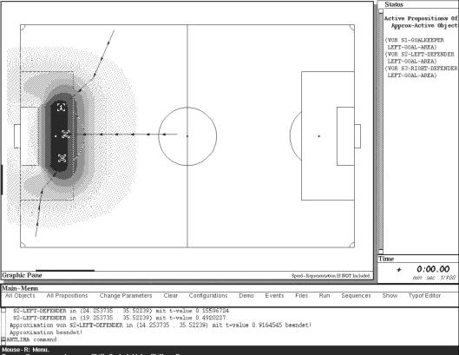
Typicality Potential Fields (TyPoFs)
‘Spieler vor dem Strafraum’

Slide 73
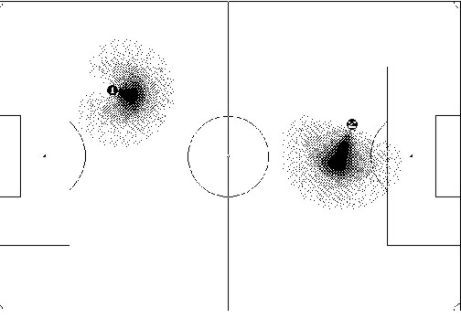
Typicality Potential Fields
TyPoFs for medium (left) and high speeds (right)
J.R.J. Schirra: Bildbeschreibung als Verbindung von visuellem und sprachlichem Raum – Eine interdisziplinäre Untersuchung von Bildvorstellungen in einem Hörermodell. Dissertation. Infix, St. Augustin, 1994

Slide 74
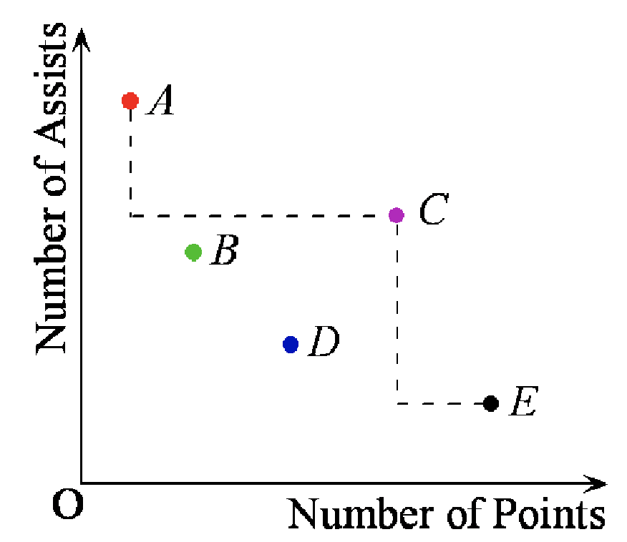
Recap: Skyline Queries
Numeric space D = (D₁, …, D_{n}),
larger values more preferable
Two points, u dominates v (u ≻ v), if
  ∀ D_{i} (1 ≤ i ≤ n), u.D_{i} ≥ v.D_{i}
  ∃ D_{j} (1 ≤ j ≤ n), u.D_{j} > v.D_{j}
Given a set of points S,
Skyline = {u | u ∈ S and u is not
dominated by
any other point}
Example:
C ≻ B, C ≻ D skyline = {A, C, E}
J. Pei, M. Hua, Y. Tao, and X. Lin: Query Answering Techniques on Uncertain and Probabilistic Data, Tutorial, SIGMOD 2008

Slide 75
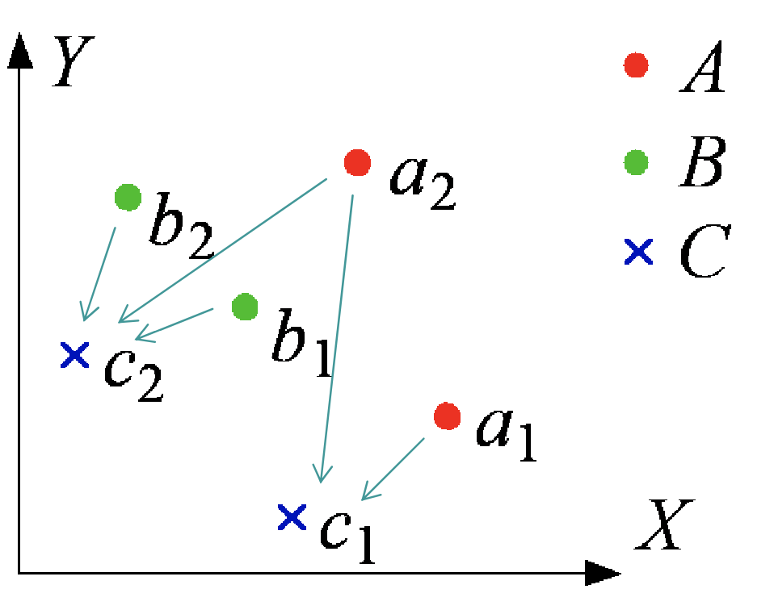
Skylines on Uncertain Data
Limitations of conventional methods
  Aggregates may be misled by outliers
  Data distribution is not captured
Probabilistic skylines
  Objects vs. instances
  An instance has a probability
  to represent the object
  An object has a probability to be in the skyline
Jian Pei, Bin Jiang, Xuemin Lin, and Yidong Yuan. 2007. Probabilistic skylines on uncertain data. In Proc. VLDB ’07, 15–26, 2007.
J. Pei, M. Hua, Y. Tao, and X. Lin: Query Answering Techniques on Uncertain and Probabilistic Data, Tutorial, SIGMOD 2008

Slide 76

A Probabilistic Skyline Model
A set of objects S = {A, B, C},
instances of each
with probability 0.5 to appear
Probabilistic Dominance
– Pr(A ≻ C) = 3/4
– Pr(B ≻ C) = 1/2
– Pr((A ≻ C) ∨(B ≻ C)) = 1
Pr(C is in the skyline) ≠(1 - Pr(A ≻ C)) ×(1 - Pr(B ≻ C))
  Probabilistic dominance Probabilistic skyline
J. Pei, M. Hua, Y. Tao, and X. Lin: Query Answering Techniques on Uncertain and Probabilistic Data, Tutorial, SIGMOD 2008

Slide 77
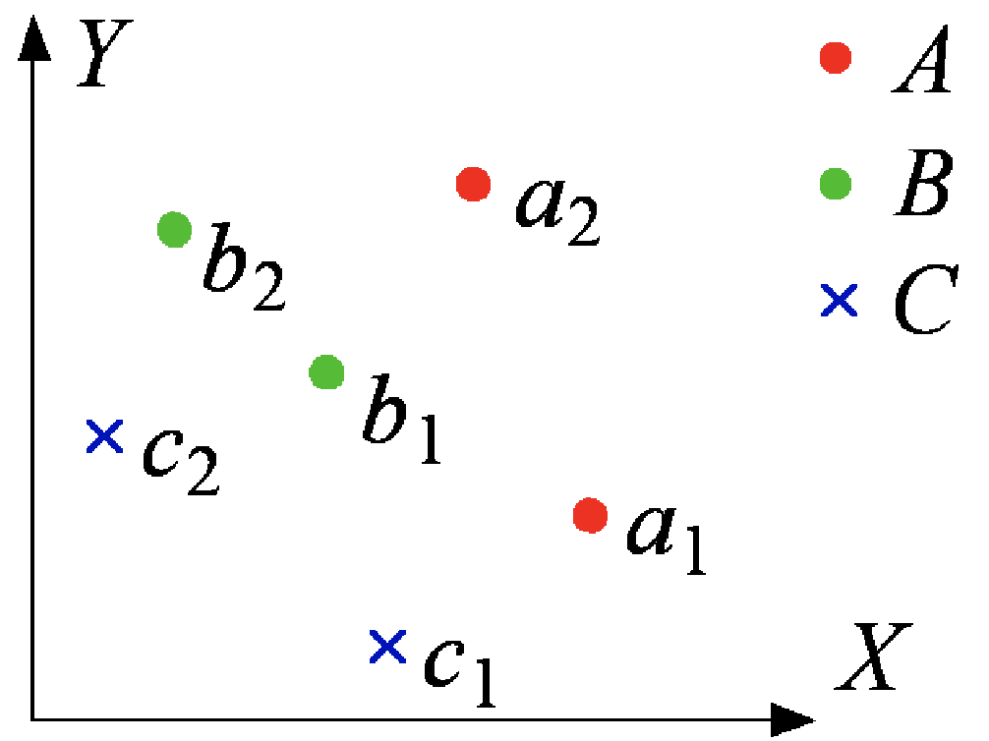
Skyline Probabilities
Possible world: W = <a_{i}, b_{j}, c_{k}> (i, j, k = 1 or 2)
– Pr(W) = 0.5 × 0.5 × 0.5 = 0.125, ∑_{W∈Ω} Pr(W) = 1
SKY(<a₁, b₁, c₁>) = {a₁, b₁}
– Objects A and B are in
SKY(<a₁, b₁, c₁>)
B is in the skyline of possible worlds <a₁, b₁, c₁>,
<a₁, b₁, c₂>, <a₁, b₂, c₁>, and
<a₁, b₂, c₂>
– Pr(B) = 4 × 0.125 = 0.5
Pr(A) = 1, Pr(C) = 0
J. Pei, M. Hua, Y. Tao, and X. Lin: Query Answering Techniques on Uncertain and Probabilistic Data, Tutorial, SIGMOD 2008

Slide 78
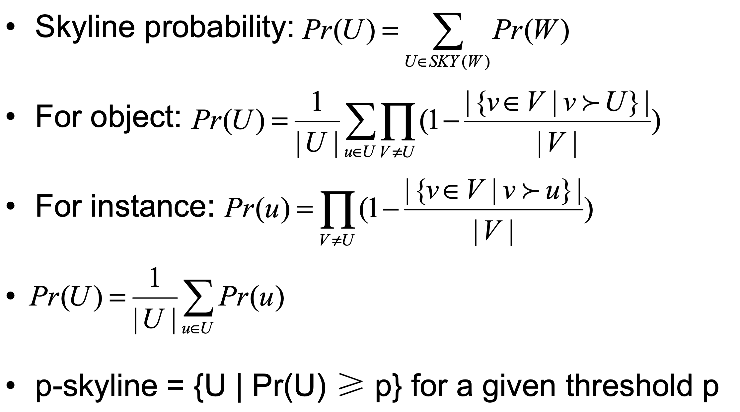
Problem Statement
u
Try to reduce
V candidates
J. Pei, M. Hua, Y. Tao, and X. Lin: Query Answering Techniques on Uncertain and Probabilistic Data, Tutorial, SIGMOD 2008

Slide 79
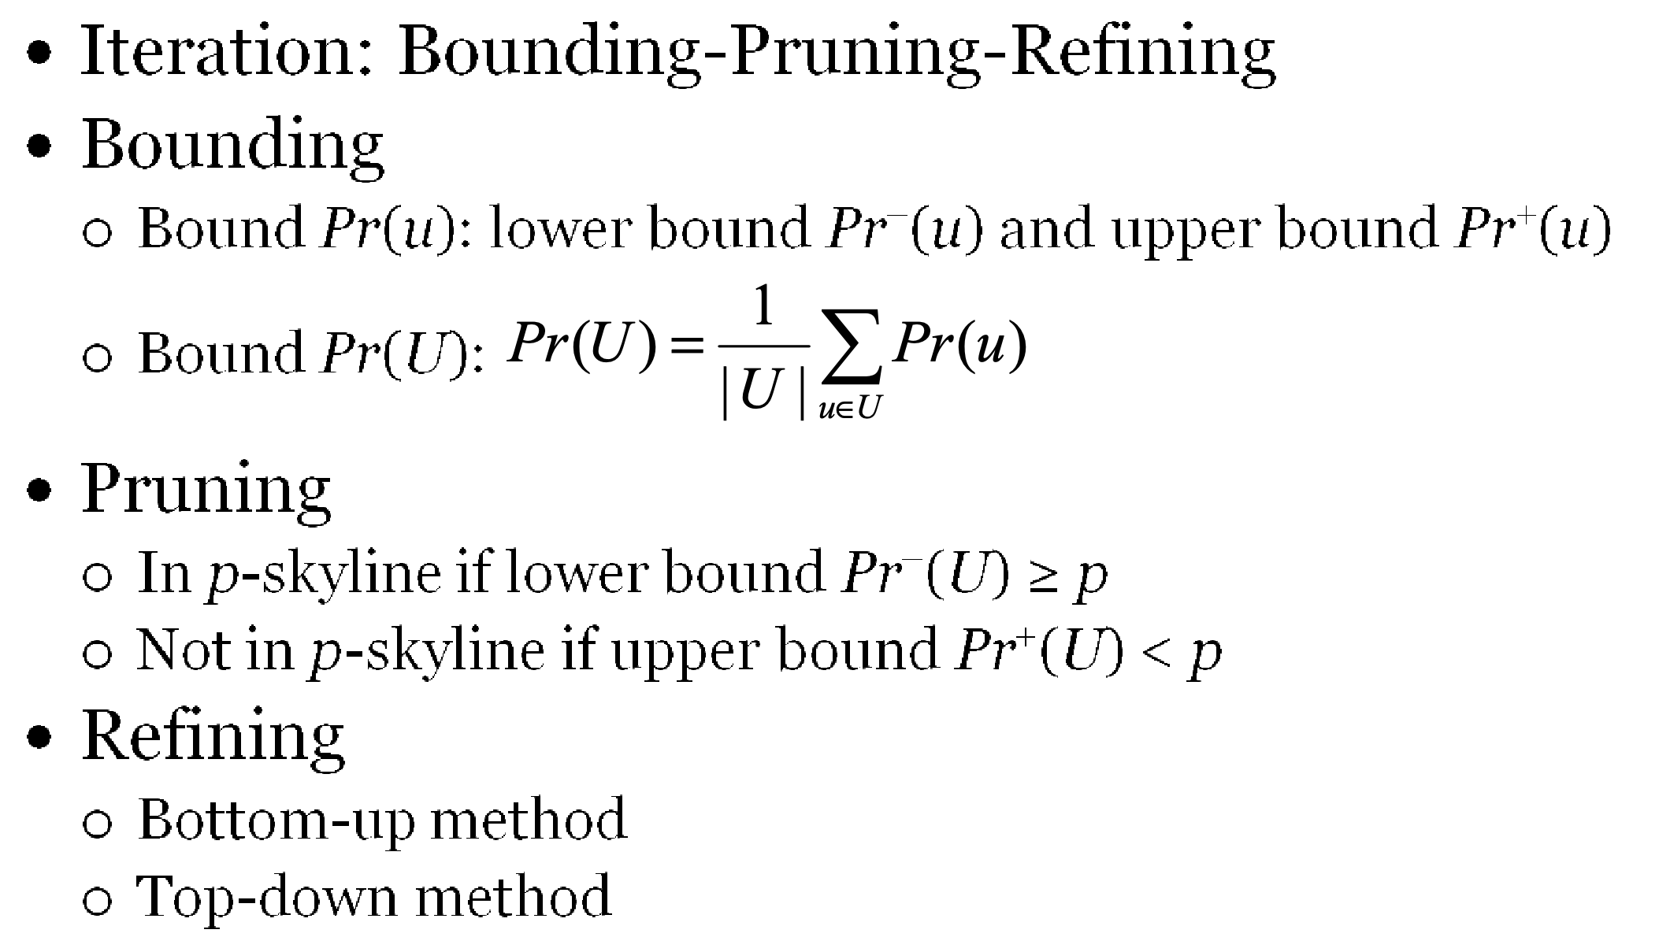
Probabilistic Skyline Computation
J. Pei, M. Hua, Y. Tao, and X. Lin: Query Answering Techniques on Uncertain and Probabilistic Data, Tutorial, SIGMOD 2008

Slide 80
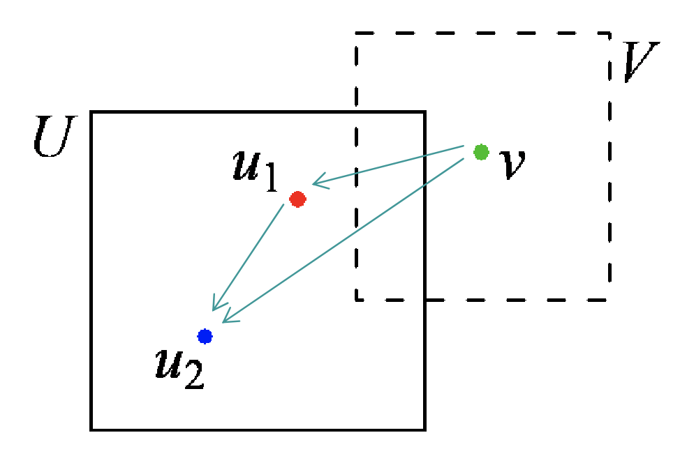
The Bottom-Up Method
Sort instances of an object according to dominance relation
such that their skyline probabilities are in descending order
Two instances u₁ and u₂ ∈ U,
if u₁ ≻ u₂ then Pr(u₁) ≥ Pr(u₂)
Identifiy
V candidates
J. Pei, M. Hua, Y. Tao, and X. Lin: Query Answering Techniques on Uncertain and Probabilistic Data, Tutorial, SIGMOD 2008

Slide 81
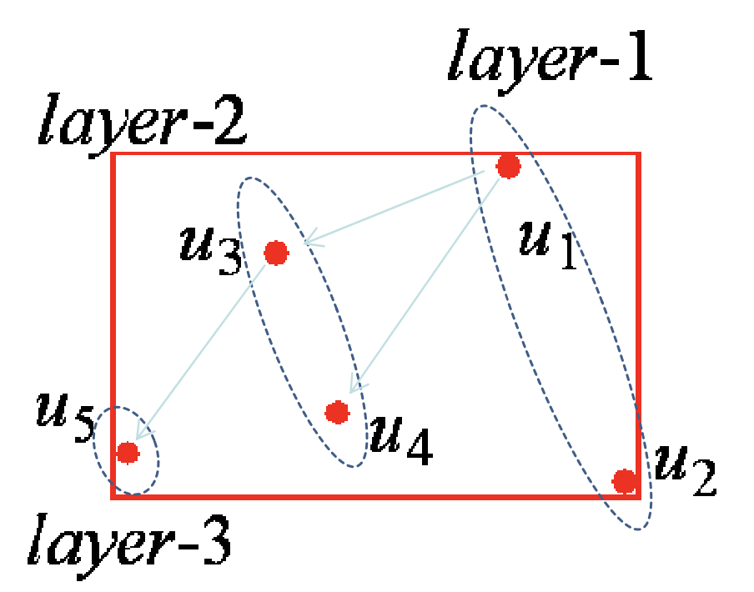
The Layer Structure
layer-1: skyline of all instances
layer-k (k > 1): skyline of instances except those at
layer-1, …, layer-(k-1)
∀ u at layer-k : ∃ u’ at layer-(k-1) :
u’ ≻ u and Pr(u’) ≥ Pr(u)
max{Pr(u) | u is at layer-(k-1)} ≥ max{Pr(u) | u is at layer-k}
Bounding example
– max{Pr(u1), Pr(u2)} ≥ max{Pr(u3), Pr(u4)} ≥ Pr(u5)
J. Pei, M. Hua, Y. Tao, and X. Lin: Query Answering Techniques on Uncertain and Probabilistic Data, Tutorial, SIGMOD 2008

Slide 82
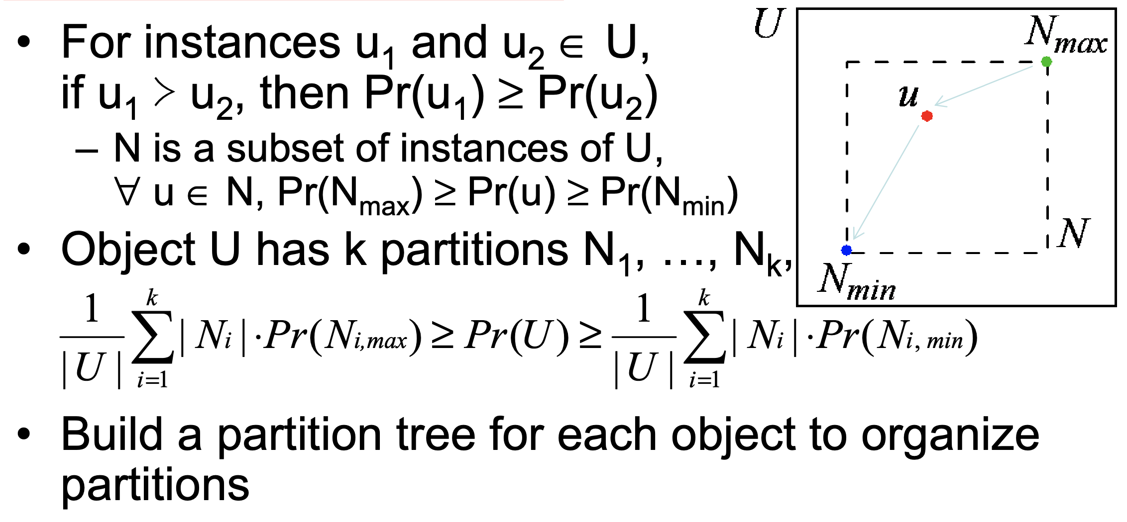
The Top-Down Method
J. Pei, M. Hua, Y. Tao, and X. Lin: Query Answering Techniques on Uncertain and Probabilistic Data, Tutorial, SIGMOD 2008

Slide 83
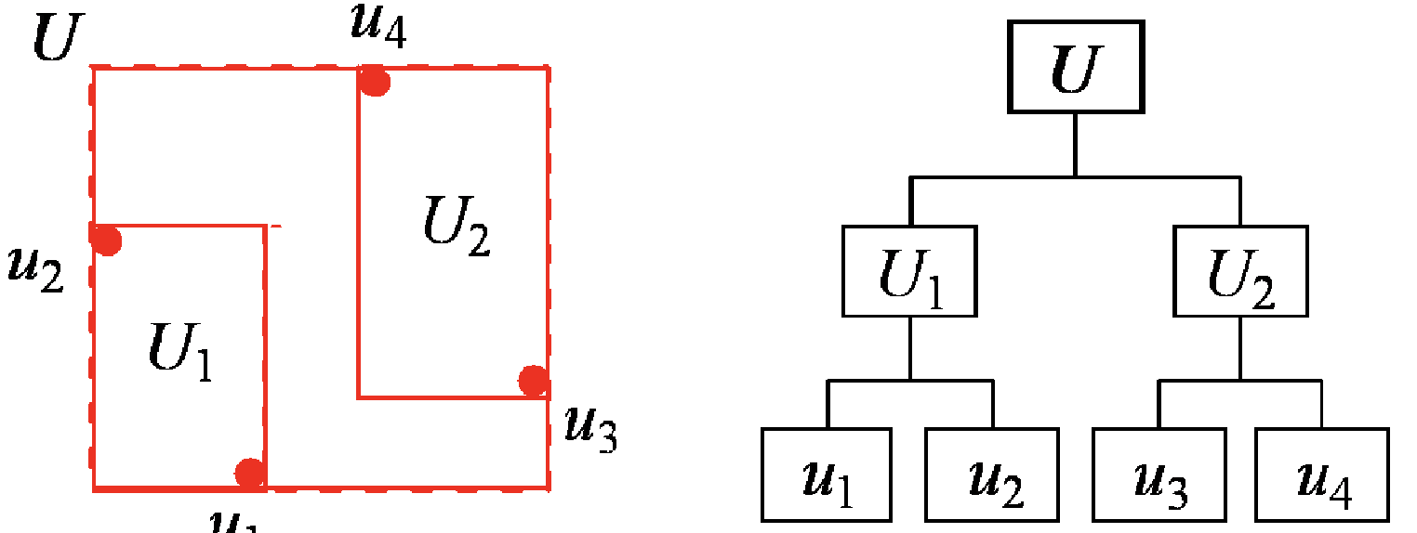
Partition Tree
Binary tree
u₁
Growing one level of the tree in each iteration
  Choose one dimension in a round-robin fashion
  Each leaf node is partitioned into two children nodes, each of which has half of instances
Bound Pr(N_{max}) and Pr(N_{min}) of a partition N
J. Pei, M. Hua, Y. Tao, and X. Lin: Query Answering Techniques on Uncertain and Probabilistic Data, Tutorial, SIGMOD 2008

Slide 84
Summary
Location-aware Environments
Location-aware Snapshot Query Processing
Location-aware Continuous Query Processing
Scalable Execution of Continuous Queries
Location-aware Query Optimizer
Uncertainty in Location-aware Query Processing
Location-aware Query Processing and Optimization: A Tutorial, Mohamed F. Mokbel, Walid G. Aref

