Slide 1
Intelligent Agents
Topic Analysis: pLSI and LDA
Ralf Möller
Universität zu Lübeck
Institut für Informationssysteme

Slide 2
Summary and Agenda
IR Agents
  Task/goal: Information retrieval
  Agents visits document repositories and returns doc recommendations
  Means:
    Vector space (bag-of-words)
      Dimension reduction (LSI)
    Probability based retrieval (binary)
      Language models
Today: Language models with dimension reduction
  Probabilistic Latent Semantic Indexing (pLSI)
  Latent Dirichlet Allocation (LDA): Topic Models
Soon: What agents can take with them
  What agents can leave at the repository (win-win)
Non-standard Databases and Data Mining

Slide 3
Acknowledgments
Ramesh M. Nallapati
presentation on
Generative Topic Models for Community Analysis
&
Sina Miran
presentation on
Probabilistic Latent Semantic Indexing (PLSI)
&
David M. Blei
presentation on
Probabilistic Topic Models

Slide 4
Topic Models
Statistical methods that analyze the words of texts
in order to:
  Discover the themes that run through them (topics)
  How those themes are connected to each other
  How they change over time
Just for illustration purposes

Slide 5
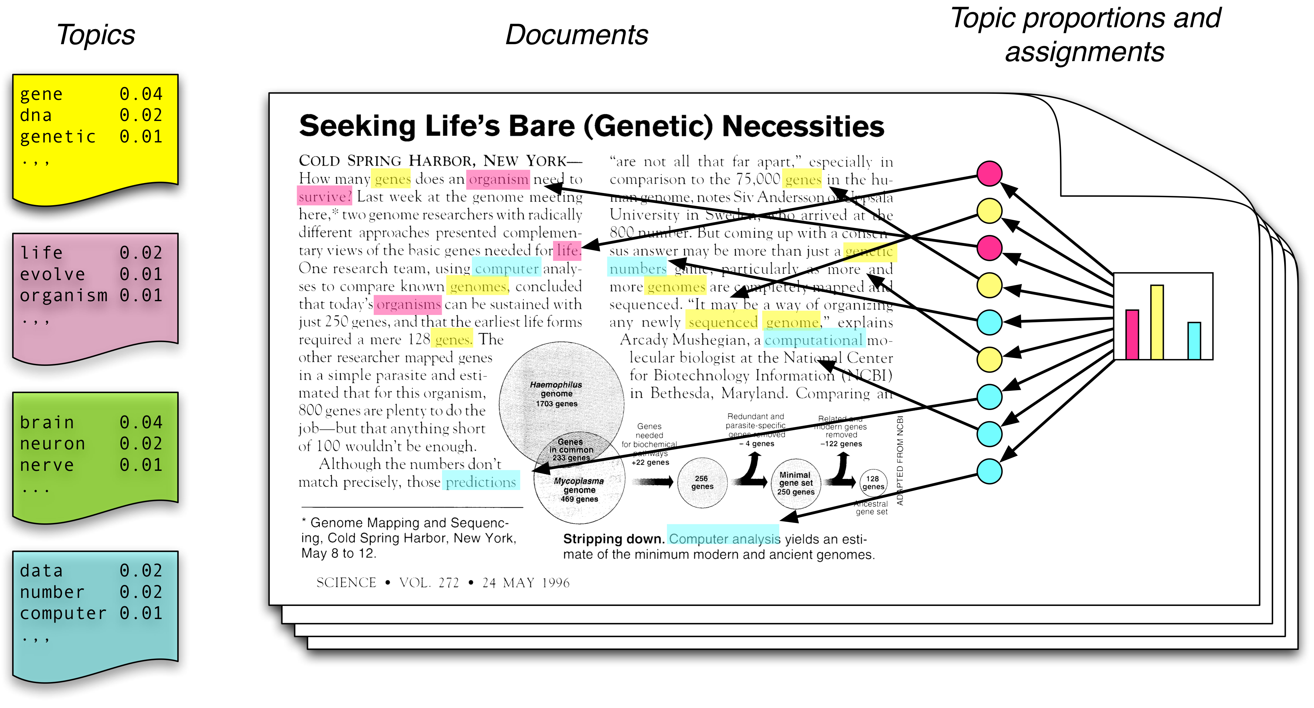
Topic Modeling Scenario
Each topic is a distribution over words
Each document is a mixture of corpus-wide topics
Each word is drawn from one of those topics

Slide 6
Topic Modeling Scenario
In reality, we only observe the documents
The other structures are hidden variables
Topic modeling algorithms infer these variables from data

Slide 7
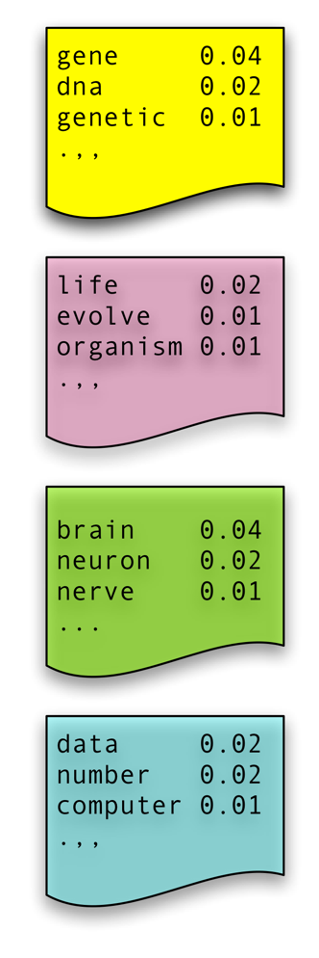
Plate Notation
Naïve Bayes Model: Compact representation
  C = topic/class (name for a word distribution)
  N = number of words in document
  W_{i} one specific word in corpus
  M documents, W now words in documents
  Idea: Generate doc from P(W, C)
C
C
…..
w₁
w₂
w₃
w_{N}
W
M
N
M

Slide 8
Generative vs. Descriptive Models
Generative models: Learn P(x, y)
  Tasks:
    Predict (infer) new data
    Transform P(x,y) into P(y | x) for classification
  Advantages
    Assumptions and model are explicit
    Use well-known algorithms
Descriptive models: Learn P(y | x)
  Task: Classify data
  Advantages
    Fewer parameters to learn
    Better performance for classification
Notes:
So discriminative algorithms try to learn p ( y | x ) directly from the data and then try to classify data. On the other hand, generative algorithms try to learn
p ( x , y ) which can be transformed into p ( y | x ) later to classify the data. One of the advantages of generative algorithms is that you can use p ( x , y ) to generate new data similar to existing data. On the other hand, discriminative algorithms generally give better performance in classification tasks.

Slide 9
Forward Sampling No Evidence
Input: Bayesian network
X= {X₁,…,X_{N}}, N- #nodes, T - # samples
Output: T samples
Process nodes in topological order – first process the ancestors of a node, then the node itself:
For t = 0 to T
For i = 0 to N
X_{i} ← sample x_{i}^{t} from P(x_{i} | pa_{i})
M. Henrion, "Propagating uncertainty in Bayesian networks by
probabilistic logic sampling”, Uncertainty in AI, pp. = 149-163, 1988

Slide 10
Sampling A Value
What does it mean to sample x_{i}^{t} from P(X_{i} | pa_{i}) ?
Assume D(X_{i})={0,1}
Assume P(X_{i} | pa_{i}) = (0.3, 0.7)
Draw a random number r from [0,1]
If r falls in [0,0.3], set X_{i} = 0
If r falls in [0.3,1], set X_{i}=1
0
0.3
r
1

Slide 11
Forward Sampling (Example)
Rejection sampling
(rather inefficient)

Slide 12
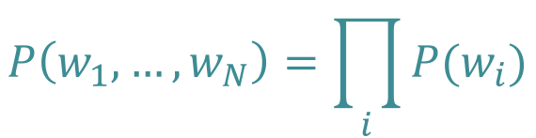
Earlier Topic Models: Topics Known
Unigram
  No context information
W
N
$$P\left(w_{1},…,w_{N}\right)=\prod_{i}{P(w_{i})}$$
Automatically generated sentences from a unigram model
Notes:
Just all words over all documents

Slide 13
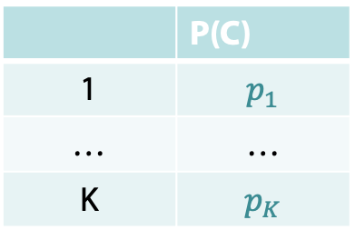
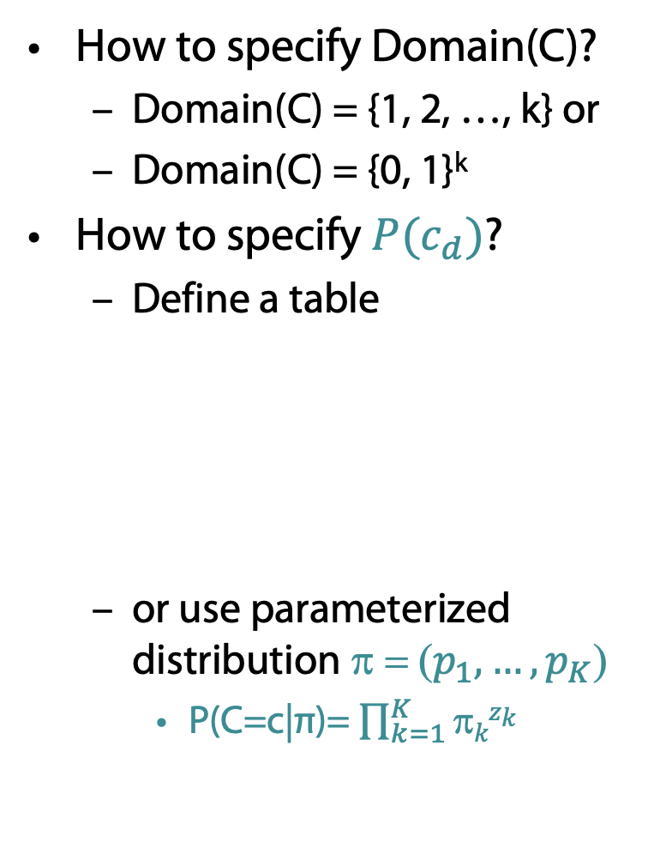
Multinomial Naïve Bayes
How to specify Domain(C)?
  Domain(C) = {1, 2, …, k} or
  Domain(C) = {0, 1}^{k}
How to specify $P(c_{d})$?
  Define a table
  or use parameterized distribution π = ($p_{1},…,p_{K}$)
    P(C=c|π)= $\prod_{k=1}^{K}{\text{π}kzk}$
π
C
Indication vector
c=(z₁,…z_{k})⊤ ∈ {0, 1}^{K}
 | P(C)
1 | $$p_{1}$$
… | …
K | $$p_{K}$$
W
N
M
β

Slide 14
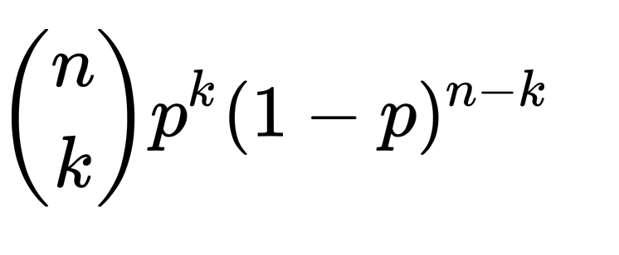
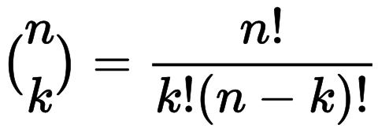
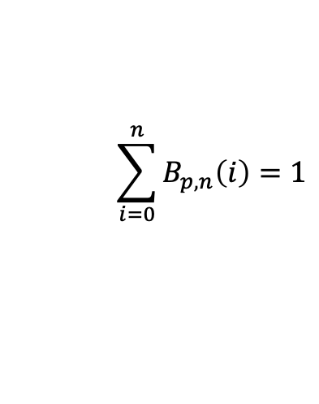
Recap: Binomial Distribution
Web and Data Science
Describes the number of successes in a series of independent trials with two possible outcomes “success” or “no success”
  n = #trials
  p = #successful trials / n
Description of frequency
of having exactly k
successful trials as
a function
B_{p, n}(k) =
Es gilt:
If n=1: Bernoulli distribution
B_{p, n}(k)
$$\sum_{i=0}^{n}{B_{p, n}\left(i\right)}=1$$
k
Notes:
Frage: wie groß ist die Wahrscheinlichkeit dafür, dass das Ereignis E genau k-mal eintritt, wenn man Zufallsexperiment genau n-mal durchführt

Slide 15
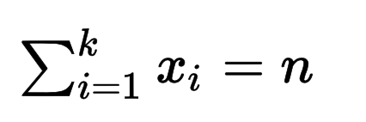

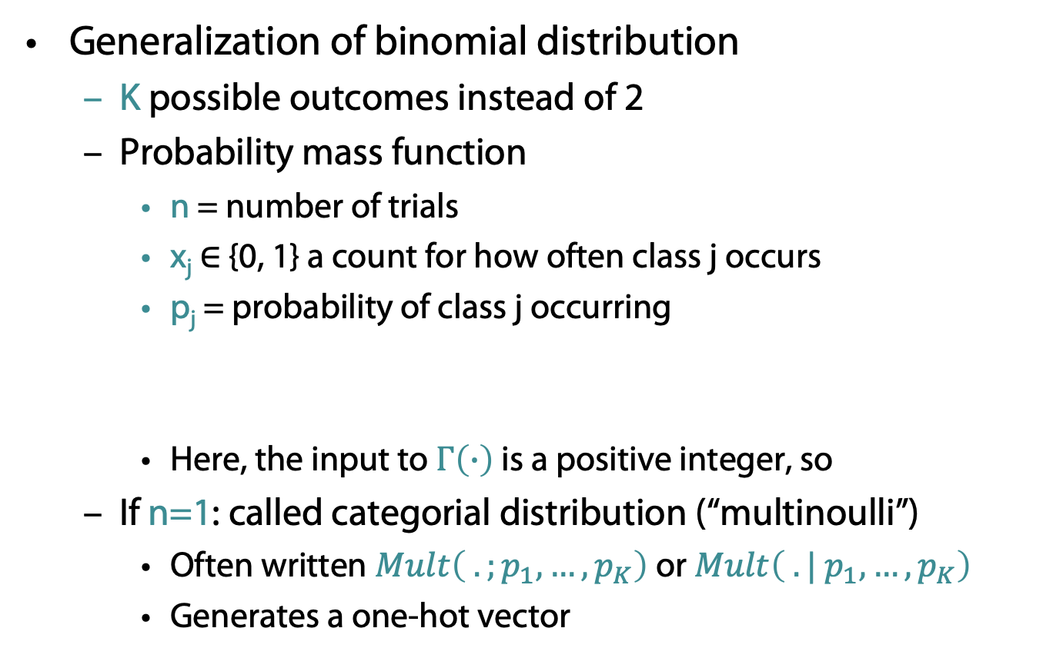

Multinomial Distribution Mult(n | π)
Generalization of binomial distribution
  K possible outcomes instead of 2
  Probability mass function
    n = number of trials
    x_{j} ∈ {0, 1} a count for how often class j occurs
    p_{j} = probability of class j occurring
    Here, the input to $Γ\left(∙\right)$ is a positive integer, so
  If n=1: called categorial distribution (“multinoulli”)
    Often written $Mult\left( . ;p_{1},…,p_{K}\right)$ or $Mult\left( . | p_{1},…,p_{K}\right)$
    Generates a one-hot vector
$$Mult\left(x_{1},…,x_{K};p_{1},…,p_{K}\right)=\frac{Γ\left(\sum_{i}{x_{i}+1}\right)}{\prod_{i}{Γ(x_{i}+1)}}\prod_{i=1}^{K}{p_{i}^{x_{i}}}$$
$$Γ\left(n\right)=\left(n−1\right)!$$

Slide 16
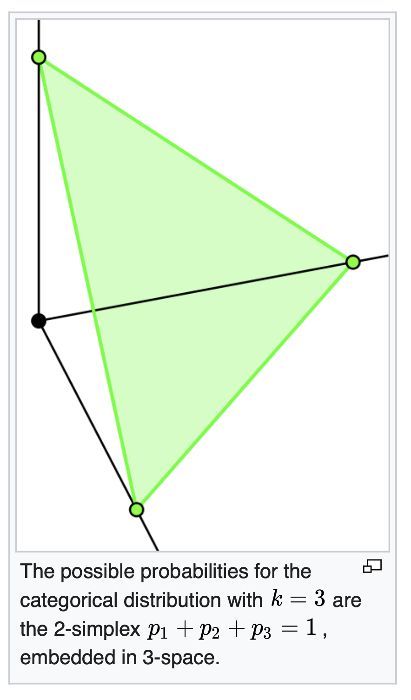
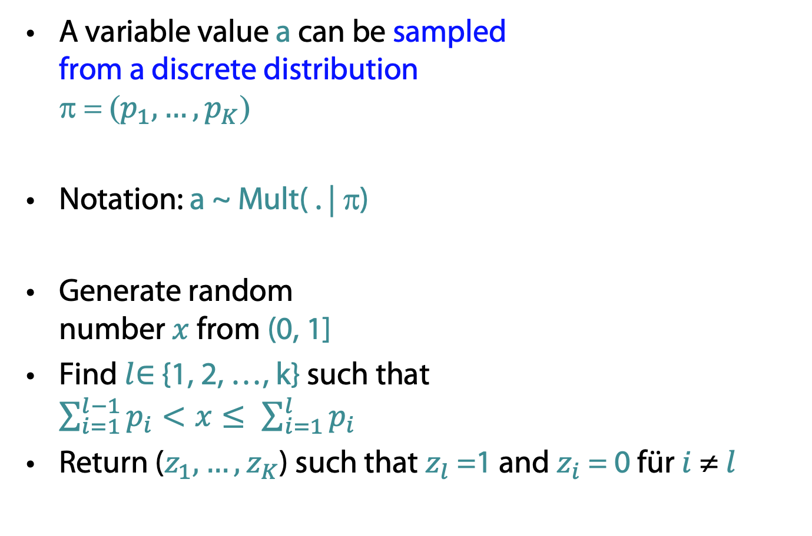
Sampling
A variable value a can be sampled
from a discrete distribution
π = ($p_{1},…,p_{K}$)
Notation: a ~ Mult( . | π)
Generate random
number $x$ from (0, 1]
Find $l$∈ {1, 2, …, k} such that
$\sum_{i=1}^{l−1}{p_{i}}<x≤ \sum_{i=1}^{l}{p_{i}}$
Return ($z_{1},…,z_{K}$) such that $z_{l}$ =1 and $z_{i}$ = 0 für $i$≠ $l$
One-hot vector to be generated with
position probability
of indicator
controlled by π

Slide 17

Multinomial with Matrices
Let $β$ be a $K×V$ matrix (V vocabulary size), each row denotes a word distribution of a topic
Select row k before applying multinomial:
  Notation: Mult( . | $β$_{k}) or Mult( . | $β, k$) or Mult( . |$k, β$)
T
T
T
T

Slide 18

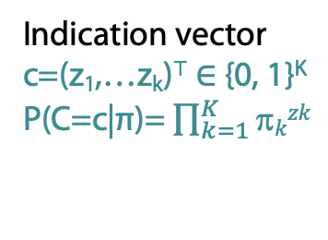
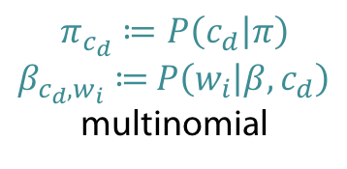
Mixture of Unigrams: Known Topics
Multinomial Naïve Bayes
  For each document d = 1, …, M
    Generate c_{d} ~ Mult( . | π)
    For each position i = 1, ... , N_{d}
      Generate w_{i} ~ Mult( . | β, c_{d})
π
= (p₁,…p_{k})⊤
C
Indication vector
c=(z₁,…z_{k})⊤ ∈ {0, 1}^{K}
P(C=c|π)= $\prod_{k=1}^{K}{\text{π}kzk}$
$$\prod_{d=1}^{M}{P\left(w_{1},…,w_{N_{d}},c_{d} | β,π\right)}$$
$$=\prod_{d=1}^{M}{P(c_{d}|π)}\prod_{i=1}^{N_{d}}{P\left(w_{i} | β,c_{d}\right)}=\prod_{d=1}^{M}{π_{c_{d}}\prod_{i=1}^{N_{d}}{β_{c_{d},w_{i}}}}$$
W
N
M
β
$$π_{c_{d}}≔P\left(c_{d} | π\right)$$
$β_{c_{d},w_{i}}≔$ $P\left(w_{i} | β,c_{d}\right)$
multinomial
Notes:
Binomial distribution, where n experiments, prob p of success (n=1: Bernoulli)
K successes: n over k p^k (1-p)^(n-k)
Multinomial distribution: generalization of binomial with k outcomes instead of 2

Slide 19
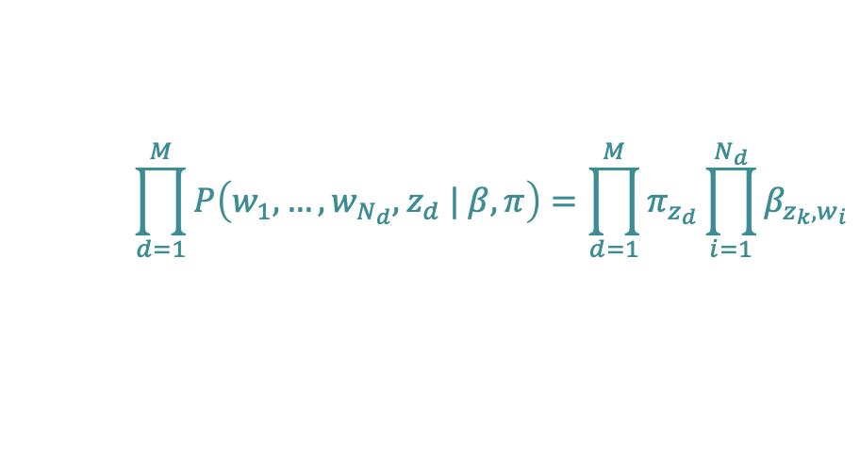
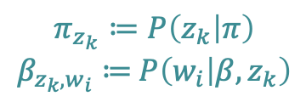
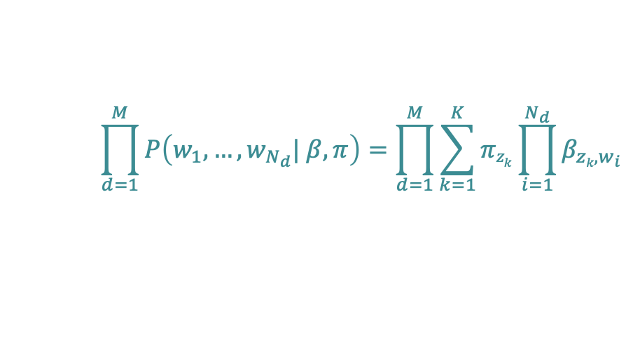
Mixture of Unigrams: Unknown Topics
Topics/classes are hidden
  Joint probability of words and classes
  Sum over topics (K = number of topics)
π
$$\prod_{d=1}^{M}{P\left(w_{1},…,w_{N_{d}},z_{d} | β,π\right)}=\prod_{d=1}^{M}{π_{z_{d}}\prod_{i=1}^{N_{d}}{β_{z_{k},w_{i}}}}$$
Z
W
$$\prod_{d=1}^{M}{P\left(w_{1},…,w_{N_{d}}| β,π\right)}=\prod_{d=1}^{M}{\sum_{k=1}^{K}{{πz}_{k}\prod_{i=1}^{N_{d}}{β_{zk,w_{i}}}}}$$
N
M
β
$$π_{z_{k}}≔P\left(z_{k} | π\right)$$
$β_{z_{k},w_{i}}≔$ $P\left(w_{i} | β,z_{k}\right)$
Kamal Nigam, Andrew Kachites Mccallum, Sebastian Thrun & Tom Mitchell, Learning to Classify Text from Labeled and Unlabeled Documents, Proc. AAAI 98, Pages 792–799, 1998.
Kamal Nigam, Andrew Kachites Mccallum, Sebastian Thrun & Tom Mitchell
Text Classification from Labeled and Unlabeled Documents using EM
Journal of Machine Learning volume 39, pages 103–134, 2000.

Slide 20
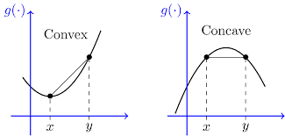
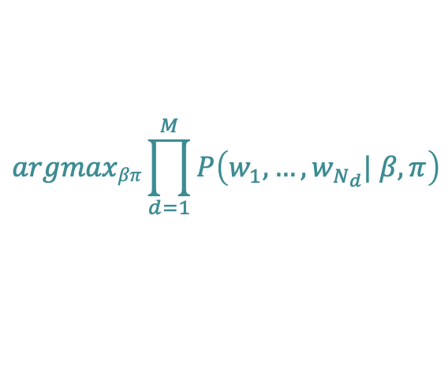
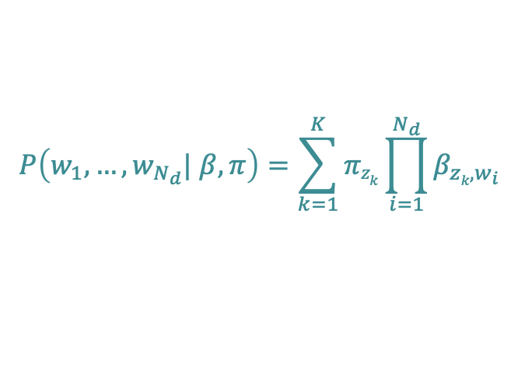



Mixture of Unigrams: Learning
Learn parameters $π$ and $β$
Use likelihood
Solve
  Not a concave/convex function
  Note: a non-concave/non-convex function
  is not necessarily convex/concave
  Possibly no unique max, many saddle or turning points
  No easy way to find roots of derivative
$$argmaxβπ\prod_{d=1}^{M}{P\left(w_{1},…,w_{N_{d}}| β,π\right)}$$
$$P\left(w_{1},…,w_{N_{d}}| β,π\right)=\sum_{k=1}^{K}{{πz}_{k}\prod_{i=1}^{N_{d}}{β_{zk,w_{i}}}}$$
$$\sum_{d=1}^{M}{\log{P\left(w_{1},…,w_{N_{d}}| β,π\right)}}=\sum_{d=1}^{M}{\log{\sum_{k=1}^{K}{{πz}_{k}\prod_{i=1}^{N_{d}}{β_{zk,w_{i}}}}}}$$
$$argmaxβπ\sum_{d=1}^{M}{\log{\sum_{k=1}^{K}{{πz}_{k}\prod_{i=1}^{N_{d}}{β_{zk,w_{i}}}}}}$$

Slide 21
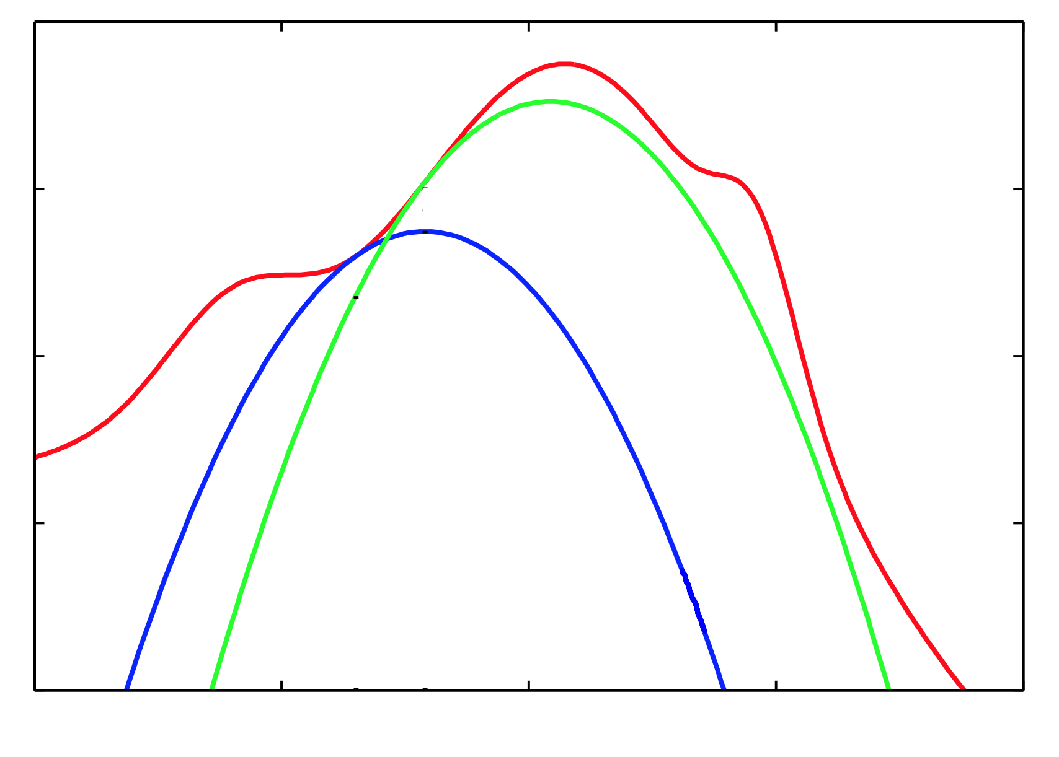

Trick: Optimize Lower Bound
$(γ_{dk}$, 𝜃)

Slide 22
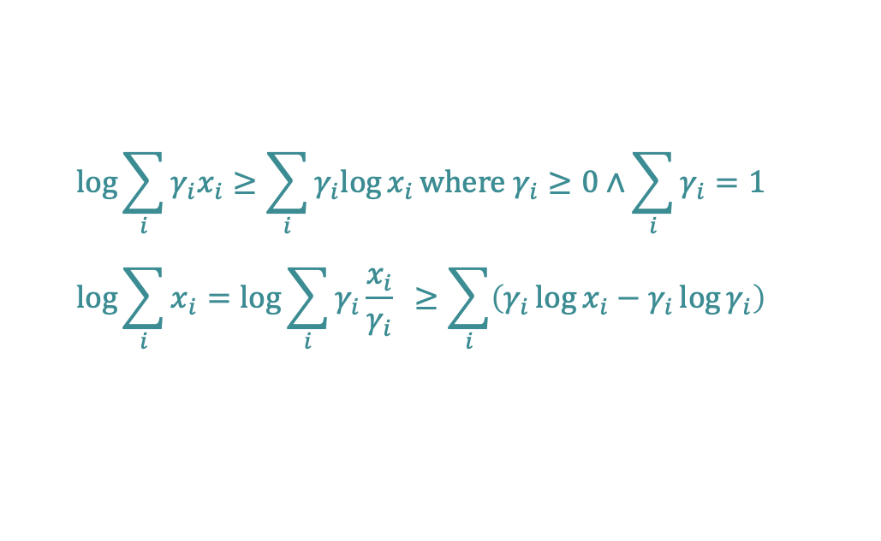


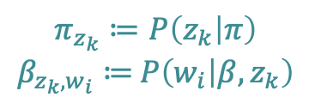

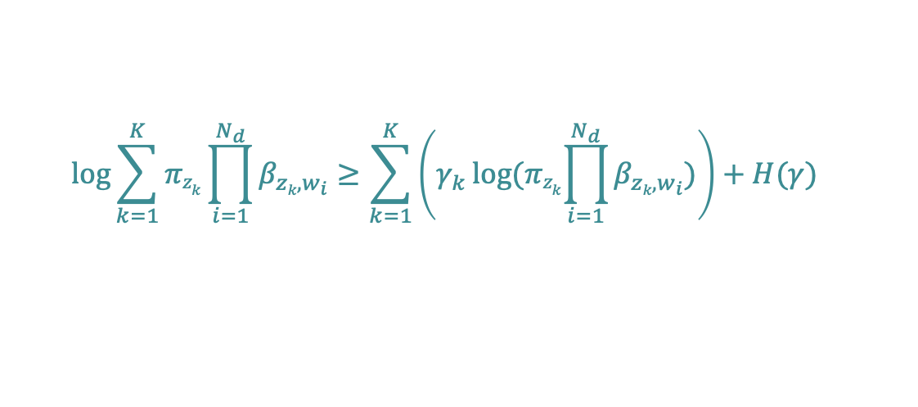
Mixture of Unigrams: Learning
$$π_{z_{k}}≔P\left(z_{k} | π\right)$$
$β_{z_{k},w_{i}}≔$ $P\left(w_{i} | β,z_{k}\right)$
$$argmaxβπ\sum_{d=1}^{M}{\log{\sum_{k=1}^{K}{{πz}_{k}\prod_{i=1}^{N_{d}}{β_{zk,w_{i}}}}}}$$
The problem
Optimize w.r.t. each document
Derive lower bound
a, b distribution
vectors
$$\log{\sum_{i}{γ_{i}x_{i}}}≥\sum_{i}{γ_{i}log{x_{i}}}\text{where} γ_{i}≥0∧\sum_{i}{γ_{i}=1}$$
$$\log{\sum_{i}{x_{i}}}=\log{\sum_{i}{γ_{i}{\frac{x_{i}}{γ_{i}}}} ≥\sum_{i}{\left(γ_{i}\log{x_{i}−γ_{i}\log{γ_{i}}}\right)}}$$
Jensen's inequality
log(a∙b) ≥ a ∙ log b
Entropy of $γ_{di}$ Sometimes called I(.)
H($γ$)
$$\log{\sum_{k=1}^{K}{{πz}_{k}\prod_{i=1}^{N_{d}}{β_{zk,w_{i}}}}}≥\sum_{k=1}^{K}{\left(γ_{k}\log{{(πz}_{k}\prod_{i=1}^{N_{d}}{β_{zk,w_{i}}}})\right)}+H(γ)$$
22

Slide 23
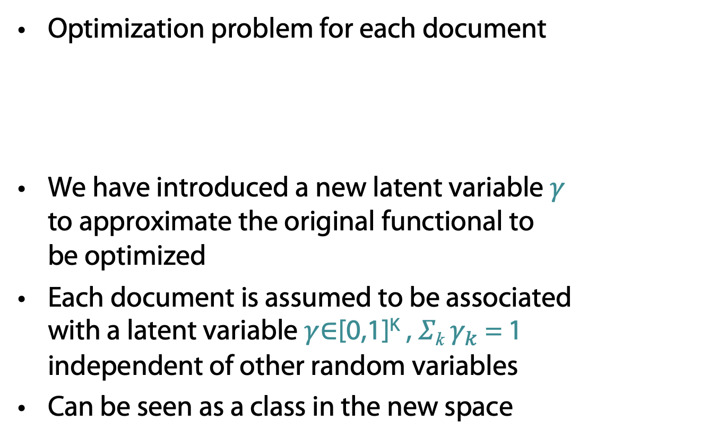

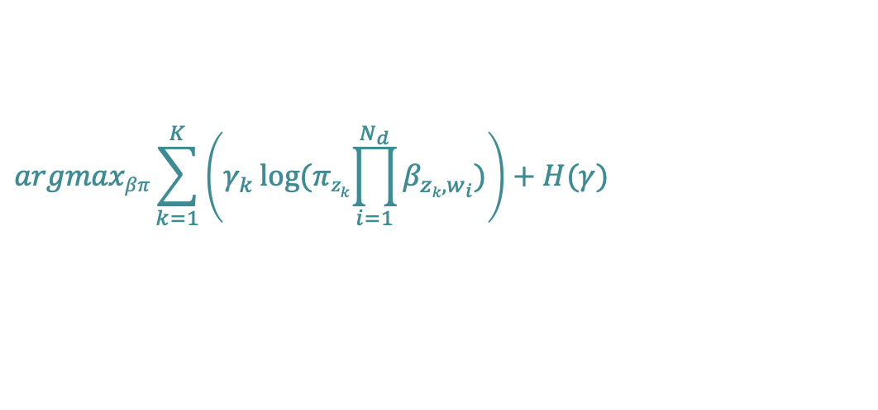
Mixture of Unigrams: Learning
Optimization problem for each document
We have introduced a new latent variable $γ$
to approximate the original functional to
be optimized
Each document is assumed to be associated
with a latent variable $γ$∈[0,1]^{K} , 𝛴_{k} $γ_{k}$ = 1
independent of other random variables
Can be seen as a class in the new space
$$argmaxβπ\sum_{k=1}^{K}{\left(γ_{k}\log{{(πz}_{k}\prod_{i=1}^{N_{d}}{β_{zk,w_{i}}}})\right)}+H(γ)$$
Convex?
Concave?
$${γ_{k}, π}_{z_{k}}, β_{z_{k},w_{i}}$$
Notes:
E: compute gamma based on current model (parameters)
M: update model parameters pi, beta given current gamma

Slide 24
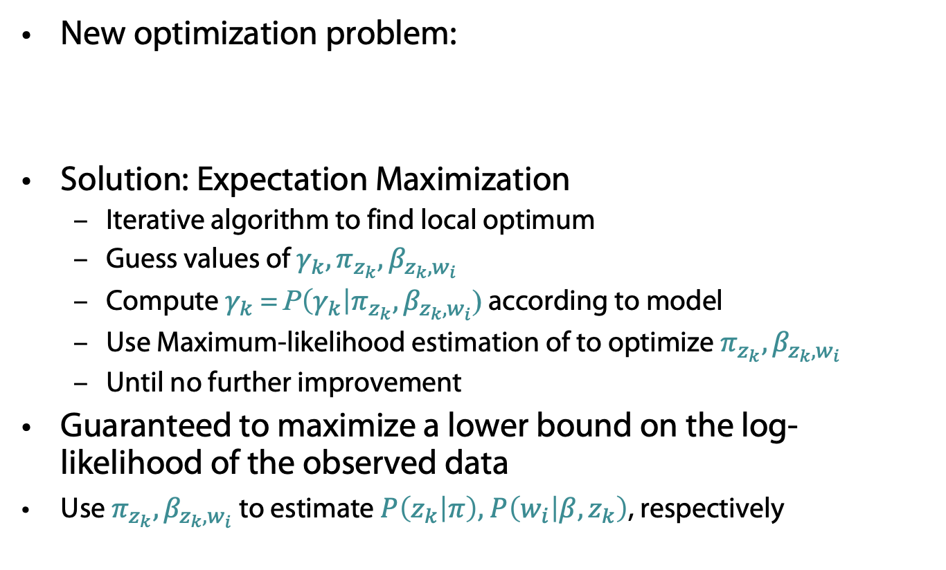

Mixture of Unigrams: Learning
New optimization problem:
Solution: Expectation Maximization
  Iterative algorithm to find local optimum
  Guess values of ${γ_{k}, π}_{z_{k}}, β_{z_{k},w_{i}}$
  Compute $γ_{k}$= P$\left(γ_{k}\right|π_{z_{k}}, β_{z_{k},w_{i}}$) according to model
  Use Maximum-likelihood estimation of to optimize $π_{z_{k}}, β_{z_{k},w_{i}}$
  Until no further improvement
Guaranteed to maximize a lower bound on the log-likelihood of the observed data
Use $π_{z_{k}}, β_{z_{k},w_{i}}$ to estimate $P\left(z_{k} | π\right), P\left(w_{i} | β,z_{k}\right)$, respectively
$$argmaxβπ\sum_{k=1}^{K}{\left(γ_{k}\log{{(πz}_{k}\prod_{i=1}^{N_{d}}{β_{zk,w_{i}}}})\right)}+H(γ)$$
Notes:
E: compute gamma based on current model (parameters)
M: update model parameters pi, beta given current gamma

Slide 25
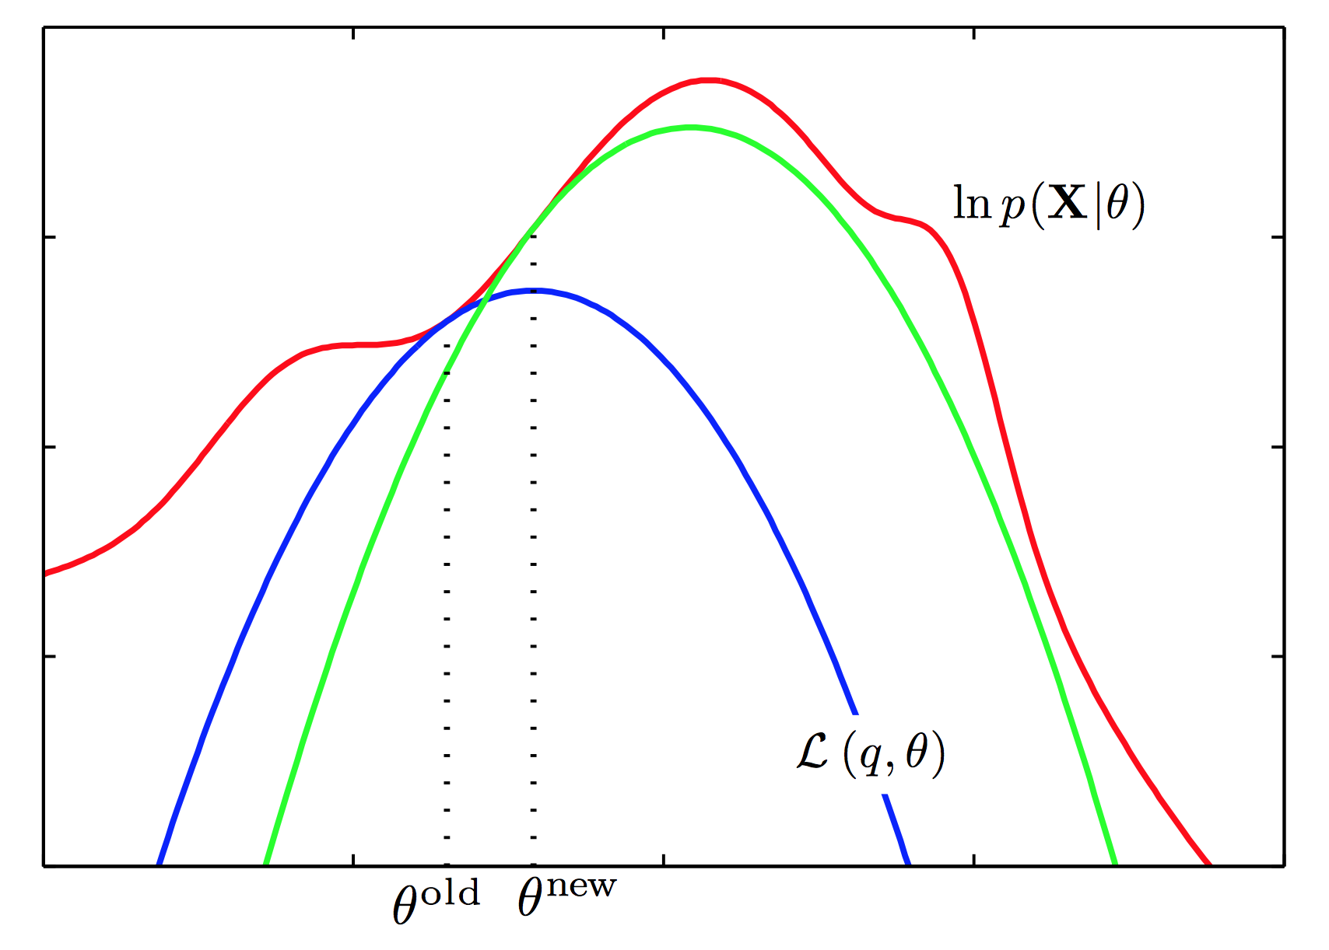


Graphical Idea of the EM Algorithm
Log-likelihood w/ latent variable
$(γ_{k}$, 𝜃)
$\text{θ}=(π_{k}$, $β_{k,w_{i}})$

Slide 26
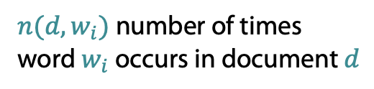

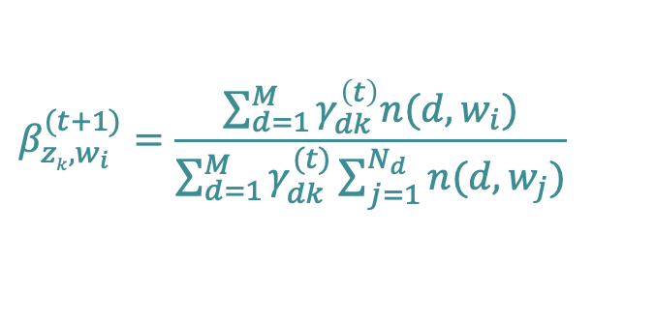
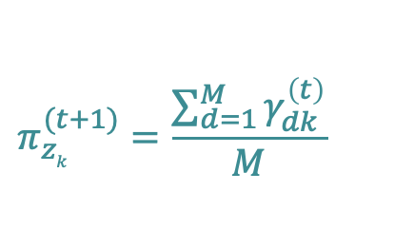
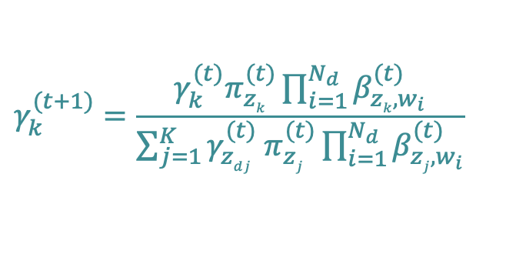
Mixture of Unigrams: Learning
EM solution
  E step (compute $γ_{k}$= P$\left(γ_{k}\right|π_{z_{k}}, β_{z_{k},w_{i}}$) )
  M step (maximum likelihood optimization: use frequencies)
$$γ_{k}^{(t+1)}=\frac{γ_{k}^{(t)}π_{zk}^{(t)}\prod_{i=1}^{N_{d}}{β_{zk,w_{i}}^{(t)}}}{\sum_{j=1}^{K}{{γ_{zdj}^{(t)} π}_{zj}^{(t)}\prod_{i=1}^{N_{d}}{β_{zj,w_{i}}^{(t)}}}}$$
Independence
assumption
$$π_{zk}^{(t+1)}=\frac{\sum_{d=1}^{M}{γ_{dk }^{\left(t\right)}}}{M}$$
$$β_{zk,w_{i}}^{(t+1)}=\frac{\sum_{d=1}^{M}{γ_{dk }^{\left(t\right)}n(d,w_{i})}}{\sum_{d=1}^{M}{γ_{dk}^{(t)}\sum_{j=1}^{N_{d}}{n(d,w_{j})}}}$$
$n(d,w_{i})$ number of times
word $w_{i}$ occurs in document $d$
Notes:
E: compute gamma based on current model (parameters)
M: update model parameters pi, beta given current gamma

Slide 27


Back to Topic Modeling Scenario
Documents are associated
with a single topic
Words do not depend on context
  Bag-of-words model
π
$$P\left(z_{k} | π\right)$$
Z
$$P\left(w_{i} | β,z_{k}\right)$$
W
N
M
β

Slide 28
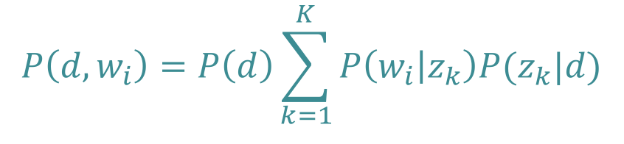
Probabilistic LSI
Select a document d with probability P(d)
For each word of d in the training set
  Choose a topic z with probability
  P(z | d)
  Generate a word with probability
  P(w | z)
Documents can have multiple topics
d
z
w
$$P\left(d,w_{i}\right)=P\left(d\right)\sum_{k=1}^{K}{P\left(w_{i} | z_{k}\right)P(z_{k}|d)}$$
N
M
  Thomas Hofmann, Probabilistic Latent Semantic Indexing, Proceedings of the 22nd Annual International SIGIR Conference on Research and Development in Information Retrieval (SIGIR-99), 1999
Notes:
Joint probability distribution

Slide 29


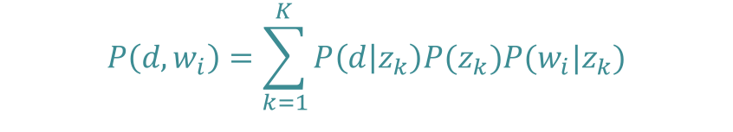
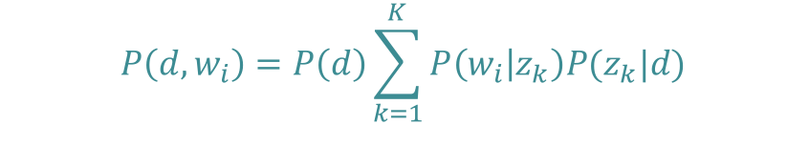
pLSI
d
Joint probability for all documents, words
Distribution for document d, word w_{i}
Reformulate $P(z_{k}|d)$ with Bayes’ Rule
P(d)
$$\prod_{d=1}^{M}{\prod_{i=1}^{N_{d}}{P{\left(d,w_{i}\right)}^{n(d,w_{i})}}}$$
z_{k}
P(z_{k}|d)
$$P\left(d,w_{i}\right)=P\left(d\right)\sum_{k=1}^{K}{P\left(w_{i} | z_{k}\right)P(z_{k}|d)}$$
w_{i}
P(w_{i}|z_{k})
z_{k}
P(z_{k})
$$P\left(d,w_{i}\right)=\sum_{k=1}^{K}{P\left(d | z_{k}\right)P(z_{k})P(w_{i}|z_{k})}$$
d
w_{i}
P(d|z_{k})
P(z_{k}|w_{i})
Notes:
Bayes rule on P(z|d)

Slide 30



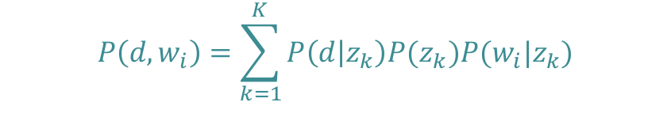
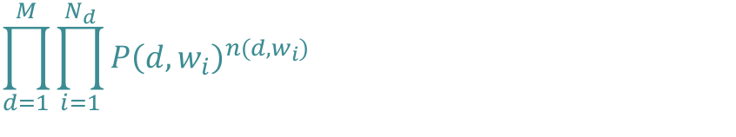

pLSI: Learning Using EM
Model
Likelihood
Parameters to learn (M step)
  (E step)
$$P\left(d,w_{i}\right)=\sum_{k=1}^{K}{P\left(d | z_{k}\right)P(z_{k})P(w_{i}|z_{k})}$$
$$\prod_{d=1}^{M}{\prod_{i=1}^{N_{d}}{P{\left(d,w_{i}\right)}^{n(d,w_{i})}}}$$
$$L= \sum_{d=1}^{M}{\sum_{i=1}^{N_{d}}{n\left(d,w_{i}\right)\log{P(d,w_{i})}}}=\sum_{d=1}^{M}{\sum_{i=1}^{N_{d}}{n(d,w_{i})\log{\sum_{k=1}^{K}{P\left(d | z_{k}\right)P(z_{k})P(w_{i}|z_{k})}}}}$$
  $$P(d|z_{k})$$
  $$P\left(z_{k}\right)$$
$$P\left(w_{i} | z_{k}\right)$$
z_{k}
P(z_{k})
P(d|z_{k})
d
w_{i}
P(z_{k}|w_{i})
$$P\left(z_{k} | d,w_{i}\right)$$

Slide 31
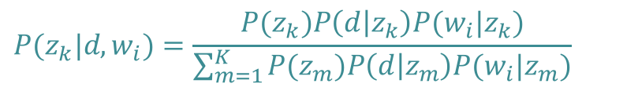
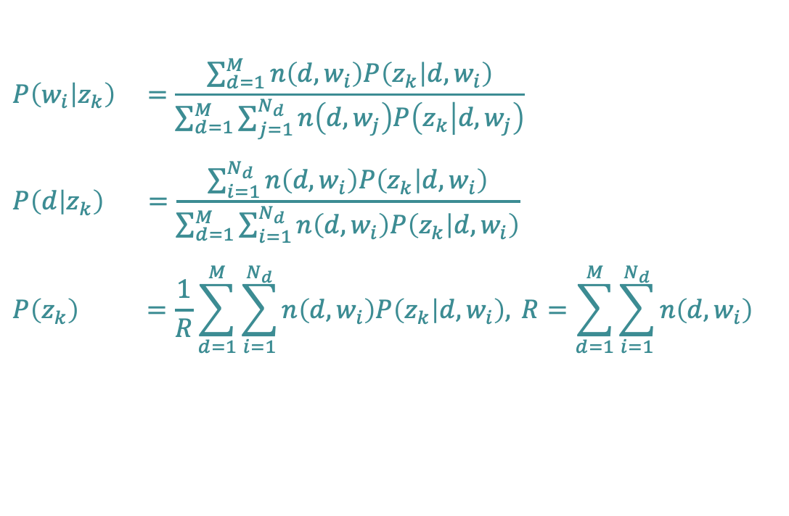
pLSI: Learning Using EM
EM solution
  E step
  M step
z_{k}
P(z_{k})
$$P(z_{k}|d,w_{i})=\frac{P(z_{k})P\left(d | z_{k}\right)P(w_{i}|z_{k})}{\sum_{m=1}^{K}{P(z_{m})P\left(d | z_{m}\right)P(w_{i}|z_{m})}}$$
P(d|z_{k})
d
w_{i}
P(z_{k}|w_{i})
$$P\left(w_{i} | z_{k}\right) =\frac{\sum_{d=1}^{M}{n\left(d,w_{i}\right)P\left(z_{k} | d,w_{i}\right)}}{\sum_{d=1}^{M}{\sum_{j=1}^{N_{d}}{n\left(d,w_{j}\right)P\left(z_{k} | d,w_{j}\right)}}}$$
$$P\left(d | z_{k}\right) =\frac{\sum_{i=1}^{N_{d}}{n\left(d,w_{i}\right)P\left(z_{k} | d,w_{i}\right)}}{\sum_{d=1}^{M}{\sum_{i=1}^{N_{d}}{n\left(d,w_{i}\right)P\left(z_{k} | d,w_{i}\right)}}}$$
$$P\left(z_{k}\right) =\frac{1}{R}\sum_{d=1}^{M}{\sum_{i=1}^{N_{d}}{n\left(d,w_{i}\right)P\left(z_{k} | d,w_{i}\right), }}R=\sum_{d=1}^{M}{\sum_{i=1}^{N_{d}}{n\left(d,w_{i}\right)}}$$

Slide 32
pLSI: Overview
More realistic than mixture model
  Documents can discuss multiple topics!
Problems
  Very many parameters
  Danger of overfitting
Notes:
Mixture parameters for each document
Poor generalization

Slide 33
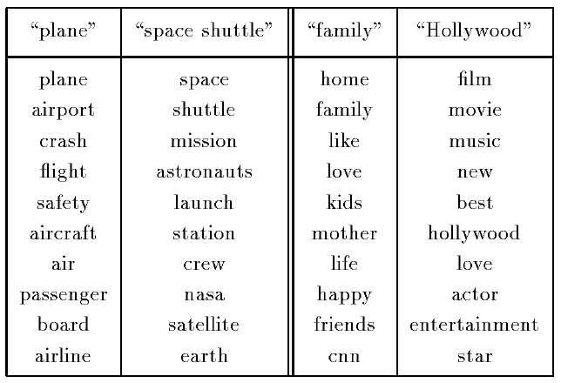
pLSI Testrun
PLSI topics (TDT-1 corpus)
  Approx. 7 million words, 15863 documents, K = 128
The two most probable
topics that generate the
term “flight” (left) and
“love” (right).
List of most probable
words per topic, with
decreasing probability
going down the list.

Slide 34
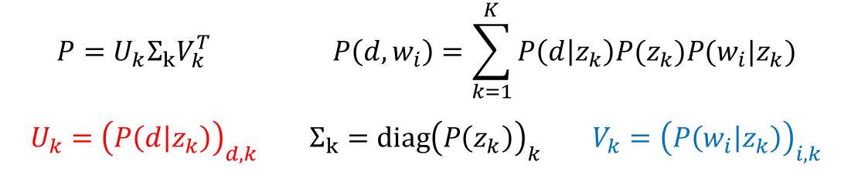
Relation with LSI
Difference:
  LSI: minimize Frobenius (L-2) norm
  pLSI: log-likelihood of training data
$$P=U_{k}Σ_{k}V_{k}^{T} P\left(d,w_{i}\right)=\sum_{k=1}^{K}{P\left(d | z_{k}\right)P(z_{k})P(w_{i}|z_{k})}$$
$$U_{k}={\left(P\left(d | z_{k}\right)\right)}_{d,k} Σ_{k}=diag{\left(P\left(z_{k}\right)\right)}_{k} V_{k}={\left(P\left(w_{i} | z_{k}\right)\right)}_{i,k}$$

Slide 35
Intelligent Agents
Topic Analysis: pLSI and LDA
Ralf Möller
Universität zu Lübeck
Institut für Informationssysteme

Slide 36



pLSI with Multinomials
$$π_{d}≔P\left(d | π\right)$$
$β_{k,w_{i}}≔$ $P\left(w_{i} | β,z_{k}\right)$
$θ_{d,k }≔$ $P\left(z_{k} | θ_{d } \right)$
π
Multinomial Naïve Bayes
  Select document d ~ Mult( ∙ | π)
    For each position i = 1, ... , N_{d}
      Generate z_{i} ~ Mult(∙ | d, $θ_{d}$)
      Generate w_{i} ~ Mult( ∙ | z_{i}, β_{k})
θ_{d}
d
Multiple topics
z
$$\prod_{d=1}^{M}{P\left(w_{1},…,w_{N_{d}},d | β,θ,π\right)}$$
$$=\prod_{d=1}^{M}{P(d| π)}\prod_{i=1}^{N_{d}}{\sum_{k=1}^{K}{P(z_{i}=k|d,θ_{d})P\left(w_{i} | β_{k},z_{i}\right)}}$$
$$=\prod_{d=1}^{M}{π_{d}\prod_{i=1}^{N_{d}}{\sum_{k=1}^{K}{{θ_{d,k}β}_{k,w_{i}}}}}$$
w
N
M
Maximum-likelihood learning?
β
  Thomas Hofmann, Probabilistic Latent Semantic Indexing, Proceedings of the 22nd Annual International SIGIR Conference on Research and Development in Information Retrieval (SIGIR-99), 1999

Slide 37
Prior Distribution for Topic Mixture
Goal: topic mixture proportions for each document could drawn from some distribution.
  Distribution on multinomials
  (k-tuples of non-negative numbers that sum to one)
The space of all of these multinomials
can be interpreted geometrically
as a (k-1)-simplex
  K-1 independent values
  Simplex = Generalization of a
  triangle to (k-1) dimensions
Criteria for selecting our prior:
  It needs to be defined for a (k-1)-simplex
  Should have nice properties
[Wikipedia]

Slide 38
LDA Model – Parameters
α
Proportions parameter
(k-dimensional vector of real numbers)
Per-document topic distribution
(k-dimensional vector of
probabilities summing up to 1)
Per-word topic assignment
(number from 1 to k)
Observed word
(number from 1 to v, where v is the number of words in the vocabulary)
Word “prior”
(v-dimensional)
θ
z
w
N
M
β

Slide 39
LDA Model
α
θ
θ
θ
z₁
z₂
z₃
z₄
z₁
z₂
z₃
z₄
z₁
z₂
z₃
z₄
w₁
w₂
w₃
w₄
w₁
w₂
w₃
w₄
w₁
w₂
w₃
w₄
β

Slide 40
Latent Dirichlet Allocation
Document = mixture of topics
(as in pLSI), but according to a Dirichlet prior
  When we use a uniform Dirichlet prior, LDA= pLSI
D. Blei, A. Ng, and M. Jordan. Latent Dirichlet Allocation.
Journal of Machine Learning Research, 3:993-1022, January 2003

Slide 41


Dirichlet Distributions
$$p(θ|α)=\frac{Γ\left(\sum_{i}{α_{i}}\right)}{\prod_{i}{Γ(α_{i})}}\prod_{i=1}^{K}{θ_{i}^{α_{i}−1}}$$
Defined over a (k-1)-simplex
  Takes K non-negative arguments
  which sum to one.
  Consequently it is a natural distribution
  to use over multinomial distributions.
The Dirichlet parameter α_{i} can be thought of as a prior count of the i^{th} class
$$Dir\left(x_{1},…,x_{K};p_{1},…,p_{K}\right)=\frac{Γ\left(\sum_{i}{x_{i}+1}\right)}{\prod_{i}{Γ(x_{i}+1)}}\prod_{i=1}^{K}{p_{i}^{x_{i}}}$$

Slide 42
Dirichlet Distribution over a 2-Simplex
A panel illustrating probability density functions of a few Dirichlet distributions over a 2-simplex, for the following α vectors (clockwise, starting from the upper left corner): (1.3, 1.3, 1.3), (3,3,3), (7,7,7), (2,6,11), (14, 9, 5), (6,2,6). [Wikipedia]

Slide 43

LDA Model – Plate Notation
α
For each document d,
  Generate θ_{d} ~ Dirichlet(α)
  For each position i = 1, ... , N_{d}
    Generate a topic z_{i} ~ Mult(∙ | θ_{d})
    Generate a word w_{i} ~ Mult(∙ | z_{i},β)
θ
z
$$P\left(β,θ,z_{1},…,z_{N_{d}},w_{1},…,w_{N_{d}}\right)$$
$$=\prod_{d=1}^{M}{P\left(θ_{d} | α\right)\prod_{i=1}^{N_{d}}{P\left(z_{i} | θ_{d}\right)P(w_{i}|β,z_{i}) }}$$
w
N
M
β

Slide 44


Corpus-level Parameter $α$ $(\text{uniform}: α$_{i =} $α$_{j})
Let $α=1$
Per-document topic distribution: K = 10, D = 15

Slide 45



Corpus-level Parameter $α$
$α=10$
$α=100$

Slide 46


Corpus-level Parameter $α$
$α=0.1$
$α=0.01$

Slide 47

Back to Topic Modeling Scenario
What are the words’ topics and word distribs of topics?
  $P\left(β,θ, z | w,α\right)$
α
θ
z
Z
w
N
M
β

Slide 48



Topic-specific Words: “Smoothed” LDA Model
Give a different word distribution to each topic
  $β$ is $K×V$ matrix (V vocabulary size), each row denotes word distribution of a topic
For each document d
  Choose θ_{d} ~ Dirichlet(α)
  Choose $β_{k}$~ Dirichlet($η$)
  For each position i = 1, ... , N_{d}
    Generate a topic z_{k} ~ Mult(∙ | θ_{d})
    Generate a word w_{i} ~ Mult(∙ | z_{k},β_{zk})
α
θ
$$η$$
z
w
$$β_{k}$$
N
K
M

Slide 49
But why does LDA actually work?
Trade-off between two goals
  For each document, allocate its words to as few topics as possible
  For each topic, assign high probability to as few terms as possible
These goals are at odds.
  Putting a document in a single topic makes #2 hard:
  All of its words must have non-negligible probability under that topic
  Putting very few words in each topic makes #1 hard:
  To cover a document’s words, it must assign many topics to it
Trading off these goals finds groups of tightly
co-occurring words

Slide 50
Query Answering Problem (non-smoothed version)
To which topics does a given document belong?
α
$$P\left(θ,z | w,α,β\right)=\frac{P\left(θ,z,w | α,β\right)}{P\left(w | α,β\right)}$$
$$P\left(θ,z,w | α,β\right)=P(θ|α)\prod_{i=1}^{N}{P\left(z_{i} | θ\right)P(w_{i}|z_{i},β)}$$
$P\left(w | α,β\right)=$ $\int{\sum_{k=1}^{K}{P\left(w, θ, z | α,β\right)} dθ}=$
$\int{\sum_{k=1}^{K}{P(θ|α)\prod_{i=1}^{N}{P\left(z_{i} | θ\right)P(w_{i}|z_{i},β)}}}$ $dθ$=
$$\frac{Γ\left(\sum_{i}{α_{i}}\right)}{\prod_{i}{Γ(α_{i})}}\int{\left(\prod_{k=1}^{K}{θ_{k}^{α_{k}−1}}\right)\left(\prod_{i=1}^{N}{\sum_{k=1}^{K}{\prod_{j=1}^{V}{{\left(θ_{k}β_{kj}\right)}^{w_{i}^{j}}}}}\right)ⅆθ}$$
θ
z
w
N
M
β
$$p(θ|α)=\frac{Γ\left(\sum_{i}{α_{i}}\right)}{\prod_{i}{Γ(α_{i})}}\prod_{i=1}^{K}{θ_{i}^{α_{i}−1}}$$

Slide 51
LDA Learning
Parameter learning:
  Variational Inference / EM
    Numerical approximation using lower-bounds
    Results in biased solutions
    Convergence has numerical guarantees
  Gibbs Sampling
    Stochastic simulation
    Unbiased solutions
    Stochastic convergence
We have a lecture on Approximation Algorithms for Probabilistic Models !
D. Blei, A. Ng, and M. Jordan. Latent Dirichlet allocation.
Journal of Machine Learning Research, 3:993-1022, January 2003

Slide 52
Back to Agents
Agents not only use models
Agents build models that are appropriate to fulfil the agents’ goals …
  … or maximize the utilities derived from preference structures and goals
Agents derive approximation algorithms for query answering on the models they find appropriate
Agents also “learn”
QA strategies

Slide 53
LDA Application: Reuters Data
Setup
  100-topic LDA trained on a 16,000 documents corpus of news articles by Reuters
  Some standard stop words removed
Top-7 words from some of the P(w|z)

Slide 54
LDA Application: Reuters Data
Result

Slide 55


Measuring Performance
Perplexity of a probability model
Describe how well a probability distribution or probability model predicts a sample
  q: Model of an unknown probability distribution p
  based on a training sample drawn from p
  Evaluate q by asking how well it predicts a separate test sample $x_{1},…,x_{N}$ also drawn from p
  Perplexity of q w.r.t. sample $x_{1},…,x_{N}$defined as
  A better model q will tend to assign higher probabilities to $q\left(x_{i}\right)$
  → lower perplexity (“less surprised by sample”)
$$2^{−\frac{1}{N}\sum_{i=1}^{N}{\log_{2}{q\left(x_{i}\right)}}}$$
[Wikipedia]

Slide 56
Perplexity of Various Models
Unigram
Mixture of Unigrams
PLSA
LDA

Slide 57
Use of LDA
A widely used topic model (Griffiths, Steyvers, 04)
Complexity is an issue
Use in IR:
  Ad hoc retrieval (Wei and Croft, SIGIR 06: TREC benchmarks)
  Improvements over traditional LM (e.g., LSI techniques)
  But no consensus on whether there is any improvement over a relevance model, i.e., model with relevance feedback (relevance feedback part of the TREC tests)
  T. Griffiths, M. Steyvers, Finding Scientific Topics.
  Proceedings of the National Academy of Sciences,
  101 (suppl. 1), 5228-5235. 2004
  Xing Wei and W. Bruce Croft. LDA-based document models for ad-hoc retrieval. In Proceedings of the 29th annual international ACM SIGIR conference on Research and development in information retrieval (SIGIR '06). ACM, New York, NY, USA, 178-185. 2006.
TREC=Text REtrieval Conference

Slide 58
Topic modelling
Acknowledgements
Tomoharu Iwata

Slide 59


Social annotation services
Delicious, Flickr, CiteULike, youtube, Last.fm, Technorati, Hatena
Users can attach annotations freely to objects, and share the annotations.
28

Slide 60




Derive content-unrelated annotations
manufacturer of camera that took the photo
  ‘nikon’, ‘canon’
when they were taken
– ‘2008’, ‘november’
remind the annotator
  ‘toread’
qualities
– ‘great’, ‘*****’
ownership
29

Slide 61

Proposed model
generative model for contents (words) and annotations with relevance based on topic models
infer relevance to the content for each annotation
group engineering brain develop theory learning human research systems modelling
(bag-of-words)
content
annotation
machine-learning toread bayes ***** neuroscience
Content-related: machine-learning bayes, neuroscience
Content-unrelated: toread *****
30

Slide 62



Latent Dirichlet allocation
latent topic for word word
Dir Mult Mult
Dir
[Blei et. al. Latent Dirichlet Allocation, JMLR2003]

Slide 63




Correspondence LDA
latent topic for word word
Dir Mult Mult
Dir
topic proportions
Dir
Mult
Mult
kd
dm
d
k
annotation
latent topic for annotation
David M. Blei and Michael I. Jordan. Modeling annotated data. In Proceedings of the 26th annual international ACM SIGIR conference on Research and development in informaion retrieval (SIGIR '03). Association for Computing Machinery, New York, NY, USA, 127–134. 2003.

Slide 64


Proposed model (Inference with Gibbs Sampling)
latent topic for word word
Dir Mult Mult
Dir
topic proportions
beta
Dir
Mult
Mult
Ber
0
latent relevance annotation latent topic for annotation
general distribution
N: #words, M: #annotations, D: #documents, K: #topics
each annotation is associated with a latent variable r, r=1 if content-related, r=0 otherwise
33

Slide 65

Topics in Delicious
unrelated Topic1 Topic2 Topic3 Topic4
Topic5
annotation
content word
35

Slide 66

Topics in Flickr
Topic1 Topic2 Topic3 Topic4
unrelated
Topic5
annotation
probable image
36

Slide 67

Perplexity
CorrLDA
x-axis: #topics y-axis:
perplexity
Proposed
an example of data without content-unrelated tags.
This data consist of patents, to which IPC code were attached by experts according to their content.
The proposed method performed better than Corr-LDA in the case of noisy social annotation data.
37

Slide 68
Generative Topic Models for Community Analysis
Acknowledgements
Ramesh Nallapati
http://www.cs.cmu.edu/~wcohen/10-802/lda-sep-18.ppt
&
Arthur Asuncion, Qiang Liu, Padhraic Smyth:
Statistical Approaches to Joint Modeling of Text and Network Data

Slide 69

What if the corpus has network structure?
CORA citation network. Figure from [Chang, Blei, AISTATS 2009]
J. Chang, and D. Blei. Relational Topic Models for Document Networks.
AISTATS, volume 5 of JMLR Proceedings, page 81-88. JMLR.org, 2009.
Notes:
Example data appropriate for the relational topic model. Each document is represented as a bag of words and linked to other documents via citation. The RTM defines a joint distribution over the words in each document and the citation links between them.

Slide 70
Outline
pLSI
LDA
Topic Models for
Community Analysis
  Citation Modeling
    with pLSI
    with LDA
  Modeling influence
  of citations
  Relational Topic Models
π
α
θ_{d}
d
θ
z
z
w
w
N
N
M
M
β
β

Slide 71

Hyperlink Modeling Using pLSI
π
Select document d ~ Mult($.|π$)
  For each position n = 1,…, N_{d}
    Generate z_{n} ~ Mult$(∙|θ_{d})$
    Generate w_{n} ~ Mult$(∙|β_{z_{n}})$
  For each citation j = 1,…, L_{d}
    Generate z_{j} ~ Mult$(∙|θ_{d})$
    Generate c_{j} ~ Mult$(∙|γ_{z_{j}})$
d
θ_{d}
z
z
w
c
N
L
M
β
γ
D. A. Cohn, Th. Hofmann, The Missing Link - A Probabilistic Model of Document Content and Hypertext Connectivity, In: Proc. NIPS, pp. 430-436, 2000

Slide 72



Hyperlink Modeling Using pLSI
$$π_{d}≔P\left(d | π\right)$$
$β_{kw_{i}}≔$ $P\left(w_{i} | β,z_{k}\right)$
$$γ_{kc_{i}}≔ P\left(c_{i} | γ,z_{k}\right)$$
$θ_{dk }≔$ $P\left(z_{k} | θ_{d } \right)$
π
pLSI likelihood
New likelihood
Learning using EM
$$\prod_{d=1}^{M}{P\left(w_{1},…,w_{N_{d}},d | θ,β,π\right)}$$
$$= \prod_{d=1}^{M}{π_{d}\left(\prod_{i=1}^{N_{d}}{\sum_{k=1}^{K}{θ_{dk}β_{kw_{n}}}}\right)}$$
d
θ_{d}
z
z
w
c
$$\prod_{d=1}^{M}{P\left(w_{1},…,w_{N_{d}},c_{1},…,c_{L_{d}},d | θ,β,γ,π\right)}$$
$$= \prod_{d=1}^{M}{π_{d}\left(\prod_{i=1}^{N_{d}}{\sum_{k=1}^{K}{θ_{dk}β_{kw_{n}}}}\right)\left(\prod_{j=1}^{L_{d}}{\sum_{k=1}^{K}{θ_{dk}γ_{kc_{j}}}}\right)}$$
N
L
M
β
γ

Slide 73

Hyperlink Modeling Using pLSI
Heuristic
  0 < α < 1 determines the relative importance of content and hyperlinks
$$\prod_{d=1}^{M}{P\left(w_{1},…,w_{N_{d}},c_{1},…,c_{L_{d}},d | θ,β,γ,π\right)}$$
$$= \prod_{d=1}^{M}{π_{d}{\left(\prod_{i=1}^{N_{d}}{\sum_{k=1}^{K}{θ_{dk}β_{kw_{n}}}}\right)}^{α}{\left(\prod_{j=1}^{L_{d}}{\sum_{k=1}^{K}{θ_{dk}γ_{kc_{j}}}}\right)}^{1−α}}$$

Slide 74
Hyperlink modeling using PLSA
Experiments: Text Classification
Datasets:
  Web KB
    6000 CS dept web pages with hyperlinks
    6 Classes: faculty, course, student, staff, etc.
  Cora
    2000 Machine learning abstracts with citations
    7 classes: sub-areas of machine learning
Methodology:
  Learn the model on complete data and obtain θ_{d} for each document
  Test documents classified into the label of the nearest neighbor in training set
  Distance measured as cosine similarity in the θ space
  Measure the performance as a function of α

Slide 75

Overview on Evaluation Measures
[Wikipedia]
https://en.wikipedia.org/wiki/Evaluation_measures_(information_retrieval)#Mean_average_precision

Slide 76
Hyperlink Modeling Using pLSI
Classification performance
Hyperlink
Content
Hyperlink
Content

Slide 77

Hyperlink modeling using LDA
α
For each document d,
  Generate θ_{d} ~ Dirichlet(α)
  For each position i = 1, ... , N_{d}
    Generate a topic z_{i} ~ Mult$(∙|θ_{d})$
    Generate a word w_{i} ~ Mult $(∙|β_{z_{n}})$
  For each citation j = 1, …, L_{c}
    Generate z_{i} ~ Mult(θ_{d})
    Generate c_{i} ~ Mult $(∙|γ_{z_{j}})$
Learning using variational EM, Gibbs sampling
θ
z
z
w
c
N
L
M
β
γ
E. Erosheva, S Fienberg, J. Lafferty, Mixed-membership models of scientific publications. Proc National Academy Science U S A. 2004 Apr 6;101 Suppl 1:5220-7. Epub 2004 Mar 12.
Notes:
So far, little dependency between topic for words and for citations

Slide 78


Link-pLSI-LDA: Topic Influence in Blogs
$$γ$$
R. Nallapati, A. Ahmed, E. Xing, W.W. Cohen, Joint Latent Topic Models for Text and Citations, In: Proc. KDD, 2008.
78
Notes:
2 sets of documents (blogs + links to other sites)
bipartite graph with all links emerging from the set of citing documents and pointing to the set of cited documents
i.e., assume each document can either be cited or be a citing document, but not both.
Citing documents -> LDA + citation modeling
Cited documents -> pLSA (variant after Bayes Rule transformation depicted)
set of cited documents as bins that are to be filled with words.
topic mixing proportions π for the entire set of cited documents.
words are filled into the bins N← times, where N← is the sum total of the document lengths of the set of cited documents, as follows: each time, we first sample a topic k from the mixing proportions π, then pick a bin d′ from Ωk and fill a word occurrence from β into the bin.

Slide 79

Modeling Citation Influences - Copycat Model
Each topic in a citing document is drawn from one of the topic mixtures of cited publications
L. Dietz, St. Bickel, and T. Scheffer, Unsupervised Prediction of Citation Influences, In: Proc. ICML 2007.
Notes:
Assumption: topics of a document are a mixture of the topics of its citations

Slide 80
Modeling Citation Influences
Citation influence model: Combination of LDA and Copycat model
L. Dietz, St. Bickel, and T. Scheffer, Unsupervised Prediction of Citation Influences, In: Proc. ICML 2007.
Notes:
S: Innovation (1) or inheritance (0)
Documents can be a mixture of the topics of the citations (inheritance)
Documents can be a new mixture of topics (innovation)

Slide 81
Modeling Citation Influences
Citation influence graph for LDA paper
Notes:
Subset of CiteSeer data set
Citational vicinity of the LDA paper (Blei et al., 2003) with the citation influence model.
input document collection consists of the paper along with two levels of citations in each direction.
trained with hyper parameters αφ =0.01,αθ =αψ =0.1,αλθ =3.0,αλψ =0.1, αγ = 1.0 and 30 topics.
Citation graph is filtered to only contain edges with an influence value γd(c) > 0.05.
Topic proportions are included in the visualization via a topic spectrum bar. Each of the 30 topics is represented by a unique color.
Model correctly identifies the influencing work on Dirichlet processes and variational inference as well as the relatedness to pLSA, PCA, and variational methods. It also yields possible application areas such as querying music and taxonomy learning.

Slide 82

Modeling Citation Influences
Words in LDA paper assigned to citations
Notes:
lists the three most influential cites and the words assigned to them

Slide 83











Relational Topic Model (RTM) [ChangBlei 2009]
Same setup as LDA, except now we have observed network information across documents
$$α$$
$$y_{d,d^{′}} \sim ψ\left(y_{d,d^{′}}\right|z_{d},z_{d^{′}},η)$$
“Link probability function”
$$θ_{d}$$
$$η$$
$$θ_{d^{′}}$$
$$z_{d,n}$$
$$y_{d,d^{′}}$$
$$z_{d^{′},n}$$
Documents with similar topics are more likely to be linked.
$$w_{d,n}$$
$$β_{k}$$
$$w_{d^{′},n}$$
$$N_{d}$$
K
$$N_{d^{′}}$$
M
J. Chang, and D. Blei. Relational Topic Models for Document Networks.
AISTATS, volume 5 of JMLR Proceedings, page 81-88. JMLR.org, 2009.
Notes:
A two-document segment of the RTM.
The variable y indicates whether the two documents are linked.
The complete model contains this variable for each pair of documents

Slide 84

Relational Topic Model (RTM) [ChangBlei 2009]
For each document d
  Draw topic proportions $θ_{d}|α \sim Dir\left(α\right)$
  For each word $w_{d,n}$
    Draw assignment $z_{d,n}|θ_{d} \sim Mult(θ_{d})$
    Draw word $w_{d,n}|z_{d,n},β_{1:K} \sim Mult(β_{z_{d,n}})$
  For each pair of documents $d,d^{′}$
    Draw binary link indicator $y|z_{d},z_{d^{′}} \sim ψ(⋅|z_{d},z_{d^{′}},η)$
$$α$$
$$θ_{d}$$
$$η$$
$$θ_{d^{′}}$$
$$z_{d,n}$$
$$y_{d,d^{′}}$$
$$z_{d^{′},n}$$
$$w_{d,n}$$
$$β_{k}$$
$$w_{d^{′},n}$$
$$N_{d}$$
K
$$N_{d^{′}}$$
Notes:
true generative model for text and citations; capable of modeling arbitrary link structure
requires explicit modeling of the presence or absence of links between each pair of documents, becomes prohibitively expensive to model large scale document collections
LDA model from before more scalable

Slide 85
Document networks
 | # Docs | # Links | Ave. Doc-Length | Vocab-Size | Link Semantics
CORA | 4,000 | 17,000 | 1,200 | 60,000 | Paper citation (undirected)
Netflix Movies | 10,000 | 43,000 | 640 | 38,000 | Common actor/director
Enron (Undirected) | 1,000 | 16,000 | 7,000 | 55,000 | Communication between person i and person j
Enron (Directed) | 2,000 | 21,000 | 3,500 | 55,000 | Email from person i to person j

Slide 86
Conclusion
Topic Modeling
Relational topic modeling provides a useful start for combining text and network data in a single statistical framework
RTM can improve over simpler approaches for link prediction
Opportunities for future work:
  Faster algorithms for larger data sets
  Better understanding of non-edge modeling
  Extended models

