Slide 1
Intelligent Agents Word Semantics, Embeddings and Latent Sequential Structures
Prof. Dr. Ralf Möller
Universität zu Lübeck
Institut für Informationssysteme

Slide 2
Word-Word Associations in Document Retrieval
Recap
LSI: Documents as vectors, dimension reduction
Topic Modeling
Topic = Word distribution
From LDA-Model: P(Z | w)
Assumption: Bag of words model (independence, naïve Bayes, unigram distribution)
Words are not independent of each other
Word similarity measures
Extend query with similar words automatically
Extend query with most frequent followers/predecessors
Insert words in anticipated gaps in a string query
Need to represent more aspects of word semantics

Slide 3
Approaches for Representing Word Semantics
Beyond bags of words
Distributional Semantics (Count)
Used since the 90’s
Sparse word-context PMI/PPMI matrix
Decomposed with SVD
Word Embeddings (Predict)
Inspired by deep learning
word2vec (Mikolov et al., 2013)
GloVe (Pennington et al., 2014)
Underlying Theory: The Distributional Hypothesis (Harris, ’54; Firth, ‘57)
“Similar words occur in similar contexts”
https://www.tensorflow.org/tutorials/word2vec
https://nlp.stanford.edu/projects/glove/
Notes:
There are two approaches for creating these vectors:
First, we’ve got the traditional count-based approach,
where the most common variant is the word-context PMI matrix.
The other, cutting-edge, approach, is word embeddings,
Which has become extremely popular with word2vec.
Now, the interesting thing…
…is that both approaches rely on the same linguistic theory: the distributional hypothesis.
<pause>
Now, in previous work, that I’ll talk about in a minute,
we showed that the two approaches are even more related.

Slide 4
Point(wise) Mutual Information: PMI
Measure of association used in information theory and statistics
Positive PMI: PPMI(x, y) = max( pmi(x, y), 0 )
Quantifies the discrepancy between the probability of their coincidence given their joint distribution and their individual distributions, assuming independence
Finding collocations and associations between words
Countings of occurrences and co-occurrences of words in a text corpus can be used to approximate the probabilities p(x) or p(y) and p(x,y) respectively
Kenneth Ward Church and Patrick Hanks. "Word association norms, mutual information, and lexicography". Comput. Linguist. 16 (1): 22–29. 1990.

Slide 5
PMI – Example
Counts of pairs of words getting the most and the least PMI scores in the first 50 millions of words in Wikipedia (dump of October 2015)
Filtering by 1,000 or more co-occurrences.
The frequency of each count can be obtained by dividing its value by 50,000,952. (Note: natural log is used to calculate the PMI values in this example, instead of log base 2)
[Wikipedia]

Slide 6
The Contributions of Word Embeddings
What’s really improving performance?
Novel Algorithms
(objective + training method)
Skip Grams + Negative Sampling
CBOW + Hierarchical Softmax
Noise Contrastive Estimation
GloVe
…
New Hyperparameters
(preprocessing, smoothing, etc.)
Subsampling of Frequent Words
Dynamic Context Windows
Context Distribution Smoothing
Adding Context Vectors
…
Improving Distributional Similarity with Lessons Learned from Word Embeddings, Omer Levy, Yoav Goldberg, Ido Dagan, Transactions of the Association for Computational Linguistics, Volume 3, 2015.
Notes:
Or maybe a bit of both?
<pause>

Slide 7
Embedding Approaches
Represent each word with a low-dimensional vector
Word similarity = vector similarity
Key idea: Predict surrounding words of every word
Faster and can easily incorporate a new sentence/document or add a word to the vocabulary

Slide 8
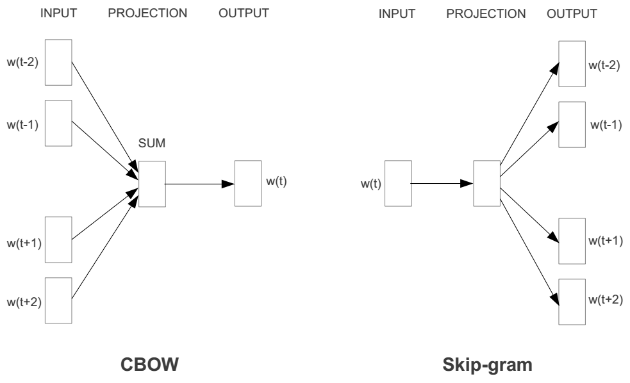
Represent the meaning of word – word2vec
2 basic network models:
Continuous Bag of Word (CBOW): use a window of word to predict the middle word
Skip-gram (SG): use a word to predict the surrounding ones in window.

Slide 9
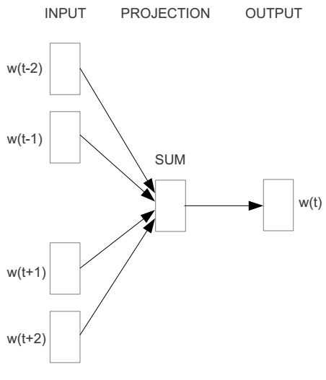
Word2vec – Continuous Bag of Words
E.g. “The cat sat on floor”
Window size = 2
the
cat
sat
on
floor
Distributed Representations of Words and Phrases and their Compositionality
Tomas Mikolov, Ilya Sutskever, Kai Chen, Greg Corrado, Jeffrey Dean, NIPS 2013

Slide 10
Input layer
Index of cat in vocabulary
0
1
0
cat
0
Hidden layer
Output layer
0
0
0
0
0
0
…
0
0
0
one-hot
vector
0
sat
one-hot
vector
0
0
0
0
1
0
…
1
0
on
0
0
0
0
…
0

Slide 11
We must learn W and W’
Input layer
0
1
0
cat
0
$$W_{V×N}$$
Hidden layer
Output layer
0
0
0
0
0
0
V-dim
…
0
0
$${W′}_{N×V}$$
0
0
sat
0
0
0
0
1
0
$$W_{V×N}$$
N-dim
…
V-dim
1
0
on
0
0
0
0
V-dim
…
N will be the size of word vector
0

Slide 12
$$W_{V×N}^{T} ×x_{cat}=v_{cat}$$
0.1 | 2.4 | 1.6 | 1.8 | 0.5 | 0.9 | … | … | … | 3.2
0.5 | 2.6 | 1.4 | 2.9 | 1.5 | 3.6 | … | … | … | 6.1
… | … | … | … | … | … | … | … | … | …
… | … | … | … | … | … | … | … | … | …
0.6 | 1.8 | 2.7 | 1.9 | 2.4 | 2.0 | … | … | … | 1.2
0
2.4
2.6
…
…
1.8
Input layer
1
$$×$$
0
$$=$$
0
0
1
0
0
0
x_{cat}
0
0
Output layer
0
0
0
$$W_{V×N}^{T}×x_{cat}=v_{cat}$$
…
0
0
0
0
0
V-dim
…
0
0
$$\hat{v}=\frac{v_{cat}+v_{on}}{2}$$
0
+
0
sat
0
0
0
0
$$W_{V×N}^{T}×x_{on}=v_{on}$$
1
0
…
V-dim
1
Hidden layer
0
x_{on}
0
0
N-dim
0
0
V-dim
…
0

Slide 13
$$W_{V×N}^{T} ×x_{on}=v_{on}$$
0.1 | 2.4 | 1.6 | 1.8 | 0.5 | 0.9 | … | … | … | 3.2
0.5 | 2.6 | 1.4 | 2.9 | 1.5 | 3.6 | … | … | … | 6.1
… | … | … | … | … | … | … | … | … | …
… | … | … | … | … | … | … | … | … | …
0.6 | 1.8 | 2.7 | 1.9 | 2.4 | 2.0 | … | … | … | 1.2
0
1.8
2.9
…
…
1.9
Input layer
0
$$×$$
0
$$=$$
0
1
1
0
0
0
x_{cat}
0
0
Output layer
0
0
0
$$W_{V×N}^{T}×x_{cat}=v_{cat}$$
…
0
0
0
0
0
V-dim
…
0
0
$$\hat{v}=\frac{v_{cat}+v_{on}}{2}$$
0
+
0
sat
0
0
0
0
$$W_{V×N}^{T}×x_{on}=v_{on}$$
1
0
…
V-dim
1
Hidden layer
0
x_{on}
0
0
N-dim
0
0
V-dim
…
0

Slide 14
Input layer
0
1
0
cat
0
$$W_{V×N}$$
Hidden layer
Output layer
0
0
0
0
0
0
V-dim
…
0
0
$$W_{N×V}^{′}×\hat{v}=z$$
0
$$\hat{y}=softmax(z)$$
0
0
0
0
0
$$\hat{v}$$
1
0
$$W_{V×N}$$
…
1
N-dim
0
on
0
${\hat{y}}_{sat}$
0
0
V-dim
0
V-dim
…
N will be the size of word vector
0

Slide 15
Logistic function
[Wikipedia]

Slide 16
softmax(z)
The
[Wikipedia]

Slide 17
Input layer
0
We would prefer $\hat{y}$ close to ${\hat{y}}_{sat}$
1
0
cat
0
$$W_{V×N}$$
Hidden layer
Output layer
0
0
0
0
0.01
0.02
0.00
0.02
0.01
0.02
0.01
0.7
…
0.00
0
0
V-dim
…
0
0
$$W_{N×V}^{′}×\hat{v}=z$$
$$\hat{y}=softmax(z)$$
0
0
0
0
0
0
$$\hat{v}$$
1
0
$$W_{V×N}$$
…
1
N-dim
0
on
0
${\hat{y}}_{sat}$
0
0
V-dim
0
V-dim
…
N will be the size of word vector
$\hat{y}$
0

Slide 18
CBOW Model
Objective: Given $w_{c−k} …,w_{c−1},w_{c+1}, …\text{, }w_{c+k}$, predict $w_{c}$
Training data: Given sequence of words < $w1, w2, …wn$>, extract context and target: $(w_{c−k} …,w_{c−1},w_{c+1}, …\text{, }w_{c+k}$; $w_{c})$
Knowns:
Training data $\{(w_{c−k} …,w_{c−1},w_{c+1}, …\text{, }w_{c+k}$; $w_{c})\}$
Vocabulary {$w1, w2, …wV\}$of the training corpus
Unknowns:
Word embedding matrices $WV$ _{x} $N$ and $W′N$ _{x} $V$ with $N$ being a hyperparameter

Slide 19
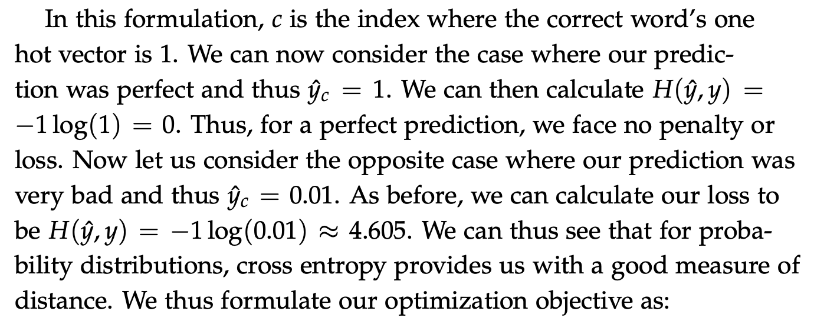
Loss Function for Learning
How to determine word embedding matrices?
Cross entropy for comparing probability distributions
$H\left(\hat{y}, y\right)=−\sum_{j=1}^{V}{yj log(\hat{y}j)}$
$y$ is a one-hot vector with a “one” at position $i$
$H\left(\hat{y}, y\right)=−yi log\left(\hat{y}i\right)=−log(\hat{y}i)$

Slide 20
CBOW: Derivation of Learning Procedure
Minimize $−\log{P\left(w_{c}\right| w_{c−k}, …,w_{c−1},w_{c+1}, …\text{, }w_{c+k})}$ = $−\log{P\left(W′\left[c\right] \right| \hat{v})}$ (and due to the softmax)
= $−\log{\frac{e^{W′\left[c\right]T\hat{v}}}{\sum_{j=1}^{V}{e^{W′\left[c\right]Tj\hat{v}}}}}$
$=− W′\left[c\right]T\hat{v}+\log{\sum_{j=1}^{V}{e^{W′\left[j\right]T\hat{v}}}}$
where
$\hat{v}= {(2k)}^{−1}\sum_{i=−k}^{k}{WTw_{c+i}}$
Use gradient decent to update word vectors

Slide 21
$$W_{V×N}^{T}$$
0.1 | 2.4 | 1.6 | 1.8 | 0.5 | 0.9 | … | … | … | 3.2
0.5 | 2.6 | 1.4 | 2.9 | 1.5 | 3.6 | … | … | … | 6.1
… | … | … | … | … | … | … | … | … | …
… | … | … | … | … | … | … | … | … | …
0.6 | 1.8 | 2.7 | 1.9 | 2.4 | 2.0 | … | … | … | 1.2
Contain word’s vectors
Input layer
0
1
0
x_{cat}
0
Output layer
0
0
$$W_{V×N}^{}$$
0
0
0
0
V-dim
…
0
0
$$W_{N×V}^{′}$$
0
0
sat
0
0
0
0
1
0
$$W_{V×N}^{}$$
…
1
0
V-dim
x_{on}
0
Hidden layer
0
N-dim
0
0
V-dim
…
0
We can consider either W or W’ as the word’s representation. Or even take the average.
Notes:
W contains input word vectors.
W’ contains output word vectors.
We can consider either W or W’ as the word’s representation. Or even take the average.

Slide 22
Intrinsic Evaluation

Slide 23
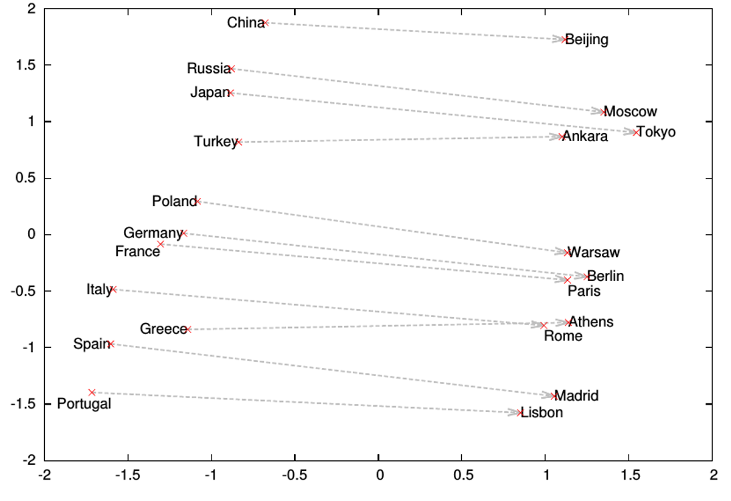
Word analogies

Slide 24
Extrinsic Evaluation
Evaluate in applications
Sentiment analysis
…

Slide 25
Intelligent Agents Word Semantics, Embeddings and Latent Sequential Structures
Prof. Dr. Ralf Möller
Universität zu Lübeck
Institut für Informationssysteme

Slide 26
$$W_{V×N}^{T}$$
0.1 | 2.4 | 1.6 | 1.8 | 0.5 | 0.9 | … | … | … | 3.2
0.5 | 2.6 | 1.4 | 2.9 | 1.5 | 3.6 | … | … | … | 6.1
… | … | … | … | … | … | … | … | … | …
… | … | … | … | … | … | … | … | … | …
0.6 | 1.8 | 2.7 | 1.9 | 2.4 | 2.0 | … | … | … | 1.2
Contain word’s vectors
Input layer
0
1
0
x_{cat}
0
Output layer
0
0
$$W_{V×N}^{}$$
0
0
0
0
V-dim
…
0
0
$$W_{N×V}^{′}$$
0
0
sat
0
0
0
0
1
0
$$W_{V×N}^{}$$
…
1
0
V-dim
x_{on}
0
Hidden layer
0
N-dim
0
0
V-dim
…
0
We can consider either W or W’ as the word’s representation. Or even take the average.
Notes:
W contains input word vectors.
W’ contains output word vectors.
We can consider either W or W’ as the word’s representation. Or even take the average.

Slide 27
Only one input vector (no averaging)
CBOW
Skip-Gram
Input layer
0
We would prefer $\hat{y}$ close to ${\hat{y}}_{sat}$
1
0
cat
0
$$W_{V×N}$$
Hidden layer
Output layer
0
0
0
0
0.01
0.02
0.00
0.02
0.01
0.02
0.01
0.7
…
0.00
0
0
V-dim
…
0
0
$$W_{N×V}^{′}×\hat{v}=z$$
$$\hat{y}=softmax(z)$$
0
0
0
0
0
0
$$\hat{v}$$
1
0
$$W_{V×N}$$
…
1
N-dim
0
on
0
${\hat{y}}_{sat}$
0
0
V-dim
0
V-dim
…
N will be the size of word vector
$\hat{y}$
0

Slide 28
Skip-Gram Model
Objective: Given $w_{c}$, predict $w_{c−k} …,w_{c−1},w_{c+1}, …\text{, }w_{c+k}$
Training data: Given sequence of words < $w1, w2, …w_{n}$>, extract input and output: $(w_{c} ; w_{c−k} …,w_{c−1},w_{c+1}, …\text{, }w_{c+k})$
Knowns:
Training data $\{(w_{c} ; w_{c−k} …,w_{c−1},w_{c+1}, …\text{, }w_{c+k})\}$
Vocabulary {$w1, w2, …w_{V}\}$of the training corpus
Unknowns:
Word embedding matrices $WV$ _{x} $N$ and $W′N$ _{x} $V$ with $N$ being a hyperparameter

Slide 29
Skip-Gram: Derivation of Learning Procedure
Minimize $−\log{P\left(w_{c−m}, …,w_{c−1},w_{c+1}, …\text{, }w_{c+m}\right| w_{c})}$ = $−\log{\prod_{j=0, j≠m}^{2m}{P \left(w_{c−m+j} \right|v_{c})}}$ (and due to softmax)
$=−\log{\prod_{j=0, j≠m}^{2m}{\frac{e^{W_{c−m+j}{ v}_{c}}}{\sum_{k=1}^{V}{e^{Wk{ v}_{c}}}}}}$
$=−\sum_{j=0, j≠m}^{2m}{W_{c−m+j}{ v}_{c}} +2m\log{\sum_{k=1}^{V}{e^{Wk{ v}_{c}}}}$
where $v_{c}=W′w_{c}$ (no averaging for skip-gram)
Use stochastic gradient decent to minimize and then to update word vectors
word2vec Explained: Deriving Mikolov et al.’s Negative-Sampling Word-Embedding Method, Yoav Goldberg and Omer Levy, arxiv, 2014.

Slide 30
What is word2vec?
word2vec is not a single algorithm
It is a software package for representing words as vectors, containing:
Two distinct models
CBoW
Skip-Gram
Various training methods
Softmax is a bottleneck (discussed next)
A rich preprocessing pipeline
Dynamic Context Windows
Subsampling of Frequent Words
Deleting Rare Words (left out)
Notes:
Now, we’re going to focus on Skip-Grams with Negative Sampling,
Which is considered the state-of-the-art.

Slide 31
Softmax is a Bottleneck (CBOW and Skip-Gram)
Rong, X. word2vec Parameter Learning Explained (cite arxiv:1411.2738). 2014.
The denominator is a sum across entire vocabulary
$−\sum_{j=0, j≠m}^{2m}{W_{c−m+j}{ v}_{c}} +2m\log{\sum_{k=1}^{V}{e^{Wk{ v}_{c}}}}$
To be computed for every window
Too expensive
Single update of parameters requires iteration of entire vocabulary (which usually is in millions)
Various optimized training methods
Hierarchical Softmax
Noise Contrastive Estimation (left out)
Negative Sampling

Slide 32
Hierarchical softmax using Trees
target word
Replace computation with V vectors of target words by computation with log(V) vectors
Need to learn
word history
path to target word at node j
predicted word vector
vector at node j of target word
sigmoid
ch(n) = left(+) or right child(-)
Mikolov, T., Chen, K., Corrado, G., Dean, J.: Efficient Estimation of Word Representations in Vector Space. In: ICLR Workshop. 2013.

Slide 33
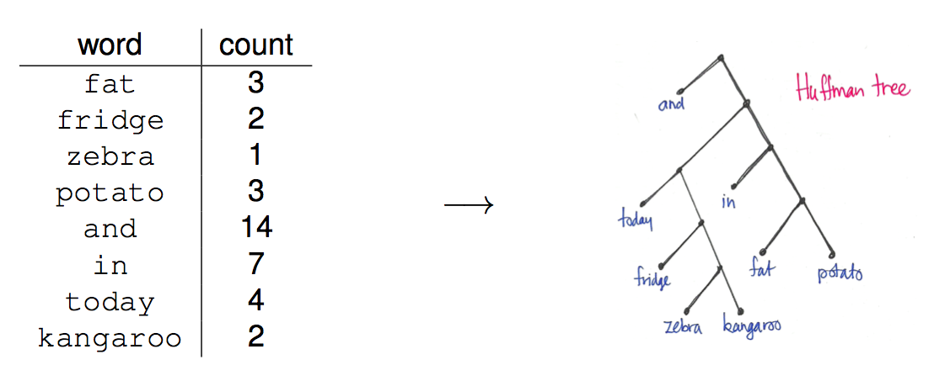
Huffman Trees instead of Balanced Trees

Slide 34
Noise-Contrastive Estimation
Conditional probability of word w in the data:
Conditional probability that word w comes from data D and not from the noise distribution:
Auxiliary binary classification problem:
Positive examples (data) vs. negative examples (noise)
Scaling factor k: noisy samples k times more likely than data samples
Noise distribution: based on unigram word probabilities
Empirically, model can cope with un-normalized probabilities:
A. Mnih and K. Kavukcuoglu (2013) “Learning word embeddings efficiently with noise-contrastive estimation“, In: Proc. NIPS, 2013
Tutorial on neural probabilistic language models, Piotr Mirowski, Microsoft Bing, 2014

Slide 35
Noise-Contrastive Estimation
Conditional probability that word w comes from data D and not from the noise distribution:
Auxiliary binary classification problem:
Positive examples (data) vs. negative examples (noise)
Scaling factor k: noisy samples k times more likely than data samples
Noise distribution: based on unigram word probabilities
Introduce log of difference between:
score of word w under data distribution
and unigram distribution score of word w
Tutorial on neural probabilistic language models, Piotr Mirowski, Microsoft Bing, 2014

Slide 36
Noise-Contrastive Estimation
New loss function to maximize:
Compare to Maximum Likelihood learning:
Tutorial on neural probabilistic language models, Piotr Mirowski, Microsoft Bing, 2014

Slide 37
Comparison
Noise contrastive estimation
Negative sampling
Remove normalization term in probabilities
Compare to Maximum Likelihood learning:
Tutorial on neural probabilistic language models, Piotr Mirowski, Microsoft Bing, 2014

Slide 38
Skip-Grams with Negative Sampling (SGNS)
Marco saw a furry little wampimuk hiding in the tree.
Distributed Representations of Words and Phrases and their Compositionality
Tomas Mikolov, Ilya Sutskever, Kai Chen, Greg Corrado, Jeffrey Dean, NIPS 2013
Notes:
And we want to understand what a wampimuk is.

Slide 39
Skip-Grams with Negative Sampling (SGNS)
Marco saw a furry little wampimuk hiding in the tree.
words contexts
wampimuk furry
wampimuk little
wampimuk hiding
wampimuk in
… …
$D$ (data)
“word2vec Explained…”
Goldberg & Levy, arXiv 2014
Notes:
What SGNS does is take the context words around “wampimuk”,
And in this way,
Constructs a dataset of word-context pairs, D.

Slide 40
Skip-Grams with Negative Sampling (SGNS)
SGNS finds a vector $\vec{w}$ for each word $w$ in our vocabulary $V_{W}$
Each such vector has $d$ latent dimensions (e.g. $d=100$)
Effectively, it learns a matrix $W$ whose rows represent $V_{W}$
Key point: it also learns a similar auxiliary matrix $C$ of context vectors
In fact, each word has two embeddings
$$d$$
$$d$$
$d$ was called $N$ before
$$W$$
$w$:wampimuk $=(−3.1, 4.15, 9.2, −6.5,…)$
$$C$$
$$V_{W}$$
$$V_{C}$$
$$≠$$
$c$:wampimuk $=(−5.6, 2.95, 1.4, −1.3,…)$
“word2vec Explained…”
Goldberg & Levy, arXiv 2014
Notes:
Now, using D,
SGNS is going to learn a vector for each word in the vocabulary
A vector of say… 100 latent dimensions.
Effectively, it’s learning a matrix W,
Where each row is a vector that represents a specific word.
Now, a key point in understanding SGNS,
Is that it also learns an auxiliary matrix C of context vectors
So in fact, each word has two different embeddings
Which are not necessarily similar.

Slide 41
Coming back to Negative Sampling
Given $(w, c)$: word and context
Let $P\left(D=1\right| w, c)$ be the probability that $(w, c)$came from the corpus data
$P\left(D=0\right| w, c)$ = probability that $(w, c)$are not from the corpus data
Let us model $P\left(D=1\right| w, c)$ with $sigmoid$
$P\left(D=1\right| w, c)=sigmoid\left(u_{w}^{T}v_{c}\right)=\frac{1}{1+e^{−u_{w}^{T}v_{c}}}$
Objective:
Maximize $P\left(D=1\right| w, c)$ if $(w, c)$is in the corpus data
Minimize$P\left(D=1\right| w, c)$ if $(w, c)$not in the corpus data
$$u_{v}=Ww v_{c}=Cc$$
Distributed Representations of Words and Phrases and their Compositionality
Tomas Mikolov, Ilya Sutskever, Kai Chen, Greg Corrado, Jeffrey Dean, NIPS 2013

Slide 42
Skip-Grams with Negative Sampling (SGNS)
Maximize: $σ\left(\vec{w}⋅\vec{c_{ }}\right)$
$c$ was observed with $w$
words contexts
wampimuk furry
wampimuk little
wampimuk hiding
wampimuk in
“word2vec Explained…”
Goldberg & Levy, arXiv 2014
Notes:
…SGNS maximizes the similarity between word and context vectors that were observed together.

Slide 43
Skip-Grams with Negative Sampling (SGNS)
Maximize: $σ\left(\vec{w}⋅\vec{c_{ }}\right)$
$c$ was observed with $w$
words contexts
wampimuk furry
wampimuk little
wampimuk hiding
wampimuk in
Minimize: $σ\left(\vec{w}⋅\vec{c_{ }}′\right)$
$c′$ was hallucinated with $w$
words contexts
wampimuk Australia
wampimuk cyber
wampimuk the
wampimuk 1985
“word2vec Explained…”
Goldberg & Levy, arXiv 2014
Notes:
…and minimizes the similarity between word and context vectors hallucinated together.

Slide 44
Math behind Negative Sampling
Maximum Likelihood approach for learning 𝜃
𝜃$=\left(W, C\right), u_{v}=Ww v_{c}=Cc$
Distributed Representations of Words and Phrases and their Compositionality
Tomas Mikolov, Ilya Sutskever, Kai Chen, Greg Corrado, Jeffrey Dean, NIPS 2013

Slide 45
Math behind Negative Sampling
Maximize log likelihood = minimize –log likelihood
$\tilde{D}$ is the negative corpus with wrong contexts
Generate $\tilde{D}$ on the fly by randomly sampling from the vocabulary
New objective function for observing context word $w_{c−m+j}$ $(j=0..2m)$ given the center word $w_{c}$ would be

Slide 46
Skip-Grams with Negative Sampling (SGNS)
“Negative Sampling”
SGNS samples $k$ contexts $c^{′}$ at random as negative examples
“Random” = unigram distribution
$$P_{ }^{ }\left(c\right)=\frac{\#c}{\sum_{c^{′}∈V_{C}}{{\left(\#c^{′}\right)}^{}}}$$
Changing this distribution has a significant effect
Distributed Representations of Words and Phrases and their Compositionality
Tomas Mikolov, Ilya Sutskever, Kai Chen, Greg Corrado, Jeffrey Dean, NIPS 2013
Notes:
Now, the way SGNS hallucinates is really important.
It’s actually where it gets its name from.
For each observed word-context pair,
SGNS samples k contexts at random,
As negative examples
Now, when we say random, we mean the unigram distribution
And Spoiler Alert: changing this distribution has quite a significant effect.

Slide 47
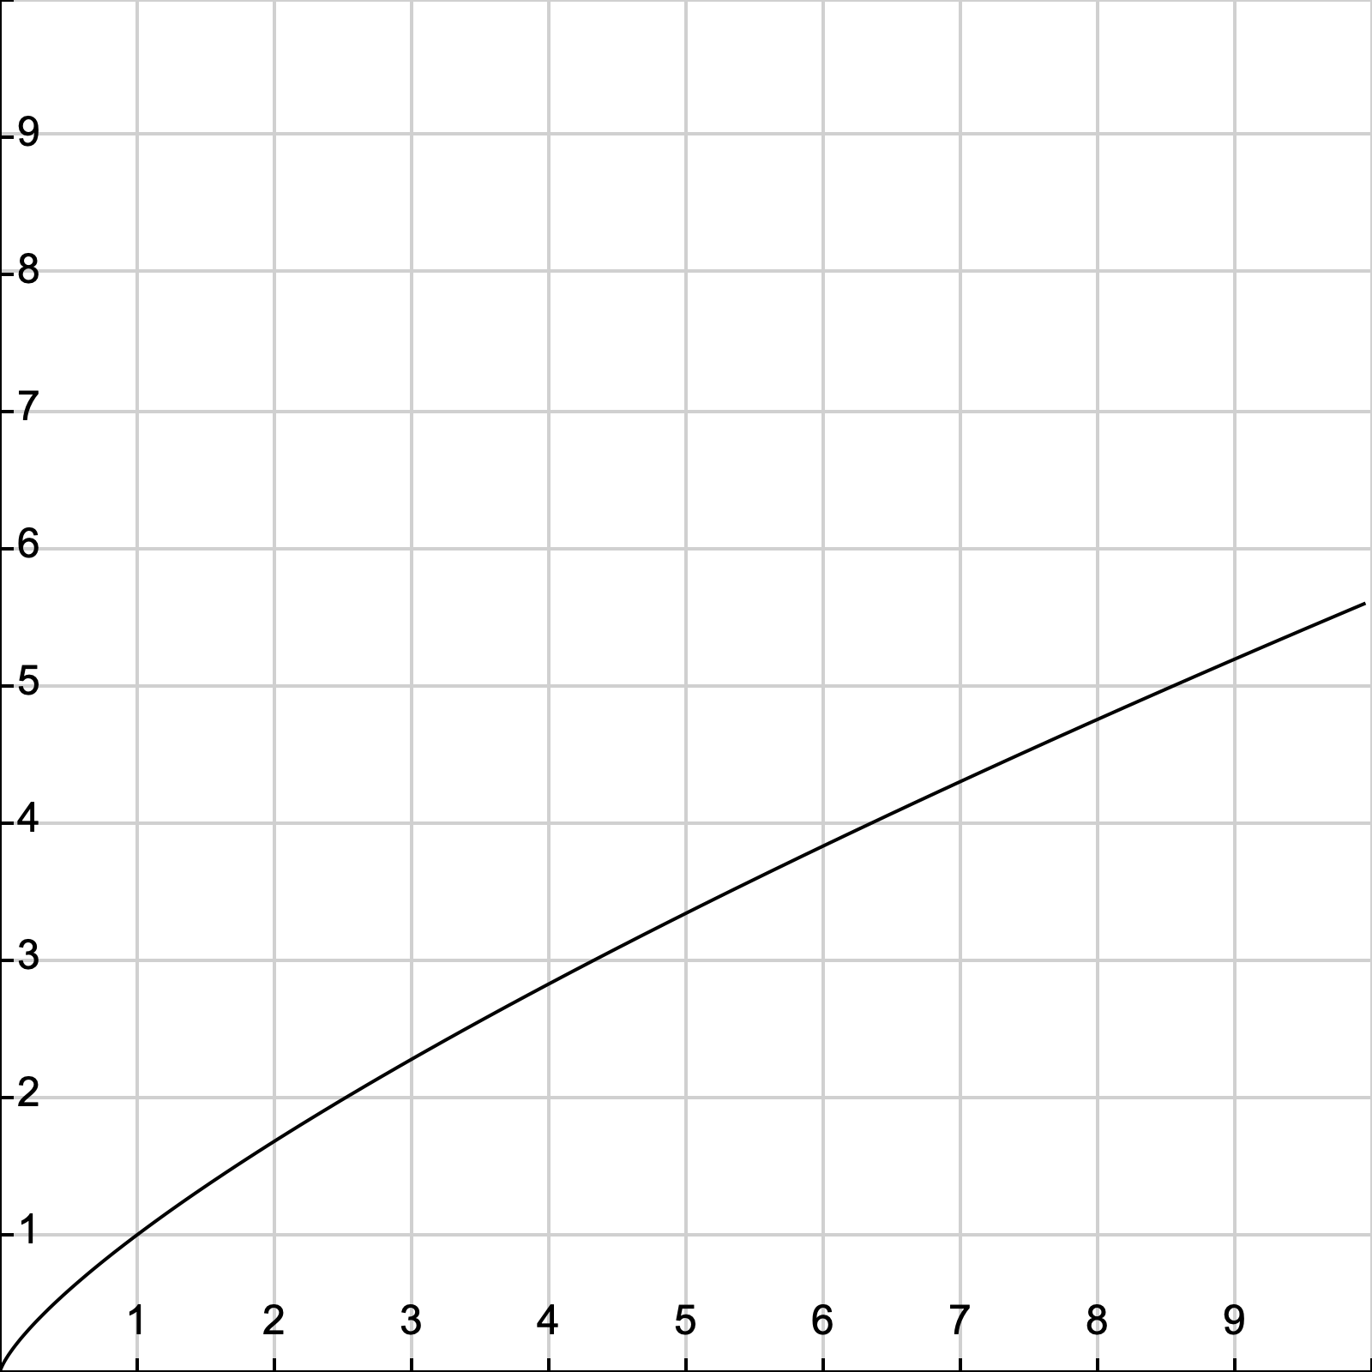
Context Distribution Smoothing
In practice, it’s a smoothed unigram distribution
$$P_{ }^{0.75}\left(c\right)=\frac{{\left(\#c\right)}^{0.75}}{\sum_{c^{′}∈V_{C}}{{\left(\#c^{′}\right)}^{0.75}}}$$
This little change makes a big difference
Distributed Representations of Words and Phrases and their Compositionality
Tomas Mikolov, Ilya Sutskever, Kai Chen, Greg Corrado, Jeffrey Dean, NIPS 2013
Notes:
In practice, it’s actually a smoothed unigram distribution.
And this tiny little change, makes quite a big difference.

Slide 48
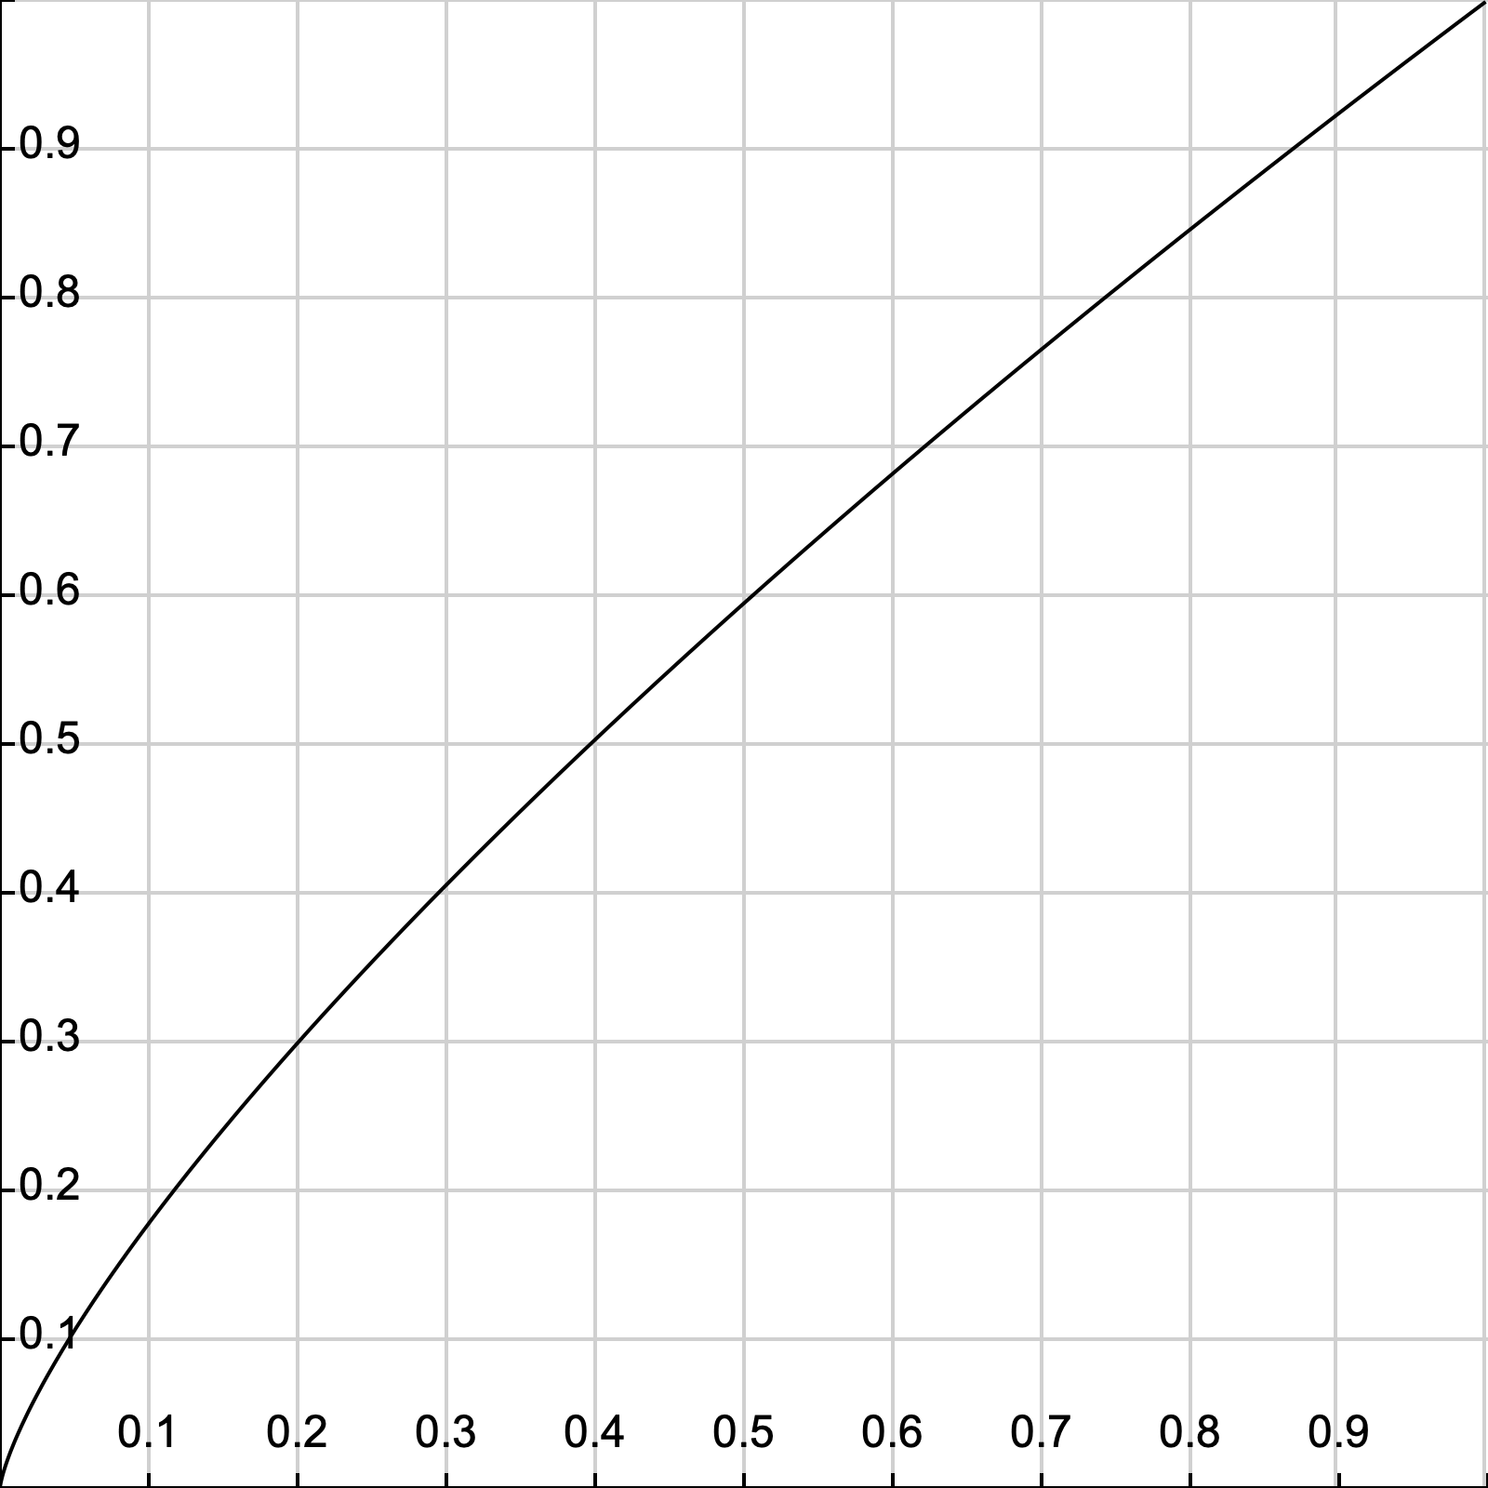
Context Distribution Smoothing
We can adapt context distribution smoothing to PMI!
Replace $P(c)$ with $P_{ }^{0.75}\left(c\right)$
$$PMI^{0.75}\left(w,c\right)=\log{\frac{P(w,c)}{P\left(w\right)⋅P^{0.75}\left(c\right)}}$$
Consistently improves PMI on every task
Always use Context Distribution Smoothing!
Notes:
Now, what’s neat about context distribution smoothing
Is that we can adapt it to PMI!
This is done by simply replacing the probability of C with the smoothed probability.
Just like this:
And this tweak consistently improves performance on every task.
So if there’s one technical detail you should remember from this talk, it’s this:
Always use context distribution smoothing!

Slide 49
Math behind CBOW with Negative Sampling
Likewise for CBOW
Objective:
where $\{{\tilde{u}}_{k} | k=1..K\}$ is sampled from vocabulary (also use context distribution smoothing)
Rather than:

Slide 50
What is SGNS learning?
Take SGNS’s embedding matrices ($W$ and $C$)
$$d$$
$$d$$
$$W$$
$$C$$
$$V_{W}$$
$$V_{C}$$
“Neural Word Embeddings as Implicit Matrix Factorization”
Levy & Goldberg, NIPS 2014
Notes:
If we take the embedding matrices

Slide 51
What is SGNS learning?
Take SGNS’s embedding matrices ($W$ and $C$)
Multiply them
What do you get?
$$d$$
$$W$$
$$V_{C}$$
$$V_{W}$$
$$d$$
$$C$$
“Neural Word Embeddings as Implicit Matrix Factorization”
Levy & Goldberg, NIPS 2014
Notes:
And multiply them
What do we get?

Slide 52
What is SGNS learning?
A $V_{W}×V_{C}$ matrix
Each cell describes the relation between a specific word-context pair
$\vec{w}⋅\vec{c}= ?$
$$d$$
$$V_{C}$$
$$W$$
$$V_{C}$$
$$?$$
$$V_{W}$$
$$d$$
$$C$$
$$=$$
$$V_{W}$$
“Neural Word Embeddings as Implicit Matrix Factorization”
Levy & Goldberg, NIPS 2014
Notes:
We get a pretty big, square matrix,
Where each cell describes the relation between a specific word, w,
With a specific context, c.

Slide 53
What is SGNS learning?
Levy&Goldberg [2014] proved that for large enough $d$ and enough iterations …
$$d$$
$$V_{C}$$
$$W$$
$$V_{C}$$
$$?$$
$$V_{W}$$
$$d$$
$$C$$
$$=$$
$$V_{W}$$
“Neural Word Embeddings as Implicit Matrix Factorization”
Levy & Goldberg, NIPS 2014
Notes:
So in our NIPS paper, we proved that with enough dimensions and iterations…

Slide 54
What is SGNS learning?
Levy&Goldberg [2014] proved that for large enough $d$ and enough iterations …
… one obtains the word-context PMI matrix
$$d$$
$$V_{C}$$
$$W$$
$$V_{C}$$
$$M^{PMI}$$
$$V_{W}$$
$$d$$
$$C$$
$$=$$
$$V_{W}$$
“Neural Word Embeddings as Implicit Matrix Factorization”
Levy & Goldberg, NIPS 2014
Notes:
…SGNS will converge to the classic word-context PMI matrix…

Slide 55
What is SGNS learning?
Levy&Goldberg [2014] proved that for large enough $d$ and enough iterations …
… one obtains the word-context PMI matrix …
shifted by a global constant
$Opt\left(\vec{w}⋅\vec{c}\right)=PMI\left(w,c\right)−\log{k}$
$$d$$
$$V_{C}$$
$$W$$
$$V_{C}$$
$$M^{PMI}$$
$$V_{W}$$
$$d$$
$$C$$
$$=$$
$$V_{W}$$
$$−\log{k}$$
where $k$ is the number of negative examples
“Neural Word Embeddings as Implicit Matrix Factorization”
Levy & Goldberg, NIPS 2014
Notes:
…with a little twist.
Now, recall that k is the number of negative samples generated for each positive example (w,c) \in D.
This is of course the optimal value, and not necessarily what we get in practice.

Slide 56
What is SGNS learning?
SGNS is doing something very similar to the older approaches
SGNS factorizes the traditional word-context PMI matrix
So does SVD!
GloVe factorizes a similar word-context matrix
Notes:
So to sum it up, SGNS is doing what we’ve been doing in NLP for a couple of decades:
It’s factorizing the PMI matrix,
Apparently, just like SVD.
And, while I didn’t explain it, GloVe also factorizes a similar matrix.

Slide 57
But embeddings are still better, right?
Plenty of evidence that embeddings outperform traditional methods
“Don’t Count, Predict!” (Baroni et al., ACL 2014)
GloVe (Pennington et al., EMNLP 2014)
How does this fit with our story?
Marco Baroni, Georgiana Dinu, Germán Kruszewski. Don’t count, predict! A systematic comparison of context-counting vs. context-predicting semantic vectors. In: Proc. ACL-14, 238–247, 2014.
Jeffrey Pennington, Richard Socher, Christopher Manning.
GloVe: Global Vectors for Word Representation.
In: Proc. EMNLP-.14, 1532–1543, 2014.
Notes:
But embeddings are still better, right?
There’s plenty of evidence,
Even a couple of papers.
So how does this fit with our story?

Slide 58
The Big Impact of “Small” Hyperparameters
word2vec & GloVe are more than just algorithms…
Introduce new hyperparameters
May seem minor, but make a big difference in practice
Notes:
So like I said at the beginning, word2vec and GloVe are more than just algorithms.
They introduce many new hyperparameters,
Which may seem minor,
but as it turns out, they make a pretty big difference in practice.

Slide 59
New Hyperparameters
Preprocessing (word2vec)
Dynamic Context Windows
Subsampling of Frequent Words
Deleting Rare Words
Postprocessing (GloVe)
Adding Context Vectors
Association Metric (SGNS)
Shifted PMI
Context Distribution Smoothing
Notes:
…we’ll look at Context Distribution Smoothing,
and see how we can adapt it to traditional count-based methods.

Slide 60
Dynamic Context Windows
Marco saw a furry little wampimuk hiding in the tree.
Notes:
So dynamic context windows
Let’s say we have our sentence from earlier,
And we want to look at a context window of 4 words around wampimuk.

Slide 61
Dynamic Context Windows
Marco saw a furry little wampimuk hiding in the tree.
Notes:
Now, some of these context words are obviously more related to the meaning of wampimuk than others.
The intuition behind dynamic context windows, is that the closer the context is to the target…

Slide 62
Dynamic Context Windows
Marco saw a furry little wampimuk hiding in the tree.
Word2vec: $\frac{1}{4}$ $\frac{2}{4}$ $\frac{3}{4}$ $\frac{4}{4}$ $\frac{4}{4}$ $\frac{3}{4}$ $\frac{2}{4}$ $\frac{1}{4}$
GloVe: $\frac{1}{4}$ $\frac{1}{3}$ $\frac{1}{2}$ $\frac{1}{1}$ $\frac{1}{1}$ $\frac{1}{2}$ $\frac{1}{3}$ $\frac{1}{4}$
Aggressive: $\frac{1}{8}$ $\frac{1}{4}$ $\frac{1}{2}$ $\frac{1}{1}$ $\frac{1}{1}$ $\frac{1}{2}$ $\frac{1}{4}$ $\frac{1}{8}$
The Word-Space Model (Sahlgren, 2006)
Magnus Sahlgren, The Word-Space Model, Dissertation, Stockholm Univ., 2006.
Notes:
…the more relevant it is.
word2vec does just that, by randomly sampling the size of the context window around each token.
What you see here are the probabilities that each specific context word will be included in the training data.
GloVe also does something similar, but in a deterministic manner, and with a slightly different distribution.
There are of course other ways to do this,
And they were all, apparently,
Applied to traditional algorithms about a decade ago.

Slide 63
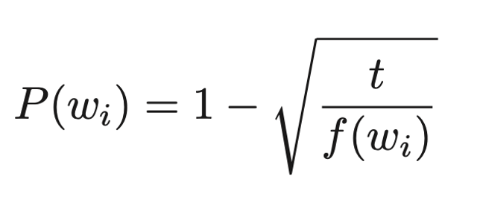
Subsampling of Frequent Words
Counter imbalance of rare and frequent words
Each word in the training set is discarded with a probability computed by
where $f(w_{i})$ is the frequency of word $w_{i}$ and $t$ is a chosen threshold
Distributed Representations of Words and Phrases and their Compositionality
Tomas Mikolov, Ilya Sutskever, Kai Chen, Greg Corrado, Jeffrey Dean, NIPS 2013

Slide 64
Adding Context Vectors
SGNS creates word vectors $\vec{w}$
SGNS creates auxiliary context vectors $\vec{c}$
So do GloVe and SVD
Instead of just $\vec{w}$
Represent a word as: $\vec{w}+\vec{c}$
Introduced by Pennington et al. (2014)
Only applied to GloVe
Notes:
So, each word has two representations, right?
So what if instead of using just the word vectors,
We’d also use the information in the context vectors,
to represent our words?
This trick was introduced as part of GloVe,
But it was also only applied to GloVe,
and not to the other methods.

Slide 65
Don’t Count, Predict! ?
“word2vec is better than count-based methods” [Baroni et al., 2014]
Hyperparameter settings account for most of the reported gaps in count-based approaches
Embeddings do not really outperform count-based methods
No unique conclusion available
Marco Baroni, Georgiana Dinu, Germán Kruszewski. Don’t count, predict! A systematic comparison of context-counting vs. context-predicting semantic vectors. In: Proc. ACL-14, 238–247, 2014.
Notes:
So, in “don’t count, predict”,
The authors show that word2vec is better than count-based methods.
And, while they did tune a lot of different hyperparameters,
Other hyperparameters remained hidden inside the code.
And it turns out,
That these hidden hyperparameters account for most of the reported performance gaps.
In our experiments, we show that embeddings are not really better than count-based methods.

Slide 66
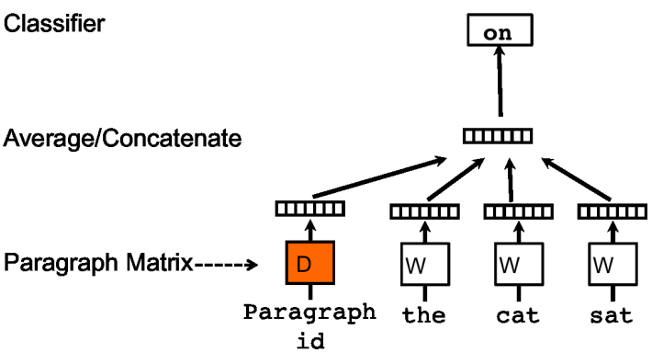
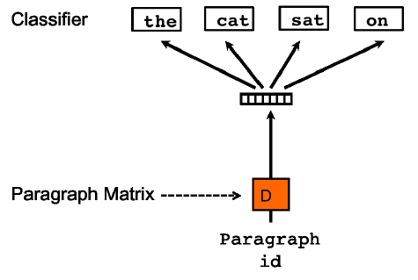
Represent the meaning of sentence/paragraph/doc
Paragraph Vector (Le and Mikolov, 2014)
Extend word2vec to text level
Also two models: add paragraph vector as the input
Quoc Le and Tomas Mikolov. Distributed representations of sentences and documents. In Proceedings ICML'14. 2014.

Slide 67
Problem
Learn low-dimensional, dense representations (or embeddings) for documents.
Document embeddings can be used off-the-shelf to solve many IR applications such as,
Document Classification
Document Retrieval
Document Ranking
Doc2Sent2Vec: A Novel Two-Phase Approach for Learning Document Representation, Ganesh J, Manish Gupta, Vasudeva Varma

Slide 68
Power of 2Vec Representations
Bag-of-words (BOW) or Bag-of-n-grams
Data sparsity
High dimensionality
Not/hardly capturing word order
Latent Dirichlet Allocation (LDA)
Computationally inefficient for larger dataset.
Paragraph Vector
Dense representation
Compact representation
Captures word order
Efficient to estimate
Doc2Sent2Vec: A Novel Two-Phase Approach for Learning Document Representation, Ganesh J, Manish Gupta, Vasudeva Varma

Slide 69
Paragraph Vector
Learn document embedding by predicting the next word in the document using the context of the word and the (‘unknown’) document vector as features.
Resulting vector captures the topic of the document.
Update the document vectors, but not the word vectors [Le et al.]
Update the document vectors, along with the word vectors [Dai et al.]
Improvement in the accuracy for document similarity tasks.
Quoc Le and Tomas Mikolov. Distributed representations of sentences and documents. In Proceedings ICML'14. 2014.
Dai, A.M., Olah, C., Le, Q.V., Corrado, G.S.: Document embedding with paragraph vectors. In: NIPS Deep Learning Workshop. 2014
Doc2Sent2Vec: A Novel Two-Phase Approach for Learning Document Representation, Ganesh J, Manish Gupta, Vasudeva Varma

Slide 70
Doc2Sent2Vec Idea - Being granular helps
Should we learn the document embedding from the word context directly?
Can we learn the document embedding from the sentence context?
Explicitly exploit the sentence-level and word-level coherence to learn document and sentence embedding respectively.
Doc2Sent2Vec: A Novel Two-Phase Approach for Learning Document Representation, Ganesh J, Manish Gupta, Vasudeva Varma

Slide 71
Notation
Document Set: D = {d₁, d₂, …, d_{M}}; ‘M’ documents;
Document: d_{m} = {s(m,1), s(m,2), …, s(m,T_{m})}; ‘T_{m}’ sentences;
Sentence: s(m,n) = {w(n,1), w(n,2), …, w(n,T_{n})}; ‘T_{n}’ words;
Word: w(n,t);
Doc2Sent2Vec’s goal is to learn low-dimensional representations of words, sentences and documents as a continuous feature vector of dimensionality D_{w} , D_{s} and D_{d} respectively.
Doc2Sent2Vec: A Novel Two-Phase Approach for Learning Document Representation, Ganesh J, Manish Gupta, Vasudeva Varma

Slide 72
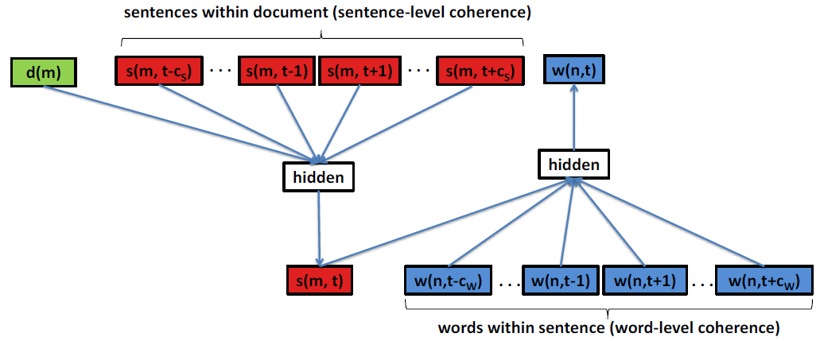
Architecture Diagram
Doc2Sent2Vec: A Novel Two-Phase Approach for Learning Document Representation, Ganesh J, Manish Gupta, Vasudeva Varma

Slide 73
Phase 1: Learn Sentence Embedding
Idea: Learn sentence representation from the word sequence within the sentence.
Input Features:
Context words for target word w(n,t): w(n,t-c_{w}), …, w(n,t-1), w(n,t+1), …, w(n,t+c_{w}) (where ‘c_{w}’ is the word context size)
Target Sentence: s(m,n) (where ‘m’ is the document id)
Output: w(n,t)
Task: Predict the target word using the concatenation of word vectors of context words along with the sentence vector as features.
Maximize the word likelihood:
L_{word} = P(w(n,t)| w(n,t-c_{w}), …, w(n,t-1), w(n,t+1), …, w(n,t+c_{w}), s(m,n))
Doc2Sent2Vec: A Novel Two-Phase Approach for Learning Document Representation, Ganesh J, Manish Gupta, Vasudeva Varma

Slide 74
Phase 2: Learn Document Embedding
Idea: Learn document representation from the sentence sequence within the document.
Input Features:
Context sentences for target sentence s(m,t): s(m,t-c_{s}), …, s(m,t-1), s(m,t+1), …, s(m,t+c_{S}) (where ‘c_{S}’ is the sentence context size)
Target Document: d(m)
Output: s(m,t)
Novel Task: Predict the target sentence using the concatenation of sentence vectors of context sentences along with the document vector as features.
Maximize the sentence likelihood:
L_{sent} = P(s(m,t)| s(m,t-c_{s}), …, s(m,t-1), s(m,t+1), …, s(m,t+c_{S}), d(m))
Doc2Sent2Vec: A Novel Two-Phase Approach for Learning Document Representation, Ganesh J, Manish Gupta, Vasudeva Varma

Slide 75
Training
Overall objective function: L = L_{word} + L_{sent}
Use Stochastic Gradient Descent (SGD) to learn parameters
Use Hierarchical Softmax (Mikolov et al.) to facilitate faster training
Doc2Sent2Vec: A Novel Two-Phase Approach for Learning Document Representation, Ganesh J, Manish Gupta, Vasudeva Varma

Slide 76
Latent Relational Structures
Processing natural language data:
Tokenization/Sentence Splitting
Part-of-speech (POS) tagging
Phrase chunking
Named entity recognition
Coreference resolution
Semantic role labeling
Ronan Collobert and Jason Weston. A unified architecture for natural language processing: deep neural networks with multitask learning. In Proceedings ICML '08. pp. 160–167. 2008.
An Introduction to Machine Learning and Natural Language Processing Tools, , V. Srikumar, M. Sammons, N. Rizzolo

Slide 77
Phrase Chunking
Identifies phrase-level constituents in sentences
[NP Boris] [ADVP regretfully] [VP told] [NP his wife] [SBAR that] [NP their child] [VP could not attend] [NP night school] [PP without] [NP permission] .
Useful for filtering: identify e.g. only noun phrases, or only verb phrases
Used as source of features, e.g. distance, (abstracts away determiners, adjectives, for example), sequence,…
More efficient to compute than full syntactic parse
Applications in e.g. Information Extraction – getting (simple) information about concepts of interest from text documents
Hand-crafted chunkers (regular expressions/finite automata)
HMM/CRF-based chunk parsers derived from training data
An Introduction to Machine Learning and Natural Language Processing Tools, , V. Srikumar, M. Sammons, N. Rizzolo

Slide 78
Named Entity Recognition
Identifies and classifies strings of characters representing proper nouns
[PER Neil A. Armstrong] , the 38-year-old civilian commander, radioed to earth and the mission control room here: “[LOC Houston] , [ORG Tranquility] Base here; the Eagle has landed."
Useful for filtering documents
“I need to find news articles about organizations in which Bill Gates might be involved…”
Disambiguate tokens: “Chicago” (team) vs. “Chicago” (city)
Source of abstract features
E.g. “Verbs that appear with entities that are Organizations”
E.g. “Documents that have a high proportion of Organizations”
An Introduction to Machine Learning and Natural Language Processing Tools, , V. Srikumar, M. Sammons, N. Rizzolo

Slide 79
Named Entity Recogniton: Definition
NE involves identification of proper names in texts, and classification into a set of predefined categories of interest
Three universally accepted categories: person, location and organisation
Other common tasks: recognition of date/time expressions, measures (percent, money, weight etc), email addresses etc.
Other domain-specific entities: names of drugs, medical conditions, names of ships, bibliographic references etc
NER ist not easy
“Introduction to Named Entity Recognition”, University of Sheffield

Slide 80
Named Entity Classification
Category definitions are intuitively quite clear, but there are many grey areas.
Many of these grey area are caused by metonymy.
Person vs. Artefact: “The ham sandwich wants his bill.” vs “Bring me a ham sandwich.”
Organisation vs. Location : “England won the World Cup” vs. “The World Cup took place in England”.
Company vs. Artefact: “shares in MTV” vs. “watching MTV”
Location vs. Organisation: “she met him at Heathrow” vs. “the Heathrow authorities”
“Introduction to Named Entity Recognition”, University of Sheffield

Slide 81
Basic Problems in NE
Variation of NEs – e.g. John Smith, Mr Smith, John.
Ambiguity of NE types
John Smith (company vs. person)
May (person vs. month)
Washington (person vs. location)
1945 (date vs. time)
Ambiguity with common words, e.g. “may”
“Introduction to Named Entity Recognition”, University of Sheffield

Slide 82
More complex problems in NER
Issues of style, structure, domain, genre etc.
Punctuation, spelling, spacing, formatting, ….all have an impact
Dept. of Computing and Maths
Manchester Metropolitan University
Manchester
United Kingdom
> Tell me more about Leonardo
> Da Vinci
“Introduction to Named Entity Recognition”, University of Sheffield

Slide 83
List Lookup Approach
System that recognises only entities stored in its lists (gazetteers).
Advantages - Simple, fast, language independent, easy to retarget
Disadvantages – collection and maintenance of lists, cannot deal with name variants, cannot resolve ambiguity
“Introduction to Named Entity Recognition”, University of Sheffield

Slide 84
Shallow Parsing Approach
Internal evidence – names often have internal structure. These components can be either stored or guessed.
location:
CapWord + {City, Forest, Center}
e.g. Sherwood Forest
Cap Word + {Street, Boulevard, Avenue, Crescent, Road}
e.g. Portobello Street
“Introduction to Named Entity Recognition”, University of Sheffield

Slide 85
Shallow Parsing Approach
External evidence - names are often used in very predictive local contexts
Location:
“to the” COMPASS “of” CapWord
e.g. to the south of Loitokitok
“based in” CapWord
e.g. based in Loitokitok
CapWord “is a” (ADJ)? GeoWord
e.g. Loitokitok is a friendly city
“Introduction to Named Entity Recognition”, University of Sheffield

Slide 86
Difficulties in Shallow Parsing Approach
Ambiguously capitalised words (first word in sentence)
[All American Bank] vs. All [State Police]
Semantic ambiguity
“John F. Kennedy” = airport (location)
“Philip Morris” = organisation
Structural ambiguity
[Cable and Wireless] vs. [Microsoft] and [Dell]
[Center for Computational Linguistics] vs. message from [City Hospital] for [John Smith].
“Introduction to Named Entity Recognition”, University of Sheffield

Slide 87
Coreference
Identify all phrases that refer to each entity of interest – i.e., group mentions of concepts
[Neil A. Armstrong] , [the 38-year-old civilian commander], radioed to [earth]. [He] said the famous words, “[the Eagle] has landed”."
The Named Entity Recognizer only gets us part-way…
…if we ask, “what actions did Neil Armstrong perform?”, we will miss many instances (e.g., “He said…”)
Coreference resolver abstracts over different ways of referring to the same person
Useful in feature extraction, information extraction
An Introduction to Machine Learning and Natural Language Processing Tools, , V. Srikumar, M. Sammons, N. Rizzolo

Slide 88
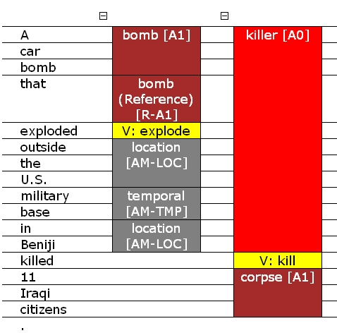
Semantic Role Labeling (SRL)
SRL reveals relations and arguments in the sentence (where relations are expressed as verbs)
Cannot abstract over variability of expressing the relations – e.g. kill vs. murder vs. slay…
An Introduction to Machine Learning and Natural Language Processing Tools, , V. Srikumar, M. Sammons, N. Rizzolo

Slide 89
Why is SRL Important – Applications
Question Answering
Q: When was Napoleon defeated?
Look for: [_{PATIENT} Napoleon] [_{PRED} defeat-synset] [_{ARGM-TMP} *ANS*]
Machine Translation
English (SVO) Farsi (SOV)
[_{AGENT} The little boy] [_{AGENT} pesar koocholo] boy-little
[_{PRED} kicked] [_{THEME} toop germezi] ball-red
[_{THEME} the red ball] [_{ARGM-MNR} moqtam] hard-adverb
[_{ARGM-MNR} hard] [_{PRED} zaad-e] hit-past
Document Summarization
Predicates and Heads of Roles summarize content
Information Extraction
SRL can be used to construct useful rules for IE
Automatic Semantic Role Labeling, S. Wen-tau Yih, K. Toutanova

Slide 90
Some History
Minsky 74, Fillmore 1976: Frames describe events or situations
Multiple participants, “props”, and “conceptual roles”
E.g., agent, instrument, target, time, …
Levin 1993: verb class defined by sets of frames (meaning-preserving alternations) a verb appears in
{break,shatter,..}: Glass X’s easily; John Xed the glass, …
Cut is different: The window broke; *The window cut.
FrameNet, late ’90s: based on Levin’s work: large corpus of sentences annotated with frames
PropBank
Marvin Minky. A Framework for Representing Knowledge Marvin Minsky, MIT-AI Laboratory Memo 306, June, 1974.
Charles J. Fillmore, Frame semantics and the nature of language
Annals of the New York Academy of Sciences 280(1):20 – 32, 1976.
Levin, B. English Verb Classes and Alternations: A Preliminary Investigation, University of Chicago Press, Chicago, IL. 1993.
Automatic Semantic Role Labeling, S. Wen-tau Yih, K. Toutanova

Slide 91
FrameNet
Frame: Hit_target (hit, pick off, shoot)
Agent Target Instrument Manner | Means Place Purpose Subregion Time
Lexical units (LUs): Words that evoke the frame
(usually verbs)
Core
Non-Core
Frame elements (FEs): The involved semantic roles
[_{Agent} Kristina] hit [_{Target} Scott] [_{Instrument} with a baseball] [_{Time} yesterday ].
Gildea, Daniel; Jurafsky, Daniel. "Automatic Labeling of Semantic Roles”. Computational Linguistics. 28 (3): 245–288. 2002.
Notes:
Moving toward statistical approaches for semantic role labeling, the first available corpus is FrameNet, which is developed in UC Berkeley. According to their definition, semantic frames are representations of situation types, such as eating or walking, together with lists of participants and conceptual roles that are components of such situations. For example, the frame shown on this slide is the hit_target situation.
In their terminology, there are two types of components of a frame. One is lexical units, which are words that evoke the frame, such as hit, pick off, and shoot here.
The other component is frame elements, which are the semantic roles involved in this frame.
Frame elements can be further categorized into 2 types, one is core elements, and the other is non-core frame elements.
------------------
http://framenet.icsi.berkeley.edu/index.php?option=com_wrapper&Itemid=118&frame=Hit_target&
What is a frame and how do you know when you've got one? Semantic frames are schematic representations of situation types (eating, spying, removing, classifying, etc.) together with lists of the kinds of participants, props, and other conceptual roles that are seen as components of such situations. The semantic arguments of a predicating word correspond to what we call the frame elements of the frame associated with that word. In principle, work on a new frame begins with the native speaker analyst's intuitive judgment that some particular conceptual pattern underlies one or more lexical units in the language in a systematic way. We are satisfied with such judgments when we see that we can analyze sentences containing the words we've assigned to the frame in terms of the frame elements that we defined in characterizing the frame. In real life, the actual experience is a kind of cognitive zigzag: a frame is proposed, and some words are suggested for illustrating the frame. Frame elements are suggested that the analyst thinks these words would have in common. In the course of doing some initial annotation, however, we often discover distinctions among the words that were not at first noticed, and often a slightly different version of the frame is formulated--one which no longer welcomes some of the words in the original list, but takes in some new ones.

Slide 92
Proposition Bank (PropBank)
Transfer sentences to propositions
Kristina hit Scott → hit(Kristina,Scott)
Penn TreeBank → PropBank
Add a semantic layer on Penn TreeBank
Define a set of semantic roles for each verb
Each verb’s roles are numbered
…[A0 the company] to … offer [A1 a 15% to 20% stake] [A2 to the public]
…[A0 Sotheby’s] … offered [A2 the Dorrance heirs] [A1 a money-back guarantee]
…[A1 an amendment] offered [A0 by Rep. Peter DeFazio] …
…[A2 Subcontractors] will be offered [A1 a settlement] …
Palmer M, Kingsbury P, Gildea D. "The Proposition Bank: An Annotated Corpus of Semantic Roles". Computational Linguistics. 31 (1): 71–106. 2005.
Notes:
The next corpus, which is the main focused data in this tutorial, is the proposition bank, or PropBank.
PropBank is developed in U Penn by a team led by Martha Palmer. The name of “proposition” comes from the goal of transferring sentences into propositions.

Slide 93
Semantic Role Labeling (SRL)
SRL reveals relations and arguments in the sentence (where relations are expressed as verbs)
Cannot abstract over variability of expressing the relations – e.g. kill vs. murder vs. slay…
An Introduction to Machine Learning and Natural Language Processing Tools, , V. Srikumar, M. Sammons, N. Rizzolo

