Slide 1
Intelligent Agents
Multi-Relational Latent Semantic Analysis
Ralf Möller
Universität zu Lübeck
Institut für Informationssysteme

Slide 2


Acknowledgements
Some slides provided by: Scott Wen-tau Yih, Microsoft Research
slides are possibly edited
Some slides are new or are taken from other authors (as indicated locally)

Slide 3

Open-Domain Question Answering
Fulfill user’s information need with direct answers
Answer Sentence Selection
Q: Who won the best actor Oscar in 1973?
S₁: Jack Lemmon was awarded the Best Actor Oscar for Save the Tiger (1973).
S₂: Academy award winner Kevin Spacey said that Jack Lemmon is remembered as always making time for others.
  Word-embedding based approaches
  Combined with models for enhanced lexical semantic

Slide 4
Continuous Semantic Representations
A lot of popular methods for creating representations
  Word/Document embedding: Vector Space Model (BoW)
  Dimension reduction: Latent Semantic Analysis

Slide 5
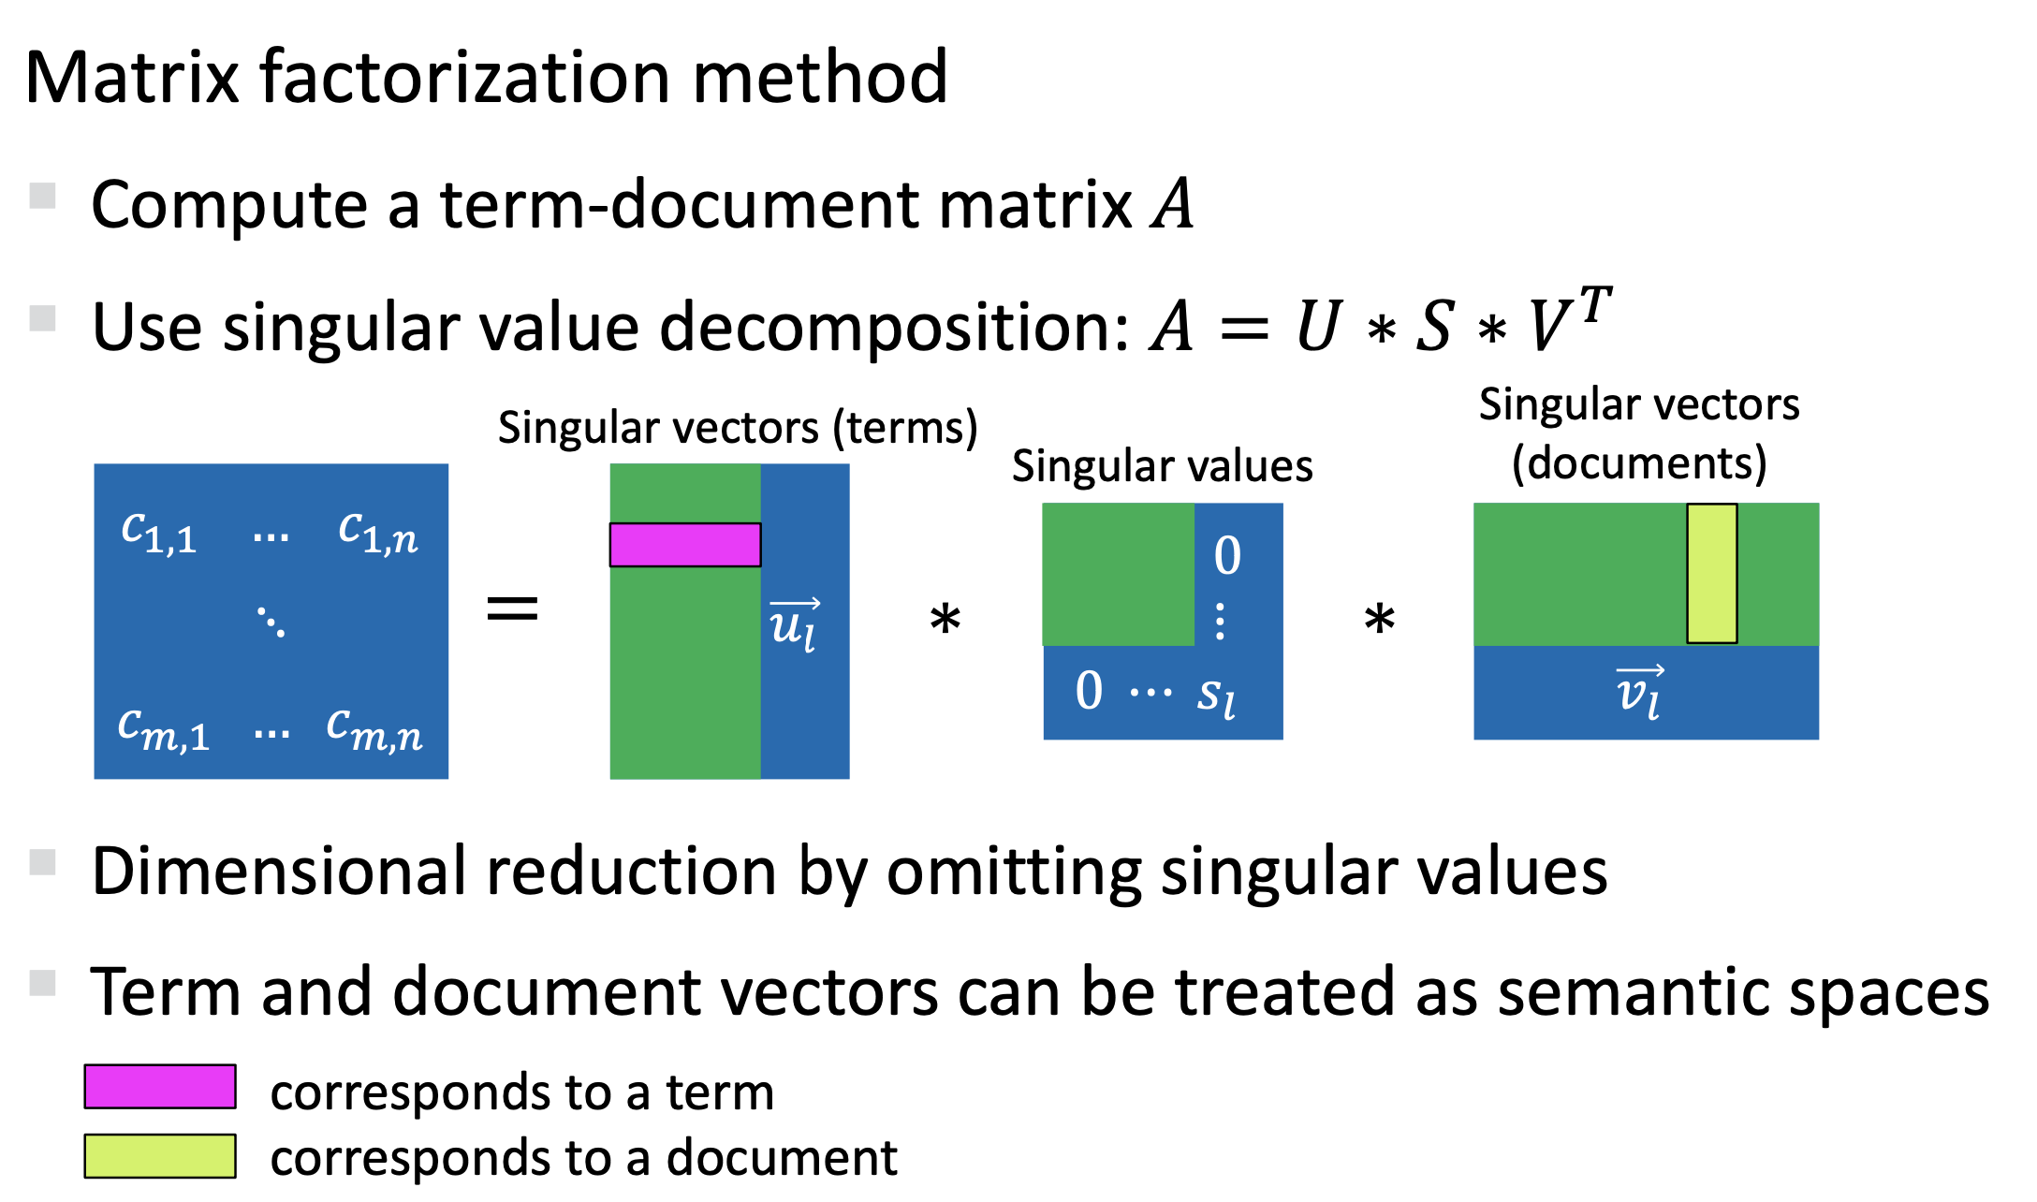
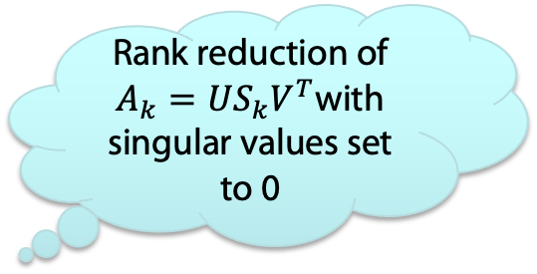
Recap: Latent Semantic Analysis (LSA, ca. 1990)
Rank reduction of $A_{k}=US_{k}V^{T}$with singular values set to 0
documents
terms
Michael Heck, The World of Word Vectors: Dialog Systems and Machine Learning, 2019

Slide 6
Continuous Semantic Representations
A lot of popular methods for creating representations
  Word/Document embedding: Vector Space Model (BoW)
  Dimension reduction: Latent Semantic Analysis
  Encoding of term co-occurrence information: PMI
  Shallow parsing: HMMs, MRFs, Deep Network Learning
    POS tagging, Phase chunking, NER, SRL
  Topic models: Latent Dirichlet Allocation
  Word embedding w.r.t. contexts: Word2Vec, GloVe, Paragraph Vector (doc2vec)…

Slide 7
Continuous Semantic Representations
sunny
rainy
cloudy
windy
car
cab
emotion
sad
wheel
joy
feeling

Slide 8
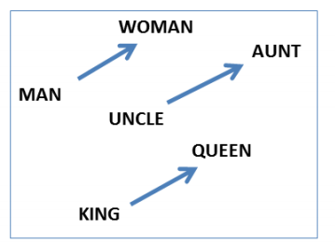
Using Learned Relational Networks for IR
Instead of words, also named entities (represented by words) can be embedded
Two entities can be associated automatically
Shallow parsing and/or
semantic role labeling might help
v_{Y}
v_{X}
v_{R}
William W Cohen, Machine Learning Dept. CMU

Slide 9
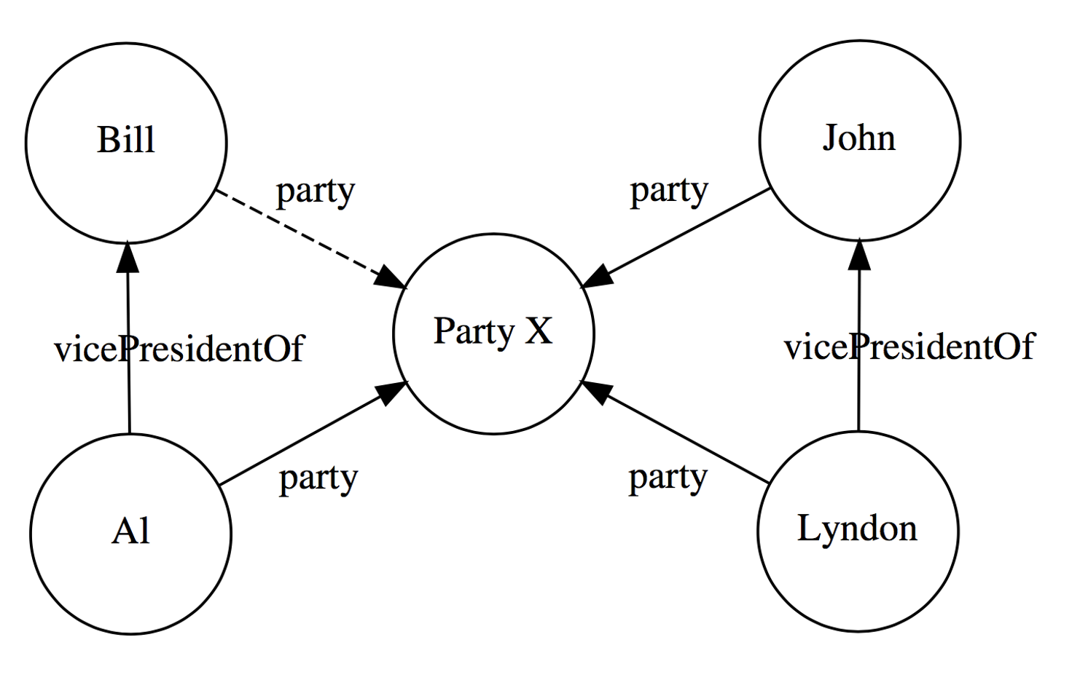
Goal: Predict relation membership
Databases from text data are inherently incomplete
Structure embedding due to similarities
“Knowledge graph” completion
Actually, we deal with database completion

Slide 10
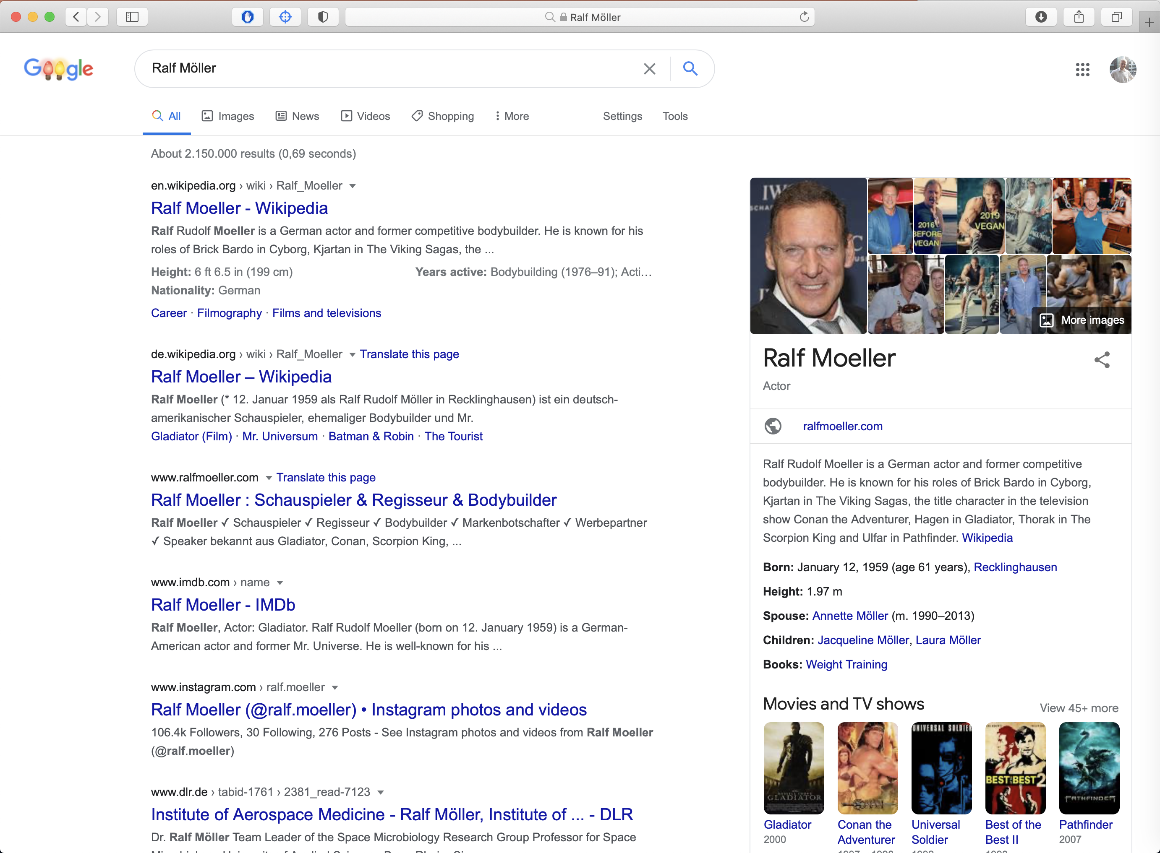
Relational Database Search vs. String Search

Slide 11

Relational Data only for Important People

Slide 12
Negative Sampling of Relational Structures?
Naively selecting arbitrary tuples of instances as negative examples by sampling?
Does not impose much control on the problem of learning embeddings
Open-world vs. closed-world assumption
Generative adversarial networks to generate negative examples of relational structures (not discussed in detail)
Liwei Cai and William Yang Wang, "KBGAN: Adversarial Learning for Knowledge Graph Embeddings", in Proceedings NAACL 2018.

Slide 13


Semantics Needs More Than Similarity
Tomorrow will be rainy.
Tomorrow will be sunny.
$similar($rainy, sunny$)$?
$antonym($rainy, sunny$)$?

Slide 14
Leverage Linguistic Knowledge
Can’t we just use the existing thesauri for information about synonyms and antonyms?
  Knowledge in these resources is never complete
  Often lack of “membership degree” for relations
    Various ways to measure “membership degree”
Goal: Create a continuous semantic representation that
  Leverages existing rich linguistic resources
  Discovers new relations
  Enables us to measure the “degree” of multiple relations (not just similarity)

Slide 15
Roadmap
Two opposite relations:
  Polarity Inducing Latent Semantic Analysis
Multiple relations:
  Multi-Relational Latent Semantic Analysis
Relational domain knowledge
Yih, Zweig & Platt. Polarity Inducing Latent Semantic Analysis. In EMNLP-CoNLL-12.
Chang, Yih & Meek. Multi-Relational Latent Semantic Analysis. In EMNLP-13.
Chang, Yih, Yang & Meek. Typed Tensor Decomposition of Knowledge Bases for Relation Extraction. In EMNLP-14.
EMNLP: Empirical Methods in Natural Language Processing
CoNLL: Computational Natural Language Learning
ACL; Annual Meeting of the Association for Computational Linguistics

Slide 16
Problem: Handling Two Opposite Relations
Can cope to some extent with homonyms and synonyms
due to word context
Embedding techniques cannot clearly distinguish antonyms
  “Distinguishing synonyms and antonyms is still perceived as a difficult open problem.” [Poon & Domingos 09]
Idea #1: Change the data representation
Synonyms: Different words, same meaning
Homonyms: Same words, different meanings
Antonyms: Opposite words
Hoifung Poon and Pedro Domingos. Unsupervised semantic parsing. In Proceedings EMNLP ‘09. 2009.

Slide 17
Polarity Inducing LSA
Data representation
  Encode two opposite relations in a matrix using “polarity”
    Synonyms & antonyms (e.g., from a thesaurus)
Factorization
  Apply SVD to the matrix to find latent components
Measuring degree of relation
  Cosine of latent vectors
Wen-tau Yih, Geoffrey Zweig, John Platt. Polarity Inducing Latent Semantic Analysis. In Proceedings EMNLP ‘12. 2012.

Slide 18
Encode Synonyms & Antonyms in Matrix
Joyfulness: joy, gladden; sorrow, sadden
Sad: sorrow, sadden; joy, gladden
Target word: row-vector
 | joy | gladden | sorrow | sadden | goodwill
Group 1: “joyfulness” | 1 | 1 | 1 | 1 | 0
Group 2: “sad” | 1 | 1 | 1 | 1 | 0
Group 3: “affection” | 0 | 0 | 0 | 0 | 1

Slide 19

Encode Synonyms & Antonyms in Matrix
Joyfulness: joy, gladden; sorrow, sadden
Sad: sorrow, sadden; joy, gladden
Inducing polarity
Target word: row-vector
 | joy | gladden | sorrow | sadden | goodwill
Group 1: “joyfulness” | 1 | 1 | -1 | -1 | 0
Group 2: “sad” | -1 | -1 | 1 | 1 | 0
Group 3: “affection” | 0 | 0 | 0 | 0 | 1
Cosine Score: $+ Synonyms$

Slide 20
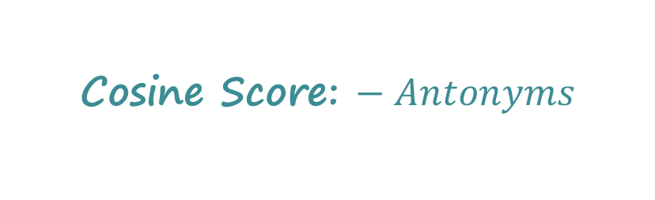
Encode Synonyms & Antonyms in Matrix
Joyfulness: joy, gladden; sorrow, sadden
Sad: sorrow, sadden; joy, gladden
Inducing polarity
Target word: row-vector
 | joy | gladden | sorrow | sadden | goodwill
Group 1: “joyfulness” | 1 | 1 | -1 | -1 | 0
Group 2: “sad” | -1 | -1 | 1 | 1 | 0
Group 3: “affection” | 0 | 0 | 0 | 0 | 1
Cosine Score: $− Antonyms$

Slide 21
Problem: How to Handle More Relations?
Limitation of the matrix representation
  Each entry captures a particular type of relation between two entities, or
  Two opposite relations with the polarity trick
Encoding other binary relations
  Is-A (hyponym) – ostrich is a bird
  Part-whole – engine is a part of car
Idea #2
  Encode multiple relations in a 3-way tensor
  (3-dim array)!
M. Nickel, V. Tresp, and H.-P. Kriegel. A three-way model for collective learning
on multi-relational data. In Proceedings of the 28th International Conference on
International Conference on Machine Learning, ICML’11, pages 809–816, 2011.

Slide 22
Encode Multiple Relations in Tensor
Represent word relations using a tensor
  Each slice encodes a relation between terms and target words.
gladden
gladden
joy
sadden
joy
sadden
feeling
feeling
joyfulness
1 | 1 | 0 | 0
1 | 1 | 0 | 0
0 | 0 | 1 | 0
0 | 0 | 0 | 0
joyfulness
0 | 0 | 0 | 0
0 | 0 | 1 | 0
1 | 0 | 0 | 0
0 | 0 | 0 | 0
gladden
gladden
sad
sad
anger
anger
Synonym layer
Antonym layer
Construct a tensor with two slices

Slide 23
Encode Multiple Relations in Tensor
Can encode multiple relations in the tensor
gladden
joy
sadden
feeling
1 | 1 | 0 | 0
1 | 1 | 0 | 0
0 | 0 | 1 | 0
0 | 0 | 0 | 0
1 | 1 | 0 | 0
1 | 1 | 0 | 0
0 | 0 | 1 | 0
0 | 0 | 0 | 0
0 | 0 | 0 | 1
0 | 0 | 0 | 0
0 | 0 | 0 | 1
0 | 0 | 0 | 1
joyfulness
gladden
sad
anger
Hyponym layer
Hyponym IS-A/TYPE-OF hypernym
Metonym: Substitute for another term
(substitute usually used for sth else)

Slide 24
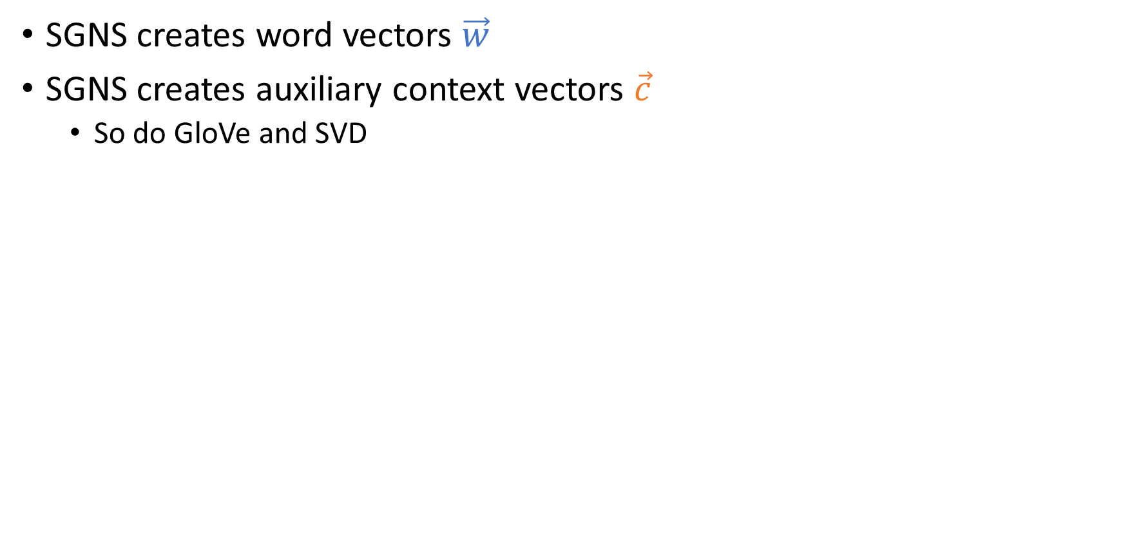



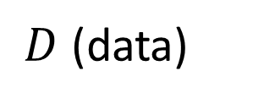



Tensor Decomposition – Analogy to SVD
Derive a low-rank approximation to generalize the data and to discover unseen relations
SVD
$$t_{1},t_{2},…, t_{n}$$
$$k$$
$$k$$
$$t_{1},t_{2},…, t_{n}$$
$$w_{1},w_{2},…, w_{d}$$
~
$$k$$
$$w_{1},w_{2},…, w_{d}$$
×
~
×
$$k$$
latent representation of words

Slide 25
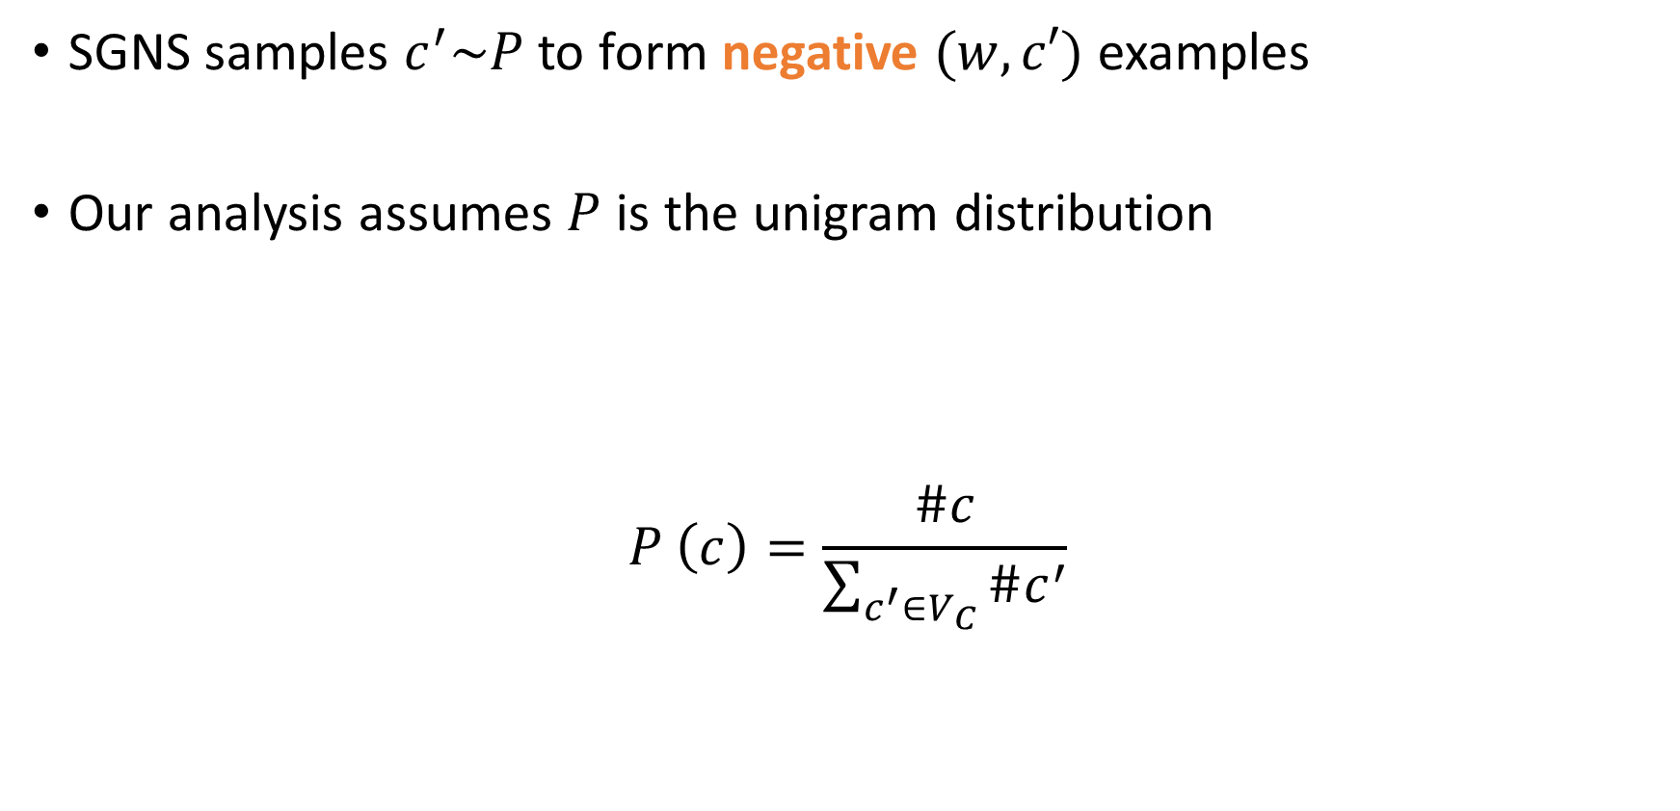

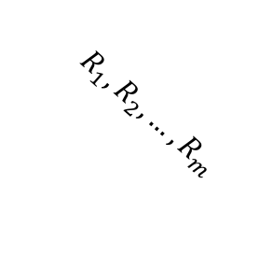

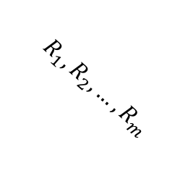
Tensor Decomposition – Analogy to SVD
Derive a low-rank approximation to generalize the data and to discover unseen relations
Apply Tucker decomposition and reformulate the results
(tensor factorization)
latent representation of a relation
(with k as a hyperparameter)
$$t_{1},t_{2},…, t_{n}$$
$$k$$
$$k$$
$$R_{1},R_{2},…, R_{m}$$
$$t_{1},t_{2},…, t_{n}$$
A
$$R_{1},R_{2},…, R_{m}$$
$$k$$
A^{T}
$$w_{1},w_{2},…, w_{d}$$
~
~
×
~
×
~
×
×
$$k$$
R_{k}
latent representation of words
Ledyard R. Tucker. "Some mathematical notes on three-mode factor analysis". Psychometrika. 31 (3): 279–311, 1966.

Slide 26
Measure Degree of Relation
Similarity
  Cosine of the latent vectors
Other relations (both symmetric and asymmetric)
  Take the latent matrix of the pivot relation (synonym)
  Take the latent matrix of the relation
  Cosine of the latent vectors after projection

Slide 27
Measure Degree of Relation: Raw Representation
$ant\left(\text{joy},\text{sadden}\right)=cos⁡\left(𝓦_{:,\text{joy},syn},𝓦_{:,\text{sadden},ant}\right)$
gladden
gladden
joy
sadden
joy
sadden
felling
felling
joyfulness
1 | 1 | 0 | 0
1 | 1 | 0 | 0
0 | 0 | 1 | 0
0 | 0 | 0 | 0
joyfulness
0 | 0 | 0 | 0
0 | 0 | 1 | 0
1 | 0 | 0 | 0
0 | 0 | 0 | 0
gladden
gladden
sad
sad
anger
anger
Synonym layer
Antonym layer

Slide 28
Measure Degree of Relation: Raw Representation
$ant\left(\text{joy},\text{sadden}\right)=cos⁡\left(𝓦_{:,\text{joy},syn},𝓦_{:,\text{sadden},ant}\right)$
gladden
gladden
joy
sadden
joy
sadden
felling
felling
joyfulness
1 | 1 | 0 | 0
1 | 1 | 0 | 0
0 | 0 | 1 | 0
0 | 0 | 0 | 0
joyfulness
0 | 0 | 0 | 0
0 | 0 | 1 | 0
1 | 0 | 0 | 0
0 | 0 | 0 | 0
gladden
gladden
sad
sad
anger
anger
Synonym layer
Antonym layer

Slide 29




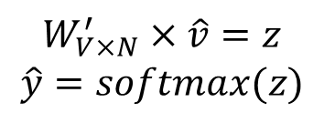


Measure Degree of Relation: Latent Representation
$rel\left({\text{w}}_{i},{\text{w}}_{j}\right)=cos⁡\left(S_{:,:,syn}V_{i,:}^{T},S_{:,:,rel}V_{j,:}^{T}\right)$
Cos ( , )
×
×
$$k$$
$$w_{1},w_{2},…, w_{n}$$
$$R_{1},R_{2},…, R_{m}$$
~
$$k$$
~
~
×
×
~
$$k$$
$$S$$
$$V^{T}$$

Slide 30
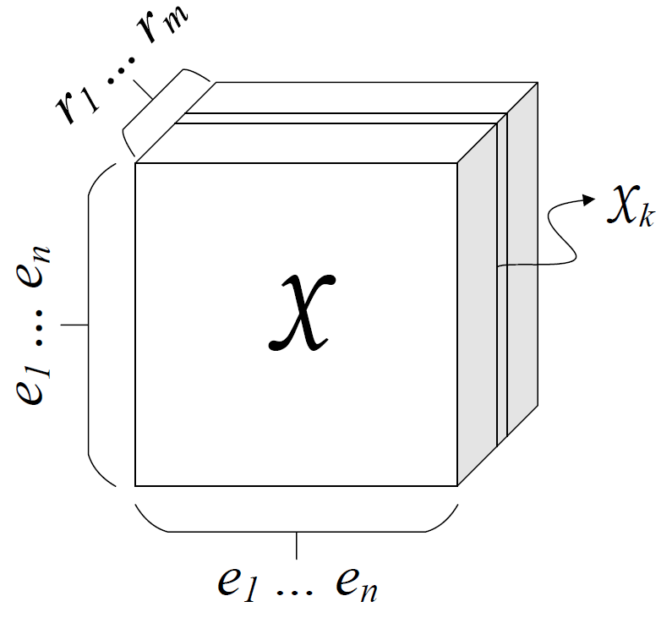
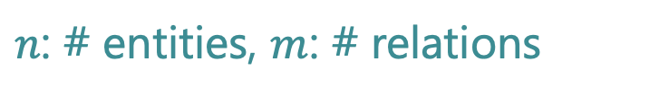
Representation of Facts (1/2)
Collection of subj-pred-obj triples – $(e_{1}, r, e_{2})$
Subject | Predicate | Object
Obama | Born-in | Hawaii
Bill Gates | Nationality | USA
Bill Clinton | Spouse-of | Hillary Clinton
Satya Nadella | Work-at | Microsoft
… | … | …
$n$: # entities, $m$: # relations
M. Nickel, V. Tresp, and H.-P. Kriegel. A three-way model for collective learning
on multi-relational data. In Proceedings of the 28th International Conference on
International Conference on Machine Learning, ICML’11, pages 809–816, 2011.

Slide 31
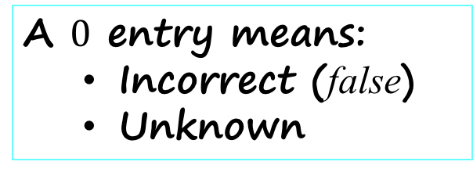
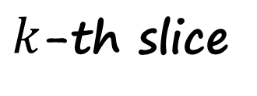
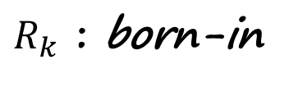

Database Representation (2/2)
$k$-th slice
$$𝒳_{k}$$
Hawaii
Obama
1
A $0$ entry means:
  Incorrect (false)
  Unknown
$R_{k}$ : born-in
M. Nickel, V. Tresp, and H.-P. Kriegel. A three-way model for collective learning
on multi-relational data. In Proceedings of the 28th International Conference on
International Conference on Machine Learning, ICML’11, pages 809–816, 2011.

Slide 32
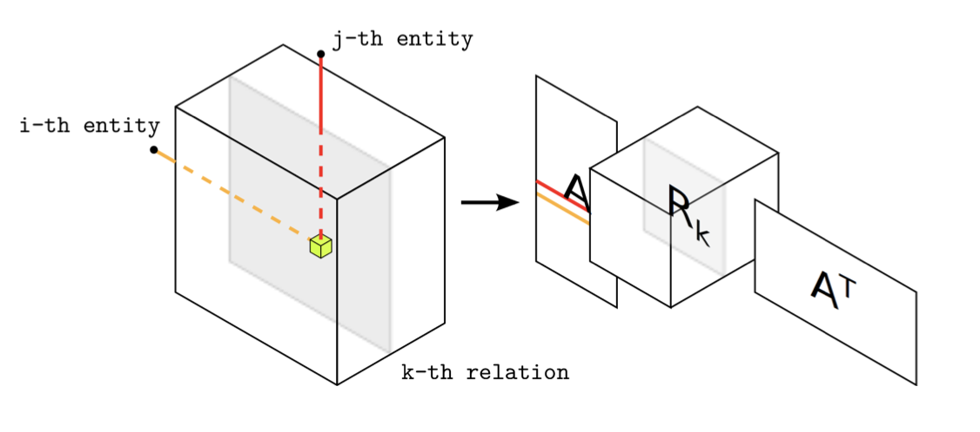
Factorization
M. Nickel, V. Tresp, and H.-P. Kriegel. A three-way model for collective learning
on multi-relational data. In Proceedings of the 28th International Conference on
International Conference on Machine Learning, ICML’11, pages 809–816, 2011.

Slide 33
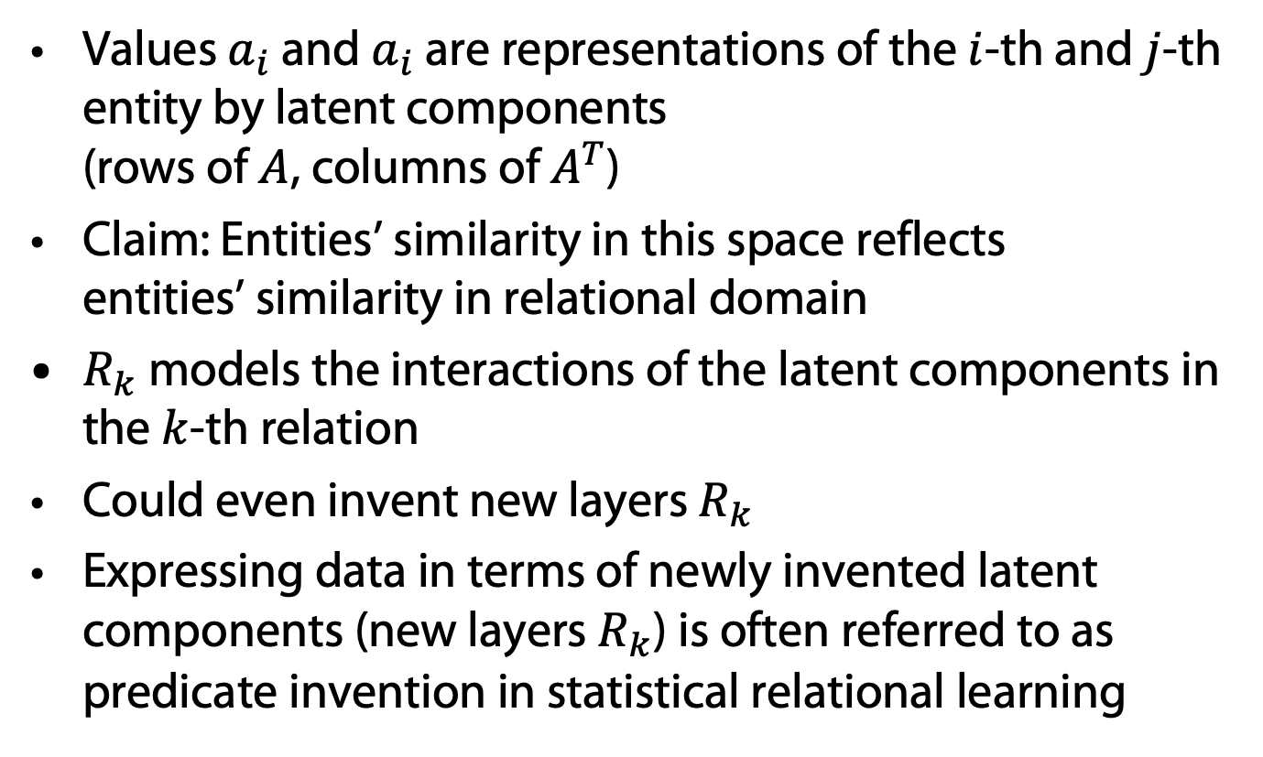
Tensor Factorization
Values $a_{i}$ and $a_{i}$ are representations of the $i$-th and $j$-th entity by latent components
(rows of $A$, columns of $A^{T}$)
Claim: Entities’ similarity in this space reflects
entities’ similarity in relational domain
$R_{k}$ models the interactions of the latent components in the $k$-th relation
Could even invent new layers $R_{k}$
Expressing data in terms of newly invented latent components (new layers $R_{k}$) is often referred to as predicate invention in statistical relational learning
Nickel, M, Tresp, V, Kriegel, HP: Factorizing YAGO. Scalable Machine Learning for Linked Data. In Proceedings of the 21st International World Wide Web Conference, 2012.

Slide 34

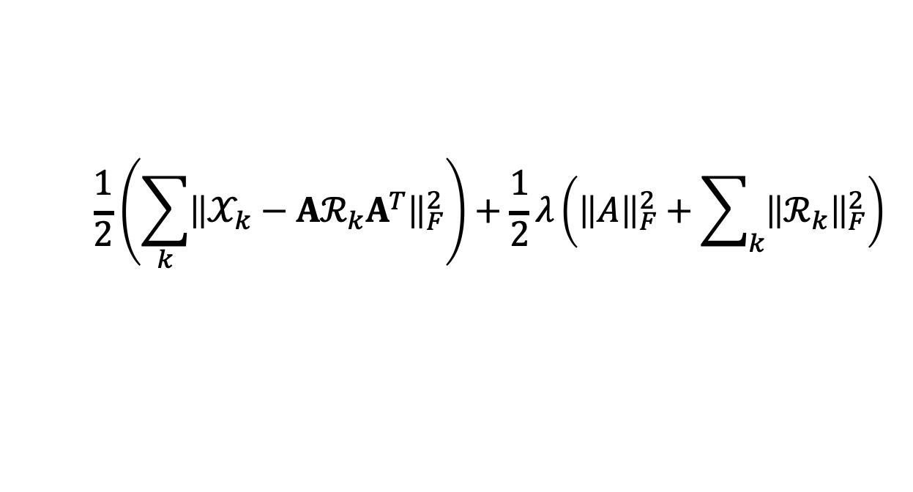
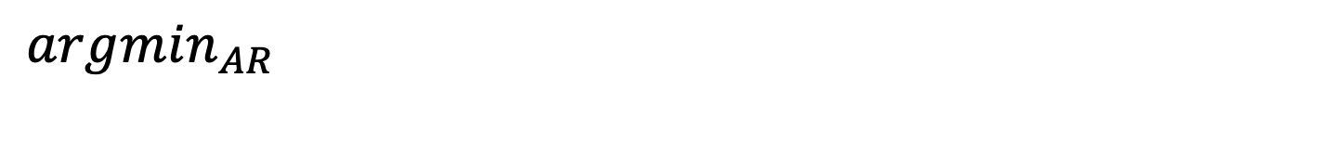
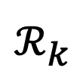



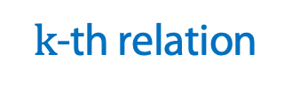
Tensor Decomposition Objective
$$\frac{1}{2}\left(\sum_{k}{{\left\|𝒳_{k}−Aℛ_{k}A^{T}\right\|}_{F}^{2}}\right)+\frac{1}{2}λ\left({\left\|A\right\|}_{F}^{2}+\sum_{k}{{\left\|ℛ_{k}\right\|}_{F}^{2}}\right)$$
${argmin}_{AR}$
Rank reduction?
Reconstruction Error (Loss)
Regularization
Dimension is a hyperparameter
$$𝒳_{k}$$
$$A$$
$$ℛ_{k}$$
$$A^{T}$$
~
×
×
~
$k$-th relation
Frobenius Norm:
Brett W. Bader, Richard A. Harshman, and Tamara G. Kolda. 2007. Temporal Analysis of Semantic Graphs Using ASALSAN. In Proc. ICDM ‘07. 2007
34

Slide 35
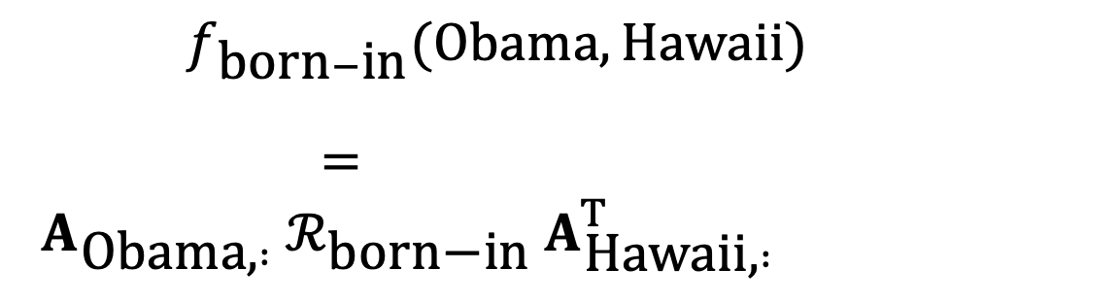
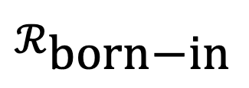


Measure the Degree of a Relationship
$f_{\text{born}−\text{in}}(\text{Obama},\text{Hawaii})$
$= A_{\text{Obama}\text{,} :} ℛ_{\text{born}\text{−}\text{in}} A_{\text{Hawaii}\text{,} :}^{T}$
$$A$$
Hawaii
$$ℛ_{\text{born}\text{−}\text{in}}$$
$$A^{T}$$
×
×
Obama
35

Slide 36
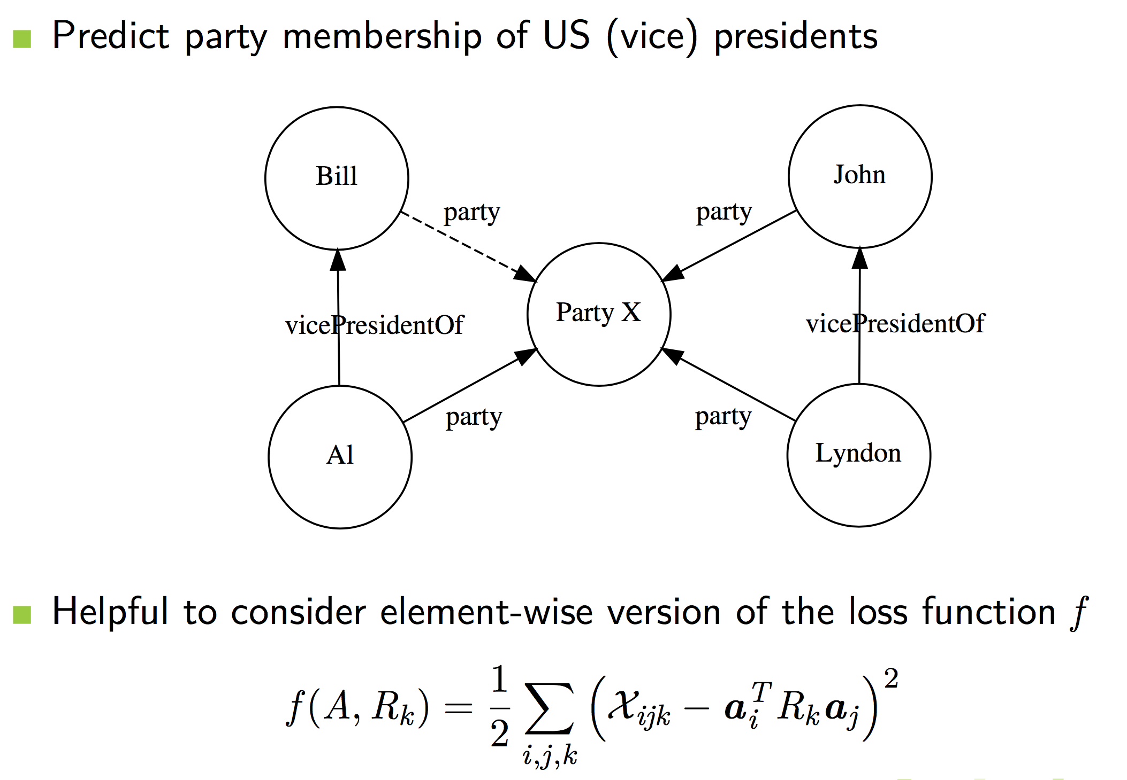
Prediction of Unknown Facts
Prediction of unknown fact party(Bill, Party X)

Slide 37
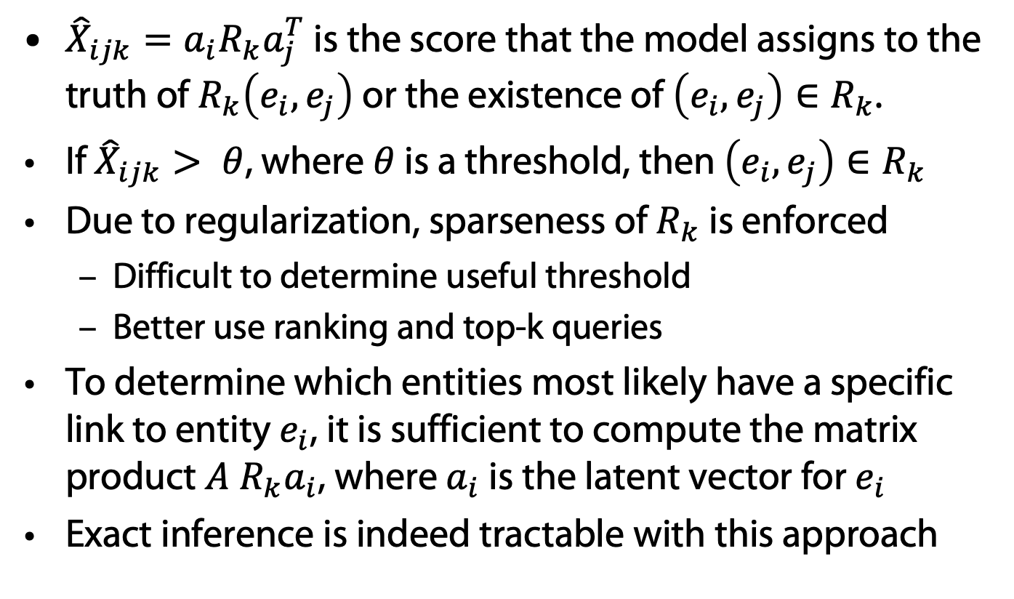
Link prediction
${\hat{X}}_{ijk}=a_{i}R_{k}a_{j}^{T}$ is the score that the model assigns to the truth of $R_{k}\left(e_{i},e_{j}\right)$ or the existence of $\left(e_{i},e_{j}\right)∈R_{k}$.
If ${\hat{X}}_{ijk}> θ$, where $θ$ is a threshold, then $\left(e_{i},e_{j}\right)∈R_{k}$
Due to regularization, sparseness of $R_{k}$ is enforced
  Difficult to determine useful threshold
  Better use ranking and top-k queries
To determine which entities most likely have a specific link to entity $e_{i}$, it is sufficient to compute the matrix product $A R_{k}a_{i}$, where $a_{i}$ is the latent vector for $e_{i}$
Exact inference is indeed tractable with this approach

Slide 38
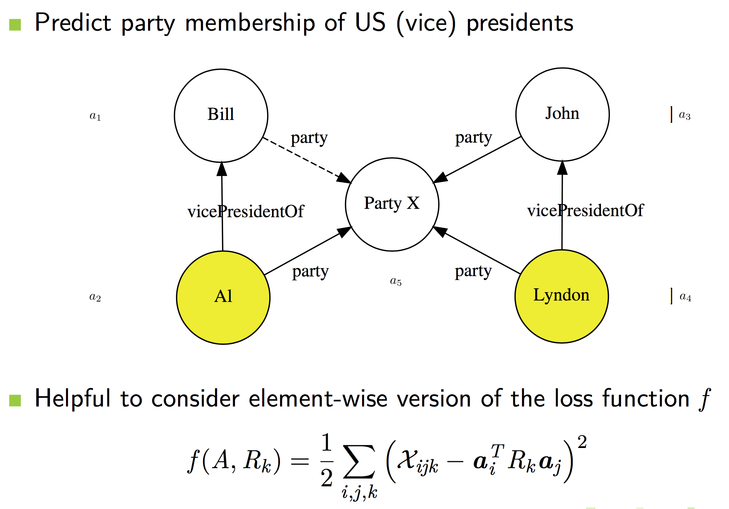
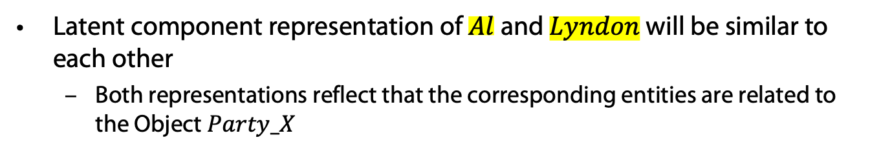
Link Prediction
Latent component representation of $Al$ and $Lyndon$ will be similar to each other
  Both representations reflect that the corresponding entities are related to the Object $Party_X$

Slide 39
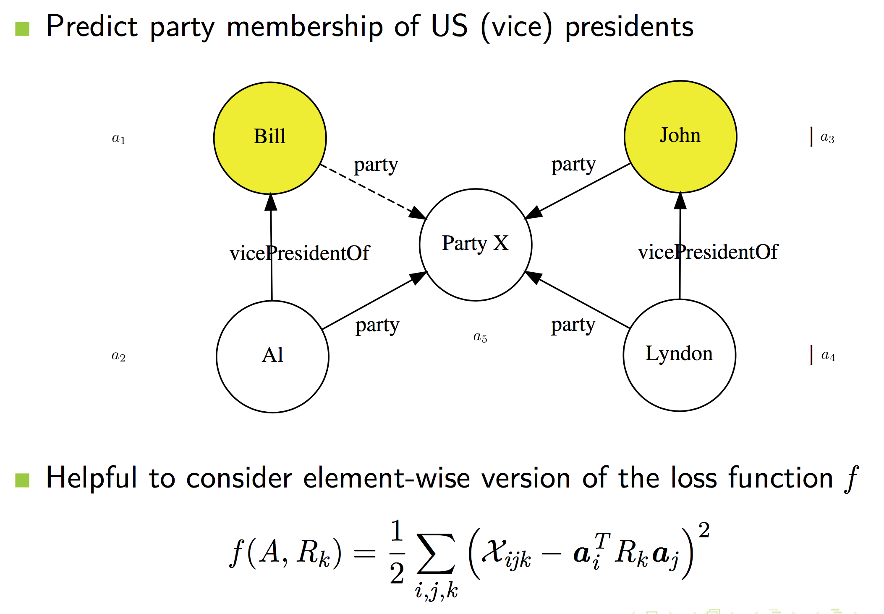
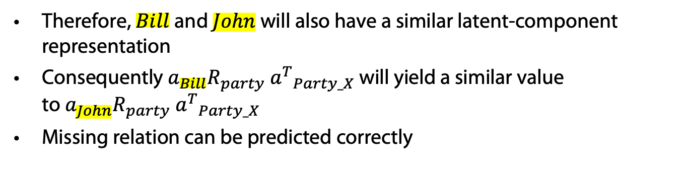
Link Prediction
Therefore, $Bill$ and $John$ will also have a similar latent-component representation
Consequently $a_{Bill}R_{party}{ a^{T}}_{Party_X}$ will yield a similar value to${ a}_{John}R_{party}{ a^{T}}_{Party_X}$
Missing relation can be predicted correctly

Slide 40
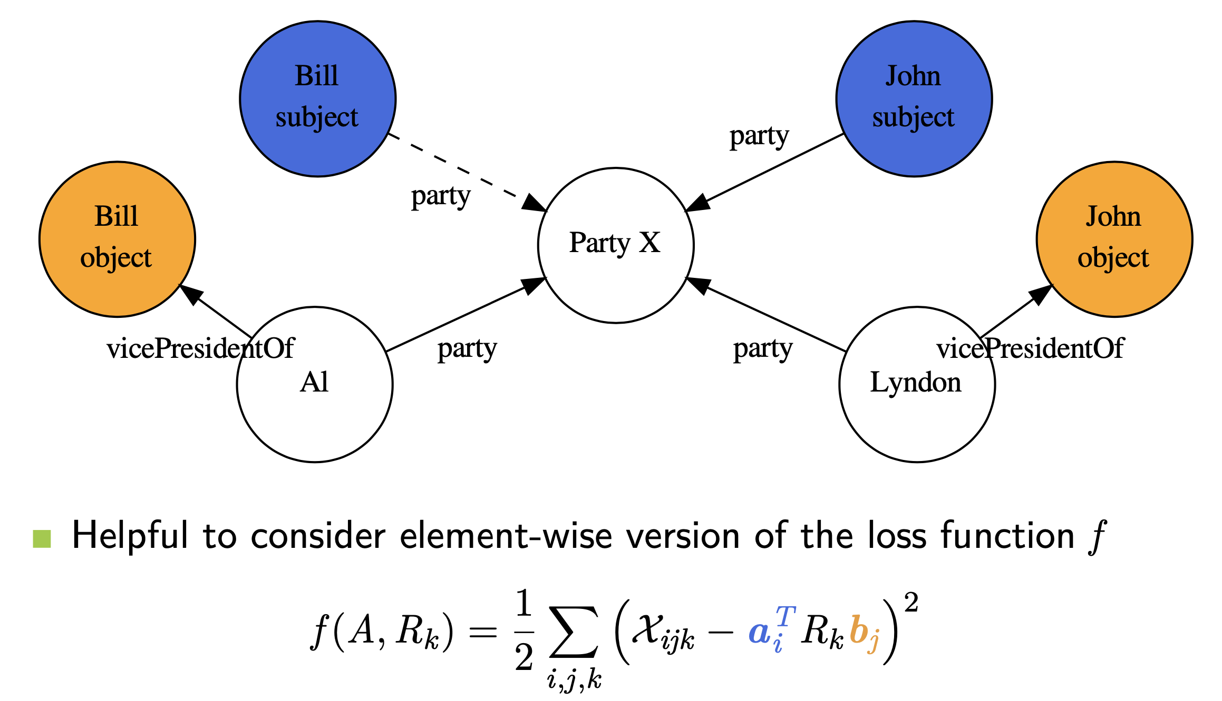
Collective Learning on Multi-Relational Data
This would break if $Bill$ and $John$ had different representations as subjects and objects

Slide 41
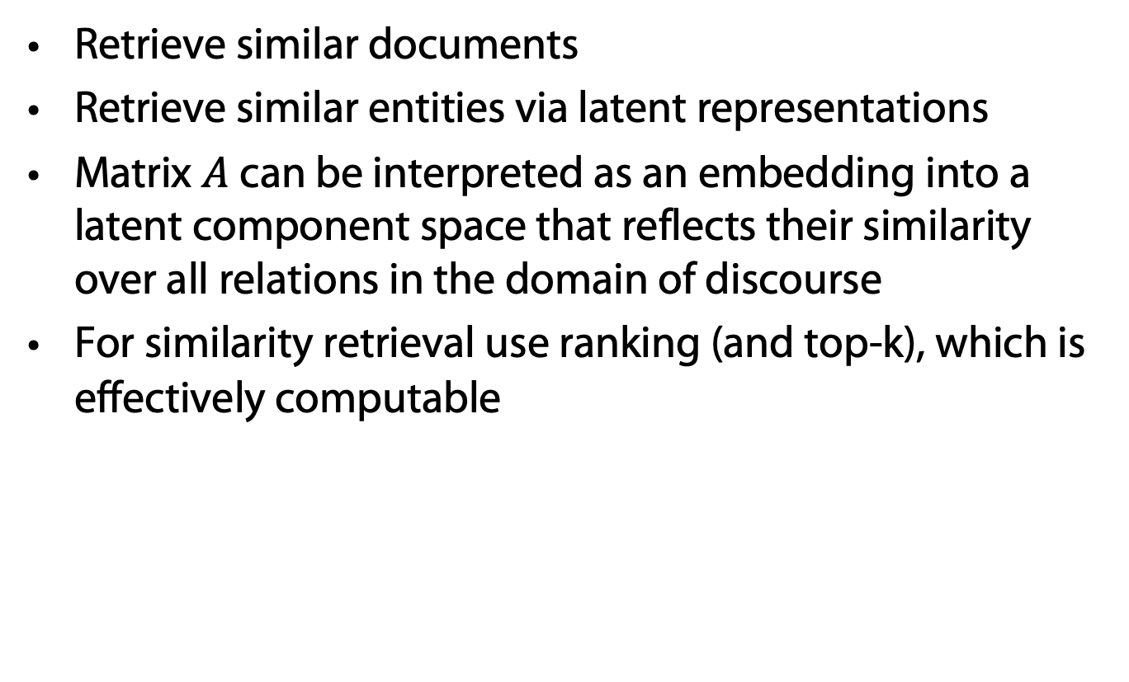
Benefits of the Latent Representation
Retrieve similar documents
Retrieve similar entities via latent representations
Matrix $A$ can be interpreted as an embedding into a latent component space that reflects their similarity over all relations in the domain of discourse
For similarity retrieval use ranking (and top-k), which is effectively computable

Slide 42
Problem: Relational Domain Knowledge
Relational data – the entity type
  Relation can only hold between the right types of entities
    Words having is-a relation have the same part-of-speech
    For relation born-in, the entity types are: (person, location)
Leverage type information to improve multi-relational LSA
Idea #3: Change the objective function

Slide 43
Typed Multi-Relational LSA (TRESCAL)
Only legitimate entities are included in the objective function of tensor decomposition
Benefits of leveraging the type information
  Faster model training time
  Higher prediction accuracy
Experiments conducted using database
  Application to Relation Extraction
Chang, Kai-Wei & Yih, Wen-tau & Yang, Bishan & Meek, Chris. Typed Tensor Decomposition of Knowledge Bases for Relation Extraction. In: Proc. EMNLP-14. 2014.

Slide 44

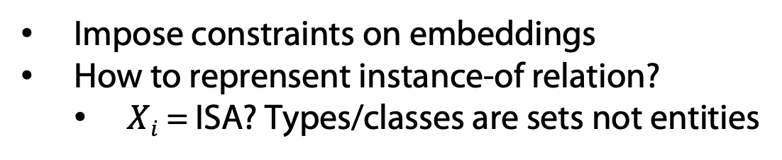
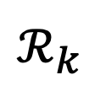


Typed Tensor Decomposition Objective
locations
$$𝒳_{k}$$
$$A$$
$$ℛ_{k}$$
$$A^{T}$$
~
×
×
~
persons
Relation: born-in
Impose constraints on embeddings
How to reprensent instance-of relation?
  $Xi$ = ISA? Types/classes are sets not entities
Kai-Wei Chang, Scott Wen-tau Yih, Bishan Yang & Chris Meek

Slide 45





Typed Tensor Decomposition Objective
$$\frac{1}{2}\sum_{k}{{\left\|𝒳_{k}^{′}−A_{k_{l}}ℛ_{k}A_{k_{r}}^{T}\right\|}_{F}^{2}}$$
Reconstruction error:
Improvements in learning time
Performance improvements
$$𝒳_{k}^{′}$$
$$A_{k_{l}}$$
$$ℛ_{k}$$
$$A_{k_{r}}^{T}$$
~
×
×
~
Chang, Kai-Wei & Yih, Wen-tau & Yang, Bishan & Meek, Chris. Typed Tensor Decomposition of Knowledge Bases for Relation Extraction. In: Proc. EMNLP-14. 2014.
45
Kai-Wei Chang, Scott Wen-tau Yih, Bishan Yang & Chris Meek

Slide 46
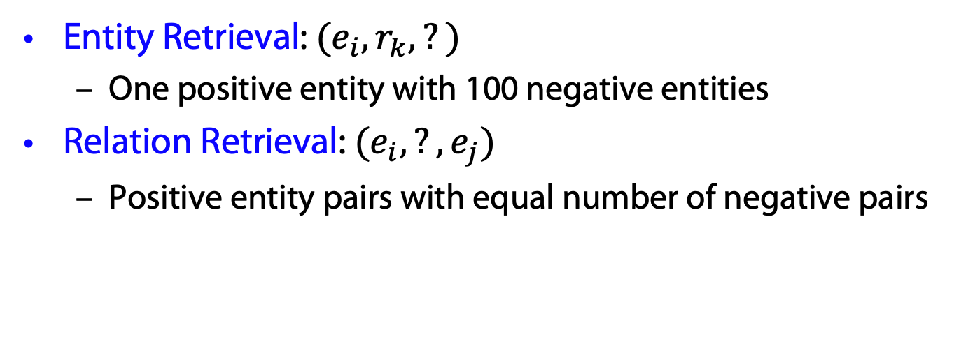
Tasks
Entity Retrieval: $(e_{i}, r_{k}, ?)$
  One positive entity with 100 negative entities
Relation Retrieval: $(e_{i}, ?, e_{j})$
  Positive entity pairs with equal number of negative pairs
46

Slide 47
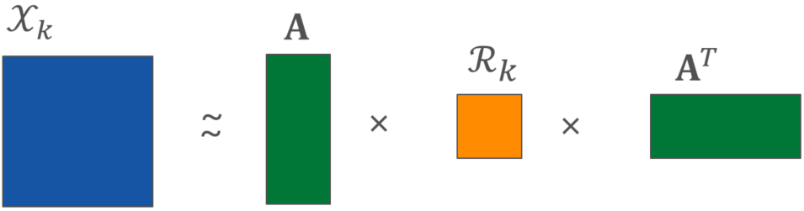
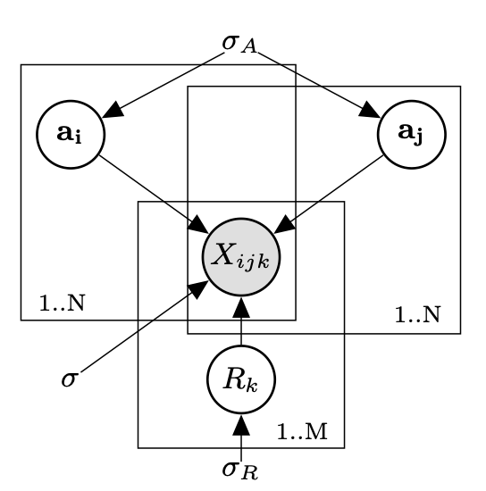
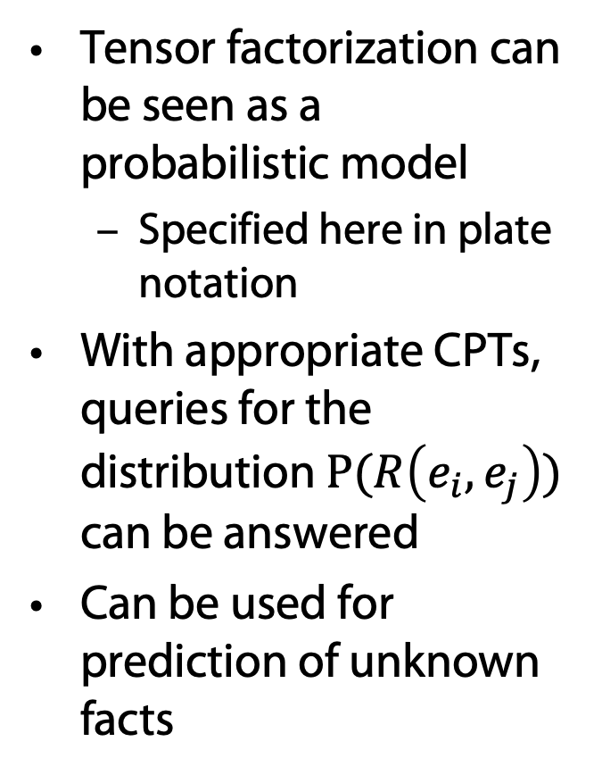
RESCAL: Graphical Model in Plate Notation
Tensor factorization can be seen as a probabilistic model
  Specified here in plate notation
With appropriate CPTs, queries for the distribution $P(R\left(e_{i}, e_{j}\right))$ can be answered
Can be used for prediction of unknown facts
Nickel, M, Tresp, V, Kriegel, HP: Factorizing YAGO. Scalable Machine Learning for Linked Data. In Proceedings of the 21st International World Wide Web Conference, 2012.

Slide 48
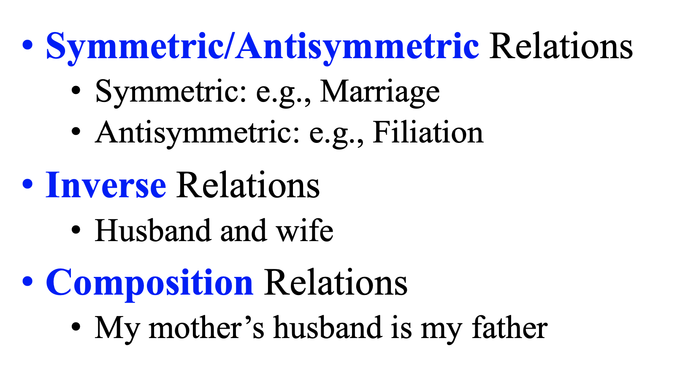
Types of Relations
if R(a, b) with a ≠ b, then R(b, a) must not hold,
Asymmetric =
antisymmetric and irreflexive

Slide 49
Using Learned Relational Networks for IR
TransE: Translating Embeddings:
Find an embedding for entities and relations so that R(X,Y) iff v_{Y}-v_{X} ~= v_{R}
v_{Y}
v_{X}
v_{R}
Instead of words, also named entities (represented by words) can be embedded
Two entities can be associated automatically
Antoine Bordes, Nicolas Usunier, Alberto Garcia-Durán, Jason Weston, and Oksana Yakhnenko. Translating embeddings for modeling multi-relational data. In Proceedings NIPS 2013.

Slide 50
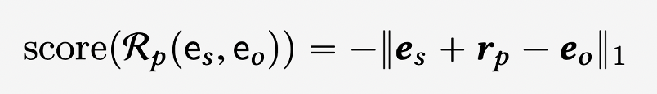
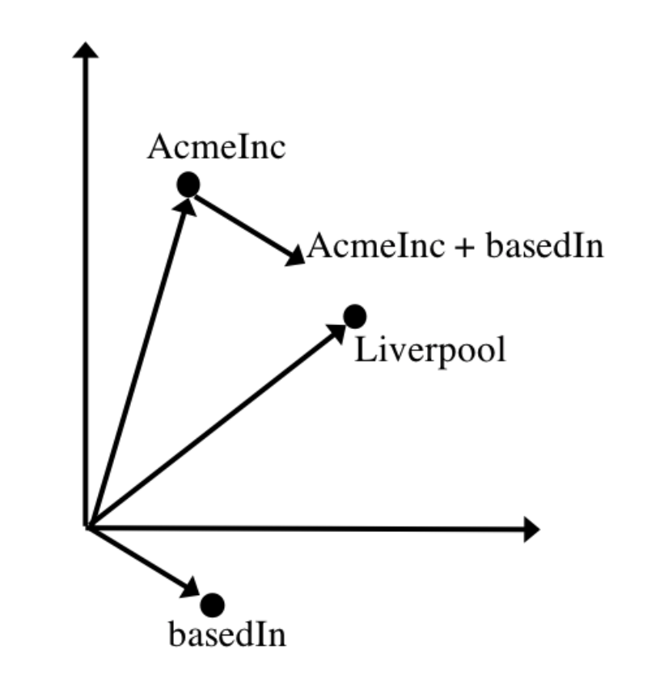
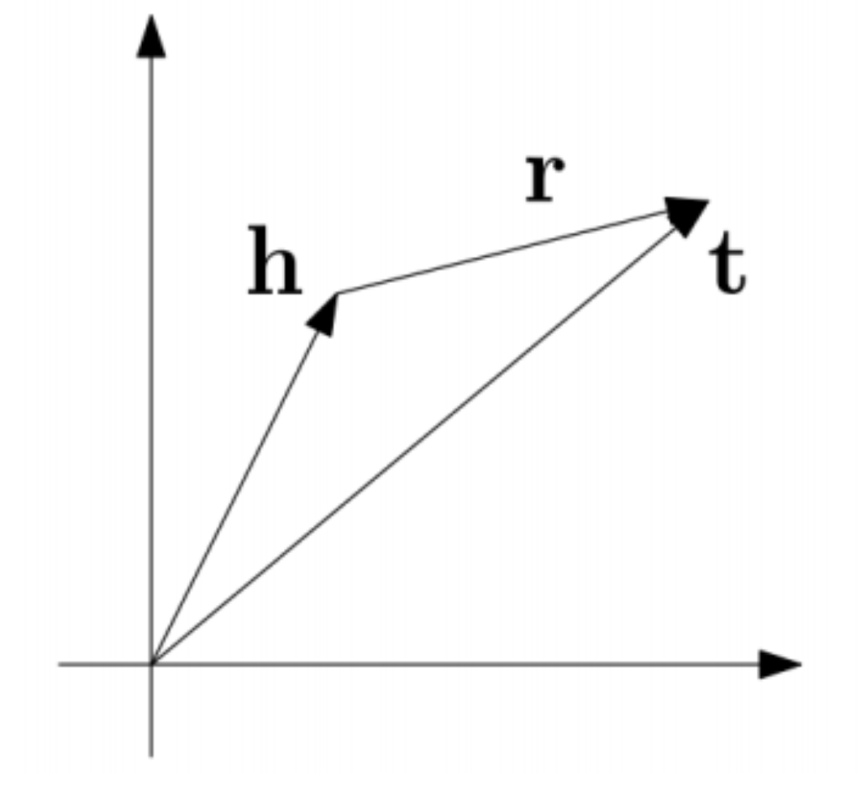
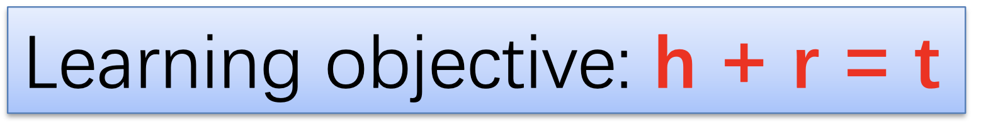
TransE: Additive Scoring Function
Inspired by word2vec

Slide 51
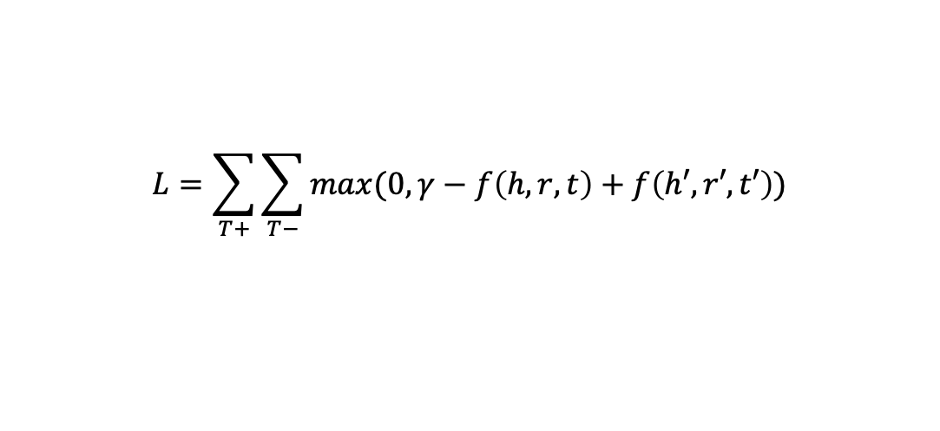
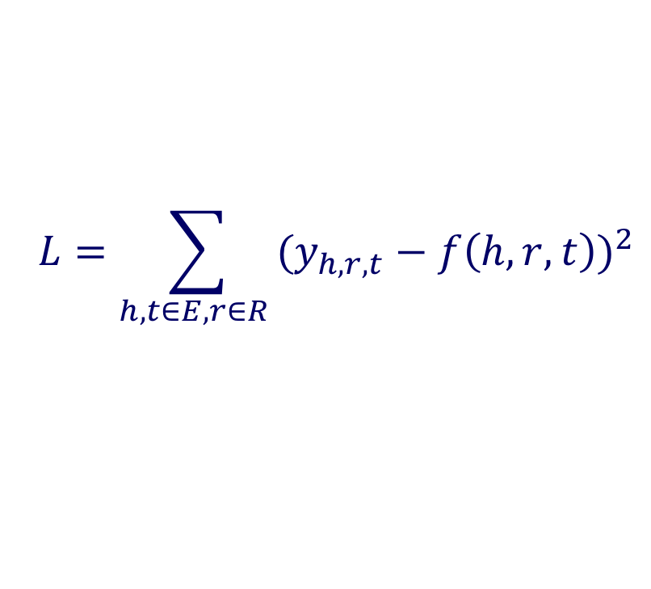
Loss Function
Closed-world assumption: square loss
Open-world assumption: triplet loss
  Need negative sampling
$$L=\sum_{h,t∈E, r∈R }{{(y_{h,r,t}−f\left(h,r,t\right))}^{2}}$$
Triple, triplet
$$L=\sum_{T+}{\sum_{T−}{max(0, γ−f\left(h,r,t\right)+f\left(h′,r′,t′\right))}}$$
Notes:
Not necessarily true

Slide 52
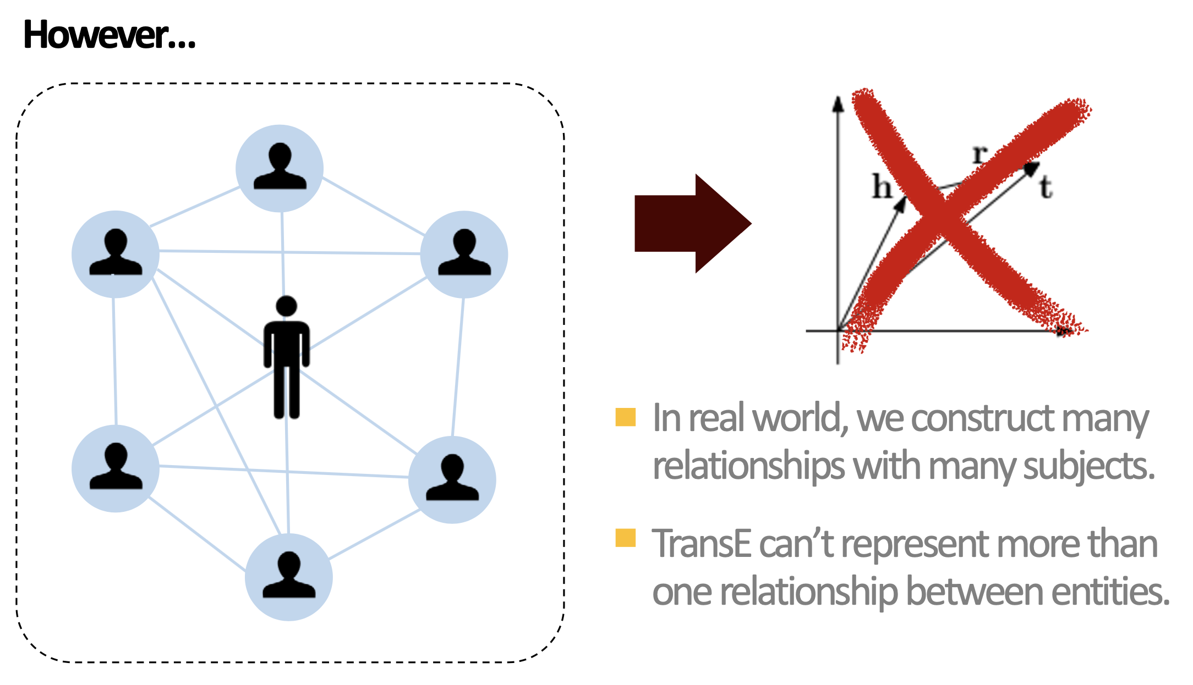
TransE

Slide 53
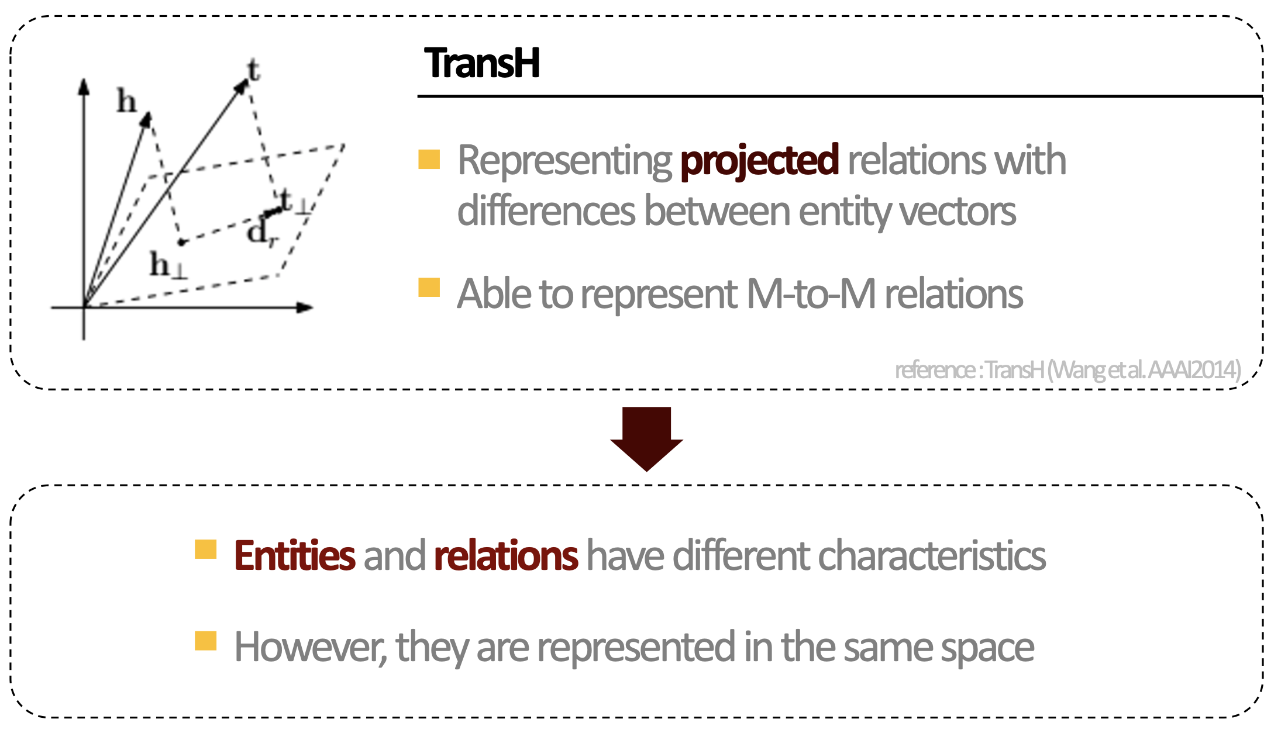
TransH: Relation-specific Embeddings
Wang, et al. Knowledge graph embedding by translating on hyperplanes. In: Proc. AAAI-14. 2014.

Slide 54

TransR/CTransR: Relation-specific Embeddings
Lin, et al. Learning entity and relation embeddings for knowledge graph completion. In: Proc. AAAI 2015.

Slide 55

PTransE
Lin, et al. Modeling Relation Paths for Representation Learning of Knowledge Bases. In: Proc. EMNLP 2015.

Slide 56

PTransE

Slide 57
Knowledge Graph?
Where is the knowledge in a knowledge graph (KG) ?
  Queries as with SQL database
  Embedding approaches rank existence of tuples
  Thresholds difficult to specify
  Use top-k queries with ranking w.r.t. score to establish existence of relations (or links)
  Want as many “true” tuples as possible in the answer set
    Standard evaluation measures: Precision and Recall
  But application treat all query answers as true answers
  No uncertainty about answers to queries
Probabilistic database with open-world assumption ?
  Course “Non-standard Databases and Data Mining”
  But: Want sparsity (or “tuples computed on demand”)

Slide 58

Benchmark Datasets

Slide 59


Using Learned Relational Networks for IR
Query answering: indirect queries requiring chains of reasoning
DB Completion: exploits redundancy in the KB + chains to infer missing facts
Fraction of positives that
rank in the top N among their negatives in validation set
Rank of a positive example is determined by the rank of its score against the scores of a certain number of negative examples
A rank of 1 is the “best” outcome as it means that the positive example had a higher score than all the negatives.
Freebase 15k benchmark
baseline method
tensor factorization
Translation-
based
embedding
59

Slide 60



Using Learned Relational Networks for IR
P(k) = Precision @ Rank k (ranked precision)
Chang, Kai-Wei & Yih, Wen-tau & Yang, Bishan & Meek, Chris. Typed Tensor Decomposition of Knowledge Bases for Relation Extraction. In: Proc. EMNLP-14. 2014.
Maximilian Nickel, Kevin Murphy, Volker Tresp, and Evgeniy Gabrilovich. A Review of Relational Machine Learning for Knowledge Graphs. Proc. IEEE 104, 1 (2016), 11–33. 2016.

Slide 61

TransD
Projection matrices not only related to relation but also head/tail entities
Ji, et al. Knowledge Graph Embedding via Dynamic Mapping Matrix. In: Proc. ACL-IJCNLP-15. 2015.

Slide 62
TransD
Uses two vectors to represent a named symbol object
(entity and relation)
  The first one represents
  the meaning of a(n) entity (relation),
  the other one is used to
  construct mapping matrix dynamically
Compared with TransR/CTransR, TransD not only considers the diversity of relations, but also entities
TransD has less parameters and has no matrix-vector multiplication operations, which makes it applicable to large scale graphs

Slide 63

KG2E
Represent relations / entities with Gaussian distribution
Consider (un)certainties of entities and relations
He, et al. Learning to Represent Knowledge Graphs with Gaussian Embedding. In: Proc. CIKM 2015.

Slide 64
Further Developments
Stochastic Neighbor Embeddings (SNE)
  Non-linear dimensionality reduction
Holographic Embeddings (HolE)
Poincaré Embeddings
Geoffrey Hinton and Sam Roweis. Stochastic neighbor embedding. In Proceedings of the 15th International Conference on Neural Information Processing Systems (NIPS'02). 2002.
Maximilian Nickel, Lorenzo Rosasco, and Tomaso Poggio. Holographic embeddings of knowledge graphs. In Proceedings of the Thirtieth AAAI Conference on Artificial Intelligence (AAAI'16). AAAI Press, 1955–1961. 2016.
Maximilian Nickel and Douwe Kiela. Poincaré embeddings for learning hierarchical representations. In Proceedings of the 31st International Conference on Neural Information Processing Systems (NIPS'17). 2017.

Slide 65

KB Completion with Tensor Networks
Model a KG with a Neural Tensor Network (NTN) and represent entities via word vectors
Socher, et al. Reasoning with neural tensor networks for knowledge base completion. In: Proc. NIPS 2013.

Slide 66
KB Completion with Tensor Networks
It represents each entity as the average of its word vectors
The goal of NTN is to be able to state whether two entities (e₁, e₂) are in a certain relationship R
  For instance, whether the relationship
  (e₁, R, e₂) = (Bengal tiger, has part, tail)
  is true and with what certainty.
Vector_{Bank_of_China}
Vector_{Bank_of_China}= 0.5*(Vector_{Bank}+ Vector_{China})
Vector_{Bank}
Vector_{China}

Slide 67

KB Completion with Tensor Networks
Each relation is described by a so-called tensor network
and pairs of entities are given as input to the model
Each entity has a vector representation,
which can be constructed by its word vectors
The model returns a high score
if they are in that relationship and a low one otherwise
This allows any fact, whether implicitly or explicitly mentioned in the database,
to be answered with a certainty score
Large text data
Word2vec

Slide 68




KB Completion with Tensor Networks
The Neural Tensor Network (NTN) replaces a standard linear neural network layer with a bilinear tensor layer
  that directly relates the two entity vectors across multiple dimensions
  The model computes a score of how likely it is that two entities are in a certain relationship by the following NTN-based function $g(e_{1}, R, e_{2})$:
f = tanh is a standard nonlinearity
applied element-wise
W_{R}^{[1:k]} ∈ $ℛ$ ^{d×d×k} is a tensor and the
bilinear tensor product
Standard layer weight V_{R} ∈ $ℛ$ ^{k×2d}

Slide 69

Learning Tensor Network Parameters
Training objective: T^{(i)}_{c} = (e^{(i)}₁, R^{(i)},e_{c}) is a triplet with a random entity corrupted from a correct triplet
T (i) = (e^{(i)}₁, R^{(i)}, e^{(i)}₂)
  Given a correct triplet (Pablo Picasso, nationality, Spain),
  a potential negative example is
  (Pablo Picasso, nationality, United States)
  For each of the N correct triplets, sample C corrupted ones
  Goal: Make sure a correct relation triplet is scored
  higher than its corrupted version
  Learning objective:

Slide 70






KB Completion with Tensor Networks
The model is trained by taking derivatives with respect to the five groups of parameters, e.g. for $W^{[1]}$or $W^{[2]}$
Cost Function
Update W using Backpropagation:
$$J$$
$$∂J/∂W$$
$$local minimum point$$
$$W=W − ∂J/∂W$$
70

Slide 71
Tensor Networks
Originally developed in the context of condensed-matter physics and based on renormalization group ideas
  Formal apparatus that allows systematic investigation of the changes of a physical system as viewed at different scales
I recommend studying tensor networks
in more detail!

Slide 72


Back to Triple Scoring – Multiply instead of Add
Multiplication: h ⚬ r =?= t
  RESCAL: score(h,r,t) = h⏉W_{r}t
  Problem: Too many parameters!!
Pseudo neuro

Slide 73
Triple Scoring - Multiply
Multiplication: h ⚬ r =?= t
  RESCAL: score(h,r,t) = h⏉W_{r}t
  DistMult: score(h,r,t) = h⏉diag(r)t
  Simplify RESCAL by using a diagonal matrix
B. Yang, W. Yih, X. He, J. Gao, and L. Deng. Embedding entities and relations for learning and inference in knowledge bases. In Proceedings of the International Conference on Learning Representations (ICLR), 2015.

Slide 74
Triple Scoring - Multiply
Multiplication: h ⚬ r =?= t
  RESCAL: score(h,r,t) = h⏉W_{r}t
  DistMult: score(h,r,t) = h⏉diag(r)t
  Simplify RESCAL by using a diagonal matrix
  Problem: Cannot deal with asymmetric relations!!

Slide 75
Triple Scoring - Multiply
Multiplication: h ⚬ r =?= t
  RESCAL: score(h,r,t) = h⏉W_{r}t
  DistMult: score(h,r,t) = h⏉diag(r)t
  Simplify RESCAL by using a diagonal matrix
  ComplEx: score(h,r,t) = Re(h⏉diag(r)t)
  Extend DistMult by introducing complex value embedding, so can handle asymmetric relations
_
Théo Trouillon, Christopher R. Dance, Éric Gaussier, Johannes Welbl, Sebastian Riedel, and Guillaume Bouchard. 2017. Knowledge graph completion via complex tensor factorization. J. Mach. Learn. Res. 18, 1, 4735–4772. 2017.

Slide 76

Triple Scoring - Multiply
Multiplication: h ⚬ r =?= t
  RESCAL: score(h,r,t) = h⏉W_{r}t
  DistMult: score(h,r,t) = h⏉diag(r)t
  ComplEx: score(h,r,t) = Re(h⏉diag(r)t)
  ConvE: Use convolutional network to reduce parameters

Slide 77


RotatE
Zhiqing Sun, Zhi-Hong Deng, Jian-Yun Nie, Jian Tang:
RotatE: Knowledge Graph Embedding by Relational Rotation in Complex Space. In Proc. ICLR 2019

Slide 78

Overview
Théo Trouillon, Christopher R. Dance, Éric Gaussier, Johannes Welbl, Sebastian Riedel, and Guillaume Bouchard. 2017. Knowledge graph completion via complex tensor factorization. J. Mach. Learn. Res. 18, 1, 4735–4772. 2017.
F. L. Hitchcock. The expression of a tensor or a polyadic as a sum of products. J. Math. Phys, 6(1):164–189, 1927.

Slide 79

Evaluation Metrics

Slide 80


Evaluation
RotatE
Zhiqing Sun, Zhi-Hong Deng, Jian-Yun Nie, Jian Tang:
RotatE: Knowledge Graph Embedding by Relational Rotation in Complex Space. In Proc. ICLR 2019.

Slide 81

Fusion of Text and KG
Relation prediction for KG – r ~ t-h
Relation extraction from text

Slide 82

RL4KG with Entity Descriptions
KG contains rich information besides network structure

Slide 83
TransE+Word2Vec
KG=>TransE, Text=>Word2Vec
Make embeddings of the same entities
in KGs and text related to each other
Wang, et al. Knowledge graph and text jointly embedding. In: Proc. EMNLP 2014.

Slide 84

Relation Classification via CNN
Zeng, et al. Relation Classification via Convolutional Deep Neural Network. In: Proc. COLING 2014.

Slide 85

Description-Embodied RL4KG
Enhance entity representation with descriptions
Model descriptions with convolutional network
Xie, et al. Representation Learning of Knowledge Graphs with Entity Descriptions. In: Proc. AAAI 2016.

Slide 86
TransSparse
Deals with heterogeneity …
  Some relations link many entity pairs and others do not
… and imbalance
  The number of head entities and that of tail entities in a relation could be different
Transfer matrices replaced by adaptive sparse matrices
  Sparseness degrees determined by the number of entities (or entity pairs) linked by relations
Guoliang Ji, Kang Liu, Shizhu He, and Jun Zhao. Knowledge graph completion with adaptive sparse transfer matrix. In Proceedings of the Thirtieth AAAI Conference on Artificial Intelligence (AAAI'16). 2016.

Slide 87

TransF
Model the correlation between relations
Translation–based method mitigating the burden of relation projection by explicitly modeling the basis subspaces of projection matrices
Zichao Huang, Bo Li, and Jian Yin. Knowledge graph embedding via multiplicative interaction. In Proceedings of the 2nd International Conference on Innovation in Artificial Intelligence (ICIAI '18). 2018.

Slide 88
Software
OpenKE
  https://github.com/thunlp/OpenKE
KnowldgeGraphEmbedding
  https://github.com/DeepGraphLearning/KnowledgeGraphEmbedding
GraphVite
  https://graphvite.io/
DGL-KGE
  https://github.com/awslabs/dgl-ke
Zhaocheng Zhu, Shizhen Xu, Meng Qu, Jian Tang. “GraphVite: A High-Performance CPU-GPU Hybrid System for Node Embedding”. WWW’19. 2019.

Slide 89
Embedding Approaches: Summary
Continuous semantic representations that
  Leverage existing rich linguistic resources
  Discover new relations
  Enable us to measure the degree of (different) relations
Good ol’ fashioned AI
  Define embedding space
  Implement learning approach
  Evaluate against benchmark dataset
Challenges
  Modeling complex relations (explained in detail)
  Fusion of text and KG (indicated above)
  Combination with symbolic logic for inference on KG (next)
89

Slide 90
Back to Information Retrieval Agents
Agents are told to fulfil IR goal
  How exactly is the IR goal specified?
    Search string
    (Abstract of) example document
    Formal query
    Relational structure as an example
    …

Slide 91

Human specifies goal: Solve a certain problem
M^{R}
M^{H} human model of the problem to be solved
M^{R}_{h} is the human’s understanding of the robot’s M^{R}
M^{R} robot model of the problem to be solved
M^{H}_{r} is the robot’s understanding of M^{H} (anticipate human behavior)
M^{R}_{h} is the robot’s understanding of M^{R}_{h} (anticipate human’s expectations)
~
~
Challenges of Human-Aware AI Systems: Subbarao Kambhampati

Slide 92
Back to Information Retrieval Agents
Agents are told to fulfil IR goal
  How exactly is the IR goal specified?
    Search string
    (Abstract of) example document
    Formal query
    Relational structure as an example
    …
Agent develops plan to fulfil goal as fast as possible
  How is the IR goal specified internally?
    Match word vectors of IR goal with word vectors of documents
    Match relational structure of IR goal with
    relational structures of documents
    …

