Slide 1
Intelligent Agents 1d-CNNs LSTMs ELMo Transformers BERT GPT
Ralf Möller
Universität zu Lübeck
Institut für Informationssysteme

Slide 2
Acknowledgements
CS546: Machine Learning in NLP (Spring 2020)
http://courses.engr.illinois.edu/cs546/
Julia Hockenmaier http://juliahmr.cs.illinois.edu
RNNs, LSTMs, ELMo, Transformers
Machine Learning (Spring 2020)
http://speech.ee.ntu.edu.tw/~tlkagk/courses_ML20.html
李宏毅 (Hung-yi Lee ) http://speech.ee.ntu.edu.tw/~tlkagk/
ELMo, BERT: http://speech.ee.ntu.edu.tw/~tlkagk/courses/ML_2019/Lecture/BERT%20(v3).pdf

Slide 3
Recap: Embedding Approaches
ConvE: Uses convolutional network
Does it really make sense to use 2d-CNN for graph data?
Why is it effective to apply 2d filters to data that is embedded into 2d space in a rather arbitrary way?
Entity
Relationship
Tim Dettmers, Pasquale Minervini, Pontus Stenetorp, Sebastian Riedel, Convolutional 2D Knowledge Graph Embeddings. In: Proc. AAAI-18. 2018.

Slide 4
Recap: Convolution

Slide 5
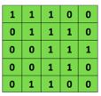
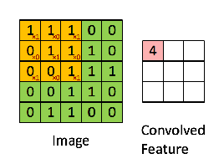
Recap: Convolutional Neural Networks (CNNs)
Main CNN idea for text:
Compute vectors for n-grams and group them afterwards
Example: “this takes too long” compute vectors for:
This takes, takes too, too long, this takes too, takes too long, this takes too long
Convolutional
3x3 filter
Input matrix
http://deeplearning.stanford.edu/wiki/index.php/Feature_extraction_using_convolution
Notes:
http://www.asimovinstitute.org/neural-network-zoo/

Slide 6
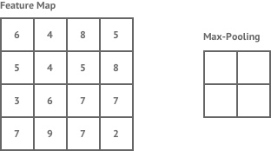
Recap: Convolutional Neural Networks (CNNs)
Main CNN idea for text:
Compute vectors for n-grams and group them afterwards
max pool
2x2 filters
and stride 2
Dimension reduction
https://shafeentejani.github.io/assets/images/pooling.gif

Slide 7
1d-CNNs for text
Text is a (variable-length) sequence of words (word vectors)
We can use a 1d-CNN to slide a window of n tokens across:
— filter size n = 3, stride = 1, no padding
The | quick | brown | fox | jumps | over | the | lazy | dog
The | quick | brown | fox | jumps | over | the | lazy | dog
The | quick | brown | fox | jumps | over | the | lazy | dog
The | quick | brown | fox | jumps | over | the | lazy | dog
The | quick | brown | fox | jumps | over | the | lazy | dog
The | quick | brown | fox | jumps | over | the | lazy | dog
— filter size n = 2, stride = 2, no padding:
The | quick | brown | fox | jumps | over | the | lazy | dog
The | quick | brown | fox | jumps | over | the | lazy | dog
The | quick | brown | fox | jumps | over | the | lazy | dog
The | quick | brown | fox | jumps | over | the | lazy | dog
CNNs (w/ ReLU and maxpool) can be used for classifying (parts of) the text
CS546 Machine Learning in NLP

Slide 8
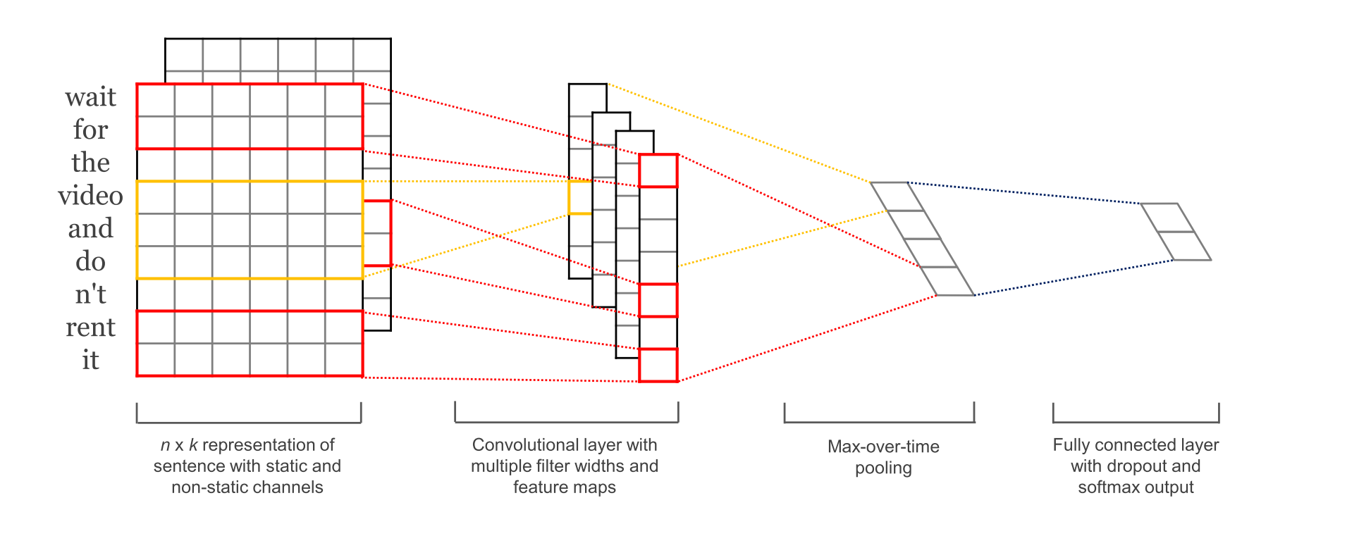
CNN with multiple filters
Kim, Y. “Convolutional Neural Networks for Sentence Classification”, EMNLP (2014)
sliding over 3, 4 or 5 words at a time

Slide 9
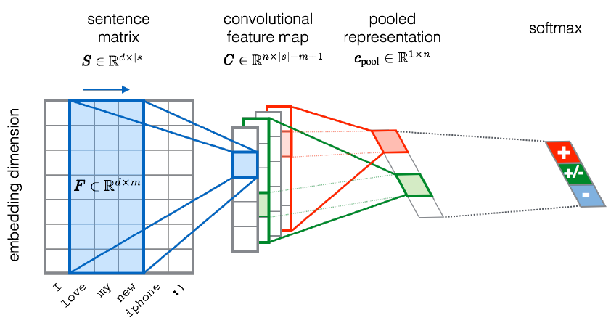
CNN for text classification
Entities and relations not considered…
Severyn, Aliaksei, and Alessandro Moschitti. "UNITN: Training Deep Convolutional Neural Network for Twitter Sentiment Classification." SemEval@ NAACL-HLT. 2015.
Notes:
the width m of the convolution filters is set to 5
n = 300 feature maps
first layer embeds words into low-dimensional vectors.

Slide 10
Fasttext (https://fasttext.cc )
Library for word embeddings and text classification
static word embeddings and ngram features
that get averaged together in one hidden layer
hierarchical softmax output over class labels
Enriching word vectors with subword information
Skipgram model where each word is a sum of character ngram embeddings and its own embedding
Each word is deterministically mapped to ngrams
Piotr Bojanowski, Edouard Grave, Armand Joulin, Tomas Mikolov. Enriching Word Vectors with Subword Information. Transactions of the Association for Computational Linguistics, Volume 5. 135-146. 2017.
Armand Joulin, Edouard Grave, Piotr Bojanowski, Tomas Mikolov, Bag of Tricks for Efficient Text Classification. Proceedings of the 15th Conference of the European Chapter of the Association for Computational Linguistics: Volume 2, Short Papers. 427-431. 2017.
Alon Jacovi, Oren Sar Shalom, Yoav Goldberg. Understanding Convolutional Neural Networks for Text Classification. In Proceedings of the 2018 EMNLP Workshop BlackboxNLP: Analyzing and Interpreting Neural Networks for NLP. 2018.
CS546 Machine Learning in NLP

Slide 11
Multilingual Knowledge Graph Embeddings
MTransE [Chen et al. 2017a; 2017b]
‐ Joint learning of structure encoders and an alignment model
‐ Alignment techniques: Linear transforms (best), vector translations, collocation (minimizing L2 distance)
JAPE [Sun et al. 2017] + Logistic-based proximity normalizer for entity attributes ITransE [Zhu et al. 2017] ‐ self-training + cross-lingual collocation of entity embeddings
KDCoE [Chen et al., 2018] leverages a weakly aligned multilingual KG for semi-supervised cross-lingual learning using entity descriptions
BootEA [Sun et al., 2018] tries iteratively enlarge the labeled entity pairs based on the bootstrapping strategy

Slide 12
Recursive Networks – Or: Copying the Pattern
Basic computational network copied per time slice
Input: previous hidden state, output: next hidden state
Compare with HMM:
Computational model
output
hidden input
Declarative model (generative)
R_{t-1} | P(R_{t}|R_{t-1})
T F | 0.7 0.3
Rain_{t-1}
Rain_{t}
Rain_{t+1}
R_{t} | P(U_{t}|R_{t})
T F | 0.9 0.2
Umbrella_{t-1}
Umbrella_{t}
Umbrella_{t+1}

Slide 13
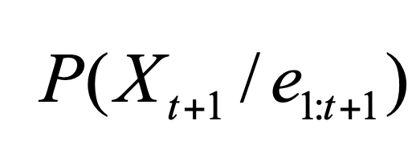
Computing the Hidden State
RNN
HMM Filtering
Computing the hidden state at time t: h^{(t)} = g(Uh^{(t−1)} + Wx^{(t)})
(t)
_{Ujih}(t−1) _{+ Wkix}(t)
The i-the element of h : h = g
t
i
( ∑
j
∑
k
)
j
k
What about smoothing?

Slide 14
Recap: Activation Functions
Sigmoid (logistic function):
σ(x) = 1/(1 + e^{−x})
3
1/(1+exp(-x))
tanh(x) max(0,x)
2.5
2
Returns values bound above and below ^{1.5}
in the 0,1 range
Hyperbolic tangent:
tanh(x) = (e^{2x −1})/(e^{2x+1})
1
0.5
0
-0.5
-1
-3
-2
-1
0
1
2
3
Returns values bound above and below in the −1, +1 range
Rectified Linear Unit:
ReLU(x) = max(0, x)
Returns values bound below in the 0, +∞ range
CS546 Machine Learning in NLP

Slide 15
RNN Variants: LSTMs, GRUs
Long Short Term Memory networks (LSTMs) are RNNs with a more complex architecture to combine the last hidden state with the current input.
Gated Recurrent Units (GRUs) are a simplification of LSTMs
Both contain “gates” to control how much of the input or past hidden state to forget or remember
$$h_{t}$$
$$C_{t−1}$$
$$h_{t−1}$$
$$h_{t−1}$$
CS546 Machine Learning in NLP

Slide 16
Gates
A gate performs element-wise multiplication of
the output of a d-dimensional sigmoid layer (all elements between 0 and 1), and
a d-dimensional input vector
Result: a d-dimensional output vector which is like the input, except some dimensions have been (partially) “forgotten”
CS546 Machine Learning in NLP

Slide 17
RNNs for Language Modeling
If our vocabulary consists of $V$ words, the output layer (at each time step) has $V$ units, one for each word.
The softmax gives a distribution over the $V$ words for the next word.
To compute the probability of a string w0w1…wn wn+1 (where w0 = <s>, and wn+1 = <\s>), feed in wi as input at time step $i$ and compute
∏ P(w_{i} | w₀ . . . w_{i−1})
i=1..n+1
CS546 Machine Learning in NLP

Slide 18
RNNs for Sequence Labeling
In sequence labeling, we want to assign a label or tag ti to each word wi
Now the output layer gives a distribution over the T possible tags.
The hidden layer contains information about the previous words and the previous tags.
To compute the probability of a tag sequence t1…tn for a given string w1…wn feed in wi (and possibly ti-1) as input at time step i and compute P(ti | w1…wi-1, t1…ti-1)
CS546 Machine Learning in NLP

Slide 19
Basic RNNs for Sequence Labeling
Each time step has a distribution over output classes
RNN
Janet
will
back
the
bill
Extension: add a HMM/CRF layer to capture dependencies among labels of adjacent tokens.
CS546 Machine Learning in NLP

Slide 20
RNNs for Sequence Classification
If we just want to assign a label to the entire sequence, we don’t need to produce output at each time step, so we can use a simpler architecture.
We can use the hidden state of the last word in the sequence as input to a feedforward net:
CS546 Machine Learning in NLP

Slide 21
Stacked RNNs
We can create an RNN that has “vertical” depth (at each time step) by stacking multiple RNNs:
21
CS546 Machine Learning in NLP

Slide 22
Comparison with Dynamic Baysian Networks

Slide 23
Bidirectional RNNs
Computational specification of smoothing?
Unless we need to generate a sequence, we can run two RNNs over the input sequence — one in the forward direction,
and one in the backward direction.
Their hidden states will capture different context information
Hidden state of biRNN: h^{(t)} = h^{(t)} ⊕ h^{(t)} where
⊕
is typically
bi fw bw
concatenation (or element-wise addition, multiplication)
CS546 Machine Learning in NLP

Slide 24
Bidirectional RNNs for sequence classification
Combine the hidden state of the last word of the forward RNN and the hidden state of the first word of the backward RNN into a single vector
Softmax
+
^{h}1_back
RNN 2 (Right to Left)
RNN 1 (Left to Right)
^{h}n_for
w
x₁
x₂
x₃
x_{n}
CS546 Machine Learning in NLP

Slide 25
Encoder-Decoder (seq2seq) model
Task: Read an input sequence and return an output sequence
Machine translation: translate source into target language
Dialog system/chatbot: generate a response
Reading the input sequence: RNN Encoder
Generating the output sequence: RNN Decoder
Encoder Decoder
output
hidden
input
<s>
CS546 Machine Learning in NLP

Slide 26
Encoder-Decoder (seq2seq) Model
Encoder RNN:
reads in the input sequence
passes its last hidden state to the initial hidden state of the decoder
Decoder RNN:
generates the output sequence
typically uses different parameters from the encoder may also use different input embeddings
CS546 Machine Learning in NLP

Slide 27
A More General View of seq2seq
In general, any function over the encoder’s output can be used as a representation of the context we want to condition the decoder on.
We can feed the context in at any time step during decoding (not just at the beginning).
CS546 Machine Learning in NLP

Slide 28
Attention Mechanisms
Define a distribution α = (α_{1t}, . . . , α_{St}) over the S elements of the input sequence that depends on the current output element t (with ∑ α_{st} = 1; ∀_{s∈1...S} 0 ≤ α_{st} ≤ 1 )
s=1..S
Use this distribution to compute a weighted average of the input: ∑ α_{st}o_{s} and feed that into the decoder.
s=1..S
hhttps://www.tensorflow.org/tutorials/text/nmt_with_attention
CS546 Machine Learning in NLP

Slide 29
Attention Mechanisms
ht: current hidden state of decoder (target)
h’s: output of the encoder for word s (source)
Attention weights αts: distribution over h’s
αts depends on score(ht, h’s) Context vector ct: weighted average of h’s Attention vector αt: computed by feedforward layer over ct and ht
hhttps://www.tensorflow.org/tutorials/text/nmt_with_attention
CS546 Machine Learning in NLP

Slide 30
From RNNs to LSTMs
In simple RNNs, hidden state depends on previous hidden state and on the input:
h_{t} = g(W_{h}[h_{t−1}, x_{t}] + b_{h}) with e.g. g=tanh
Vanishing gradient problem
RNNs can’t be trained effectively on long sequences
LSTMs (Long Short-Term Memory networks) to the rescue
Additional cell state passed through the network and updated at each time step
LSTMs define four different layers (gates) that read in the previous hidden state and current input.
CS546 Machine Learning in NLP

Slide 31
Long Short Term Memory Networks (LSTMs)
https://colah.github.io/posts/2015-08-Understanding-LSTMs/
CS546 Machine Learning in NLP

Slide 32
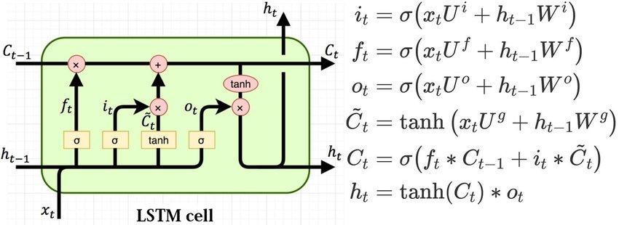
Long Short Term Memory Networks (LSTMs)
t
At time , the LSTM cell reads in
— a c-dimensional previous cell state vector c
t−1
— an h-dimensional previous hidden state vector h_{t−1}
— a d-dimensional current input vector At time , the LSTM cell returns
t
— a c-dimensional previous cell state vector c_{t}
— an h-dimensional previous hidden state vector h_{t} (which may also be passed to an output layer)
https://colah.github.io/posts/2015-08-Understanding-LSTMs/
CS546 Machine Learning in NLP

Slide 33
Bi-LSTM Encoder w/ HMM/CRF Layer
Contextualized Representations

Slide 34
Embeddings from Language Models
Replace static embeddings (lexicon lookup) with context-dependent embeddings (produced by a deep language model)
=> Each token’s representation is a function of the entire input sentence, computed by a deep (multi-layer) bidirectional language model
=> Return for each token a (task-dependent) linear combination of its representation across layers.
=> Different layers capture different information
CS546 Machine Learning in NLP

Slide 35
Embeddings from Language Model (ELMO)
RNN-based language models (trained from lots of sentences)
e.g., given “潮水 退了 就 知道 誰 沒穿 褲子”
潮水
退了
就
潮水
退了
就
RNN
RNN
RNN
…
…
RNN
RNN
RNN
…
RNN
RNN
RNN
…
…
RNN
RNN
RNN
…
<BOS>
潮水
退了
退了
就
知道
潮水 退了 就 知道 誰 沒穿 褲子 = When the tide goes out, you know who's not wearing pants.
https://arxiv.org/abs/1802.05365
http://speech.ee.ntu.edu.tw/~tlkagk/courses_ML20.html

Slide 36
ELMO
Each layer in deep LSTM can generate a latent representation.
Which one should we use???
…
…
…
…
…
…
RNN
RNN
RNN
…
…
RNN
RNN
RNN
…
$$h_{2}$$
RNN
RNN
RNN
…
…
RNN
RNN
RNN
…
RNN
RNN
RNN
…
…
RNN
RNN
RNN
…
$$h_{1}$$
<BOS>
潮水
退了
退了
就
知道
http://speech.ee.ntu.edu.tw/~tlkagk/courses_ML20.html

Slide 37
ELMo architecture
Train a multi-layer bidirectional language model with character convolutions on raw text
Each layer of this language model network computes a vector representation for each token.
Freeze the parameters of the language model.
For each task: train task-dependent softmax weights to combine the layer-wise representations into a single vector for each token jointly with a task-specific model that uses those vectors
CS546 Machine Learning in NLP

Slide 38
ELMO
=
$$α_{1}$$
+
$$α_{2}$$
ELMO
Learned with the down stream tasks
潮水
退了
就
知道
……
http://speech.ee.ntu.edu.tw/~tlkagk/courses_ML20.html

Slide 39
ELMo’s bidirectional language models
The forward LM is a deep LSTM that goes over the sequence from start to end to predict token tk based on the prefix t1…tk-1: p(t_{k} | t₁, …, t_{k−1}; Θ_{x}, Θ_{LSTM}, Θ_{s})
Parameters: token embeddings Θ_{x} LSTM Θ_{LSTM} softmax Θ_{s}
The backward LM is a deep LSTM that goes over the sequence from end to start to predict token tk based on the suffix tk+1…tN: p(t_{k} | t_{k+1}, …, t_{N}; Θ_{x}, Θ_{LSTM}, Θ_{s})
Train these LMs jointly, with the same parameters for the token representations and the softmax layer (but not for the LSTMs)
N
∑
log p(t | t , …, t ; Θ , Θ , Θ ) + log p(t | t , …, t ; Θ , Θ , Θ )
(
k 1 k−1 x LSTM s k k+1 N x LSTM s
)
k=1
CS546 Machine Learning in NLP

Slide 40
ELMo’s token representations
The input token representations are purely character- based: a character CNN, followed by linear projection to reduce dimensionality
“2048 character n-gram convolutional filters with two highway layers, followed by a linear projection to 512 dimensions”
Advantage over using fixed embeddings:
no UNK tokens, any word can be represented
CS546 Machine Learning in NLP

Slide 41
ELMo’s token representations
Given a token representation xk, each layer j of the LSTM language models computes a vector representation hk,j for every token k.
With L layers, ELMo represents each token as
ELMo learns softmax weights s^{task} to collapse these vectors into a
j
single vector and a task-specific scalar γ^{task}
Learning objective:
CS546 Machine Learning in NLP

Slide 42
Weighted Softmax
[Wikipedia]

Slide 43
How do you use ELMo?
ELMo embeddings can be used as (additional) input to any further language model
ELMo can be tuned with dropout and L2-regularization (so that all layer weights stay close to each other)
It often helps to fine-tune the biLMs (train them further) on task-specific raw text
In general: concatenate ELMo
task
with other
k
embeddings x_{k} for token input
CS546 Machine Learning in NLP

Slide 44
Results
ELMo gave improvements on a variety of tasks:
question answering (SQuAD)
entailment/natural language inference (SNLI)
semantic role labeling (SRL)
coreference resolution (Coref)
named entity recognition (NER)
sentiment analysis (SST-5)
OUR ELMO +
BASELINE BASELINE
INCREASE (ABSOLUTE/ RELATIVE)
TASK
PREVIOUS SOTA
SQuAD SNLI SRL
Coref NER SST-5
Liu et al. (2017) Chen et al. (2017) He et al. (2017) Lee et al. (2017) Peters et al. (2017)
McCann et al. (2017)
84.4 81.1
88.6 88.0
81.7 81.4
67.2 67.2
90.15
53.7 51.4
85.8
4.7 / 24.9%
0.7 / 5.8%
3.2 / 17.2%
3.2 / 9.8%
2.06 / 21%
3.3 / 6.8%
88.7 ± 0.17
84.6
70.4
91.93 ± 0.19
92.22 ± 0.10
54.7 ± 0.5
CS546 Machine Learning in NLP

Slide 45
Using ELMo at input vs output
Task
Input Only
Input & Output
Output Only
SQuAD | 85.1 | 85.6 | 84.8
SNLI | 88.9 | 89.5 | 88.7
SRL | 84.7 | 84.3 | 80.9
Table 3: Development set performance for SQuAD, SNLI and SRL when including ELMo at different lo- cations in the supervised model.
Figure 2: Visualization of softmax normalized biLM layer weights across tasks and ELMo locations. Nor- malized weights less then 1/3 are hatched with hori- zontal lines and those greater then 2/3 are speckled.
The supervised models for question-answering, entailment and SRL all use sequence architectures.
— We can concatenate ELMo to the input and/or the output of that network (with different layer weights)
—> Input always helps, Input+output often helps
—> Layer weights differ for each task
CS546 Machine Learning in NLP

Slide 46
Transformers
Sequence transduction model based on attention (no convolutions or recurrence)
easier to parallelize than recurrent nets
faster to train than recurrent nets
captures more long-range dependencies than CNNs with fewer parameters
Transformers use stacked self-attention and pointwise, fully-connected layers for the encoder and decoder
CS546 Machine Learning in NLP

Slide 47
Transformer Architecture
Encoder
Decoder
47
CS546 Machine Learning in NLP

Slide 48
Encoder
A stack of N=6 identical layers
All layers and sublayers are 512-dimensional
Each layer consists of two sublayers
one multi-headed self attention layer
one position-wise fully connected layer
Each sublayer has a residual connection and is normalized:
LayerNorm(x + Sublayer(x))
CS546 Machine Learning in NLP

Slide 49
Decoder
A stack of N=6 identical layers
All layers and sublayers are 512-d
Each layer consists of three sublayers
one multi-headed self attention layer
over decoder output (ignoring future tokens)
one multi-headed attention layer over encoder output
one position-wise fully connected layer
Each sublayer has a residual connection and is normalized:
LayerNorm(x + Sublayer(x))
Nx
CS546 Machine Learning in NLP

Slide 50
Attention mechanisms
Compute a probability distribution α = (α_{1t}, . . . , α_{St}) over the
encoder’s hidden states h^{(s)} that depends on the decoder’s current h^{(t)}
exp(s(h^{(t)}, h^{(s)}))
α =
ts
∑_{s′} exp(s(h^{(t)}, h^{(s′)}))
Compute a weighted avg. of the encoder’s h^{(s)}: c^{(t)} = ∑ α_{ts}h^{(s)}
_{(t}s=1..S
(t) (t) (t)
that gets then used with h , e.g. in o = tanh(W₁h ⁾ + W₂c )
— Hard attention (degenerate case, non-differentiable): is a one-hot vector
Soft attention (general case): is not a one-hot
s(h^{(t)}, h^{(s)}) = h^{(t)} ⋅ h^{(s)} is the dot product (no learned parameters)
s(h^{(t)}, h^{(s)}) = (h^{(t)})^{T}W h^{(s)} (learn a bilinear matrix W)
s(h^{(t)}, h^{(s)}) = v^{T} tanh(W₁h^{(t)} + W₂h^{(s)}) concat. hidden states
CS546 Machine Learning in NLP

Slide 51
Self-Attention
Attention so far (in seq2seq architectures):
In the decoder (which has access to the complete input sequence), compute attention weights over encoder positions that depend on each decoder position
Self-attention:
If the encoder has access to the complete input sequence,
we can also compute attention weights over encoder positions that depend on each encoder position
self-attention:
encoder
For each decoder position t,
compute an attention weight for each encoder position s renormalize these weights (that depend on t) w/ softmax to obtain a new weighted avg. of the input sequence vectors
CS546 Machine Learning in NLP

Slide 52
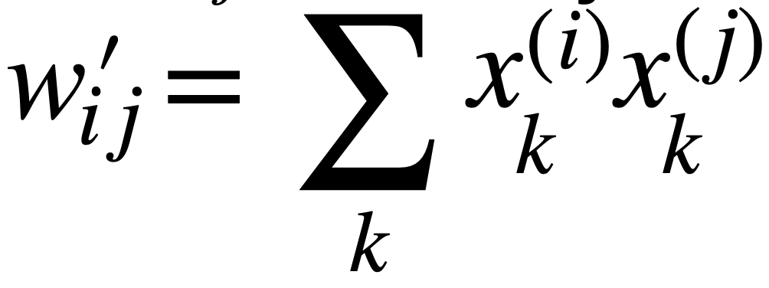
Self-attention
Given T k-dimensional input vectors x⁽¹⁾…x^{(i)}…x^{(T)}, compute T k-dimensional output vectors y⁽¹⁾…y^{(i)}…y^{(T)}
where each y^{(i)} is a weighted average of the input vectors, and
where the weights wij depend on y^{(i)} and x^{(j)}
_{y}(i) _{= ∑ wijx}( j)
j=1..T
Computing weights wij
use dot product: w_{i}′_{j} =
naively:
_{x}(i)_{x}( j)
∑
k k
k
exp(w_{i}′_{j})
followed by softmax: w =
ij
∑ exp(w′)
j
ij
CS546 Machine Learning in NLP

Slide 53
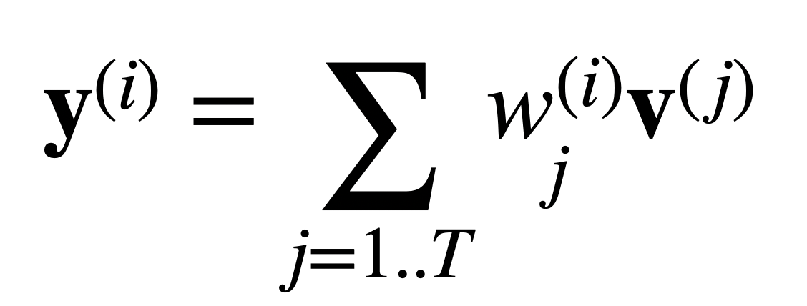
Queries, keys, values
Let’s add learnable parameters (kxk weight matrices), and turn each vector x^{(i)} into three versions:
Query vector q^{(i)} = W_{q}x^{(i)}
Key vector: k^{(i)} = W_{k}x^{(i)}
Value vector: v^{(i)} = W_{v}x^{(i)}
The attention weight of the j-th position to compute the new output or the i-th position depends on the query of i and the key of j:
exp(q^{(i)}k^{( j)})
exp( ∑_{l} q^{(i)}k^{( j)})
(i)
l l
w =
=
j
∑ exp(q^{(i)}k^{( j)})
∑ exp( ∑ q^{(i)}k^{( j)})
j
j l
l l
The new output vector for the i-th position depends on
the attention weights and value vectors of all input positions j:
_{y}(i) _{= w}(i)_{v}( j)
∑
j
j=1..T
CS546 Machine Learning in NLP

Slide 54
Scaling attention weights
Value of dot product grows with vector dimension k
To scale back the dot product, divide by k:
exp(q^{(i)}k^{( j)})/ (k)
_{w}(i) ₌
j
∑ (exp(q^{(i)}k^{( j)})/ k)
j
CS546 Machine Learning in NLP

Slide 55
Scaled Dot-Product Attention
55
CS546 Machine Learning in NLP

Slide 56
Multi-Head attention
Learn h different
linear projections of Q,K,V
Compute attention separately on each of these h versions
Concatenate and project the resultant vectors to a lower dimensionality.
Each attention head
can use low dimensionality
CS546 Machine Learning in NLP

Slide 57
Position-wise feedforward nets
We train a feedforward net for each layer that only reads in input for its token
(two linear transformations with ReLU in between)
Input and output: 512 dimensions Internal layer: 2048 dimensions
Parameters differ from layer to layer (but are shared across positions) (cf. 1x1 convolutions)
CS546 Machine Learning in NLP

Slide 58
Positional Encoding
How does this model capture sequence order?
Positional embeddings have the same dimensionality as word embeddings (512) and are added in.
Fixed representations: each dimension is a sinuoid (a sine or cosine function with a different frequency)
CS546 Machine Learning in NLP

Slide 59
A word can have multiple senses.
Have you paid that money to the bank yet ?
It is safest to deposit your money in the bank .
The victim was found lying dead on the river bank .
They stood on the river bank to fish.
The hospital has its own blood bank.
The third sense or not?
https://arxiv.org/abs/1902.06006
http://speech.ee.ntu.edu.tw/~tlkagk/courses_ML20.html
Notes:
Examples
The :

Slide 60
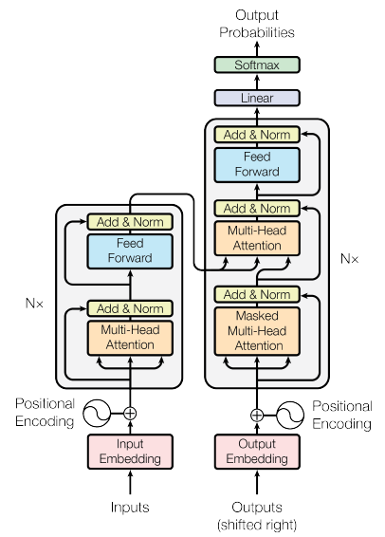
Bidirectional Encoder Representations from Transformers (BERT)
BERT = Encoder of Transformer
Learned from a large amount of text without annotation
Encoder
……
BERT
潮水
退了
就
知道
……
http://speech.ee.ntu.edu.tw/~tlkagk/courses_ML20.html

Slide 61
Training of BERT
vocabulary size
Predicting the masked word
Approach 1:
Masked LM
Linear Multi-class
Classifier
……
BERT
潮水
[MASK]
……
退了
就
知道
http://speech.ee.ntu.edu.tw/~tlkagk/courses_ML20.html
Notes:
Can we compare BERT and ELMO??

Slide 62
Training of BERT
Approach 2: Next Sentence Prediction
yes
[CLS]: the position that outputs classification results
Linear Binary
Classifier
[SEP]: the boundary of two sentences
Approaches 1 and 2 are used at the same time.
BERT
[CLS]
醒醒
吧
[SEP]
你
沒有
妹妹
http://speech.ee.ntu.edu.tw/~tlkagk/courses_ML20.html

Slide 63
Training of BERT
Approach 2: Next Sentence Prediction
No
[CLS]: the position that outputs classification results
Linear Binary
Classifier
[SEP]: the boundary of two sentences
Approaches 1 and 2 are used at the same time.
BERT
[CLS]
醒醒
吧
[SEP]
眼睛
業障
重
http://speech.ee.ntu.edu.tw/~tlkagk/courses_ML20.html

Slide 64
How to use BERT – Case 1
class
Linear Classifier
Trained from Scratch
Input: single sentence,
output: class
Example:
Sentiment analysis (our HW),
Document Classification
BERT
Fine-tune
[CLS]
w₁
w₂
w₃
sentence
http://speech.ee.ntu.edu.tw/~tlkagk/courses_ML20.html
Notes:
(https://arxiv.org/abs/1805.12471)

Slide 65
How to use BERT – Case 2
class
class
class
Linear Cls
Linear Cls
Linear Cls
Input: single sentence,
output: class of each word
Example: Slot filling
BERT
[CLS]
w₁
w₂
w₃
sentence
http://speech.ee.ntu.edu.tw/~tlkagk/courses_ML20.html
Notes:
(https://arxiv.org/abs/1805.12471)

Slide 66
How to use BERT – Case 3
Class
Input: two sentences, output: class
Example: Natural Language Inference
Linear Classifier
Given a “premise”, determining whether a “hypothesis” is T/F/ unknown.
BERT
[CLS]
w₁
w₂
[SEP]
w₃
w₄
w₅
Sentence 1
Sentence 2
http://speech.ee.ntu.edu.tw/~tlkagk/courses_ML20.html
Notes:
determining whether a “hypothesis” is true (entailment), false (contradiction), or undetermined (neutral) given a “premise”.

Slide 67
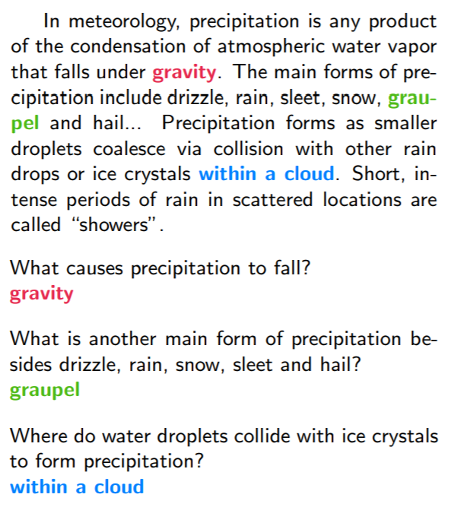
How to use BERT – Case 4
Extraction-based Question Answering (QA) (E.g. SQuAD)
17
Document:
$$D=\left\{d_{1},d_{2},⋯,d_{N}\right\}$$
Query:
$$Q=\left\{q_{1},q_{2},⋯,q_{N}\right\}$$
77
79
$$D$$
QA
Model
$$s$$
$$e$$
$$s=17,e=17$$
$$Q$$
output: two integers ($s$, $e$)
Answer:
$$A=\left\{q_{s}, ⋯,q_{e}\right\}$$
$$s=77,e=79$$
http://speech.ee.ntu.edu.tw/~tlkagk/courses_ML20.html

Slide 68
How to use BERT – Case 4
Learned from scratch
0.3
0.5
0.2
s = 2, e = 3
Softmax
The answer is “d₂ d₃”.
dot product
BERT
[CLS]
q₁
q₂
[SEP]
d₁
d₂
d₃
question
document
http://speech.ee.ntu.edu.tw/~tlkagk/courses_ML20.html
Notes:
determining whether a “hypothesis” is true (entailment), false (contradiction), or undetermined (neutral) given a “premise”.

Slide 69
How to use BERT – Case 4
Learned from scratch
0.1
0.2
0.7
s = 2, e = 3
Softmax
The answer is “d₂ d₃”.
dot product
BERT
[CLS]
q₁
q₂
[SEP]
d₁
d₂
d₃
question
document
http://speech.ee.ntu.edu.tw/~tlkagk/courses_ML20.html
Notes:
determining whether a “hypothesis” is true (entailment), false (contradiction), or undetermined (neutral) given a “premise”.

Slide 70
BERT 屠榜 ……
SQuAD 2.0
http://speech.ee.ntu.edu.tw/~tlkagk/courses_ML20.html
Notes:
屠榜

Slide 71
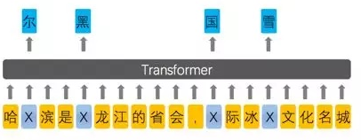
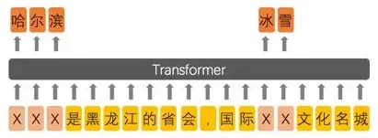
Enhanced Representation through Knowledge Integration (ERNIE)
Designed for Chinese
BERT
ERNIE
Source of image:
https://zhuanlan.zhihu.com/p/59436589
https://arxiv.org/abs/1904.09223
http://speech.ee.ntu.edu.tw/~tlkagk/courses_ML20.html
Notes:
From 擺渡https://zhuanlan.zhihu.com/p/59436589

Slide 72
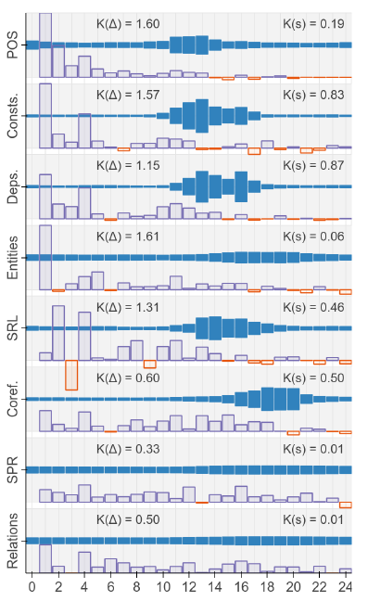
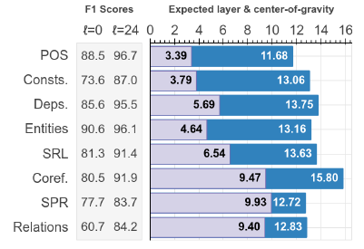
What does BERT learn?
https://arxiv.org/abs/1905.05950
https://openreview.net/pdf?id=SJzSgnRcKX
http://speech.ee.ntu.edu.tw/~tlkagk/courses_ML20.html
Notes:
BERT Rediscovers the Classical NLP Pipeline

Slide 73
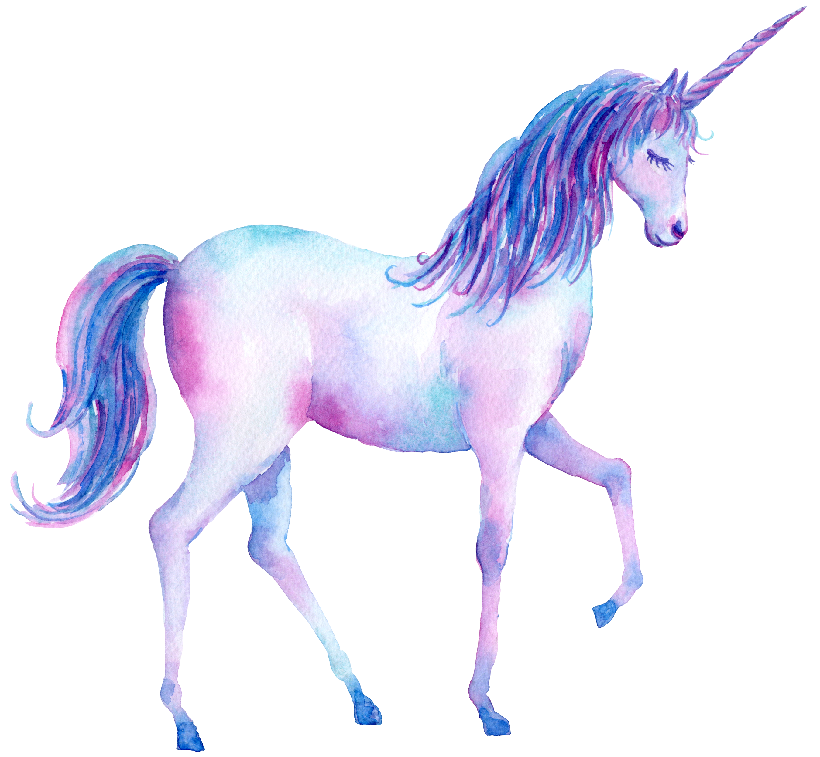
Generative Pre-Training (GPT)
Transformer Decoder
BERT (340M)
ELMO (94M)
GPT-2 (1542M)
Source of image: https://huaban.com/pins/1714071707/
https://d4mucfpksywv.cloudfront.net/better-language-models/language_models_are_unsupervised_multitask_learners.pdf
Notes:
93.6M
340M
1542M
40 GB

Slide 74
Generative Pre-Training (GPT)
退了
Many Layers …
$$b^{2}$$
$${\hat{α}}_{2,1}$$
$${\hat{α}}_{2,2}$$
$$q^{1}$$
$$k^{1}$$
$$v^{1}$$
$$q^{2}$$
$$k^{2}$$
$$v^{2}$$
$$q^{3}$$
$$k^{3}$$
$$v^{3}$$
$$q^{4}$$
$$k^{4}$$
$$v^{4}$$
$$a^{1}$$
$$a^{2}$$
$$a^{3}$$
$$a^{4}$$
<BOS>
潮水
http://speech.ee.ntu.edu.tw/~tlkagk/courses_ML20.html

Slide 75
Generative Pre-Training (GPT)
就
Many Layers …
$$b^{3}$$
$${\hat{α}}_{3,1}$$
$${\hat{α}}_{3,2}$$
$${\hat{α}}_{3,3}$$
$$q^{1}$$
$$k^{1}$$
$$v^{1}$$
$$q^{2}$$
$$k^{2}$$
$$v^{2}$$
$$q^{3}$$
$$k^{3}$$
$$v^{3}$$
$$q^{4}$$
$$k^{4}$$
$$v^{4}$$
$$a^{1}$$
$$a^{2}$$
$$a^{3}$$
$$a^{4}$$
<BOS>
潮水
退了
就
http://speech.ee.ntu.edu.tw/~tlkagk/courses_ML20.html

Slide 76
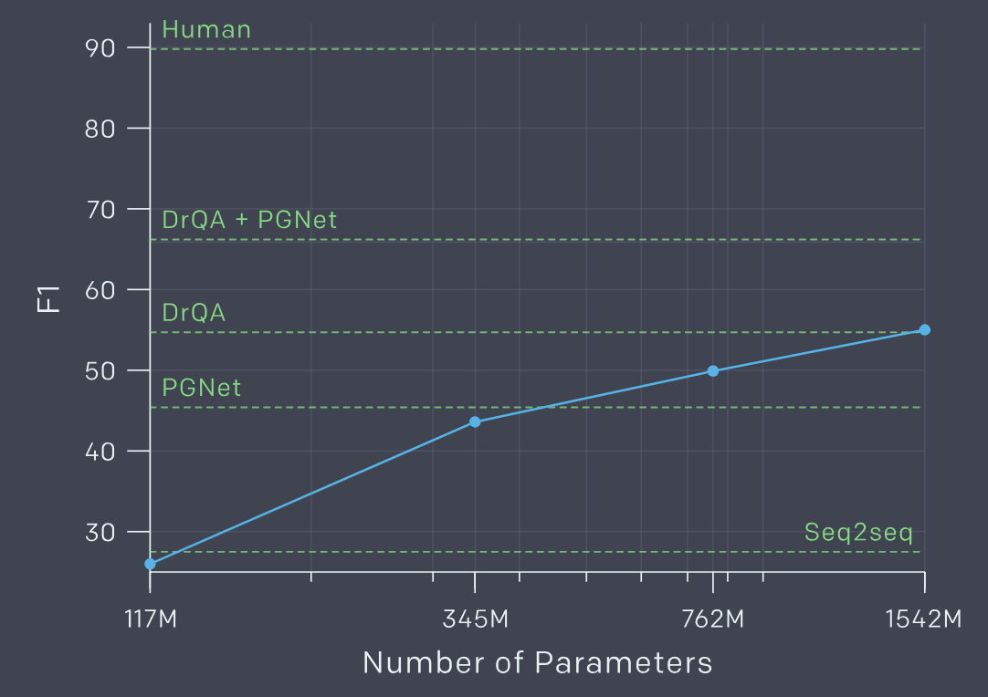
Zero-shot Learning?
Reading Comprehension
$d_{1},d_{2},⋯,d_{N}$,
”Q:”, $q_{1},q_{2},⋯,q_{N}$, “A:”
CoQA
Summarization
$d_{1},d_{2},⋯,d_{N}$,”TL;DR:”
Translation
English sentence 1
=
French sentence 1
English sentence 2
=
French sentence 2
English sentence 3
=
http://speech.ee.ntu.edu.tw/~tlkagk/courses_ML20.html
Notes:
展現神蹟

Slide 77
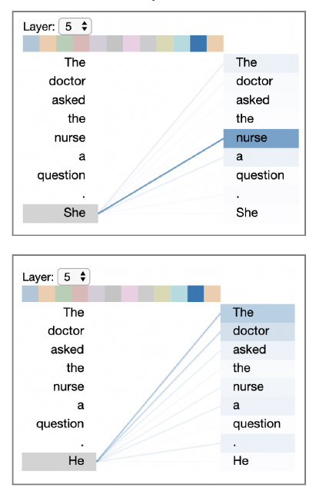
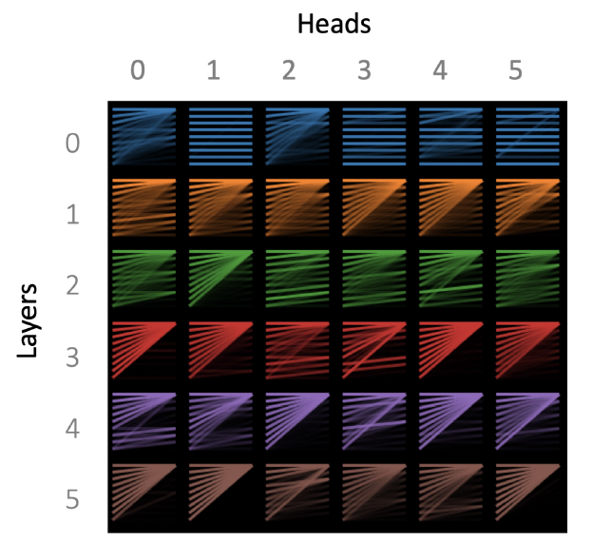
Visualization
https://arxiv.org/abs/1904.02679
(The results below are from GPT-2)
http://speech.ee.ntu.edu.tw/~tlkagk/courses_ML20.html

Slide 78
BERT as a Markov Random Field Language Model
Show that BERT (Devlin et al., 2018) is a Markov random field language model
Gives way to a natural procedure to sample sentences from BERT
Can produce high quality, fluent generations
Generates sentences that are more diverse but of slightly worse quality
Alex Wang, Kyunghyun Cho. BERT has a Mouth, and It Must Speak: BERT as a Markov Random Field Language Model. Volume:
In Proc. of the Workshop on Methods for Optimizing and Evaluating Neural Language Generation, June 2019.
https://arxiv.org/abs/1902.04094
http://speech.ee.ntu.edu.tw/~tlkagk/courses_ML20.html

