Slide 1
Intelligent Agents
GNNs, ExpressGNN, pLogicNet, MLN Learning
Prof. Dr. Ralf Möller
Universität zu Lübeck
Institut für Informationssysteme

Slide 2
Acknowledgements
Slides for this presentation are taken from
  Representation Learning on Networks snap.stanford.edu/proj/embeddings-www, WWW 2018
  Efficient Probabilistic Logic Reasoning with Graph Neural Networks
  Yuyu Zhang, Xinshi Chen, Yuan Yang, Arun Ramamurthy, Bo Li, Yuan Qi & Le Song (slides taken from a presentation by Hengda Shi, Gaohong Liu and Jian Weng)
  Probabilistic Logic Neural Network for Reasoning, Meng Qu, Jian Tang
  (slides taken from a presentation by Zijie Huang, Roshni Iyer, Alex Wang)
Slides have been adapted (all faults are mine)

Slide 3
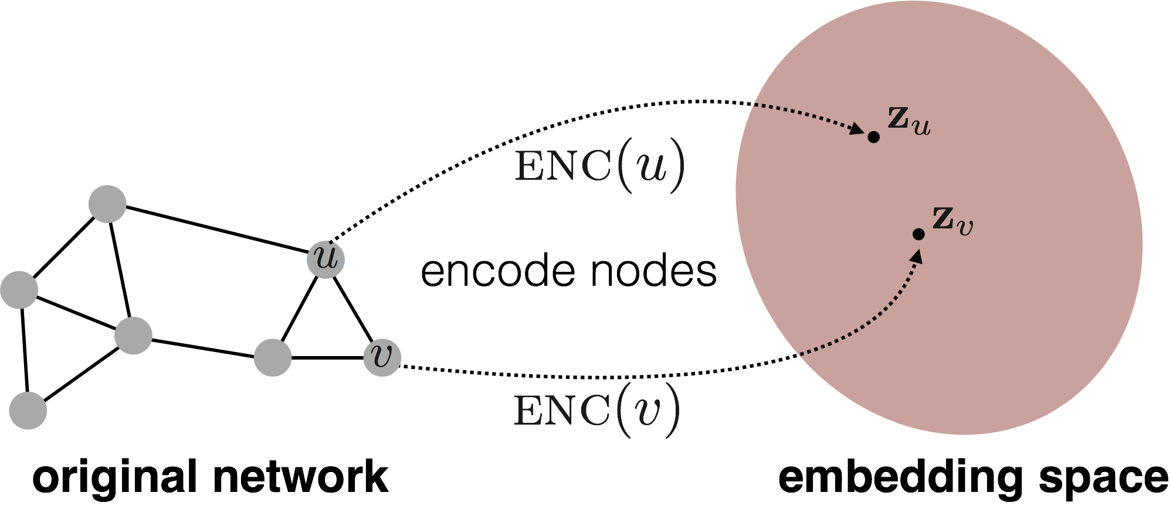
Embedding Nodes
Encode nodes so that …
  similarity in the embedding space approximates …
  similarity in the original network

Slide 4
Embedding Nodes
d-dimensional embedding
Need to define!

Slide 5
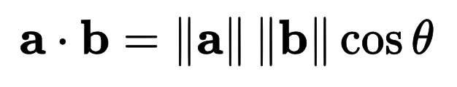
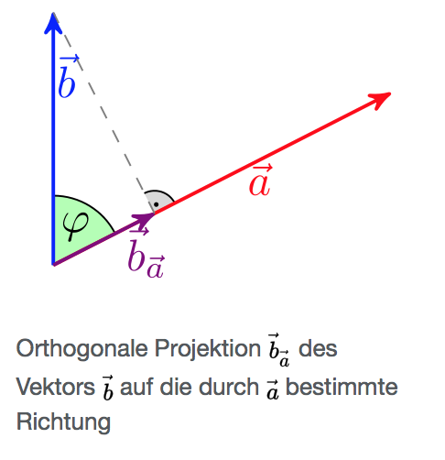
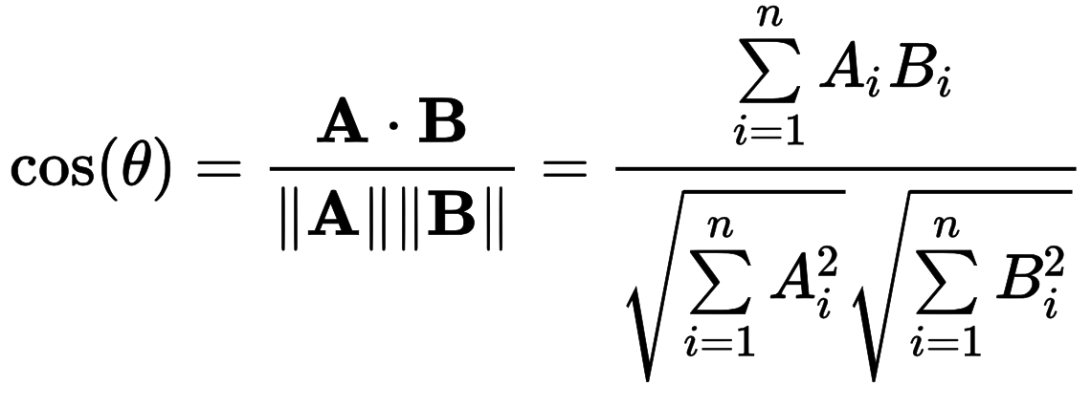
Recap: Dot Product
||b_{a}||
𝜑
(𝜑)
Wikipedia

Slide 6
Simple (“Shallow”) Embedding Approaches
Vectors with d components (with d being a hyperparameter)
Solve optimization problem
Select embedding vectors for nodes
such that “similar” nodes have similar vectors
Various ways to specify similarity of nodes
Adjacency-based embedding
Multi-hop embedding
Random walk approaches
More or less clever approaches, but appropriate similarity features should better be found automatically
Probability that u and v co-occur in a random walk over the network
Hamilton et al. Representation Learning on Graphs: Methods and Applications. IEEE Data Engineering Bulletin on Graph Systems. 2017.

Slide 7

From “Shallow” to “Deep”
Shallow: Define features based on selected features
Embedding vector for a specific node
Embedding matrix
$$z_{j}$$
Dimension/size of embeddings d
One column per node

Slide 8
From “Shallow” to “Deep”
Limitations of shallow encoding:
  O(|Vd|) parameters needed
    No parameter sharing
    Every node has its own unique embedding vector
  Inherently “transductive” (not inductive)
    Impossible to generate embeddings for nodes
    that were not seen during training
  Does not incorporate node features
    Many graphs have nodes with features
    that we can and should leverage
Need to find embeddings based on holistic view on graph
Scarselli et al. The Graph Neural Network Model. IEEE Transactions on Neural Networks. 2005,

Slide 9
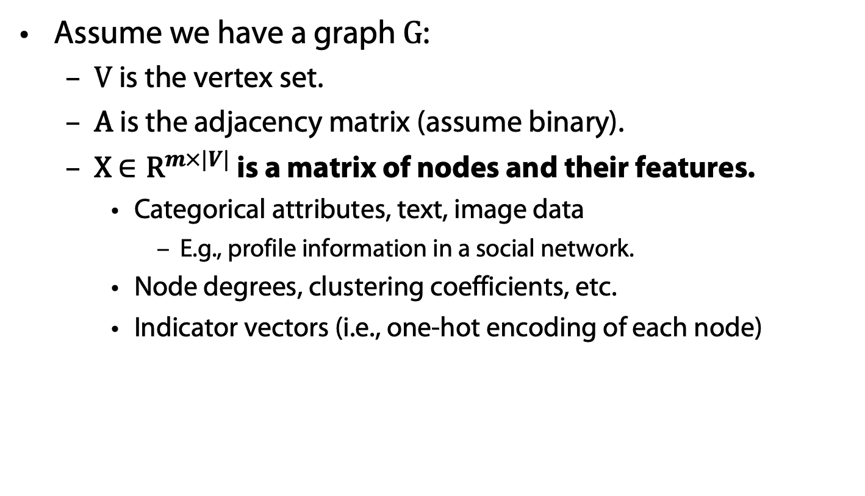
Setup
Assume we have a graph G:
  V is the vertex set.
  A is the adjacency matrix (assume binary).
  X $∈{\text{R}}^{m×|V|}$ is a matrix of nodes and their features.
    Categorical attributes, text, image data
      E.g., profile information in a social network.
    Node degrees, clustering coefficients, etc.
    Indicator vectors (i.e., one-hot encoding of each node)

Slide 10
Neighborhood Aggregation
Key idea
  Generate node embeddings based on local neighborhoods
  Nodes aggregate information from their neighbor
  Computation graph for every node

Slide 11
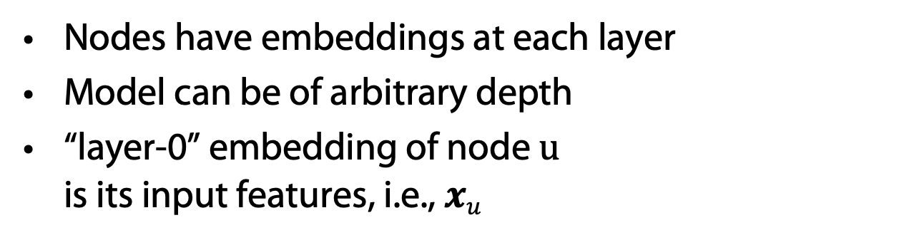
Neighborhood Aggregation
Nodes have embeddings at each layer
Model can be of arbitrary depth
“layer-0” embedding of node u
is its input features, i.e., $xu$
Layer-0
Layer-1
Layer-2
What’s in the boxes?

Slide 12
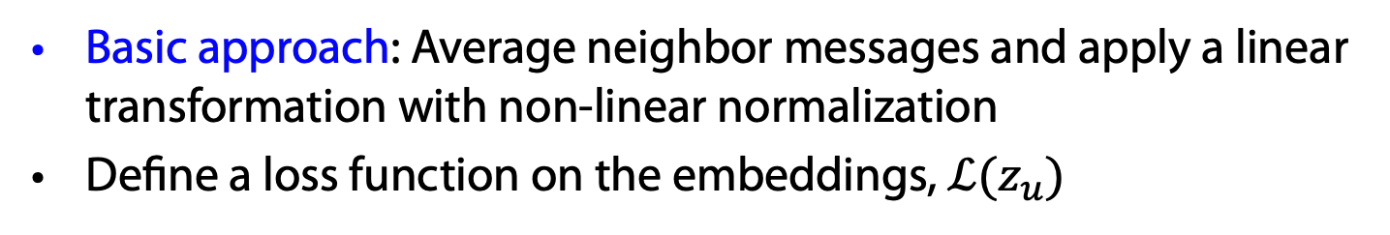

Graph Networks (GNNs)
Graph (Neural) Networks
Basic approach: Average neighbor messages and apply a linear transformation with non-linear normalization
Define a loss function on the embeddings, $ℒ(z_{u})$
Initial “layer 0” embeddings are equal to node features
previous layer embedding of v
kth layer embedding of $v$
non-linearity
(e.g., ReLU or tanh)
average of neighbor’s
previous layer embeddings

Slide 13
Unsupervised Training
trainable matrices
(i.e., what we learn)
After K-layers of neighborhood aggregation, we get output embeddings for each node
Feed these embeddings into any loss function …
and run stochastic gradient descent
to train the aggregation parameters

Slide 14

Supervised Training
E.g., based on node classification $y_{v}∈\{0, 1\}$:
classification weights
Human or bot?
output node embedding
node class label

Slide 15
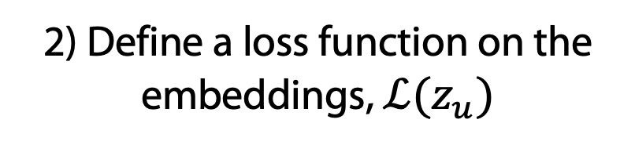
Overview of Model Design
1) Define a neighborhood aggregation function.
2) Define a loss function on the embeddings, $ℒ(z_{u})$

Slide 16
Overview of Model Design
3) Train on a set of nodes, i.e., a batch of compute graphs

Slide 17
Overview of Model
4) Generate embeddings for nodes as needed
Even for nodes we never trained on!!!!

Slide 18
Inductive Capability
Same aggregation parameters are shared for all nodes.
Number of model parameters is sublinear in |V| …
… and we can generalize to unseen nodes!

Slide 19
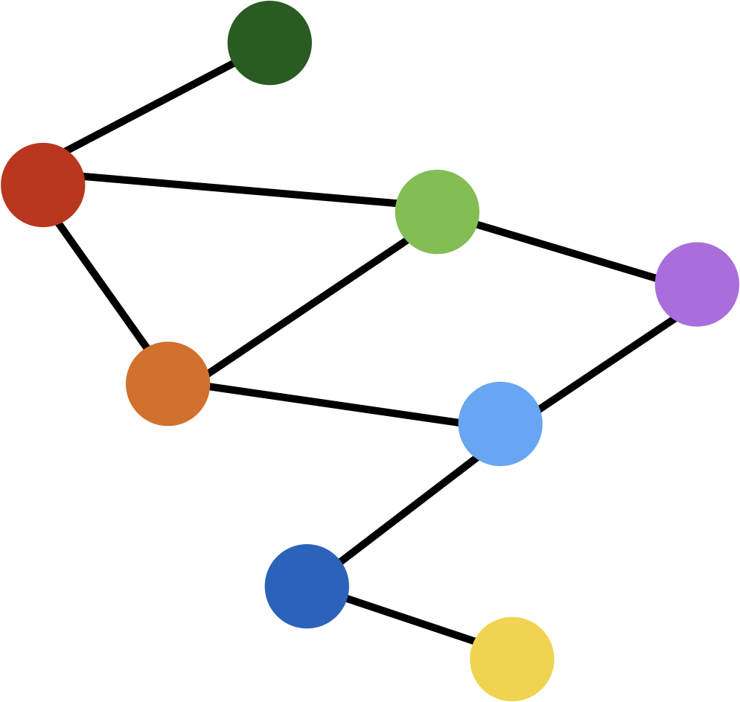
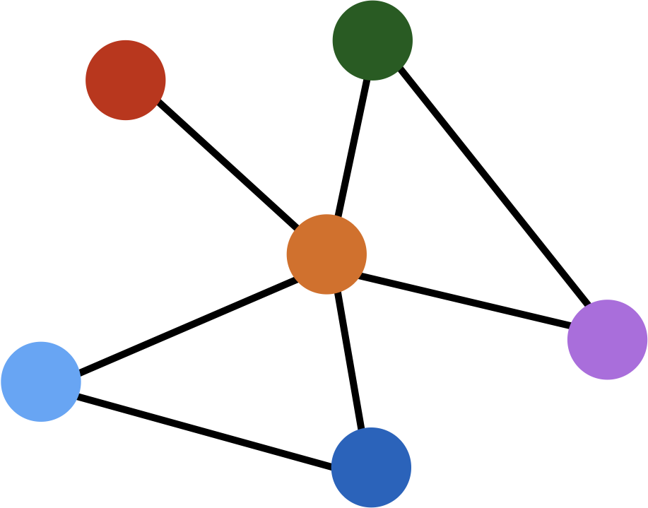
Inductive Capability
train on one graph
generalize to new graph
Inductive node embedding generalize to entirely unseen graphs
e.g., train on protein interaction graph from model organism A and generate embeddings on newly collected data about organism B

Slide 20
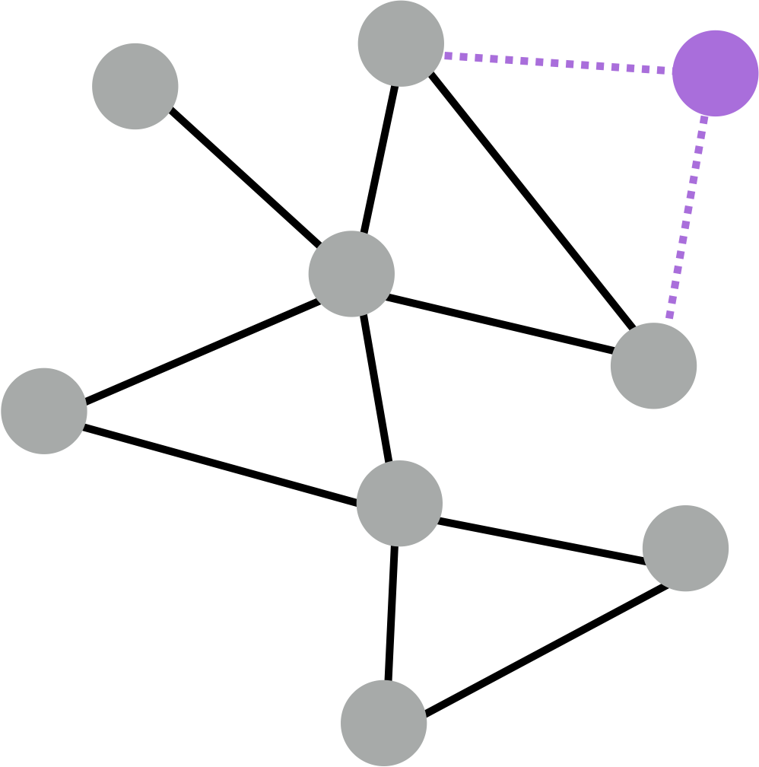
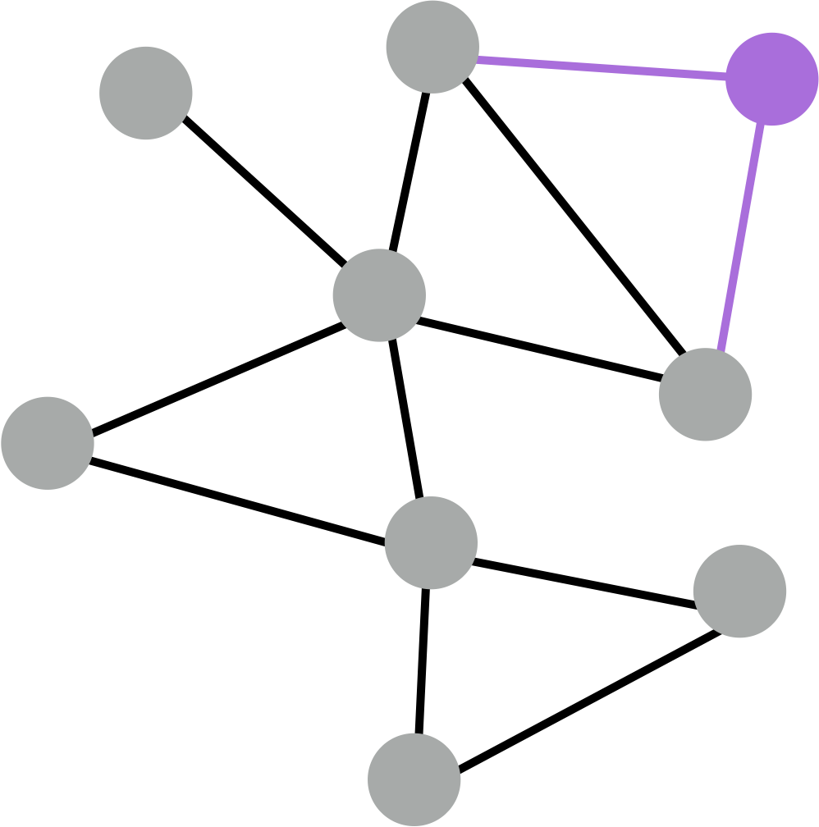
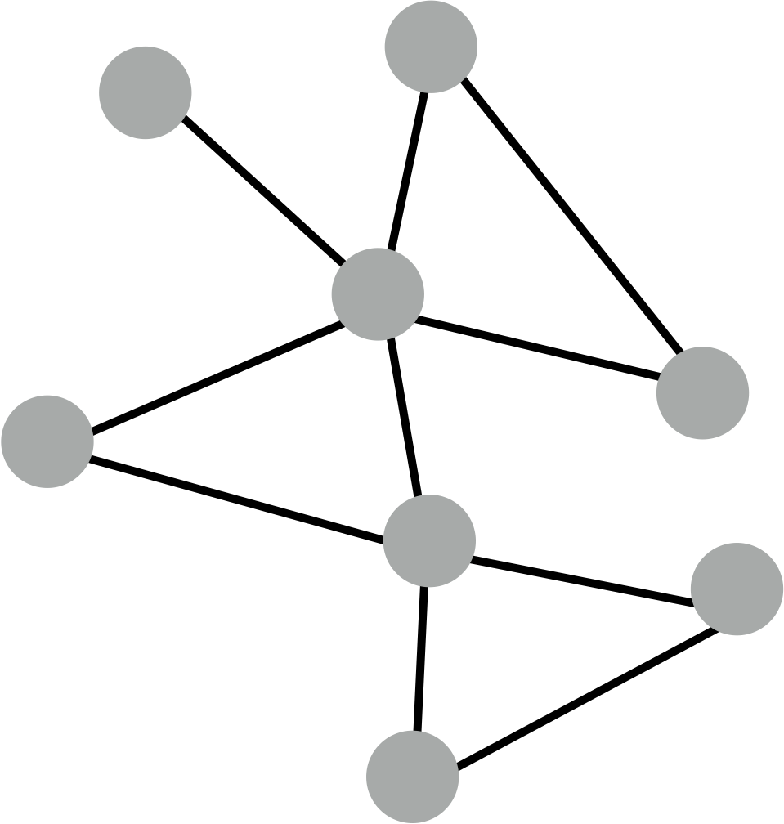
Inductive Capability
generate embedding for new node
train with snapshot
new node arrives
Many application settings constantly encounter previously unseen nodes.
e.g., Reddit, YouTube, GoogleScholar, ….
Need to generate new embeddings “on the fly”

Slide 21
Neighborhood Aggregation
Key distinctions are in how different approaches aggregate messages
What else can we put in the box?
?
???
?
?

Slide 22
Graph Convolutional Networks (GCNs)
Slight variation on the neighborhood aggregation idea:
Empirically, this configuration to give the best results
  More parameter sharing
  Down-weights high degree neighbors
same matrix for self and neighbor embeddings
per-neighbor normalization
Semi-supervised classification with graph convolutional networks
TN Kipf, M Welling. In Proc. 5th International Conference on Learning Representations (ICLR-17), 2017.

Slide 23
GraphSAGE (SAmple and aggreGatE)
So far we have aggregated the neighbor messages by taking their (weighted) average. Can we do better?
?
???
?
Any differentiable function that maps set of vectors to a single vector.
?
concatenate self embedding and neighbor embedding

Slide 24
GraphSAGE Variants
Mean:
Pool:
  Transform neighbor vectors and apply symmetric vector function
LSTM-based RNNs:
  Apply LSTM to random permutation of neighbors (LSTMs work on seqences)
Transformers?
element-wise mean/max
William L. Hamilton, Rex Ying, and Jure Leskovec. 2017. Inductive representation learning on large graphs. In Proc. NIPS’17. 2017.

Slide 25
Neighborhood Aggregation
GCNs and GraphSAGE generally only 2-3 layers deep
What if we want to go deeper?
  Overfitting from too many parameters.
  Vanishing/exploding gradients during backpropagation

Slide 26
Gated Graph Networks
Use techniques from recurrent networks
Parameter sharing across layers, recurrent state update
same mappings across layers
Handle >20 layers:
Allows for complex information about global graph structure to be propagated to all nodes

Slide 27
Neighborhood aggregation with RNN state update
Get “message” from neighbors at step k:
Update node “state” using Gated Recurrent Unit (GRU)
New node state depends on the old state and
the message from neighbors:
Aggregation function does not depend on k
Yujia Li Richard Zemel Marc Brockschmidt Daniel Tarlow, Gated Graph Sequence Neural Networks
Proceedings of ICLR’16. 2016.

Slide 28
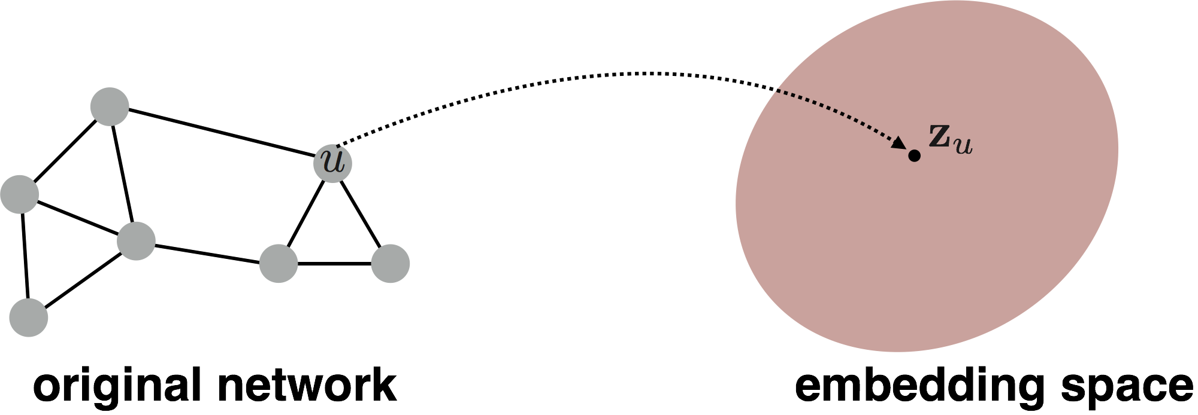
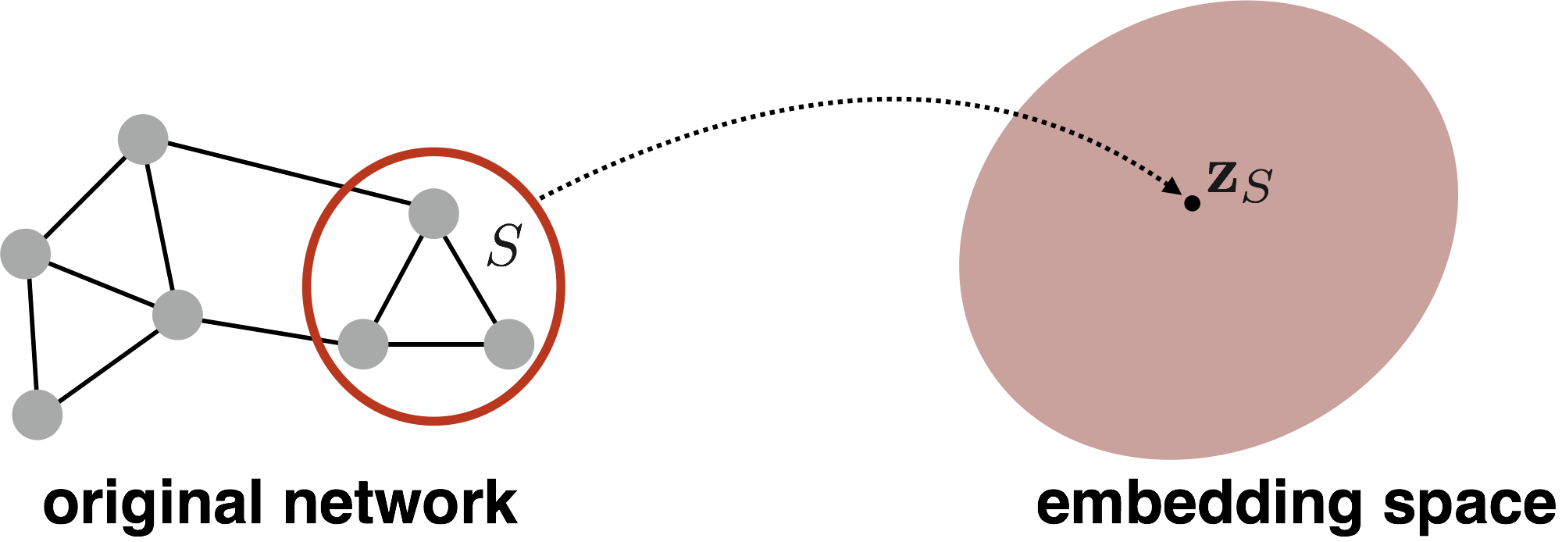
(Sub)graph Embeddings
So far we have focused on node-level embeddings…
But what about subgraph embeddings?

Slide 29

(Sub)graph Embeddings
  How to embed (sub)graphs with millions or billions of nodes?
Use representative as a virtual node
Sum or average node embeddings:
Li et al. Gated Graph Sequence Neural Networks. In Proc. ICLR. 2016.
  How to do the analog of CNN “pooling” on networks?
Duvenaud et al. Convolutional Networks on Graphs for Learning Molecular Fingerprints. In Proc. ICML 2016.

Slide 30
Summary so far
Key idea: Generate node embeddings based on local neighborhoods.
  GraphSAGE
    Generalized neighborhood aggregation
  Gated Graph Networks
    Neighborhood aggregation + recursion
    (same mappings for a layer) + GRUs
  Graph Convolutional Networks
    Average neighborhood information
    and stack computational networks

Slide 31
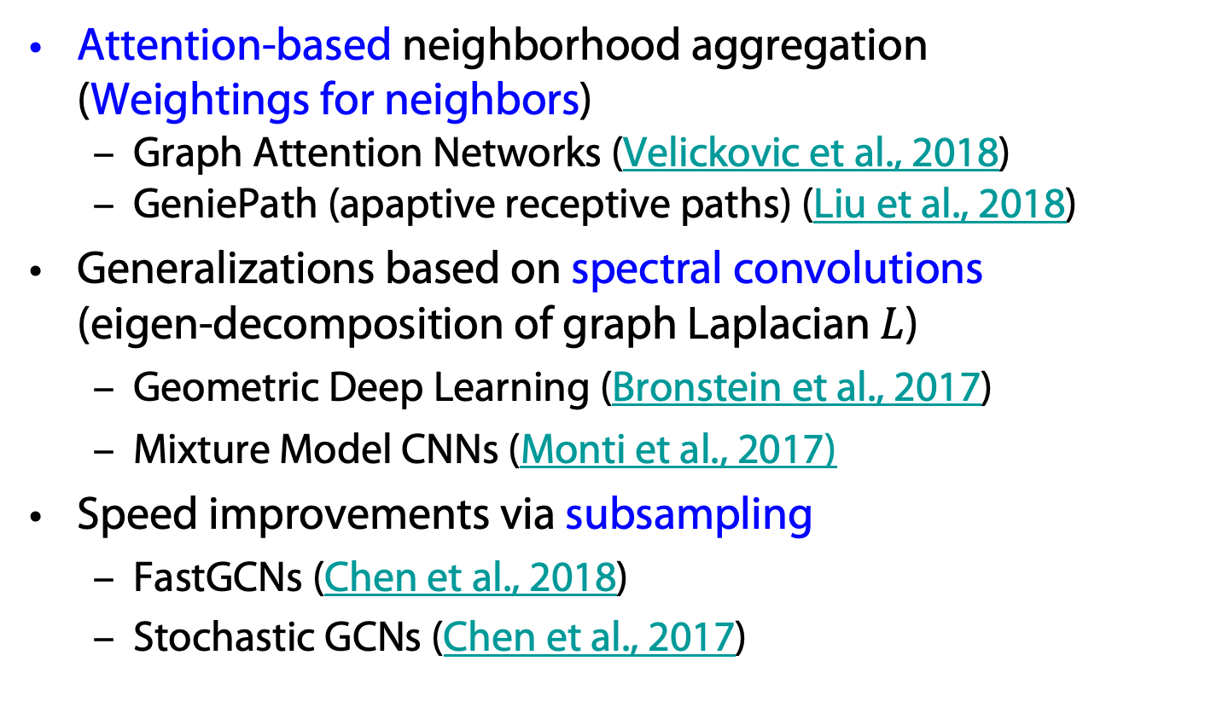

Recent Advances in Graph Networks
Attention-based neighborhood aggregation
(Weightings for neighbors)
  Graph Attention Networks (Velickovic et al., 2018)
  GeniePath (apaptive receptive paths) (Liu et al., 2018)
Generalizations based on spectral convolutions
(eigen-decomposition of graph Laplacian $L$)
  Geometric Deep Learning (Bronstein et al., 2017)
  Mixture Model CNNs (Monti et al., 2017)
Speed improvements via subsampling
  FastGCNs (Chen et al., 2018)
  Stochastic GCNs (Chen et al., 2017)
$L=D −A$ (degree matrix – adjacency matrix)

Slide 32
Graph Networks, Embeddings, and KGs
Graph networks allow for the computation of embeddings for nodes in a KG
With embeddings, existence of links between nodes can be estimated (KG completion)
  See also, e.g., node2vec
If nodes originate from words …
… we have another way to embed nodes
  See also, e.g., word2vec
  KG completion based on word embeddings
node2vec: Scalable Feature Learning for Networks. A. Grover, J. Leskovec. ACM SIGKDD International Conference on Knowledge Discovery and Data Mining (KDD), 2016

Slide 33
Approaches for Completing KGs
Graph Network approach
Embedding approach
What about probabilistic graphical models?
  Markov logic networks for link estimation?

Slide 34
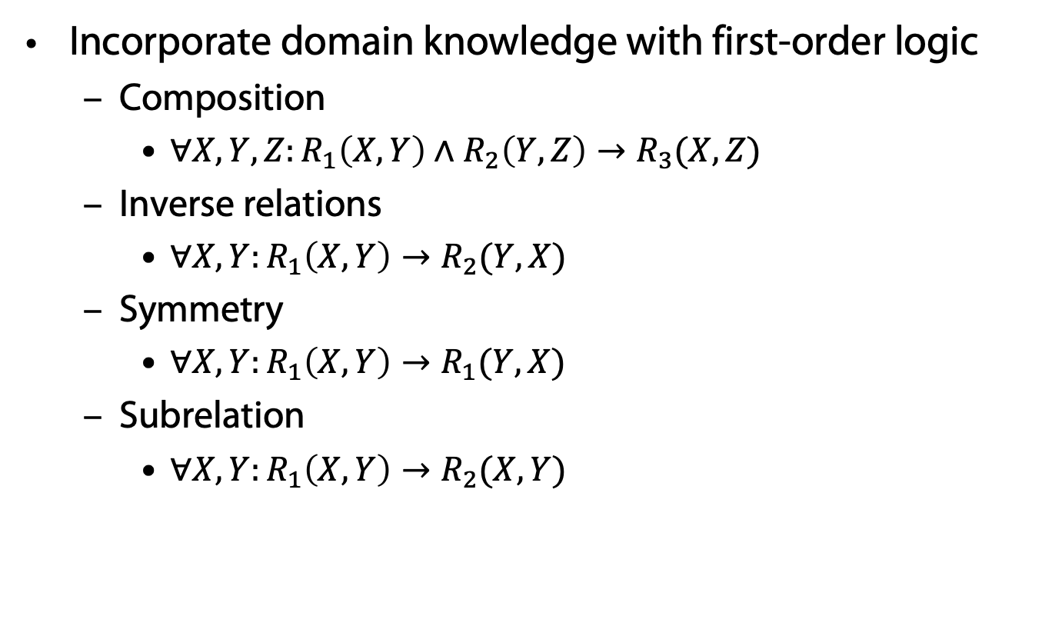
Advantages of MLNs
Incorporate domain knowledge with first-order logic
  Composition
    $∀X,Y,Z:R_{1}\left(X, Y\right)∧R_{2}\left(Y,Z\right)→R_{3}(X, Z)$
  Inverse relations
    $∀X,Y:R_{1}\left(X, Y\right)→R_{2}(Y, X)$
  Symmetry
    $∀X,Y:R_{1}\left(X, Y\right)→R_{1}(Y, X)$
  Subrelation
    $∀X,Y:R_{1}\left(X, Y\right)→R_{2}(X, Y)$

Slide 35
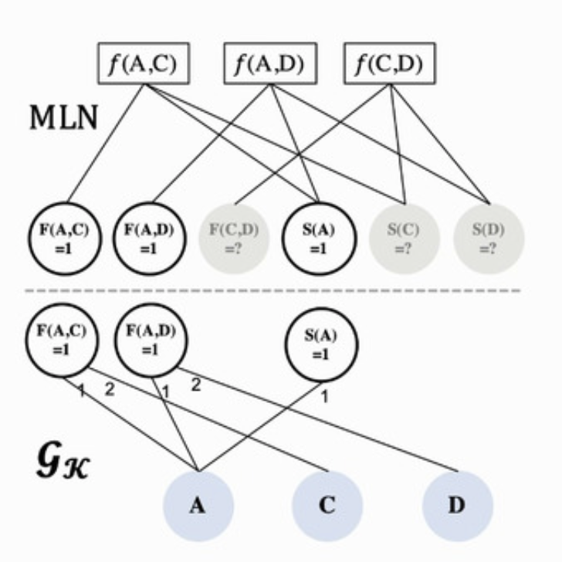
MLNs and Knowledge Graphs
Ground KG of MLN
Knowledge graph
(e.g., from text)
as evidence

Slide 36
Markov Logic Networks
Pros:
Logic formulas incorporate prior knowledge
Allows MLN to generalize in tasks
with small amount of labeled data
Cons:
Inference in MLN is computationally intensive
Logic formulas can only cover a small part of the possible combinations of knowledge graph relations in real-world texts

Slide 37
Graph Networks / Word-based Embeddings
Pros:
Efficiency – Directly work on KG
Compactness – GNNs with shared parameters can be memory efficient
Expressiveness – GNN can capture structure knowledge encoded in the KG, and so-called tunable embeddings
can encode entity-specific information (see below)
Cons:
GNNs do not explicitly incorporate prior knowledge
into models and may require many labeled examples
for a target task

Slide 38
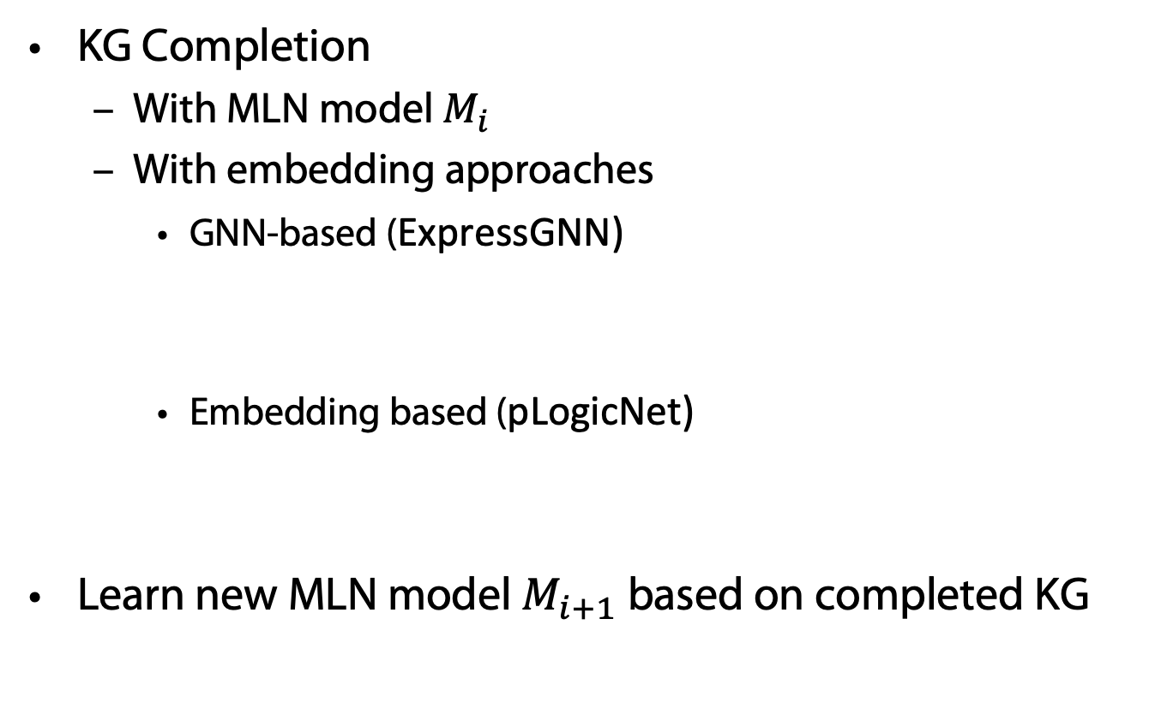
Combining MLNs and KG Embeddings
KG Completion
  With MLN model $M_{i}$
  With embedding approaches
    GNN-based (ExpressGNN)
    Embedding based (pLogicNet)
Learn new MLN model $M_{i+1}$ based on completed KG
Efficient Probabilistic Logic Reasoning with Graph Neural Networks
Yuyu Zhang, Xinshi Chen, Yuan Yang, Arun Ramamurthy, Bo Li, Yuan Qi & Le Song.
In: Proc. ICLR-20. https://iclr.cc/virtual/poster_rJg76kStwH.html 2020.
Probabilistic Logic Neural Network for Reasoning, Meng Qu, Jian Tang.
In: Proc. NeurIPS-20. https://github.com/DeepGraphLearning/pLogicNet 2019.

Slide 39
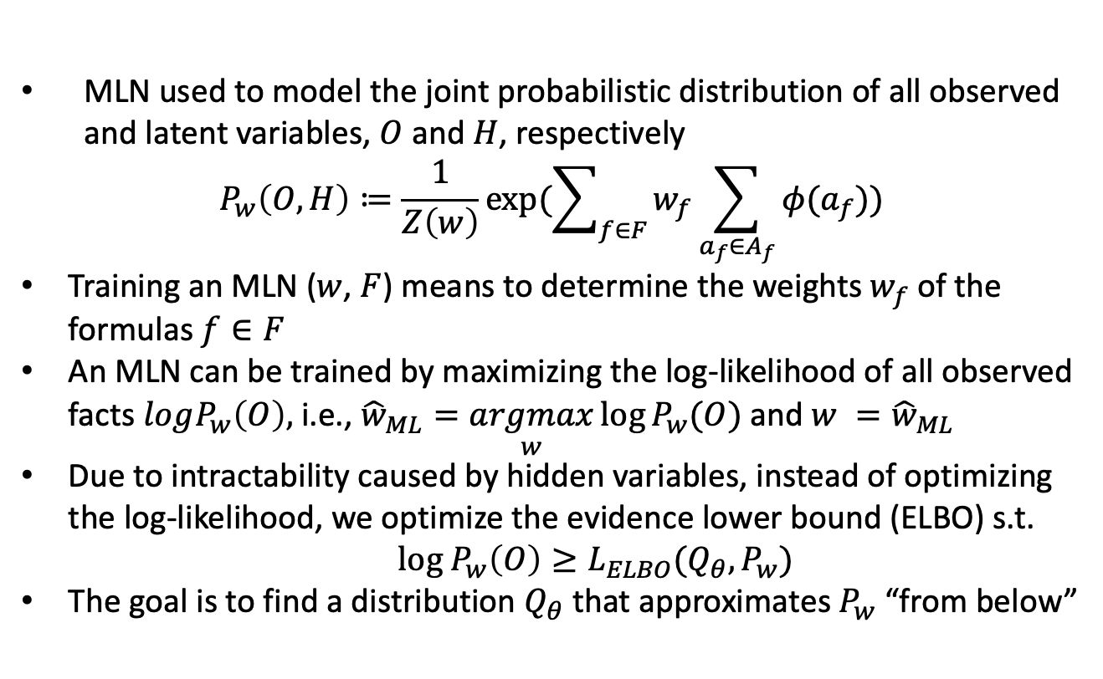
Variational EM for MLN Learning
MLN used to model the joint probabilistic distribution of all observed and latent variables, $O$ and $H$, respectively
$$P_{w}\left(O,H\right)≔\frac{1}{Z\left(w\right)}\exp{(\sum_{f∈F}{w_{f}\sum_{a_{f}∈A_{f}}{φ(a_{f})}})}$$
Training an MLN ($w$, $F$) means to determine the weights $w_{f}$of the formulas $f∈F$
An MLN can be trained by maximizing the log-likelihood of all observed facts $logP_{w}\left(O\right),$ i.e., ${\hat{w}}_{ML}=\underset{w}{argmax}\log{P_{w}(O)}$ and $w ={\hat{w}}_{ML}$
Due to intractability caused by hidden variables, instead of optimizing the log-likelihood, we optimize the evidence lower bound (ELBO) s.t.
  $log P_{w}\left(O\right)≥L_{ELBO}(Q_{θ},P_{w})$
The goal is to find a distribution $Q_{θ}$ that approximates $P_{w}$ “from below”

Slide 40
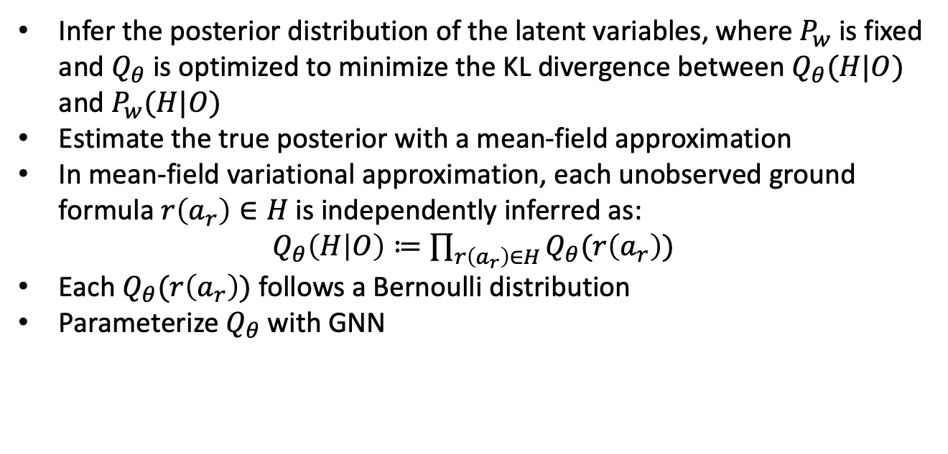
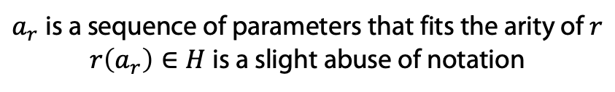
E step: Inference
Infer the posterior distribution of the latent variables, where $P_{w}$ is fixed and $Q_{θ}$ is optimized to minimize the KL divergence between $Q_{θ}(H|O)$ and $P_{w}(H|O)$
Estimate the true posterior with a mean-field approximation
In mean-field variational approximation, each unobserved ground formula $r\left(a_{r}\right)∈H$ is independently inferred as:
$Q_{θ}\left(H | O\right)≔\prod_{r\left(a_{r}\right)∈H}{Q_{θ}(r\left(a_{r}\right))}$
Each $Q_{θ}(r\left(a_{r}\right))$ follows a Bernoulli distribution
Parameterize $Q_{θ}$ with GNN
$a_{r}$is a sequence of parameters that fits the arity of $r$
$r\left(a_{r}\right)∈H$ is a slight abuse of notation

Slide 41
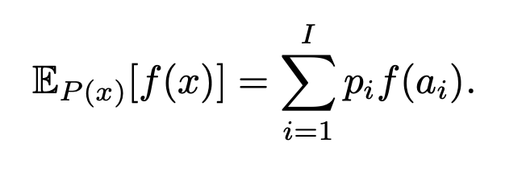
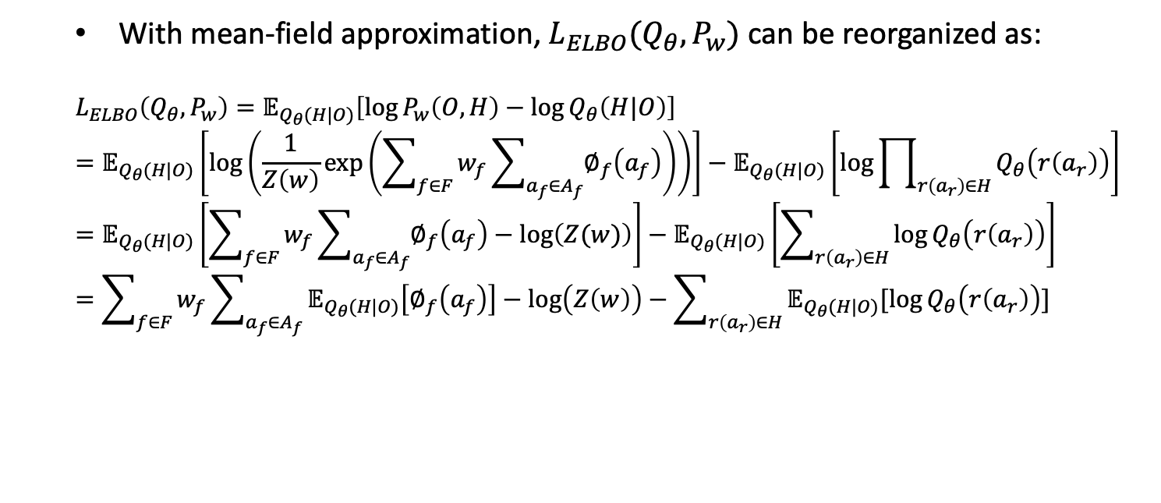
E step: Inference
With mean-field approximation, $L_{ELBO}(Q_{θ},P_{w})$ can be reorganized as:
$$L_{ELBO}\left(Q_{θ},P_{w}\right)=𝔼_{Q_{θ}(H|O)}\left[\log{P_{w}\left(O,H\right)−\log{Q_{θ}\left(H|O\right)}}\right]=𝔼_{Q_{θ}(H|O)}\left[log\left(\frac{1}{Z\left(w\right)}\exp\left(\sum_{f∈F}{w_{f}}\sum_{a_{f}∈A_{f}}{∅_{f}\left(a_{f}\right)}\right)\right)\right]−𝔼_{Q_{θ}(H|O)}\left[\log{\prod_{r\left(a_{r}\right)∈H}{Q_{θ}\left(r\left(a_{r}\right)\right)}}\right]=𝔼_{Q_{θ}(H|O)}\left[\sum_{f∈F}{w_{f}}\sum_{a_{f}∈A_{f}}{∅_{f}\left(a_{f}\right)}−log\left(Z(w)\right)\right]−𝔼_{Q_{θ}(H|O)}\left[\sum_{r\left(a_{r}\right)∈H}{\log{Q_{θ}\left(r\left(a_{r}\right)\right)}}\right]=\sum_{f∈F}{w_{f}}\sum_{a_{f}∈A_{f}}{𝔼_{Q_{θ}(H|O)}\left[∅_{f}\left(a_{f}\right)\right]}−log\left(Z\left(w\right)\right)−\sum_{r\left(a_{r}\right)∈H}{𝔼_{Q_{θ}(H|O)}[log{Q_{θ}\left(r\left(a_{r}\right)\right)]}}$$

Slide 42
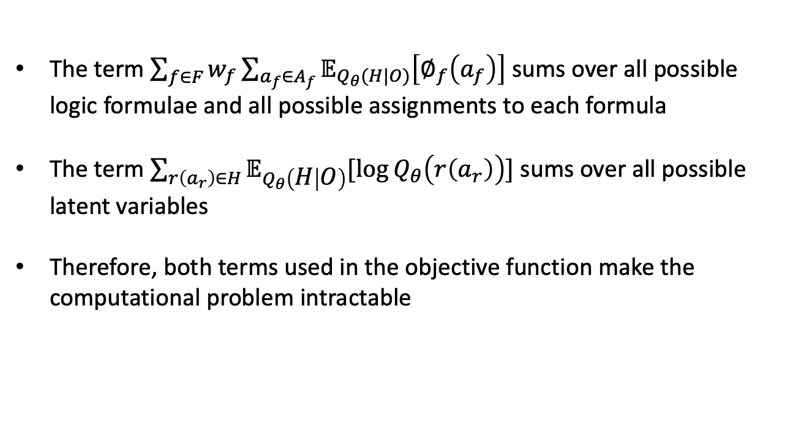
E step: Inference
The term $\sum_{f∈F}{w_{f}}\sum_{a_{f}∈A_{f}}{𝔼_{Q_{θ}(H|O)}\left[∅_{f}\left(a_{f}\right)\right]}$ sums over all possible logic formulae and all possible assignments to each formula
The term $\sum_{r\left(a_{r}\right)∈H}{𝔼_{Q_{θ}\left(H | O\right)}[log{Q_{θ}\left(r\left(a_{r}\right)\right)]}}$ sums over all possible latent variables
Therefore, both terms used in the objective function make the computational problem intractable

Slide 43
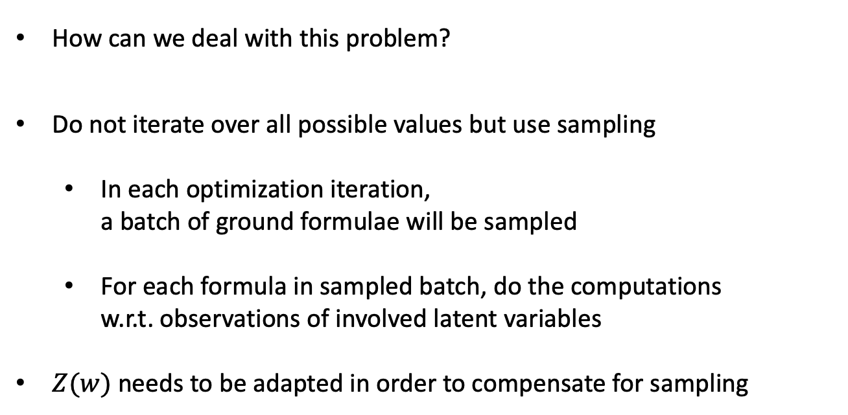
E step: Inference with Sampling
How can we deal with this problem?
Do not iterate over all possible values but use sampling
  In each optimization iteration,
  a batch of ground formulae will be sampled
  For each formula in sampled batch, do the computations
  w.r.t. observations of involved latent variables
$Z(w)$ needs to be adapted in order to compensate for sampling

Slide 44
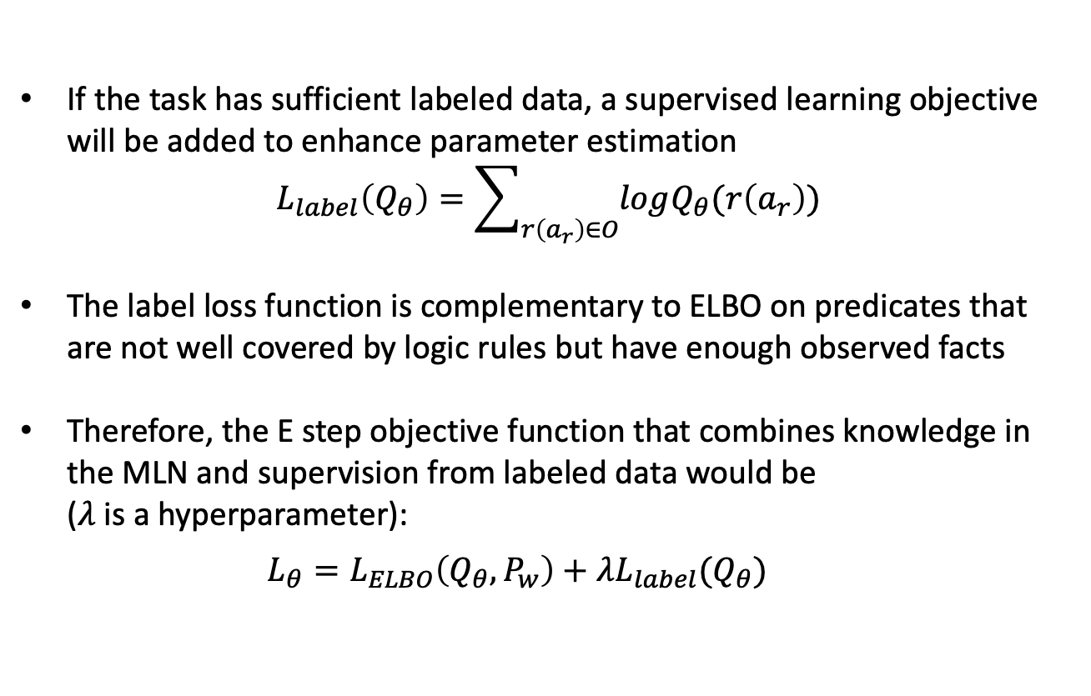
E step: Add-on
If the task has sufficient labeled data, a supervised learning objective will be added to enhance parameter estimation
$$L_{label}\left(Q_{θ}\right)=\sum_{r\left(a_{r}\right)∈O}{logQ_{θ}(r\left(a_{r}\right))}$$
The label loss function is complementary to ELBO on predicates that are not well covered by logic rules but have enough observed facts
Therefore, the E step objective function that combines knowledge in the MLN and supervision from labeled data would be
($λ$ is a hyperparameter):
  $$L_{θ}=L_{ELBO}\left(Q_{θ},P_{w}\right)+λL_{label}(Q_{θ})$$

Slide 45
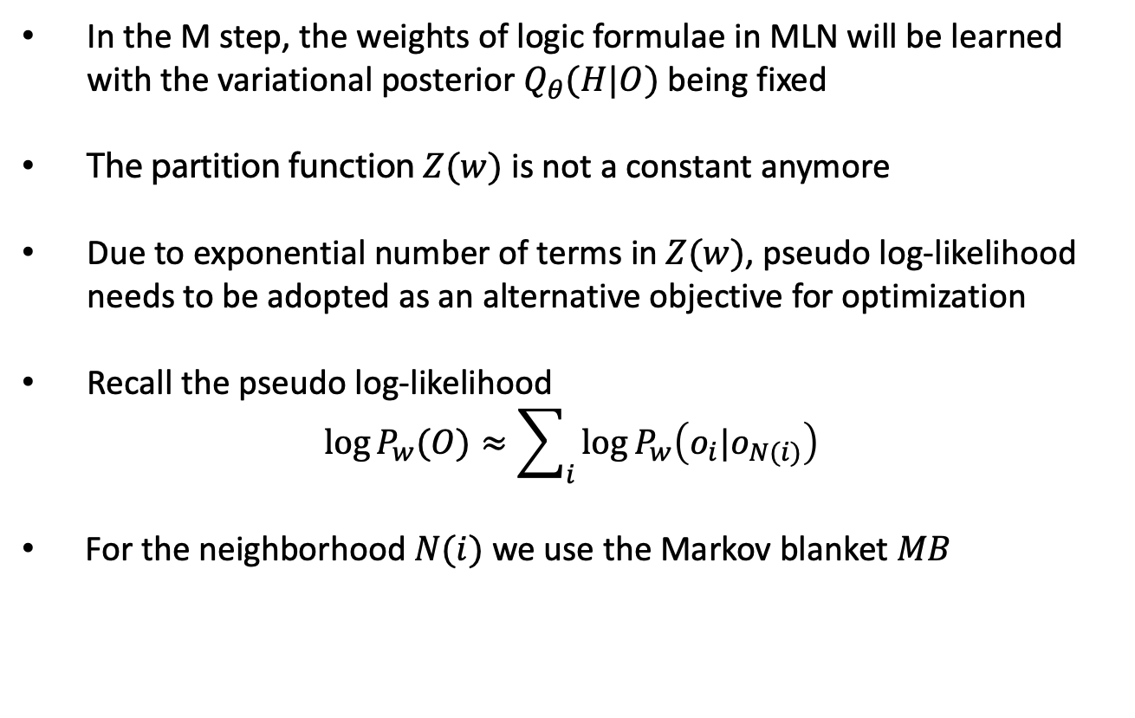
M step: Learning
In the M step, the weights of logic formulae in MLN will be learned with the variational posterior $Q_{θ}(H|O)$ being fixed
The partition function $Z(w)$ is not a constant anymore
Due to exponential number of terms in $Z(w)$, pseudo log-likelihood needs to be adopted as an alternative objective for optimization
Recall the pseudo log-likelihood
$$\log{P_{w}(O)≈\sum_{i}{\log{P_{w}\left(o_{i}|o_{N(i)}\right)}}}$$
For the neighborhood $N(i)$ we use the Markov blanket $MB$

Slide 46
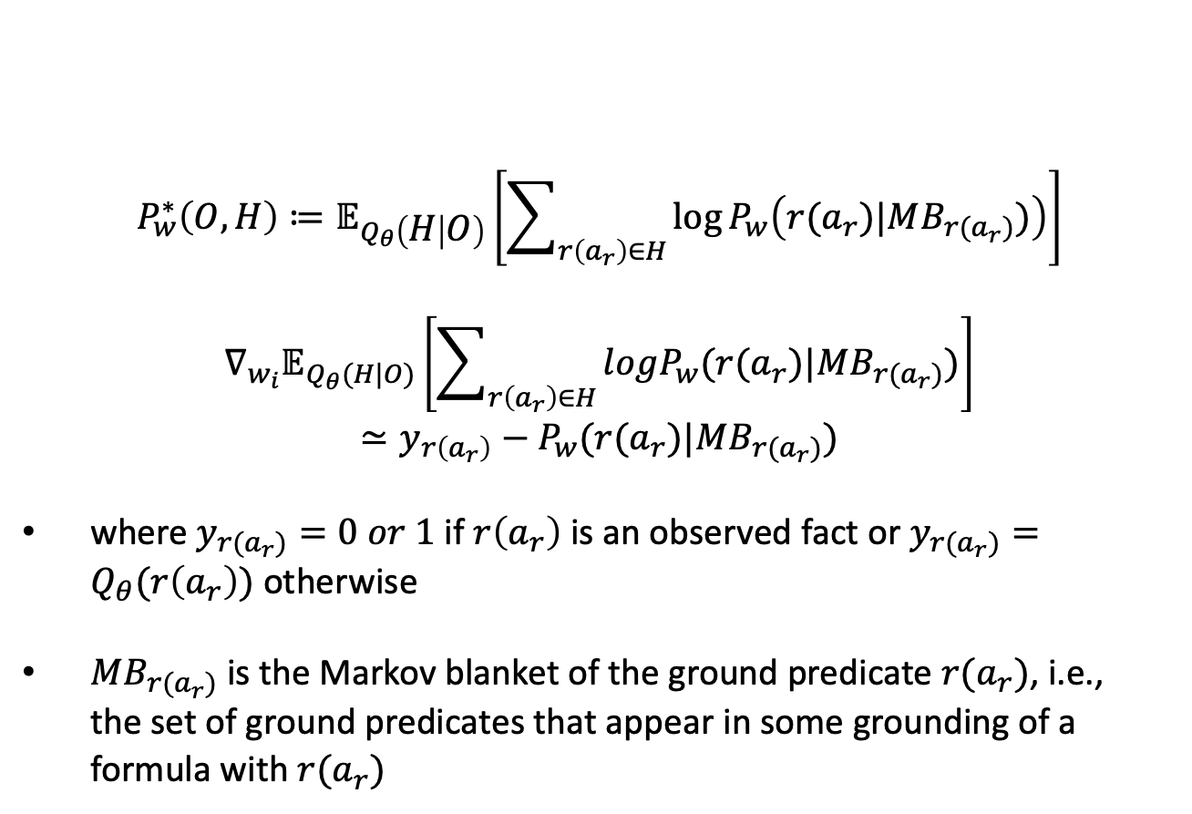
Pseudo-Likelihood
$$P_{w}^{∗}\left(O,H\right)≔𝔼_{Q_{θ}\left(H | O\right)}\left[\sum_{r\left(a_{r}\right)∈H}{\log{P_{w}\left(r(a_{r})|MB_{r(a_{r})})\right)}}\right]$$
$$∇_{w_{i}}𝔼_{Q_{θ}(H|O)}\left[\sum_{r\left(a_{r}\right)∈H}{logP_{w}(r(a_{r})|MB_{r(a_{r})})}\right]≃y_{r\left(a_{r}\right)}−P_{w}(r(a_{r})|MB_{r(a_{r})})$$
where $y_{r(a_{r})}=0 or 1$ if $r\left(a_{r}\right)$ is an observed fact or $y_{r(a_{r})}=Q_{θ}(r\left(a_{r}\right))$ otherwise
$MB_{r(a_{r})}$ is the Markov blanket of the ground predicate $r(a_{r})$, i.e.,
the set of ground predicates that appear in some grounding of a formula with $r(a_{r})$

Slide 47
Sampling Scheme for M step
Computationally intractable to use all possible ground predicates to compute the gradients
The solution is to only consider all ground formulae with at most one latent predicate and pick up the ground predicate if its truth value determines the formula’s truth value
Using this sampling scheme, only a small subset of ground predicates is kept and each of which can directly determine the truth value of a ground formula in MLN
Intuitively, this small subset contains all representative ground predicates, and makes good estimation of the gradients with much cheaper computational cost

Slide 48
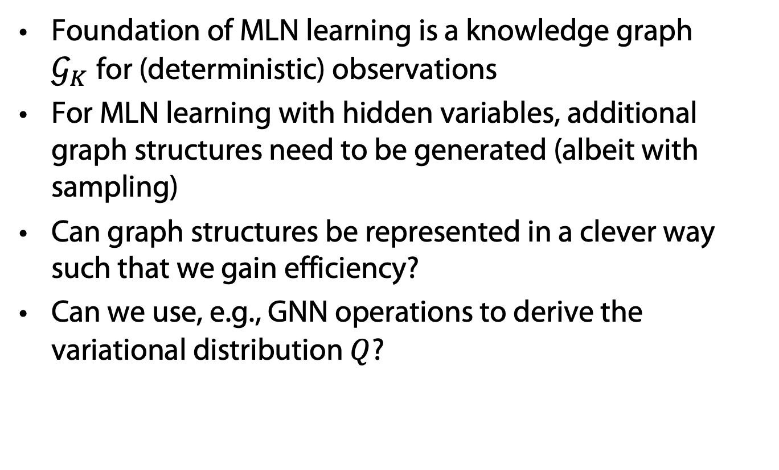
Representing graph structures
Foundation of MLN learning is a knowledge graph $𝒢_{K}$for (deterministic) observations
For MLN learning with hidden variables, additional graph structures need to be generated (albeit with sampling)
Can graph structures be represented in a clever way such that we gain efficiency?
Can we use, e.g., GNN operations to derive the variational distribution $Q$?

Slide 49
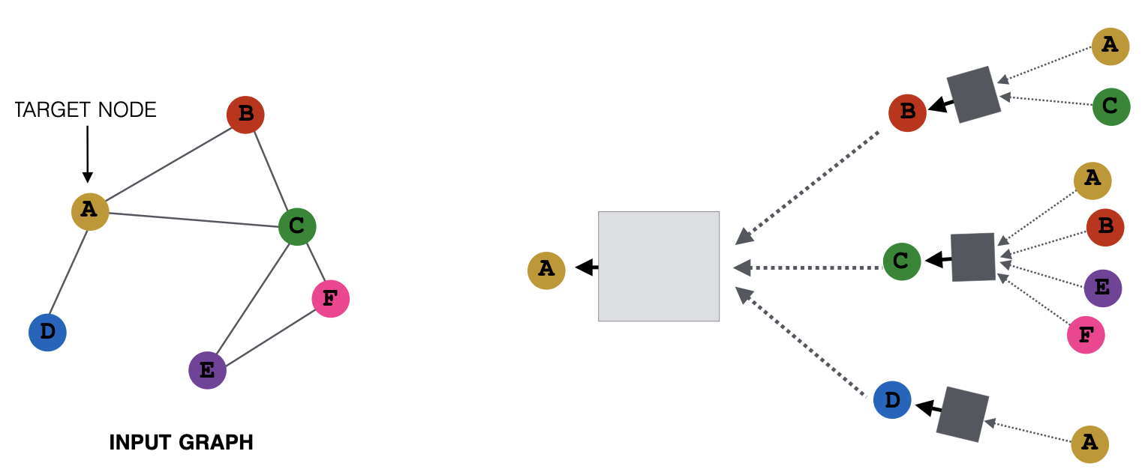
ExpressGNN
ExpressGNN has three parts:
  Vanilla Graph Network
  Tunable Embeddings
  Define posterior using embeddings
KNOWLEDGE GRAPH
Yuyu Zhang, Xinshi Chen, Yuan Yang, Arun Ramamurthy, Bo Li, Yuan Qi & Le Song. Efficient Probabilistic Logic Reasoning with Graph Neural Networks. In: Proc. ICLR 2020.

Slide 50
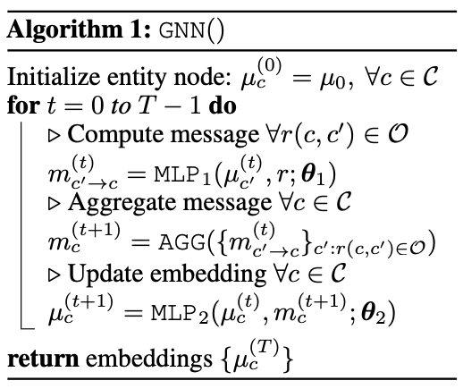
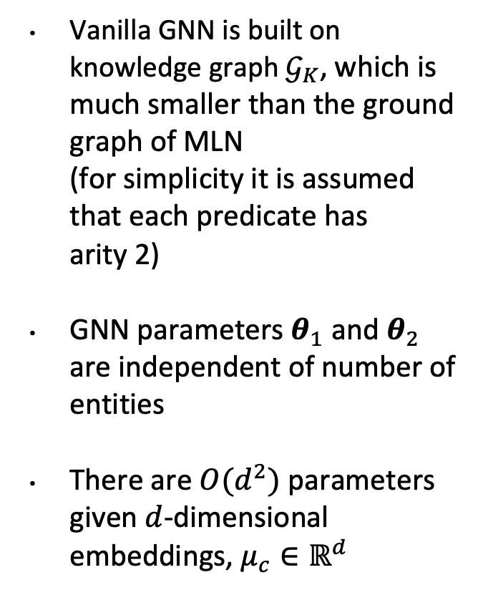
Vanilla GNN
Vanilla GNN is built on knowledge graph $𝒢_{K}$, which is much smaller than the ground graph of MLN
(for simplicity it is assumed
that each predicate has
arity 2)
GNN parameters $θ_{1}$ and $θ_{2}$ are independent of number of entities
There are $O(d^{2})$ parameters given $d$-dimensional embeddings, $μ_{c}∈ℝ^{d}$

Slide 51
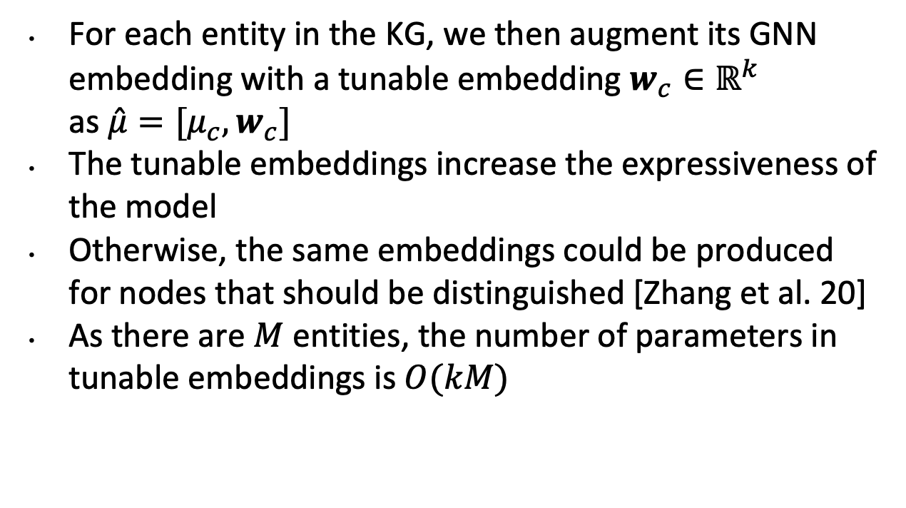
Tunable Embeddings
For each entity in the KG, we then augment its GNN embedding with a tunable embedding $w_{c}∈ℝ^{k}$
as $\hat{μ}=[μ_{c},w_{c}]$
The tunable embeddings increase the expressiveness of the model
Otherwise, the same embeddings could be produced for nodes that should be distinguished [Zhang et al. 20]
As there are $M$ entities, the number of parameters in tunable embeddings is $O(kM)$
Yuyu Zhang, Xinshi Chen, Yuan Yang, Arun Ramamurthy, Bo Li, Yuan Qi & Le Song. Efficient Probabilistic Logic Reasoning with Graph Neural Networks. In: Proc. ICLR 2020.

Slide 52
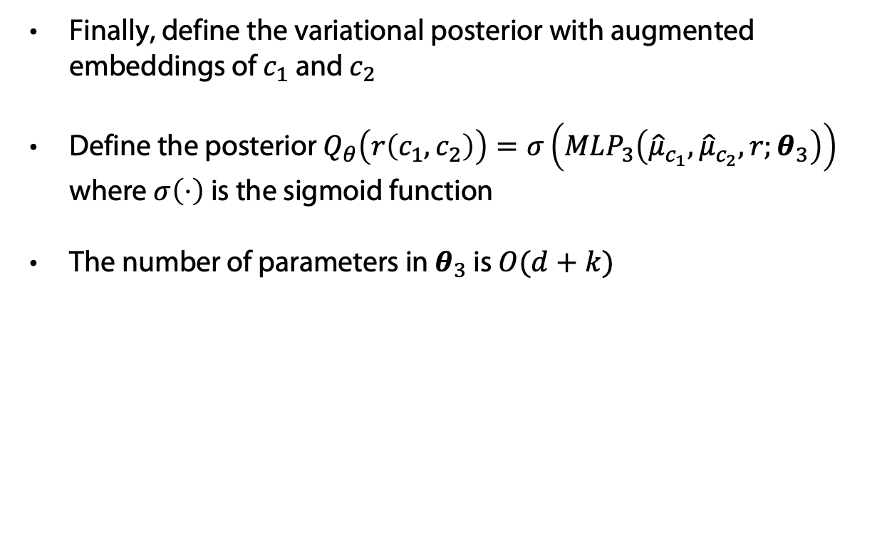
Define Variational Posterior
Finally, define the variational posterior with augmented embeddings of $c_{1}$ and $c_{2}$
Define the posterior $Q_{θ}\left(r\left(c_{1},c_{2}\right)\right)=σ\left(MLP_{3}\left({\hat{μ}}_{c_{1}},{\hat{μ}}_{c_{2}},r;θ_{3}\right)\right)$
where $σ\left(⋅\right)$ is the sigmoid function
The number of parameters in $θ_{3}$ is $O(d+k)$

Slide 53
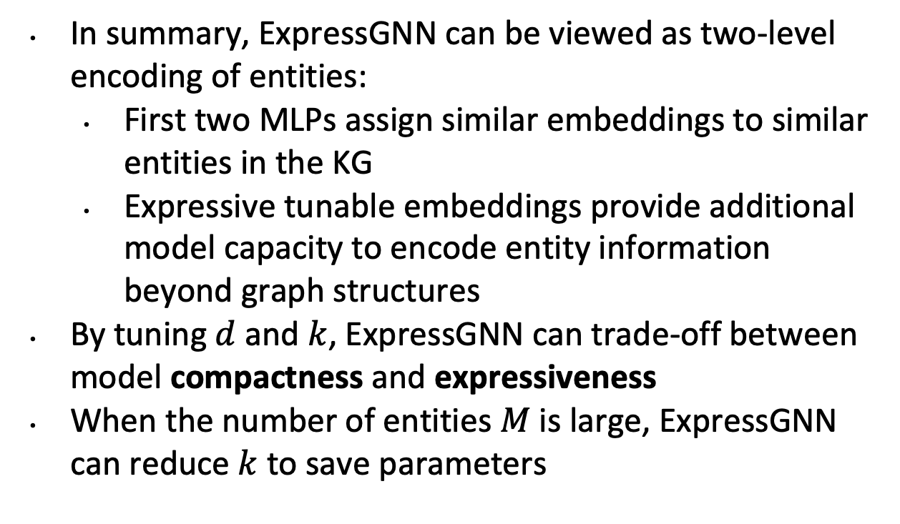
Summary so far: ExpressGNN
In summary, ExpressGNN can be viewed as two-level encoding of entities:
  First two MLPs assign similar embeddings to similar entities in the KG
  Expressive tunable embeddings provide additional model capacity to encode entity information beyond graph structures
By tuning $d$ and $k$, ExpressGNN can trade-off between model compactness and expressiveness
When the number of entities $M$ is large, ExpressGNN can reduce $k$ to save parameters

Slide 54
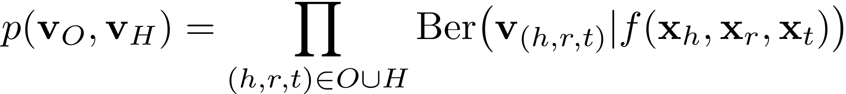

pLogicNet: Embeddings again
Each entity e ∈ E and relation r ∈ R in a KG is associated with an embedding xe and xr
The joint distribution of all triplets can be defined as:
Where f( . , . , . ) is the scoring function on the entity and relation embeddings that computes the probability of the triplet (h, r, t) being true
Example: the f used in TransE (a KG embedding model) is formulated as:

Slide 55
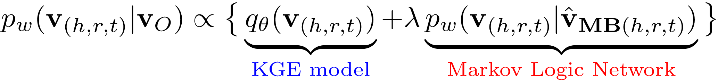
Combining MLNs with Embedding Approaches
Meng Qu and Jian Tang. Probabilistic logic neural
networks for reasoning. In: Proc. NeurIPS 2019.

Slide 56

MLNs w/ Node Attributes
Model the joint distribution of the object labels given object features, i.e., $p(y_{V}|x_{V})$
?
Object labels
?
?
?
?
?
Object features
$$ψ_{i,j}\left(y_{i},y_{j},x_{V}\right)=\exp{(\sum_{k=1}^{K}{λ_{k}f_{k}\left(y_{i},y_{j},x_{i},x_{j}\right)+μ_{k}g_{k}(y_{i},}x_{i})) }$$
Edge potential functions
node potential functions

Slide 57
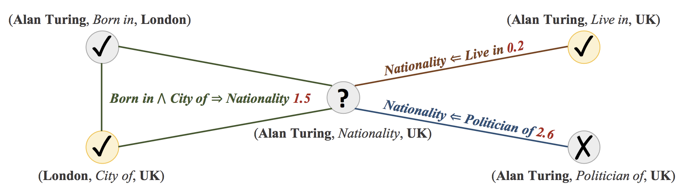
MLN Learning with pLogicNet
pLogicNet formulates the joint distribution of all graph triplets with a Markov logic network, which is trained with the variational EM algorithm.
In E-step, a KGE model infers missing (hidden) triplets. Knowledge preserved by logic rules can be effectively distilled into the learned embeddings.
In M-step, the weights of the logic rules are updated based on both the observed triplets and those inferred by KGE model. Therefore, KGE model provides extra supervision for weight learning

Slide 58
Summary
MLNs help to augment KGs
  Constraints on graphs describe completion rules
KGs can be used to support MLN learning
  Embedding-based graph completion to infer missing (hidden) information, which can be used for learning
  GNN embeddings of KG nodes for variational EM
We can in principle combine the advantages of both worlds, logic and embedding approaches!

