Slide 1
Intelligent Agents
Game Theory and Social Choice
Ralf Möller
Universität zu Lübeck
Institut für Informationssysteme

Slide 2
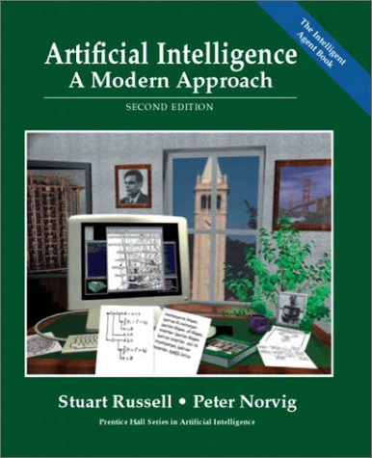
Literature
Chapter 17
Presentations from CS 886
Advanced Topics in AI Electronic Market Design
Kate Larson
Waterloo Univ.

Slide 3
Acknowledgements also to…
… and to many other lecturers
who have shared their slides on
the web!

Slide 4
Full vs bounded rationality
Full
rationality
Bounded
rationality
Descriptive vs. prescriptive
theories of bounded rationality
solution quality
Notion of Utility: u_{i}(outcome)
worth of solution
time
deliberation cost

Slide 5
Impact of Reasoning Machinery
Everything else being equal, an agent that has better algorithms and heuristics could make "more rational" (more optimal) decisions than one that has poorer heuristics and algorithms
An agent should be able to learn heuristics
  Possibly as important as learning models
Rather than trying to solve a (too) difficult problem alone, an agent might decide to collaborate with others
Need to analyze multiagent systems

Slide 6
Mechanisms, Protocols, and Strategies
A mechanism defines the “rules of encounter” or protocol between agents
Mechanism design is the theory about designing mechanisms so that they have certain desirable properties
Given a particular protocol, how can a particular strategy be designed that individual agents can use?
Notion of a dominant strategy
  Best strategy to be determined w/o knowing the (best) strategies of other agents

Slide 7
Multiagent Systems: Criteria
Social welfare: max_{outcome} ∑_{i} u_{i}(outcome)
Surplus: social welfare of outcome – social welfare of status quo
  Constant sum games have 0 surplus.
  Markets are not constant sum
Pareto efficiency: An outcome o is Pareto efficient if there exists no other outcome o’ s.t. some agent has higher utility in o’ than in o and no agent has lower
  Implied by social welfare maximization
Individual rationality: Participating in a negotiation (or individual deal) is no worse than not participating
Stability: No agents can increase their utility by changing their strategies
(aka policies)
Symmetry: No agent should be inherently preferred, e.g., as a dictator

Slide 8
Example Mechanisms: Auctions
An auction takes place between an agent known as the auctioneer and a collection of agents known as the bidders
The goal of the auction is for the auctioneer to allocate the good to one of the bidders
In most settings the auctioneer desires to maximize the price; bidders desire to minimize price

Slide 9
Auction Parameters
Goods can have
  private value
  public/common value
  correlated value
Winner determination may be
  first price
  second price
Bids may be
  open cry
  sealed bid
Bidding may be
  one shot
  ascending
  descending

Slide 10
English Auctions
Most commonly known type of auction:
  First price
  Open cry
  Ascending
Dominant strategy is for agent to successively bid a small amount more than the current highest bid until it reaches their valuation, then withdraw
Susceptible to:
  Winner’s curse
  Shill-bidding

Slide 11
Dutch Auctions
Dutch auctions are examples of
open-cry descending auctions:
Auctioneer starts by offering good
at artificially high value
Auctioneer lowers offer price until some agent makes a bid equal to the current offer price
Good is then allocated to the agent
that made the offer

Slide 12
Game Theory: Describing the Interaction of Agents
A game: Formal representation of a situation of strategic interdependence
Set of agents, I (|I|=n)
  Aka players
Each agent, j, has a set of actions, A_{j}
  Aka moves
Actions define outcomes
  For each possible action there is an outcome.
Outcomes define payoffs
  Agents derive utility from different outcomes

Slide 13
Normal form game* (matching pennies)
Agent 2
H
T
Action
Outcome
H
-1, 1
1, -1
Payoffs
Agent 1
T
1, -1
-1, 1
*Aka strategic form, matrix form

Slide 14
Extensive form game (matching pennies)
Agent 1
Action
T
H
Agent 2
H
T
H
T
Terminal node (outcome)
(-1,1)
(1,-1)
(1,-1)
(-1,1)
Payoffs
Not necessarily executed sequentially

Slide 15
Strategies (aka Policies)
Strategy:
  A strategy, s_{j}, is a complete contingency plan;
  defines the actions agent j should take for all possible states of the world
Strategy profile: s=(s₁,…,s_{n})
  s_{-i} = (s₁,…,s_{i-1},s_{i+1},…,s_{n})
Utility function: u_{j}(s)
  Note that the utility of an agent j depends on the strategy profile, not just its own strategy
  We assume agents are expected utility maximizers

Slide 16
Normal form game* (matching pennies)
Agent 2
Strategy for Agent 1: H
Agent 2: T
H
T
H
Strategy
profile
(H,T)
-1, 1
1, -1
Agent 1
U1((H,T))=1
U2((H,T))=-1
T
1, -1
-1, 1
*aka strategic form, matrix form

Slide 17
Extensive form game (matching pennies)
Strategy for Agent 1: T
Agent 2: T
Player 1
Action
T
H
Strategy profile: (T,T)
Player 2
H
T
T
H
Terminal node (outcome)
U1((T,T))=-1
U2((T,T))=1
(-1,1)
(1,-1)
(1,-1)
(-1,1)
Payoffs

Slide 18
Extensive form game (matching pennies, seq moves)
Recall: A strategy is a contingency plan for all states of the game
Strategy for Agent 1: T
T
Strategy for Agent 2:
H if 1 plays H, T if 1 plays T
Notation: (H,T)
H
H
T
T
H
Strategy profile: (T,(H,T))
U1((T,(H,T)))=-1
U2((T,(H,T)))=1
(-1,1)
(1,-1)
(1,-1)
(-1,1)

Slide 19
Game Representation
H,H
H,T
T,H
T,T
T
H
H
-1,1
-1,1
1,-1
1,-1
H
T
T
H
T
1,-1
-1,1
1,-1
-1,1
(-1,1)
(1,-1)
(1,-1)
(-1,1)
Potential combinatorial explosion

Slide 20
Ascending Auction
State of the world is defined by (x,p)
  x∈{0,1} indicates if the agent has the object
  p is the current next price
Strategy s_{j}((x,p))
p, if v_{j} ≧p and x=0
s_{j}((x,p)) =
No bid otherwise

Slide 21
Dominant Strategies
Recall that
  Agents’ utilities depend on what strategies other agents are playing
  Agents are expected utility maximizers
Agents will play best-response strategies
A dominant strategy is a best-response for all s_{-i}
  They do not always exist
  Inferior strategies are called dominated
s_{i}* is a best response if u_{i}(s_{i}*,s_{-i})≥u_{i}(s_{i}’,s_{-i}) for all s_{i}’

Slide 22
Dominant Strategy Equilibrium
A dominant strategy equilibrium is a strategy profile where the strategy for each player is dominant
  s*=(s₁*,…,s_{n}*)
  u_{i}(s_{i}*,s_{-i})≥u_{i}(s_{i}’,s_{-i}) for all i, for all s_{i}’, for all s_{-i}
GOOD: Agents do not need to counterspeculate!

Slide 23
Example: Prisoner’s Dilemma
Two people are arrested for a crime, and they are interrogated separately
If neither suspect confesses, both are released (but still, the interrogation is nasty)
If both confess (to have carried out the crime together),
then they get sent to jail
If one confesses and the other does not,
then the confessor gets a light sentence and the other gets a heavy sentence.
A: Don’t
Confess
A: Confess
Dom. Str. Equil
B:Confess
B=-5, A=-5 | B=-1, A=-10
B=-10, A=-1 | B=-2, A=-2
Pareto Optimal Outcome
B:Don’t
Confess
Dominant strategy exists but is not Pareto efficient

Slide 24
Example: Split or Steal
Does initial communication help?
Only if agents do not lie to the other
A: Steal
A: Split
Dom. Str. Eq
B:Steal
B=0, A=0 | B=100, A=0
B=0, A=100 | B=50, A=50
Pareto Optimal Outcome
B:Split
Example from British Game Show „Golden Balls“
See http://blogs.cornell.edu/info2040/2012/09/21/split-or-steal-an-analysis-using-game-theory/

Slide 25
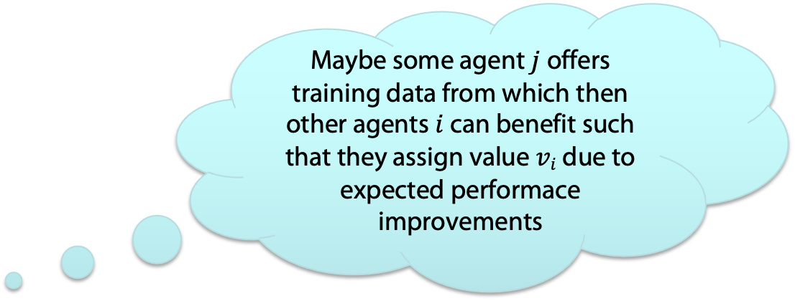
Vickrey *) Auctions
Maybe some agent $j$ offers training data from which then other agents $i$ can benefit such that they assign value $vi$due to expected performace improvements
Vickrey auctions are:
  Second-price
  Sealed-bid
Good is awarded to the agent that made the highest bid; at the price of the second highest bid
Bidding to your true valuation is dominant strategy in Vickrey auctions
Vickrey auctions susceptible to antisocial behavior
*) Named after William Vickrey (1914–1996), who won the 1996 Nobel Prize in economics for this work and died of a heart attack three days later

Slide 26
Example: Vickrey Auction (2nd price sealed bid)
Each agent i has value v_{i}
Strategy b_{i}(v_{i})∈[0,∞)
b*:= 2nd best bid.
v_{i}-b* if b_{i}>b*
u_{i}(b_{i},b_{-i}) =
0 otherwise
Claim: Given value v_{i}, b_{i}(v_{i})=v_{i} is dominant.
Let b’=max_{j⧧i}b_{j}. If b’<v_{i} then any bid b_{i}(v_{i})≥b’ is optimal. If b’≥v_{i}, then any bid b_{i}(v_{i})≤ v_{i} is optimal. Bid b_{i}(v_{i})=v_{i} satisfies both constraints.
Dominant strategy is Pareto efficient

Slide 27
Phone Call Competition Example
Customer wishes to place long-distance call
Carriers simultaneously bid, sending proposed prices
Phone automatically chooses the carrier (dynamically)
MCI
AT&T
Sprint
$0.20
$0.18
$0.23

Slide 28
Best Bid Wins
Phone chooses carrier with lowest bid
Carrier gets amount that it bid
MCI
AT&T
Sprint
$0.20
$0.18
$0.23

Slide 29
Attributes of the Mechanism
Distributed
Symmetric
Stable
Efficient
Carriers have an incentive to invest effort in strategic behavior
AT&T
MCI
Sprint
$0.20
“Maybe I can bid as high as $0.21...”
$0.18
$0.23

Slide 30
Best Bid Wins, Gets Second Price (Vickrey Auction)
Phone chooses carrier with lowest bid
Carrier gets amount of second-best price
MCI
AT&T
Sprint
$0.20
$0.18
$0.23

Slide 31
Attributes of the Vickrey Mechanism
Distributed
Symmetric
Stable
Efficient
Carriers have no incentive to invest effort in strategic behavior
AT&T
MCI
Sprint
$0.20
“I have no reason to overbid...”
$0.18
$0.23

Slide 32
Lies and Collusion
The various auction protocols are susceptible to lying on the part of the auctioneer, and collusion among bidders, to varying degrees
All four auctions (English, Dutch, First-Price Sealed Bid, Vickrey) can be manipulated by bidder collusion
A dishonest auctioneer can exploit the Vickrey auction by lying about the 2nd-highest bid
Shill-bids can be introduced to inflate bidding prices in English auctions

Slide 33
Does a dom. str. equil always exist?
A couple likes going to concerts together. One loves Bach but not Stravinsky. The other loves Stravinsky but not Bach. However, they prefer being together than being apart.
What should be the strategy profile?
Best action depends on best action of other agent
B
S
2,1 | 0,0
0,0 | 1,2
B
No dom. str. equil.
S

Slide 34
Nash Equilibrium
Sometimes an agent’s best-response depends on the strategies other agents are playing
  No dominant strategy equilibria
A strategy profile is a Nash equilibrium if no player has incentive to deviate from his strategy
given that others do not deviate:
  For every agent i, u_{i}(s_{i}*,s*_{-i}) ≥ u_{i}(s_{i}’,s*_{-i}) for all s_{i}’
B
S
B
2,1 | 0,0
0,0 | 1,2
S

Slide 35
Nash Equilibrium
Interpretations:
  Focal points, self-enforcing agreements, stable social convention, consequence of rational inference
Criticisms
  They may not be unique (Bach or Stravinsky)
    Ways of overcoming this
      Refinements of equilibrium concept, mediation, learning
  Do not exist in all games (in the form defined above)
  They may be hard to find
  People don’t always behave based on what equilibria would predict (ultimatum games and notions of fairness,…)

Slide 36
Extensive Form Games
Any finite game of perfect information has a pure strategy Nash equilibrium. It can be found by backward induction.
T
H
H
T
T
H
Pure strategy: no elements of chance involved
(1,2)
(2,1)
(2,1)
(4,0)
Chess is a finite game of perfect information. Therefore, it is a “trivial” game from a game-theoretic point of view.

Slide 37
Example: 1st price sealed-bid auction
2 agents (1 and 2) with values v₁,v₂ drawn uniformly from [0,1].
Utility of agent i if it bids b_{i} and wins the item is u_{i}=v_{i}-b_{i}.
Assume that agent 2’s bidding strategy is b₂(v₂)=v₂/2
(but we do not know θ₂ = v₂)
How should 1 bid? (i.e., what is b₁(v₁)=z?)
U₁
Note: given b₂(v₂)=v₂/2, agent 1 only wins if v₂<2z otherwise U₁ is 0, assume uniform distribution on [0, 2z]
argmax_{z}[2zv₁-2z² ] when z=b₁(v₁)=v₁/2
Similar argument for agent 2, assuming b₁(v₁)=v₁/2. We have an equilibrium
2z
V₂
Expected U₁=∫_{x=0}^{2z}(v₁-x)dx = [v₁x-$\frac{1}{2}$x²]₀^{2z} = 2zv₁-2z²

Slide 38
Example: Matching Pennies
H
T
No equil. exists
-1, 1 | 1,-1
1,-1 | -1, 1
H
T
So far, we have talked only about pure (deterministic) strategy equilibria.
Not all games have pure strategy equilibria. Some equilibria are mixed (randomzied) strategy equilibria.

Slide 39
Mixed strategy equilibria
Let ∑_{i} be the set of probability distributions over S_{i}
σ_{i} in ∑_{i}
Strategy profile: σ=(σ₁,…, σ_{n})
Expected utility: u_{i}(σ)=∑_{s∈Si} σ_{i}(s)u_{i}(s)
Nash Equilibrium:
  σ* is a (mixed) Nash equilibrium iff
  u_{i}(σ*_{i}, σ*_{-i})≥u_{i}(σ_{i}, σ*_{-i}) for all σ_{i}∈∑_{i}, for all i

Slide 40
Example: Matching Pennies
q H
1-q T
-1, 1 | 1,-1
1,-1 | -1, 1
p H
1-p T
Want to play each strategy with a certain probability so that the competitor is indifferent between its own strategies.
1p+(-1)(1-p)=(-1)p+1(1-p)
p=1/2
q-(1-q)=-q+(1-q)
q=1/2

Slide 41
Mixed Nash Equilibrium
Theorem (Nash 50):
  Every game in which the strategy sets, S₁,…,S_{n} have a finite number of elements has a mixed strategy equilibrium
Complexity of finding Nash Equilibria
  “Together with prime factoring, the complexity of finding a Nash Equils is, in my opinion, the most important concrete open question on the boundary of P today.” (Papadimitriou)
  (Daskalakis, Goldberg/Papadimitriou, 2005): Finding Nash equilibrium is very hard (though not NP complete):
  PPAD complete (Polynomial Parity Arguments on Directed graphs)

Slide 42
Imperfect Information about Strategies and Payoffs
So far, we have assumed that agents have complete information about each other (including payoffs)
  Very strong assumption!
Assume agent i has type θ_{i}∈Θ_{i}, which defines the payoff u_{i}(s, θ_{i})
Agents have common prior over distribution of types p(θ)
  Conditional probability p(θ_{-i}| θ_{i}) (obtained by Bayes Rule)

Slide 43
Bayesian-Nash Equil
Strategy: σ_{i}(θ_{i}) is the (mixed) strategy agent i plays if its type is θ_{i}
Strategy profile: σ=(σ₁,…, σ_{n})
Expected utility:
  EU_{i}(σ_{i}(θ_{i}),σ_{-i}(),θ_{i})=∑_{θ-i} p(θ_{-i}|θ_{i})u_{i}(σ_{i}(θ_{i}),σ_{-i}(θ_{-i}),θ_{i})
Bayesian Nash Equil: Strategy profile σ* is a Bayesian-Nash Equil
iff for all i, for all θ_{i},
  EU_{i}(σ*_{i}(θ_{i}),σ*_{-i}(),θ_{i})≥ EU_{i}(σ_{i}(θ_{i}),σ*_{-i}(),θ_{i})
  (best responding w.r.t. its beliefs about the types of the other agents, assuming they are also playing a best response)
Harsanyi, John C., "Games with Incomplete Information Played by Bayesian Players, I-III." Management Science 14 (3): 159-183 (Part I), 14 (5): 320-334 (Part II), 14 (7): 486-502 (Part III) (1967/68)
John Harsanyi was a co-recipient along with John Nash and Reinhard Selten of the 1994 Nobel Memorial Prize in Economics

Slide 44
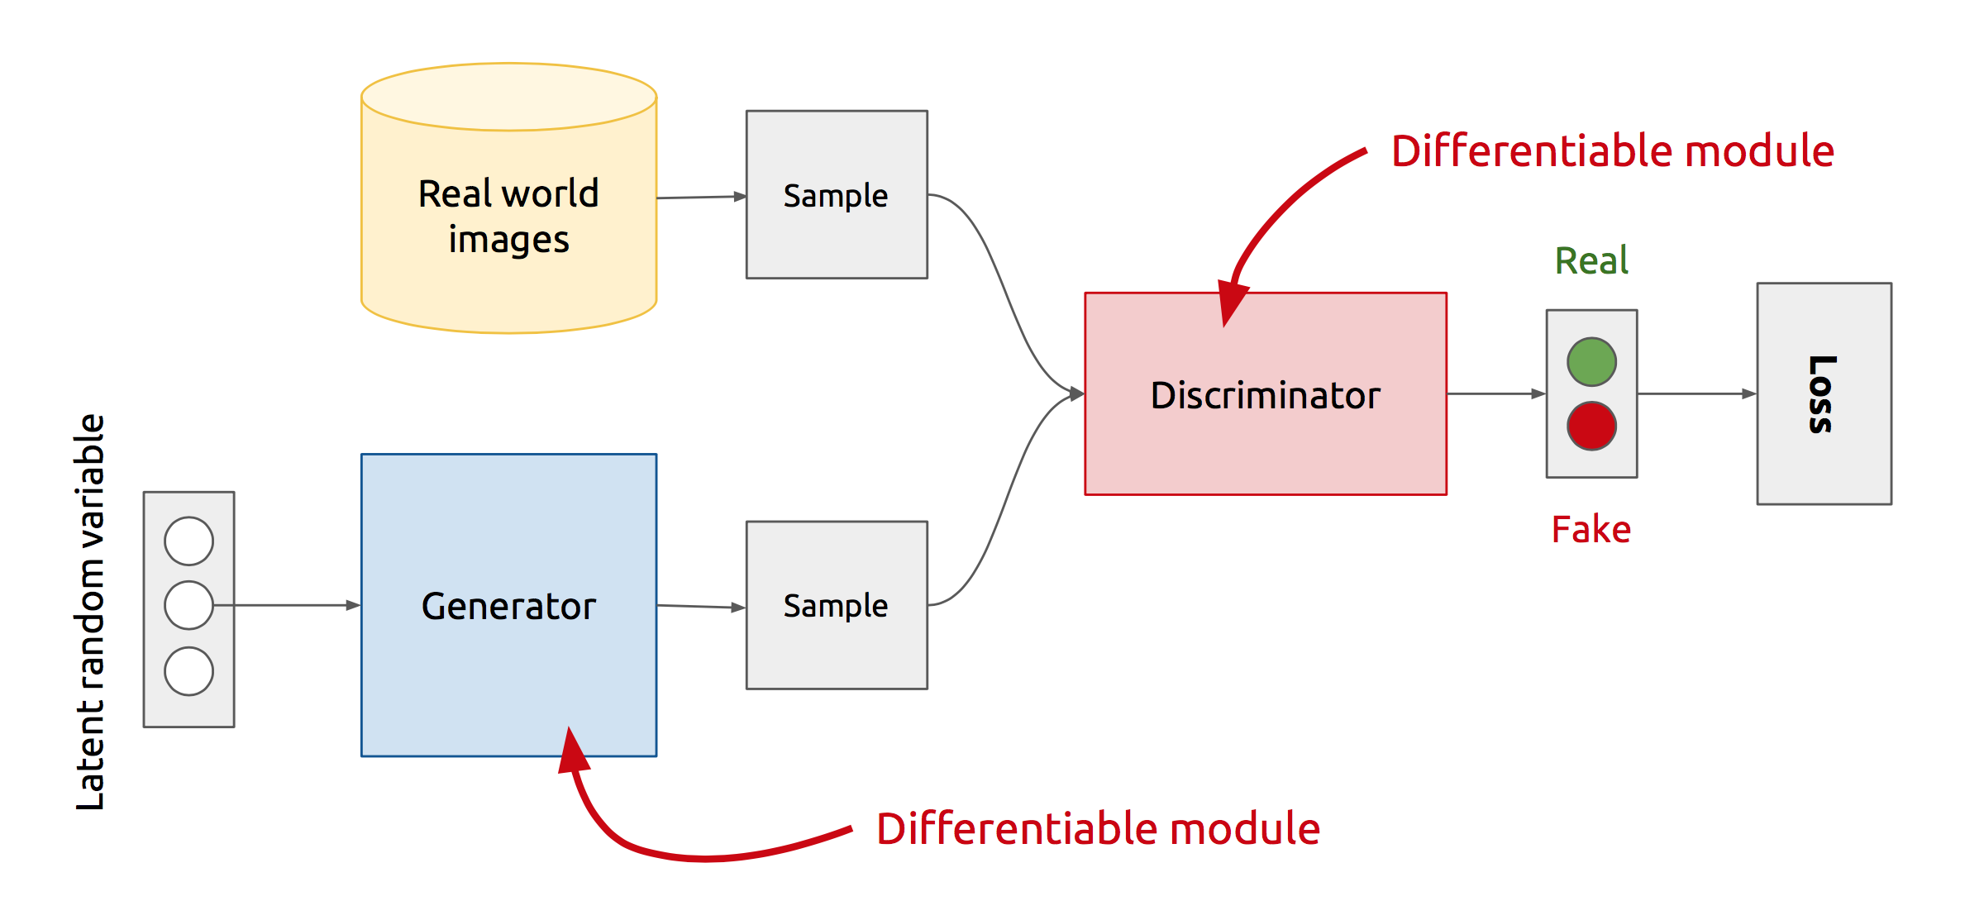
Example: GAN Architecture
x
D
D(x)
z
G
G(z)
D(G(z))
Z is some multidimensional random noise (Gaussian/Uniform).
Z can be thought as the latent representation of the image.
Notes:
Let’s look at the real GAN architecture now :-
-- We have two networks here Generator and Discriminator
-- Discriminator gets input from both the Generator and Real training samples and predicts which one is real and which one is fake.
-- The way Generator generates fake images is .. It randomly samples a noise z, passes it through its network, and the output of the network gives us the image.
-- So, the rationale with that will be that z is sort of your latent representation for the image.. And you generate the image from your latent representation by passing it through
the generator network.
Never directly see true samples.

Slide 45
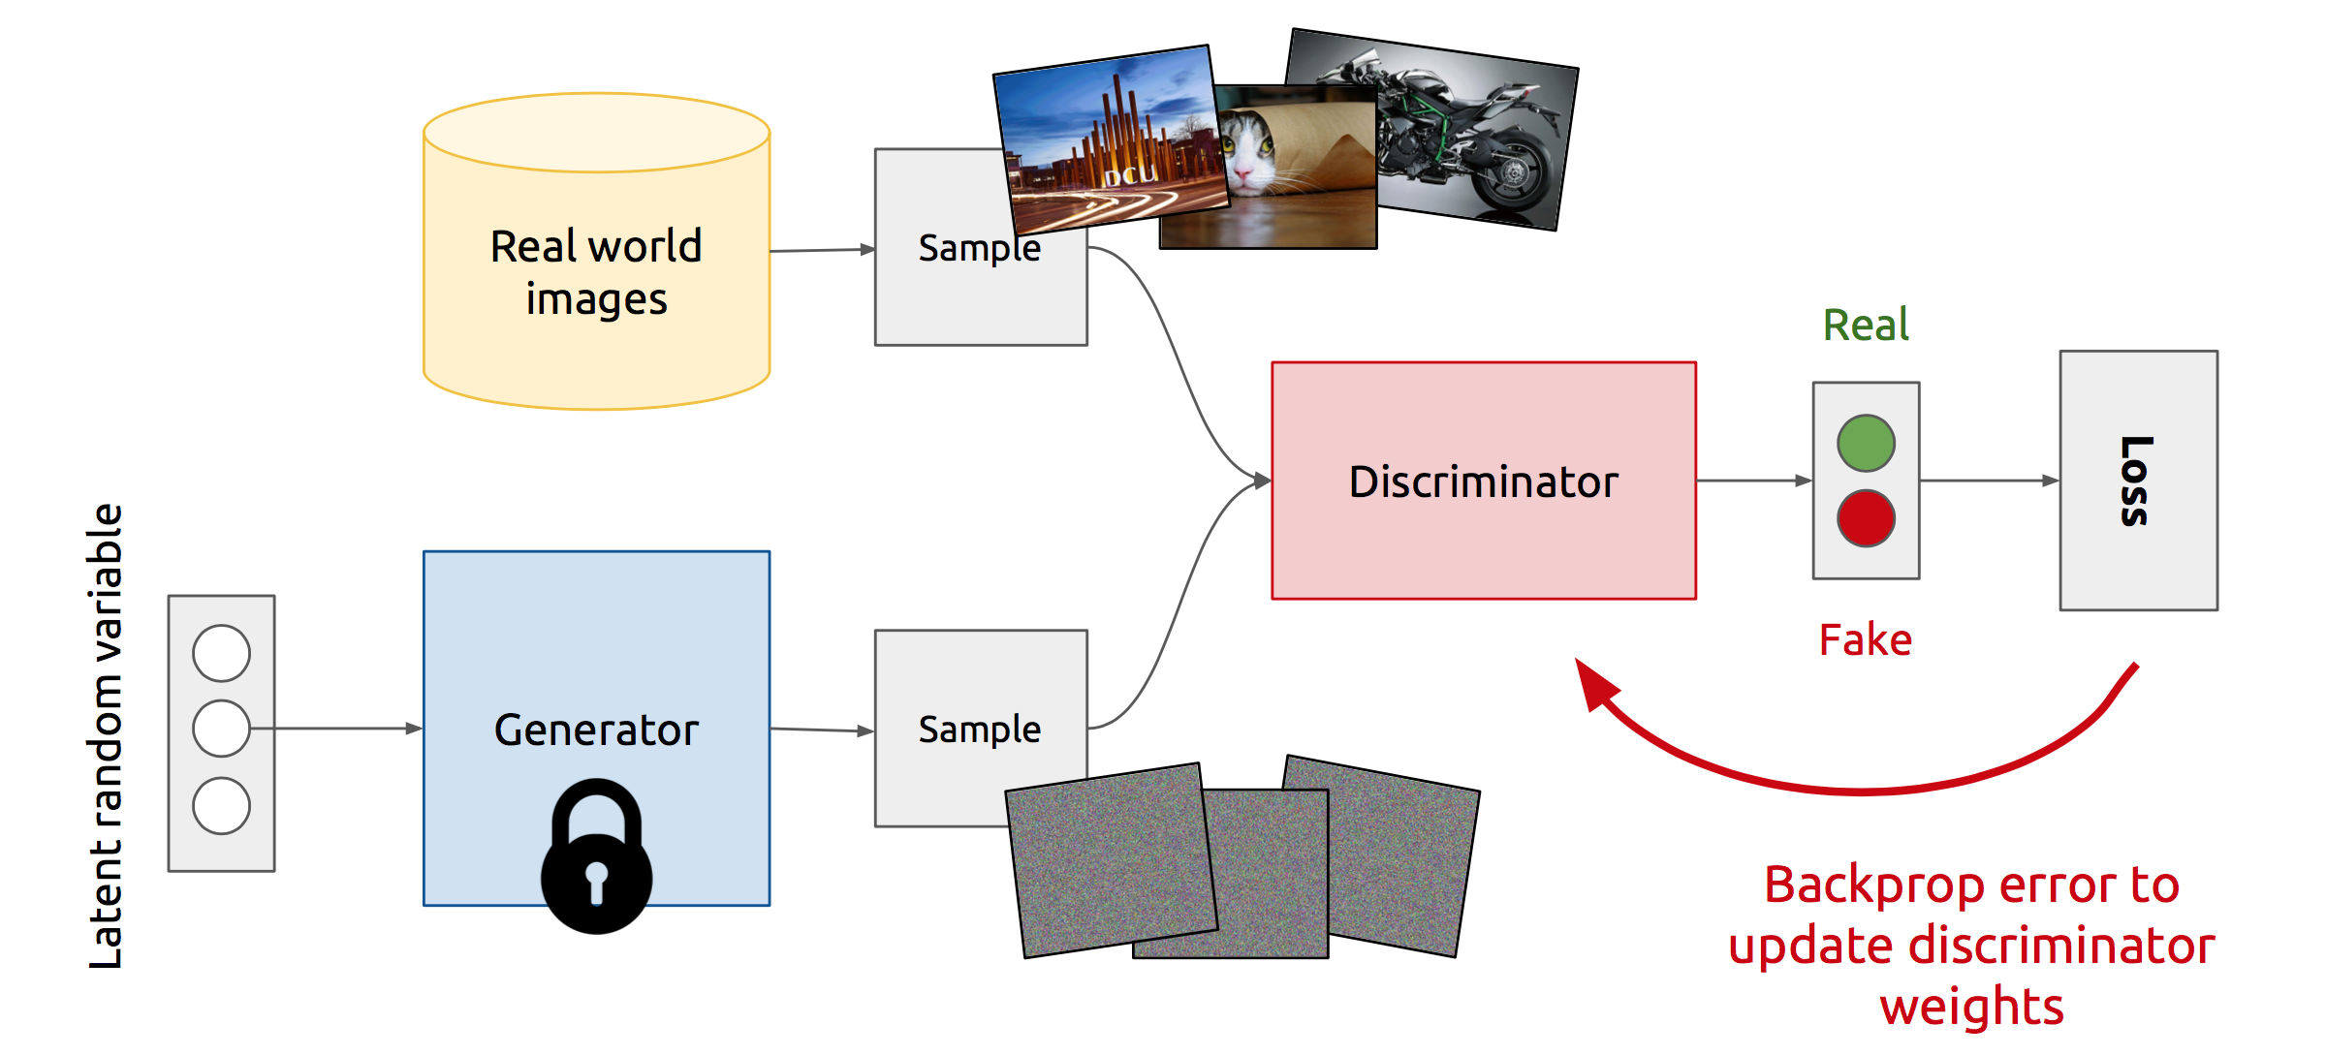
Training Discriminator
Agent D changes its actions to maximize payoff (minimize loss)
Notes:
So, this is how GANs operate :-
At the start of the iteration, a true example is selected and passed through the discriminator. The discriminator outputs the probability of it being a real example, calculate its loss, and update its weights while keeping the generator weights as constant.

Slide 46
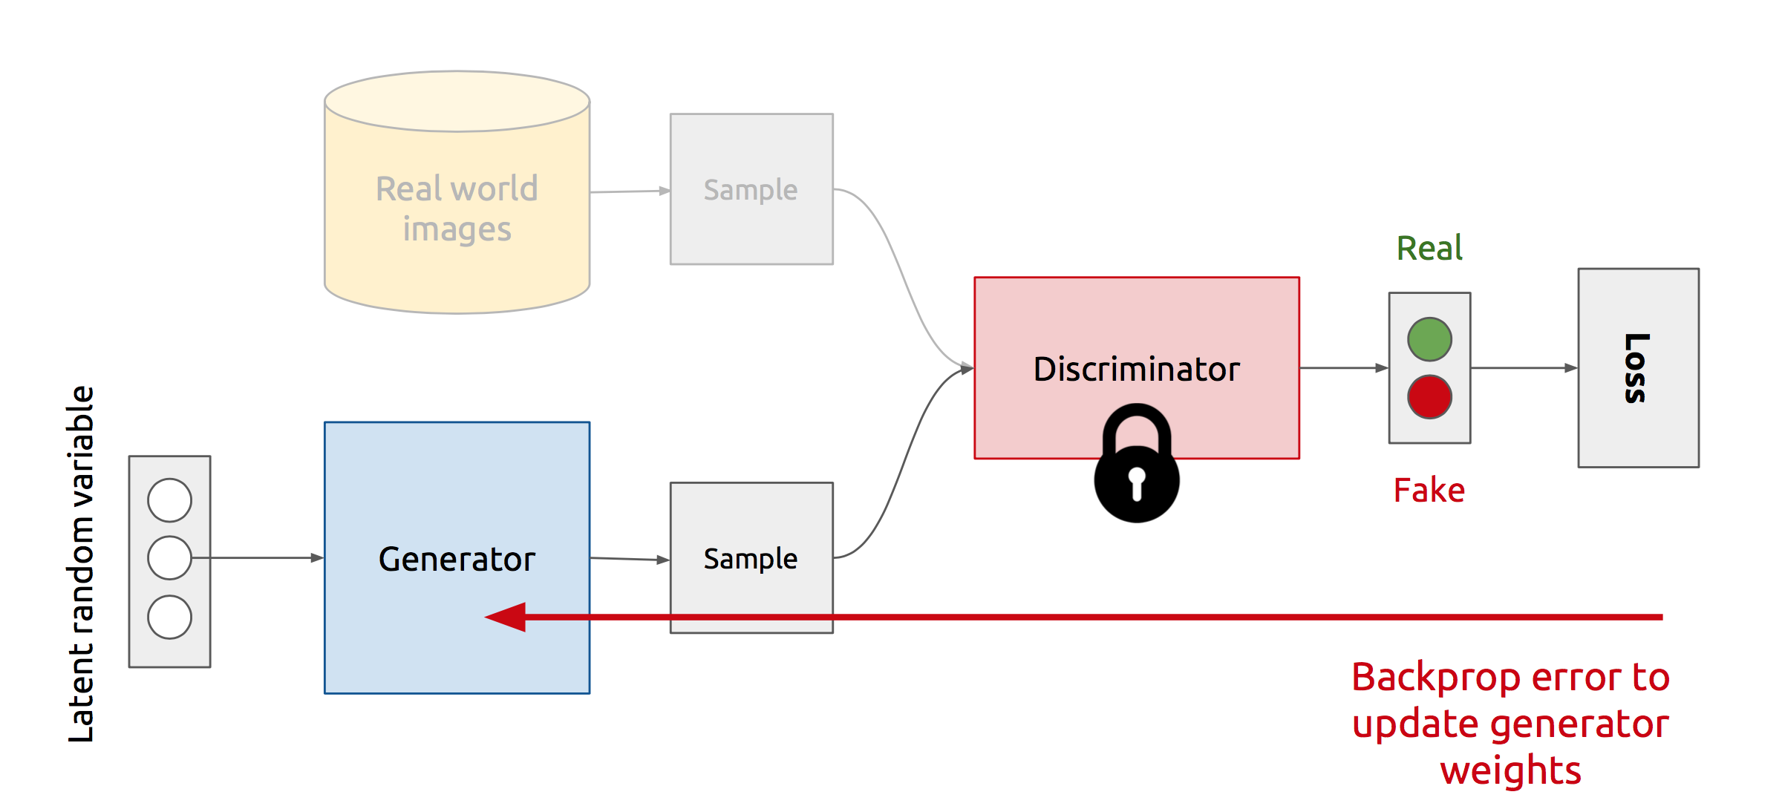
Training Generator
Agent G changes its actions to maximize payoff (minimize loss)
Do not change action, if other agent does not change action: Nash Equil. computed
Notes:
Now :-
Generator selects a random noise z, passes it through the generator network to generate a fake image, and then passes it through the discriminator network to output the probability of it being fake. It then calculates its loss, and update its weights while keeping the discriminator’s weights as constant
And we repeat this process of Alternate updates.
Act as complicated loss function.

Slide 47
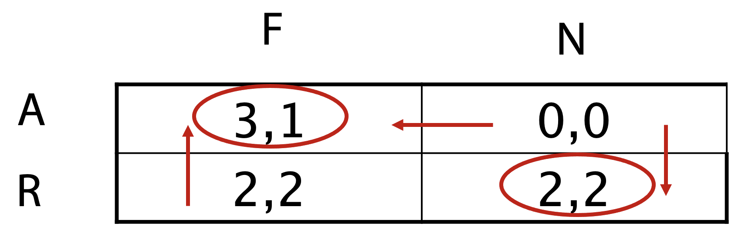
Example: Cuban Missile Crisis – Credible Threats
Nuke
0, 0
Kennedy
Arm
Khrushchev
Fold
3, 1
2, 2
Retract
Pure strategy Nash equilibria:
(Arm, Fold) and (Retract, Nuke) if
Kennedy ever was in a position to react
Proper case distinction: If Krushchev did arm,
it would not be a good idea for Kennedy to nuke
Pure strategy subgame perfect equilibria: (Arm, Fold)
In case of Khrushchev doing a proper case distinction:
Kennedy’s Nuke threat is not credible
[Reinhard Selten 72]

Slide 48
Example: Markets – Credible Threats
Prince war
0, 0
Company 2
In
Company 1
3, 1
2, 2
Out
Extract effort of case distinctions pays off
[Reinhard Selten 72]

Slide 49
Intelligent Agents
Game Theory and Social Choice
Ralf Möller
Universität zu Lübeck
Institut für Informationssysteme

Slide 50
Social Choice Theory
Assume a group of agents make a decision
Agents have preferences over alternatives
  Agents can rank order the outcomes:
    a>b>c=d is read as “a is preferred to b
    which is preferred to c which is equivalent to d”
Voters are sincere
  They truthfully tell their preferences
Outcome is enforced on all agents

Slide 51
The problem
Majority decision:
  If more agents prefer a to b, then a should be chosen
Two-outcome setting is easy
  Choose outcome with more votes!
What happens if you have
3 or more possible outcomes?

Slide 52

Case 1: Agents specify their top preference
Ballot
X

Slide 53
Election System
Plurality Voting
  One name is ticked on a ballot
  One round of voting
  One candidate is chosen
Is this a “good” system?
What do we mean by good?

Slide 54
Example: Plurality
3 candidates
  Lib, NDP, C
21 voters with the preferences
  10 Lib>NDP>C
  6 NDP>C>Lib
  5 C>NDP>Lib
Result: Lib 10, NDP 6, C 5
  But a majority of voters (11) prefer all other parties more than the Libs!

Slide 55
What can we do?
Majority system
  Works well when there are 2 alternatives
  Not great when there are more than 2 choices
Proposal:
  Organize a series of votes between 2 alternatives at a time
  How this is organized is called an agenda
    Or a cup (often in sports)

Slide 56
Agendas
3 candidates {a,b,c}
Agenda a,b,c
Majority vote between a and b
a
b
c
Chosen candidate

Slide 57
Agenda paradox
Binary protocol (majority rule) = cup
Three types of agents:
x > z > y (35%)
y > x > z (33%)
z > y > x (32%)
x
y
z
x
z
y
y
z
x
y
x
z
z
y
x
Power of agenda setter (e.g., chairman)
Vulnerable to irrelevant alternatives (z)
  x vs. y only lets y win
  But adding z may lead to y winning (last agenda)

Slide 58
Another problem: Pareto dominated winner paradox
Agents:
x > y > b > a
a > x > y > b
b > a > x > y
x
a
b
y
a
b
BUT
Everyone prefers x to y!
y

Slide 59
Case 2: Agents specify their complete preferences
Maybe the problem was with the ballots!
Ballot
X>Y>Z
Now have more information

Slide 60
Condorcet
Proposed the following
  Compare each pair of alternatives
  Declare “a” is socially preferred to “b” if more voters strictly prefer a to b
Condorcet Principle: If one alternative is preferred to all other candidates then it should be selected
Wikipedia: Condorcet voting methods are named for the 18th-century French mathematician and philosopher Marie Jean Antoine Nicolas Caritat, the Marquis de Condorcet, who championed such voting systems. However, Ramon Llull devised the earliest known Condorcet method in 1299.

Slide 61
Example: Condorcet
3 candidates
  Lib, NDP, C
21 voters with the preferences
  10 Lib>NDP>C
  6 NDP>C>Lib
  5 C>NDP>Lib
Result:
  NDP win! (11/21 prefer them to Lib, 16/21 prefer them to C)

Slide 62
A Problem
3 candidates
  Lib, NDP, C
3 voters with the preferences
  Lib>NDP>C
  NDP>C>Lib
  C>Lib>NDP
Result:
  No Condorcet Winner
Lib
NDP
C

Slide 63
Borda Count
Each ballot is a list of ordered alternatives
On each ballot compute the rank of each alternative
Rank order alternatives based on sum of their ranks
(lowest rank preferred)
A>B>C
A>C>B
C>A>B
A: 4
B: 8
C: 6
Wikipedia: Jean-Charles de Borda devised the system in June 1770, as a fair way to elect members to the French Academy of Sciences. The ideas were also propsed earlier.

Slide 64
Borda Count
Simple
Always a Borda Winner
BUT does not always choose Condorcet winner!
3 voters
  2: b>a>c>d
  1: a>c>d>b
Borda scores:
a:5, b:6, c:8, d:11
Therefore a wins
BUT b is the Condorcet winner

Slide 65
Inverted-order paradox
Borda rule with 4 alternatives
  Each agent gives 1 point to best option, 2 to second best...
Agents:
x=13, a=18, b=19, c=20
Remove x: c=13, b=14, a=15
x > c > b > a
a > x > c > b
b > a > x > c
x > c > b > a
a > x > c > b
b > a > x > c
x > c > b > a

Slide 66
Borda rule vulnerable to irrelevant alternatives
Three types of agents:
Borda winner is x
Remove z: Borda winner is y
x > z > y (35%)
y > x > z (33%)
z > y > x (32%)

Slide 67
Desirable properties for a voting protocol
No dictators
Universality (unrestricted domain)
  It should work with any set of preferences
Non-imposition (citizen sovereignty)
  Every possible societal preference order should be achievable
Independence of irrelevant alternatives (IIA)
  The comparison of two alternatives should depend only on their standings among agents’ preferences, not on the ranking of other alternatives
Monotonicity
  An individual should not be able to hurt an option by ranking it higher.
Paretian
  If all all agents prefer x to y then in the outcome x should be preferred to y

Slide 68
Arrow’s Theorem (1951)
If there are 3 or more alternatives and a finite number of agents then there is no protocol which satisfies all desired properties

Slide 69
Proof of Arrow’s theorem (slide 1 of 3)
Follows [Mas-Colell, Whinston & Green, 1995]
Assuming G is Paretian and independent of irrelevant alternatives, we show that G is dictatorial
Def. Set S ⊆ A is decisive for x over y whenever
  x >_{i} y for all i ∈ S
  x < _{i} y for all i ∈ A-S
  => x > y
Lemma 1. If S is decisive for x over y, then for any other candidate z, S is decisive for x over z and for z over y
Proof. Let S be decisive for x over y. Consider: x >_{i} y >_{i} z for all i ∈ S and y >_{i} z >_{i} x for all i ∈ A-S
  Since S is decisive for x over y, we have x > y
  Because y >_{i} z for every agent, by the Pareto principle we have y > z
  Then, by transitivity, x > z
  By independence of irrelevant alternatives (y), x > z whenever every agent in S prefers x to z and every agent not in S prefers z to x. I.e., S is decisive for x over z
To show that S is decisive for z over y, consider: z >_{i} x >_{i} y for all i ∈ S and y >_{i} z >_{i} x for all i ∈ A-S
  Then x > y since S is decisive for x over y
  z > x from the Pareto principle and z > y from transitivity
  Thus S is decisive for z over y 

Slide 70
Proof of Arrow’s theorem (slide 2 of 3)
Given that S is decisive for x over y, we deduced that S is decisive for x over z and z over y.
Now reapply Lemma 1 with decision z over y as the hypothesis and conclude that
  S is decisive for z over x
  which implies (by Lemma 1) that S is decisive for y over x
  which implies (by Lemma 1) that S is decisive for y over z
  Thus: Lemma 2. If S is decisive for x over y, then for any candidates u and v, S is decisive for u over v (i.e., S is decisive)
Lemma 3. For every S ⊆ A, either S or A-S is decisive (not both)
Proof. Suppose x >_{i} y for all i ∈ S and y >_{i} x for all i ∈ A-S (only such cases need to be addressed, because otherwise the left side of the implication in the definition of decisiveness between candidates does not hold). Because either x > y or y > x, S is decisive or A-S is decisive 

Slide 71
Proof of Arrow’s theorem (slide 3 of 3)
Lemma 4. If S is decisive and T is decisive, then S ∩ T is decisive
Proof.
  Let S = {i: z >_{i} y >_{i} x } ∪ {i: x >_{i} z >_{i} y }
  Let T = {i: y >_{i} x >_{i} z } ∪ {i: x >_{i} z >_{i} y }
  For i ∉ S ∪ T, let y >_{i} z >_{i} x
  Now, since S is decisive, z > y
  Since T is decisive, x > z
  Then by transitivity, x > y
  So, by independence of irrelevant alternatives (z), S ∩ T is decisive for x over y.
    (Note that if x >_{i} y, then i ∈ S ∩ T.)
  Thus, by Lemma 2, S ∩ T is decisive 
Lemma 5. If S = S₁ ∪ S₂ (where S₁ and S₂ are disjoint and exhaustive) is decisive, then S₁ is decisive or S₂ is decisive
Proof. Suppose neither S₁ nor S₂ is decisive. Then ~ S₁ and ~ S₂ are decisive. By Lemma 4, ~ S₁ ∩ ~ S₂ = ~S is decisive. But we assumed S is decisive. Contradiction 
Proof of Arrow’s theorem
  Clearly the set of all agents is decisive. By Lemma 5 we can keep splitting a decisive set into two subsets, at least one of which is decisive. Keep splitting the decisive set(s) further until only one agent remains in any decisive set. That agent is a dictator. QED

Slide 72
Stronger version of Arrow’s theorem
In Arrow’s theorem, social choice functional G outputs a ranking of the outcomes
The impossibility holds even if only the highest ranked outcome is sought:
Thrm. Let |O | ≥ 3. If a social choice function f: R -> outcomes is monotonic and Paretian, then f is dictatorial
  f is monotonic if [ x = f(R) and x maintains its position in R’ ] => f(R’) = x
  x maintains its position whenever x >_{i} y => x > _{i}’ y

Slide 73
Take-home Message
Despair?
  No ideal voting method
  That would be boring!
A group is more complex than an individual
Weigh the pro’s and con’s of each system and understand the setting they will be used in
Do not believe anyone who says they have the best voting system out there!

