Slide 1
Intelligent Agents
Negotiation and Rules of Encounter
Prof. Dr. Ralf Möller
Universität zu Lübeck
Institut für Informationssysteme

Slide 2
Strategies of Agents and Game Theory
Given a set of agents, their preferences, and an agreed protocol, the final ingredient is the agent’s strategy
The strategy may specify what oﬀer to make next or what information to reveal (truthfully or not)
A rational agent’s strategy must aim to achieve the best possible outcome for him/her
Game-theory is used to analyze agents’ strategic behavior
Discussed optimal strategies for auctions last time
Multi-Agent Systems, Negotiation, Silvia Rossi

Slide 3
Negotiation, Bargaining Problems
Auctions are only concerned with the
allocation of goods
Negotiation is the process of
reaching agreements on matters of common interest (bargaining problem)
  E.g., who does what?

Slide 4
Negotiation, Mechanisms, Strategies, Deals
Negotiations governed by mechanism (or protocol)
  Rules of encounter between the agents
  Public rules by which the agents will come to agreements
  Strategies that agents should use
  Deals that can be made
  Sequence of offers and counter-offers that can be made
Negotiations can involve
  Exchange of information (cf. value of information)
  Relaxation of initial goals
  Mutual concession (e.g., concerning division of labor)

Slide 5
Negotiation in Applications
Fosuc on TODs
Task-oriented domains (TOD)
  Each agent is associated with a set of tasks
  (e.g., web mining tasks)
  Goal: redistribute tasks such that overall costs of
  completing the tasks is reduced/minimized
State-oriented domains (SOD ⊇ TOD)
  Each agent has a set of goal states it would like to achieve
  Use negotiation to achieve a common goal (actions can have positive or negative side effects)
Worth-oriented domains (WOD ⊇ SOD)
  Agents assign worth to state (agent-local utility)
  Goal: maximize mutual worth / compromise on goals

Slide 6
How many agents?
One to one
One to many
(auction as an example of one seller and many buyers)
Many to many (could be divided into buyers and sellers, or all could be identical in role – like officemate)
  n(n-1)/2 number of pairs

Slide 7
Criteria of a Negotiation Protocols
Efficiency
  Do not waste utility (compute optimal solution)
Stability
  No agent has an incentive to deviate from dominant strategy
Simplicity
  Low computational demands on agents (e.g., no counter-speculation required → "dominant strategy" exists)
Distribution
  No central decision maker
Symmetry (possibly)
  May not want agents to play different roles

Slide 8
Negotiation Process
Negotiation usually proceeds in a series of rounds, with every agent making a proposal at every round.
Communication during negotiation:
Another way
of looking at the
negotiation process:
Who ”moves” the farthest
Proposal
Counter Proposal
Agenti concedes
Agenti
Agentj
Proposals by A_{i}
Point of
Acceptance/
aggreement
Proposals by A_{j}

Slide 9
Types of Deals
Conflict: Keep the same tasks as had originally
Pure: Divide up tasks
Mixed: Divide up the tasks, but decide probabilistically who should do what
All or Nothing (A/N): Mixed deal, with added requirement that we only have all or nothing deals
(one of the tasks sets is empty)

Slide 10
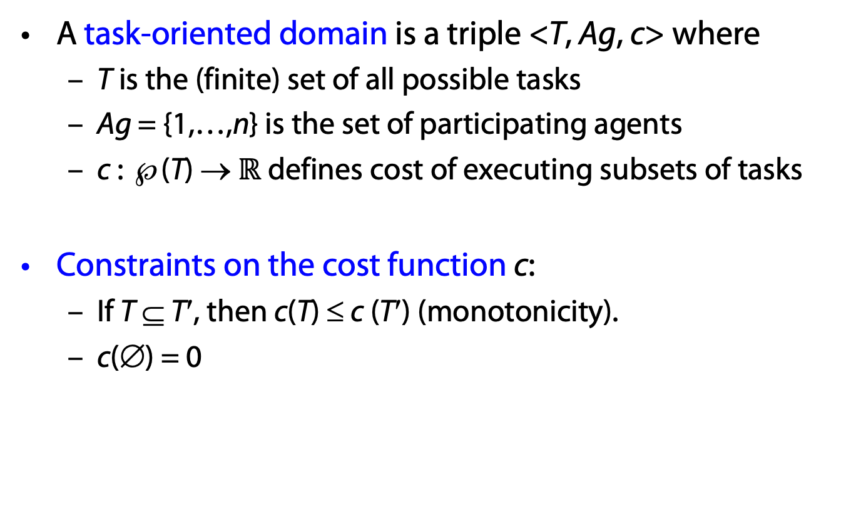
Task-Oriented Domain (TOD)
A task-oriented domain is a triple <T, Ag, c> where
  T is the (finite) set of all possible tasks
  Ag = {1,…,n} is the set of participating agents
  c : ℘(T) → $ℝ$ defines cost of executing subsets of tasks
Constraints on the cost function c:
  If T ⊆ T′, then c(T) ≤ c (T′) (monotonicity).
  c(∅) = 0

Slide 11
The Case of Two Agents
Let (T₁, T₂) be the original tasks of two agents and
let δ = (D₁, D₂) be a new task allocation ( a deal ), i.e.,
T₁ ∪ T₂ = D₁ ∪ D₂
An agent i’s utility of a deal δ is defined as follows:
utility_{i}(δ) = c(T_{i}) – c(D_{i})
δ₁ dominates δ₂ when one agent is better off
and none is worse off
Pareto optimal deals: non-dominated deals

Slide 12
TOD: Postmen Domain
Post Office
1
2
a
Payment per letter
but trip costs subtracted
/
/
b
c
/
/
Special case
Delivery Domain (postmen don’t have to return to post office)
f
/
d
e

Slide 13
TOD: Database/Web Mining Domain
Common Database
“All female employees
making over $50,000 a
year.”
“All female employees
with more than three
children.”
2
1

Slide 14
TOD: Fax Domain
1
2
faxes to
send
a
b
c
Cost is
only to
establish
connection
f
d
e

Slide 15
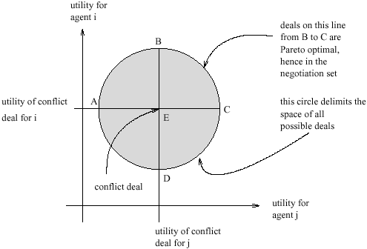
The Negotiation Set Illustrated

Slide 16
Negotiation Set
The negotiation set consists of the deals that are Pareto efficient and individual rational
  A deal is Pareto efficient (Pareto optimal) if it is not dominated by another task allocation
  A deal is individual rational if neither agent is worse off than in the original allocation (the ‘conflict deal’)
Negotiation set
Extra utility of agent 2
Individual rational
Extra utility of agent 1
Conflict deal

Slide 17
Monotonic Concession Protocol
δ₂¹
δ₂²
Extra utility of agent 2
δ₁²
δ₁¹
Extra utility of agent 1
Utility of confllict deal

Slide 18
Monotonic Concession Protocol
Both agents make several small concessions until an agreement is reached.
  Each agent proposes a deal
  If one agent matches or exceeds what the other demands, the negotiation ends
  Else, each agent makes a proposal that is equal or better for the other agent (concede)
If no agent concedes, the negotiation ends with the conflict deal

Slide 19
Monotonic Concession Protocol
What is a good negotiation strategy
for the Monotonic Concession Protocol?
Consider danger of getting it wrong:
  If you concede too often (or too much), then you risk not getting the best possible deal for yourself.
  If you do not concede often enough, then you risk conflict (which has utility 0).

Slide 20
Zeuthen Strategy
Idea: Analyse willingness to risk conflict
δ₂
Extra utility of agent 2
δ₁
Extra utility of agent 1
The strategy was introduced in 1930 by the Danish economist Frederik Zeuthen.

Slide 21
Zeuthen Strategy
Start with deal that is best among all deals in the negotiation space for yourself
Calculate willingness to risk conflict of self and opponent
If willingness to risk conflict is smaller than opponent, offer minimal sufficient concession (a sufficient concession makes opponent’s willingness to risk conflict less than yours); else offer original deal

Slide 22
Game-Theoretic Analysis
A bargaining problem is defined as a pair (S, d)
  S is bargaining set, that is the set of all utility pairs resulting from an agreement
  d is the disagreement point where each agent i gets u_{i}(d) even if there is no agreement
A bargaining solution is a function f that maps every barging problem (S, d) to an outcome in S, i.e., f(S,d)-> S
A Nash solution is defined as follows:
Nash product
Multi-Agent Systems, Negotiation, Silvia Rossi

Slide 23
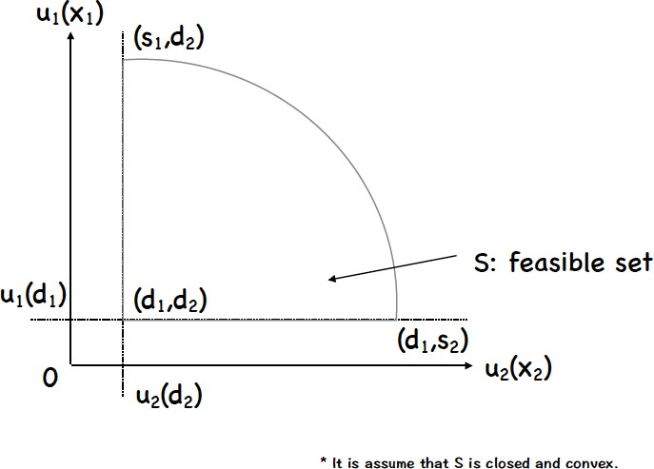
Multi-Agent Systems, Negotiation, Silvia Rossi

Slide 24
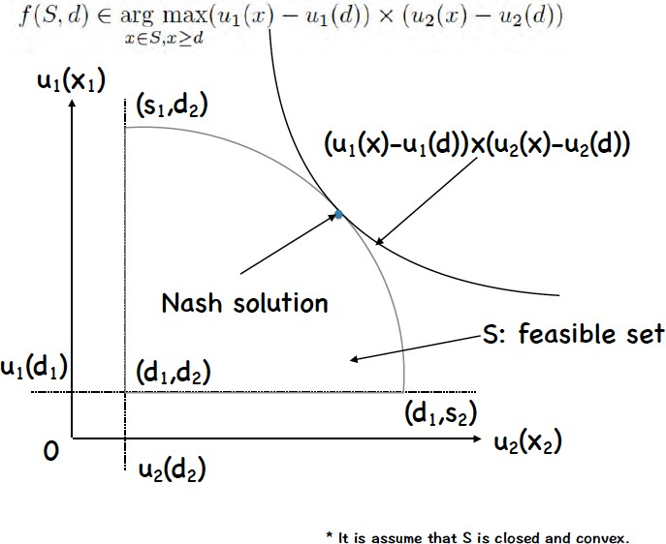
Multi-Agent Systems, Negotiation, Silvia Rossi

Slide 25
Nash Solution
Nash proved that the solution that satisfies the five axioms below is a (unique) Nash solution:
  Axiom 1 (Individual Rationality) : Each agent can get at least disagreement point: f(S,d) ≥ d
  Axiom 2 (Symmetry) : The solution is independent form agent’s name, like A or B
  Axiom 3 (Pareto Optimality)
  Axiom 4 (Invariance from Affine Transformation) : The solution should not change as a result of linear changes to the utility for either agent
  Axiom 5 (Independence of Irrelevant Alternatives) : Eliminating feasible alternatives that are not chosen should not aﬀect the solution. Namely,
Multi-Agent Systems, Negotiation, Silvia Rossi

Slide 26
Negotiation Protocols
Agents use a product-maximizing negotiation protocol
It should be a symmetric PMM
(product maximizing mechanism)
Examples
  1-step protocol (e.g., second price sealed bid)
  Monotonic concession protocol
Multi-Agent Systems, Negotiation, Silvia Rossi

Slide 27
Summary: Monotonic Concession Protocol
Properties
  Termination: guaranteed if the agreement space is finite
  Verifiability: easy to check that an opponent really concedes (only one’s own utility function matters)
Criticism
  You need to know your opponent’s utility function to be able to concede (typical assumption in game theory; not always appropriate)

Slide 28
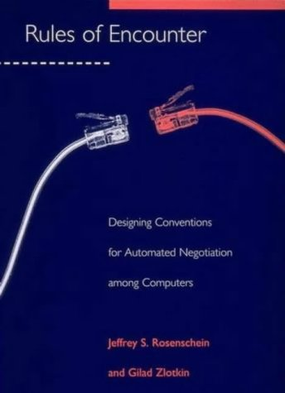
Automated Negotiation among Agents: TOD
Tasks of other agents not necessarily known
Jeffrey S. Rosenschein and Gilad Zlotkin. Rules of encounter: Designing Conventions for Automated Negotiation among Computers. MIT Press. 1994.
Jeffrey S. Rosenschein and Gilad Zlotkin
Designing Conventions for Automated Negotiation
AI Magazine Volume 15 Number 3. 1994.

Slide 29
Negotiation with Incomplete Information
Post Office
1
/
h
a
b
1
2
g
c
What if the agents don’t know each other’s letters?
f
e
d
/
/
1
2

Slide 30
Pre-Game: Broadcast Tasks
Post Office
1
b, f
/
h
a
b
1
e
2
g
c
Agents will flip a coin to decide who delivers all the letters
f
e
d
/
/
1
2

Slide 31
Hiding Letters
Post Office
1
f
b
/
h
a
b
(1)
e
(hidden)
2
g
c
f
e
d
/
/
They then agree that Agent 2 delivers to f and e
1
2

Slide 32
Another Possibility for Deception
Post Office
b, c
1
a
b, c
2
c
b
/
/
1, 2
Agents will agree to flip a coin to decide who goes to b and who goes to c
1, 2

Slide 33
Phantom Letter
Post Office
b, c, d
1
a
b, c
2
c
b
/
/
1, 2
They agree that Agent 1 goes to c
1, 2
/
d
1 (phantom)

Slide 34
Negotiation over Mixed Deals
Mixed deal <D₁, D₂> : p
  Agent 1 will perform D₁ with probability p and D₂ with probability 1-p, and vice versa.
Agents need to reason about expected utility
The more burden initially, the more burden in the final deal
Theorem:
With mixed deals, agents can always agree on the “all-or-nothing” deal where D₁ is T₁ ∪ T₂ and D₂ is the empty set, and p := 0.5 | T’₁ | / | T’₁ ∪ T’₂ |
where T_{i}’ is the announced task of agent i and |.| denotes the #steps
By adding probabilities, the deal space has become continuous

Slide 35
Hiding Letters with Mixed All-or-Nothing Deals
Post Office
1
f
b
/
h
a
b
e
(1)
2
(hidden)
g
c
They will agree on the mixed deal where Agent 1 has a 3/8 chance of delivering to
f and e
f
e
d
/
/
1
2

Slide 36
Phantom Letters with Mixed Deals
Post Office
b, c, d
1
a
b, c
2
c
b
/
1, 2
They will agree on the mixed deal where Agent 1 has 3/4 chance of delivering all letters, lowering his expected utility
/
1, 2
/
d
1 (phantom)

Slide 37
Sub-Additive TODs
TOD < T, Ag, c > is sub-additive if for all finite sets of tasks X, Y in T we have:
c(X ∪ Y) ≤ c(X) + c(Y)

Slide 38
Sub-Additivity
X
Y
c(X ∪ Y) ≤ c(X) + c(Y)

Slide 39
Sub-Additive TODs
The Postmen Domain, Database Domain,
and Fax Domain are sub-additive
“Delivery Domain”
(where postmen don’t have to return to the Post Office) is not sub-additive
/
/

Slide 40
Incentive Compatible Mechanisms
Sub-Additive
A mechanism is called incentive-compatible (IC) if every participant can achieve the best outcome to themselves just by acting according to their true preferences
Hidden
Phantom
Pure
L
L
A/N
T
T/P
Mix
L
T/P
L means “there exists a beneficial lie in some encounter”
T means “truth telling is dominant, there never exists a beneficial lie, for all encounters”
T/P means “truth telling is dominant, if a discovered lie carries a sufficient penalty”
A/N signifies all-or-nothing mixed deals

Slide 41
Incentive Compatible Mechanisms
/
a
h
a
b
(1)
c
(hidden)
/
g
c
Sub-Additive
b
/
1, 2
f
e
d
Hidden
Phantom
1, 2
/
d
/
/
1
(phantom)
1
2
Pure
L
L
A/N
T
T/P
Mix
L
T/P
Theorem: For all encounters in all sub-additive TODs, when using a PMM over all-or-nothing deals, no agent has an incentive to hide a task.
product-maximizing mechanism (PMM)

Slide 42
Incentive Compatible Mechanisms
Hidden
Phantom
Pure
L
L
A/N
T
T/P
Mix
L
T/P
Explanation of the up-arrow:
If it is never beneficial in a mixed deal encounter to use a phantom lie (with penalties), then it is certainly never beneficial to do so in an all-or-nothing mixed deal encounter (which is just a subset of the mixed deal encounters)

Slide 43
Decoy Tasks
Decoy tasks, however, can be beneficial even with all-or-nothing deals
1
/
/
2
1
/
1
/
2
Sub-Additive
/
/
Hidden
Phantom
Decoy
1
1
Pure
L
L
L
A/N
T
T/P
L
Mix
L
T/P
L
Decoy lies are simply phantom lies where the agent is able to manufacture the task (if necessary) to avoid discovery of the lie by the other agent.

Slide 44
Decoy Tasks
Sub-Additive
Hidden
Phantom
Decoy
Pure
L
L
L
A/N
T
T/P
L
Mix
L
T/P
L
Explanation of the down arrow:
If there exists a beneficial decoy lie in some all-or-nothing mixed deal encounter, then there certainly exists a beneficial decoy lie in some general mixed deal encounter (since all-or-nothing mixed deals are just a subset of general mixed deals)

Slide 45
Decoy Tasks
Sub-Additive
Hidden
Phantom
Decoy
Pure
L
L
L
A/N
T
T/P
L
Mix
L
T/P
L
Explanation of the horizontal arrow:
If there exists a beneficial phantom lie in some pure deal encounter, then there certainly exists a beneficial decoy lie in some pure deal encounter (since decoy lies are simply phantom lies where the agent is able to manufacture the task if necessary)

Slide 46
Concave TODs
TOD < T, Ag, c > is concave if for all finite sets of tasks Y and Z in T , and X ⊆ Y, we have:
c(Y ∪ Z) – c(Y) ≤ c(X ∪ Z) – c(X)
Concavity implies sub-additivity

Slide 47
Concavity
Z
Y
X
The cost Z adds to X is more than the cost it adds to Y.
(Z - X is a superset of Z - Y)

Slide 48
Concave TODs
The Database Domain and Fax Domain are concave (not the Postmen Domain, unless restricted to trees).
Z
1
/
This example is not concave:
Z adds 0 to X, but adds 2 to its superset Y (all blue nodes)
/
2
X
1
/
1
/
2
/
/
1
1

Slide 49
Three-Dimensional Incentive Compatible Mechanism Table
Theorem: For all encounters in all concave TODs, when using a PMM over all-or-nothing deals, no agent has any incentive to lie.
Concave
Hidden
Phantom
Decoy
Pure
L
L
L
A/N
T
T
T
Mix
L
T
T
Sub-Additive
Hidden
Phantom
Decoy
Pure
L
L
L
A/N
T
T/P
L
product-maximizing mechanism (PMM)
Mix
L
T/P
L

Slide 50
Modular TODs
TOD < T, Ag, c > is modular if for all finite sets of tasks X, Y in T we have:
c(X ∪ Y) = c(X) + c(Y) – c(X ∩ Y)
Modularity implies concavity

Slide 51
Modularity
X
Y
c(X ∪ Y) = c(X) + c(Y) – c(X ∩ Y)

Slide 52
Modular TODs
The Fax Domain is modular (not the Database Domain nor the Postmen Domain, unless restricted to a star topology).
Even in modular TODs, hiding tasks can be beneficial in general mixed deals

Slide 53
Three-Dimensional Incentive Compatible Mechanism Table
Modular
H
P
D
Pure
L
T
T
Concave
A/N
T
T
T
H
P
D
Mix
L
T
T
Pure
L
L
L
Sub-Additive
A/N
T
T
T
H
P
D
Mix
L
T
T
Pure
L
L
L
A/N
T
T/P
L
Mix
L
T/P
L

Slide 54
Related Work
Similar analysis made of State Oriented Domains,
but the situation is more complicated
Coalitions (more than two agents, Kraus, Shechory)
Mechanism design (Sandholm, Nisan, Tennenholtz, Ephrati, Kraus)
Other models of negotiation (Kraus, Sycara, Durfee, Lesser, Gasser, Gmytrasiewicz)
Consensus mechanisms, voting techniques, economic models (Wellman, Ephrati)

Slide 55
Summary
By appropriately adjusting the rules of encounter by which agents must interact, we can influence the private strategies that designers build into their machines
The interaction mechanism should ensure the efficiency of multi-agent systems
Rules of Encounter
Efficiency

Slide 56
Summary
To maintain efficiency over time of dynamic multi-agent systems, the rules must also be stable
The use of formal tools enables the design of efficient and stable mechanisms, and the precise characterization of their properties
Stability
Formal Tools

