Slide 1
Web-Mining Agents
Computational Learning Theory
Özgür Özcep
Universität zu Lübeck
Institut für Informationssysteme

Slide 2
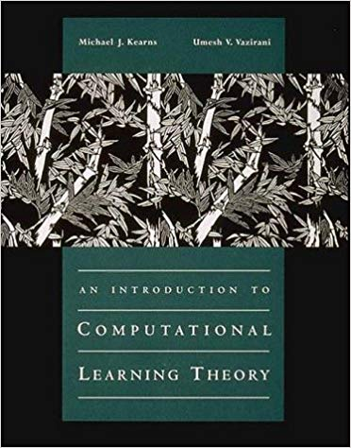
<- ÖÖ recommends;
but you can also
Look up any theoretical ML book to find
a chapter on PAC

Slide 3
Computational Learning Theory
(Adapted) Slides by Carla P. Gomes and Nathalie Japkowicz
(Reading: R&N AIMA 3rd ed., Chapter 18.5)

Slide 4
Computational Learning Theory
Inductive learning:
given the training set, a learning algorithm generates a hypothesis.
Run hypothesis on the test set. The results say something about how good our hypothesis is.
But how much do the results really tell you? Can we be certain about how the learning algorithm generalizes?
We would have to see all the examples.
Insight: introduce probabilities to measure degree of certainty and correctness (Valiant 1984).

Slide 5
Computational Learning Theory
Example:
We want to use height to distinguish men and women drawing people from the same distribution for training and testing.
We can never be absolutely certain that we have learned correctly our target (hidden) concept function. (E.g., there is a non-zero chance that, so far, we have only seen a sequence of bad examples)
E.g., relatively tall women and relatively short men…
We’ll see that it’s generally highly unlikely to see a long series of bad examples! (under a stationarity assumption)

Slide 6
Aside: flipping a coin

Slide 7
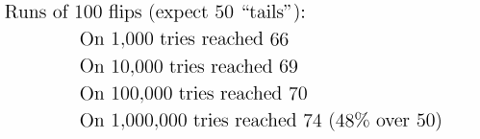
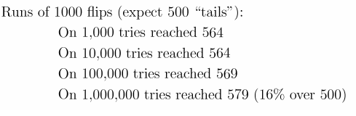
Experimental data
C program – simulation of flips of a fair coin:
i.e., in at least one of the 1000 tries of 100-flip-runs
one got 66 tails (in all other tries one got less than 66)

Slide 8
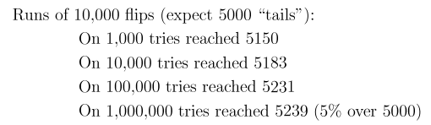
Experimental Data Contd.
With a sufficient number of flips
large outliers become quite rare.
Coin example is the key to computational learning theory!

Slide 9

Computational Learning Theory
Intersection of AI, statistics, and theory of computation.
Introduce Probably Approximately Correct Learning concerning efficient learning
For our learning procedures we would like to prove that:
With high probability an (efficient) learning algorithm will find a hypothesis that is approximately identical to the hidden target concept.
Note the double “hedging” – probably and approximately.
Why do we need both levels of uncertainty (in general)?
L. G. Valiant. A theory of the learnable. Commun. ACM, 27(11):1134–1142, Nov. 1984.
Notes:
We have to talk about the “distance” between the hypothesis and the true function (approximately correct – proportion of incorrect examples)
The probability of getting an approximately correct hypothesis (delta) (i.e. with a given proportion or less)

Slide 10
Probably Approximately
Correct Learning
Underlying principle:
Seriously wrong hypotheses can be found out almost certainly (with high probability) using a “small” number of examples
  Any hypothesis that is consistent with a significantly large set of training examples is unlikely to be seriously wrong: it must be probably approximately correct.
  Any (efficient) algorithm that returns hypotheses that are PAC is called a PAC-learning algorithm

Slide 11
Probably Approximately
Correct Learning
How many examples are needed to guarantee correctness?
  Sample complexity (# of examples to “guarantee” correctness) grows with the size of the Hypothesis space
  Stationarity assumption: Training set and test sets are drawn from the same distribution

Slide 12
Notations
ÖÖ:
Error is ``true error = generalization error‘‘ . Different from training error
True error depends on distribution D
Notations:
  X: set of all possible examples
  D: distribution from which examples are drawn
  H: set of all possible hypotheses
  N: the number of examples in the training set
  f: the true function to be learned
  Assume: the true function f is in H.
  Error of a hypothesis h wrt f :
  Probability that h differs from f on a randomly picked example:
error(h) = P(h(x) ≠ f(x)| x drawn from D)
Exactly what we are trying to measure with our test set.
Why is this measurement justified?

Slide 13
Approximately Correct
A hypothesis h is approximately correct if:
error(h) ≤ ε,
where ε is a given threshold, a small constant
Goal:
Show that after seeing a small (poly) number of examples N, with high probability, all consistent hypotheses will be approximately correct.
I.e., chance of “bad” hypothesis, (high error but consistent with examples) is small (i.e, less than δ)
ÖÖ:
Poly = polynomial in the size for repsenting the examples; e.g., for boolean functions of n variables, size would be n.

Slide 14
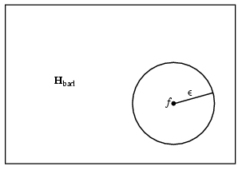
Approximately Correct
ÖÖ: Note that error depends on distribution D
Approximately correct hypotheses lie inside
the ε -ball around f;
Those hypotheses that are seriously wrong
(h_{b} ∈ H_{bad}) are outside the ε -ball,
Error(h_{b})= P(h_{b}(x) ≠ f(x)| x drawn from D) > ε,
Thus the probability that the h_{b} (a seriously wrong hypothesis) disagrees with one example is at least ε
(definition of error).
Thus the probability that the h_{b} (a seriously wrong hypothesis) agrees
with one example is no more than (1- ε).
So for N examples, P(h_{b} agrees with N examples) ≤ (1- ε )^{N}.
Notes:
Error - proportion

Slide 15
Approximately Correct Hypothesis
The probability that H_{bad} contains at least one consistent hypothesis is
bounded by the sum of the individual probabilities.
P(H_{bad} contains a consistent hypothesis, agreeing with all the examples) ≤ |H_{bad}|(1- ε )^{N} ≤ |H|(1- ε )^{N}
h_{b} agrees with one example is no more than (1- ε).

Slide 16



P(H_{bad} contains a consistent hypothesis) ≤ |H_{bad}|(1- ε )^{N} ≤ |H|(1- ε )^{N}
Goal –
Bound the probability of learning a bad hypothesis below some small number δ.
  The more accuracy (smaller ε), and
  the more certainty (with smaller δ)
  one wants, the more examples one needs.
Note:
P(H_{bad} contains a consistent hypothesis) ≤
Sample Complexity: Number of examples to
guarantee a PAC learnable function class
If the learning algorithm returns a
hypothesis that is consistent with this many
examples, then with probability at least (1-δ) the
learning algorithm has an error of at most ε.
and the hypothesis is
Probably Approximately Correct.

Slide 17
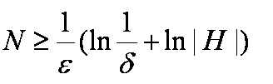
How to „abduce“ this inequality
from the one before?
Probably Approximately correct hypothesis h:
  If the probability of a small error (error(h) ≤ ε) is greater than or equal to a given threshold 1 - δ
  A bound on the number of examples (sample complexity) needed to guarantee PAC:
  (The more accuracy (with smaller ε), and the more certainty desired (with smaller δ), the more examples one needs.)
  One seeks for (computationally) efficient learning algorithms:
  sample complexity N depends only polynomially from some parameter characterizing H and one gets ε-correct hypothesis after polynomially many steps
Theoretical results apply to fairly simple learning models (e.g., decision list learning)

Slide 18
PAC Learning
ÖÖ:
Here one assumes that H contains target function f
In case f is not contained in H one talks about agnostic PAC learning.
Similar bound derivable:
N ≥ 1/(2ε²)(ln(1/δ) + ln(|H|)
Two steps:
Sample complexity – a polynomial number of examples suffices to specify a good consistent hypothesis (error(h) ≤ ε ) with high probability (≥ 1 – δ).
Computational complexity – there is an efficient algorithm for learning a consistent hypothesis from the small sample.
Let’s be more specific with examples.

Slide 19
Example:
Boolean Functions
Consider H the set of all Boolean function on n attributes→
So the sample complexity grows as 2^{n} ☹!
(same as the number of all possible examples)
Not PAC-Learnable!
So, any learning algorithm will do not better than a lookup table
if it merely returns a hypothesis that is consistent with all known examples!
Intuitively what does it say about H?
Finite H required!
(ÖÖ: or finitely representable H)

Slide 20
Coping With Learning Complexity
Force learning algorithm to look for small/simple consistent hypothesis.
  We (they, not we :), ÖÖ) considered that for Decision Tree Learning, often worst case intractable though.
Restrict size of hypothesis space.
  e.g., Decision Lists (DL) → restricted form of Boolean Functions:
  Hypotheses correspond to a series of tests, each of which is a conjunction of literals
  Good news: only a poly size number of examples
  is required for guaranteeing PAC learning K-DL functions
  (maximal K conjuncts) and there are efficient algorithms for learning K-DL

Slide 21

Decision Lists
DLs resemble Decision Trees, but with simpler structure:
Series of tests, each test a conjunction of literals;
If a test succeeds, decision list specifies value to return;
If test fails, processing continues with the next test in the list.
Forall x: Willwait(x) <-> Patrons(x,some) or (Patrons(full) & Fri/Sat(x))
No
(a) (b∧c)
Y Y N
a=Patrons(x,Some)
b=patrons(x,Full)
c=Fri/Sat(x)
Note: if we allow arbitrarily many literals per test, decision list can express all Boolean functions.
Notes:
Example from Restaurant Scenario: To learn whether one is going to wait in the restaurant: depends of number of people in restaurant and day of week.

Slide 22
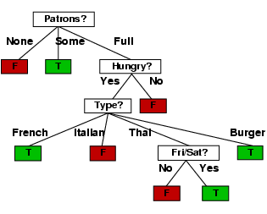
(a)
(b)
(¬d)
(e)
(f)
(h)
(i)
No
Yes
No
Yes
No
Yes
Yes
No
a=Patrons(x,None)
b=Patrons(x,Some)
d=Hungry(x)
e=Type(x,French)
f=Type(x,Italian)
g=Type(x,Thai)
h=Type(x,Burger)
i=Fri/Sat(x)

Slide 23
K Decision Lists
Decision Lists with limited expressiveness (K-DL) – at most k literals per test
K-DL is PAC learnable!!!
For fixed k literals, the number of examples needed for PAC learning a
K-DL function is polynomial in the number of attributes n.
(a) (b∧c)
Y Y N
2-DL
  There are efficient algorithms for learning K-DL functions.
So how do we show K-DL is PAC-learnable?

Slide 24
K Decision Lists:
Sample Complexity
2-DL
(x)
(y)
(w∧¬v)
(u∧¬b)
No
Yes
No
Yes
No
What’s the size of the hypothesis space H,
i.e, |K-DL(n)|?
K-Decision Lists → set of tests: each test is a conjunct of at most k literals
How many possible tests (conjuncts) of length at most k, given n attributes, conj(n,k)?
A conjunct (or test) can appear in the list as: Yes, No, absent from list
So we have at most 3 ^{|Conj(n,k)|} different K-DL lists (ignoring order)
But the order of the tests (or conjuncts) in a list matters.
|k-DL(n)| ≤ 3 ^{|Conj(n,k)|} |Conj(n,k)|!

Slide 25
After some work (ÖÖ: using Stirling formula say), we get (exercise)
1 - Sample Complexity of K-DL is:
Recall sample complexity formula
For fixed k literals, the number of examples needed for PAC learning a
K-DL function is polynomial in the number of attributes n, ☺!
2 – Efficient learning algorithm – a decision list of length k can be learned in polynomial time.
So K-DL is PAC learnable!!!

Slide 26
Decision-List-Learning Algorithm
Greedy algorithm for learning decisions lists:
→repeatedly finds a test that agrees with some subset of the training set;
adds test to the decision list under construction and removes the corresponding examples.
→uses the remaining examples, until there are no examples left, for constructing the rest of the decision list.
(Selection strategy not specified)

Slide 27
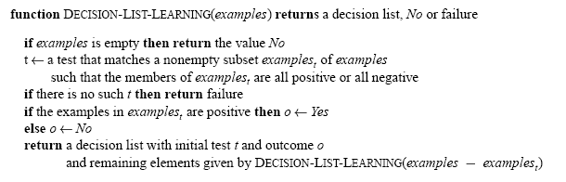
Decision-List-Learning Algorithm
Greedy algorithm for learning decisions lists:

Slide 28
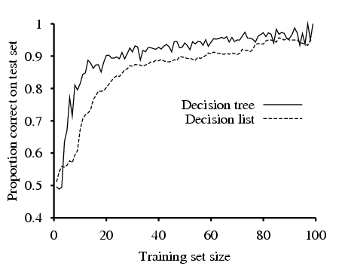
Decision-List-Learning Algorithm
ÖÖ: Here algorithm with selection strategy:
„Find smallest test set for uniformly classified subset“
Restaurant data.
Notes:
Greedy – maybe not finding the Most likely DL is quite likely not expressive enough for the

Slide 29
Examples
H space of Boolean functions: Not PAC Learnable, hypothesis space too big: need too many examples (sample complexity not polynomial)!
K-DL: PAC learnable
Conjunction of literals: PAC learnable
ÖÖ:
PAC-Learnability depends on the hypothesis space
  Sometimes using a hypothesis space different from space of target functions helps!
  E.g. k-term DNF (k disjuncts of conjuncts with n attributes) learnable with hypothesis space consisting of k-cnfs (conjunctions of arbitrary length with disjunctions up to length k)

Slide 30
Probably Approximately Correct Learning (PAC) Learning (summary)
A class of functions is said to be PAC-learnable if there exists an efficient (i.e., polynomial in size of target function, size of example instances (n), 1/ε, and 1/ δ)
Learning algorithm such that for all functions in the class, and for all
probability distributions on the function's domain, and for any values of
ε and δ (0 < ε, δ <1), using a polynomial number of
examples, the algorithm will produce a hypothesis whose error is smaller
than ε with probability at least 1-δ.
The error of a hypothesis is the probability that it will differ from the target function on a
random element from its domain, drawn according to the given probability distribution.
Basically, this means that:
there is some way to learn efficiently a "pretty good“ approximation of the target function.
the probability is as big as you like that the error is as small as you like.
(Of course, the tighter you make the bounds, the harder the learning algorithm is likely to have to work).

Slide 31
Discussion
Computational Learning Theory studies the tradeoffs between the
expressiveness of the hypothesis language and the complexity of learning
Probably Approximately Correct learning concerns efficient learning
Sample complexity --- polynomial number of examples
Efficient Learning Algorithm
Word of caution:
PAC learning results → worst case complexity results.

Slide 32
Sample Complexity for Infinite Hypothesis Spaces I: VC-Dimension
The PAC Learning framework has 2 disadvantages:
  It can lead to weak bounds
  Sample Complexity bound cannot be established for infinite hypothesis spaces (with functions having continuous domain/range, say)
We introduce new ideas for dealing with these problems:
  A set of instances S is shattered by hypothesis space H iff for every dichotomy of S there exists some hypothesis in H consistent with this dichotomy.
Nathalie Japkowicz

Slide 34

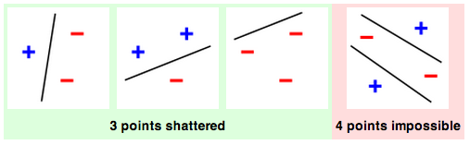
VC Dimension: Example

Slide 35
Sample Complexity for Infinite Hypothesis Spaces I: VC-Dimension
  The Vapnik-Chervonenkis dimension, VC(H),
  of hypothesis space H defined over instance space X
  is the size of the largest finite subset of X shattered by H.
  If arbitrarily large finite sets of X can
  be shattered by H, then VC(H)=∞
Nathalie Japkowicz

Slide 36
Aside:
Intuitive derivation of VC dimension
  How to define a natural notion of dimension on Hypothesis space HP(X) = {h | h: X -> {0,1}}
  Dimension should be monotone
  So define Dimension on simple/small spaces first
  Aim: Define dimension for all subsets H of HP(X)
    Simple Case (H= HP(X)): dim(H) = |X|
    (If X infinite, then dim(H) = ∞)
    Complex case (H proper subset of HP(X)):
    dim(H) = size of biggest simple subset of H
    = size of biggest subset Y of X s.t. H(Y) subset of H
    Observation: Dim(H) = VC(H)
„Making Learning less Shattering“
https://rjlipton.wordpress.com/2014/01/19/making-learning-less-shattering/

Slide 37
VC dimension and PAC Learning
  PAC Learning possible by restricting hypothesis space H
  Leads to bias
  Remember: Sample complexity for PAC learning
  With VC dimension (also applicable for infinite spaces; H_{n} subclass of hypothesis parameterized by n):
  N >=

Slide 38
VC Dimension: Example 2
H = Axis parallel rectangles in R²
What is the VC dimension of H
Can we PAC learn?
whesse@clarkson.edu

Slide 39
Learning Rectangles
Consider axis parallel rectangles in the real plane
Can we PAC learn it ?
(1) What is the VC dimension ?
Some four instances (points on the rectangle) can be shattered
Shows that VC(H)>=4
whesse@clarkson.edu
Notes:
Rectangle functions label anything within it as 1 outside it with 0

Slide 40
Learning Rectangles
Consider axis parallel rectangles in the real plane
Can we PAC learn it ?
(1) What is the VC dimension ?
But, no five instances can be shattered
Pick the topmost, bottommost, leftmost and rightmost points
and give them the label “+”. The fifth one gets -.
Cannot be shattered.
+
+
-
+
+
Therefore VC(H) = 4
whesse@clarkson.edu

Slide 41
Learning Rectangles
Consider axis parallel rectangles in the real plane
Can we PAC learn it ?
(1) What is the VC dimension ?
(2) Can we give an efficient algorithm ?
whesse@clarkson.edu

Slide 42
Learning Rectangles
Consider axis parallel rectangles in the real plane
Can we PAC learn it ?
(1) What is the VC dimension ?
(2) Can we give an efficient algorithm ?
Find the smallest rectangle that
contains the positive examples
(necessarily, it will not contain any
negative example, and the hypothesis
is consistent).
Axis parallel rectangles are efficiently PAC learnable.
Exercise: What is the VC dimension of intervals on R?
whesse@clarkson.edu

Slide 43
The Mistake Bound Model of Learning
The Mistake Bound framework is different from the PAC framework as it considers learners that receive a sequence of training examples and that predict, upon receiving each example, what its target value is.
(So, it has an incremental, online-flavor )
The question asked in this setting is: “How many mistakes M_{A} will the learner A make in its predictions before it learns the target concept?”
This question is significant in practical settings where learning must be done while the system is in actual use.
Nathalie Japkowicz

Slide 44
Optimal Mistake Bounds
Definition: Let C be an arbitrary nonempty concept class. The optimal mistake bound for C, denoted Opt(C), is the minimum over all possible learning algorithms A of M_{A}(C). Opt(C)=min_{A∈Learning_Algorithms} M_{A}(C)
Proposition: For any concept class C, the optimal mistake bound is bound as follows:
VC(C) ≤ Opt(C) ≤ log₂(|C|)
Nathalie Japkowicz

