Slide 1
Non-Standard Datenbanken und Data Mining
From Clustering to Embedding
Prof. Dr. Ralf Möller
Universität zu Lübeck
Institut für Informationssysteme

Slide 2
Übersicht
Semistrukturierte Datenbanken (JSON, XML) und Volltextsuche
Information Retrieval
Mehrdimensionale Indexstrukturen
Cluster-Bildung
Einbettungstechniken
First-n-, Top-k-, und Skyline-Anfragen
Probabilistische Datenbanken, Anfragebeantwortung, Top-k-Anfragen und Open-World-Annahme
Probabilistische Modellierung, Bayes-Netze, Anfragebeantwortungsalgorithmen, Lernverfahren,
Temporale Datenbanken und das relationale Modell,
Probabilistische Temporale Datenbanken
SQL: neue Entwicklungen (z.B. JSON-Strukturen und Arrays), Zeitreihen (z.B. TimeScaleDB)
Stromdatenbanken, Prinzipien der Fenster-orientierten inkrementellen Verarbeitung
Approximationstechniken für Stromdatenverarbeitung, Stream-Mining
Probabilistische raum-zeitliche Datenbanken und Stromdatenverarbeitungsssysteme: Anfragen und Indexstrukturen, Raum-zeitliches Data Mining, Probabilistische Skylines
Von NoSQL- zu NewSQL-Datenbanken, CAP-Theorem, Blockchain-Datenbanken

Slide 3
Acknowledgments
Slides have been taken from
  “Improving Distributional Similarity
  with Lessons Learned from Word Embeddings”
    Omer Levy, Yoav Goldberg, Ido Dagan
  Stanford CS224d: Deep Learning for NLP
    Richard Socher
  Rensselaer: Natural Language Processing
    Heng Li

Slide 4
Word-Word Associations in Document Retrieval
Recap bag-of-words approaches
  LSI: Documents as vectors, dimension reduction
Words are not independent of each other
Word similarity measures
Extend query with similar words automatically
Extend query with most frequent followers/predecessors
Insert words in anticipated gaps in a string query
Need to represent some aspects of word semantics

Slide 5
Approaches for Representing Word Semantics
Beyond bags of words
Distributional Semantics (Count)
Used since the 90’s
Sparse word-context PMI/PPMI matrix
Decomposed with SVD
Word Embeddings (Predict)
Inspired by deep learning
word2vec
(Mikolov et al., 2013)
GloVe
(Pennington et al., 2014)
Underlying Theory: The Distributional Hypothesis (Harris, ’54; Firth, ‘57)
“Similar words occur in similar contexts”
https://www.tensorflow.org/tutorials/word2vec
https://nlp.stanford.edu/projects/glove/
Notes:
There are two approaches for creating these vectors:
First, we’ve got the traditional count-based approach,
where the most common variant is the word-context PMI matrix.
The other, cutting-edge, approach, is word embeddings,
Which has become extremely popular with word2vec.
Now, the interesting thing…
…is that both approaches rely on the same linguistic theory: the distributional hypothesis.
<pause>
Now, in previous work, that I’ll talk about in a minute,
we showed that the two approaches are even more related.

Slide 6
References
Harris 54
Firth 57
Micholov et al. 13
Pennington et al. 14
Harris, Zellig. Distributional structure. Word 10(23). 146–162. 1954.
Tomas Mikolov, Ilya Sutskever, Kai Chen, Greg Corrado, and Jeffrey Dean. Distributed representations of words and phrases and their compositionality. In Proceedings of the 26th International Conference on Neural Information Processing Systems - Volume 2 (NIPS‘13). 2013.
Firth, John R. A synopsis of linguistic theory 1930–1955. In Studies in linguistic analysis, 1–32. Oxford: Blackwell. 1957.
Jeffrey Pennington, Richard Socher, and Christopher D. Manning. GloVe: Global Vectors for Word Representation. 2014.

Slide 7
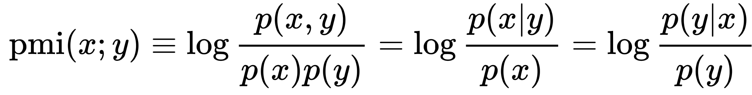
Point(wise) Mutual Information: PMI
Measure of association used in information theory and statistics
Positive PMI: PPMI(x, y) = max( pmi(x, y), 0 )
Quantifies the discrepancy between the probability of their coincidence given their joint distribution and their individual distributions, assuming independence
Finding collocations and associations between words
Countings of occurrences and co-occurrences of words in a text corpus can be used to approximate the probabilities p(x) or p(y) and p(x,y) respectively
[Wikipedia]

Slide 8
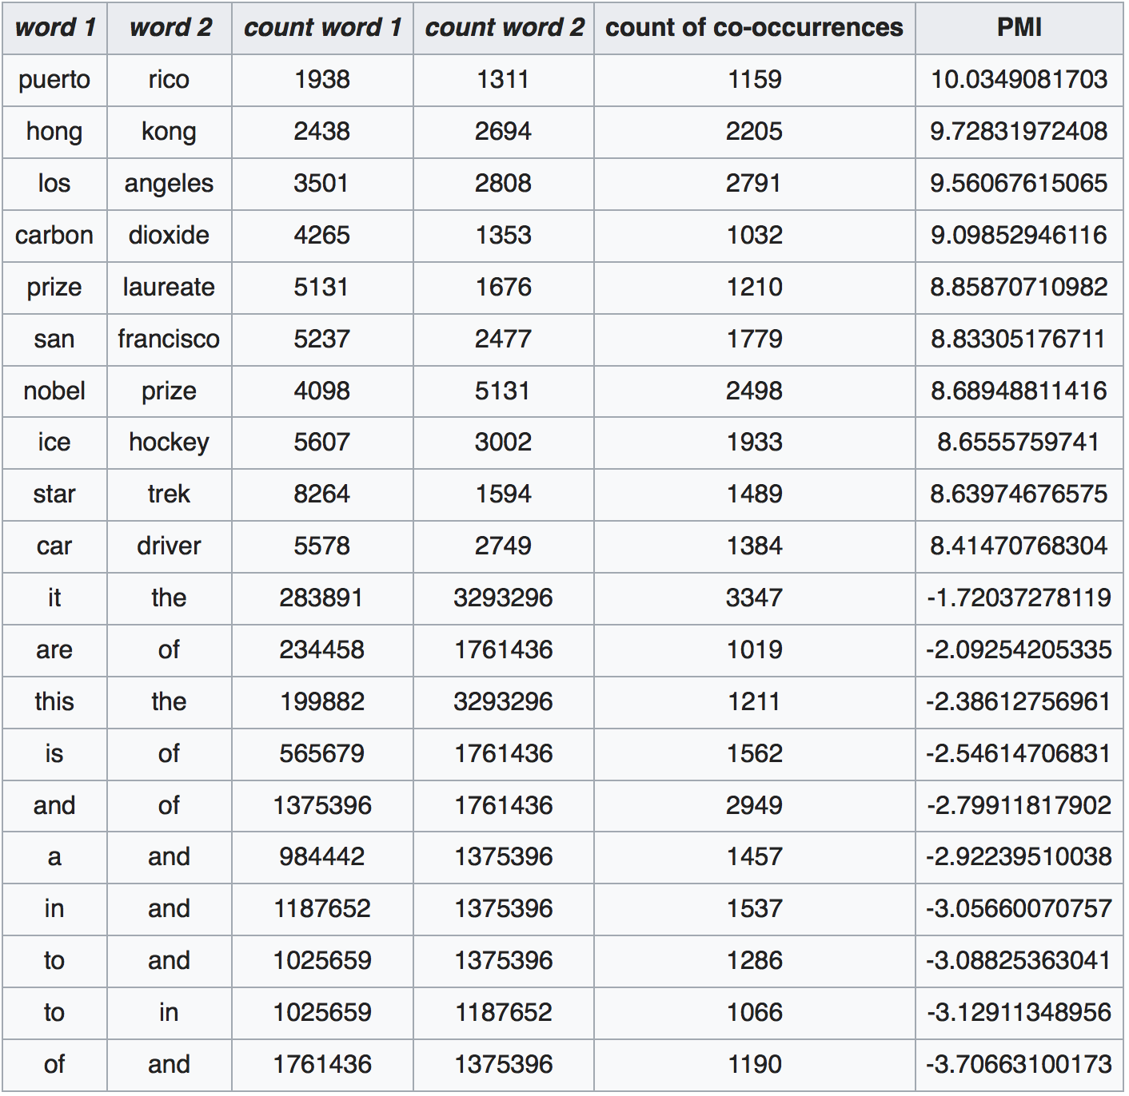
PMI – Example
Counts of pairs of words getting the most and the least PMI scores in the first 50 millions of words in Wikipedia (dump of October 2015)
Filtering by 1,000 or more co-occurrences.
The frequency of each count can be obtained by dividing its value by 50,000,952. (Note: natural log is used to calculate the PMI values in this example, instead of log base 2)
[Wikipedia]

Slide 9
Applications of PMI Data
Extend query with most frequent followers/predecessors
Insert words in anticipated gaps in a string query
Church, K.W., Hanks, P.: Word association norms mutual information, and lexicography. Comput. Linguist. 1(1), 22–29, 1990

Slide 10
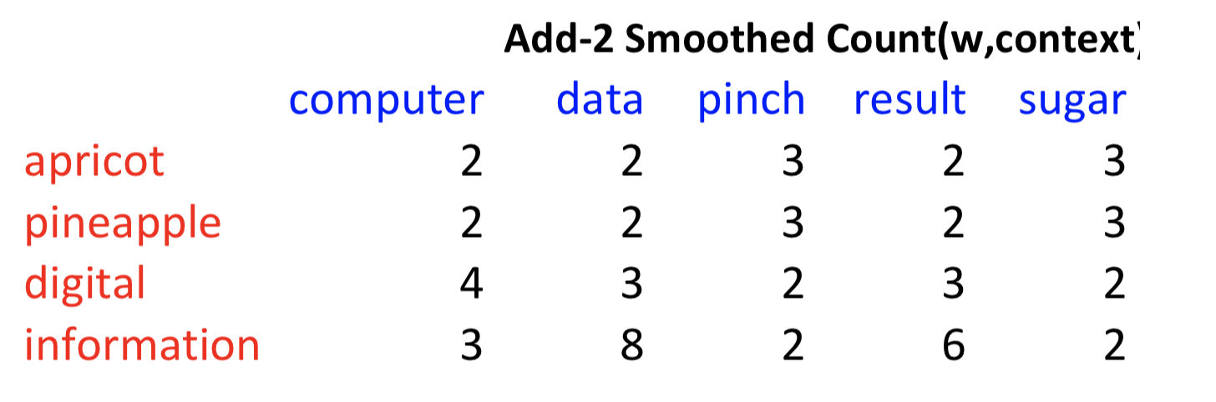
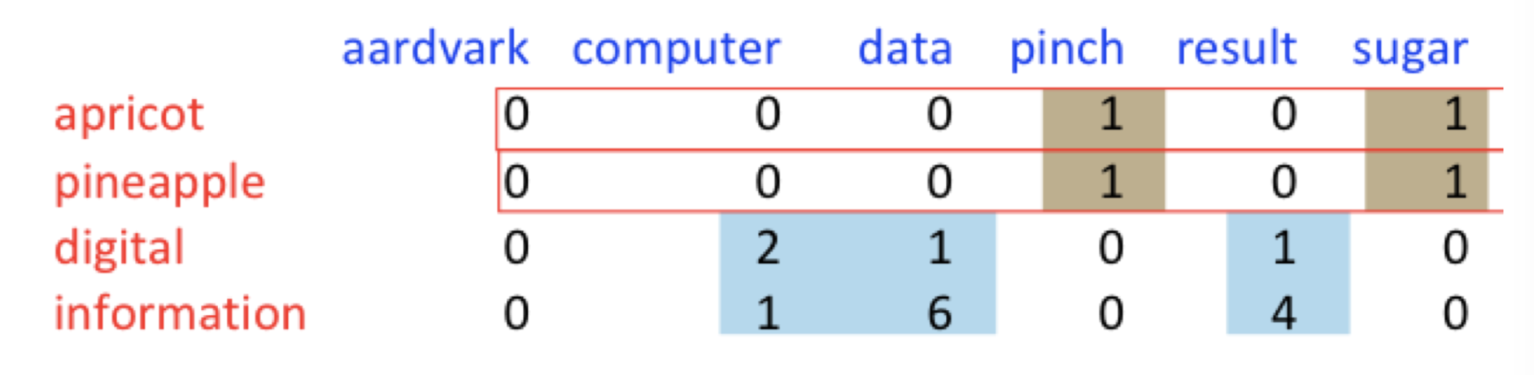
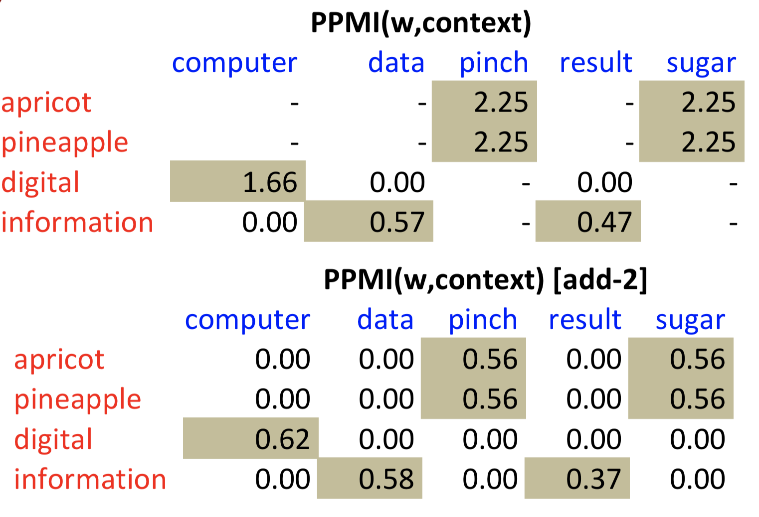
PMI – Co-occurrence Matrix
Count(w, context)

Slide 11
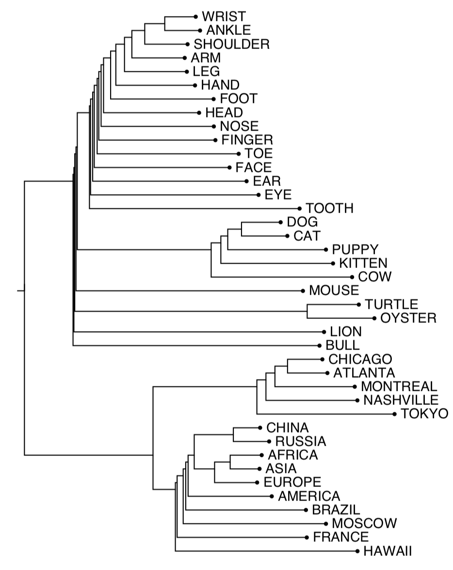
1. Clustering Approach to Word Semantics
Clustering vectors to visualize similarity in co-occurrence matrices
(Rohde et al. 2005)
Use whatever
clustering algorithm
you prefer to determine
”related” words
Application:
Extend query with related words automatically

Slide 12
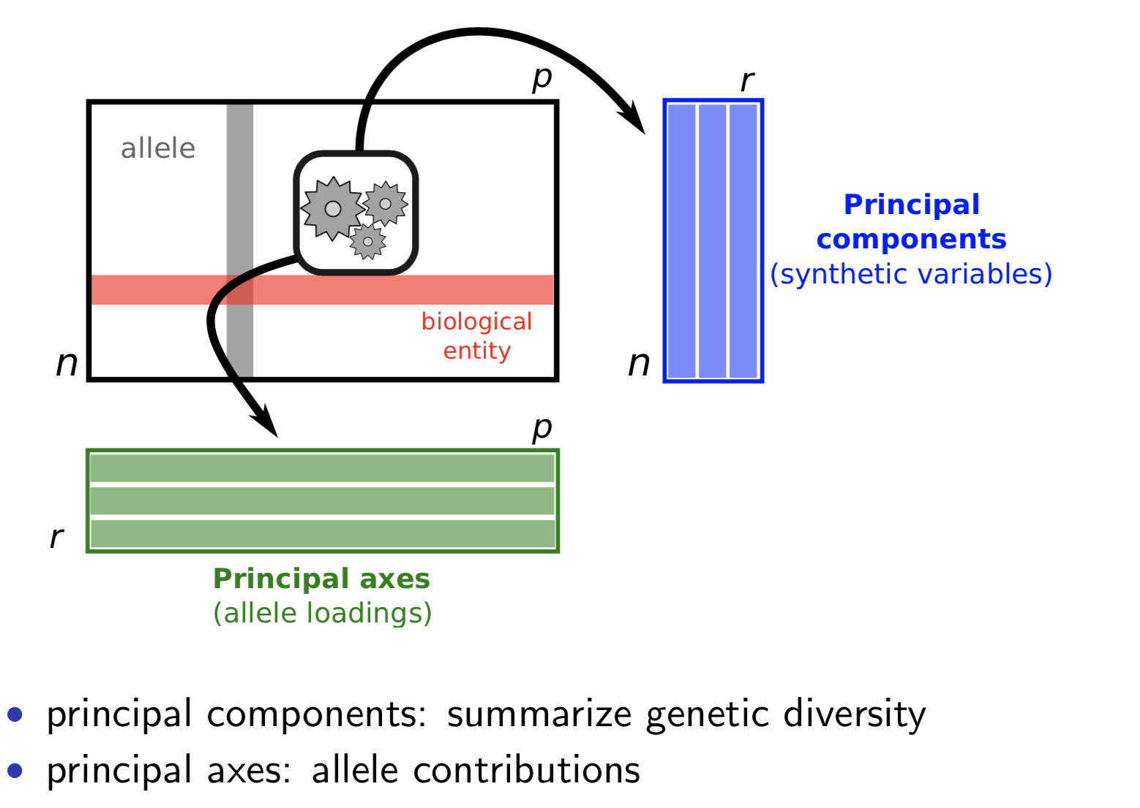
Apply SVD-based Dimension Reduction
Word context vectors
Number of clusters

Slide 13
2. Embedding Approaches to Word Semantics
Represent each word with a low-dimensional vector
Word similarity = vector similarity
Key idea: Predict surrounding words of every word

Slide 14
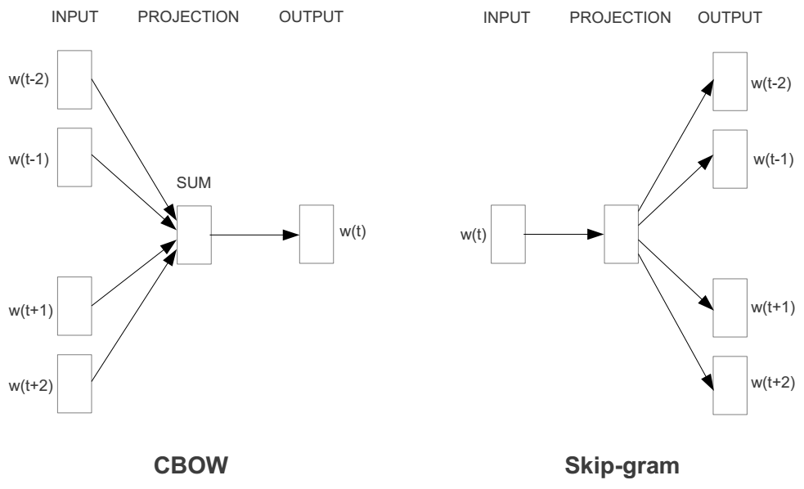
Represent the meaning of words – word2vec
2 basic structural models:
  Continuous Bag of Words (CBOW): use a window of words to predict the middle word
  Skip-gram (SG): use a word to predict the surrounding ones in window.

Slide 15
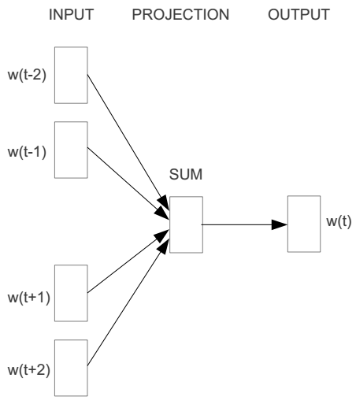
Word2vec – Continuous Bag of Word
E.g. “The cat <sat> on floor”
  Window size = 2
the
cat
sat
on
floor

Slide 16
Input layer
Index of cat in vocabulary
0
1
0
cat
0
Hidden layer
Output layer
0
0
0
0
0
0
…
0
0
0
one-hot
vector
0
sat
one-hot
vector
0
0
0
0
1
0
…
1
0
on
0
0
0
0
…
0

Slide 17
We must learn W and W’
Input layer
0
1
0
cat
0
$$W_{V×N}$$
Hidden layer
Output layer
0
0
0
0
0
0
V-dim
…
0
0
$${W′}_{N×V}$$
0
0
sat
0
0
0
0
1
0
$$W_{V×N}$$
N-dim
…
V-dim
1
0
on
0
0
0
0
V-dim
…
N will be the size of word vector
0

Slide 18
$$W_{V×N}^{T} ×x_{cat}=v_{cat}$$
0.1 | 2.4 | 1.6 | 1.8 | 0.5 | 0.9 | … | … | … | 3.2
0.5 | 2.6 | 1.4 | 2.9 | 1.5 | 3.6 | … | … | … | 6.1
… | … | … | … | … | … | … | … | … | …
… | … | … | … | … | … | … | … | … | …
0.6 | 1.8 | 2.7 | 1.9 | 2.4 | 2.0 | … | … | … | 1.2
0
2.4
2.6
…
…
1.8
Input layer
1
$$×$$
0
$$=$$
0
0
1
0
0
0
x_{cat}
0
0
Output layer
0
0
0
$$W_{V×N}^{T}×x_{cat}=v_{cat}$$
…
0
0
0
0
0
V-dim
…
0
0
$$\hat{v}=\frac{v_{cat}+v_{on}}{2}$$
0
+
0
sat
0
0
0
0
$$W_{V×N}^{T}×x_{on}=v_{on}$$
1
0
…
V-dim
1
Hidden layer
0
x_{on}
0
0
N-dim
0
0
V-dim
…
0

Slide 19
$$W_{V×N}^{T} ×x_{on}=v_{on}$$
0.1 | 2.4 | 1.6 | 1.8 | 0.5 | 0.9 | … | … | … | 3.2
0.5 | 2.6 | 1.4 | 2.9 | 1.5 | 3.6 | … | … | … | 6.1
… | … | … | … | … | … | … | … | … | …
… | … | … | … | … | … | … | … | … | …
0.6 | 1.8 | 2.7 | 1.9 | 2.4 | 2.0 | … | … | … | 1.2
0
1.8
2.9
…
…
1.9
Input layer
0
$$×$$
0
$$=$$
0
1
1
0
0
0
x_{cat}
0
0
Output layer
0
0
0
$$W_{V×N}^{T}×x_{cat}=v_{cat}$$
…
0
0
0
0
0
V-dim
…
0
0
$$\hat{v}=\frac{v_{cat}+v_{on}}{2}$$
0
+
0
sat
0
0
0
0
$$W_{V×N}^{T}×x_{on}=v_{on}$$
1
0
…
V-dim
1
Hidden layer
0
x_{on}
0
0
N-dim
0
0
V-dim
…
0

Slide 20
Input layer
0
1
0
cat
0
$$W_{V×N}$$
Hidden layer
Output layer
0
0
0
0
0
0
V-dim
…
0
0
$$W_{N×V}^{′}×\hat{v}=z$$
0
$$\hat{y}=softmax(z)$$
0
0
0
0
0
$$\hat{v}$$
1
0
$$W_{V×N}$$
…
1
N-dim
0
on
0
${\hat{y}}_{sat}$
0
0
V-dim
0
V-dim
…
N will be the size of word vector
0

Slide 21
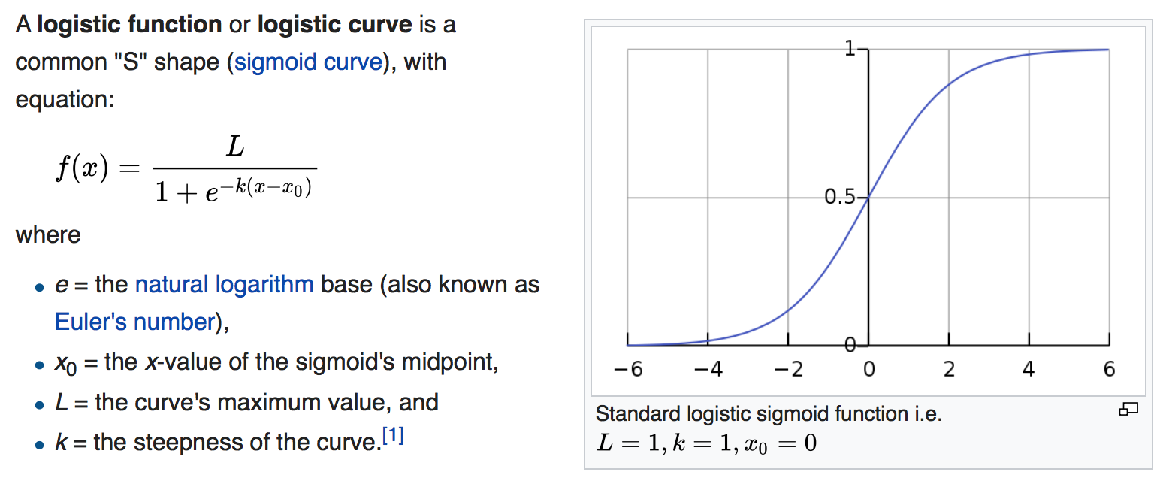
Logistic function
[Wikipedia]

Slide 22
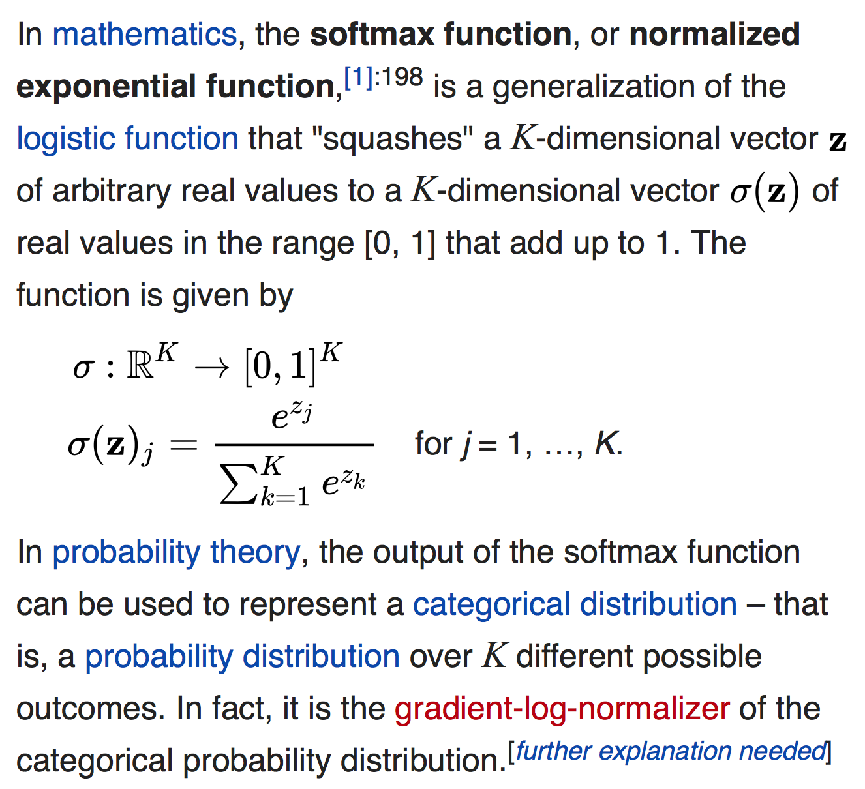
softmax(z)
The
[Wikipedia]

Slide 23
Input layer
0
We would prefer $\hat{y}$ close to ${\hat{y}}_{sat}$
1
0
cat
0
$$W_{V×N}$$
Hidden layer
Output layer
0
0
0
0
0.01
0.02
0.00
0.02
0.01
0.02
0.01
0.7
…
0.00
0
0
V-dim
…
0
0
$$W_{N×V}^{′}×\hat{v}=z$$
$$\hat{y}=softmax(z)$$
0
0
0
0
0
0
$$\hat{v}$$
1
0
$$W_{V×N}$$
…
1
N-dim
0
on
0
${\hat{y}}_{sat}$
0
0
V-dim
0
V-dim
…
N will be the size of word vector
$\hat{y}$
0

Slide 24
$$W_{V×N}^{T}$$
0.1 | 2.4 | 1.6 | 1.8 | 0.5 | 0.9 | … | … | … | 3.2
0.5 | 2.6 | 1.4 | 2.9 | 1.5 | 3.6 | … | … | … | 6.1
… | … | … | … | … | … | … | … | … | …
… | … | … | … | … | … | … | … | … | …
0.6 | 1.8 | 2.7 | 1.9 | 2.4 | 2.0 | … | … | … | 1.2
Contains word vectors
Input layer
0
1
0
x_{cat}
0
Output layer
0
0
$$W_{V×N}^{}$$
0
0
0
0
V-dim
…
0
0
$$W_{N×V}^{′}$$
0
0
sat
0
0
0
0
1
0
$$W_{V×N}^{}$$
…
1
0
V-dim
x_{on}
0
Hidden layer
0
N-dim
0
0
V-dim
…
0
We can consider either W or W’ as the word’s representation.
Notes:
W contains input word vectors.
W’ contains output word vectors.
We can consider either W or W’ as the word’s representation. Or even take the average.

Slide 25
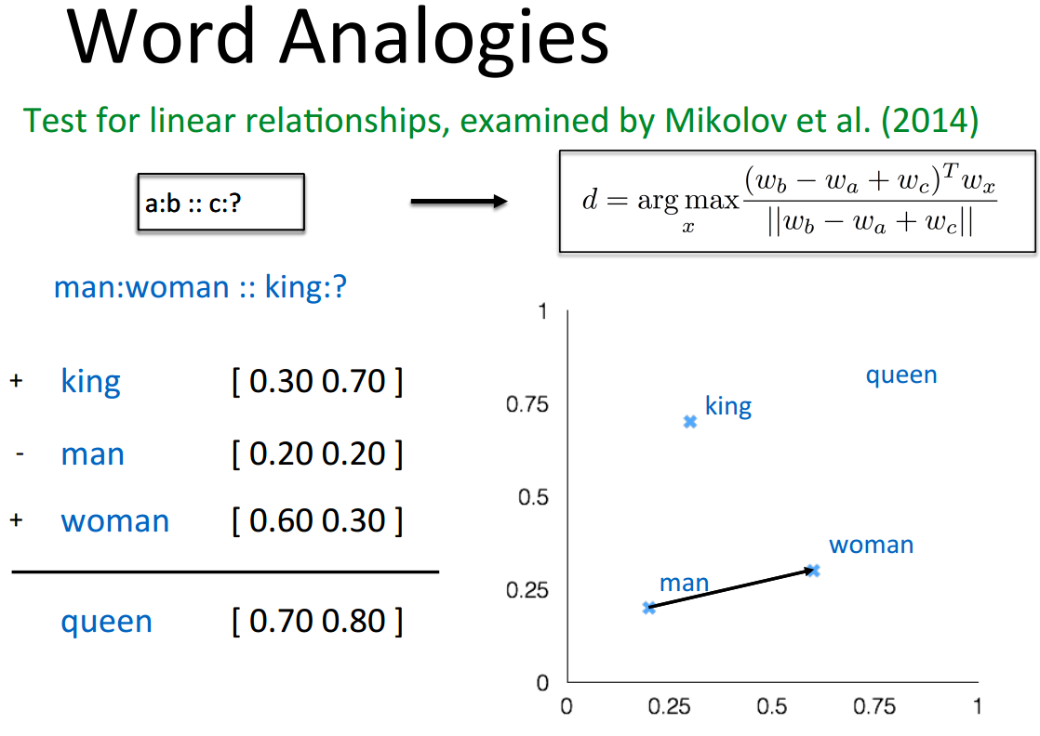
Word Analogies
||w_{x}||

Slide 26
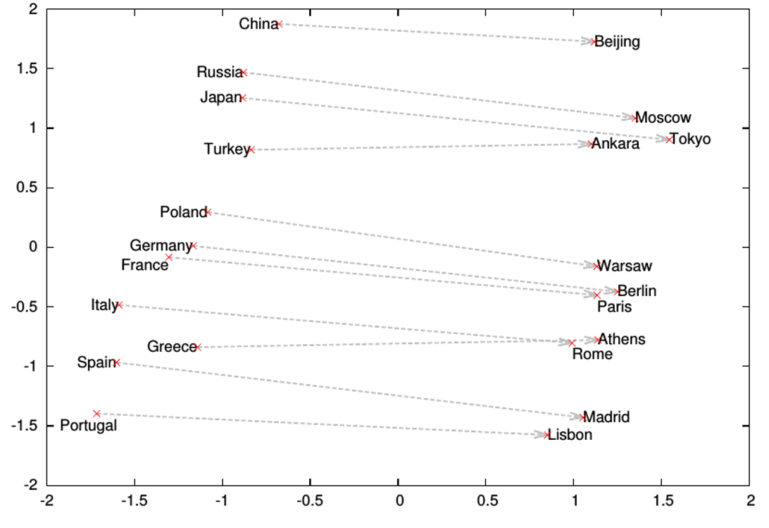
Word Analogies

Slide 27
What is word2vec?
word2vec is not a single algorithm
It is a software package for representing words as vectors, containing:
  Two distinct models
    CBoW
    Skip-Gram (SG)
  Various training methods
    Negative Sampling (NS)
    Hierarchical Softmax
  A rich preprocessing pipeline
    Dynamic Context Windows
    Subsampling
    Deleting Rare Words
Notes:
Now, we’re going to focus on Skip-Grams with Negative Sampling,
Which is considered the state-of-the-art.

Slide 28
Skip-Grams with Negative Sampling (SGNS)
Marco saw a furry little wampimuk hiding in the tree.
“word2vec Explained…”
Goldberg & Levy, arXiv 2014
Notes:
So, how does SGNS work?
Let’s say we have this sentence,
(This example was shamelessly taken from Marco Baroni)

Slide 29
Skip-Grams with Negative Sampling (SGNS)
Marco saw a furry little wampimuk hiding in the tree.
“word2vec Explained…”
Goldberg & Levy, arXiv 2014
Notes:
And we want to understand what a wampimuk is.

Slide 30

Skip-Grams with Negative Sampling (SGNS)
Marco saw a furry little wampimuk hiding in the tree.
words contexts
wampimuk furry
wampimuk little
wampimuk hiding
wampimuk in
… …
$D$ (data)
“word2vec Explained…”
Goldberg & Levy, arXiv 2014
Notes:
What SGNS does is take the context words around “wampimuk”,
And in this way,
Constructs a dataset of word-context pairs, D.

Slide 31

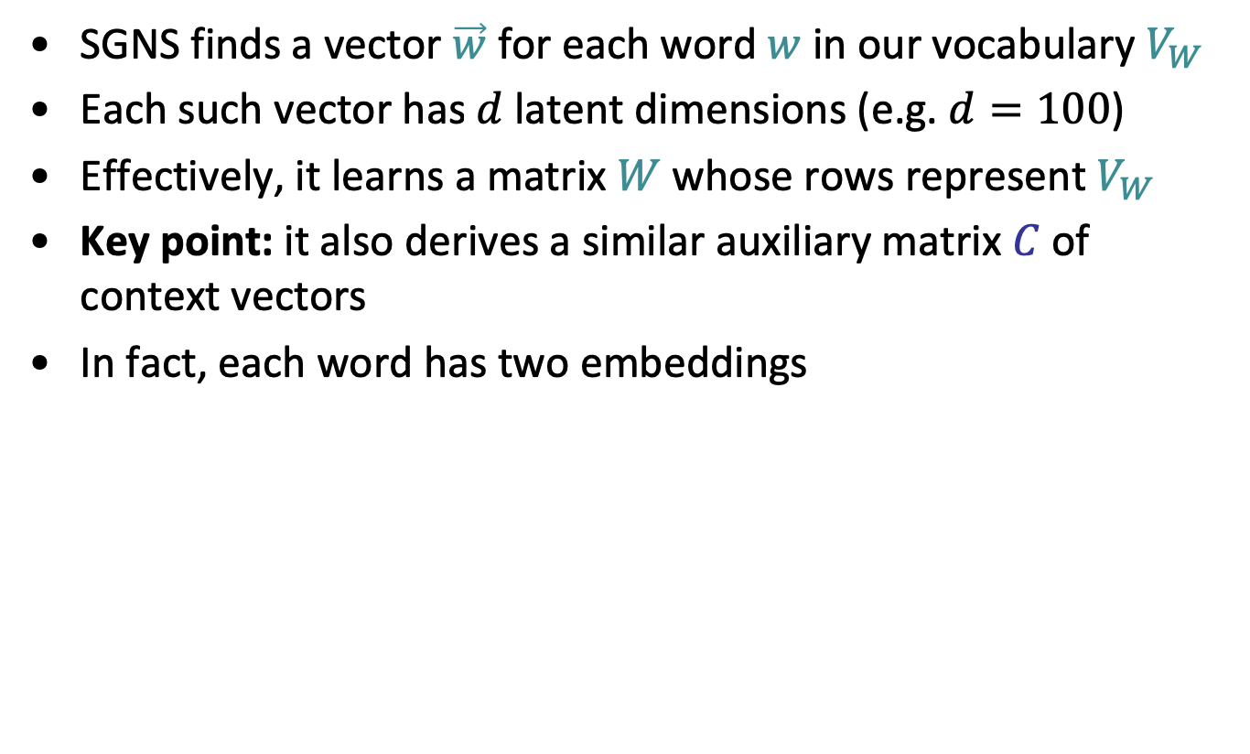
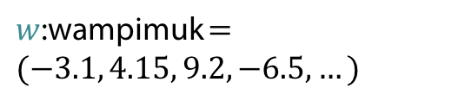







Skip-Grams with Negative Sampling (SGNS)
SGNS finds a vector $\vec{w}$ for each word $w$ in our vocabulary $V_{W}$
Each such vector has $d$ latent dimensions (e.g. $d=100$)
Effectively, it learns a matrix $W$ whose rows represent $V_{W}$
Key point: it also derives a similar auxiliary matrix $C$ of context vectors
In fact, each word has two embeddings
$$d$$
$$d$$
$$W$$
$w$:wampimuk $=(−3.1, 4.15, 9.2, −6.5,…)$
$$C$$
$$V_{W}$$
$$V_{C}$$
$$≠$$
$c$:wampimuk $=(−5.6, 2.95, 1.4, −1.3,…)$
“word2vec Explained…”
Goldberg & Levy, arXiv 2014
Notes:
Now, using D,
SGNS is going to learn a vector for each word in the vocabulary
A vector of say… 100 latent dimensions.
Effectively, it’s learning a matrix W,
Where each row is a vector that represents a specific word.
Now, a key point in understanding SGNS,
Is that it also learns an auxiliary matrix C of context vectors
So in fact, each word has two different embeddings
Which are not necessarily similar.

Slide 32
Skip-Grams with Negative Sampling (SGNS)
“word2vec Explained…”
Goldberg & Levy, arXiv 2014
Notes:
So to train these vectors…

Slide 33
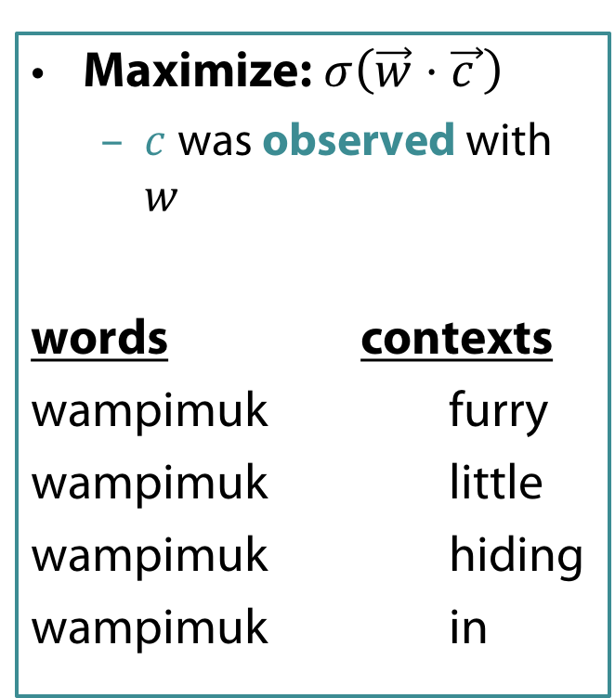
Skip-Grams with Negative Sampling (SGNS)
Maximize: $σ\left(\vec{w}⋅\vec{c_{ }}\right)$
  $c$ was observed with $w$
words contexts
wampimuk furry
wampimuk little
wampimuk hiding
wampimuk in
“word2vec Explained…”
Goldberg & Levy, arXiv 2014
Notes:
…SGNS maximizes the similarity between word and context vectors that were observed together.

Slide 34
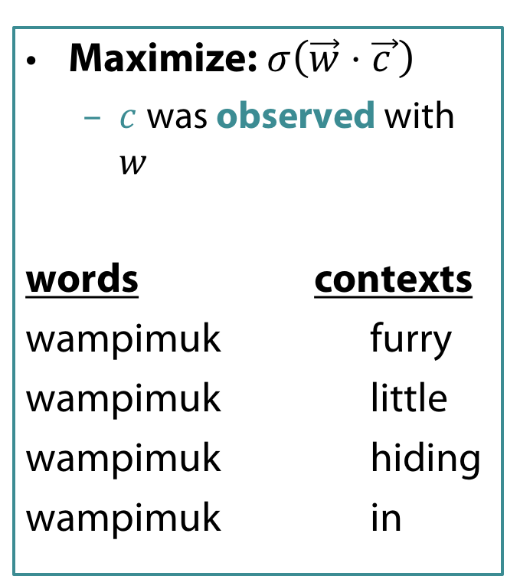
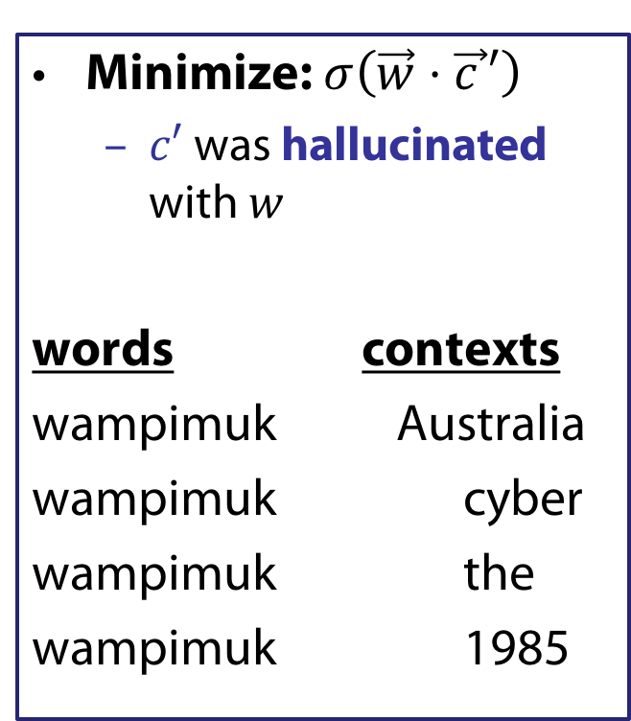
Skip-Grams with Negative Sampling (SGNS)
Maximize: $σ\left(\vec{w}⋅\vec{c_{ }}\right)$
  $c$ was observed with $w$
words contexts
wampimuk furry
wampimuk little
wampimuk hiding
wampimuk in
Minimize: $σ\left(\vec{w}⋅\vec{c_{ }}′\right)$
  $c′$ was hallucinated with $w$
words contexts
wampimuk Australia
wampimuk cyber
wampimuk the
wampimuk 1985
“word2vec Explained…”
Goldberg & Levy, arXiv 2014
Notes:
…and minimizes the similarity between word and context vectors hallucinated together.

Slide 35

Skip-Grams with Negative Sampling (SGNS)
“Negative Sampling”
SGNS samples $k$ contexts $c^{′}$ at random
as negative examples
Notes:
Now, the way SGNS hallucinates is really important.
It’s actually where it gets its name from.
For each observed word-context pair,
SGNS samples k contexts at random,
As negative examples
Now, when we say random, we mean the unigram distribution
And Spoiler Alert: changing this distribution has quite a significant effect.

Slide 36







What is SGNS learning?
Take SGNS’s embedding matrices ($W$ and $C$)
$$d$$
$$d$$
$$W$$
$$C$$
$$V_{W}$$
$$V_{C}$$
“Neural Word Embeddings as Implicit Matrix Factorization”
Levy & Goldberg, NIPS 2014
Notes:
If we take the embedding matrices

Slide 37





What is SGNS learning?
Take SGNS’s embedding matrices ($W$ and $C$)
Multiply them
What do you get?
$$d$$
$$W$$
$$V_{C}$$
$$V_{W}$$
$$d$$
$$C$$
“Neural Word Embeddings as Implicit Matrix Factorization”
Levy & Goldberg, NIPS 2014
Notes:
And multiply them
What do we get?

Slide 38





What is SGNS learning?
A $V_{W}×V_{C}$ matrix
Each cell describes the relation between a specific word-context pair
$\vec{w}⋅\vec{c}= ?$
$$d$$
$$V_{C}$$
$$W$$
$$V_{C}$$
$$?$$
$$V_{W}$$
$$d$$
$$C$$
$$=$$
$$V_{W}$$
“Neural Word Embeddings as Implicit Matrix Factorization”
Levy & Goldberg, NIPS 2014
Notes:
We get a pretty big, square matrix,
Where each cell describes the relation between a specific word, w,
With a specific context, c.

Slide 39


What is SGNS learning?
Levy&Goldberg [2014] proved that for large enough $d$ and enough iterations …
… one obtains the word-context PMI matrix
$$d$$
$$V_{C}$$
$$W$$
$$V_{C}$$
$$M^{PMI}$$
$$V_{W}$$
$$d$$
$$C$$
$$=$$
$$V_{W}$$
“Neural Word Embeddings as Implicit Matrix Factorization”
Levy & Goldberg, NIPS 2014
Notes:
…SGNS will converge to the classic word-context PMI matrix…

Slide 40


What is SGNS learning?
Levy&Goldberg [2014] proved that for large enough $d$ and enough iterations …
… one obtains the word-context PMI matrix …
shifted by a global constant
$Opt\left(\vec{w}⋅\vec{c}\right)=PMI\left(w,c\right)−\log{k}$
$$d$$
$$V_{C}$$
$$W$$
$$V_{C}$$
$$M^{PMI}$$
$$V_{W}$$
$$d$$
$$C$$
$$=$$
$$V_{W}$$
$$−\log{k}$$
“Neural Word Embeddings as Implicit Matrix Factorization”
Levy & Goldberg, NIPS 2014
Notes:
…with a little twist.
Now, recall that k is the number of negative samples generated for each positive example (w,c) \in D.
This is of course the optimal value, and not necessarily what we get in practice.

Slide 41
Word Analogies
||w_{x}||

