Slide 1
Non-Standard-Datenbanken und Data Mining
Bayesian Networks, Inference, and Learning
Prof. Dr. Ralf Möller
Universität zu Lübeck
Institut für Informationssysteme

Slide 2
Übersicht
Semistrukturierte Datenbanken (JSON, XML) und Volltextsuche
Information Retrieval
Mehrdimensionale Indexstrukturen
Cluster-Bildung
Einbettungstechniken
First-n-, Top-k-, und Skyline-Anfragen
Probabilistische Datenbanken, Anfragebeantwortung, Top-k-Anfragen und Open-World-Annahme
Probabilistische Modellierung, Bayes-Netze, Anfragebeantwortungsalgorithmen, Lernverfahren,
Temporale Datenbanken und das relationale Modell,
Probabilistische Temporale Datenbanken
SQL: neue Entwicklungen (z.B. JSON-Strukturen und Arrays), Zeitreihen (z.B. TimeScaleDB)
Stromdatenbanken, Prinzipien der Fenster-orientierten inkrementellen Verarbeitung
Approximationstechniken für Stromdatenverarbeitung, Stream-Mining
Probabilistische raum-zeitliche Datenbanken und Stromdatenverarbeitungsssysteme: Anfragen und Indexstrukturen, Raum-zeitliches Data Mining, Probabilistische Skylines
Von NoSQL- zu NewSQL-Datenbanken, CAP-Theorem, Blockchain-Datenbanken

Slide 3
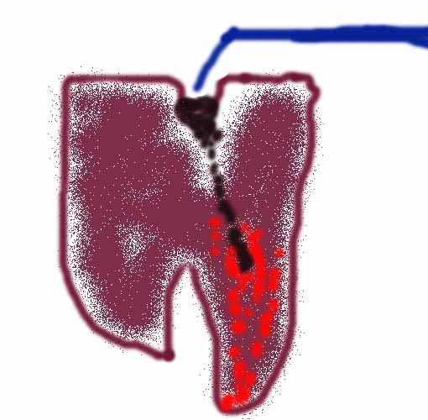

Beispiel
Zahnarzt-Problem mit vier Variablen:
Toothache (Sind besagte Schmerzen wirklich Zahnschmerzen?)
Cavity (Es könnte ein Loch sein?)
Catch (Stahlinstrument erzeugt Testschmerz?)
Weather (Wetter: sunny,rainy,cloudy,snow)
Nachfolgende Präsentationen enthalten Material aus Kapitel 14
(Sektion 1 and 2)

Slide 4
Bayesian Approach: Prior probability
Prior or unconditional probabilities of propositions
  e.g., P(Cavity = true) = 0.1 and P(Weather = sunny) = 0.72 correspond to belief prior to arrival of any (new) evidence
Probability distribution
gives values for all possible assignments:
  P(Weather) = <0.72, 0.1, 0.08, 0.1>^{T}
  (normalized, i.e., sums to 1 because one condition must be the case)
Notes:
Prior can come from statistical date or other insights e.g. dice (computational)

Slide 5
Full joint probability distribution
Joint probability distribution for a set of random variables gives the probability of every atomic event on those random variables
  P(Weather,Cavity) is a 4 × 2 matrix of values:
Weather = sunny rainy cloudy snow
Cavity = true 0.144 0.02 0.016 0.02
Cavity = false 0.576 0.08 0.064 0.08
Full joint probability distribution: all random variables involved
  P(Toothache, Catch, Cavity, Weather)
Every query about a domain can be answered by the full joint distribution

Slide 6
Discrete random variables: Notation
Dom(Weather) = {sunny, rainy, cloudy, snow} and Dom(Weather) disjoint from domain of other random variables:
  Atomic event Weather=rainy often written as rainy
  Example: P(rainy), the random variable Weather is implicitly defined by the value rainy
Boolean variable Cavity
  Atomic event Cavity=true written as cavity
  Atomic event Cavity=false written as ¬cavity
  Examples: P(cavity) or P(¬cavity)

Slide 7

Inference by enumeration
Start with the joint probability distribution:
For any proposition φ, sum the probability
where it is true: P(φ) = Σ_{ω:ω╞φ} P(ω)
P(toothache) = 0.108 + 0.012 + 0.016 + 0.064 = 0.2
Unconditional or marginal probability of toothache
Process is called marginalization or summing out
  Ax₃: P(A ∪ B) = P(A) + P(B)
  for disjoint events A, B ⊆ Ω

Slide 8
Conditional probability
Conditional or posterior probabilities
  e.g., P(cavity | toothache) = 0.8
  or: <0.8>
  i.e., given that Toothache=true is all I know
(Notation for conditional distributions:
  P(Cavity | Toothache) is a 2-element vector of 2-element vectors
If we know more, e.g., cavity is also given, then we have
  P(cavity | toothache, cavity) = 1
New evidence may be irrelevant, allowing simplification, e.g.,
  P(cavity | toothache, sunny) = P(cavity | toothache) = 0.8
This kind of inference, sanctioned by domain knowledge, is crucial

Slide 9
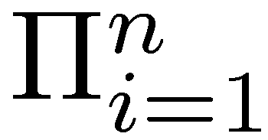
Conditional probability
Definition of conditional probability (in terms of uncond. prob.):
  P(a | b) = P(a ∧ b) / P(b) if P(b) > 0
Product rule gives an alternative formulation (∧ is commutative):
  P(a ∧ b) = P(a | b) P(b) = P(b | a) P(a)
A general version holds for whole distributions, e.g.,
  P(Weather,Cavity) = P(Weather | Cavity) P(Cavity)
View as a set of 4 × 2 equations, not matrix mult.
(1,1) P(Weather=sunny |Cavity=true) P(Cavity=true)
(1,2) P(Weather=sunny |Cavity=false) P(Cavity=false), ….
Chain rule is derived by successive application of product rule:
  P(X₁, …,X_{n}) = P(X₁,...,X_{n-1}) P(X_{n} | X₁,...,X_{n-1})
  = P(X₁,...,X_{n-2}) P(X_{n-1} | X₁,...,X_{n-2}) P(X_{n} | X₁,...,X_{n-1})
  = …
  = P(X_{i} | X₁, … ,X_{i-1})
Notes:
Proofable Rules are important for algorithmically rewriting of statements.
First rules makes sense because we know that b=true we can rule out other worlds. Reduce view of the world sum also to one because
Sum must be one.Therefore the fraction.

Slide 10
Marginalization and conditioning
Let Y, Z be sequences of random variables s.th.
Y ∪ Z denotes all random variables describing the world
Marginalization
  P(Y) = Σ_{z ∈ Z}P(Y,z)
Conditioning
  P(Y) = Σ_{z ∈ Z}P(Y|z)P(z)

Slide 11

Inference by enumeration
Start with the joint probability distribution:
For any proposition φ, sum the atomic events where it is true:
P(φ) = Σ_{ω:ω⊨φ} P(ω)
P(cavity ∨ toothache) = 0.108 + 0.012 + 0.072 + 0.008+ 0.016 + 0.064 = 0.28
(P(cavity ∨ toothache) = P(cavity) + P(toothache) – P(cavity ∧ toothache))

Slide 12

Inference by enumeration
Start with the joint probability distribution:
Can also compute conditional probabilities:
P(¬cavity | toothache) = P(¬cavity ∧ toothache)
P(toothache)
= 0.016+0.064
0.108 + 0.012 + 0.016 + 0.064
= 0.08/0.2 = 0.4
P(cavity | toothache) = (0.108+0.012)/0.2 = 0.6
Product rule

Slide 13
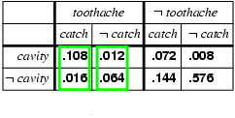
Normalization
Denominator P(z) (or P(toothache) in the example before) can be viewed as a normalization constant α
P(Cavity | toothache) = α P(Cavity,toothache)
  = α [P(Cavity,toothache,catch) + P(Cavity,toothache,¬ catch)]
  = α [<0.108,0.016> + <0.012,0.064>]
  = α <0.12,0.08> = <0.6,0.4>
General idea: compute distribution on query variable by fixing evidence variables (Toothache) and summing over hidden variables (Catch)

Slide 14
Inference by enumeration, contd.
Typically, we are interested in
the posterior joint distribution of the query variables Y
given specific values e for the evidence variables E
(X are all variables of the modeled world)
Let the hidden variables be H = X - Y – E then the required summation of joint entries is done by summing out the hidden variables:
  P(Y | E = e) = αP(Y,E = e) = αΣ_{h}P(Y,E= e, H = h)
The terms in the summation are joint entries because Y, E and H together exhaust the set of random variables (X)
Obvious problems:
  Worst-case time complexity O(d^{n}) where d is the largest arity and n denotes the number of random variables
  Space complexity O(d^{n}) to store the joint distribution
  How to find the numbers for O(d^{n}) entries?

Slide 15
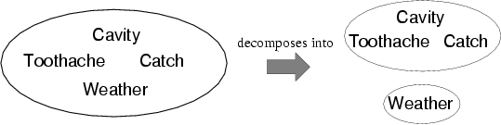
Independence
A and B are independent iff
P(A|B) = P(A) or P(B|A) = P(B) or P(A, B) = P(A) P(B)
  P(Toothache, Catch, Cavity, Weather)
  = P(Toothache, Catch, Cavity) P(Weather)
32 entries reduced to 12;
Absolute independence powerful but rare
Dentistry is a large field with hundreds of variables, none of which are independent. What to do?

Slide 16
Conditional independence
P(Toothache, Cavity, Catch) has 2³ – 1 = 7 independent entries
If I have a cavity, the probability that the probe catches in it doesn't depend on whether I have a toothache:
  (1) P(catch | toothache, cavity) = P(catch | cavity)
The same independence holds if I haven't got a cavity:
  (2) P(catch | toothache,¬cavity) = P(catch | ¬cavity)
Catch is conditionally independent of Toothache given Cavity:
  P(Catch | Toothache,Cavity) = P(Catch | Cavity)
Equivalent statements:
  P(Toothache | Catch, Cavity) = P(Toothache | Cavity)
  P(Toothache, Catch | Cavity) = P(Toothache | Cavity) P(Catch | Cavity)

Slide 17
Representation of Domain Knowledge
P(A | B) = P(A, B) / P(B)
Catch is conditionally independent of Toothache given Cavity:
P(Catch | Toothache, Cavity) = P(Catch | Cavity)
Equivalent statements:
P(Toothache | Catch, Cavity) = P(Toothache | Cavity)
  P(Toothache | Catch, Cavity)
  = P(Toothache, Catch, Cavity) / P(Catch, Cavity)
= P(Catch, Toothache, Cavity) / P(Catch | Cavity) P(Cavity)
= P(Catch | Toothache, Cavity) P(Toothache, Cavity) / P(Catch | Cavity) P(Cavity)
= P(Catch | Cavity) P(Toothache | Cavity) P(Cavity) / P(Catch | Cavity) P(Cavity)
= P(Toothache | Cavity)

Slide 18
Conditional independence contd.
Very many factorizations
Write out full joint distribution using chain rule:
P(Toothache, Catch, Cavity)
  = P(Toothache | Catch, Cavity) P(Catch, Cavity)
  = P(Toothache | Catch, Cavity) P(Catch | Cavity) P(Cavity)
  conditional independence
  = P(Toothache | Cavity) P(Catch | Cavity) P(Cavity)
i.e., 2 + 2 + 1 = 5 independent numbers
In most cases, the use of conditional independence reduces the size of the representation of the joint distribution
from exponential in n to linear in n
Conditional independence is our most basic and robust form of knowledge about uncertain environments

Slide 19
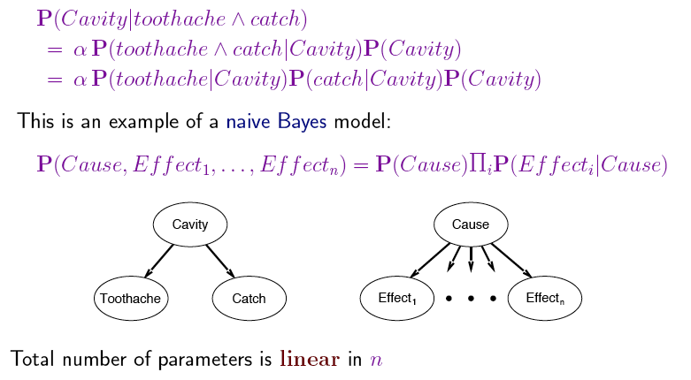
Naïve Bayes Model
Usually, the assumption that effects are independent is wrong,
but works well in practice

Slide 20
Agents
Example: Agent D (doctor) treating patients
Joint distribution: his understanding of the world (belief state)
  reason about inputs and
  act such that outputs are produced
Input (so-called evidence) is based on the structure of the joint
Evidence about the world
can be uncertain, i.e. we
need to update belief state
For a computational agent
we need a computationally
feasible representation of the joint
for implementing reasoning and acting
If the structure of joint distribution were adapted by the agent itself, we would enter the realm of AI

Slide 21
Uncertain Evidence: Updating the Belief State
 | PCatch | ¬PCatch | PCatch | ¬PCatch
Cavity | 0.108 | 0.012 | 0.072 | 0.008
¬Cavity | 0.016 | 0.064 | 0.144 | 0.576
Toothache
¬Toothache
Let D now observe Toothache=true with probability 0.8 (e.g., “the patient says so”)
How should D update its belief state?

Slide 22
Uncertain Evidence: Updating the Belief State
 | PCatch | ¬PCatch | PCatch | ¬PCatch
Cavity | 0.108 | 0.012 | 0.072 | 0.008
¬Cavity | 0.016 | 0.064 | 0.144 | 0.576
Toothache
¬Toothache
Let E be the evidence such that P(Toothache|E) = 0.8
We want to compute P(c∧t∧pc|E) = P(c∧pc|t,E) P(t|E)
Since E is not directly related to the cavity or the probe catch, we consider that c and pc are independent of E given t, hence: P(c∧pc|t,E) = P(c∧pc|t)

Slide 23
Uncertain Evidence: Updating the Belief State
 | PCatch | ¬PCatch | PCatch | ¬PCatch
Cavity | 0.108 | 0.012 | 0.072 | 0.008
¬Cavity | 0.016 | 0.064 | 0.144 | 0.576
Toothache
¬Toothache
0.432
0.048
0.018
0.002
0.064
0.256
0.036
0.144
Let E be the evidence such that P(Toothache|E) = 0.8
We want to compute P(c∧t∧pc|E) = P(c∧pc|t,E) P(t|E)
Since E is not directly related to the cavity or the probe catch, we consider that c and pc are independent of E given t, hence: P(c∧pc|t,E) = P(c∧pc|t)
To get these 4 probabilities
we normalize their sum to 0.8
To get these 4 probabilities
we normalize their sum to 0.2

Slide 24
Issues
If a state is described by n propositions, then a belief state contains 2^{n} states (possibly, some have probability 0)
→ Modeling difficulty: many numbers must be entered in the first place
→ Computational issue: memory size and time

Slide 25
 | PCatch | ¬PCatch | PCatch | ¬PCatch
Cavity | 0.108 | 0.012 | 0.072 | 0.008
¬Cavity | 0.016 | 0.064 | 0.144 | 0.576
Toothache
¬Toothache
Toothache and PCatch are independent given Cavity (or ¬Cavity), but this relation is hidden in the numbers ! [Verify this]
Bayesian networks explicitly represent independence among propositions to reduce the number of probabilities defining a belief state

Slide 26
Bayesian networks
A simple, graphical notation for conditional independence assertions and hence for compact specification of full joint distributions
Syntax:
  a set of nodes, one per variable
  a directed, acyclic graph (link ≈ "directly influences")
  a conditional distribution for each node given its parents:
    P (X_{i} | Parents (X_{i}))
In the simplest case, conditional distribution represented as a conditional probability table (CPT) giving the distribution over X_{i} for each combination of parent values

Slide 27
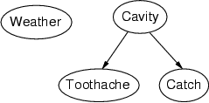
Example
Topology of network encodes conditional independence assertions:
Weather is independent of the other variables
Toothache and Catch are conditionally independent given Cavity

Slide 28
Example
I'm at work, neighbor John calls to say my alarm is ringing, but neighbor Mary doesn't call. Sometimes it's set off by minor earthquakes. Is there a burglary?
Variables: Burglary, Earthquake, Alarm, JohnCalls, MaryCalls
Network topology reflects "causal" knowledge:
  A burglar can set the alarm off
  An earthquake can set the alarm off
  The alarm can cause Mary to call
  The alarm can cause John to call
Notes:
Burglar alarm system installed. Judea Pearl researcher and living in LA

Slide 29
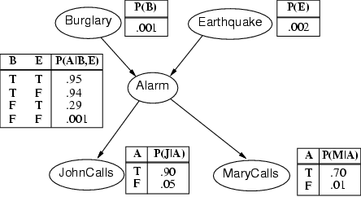
Example contd.
Notes:
John nearly calls ervery time the alarm is ringing but sometimes confuses whether it is the telephone or the alarm.
Mary often hears loud music. J & M only Alarm means we assume that they can not directly observe burglars and minor earthquakes.
Rows sum up to one because they represent all the cases for a variable. One must be the case. Any irrelevant attributes are encoded in prob-> laziness, ignorance

Slide 30
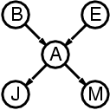
Compactness
A CPT for Boolean X_{i} with k Boolean parents has 2^{k} rows for the combinations of parent values
Each row requires one number p for X_{i} = true
(the number for X_{i} = false is just 1-p)
If each variable has no more than k parents,
the complete network requires n · 2^{k} numbers
i.e., grows linearly with n, vs. 2^{n} for the full joint distribution
For burglary net, 1 + 1 + 4 + 2 + 2 = 10 numbers (vs. 2⁵-1 = 31)

Slide 31
Semantics
The full joint distribution is defined as the product of the local conditional distributions:
P (X₁, … ,X_{n}) = π_{i = 1} P (X_{i} | Parents(X_{i}))
e.g., P(j ∧ m ∧ a ∧ ¬b ∧ ¬e)
= P (j | a) P (m | a) P (a | ¬b, ¬e) P (¬b) P (¬e)
= 0.90x0.7x0.001x0.999x0.998
≈ 0.00063
n

Slide 32
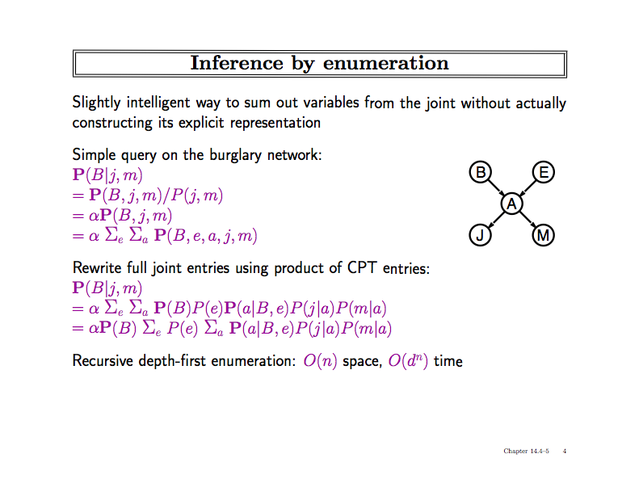

Slide 33
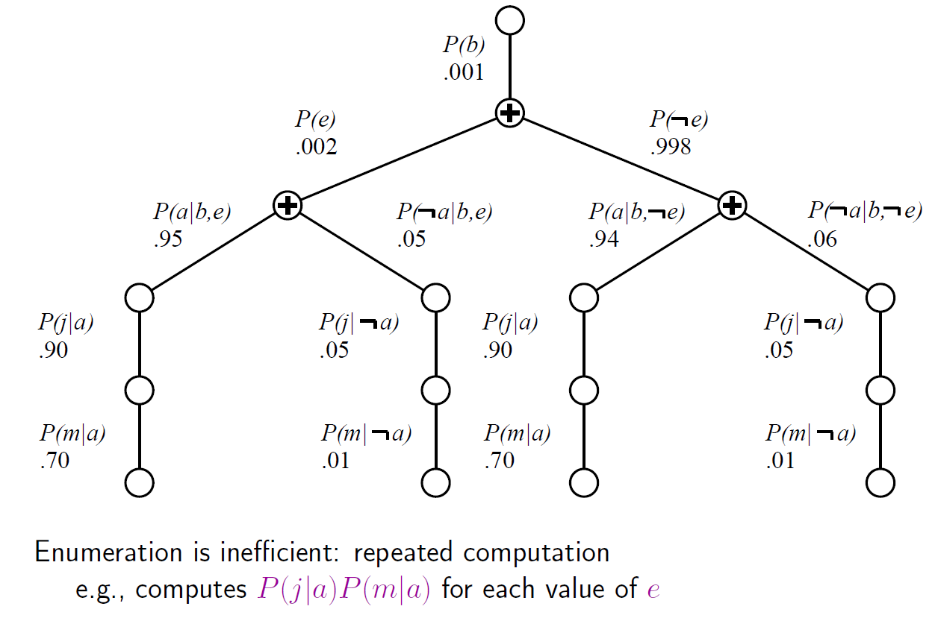
Evaluation Tree

Slide 34
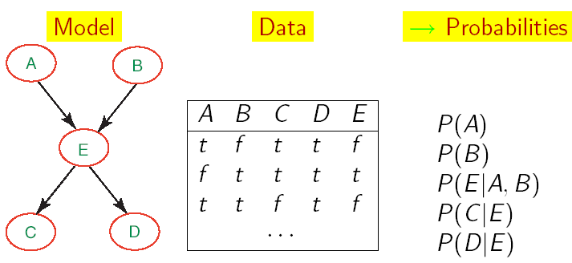
Learning BNs: Data Science w/ Complete Data
We will start by applying ML to the simplest type of BNets learning:
  known structure
  Data containing observations for all variables
    All variables are observable, no missing data
The only thing that we need to learn are the network’s parameters

Slide 35
Maximum-Likelihood-Parameterschätzung
Nehme an, die Struktur eines BNs sei bekannt
Ziel: Schätze BN-Parameter 𝜃
  Einträge in CPTs, P(X | Parents(X))
Eine Parametrierung 𝜃 ist gut, falls hierdurch die beobachteten Daten wahrscheinlich generiert werden:
Maximum Likelihood Estimation
(MLE) Prinzip: Wähle 𝜃* so,
dass P(D| 𝜃*) maximiert wird
Gleichverteilte, unabhängige Stichprobem
(i.i.d. samples)
35

Slide 36
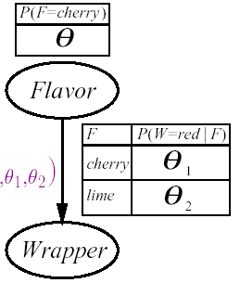
Anwendungsbeispiel Bonbonfabrik
Ein Hersteller wählt die Farbe des Bonbonpapiers mit einer bestimmten Wahrscheinlichkeit je nach Geschmack, wobei die entsprechende Verteilung nicht bekannt sei
  Wenn Geschmack=cherry, wähle rotes Papier mit W'keit 𝜃₁
  Wenn Geschmack=lime, wähle rotes Papier mit W'keit 𝜃₂
Das Bayessche Netzwerk enthält drei zu lernende Parameter
  𝜃 𝜃 ₁ 𝜃 ₂

Slide 37
Anwendungsbeispiel Bonbonfabrik
P( W=green, F = cherry| h_{𝜃𝜃1𝜃2}) = (*)
= P( W=green|F = cherry, h_{𝜃𝜃1𝜃2}) P( F = cherry| h_{𝜃𝜃1𝜃2})
= 𝜃 (1-𝜃 ₁)
Wir packen N Bonbons aus
  c sind cherry und l sind lime
  r^{c} cherry mit rotem Papier, g^{c} cherry mit grünem Papier
  r^{l} lime mit rotem Papier, g ^{l} lime mit grünem Papier
  Jeder Versuch liefert eine Kombination aus Papier und Geschmack wie bei (*)
P(d| h_{𝜃𝜃1𝜃2})
= ∏_{j} P(d_{j}| h_{𝜃𝜃1𝜃2}) = 𝜃^{c} (1-𝜃) ^{l} (𝜃 ₁) ^{rc} (1-𝜃 ₁) ^{gc} (𝜃 ₂) ^{r l} (1-𝜃 ₂) ^{g l}

Slide 38
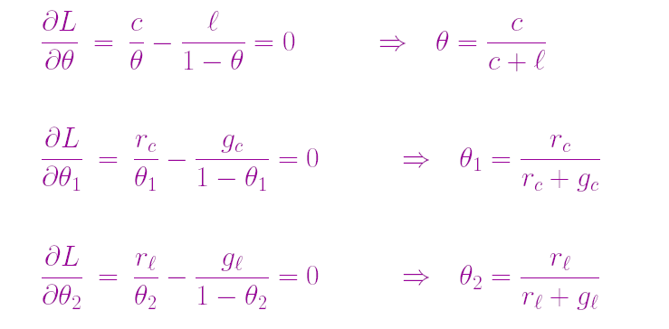
Anwendungsbeispiel Bonbonfabrik
Maximierung des Logarithmus der Zielfunktion
  L = clog𝜃 + l log(1- 𝜃) + r^{c} log 𝜃 ₁ + g^{c} log(1- 𝜃 ₁) + r^{l} log 𝜃 ₂ + g ^{l} log(1- 𝜃 ₂)
Bestimmung der Ableitungen bzgl. 𝜃, 𝜃 ₁ ,𝜃 ₂
  Ausdrücke ohne Term, nach dem abgeleitet wird, verschwinden

Slide 39
Maximum-Likelihood-Parameterschätzung
Schätzung durch Bildung relativer Häufigkeiten
Dieser Prozess ist auf jedes voll beobachtbare BN anwendbar
Mit vollständigen Daten und Maximum-Likelihood-Parameterschätzung:
  Parameterlernen zerfällt in separate Lernprobleme für jeden Parameter (CPT) durch Logarithmierung
  Jeder Parameter wird durch die relative Häufigkeit eines Knotenwertes bei gegebenen Werten der Elternknoten bestimmt

Slide 40
Beliebte Anwendung: Naives Bayes-Modell
C
Naïve Bayes-Modell: Sehr einfaches
Bayessches Netzwerk zur Klassifikation
  Klassenvariable C (vorherzusagen) bildet Wurzel
  Attributvariablen X_{i} (Beobachtungen) sind Blätter
Naiv, weil angenommen wird, dass die Attributwerte bedingt unabhängig sind, wenn die Klasse gegeben ist
Deterministische Vorhersagen können durch Wahl der wahrscheinlichsten Klasse erreicht werden
Skalierung auf realen Daten sehr gut:
  2n + 1 Parameter benötigt
X_{n}
X₁
X₂

Slide 41
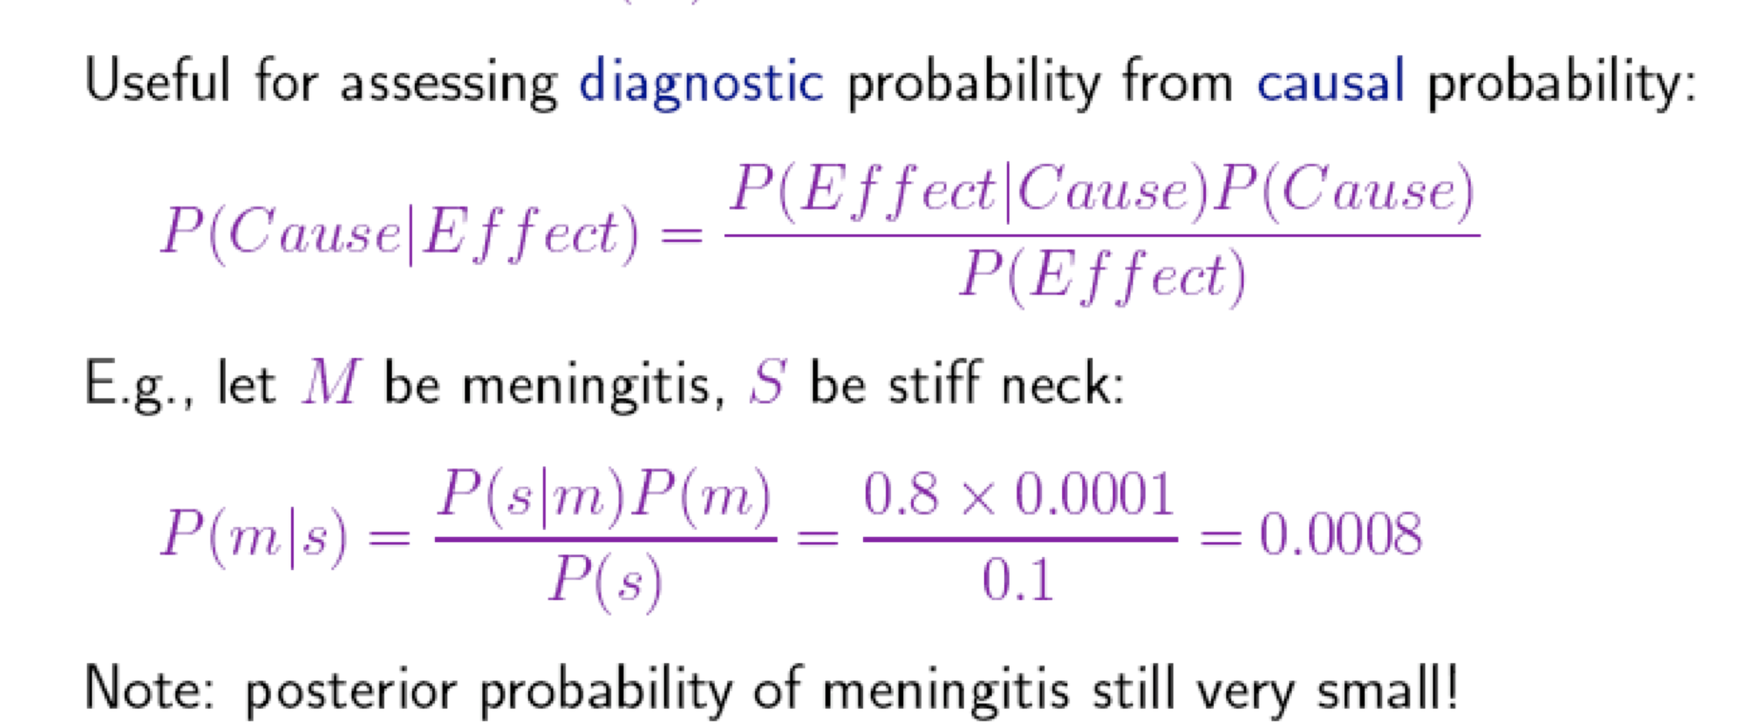
Anwendung: Diagnose

Slide 42
Constructing Bayesian networks
1. Choose an ordering of variables X₁, … ,X_{n}
2. For i = 1 to n
  add X_{i} to the network
  select parents from X₁, … ,X_{i-1} such that
  P (X_{i} | Parents(X_{i})) = P (X_{i} | X₁, ... X_{i-1})
This choice of parents guarantees:
(chain rule)
P (X₁, … ,X_{n}) = 𝚷_{i =1} P (X_{i} | X₁, … , X_{i-1})
(by construction)
= 𝚷_{i =1}P (X_{i} | Parents(X_{i}))
n
n

Slide 43
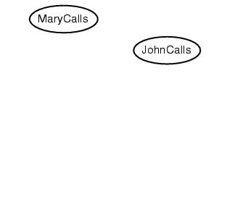
Example
Suppose we choose the ordering M, J, A, B, E
P(J | M) = P(J)?

Slide 44
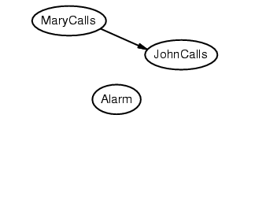
Example
Suppose we choose the ordering M, J, A, B, E
P(J | M) = P(J)? No
P(A | J, M) = P(A)? P(A | J, M) = P(A | J)?

Slide 45
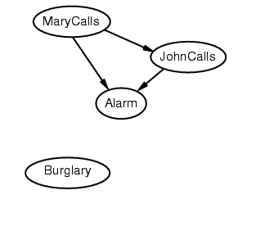
Example
Suppose we choose the ordering M, J, A, B, E
P(J | M) = P(J)? No
P(A | J, M) = P(A)? P(A | J, M) = P(A | J)? No
P(B | A, J, M) = P(B | A)?
P(B | A, J, M) = P(B)?

Slide 46
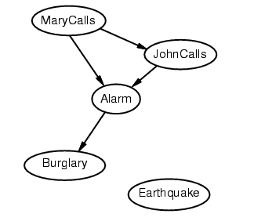
Example
Suppose we choose the ordering M, J, A, B, E
P(J | M) = P(J)? No
P(A | J, M) = P(A | J)? P(A | J, M) = P(A)? No
P(B | A, J, M) = P(B | A)? Yes
P(B | A, J, M) = P(B)? No
P(E | B, A ,J, M) = P(E | A)?
P(E | B, A, J, M) = P(E | A, B)?

Slide 47
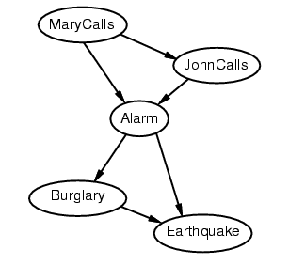
Example
Suppose we choose the ordering M, J, A, B, E
P(J | M) = P(J)? No
P(A | J, M) = P(A | J)? P(A | J, M) = P(A)? No
P(B | A, J, M) = P(B | A)? Yes
P(B | A, J, M) = P(B)? No
P(E | B, A, J, M) = P(E | A)? No
P(E | B, A, J, M) = P(E | A, B)? Yes

Slide 48
Example contd.
Deciding conditional independence is hard in non-causal directions
(Causal models and conditional independence seem hardwired for humans!)
Network is less compact: 1 + 2 + 4 + 2 + 4 = 13 numbers needed
instead of 10.

Slide 49
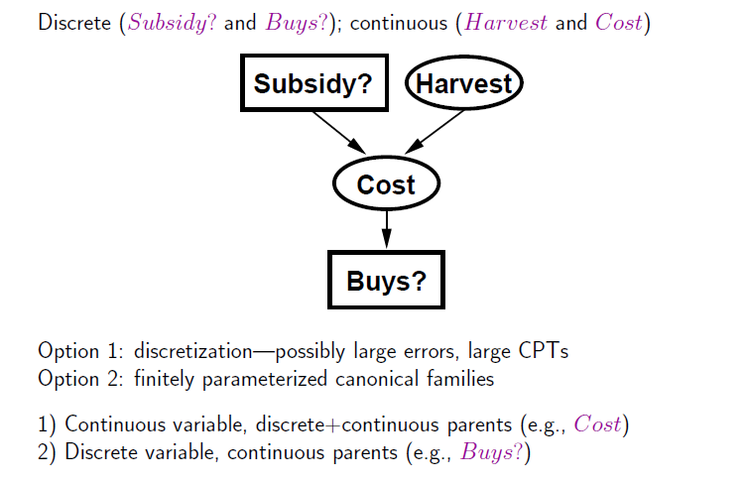
Hybrid (discrete+continuous) networks
BNs can also deal with continuous RVs or even hybrid ones
(e.g., Gaussian Distribution)

Slide 50
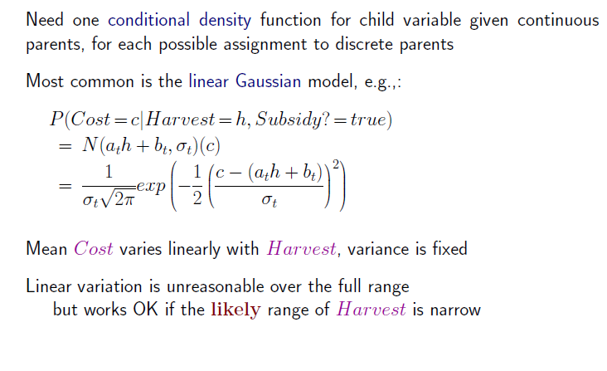
Continuous child variables

Slide 51
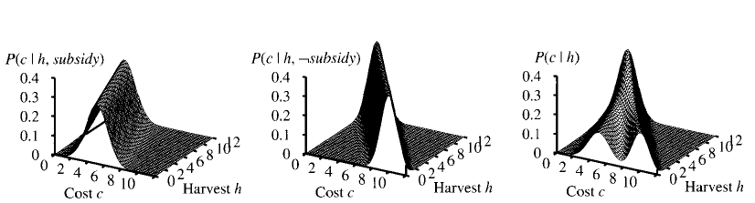
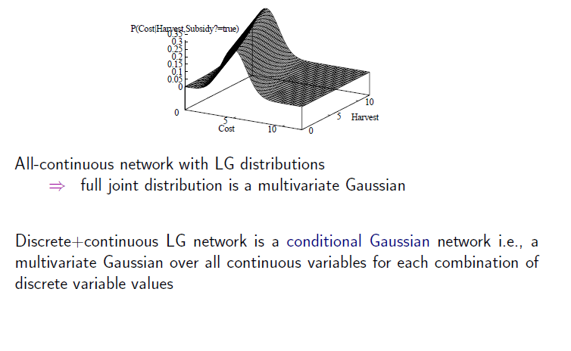
Continuous child variables
LG = linear Gaussian

Slide 52
Noisy-OR-Representation
A
B
A
B
0.8
0.1
C
Meaning
C
A
B
c
f
f
0.0
f
t
0.1
t
f
0.8
t
t
0.1+0.8 - 0.1*0.8
Substantial reduction of the probabilities to be stored
52

Slide 53
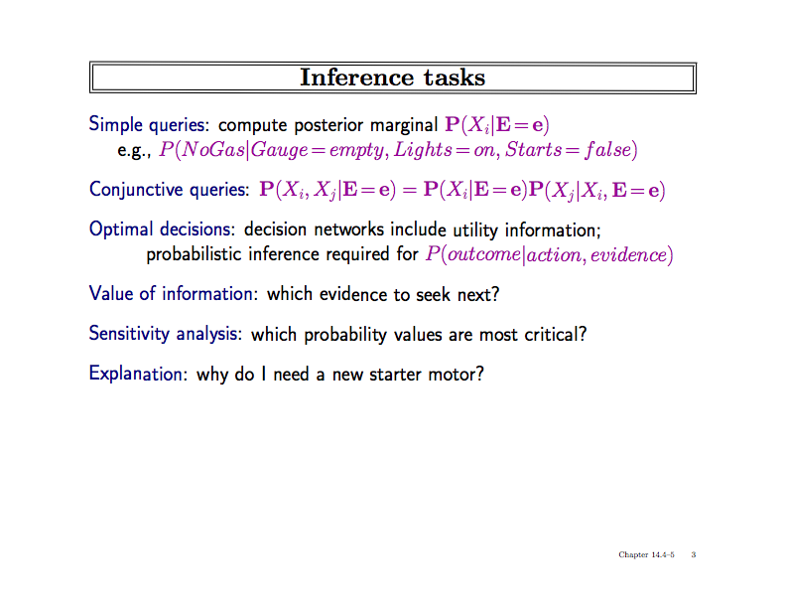
what must be true to allow for a certain (desired) conclusion?

Slide 54
(Calculation over sum-product evaluation tree
with path length n (=number of RVs) and degree d
(= maximal number domain elements) )

Slide 55
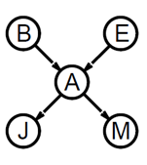
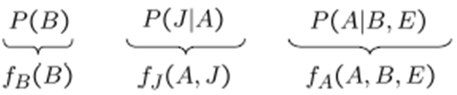
Basic Objects of VE
Track objects called factors
(right-to-left, in tree: bottom up)
Initial factors are local CPTs
During elimination create new factors
Form of Dynamic Programming
P(M|A)
f_{M}(A)

Slide 56
Basic Operations: Pointwise Product
Pointwise product of factors f₁ and f₂
  for example: f₁(A,B) * f₂(B,C)= f(A,B,C)
  in general:
  f₁(X₁,...,X_{j},Y₁,…,Y_{k}) *f₂(Y₁,…,Y_{k},Z₁,…,Z_{l})= f(X₁,...,X_{j},Y₁,…,Y_{k},Z₁,…,Z_{l})
  has 2^{j+k+l} entries (if all variables are binary)

Slide 57

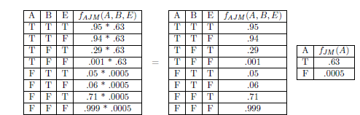
Join by pointwise product

Slide 58
Basic Operations: Summing out
Summing out a variable from a product of factors
  Move any constant factors outside the summation
  Add up submatrices in pointwise product of remaining factors
  𝛴_{x} f₁* …*f_{k} = f₁*…*f_{i}*𝛴_{x} f_{i+1}*…*f_{k}
  = f₁*…*f_{i}* f_{X}
  assuming f₁, …, f_{i} do not depend on X

Slide 59
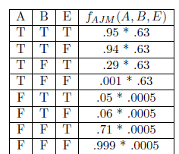
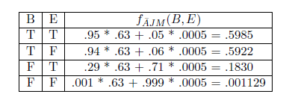
Summing out
Summing out a

Slide 60
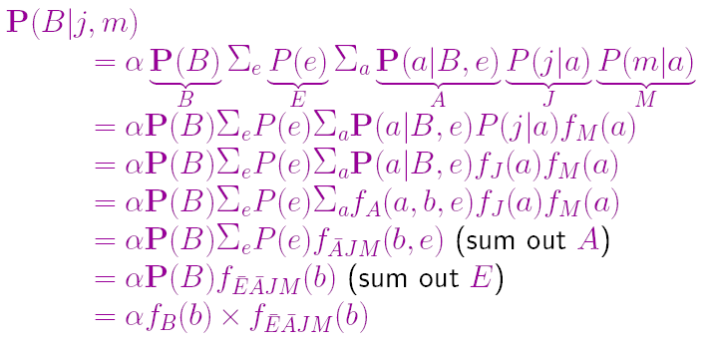
VE result for Burglary Example

Slide 61
Optimization by Finding Irrelevant Variables
{Alarm, Earthquake, Burglary}
Irrelevant variables can be identified by a graph theoretical criterion on the associated moral graph by m-separation

Slide 62
What else can we do?
General methodology: Consider special cases (special data structures)
Here: Consider polytrees (singly connected networks)
The following slides on Pearl‘s belief propagation algorithm are based on slides by Tomas Singliar (adapted by Daniel Lowd)

Slide 63
Polytree Bayesian Networks
Bayesian network graph is a polytree (alias: singly connected network) iff there is at most one path between any two nodes, V_{i} and V_{k} (iff the underlying non-directed graph is a tree)
Exact BN inference is NP-hard but O(n) on polytree
(Non-)Examples:
V₁
V₁
V₄
V₁
V₃
V₂
V₃
V₂
V₃
V₂
V₄
V₄
V₅
V₆
V₅
V₆
-
+
-
Notes:
This slide introduces BBNs and the notion of polytree.

Slide 64
Our inference task
We know the values of evidence variables given in set E:
We wish to compute the conditional probability P(X_{i} |E)
for all non-evidence variables X_{i}.
IDEA:
  Do variable elimination in parallel (locally on each node/RV)
  Send/receive required data to/from other nodes
The following soldier counting example on message passing is adapted from slides of M. Gormley
Notes:
Can have less than all nodes to compute (goal oriented).

Slide 65
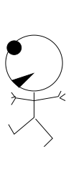
____ ____ __ ______ ______
Counting soldiers example (linear)
there's
1 of me
1
before
you
2 before
you
3 before
you
4 before
you
5 before
you
5 behind you
4 behind you
3 behind you
2 behind you
1 behind you
adapted from
MacKay (2003): Information Theory, Inference and Learning Algorithms.

Slide 66
Counting soldiers example (beliefs)
Belief:
Must be
2 + 1 + 3 = 6 of us
there's
1 of me
2 before
you
2 before
you
only see
my incoming
messages
3 behind you

Slide 67
Counting soldiers example (locality)
Belief:
Must be
1 + 1 + 4 = 6 of us
Belief:
Must be
2 + 1 + 3 = 6 of us
there's
1 of me
1 before
you
only see
my incoming
messages
4 behind you

Slide 68
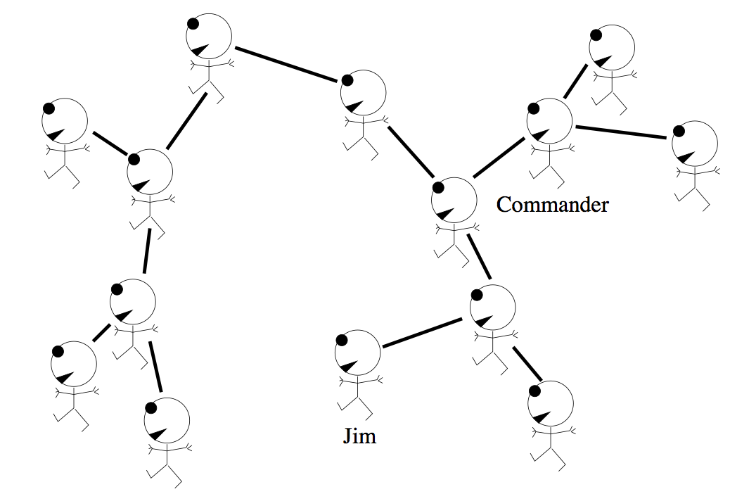
Counting soldiers example (in polytree)
3 here
7 here
1 of me
11 here
(= 7+3+1)

Slide 69
Counting soldiers example (in polytree)
3 here
7 here
(= 3+3+1)
3 here

Slide 70
Counting soldiers example (in polytree)
11 here
(= 7+3+1)
7 here
3 here

Slide 71
Counting soldiers example (in polytree)
3 here
7 here
Belief:
Must be
14 of us
3 here

Slide 72
Counting soldiers example (non-circularity)
3 here
7 here
Belief:
Must be
14 of us
3 here
wouldn't work correctly
with a 'loopy' (cyclic) graph
But you might foresee
the junction tree algorithm:
One has to partition the graph
into a tree of clusters

Slide 73
Pearl‘s belief propagation algorithm
Local computation for one node V desired
Information flows through the links of G
  flows as messages of two types – λ and π
V splits network into two disjoint parts
  Strong independence assumptions induced – crucial!
Denote E_{V}⁺ the part of evidence accessible
through the parents of V (causal, predictive, prior)
  passed downward in π messages
Analogously, let E_{V}⁻ be the diagnostic (or likelihood) evidence
  passed upwards in λ messages

Slide 74
Pearl‘s Belief Propagation
U₁
U₂
λ(U₂)
π(U₁)
π(U₂)
λ(U₁)
V
λ(V₁)
π(V₂)
π(V₁)
λ(V₂)
V₁
V₂
Notes:
Arrows are to indicate that this is a general situation.

Slide 75
The π Messages
What are the messages?
For simplicity, let the nodes be Boolean
V₁=T | 0.8
V₁=F | 0.2
The message passes on information.
What information? Observe:
P(V₂) = P(V₂| V₁=T)P(V₁=T)
+ P(V₂| V₁=F)P(V₁=F)
V₁
P | V₁=T | V₁=F
V₂=T | 0.4 | 0.9
V₂=F | 0.6 | 0.1
The information needed is the CPT of V₁ = π_{V}(V₁)
π messages capture information passed from parent to child
V₂
Notes:
Let’s figure out what the messages are. Make the reservation that it is not exactly CPT but evidence needs to be incorporated. What is a CPT? It captures what we should believe the value of the node is. Based on parent information – may involve (causal) evidence.

Slide 76
The Evidence
Evidence – values of observed nodes
  V₃ = T, V₆ = 3
Our belief in what the value of V_{i}
‘should’ be changed
This belief is propagated
As if the CPTs became
V₁
V₃
V₂
V₄
V₃=T | 1.0
V₃=F | 0.0
P | V₂=T | V₂=F
V₆=1 | 0.0 | 0.0
V₆=2 | 0.0 | 0.0
V₆=3 | 1.0 | 1.0
V₅
V₆

Slide 77
The Messages
We know what the π messages are
What about λ?
The messages are π(V)=P(V|E⁺) and λ(V)=P(E⁻|V)
Assume E = { V₂ } and compute by Bayes rule:
The information not available at V₁ is P(V₂|V₁). To be passed upwards by a λ-message. Again, this is not in general exactly the CPT, but the belief based on evidence down the tree.
V₁
V₂

Slide 78
Combination of evidence in node V
Recall that E_{V} = E_{V}⁺ ∪ E_{V}⁻ and let us compute
α is the normalization constant ( 1/P(E⁻|E⁺) )
  normalization is not necessary (can do it at the end)
  but may prevent numerical underflow problems

Slide 79
λ message combination
Assume X received λ-messages from neighbors
How to compute λ(x) = P(e⁻|x)?
Let Y₁, … , Y_{c} be the children of X
λ_{YX}(x) denotes the λ-message sent from Y to X
Derivation:
Assume two children Y, Z of X; then:
P(e⁻|x) = P(e⁻_{Y}, e⁻_{Z}|x) = P(e⁻_{Y}|x)* P(e⁻_{Z}|x)
(siblings independent given parent)

Slide 80
π message combination
Assume X received π-messages from neighbors
How to compute π(x) = P(x|e⁺) ?
Let U₁, … , U_{p} be the parents of X
π_{XY}(x) denotes the π-message sent from X to Y
summation over the CPT
Derivation: Condition on all U_{i} and note that each pair
(parent U_{i},evidence e⁺_{i}) is independent of the other pairs (U_{j},e⁺_{j})

Slide 81
Messages to pass
We need to compute π_{XY}(x) for each child Y
Derivation
π_{XYj}
= P(x | e⁺_{XYj})
= P(x | e – e⁻_{XYj}) =
= [ Bel(x) when evidence e⁻_{XYj} is surpressed]
= Bel(x) setting λ_{XYj}(x) = 1
= formula above
e⁺_{XY} = evidences on tail side
(X side) of link X->Y
e⁻_{XY} = evidences on head side
(Y-side) of link X -> Y

Slide 82
Messages to pass
e⁺_{XYj}
e⁺_{VYj}
Derivation hint
λ_{YjX} = P(e⁻_{XYj}|x)
= P(e⁺_{VYj},e⁻_{Yj}|X)
then condition on YJ and V,
And use independences
  Y_{j} separates e⁺_{VYj} from e⁻_{Yj}
  V separates e⁺_{VYj} from X
X
V
λ_{YjX}
Yj
λ_{Yj}
e⁻_{Yj}
Symbolically, group other (≠X) parents of Y_{j} into single complex
V = V₁, … , V_{q} and treat link X->Y_{j} vs. V-> Y_{j}

Slide 83
Pearl’s Belief Propagation Algorithm
  Initialization step
    For all V_{i}=e_{i} in E:
      λ(x_{i}) = 1 whenever x_{i} = e_{i} ; 0 otherwise
      π(x_{i}) = 1 whenever x_{i} = e_{i} ; 0 otherwise
    For nodes (not in E) without parents
      π(x_{i}) = p(x_{i}) - prior probabilities
    For nodes without children
      λ(x_{i}) = 1 uniformly (normalize at end)

Slide 84
Pearl’s Belief Propagation Algorithm
  Iterate until no change occurs
    (For each node X) if X has received all the π messages from its parents, calculate π(x)
    (For each node X) if X has received all the λ messages from its children, calculate λ(x)
    (For each node X) if π(x) has been calculated and X received all the λ-messages from all its children (except Y), calculate π_{XY}(x) and send it to Y.
    (For each node X) if λ(x) has been calculated and X received all the π-messages from all parents (except U), calculate λ_{XU}(u) and send it to U.
  Compute BEL(X) = λ(x)π(x) and normalize
Notes:
in step 3, of course the message from Y may have been received too. analogously in step 4

Slide 85
Complexity
On a polytree, the BP algorithm converges in time proportional to diameter of network – at most linear
Work done in a node is proportional to the size of CPT
Hence BP is linear in number of network parameters
For general BNs
  Exact inference is NP-hard
  Approximate inference is NP-hard
Most BNs are not polytrees. What to do?
  Clustering (e.g., junction tree) algorithm (somewhat later) to make graph tree like and then use BP
  Approximate inference (next slides)

Slide 86
Approximate Inference over BNs

Slide 87
Approximation
We are going to approximate answers to queries such as the posterior P(X|E).
Here we presume an intuitive notion of approximation:
  The answer may be erroneous to some extent
Formally treated in PAC theory (Probably Approximately Correct) by parameters (δ,ε)
  Confidence (quantified by δ) in that found solution maximally deviates from true solution up to ε
87

Slide 88
Approximate Inference in Bayesian Networks
Monte Carlo algorithm
  Widely used to estimate quantities that are difficult to calculate exactly (Remember: for BNs NP-hardness)
  Randomized sampling algorithm
  Accuracy depends on the number of samples
  Two families
    Direct sampling
    Markov chain sampling

Slide 89
Inference by stochastic simulation

Slide 90
Sampling A Value
What does it mean to sample x_{i}^{t} from P(X_{i} | pa_{i}) ?
Assume D(X_{i})={0,1}
Assume P(X_{i} | pa_{i}) = (0.3, 0.7)
Draw a random number r from [0,1]
If r falls in [0,0.3], set X_{i} = 0
If r falls in [0.3,1], set X_{i}=1
0
0.3
r
1

Slide 91
Example in simple case
P(C)=.5
Sampling
Cloudy
[Cloudy, Sprinkler, Rain, WetGrass]
C P(R|C)
________
t .80
f .20
C P(S|C)
________
t .10
f .50
[true, , , ]
[true, false, , ]
Sprinkler
Rain
[true, false, true, ]
[true, false, true, true]
S R P(W|S,R)
______________
t t .99
t f .90
f t .90
f f .00
WetGrass
Estimating
N = 1000 (# generated samples)
N(Rain=true) = N([ _ , _ , true, _ ]) = 511
(# of samples for this event)
P(Rain=true) = 0.511 (approximated probability)
Notes:
N(e) = Number of samples generated for event e
Explanation of algorithm on next slide. Note that N = 511 is the outcome of the random sampling; it is not calculated.

Slide 92
Sampling from empty network
Generating samples from a network that has no evidence associated with it (empty network)
Basic idea
  sample a value for each variable in topological order
  using the specified conditional probabilities

Slide 93
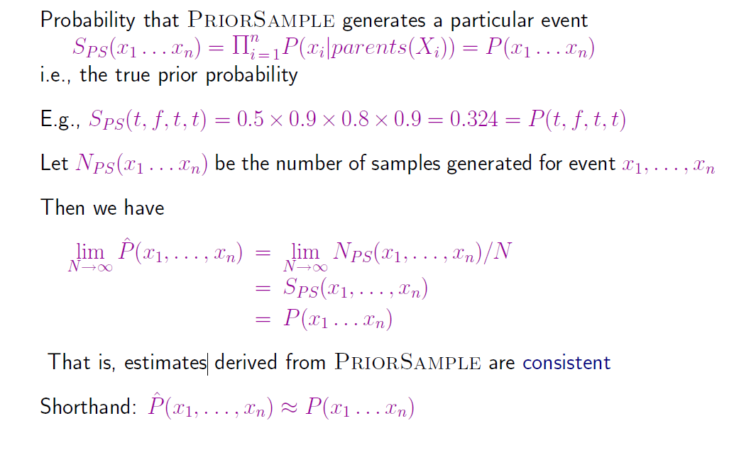
Properties
Notes:
Note: second probability is 0.9 = 1 – 0.1 = 1 – P(S|C)

Slide 94
What if evidence is given?
Sampling as defined above would generate cases that cannot be used

Slide 95
Rejection Sampling
Used to compute conditional probabilities
Procedure
  Generating sample from prior distribution specified by the Bayesian Network
  Rejecting all attempts that do not match the evidence
  Estimating probability

Slide 96
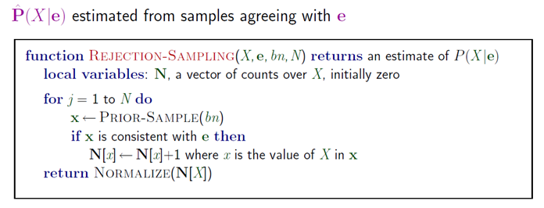
Rejection Sampling

Slide 97
Rejection Sampling Example
Let us assume we want to estimate P(Rain|Sprinkler = true) with 100 samples
100 samples
  73 samples => Sprinkler = false
  27 samples => Sprinkler = true
    8 samples => Rain = true
    19 samples => Rain = false
P(Rain|Sprinkler = true) = NORMALIZE((8,19)) = (0.296,0.704)
Problem
  It rejects too many samples

Slide 98
Analysis of rejection sampling
Notes:
So, many many runs will have to be discarded as the events have small probability

Slide 99
Likelihood Weighting
Goal
  Avoiding inefficiency of rejection sampling
Idea
  Generating only events consistent with evidence
  Each event is weighted by likelihood that the event accords to the evidence

Slide 100
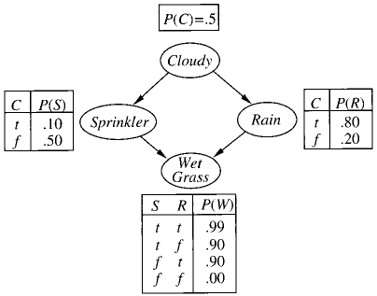
Likelyhood Weighting: Example
P(Rain|Sprinkler=true,
WetGrass = true)?
Sampling
  The weight is set to 1.0
  Sample from P(Cloudy) = (0.5,0.5) => true
  Sprinkler is an evidence variable with value true
  w ⬅ w * P(Sprinkler=true | Cloudy = true) = 0.1
  Sample from P(Rain|Cloudy=true)=(0.8,0.2) => true
  WetGrass is an evidence variable with value true
  w ⬅w * P(WetGrass=true |Sprinkler=true, Rain = true) = 0.099
  [true, true, true, true] with weight 0.099
Estimating
  Accumulating weights to either Rain=true or Rain=false
  Normalize (= divide by sum of weights)
Notes:
Weight is low because its a cloudy day what makes sprinkler unlikley

Slide 101
Likelyhood Weighting: Example
P(Rain|Cloudy=true,
WetGrass = true)?
Sampling
  Cloudy is an evidence
  w ⬅ w * P(Cloudy = true) = 0.5
  Sprinkler no evidence
  Sample from P(Sprinkler| Cloudy=true)=(0.1, 0.9) => false
  Sample from P(Rain|Cloudy=true)=(0.8,0.2) => true
  WetGrass is an evidence variable with value true
  w ⬅w * P(WetGrass=true |Sprinkler=false, Rain = true) = 0.45
  [true, false, true, true] with weight 0.45
Notes:
Weight is high because its a cloudy day and now sprinkler=fase

Slide 102
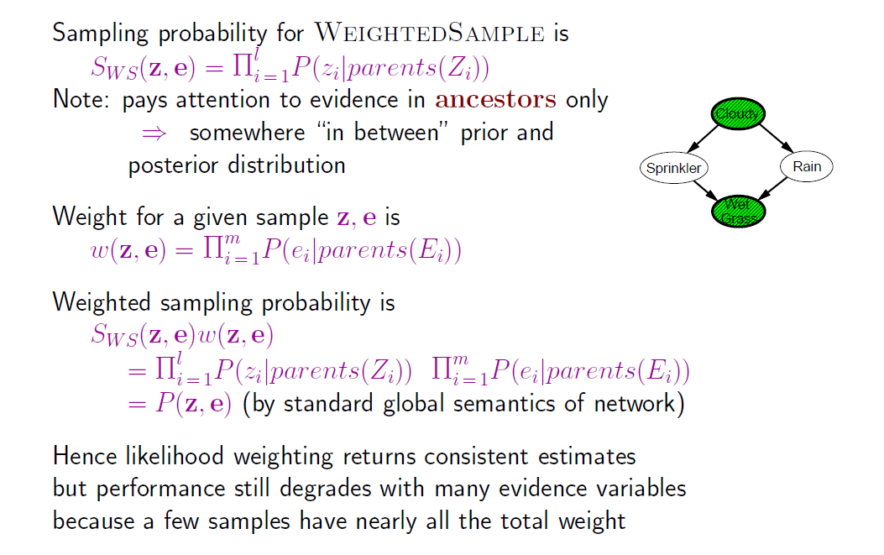
Likelihood analysis

Slide 103
Likelihood weighting

Slide 104
Markov Chain Monte Carlo
Let’s think of the network as being in a particular current state specifying a value for every variable
MCMC generates each event by making a random change to the preceding event
The next state is generated by randomly sampling a value for one of the non-evidence variables X_{i}, conditioned on the current values of the variables in the Markov blanket of X_{i}
Likelihood Weighting only takes into account the evidences of the parents. (Problematic if evidence on leaves).

Slide 105
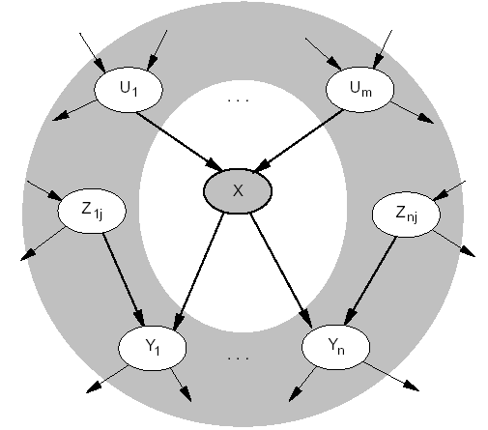
Markov Blanket
Markov blanket: Parents + children + children’s parents
Node is conditionally independent of all other nodes in network, given its Markov Blanket

Slide 106
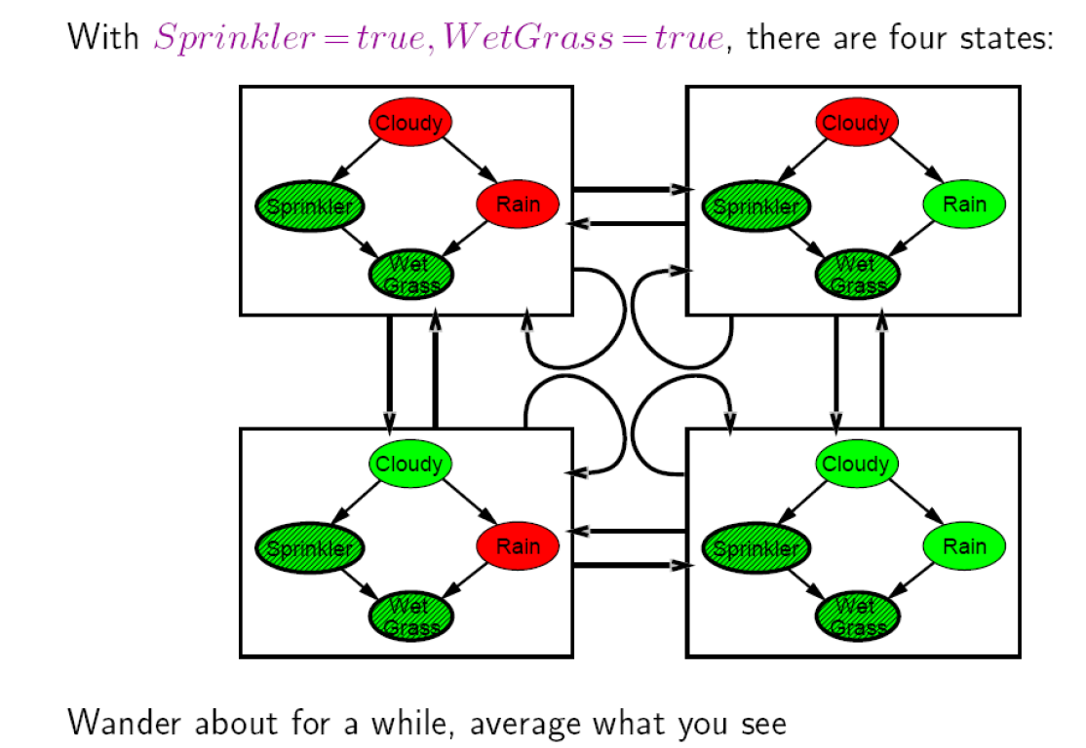
Arrows describe transition probabilities; leads to a (the Markov) chain of states

Slide 107
Markov Chain Monte Carlo: Example
P(Rain|Sprinkler = true, WetGrass = true) = ?
Initial state is [true, true, false, true] (for [Cloudy,Sprinkler,Rain,WetGrass])
The following steps are executed repeatedly:
  Cloudy is sampled, given the current values of its Markov blanket variables
  So, we sample from P(Cloudy|Sprinkler= true, Rain=false)
  Suppose the result is Cloudy = false.
  Now current state is [false, true, false, true] and counts are updated
  Rain is sampled, given the current values of its Markov blanket variables
  So, we sample from P(Rain|Cloudy=false,Sprinkler=true, WetGrass=true)
  Suppose the result is Rain = true.
  Then current state is [false, true, true, true]
After all the iterations, let’s say the process visited 20 states where Rain is true and 60 states where Rain is false then the answer of the query is NORMALIZE((20,60))=(0.25,0.75)

Slide 108
MCMC
s
s
Z
s
s
s

Slide 109
Summary
Bayesian networks provide a natural representation for (causally induced) conditional independence
Topology + CPTs = compact representation of joint distribution
Generally easy for domain experts to construct
Exact inference by variable elimination
  polytime on polytrees, NP-hard on general graphs
  space can be exponential as well
Exact inference by belief propagation on polytrees
Approximate inference based on sampling and counting help to overcome complexity of exact inference

Slide 110
Acknowledgements
Slides from AIMA book provided by Cristina Conati, UBC
110

Slide 111
Data Mining Bayesian Networks
Full Bayesian Learning
MAP learning
Maximum Likelihood Learning
Learning Bayesian Networks
  Fully observable
  With hidden (unobservable) variables

Slide 112
Full Bayesian Learning
In the learning methods we have seen so far, the idea was always to find the best model that could explain some observations
In contrast, full Bayesian learning sees learning as Bayesian updating of a probability distribution over the hypothesis space, given data
  H is the hypothesis variable
  Possible hypotheses (values of H) h₁…, h_{n}
  P(H) = prior probability distribution over hypothesis space
j_{th} observation d_{j} gives the outcome of random variable D_{j}
  training data d= d₁,..,d_{k}

Slide 113
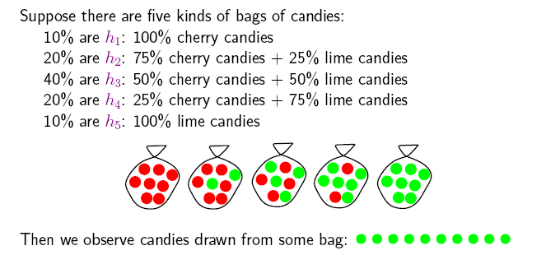
Example
Suppose we have 5 types of candy bags
  10% are 100% cherry candies (h₁₀₀)
  20% are 75% cherry + 25% lime candies (h₇₅)
  40% are 50% cherry + 50% lime candies (h₅₀)
  20% are 25% cherry + 75% lime candies (h₂₅)
  10% are 100% lime candies (h₀)
Then we observe candies drawn from some bag
Let‘s call 𝜃 the parameter that defines the fraction of cherry candy in a bag, and h_{𝜃} the corresponding hypothesis
Which of the five kinds of bag has generated my 10 observations? P(h _{𝜃} |d).
What flavour will the next candy be? Prediction P(X|d)

Slide 114
Full Bayesian Learning
Given the data so far, each hypothesis h_{i} has a posterior probability:
  P(h_{i} |d) = αP(d| h_{i}) P(h_{i}) (Bayes theorem)
  where P(d| h_{i}) is called the likelihood of the data under each hypothesis
Predictions over a new entity X are a weighted average over the prediction of each hypothesis:
  P(X|d) =
  = ∑_{i} P(X, h_{i} |d)
  = ∑_{i} P(X| h_{i},d) P(h_{i} |d)
  = ∑_{i} P(X| h_{i}) P(h_{i} |d)
  ~ ∑_{i} P(X| h_{i}) P(d| h_{i}) P(h_{i})
  The weights are given by the data likelihood and prior of each h
+ No need to pick one best-guess hypothesis!
- Need to iterate over all hypotheses
The data does not add anything to a prediction given a hypothesis
Man findet ∝ oder ~ oder = 𝛼∙ …

Slide 115
Example
If we re-wrap each candy and return it to the bag, our 10 observations are independent and identically distributed, i.i.d, so
  P(d| h_{𝜃}) = ∏_{j} P(d_{j}| h_{𝜃}) for j=1,..,10
For a given h_{𝜃} , the value of P(d_{j}| h_{𝜃}) is
  P(d_{j} = cherry| h_{𝜃}) = 𝜃; P(d_{j} = lime|h_{𝜃}) = (1-𝜃)
And given N observations, of which c are cherry and l = N-c lime
  Binomial distribution: probability of # of successes in a sequence of N independent trials with binary outcome, each of which yields success with probability 𝜃.
For instance, after observing 3 lime candies in a row:
  P([lime, lime, lime] | h ₅₀) = 0.5³ because the probability of seeing lime for each observation is 0.5 under this hypotheses

Slide 116
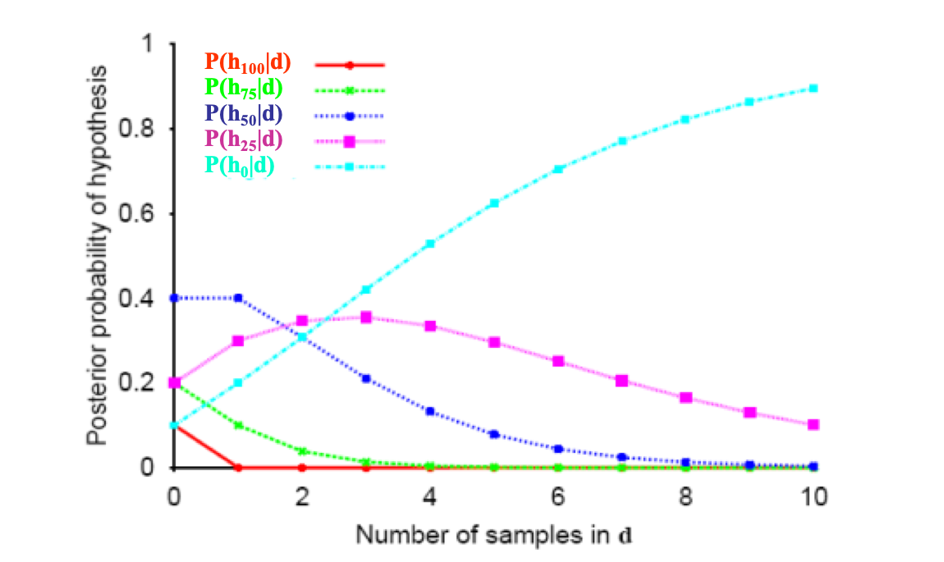
All-limes: Posterior Probability of H
P(h_{i} |d) = αP(d| h_{i}) P(h_{i})
Initially, the h_{p} with higher priors dominate (h₅₀ with prior = 0.4)
As data comes in, the finally best hypothesis (h₀) starts dominating, as the probability of seeing this data given the other hypotheses gets increasingly smaller
  After seeing three lime candies in a row, the probability that the bag is the all-lime one starts taking off

Slide 117
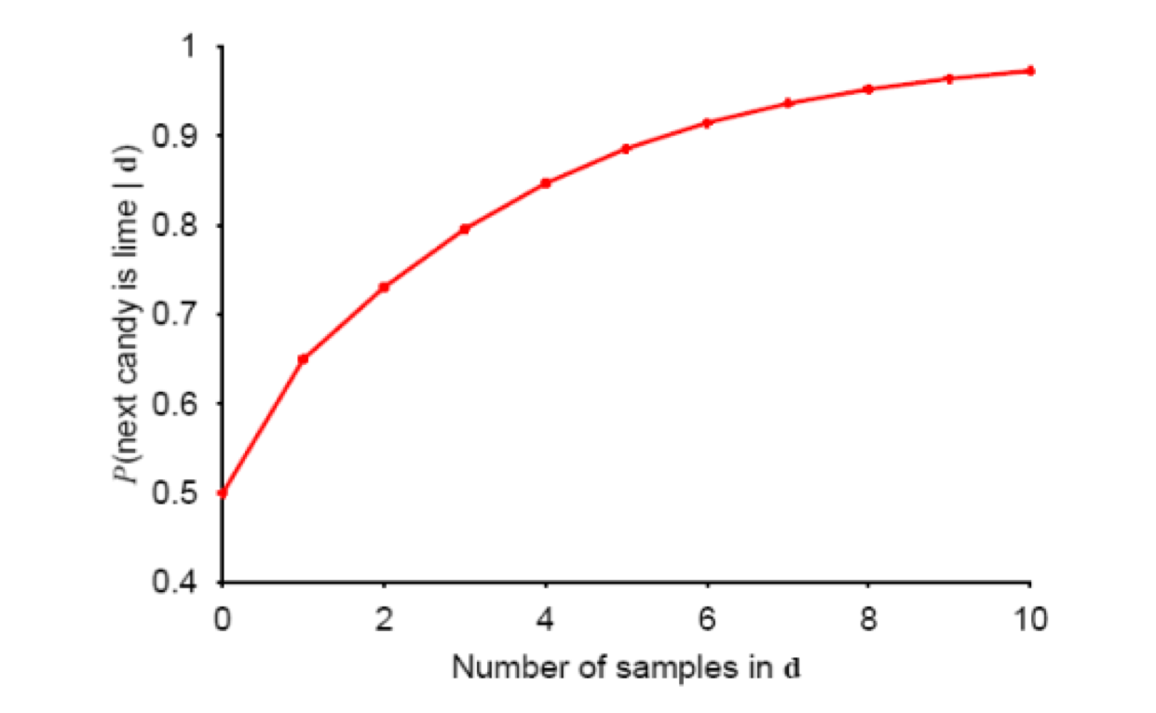
Prediction Probability
∑_{i} P(next candy is lime| h_{i}) P(h_{i} |d)
The probability that the next candy is lime increases with the probability that the bag is an all-lime one

Slide 118
Overview
Full Bayesian Learning
MAP learning
Maximum Likelihood Learning
Learning Bayesian Networks
  Fully observable
  With hidden (unobservable) variables

Slide 119
MAP approximation
Full Bayesian learning seems like a very safe bet, but unfortunately it does not work well in practice
  Summing over the hypothesis space is often intractable (e.g., 18,446,744,073,709,551,616 Boolean functions of 6 attributes)
Very common approximation: Maximum a posterior (MAP) learning:
  Instead of doing prediction by considering all possible hypotheses , as in
    P(X|d) = ∑_{i} P(X| h_{i}) P(h_{i} |d) ∝ ∑_{i} P(X| h_{i}) P(d| h_{i}) P(h_{i})
  Make predictions based on h_{MAP} that maximises P(h_{i} |d)
    I.e., maximize P(d| h_{i}) P(h_{i})
    P(X|d) ≈ P(X| h_{MAP} )
Man findet ∝ oder ~ oder = 𝛼∙ …

Slide 120
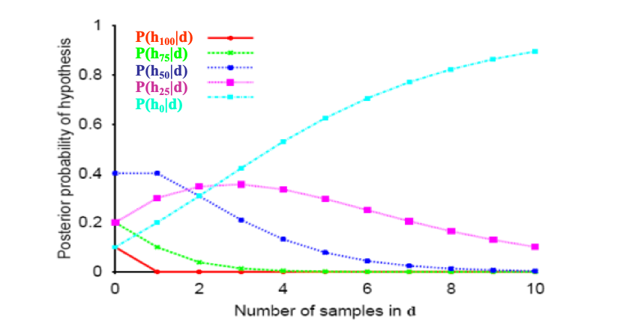
MAP approximation
MAP is a good approximation when P(X |d) ≈ P(X| h_{MAP})
  In our example, h_{MAP} is the all-lime bag after only 3 candies, predicting that the next candy will be lime with p =1
  The Bayesian learner gave a prediction of 0.8, safer after seeing only 3 candies

Slide 121
Bias
As more data arrive, MAP and Bayesian prediction become closer, as MAP’s competing hypotheses become less likely
Often easier to find MAP (optimization problem) than deal with a large summation problem
P(H) plays an important role in both MAP and Full Bayesian Learning (defines learning bias)
Used to define a tradeoff between model complexity and its ability to fit the data
  More complex models can explain the data better => higher P(d| h_{i}) danger of overfitting
  But they are less likely a priory because there are more of them than simpler model => lower P(h_{i})
  I.e. common learning bias is to penalize complexity

Slide 122
Overview
Full Bayesian Learning
MAP learning
Maximum Likelihood Learning
Learning Bayesian Networks
  Fully observable
  With hidden (unobservable) variables

Slide 123
Maximum Likelihood (ML) Learning
Further simplification over full Bayesian and MAP learning
  Assume uniform priors over the space of hypotheses
  MAP learning (maximize P(d| h_{i}) P(h_{i})) reduces to maximize P(d| h_{i})
When is ML appropriate?
Howard, R.: Decision analysis: Perspectives on inference, decision, and experimentation. Proceedings of the IEEE 58(5), 632-643, 1970

Slide 124
Maximum Likelihood (ML) Learning
Further simplification over Full Bayesian and MAP learning
  Assume uniform prior over the space of hypotheses
  MAP learning (maximize P(d| h_{i}) P(h_{i})) reduces to maximize P(d| h_{i})
When is ML appropriate?
  Used in statistics as the standard (non-bayesian) statistical learning method by those who distrust subjective nature of hypotheses priors
  When the competing hypotheses are indeed equally likely (e.g. have same complexity)
  With very large datasets, for which P(d| h_{i}) tends to overcome the influence of P(h_{i})

Slide 125
Overview
Full Bayesian Learning
MAP learning
Maximum Likelihood Learning
Learning Bayesian Networks
  Fully observable (complete data)
  With hidden (unobservable) variables

Slide 126
Learning BNs: Data Science w/ Complete Data
We will start by applying ML to the simplest type of BNets learning:
  known structure
  Data containing observations for all variables
    All variables are observable, no missing data
The only thing that we need to learn are the network’s parameters

Slide 127
Maximum-Likelihood Estimation (MLE)
argmax
𝛳
Maximize log P(D | 𝛳)
Compute the derivative of every summand
Compute roots, resolve equation to each parameter
Determine frequencies according to graph structure and CPT construction

Slide 128
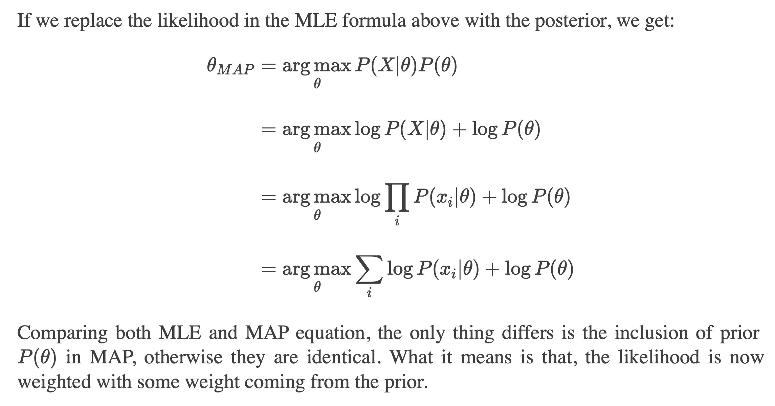
Extension to MAP

Slide 129
Überblick
Volles Bayessches Lernen (BMA)
MAP-Lernen
Maximum-Likelihood-Lernen
  Vollständig beobachtbar (vollständige Daten)
  Mit versteckten (unbeobachtbaren) Variablen

Slide 130
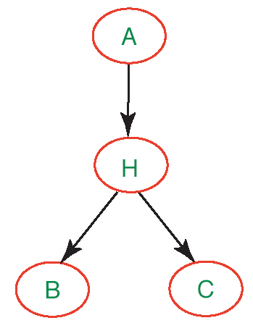
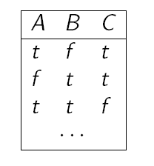
Parameterlernen mit versteckten Variablen
Bisher haben wir angenommen, Daten für jede Variable des BNs stehen zur Verfügung
Was machen wir, wenn das nicht der Fall ist, d.h. es gibt versteckte (hidden) Variablen im Netzwerk?
Den Ansatz mit relativen Häufigkeiten können wir nicht so einfach übernehmen (keine Zähler für Variable H bekannt)

Slide 131
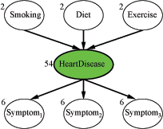
Vermeintliche Lösung
Vermeide versteckte Variablen
Könnte klappen bei kleinen Netzwerken
Doch was machen wir hier?
  Jede Variable habe 3 Werte (low, moderate, high)
  Die Zahlen an den Knoten repräsentieren, wie viele Parameter für die CPT des betreffenden Knotens bestimmt werden müssen
  78 Wahrscheinlichkeitswerte insgesamt

Slide 132
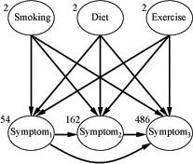
HeartDisease wegzulassen ist gar keine gute Lösung!
Die Symptome sind nicht länger bedingt unabhängig
gegeben die Elternknotenwerte
  Sehr viel mehr Kanten, sehr viel mehr Wahrscheinlichkeiten zu spezifizieren: 708 insgesamt
  Wir brauchen sehr viel mehr Daten,
  um diese ganzen Werte vernünftig zu lernen

Slide 133
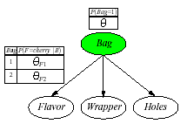
Beispiel: Bonbonfabrik wieder einmal
Zwei Bonbontüten (1 and 2) wurden vermischt
Bonbons werden durch drei Eigenschaften beschrieben: Flavor und Wrapper wie vorher, plus Hole (ob ein Loch in der Mitte ist)
Die Merkmale von Bonbons hängen mit bestimmten Wahrscheinlichkeiten von der Tüte ab, aus der sie kommen
Wir wollen für jedes Bonbon vorhersagen, aus welcher Tüte es kam, je nach vorgefundenen Eigenschaften: Naïve-Bayes-Modell
𝜃= P(Bag = 1)
𝜃_{Fj} = P(Flavor = cherry|Bag = j)
𝜃_{Wj} = P(Wrapper = red|Bag = j)
𝜃_{Hj} = P(Hole = yes|Bag = j)
j =1,2

Slide 134
Expectation-Maximization (EM)
Wenn wir versteckte Variablen beibehalten und die Netzwerkparameter aus Daten lernen wollen, haben wir eine Form des unüberwachten Lernens (unsupervised learning)
  Die Daten geben nicht über alle Aspekte von Datenpunkten Auskunft
Expectation-Maximization
  Genereller Algorithmus zum Lernen von Modellparametern bei unvollständigen Daten
  Hier für diskrete Datenwerte im BN-Kontext gezeigt

Slide 135
EM: Generelle Idee
Falls wir Daten für alle Variablen im BN hätten, könnten wir die Parameter mit ML- (oder MAP-) Ansätzen lernen
  Relative Häufigkeiten bestimmen, wie vorher besprochen
Falls wir die Parameter hätten, könnten wir die Posterior-Wahrscheinlichkeiten jedes Ereignisses schätzen:
  P(H|A,B,C)
Dempster, A.P., Laird. N.M., Rubin, D.B.: Maximum-Likelihood from incomplete data via the EM algorithm. Journal of the Royal Statistical Society, 1977

Slide 136
EM: Generelle Idee
Der Algorithmus startet mit "erfundenen" (zufällig generierten) Informationen, um das Lernproblem zu lösen:
  Erfundene Netzwerkparameterwerte (virtuell notiert in den CPTs)
Dann werden die Initialwerte in zwei Schritten verfeinert:
  Expectation (E): Aktualisiere die Daten (virtuell) mit aus dem aktuellen Modell hergeleiteten Erwartungen
  Maximization (M): Gegeben die aktualisierten Daten, aktualisieren die Parameter des BNs mitteln Maximum Likelihood (ML) Ansatz
    Das ist der gleiche Schritt, wie im voll beobachtbaren Fall
CPT: Conditional Probability Table

Slide 137
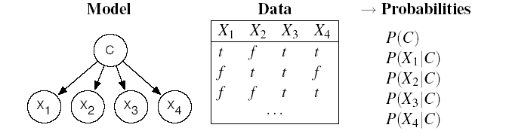
EM: Wie funktioniert das mit Naive Bayes-Modelen
Betrachtet die folgenden Daten, …
  N Beispiele mit Booleschen Attributen X₁, X₂, X₃, X₄
… die wir kategorisieren wollen mit möglichen Werten einer Klasse C = {1,2,3}
Wir verwenden einen naiven Bayes-Klassifikator mit versteckter Variable C
?
?
?
?
?

Slide 138
EM: Initialisierung
Der Algorithmus startet mit "erfundenen" (zufällig generierten) Informationen, um das Lernproblem zu lösen:
  Erfundene Netzwerkparameterwerte (virtuell notiert in den CPTs)
?
?
?
?
?
Definiere
zufällige
Parameter

Slide 139
EM: Expectation-Schritt (Bestimmung der erwarteter Zahlen)
?
?
?
?
?
Was benötigen wir, um die Netzwerkparameter mit dem
Maximum-Likelihood-Ansatz zu lernen?
  Für P(C) = Anzahl(Datenpunkte mit C=i) / Anzahl (alle Datenpunkte) i=1,2,3
  Für P(X_{h}|C) = Anzahl(Daten mit X_{h} = val_{k} und C=i) / Anzahl(Daten mit C=i)
  für alle Werte val_{k} von X_{h} und i=1,2,3

Slide 140
EM: Expectation-Schritt (Bestimmung der erwarteter Zahlen)
Bislang haben wir nur: N = Anzahl(Datenpunkte)
Wir approximieren alle weiteren Zähler mit erwarteten Zählerwerten, die aus dem Modell mit den "erfundenen" Parametern abgeleitet werden
Der erwartete Zähler ist die Summe, über alle N Beispieldaten, der Wahrscheinlichkeiten, dass jedes Beispiel in Kategorie i fällt
Attribute von Beispiel e_{j} )

Slide 141
EM: Expectation-Schritt (Bestimmung der erwarteter Zahlen)
Wie erhalten wir die notwendigen Werte aus dem Modell?
Leicht mit naivem Bayesschen Netzwerk
Attribute von Beispiel e_{j} )
Auch direkt aus Netzwerk bestimmbar.
Übungsaufgabe
Erfundene Parameter für das Netzwerk

Slide 142
EM: Expectation-Schritt (Bestimmung der erwarteter Zahlen)
Durch einen ähnlichen Schritt erhalten wir die erwarteten Zähler für Beispiele mit Attribut X_{h}= val_{k} und Kategorie i
Diese werden später benötigt zur Schätzung von P(X_{h} | C):
  für alle Werte val_{k} von X_{h} und i=1,2,3
Zum Beispiel
Wiederum erhalten wir diese W'keiten
aus dem aktuellen Modell

Slide 143
EM: Generelle Idee
Der Algorithmus startet mit "erfundenen" (zufällig generierten) Informationen, um das Lernproblem zu lösen:
  Erfundene Netzwerkparameterwerte (virtuell notiert in den CPTs)
Dann werden die Initialwerte in zwei Schritten verfeinert:
  Expectation (E): Aktualisiere die Daten (virtuell) mit aus dem aktuellen Modell hergeleiteten Erwartungen
  Maximization (M): Gegeben die aktualisierten Daten, aktualisieren die Parameter des BNs mitteln Maximum Likelihood (ML) Ansatz
    Das ist der gleiche Schritt, wie im voll beobachtbaren Fall
CPT: Conditional Probability Table

Slide 144
Maximization-Schritt: (Verfeinerung der Parameter)
Nun verfeinern wir die Netzwerkparameter mittels
Maximum-Likelihood-Lernen auf den erwarteten Zählern
  für alle Werte val_{k} von X_{j} und i=1,2,3

Slide 145
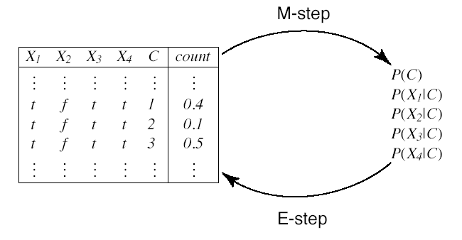
EM-Zyklus
Nun kann der E-Schritt wiederholt werden
Erwartete Zähler
(“Augmented data”)
Wahrscheinlichkeiten

Slide 146
Beispiel: Bonbonfabrik wieder einmal
Zwei Bonbontüten (1 and 2) wurden vermischt
Bonbons werden durch drei Eigenschaften beschrieben: Flavor und Wrapper wie vorher, plus Hole (ob ein Loch in der Mitte ist)
Die Merkmale von Bonbon hängen mit bestimmten Wahrscheinlichkeiten von der Tüte ab, aus der sie kommen
Wir wollen für jedes Bonbon vorhersagen, aus welcher Tüte es kam, je nach vorgefundenen Eigenschaften: Naïve-Bayes-Modell
𝜃= P(Bag = 1)
𝜃_{Fj} = P(Flavor = cherry|Bag = j)
𝜃_{Wj} = P(Wrapper = red|Bag = j)
𝜃_{Hj} = P(Hole = yes|Bag = j)
j =1,2

Slide 147

Daten
Nehmen wir an, die wahren Parameter seien:
  𝜃= 0.5;
  𝜃_{F1} = 𝜃_{W1} = 𝜃_{H1} = 0.8;
  𝜃_{F2} = 𝜃_{W2} = 𝜃_{H2} = 0.3;
Annahme: Die folgenden Zähler werden "gesampelt" aus P(C, F, W, H) (N = 1000): Wir haben einen Datensatz
Wir wollen nun die wahren Parameter aus diesen Daten mittels EM rekonstruieren

Slide 148
EM: Initialisierung
Weise Parametern zufällige Initialwerte zu
  Zu Vereinfachung der Darstellung verwenden wir hier:
Nun durchlaufen wir einen EM-Zyklus
zur Berechnung von 𝜃^{(1).}

Slide 149
E-Schritt
Zuerst brauchen wir die erwarteten Zähler für Bonbon von Tüte 1:
  Addiere die Wahrscheinlichkeiten, dass jedes der N Datenpunkte aus Tüte 1 kommt
  Seien flavor_{j}, wrapper_{j}, hole_{j} die Werte der entsprechenden Attribute für den j-ten Datenpunkt

Slide 150
E-step
Die Summation kann in die 8 Bonbongruppen aus der Tabelle
aufgebrochen werden.
  Zum Beispiel ergibt die Summe über 273 cherry-Bonbons mit rotem Papier und einem Loch (erster Eintrag in der Tabelle)

Slide 151
M-Schritt
Mit der Berechnung der anderen 7 Bonbongruppe erhalten wir
Nun führen wir den M-Schritt aus, um 𝜃 zu verfeinern. Hierzu nehmen wir den erwarteten Zählerwert der Datenpunkte aus Tüte 1

Slide 152
Noch ein Parameter…
Wir machen das gleiche für den Parameter 𝜃_{F1}
E-Schritt: Bestimme erwarteten Zählerwert von cherry-Bonbons aus Tüte 1
Bestimmbar aus naivem Bayesschen Modell wie vorher besprochen
Als Übung…
M-Schritt: Verfeinere 𝜃_{F1} durch Bestimmung der relativen Häufigkeiten

Slide 153
Lernergebnis
Nach einem vollen Zyklus über alle Parameter haben wir
Für jeden Satz von Parametern können wir die Log-Likelihood bestimmen wie auch schon früher
Man kann zeigen, dass dieser Wert mit jeder EM-Iteration steigt (Konvergenz)
EM mit Maximum-Likelihood bleibt aber bei lokalen Maxima hängen bleiben (ggf. mehrere Startwerte nehmen, Priors berücksichtigen oder MAP nehmen)

Slide 154
Lernergebnis
Nach einem vollen Zyklus über alle Parameter haben wir
Für jeden Satz von Parametern können wir die Log-Likelihood bestimmen wie auch schon früher
Wir können zeigen, das die Log-Likelihood L = log P(d, h_{𝜃})
in jeder Iteration ansteigt, so dass die initiale Likelihood schon nach drei Iterationen überflügelt wird
L of true model
L of iterated
model

Slide 155
EM: Diskussion
Für komplexere BNs ist der Algorithmus der gleiche
  Im allgemeinen müssen wir die CPT-Einträge für jede Variable X_{i} gegeben die Elternknotenwerte Pa_{i} berechnen
  𝜃_{ijk}= P(X_{i} = x_{ij}|Pa_{i =} pa_{ik})
Die erwarteten Zählerwerte werden durch Summierung über die Beispiele berechnet, nachdem all notwendigen
P(X_{i} = x_{ij},Pa_{i =} pa_{ik}) mittels BN-Algorithmen bestimmt sind
Das Verfahren kann in eine kombinatorische Explosion laufen (ggf. Approximationstechniken angewendet)

Slide 156
Learning Bayesian network structures
Given training set
Find model that best matches D
  model selection
  parameter estimation
B
E
Inducer
A
C
Data D
Some of the following slides from an AI course „Graphical models“
by Burgard/De Raedt/Kersting/Nebel
156

Slide 157
Model selection
Goal: Select the best network structure, given the data
Input:
  Training data
  Scoring function
Output:
  A network that maximizes the score
157

Slide 158
Structure selection: Scoring
Bayesian: prior over parameters and structure
  get balance between model complexity and fit to data as a byproduct
Score_{D} (G) = log P(G|D) = α log [P(D|G) P(G)]
Marginal likelihood just comes from our parameter estimates
Prior on structure can be any measure we want; typically a function of the network complexity (MDL principle)
Can we learn G’s params from D?
Does G explain D with ML?
Prior w.r.t. MDL
Same key property: Decomposability
Score(structure) = Σ_{i} Score(substructure of X_{i})
158
Notes:
Remember: MDL = minimum description length, here network complexity; the more complex a system the lesser its probability.

Slide 159
Heuristic search
B
E
Add E→C
A
B
E
Δscore(C)
A
C
Reverse E→A
C
Δscore(A)
Delete E→A
B
E
Δscore(A)
B
E
A
A
C
C
159

Slide 160

That‘s fine.
But what to do if we have
non-complete data??
Cannot use decomposability
=> Rerun parameter estimation
160

Slide 161
Local Search in Practice
Perform EM for each candidate graph
Parameter space
G₃
G₂
G₁
Parametric optimization (EM)
Local Maximum
G₄
G_{n}

Slide 162
Local Search in Practice
Perform EM for each candidate graph
Parameter space
G₃
G₂
G₁
Parametric optimization (EM)
Local Maximum
G_{n}
Computationally expensive:
  Parameter optimization via EM — non-trivial
  Need to perform EM for all candidate structures
  Spend time even on poor candidates
⇒ In practice, considers only a few candidates
G₄

Slide 163
Structural EM [Friedman et al. 98]
Recall, in complete data we had
  Decomposition ⇒ efficient search
Idea:
Instead of optimizing the real score…
Find decomposable alternative score
Such that maximizing new score
    ⇒ improvement in real score

Slide 164
Structural EM
Idea:
Use current model to help evaluate new structures
Outline:
Perform search in (Structure, Parameters) space
At each iteration, use current model for finding either:
  Better scoring parameters: “parametric” EM step
  or
  Better scoring structure: “structural” EM step
Nir Friedman. The Bayesian structural EM algorithm. In Proceedings of the 14th conference on Uncertainty in artificial intelligence (UAI'98), 129-138. 1998

Slide 165
Variations on a theme
Known structure, fully observable: only need to do parameter estimation
Known structure, hidden variables:
use expectation maximization (EM) to estimate parameters
Unknown structure, fully observable: do heuristic search through structure space, then parameter estimation
Unknown structure, hidden variables: structural EM
165

Slide 166




Big Datasets Destroy Simple Abstractions
Big data
Probabilistic data
SELECT *
FROM RAWDATA
INPUT FILE
time | id | temp
10am | 1 | 20
10am | 2 | 21
.. | .. | …
10am | 7 | 29
time | id | temp
10am | 1 | 20
10am | 2 | 21
.. | .. | …
10am | 7 | 29
…
Raw Data Tables
OUTPUT FILE
Sensor/RFID streams
(+ metadata, floor plans, …)
Relational DBMS
Managing Large, Uncertain Data
Repositories with Probabilistic Graphical Models
Daisy Zhe Wang+, Eirinaios Michelakis+, Minos Garofalakis*+, Joseph M. Hellerstein+ University of California Berkeley+, Yahoo! Research*
25th August 2008, VLDB
HeisenData -- Towards a Next-Generation Uncertain Data Management System
Project Funding: FP7 Marie-Curie International Reintegration Grants
(FP7-PEOPLE-2009-RG, Reference No. 249217)
Project Duration: 1/3/2010 - 28/2/2014
Fellow & Scientist-in-Charge: Prof. Minos Garofalakis
Daisy Zhe Wang, Eirinaios Michelakis, Minos Garofalakis, and Joseph M. Hellerstein. "BAYESSTORE: Managing Large, Uncertain Data Repositories with Probabilistic Graphical Models", Proceedings of VLDB'2008 (PVLDB, Vol. 1), 2008.
Minos Garofalakis, Projekt HeisenData

Slide 167
Bayesian Networks: Isomorphic Structures
Bayesian nets use propositional representation
Real world has objects, related to each other
Intelligence
These “instances” are not independent
Intell_Jane
Difficulty
Diffic_CS101
Intell_George
Diffic_CS101
A
Grade_Jane_CS101
C
Grade_George_CS101
Grade
Intell_George
Diffic_Geo101
Grade_George_Geo101
Probabilistic Models of Relational Domains, Daphne Koller, Stanford University
Notes:
One of the key benefits of the propositional representation was our ability to represent our knowledge without explicit enumeration of the worlds. In turns out that we can do the same in the probabilistic framework. The key idea, introduced by Pearl in the Bayesian network framework, is to use locality of interaction. This is an assumption which seems to be a fairly good approximation of the world in many cases.
However, this representation suffers from the same problem as other propositional representations. We have to create separate representational units (propositions) for the different entities in our domain. And the problem is that these instances are not independent. For example, the difficulty of CS101 in one network is the same difficulty as in another, so evidence in one network should influence our beliefs in another.

Slide 168

Attribute-Based Worlds
Smart_Jane & easy_CS101 → GetA_Jane_CS101
Smart_Mike & easy_Geo101 → GetA_Mike_Geo101
Smart_Jane & easy_Geo101 → GetA_Jane_Geo101
Smart_Rick & easy_CS221 → GetA_Rick_C
World = assignment of values to attributes / truth values to propositional symbols
Probabilistic Models of Relational Domains, Daphne Koller, Stanford University
Notes:
A somewhat more transparent representation is based on attributes or propositions. Here, the representation makes an explicit commitment
that the world is described by a set of attributes or (in the binary case) propositional symbols. The knowledge base tells us how these different symbols interact with each other. Semantically, each possible world that the agent considers is an assignment of values to these attributes. This more transparent representation gives us a lot more power. For example, using logical inference techniques we can often conclude that certain propositions must take a specific truth value, without enumerating the entire space of truth assignments.
However, propositional reasoning has its own problems. In many cases, it requires that we repeat what is basically the same piece of information many many times. For example, if we wanted to write down the rules of chess (just those governing the single-move successor function), we would have to restate the rules for pawn movement separately for every board position. In fact, this process would require about 10^7 axioms. I can’t write even one of these axioms down for you, because it would be too long, so let me use a simpler example, one which will be my running example for most of this talk.

Slide 169
Object-Relational Worlds
∀x,y(Smart(x) & Easy(y) & Take(x,y)
→ Grade(A,x,y))
World = relational interpretation:
  Objects in the domain
  Properties of these objects
  Relations (links) between objects
Probabilistic Models of Relational Domains, Daphne Koller, Stanford University
Notes:
The reason for the tremendous representation inefficiency of propositional logic is that it does not contain the concept of an object. When we think about the world, we always think about objects --- people, cars, cities, even talks --- are viewed as separate entities. Each of these has its own properties, or attributes. And, they are all linked to each other via a complex network of interactions. A yet more transparent representation is relational logic. In this case, the possible worlds specify a set of objects, their properties, and the relations between them. By making objects explicit, we can now generalize over them, specifying universal patterns that apply to all objects. This allows us to state many things at once, and provide a much more compact representation. In particular, the rules of chess now require only about 100 axioms.

Slide 170
St. Nordaf University
Prof. Jones
Prof. Smith
Low
High
Teaching-ability
Teaching-ability
High
High
Teaches
Teaches
Grade
C
In-course
B
Registered
Intelligence
Weak
Weak
Satisfac
Like
Hate
Welcome to
Geo101
George
Grade
B
C
Difficulty
Registered
Easy
Easy
In-course
Satisfac
Hate
Welcome to
Hate
CS101
Intelligence
Smart
Smart
Grade
A
A
Difficulty
Easy
Hard
Registered
Jane
Satisfac
Like
In-course
Hate
Probabilistic Models of Relational Domains, Daphne Koller, Stanford University
Notes:
Let us consider an imaginary university called St. Nordaf. St. Nordaf has two faculty, two students, two courses, and three registrations of students in courses, each of which is associated with a registration record. These objects are linked to each other: professors teach classes, students register in classes, etc. Each of the objects in the domain has properties that we care about.

Slide 171
Relational Bayesian Network
Universals: Probabilistic patterns hold for all objects in class
Locality: Represent direct probabilistic dependencies
  Links define potential interactions
Professor
Teaching-Ability
Student
Intelligence
Course
Difficulty
A
B
C
Reg
Grade
[K. & Pfeffer; Poole; Ngo & Haddawy]
Satisfaction
Probabilistic Models of Relational Domains, Daphne Koller, Stanford University
Notes:
The two key ideas that come to our rescue derive from the two approaches that we are trying to combine. From relational logic, we have the notion of universal patterns, which hold for all objects in a class. From Bayesian networks, we have the notion of locality of interaction, which in the relational case has a particular twist: Links give us precisely a notion of “interaction”, and thereby provide a roadmap for which objects can interact with each other.
In this example, we have a template, like a universal quantifier for a probabilistic statement. It tells us: “For any registration record in my database, the grade of the student in the course depends on the intelligence of that student and the difficulty of that course.” This dependency will be instantiated for every object (of the right type) in our domain. It is also associated with a conditional probability distribution that specifies the nature of that dependence. We can also have dependencies over several links, e.g., the satisfaction of a student on the teaching ability of the professor who teaches the course.

Slide 172

Develop probabilistic relational model inside a database

