Slide 1
Non-Standard-Datenbanken und Data Mining
Prof. Dr. Ralf Möller
Universität zu Lübeck
Institut für Informationssysteme

Slide 2
Übersicht
Semistrukturierte Datenbanken (JSON, XML) und Volltextsuche
Information Retrieval
Mehrdimensionale Indexstrukturen
Cluster-Bildung
Einbettungstechniken
First-n-, Top-k-, und Skyline-Anfragen
Probabilistische Datenbanken, Anfragebeantwortung, Top-k-Anfragen und Open-World-Annahme
Probabilistische Modellierung, Bayes-Netze, Anfragebeantwortungsalgorithmen, Lernverfahren,
Temporale Datenbanken und das relationale Modell, SQL:2011
Probabilistische Temporale Datenbanken
SQL: neue Entwicklungen (z.B. JSON-Strukturen und Arrays), Zeitreihen (z.B. TimeScaleDB)
Stromdatenbanken, Prinzipien der Fenster-orientierten inkrementellen Verarbeitung
Approximationstechniken für Stromdatenverarbeitung, Stream-Mining
Probabilistische raum-zeitliche Datenbanken und Stromdatenverarbeitungsssysteme: Anfragen und Indexstrukturen, Raum-zeitliches Data Mining, Probabilistische Skylines
Von NoSQL- zu NewSQL-Datenbanken, CAP-Theorem

Slide 3
Acknowledgements:
This presentation is based on the following two presentations
10 Years of Probabilistic Querying – What Next?
Martin Theobald
University of Antwerp
Temporal Alignment
Anton Dignös¹ Michael H. Böhlen¹ Johann Gamper² ¹University of Zürich, Switzerland
²Free University of Bozen-Bolzano, Italy

Slide 4
Recap: Probabilistic Databases
A probabilistic database D^{p} (compactly) encodes a probability distribution over a finite set of deterministic database instances D_{i}.
D₁: 0.42
D₂: 0.18
D₃: 0.28
D₄: 0.12
WorksAt(Sub, Obj)
Jeff | Stanford
Jeff | Princeton
WorksAt(Sub, Obj)
Jeff | Stanford
WorksAt(Sub, Obj)
Jeff | Princeton
WorksAt(Sub, Obj)
Special Cases:
Query Semantics: (“Marginal Probabilities”)
Run query Q against each instance D_{i}; for each answer tuple t, sum up the probabilities of all instances D_{i} where t is a result.
(1) D^{p} tuple-independent
(II) D^{p} block-independent
WorksAt(Sub, Obj) |  | p
Jeff | Stanford | 0.6
Jeff | Princeton | 0.7
WorksAt(Sub, Obj) |  | p
Jeff | Stanford | 0.6
 | Princeton | 0.4
Note: (I) and (II)
are not equivalent!

Slide 5
Probabilistic & Temporal Databases
A temporal-probabilistic database D^{Tp} (compactly) encodes a probability distribution over a finite set of deterministic database instances D_{i} at each time point of a finite time domain Ω^{T}.
BornIn(Sub,Obj) |  | T | p
DeNiro | Green- which | [1943, 1944) | 0.9
DeNiro | Tribeca | [1998, 1999) | 0.6
Wedding(Sub,Obj) |  | T | p
DeNiro | Abbott | [1936, 1940) | 0.3
DeNiro | Abbott | [1976, 1977) | 0.7
Divorce(Sub,Obj) |  | T | p
DeNiro | Abbott | [1988, 1989) | 0.8
Sequenced Semantics & Snapshot Reducibility:
Built-in semantics: reduce temporal-relational operators to their non-temporal counterparts at each snapshot (i.e., time point) of the database.
Coalesce/split tuples with consecutive time intervals based on their lineages.
Non-Sequenced Semantics
Queries can freely manipulate timestamps just like regular attributes. Single temporal operator ≤^{T} supports all of Allen’s 13 temporal relations.
Deduplicate tuples with overlapping time intervals based on their lineages.
[Dignös, Gamper, Böhlen: SIGMOD’12]
marriedTo(x,y)[t_{b1},T_{max}) ⇐ wedding(x,y)[t_{b1},t_{e1}) ∧ ¬divorce(x,y)[t_{b2},t_{e2})
[Dylla,Miliaraki,Theobald: PVLDB’13]

Slide 6
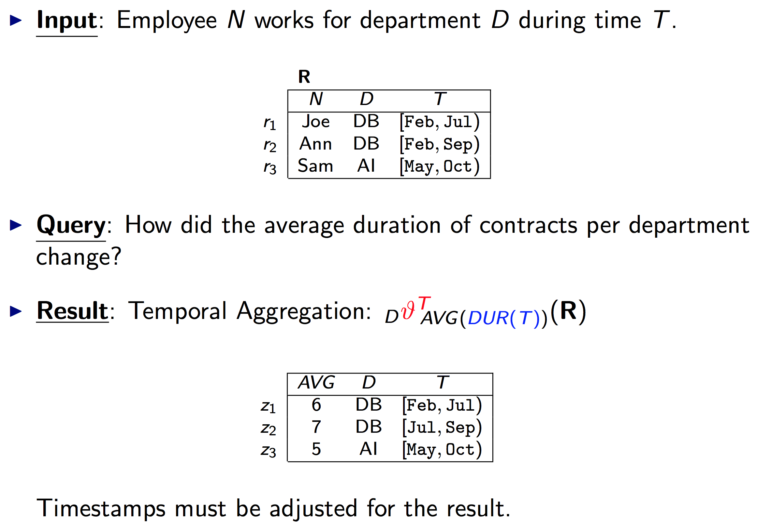
Sequenced Semantics: Example
OWA: Intervals not necessarily maximal
OWA: Are the numbers lower bounds?
[Dignös, Gamper, Böhlen: SIGMOD’12]

Slide 7
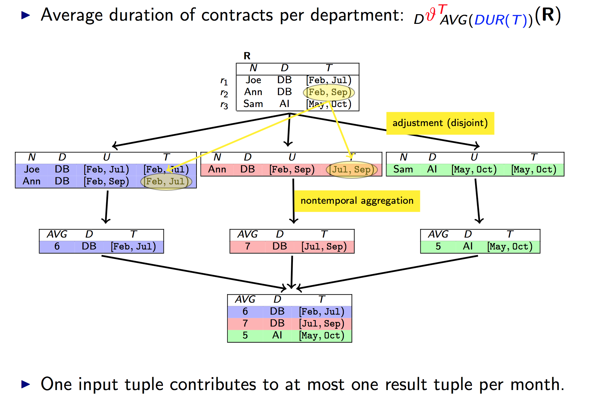
Temporal Splitter / Snapshot Reduction
[Dignös, Gamper, Böhlen: SIGMOD’12]

Slide 8
Temporal Alignment & Deduplication Example
(f₁ ∧ f₃) ∨ (f₁ ∧ ¬f₃) ∨
(f₂ ∧ f₃) ∨ (f₂ ∧ ¬f₃)
Dedupl.
Facts
(f₁ ∧ f₃) ∨ (f₁ ∧ ¬f₃)
(f₁ ∧ ¬f₃) ∨ (f₂ ∧ ¬f₃)
BornIn(Sub,Obj) |  | T | p
DeNiro | Green- which | [1943, 1944) | 0.9
DeNiro | Tribeca | [1998, 1999) | 0.6
Wedding(Sub,Obj) |  | T | p
DeNiro | Abbott | [1936, 1940) | 0.3
DeNiro | Abbott | [1976, 1977) | 0.7
Divorce(Sub,Obj) |  | T | p
DeNiro | Abbott | [1988, 1989) | 0.8
f₁ ∧ f₃
Derived
Facts
f₁ ∧ ¬f₃
f₂ ∧ f₃
f₂ ∧ ¬f₃
f₃
Base
Facts
wedding(DeNiro,Abbott)
f₂
divorce(DeNiro,Abbott)
f₁
wedding(DeNiro,Abbott)
Ω^{T}
T_{min}
1936
1976
1988
T_{max}
Non-Sequenced Semantics:
marriedTo(x,y)[t_{b1},T_{max}) ⇐ wedding(x,y)[t_{b1},t_{e1}) ∧ ¬divorce(x,y)[t_{b2},t_{e2})
marriedTo(x,y)[t_{b1},t_{e2}) ⇐ wedding(x,y)[t_{b1},t_{e1}) ∧ divorce(x,y)[t_{b2},t_{e2}) ∧ t_{e1} ≤^{T} t_{b2}

Slide 9
Inference in Probabilistic-Temporal Databases
[Wang,Yahya,Theobald: MUD’10; Dylla,Miliaraki,Theobald: PVLDB’13]
Derived
Facts
⇐
teamMates(Beckham,
Ronaldo, T₃)
playsFor(Beckham, Real, T₁)
playsFor(Ronaldo, Real, T₂)
overlaps(T₁, T₂, T₃)
0.16
0.08
0.12
‘03
‘04
‘05
‘07
0.6
0.4
0.4
0.2
0.2
0.1
Base
Facts
‘03
‘05
‘07
‘00
‘02
‘04
‘05
‘07
playsFor(Beckham, Real, T₁)
playsFor(Ronaldo, Real, T₂)
Example using the Allen predicate overlaps

Slide 10
Inference in Probabilistic-Temporal Databases
[Wang,Yahya,Theobald: MUD’10; Dylla,Miliaraki,Theobald: PVLDB’13]
Derived
Facts
teamMates(Beckham,
Zidane, T₅)
teamMates(Beckham,
Ronaldo, T₄)
teamMates(Ronaldo,
Zidane, T₆)
0.16
0.08
0.12
‘03
‘04
‘05
‘07
Non-independent
Independent
0.6
0.4
0.4
0.2
0.2
0.1
Base
Facts
playsFor(Zidane, Real, T₃)
‘03
‘05
‘07
‘00
‘02
‘04
‘05
‘07
playsFor(Beckham, Real, T₁)
playsFor(Ronaldo, Real, T₂)

Slide 11
Inference in Probabilistic-Temporal Databases
[Wang,Yahya,Theobald: MUD’10; Dylla,Miliaraki,Theobald: PVLDB’13]
Derived
facts stored in views
teamMates(Beckham,
Zidane, T₅)
teamMates(Beckham,
Ronaldo, T₄)
teamMates(Ronaldo,
Zidane, T₆)
Need
Lineage!
Non-independent
Independent
Closed and complete representation model (incl. lineage)
Temporal alignment is polyn. in the number of input intervals
Confidence computation per interval remains #P-hard
In general requires Monte Carlo approximations (Luby-Karp for DNF, MCMC-style sampling), decompositions, or top-k pruning
Base
Facts
playsFor(Zidane, Real, T₃)
playsFor(Beckham, Real, T₁)
playsFor(Ronaldo, Real, T₂)

Slide 12
Literature
[Das Sarma,Theobald,Widom: ICDE’08]
Das Sarma, Anish and Theobald, Martin and Widom, Jennifer, Exploiting Lineage for Confidence Computation in Uncertain and Probabilistic Databases. In: 24th International Conference on Data Engineering (ICDE 2008), IEEE Computer Society Press, pp. 1023-1032. 2008
[Wang,Yahya,Theobald: MUD’10]
Wang, Yafang and Yahya, Mohamed and Theobald, Martin, Time-aware Reasoning in Uncertain Knowledge Bases. In: 4th International VLDB Workshop on Management of Uncertain Data, Vol. WP 10-, pp. 51-65, 2010
[Dignös, Gamper, Böhlen: SIGMOD’12]
A. Dignös, M.H. Böhlen, J. Gamper. Temporal alignment. In Proc. of the SIGMOD-12, pages 433-444, Scottsdale, AZ, USA, May 20-24, 2012
[Dylla,Miliaraki,Theobald: PVLDB’13]
Maximilian Dylla, Iris Miliaraki, Martin Theobald, A Temporal-Probabilistic Database Model for Information Extraction, Proceedings of the VLDB Endowment, Volume 6, Issue 14, 2013

