Slide 1
Non-Standard-Datenbanken und Data Mining
SQL: New Developments
Prof. Dr. Ralf Möller
Universität zu Lübeck
Institut für Informationssysteme

Slide 2
Übersicht
Semistrukturierte Datenbanken (JSON, XML) und Volltextsuche
Information Retrieval
Mehrdimensionale Indexstrukturen
Cluster-Bildung
Einbettungstechniken
First-n-, Top-k-, und Skyline-Anfragen
Probabilistische Datenbanken, Anfragebeantwortung, Top-k-Anfragen und Open-World-Annahme
Probabilistische Modellierung, Bayes-Netze, Anfragebeantwortungsalgorithmen, Lernverfahren,
Temporale Datenbanken und das relationale Modell, SQL:2011
Probabilistische Temporale Datenbanken
SQL: neue Entwicklungen (z.B. JSON-Strukturen und Arrays), Zeitreihen (z.B. TimeScaleDB)
Stromdatenbanken, Prinzipien der Fenster-orientierten inkrementellen Verarbeitung
Approximationstechniken für Stromdatenverarbeitung, Stream-Mining
Probabilistische raum-zeitliche Datenbanken und Stromdatenverarbeitungsssysteme: Anfragen und Indexstrukturen, Raum-zeitliches Data Mining, Probabilistische Skylines
Von NoSQL- zu NewSQL-Datenbanken, CAP-Theorem, Blockchain-Datenbanken

Slide 3
SQL Standard – Brief History
SO/IEC 9075 Database Language SQL
  SQL-86 – Transactions, Create, Read, Update, Delete
  SQL-89 – Referential Integrity
  SQL-92 – Internationalization, etc.
  SQL:1999 – User Defined Types
  SQL:2003 – XML
  SQL:2008 – Expansions and corrections
  SQL:2011 – Temporal
  SQL:2016 – JSON, PTFs (Polymorphic Table Functions), RPR (Row-Pattern Recognition)
  SQL:2019 – MDA
30+ years of support and expansion of the standard

Slide 4
SQL:2016 New Features
Support for Java Script Object Notation (JSON)
  Store, query, and retrieve JSON structures
Polymorphic table functions
  Parameters and function return values can be tables
  whose shape is not known until query time
Row pattern recognition
  Regular Expressions across sequences of rows
Additional functions (e.g., for analytics)
  Trigonometric and logarithm functions
  Concatenate strings over groups of rows
Default values and names for arguments of SQL functions

Slide 5
Acknowledgements
Parts of subsequent presentations are taken from
J. Michels et al., The New and Improved SQL:2016 Standard, SIGMOD Record, Vol. 47, No. 2, pp. 51-60, 2018

Slide 6
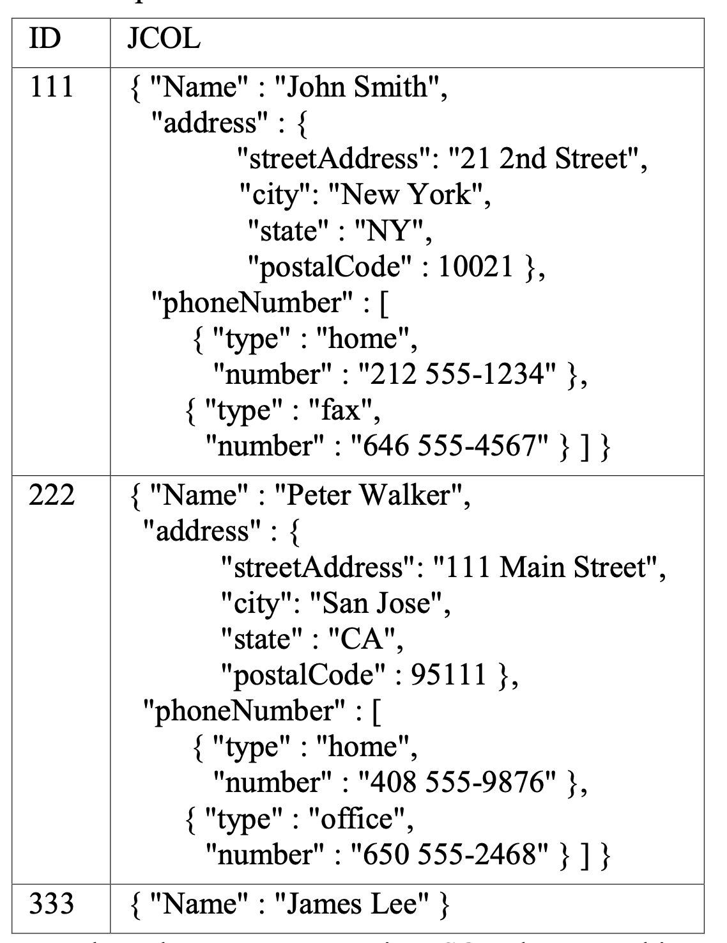
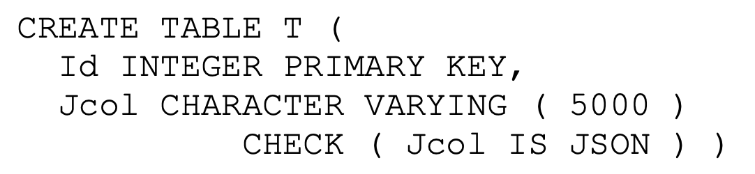
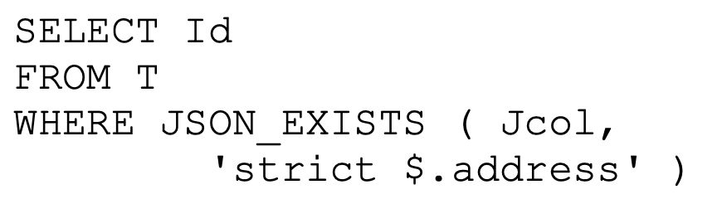
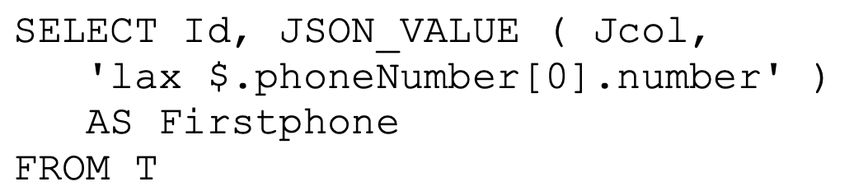
Support for Java Script Object Notation
JSON Type
JSON Path Expressions
Find 111 and 222 but not 333 (due to strict)
Extract scalars
Lax is default
Find 111, 222 with respective numbers,
and 333 with null (due to lax)

Slide 7
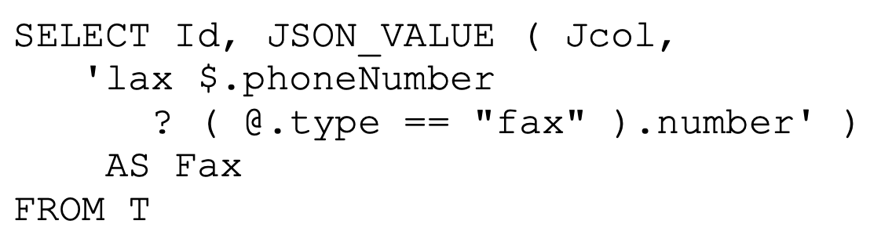
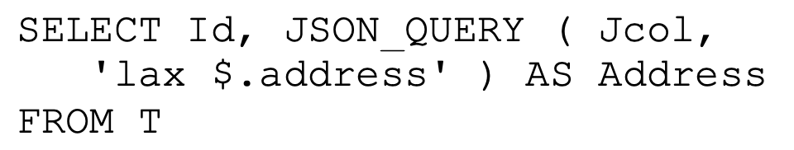
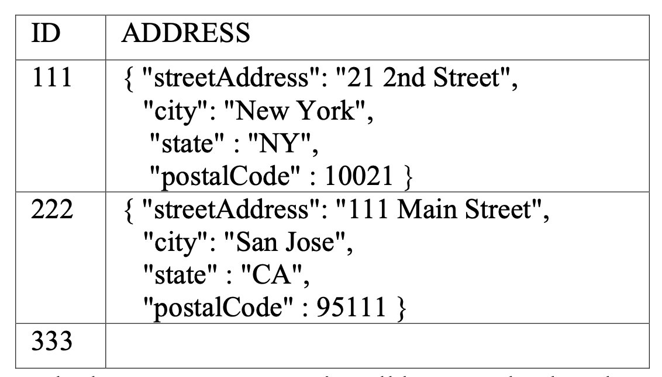
Support for Java Script Object Notation
Filters
Find 111 with number, 222 with null, and 333 with null
Return type is string if not specified otherwise
Extract JSON fragments (objects, arrays, scalars)

Slide 8
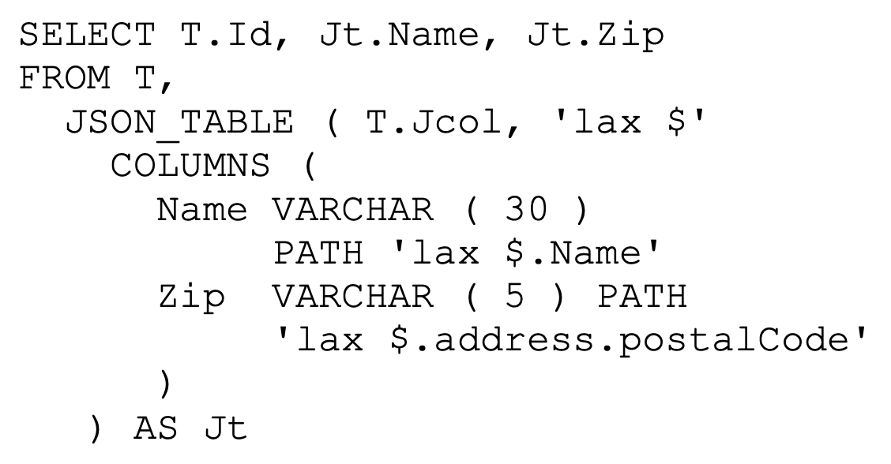
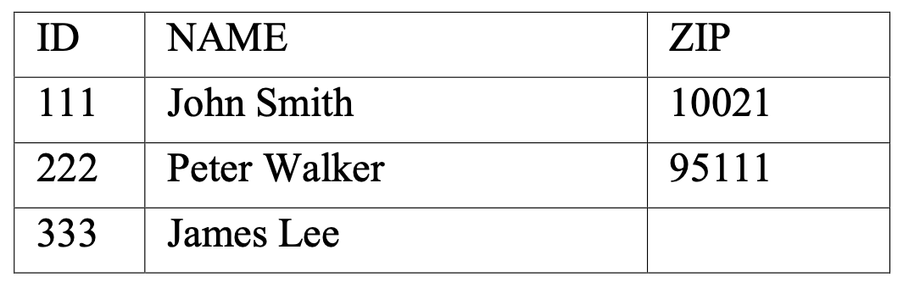
Support for Java Script Object Notation
JSON to tables
Also used for unnesting (deeply) nested
JSON structures or arrays

Slide 9
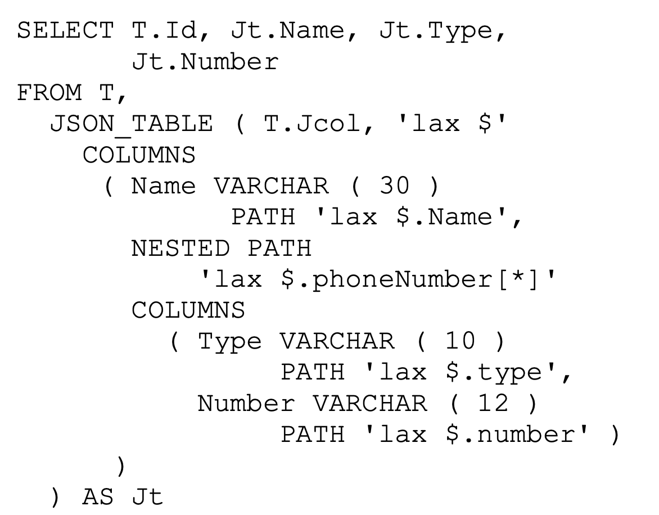
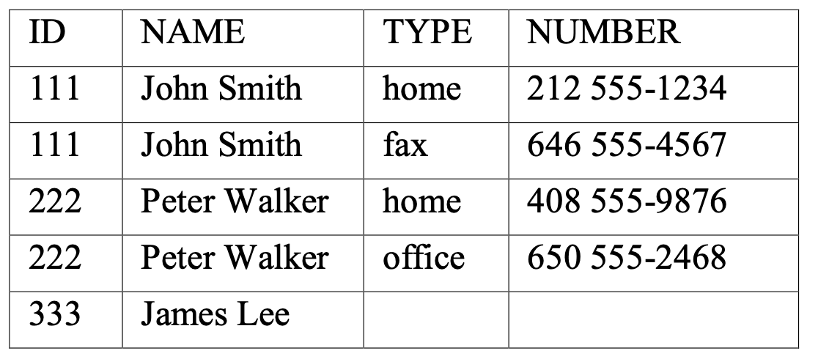
Support for Java Script Object Notation
JSON to tables

Slide 10
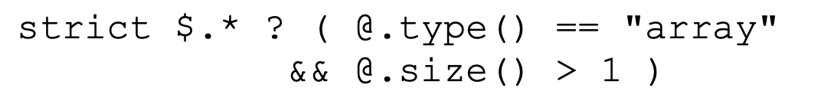
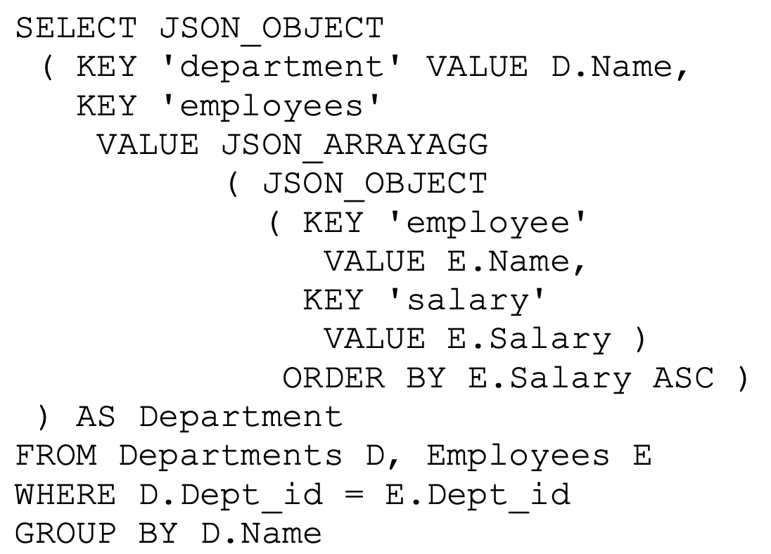
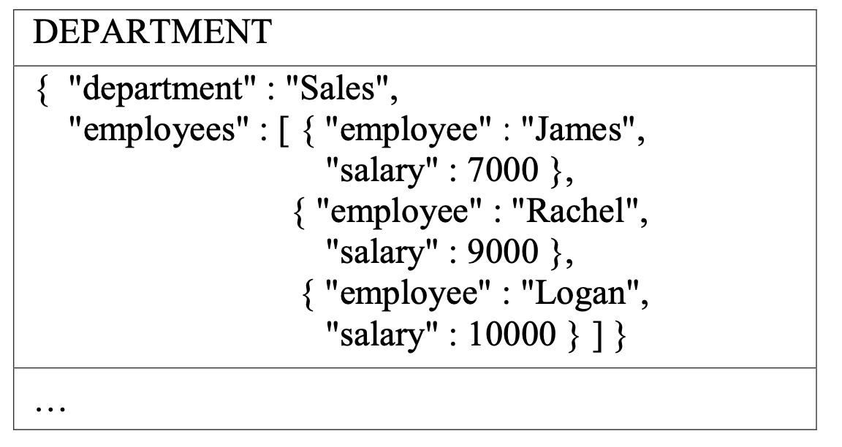
Support for Java Script Object Notation
Structural inspection
Tables to JSON objects

Slide 11
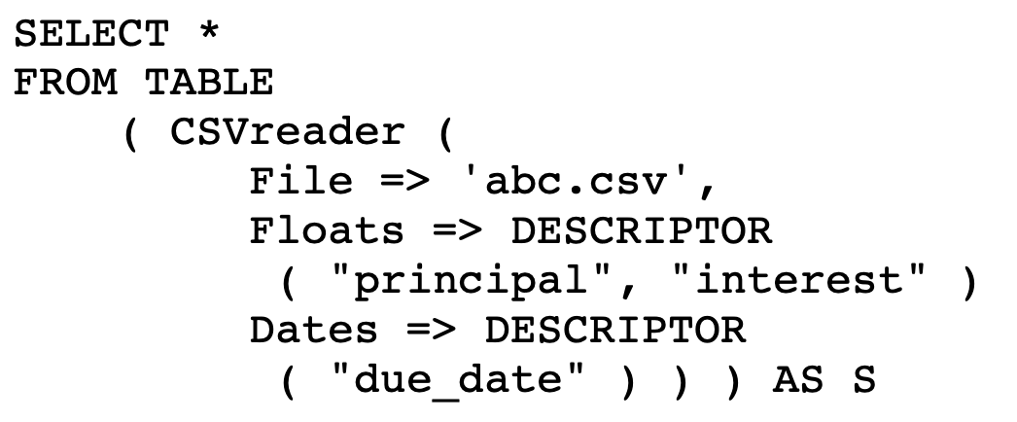
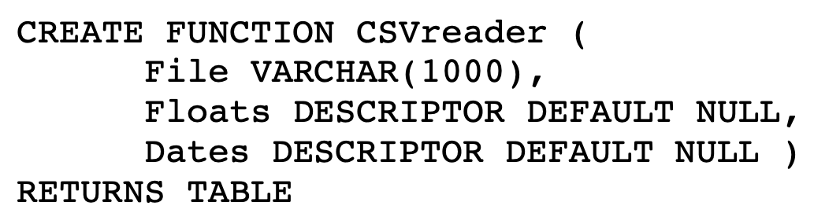
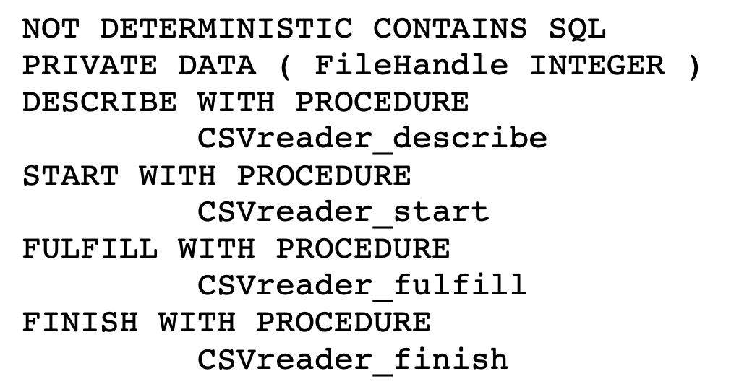
Polymorphic Table Functions (PTFs)
Reading a CSV file returns
a table with structure
unknown at compile time
There must be column names „principal“ and „interest“ as well as
a „due_date“ column
Different results with
same input parameters
Code supplied with
SQL stored procedures
DESCRIBE: Determine row type
START: Allocate resources
FULFILL: Read a tuple
FINISH: Deallocate resources

Slide 12
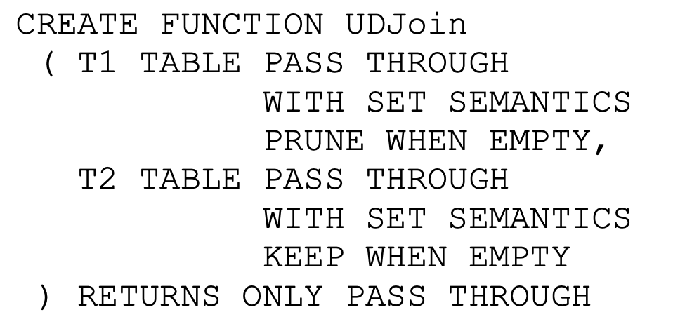
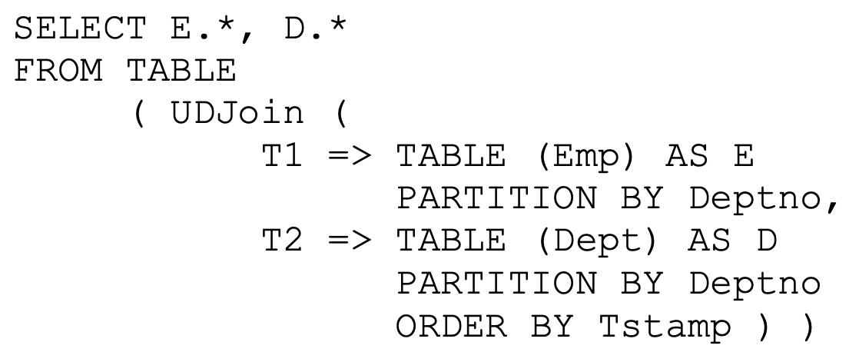
Polymorphic Table Functions (PTFs)
User-defined joins
WITH SET SEMANTICS
all rows of a partition to be processed
on the same virtual processor
(“partitionable“)
PARTITION BY:
Table partitioned on list of columns,
to be processed on separate virtual
processor each

Slide 13
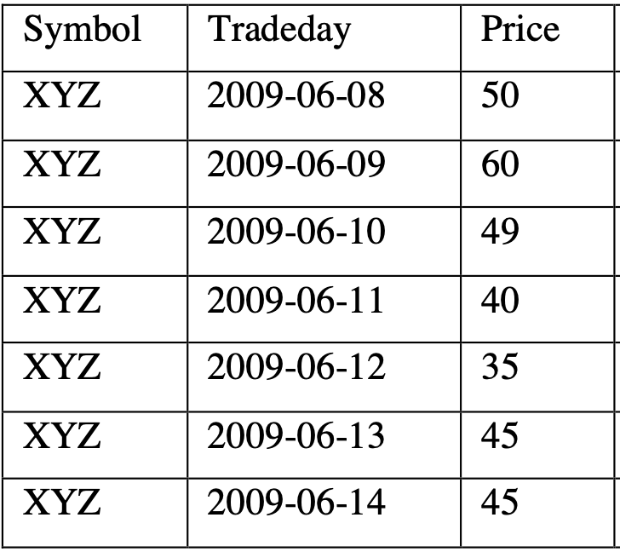
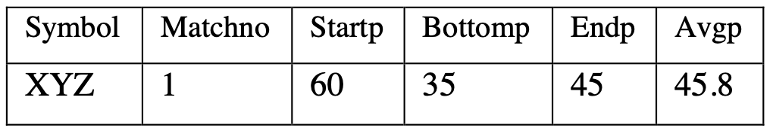
Row Pattern Recognition
Search an ordered partition of
rows for matches to a
regular expression
RPR can be supported in
either the FROM clause
or the WINDOW clause

Slide 14
What‘s Next?
SQL:2019: Multi Dimensional Arrays – SQL/MDA
  Applications in natural sciences research (heat maps),
  geo applications (e.g., remote sensing image processing)
  1D-Arrays already in SQL:1999 (very limited ways to query and update)
  Multidimensional arrays discussed for more than 20 years
  Prominent example array databases:
    Rasdaman (Peter Baumann)
    SciDB (Michael Stonebraker)
SQL:2020+: Property Graphs
  Also discussed for about 20 years
    Neo4j graph database (Cypher)
    RDF (SPARQL)
In the works: Streaming SQL
Probabilistic modeling in SQL:2030?
It takes about 20-30 years from non-standard features to standard elements

Slide 15
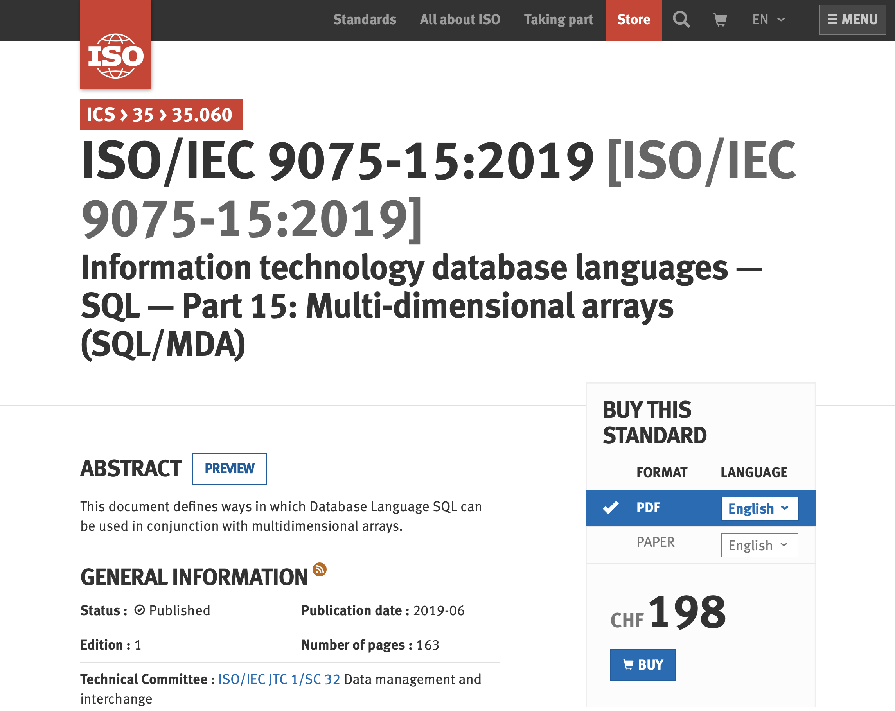
SQL:2019 Part 15 ISO Standard

Slide 16
Acknowledgements
Parts of subsequent presentations are taken from
Dimitar Mišev, Peter Baumann, SQL Support for Multidimensional Arrays
Jacobs Universität, Technical Report No. 34, July 2017

Slide 17
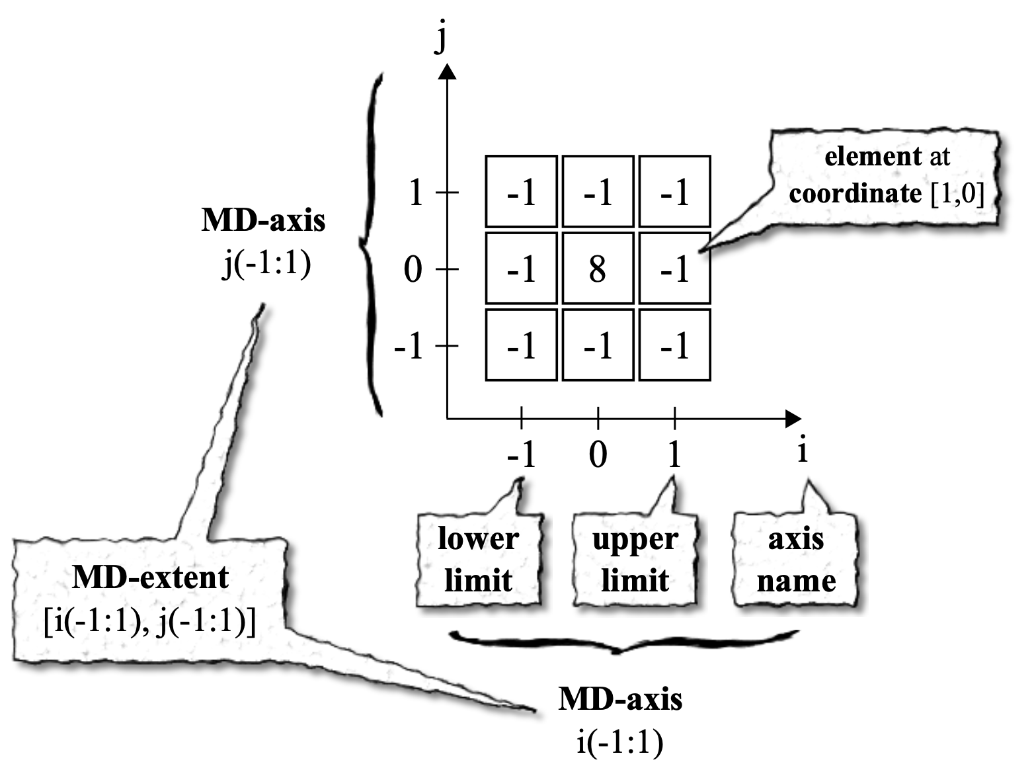
Array Data Model

Slide 18
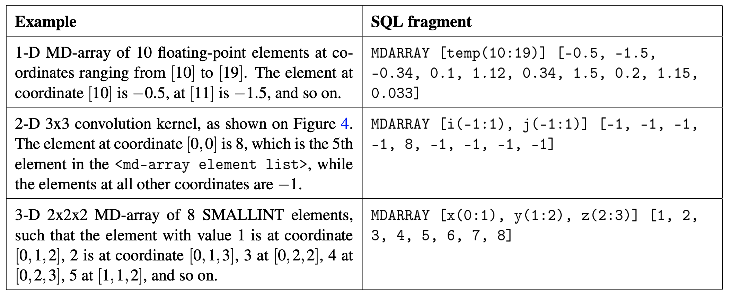
MD-arrays Constructed by Element Enumeration

Slide 19
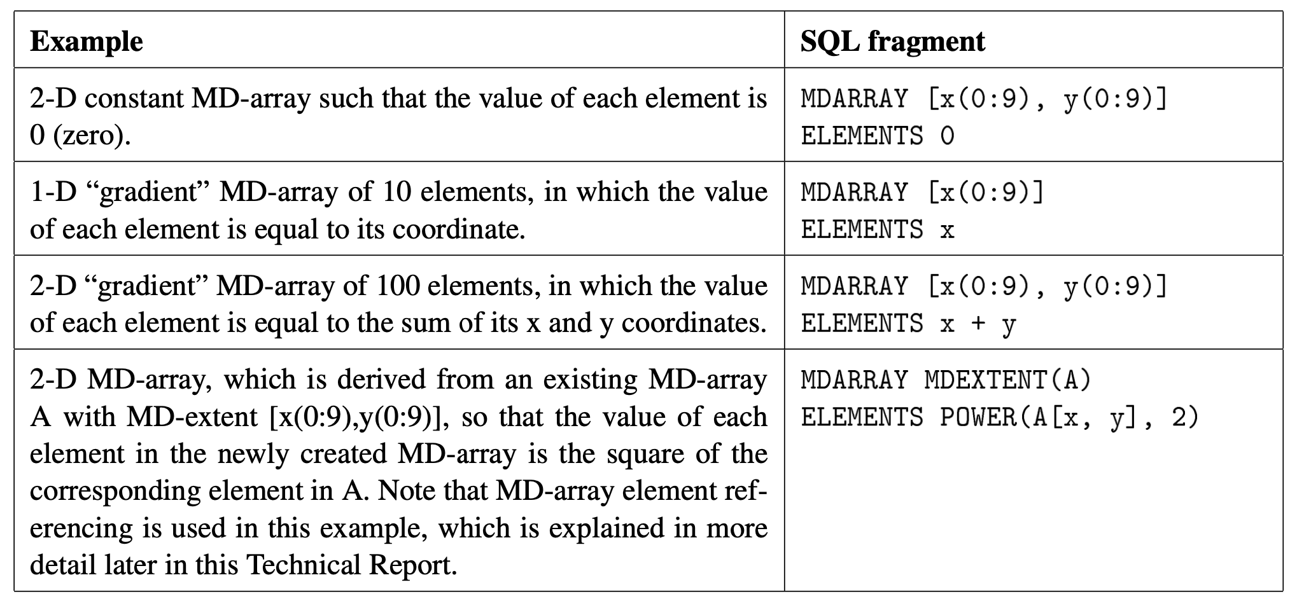
MD-arrays Created with Constructor by Iteration

Slide 20
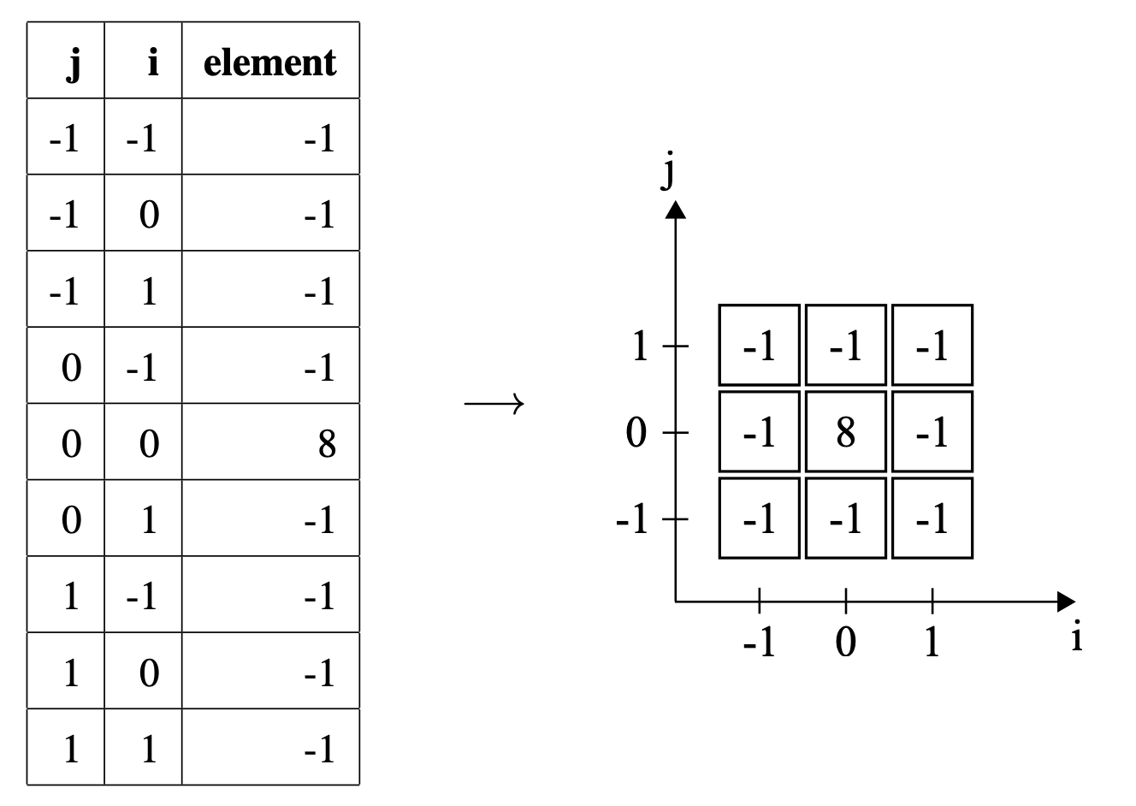
From Tables to Arrays

Slide 21
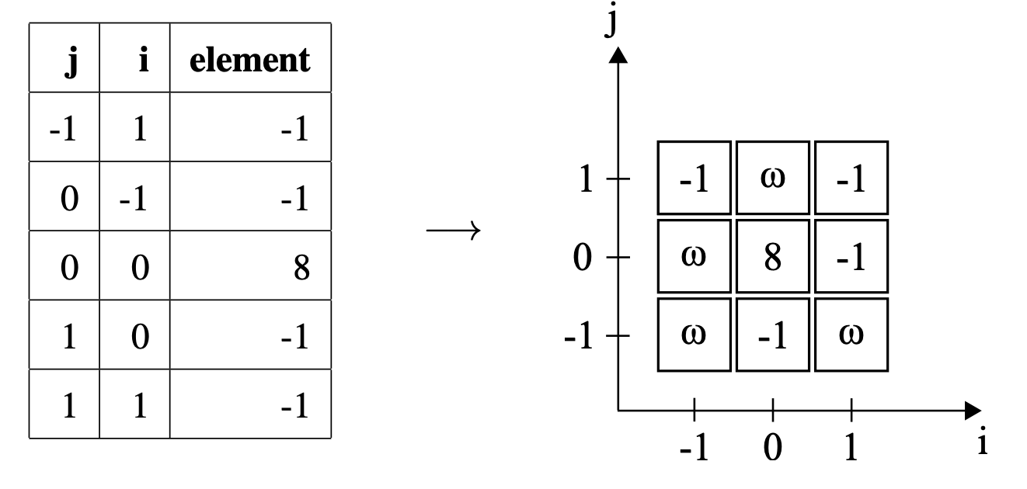
From Tables to Arrays with Nulls (𝜔)

Slide 22
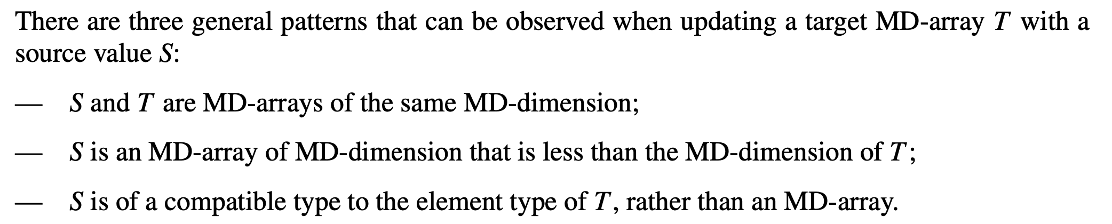
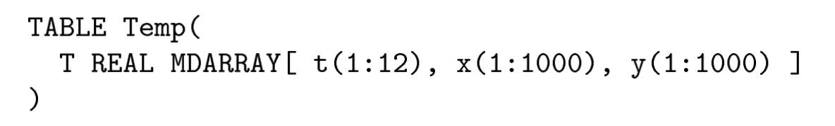
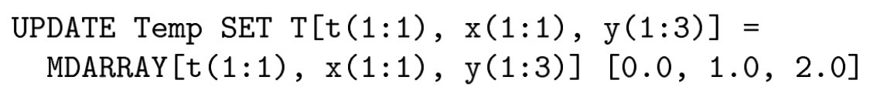
Array Updates
S

Slide 23
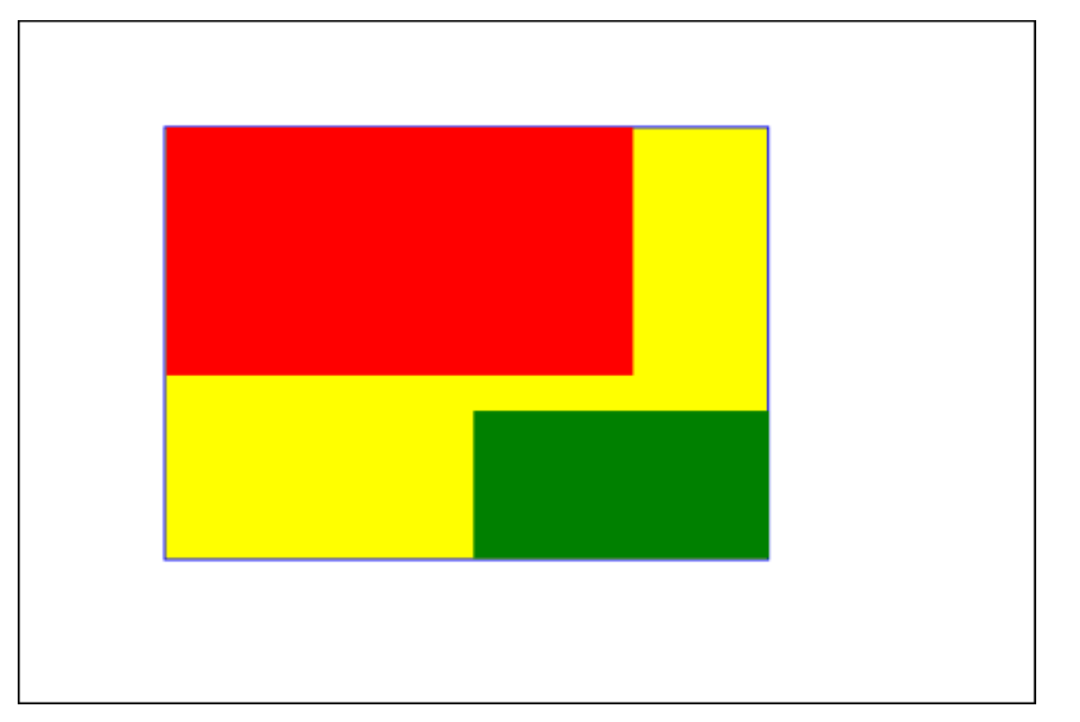
Array Updates as an Extension
Red rectangle: MD-extent of T ,
White rectangle with black border: maximum MD-extent
Green rectangle: MD-extent of S
Result MD-array of update: rectangle formed of the red, yellow and green parts; elements in the yellow subset are set to null.

Slide 24
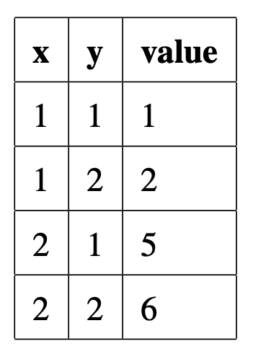
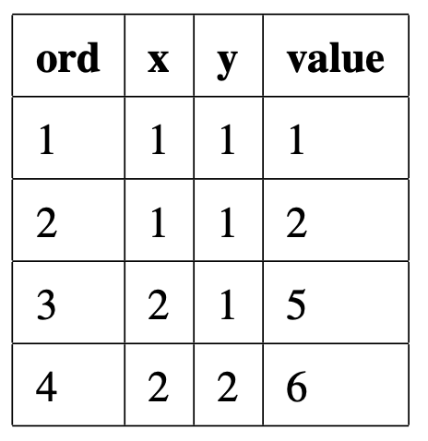

From Arrays to Tables

Slide 25
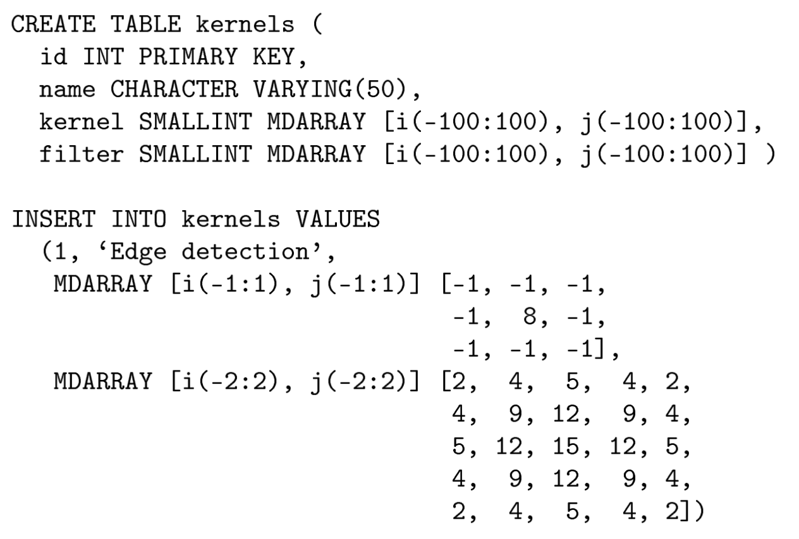
Examples

Slide 26
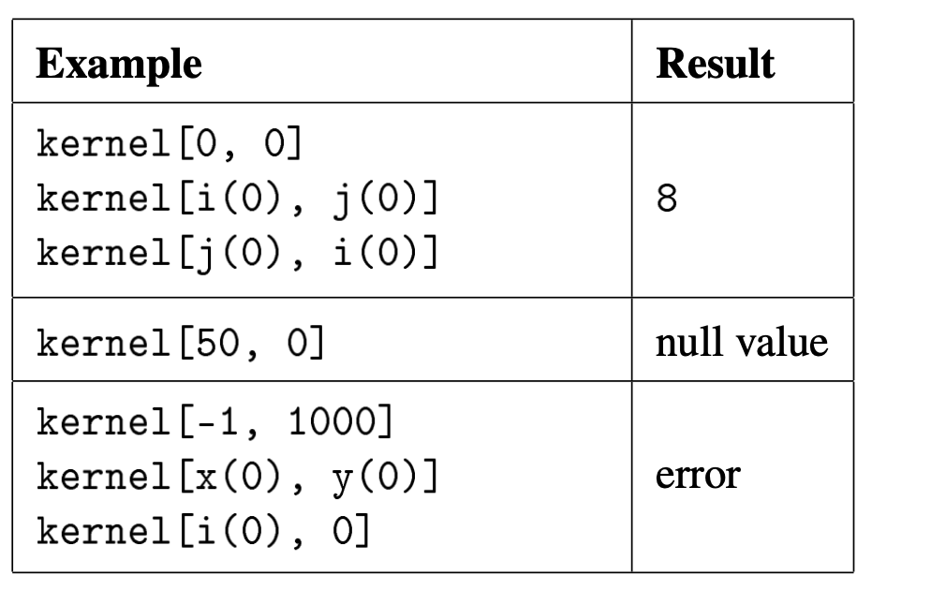
Referencing Elements

Slide 27
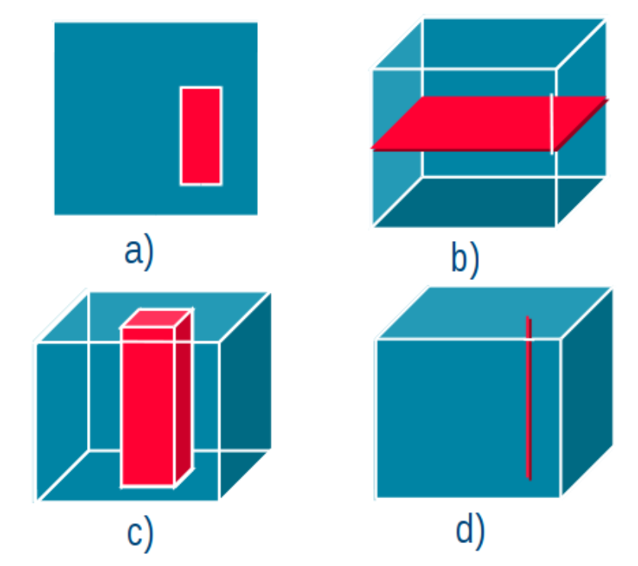
Projection on Arrays („Subsetting“)

Slide 28
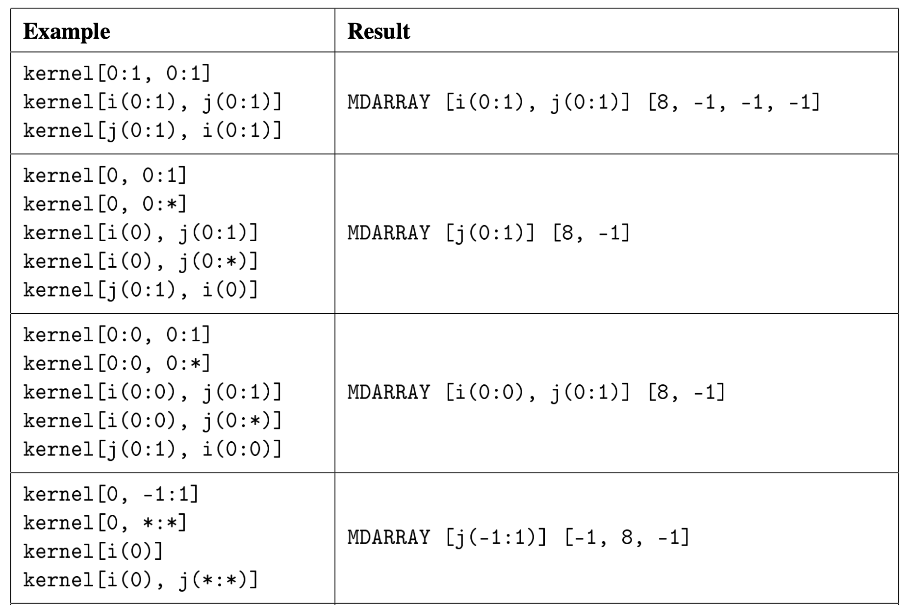
Projection

Slide 29
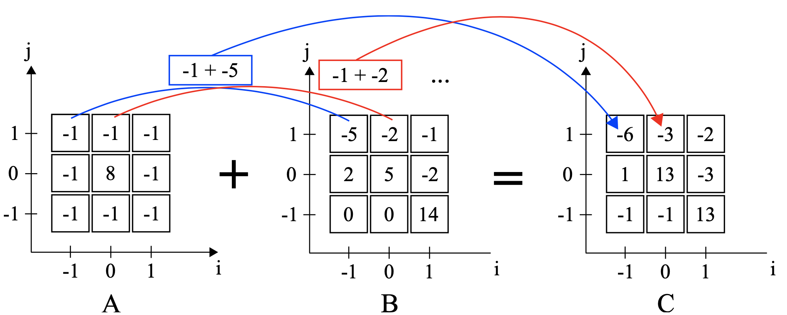
Further Array Operations
Reshaping
Shifting
Axis renaming
Scaling
Concatenation
Operations
  Function application
Cast operations

Slide 30
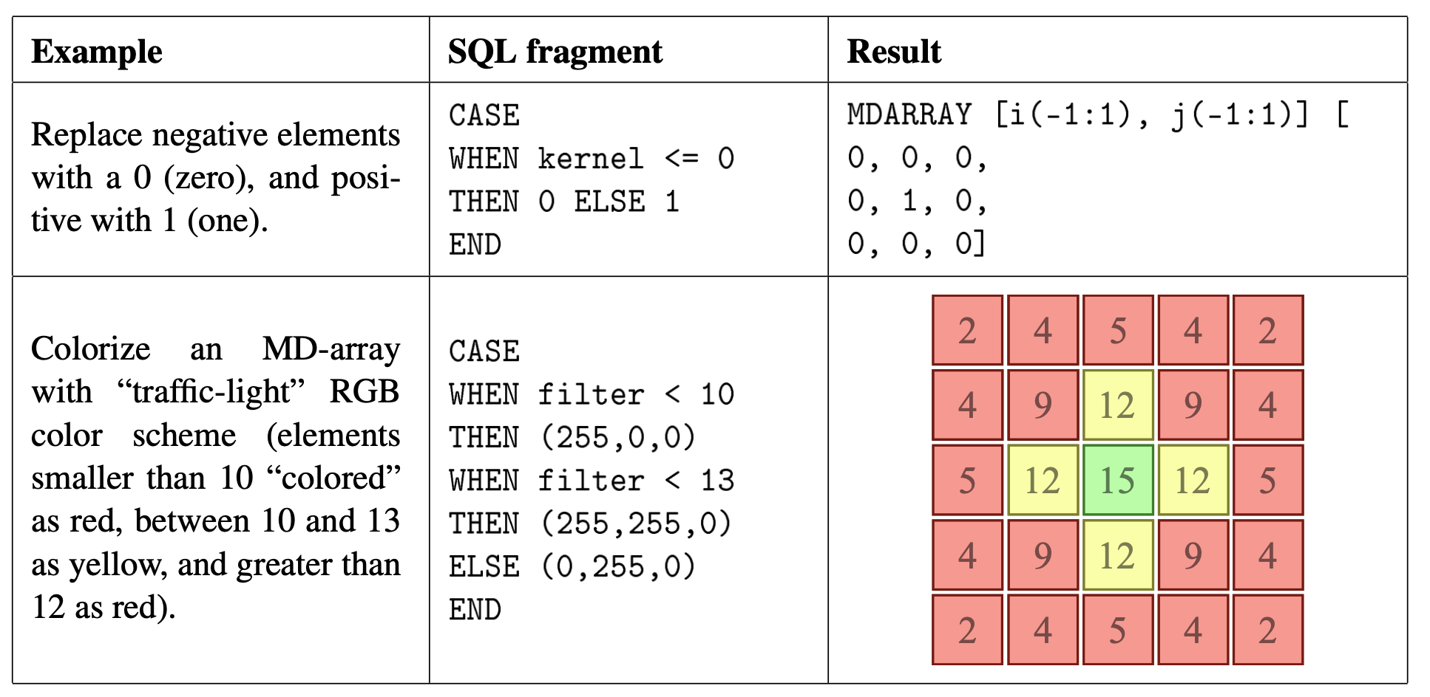
Array Construction

Slide 31
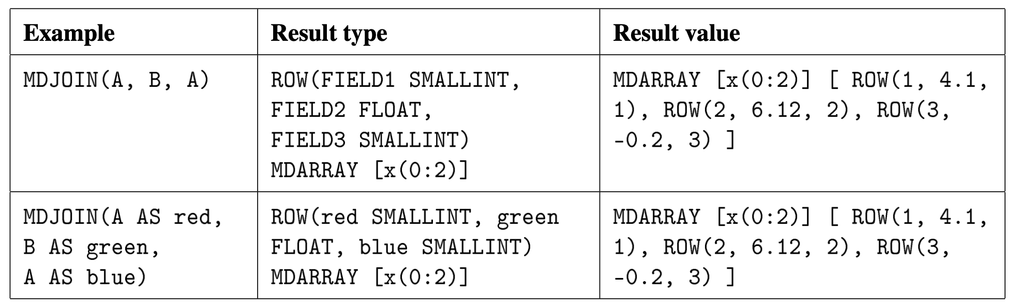
Joins on Arrays
MDJOIN performs a join on two or more MD-arrays of equal MD-extents based on their coordinates
Let A be defined as MDARRAY [x(0:2)] [1, 2, 3]
and B as MDARRAY [x(0:2)] [4.1, 6.12, -0.2]

Slide 32
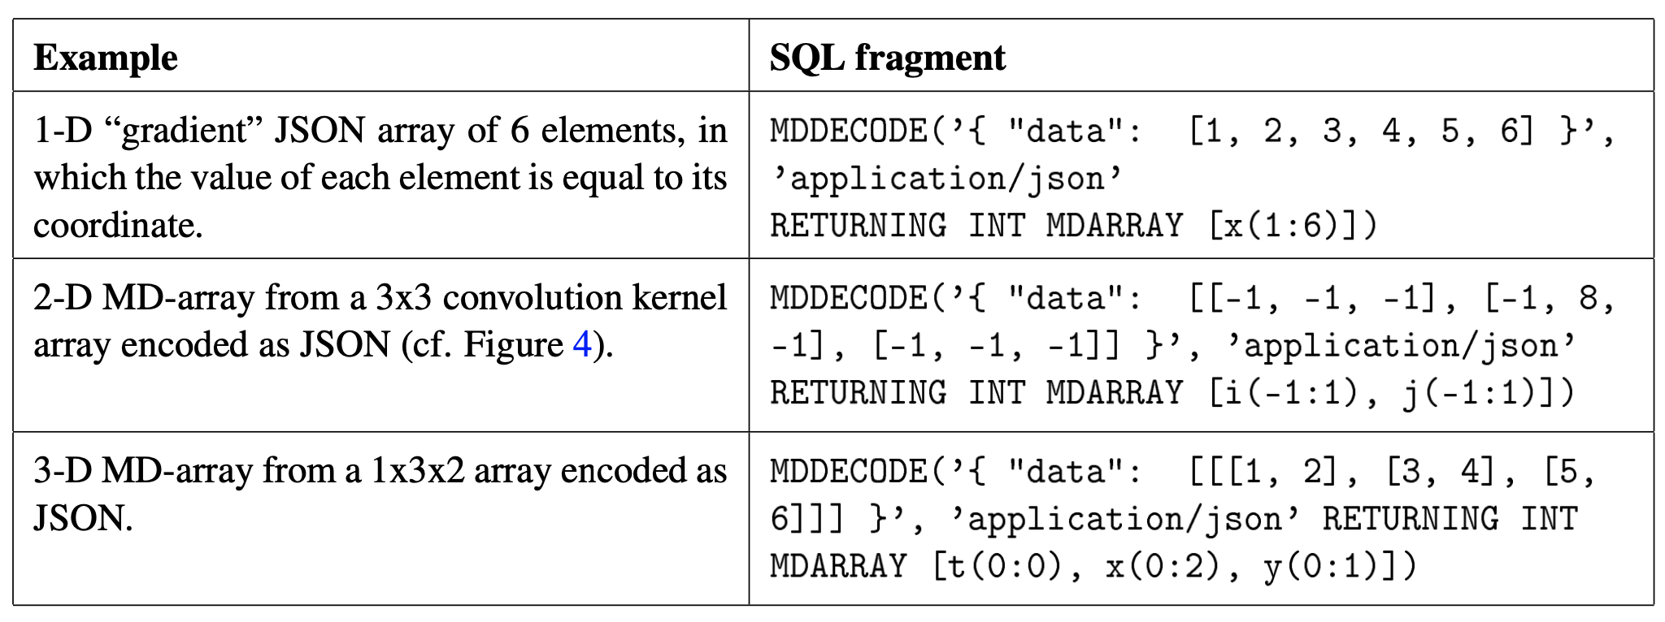
Decoding/Encoding
Arrays from/to JSON structures
Arrays from/to TIFF files
…

Slide 33
Scalability for Array Query Answering
Scalability by specific partitioning techniques to distribute array data over multiple computing nodes
Transactions across machines automatically managed for updates
Exploit GPUs

Slide 34
Applications
Image processing (e.g., photogrammetry)
(Static) time series (e.g., histograms)

Slide 35
Summary SQL:2016 and Beyond
Data structures in SQL
  (Multi-)Sets of records (tables of tuples)
  Trees of nested semi-structured objects (XML and JSON)
  Multidimensional arrays (unnested)
  Graphs
Each structure with respective data definition
and query language elements

Slide 36
Dynamic Time Series Data
Occur in many application scenarios
(e.g., sensor networks)
  Could be seen implemented as an extensible 1D-array
  Could be implemented in a table
  [Timestamp, sensor, measurements…]
Two challenges for data insertion and query answering
  Scaling up: Swapping from disk is expensive
  Scaling out: Transactions across machines expensive
Specific features for time series management required to ensure scalability

Slide 37
Acknowledgements
The following slides show diagrams of a presentation provided by timescale.com:
Building a scalable time-series database using Postgres
by Mike Freedman
https://github.com/timescale/timescaledb

Slide 38
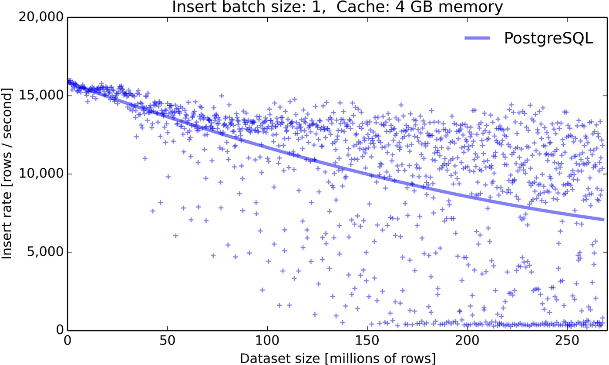
Inserting Rows into a Postgres Database
Postgres 9.6.2 on Azure standard DS4 v2 (8 cores), SSD (premium LRS storage)
Each row has 12 columns (1 timestamp, indexed, 1 host ID, 10 metrics)
LRS = Locally redundant storage

Slide 39
Challenges to scalability
As tables grow larger
  Data and indexes no longer fit in memory
  Reads/writes to random locations in B-tree
  Separate B-tree for each secondary index
I/O amplification makes it worse
  Reads/writes at full-page granularity (8KB),
  not individual series elements
  It doesn’t help to shrink DB page:
    HDD still seeks
    SSD has min Flash page size

Slide 40
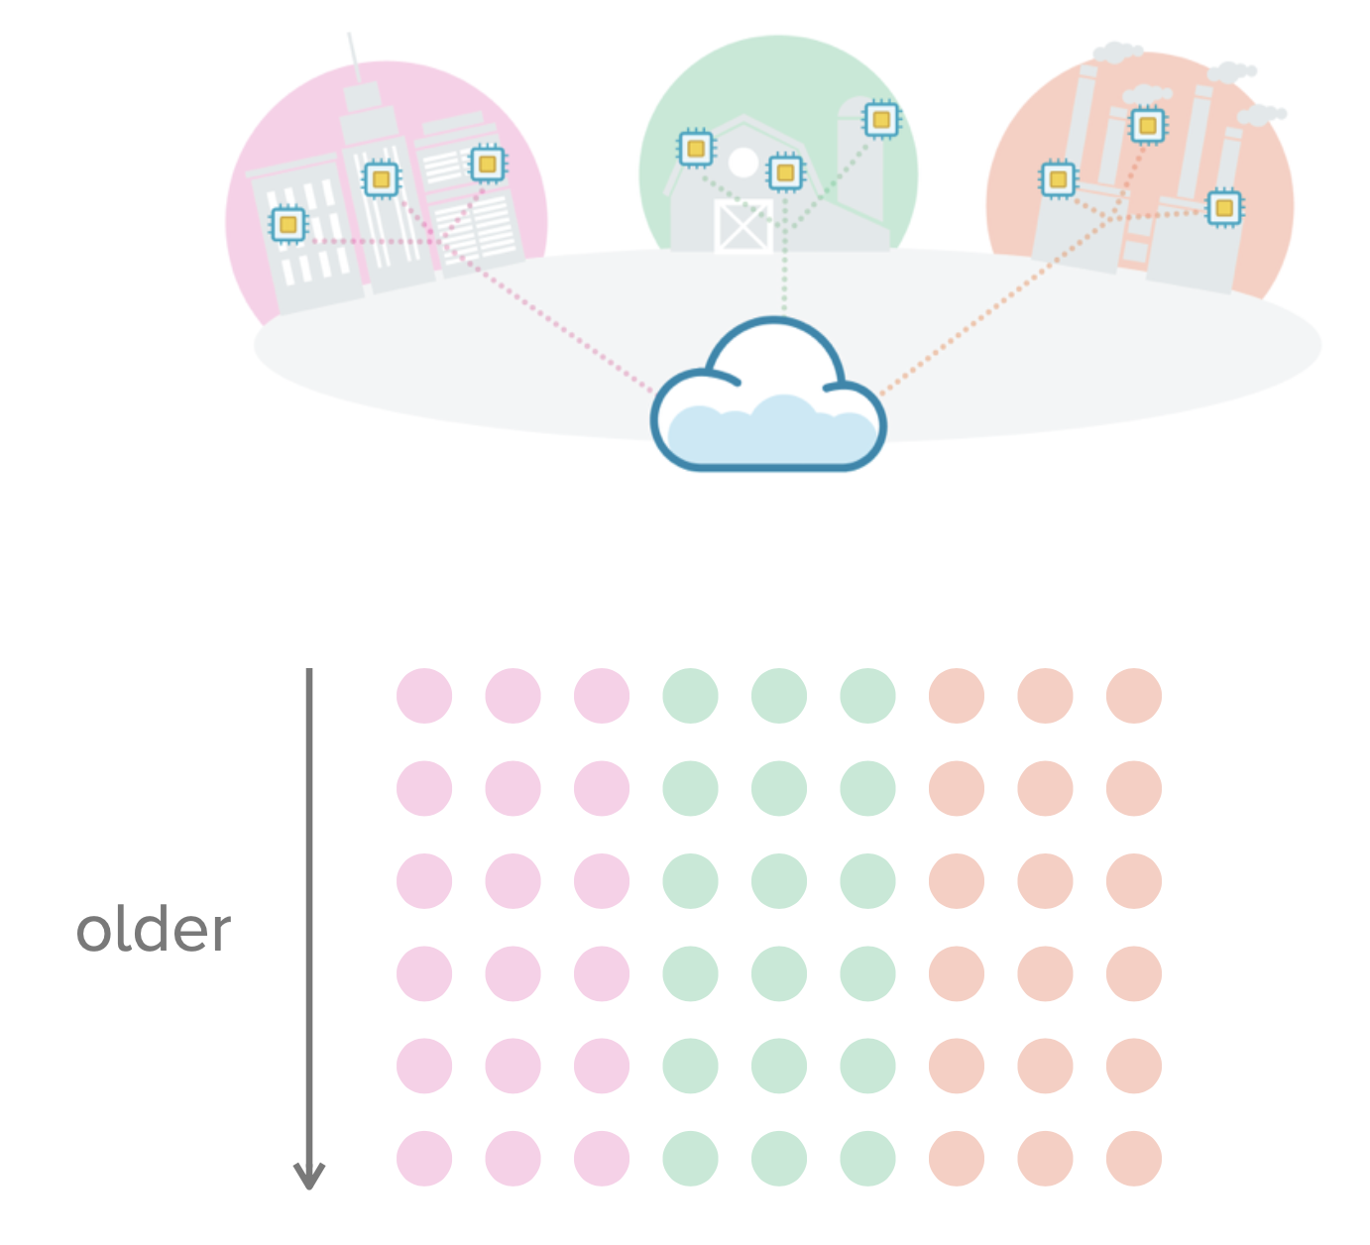
Application Scenario

Slide 41
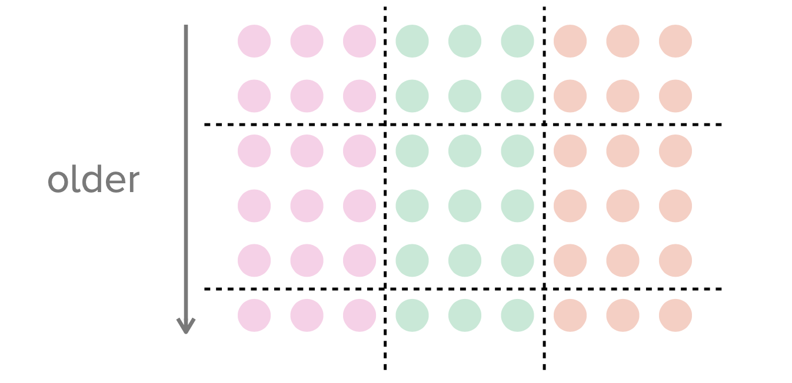
Adaptive time/space partitioning

Slide 42
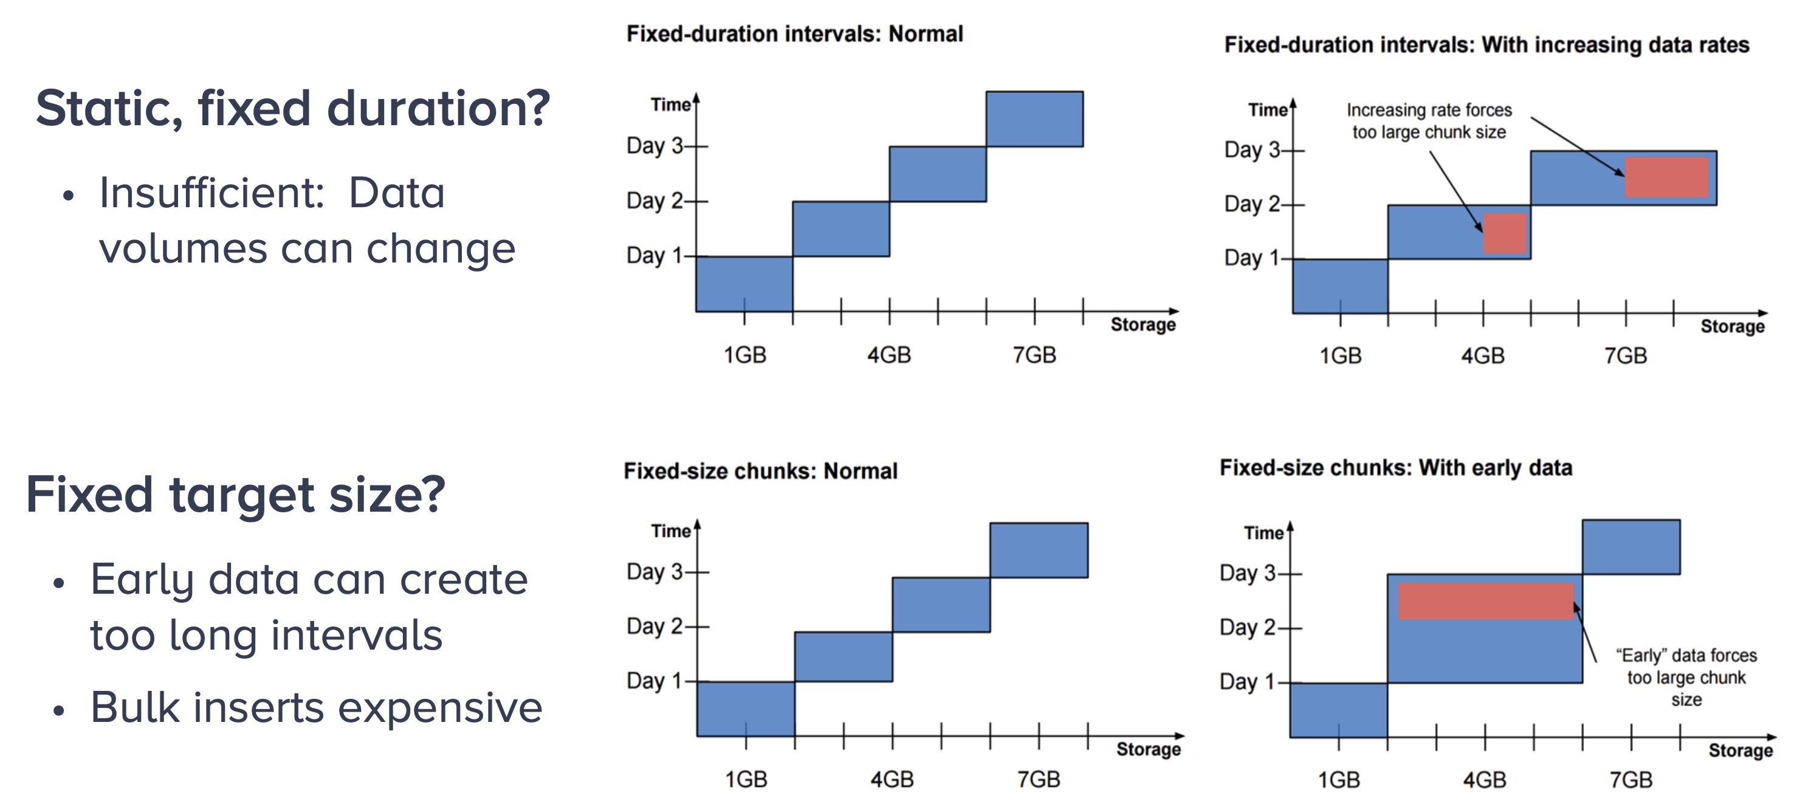
How EXACTLY do we partition by time?

Slide 43
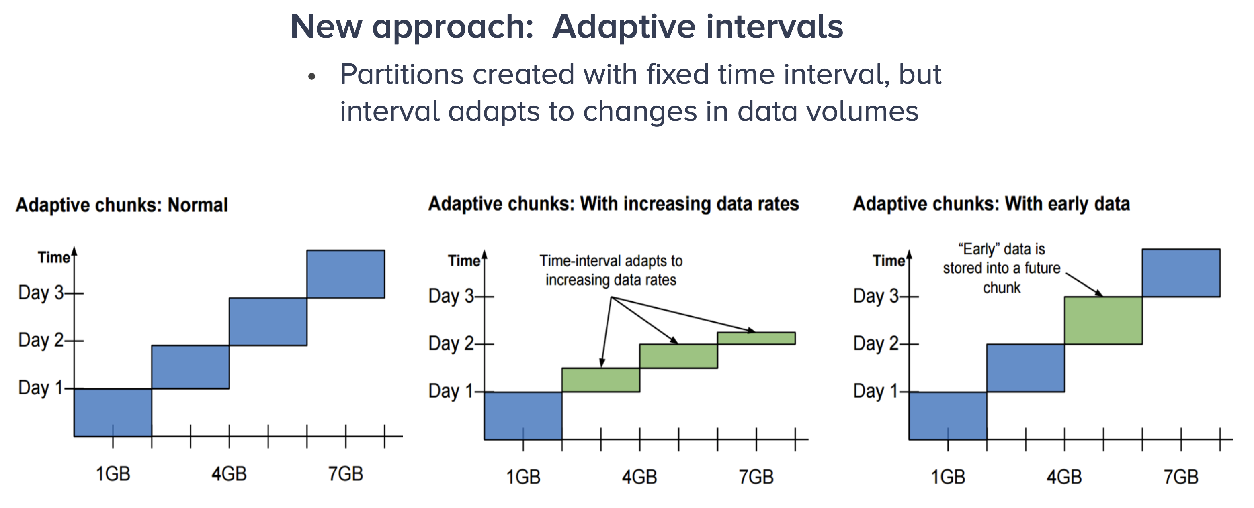
Adaptive time/space partitioning benefits

Slide 44
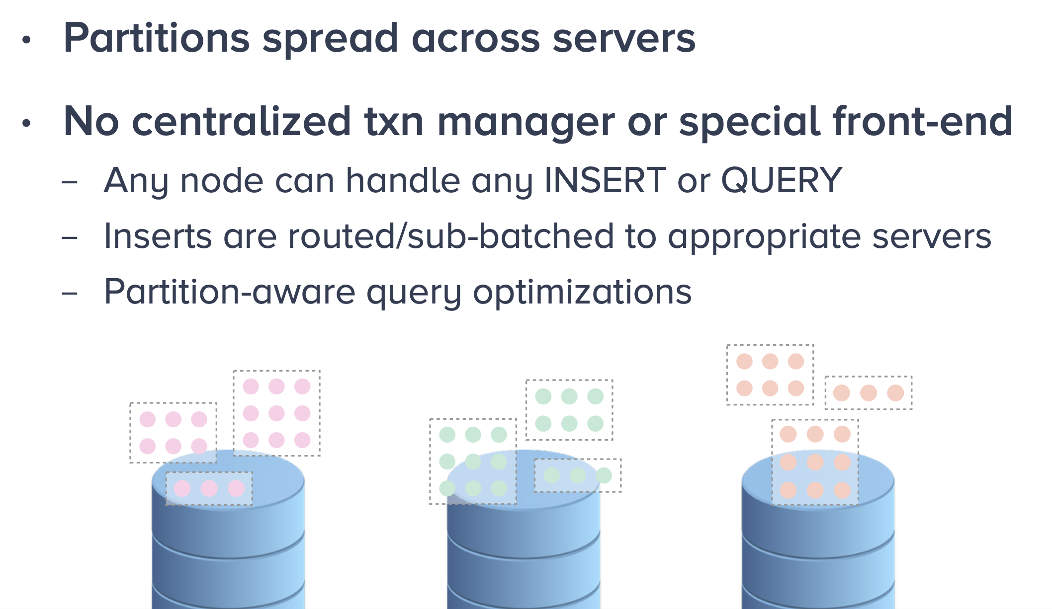
Adaptive time/space partitioning benefits

Slide 45
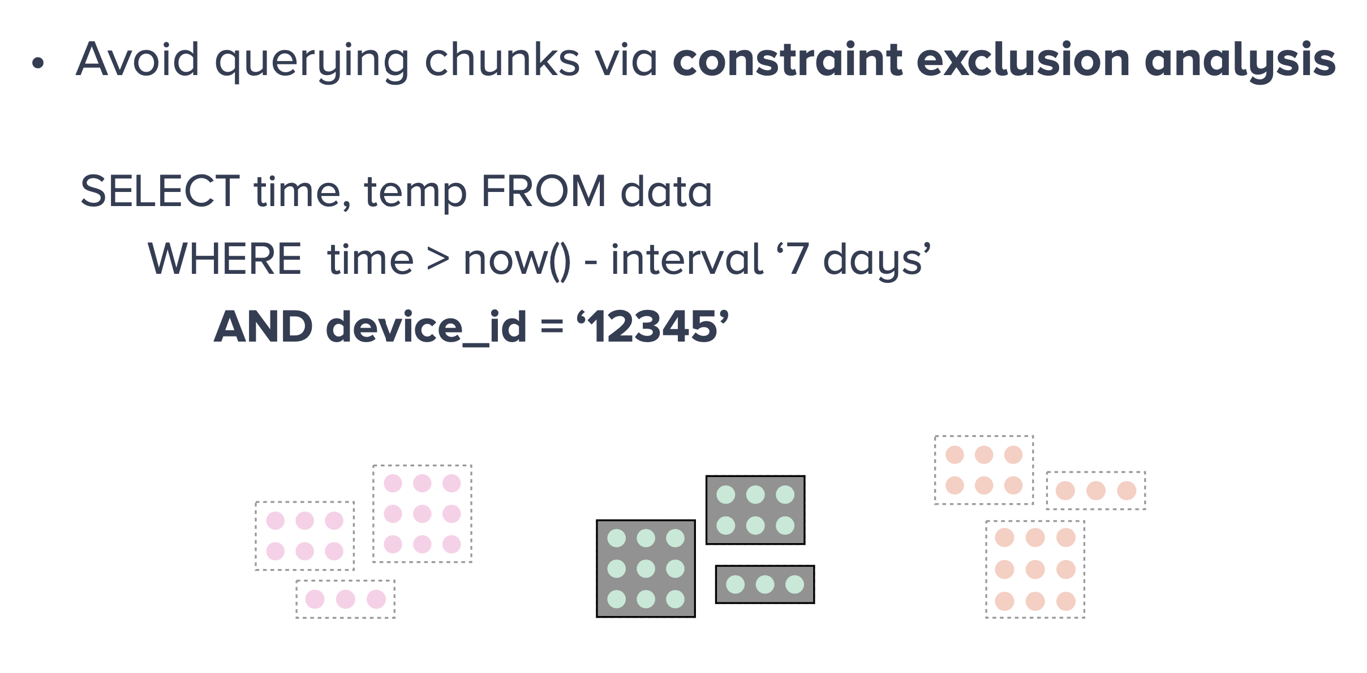
Partition-aware Query Optimization
Prevent unneeded chunks from entering a query plan
now() function makes the expression no longer accessible to plan time constraint exclusion
Need runtime exclusion
All data for ‘12345’ on Server 2
https://www.timescale.com/blog/implementing-constraint-exclusion-for-faster-query-performance/

Slide 46
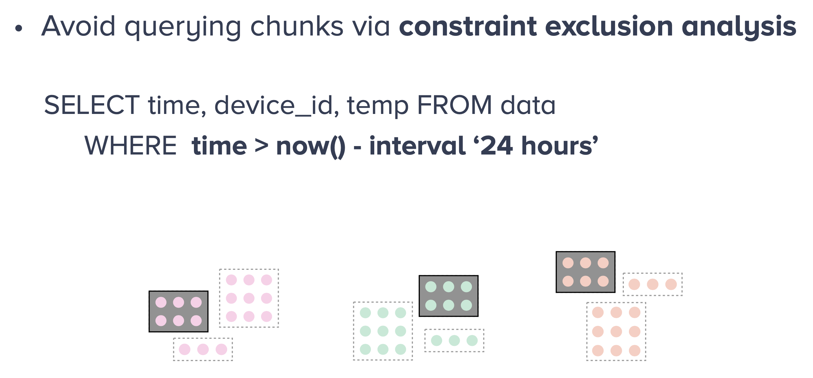
Partition-aware Query Optimization
All servers involved
https://www.timescale.com/blog/implementing-constraint-exclusion-for-faster-query-performance/

Slide 47
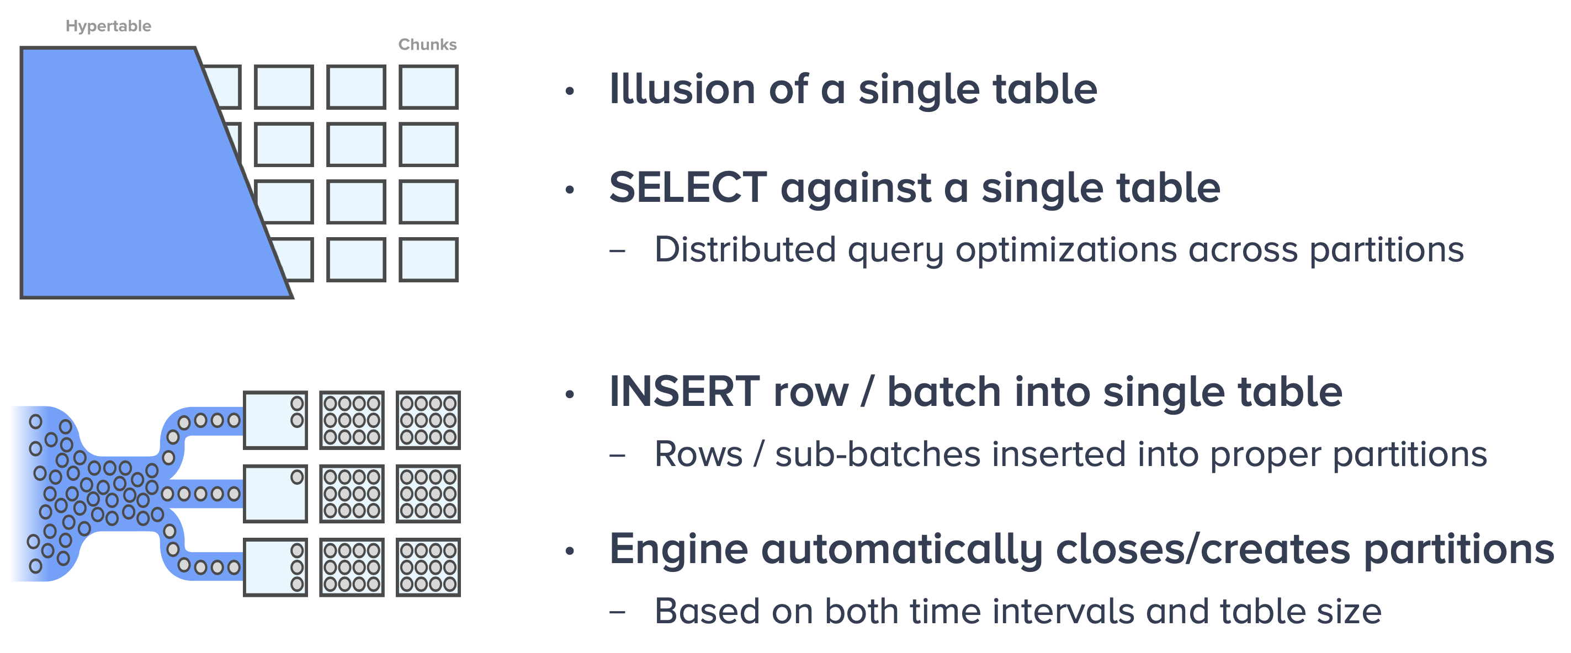
Hyper-Table Abstraction

Slide 48

Example: Importing Bulk Data
Partitioning column and number of partitions

Slide 49


Slide 50


Slide 51


Slide 52

Summary
Time series support in databases (e.g., sensor data)
  Example: TimescaleDB.com
Time/space partitioning to ensure scalability
  Example: TimescaleDB „hypertables“
Bulk reading performance improved
Partitioning-aware query optimization
  TimescaleDB also much more efficient than Postgres for some queries referring to time data

Slide 53

Add on: Timeseries Visualization (Grafana)

